Slide 1


Edition 4.2 EBAF
Surface product update
Seiji Kato¹, Fred G. Rose², Seung-Hee Ham², Tyler J. Thorsen¹
and the SARB working group^{1,2,3}
¹NASA Langley Research Center
²Analytical Mechanics Associates, Inc.
³ADNET Systems, Inc

Slide 2
Difference of Edition 4.2 EBAF from the previous version
MERRA-2 temperature and humidity profiles were used for irradiance computations.
  Clouds are retrieved using GEOS-5.4.1
Only MODIS and VIIRS retrieved cloud properties were used
  No geostationary satellite derived cloud properties were used.

Slide 3
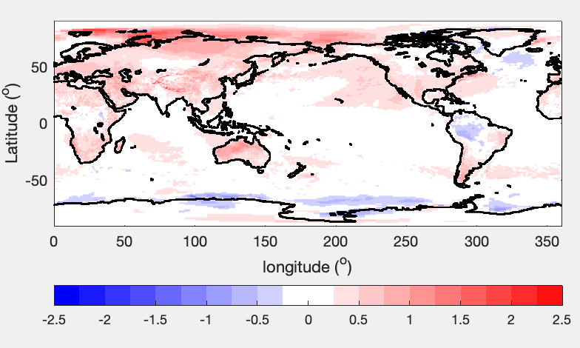
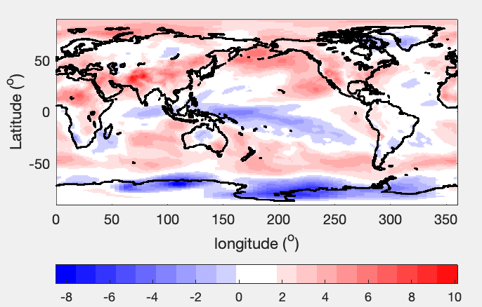
Trends of input variables
Precipitable water
Global mean trend
1.5% dec-1
1.5% / 0.22 K = 6.8% K-1
Skin temperature (K dec-1)
Global mean trend: 0.22 K dec-1
Skin temperatures are hybrid of GEOS-5.4.1 and those retrieved by the cloud group
Precipitable water is from MERRA-2

Slide 4
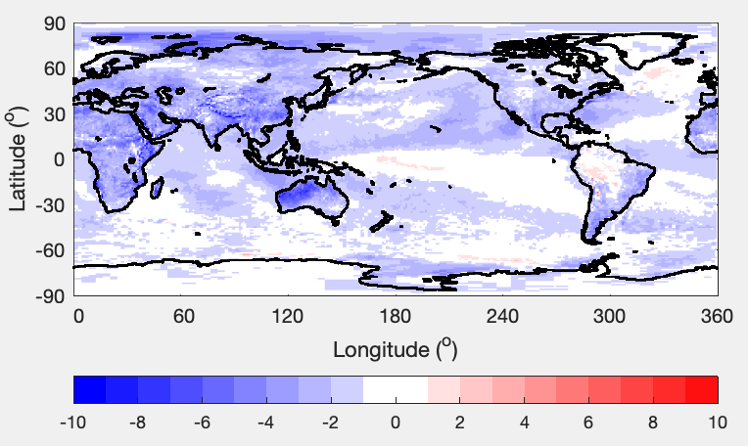
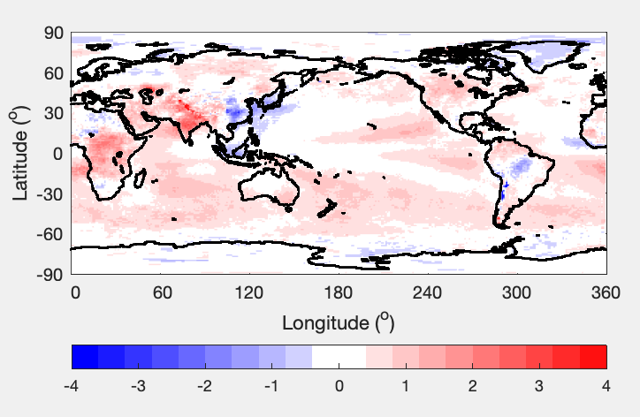
Clear-sky irradiance trends
Shortwave absorbed irradiance by the atmosphere
Net TOA shortwave – net surface shortwave
Longwave TOA up – longwave surface up
Notes:
More than compute irradiances with increasing water vapor, since TOA is observed by CERES. Surface irradiances need to be consistent with the observations.

Slide 5
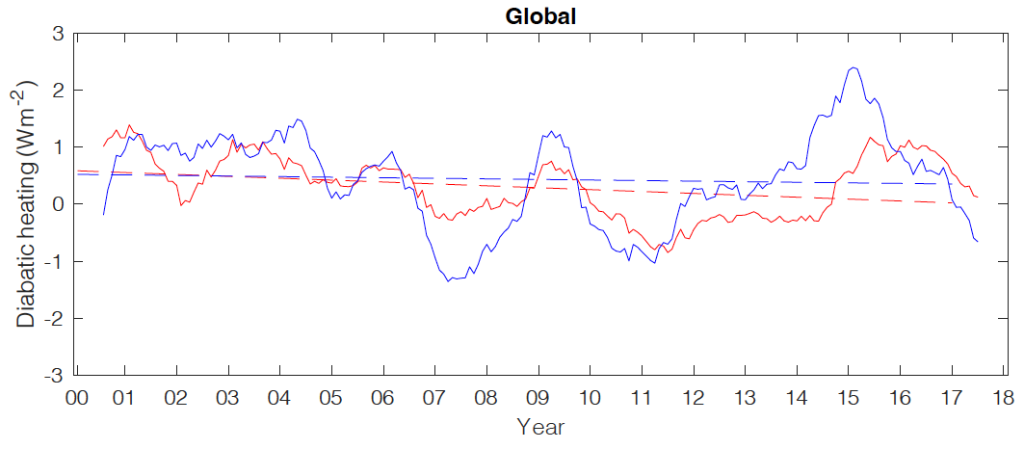
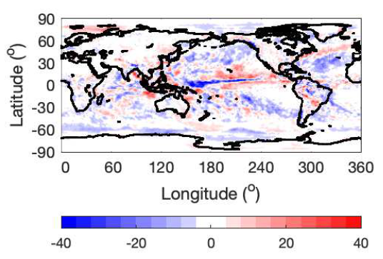
Precipitation trend from January 2001 through December 2018
Regional trend from GPCP
GPCP
-(Atm net irradiance + sensible heat)
Trend
GPCP: -0.06±0.59 Wm⁻² dec⁻¹
Ed4 EBAF + sensible flux: -0.33±0.37 Wm⁻² dec⁻¹
Anomalies are computed relative to July 2005 – June 2015 climatology
Sensible heat flux: Seaflux V3 over ocean and ERA5 over land

Slide 6
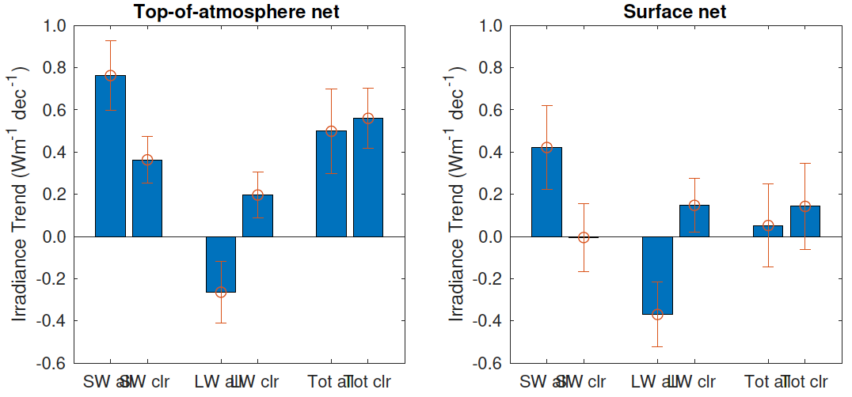
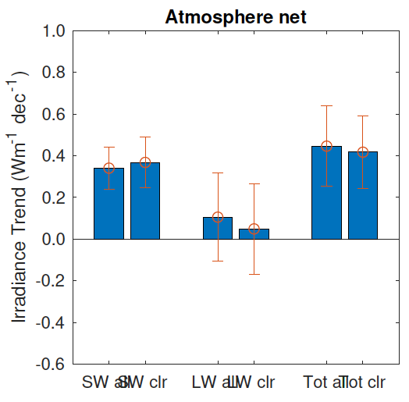
Global TOA, surface and atmosphere flux trends from March 2000 through June 2023
All-sky
Clear-sky
All-sky
Clear-sky
All-sky
Clear-sky
SW LW Total
SW LW Total
SW LW Total
A positive trend indicates energy inputs at TOA or surface
Difference between all-sky and clear-sky is due to clouds
Notes:
Climatology, July 2005 through June 2015.

Slide 7
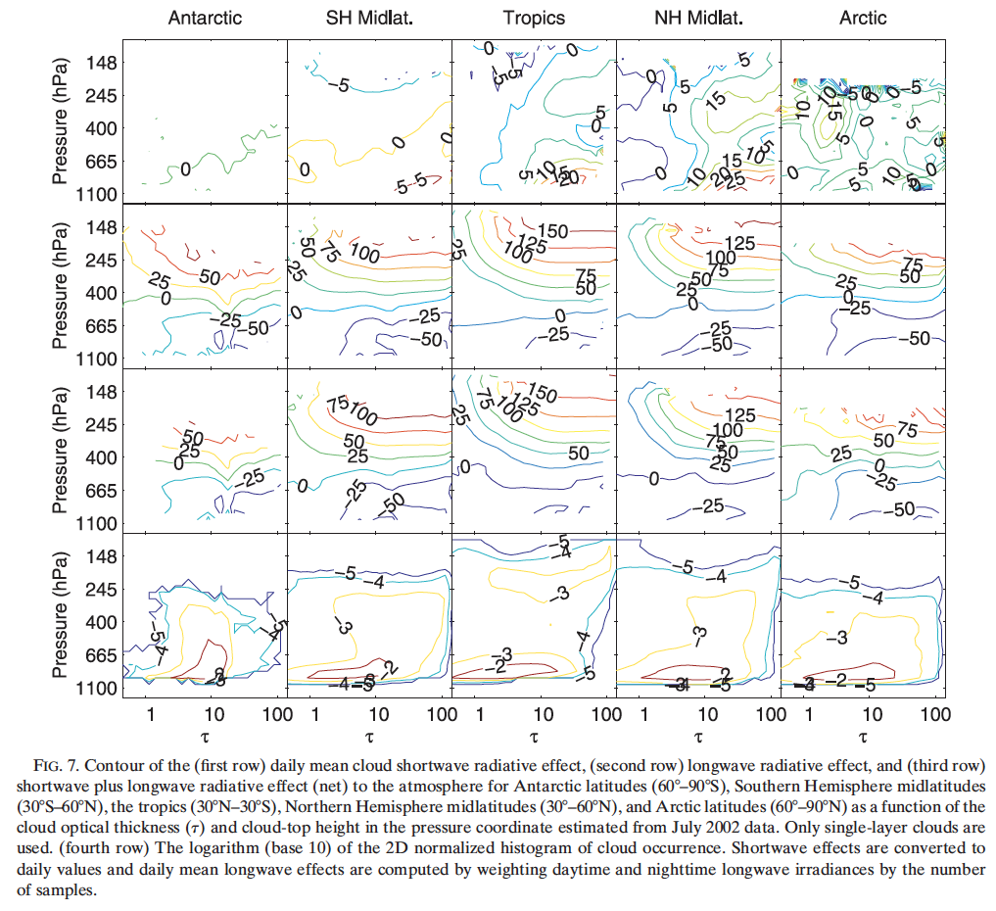
Effect of clouds on net longwave atmospheric irradiance

Slide 8
aerosol

Slide 9
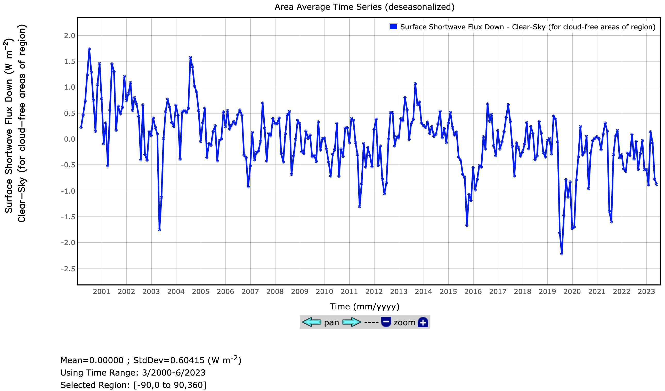
Global monthly surface clear-sky downward shortwave anomalies
August 2000
missing Terra data
June 2011
Canadian smoke
May 2003
Siberian forest fire??
October 2015
Indonesian smoke
August 2019
Siberian wildfire
January 2020
Australian fire
August 2021
Siberian wildfire
Standard deviation = 0.59 Wm⁻²
Number of month > 2𝝈: 14 (out of 261)
8 occurred after 2010 5 occurred after 2019
Notes:
Over arctic, we need a good model.
Instrument, satellites consistency, no AERONET assimilation. Use AERONET as an independent validation. Adjust fine/coarse modes independently
TOA clear-sky EBAF anomalies

Slide 10
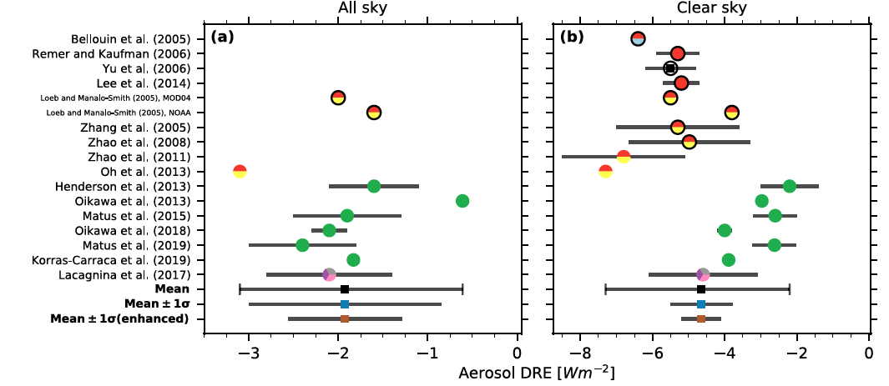
Global mean direct aerosol radiative effects
Land + Ocean
CERES SYN: -2.2 Wm⁻²
Land + Ocean
200003 to 202306
CERES SYN: -5.2 Wm⁻²
Land + Ocean
200003 to 202306
Thorsen et al. 2021
Notes:
Syn/noGEO/my+plot/plot_clim_anom_syn_global.m

Slide 11
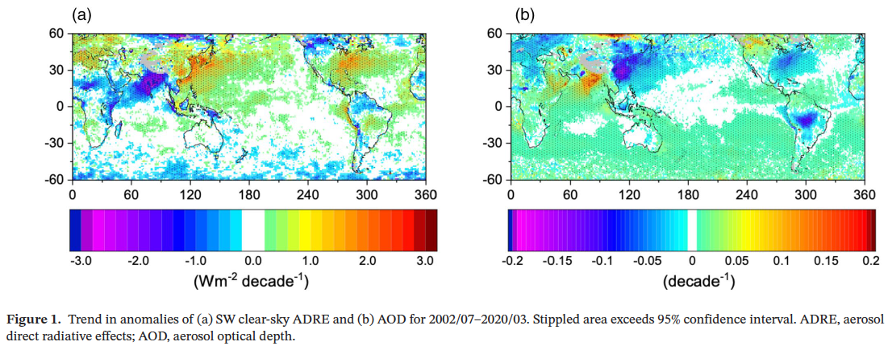
Trend of clear-sky TOA direct aerosol radiative effect
Loeb et al. 2020
0.18 ± 0.17 Wm⁻² dec⁻¹

Slide 12
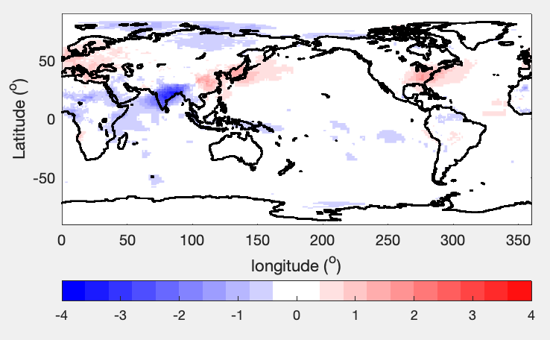
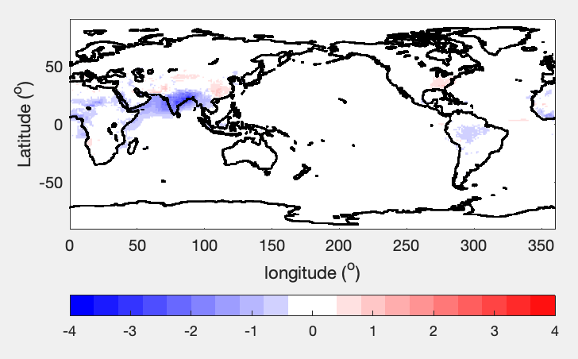
Clear-sky and all-sky cloud radiative effects
Clear-sky TOA shortwave direct aerosol radiative effect (clear-sky – pristine) from Ed. 4.1 SYN GEO
All-sky TOA shortwave direct aerosol radiative effect (all-sky – all-sky no aerosol) from Ed. 4.1 SYN GEO

Slide 13
Positive SW cloud radiative effect at the surface

Slide 14
Ed 4.2 Issues
Negative total area clear-sky surface irradiances
  These are caused using an older version of the SYNI code for March 2000 to January 2023.
Positive cloud radiative effect on surface downward shortwave irradiances
Negative cloud radiative effect on surface downward longwave irradiance
These cloud radiative effect anomalies occur throughout the Ed. 4.2 period (March 2000 through June 2023). The maximum occurrence is in February 2023
Larger clear-sky irradiance anomalies in December 2000 and December 2001 (the cause is unknown, unable to reproduce the problem).

Slide 15
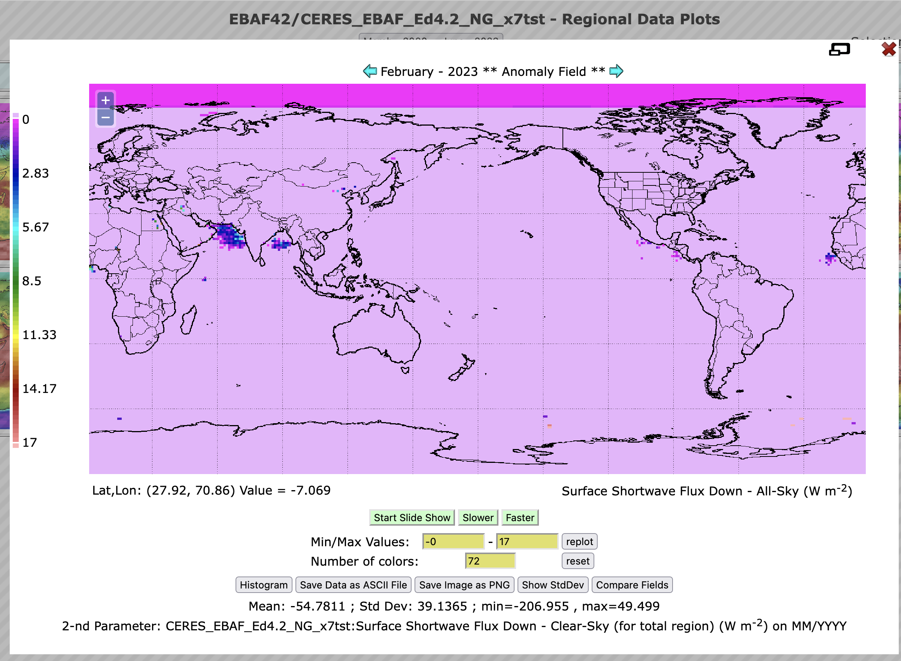
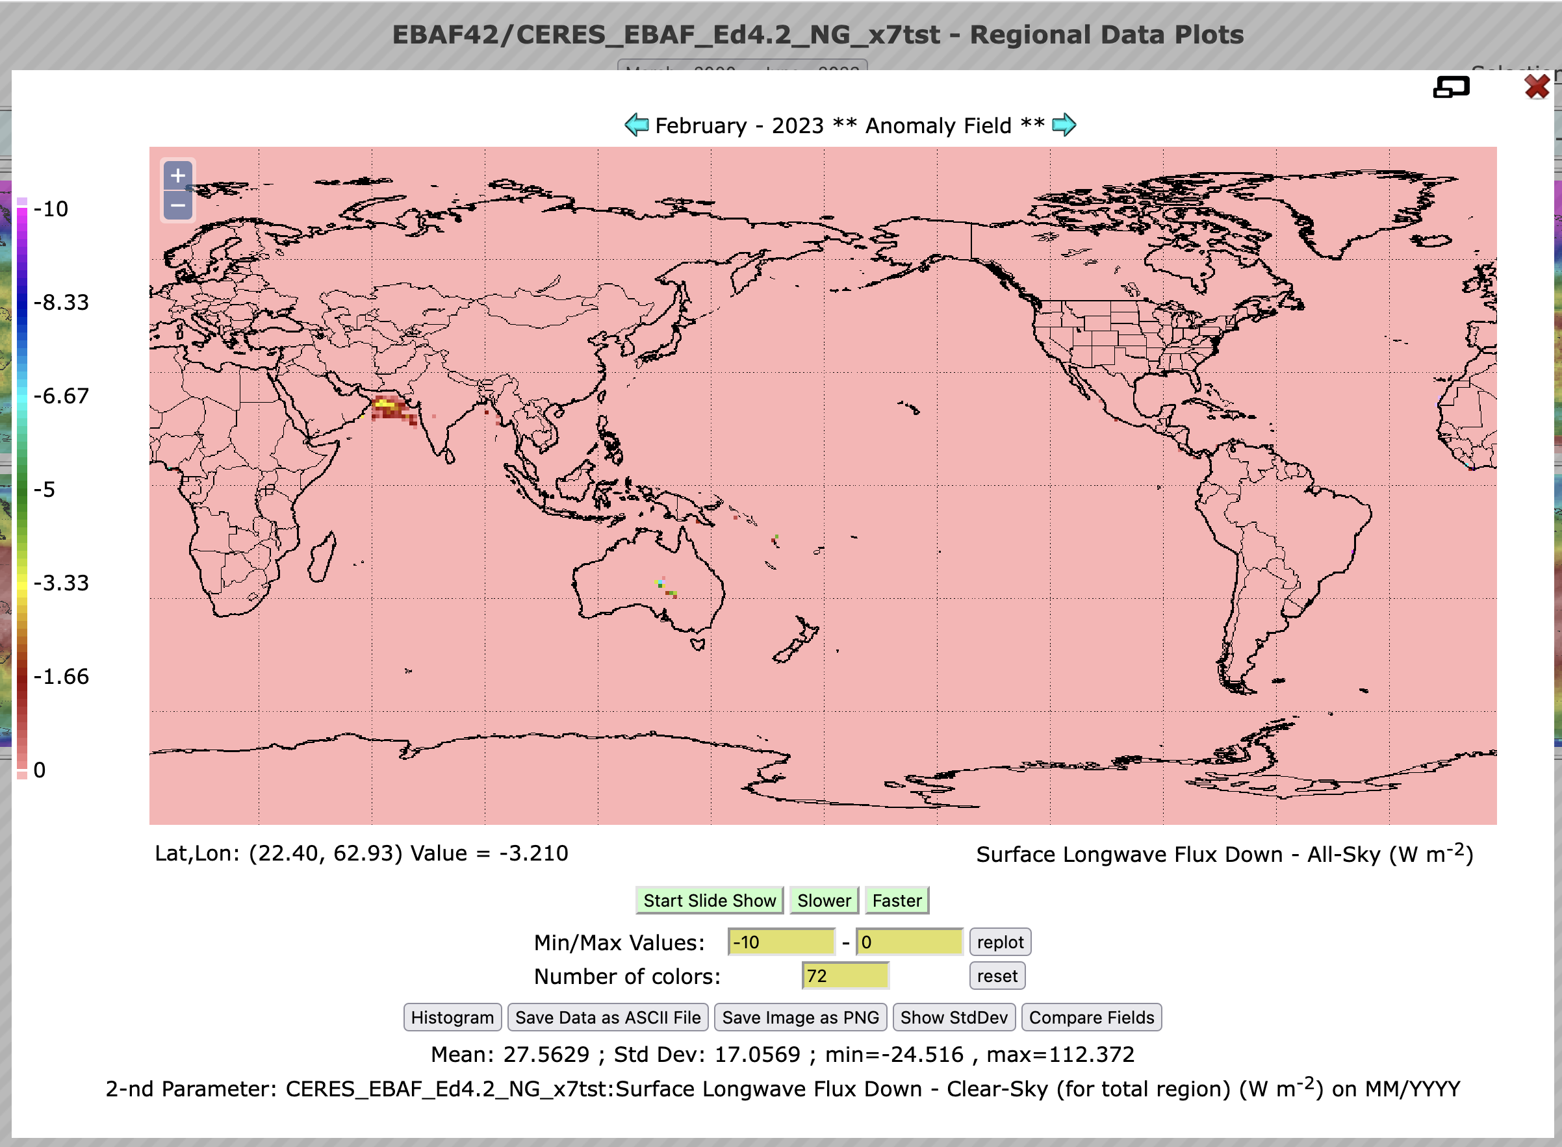
February 2023 case:
All-sky – Clear sky irradiances
Downward shortwave irradiances
Downward longwave irradiances

Slide 16
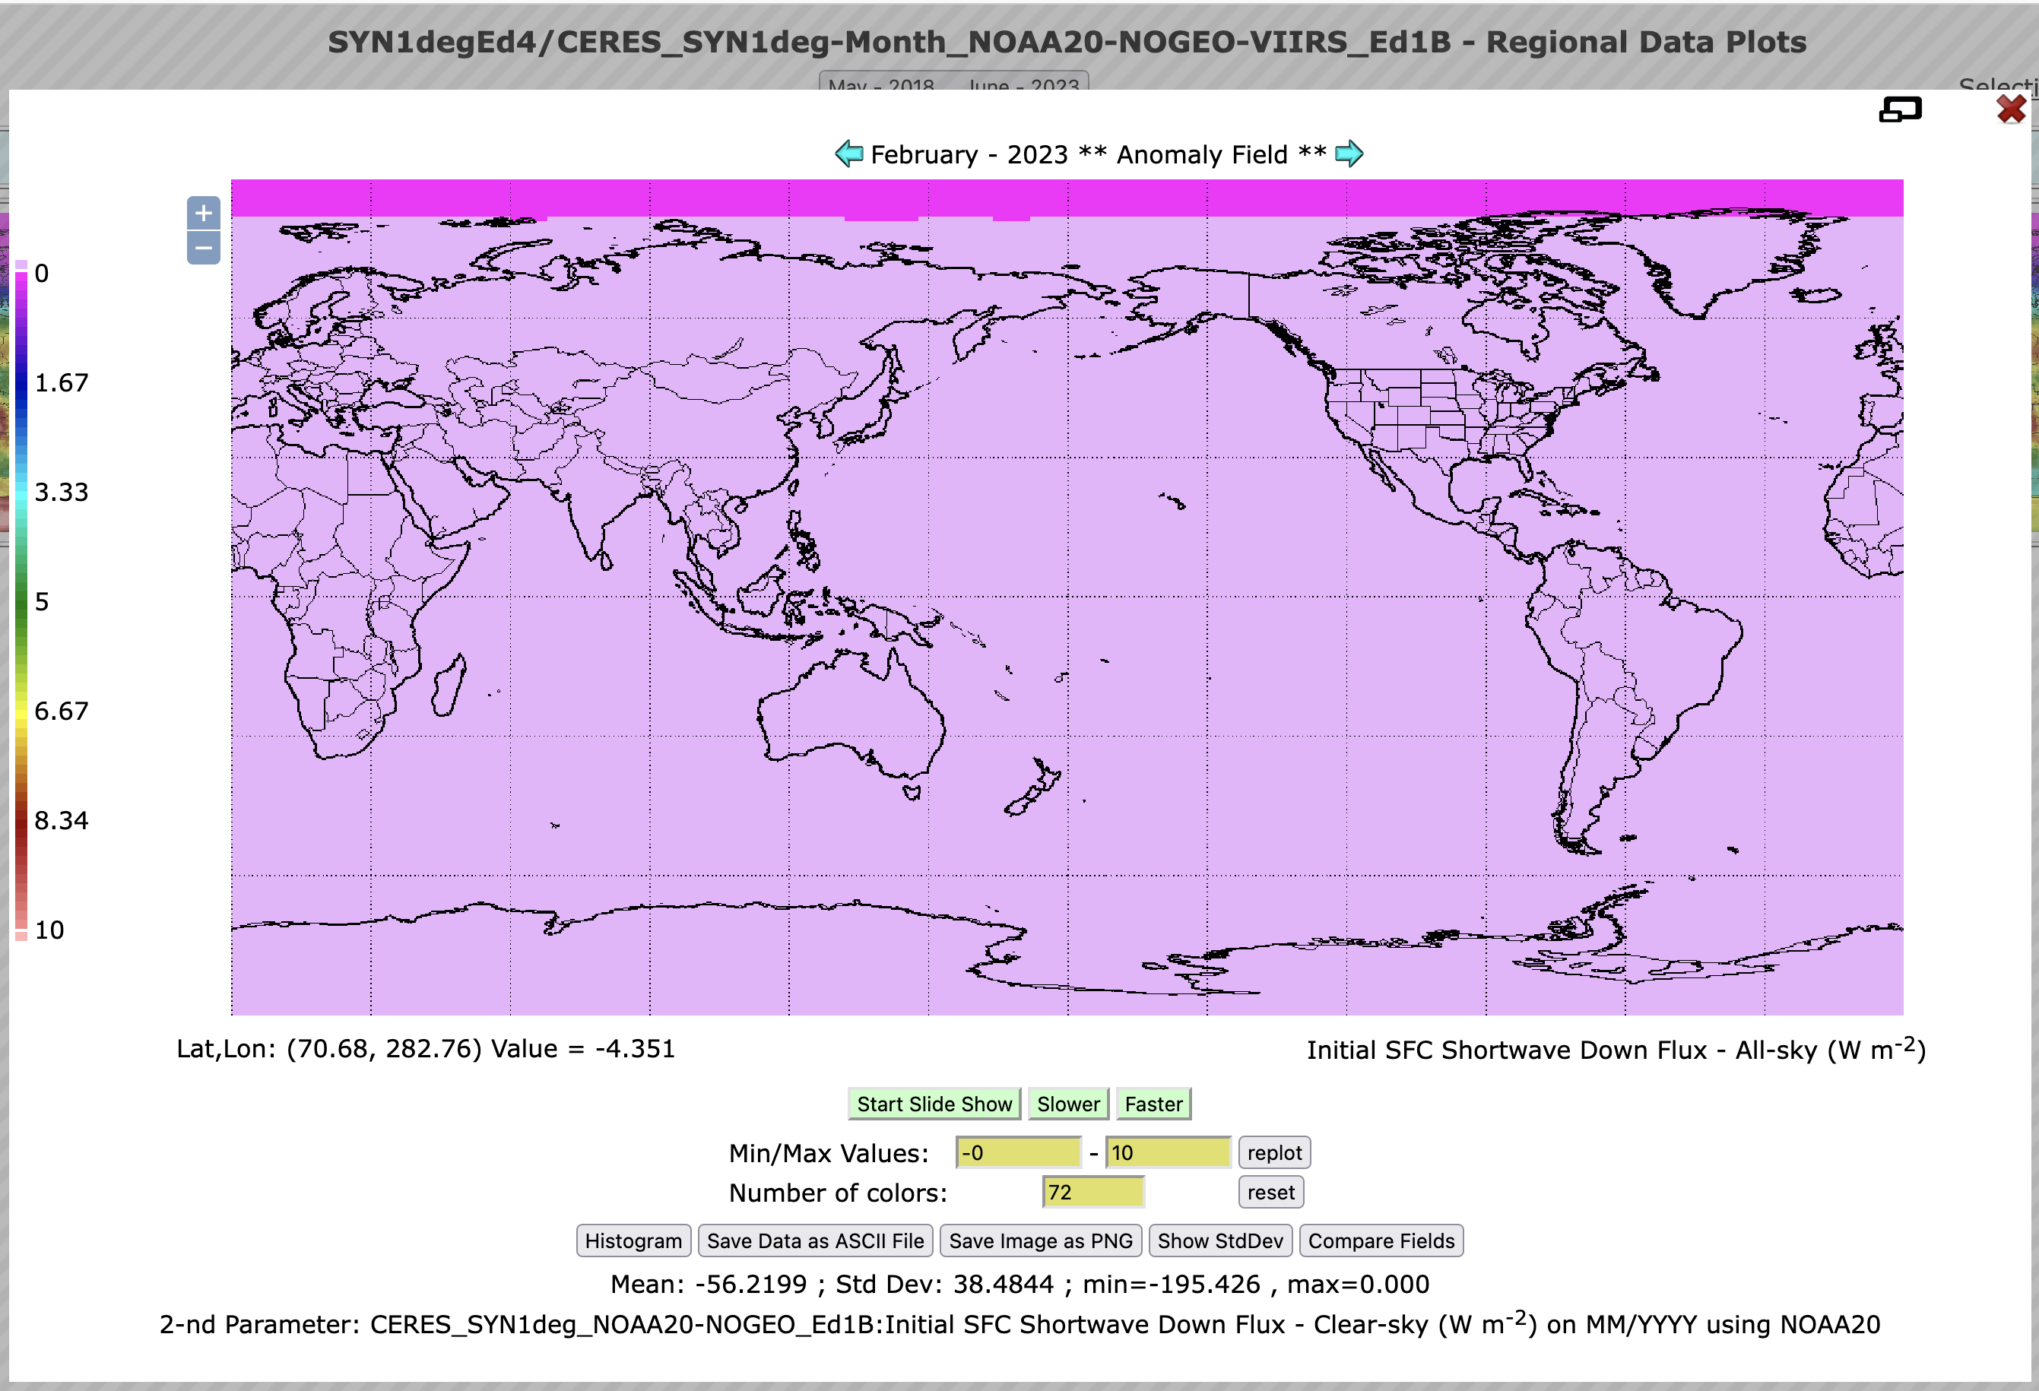
Positive shortwave cloud radiative effects do not occur in SYN noGEO

Slide 17
Summary of Ed.4.2 synopsis and future plan
Global mean skin temperature (a combination of GEOS-5.4.1 surface skin temperature and retrieved surface skin temperature) increases at a rate of 0.22 K dec-1
  Land skin temperature increases faster than sea surface temperature
Precipitable water (MERRA-2) increases at a rate of 1.55 dec-1 (6.8% K⁻¹).
Trend of net total (SW+LW) atmospheric irradiance anomalies is qualitatively consistent with GPCP global precipitation trend.
Aerosol optical depth (MODIS derived for clear-sky scenes and MATCH modeled aerosol for cloudy scenes)
  Modeled aerosol radiative effect is consistent with that derived from TOA observations.
  Increasing the frequency of large aerosol anomalies that affect global mean clear-sky surface downward shortwave is evident.
Edition 4.3 EBAF will be released early 2024
  Due to some errors in Cloud radiative effects

Slide 18
backups

Slide 19
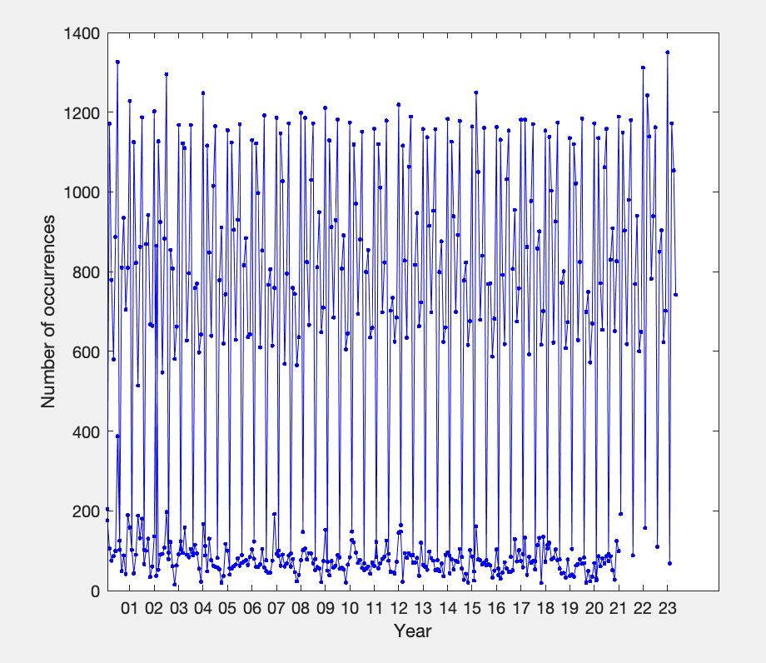
Number of occurrences of positive cloud radiative effect on downward shortwave fluxes
Edition 4.2
Edition 4.1

Slide 20
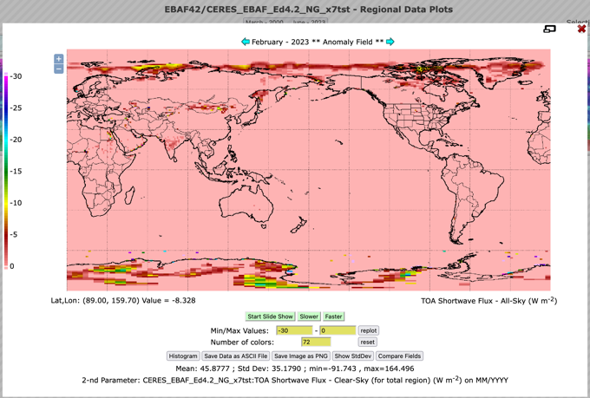
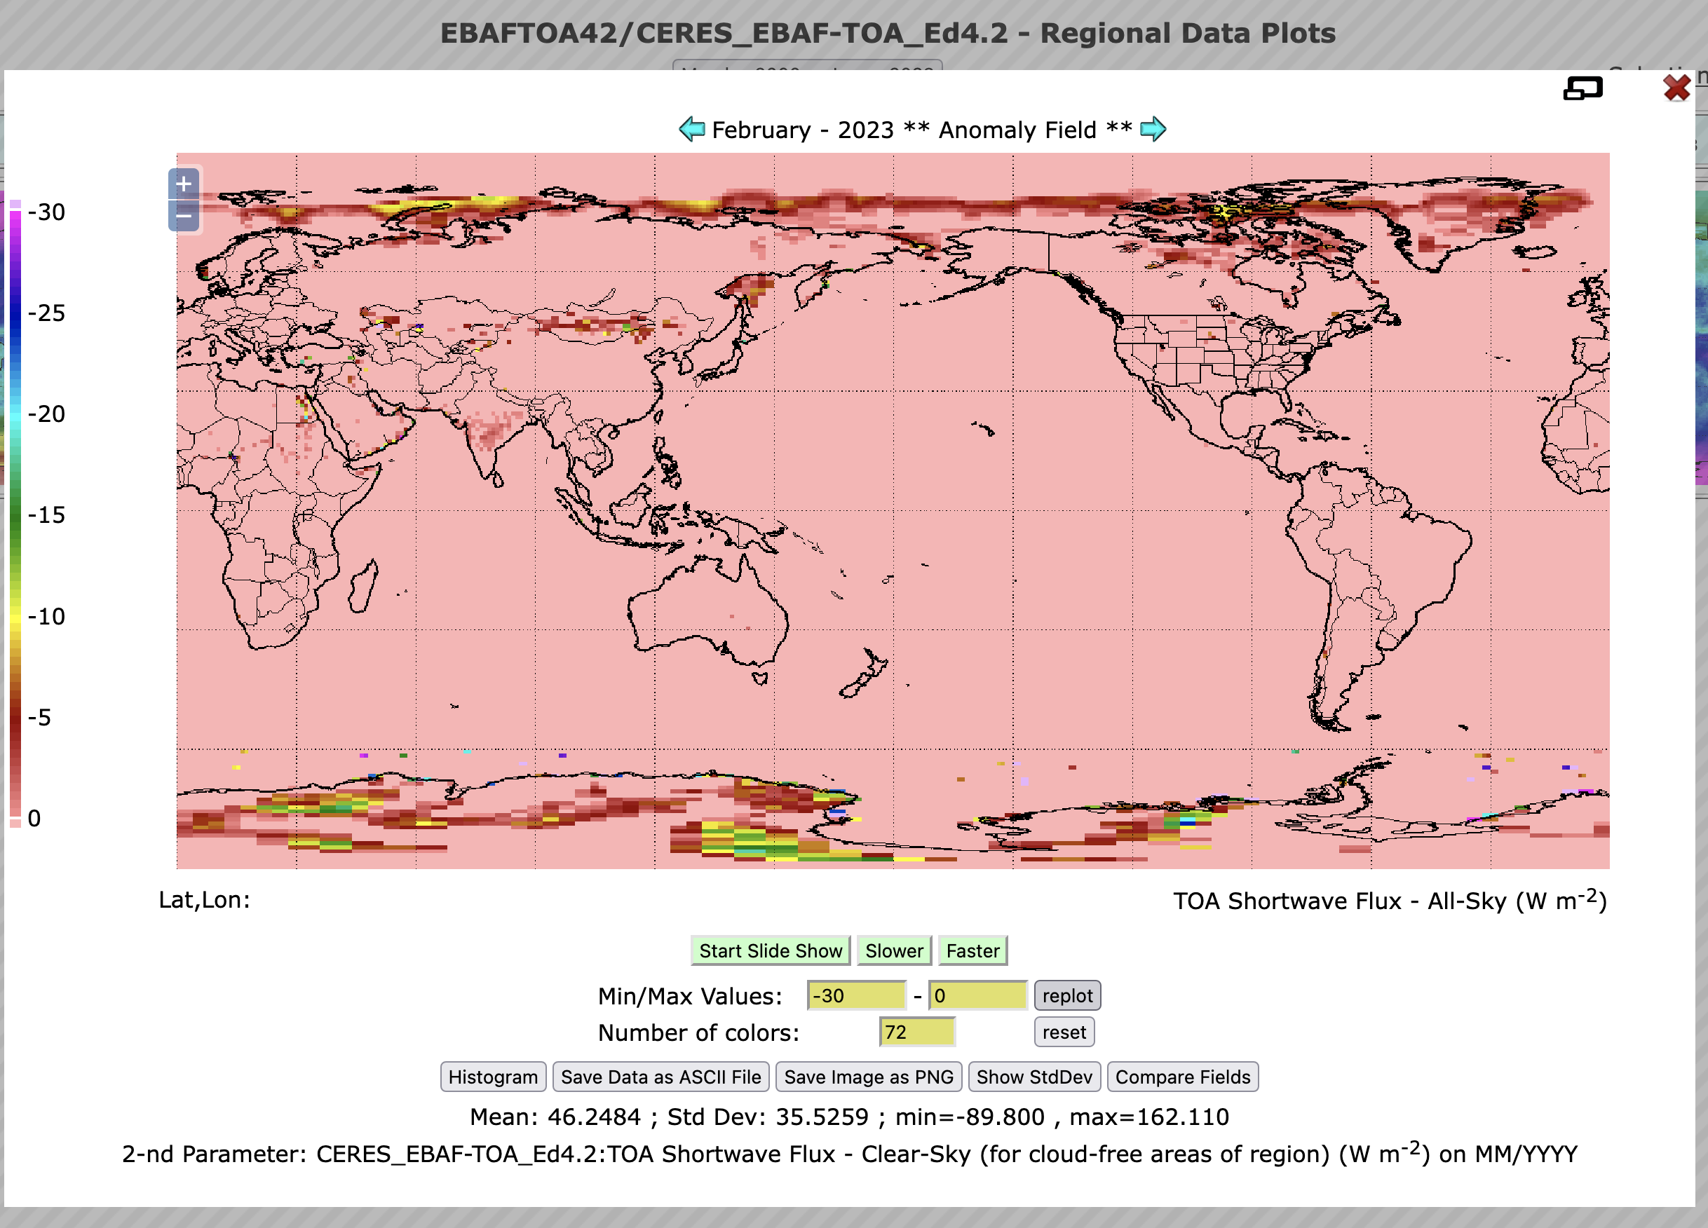
Shortwave cloud radiative effect anomalies at TOA
All-sky minus clear-sky (total area)
All-sky minus clear-sky (cloud free area)

