Slide 1

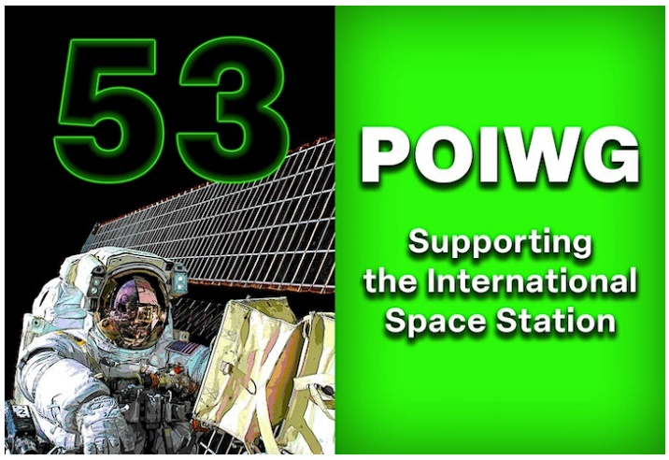
Title: POIWG 53
Splinter Session
Space Acceleration Measurement System
(SAMS)
Author: Ken Hrovat
Affiliation: Voyager Space
October 25, 2023

Slide 2
Space Acceleration Measurement System (SAMS)
Outline
SAMS Customer Support
Overview of SAMS (and MAMS)
Microgravity Acceleration Measurement System (MAMS)
SAMS Topology
More Overview
Summarize SAMS Measurements Over ~ the Past Year
SAMS Contacts:
Kevin McPherson, SAMS Program Manager
kevin.m.mcpherson@nasa.gov
Ken Hrovat, SAMS Operations & Analysis
hrovatk@zin-tech.com
Jennifer Keller, SAMS Project Manager
kellerj@zin-tech.com
Eric Kelly, SAMS Software Lead
kellye@zin-tech.com
Helen Brown, SAMS Integration
helen.c.brown@nasa.gov
Robert McCormick, SAMS POIS
robert.j.mccormick@nasa.gov
Robert Waymire, SAMS PARC robert.l.waymire@nasa.gov
Group Email
pimsops@grc.nasa.gov

Slide 3
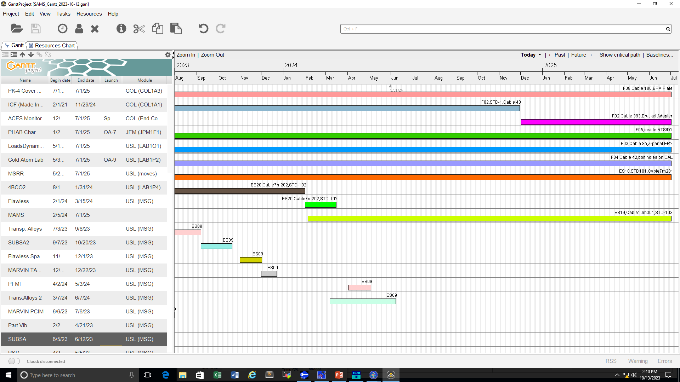


Customer Support: View by Payload
Mention Halley’s note about flight notes system to keep POIC cognizant of upcoming science runs so SAMS can be recovered quickly (if needed).
*
MAMS on NG-20, not sure when to be deployed
*
Move SAMS from 4BCO2 to Flawless Space Fibers
*
Two Items Above Need:
Topology Assessment for sensor and cabling
POIC Chit (request JSC equipment) for SAMS
Crew Procedure
NOT SHOWN: dedicated TSH sensors es05 in CIR & es06 in FIR
Chit also needed for SAMS support for MSRR

Slide 4
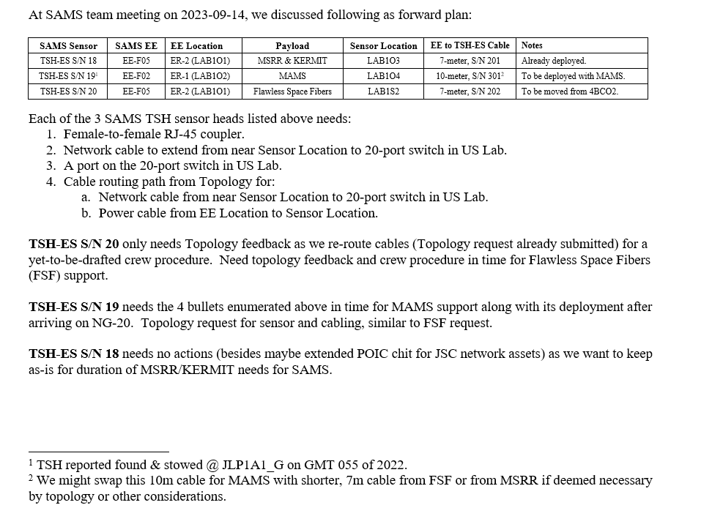
Chits for 3 Sets of Borrowed JSC Assets (through life of station)

Slide 5
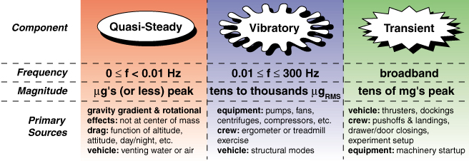

Overview
MAMS
SAMS Capabilities and Services:
measure the local vibratory regime in all 3 ISS labs
goal is continuous, 24x7 operations (CIR, FIR, and MSG turn on/off as needed)
measurement frequency range: 0.01 < f < 200 Hz
SAMS
As of 10/6/2023, SAMS had collected over 735,000 sensor hours (nearly 19 terabytes) of data on ISS.
For questions, email: hrovatk@zin-tech.com AND/or pimsops@grc.nasa.gov

Slide 6
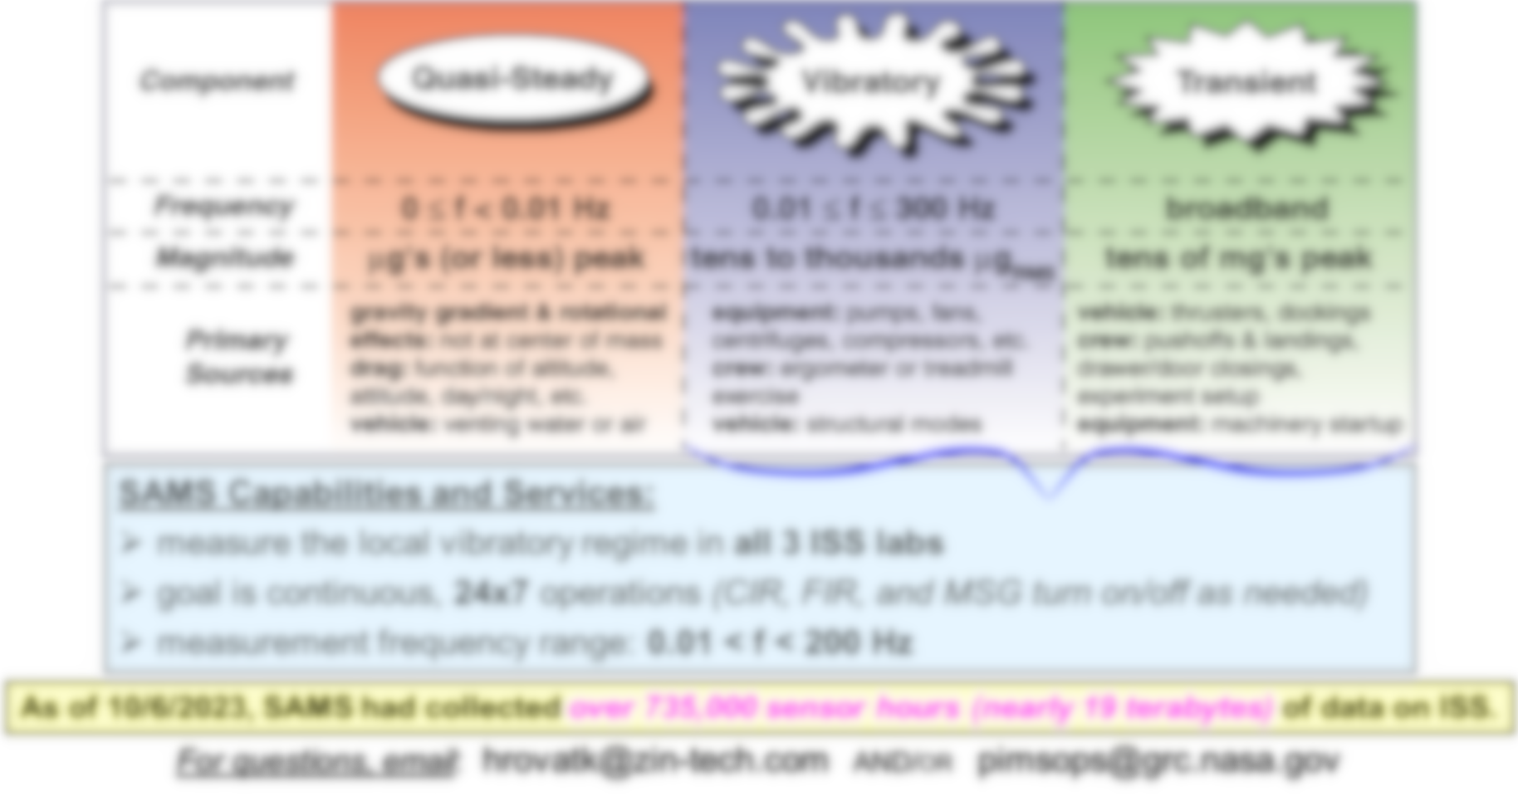
Note: Archived SAMS data has as-measured mean (average) value intact, but that component is not accurate. Do not use the mean value of SAMS data with any degree of confidence. A first step in our in-house data processing and analysis chain is to demean (subtract the mean) on per-axis basis. Just about all SAMS analysis results are derived from demeaned data.

Slide 7

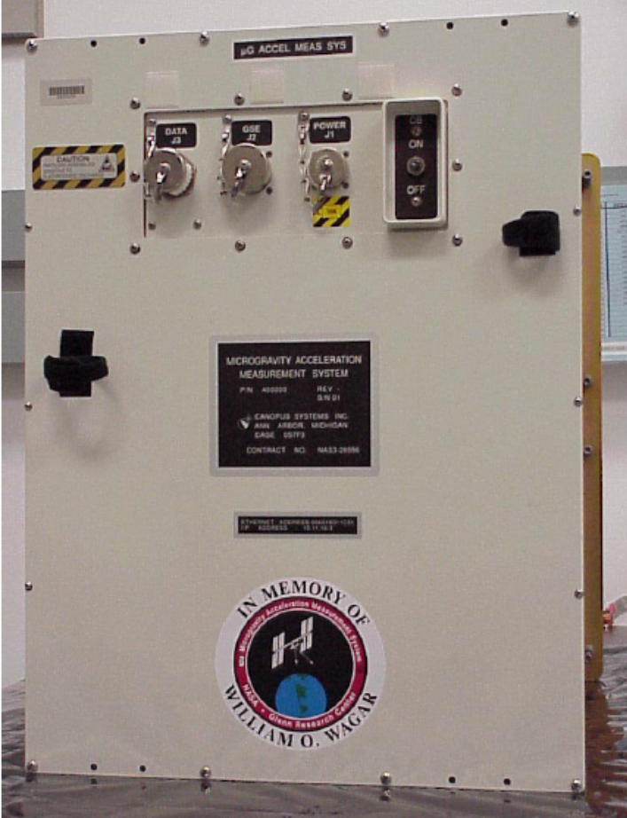
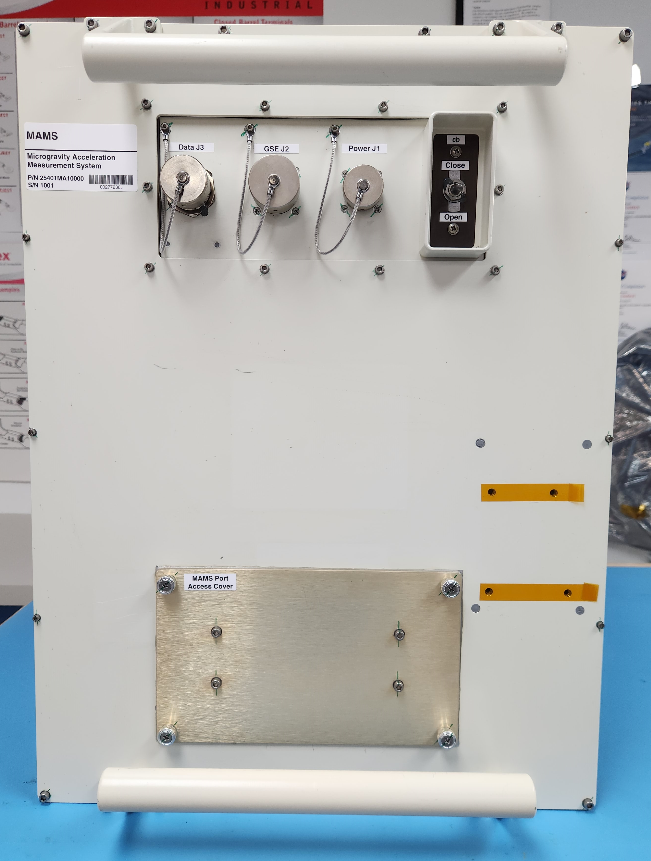
Microgravity Acceleration Measurement System (MAMS)
MAMS Contacts:
Kevin McPherson, MAMS Program Manager
kevin.m.mcpherson@nasa.gov
Scott Horan, MAMS Project Manager
horans@zin-tech.com
Helen Brown, MAMS Integration & Operations
brownh@zin-tech.com or helen.c.brown@nasa.gov
Post installation:
Eric Kelly, MAMS Operations & Analysis
kellye@zin-tech.com
Ken Hrovat, MAMS Operations & Analysis
hrovatk@zin-tech.com
SAMS Sensor Head
Bolts Here
Old MAMS Hardware
photo
New MAMS Hardware
FIT photo

Slide 8
Microgravity Acceleration Measurement System (MAMS)
Capabilities:
Provides centralized measurement of the quasi-steady (low-frequency, low magnitude) portion of the acceleration spectrum (below 0.01 Hz) to complement SAMS (> 0.01 Hz).
Designed for continuous, 24x7 measurement similar to SAMS.
Measurements can be mapped mathematically to an arbitrary location. This assumes that the space station is a rigid body at low-frequencies.
History & Future:
Launched on STS-100/6A on April 19, 2001 with nearly flawless, nearly continuous operation on the ISS from GMT 2001-05-03 to 2017-04-22. MAMS collected over 217,615 sensor hours (5 TB) of data in that span. Currently on the ground being re-furbished at ZIN Technologies (now Voyager Space) in Cleveland, Ohio.
Customers are anybody interested in the quasi-steady environment, and we have heard from at least 3 high-profile payloads wanting MAMS support already: ZBOT-NC, Cold Atom Lab and GTCS.
Manifested on NG-20 (Increment 70!), to be located in ER-6 (LAB1O4).

Slide 9
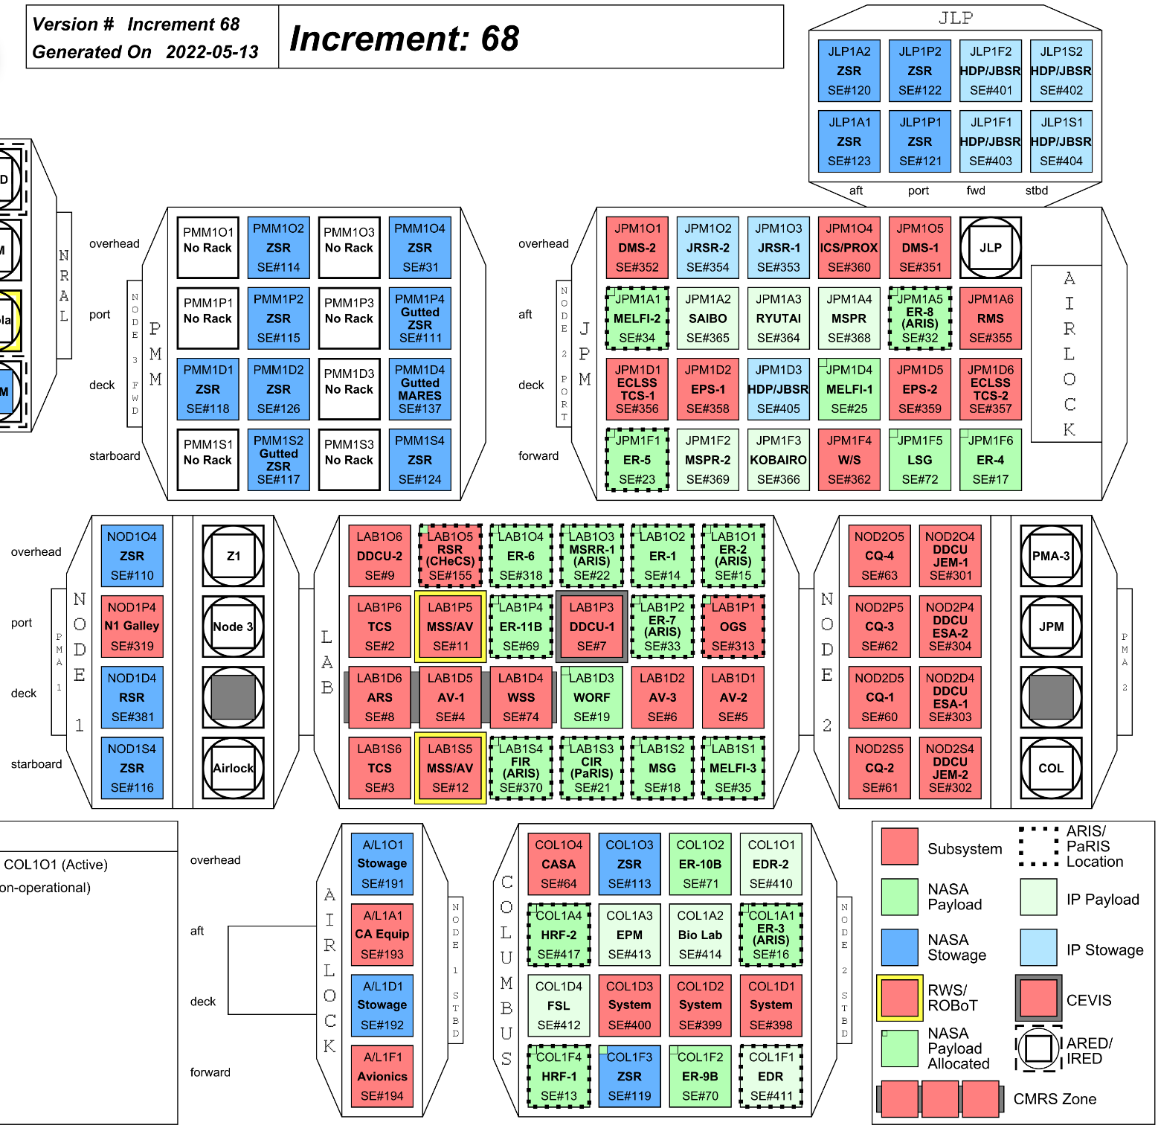
Topology:
SAMS Sensor Locations
2023-10-12
SAMS Sensor Head Locations
SE F02, COL1A1, ER3, Seat Track
SE F03, LAB1O1, ER2, Lower Z Panel
SE F04, LAB1P2, ER7, Cold Atom Lab Front
SE F05, JPM1F1, ER5, Inside RTS/D2
SE F08, COL1A3, EPM, near PK-4
TSH-ES09, LAB1S2, MSG
TSH-ES05, LAB1S3, CIR
TSH-ES06, LAB1S4, FIR
TSH-ES18, LAB1O3, MSRR, KERMIT
TSH-ES20, LAB1P4, ER11B, 4BCO2
TSH-ES03, -ES19, stowed spares
- - - - - - - - - - - - - - - - - - - - - - - - - - - - - - - - - - - -
LEGEND:
Sensor that does not move
Sensor that has moved or may move
Sensor that has never moved
Stowed or not currently connected
MSG sensor gets installed for some payloads
2
3
4
5
8
9
5
5
6
18
3
3
18
hard-wired
20
hard-wired
20
4
CIR, FIR, and MSG turn SAMS sensors ON/OFF with their own ops.
All other sensors nominally operate 24x7.
6
5
9
8
2

Slide 10
Topology:
SAMS Electronics Enclosure (EE)
Locations 2023-10-12
Code | EE | Location | Rack | Type
 | EE-F01 | LAB1P2 | ER7 | embedded
 | EE-F02 | LAB1O2 | ER1 | RTS/D1
 | EE-F06 | JPM1F1 | ER5 | RTS/D2
 | EE-F04 | COL1A1 | ER3 | embedded
 | EE-F05 | LAB1O1 | ER2 | embedded
 | EE-F07 | JPM1A5 | ER8 | embedded
7
1
2
6
6
2
5
4
5
1
7
As of GMT 2023-10-12, this EE is not hosting any sensors and is not powered
4

Slide 11
More Overview
If I want to… | then…
download SAMS data | visit https://gipoc.grc.nasa.gov/pims/pub/pad -- e.g. use the vibration measurements recorded by SAMS in your own models or correlate with your results
read the binary acceleration data files | visit the link shown just below here to see how you can start working with acceleration data https://gipoc.grc.nasa.gov/pims/plots/user/mohan/how2read_pad_binary_files.html
browse daily summary “roadmap” plots | visit https://gipoc.grc.nasa.gov/pims/roadmap -- these roadmap plots show patterns, structure and boundaries in both time and frequency; these are updated daily
browse acceleration handbook pages | visit https://gipoc.grc.nasa.gov/wp/pims/handbook -- these are a collection of PDF files that briefly quantify & qualify various events, activities and various aspects of the microgravity acceleration environment
monitor vibratory environment, near real-time | visit https://gipoc.grc.nasa.gov/wp/pims/current-real-time/

Slide 12
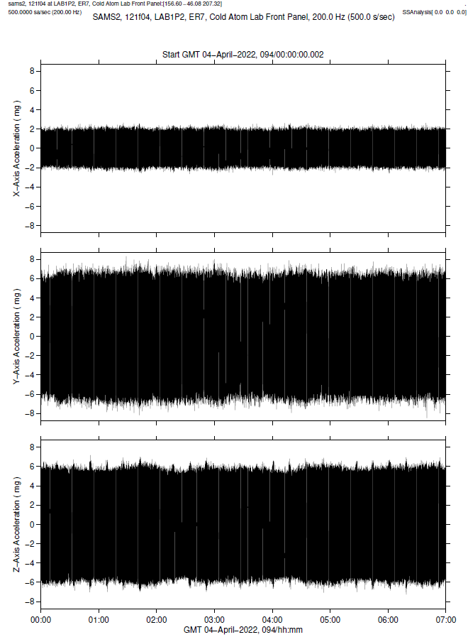
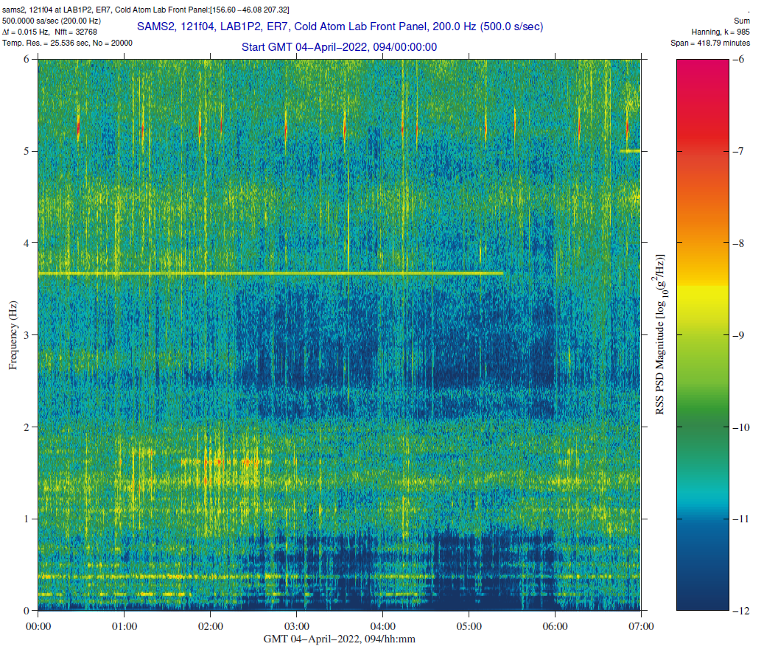
raw data, as-measured
More Overview
Why use spectrograms for near real-time monitoring?
same data set as raw data on the left
…patterns…
more insight…
…boundaries…
…and structure in both time & frequency

