Slide 1
TISA Working Group Update
CERES TISA Sublead: D. Doelling
TISA: B. Branch, A. Gopalan, K. Itterly, E. Kizer, P. Mlynczak, C. Nguyen*,
M. Nordeen, M. Sun, J. Wilkins, F. Wrenn*
GEO and Imager calibration: P. Khakurel, C. Haney, B. Scarino
K. Dejwakh, W. Miller & subsetter team
Raj Bhatt (CLARREO),
Fall 2023 CERES science team meeting
NASA GISS, New York City, NY, October 17-19, 2023
*leaving the team

Slide 2
OUTLINE
CERES L3 Products overview and status
  Transitioning CERES products to NOAA-20 due to the Aqua and Terra drifting orbits
MODIS C6.1 to C7 reflective solar band improvements
  By scan angle and spectrally
Radiometrically scale N20-CERES to the NPP-CERES calibration reference
  Method does not require coincident measurements but relies on that NPP and N20 are in the orbit but spaced 8-days apart
SYN1deg computed flux temporal interpolation improvement
  To be implemented in SYN1deg Ed4.2
TISA Ed5 framework

Slide 3
CERES L3 PRODUCTS

Slide 4
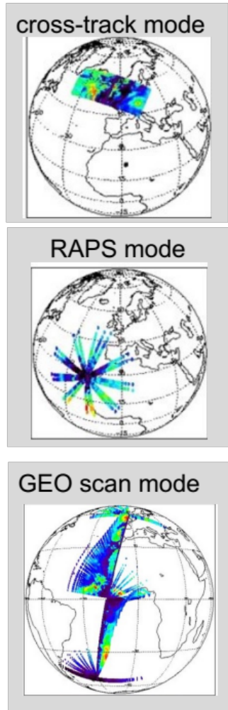
CERES instrument scan modes
Cross-track mode designed for uniform spatial sampling
  This provides observations for SSF1deg and SYN1deg data products
RAPS mode designed to capture all view and azimuthal angles
  This provides observations to build ADMs
GEO scan mode where the CERES instrument is pointed to the same line of sight as the GEO operational scanning.
  This provides coincident angle matched GEO and CERES observations

Slide 5
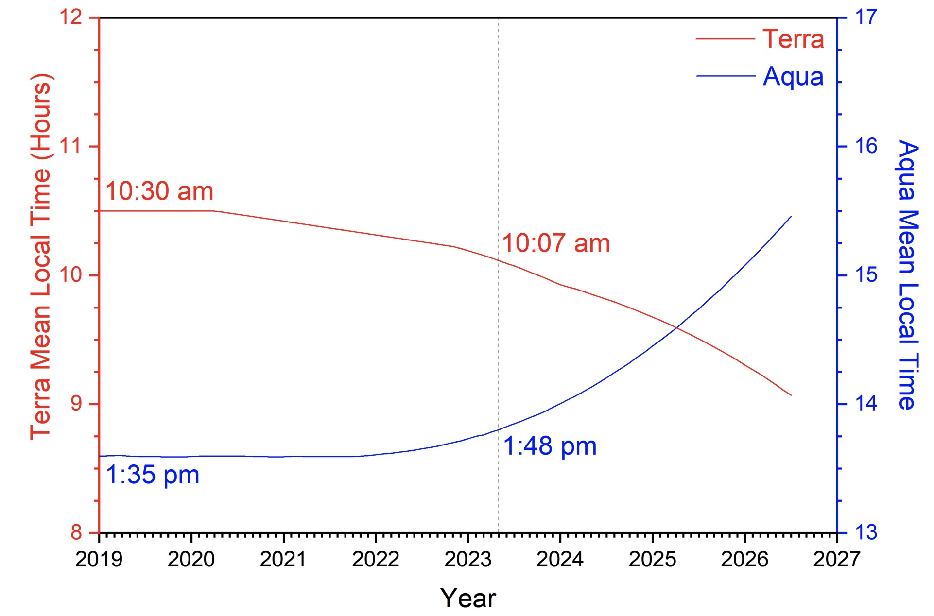
Terra and Aqua orbital drift
CERES instrument scan mode table
March 2023
instrument | Prior to March 2023 | March 2023
Terra-FM1 | Cross-track | Cross-track GEOscan (every 5th day)
Aqua-FM3 | Cross-track | RAPS/GEOscan
N20 (FM6) | Cross-track | Cross-track

Slide 6
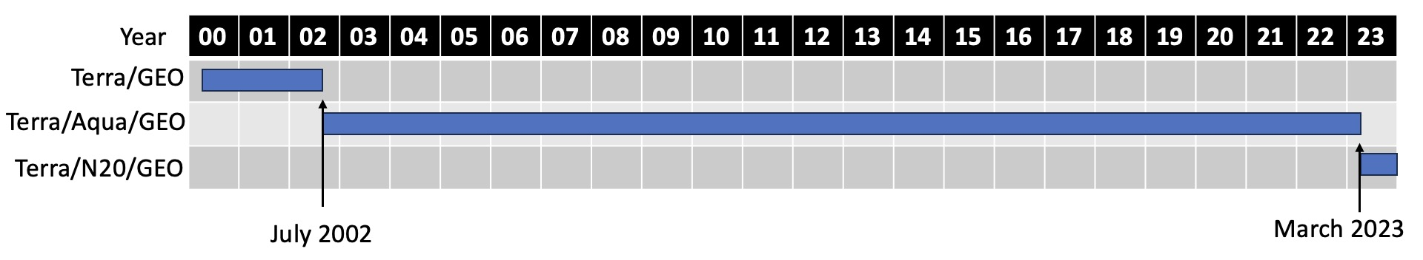
SYN1deg and CldTypHist Ed4.1 products
The SYN1deg product utilizes hourly GEO fluxes and clouds to infer the regional diurnal in between CERES measurements
  SYN1deg-hour, SYN1deg-day, SYN1deg-mhour, SYN1deg-month
The CldTypHist product combines the imager and GEO cloud properties and stratifies them into 3x3 cloud layer and optical bins
  CldtypHist-mhour, CldtypHist-month(daytime, nighttime, 24-hour)
The SYN1deg product is in forward processing mode
The CldTypHist product has stopped in February 2023, will be available by the science team meeting and is in forward processing mode
  THe CldTypHist was rerun beginning with December 2017, because a few sporadic months had dropped the Aqua input due to a processing glitch

Slide 7
SYN1deg Ed4B product
GEO reprocessing of the entire (2000-2023) for greater computed flux and cloud consistency across the record, projected release date of Spring 2024
  Met 8,9 and 10 reprocessed consistently using the latest Met-11 code
  GEO 2-channel satellites, reprocessed with improved cloud mask and night-time optical depths
    GMS-5 Mar 2000 to Apr 2003
    Met-5 57° Mar 2000 to Jan 2007
    Met-7 0° Mar 2000 to Apr 2004
    Met-7 63° Jan 2007 to Jan 2017
The twilight cloud retrievals (SZA>60) to be temporally interpolated across the twilight hour-boxes
  Twilight retrieved clouds caused noisy surface fluxes, use interpolated clouds instead
Code bug fixes
Consistent GEO boundaries
  Rather than the bisecting longitude between satellites
To be released early 2024

Slide 8
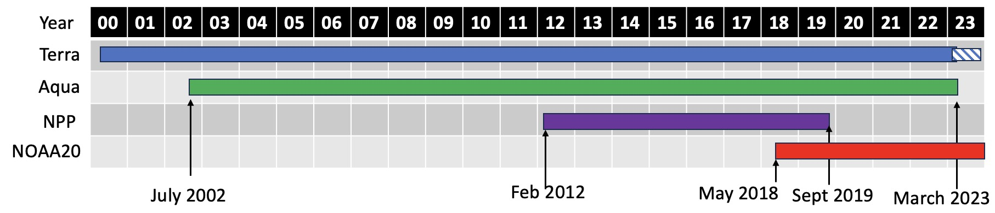
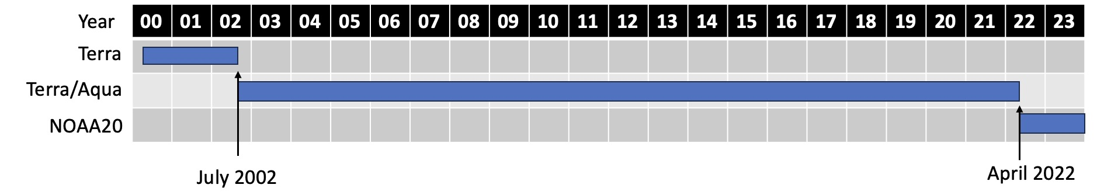
SSF1deg and EBAF products
The SSF1deg product utilizes constant meteorology albedo diurnal models and LW temporal interpolation to infer the regional diurnal in between CERES measurements
The EBAF product climate quality fluxes combines the stability of the SSF1deg and regional diurnal flux of the SYN1deg product free of GEO artifacts. Utilizes imager derived BB fluxes for spatially complete clear-sky fluxes. The TOA net flux is constrained to the ocean heat storage. Uses regional climatology adjustment factors to bridge satellite records

Slide 9
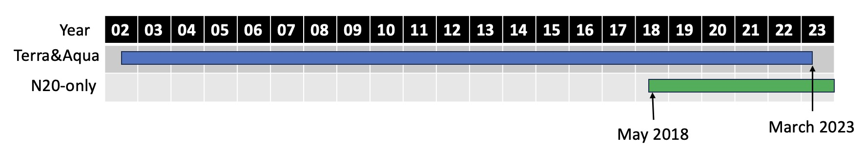
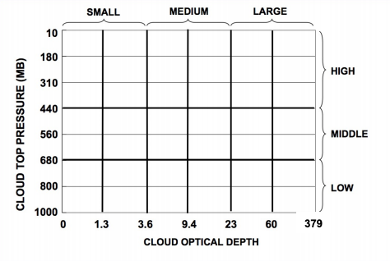
FBCT-N20 product
The FluxByCloudType (FBCT) product provides observed daytime CERES fluxes stratified by 7 cloud layer and 6 optical depth bins (similar to ISCCP)
  The TRMM directional models are used to compute the daily SW flux
Climatology adjustments to bridge the gap between Terra&Aqua and a NOAA20-only records were unsuccessful
  mostly due to optically thin cloud differences between MODIS and VIIRS
The FBCT-Terra /Aqua will end with February 2023 and a NOAA-20 record begins in May 2018 and is in forward processing mode
  Projected release date by the science team meeting
February 2023

Slide 10
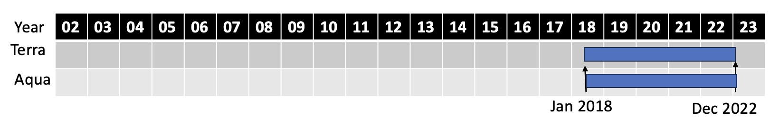
CRS1deg-hour product
CRS L2 provides footprint computed profile and surface fluxes with associated cloud and meteorological parameters by instrument.
  SSF1deg-L2Ed4 provides parameterized surface fluxes
The TISA group has spatially gridded the CRS L2 footprint computed fluxes into the CRS1deg-hour product using the new Ed5 framework code
Working on placing the CRS1deg-hour on the subsetter
  A preliminary version of January 2018 is available internally for validation
Will eventually combine the SSF1deg-hour and CRS1deg products on the same subsetter ordering page
different color for Aqua

Slide 11
MODIS C6.1 to C7 improvements

Slide 12
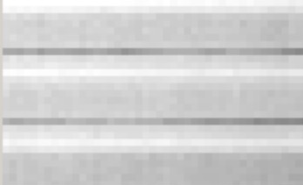
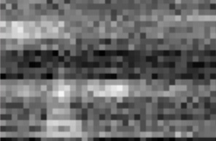
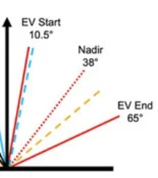
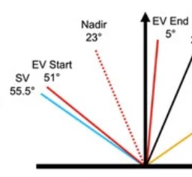
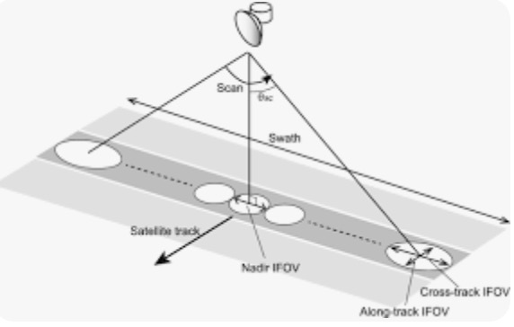
MODIS and VIIRS onboard calibration
detector striping
Detector to detector striping or gain equalization
  MODIS has a 10-detector swath, whereas VIIRS has 16-detector swath
  Each detector is individually calibrated with the solar diffuser or blackbody
Response vs scan angle gain equalization
  The scanning is performed by rotation of a scan mirror
  The mirror degrades unevenly overtime and must be characterized on orbit
Long-term trending
  MODIS and VIIRS use solar diffusers and lunar looks to monitor stability
noisy detectors
Earthview Start, 10.5°
Earthview End, 5°
Moon 11.2°
Solar Diffuser 50.25°
Earthview Start, 51°
Solar Diffuser and Moon 55.5°
VIIRS
nadir
Earthview End, 65°
MODIS
scan position

Slide 13
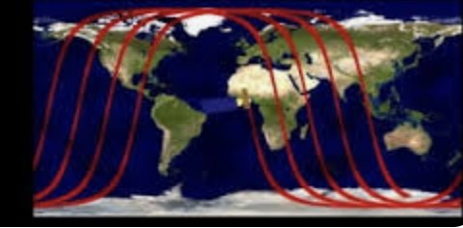
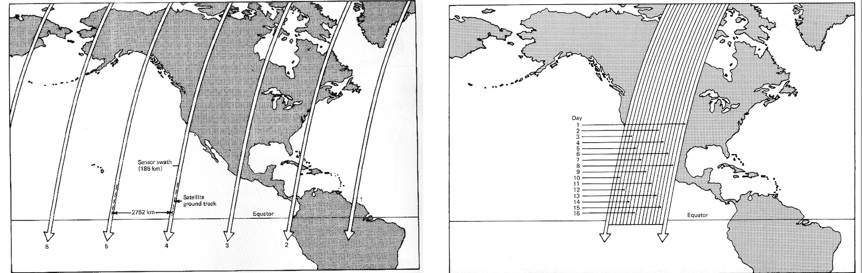
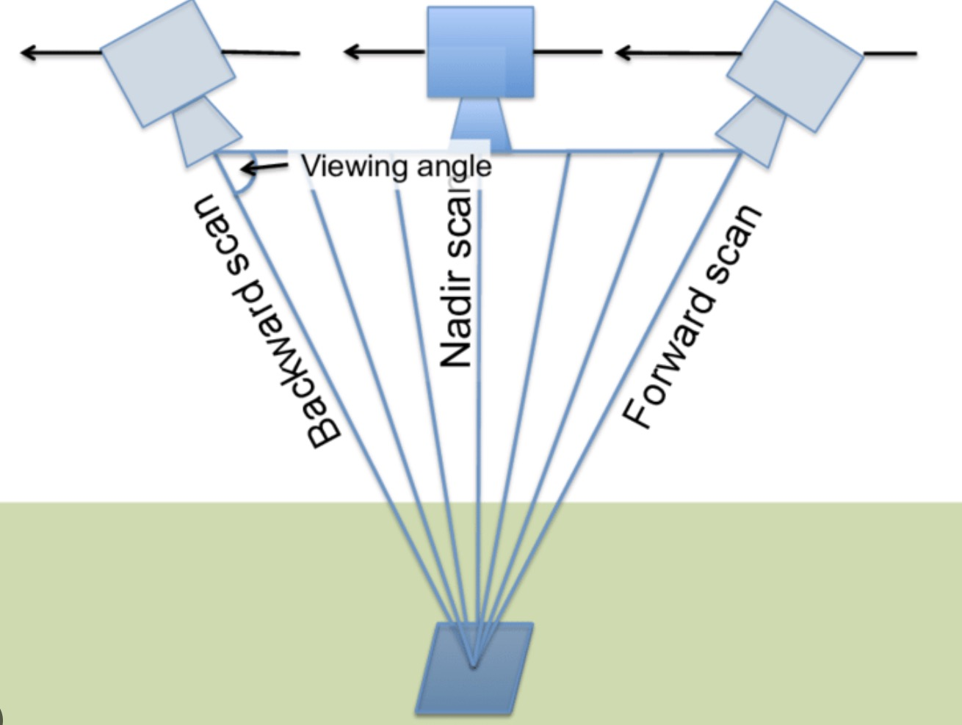
Orbit ground track repeat time
Aqua orbit
Terra, Aqua, JPSS, NOAA-20 are sun-synchronous polar orbiters
  Aqua ~14.5 orbits per day, ~99 minutes per orbit, 720 km altitude, small data gaps between swaths at equator
  NOAA-20 ~14.3 orbits day, ~101 minutes per orbit, 820 km altitude. swath contiguous at equator
Terra, Aqua, JPSS, NOAA-20 have a 16-day orbit repeat time
  Terra has mean local equator crossing time at 10:30AM
  Aqua, NPP and NOAA-20 have a mean local equator crossing time of 1:30PM
day 10
day 9
day 1
single day orbit tracks
16-day orbit tracks

Slide 14
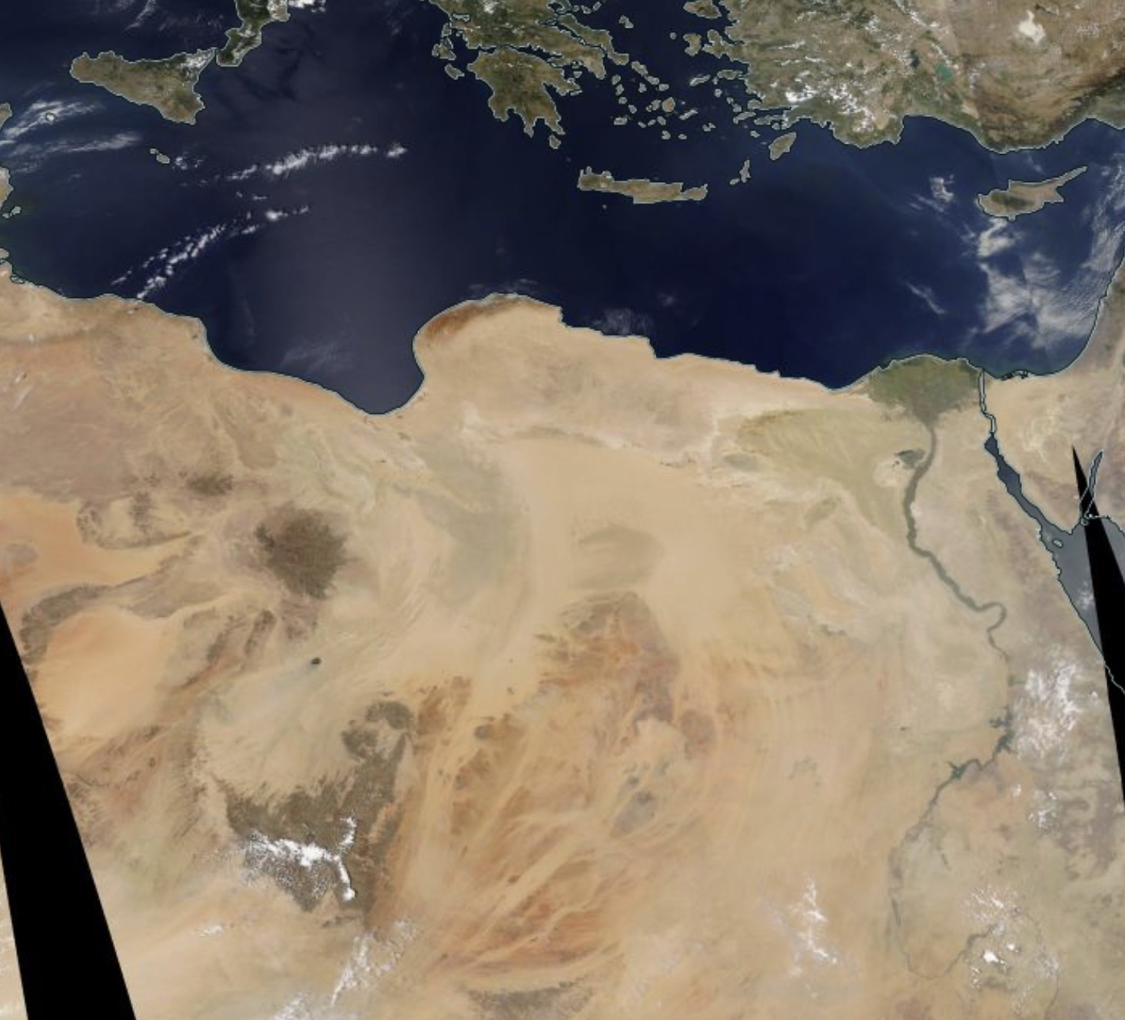
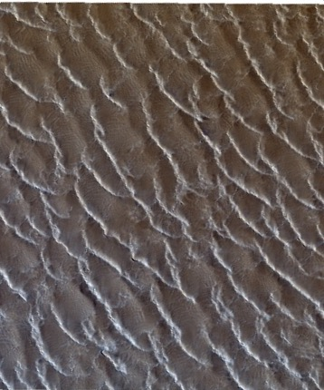
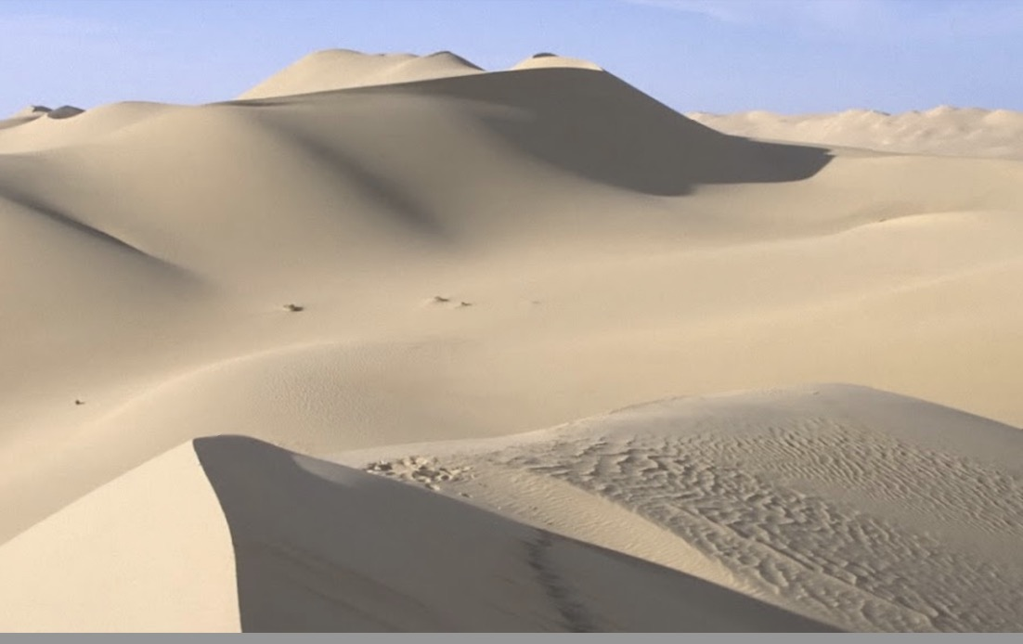
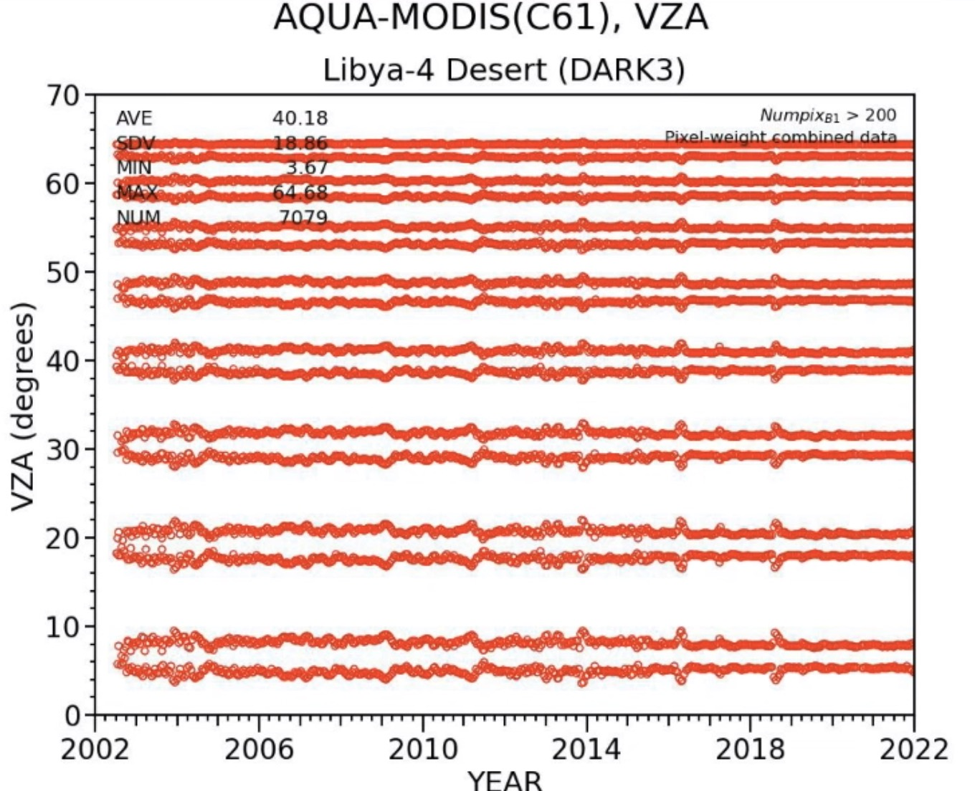
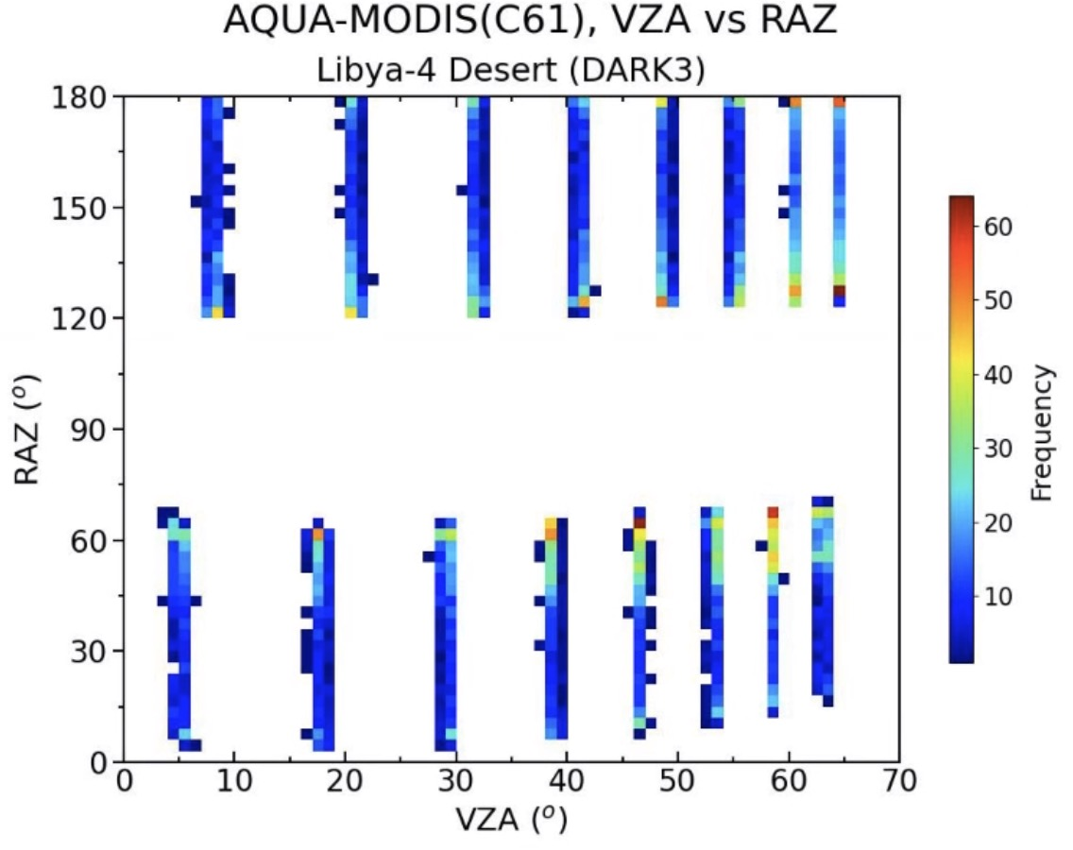
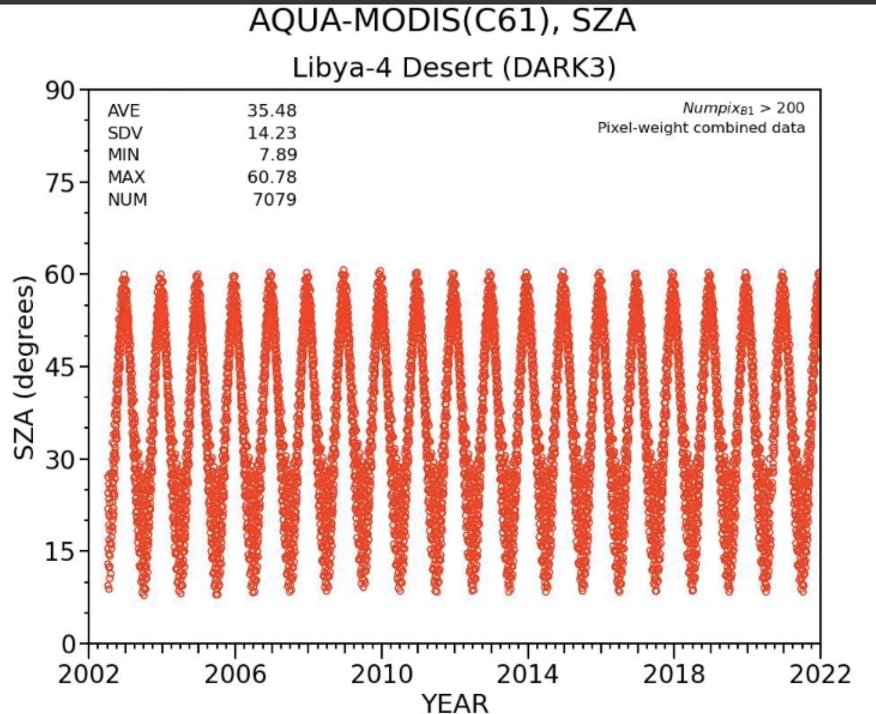
Libya4 invariant target
EOSDIS Worldview Aqua image
The Libya 4 site is one of the most often-used Pseudo-invariant Calibration Sites (PICS) by the Committee on Earth Observation Satellites (CEOS) Working Group for Calibration and Validation
Libya4 (28°-29°Norht and 22° to 23° East) is composed of sand dunes and no vegetation, highly reflective and little cloud cover
Bin the MODIS radiances into 16 repeat day angular bins
Libya4 SZA range between 10° and 60° over the year
ISS-DESIS 30-m
Google Maps photo
summer azimuth
backscatter
winter azimuth
16 angular bins
forward scatter

Slide 15
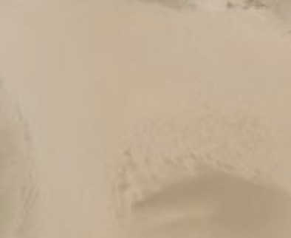
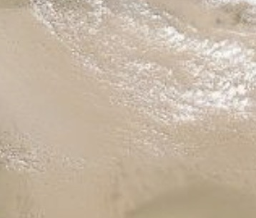
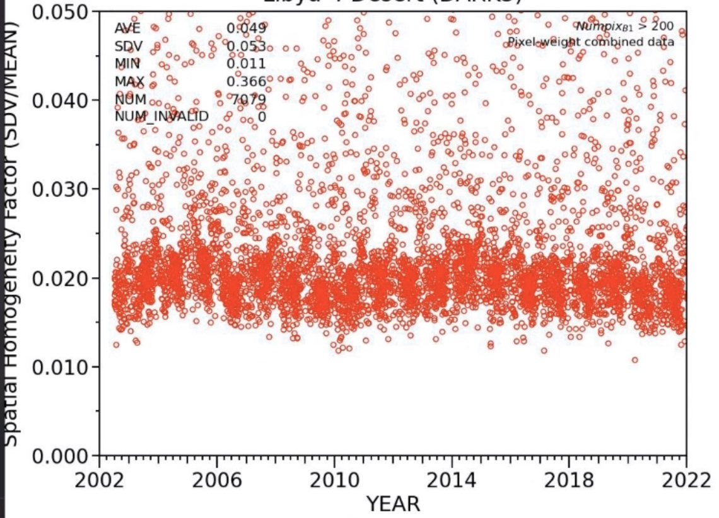
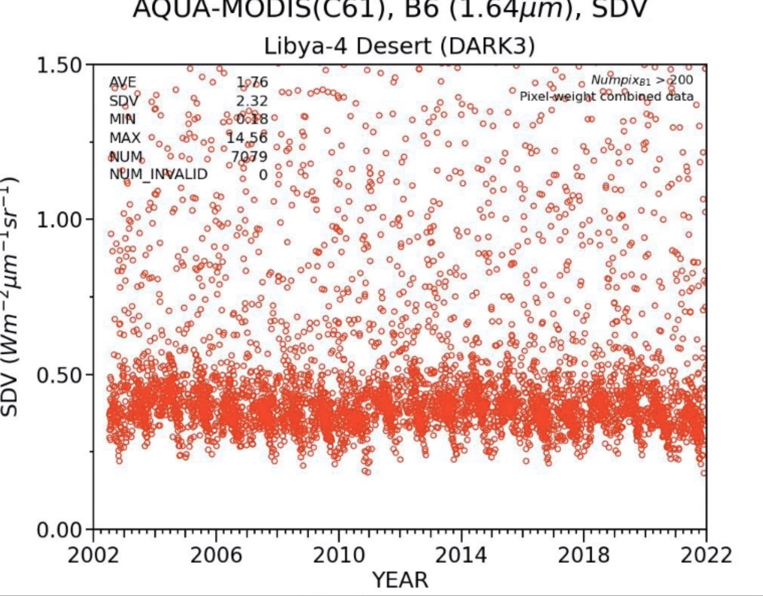
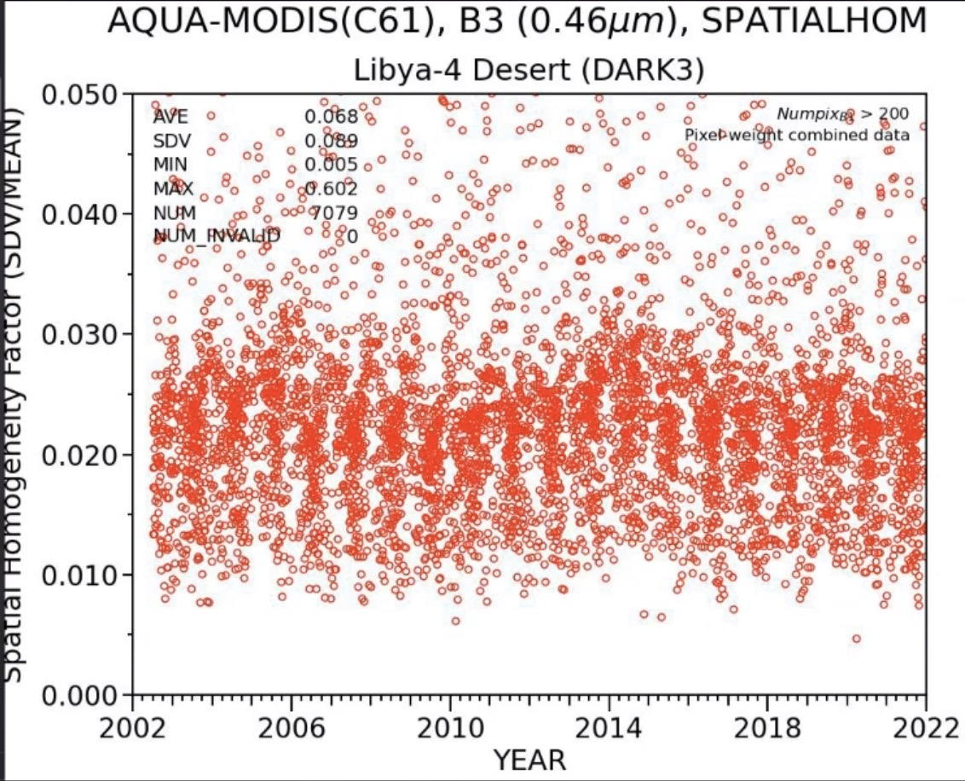
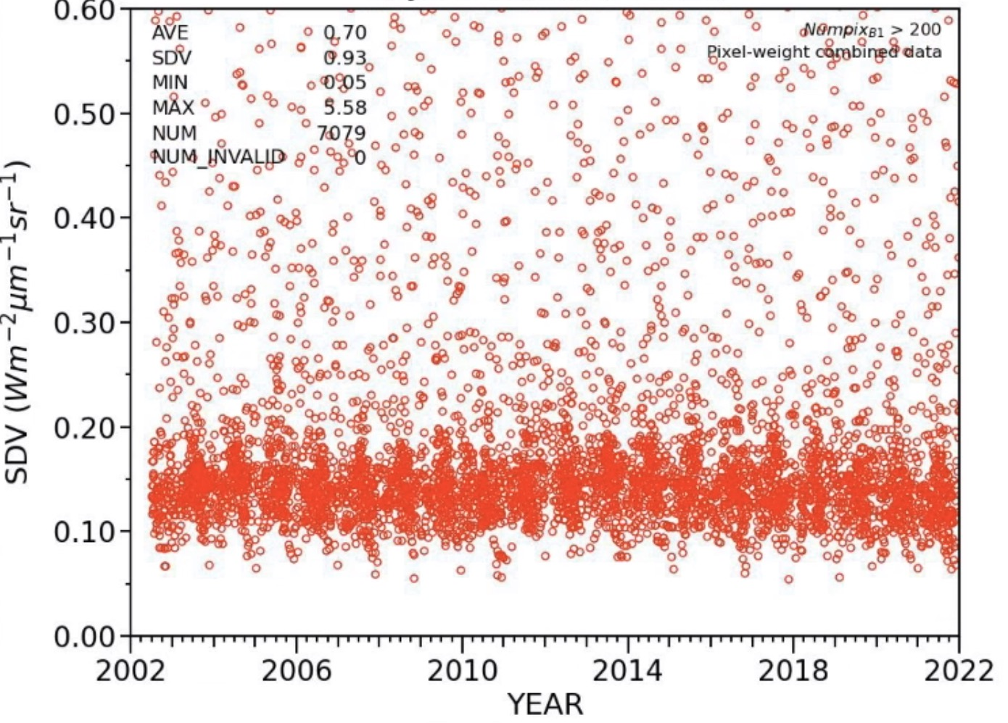
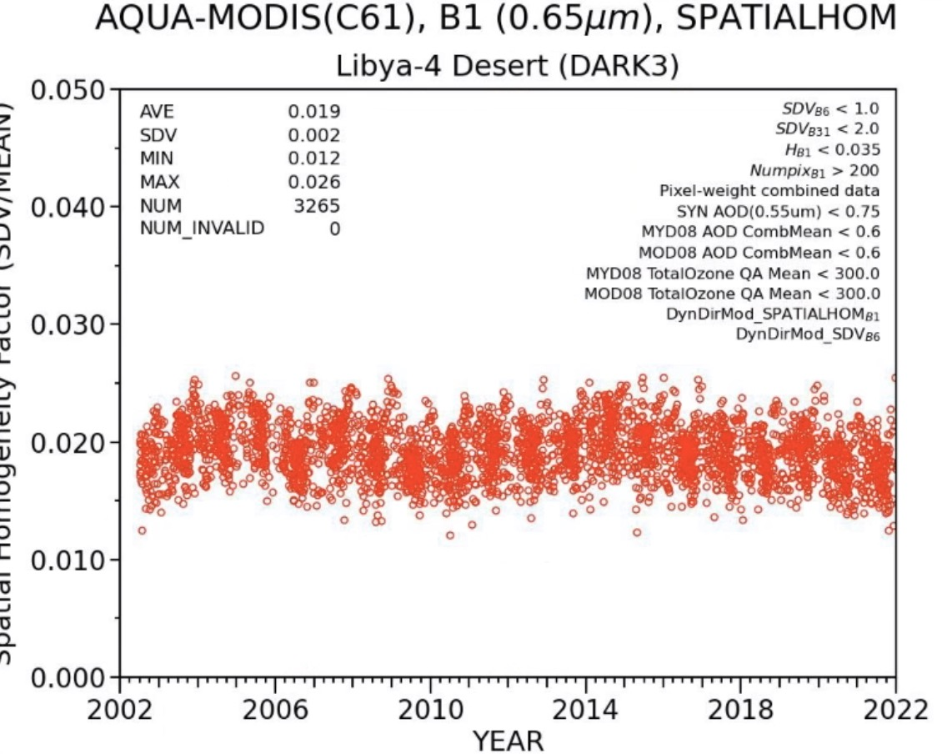
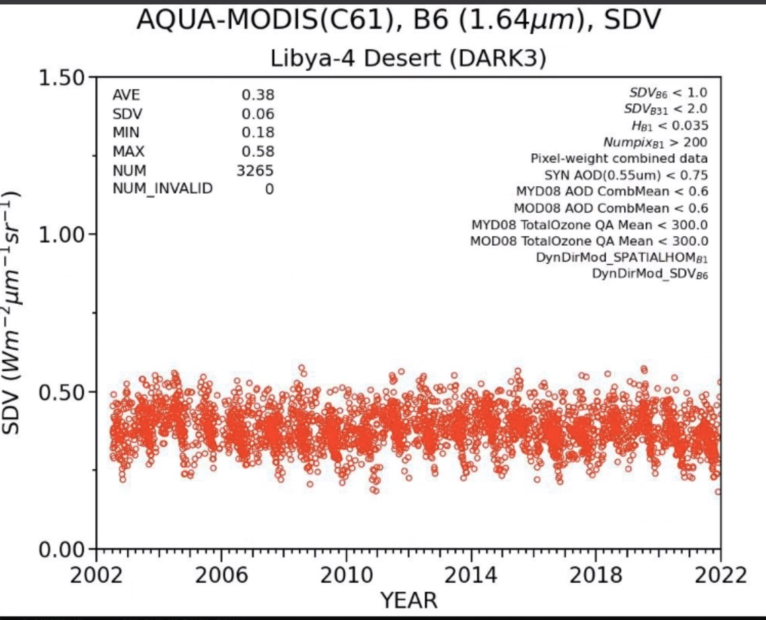
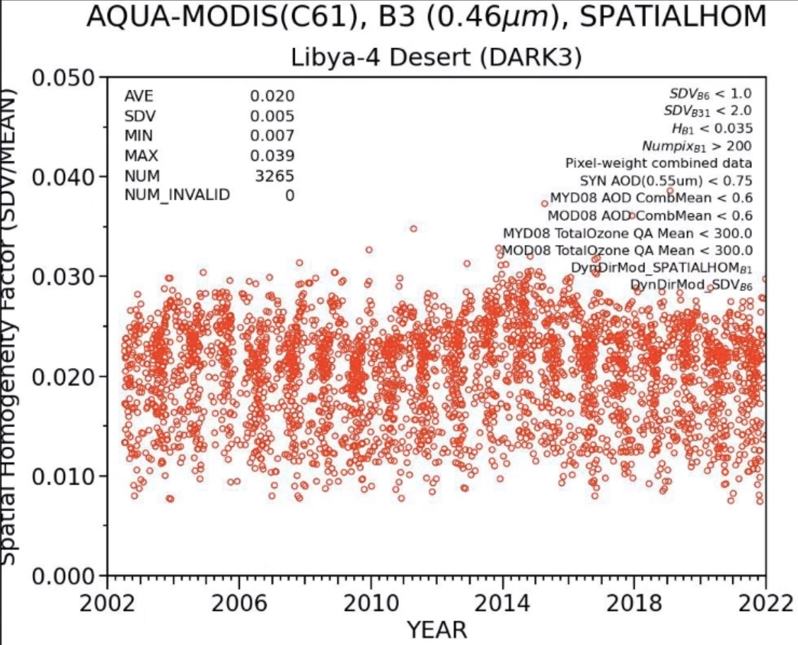
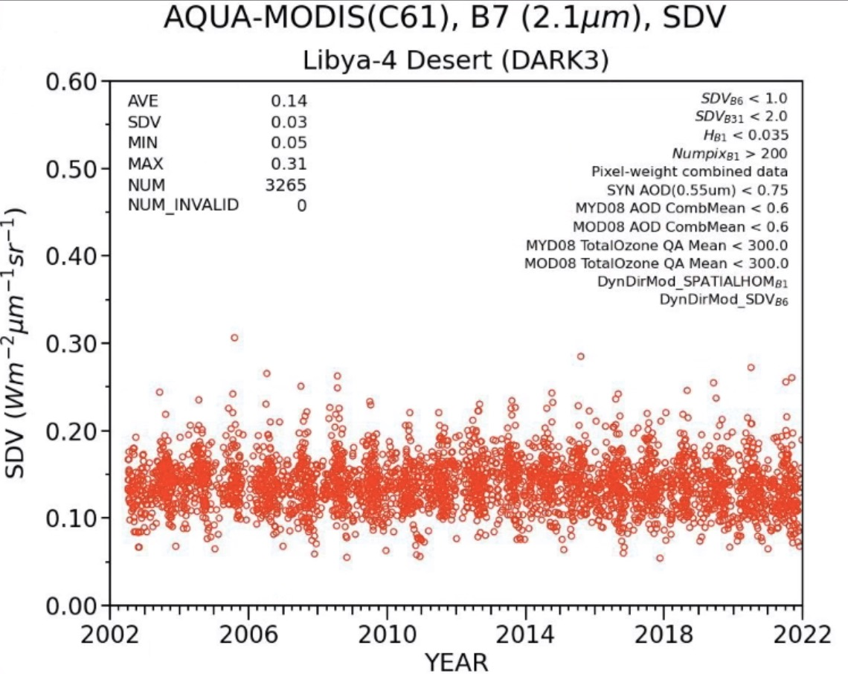
Libya4 clear-sky determination
0.65µm clear-sky
SHF = 0.02
0.65µm cloudy-sky
SHF = 0.10
A spatial homogeneity (SHF) threshold applied to non-absorbing channel is used to filter cloudy observations
  Apply a 2-sigma filter of the homogeneity factor to each directional model
  50% of the observations were deemed clear
Aqua-MODIS Band 1 0.65µm
Aqua-MODIS Band 6 1.65µm
Aqua-MODIS Band 3 0.48µm
Aqua-MODIS Band 7 2.1µm
All observations
non-absorbing
non-absorbing
aerosols, Rayleigh scattering
water vapor absorption
clear-sky filters applied

Slide 16
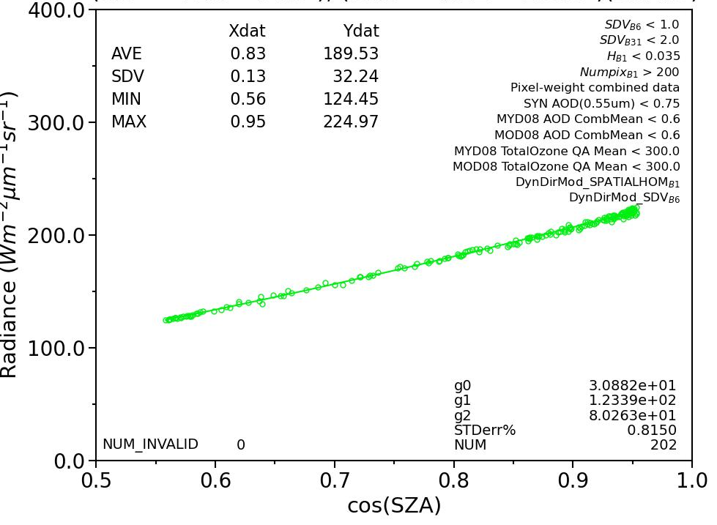
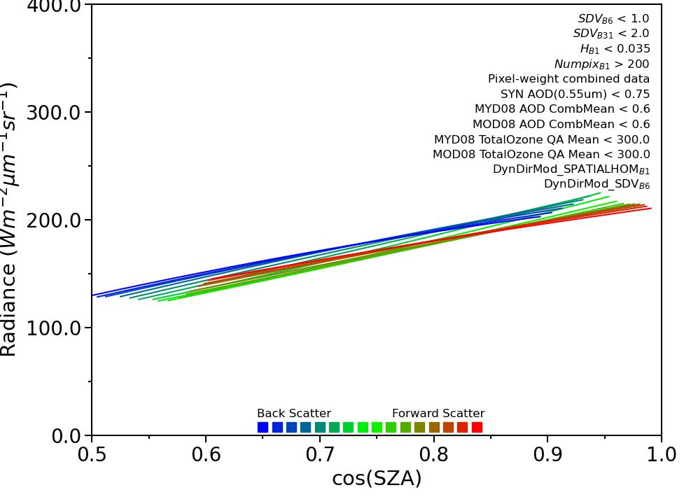
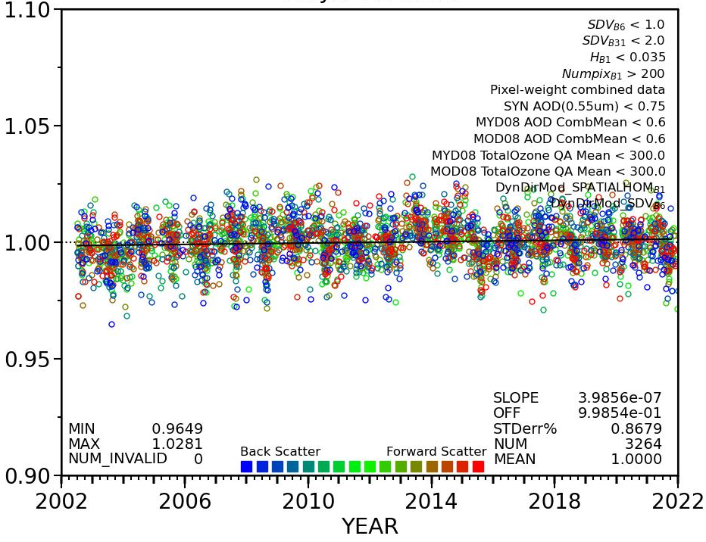
BRDF and Atmospheric Correction
0°<VZA<7° backscatter, Aqua-MODIS, 0.65µm
For each angular bin and spectral channel, the BRDF is characterized by regressing the clear-sky daily radiances over the record as follows
  Rad_{pred} = g₀ + g₁*cos(SZA) + g₂*cos(SZA)²
The atmospheric correction are linear coefficients based on the daily PW, ozone concentration, and AOD retrievals over Libya4
  MYD08 MODIS deep blue AOD, GEOS O₃, MYD08-D3 PW (based on MODIS NIR channels)
  Rad_{pred} = a₀ + a₁*cos(SZA) + a₂*cos(SZA)² + a₃*PW + a₄*O₃ + a₅*AOD
The normalized radiance is computed as follows
  rad_{norm} = rad_{obs}/ rad_{pred}
Aqua-MODIS angular models, 0.65µm
Aqua-MODIS, 0.65µm
normalized radiance

Slide 17
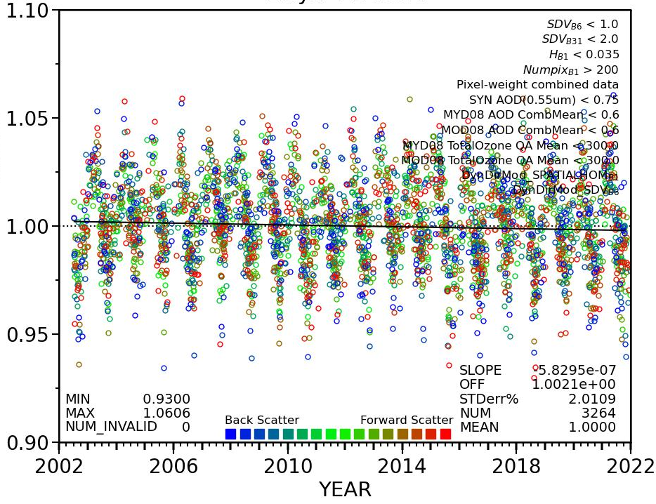
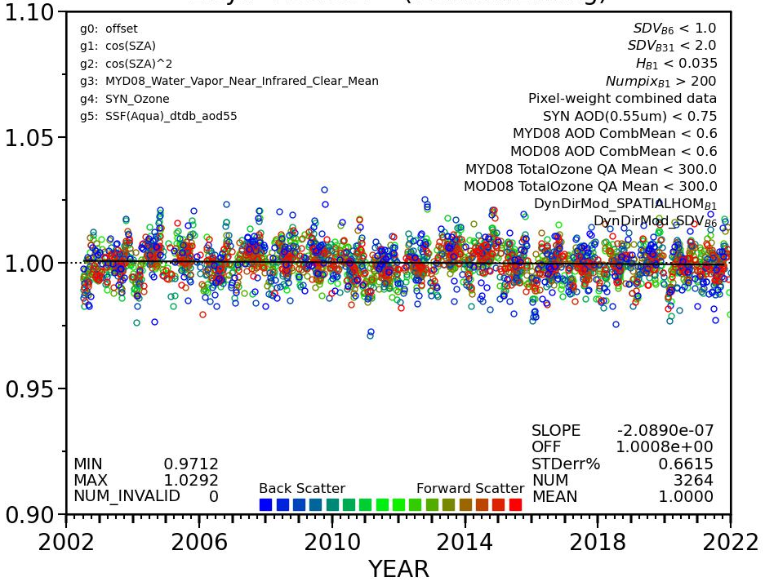
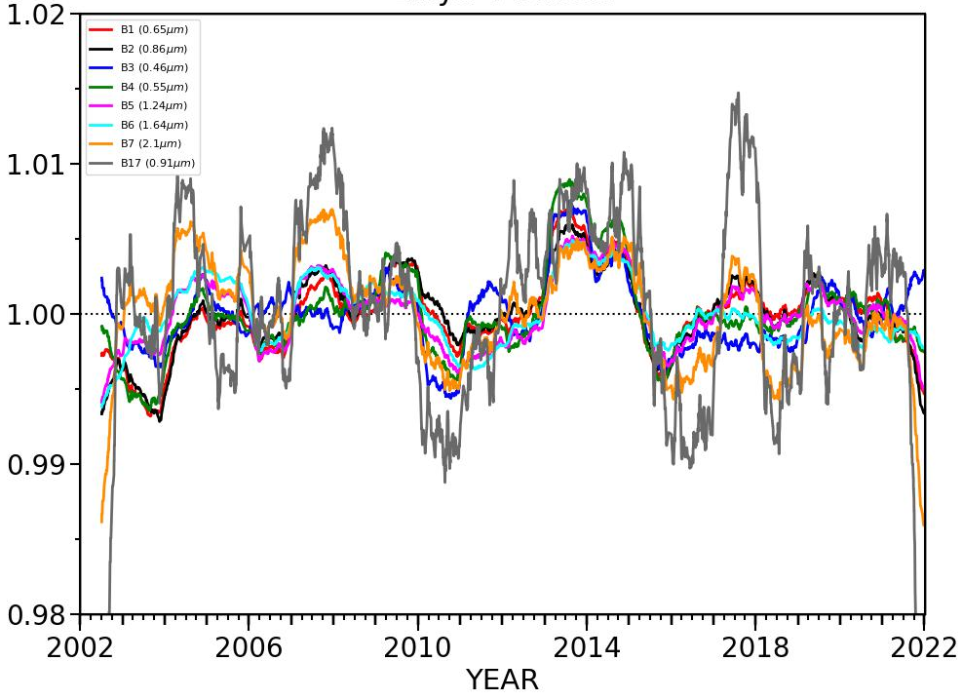
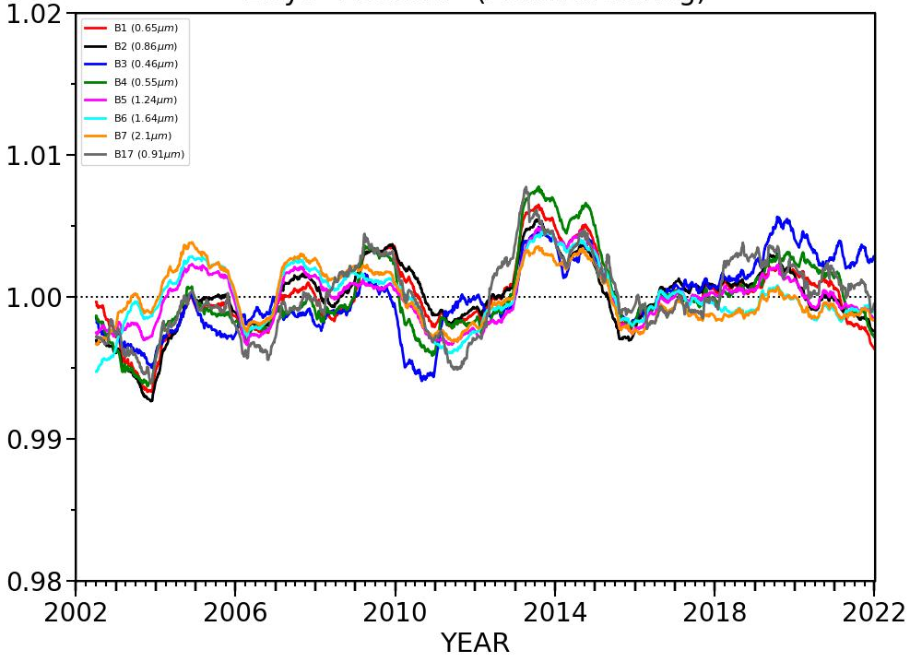
Libya-4 Aqua-MODIS band trend comparison
SZA terms only
with atmospheric terms
Normalize each clear-sky daily observed radiance by the corresponding angular model
Aqua-MODIS 2.1µm
Aqua-MODIS 2.1µm
daily observations
normalized radiance
normalized radiance
For Aqua-MODIS 2.1µm channel the atmospheric correction has reduced the daily sigma from 2.0% to 0.7%
Aqua-MODIS all visible bands
Aqua-MODIS all visible bands
Perform a 365-day running mean on the normalized clear-sky radiances
365-day running mean
normalized radiance
normalized radiance
B3(0.49 µm), B4 (0.56µm), B1(0.65µm), B2(0.86µm), B17 (0.91µm), M08(1.24µm), M10(1.61µm), M11(2.25µm)

Slide 18
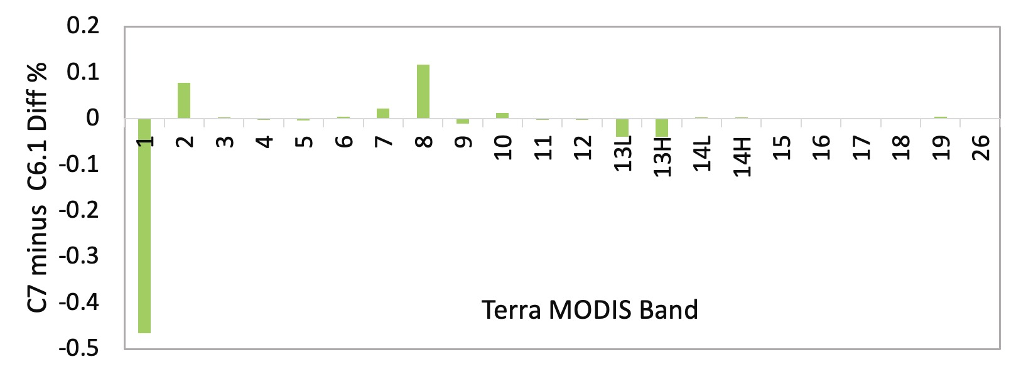
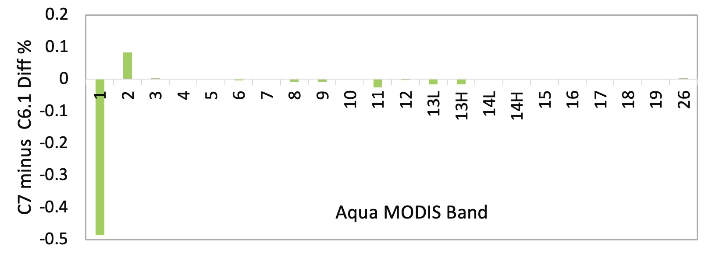
MODIS C6.1 and C7 calibration differences
The NASA MODIS calibration group has given us MODIS C6.1 to C7 visible channel scaling factors
These are a function of scan angle position, mirror side, and time
absolute calibration difference over the record (%)
MODIS combines 3 solar spectra,
Thuillier et al. (1998) for 350–800 nm,
Neckel and Labs (1984) 800–1100 nm, and
Smith and Gottlieb (1974) 1100–2500 nm.
For most bands the C6.1 to C7 difference is small <0.1% for both Terra and Aqua
0.86µm
0.41µm (not used by CERES)
NPP VIIRS solar spectra, Kurucz 1995 (Modtran)
N20 VIIRS solar spectra, Thuillier 2003
0.65µm
MODIS and VIIRS are reflectance-based observations, the L1B radiance is the reflectance multiplied by the convolved solar spectra
The 0.65µm absolute calibration difference is due to the redefined solar spectra
The band specific NPP/N20 radiance ratio can reach 3% due to the difference of the solar spectra especially for SWIR bands (>1µm)
Remember the NASA MODIS and VIIRS L1B product reflectances are not placed on the same radiometric scale, the CERES GEO and imager calibration group updates the scaling factors tied to the MODIS C5 calibration reference each January

Slide 19
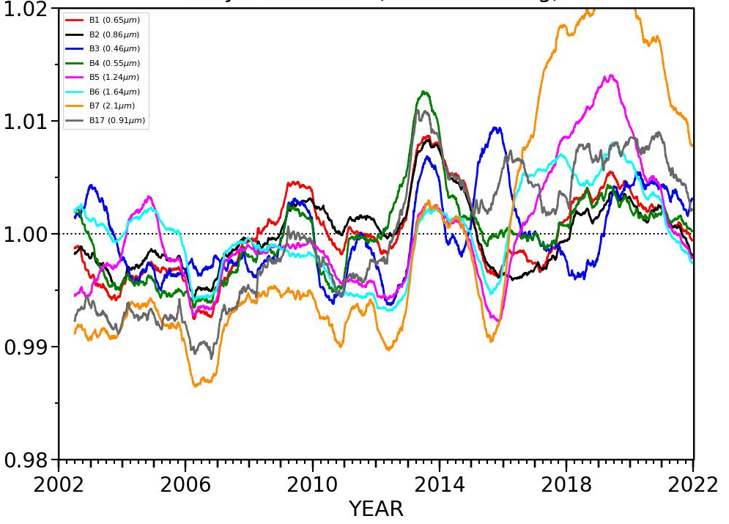
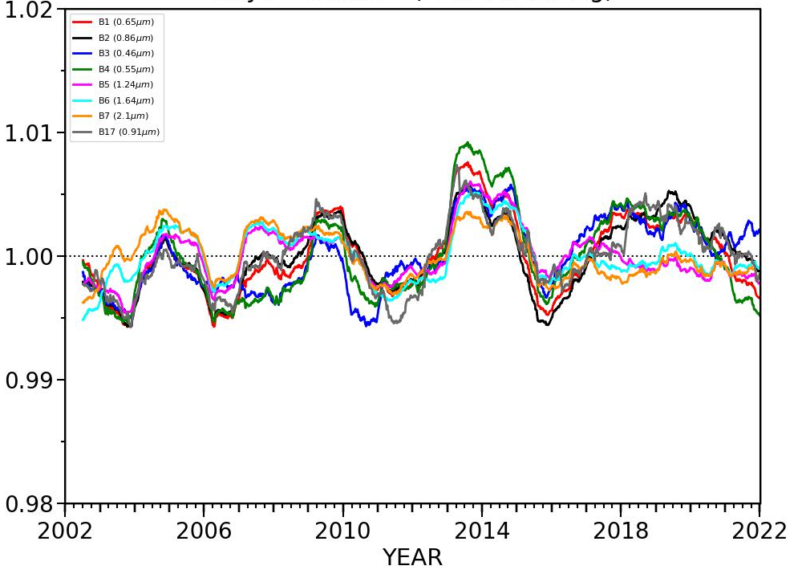
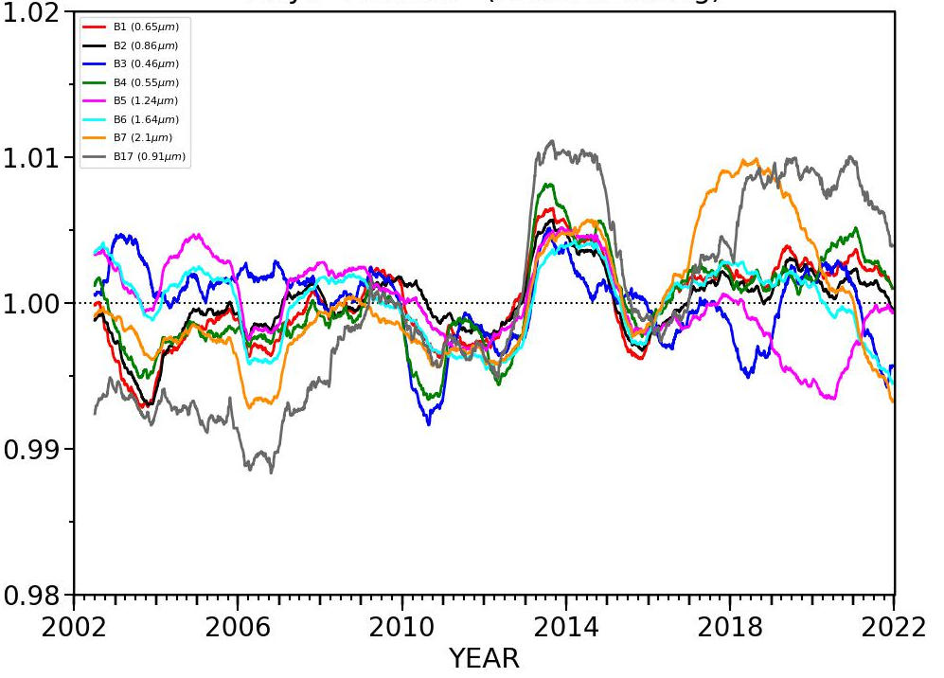
MODIS C6.1 and C7 trend differences
Terra
Aqua
B3(0.49 µm), B4 (0.56µm), B1(0.65µm), B2(0.86µm), B17 (0.91µm), M08(1.24µm), M10(1.61µm), M11(2.25µm)
Collection 6.1
normalized radiance
All MODIS channels were made slightly more stable with C7
normalized radiance
Terra-MODIS SWIR band (>1µm) drift after the Terra satellite safehold event in 2016 was reduced with C7
Collection 7
normalized radiance
normalized radiance

Slide 20
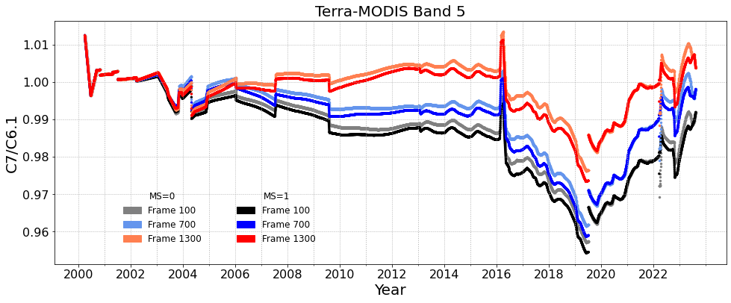
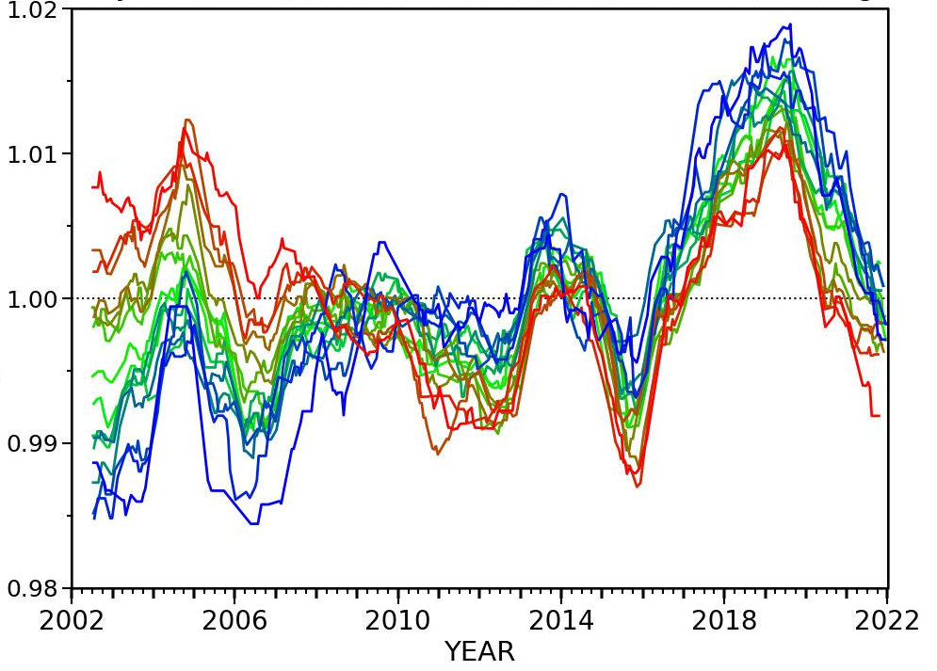
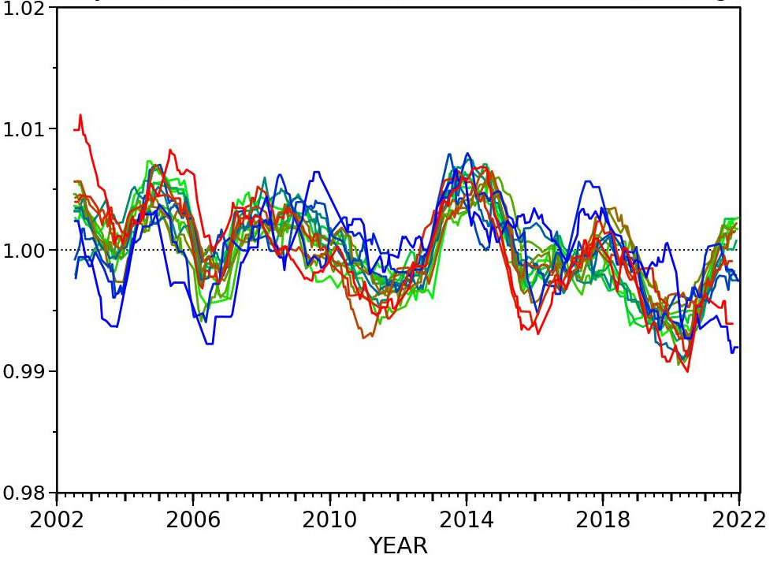

MODIS C6.1 and C7 scan angle differences
The C6.1 do C7 corrections are a function of scan angle position, mirror side, and time
For each scan position (angular model) perform 365-day running mean of the normalized daily radiances
C7/C6.1 ratio
C6.1
C7
forward scatter
Terra-MODIS 1.24µm channel
backscatter
normalized radiance
normalized radiance
For Terra-MODIS 1.24µm, the angular bin normalized radiances are more stable with C7

Slide 21
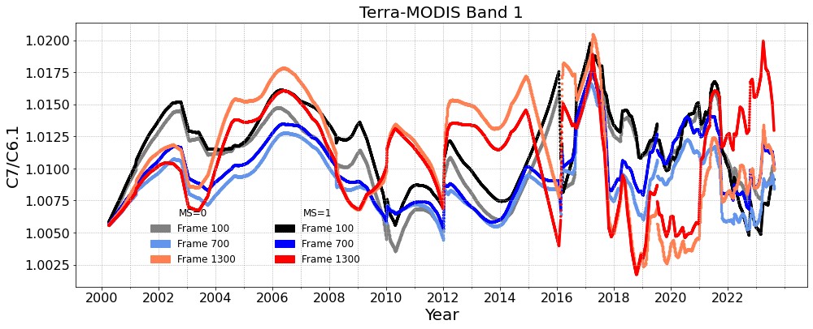
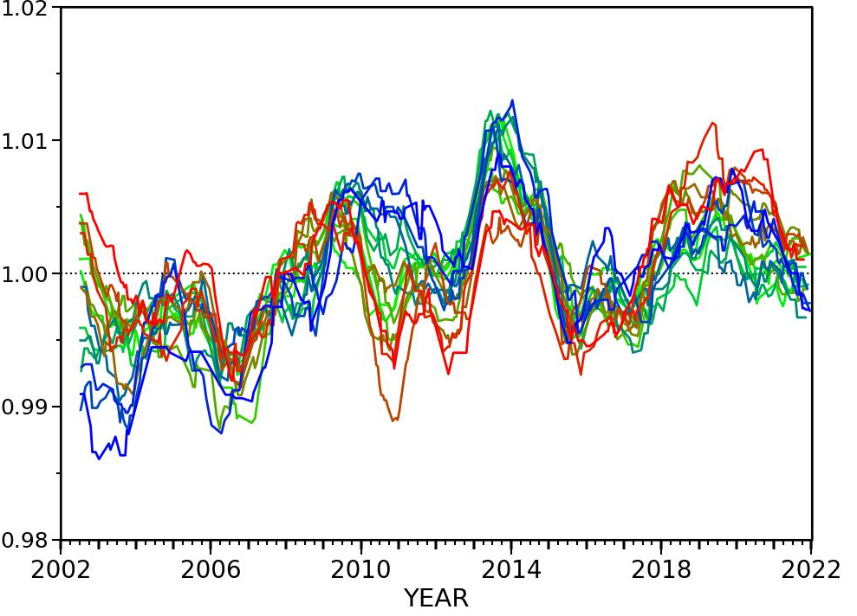
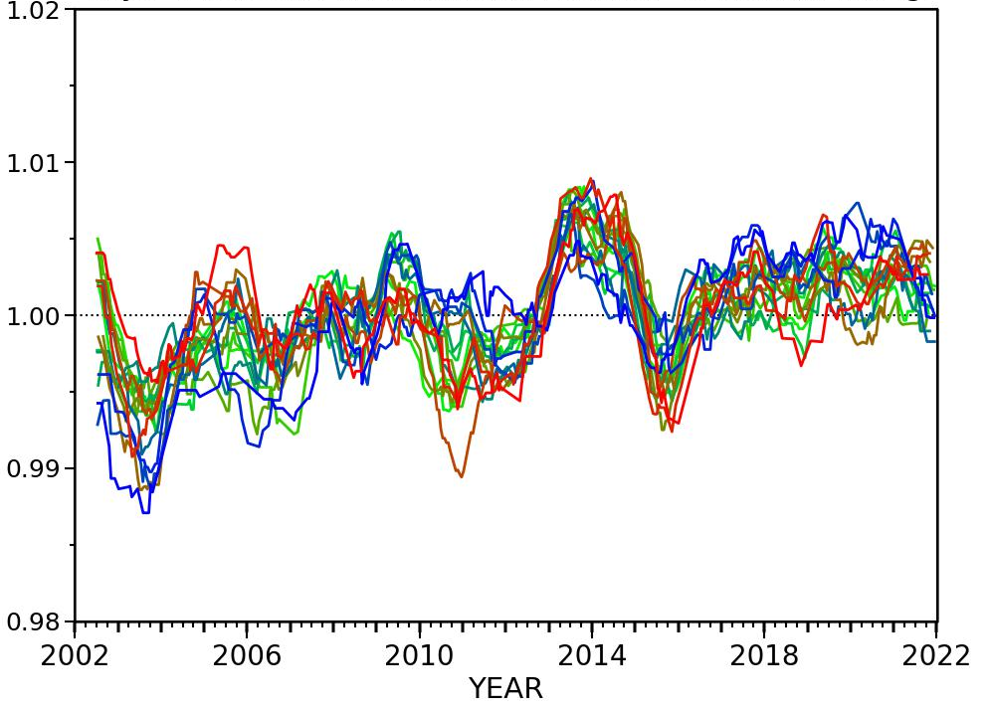



MODIS C6.1 and C7 scan angle differences
C7/C6.1 ratio
C6.1
C7
forward scatter
backscatter
Terra-MODIS 0.65µm
normalized radiance
normalized radiance
nadir
backscatter
Aqua-MODIS 0.86µm
forward scatter
normalized radiance
normalized radiance
nadir

Slide 22
Radiometrically scale N20-CERES with NPP over Libya-4

Slide 23




Aqua-CERES Libya-4 angular models
(0°VZA<14° backscatter) angular model
All angular models
The CERES radiance by angular model shows that the desert is not Lambertian and that the CERES radiances need to be modeled by angular conditions
Aqua-CERES SW radiance
(0°VZA<14° backscatter) angular model
All angular models
The CERES flux consistency by angular model validates that the CERES ADMs are effective
Aqua-CERES SW flux

Slide 24



Aqua-CERES Libya-4 stability assessment
Similar to MODIS, the CERES radiances are normalized their corresponding angular model
SZA terms only
with atmospheric terms
with atmospheric terms
daily observations
daily observations
365 running day mean
normalized SW radiance
normalized SW radiance
normalized SW radiance
The atmospheric correction has reduced the standard error from 2.4% to 0.8%
The CERES SW radiance temporal variability is similar to MODIS suggesting that the variability is mostly due to the Libya surface reflectance changes

Slide 25



N20-CERES scaled to NPP
• Make sure the NPP and N20 temporal trends are consistent.
• If not consistent radiometric would be more difficult
The N20 radiances can be normalized using the NPP angular models to radiometrically scale N20 to the NPP CERES calibration reference
The N20 radiances are normalized using the N20 angular models
Terra/Aqua/NPP/N20 relative ratios
N20 normalized radiances
N20 (scaled to NPP)/N20 radiances
Lbya-4 CERES radiance
normalized SW radiance
normalized radiance
normalized radiance
The CERES instrument ratios are temporally consistent suggesting excellent CERES onboard calibration
The normalized NOAA-20 daily observations have a Libya-4 temporal uncertainty of 0.9%
N20 (scaled to NPP)/N20 = 1.0005
and is insignificant since it is within the Libya-4 temporal uncertainty of 1.1%

Slide 26
SYN1deg Computed flux temporal interpolation

Slide 27

SYN1deg Ed4a computed flux temporal interpolation
atmospheric profiles
The SYN1deg regional TOA/surface/in-atmospheric fluxes are computed hourly from the cloud/surface/atmospheric-profile inputs
Fluxes are computed for clear-sky and up to 4-layers of cloud conditions with and without aerosols
  if any condition fails, all computed fluxes are denoted as default values in the SYNI internal product, this is a rare occurrence
  The clear-sky and 4-layer computations are aggregated into the all-sky flux
SYN1deg Ed4 temporally interpolates across the hourly computed flux default values
  All computed flux parameters are temporally interpolated independently
  For each parameter, the hourly fluxes over the month are linearly regressed as a function of the cosine of the solar zenith angle (CSZA)
  The linearly regression slope and offset are applied to the default hourbox CSZA
  For some interpolated fluxes the surface albedo exceeds 1 or up>down flux.
up
down

Slide 28



Ed5 computed flux temporal interpolation strategy
Libyan Desert region, clear-sky surface SW flux
Number of default UpSW_sfc_ClrSky, Terra+Aqua March 2007
Ed4A linear regression temporal interpolation
Ed4B CSZA bin temporal interpolation
interpolated
computed
• The TISA code can only temporally interpolate computed fluxes one parameter at a time
• This CSZA bin approach was successful, there are no more SWdn<Swup cases over the 21-year record
max =56
Note that the regions with default values is not random but occur over regions with large surface reflectances

Slide 29
Ed5 computed flux temporal interpolation strategy
Libyan Desert region, clear-sky surface SW flux
Albedo at surface
transmission at surface
hr SZA Dn_ClrSky Up_ClrSky Dn-Up Up/Dn_sfc Dn_sfc/TOADn
199 86.39 21.52. 11.60 9.92 0.54 0.25
200 74.03 149.12 70.65 78.47 0.47 0.39
201 61.76 307.08 72.70 234.38 0.24 0.47
202 50.49 477.35 128.18 349.17 0.27 0.54
203 41.13 610.70 172.40 438.30 0.28 0.59
204 35.28 801.47 240.12 561.35 0.30 0.71
205 34.81 776.88 235.12 541.75 0.30 0.69
206 39.91 679.10 209.43 469.67 0.31 0.64
207 48.83 518.88 151.27 367.60 0.29 0.57
208 59.87 329.10 88.05 241.05 0.27 0.48
209 72.02 150.90 32.60 118.30 0.22 0.35
210 84.67 32.03 17.17 14.85 0.54 0.25
the transmission and albedo have a distinct diurnal variation
For Ed5
For SW down temporally interpolate the transmission (Down/Solar incoming)
For SW up temporally interpolate the albedo (Up/Down)

Slide 30
TISA Edition 5 framework

Slide 31
TISA Edition 5 framework update
The CRS1deg was processed with the new TISA Edition 5 framework
No need to revise the code for the following, just the JSON file during compilation
  Variable spatial gridding resolution (0.5°, 1.0°) (equal angle, nested)
  Each parameter has a spatial averaging strategy (linear, log, weighted, SZA equalized)
  Dynamic cloud layer or cloud-type binning (3-layers, 4-layers, 3x3 pc-tau)
  Dynamic computed flux profile levels, and spectral wavelengths
  Dynamic parameter processing (all parameters, fluxes-only, etc)
  Parameter specific range min and max checking of input files
The Ed5 CRS1deg code base will be used for the SSF L2 alpha run
  Just a few parameter specific additional modules will need to be coded

Slide 32
TISA Edition 5 framework update
All of the new Ed5 SW and Ed4 SW/LW narrowband to broadband, TRMM ADMs and directional models, CERES/GEO normalization binary LUTs have been converted as self-described netCDF files
  Where the LUTs, angle and cloud bin bounds and centers can be read, so that the LUT value can be retrieved using generic functions
  Updated the CERES/GEO regional normalization validation diagnostic in Python
The ED5 Geostationary spatial gridding will be a joint clouds/flash/TISA effort allowing for a common code base and implementation
  The Ed5 GEO gridding will be designed to facilitate efficient (surface) flux computations, custom inputs and outputs - Bao and Arun are working on the alpha version
TISA has developed the code that will aggregate the IGBP (18-types), water fraction, and daily snow/ice, at the 10-minute resolution for consistent application across TISA Ed5 products
  Ed4 relied on the SSF L2 values and temporally interpolated the surface types
TISA has standardized the cloud property temporal interpolation and averaging diagnostics and can process both monthly (TISA) and 3-day (flash) time intervals using the same code base

