Slide 1
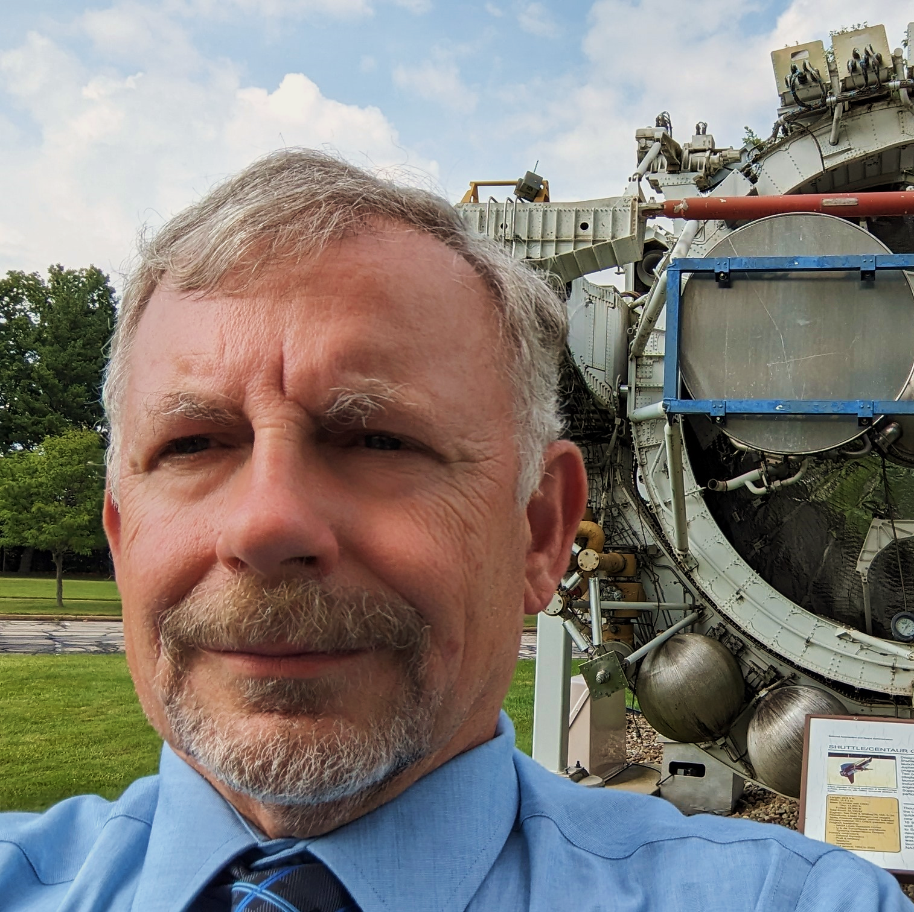
Andrew Trunek NASA GRC
Melanin Overview
Notes:
This will be introduction to melanin, its properties and some potential applications.

Slide 2
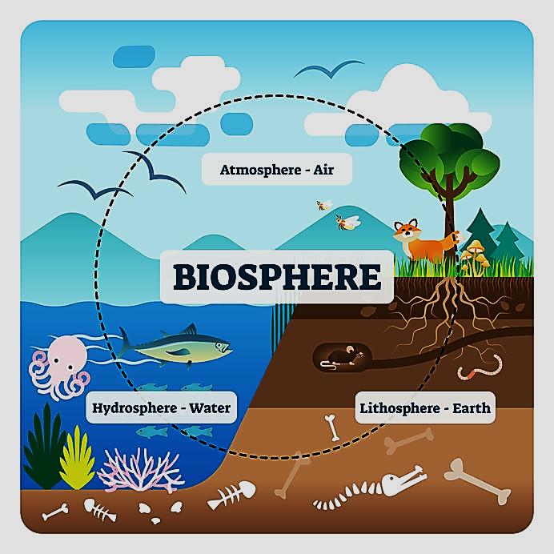
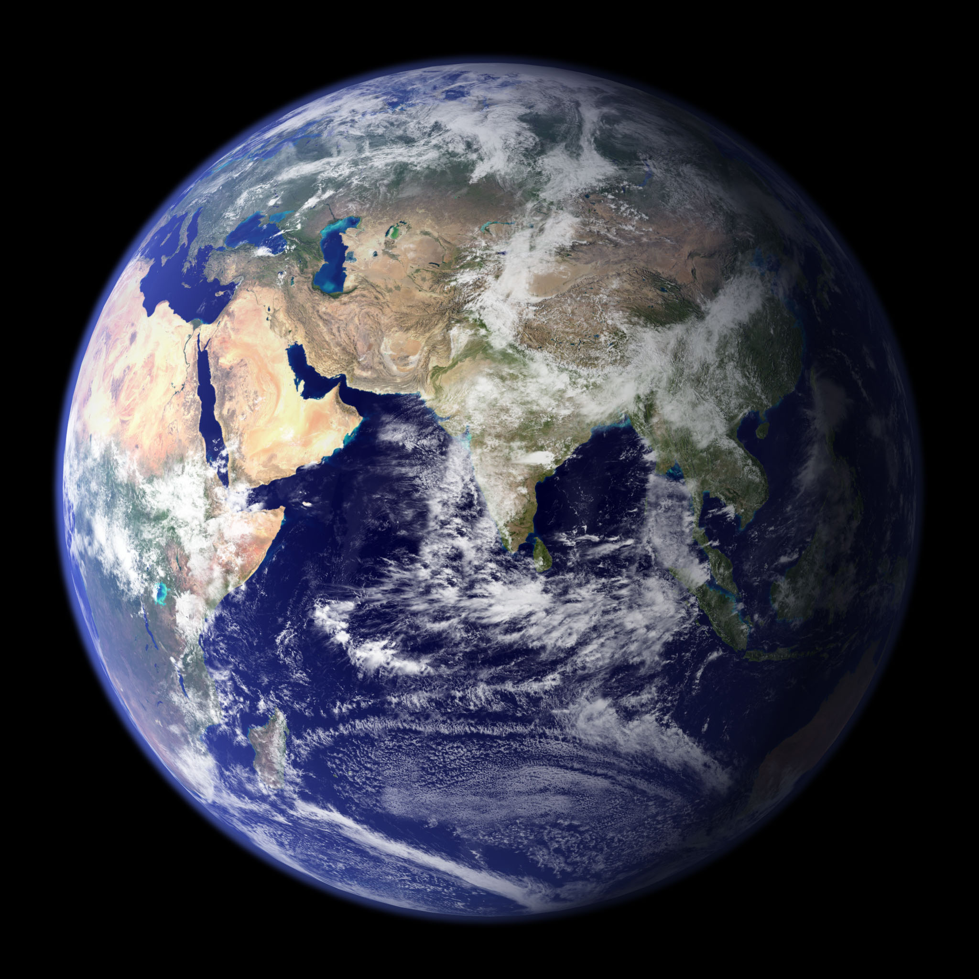
What is Melanin?
Melanins are biopolymers that are considered natural pigments.
Notes:
Melanins are considered natural pigments that are ubiquitous in living organisms
throughout the biosphere, from the depths of the oceans, to polar deserts, encompassing
all life forms, from bacteria, mold, plants, animals and humans.
Given the diversity of environments and organisms ,melanins are found to play
widely diverse but important roles in sustaining life on Earth, far beyond providing color.
In can be stated that without life, melanin does not exist, and without melanin, life does not exist.
It is, that essential to life.

Slide 3
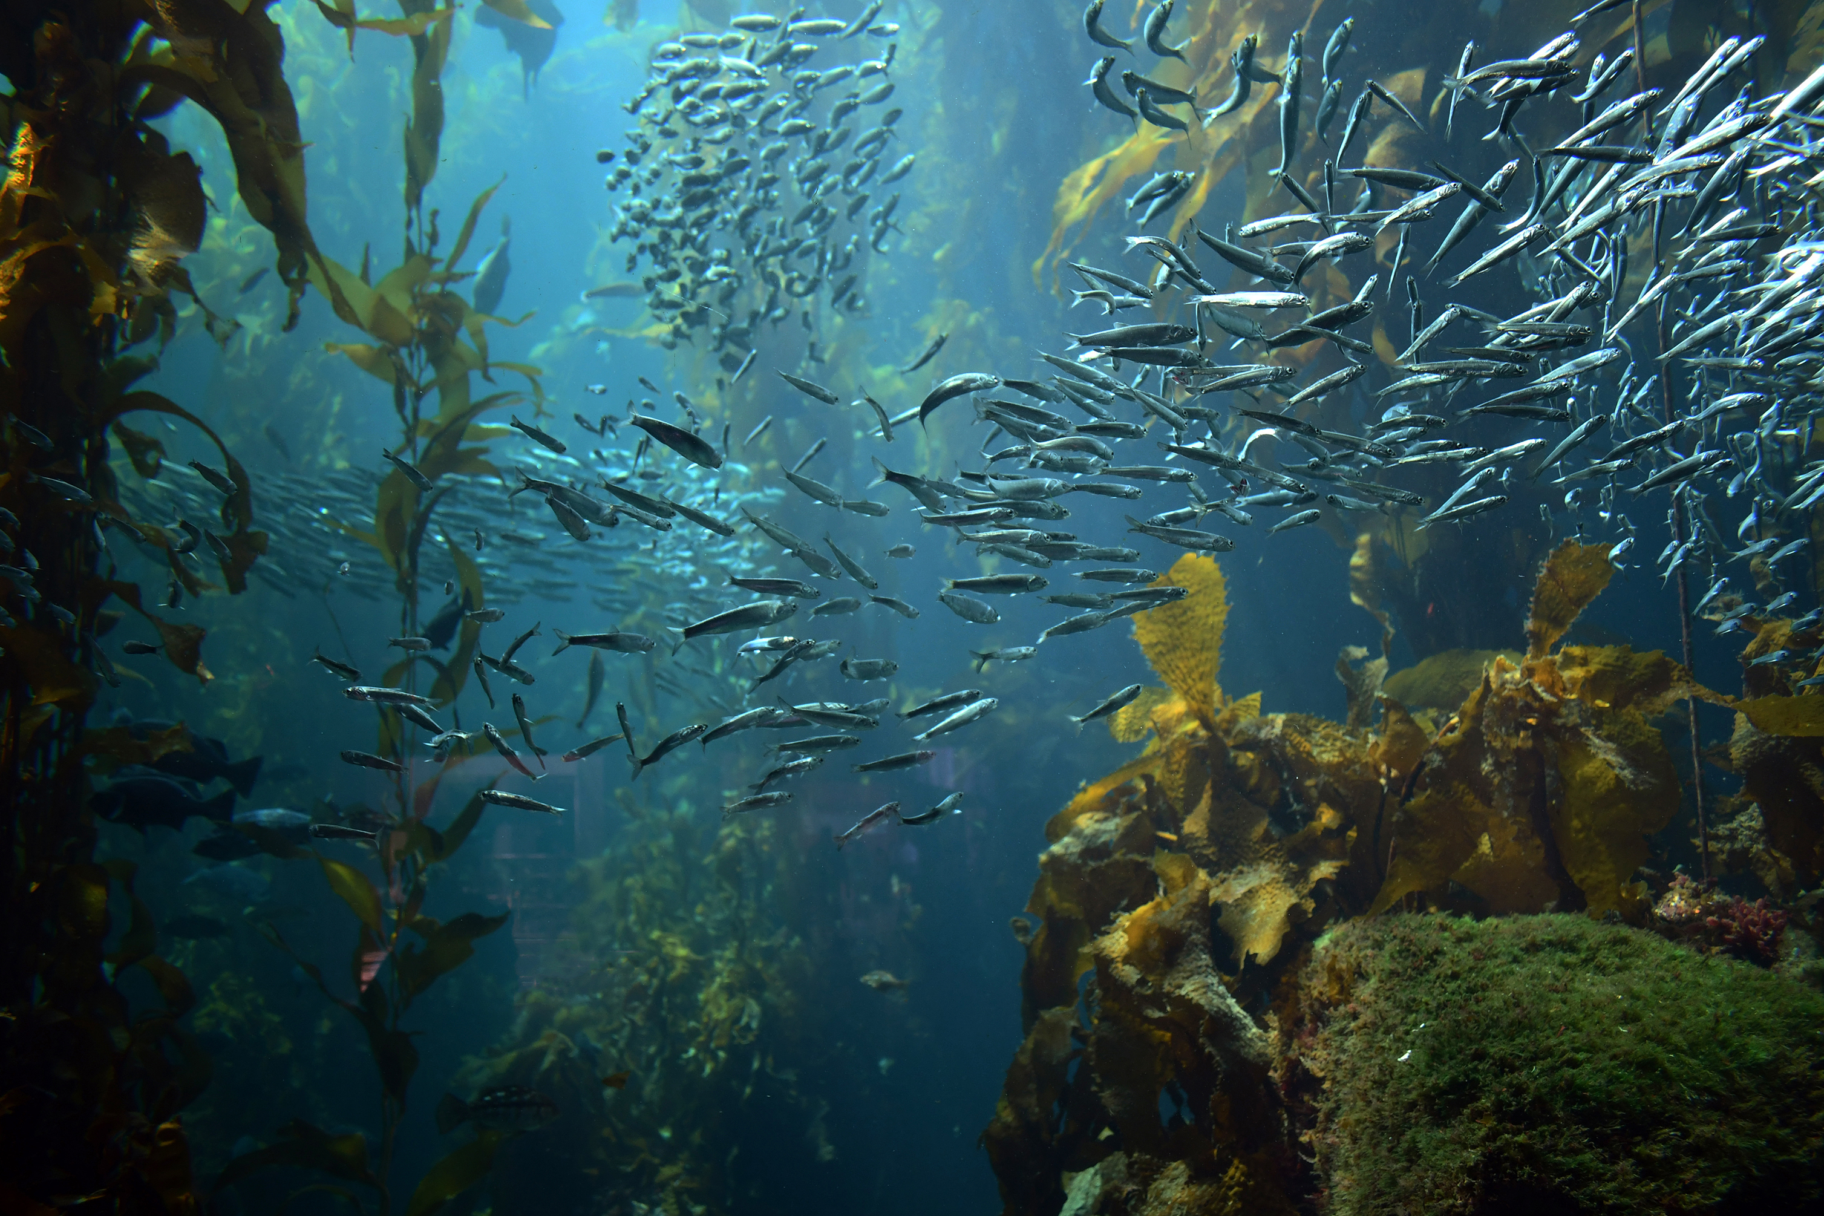
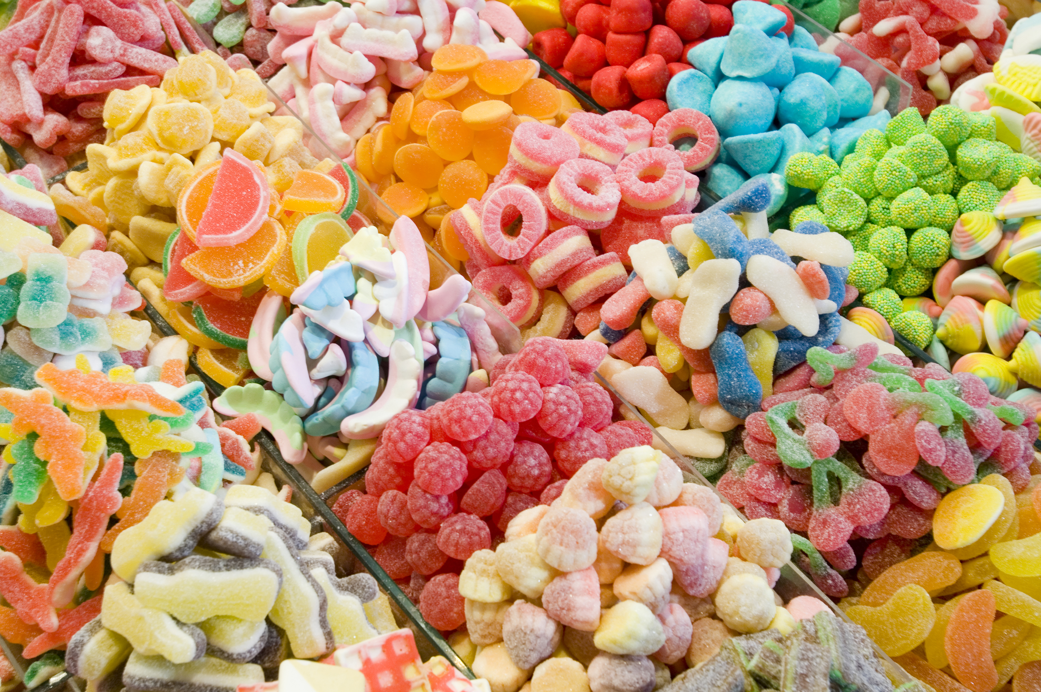


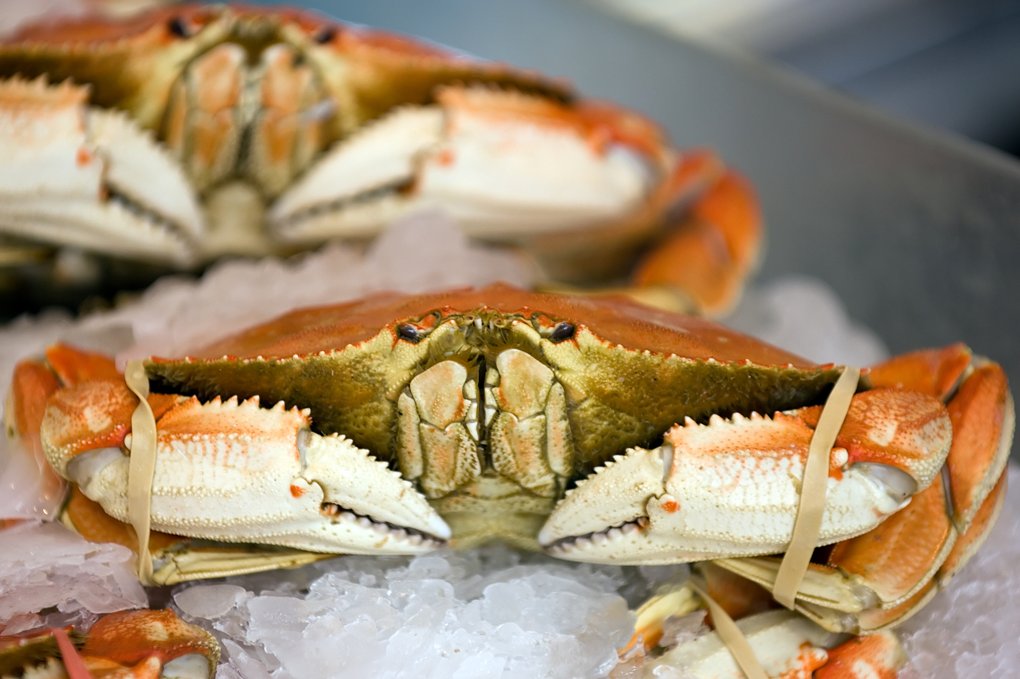

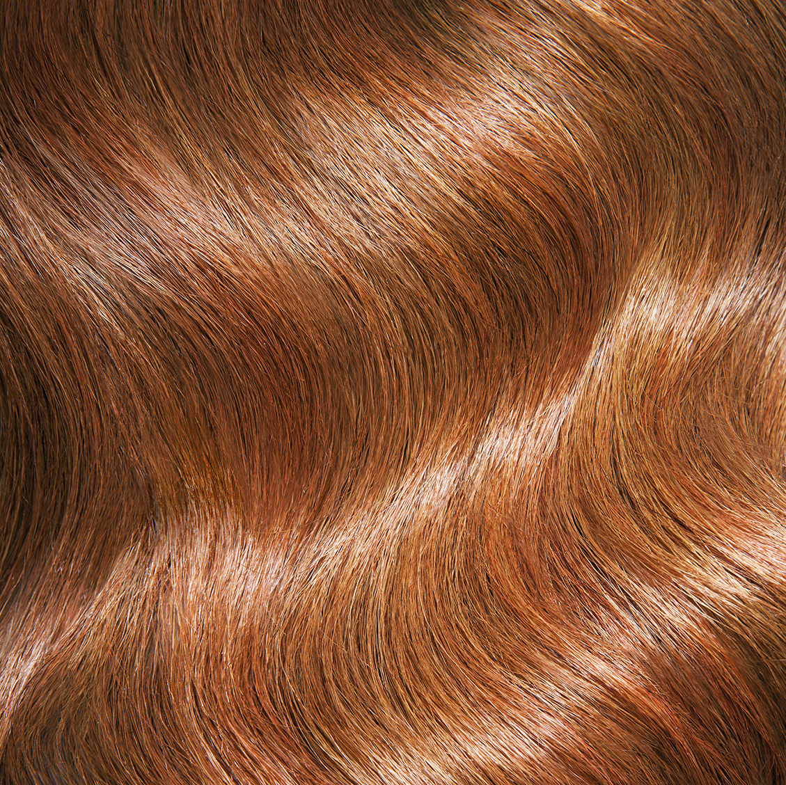
What is a biopolymer?
Biopolymers are natural polymers produced by the cells of living organisms.
Alginate
Gelatin
Keratin
Cellulose
Chitin
Lignin
Collagen
Notes:
Biopolymers are simply polymers that are synthesized by the cells of living organisms.
This include includes melanins.
This is a few examples biopolymers.
Sorry for diving right into organic chemistry, but it comes with the territory.

Slide 4
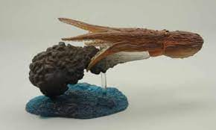

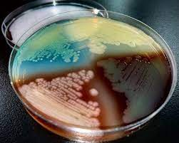
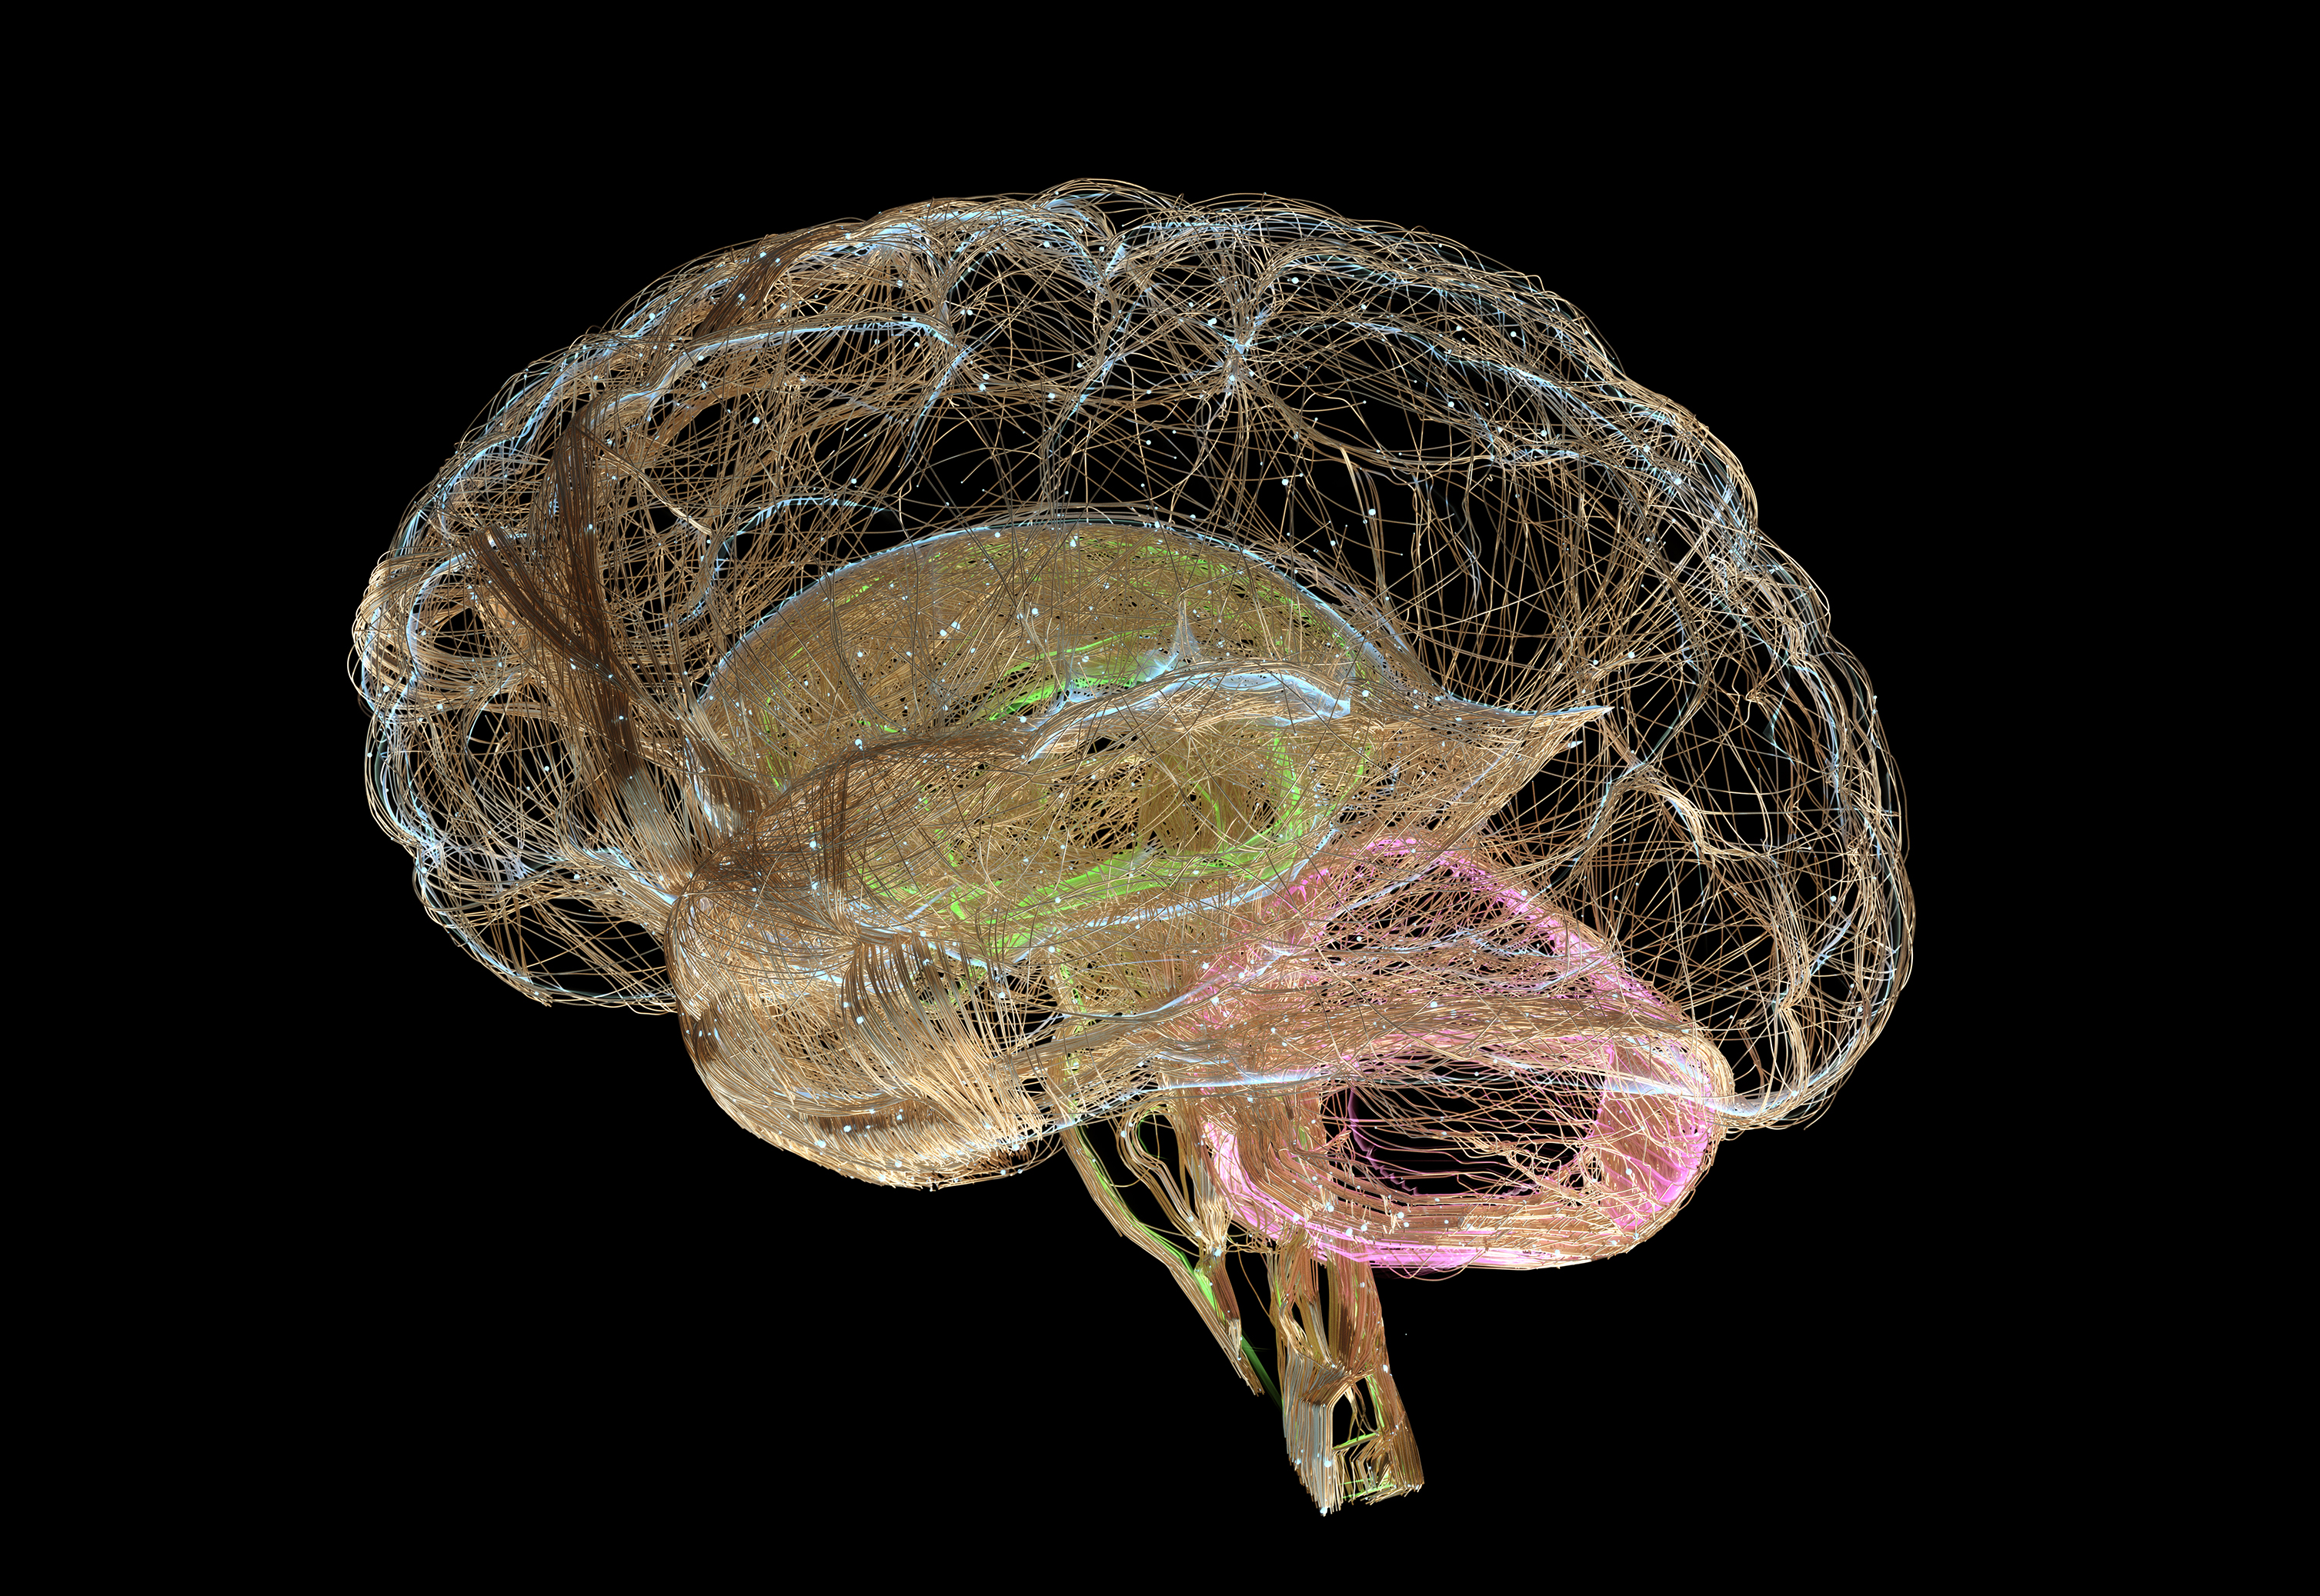
Five different kinds natural melanin
Melanin is a generic term, used to reference any of the naturally produced melanin’s.
Eumelanin
Pheomelanin
Allomelanin and Pyomelanin
Neuromelanin
Squid Ink
Red Hair
Yeast
Substantia Nigra
Notes:
There are five main groups of natural melanins with numerous variations within each group.
Additionally, melanins can be chemically synthesized.
I will briefly go over each of these in the following slides.

Slide 5
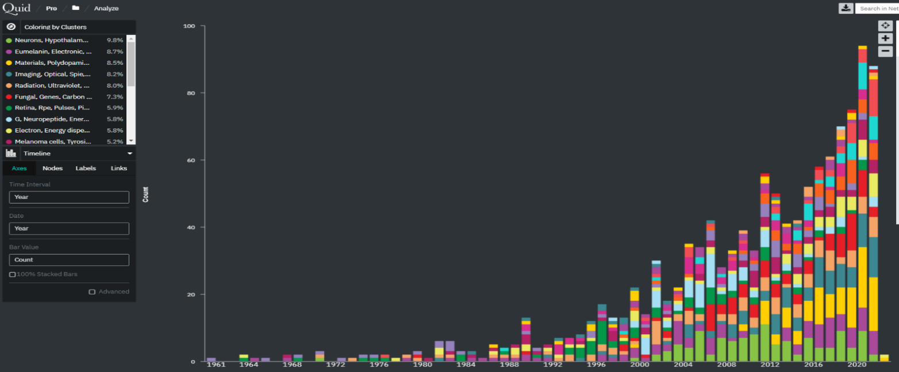
The accident that started it all
Chernobyl
1986
1961
2021
Non-medical Melanin Publication Data
Notes:
Quid’s capabilities enable the data to be pivoted on various output formats including timelines, as shown here. Analysis of the data showed the vast majority of the publications were relatively recent, within the last two decades. Prior to Chernobyl non-medical melanin publications were background noise. The accidental discovery of highly melaninized fungi thriving in the deadly radiation of Chernobyl seems to be the impetus that spurred an interest in melanin research. A seminal paper was instrumental in generating the current interest in melanin research. A paper on Destruction of radioactive particles by strains of Cladosporium cladosporoides by Nellie Zhdanova and others. Followed soon after by Ionizing radiation: how fungi cope, adapt, and exploit with the help of melanin, by Katerina Dadachova and Arturo Casadevall

Slide 6



Why is there interest in melanins?
Photoprotection
Radiation Tolerant
Thermal Regulation
Notes:
The diagram shows melanin at the center, surrounded by its properties and finally potential applications in the outer ring.
The broad spectrum of properties leads to many application areas. That I will briefly go over in the following slides.

Slide 7

Why is there interest in melanins?
Chemical protection
Hygroscopic
Affinity for free radicals
Fe²⁺,Zn²⁺,Mn²⁺,Mg²⁺,Ca²⁺,Cd²⁺,Cu²⁺
Notes:
The diagram shows melanin at the center, surrounded by its properties and finally potential applications in the outer ring.
The broad spectrum of properties leads to many application areas. That I will briefly go over in the following slides.

Slide 8

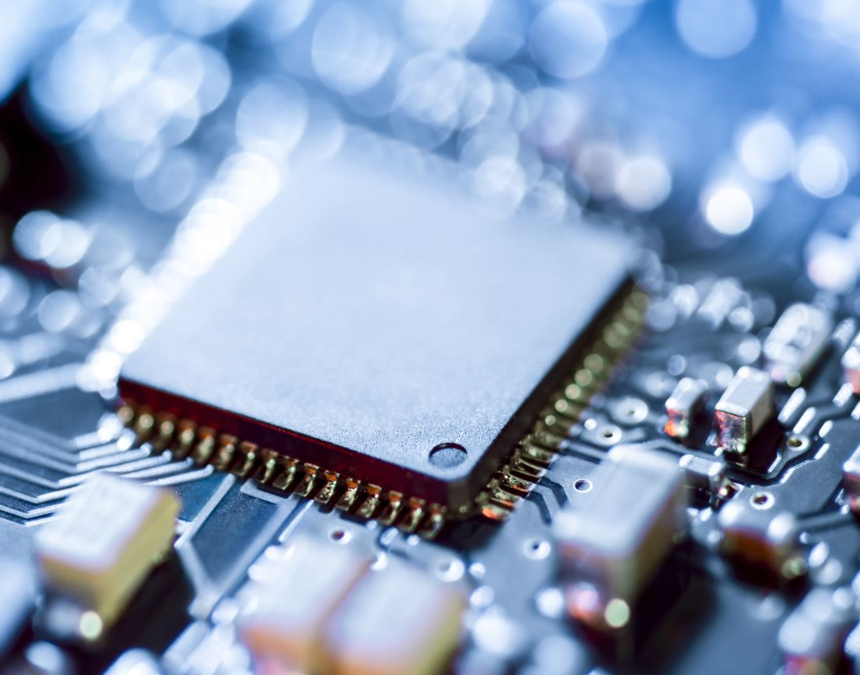
Why is there interest in melanins?
Mechanical protection
Semiconductor like properties
Affinity for free radicals
Fe²⁺,Zn²⁺,Mn²⁺,Mg²⁺,Ca²⁺,Cd²⁺,Cu²⁺
Notes:
The diagram shows melanin at the center, surrounded by its properties and finally potential applications in the outer ring.
The broad spectrum of properties leads to many application areas. That I will briefly go over in the following slides.

Slide 9
Non-Medical Applications?
Energy Harvesting Conversion
Water Purification IN-SITU Resource Utilization
Battery Anodes Cathodes
Notes:
This will be introduction to melanin, its properties and some potential applications.

Slide 10
Non-Medical Applications?
Space Suits
Radiation Shielding Habitats
Sensors and Electronics for extreme environments or biologically compatible
Thermal Protection Heat shields and heatsinks
Notes:
This will be introduction to melanin, its properties and some potential applications.

Slide 11
Non-Medical Applications?
Anti-dessicant
Mechanical Reinforcement
Uniform Broadband Absorption from UV to IR
Battery Anodes Cathode
Notes:
This will be introduction to melanin, its properties and some potential applications.

