Slide 1
Nitric Oxide Infrared Cooling Emissions Cubesat "NICEcube”
Marty Mlynczak, NASA Langley Research Center
Roy Esplin, Space Dynamics Laboratory
Kent Tobiska, Space Environment Technologies
Cindy Young, NASA Langley Research Center
Charles Hill, NASA Langley Research Center
Kenny Squire, Space Dynamics Laboratory
Zakk Rhodes, Space Dynamics Laboratory
Andrew Peterson, NASA Langley Research Center

Slide 2
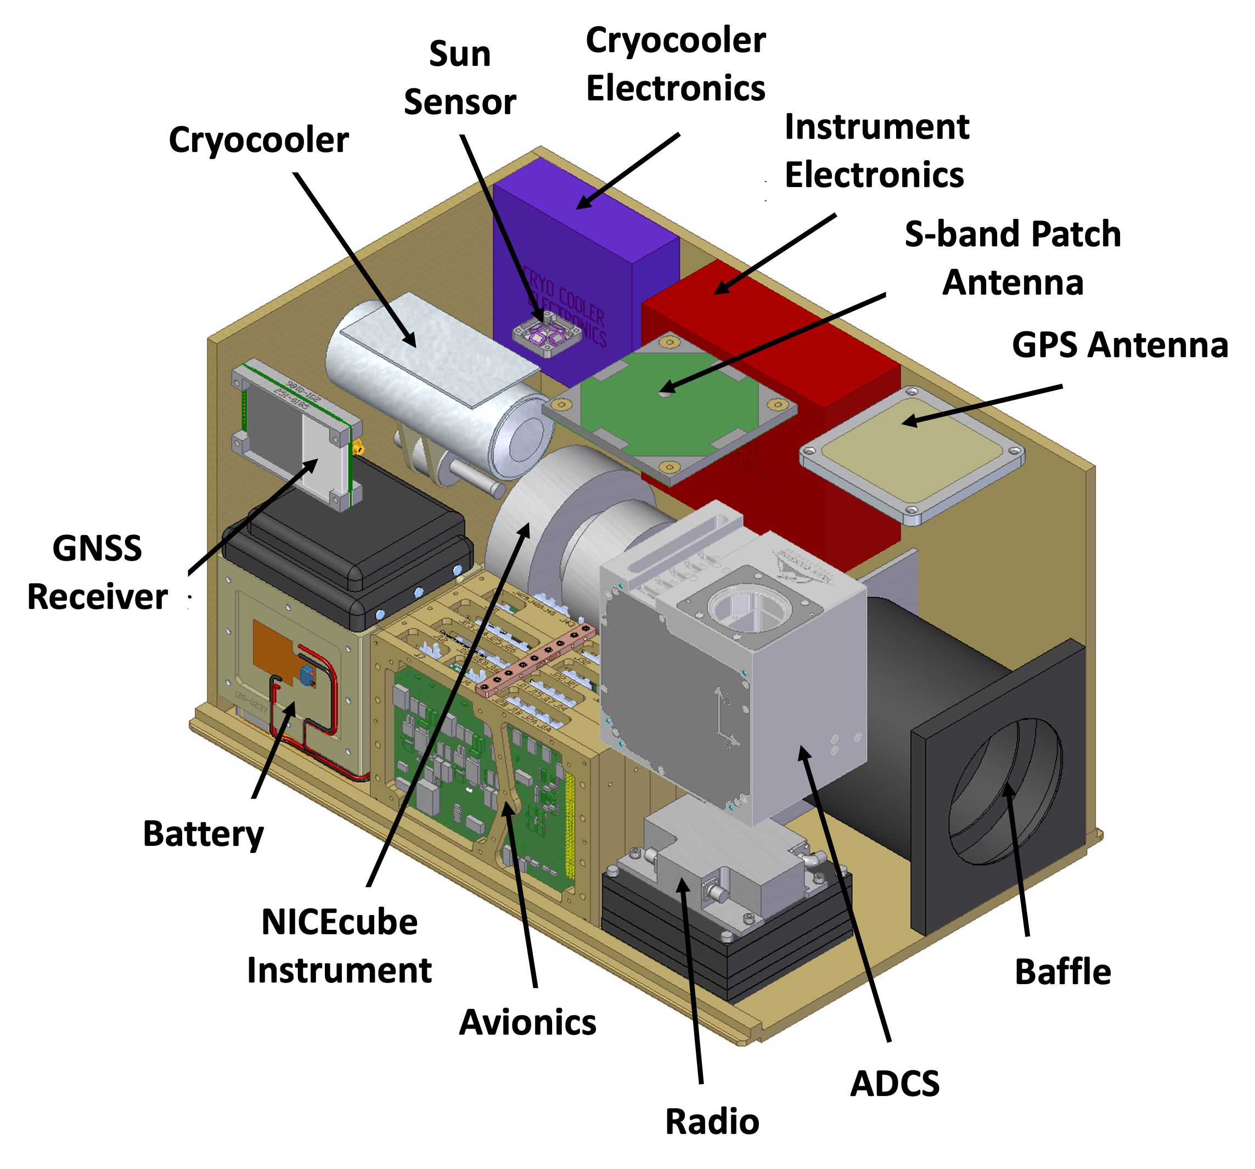
NICEcube
Nitric oxide Infrared Cooling Emissions Cubesat
Place Image Here
Principal Investigator: | Marty Mlynczak
E-mail: | m.g.mlynczak@nasa.gov
Organization: | Science Directorate NASA Langley Research Center
ROSES Element : | H-FOS, H-FORT
Research Regime: | Ionosphere-Thermosphere-Mesosphere (ITM)
Instrument Type/Mission Type | Cubesat/H-FORT/Mission of Opportunity
TRL (if applicable) | TRL: All NICEcube components are in the range of TRL 4-6
Infrared radiation emitted by nitric oxide (NO) at 5.3 μm is a fundamental component of the energy budget of Earth’s thermosphere between 115 km and 300 km. For the past 21.5 years and counting, vertical profiles of infrared cooling rates (W m⁻³) due to thermospheric NO have been derived from measurements made by the SABER instrument on the NASA TIMED satellite. NO infrared cooling rates have been shown using SABER data to be critical to understanding and predicting the density response of the thermosphere. However, reliable density forecasts, prior to, during, and after geomagnetic storm events remain elusive as thermospheric density can increase or decrease rapidly during a storm event. NICEcube is a 12-U cubesat designed to provide near real time observations for assimilation to space weather models for ‘nowcasts’ of thermospheric density. It is envisioned that a future network of NICEcubes in orbit will provide critical new data for space weather forecasts.

Slide 3
Acknowledgements
NASA Headquarters Science Innovation Fund, 2015-2016
NASA Living with a Star Virtual Institute on Space Vehicle Drag, 2016-2017
NASA Langley Research Center Creativity and Innovation Fund, 2017-2018
NASA Heliophysics Division H-FOS Program, 2021-2022
NASA TIMED satellite project

Slide 4
Main Points
Forecasts of satellite and space asset positions require accurate thermospheric density forecasts
Reliable thermospheric density forecasts, prior to, during, and after geomagnetic storm events remain elusive
Thermospheric density can increase or decrease rapidly during a geomagnetic storm event
Density and composition responses depend directly on magnitude of infrared radiative cooling by NO (5.3 μm) and to a lesser extent by CO₂ (15 μm)
Density models do not explicitly consider infrared (IR) cooling in their forecasts
Real-time observations of NO infrared thermospheric cooling can
substantially improve thermospheric density forecasts

Slide 5
From the 2013 Heliophysics Decadal Survey
Under “Key Science Goal 2”, page 25
“Theory still cannot explain how the global thermosphere “inflates” several hours after the onset of high-latitude heating, nor have studies yet captured the subsequent cooling with the fidelity that is needed to predict changes in satellite orbits occurring during magnetic storms”

Slide 6
Concept of Space-Based Sentinels for Measuring Infrared Cooling in Near-Real Time
Mlynczak et al., Space Weather, 16, https://doi.org/10.1002/2017SW001757

Slide 7
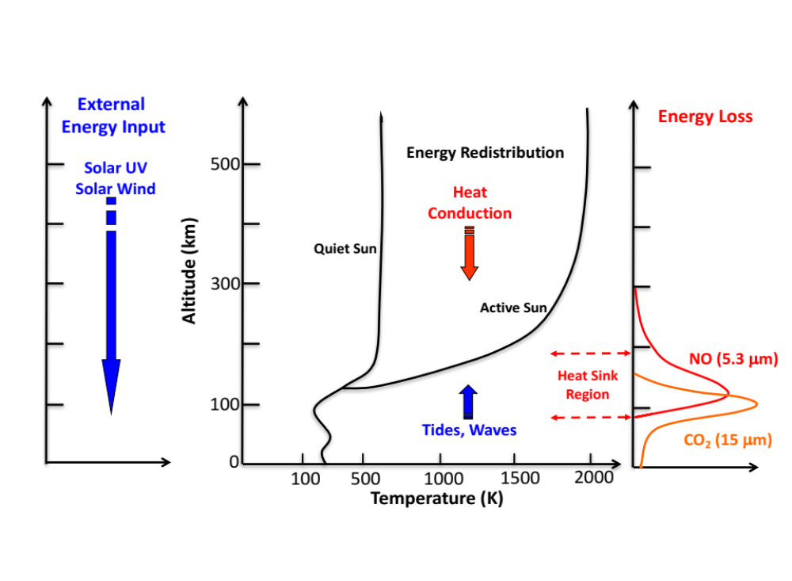
Energy Deposition and Loss Processes
Mlynczak et al., Space Weather, 2018

Slide 8
Infrared Radiative Cooling in the Thermosphere
Radiative cooling is the action of infrared radiation to reduce the kinetic temperature of the neutral atmosphere
It is accomplished almost entirely by two species:
  Carbon Dioxide (CO₂, 15 μm)
  Nitric Oxide (NO, 5.3 μm)
Collisions between atomic oxygen (O) and CO₂ and NO initiate the cooling process
  NO (υ = 0) + O → NO (υ = 1) + O (Kinetic Energy Removal)
  NO (υ = 1) → NO (υ = 0) + hν (5.3 μm) (Kinetic Energy Loss)
  NO (υ = 1) + O → NO (υ = 0) + O (Kinetic Energy Returned)
Collisional process are highly temperature dependent!

Slide 9
Observations of Thermospheric Infrared Cooling
The SABER Instrument on the NASA TIMED Satellite
SABER on TIMED since January 2002
Measures IR limb radiance from NO and CO₂ – derives IR cooling rates (W/m³)
SABER Limb Radiance (mW/m²/sr), 77 – 90 N
SABER Cooling Rates (W/m³), 77 – 90 N
Mlynczak et al., Space Weather, 2018

Slide 10
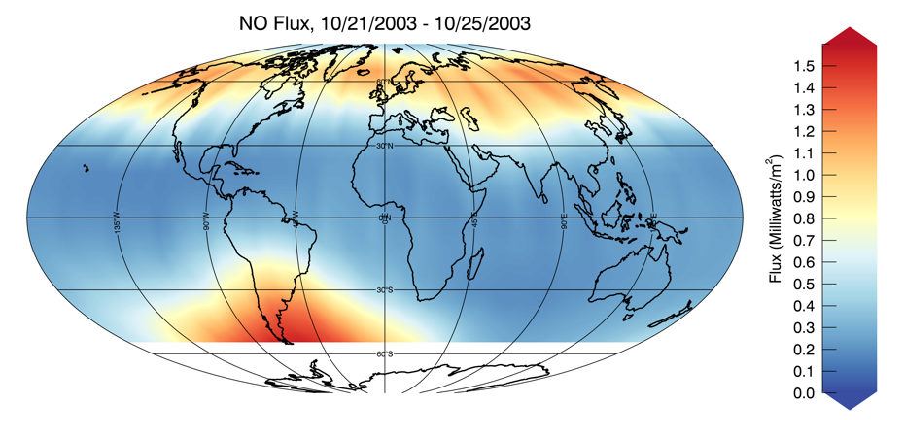
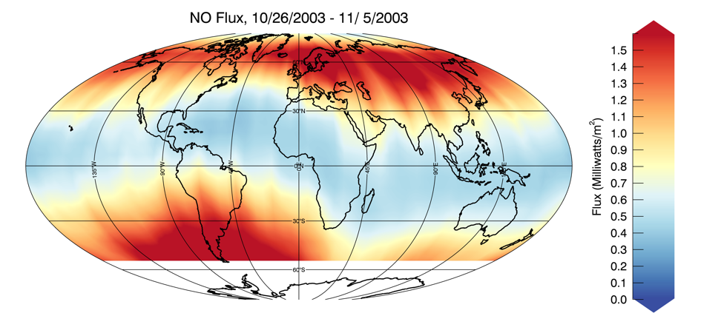
The Infrared “Thermostat” of Nitric Oxide Emission
QUIET TIME
STORM TIME
Infrared flux (mW/m²) from thermospheric NO
four days prior to “Halloween Storms” of 2003
Infrared flux (mW/m²) from thermospheric NO
during the “Halloween Storms” of 2003
Total Global Power (W) increased by a factor of ~ 10 during storm from pre-storm conditions
This is the ‘natural thermostat’ of NO – the process by which storm energy is expelled from the atmosphere
Mlynczak et al., Space Weather, 2018

Slide 11
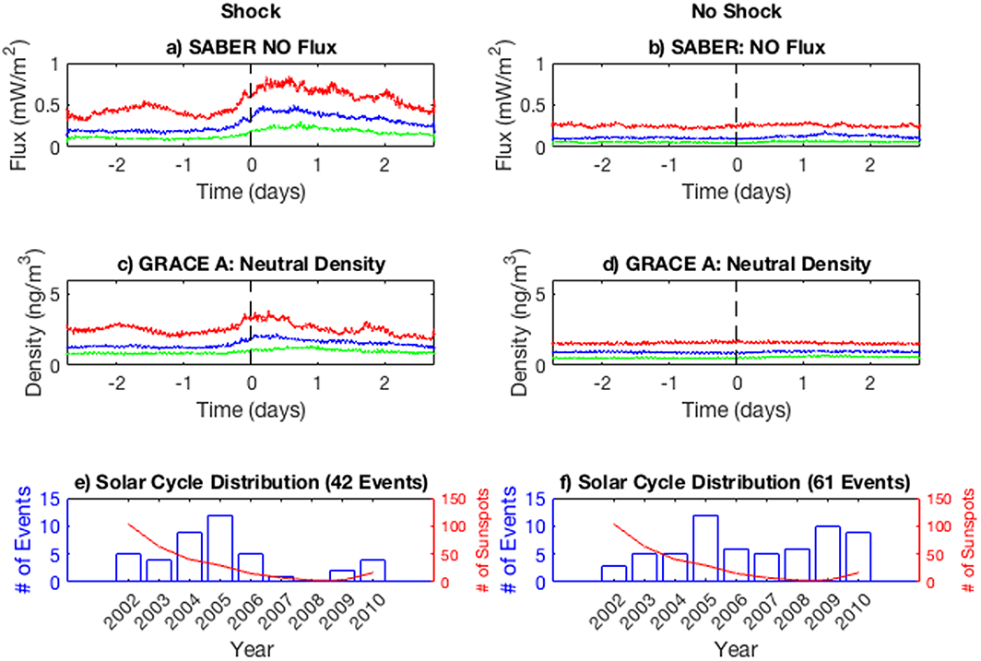
Relationship Between IR Cooling and Neutral Density/Drag
Density and infrared response depend
on structure of the CME causing the storm
Superposed Epoch Analysis of ~ 100 storm events from 2002 to 2014 using SABER and GRACE density data
Shocked CME’s produce substantial
density and IR response – storms without
shocks generate little response
SABER NO cooling and GRACE density
observed to track each other
Knipp et al., Space Weather, 2017

Slide 12
NICEcube - Summary
Space weather forecasting is transitioning to physics-based models in need of real-time observations, just like tropospheric weather forecasts models use
Radiative cooling by Nitric Oxide fundamentally controls the density response of the thermosphere to changes in space weather
A network ( < 6) of NICEcubes carrying 5.3 μm radiometers would provide critical, real-time data on state of thermosphere
All components proposed to build NICEcube now are at TRL 4-6
Priority now is to build one NICEcube and validate its operation in orbit at exiting TRL 6-7

Slide 13
Nitric Oxide Infrared Emissions Cubesat – NICEcube
PI: Marty Mlynczak, NASA Langley Research Center
Description and Objectives
Dramatically improve density forecasts 72 Provide near-real time measurements of infrared radiative cooling by nitric oxide in the thermosphere
Measurements to be assimilated in real time thermosphere density forecasts
Key challenge(s)/Innovation
Small (12 U) cubesat
Accurate infrared radiometry
High off-axis rejection with cryogenically cooled focal plane
Key NICEcube Parameters
Mass: 21.2 kg
Power: 24 W
Size: 12 U
Focal Plane Temp: 110 K
One detector @ 5.3 μm
Excellent Stray Light Rejection
Approach
NICEcube designed through H-FOS, proposed to H-FORT-22, proposal declined.
Application/Mission (Infusion Plans)
Future H-FORT technical demonstration followed by proposal to Heliophysics MOO to demonstrate sentinel concept with 2 or more NICecubes
Transition to operational system of TBD cubesats providing data to next-generation space weather forecast models
Collaborators
NASA Langley Research Center
Space Dynamics Laboratory
Space Environment Technology
Milestones and Schedule
Completed H-FOS Phase A Study March 2022
Proposed NICEcube to H-FORT in June 2022
NICEcube proposal declined largely on basis of funds availabilty
Continuing work on breadboard with IRAD
Examining next steps and future proposal opportunities
Technology Readiness Level
All proposed sub-systems and components at TRL 4-6
Key Parameters
Mass: 21.2 kg
Power: 24 W
Size: 12U
Focal plane Temp: 110 K
One detector @ 5.3 mm
Excellent stray light rejection

Slide 14
Backup Slides

Slide 15
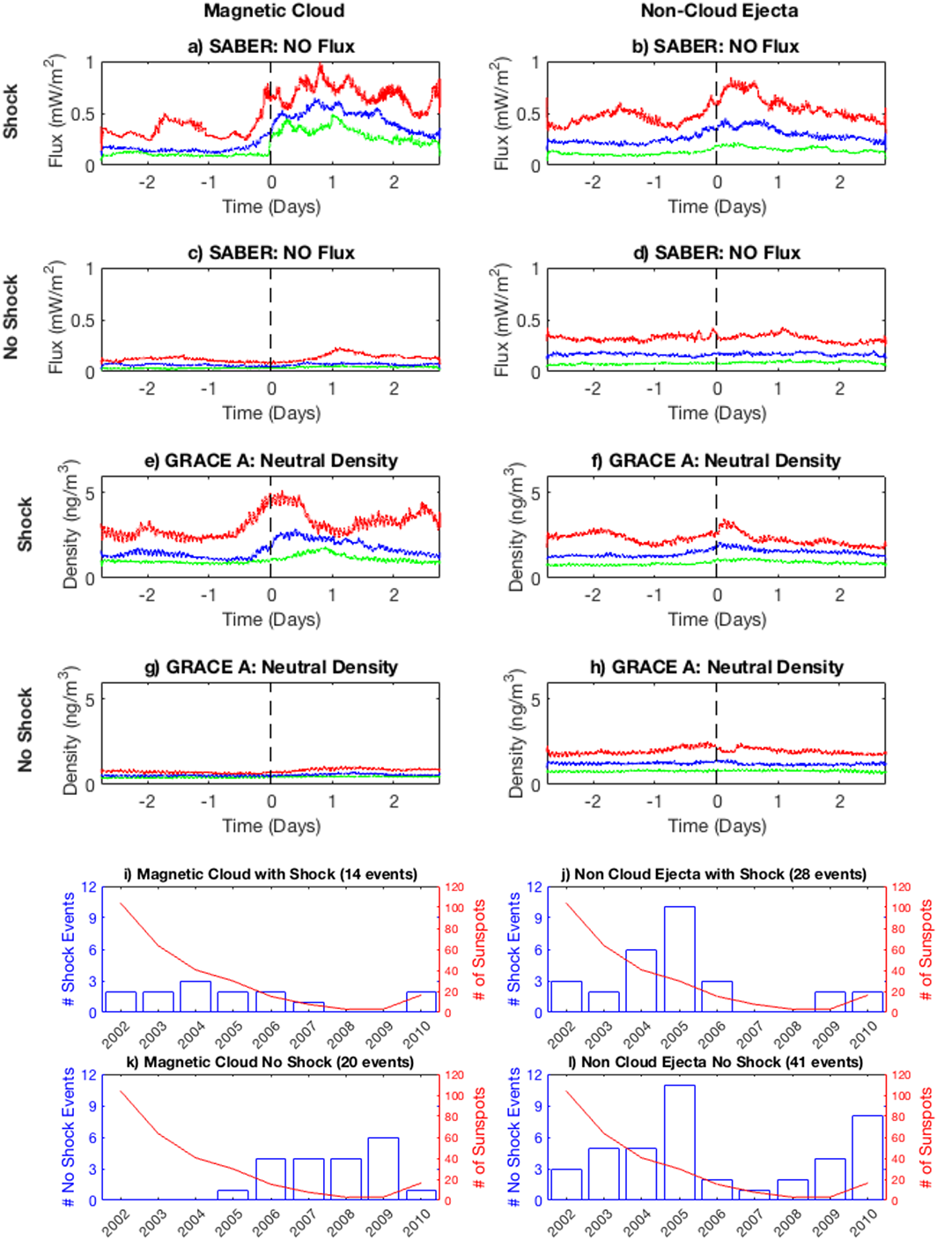
IR Cooling and Neutral Density – Overcooling
Some events result in “overcooling” of thermosphere
[Lei et al., 2012]
So much NO is produced that it rapidly cools the
thermosphere to a state colder than before the storm
Density “collapses” rapidly after initial increase
These overcooling events most often result in failed
density forecasts [Knipp et al., 2013]
Unlikely that overcooling events can be defined a priori
in forecasts, nor can their extent be predicted
Understanding and predicting overcooling is recognized
as a Key Science Goal in Space Physics in the 2013
Decadal Survey
Density Collapse
Knipp et al., Space Weather, 2017

Slide 16
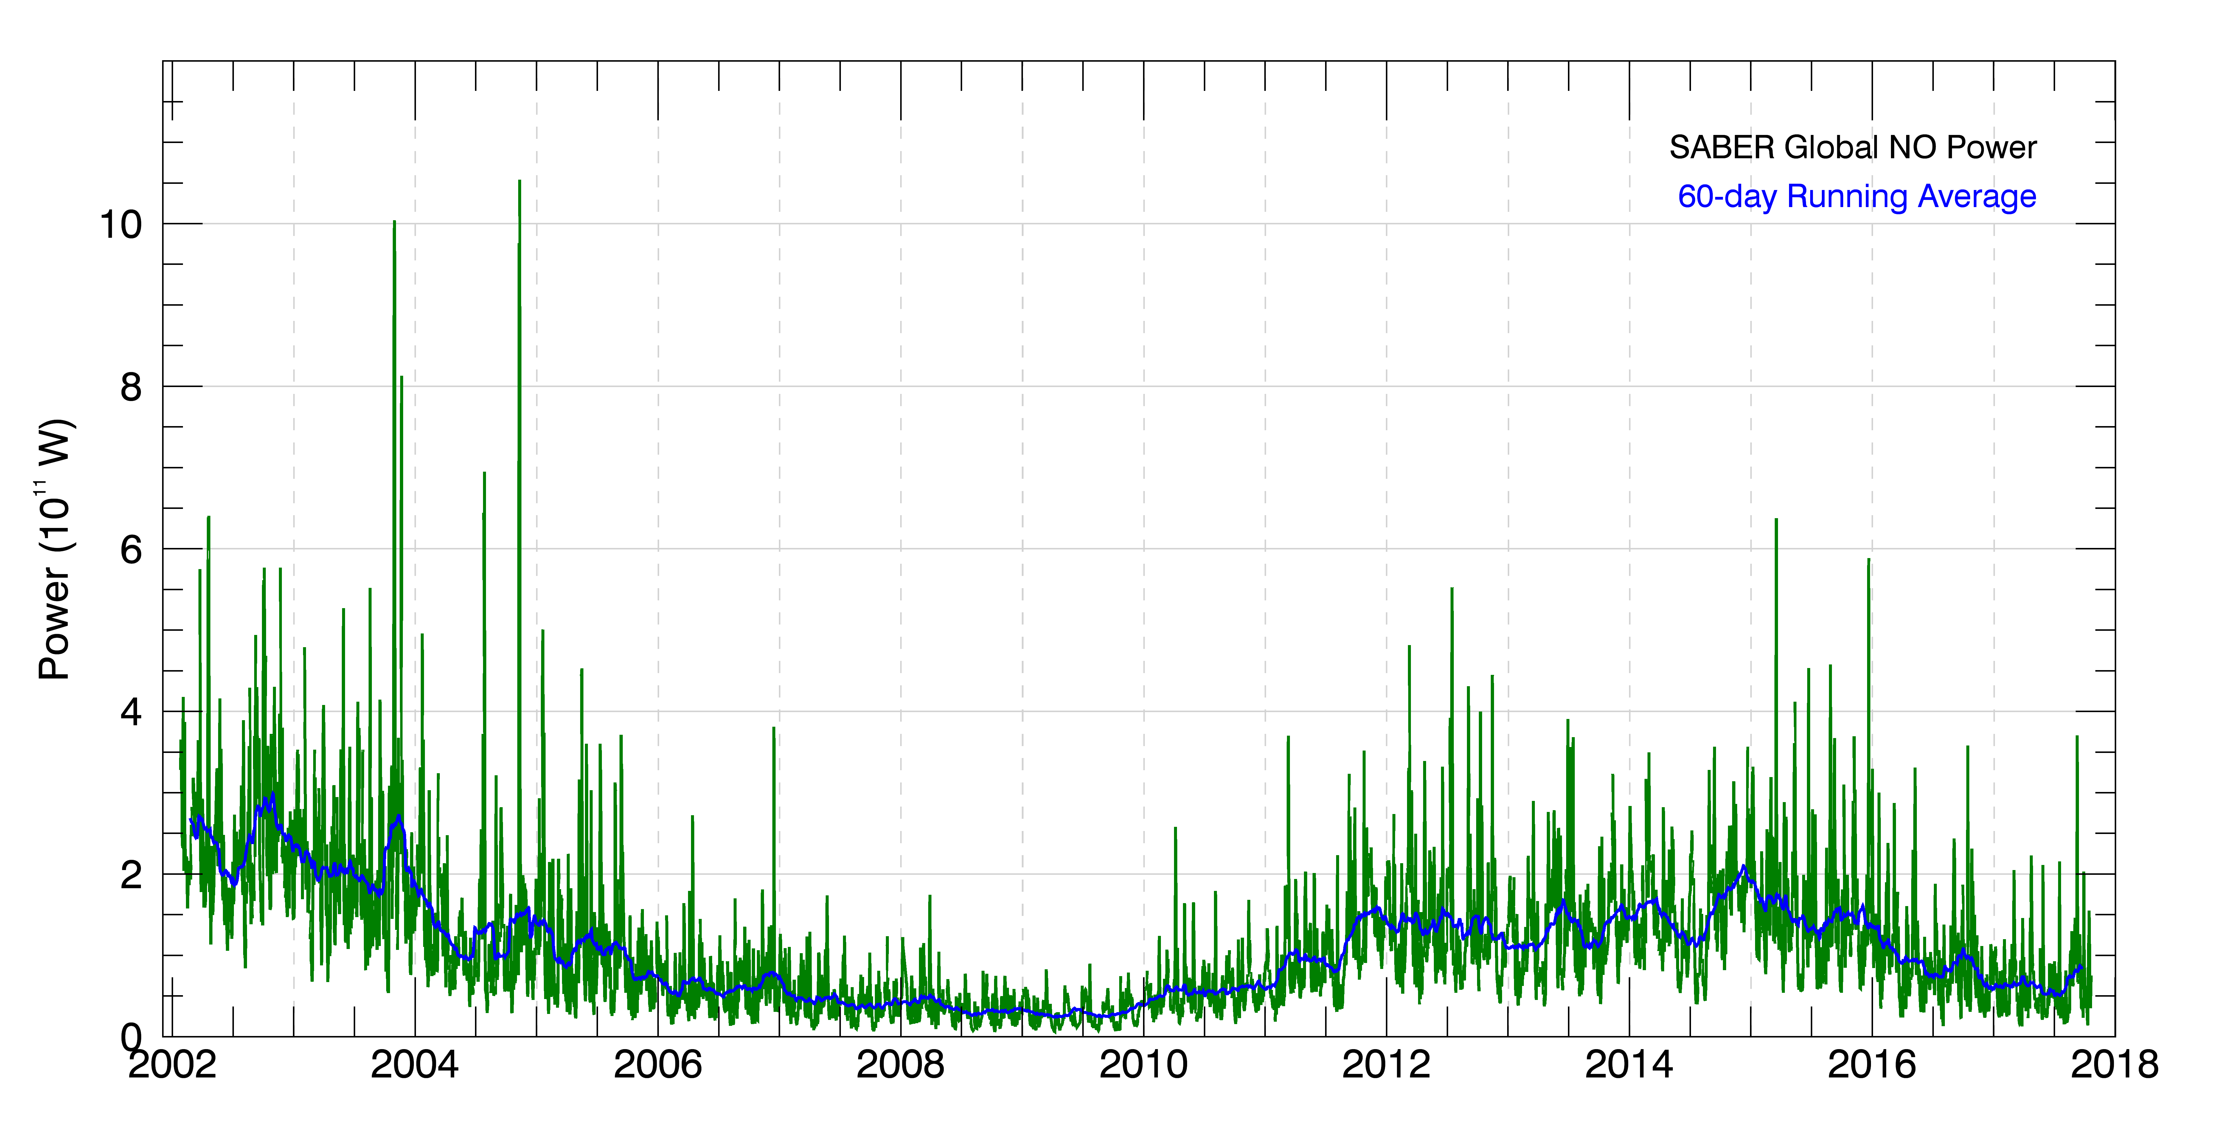
From SABER Limb Radiances to Global Infrared Power
Abel Transform
Radiance – (W/m²/sr)
Cooling Rate
(nW/m³)
Vertical Integration
Daily Global Power - (W)
Area
Integration
Flux – (W/m²)

