Slide 1






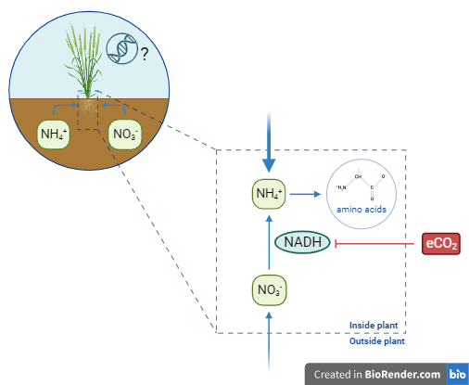
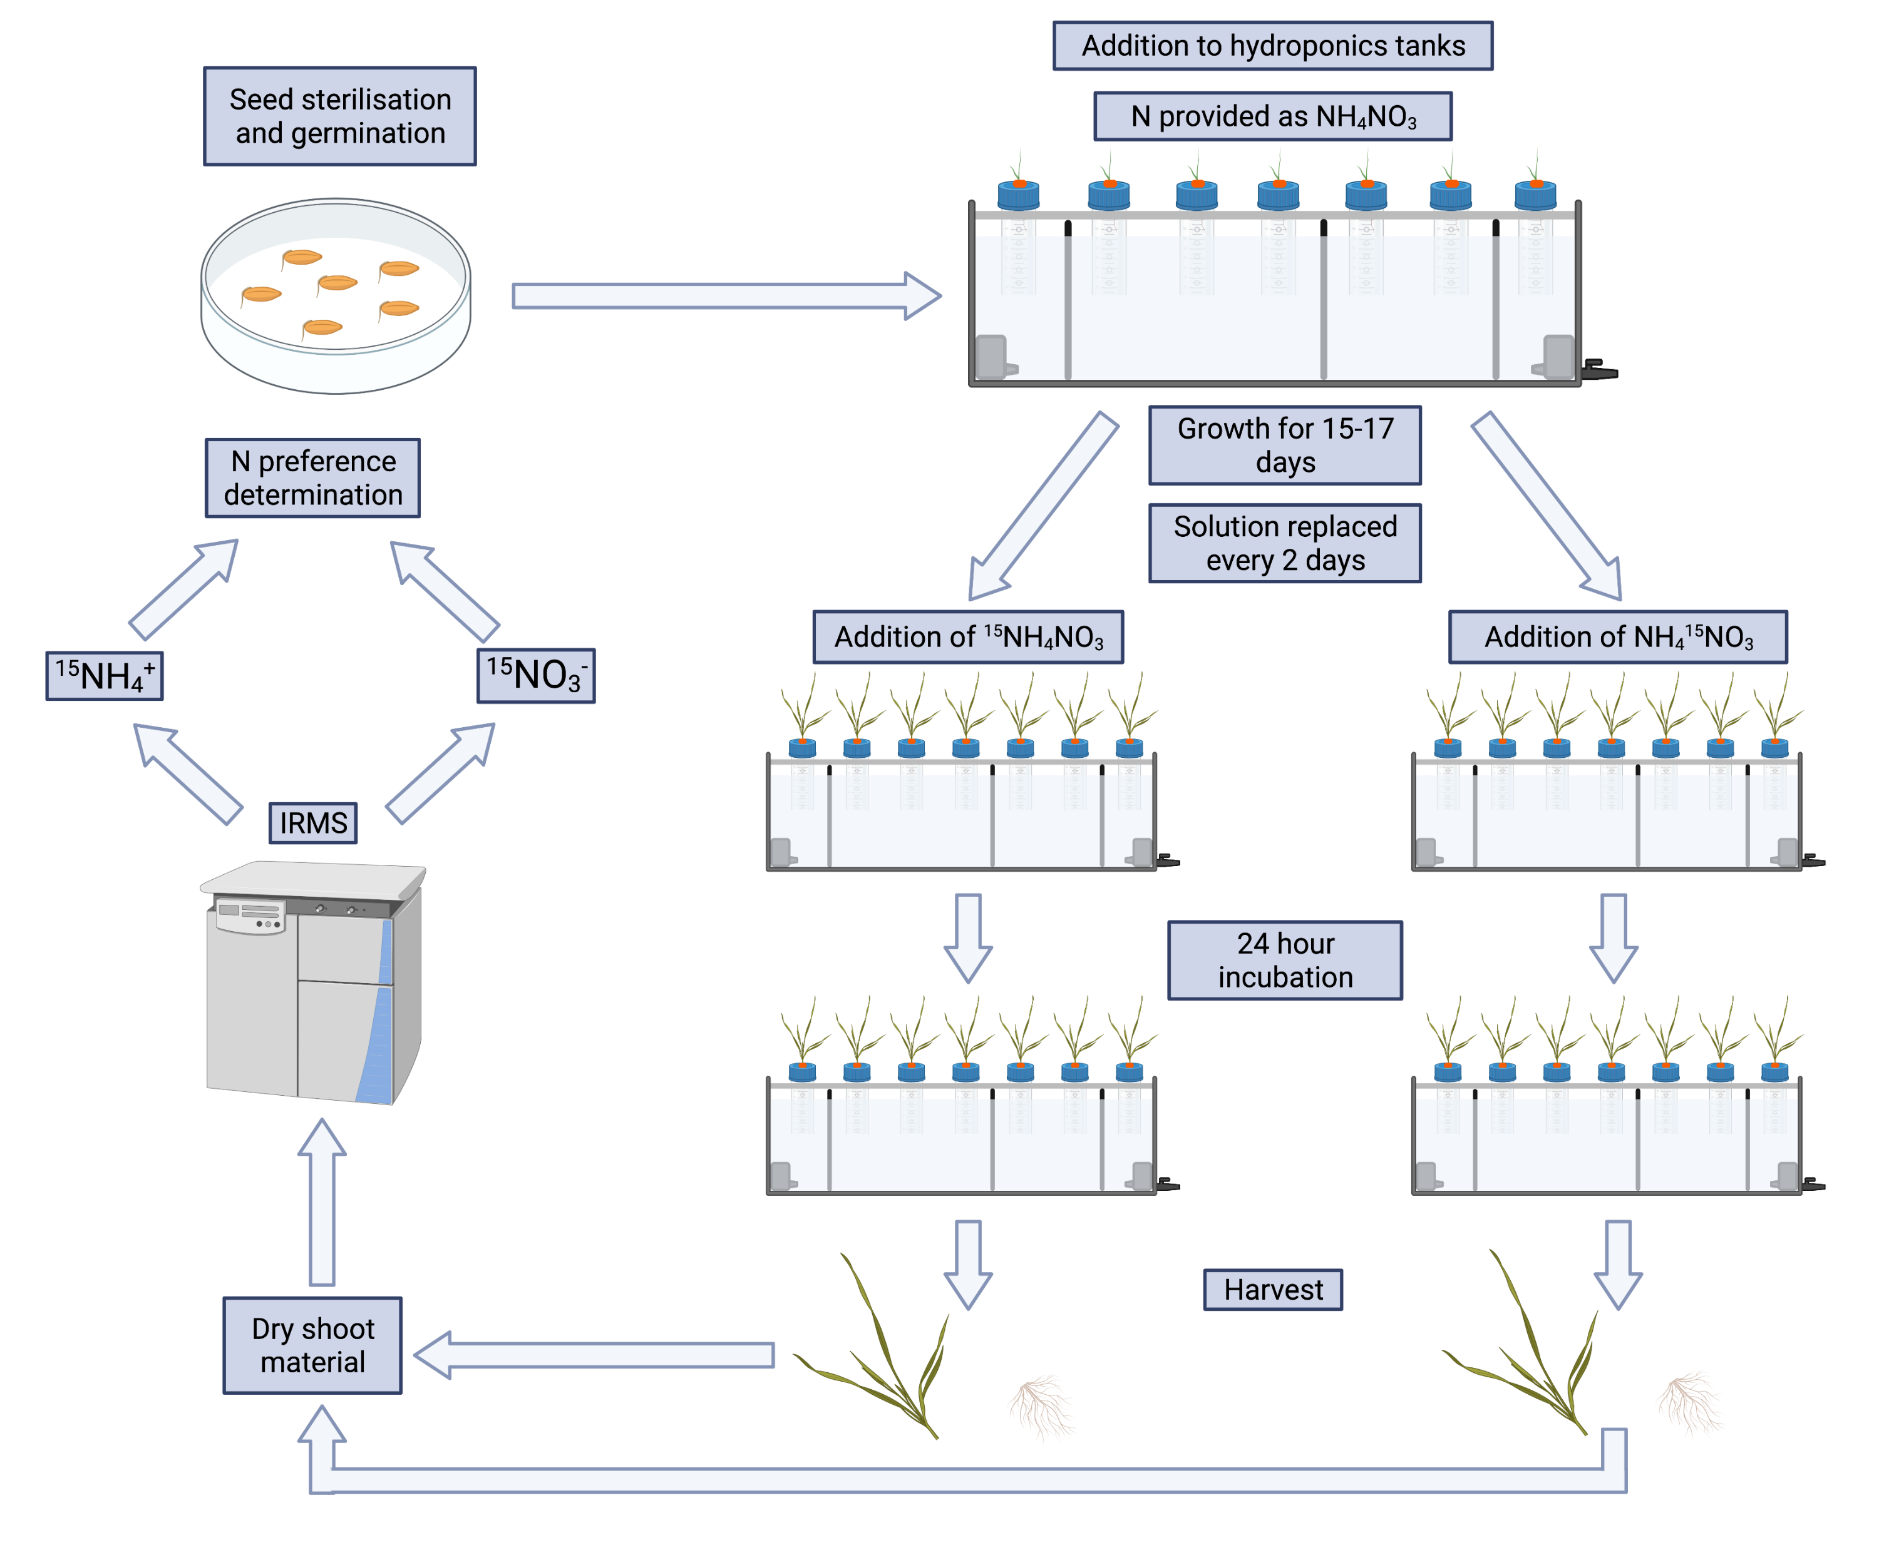
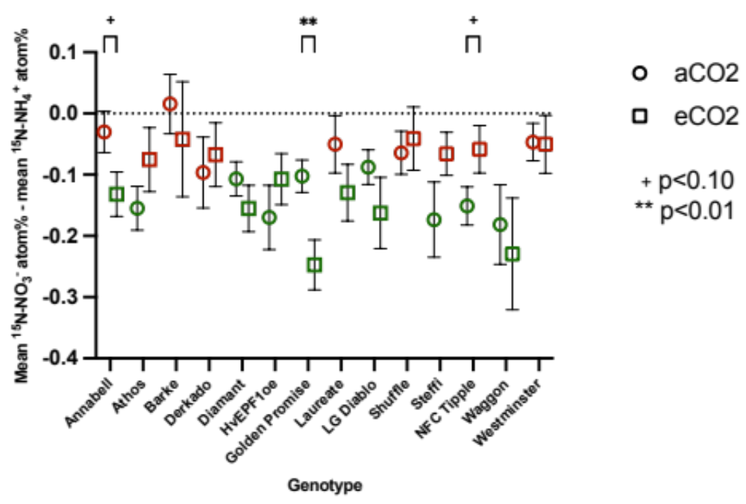
Understanding plant nitrogen preference responses to elevated CO₂ Earth and spaceflight cabin environments.
luke.l.fountain@nasa.gov
Dr Luke Fountain MRSB
@lukefountain8
Luke Fountain^{1,3}, Elison Blancaflor², Ray Wheeler², Tim Daniell³, Duncan Cameron⁴, Julie Gray³ & Gioia Massa²
¹ NASA Postdoctoral Fellow, Kennedy Space Center, Florida, USA.
² Exploration Research & Technology Programs, Kennedy Space Center, Florida, USA.
³ School of Biosciences, The University of Sheffield, Sheffield, UK.
⁴ Department of Earth and Environmental Sciences and Manchester Institute of Biotechnology, The University of Manchester, Manchester, UK.
Introduction
The growth of crops to sustain astronauts will be critical to long-duration spaceflight missions. Carbon dioxide (CO₂) concentrations are very high in spaceflight cabin environments, often over 10x the CO₂ concentration on Earth ¹. It is therefore crucial to understand how plants respond to elevated CO₂ (eCO₂). Nitrogen (N) is crucial for plant survival and plants often prefer to take up one form over another, e.g., ammonium (NH₄⁺) over nitrate (NO₃⁻). The amount of NADH available for NO₃⁻ reduction in plant leaves may be reduced by eCO₂ through reduced photorespiration and increased C fixation ² (Figure 1), possibly driving increased NH₄⁺ preference, but the universality of this response remains unclear. Understanding N preference in candidate space crops can help with cultivar selection and wastewater processing system design requirements ³.
Figure 1: Simplified diagram illustrating N preference and potential effects of eCO₂. It is unclear if this response is universal across and within species.
Methods
Results
All plants showed either NH₄⁺ preference or no N preference (calculated using Equation 1), regardless of cultivar or CO₂ level (Figure 3). Several cultivars showed trends towards increased NH₄⁺ preference at eCO₂ (720 ppm) compared to ambient CO₂ (aCO₂) (410 ppm), which was significant for Golden Promise (Figure 3). Others displayed no change in N preference, and others still showed a trend towards increased NO₃⁻ preference at eCO₂, most notably NFC Tipple.
Figure 2: N preference experimental workflow ⁴. The same procedure was followed for plants grown at aCO₂ and eCO₂.
N preference = Mean ¹⁵NO₃ ⁻atom % - Mean ¹⁵NH₄⁺ atom %
Equation 1
Summary
Increased NH₄⁺ preference was observed as expected for several barley cultivars at eCO₂, particularly Golden Promise, however other cultivars displayed an increase in NO₃⁻ preference or no change in preference at eCO₂.
N preference responses to eCO₂ may also be genetically driven and not simply a physiological response to less available reducing power. This approach can help inform space crop cultivar selection.
Figure 3: Mean N preference at aCO2 and eCO2 ⁴. Green values indicate significant NH₄⁺ preference, red values indicate no preference (one-sample two-tailed t-test). Significant differences between CO₂ levels within cultivars are indicated with ** (p<0.01) or + (p<0.10) (independent samples t-test).
Future work
Acknowledgements
Understand the universality of the eCO₂ preference response across space candidate crop species.
Assess whether the same responses are observed at super-elevated CO₂ (seCO₂) i.e. >1000 ppm, compared to eCO₂.
Can this response be used to select for varieties better adapted to the seCO₂ space cabin environment or to tailor N provision to maximize yield?
Plants adapted to NH₄⁺ nutrition may play a role in future plant-based bioregenerative life support systems with higher NH₄⁺ concentrations due to wastewater recycling.
Research presented here was funded by a BBSRC Mechanistic Biology White Rose DTP PhD scholarship. Ongoing research is supported by an appointment to the NASA Postdoctoral Program at Kennedy Space Center, administered by Oak Ridge Associated Universities under contract with NASA. Figures 1 and 2 were created using BioRender.
References
¹ Law et al. (2014). Relationship between carbon dioxide levels and reported headaches on the International Space Station. Journal of Occupational and Environmental Medicine 56, 477-483.
² Bloom (2015). The increasing importance of distinguishing among plant nitrogen sources. Current Opinion in Plant Biology 25, 10-16.
³ Schiefloe et al. (2023). From urine to food and oxygen: effects of high and low NH₄⁺:NO₃⁻ ratio on lettuce cultivated in a gas-tight hydroponic facility. Frontiers in Plant Science 14:1229476.
⁴ Fountain (2022). Understanding interactions of barley (Hordeum vulgare) with soil nitrogen cycling activity and links to plant nitrogen preference. PhD Thesis, University of Sheffield.

