Slide 1
Effects Of Five-Ion Galactic Cosmic Radiation Simulation On Immune Function, Brain, And Behavior In Male And Female Mice
Stephanie Puukila
Blue Marble Space Institute of Science
NASA Ames Research Center
Team: J.S. Iyer, S.D. Mhatre, S. Tabares Ruiz, J. Hayes, A. Brekker, O. Siu, M. Burke, M. Semel, M. Lowe, L. Rubinstein, M. B. Sowa, A.M. Paul, C.G.T. Tahimic, J. S. Alwood
PI: A.E. Ronca
2023 RRS Fall Workshop

Slide 2
Spaceflight
We are embarking on a new era of deep space exploration, with missions back to the moon (Artemis) and on to Mars.
Humans will be exposed to simultaneous spaceflight hazards for extended periods. Cosmic Radiation, altered gravity and social isolation are primary concerns.
It's clear that deep space hazards pose significant risks to human biology, and further, that we don't yet have the data needed to address these concerns.

Slide 3
Cosmic Radiation
Space radiation is made up of three types:
particles trapped in the Earth’s magnetic field
particles shot into space during solar flares (solar particle events)
galactic cosmic rays (GCR)
GCR are high-energy protons and heavy ions from outside our solar system. Consist of electrons and positrons (2%), protons (85%), helium nuclei (12%), HZE-charged particles (1%) (Durante and Cucinotta 2008).
https://www.nasa.gov/missions/analog-field-testing/why-space-radiation-matters/

Slide 4
Doses
Predicted Doses assuming 10 g/cm² shielding and ICRP 60 quality factors (NASA, summarized by Nelson 2016)
LEO (6–12 months) – 50–100 mSv (1/3 from protons and 2/3 from GCRs)
Lunar visit/habitat – 120–150 mGy GCR dose
Deep-space journey (1 year) – 200 mGy GCR dose
Mars mission (approximately 3 years) – 1.0–1.2 Sv (245–360 mGy)
Notes:
NASA has estimated that exposures will result in each of an astronaut's cells (assuming ≈100 um² projected area or geometric cross section) being “hit” (traversed) by a proton once every three days, a helium nucleus once every few weeks and a heavy ion (Z > 2) once every few months

Slide 5
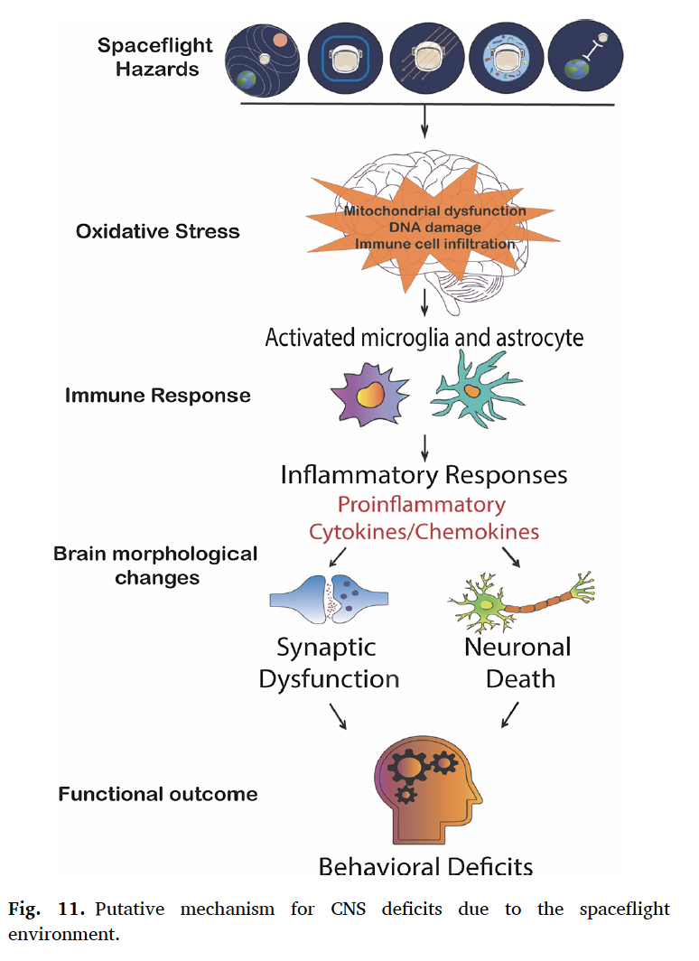
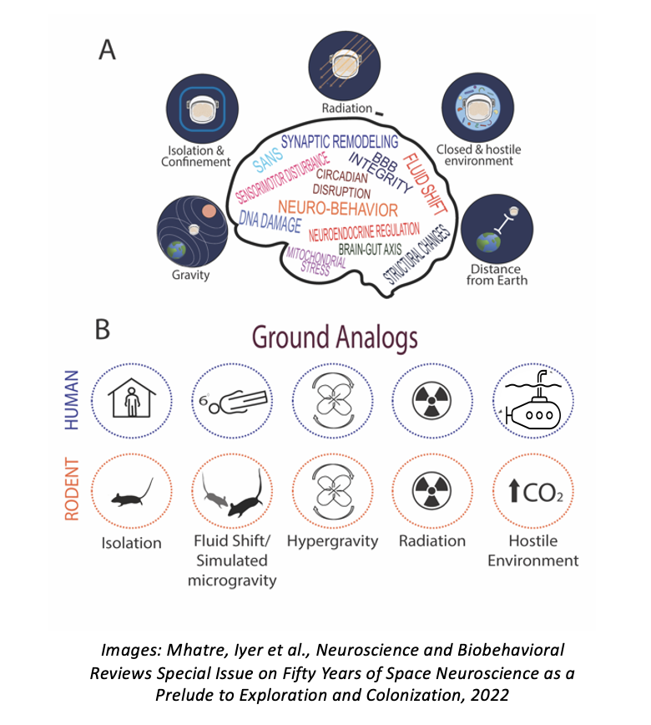
Hypothesis and Model
Spaceflight hazards combine synergistically, in a sex-specific manner, to trigger oxidative stress that, in turn, alters immune homeostasis, brain morphology and function, and neurobehavioral and cognitive performance.
Notes:
How do we investigate this? Send people to space, sample size relatively small and mainly LEO, send animals to space, inverts and verts, Rodent Research, though also only LEO
Lead to countermeasure

Slide 6
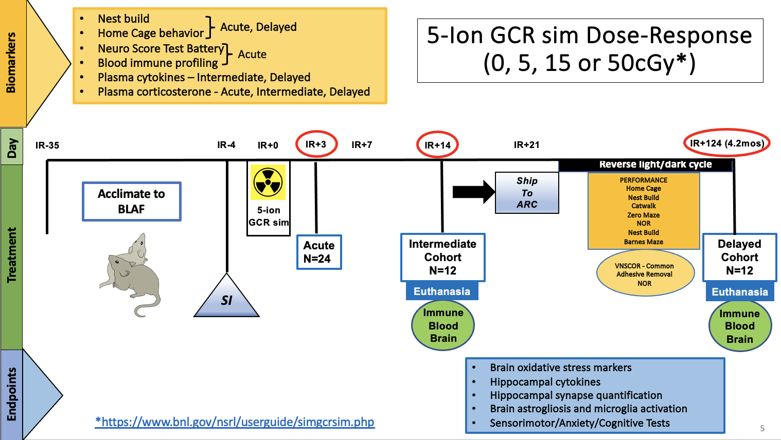
Aim 1: Experimental Design
Notes:
Male and female - Historically low numbers of female astronauts have traveled to space (as we know) – a trend that has rapidly changed in the past decade.
-We now recognize that for most physiological systems, including the brain, men and women respond differently to spaceflight.
Crew aged matched

Slide 7
Simplified GCRSim
6 beams, 5 ions
Ion | Energy (MeV/n) | Fraction
H | 1000 | 35%
Si | 600 | 1%
He | 250 | 18%
O | 350 | 6%
Fe | 600 | 1%
H | 250 | 39%
Dose (cGy) | Dose Rate (cGy/min)
5 | 0.4-0.9
15 | 0.9-1.2
50 | 1.0-1.3

Slide 8
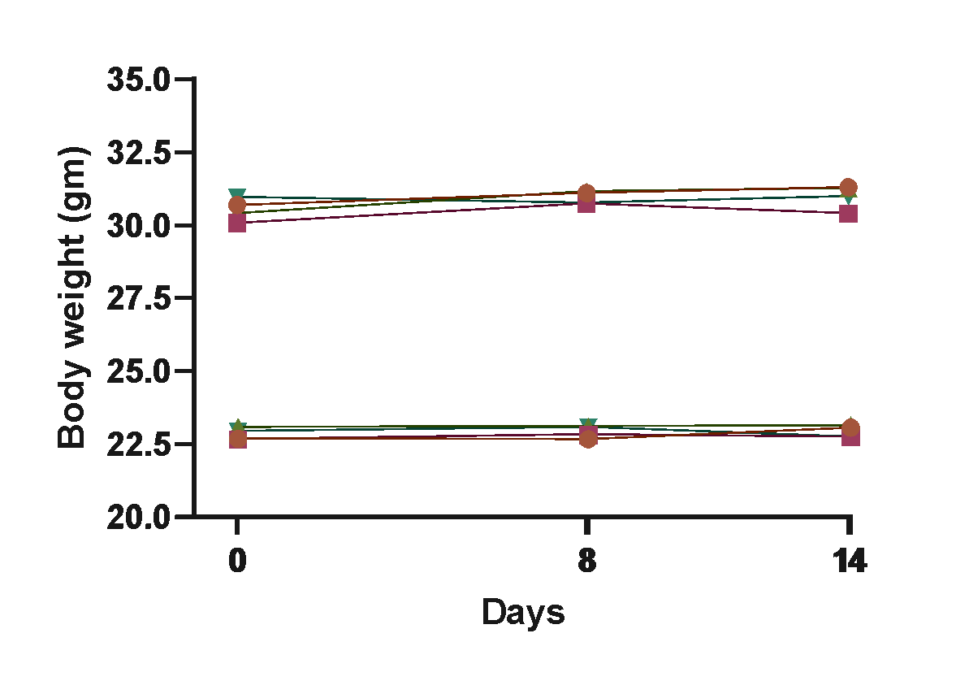
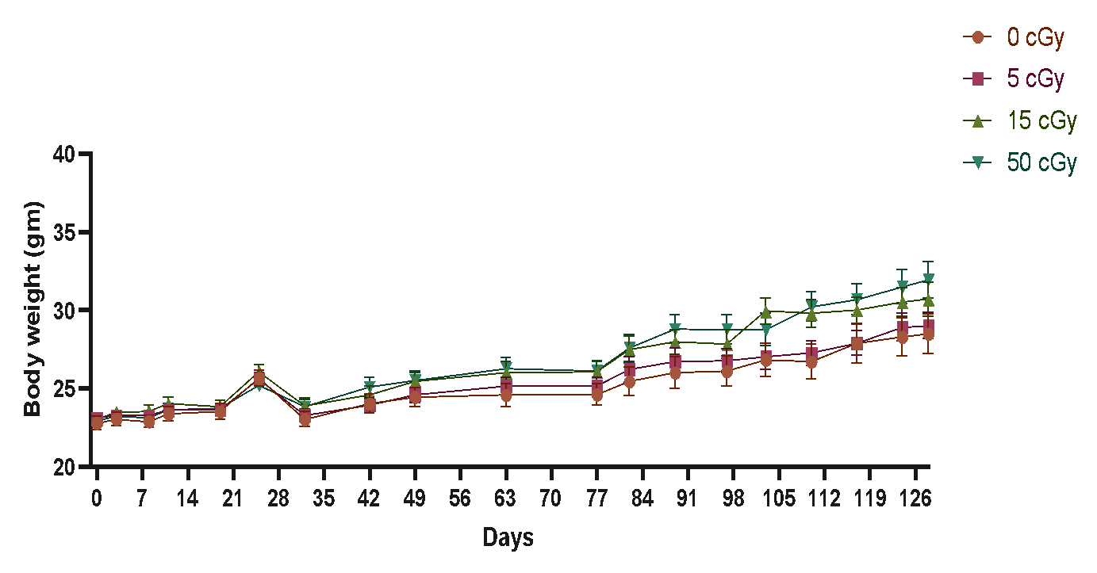
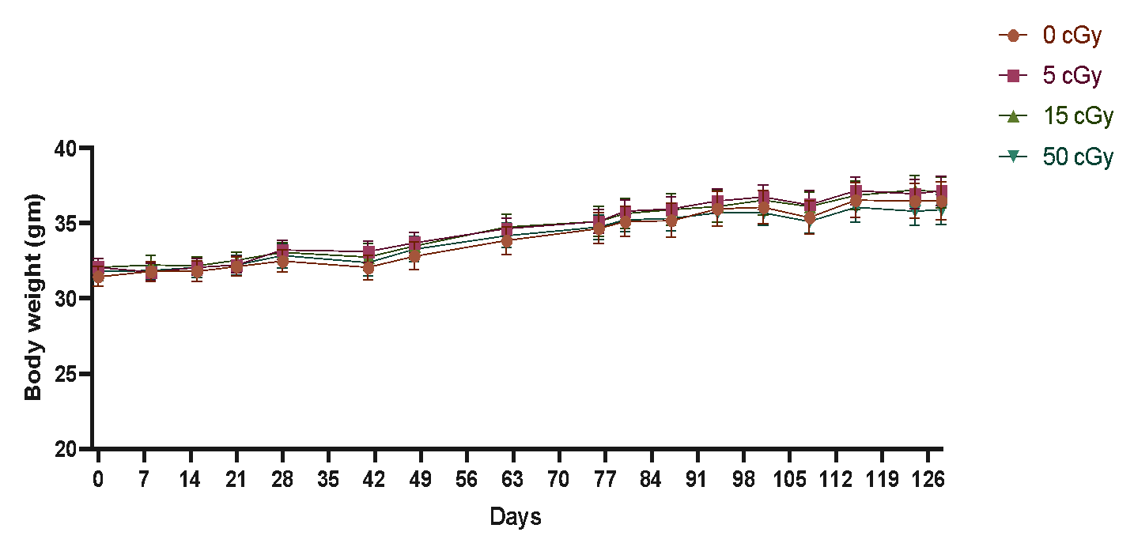
Body weight and adrenal weight varied by sex
but not GCR dose
Intermediate (IR+14d)
Delayed (IR+124d)
Males
Females
Males
Females

Slide 9
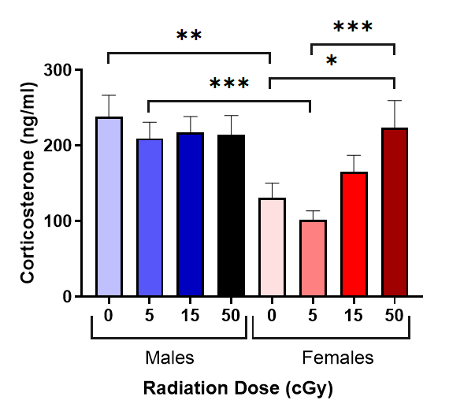
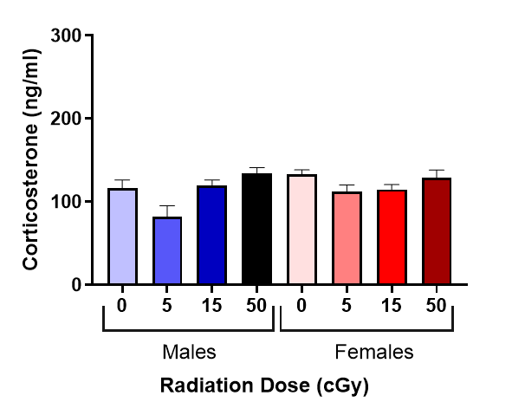
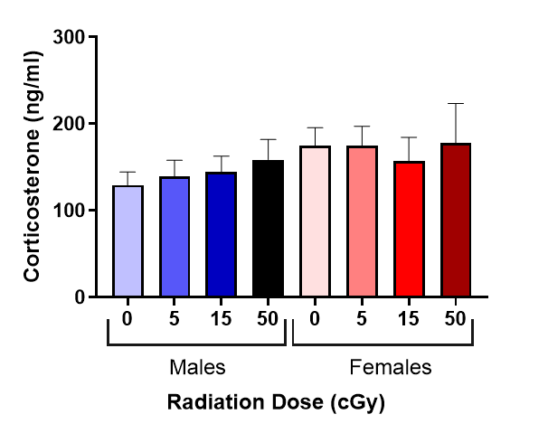
Plasma corticosterone GCR dose and sex effects
at delayed, but not acute or intermediate timepoints
Acute, IR+3d
Intermediate, IR+14d
Delayed, IR+124d
Delayed timepoint males generally elevated relative to females (even shams) and females overall dose-related increase

Slide 10
Plasma Cytokine and Chemokine Expression
44-plex Luminex panel
Notes:
Plasma cytokine concentration may serve as an indicator of in‐vivo physiological changes or immune system mobilization (Kroemer 1991). Increases in plasma concentrations may reflect large magnitude localized reactions, or the manifestation of systemic reactions. To determine in vivo immune homeostasis, we investigated plasma cytokine and chemokine profiles in peripheral blood as a biomarker of immune status in the intermediate cohort IR+14 at 5, 15 and 50cGy radiation doses.
We assessed 44-plex Luminex panel as shown,. This panel has a good mix of inflammatory, anti-inflammatory, regulatory, growth factors and chemokines.

Slide 11
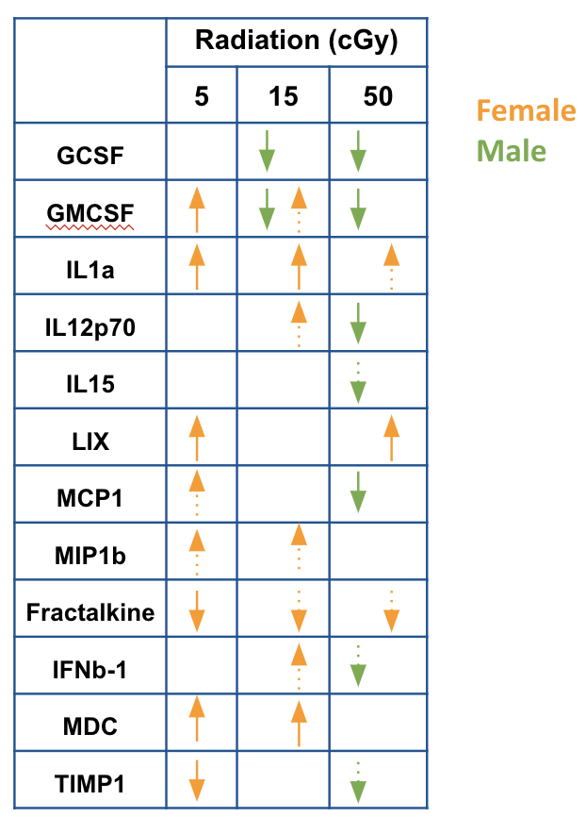
Plasma Cytokine and Chemokine Expression (Intermediate, IR+14d)
FEMALES
MALES
MIN.
MAX.
Notes:
Of the 44plex Luminex panel, 25 showed sex- specific differences. The heatmap shown here highlights these changes.
The left 12 boxes are females and the right twelve males.
Red shows high levels and blue- lower levels of expression.
Overall, the females exhibit higher cytokine/chemokine expression.
when we look at the changes due to radiation dose, this table shows IR response by sex across radiation dose relative to sham controls.
Solid arrow represents significance and dotted arrows are trends.
Again we see increased expression in females, particularly at 5 and 15cGy GCRSim.
To summarize,
-We observed sex differences all doses
-Females displayed elevated expression at 5 and 15 relative to sham
-Males displayed reduced expression for all detectable cytokines at 50cGy with growth factors GCSF and GMCSF expression downregulated at 15cGy

Slide 12
Brain Cytokine/Chemokine – Intermediate, IR+14
Intermediate
44-plex Luminex panel
 | Radiation(cGy)
 | 5 | 15 | 50
IL1a
IP10
KC
LIX
MIP1a
Fractalkine
IFNb-1
IL16
MCP5
TARC
Eotaxin
IL2
IL9
IL10
Exodus
MIP-1a
Classical neutrophil attractant
Expression by resident brain cells
precedes neutrophil infiltration in brain
- Hippocampal modulator associated
with spatial memory impairment
Increased in AD brain vasculature
Regulated by oxidative stress
Sex difference
Female
Male
Notes:
In the nervous system, cytokines and chemokines function as neuromodulators and regulate neurodevelopment, neuroinflammation, and synaptic transmission. Cytokines and chemokines are crucial to the brain’s immune function serving to maintain immune surveillance, facilitate leukocyte traffic, and recruit other inflammatory factors.
We assessed 44-plex Luminex panel. As with plasma, this panel has a good mix of inflammatory, anti-inflammatory, regulatory, growth factors and chemokines. Here I am showing the changes in the intermediate time point.
-----More changes are observed in males when compared to the shams.
The male-female differences in the table marked in purple - overall we observe multiple chemokines and one cytokine (IFNB1) –NO fractalkine showing sex differences.
Particularly mip1a- show significant increase in males at 15cGy and 50cGy radiation dose.
Macrophage inflammatory protein-1 alpha (MIP-1α/CCL3) is a classical neutrophil attractant. Expression of mip1a by resident brain cells precedes neutrophil infiltration in the brain (https://jneuroinflammation.biomedcentral.com/articles/10.1186/1742-2094-8-41 ). It is also associated with spatial memory impairment by acting as a hippocampal neuromodulator (https://www.nature.com/articles/srep15862#:~:text=MIP%2D1%CE%B1%2FCCL3%20is%20classically,%2C23%2C24%2C25). Mip1a is also increased in AD brain vessels and is regulated by oxidative stress (https://pubmed.ncbi.nlm.nih.gov/17656823/ )

Slide 13
Brain Cytokine/Chemokine – Delayed, IR+124
Delayed
 | Radiation (cGy)
 | 5 | 15 | 50
IL1a
IP10
KC
LIX
MIP1a
Fractalkine
IFNb-1
IL16
MCP5
TARC
Eotaxin
IL2
IL9
IL10
Exodus
Exodus
TARC
Sex difference
Female
Male
Notes:
Here I am showing the changes in the delayed time point. Again, similar to the intermediate tie point, we observe multiple cytokines/chemokines showing sex differences. and More changes are observed in male cytokines in radiated cohorts when compared to the shams. STRIKINGLY, Females did not show significant changes in any of the tested cyto/chemokine panel.
During an inflammatory response, Exodus/CCL21 recruits immune cells to sites of inflammation (Gomez-Nicola et al., 2010, Kar et al., 2011, Warnock et al., 2000, Willimann et al., 1998). In the central nervous system (CNS), Exodus/CCL21 expression has been reported in endangered neurons, aiding in microglial activation through an alternative receptor, C-X-C chemokine receptor 3 (CXCR3) (de Jong et al., 2008).
Various preclinical models have shown that TARC/CCL17 functions in the brain. TARC/CCL17 was reported to be a homeostatic and inflammatory neuromodulatory chemokine whereby it could increase the microglia population while down modulating the basal synaptic transmission of neurons in the hippocampus.
Transition to next slide: Overall, we observe that the brains of male mice display changes in the chemokine and cytokine profiling at both the time points.
This is interesting because ….

Slide 14
Peripheral and Central Immune Response
Plasma
Intermediate
Hippocampal
Intermediate
Hippocampal
Delayed
 | Radiation (cGy)
 | 5 | 15 | 50
GCSF
GMCSF
IL1a
IL12p70
IL15
LIX
MCP1
MIP1b
Fractalkine
IFNb-1
MDC
TIMP1
 | Radiation(cGy)
 | 5 | 15 | 50
IL1a
IP10
KC
LIX
MIP1a
Fractalkine
IFNb-1
IL16
MCP5
TARC
Eotaxin
IL2
IL9
IL10
Exodus
 | Radiation (cGy)
 | 5 | 15 | 50
IL1a
IP10
KC
LIX
MIP1a
Fractalkine
IFNb-1
IL16
MCP5
TARC
Eotaxin
IL2
IL9
IL10
Exodus
Female
Male
Notes:
plasma cytokine profile shows more changes in female while brain profile shows changes in males - differential regulation of peripheral immune response and central immune response.

Slide 15
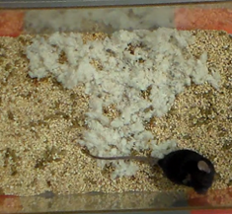
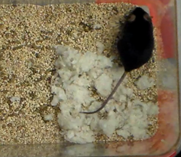
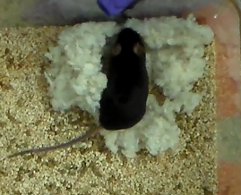
Nest Build (Acute, IR+3d and Delayed, IR+91d)
Deacon Score
Least developed nestlet build
Most developed nestlet build
3
4
5
Males
Females
*
*
Acute, IR+3d
- 15cGy males poorer than sham
- 50cGy females better than sham
- Females better than males (50cGy)
Delayed, IR+91d
- No significant dose or sex differences
- Nest builds degraded
15
Puukila et al. 2023

Slide 16
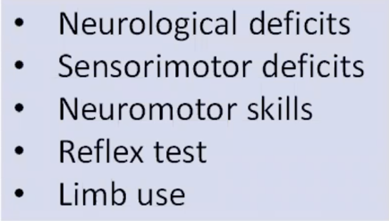
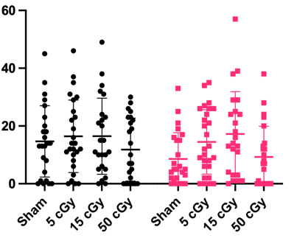
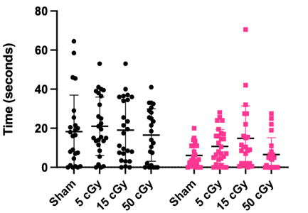
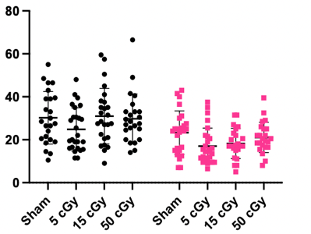
Neuroscore Test Battery
Homecage Behavior
Reflex Score(Acute, IR+3d)
*
*
Digging
Frequency
Males
Acute, IR+3d
15 cGy > sham
female digging only
Delayed, IR+91d
No dose
or sex differences
Rearing
Frequency
Females
No 5-ion GCRsim Dose or Sex Differences
Puukila et al. 2023

Slide 17
Catwalk Gait Analysis (IR+37d)
Catwalk Gait Analysis
Sex differences at all doses for some measures
Females > Males - Speed, Not Regularity index
No dose effects

Slide 18
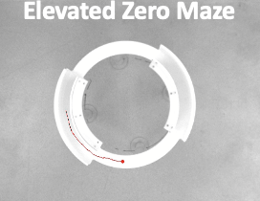
Anxiety
Trial 1
Trial 2
Zero
IR+43d
No dose effects
Trial 2 Only: Males spent more time than females in open arms
Open Field
Day 1
Day 2
IR+85d
No dose or sex differences

Slide 19
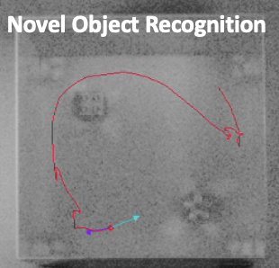
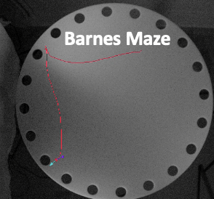
Object Recognition Memory
Novel Object Recognition
IR+85d
IR+85d
No dose or sex differences
Spatial Memory
Males
Females
IR+105d
No dose differences
Males did not improve over days whereas females did
Notes:
Remember – MIP-1alpha expression, which is associated with spatial memory impairment, was increased in males (brain) but not females

Slide 20
GCRsim Dose-Response Summary
Plasma cytokine/chemokine expression (IR+14)
Sex differences at all doses
Overall, females exhibited greater cytokine/chemokine expression than males
Brain cytokine/chemokine expression (IR+14)
Sex differences observed in multiple chemokines and one cytokine (IFNB1)
More changes in males compared to shams
MIP-alpha significantly increased in males, but not females, at 15- and 50 cGy.
Brain cytokine/chemokine expression (IR+124)
Changes in males only - Exodus and TARC
Differential regulation of peripheral immune response and
central immune responses in females (plasma) and males (brain)

Slide 21
GCRsim Dose-Response Summary
Delayed timepoint males showed elevated corticosterone, compared to female (sham). Females – 50 cGy > sham
Early timepoint males displayed disrupted nestlet behavior as compared to females, normalized at the delayed timepoint
Delayed timepoint female spatial memory performance improved faster relative to males suggestive of hippocampal sex disparities
Highly divergent, sexual dimorphism independent of GCR dose

Slide 22
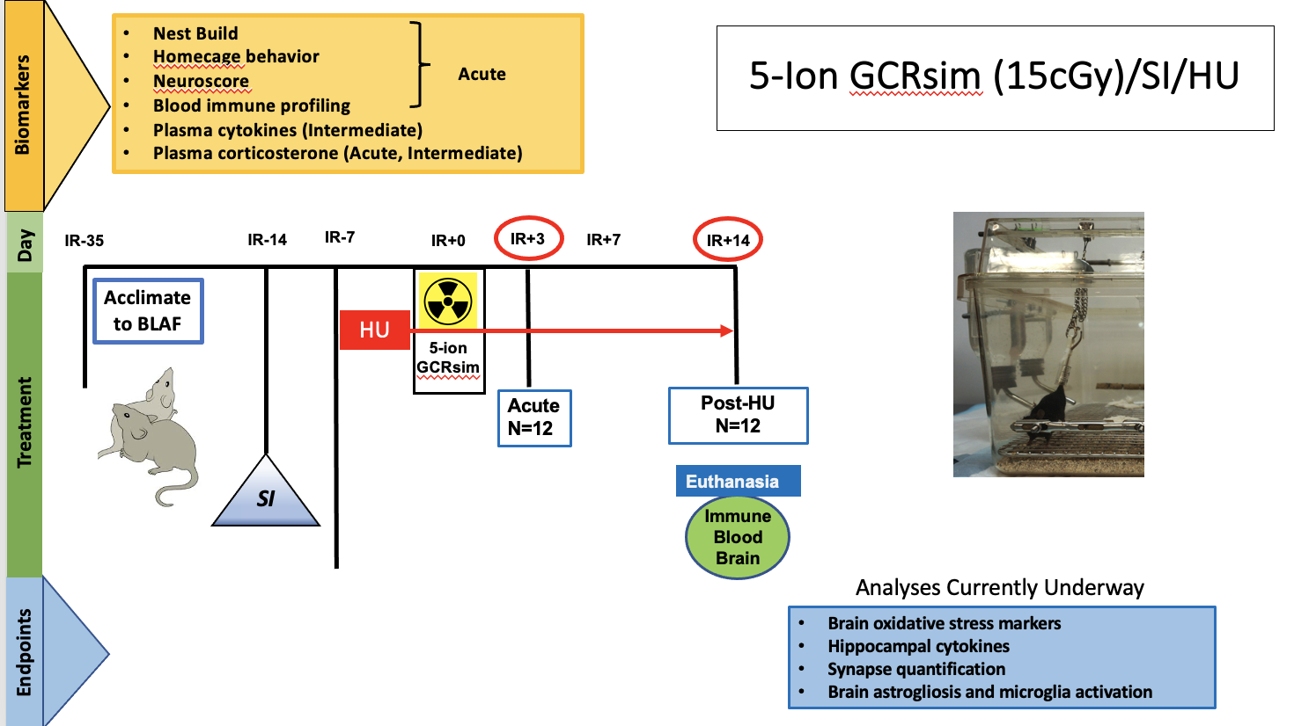
Combined Stressors

Slide 23
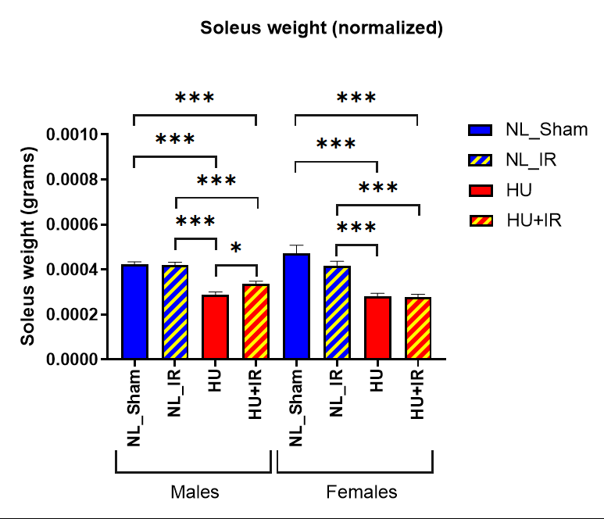
Tissue Weights- Normalized for Body Weight, IR+14
HU Model Verification

Slide 24
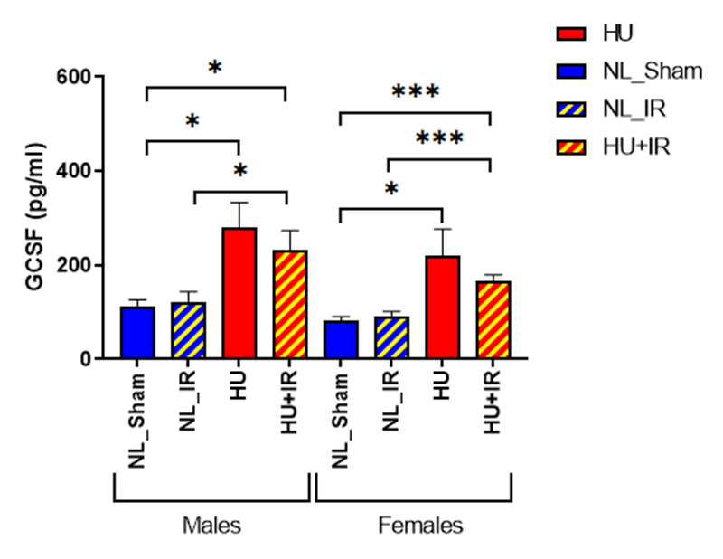
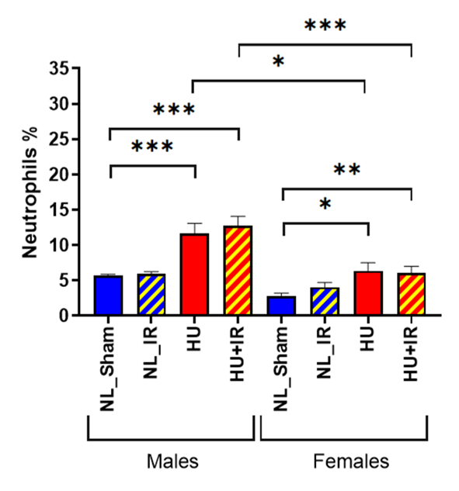
Granulocyte colony stimulating factor
GCSF
Glycoprotein cytokine in blood and bone marrow
Participates in the proliferation and differentiation of myeloid progenitors
Key regulator of neutrophil production and survival
Notes:
GCSF (Granulocyte colony stimulating factor) is a glycoprotein cytokine in blood and bone marrow. It participates in the proliferation and differentiation of myeloid progenitors and is a key regulator of neutrophil production from bone marrow and neutrophil survival (https://www.nature.com/articles/ncprheum0291)
We observe an significant increase in GCSF levels in both males and females in both HU and HU/IR condition
Increase in GCSF is observed in chronic inflammatory conditions such as RA (https://pubmed.ncbi.nlm.nih.gov/26848119/) (https://www.ncbi.nlm.nih.gov/pmc/articles/PMC509212/)
Plasma GCSF levels as marker for TBI (https://www.ncbi.nlm.nih.gov/pmc/articles/PMC7770509/)
When we look at the differential cell population of neutrophils at the same time point, we see a similar pattern where neutrophil population is significantly increased in both the sexes in both HU and HU/IR condition.
Overall suggesting that HU and HU/IR can show increase in inflammatory responses for both the sex, which may lead to maladaptive immune response.
This can be a potential biomarker(?)

Slide 25
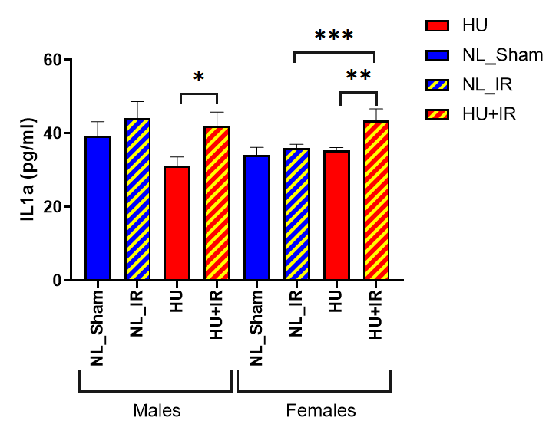
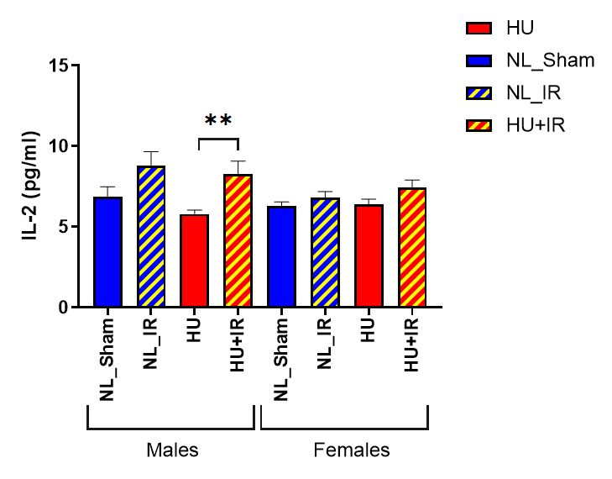
Brain Cytokines/Chemokines
IL1a
IL2
MIP2
Notes:
Interleukin 1α (IL-1α) and IL-1β are equally potent inflammatory cytokines that activate the inflammatory process, and their deregulated signaling causes devastating diseases manifested by severe acute or chronic inflammation.
IL-2 is a cytokine produced by T-cells and it stimulates the proliferation and differentiation of T-cells, B-cells and NK cells. It helps to activate and maintain immune cell populations at the site of inflammation.
Macrophage inflammatory protein (MIP)-2, also known as CXC ligand (CXCL)2, is one of the CXC chemokines. It assists in the recruitment of polymorphonuclear neutrophils (PMNs) to sites of injury or infection and thereby modulates immune and inflammatory responses.

Slide 26
Modeling/Correlations
Predictive modeling of cognitive deficits based on biomarkers.
Principal Component Analysis
Directed Acyclic Graph (DAG) - identify, assess, track and report on the risks due to spaceflight. Used to represent the chain of events that lead from spaceflight exposures to negative mission-level outcomes.

Slide 27
Acknowledgements
NASA Ames
April Ronca
Siddhita Mhatre
Janani Iyer
Josh Alwood
Steffy Tabares Ruiz
Moniece Lowe
Linda Rubinstein
Yasaman Shirazi-Fard
Egle Cekanaviciute
Sonali Verma
Ahleah Rohr-Daniel
Marianne Sowa
University of North Florida
Candice Tahimic,
Adaline Brekker, Maya Semel, Ivan Korostenskij
Embry-Riddle Aeronautical
Amber Paul, Olivia Siu,
Marissa Burke, Cassie Juran
University Of Kansas Medical Center
Lane Christenson
Anamika Ratri
Cornell University
Kelly Wong
Texas A&M
John Hayes
USC
Yuli Talyansky
Brookhaven National Laboratory
Laura Loudenslager
Angela Kim
Cynthia Vongerichten
BLAF
Janelle Collins
Linda Morrell
Clarisse Kershaw
Jody Hamilton
NSRL
Peter Guida
Adam Rusek
Deborah Snyder
Lifesource
Stephanie Solis
Allison Brown
VNSCOR Team
UCSF
Susanna Rosi
Katie Grue
Kira Reinecker
EVSMl
Larry Sanford
Rich Britton
Funding provided by: NASA HRP Human Factors Behavioral Performance (HFBP) Element (80JSC018N0001-FLAGSHIP Grant), ERAU funding to AMP, HRP Space Radiation funding to CGTT, Research was sponsored by NASA through a contract with ORAU and supported by Blue Marble Space Institute of Science.

