Slide 1
A Multi-Probe Mission at Jupiter is Within our Reach!!
Ethiraj Venkatapathy
NASA Senior Technologist for Entry Systems
Chief Technologist for the Entry Systems and Technology Division
NASA Ames Research Center
OPAG
November 2023
Contributions by Mairead Stackpoole, Donald Ellerby, and Megan MacDonald of NASA Ames are gratefully acknowledged

Slide 2
“Chicken or the Egg?” => ”Science or Technology?”
Interest in and the importance of a Jupiter in-situ mission, though it is not a priority now, will require both science and technology communities to work together, starting now, for such a mission to come about in the future.
The TPS technology needed for a Jupiter in-situ mission is also needed for higher speed (>14.5 km/s) Earth entry and sample return missions.
The Talk is to:
Inform the Science Community of the feasibility of a future Jupiter Multi-Probes Mission and encourage its pursuit
Engage the Entry Systems/TPS Technology Community as to emerging capabilities and the need to preserve them
Educate and excite the early career and next generation students interested in future science and technology challenges
Technology and Science go hand-in-hand
One cannot be without the Other
Notes:
Focus on Jupiter Multi-Probe Missions that we looked at in late 1990 and early 2000 and gave-up on Jupiter but it motivated us to invent Entry System and TPS Technologies that enabled
Orion with 3DMAT for the Compression Pad
MSR Earth Entry System with 3MDCP heatshield
Dual-layer HEEET that will

Slide 3
Importance of and Interest from Scientists – A Small Sample

Slide 4
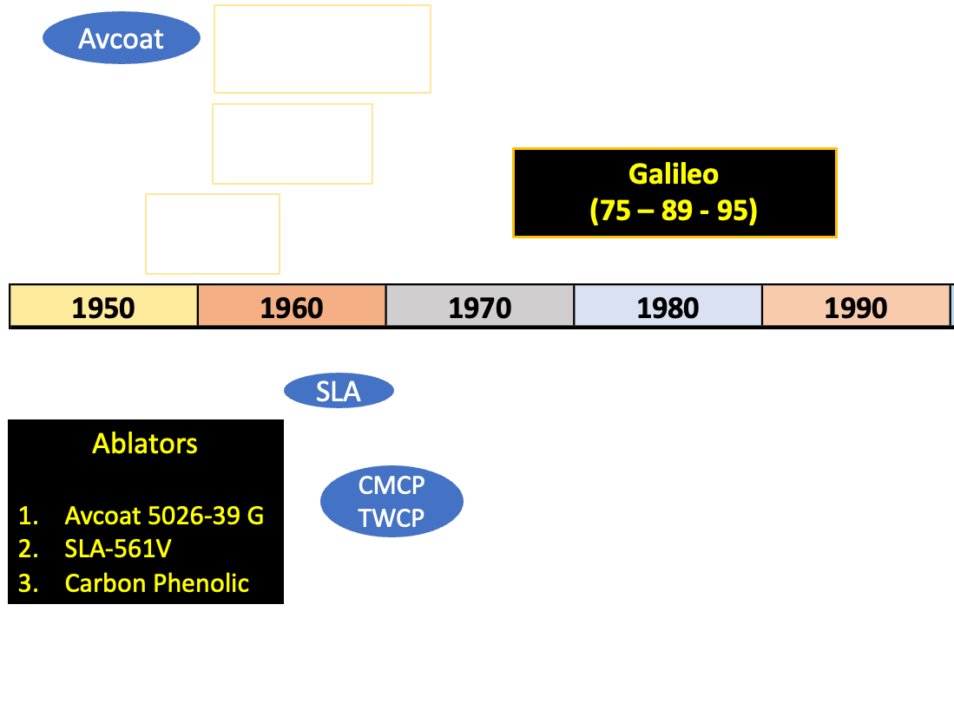
History of NASA Missions (1950 – 1980) Leading to
Galileo Orbiter and Probe Mission:
“Ballistic entries into Jupiter …feasible for posigrade equatorial entries with heat-shield mass fractions of the order of 0.45 of the mass at entry.”
  Tauber, M., and Wakefield R. M., “Heating Environment and Protection during Jupiter Entry,” J. Spacecraft, June 1971
“ An early Phase A conceptual design study and subsequent follow-on investigations … have clearly demonstrated the suitability of such a system for performing near-term (1979-1983) exploratory in situ investigations of the outer planets Saturn, Uranus, and with suitable modifications, Jupiter.
  Vojvodich, N., R. Reynolds, T. Grant, and P. Nachtsheim,"Outer planet atmospheric entry probes-an overview of technology readiness." In Conference on the Exploration of the Outer Planets, p. 1147. 1975
Jupiter was unknown atmosphere (H₂/He), and entry speed of 48 km/s meant
  Extreme heating – Shock layer interaction with ablative TPS not well understood
  Shock layer radiation of ~50,000 W/cm² and massive ablation
Three things were a must:
  New tools for analysis, simulations, and design
  New Test Facilities
  TPS - with the success of P-V, carbon-phenolic was the material of choice.
Notes:
May 25, 1961 Apollo was chartered to land men on the Moon by President John F. Kennedy

Slide 5
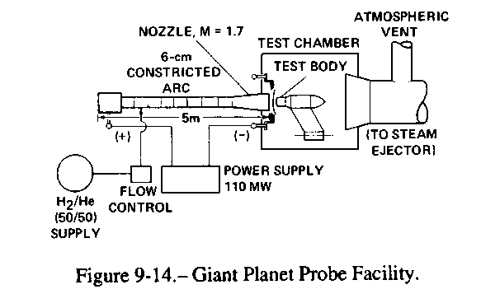
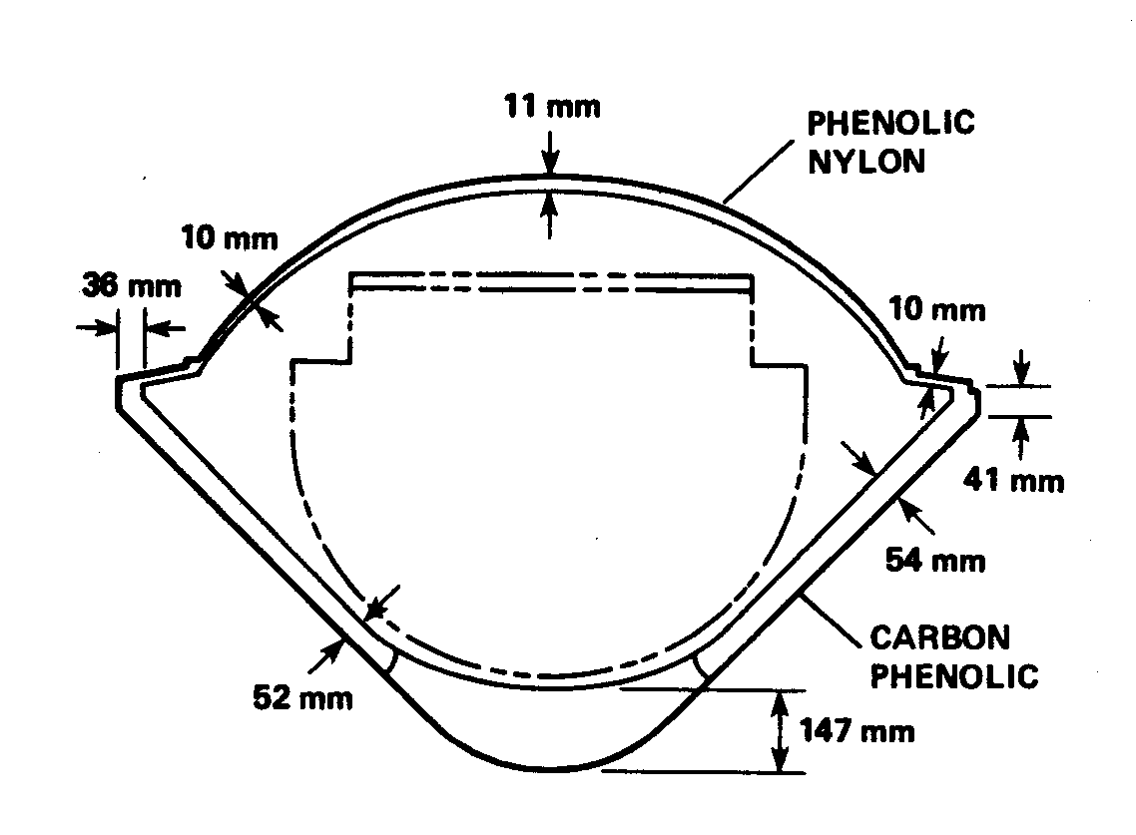
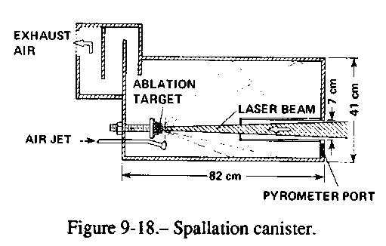
Galileo Entry at 47.4 km/sec:
Stagnation heat flux and pressure were estimated to be 30,000 W/cm² and 7.3 atm
On the Design Front
TPS Testing
Multiple NASA and GE teams made heating predictions, and a consensus was reached as to the heatshield design.
Heat shield mass was 45% of entry mass by design with 14.7 cm thickness at the stagnation point and 5.4 cm at the flank and shoulder regions.
Interaction Heating Facility (IHF) 60 MW (air)
Giant Planet Facility (GPF) 60 MW (H2/He)
Laser Test Facility (45 kW CO₂ laser at 10.6 mm)
From: Givens, J., L. Nolte, and L. Pochettino. "Galileo Atmospheric Entry Probe System-Design, development, and test." 21st Aerospace Sciences Meeting. 1983.
Notes:
(1) Phenolic nylon, a moderate density, low conductivity material, which forms a relatively weak char layer.
(2) Carbon phenolic, a higher density,. high conductivity material which forms a relatively stable char.
(3) Teflon, a moderate density, low conductivity material that forms no char layer but is reflective to shock layer radiation.
(4) A foamed silicone elastomer, GE ESM 1004, the lowest density material considered, with low conductivity, but a relatively high char layer vaporization rate.
Heat shield thickness requirements are relatively insensitive to the heat load
Mass loss and recession were minimal for CP

Slide 6
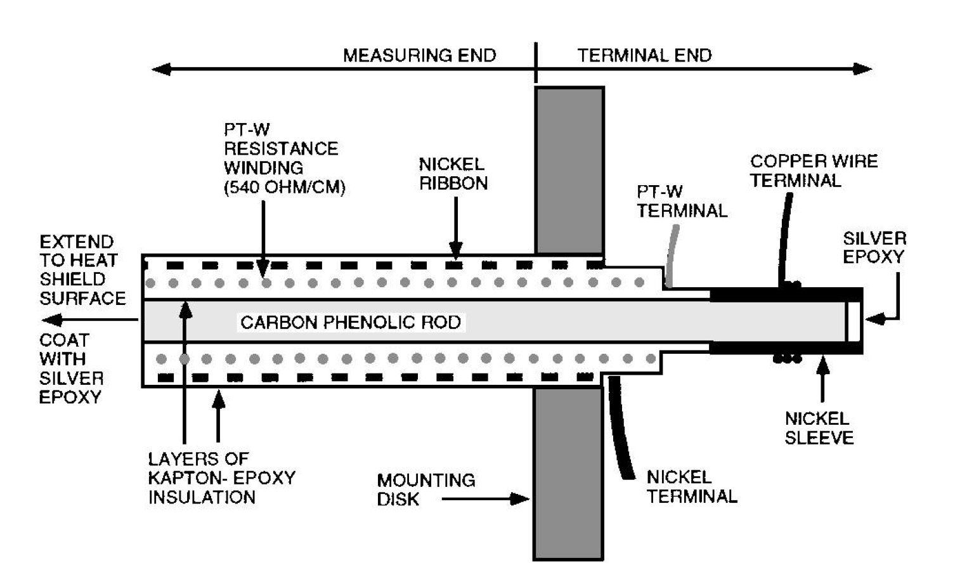
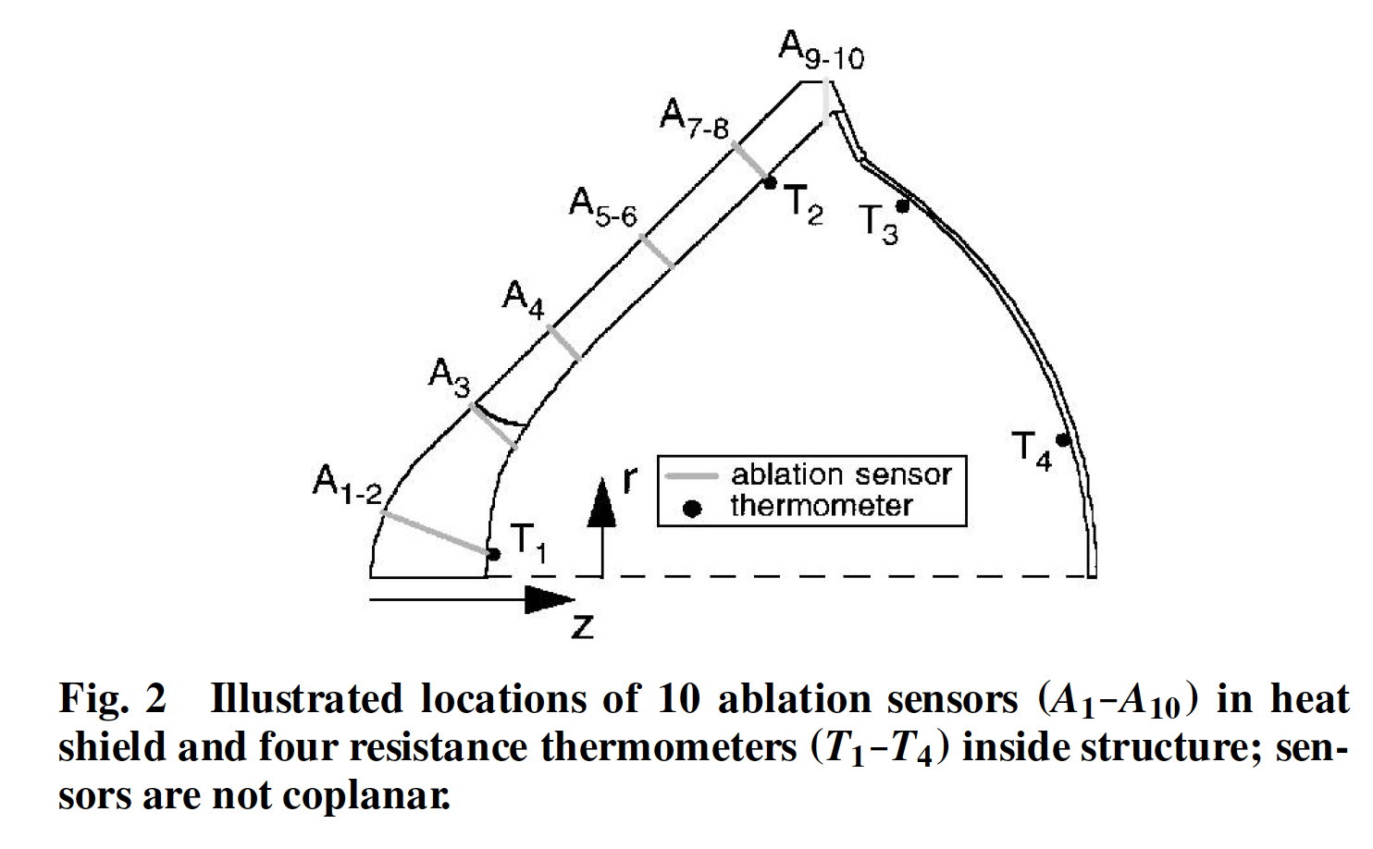
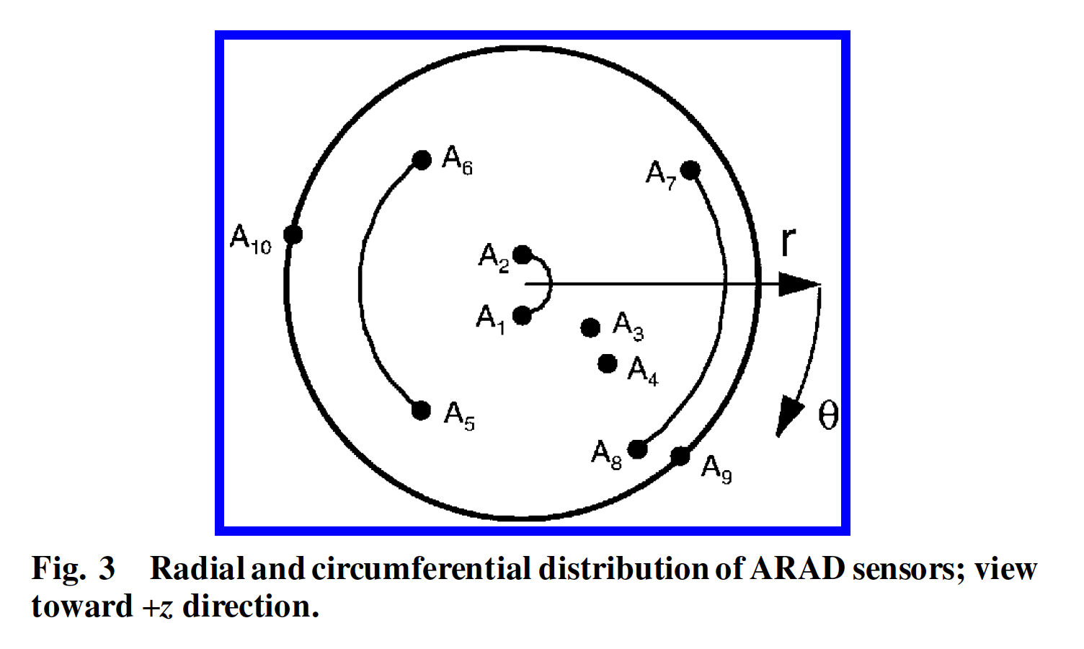
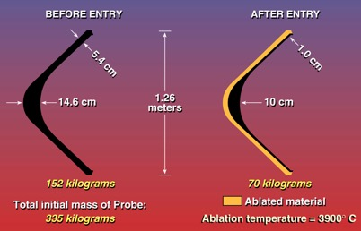
Galileo Probe - Recession Measurements
An ARAD sensor is a three-terminal electrical device that produces a voltage proportional to the length of the sensor.
Recession was rapid; in about 12 sec ~ 53% of the heatshield mass loss occurred (~25% of the entry mass ablated away). The overall recession was nearly uniform (~4.5 cm).
Post-flight analysis:
  Over estimated nose heating rates and surface recession.
  Underestimated cone frustum heating rates and surface recession.
  TPS design tools and analysis capabilities were inadequate even though mission was successful.
  Future missions to Jupiter, even for near equatorial entry, will require higher TPS mass fraction.
Missions to higher latitude or polar entry will be even more demanding.
Notes:
An ARAD sensor16 is a three-terminal electrical device that produces a voltage proportional to the length of the sensor.
As shown in Fig. 4, the sensor contains three coaxial electrically conductive components: an inner carbon-phenolic rod, a closely wound helical coil of platinum tungsten wire, and a outer winding of nickel ribbon. The carbon phenolic rod and nickel ribbon have relatively low resistance, whereas the platinum tungsten wire is wound to a nominal resistance of 540 /cm of ARAD length. Kapton® tape and epoxy are used to insulate the conductive elements. The ARAD sensor has a diameter of about 0.1 cm and can be wound to any desired length.
If the sensor tip is heated to sufficiently high temperature (above 800–900 K), the Kapton and epoxy layers pyrolyze to form a tenacious, conductive char that completes a circuit for electric current to pass through the ARAD. Because the ARAD is open circuited without a char layer at the tip, a coating of silver epoxy was placed on the outboard end of the ARADs to obtain prefIght measurements of the sensor resistances.

Slide 7
Post-Galileo Mission –Capabilities and Expertise Atrophy (1985 – 2010)
Capabilities and expertise in ablative TPS in general were deemed as not needed in the immediate future.
  The Giant Planet Facility and the laser test facilities were allowed to atrophy.
  The ability to manufacture heritage (P-V and Galileo) carbon-phenolic also atrophied.
  Until Pathfinder showed up in the mid 1990s, there was no planetary mission so to speak, and experts in ablative TPS moved on to other areas. The expertise and capabilities have to be revived.
In around (1998 – 2002), when NASA embarked on Mars Sample Return mission planning, NASA SMEs discovered that the capability of making carbon-phenolic heatshields had been lost.
The science community was interested in the Jupiter Polar Orbiter and Probe (JPOP) mission (~2002) but could not propose such a mission.
  TPS became the single impediment for proposing JPOP. Scott Bolton proceeded to propose Juno without probes.

Slide 8
Current Status
Recent Advances in Modeling, Simulation, and Analysis Capabilities
Recent Advances in Test Capabilities
Recent Advances in TPS Materials

Slide 9
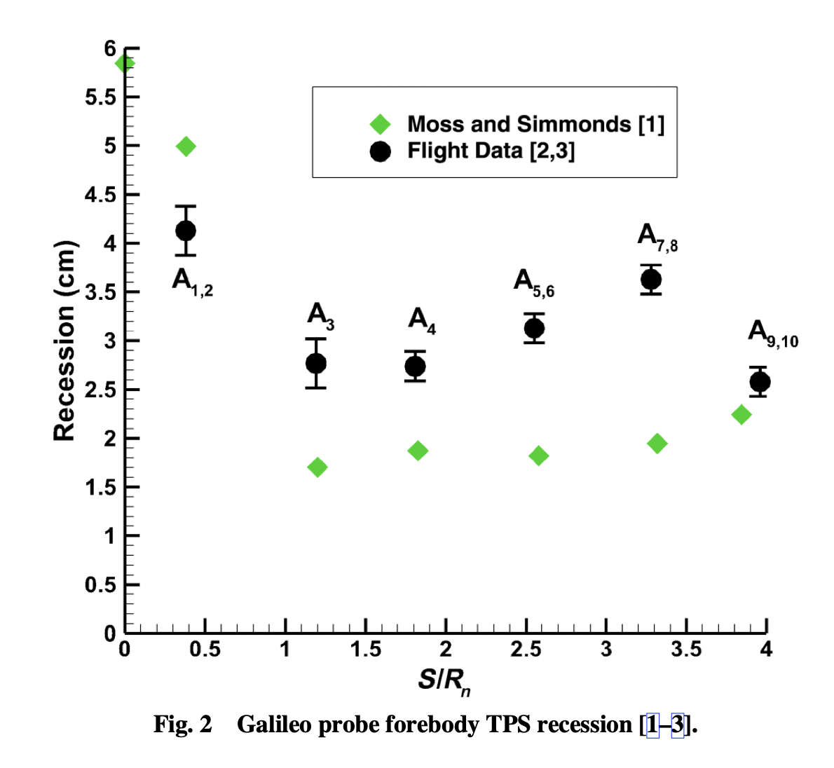
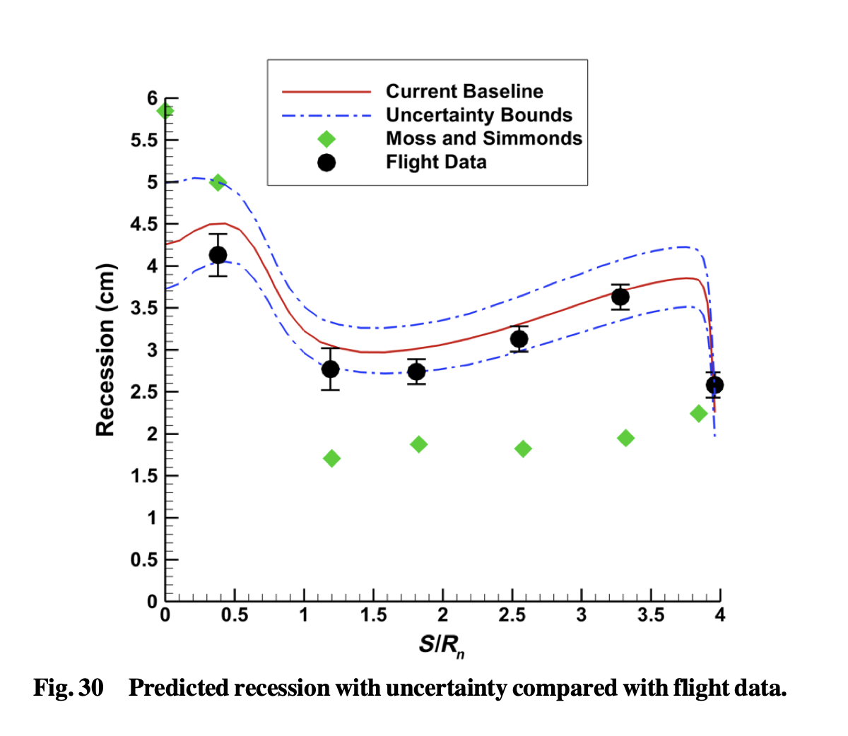
Advances in modeling, simulation, and analysis capabilities (2020)
The comprehensive work of Aaron Erb, Tom West, and Chris Johnston is a great achievement. The work is built on 40+ years of knowledge and advances. The detailed modelling to capture the flow-physics interactions and sensitivities outlined are key to future mission design.
1982
2020
Moss, J. N., and Simmonds, A. L., “Galileo Probe Forebody Flowfield Predictions,” AIAA paper 82-0874, 1982. (Fig. from Aaron, 2020)
Figure from Aaron J. Erb, Thomas K. West, and Christopher O. Johnston, “Investigation of Galileo Probe Entry Heating with Coupled Radiation and Ablation,” Journal of Spacecraft and Rockets, Vol. 57, No. 4, July–August 2020

Slide 10
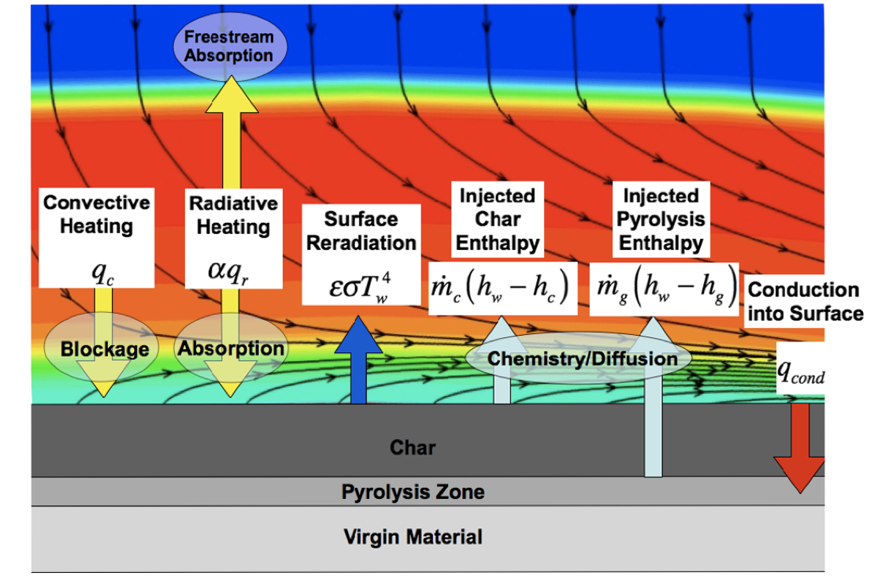
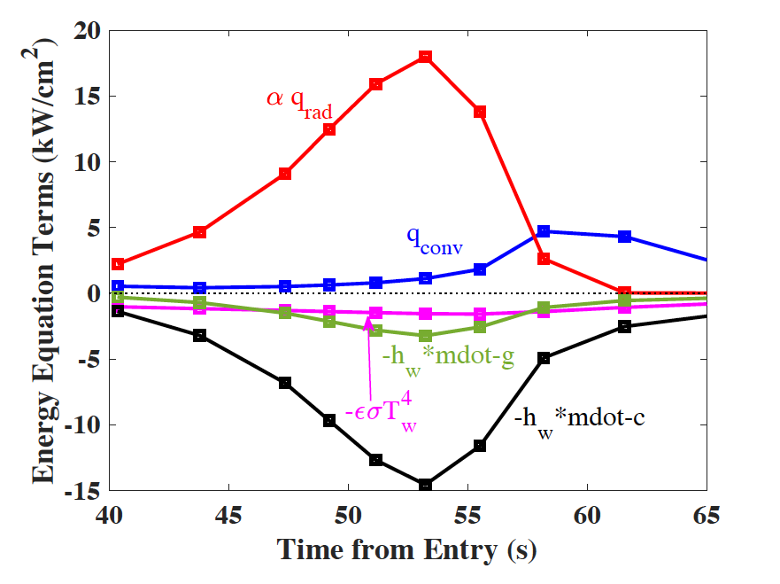
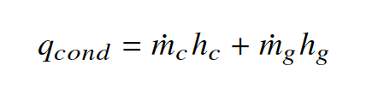
Advances in modeling, simulation, and analysis capabilities (2020)
Parametric Uncertainty Analysis:
Uncertainties in physical quantities, such as kinetic rates, lines strengths of atomic species, oscillator strengths of molecular species, and heats of formation
Modeling and Flow-Physics:
  Coupled Ablation
  Heatshield Shape Change
  Radiative heating
  Multicomponent Diffusion
  Ionization Potential Lowering
  Coupled Flowfield and Radiation
  Impact of Freestream Radiative Absorption
Important Assumption:
Steady-state ablation

Slide 11
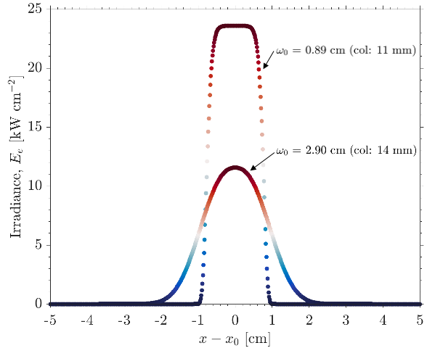
A New Capability - Laser Enhanced Arc Jet Testing
The Interaction Heating Facility (IHF) has a 60-MW constricted arc-heater which operates at pressures from 0.1 to 1 MPa and enthalpy levels from 5 to 28 MJ/kg (2000 to 12,000 Btu/lb).
Can deliver heat fluxes as high as 7.5 kW/cm² to stagnation models (7.6-cm nozzle)
Can operate in stagnation, free jet wedge, or flat panel test configurations in simulated hypersonic boundary layer flow environments
Laser Enhanced Arc jet Facility (LEAF) is located at IHF
50 kW set power

Slide 12
New & Heritage TPS Materials
TPS potentially capable of supporting a future multi-probe Jupiter mission are:
Heritage Carbon-Phenolic capability for a small probe could be revived
  NASA secured heritage rayon from stockpile and converted it into carbon-fibers (2000 – 2007)
  NASA also recovered all of the manufacturing processes for making Chop Molded and Tape Wrapped carbon-phenolic systems and demonstrated the capability (2005 – 2007)
3-D woven TPS - NASA funded the development of HEEET (2014 – 2019)
  The 2-layer, 3-D woven HEEET TPS was matured to TRL 6 to enable missions to Venus, faster sample return and Outer Planets missions except Jupiter probe mission.
  A variant, a single layer system 3-D woven, is now baselined for MSR Earth Entry System.
3-D Carbon-Carbon
  3-D Woven TPS preform molded and converted into fully dense carbon-carbon.
  With higher density, 3-D CC is 50% more energy absorbing than carbon-phenolic.
Other - 2.5-D C-C variants

Slide 13
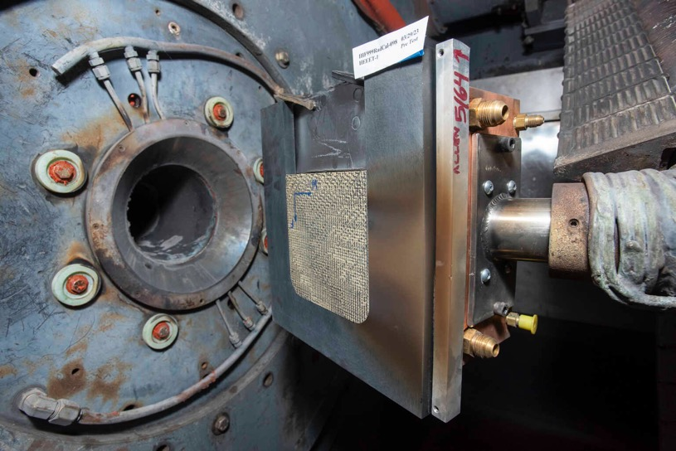
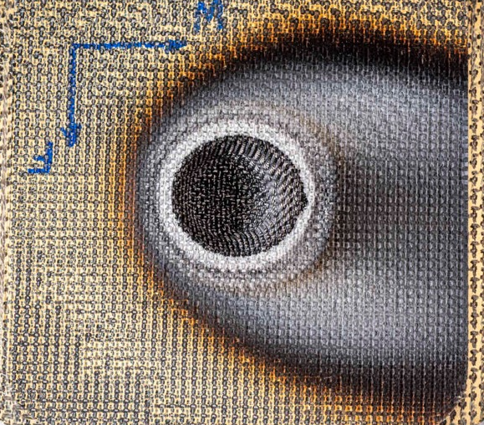
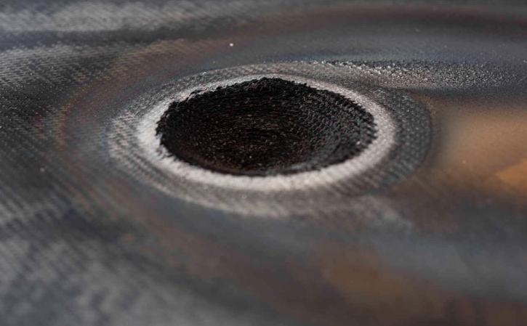
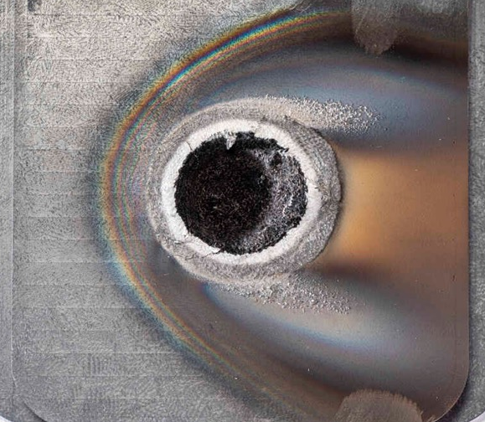
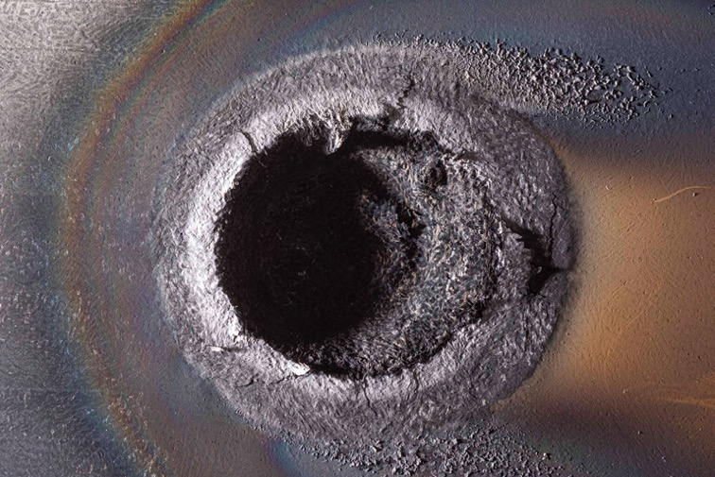
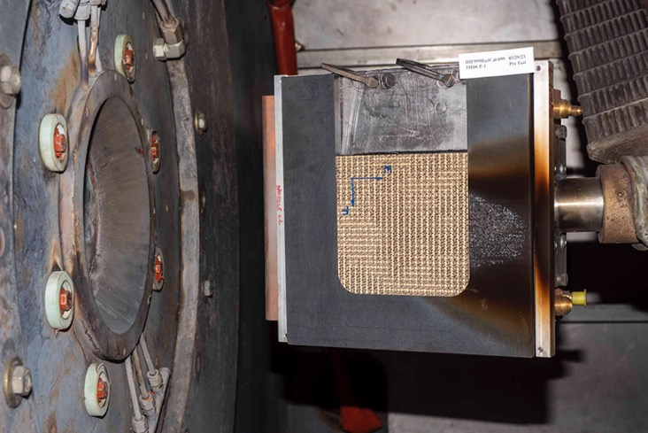
Recent Exploratory Testing using LEAF (Laser) Testing is Encouraging
Exploratory LEAF testing at 11.6 kW/cm² peak irradiance using a single 50 kW laser.
  Heritage carbon-phenolic, both chop-molded and tape-wrapped, HEEET dual layer and single layer were tested.
Future plans are to test 3-D carbon-carbon.
Combined environment testing has been demonstrated.
With all four lasers, we can achieve heating conditions higher than Galileo entry on a reasonable size wedge test article along with traditional arc jet flow (convective heating)
HEEET (top)
LEAF Wedge Model Setup
Carbon Phenolic (bottom)

Slide 14
Concluding Remarks and Recommendations
Ensuring current and next generation of scientists, mission designers, and engineers are made aware of the possibility is the goal of this talk. We intend to do an assessment and keep the community informed.
Two decades ago, lack of TPS capability resulted in Juno being an orbiter only mission.
Today, analysis, testing, and materials capabilities are showing great promise for a future higher latitude, multiple probes Jupiter mission.
We recognize a future Jupiter in-situ mission will take time and perseverance.
Recommendations:
The science community needs to continue to make the case for Jupiter in-situ investigations.
The mission design community needs to perform studies to guide the science and technology.
The EDL community needs to continue the advancement of TPS and EDL systems.
  The TPS for Jupiter entry is also needed for higher speed Earth and sample return missions – a broader need.

