Slide 1
JWST Lessons Learned Presentation
HWO Face to Face Meeting, November 1st, 2023
JWST Lessons Learned team: Lee Feinberg, Mike Menzel, Paul Geithner, Keith Parrish, Julie Van Campen, Mike McElwain, Matt Bolcar, Breann Sitarski, NASA GSFC

Slide 2
Lessons Learned Background
In August of 2022, the Associate Administrator for the Science Mission Directorate convened this team from JWST to study lessons learned and how they can be applied to future missions as “design principles” with special focus on the Habitable Worlds Observatory (HWO)
  Evaluating key technical and programmatic drivers that drove schedule and risk
  Developed recommended design guidelines for next generation mission
  Documenting lessons learned (papers, final report)
  Developing yardstick concept consistent with recommended guidelines to assess feasibility and tall poles
  Effort funded through fiscal year ‘23
Primary effort completed in September 2023
  Final reports are being submitted for review, include public and government only (programmatics) sections
  Will make written public report available to team
Two very comprehensive JATIS Papers Submitted in Upcoming Issues
  Lessons Learned from the James Webb Space Telescope, Menzel et al
  JWST Optical Stability Lessons Learned, Feinberg
Developed separate programmatic lessons not included in this discussion but part of government only section

Slide 3
Overall Process Summary
Assess JWST Lessons Learned
Generate Next Gen
Design Principles
Feedback from Stakeholders
Generate Lesson Learned Statements Traced to Guiding Principles
Detailed Lessons Learned in Journal Articles
Yardstick Evaluation/
Discussion With Big Rocket and Servicing Entities
Final Report

Slide 4
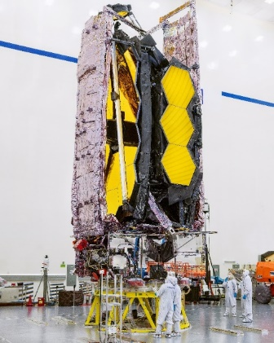
Summary of Guiding Principles
    Utilize revolutionary big rockets to reduce system complexity:
    Telescope Evolution not Revolution: Segmented, scalable, verifiable telescopes building upon JWST (but with a baffle)
    Planned Servicing: Mountaintop-like observatory at L2 can reduce initial instrument development time, reduce risks, and optimize science/dollar
    Large margin from the start: science and technical margin built into the architecture reduce risk and design and analysis iterations.
    “Build to schedule philosophy”: Fix development schedule and make it a requirement
    Mature architecture holistically fully before starting development phase with proper budget phasing
    System and verification complexity are major elements of risk. A warm telescope with active technologies will reduce these risks.
    Managing human factors throughout the mission lifecycle is critical to mission success
Additional Programmatic Lessons Learned are Standalone

Slide 5
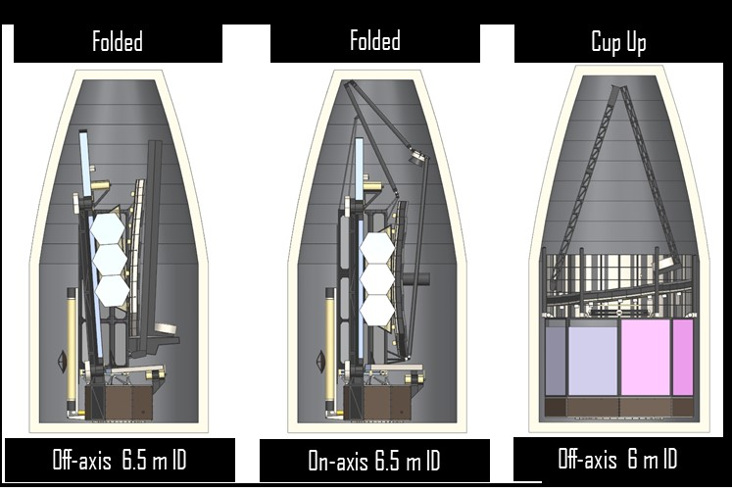
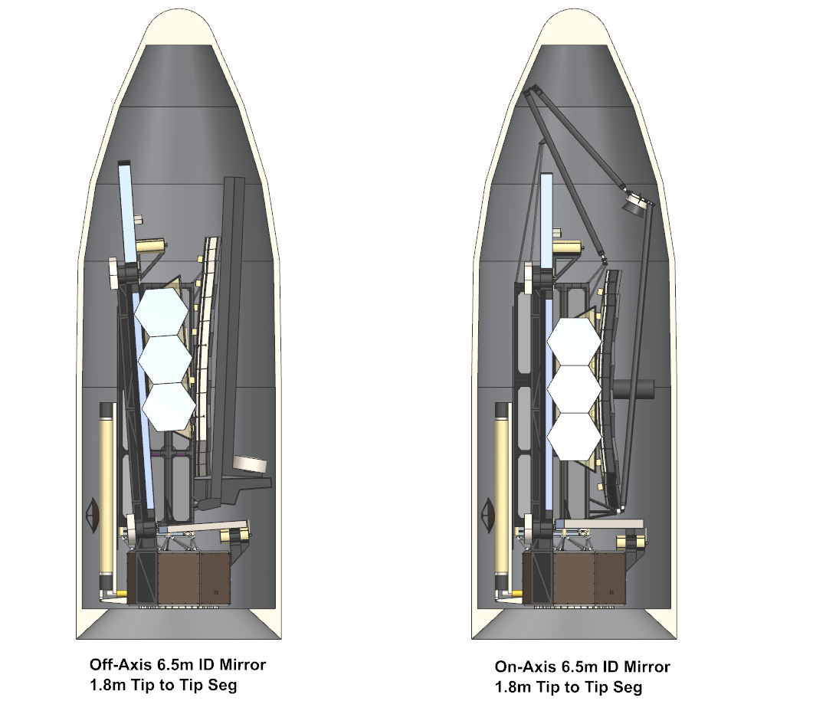
Design Principle 1: Utilize revolutionary big rockets to reduce system complexity
LL 1.1: Large rockets provide large mass and volume capabilities (see DP4) that enable simplicity, modularity, solutions to technical problems, allowing less-coupled interfaces
Avoids time consuming iterative detailed analyses after each couple loads assessments
Can potentially simplify or eliminate complex deployments or difficult to manufacture subsystems
Example: Sufficient mass can enable one to design to “no-test” factors of safety where it is possible to avoid complex strength tests (enabled by mass as a commodity)
LL 1.2: Launch vehicle capabilities and performance and accommodations need to be factored in very early (pre-phase A)
Launch vehicle choice needs to include many factors including coupled loads, venting, thermal, contamination, volume, mass, etc.
LL 1.3: Lower cost launch services can enable servicing (see DP3)
Early Big Rocket Evaluation
Space X Starship Standard
Blue Origin New Glenn
Off-axis 6.5 m ID
On-axis 6.5 m ID
6.5 m ID off- and on-axis telescopes fit in the Starship Standard (mass/volume margin) and New Glenn
6 m off-axis monolith only fits in the Starship Standard (secondary and upper baffle deploy, volume tight)
SLS TBD – Depends on Large Fairing, Mass Capable

Slide 6
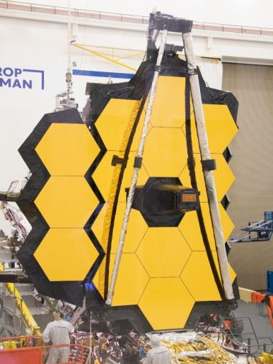
Design Principle 2: Telescope Evolution not Revolution: Segmented, scalable, verifiable telescopes building upon JWST (but with a baffle)
LL 2.1: Selectively take on unknowns to balance risk vs benefits
LL 2.2: An evolutionary architecture provides a basis-of-estimate and reduces cost and schedule risk and builds upon a solution that has undergone the full lifecycle of risk
LL 2.3: Scalability and modularity of the design enables flexibility as science trades commence (e.g., aperture size, instrument complexity)
A modular repeated design allows for economies of scale (one NRE), less susceptibility to single point failures
LL 2.4: Semi-rigid segmented optics are well understood (including fabrication and gravity effects), scalable, deployable, evolvable, verifiable, and therefore a low risk
LL 2.5: Air and road transportation must be considered early in designing the large telescope elements.
LL 2.6: Deployables are not all created equal; deterministic deployments are lower risk. The key risk involves non-deterministic deployables, complex shapes, and large soft structures.
JWST
JWST Open
Architecture

Slide 7
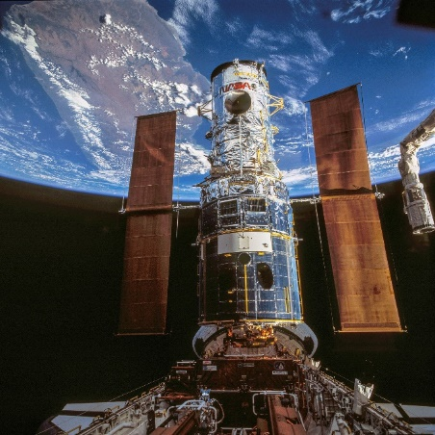
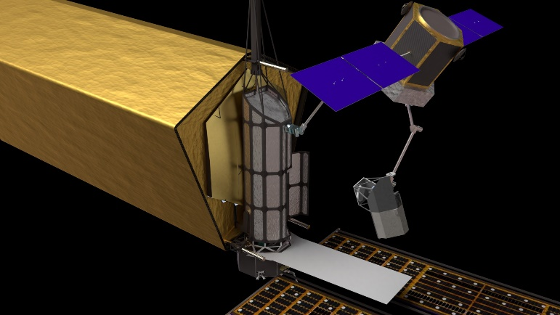
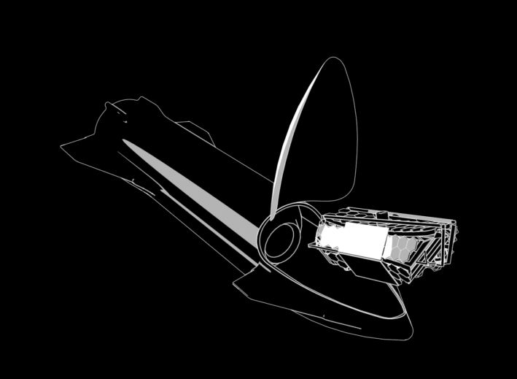
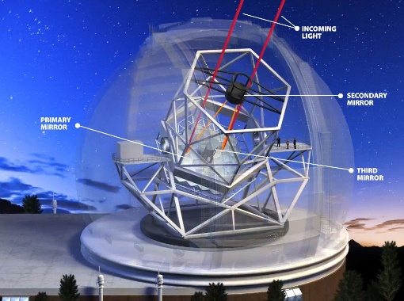
Design Principle 3: Planned Servicing: Mountaintop-like observatory at L2 can reduce initial instrument development time, reduce risks, and optimize science/dollar
Hubble Servicing
Robotic Servicing at L2
LL 3.1: Instrument complexity can drive critical path. Servicing enables simpler instruments that reduce time to launch and lower TRL maturation risk.
If there aren’t second generation instruments, more emphasis is placed on getting full instrument capabilities initially making them more complex.
Observatory performance can be taken into account in 2nd generation instrument design
LL 3.2: Modularity enables clean interfaces that provide I&T flexibility and reduces schedule risk
Note: This was not done on JWST for mass and volume reasons
LL 3.3: Servicing increases mission life and tolerance to failure.
A non-serviceable flagship requires higher reliability and confidence.
Mountaintop Observatory
Hubble/Shuttle Model

Slide 8
Design Principle 4: Large margin from the start: science and technical margin built into architecture reduce risk and design and analysis iterations
LL 4.1: Ample mass and volume margin reduces cost and schedule risk and is critical.
Allows one to design to no-test factors / higher factors of safety. Allows tailoring of margins via systems engineering early.
Enables one to solve hard engineering issues like stability
LL 4.2: Need to consider pathological cases for high technical impacts especially with respect to the environment (e.g., micrometeoroids)
LL 4.3: Include engineering liens and threats as part of your Technical Performance Metric (TPM) monitoring.
LL 4.4: Plan for a margin requirements document, owned by Mission Systems Engineering.
LL 4.5: Science margin provides robustness as technology matures assuring minimum science is still achievable

Slide 9
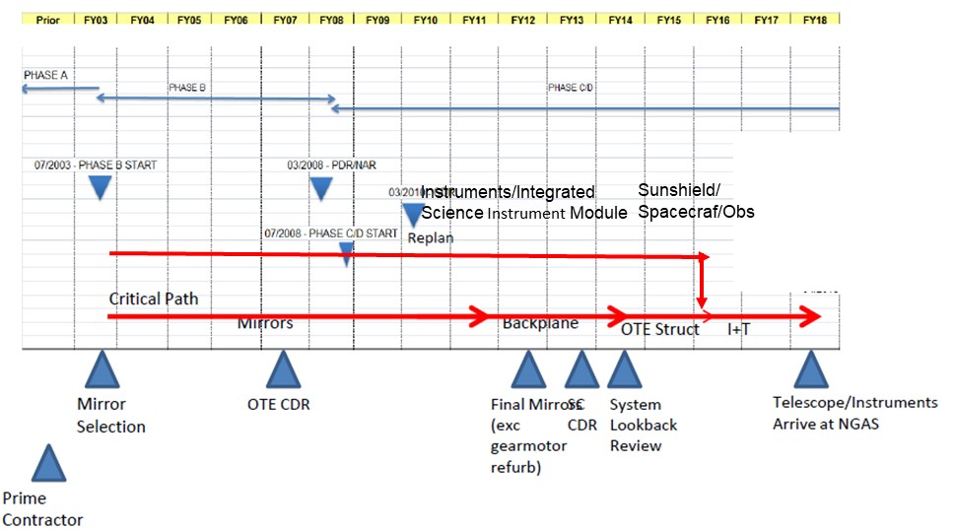
Design Principle 5: “Build to schedule philosophy”: Fix development schedule and make it a requirement
LL 5.1: Non-servicable observatory with non-descopable requirements limits flexibility to address schedule risk
Treat flagships like planetary missions; schedule is a Level 1 requirement
Funding profile needs to be finalized by the time you commit to a launch schedule (e.g. NAR).
Take advantage of servicing to change the culture of doing everything by the telescope launch
Don’t forget you only get one shot at the telescope.
LL 5.2: Evolution approach enables early rigorous systematic critical path analysis to assess schedule risks based on informed roadmaps (e.g., with Monte Carlos, Joint Confidence Levels (JCL))
JWST critical path was instruments and mirrors/backplane

Slide 10
Design Principle 6: Mature architecture and technology fully before starting development phase with proper budget phasing
LL 6.1: Need to do holistic maturation, including Concept Maturity Level (CML) and Manufacturing Readiness Level (MRL), and verification approaches and not just Technology Readiness Level (TRL).
Cryogenic margins, radiator developments are examples
Note: TRL maturation was actually a success story on JWST
LL 6.2: Need for equitable maturity by leveling the risk playing field (don’t put all your risk in one basket).
LL 6.3: Even traditional observatory components require attention. Mundane aspects (harnesses, test sensors, etc.) may need careful and early attention up front.
LL 6.4: Critical deployments need to be assessed in detail early.
LL 6.5: Competition can be very valuable for maturing technology (e.g., AMSD), especially in high risk technology areas
LL 6.6: Large composites can be a critical path driver and need design and Manufacturing Readiness Level (MRL) maturity early

Slide 11
Design Principle 7: System and verification complexity are major elements of risk. A warm telescope with active technologies will reduce these risks.
LL 7.1: Cryogenic operating temperatures (with JWST levels of optical performance) were a major factor with both system and verification complexity.
LL 7.2: Verification by analysis does not obviate the need to test for design validation and integration workmanship verification.
LL 7.3: Requirements flow down on a complex system needs to be done thoughtfully and carefully, considering verification capabilities.
Large soft structure deployments are particularly vulnerable to verification difficulties and failures that are difficult to resolve
Aspects of large structure verification can only be done by analysis, and that has inherent risks that drive costs
LL 7.6: Stray light is an underrated part of system complexity and needs early and consistent attention and associated resources.
LL 7.7: Passive stability presents special challenges for design and verification
LL 7.8: Consider verification approaches during the early architecture and technology definition phase so that interfaces, degrees of freedom, facilities, and other system issues are not broken later in development.
LL 7.9: Consider existing facility size/capacity limitations and design to these to avoid having to build large new facilities, and include experienced people in these trades to execute proper due diligence (JWST: large vibration facility at GSFC, cryo/vac optics facility at JSC)

Slide 12
Design Principle 8: Managing human factors throughout the mission lifecycle is critical to mission success
LL 8.1: Be aware of the range of experience on the team (and motivations) and lack of experience in assigned tasks
Right people, with the right skills, at the right time
Need thoughtful transitions from JWST, RST across industry and government
LL 8.2: Be careful about blindly implementing new systems engineering and management practices on flagships (e.g., total system authority, faster better cheaper).
LL 8.3: Beware of external pressures with cost and schedule (e.g., afraid of cancellation)
Counter irrational exuberance with thorough risk management especially early
LL 8.4: Sufficient engineering and tabletop peer reviews should be included in the contract (e.g., engineering peer reviews, deliverables)
LL 8.5: Acknowledge expertise across different institutions even when it conflicts w​ith the GSFC institutional knowledge
LL 8.6: Specialized review teams for high risk areas were very effective (e.g., optical PIT, evaluating advice across institutions) and should be encouraged

Slide 13
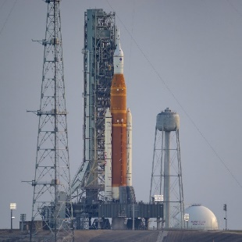
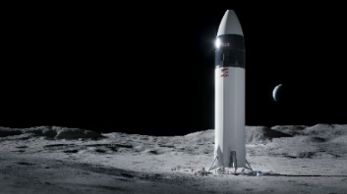
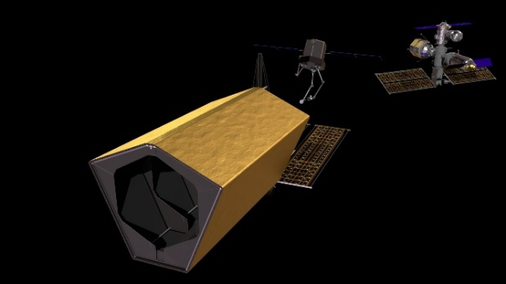
Summary of Guiding Principles
    Utilize revolutionary big rockets to reduce system complexity:
    Telescope Evolution not Revolution: Segmented, scalable, verifiable telescopes building upon JWST (but with a baffle)
    Planned Servicing: Mountaintop-like observatory at L2 can reduce initial instrument development time, reduce risks, and optimize science/dollar
    Large margin from the start: science and technical margin built into the architecture reduce risk and design and analysis iterations.
    “Build to schedule philosophy”: Fix development schedule and make it a requirement
    Mature architecture holistically fully before starting development phase with proper budget phasing
    System and verification complexity are major elements of risk. A warm telescope with active technologies will reduce these risks.
    Managing human factors throughout the mission lifecycle is critical to mission success

Slide 14
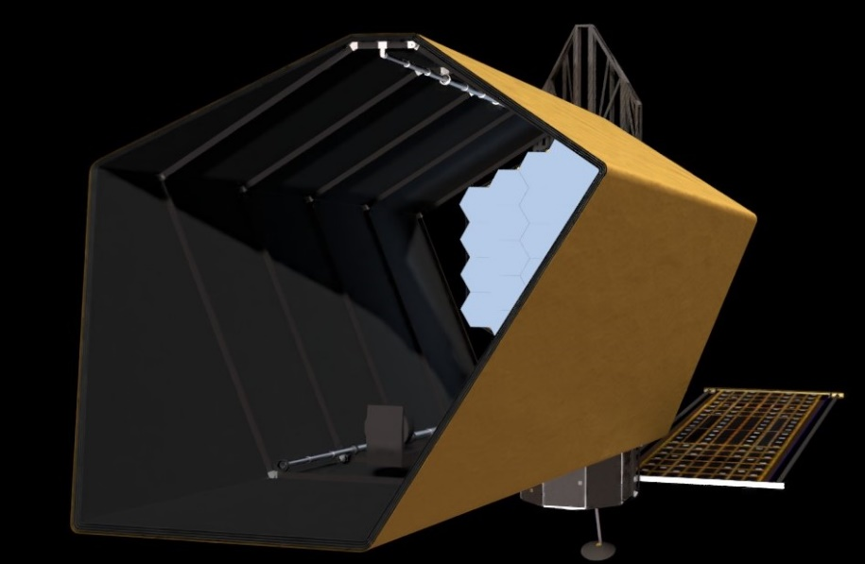
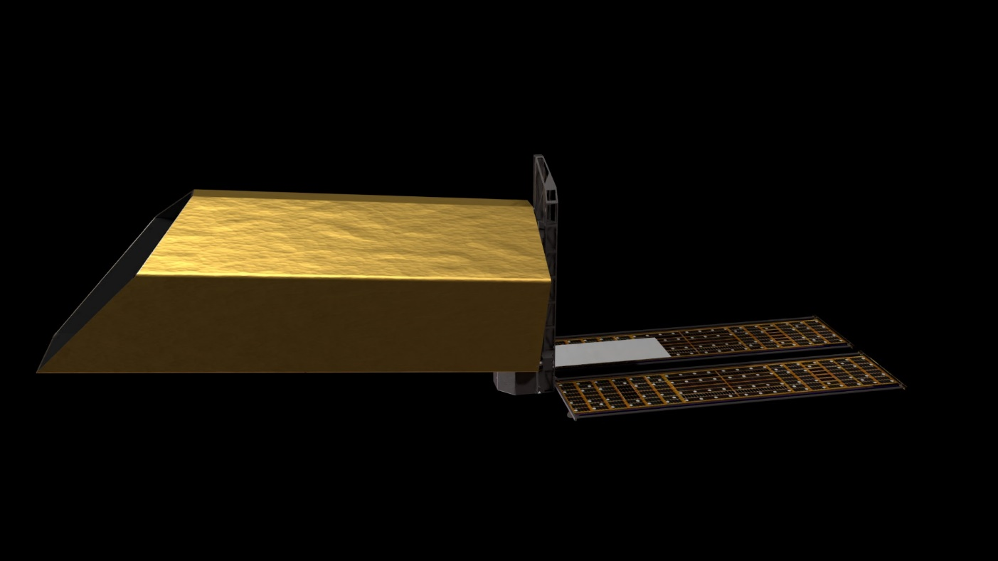
Summary
JWST was the first of a kind large segmented telescope in space
Habitable Worlds Observatory is opportunity to implement lessons learned
Team is continuing to document work, mature ideas, and infuse hard-won knowledge into next steps
Next step will be to transition beyond developing lessons learned into implementation

