Slide 1
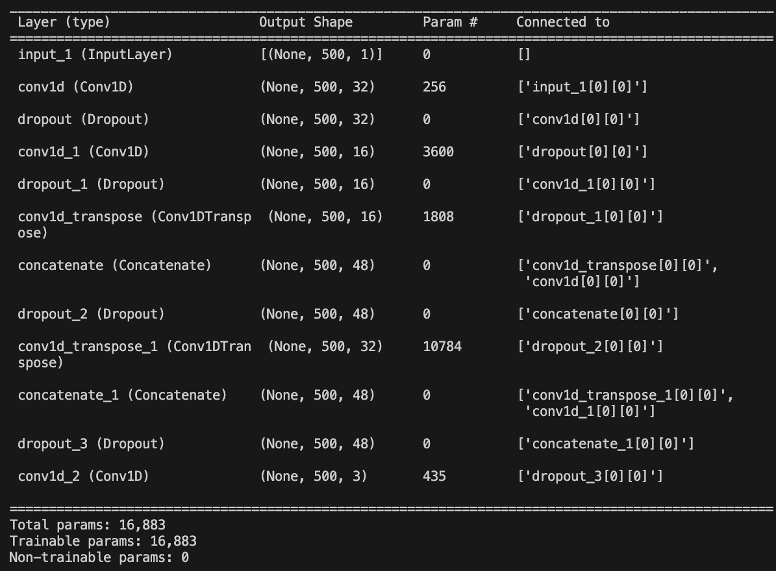
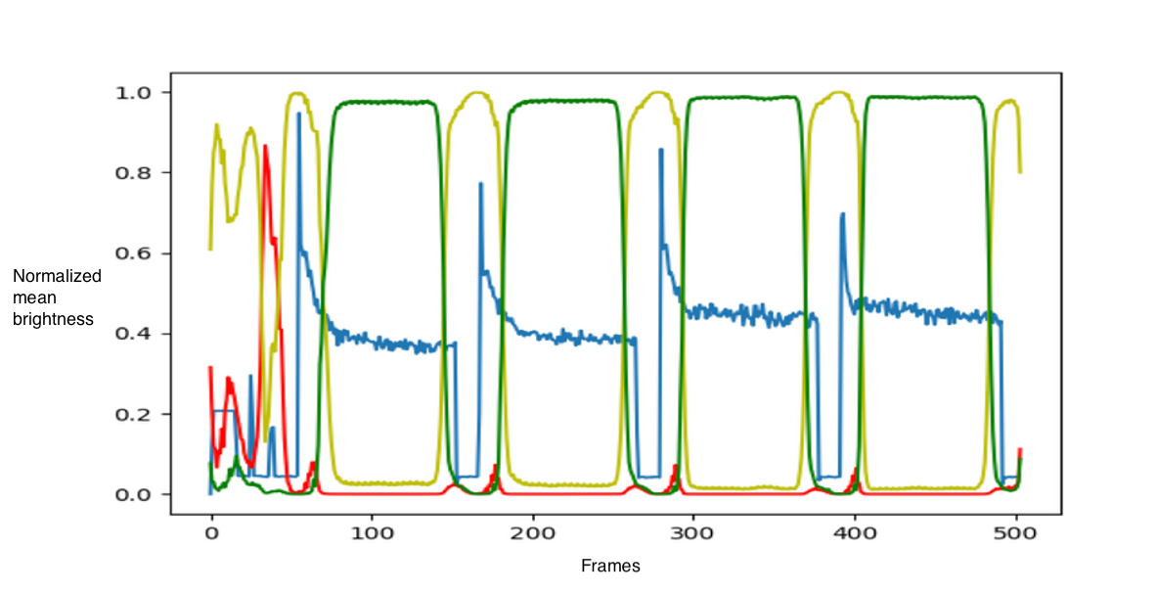
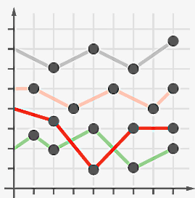
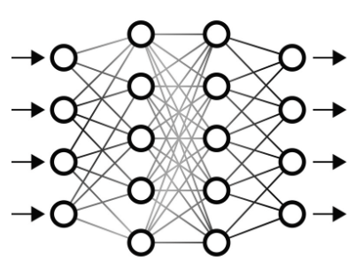
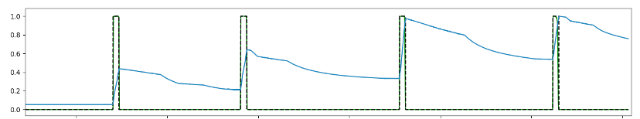
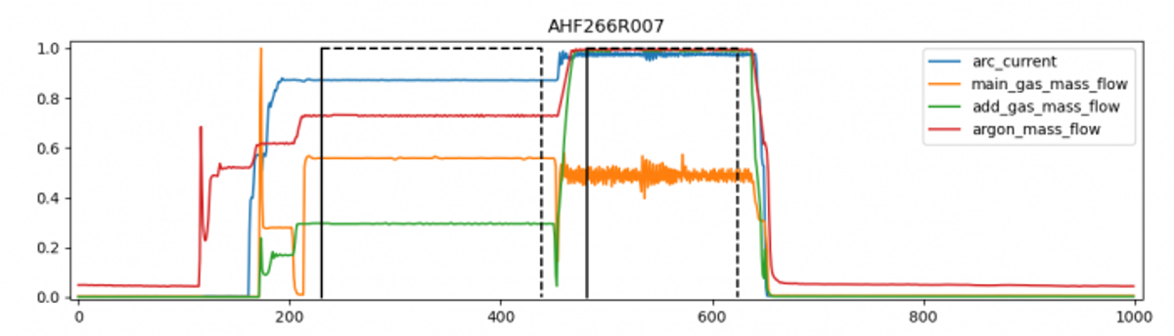
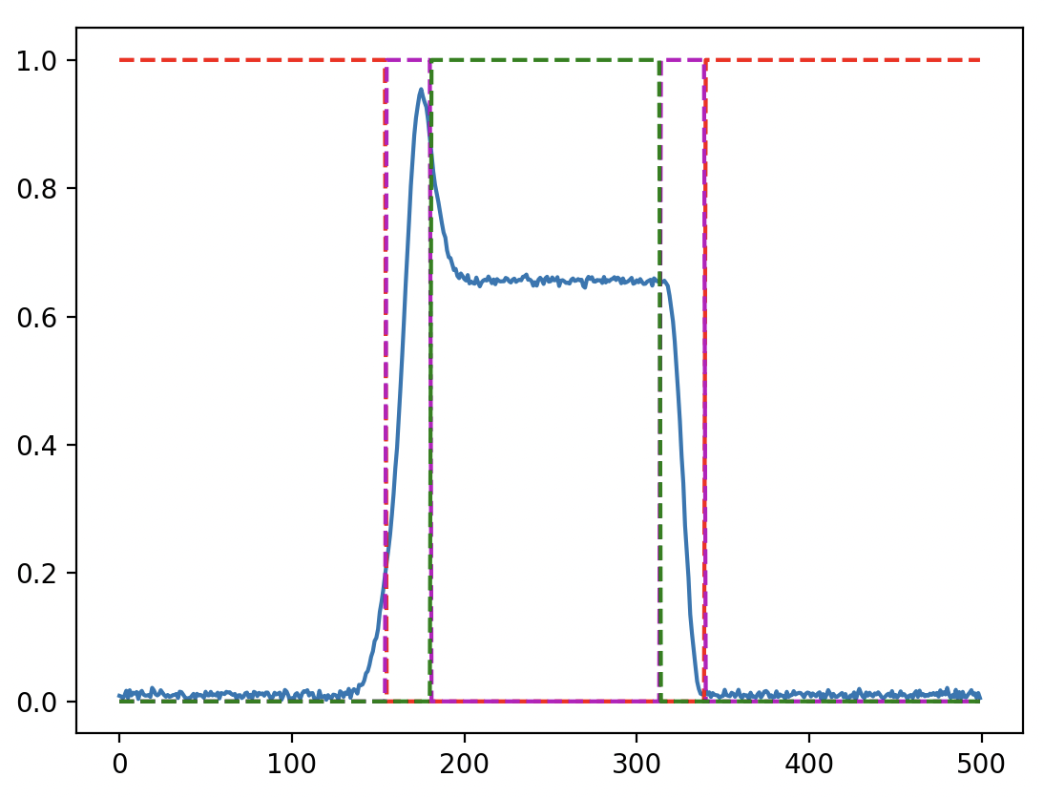

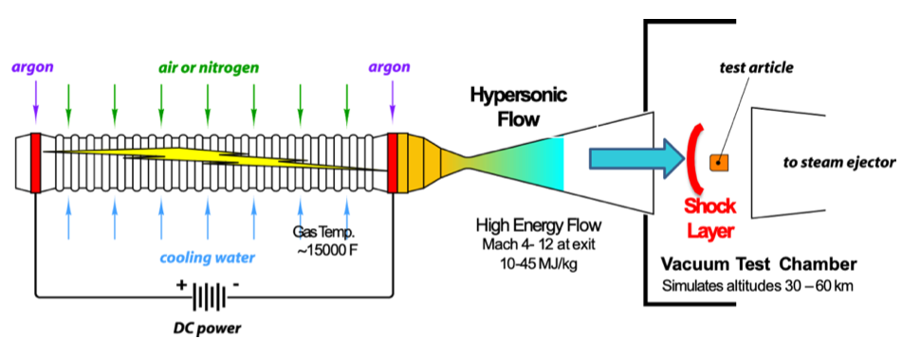
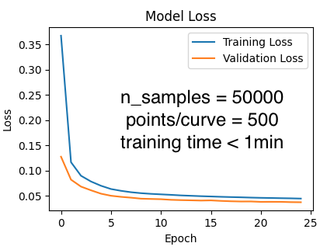
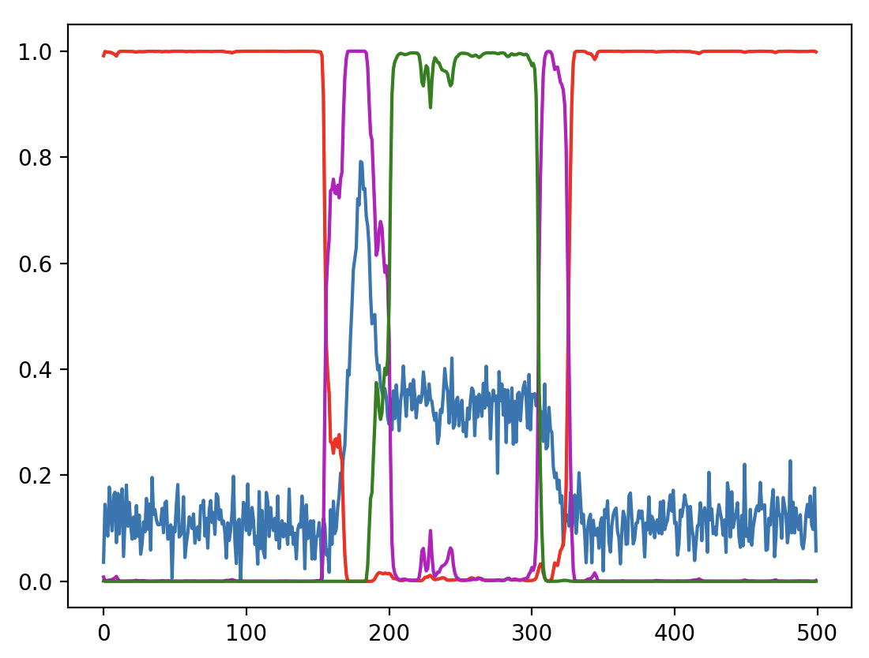
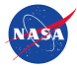
1D-Convolutional Neural Network Architecture for Generalized Time-series Segmentation
Magnus A. Haw¹, Alexandre M. Quintart², Koushik Chennakesavan³
¹NASA Ames Research Center ²Flying Squirrel ³Analytical Mechanics Associates Inc.
Abstract
Architecture
Applications
Time segmentation of experimental data is a common and typically tedious task. Simple thresholding algorithms are often insufficiently robust due to noise, while manual inputs are labor intensive and inconsistent. This paper proposes a simple 1D convolutional neural net (CNN) architecture as a generalized solution for segmentation of time series data.
A 1D CNN architecture was created by converting the popular 2D UNet CNN (developed for multiscale feature recognition in medical imagery) down to 1D and minimizing the number of layers.
The resulting architecture performed well for a variety of segmentation tasks with minimal reconfiguration.
The layer architecture is shown to the left and consists of two downsampling convolutional layers, two upsampling convolutional layers, skip connections and a final output layer which classifies the data into 3 classes: OFF, TRANSITION, ON.
The resulting network is small with < 10³ parameters.
Video Clip-of-Interest Segmentation
Video data for arcjet facilities needs to be cropped for each sting arm insertion. The 1D CNN is used to segment the integrated frame pixel values over time [2].
Bad
Good
Ugly
Calorimeter Insertion Data
Calorimeter data occasionally has multiple insertions during a run and these start/stop times need to be identified
1D Data
1D CNN
Labeled Data
Mining Legacy Data
This architecture was chosen since it implements a fully convolutional semantic segmentation. This gives the network the capability to run on arbitrary length time series and classify arbitrarily many events within that series. The class predictions are also probabilistic enabling additional post-processing logic to be added by the user. Since the number of layers is small, the computational cost is similarly small, making it suitable for use on non-GPU machines.
Legacy arcjet data was mined by segmenting steady state conditions to create a database [3] of historical experiments. Stats are used to identify anomalous behavior.
Background
Despite the best initial designs, all experiments and facilities will eventually collect data which is not sufficiently well labeled. The data is often noisy and simple thresholding algorithms are not sufficiently robust. Consequently, a more automated capability is valuable to reduce the need for manual segmentation.
The following work was developed to automate segmentation of several types of time series data produced by the NASA Ames arcjet facilities [1]. These facilities are used to simulate atmospheric entry conditions experienced by spacecraft descending from orbit and test heatshield materials/systems (high heat flux, low plasma temperature: 100-10000 W/cm², < 2 eV).
Training
The network was trained using simulated data with a range of noise, shapes and slopes matching the distribution of expected signals.
The plot to the right shows a typical artificially generated and labeled curve used in a training set. The classes are labeled with dotted lines-red:OFF, purple:TRANSITION, and green:ON.
Since the training data is simulated, many curves can be randomly generated and the training time is minimal (e.g., for 50,000 curves of length 500, generating the data and training on a personal laptop took < 1 min).
Consequently, if reasonable simulated data curves can be generated, the model can be instantly retrained to segment a new feature.
This makes the model simpler to update (e.g., adding edge cases) than a heuristic algorithm.
The short training time also makes metaparameter optimization possible for the average user without the need for a GPU supercomputer.
Future Work
Metaparameter optimization
Reconfigurable number of classes
Reconfigurable number of layers
Reconfigurable number of inputs (parallel time series)
Scan me!
Figure 2: Example of artificial training data
Conclusions
Pros
Fast to train
Accurate and robust classification
Small memory/processor footprint
Extensible
Cons
Black box
Complexity
Figure 1: Diagram of segmented arcjet facility
1D CNNs provide a powerful generalizable option for automated time series segmentation. They are simple to train and upgrade using artificial data and outperform heuristic algorithms. The model outlined here has enabled automation of several additional data pipelines (video segmentation, calorimeter series segmentation, and legacy data mining).
The facilities collect a variety of data from in-situ sensors on insertion arms (calorimeters, pressure probes, thermocouples), optical diagnostics (video, spectrometers), and various operational diagnostics.
Certain measurements still require manual segmentation (video segmentation, calorimeter start/stop times, legacy data, facility steady-state start/stop times) Consequently, there was a need for more automated segmentation with the following constraints:
Simulation mesh (20x20x25)
After training, the model predictions are robust even with significant noise
References:
[1] Calomino, A., Bruce, et al., “Evaluation of the NASA Arc Jet Capabilities to Support Mission Requirements,” NASA Technical Reports Server, , No.
20110007355, 2010. URL https://ntrs.nasa.gov/citations/20110007355.
[2] Alexandre Quintart and Magnus A. Haw. "ArcjetCV: a new machine learning application for extracting time-resolved recession measurements from arc jet test videos," AIAA SCITECH 2023 Forum. January 2023.
[3] Magnus A. Haw, Megan E. MacDonald and Sebastian V. Colom. "Big-data Efficient and Automated Science Transfer (BEAST): an open-source software architecture for arc jet data management, modeling, and automation," AIAA SCITECH 2023 Forum. January 2023.
Requirements:
Classify arbitrary length sequences
Identify start/stop and steady-state start/stop times
Continuous classification handling multiple events
Low computational cost suitable for non-GPU PC
F1 scores:
OFF:0.99, TRANSITION:0.93, ON:0.97
Acknowledgements:
This work was supported by TSM IRAD funds, the NASA Ames Thermophysics Facility Branch, Mars Sample Return EES.

