Slide 1
Radiation Data Collection and Risk Assessment
Jesse Leitner
SMA Chief Engineer
NASA GSFC Code 300

Slide 2
Definitions (as used in this document)
COTS parts: Parts for which the part manufacturer solely establishes and controls the specifications for performance, configuration and reliability, including design, materials, processes, and testing without additional requirements imposed by users and external organizations. The use of any particular MIL-PRF or MIL-STD test, or performance of any type of testing is at the manufacturer’s discretion, as would be the decision to issue a product change notice.
FMRR*: fully manufacturer radiation rated, to be used with rated levels for each radiation variant - includes manufacturer-rated radiation assurance for TID, SEE, and DDD
PMRR: partially manufacturer radiation rated – includes manufacturer-rated radiation assurance for one or two of TID, SEE, and DID
RHA: Radiation Hardness Assurance – the overall practice of assuring a mission’s performance in a radiation environment
Radiation-tolerance: ability to sustain performance and reliability under some level of radiation exposure
Radiation design margin (RDM): the multiple of the expected amount of time that a particular part, component, or system can survive in the given radiation environment. We recommend discontinuing the use of this term, not just due to ambiguity, but because RDM has never proven to be a valid predictor or limiter of time or exposure of a mission or its individual parts to radiation
Strategic testing: testing performed from a general, focused testing effort outside of a project or program, generally in contrast to lot-specific testing.
*often the RHA term is used accordingly, but we introduce these terms to avoid conflict with the general process of radiation hardness assurance and to allow for specification of the manufacturer rated values when pertinent, e.g. FMRR 100 krad (TID), 37 MeV cm^2/mg (SEE), 1e12 Neutrons/cm^2 (DDD)

Slide 3
Background
Radiation concerns in space missions have largely been addressed
  At the piece part level
  By avoiding non-FMRR parts
  Based on worst-case judgments about both the environment and the part
  By extensive radiation testing in-line with projects and in some cases strict guidelines about parts being from the same lot for similarity
  By assuming uncertainty or deviation from rules == high risk
As technology has evolved and the supply chain has transformed
  The ability to produce parts with advanced capabilities that are hardened or tested to the extremes has dwindled
  The availability and affordability of FMRR parts have become more elusive
  Numerous missions have flown non-FMRR parts in space successfully, many with no radiation testing but sound design practices (note: by non-FMRR parts, we do not necessarily mean parts that have had no consideration for radiation)
Several organizations have been flying non-FMRR parts successfully since the 1980’s, and many have more recently perfected their own approaches
Note: COTS and non-FMRR are not synonymous, nor is there a connection or opposition between COTS and radiation

Slide 4
However …
Before we begin transforming our approach for dealing with radiation (which had begun long ago), we must dispel an important notion
It is not the use of COTS that demands new radiation risk mitigation approaches
It is the demand for exploiting current technology and manufacturing capability that does
  We have required the use of non-FMRR parts for decades because FMRR or even PMRR solutions often did not exist or were not available
  We have dealt with that by radiation testing, largely at the piece part level, and other forms of analysis, such as ray tracing
  We can continue using the same approach, albeit with technology limitations
If we are satisfied with the capabilities we fly today being three or more generations behind with a growing gap, costing progressively more, and taking progressively longer times to get to space, then we don’t need to change anything

Slide 5
Early Lessons from study
While some passive devices might experience radiation effects (part-level radiation testing has shown some examples), rarely is radiation hardness assurance performed on passives, no NASA missions require it, and there is no evidence discovered yet that passive part radiation susceptibility has contributed to any on-orbit events
  Circuit effects due to radiation are always possible and often do not rely on susceptibility of individual parts. These are often missed since there is rarely a test as you fly approach that involves radiation.
  Radiation should not be a consideration for resistors or capacitors
  Actives generally represent < 10% of parts counts
Radiation is not in opposition to COTS (nor is there any relationship at all between radiation and COTS)
  Most MIL-SPEC parts do not have FMRR (or even PMRR)
    Ex: JANS2N2907AUB (numerous similar examples exist)
  Many COTS parts do have FMRR or PMRR
    Ex: IRHM57160 (numerous similar examples exist)
  Unfortunately, the term “COTS” is often selectively misused today to mean “non-FMRR” (among other things)
There are a wide range of successful approaches to address radiation
  Lot-specific radiation testing of all susceptible part types combined with circuit level analyses (this largely will not work with broad use of non-FMRR parts)
  Strategic testing of parts (not lot specific) with periodic retesting to check variability combined with radiation-tolerant design
  Use of familiar parts
  Strict radiation-tolerant design and rad-hard by design methods using FMRR parts as front-end defenders
Using non-FMRR parts demands a holistic approach at radiation, but most parts we use today are non-FMRR

Slide 6
Transition to risk-based radiation approach
The current approach, which is essentially based on an all or nothing view and more importantly a perspective that most or all parts require radiation consideration, will in many cases result in unacceptable resource burdens for Class A-C and human space flight missions and unacceptable risk for the D missions and below (because the extreme approach is intractable), and in many cases, trap us in to decades-old technology
The current approach will also step on any forward-looking recommendations about the necessary phasing in of current-technology active non-FMRR parts, whether they are COTS or MIL-SPEC
To avoid being trapped out of the ability to move forward and surpassed by the broad space community, we will need to develop a capability to make realistic determinations of mission risk related to radiation for the small set of parts for which high performance is needed but radiation susceptibility is not understood.
  We will also need to remove red herrings that link non-FMRR with COTS because they simply distract from the technical aspects of addressing risks associated with radiation
Leveraging from a current GSFC effort beginning with the current GSFC risk assessment handbook, we will use the same principles to develop a radiation-specific risk assessment handbook to help characterize mission level risks associated with general radiation scenarios through part and system level.
The effort will combine rigorous engineering risk assessment methodology with radiation data and system reliability and fault-tolerance principles

Slide 7
MSIW – AGP radiation risk sub-group effort
Gather data
Review existing successful and unsuccessful practices
Identify failure mechanisms in practice
Determine context and likelihoods for failures
Form generic risks
Establish feasible approaches for addressing radiation
  Traditional part-level, lot-specific radiation testing or FMRR
  Part-level, familiar part, strategic radiation testing
  Design and operational mitigation, minimal part-level
Develop “institutionalizable” standard
*green items are being performed in current GSFC effort, but subject to support from MSIW group

Slide 8
Data gathering
GSFC effort has combed all the tens of thousands of Spacecraft On-orbit Anomaly Records (SOARs) since the late 1980’s to cull out radiation-related anomalies
  Initial broad search identified ~140
  Subsequent poring through data opened up over 700 more
  None with catastrophic mission results
  Currently setting up process to correlate against pertinent hardware, events, and locations
  Many radiation effects have been experienced on FMRR parts and other parts deemed “space-grade”
Collecting mission experiential data for missions broadly flying non-FMRR parts
  Substantial datasets from GSFC and some other organizations
Reviewed mission lifetime data compared to radiation-driven design lifetimes for all GSFC-managed missions since 2000
  One conclusion: radiation-driven lifetime (RDM) has no connection to actual lifetime
Reviewed numerous parts lists from high-end missions, such as SDO and JWST

Slide 9
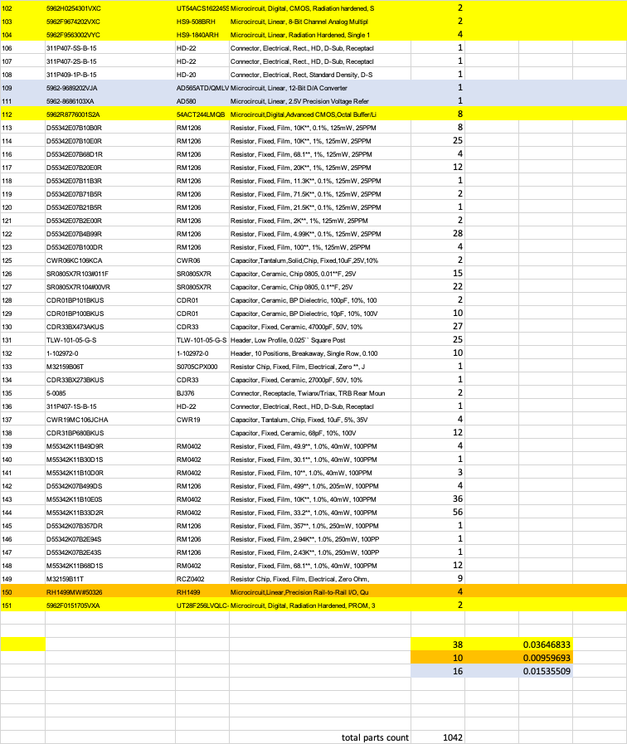
Typical BOM excerpt from high-end mission (Class B GEO)
Yellow highlight
MIL-SPEC FMRR
Orange highlight
COTS FMRR
Gray/purple highlight
Actives with no FMRR
Total parts count: 1042
Total MIL-SPEC FMRR: 3.6%
Total COTS FMRR: 10: 0.96%
Total non-FMRR and discrete semiconductors (requiring radiation testing or other forms of analysis: 16 (1.5%)

Slide 10
What do this BOM and other similar BOMs tell us?
Total active parts generally < 10% of part count (example has 6.1%)
FMRR parts are a mix of COTS and MIL-SPEC parts (example has 3.6% MIL/0.96% COTS)
Remaining active parts make up the rest, requiring radiation testing, ray-tracing, or other forms of analysis (example has 1.5% non-FMRR)
Non-FMRR parts were most likely not selected to save money (because cost for radiation testing was much higher than the savings, and thus cost was much higher)
If COTS were broadly permitted, then this would have no effect on the FMRR parts, but it would have simply opened more options for the non-FMRR parts, which all required radiation testing anyway (and which would require radiation testing whether COTS or MIL-SPEC)
Furthermore, the biggest drivers for the use of COTS are passives, e.g., needed to support modern FPGAs (extremely high capacitance with limited real estate).
Expanded use of COTS does not increase radiation risk for a project; however advanced technology missions enabled by high-performance COTS microcircuits will often demand new approaches to address radiation

Slide 11
Observations
In general, lot-specific testing of every lot is excessive and unnecessary even though there are anecdotal cases that have involved sensitive parts with significant variability from lot to lot.
  Lot to lot variability can be characterized strategically through periodic testing just as sampling has always been an element of quality assurance.
Specific part numbers within part families, particularly for sensitive parts such as MOSFETs, may not be well representative of radiation sensitivity of other part numbers within the same family – be wary of family-based radiation qualification.
  Unless there is a detailed assessment for a specific family under a common datasheet, the user should assume that assessments should be part number and manufacturer specific.
  MIL-SPEC parts without FMRR that are produced under the same P/N and different manufacturers should be individually assessed for the particular manufacturer since there is no control of radiation susceptibility properties.
The developer of a particular component or spacecraft might follow one or more of a wide range of different approaches, from piece-part-based, circuit-based, or system-based for mitigating radiation effects and traditional oversight approaches might not constitute an effective means for assurance.

Slide 12
Radiation and on-orbit non-RHA performance data sources
Test data:
  Traditional: radhome.gsfc.nasa.gov, transitioned to https://nepp.nasa.gov/pages/pubs.cfm
  New: esarad.esa.int
  New: pmpedia.space
On-orbit experiences (“fact of” - some info available)
  Spacecube data (LEO on-orbit – extensive non-FMRR and COTS – 10+ yr)
  Aerocube data (LEO on-orbit – 100% non-FMRR COTS – 10+ yr) (Aerospace Corporation)
  Swift data (585km x 604km, 20.6 deg - extensive COTS ~ 19 yrs)
  Ascent (GEO cubesat – launched 12/2021) (AFRL)
  Biosentinel (deep space cubesat – launched with Artemis)
  Newspace – extensive, limited data availability

Slide 13
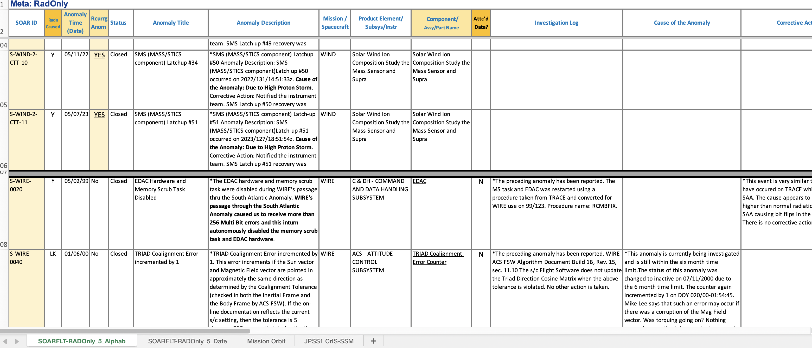
SOARS data review (1)

Slide 14
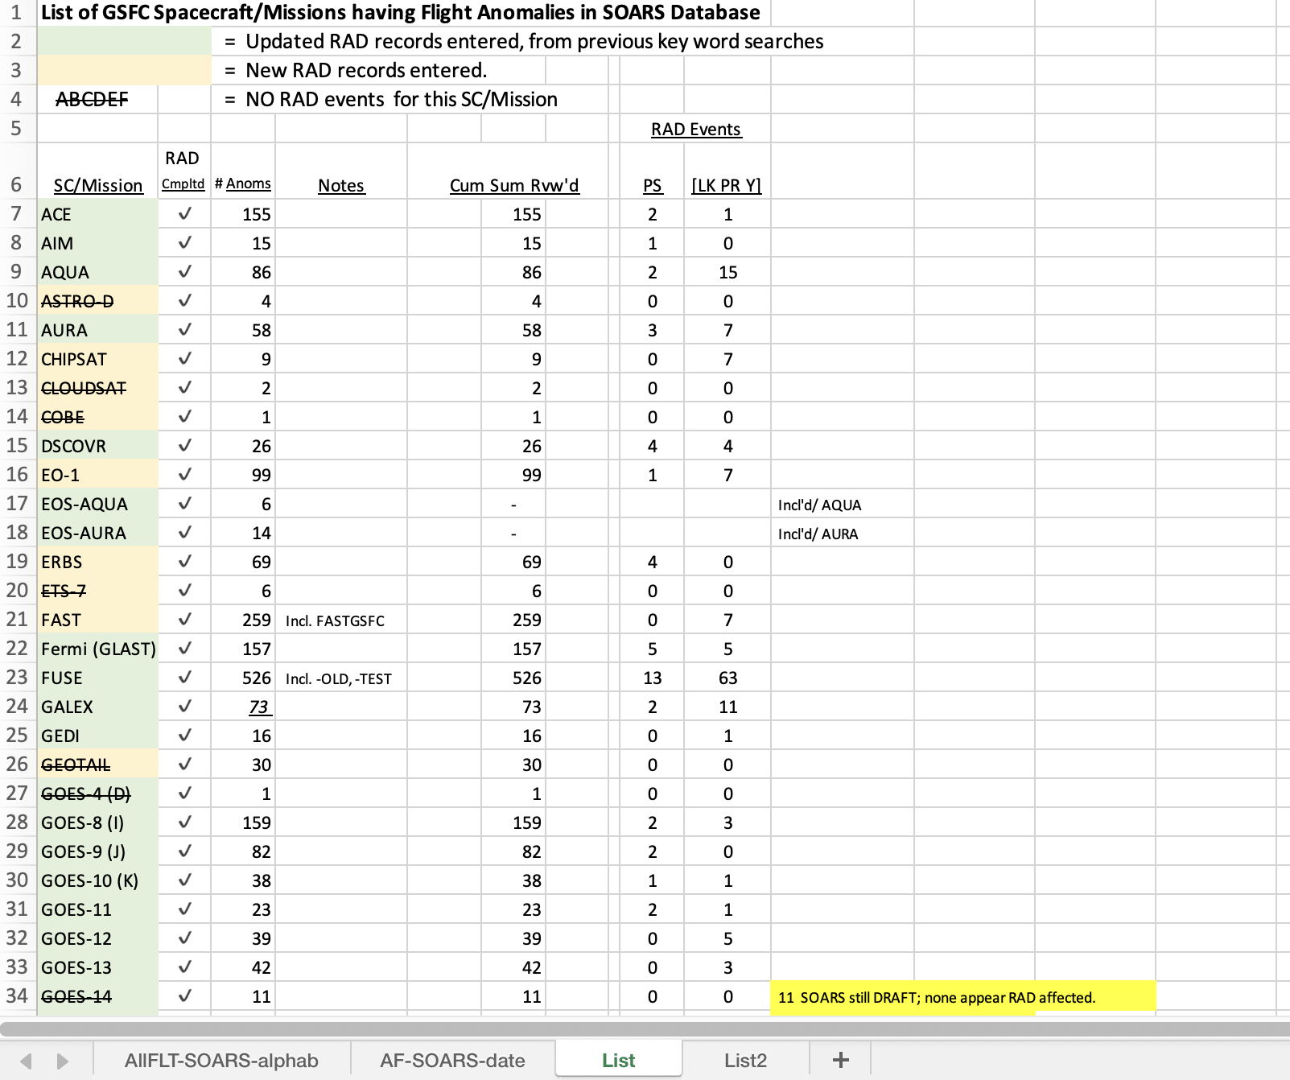
SOARS data review (2)

Slide 15
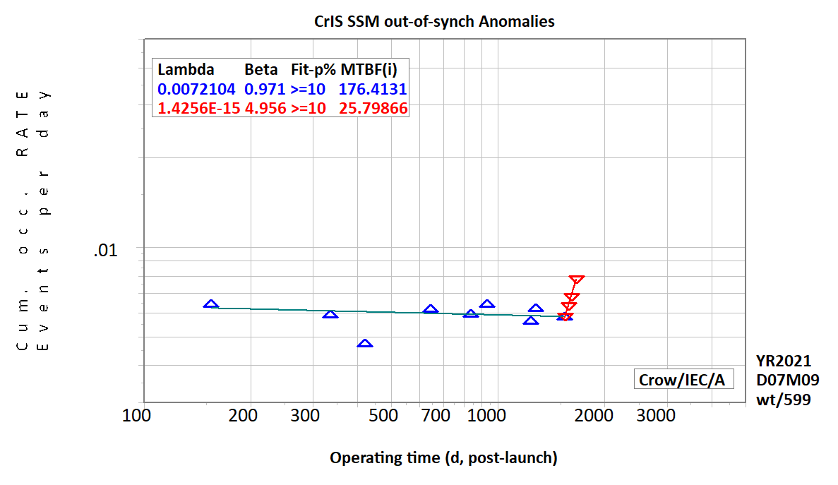
NPP CrIS Crow-AMSAA
CrIS out-of-synchronization (OOS) on-orbit anomalies.
For the first ~ 4.2 years, these anomalies were occurring randomly with time (β ~ 1). At day 1542 post-launch, anomalies began occurring at a significantly increasing rate. It appears that something changed in the system that induced OOS events to occur no longer randomly and at an increasing rate. The "system" includes the instrument itself, any possible spacecraft effects on the instrument, and any space environmental changes.
WT/599/2109007/Fn: CrIS-OOS-Anom's.pptx

Slide 16
SpaceCube Time-on-orbit
As of Oct 2021 (STP-H6 was turned off Dec 9, 2021 to make room for the next instrument)
Project | Version | Part Req | BOM Count | Operation Months | Xilinx Quantity | COTS % | COTS Months
RNS | v1.0 | 2+ | 3700 | 0.0833333 | 4 | 1% | 3.08333
MISSE-7 | v1.0 | N/A | 3100 | 90 | 4 | 2% | 5580
SMART | v1.5 | N/A | 1000 | 0.0333333 | 1 | 95% | 31.6667
STP-H4 CIB | v1.0 | N/A | 1500 | 30 | 2 | 1% | 450
STP-H4 ISE2.0 | v2.0-EM | N/A | 1250 | 30 | 3 | 98% | 36750
STP-H5 CIB | v1.0 | N/A | 1500 | 46.933333 | 2 | 1% | 704
STP-H5 ISEM | v2.0 Mini | N/A | 1000 | 46.933333 | 1 | 26% | 12202.7
STP-H5 Raven | v2.0-EM | N/A | 1500 | 46.933333 | 3 | 99% | 69696
RRM3 | v2.0 | N/A | 1429 | 36.666667 | 2 | 65% | 34057.8
STP-H6 CIB | v1.0 | N/A | 1500 | 31.833333 | 2 | 1% | 477.5
STP-H6 GPS | v2.0 | N/A | 1157 | 31.833333 | 2 | 65% | 23940.3
Restore-L Lidar | v2.0 | 3 | 2000 |  | 2 | 0% | N/A
STPSat6 | v2.0 Mini | N/A | 1500 |  | 1 | 98% | N/A
Totals | Units Flown | 11
 | Commercial FPGAs | 26
 | Commercial FPGA Device-Years | 83
 | Part Years | 57213
 | COTS Parts Years | 15324
Also to note: We flew many COTS components on some of these projects:
ISE2.0, SMART, and ISEM all flew COTS cameras that were ruggedized. SMART flew COTS SATA drives.
Raven flew a $5 USB interface card to an IR sensor
STP-H5 and -H6 have CHREC Space Processors (CSPs) that were 95% COTS components. See references for more info on CSP results (no failures to date)
RRM3 suffered a failure (outside of SpaceCube) that may have involved a specific COTS part, but the part was used in a stressing condition that any part would eventually fail.
NavCube Commercial vendor populated PWBs

Slide 17
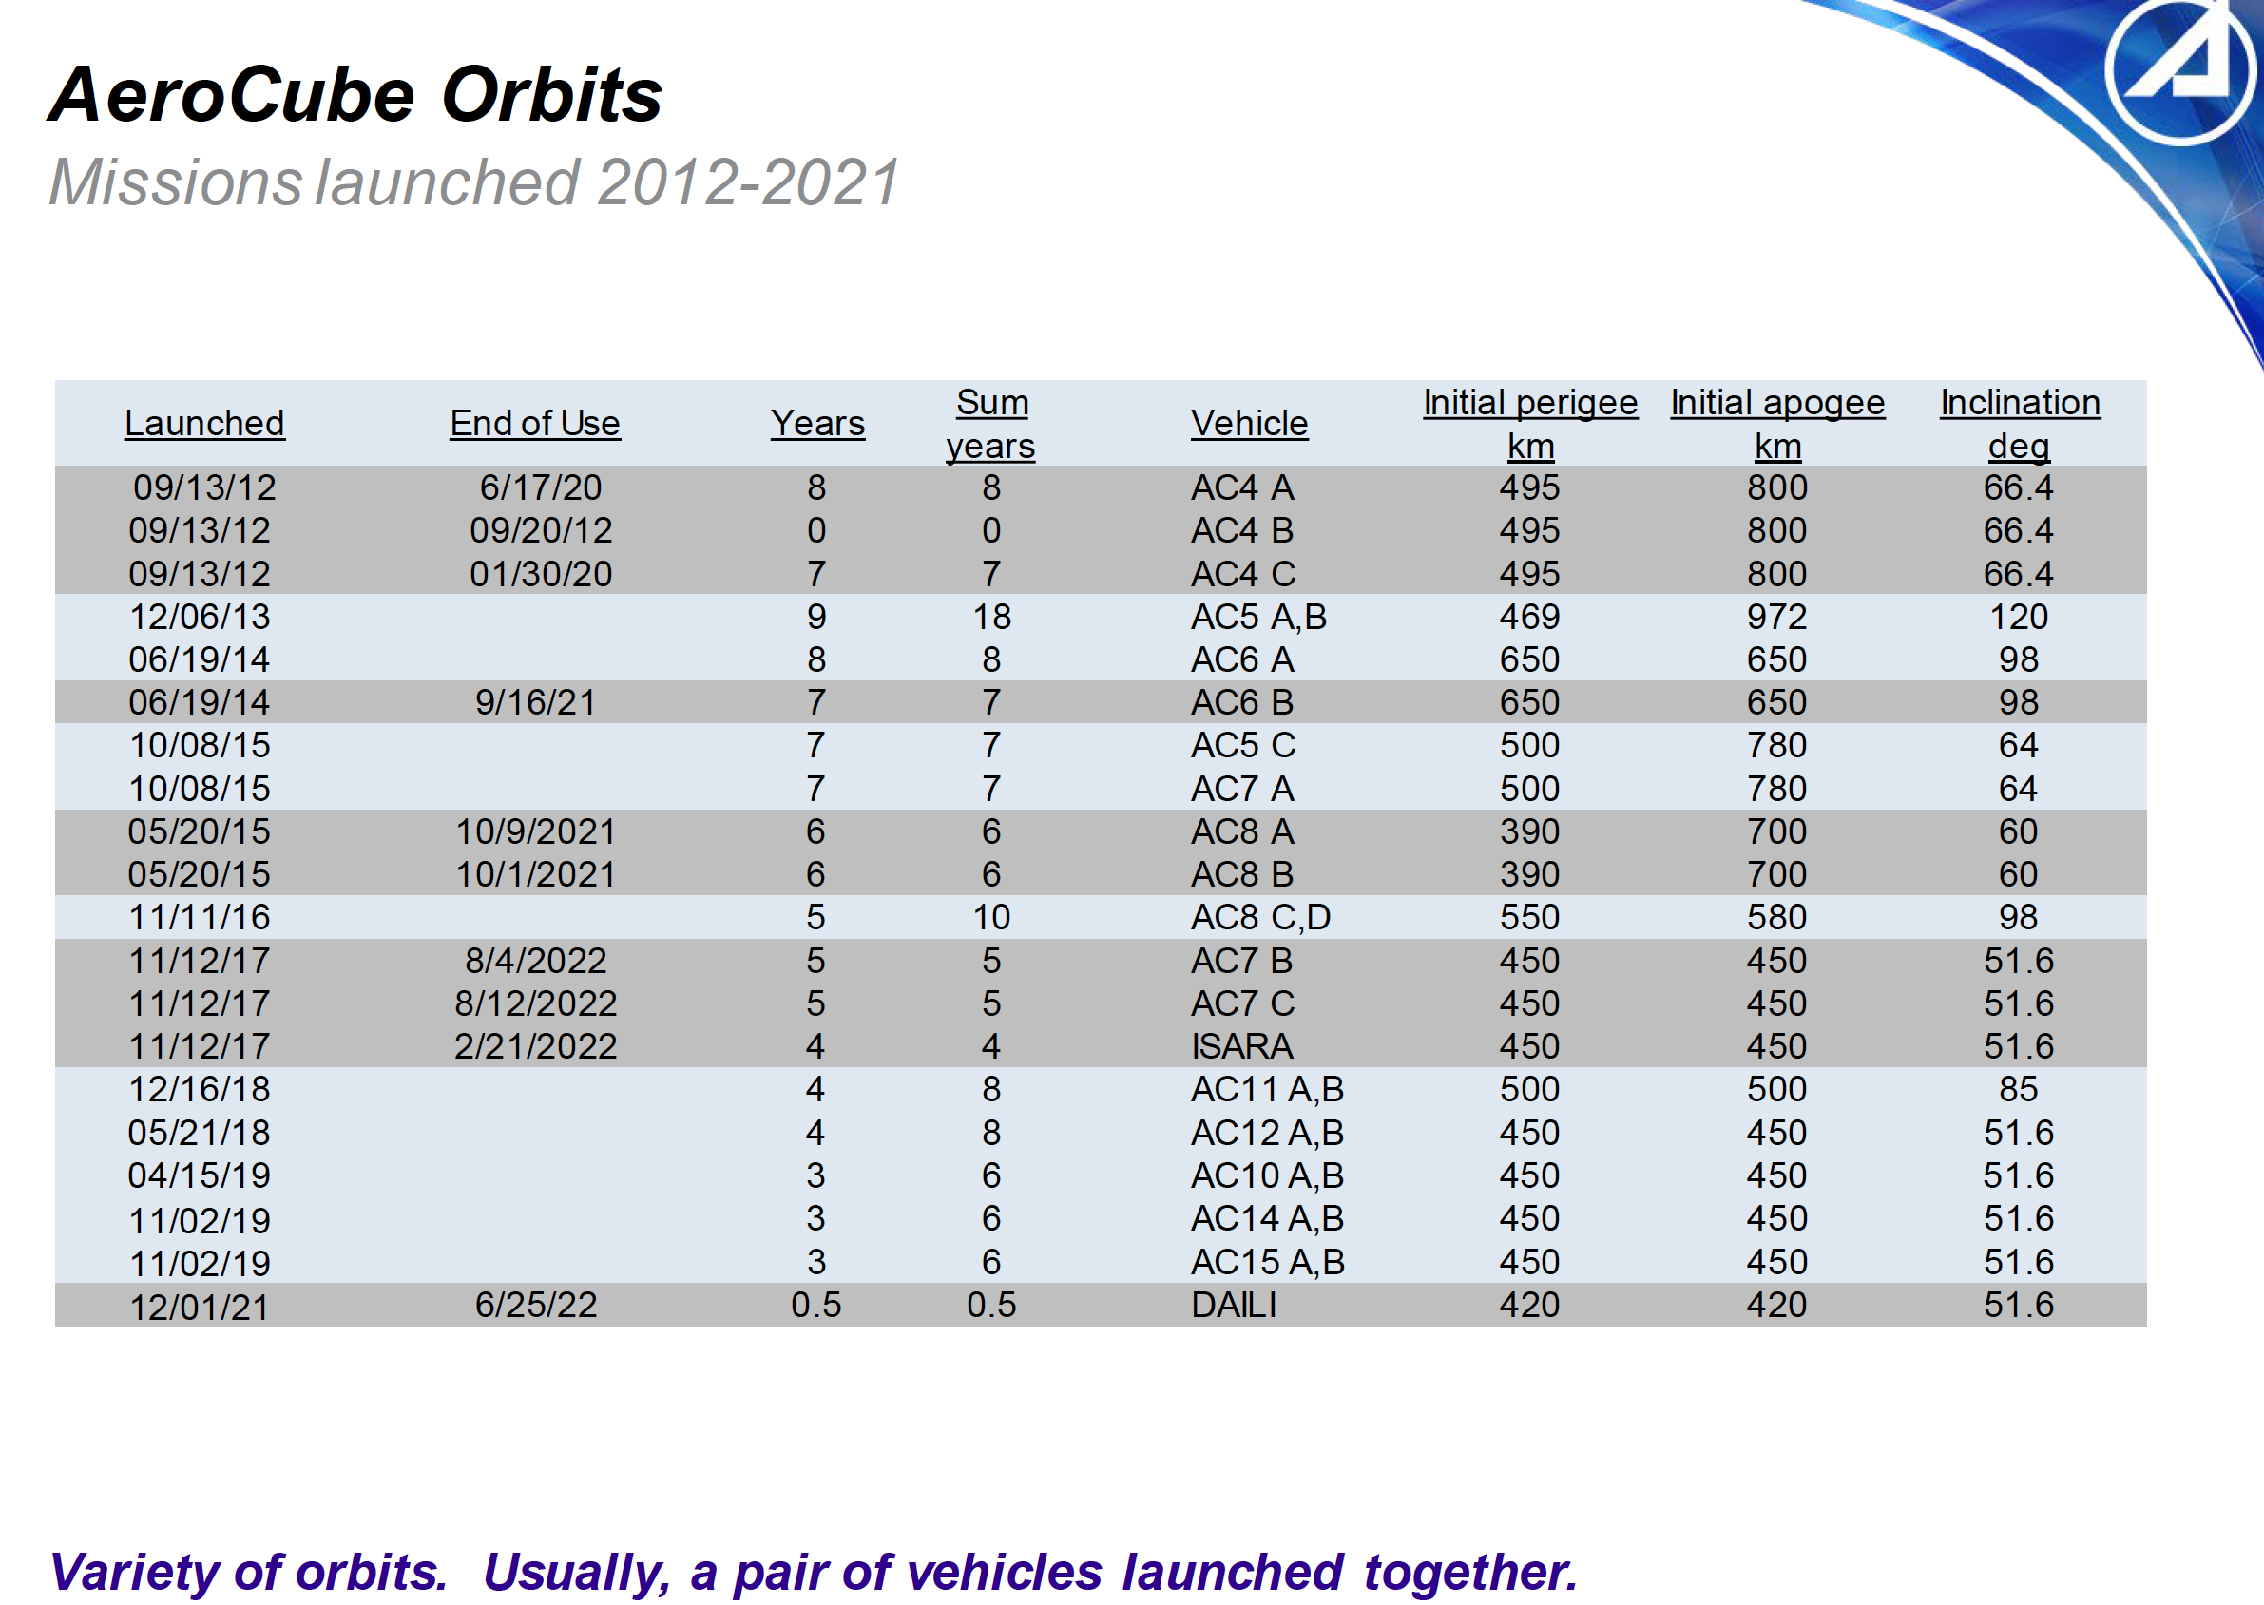
Aerocube orbits
No FMRR or PMRR parts used
Chart from: "Overview of the AeroCube Program and Experience with Alt-Grade Parts Usage”
Aerospace Corp, “MICROELECTRONICS RELIABILITY AND QUALIFICATION WORKSHOP”, Feb, 2023
Brian Hardy, The Aerospace Corporation

Slide 18
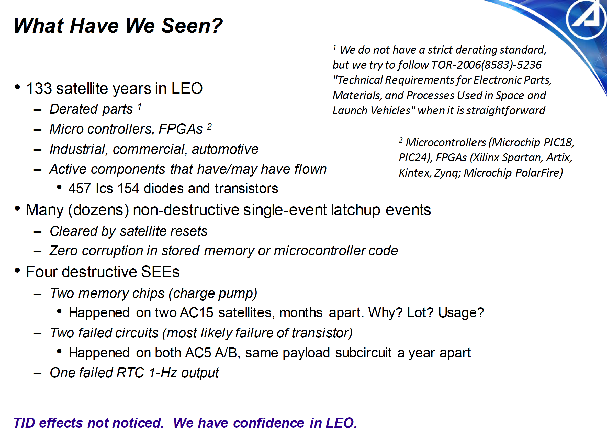
No FMRR or PMRR parts used
Chart from: "Overview of the AeroCube Program and Experience with Alt-Grade Parts Usage”
Aerospace Corp, “MICROELECTRONICS RELIABILITY AND QUALIFICATION WORKSHOP”, Feb, 2023
Brian Hardy, The Aerospace Corporation

Slide 19
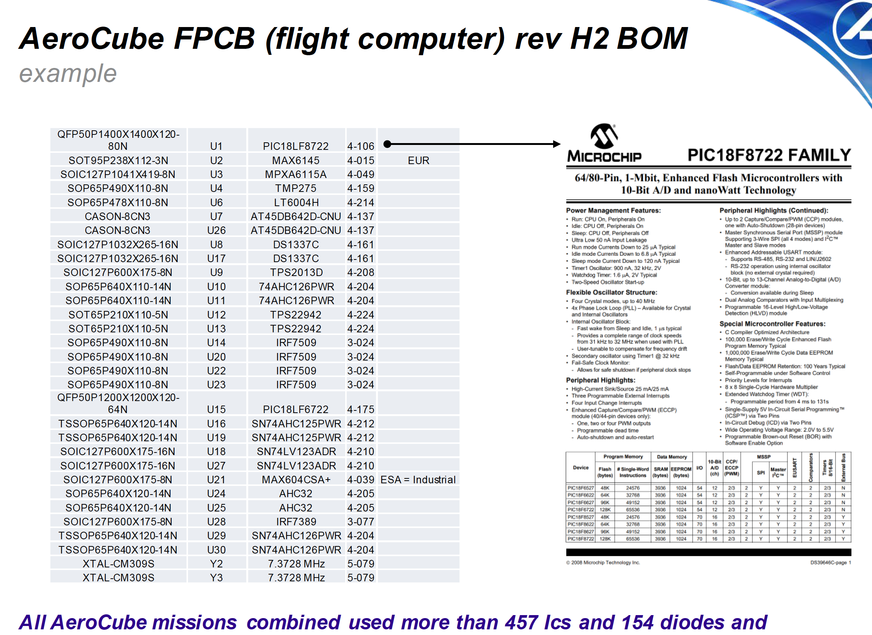
No FMRR or PMRR parts used
Chart from: "Overview of the AeroCube Program and Experience with Alt-Grade Parts Usage”
Aerospace Corp, “MICROELECTRONICS RELIABILITY AND QUALIFICATION WORKSHOP”, Feb, 2023
Brian Hardy, The Aerospace Corporation

Slide 20
Radiation mitigation approaches

Slide 21
Piece-part level radiation assurance (newspace)
Best fit for long-term repeated manufacture elements, such as standard spacecraft components and standard buses. But for the manufacturer themselves, not the procuring organizations. The procuring organizations should be considering the history of the product in the target environment (established reliability), not the piece parts.
Part-level radiation testing should be performed strategically and minimally in-line with projects that are on fixed schedules
Preferred parts lists (based on experiences and testing) should be maintained
New parts introduced should invoke new strategic testing
Periodically subsequent lots of non-FMRR parts should be tested to characterize variability
Is “easy” to implement, but cost and availability are often detrimental, and in general is not sufficient to account for all circuit radiation effects.
Results can be used to enter part data into models for other missions
Conservative radiation design margins have not proven effective; in fact, most major missions have surpassed many multiples of their RDMs and still have not been radiation-limited
Conservatism is not only costly, but can often be detrimental to both performance and reliability by driving to less capable or less proven components

Slide 22
Circuit-level radiation assurance
Best fit for assurance for current (in development) one-of-a-kind missions on fixed schedules
Can often make use of part-level strategic testing.
This approach is sufficient to account for all radiation effects on the specific circuit
Only option to employ when parts cannot be obtained with proper performance, availability, and radiation-tolerance
Results can be used for other missions when the same circuit is used, but not to validate parts themselves for future missions in other circuit designs.

Slide 23
Approach Categorization (excerpt)
Scores
Risk
Factors
Resource
Usage
Performance/
Tech infusion
1. COTS by exception, FMRR or lot-specific radiation testing
Traditional space
3 10 10
2. COTS inclusive, FMRR or lot-specific radiation testing
Traditional space w/expanded COTS
2 7 5
3. COTS inclusive, FMRR or strategic (non-lot-specific) radiation testing
4 4 2
4. COTS inclusive, FMRR, strategic (non-lot-specific) radiation testing with select radiation tolerant design
3 4-5 2
5. COTS inclusive, strategic (non-lot-specific) radiation testing with select rad-tolerant design
3 4-5 2
Newspace conservative
6. COTS inclusive, full rad-tolerant design, FMRR or strategic rad testing for front-line defenders and NVRAM
1-2 2-4. 2-5
NASA ARC
7. COTS inclusive, no radiation testing or FMRR, select rad-tolerant design
Aerocube
4-6 1-2 1-2
8. COTS inclusive, no consideration of radiation
Cheap and fast
10 1 1
9. MIL-SPEC exclusive, no radiation testing, FMRR, or rad-tolerant design
For reference only
10 6 10
Low risk modern approach
Medium-high risk Rapid technology infusion
Traditional+COTS
Fast, cheap, high risk

Slide 24
Observations about radiation engineering at GSFC and elsewhere
When full cost accounting kicked in in earnest in 2004, many discipline SMEs (including radiation engineers) were cut off from projects after Phase A
  No mechanism for radiation engineers to be aware of anomalies in I&T that might affect on-orbit radiation performance (might have contributed to SMAP radar failure at JPL)
  No feedback from on-orbit experiences to drive early practices or requirements updates
Radiation engineers are often pressured (by circumstance) into more of a parts assurance function rather than radiation engineering
  Assumption always carried (at the project and organizational level) that the radiation problem is solved at the part level
  If all parts meet radiation requirements and none have special concerns, the RE’s job is done
  Battles might ensue at the part level when parts do not meet radiation requirements
  Radiation engineering is often performed as a last resort based on our current post-FCA construct (not at the choice of radiation engineering organization)
This has trapped us into maintaining the same practices and has put too much focus on radiation testing or using traditional parts
When GSFC is involved in developing new designs with current technology, radiation engineering should be part of the design process with a focus on designing a radiation-resilient system

Slide 25
Next Steps
Execute the correlation plan of event data vs circumstance
Continue to collect on-orbit data
Provide inputs to the SPARK SBIR effort
Formulate risk assessment strategies
Develop actionable and contextual guidelines and requirements

Slide 26
Backup

Slide 27
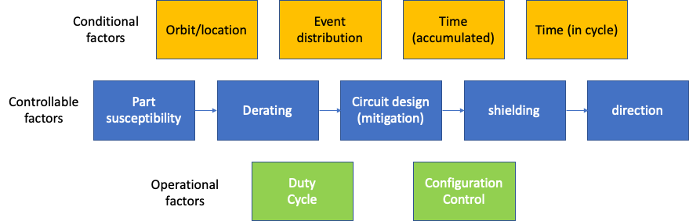
The multi-dimensional radiation problem

Slide 28
The charge
This effort must be driven by and informed from on-orbit experiences and data
On-orbit data show lack of correlation between piece-part radiation data and on-orbit experiences of spacecraft systems
  Hubble
  SMAP
  Chandra
  Swift
  Others
Benchmark problem
  Consider on-orbit experiences of non-RHA FPGA in a range of different regimes and lifetimes to estimate risk in new regime not enveloped by any of the other regimes

Slide 29
Status
First “skeleton draft” complete
  Includes the basic risk assessment principles
  Includes basic concepts relating radiation to risk
Effort on-going for several months
  Reliability expertise on board
  Radiation expertise on board
  Completed review of 30+ years of on-orbit anomaly data from GSFC missions (~9000 flight anomalies)
  Over 1000 hits associated with radiation-related search terms, pared down to ~140 that are due to radiation or possibly due to radiation.
    Subsequently, manual searches revealed that global searches were not sufficient, uncovering approximately 1000 more
  Hits are being correlated against regions, events, designs, components, and parts
Interacting with NOAA endorsed SBIR, which is developing a tool to broadly characterize and display space weather and radiation events
Presentation completed proving that expanded use of COTS parts does not increase radiation risk

Slide 30
White area: radiation susceptible (active) parts
Not radiation susceptible (green shaded)
COTS
custom
Note: this is not a Venn diagram, it is meant to give a rough sense of scale. The orange shaded area is not a subset of the green shaded area.
ESA/JAXA spec
RHA (orange shaded)
MIL-SPEC

Slide 31
Radiation risk and traceability
Traceability to wafer lot feeds radiation risk if you are using parts from multiple lot date codes and are not testing or demonstrating all lot date codes in space.
  Strategic testing can retire most of that risk
  The same points that are required about ILPMs, statistical process controls, and volume, all play into such risk in the same way
  If you purchase cheap consumer grade parts, then there may be uncertainty as to the origins of the parts or whether they really came from the same lot.
  Even ”hi-rel” parts might have multiple wafer lots in a single lot
  In general, the same features required to assure the selection and procurement of reliable COTS parts also address traceability concerns within a lot.
  Any part that is not process-controlled for radiation susceptibility can have variability throughout the lot, COTS or MIL-SPEC

Slide 32
Risk of failing radiation tests
This is not an artifact of using COTS; it’s an artifact of requiring a function that has no available solution that meets the radiation requirements, and the concern would apply to COTS and MIL-SPEC parts
Many developers use almost exclusively non-RHA parts very successfully, so this is not a significant concern
In some cases, the higher performance you are trying to achieve and the newer technology, the greater the challenge.
  In that case the choice is use what’s available or don’t execute the mission
Radiation-tolerant design and Rad-Hard By Design techniques will be needed to keep us moving forward

Slide 33
Major part failures and issues since 2005
Mission | Occurrence | Location | Part | Result | Root Cause | Lesson
SMAP | power supply failure | On-orbit | JANSR MOSFET | Radar failure | Use of piece part RHA to mitigate radiation | Radiation must be solved at the circuit and system level
SAC-D | Power supply failures | On-orbit | NASA-screened (level 1) COTS DC/DC converters | (Extended) mission failure | Parts were overtested in screening | Respect the datasheet in handling, testing, and usage
MMS | Part screening and lot acceptance challenges | Ground | NASA-screened COTS HV801 optocoupler | Significant reduction in back-end testing | Use of low-volume hand produced parts well outside of proven bounds | Be sure all specialized low-volume parts have been proven for the current envmt or plan on full qual program. NASA screening cannot overcome parts that are not proven for application
MMS | Part failures | On-orbit | NASA-screened COTS HV801 optocoupler | No appreciable effect | Use of low-volume hand produced parts well outside of proven bounds | Fault-tolerant design can be very effective when parts are not perfect
MMS | Part failure due to corrosion | Ground | JANS BJT | Late failure, rework | Reliance on hermeticity to avoid corrosion, absolute reliance on JANS for perfect parts | JANS requirements do not assure perfect parts

Slide 34
Major part failures and issues since 2005
Mission | Occurrence | Location | Part | Result | Root Cause | Lesson
GOES-R | Part corrosion failure in I&T | Ground | JANS BJTs | $multi-M cost increase, launch slip | Reliance on hermeticity to avoid corrosion, absolute reliance on JANS for perfect parts | JANS requirements do not assure perfect parts, requirements for hermeticity can elevate risk of corrosion
GOES-R GLM | Part anomalous performance and failure after testing over datasheet limits | Ground | NASA-screened COTS LICCs (low ESL MLCCs) | Programmatic hit | Variability in specialized parts, COTS parts tested over datasheet levels (by manufacturer per demands from prime) | Do not test COTS parts over rated datasheet values unless it is part of a proven manufacturer package
LCRD | Part anomalous performance and failure after testing over internal element limits | Ground | NASA-screened Custom VCSO | Programmatic hit | Custom part not fully understood by manufacturer, part overtested in screening | Before applying screening tests to custom parts, be aware of limites
SDO | Circuit misbehavior | On-orbit | M55681 Level 1 MLCC | EVE instrument failure | (1) MIL-SPEC Level 1 Assurance is neither necessary nor sufficient to assure parts to be good for use. (2) Per standard Agency and GSFC practices, parts were tested in non-flight conditions | Over-reliance on testing approaches that are neither necessary or sufficient for success can lead to enormous and broad problems Manufacturers are best tuned to identify processes needed to assure reliability of components based on their own manufacturing processes, experiential observations, and usage

Slide 35
Major part failures and issues since 2005
Mission | Occurrence | Location | Part | Result | Root Cause | Lesson
LandSat-8 | Persistent TIRS instrument safeholds | On-orbit | M55681 Level 1 MLCC | Switch to open loop pointing | (1) MIL-SPEC Level 1 Assurance is neither necessary nor sufficient to assure parts to be good for use. (2) Per standard Agency and GSFC practices, parts were tested in non-flight conditions | Over-reliance on testing approaches that are neither necessary or sufficient for success can lead to enormous and broad problems Manufacturers are best tuned to identify processes needed to assure reliability of components based on their own manufacturing processes, experiential observations, and usage
Insight | Part corrosion failure in I&T | Ground | JANS BJTs | $multi-M cost increase to GOES-R, launch slip for GOES-R | Reliance on hermeticity to avoid corrosion, absolute reliance on JANS for perfect parts | JANS requirements do not assure perfect parts, requirements for hermeticity can elevate risk of corrosion

Slide 36
Major part failures and issues since 2005
Mission | Occurrence | Location | Part | Result | Root Cause | Lesson
SMAP | power supply failure | On-orbit | JANSR MOSFET | Radar failure | Use of piece part RHA to mitigate radiation | Radiation must be solved at the circuit and system level
SAC-D | Power supply failures | On-orbit | NASA-screened (level 1) COTS DC/DC converters | (Extended) mission failure | Parts were overtested in screening | Respect the datasheet in handling, testing, and usage
MMS | Part screening and lot acceptance challenges | Ground | NASA-screened COTS HV801 optocoupler | Significant reduction in back-end testing | Use of low-volume hand produced parts well outside of proven bounds | Be sure all specialized low-volume parts have been proven for the current envmt or plan on full qual program. NASA screening cannot overcome parts that are not proven for application
MMS | Part failures | On-orbit | NASA-screened COTS HV801 optocoupler | No appreciable effect | Use of low-volume hand produced parts well outside of proven bounds | Fault-tolerant design can be very effective when parts are not perfect
MMS | Part failure due to corrosion | Ground | JANS BJT | Late failure, rework | Reliance on hermeticity to avoid corrosion, absolute reliance on JANS for perfect parts | JANS requirements do not assure perfect parts
GOES-R | Part corrosion failure in I&T | Ground | JANS BJTs | $multi-M cost increase, launch slip | Reliance on hermeticity to avoid corrosion, absolute reliance on JANS for perfect parts | JANS requirements do not assure perfect parts, requirements for hermeticity can elevate risk of corrosion
GOES-R GLM | Part anomalous performance and failure after testing over datasheet limits | Ground | NASA-screened COTS LICCs (low ESL MLCCs) | Programmatic hit | Variability in specialized parts, COTS parts tested over datasheet levels (by manufacturer per demands from prime) | Do not test COTS parts over rated datasheet values unless it is part of a proven manufacturer package
LCRD | Part anomalous performance and failure after testing over internal element limits | Ground | NASA-screened Custom VCSO | Programmatic hit | Custom part not fully understood by manufacturer, part overtested in screening | Before applying screening tests to custom parts, be aware of limites
SDO | Circuit misbehavior | On-orbit | M55681 Level 1 MLCC | EVE instrument failure | (1) MIL-SPEC Level 1 Assurance is neither necessary nor sufficient to assure parts to be good for use. (2) Per standard Agency and GSFC practices, parts were tested in non-flight conditions | Over-reliance on testing approaches that are neither necessary or sufficient for success can lead to enormous and broad problems Manufacturers are best tuned to identify processes needed to assure reliability of components based on their own manufacturing processes, experiential observations, and usage
LandSat-8 | Persistent TIRS instrument safeholds | On-orbit | M55681 Level 1 MLCC | Switch to open loop pointing | (1) MIL-SPEC Level 1 Assurance is neither necessary nor sufficient to assure parts to be good for use. (2) Per standard Agency and GSFC practices, parts were tested in non-flight conditions | Over-reliance on testing approaches that are neither necessary or sufficient for success can lead to enormous and broad problems Manufacturers are best tuned to identify processes needed to assure reliability of components based on their own manufacturing processes, experiential observations, and usage
Insight | Part corrosion failure in I&T | Ground | JANS BJTs | $multi-M cost increase to GOES-R, launch slip for GOES-R | Reliance on hermeticity to avoid corrosion, absolute reliance on JANS for perfect parts | JANS requirements do not assure perfect parts, requirements for hermeticity can elevate risk of corrosion

