Slide 1
ASCEND 2023
Artemis Medical System Overview
^{Christopher Haas, MD, MPH}
^{Artemis II Deputy Crew Surgeon}
^{NASA Johnson Space Center}
^{October 24, 2023}

Slide 2
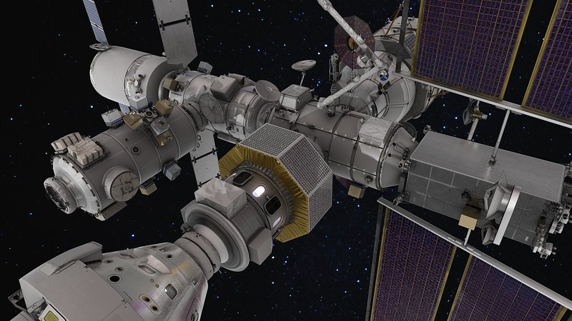
Orion Docked to Gateway (Artemis IV+)
Credit: NASA Johnson
Notes:
Image Credit: https://www.nasa.gov/mission/gateway/

Slide 3
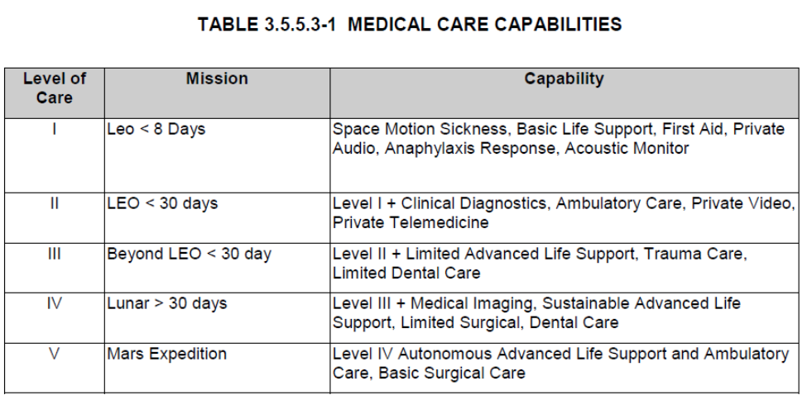
Medical System Scope: Mission Design & NASA Standard
Medical system definition for exploration is based upon several key factors:
Mission duration - launch to landing/recovery
Crew Size
Mission Design (e.g., docking? lunar landing/EVA?)
Mission Architecture (e.g., vehicle volume/config, exercise equipment, ConOps for contingencies)
The scope is derived from NASA standards of medical care but based on factors above and output from probabilistic event modeling.
Artemis missions fall into either Level III or IV depending upon the mission.

Slide 4
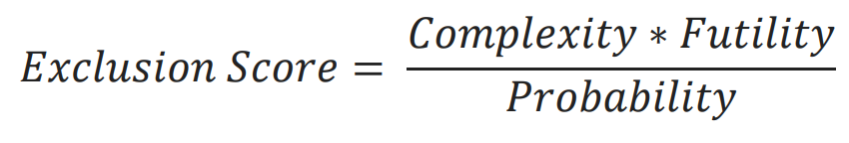
Medical System Development: Design of Orion Med Kit
Integrated Medical Model (IMM)
Identify:
Probability of condition occurrence
Estimated resource mass & volume
Optimized Kit *
Ranked Conditions
Calculated Exclusion Scores
“Plan to Treat” Determination
* Subject to IMM limitations
Condition incidence rates rely on terrestrial data
Built originally for Space Station
Results are a starting point, not a solution
Identified Specific Resources
What do we use terrestrially?
What do we need for this Mission?
What fits in the medical kit?

Slide 5
Medical System Development
Artemis Medical System development effort ongoing
  Orion 21-day mission medical system design baselined and prototype built
  Deltas under consideration for addition of Gateway and landing system
  Goal is to balance crew health needs with mission constraints, while eliminating redundancy across vehicles
Lunar surface mission will add to medical risk and is being evaluated
  Current probabilistic modeling methods are being updated by NASA
  Expert interviews also used to appropriately scope added capabilities
  Medical ConOps to include entire mission and all vehicles
Priority at this stage remains defining capabilities → hardware → then vehicle impacts
Notes:
not physiological adaptations: especially when it comes to SANS/CO2

Slide 6
Medical System - Assumptions
      No EVAs planned for Orion-only mission (Artemis II)
      Integrated capabilities across programs are being pursued
        Gateway will only be occupied when Orion is present
        Gateway to leverage as much as possible from Orion medical capabilities
        Lander medical capabilities are for lunar sortie only
      Medical capability design for early Artemis with lunar lander missions:
        ~30-day duration
        Multi-day Lunar sortie by 2 crewmembers, 2 remain in Lunar orbit
        Orion Medical System mass/volume allocation is relatively fixed

Slide 7
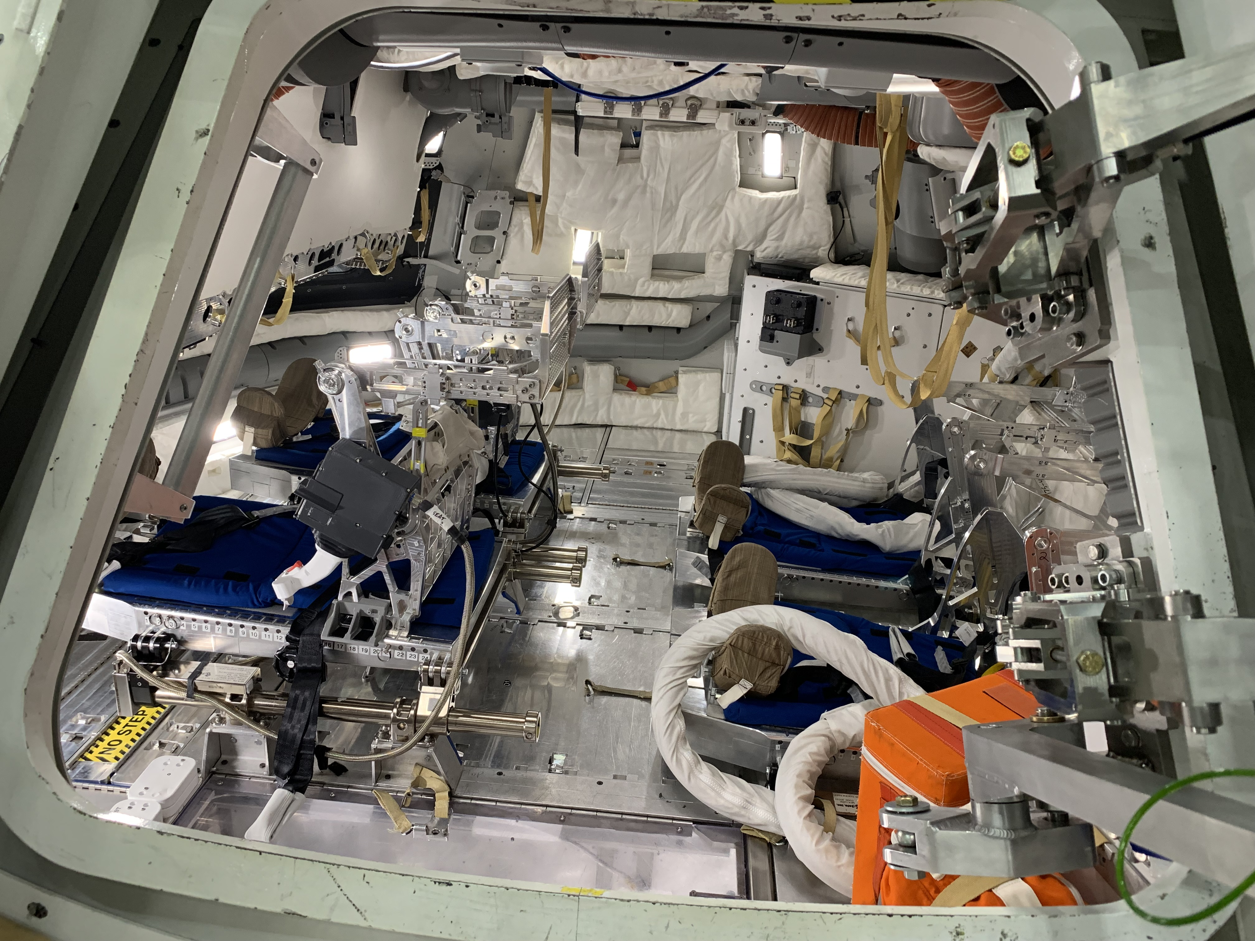
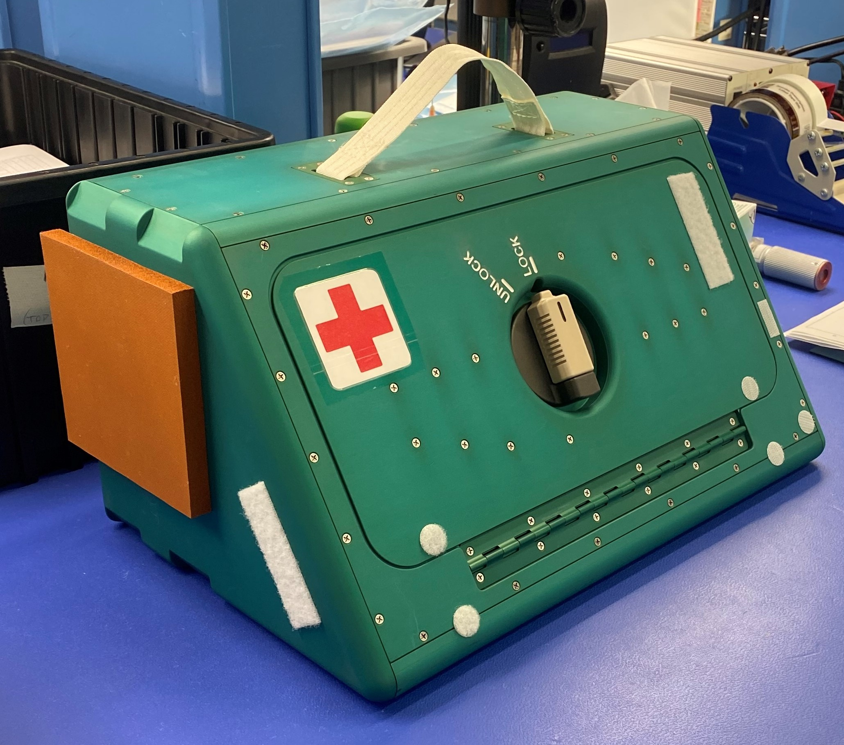
Orion Mockup Interior & Medical Kit

Slide 8
Orion Medical System Components
Orion Prime Medical Kit
(OPMK)
Hard-sided kit mounted to wall in open cabin
Only accessible in-flight
In-Suit Pill Delivery Tool
Tool for administering medication to a pressurized, suited crew
Used in event of a suited return contingency scenario
Orion Medical Kit System
(OMKS)
Orion Secondary Medical Kit (OSMK)
Additional stowed medical supplies
Only accessible in-flight
- Collective suite of hardware that includes multiple kits
Supplemental Oxygen
Oxygen hardware to treat smoke inhalation in the event of a fire
Use as directed by flight surgeons for additional scenarios
Orion Medical Accessory Kit (OMAK)
Similar to ISS Medical Accessory Kit (IMAK)
Contains personal/medical items unique to each crewmember
Stowed in lockers during launch and landing
Only accessible in-flight
Seat Accessible Medical Items (SAMI)
Medical items required to be accessible to a seated/restrained crewmember pre-launch, post-ascent and post-landing
Minimal supplies (small volume); few pills, pair of glasses, etc.
One kit per crewmember
Stowed in suit forearm pocket

Slide 9
Artemis Mission Medical Needs
Flown on Orion
Medications
Anti-inflammatory |  | Antibiotic/Antiviral/Antifungal Medication |  | Therapeutics
Pain Medication |  | Anti-arrhythmia Medication |  | Splinting
Sleep Medication |  | Anticoagulant Medications |  | Wound Closure
Stimulant Medication |  | Bronchodilator Medication |  | Wound Dressing
Decongestant Medication |  | Pre-landing fluid support |  | Dental Repair
Anti-Histamine Medication |  | Allergic/ Anaphylactic Reaction Medications |  | Nasal Packing
Anti-Emetic Medication |  | Ophthalmic Medications |  | Saliva/Blood Absorbance
Laxative/Motility Medication |  |  |  | Urinary Catheterization
 |  |  |  | Manual Ventilation Method
Diagnostics |  |  |  | Collapsed Lung Decompression
Lighted Imaging Capability |  | Point-of-care Urinalysis |  | Enriched Oxygen Breathing Gas Delivery
Electrocardiography |  | Personal Protection (Equipment) |  | Airway Tailored to Mission and Care Levels
Vitals Measurement |  | Antiseptic Surface Cleansing
Auscultation Method |  | Corneal Evaluation
Flown on Gateway
Extended limb injury care: Finger and Joint
Ultrasonography
Semi-invasive Wound Care
Wound Care consumables (20-day supply)
Co-oximetry
Positive Pressure Breathing Support Device

Slide 10
Medical Kit Device Capabilities
Device | Standalone Capability? | Data Display Requires Laptop or Other Device | Data Storage Laptop or Other Device | Data Transmission Mission Control
Augmented Stethoscope | No | No | Requirement | Requirement
Otoscope | No | Requirement | Requirement | Requirement
ECG | No | Requirement | Requirement | Requirement.
Blood Pressure Cuff | Yes | No | Should- Manually Entered Ok | Should
Pulse Ox | Yes | No | Should-Manually Entered Ok | Should

Slide 11
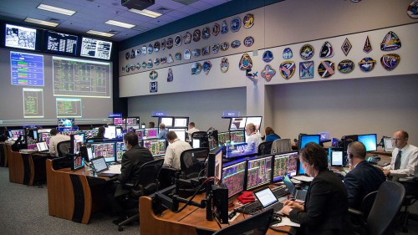
Medical System Space-to-Ground Plan
For Orion and Artemis II:
  Capability of audio +/- video connection with Mission Control
  Private audio with flight surgeon for medical discussions
  Videoconferencing during medical events expected
    Private video bring patient and physician “together”
  Medical procedures will be stored on crew personal computing devices (and on main flight computer)
    Small number of paper cue cards for
    critical devices/procedures
  Advanced remote guidance or automated
  guidance a future goal
Credit: NASA

Slide 12

Artemis (Lunar Sortie) Initial Phase Medical Conops Development
Conditions grouped by body system
START:
IMM Condition List
Remove conditions:
non-applicable
Add groupings per
Mission Design
Artemis Conditions Group List
11 NASA flight surgeons interviewed: consolidated anonymized consensus developed for each body system
FINISH:
Distribute contents
Derive treatments
Orion Medical Kit Contents
Artemis Treatment List
Derive condition descriptions
Lander Provider Medical Kit:
Designed with NASA Subject Matter Expert Consultation
Gateway Medical Kit Contents
Artemis / Gateway Medical ConOps

Slide 13


WE ARE GOING!
BACK TO THE MOON!
Artemis II
Questions?

