Slide 1


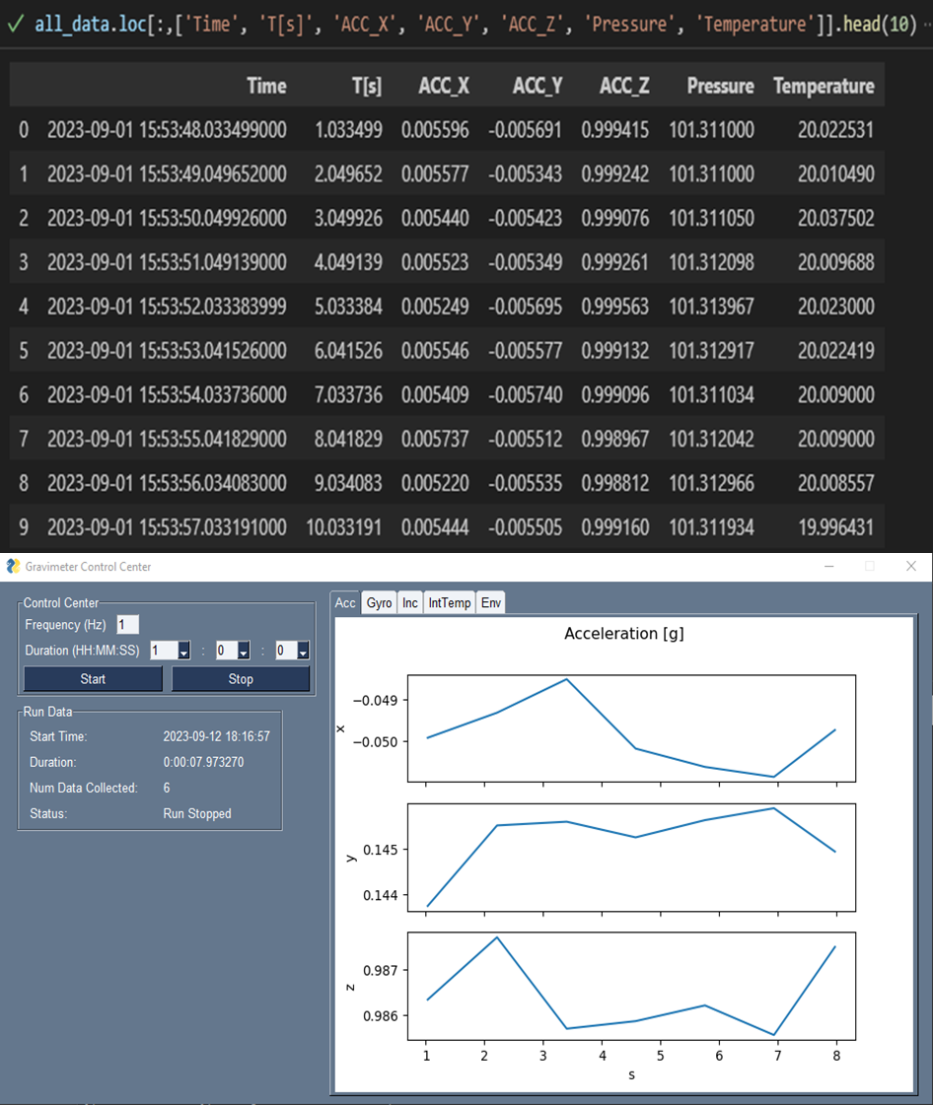
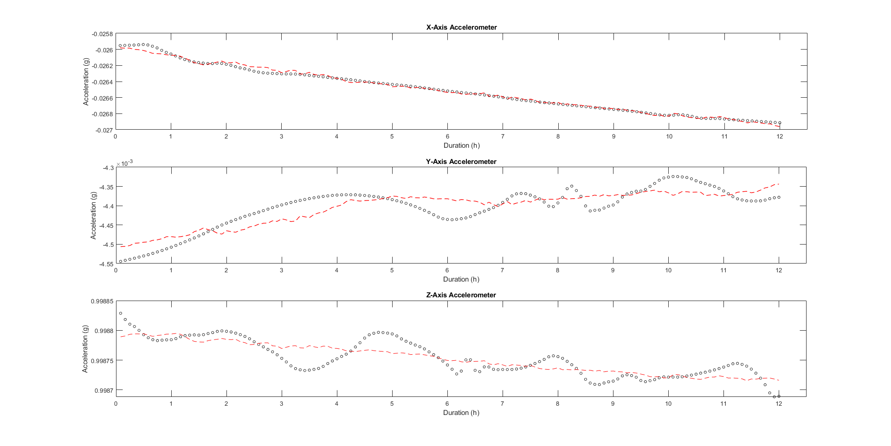
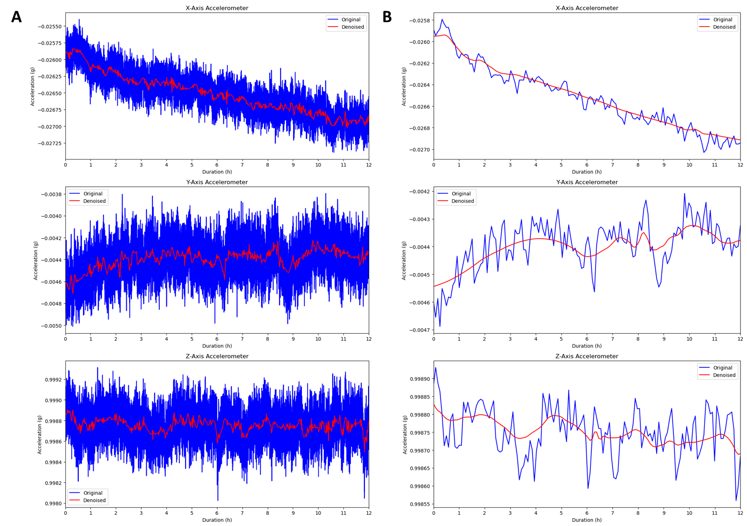

Subsurface Gravimetry Using Rover IMU Navigation Systems Data
TBD
PM / PI Info Chandler Lawson | chandler.lawson@nasa.gov
EXECUTIVE SUMMARY
Gravimetry is a valuable analytical tool for probing density distributions in the subsurface. Extraterrestrial data is currently limited to orbital collection, restricting spatial resolution to tens to hundreds of kilometers. Therefore, surface-based gravity surveys are necessary to study the gravity field and lateral density variations at a finer scale. Traditional gravity sensors (gravimeters) are rare on science payloads owing to their relatively high mass, fragility, and cost. Inertial measurement units (IMU); however, are included on every rover platform to perform navigation and attitude determination. This project aims to solve this issue by demonstrating the utility in recalibrating the accelerometers contained within an IMU to measure the static acceleration of gravitational fields and, by extension, gravity anomalies induced by subsurface density variations.
Innovation
This project utilizes the STIM300 IMU, a navigation-grade IMU in the same class as the LN200S IMU included on virtually all rover platforms. These IMUs contain triaxial micro-electromechanical (MEMS) accelerometers. MEMS accelerometers suffer from time-dependent unidirectional drift, thermal instabilities induced by internal sensor and ambient temperature variations, an air buoyancy effects caused by barometric pressure variations, and relatively low signal-to-noise ratios due to thermo-mechanical white noise and seismic disturbances. This project has developed an algorithm that:
Models time-dependent unidirectional drifts and the response of the accelerometers to variations in ambient temperature, internal sensor temperature, and barometric pressure.
Calibrates the raw accelerometer data for the aforementioned variables.
Performs noise compensation using wavelet analysis and denoising to decompose the calibrated accelerometer signal into constituent frequency components and isolate gravity signal in the low frequency components.
Collaboration
Laboratory testing and calibration was completed in the Advanced Concepts for Exploration Lab. This project supports ongoing efforts and projects to develop and mature gravimetric data collection methods and sensors such as GEMMA (Geophysical Exploration of the Moon using MEMS Accelerometers) and the Artemis Rover Science Team project “A geophysical traverse at the lunar south pole using the VIPER accelerometers.” This project is in collaboration with Johns Hopkins University and the Artemis Rover Science Team through Dr. Kevin Lewis.
Sensor communication interface (top) and graphical user interface (bottom).
Outcomes & Infusion
This project resulted in the development of novel procedures and algorithms to calibrate MEMS accelerometers for measurement of gravitational acceleration and gravity anomalies. Completed milestones include:
Integrated environmental sensors and IMU through development of a communication interface software that controls sensor parameters, performs time synchronization, and displays real-time data from multiple sensors via a custom graphical user interface.
Developed a wavelet decomposition and denoising method to isolate low-frequency signal components that contain the underlying gravity signal.
Developed calibration models for each of the three accelerometers using non-linear least squares regression:
$$g=A_{i}+\left(β_{1}d+β_{2}T_{acc_{i}}+β_{3}T_{env}+β_{4}p\right)+ε$$
Future Work
Future work includes the following:
Pursue additional fundings mechanisms such as IRAD or PSTAR.
Validate system performance through field analog studies and investigate additional calibrations.
Integrate current sensors into a prototype rover platform to develop operational procedures.
Incorporate findings and methods into VIPER gravity data collection operations.
Develop additional methods for surface and near-surface gravimetry
  Moving-base gravimetry using rovers
  Drone-based gravimetry for Mars, Titan, etc.
  Gravity gradiometry
Modeled response of each accelerometer to environmental variables (red).
Results of wavelet denoising method. A: 12-hour accelerometer time series. B: Same 12-hour time series averaged over 5-minute intervals to reflect real rover attitude data.
DAA# | 20230012987
NTR#(s) | MSC-27633-1

