Slide 1


Earth-GRAM Overview and Update Status
2023 GRAM Workshop
Patrick White (patrick.w.white@nasa.gov) - Earth-GRAM Lead
MSFC / Natural Environments Branch
Notes:
Title Slide

Slide 2
Outline
Overview
Current Global Reference Atmospheric Model (GRAM) Suite Planned Updates to Earth-GRAM
  Modern Era Retrospective Analysis for Research and Applications, Version 2 (MERRA-2) Global Atmosphere Upgrade – Fall 2023
  Gridded Forecast Upgrade – Spring 2024
  Thermosphere Update – Fall 2024
Future Planned GRAM Suite Upgrades to Earth-GRAM

Slide 3
Earth-GRAM Overview
Earth-GRAM provides monthly mean and standard deviation for any point in the atmosphere
  Includes Monthly, Geographic, and Altitude variations
Atmospheric variables output include: pressure, density, temperature, horizontal and vertical winds, speed of sound, and atmospheric constituents
Used by engineering community because of ability to create dispersions in the atmosphere at a rapid runtime
  Often embedded in trajectory simulation software
Earth-GRAM is not a forecast model
Does not readily capture localized atmospheric effects
Included within the GRAM Suite and available via the NASA Software Catalog https://software.nasa.gov/software/MFS-33888-1

Slide 4
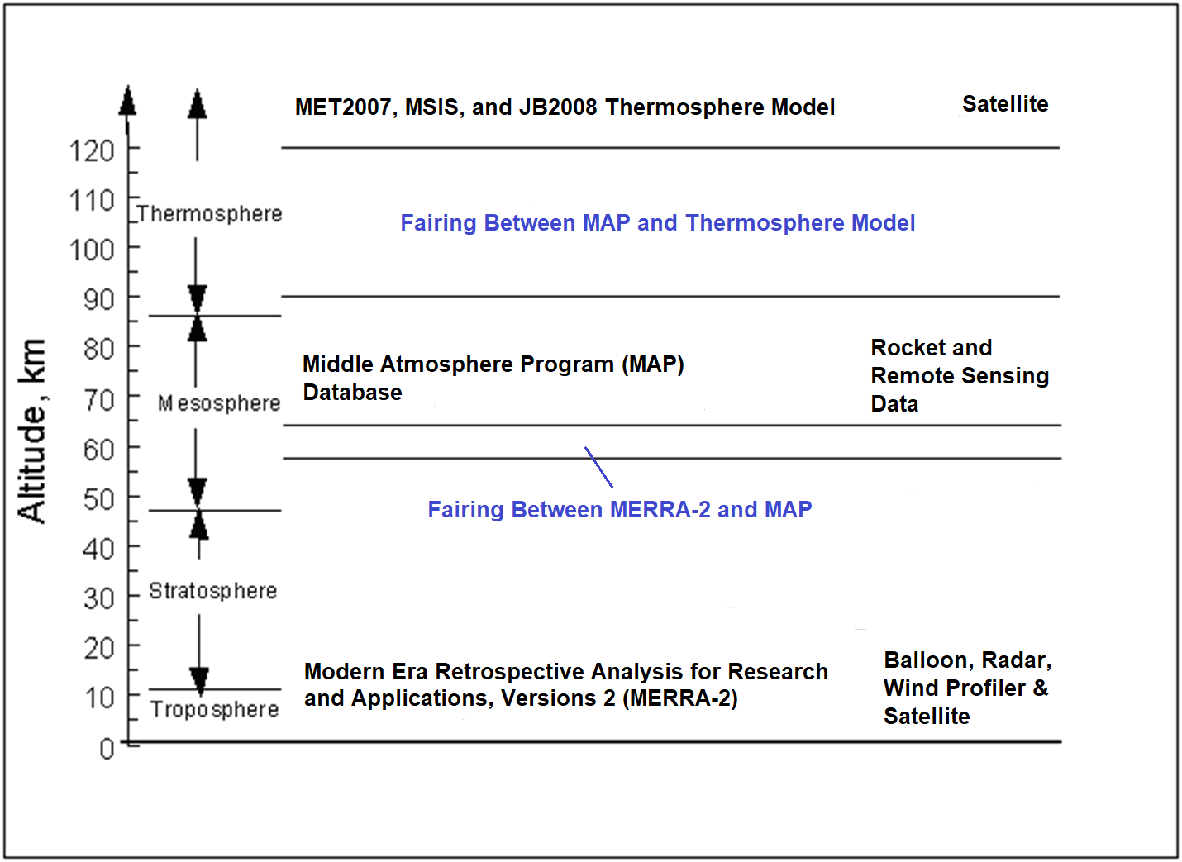
Earth-GRAM Input (Update)
Range Reference Atmosphere (RRA) Option
Auxiliary Profile Input Option

Slide 5
Range Reference Atmosphere (RRA)
Auxiliary Profile Option
Earth-GRAM can use the RRA site specific databases
  Earth-GRAM 2021 includes 1983, 2006, 2013, and 2019 RRA databases
  11 2019 RRA sites developed by MSFC/Natural Environments Branch for the Range Commanders Council – Meteorology Group
Climatology built from balloon and rocketsonde measurements
MSFC - Natural Environments recommends the use of the 2013 and 2019 RRA database
  Both databases follow a similar and well documented process
  The 2019 RRA compiles new data in the period of record
Auxiliary Profile option allows users the option to include profile of their choice

Slide 6
Earth-GRAM Perturbation Model
Values From Earth-GRAM =
Mean value + Large-scale perturbation + Small-scale perturbation
Modeled as a wave
Modeled as a stochastic (random) process
Driven by observed standard deviation

Slide 7
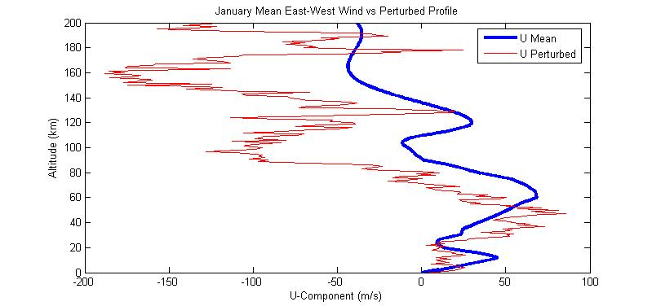
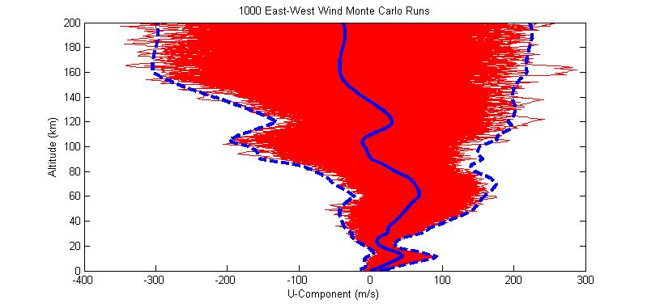
Sample GRAM Output
Mean and Dispersed East-West Wind
1000 Monte Carlo Dispersed Profiles with
January Monthly 3-Sigma Envelope

Slide 8
MERRA-2 Update
MERRA-2 reanalysis data set developed by Goddard Modeling and Assimilation Office (GMAO)
Improved horizontal resolution: 0.625°x0.5° longitude-by-latitude grid (NCEP reanalysis I, 2.5°x2.5° currently used in Earth-GRAM)
Improved altitudinal coverage: 72 model layers or interpolated to 42 pressure levels to 0.1 hPa (NCEP reanalysis I, 10hPa)
MERRA-2 provides lower and middle atmosphere coverage and provides improvement over aging MAP data set.
Input Observations:
  Surface: land, ship and buoy observations
  Upper Air: balloon, radar, wind profiler, satellite derived winds, and satellite retrieved measurements

Slide 9
MERRA-2 Development
Source: Global gridded data set developed from MERRA-2 daily files from 1999 to 2018
Variables: Monthly means and standard deviations taken from daily files for thermodynamic, winds, and moisture variables at surface and 42 pressure levels.
Time: Climatology developed every 3 hours (00Z, 03Z, 06Z, 09Z, 12Z, 15Z, 18Z, 21Z) and total average option
Binary data files developed and read into GRAM Suite
  Additional files created at 2° x 2° horizontal resolution as optional small file sizes
User input option to refine geographic scope of data
  Improves speed of runs

Slide 10
MERRA-2 V&V
Regression testing performed through unit, system-level, and beta testing
Unit Testing: Jim Hoffman has built test cases in code base to test on component-level
System-level Testing: compared to all 2013 and 2019 RRA sites and ran test cases for various inputs.
Beta Testing: Participation by LaRC and MSFC
Validation: Comparisons to 2013 and 2019 RRAs

Slide 11
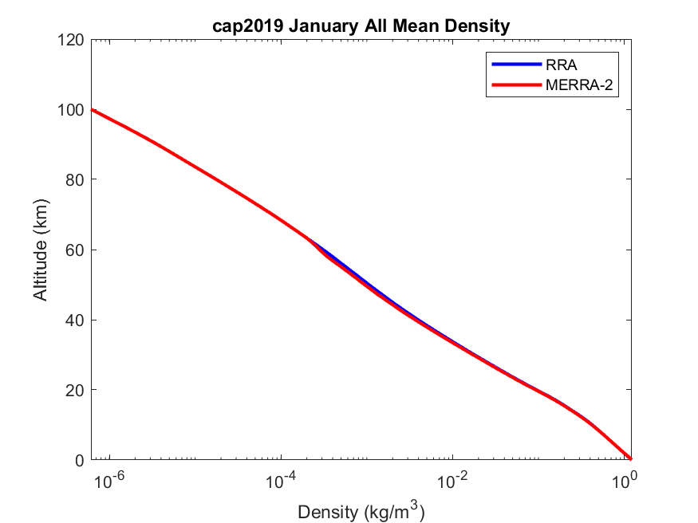
MERRA-2 Comparison
Mean January MERRA-2 vs RRA/MAP Density Comparison

Slide 12
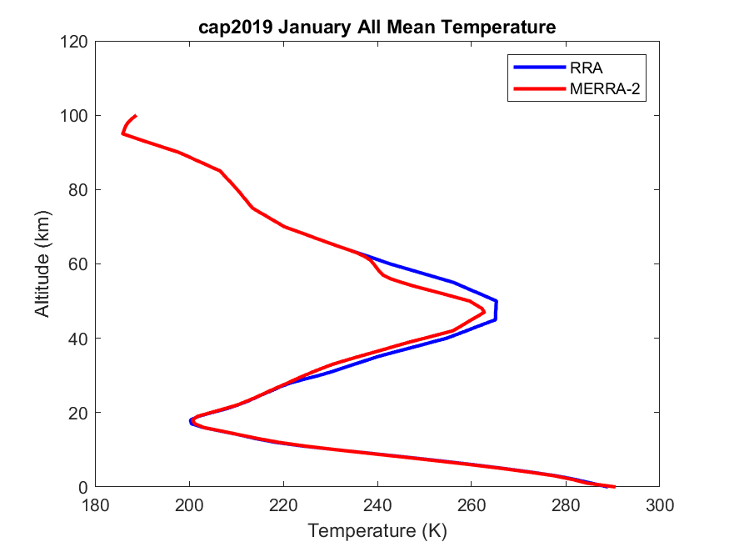
MERRA-2 Comparison
Mean January MERRA-2 vs RRA/MAP Temperature Comparison

Slide 13
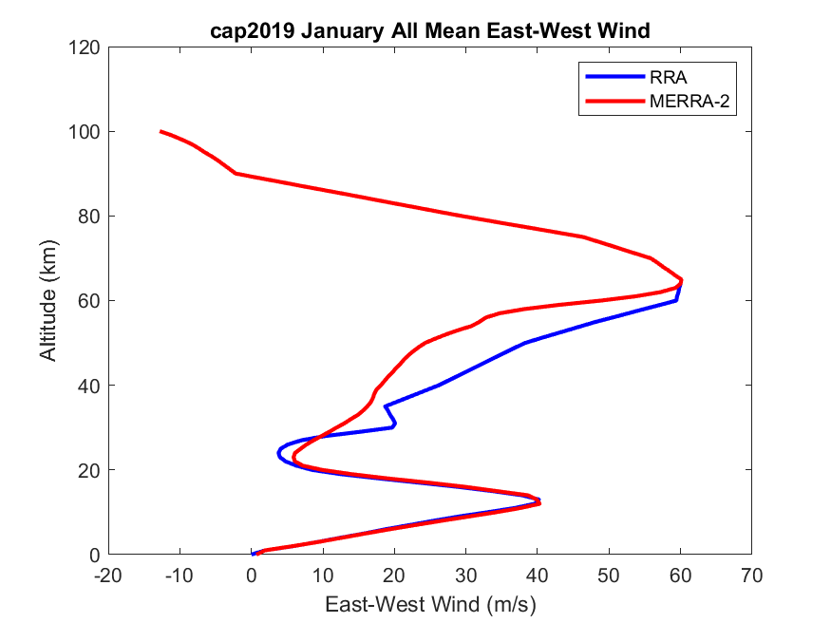
MERRA-2 Comparison
Mean January MERRA-2 vs RRA/MAP East-West Wind Comparison

Slide 14
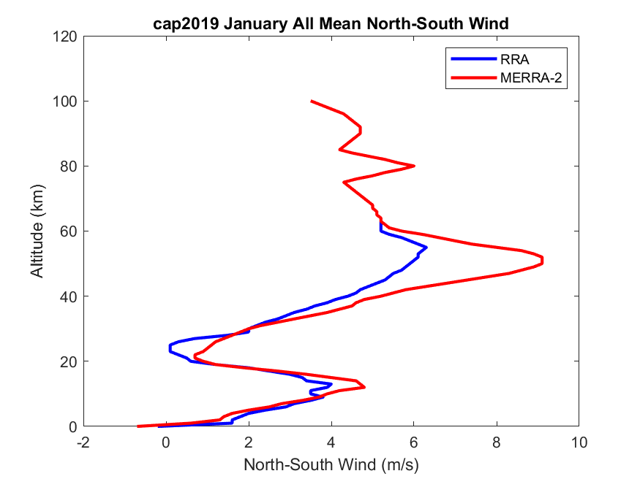
MERRA-2 Comparison
Mean January MERRA-2 vs RRA/MAP North-South Wind Comparison

Slide 15
Gridded Forecast Update
Partnered with LaRC to develop capability to integrate gridded forecast data in Earth-GRAM to support balloon drift studies
Have currently developed capability to read in and process Global Forecasting System (GFS) forecast data to replace the monthly climatological data
  Horizontal resolution: 0.25°
  Data at surface and on 42 pressure levels up to 0.01 mb
Would like to incorporate ability to use other forecast sources.
Delivered testable version to LaRC fall 2023

Slide 16
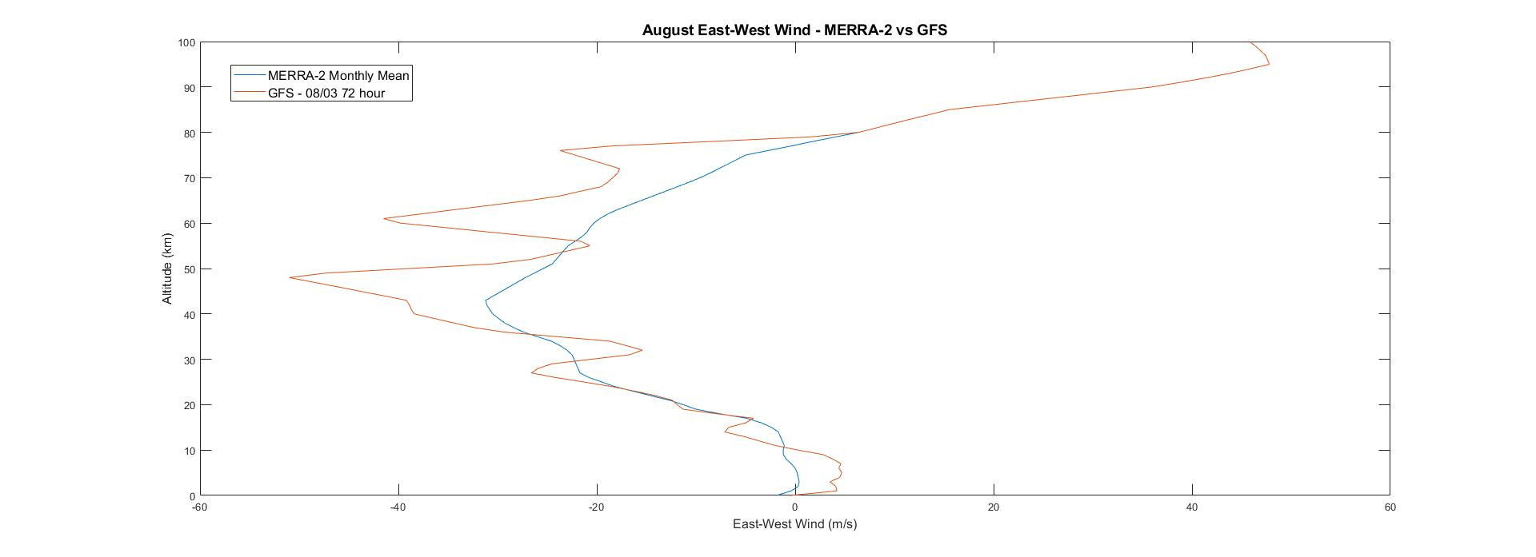
GFS Compare, Cape Canaveral, FL
Comparison of East-West Wind: MERRA-2 August Monthly Mean vs GFS 08/03

Slide 17
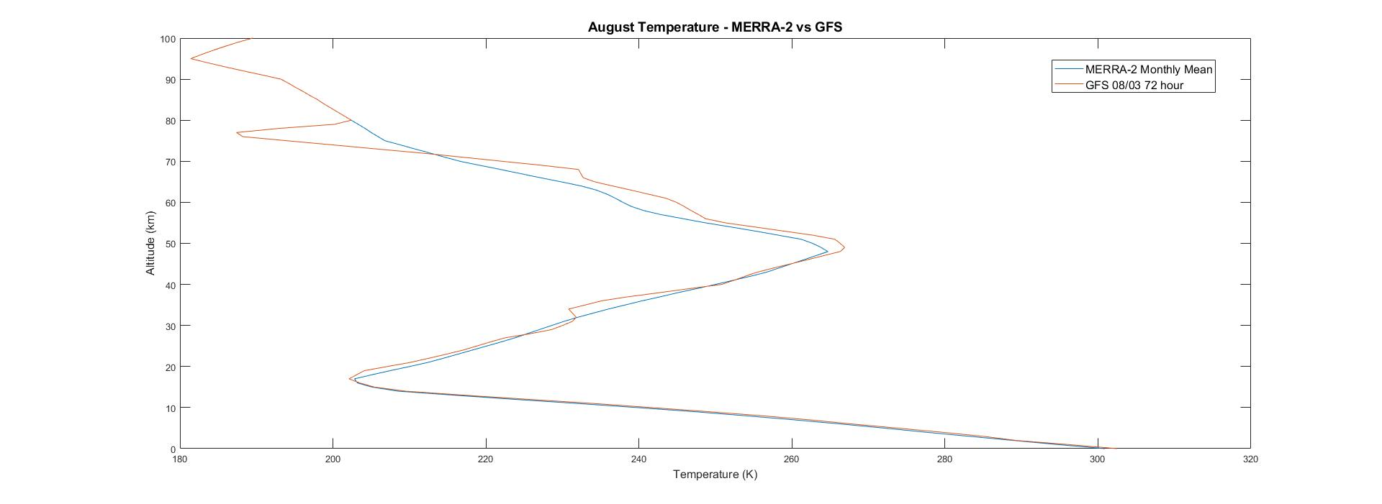
GFS Compare, Cape Canaveral, FL
Comparison of Temperature: MERRA-2 August Monthly Mean vs GFS 08/03

Slide 18
Future Upgrades
Application Program Interface (API)
  Python – Fall 2024 GRAM Suite Release
  MATLAB – Spring 2024 GRAM Suite Release
Thermosphere Update
  Update to Naval Research Lab Mass Spectrometer Incoherent Scatter (NRLMSIS) 2.1 to replace MSIS
  Targeting Fall 2024 GRAM Suite Release
Boundary Layer Improvements
  Improve BL horizontal winds: mean log wind speed profile
  Improve topography resolution
  Should improve parachute case and launch abort case environment

Slide 19
Summary
Released MERRA-2 update to GRAM Suite Fall 2023.
  Good comparison to RRA data and improvement to middle atmosphere environment
  Improvement in horizontal resolution, altitudinal extent, and hourly data selection
Plan to release testable version of Gridded Forecast update by Fall 2023 (Full Release to GRAM Suite, Spring 2024).
  Supports balloon drift studies
  Likely applicable for post-flight atmosphere reconstruction
Plan to release APIs to GRAM Suite
  Python – Fall 2023
  MATLAB – Spring 2024
Thermosphere Upgrade – Fall 2024 GRAM Suite Release
Future updates planned to address Earth-GRAM limitations
Feedback regarding Earth-GRAM encouraged and welcomed

