Slide 1

Ongoing GLM16/NLDN
National Climate Assessment Analyses
GLM Science Meeting, Huntsville, AL
15 November 2023
William Koshak, NASA/MSFC
Kenneth Cummins, University of Arizona

Slide 2
LIghtning MOnitor (LIMO)
Research Tool for monitoring lightning attributes as related to changes in climate
  Written in the Wolfram Language (Mathematica 13.2.1.0) by Koshak
  Replaces & expands upon the older Lightning Analysis Tool (LAT) written in IDL
  Puts Wolfram Knowledge Base “at your fingertips & ready for computation”
Ingests GLM-16 & NLDN datasets, and now produces PRATIO & ALPHA plots
Continuously evolving to identify, analyze & monitor new/insightful parameters derived from the GLM/NLDN data. (also useful for GLM cal/val)
Supports National Climate Assessment (NCA) … so focus on CONUS primarily
  How does a changing climate affect US lightning?
  What impact do changes in US lightning have on US infrastructure, economy, safety …?
    LNOx, wildfires, power-outages, deaths/injuries, crop/property damage, …
  What can changes in lightning tell us (i.e. “indicate”) about changes in climate?

Slide 3
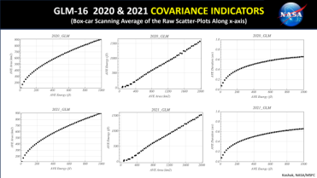
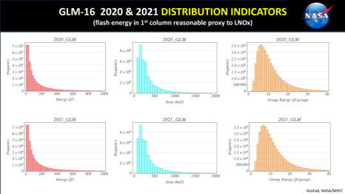
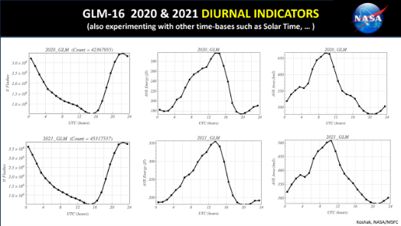
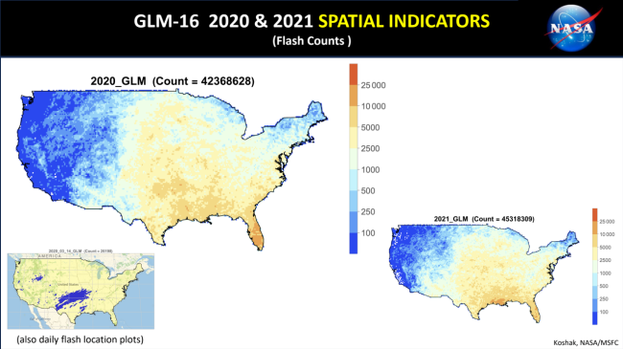
Overview of LIMO Analyses
.
.
18 Flash Parameters:
(NLDN, GLM)
p = CG peak current
m = CG multiplicity
p- = -CG peak current
m- = -CG multiplicity
p+ = +CG peak current
m+ = +CG multiplicity
e = energy … proxy for LNOx
a = area
d = duration
r = # groups
x = MGA
s = e/r = ave group energy
PRATIO = Ng+/Ng
ALPHA = Ng/N (hybrid)
Ng = # NLDN CGs
Ng- = # NLDN -CGs
Ng+ = # NLDN +CGs
N = # GLM flashes
Z = (N-Ng)/Ng = 1/ALPHA -1
Plot Types:
HIS: histogram
MAP: geographical CONUS heat map
DIU: diurnal variation
TIM: time evolution
LOC: flash location
COV: ave(VAR1) vs ave(VAR2)
Many Plots!
Statistics:
Size, Max, Mean, Std Dev, Median, Min
Analysis Periods:
Single Day
Multiple Days in a Month
Single Month
Multiple Months in a Year
Single Year
Multiple Years
.
.
.
Koshak, NASA/MSFC

Slide 4
Reclassified NLDN
NLDN “type classification” (IC vs. CG) has changed/evolved over the years
  2015, 2018, 2022: See Murphy et al. (2021, JTECH-A) for details
Therefore, “Normalization” is required to minimize effects of these changes on long-term trends in CONUS CG flash counts for NLDN reports since August 2015
Our Approach: “reclassify” all NLDN strokes and flashes using “pre-2015” classification
  Re-classify NLDN sensor reports as IC or CG using the classification algorithm and parameters employed before August 2015 (uses peak current, polarity, and waveform peak-to-zero time)
  Re-classify located strokes/cloud pulses using two nearest sensors >50 km from discharge location
  Re-classify located flashes based on member strokes / cloud pulses
    If a flash includes any CG strokes, it is classified as a CG flash

Slide 5
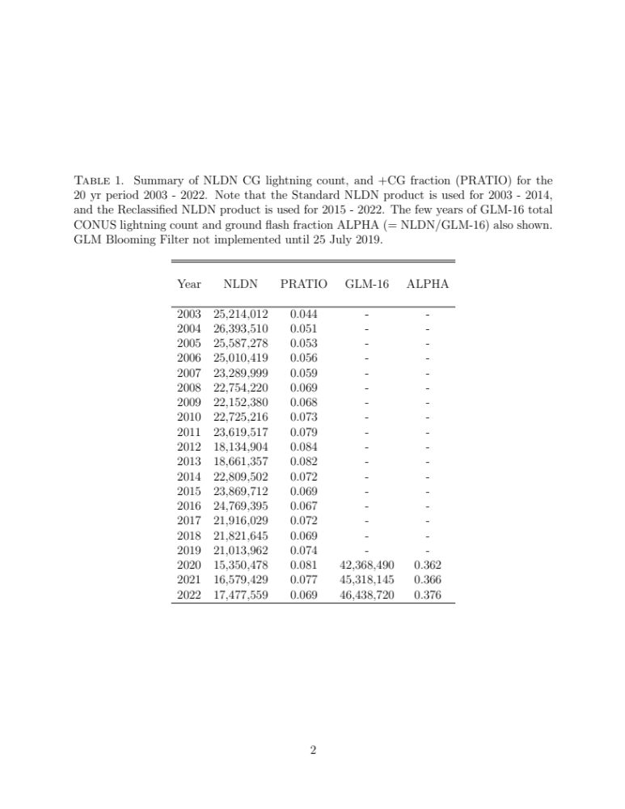
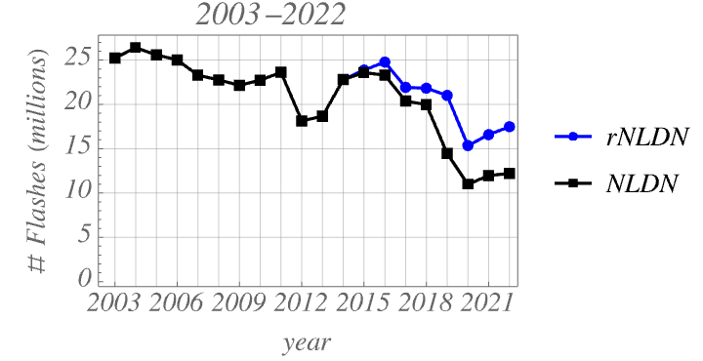
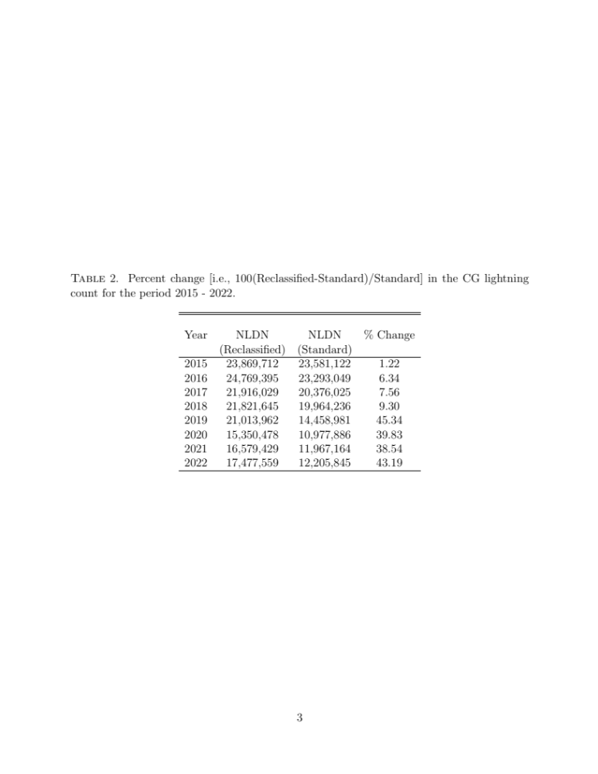
20 yr NLDN Flash Counts (2003 – 2022)
(17,477,559-25,214,012)/25,214,012 = -30.7% drop
Reclassified NLDN
Standard NLDN
Blooming Filter not implemented until
25 July 2019 … so ”clean” GLM-16 annual
results start in 2020.
Upticks in NLDN & GLM-16 occur coming out of COVID
GLM-16 flash counts not DE-corrected
Koshak, NASA/MSFC

Slide 6
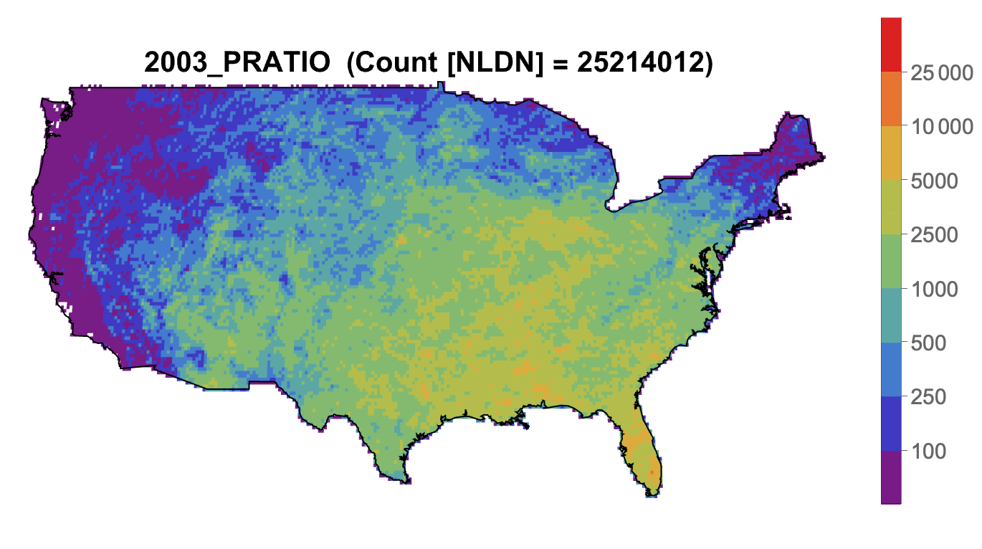
20 yr NLDN CG Flash Counts (2003 – 2022)
Koshak, NASA/MSFC

Slide 7
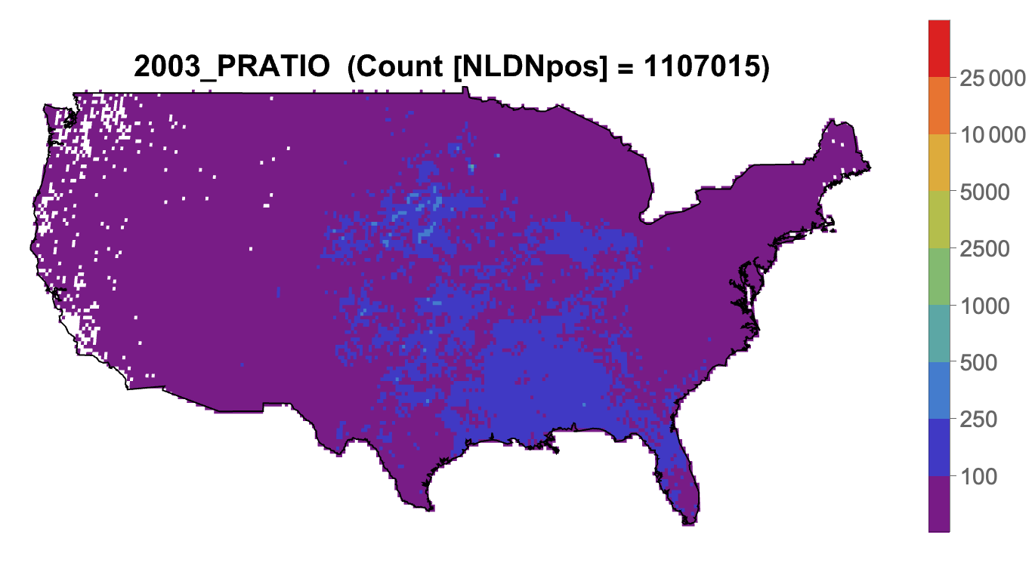
20 yr NLDN +CG Flash Counts (2003 – 2022)
Koshak, NASA/MSFC

Slide 8
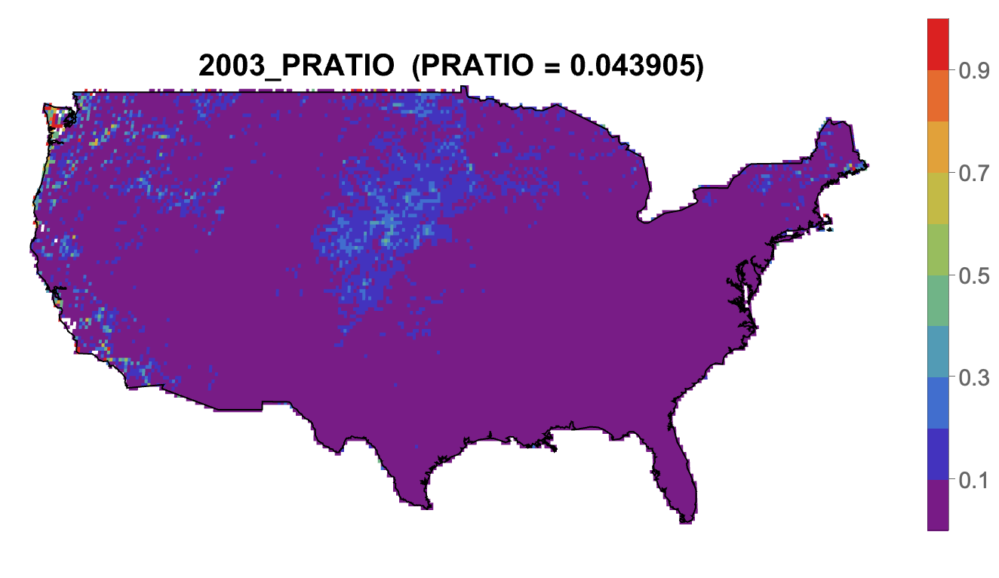
20 yr PRATIO = +CG/CG (2003 – 2022)
Koshak, NASA/MSFC

Slide 9
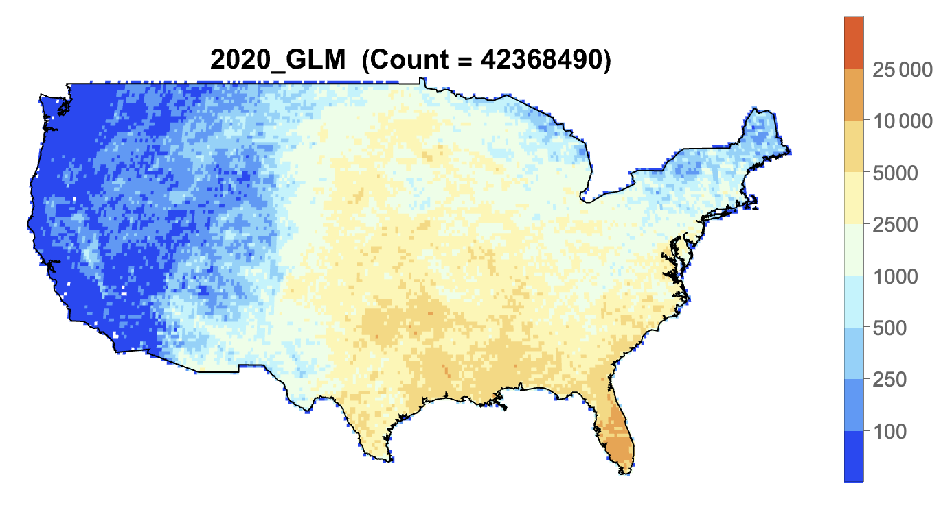
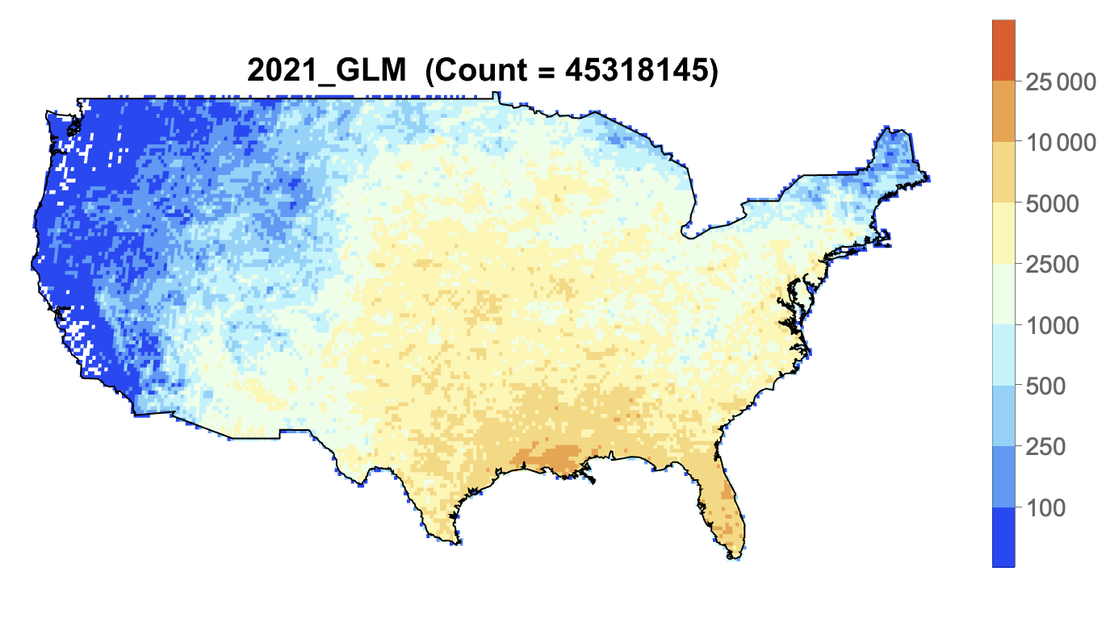
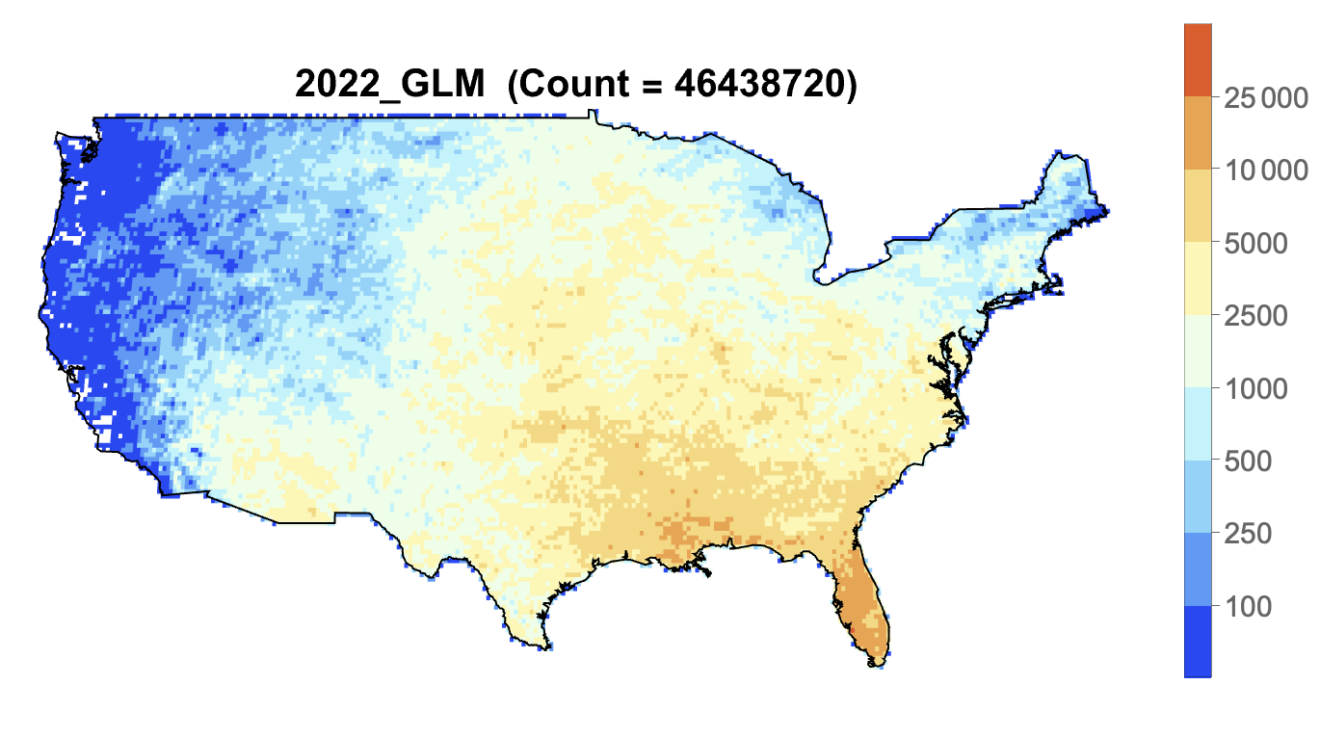
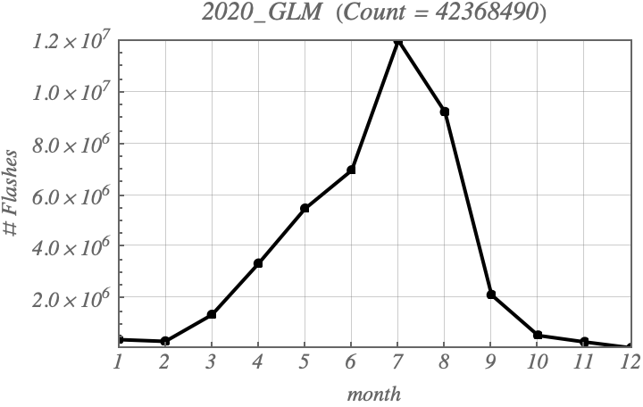
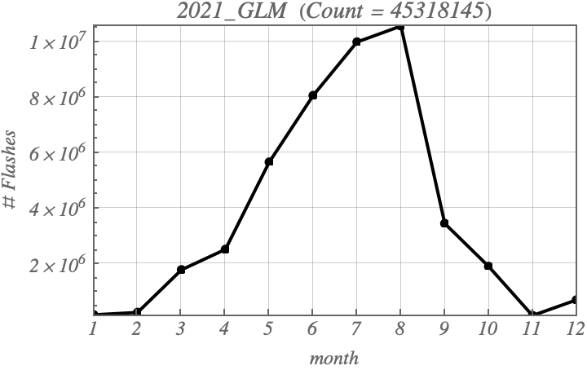
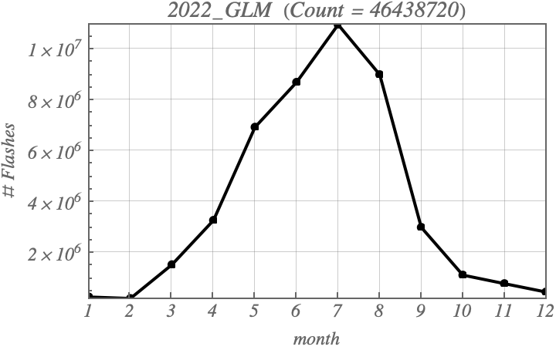
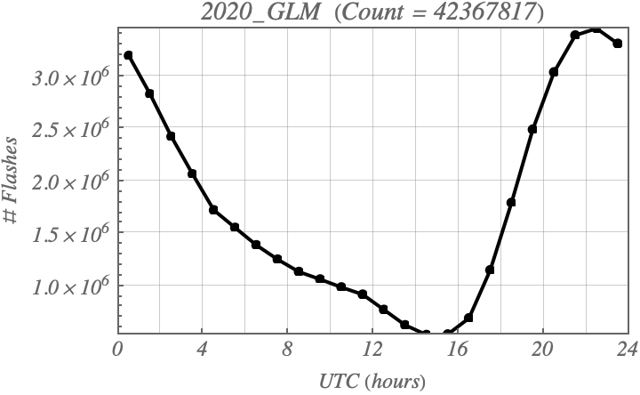
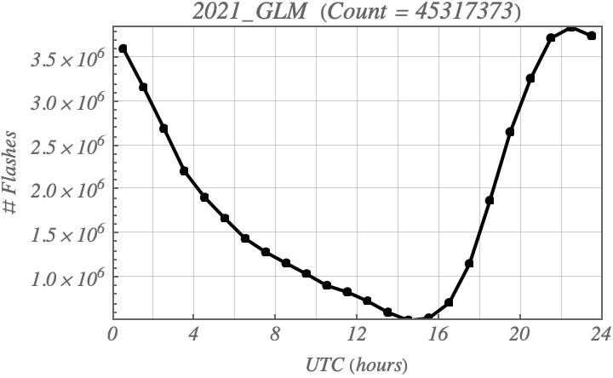
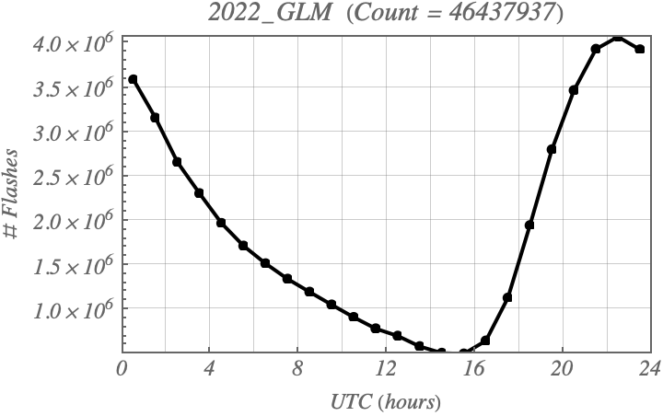
GLM-16 Flash Counts (2020 – 2022)
Koshak, NASA/MSFC

Slide 10
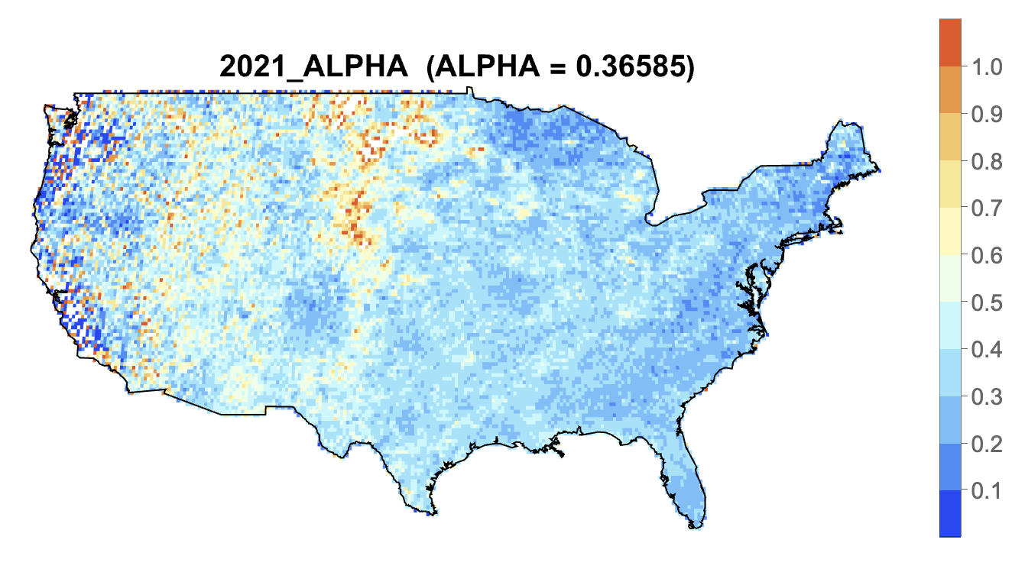
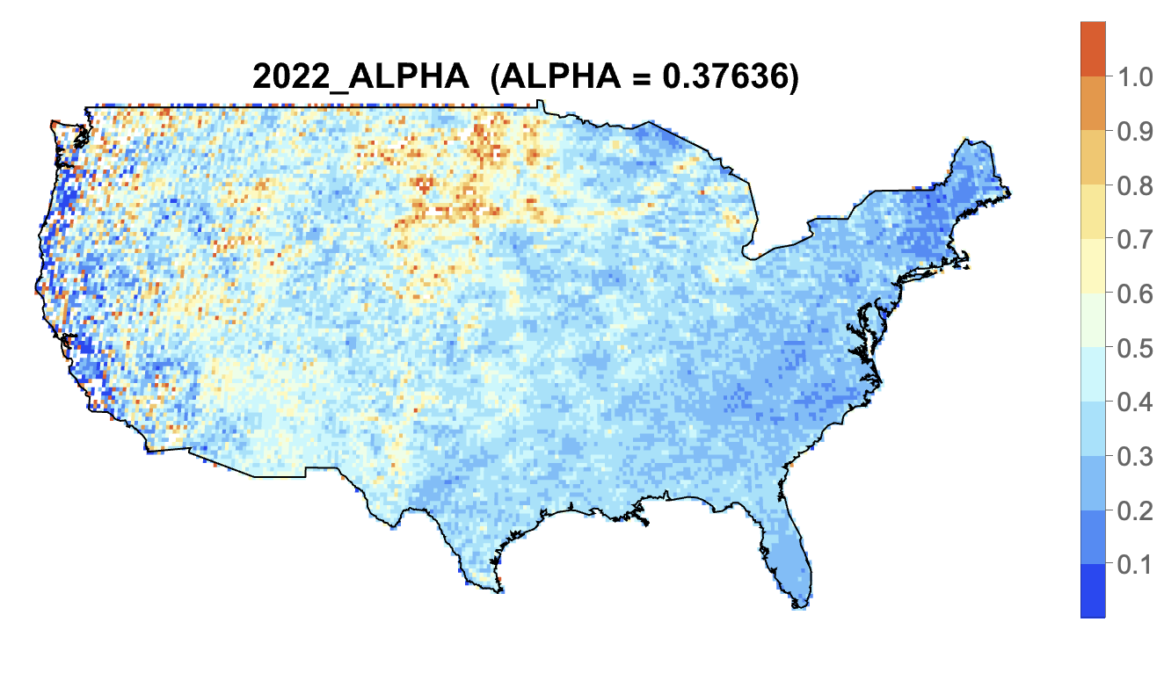
NLDN/GLM-16 Ground Flash Fraction (2020 – 2022)
TO BE REVISED
GLM-16 Counts Need DE-Correction
in Order to Show Proper Pattern
(see Medici et al., 2017)
Koshak, NASA/MSFC

Slide 11
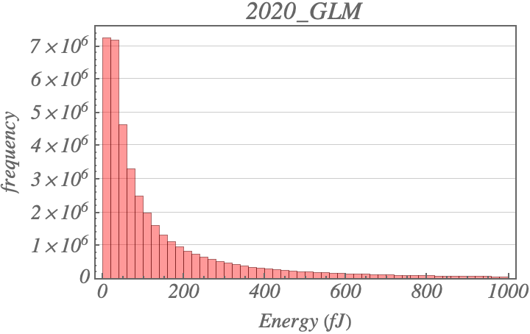
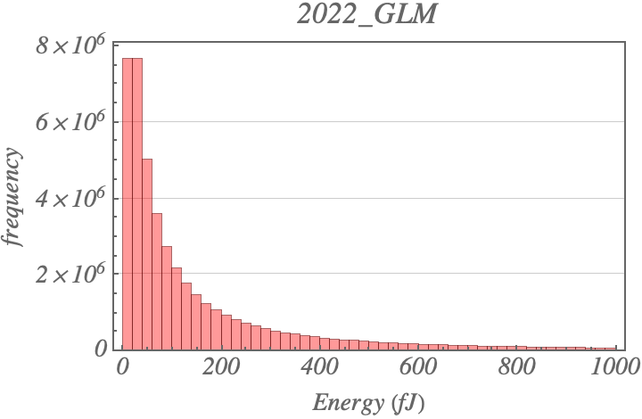

GLM-16 Flash Energy (2020 – 2022)
N = 42,368,490
Max = 65,535
Ave = 202.7
Std = 432.6
Med = 72.3
Min = 1.3
N = 46,438,720
Max = 65,530
Ave = 210.5
Std = 439.6
Med = 75.3
Min = 1.3
N = 45,318,145
Max = 65,535
Ave = 215.3
Std = 445.6
Med = 76.3
Min = 1.3
Koshak, NASA/MSFC

Slide 12
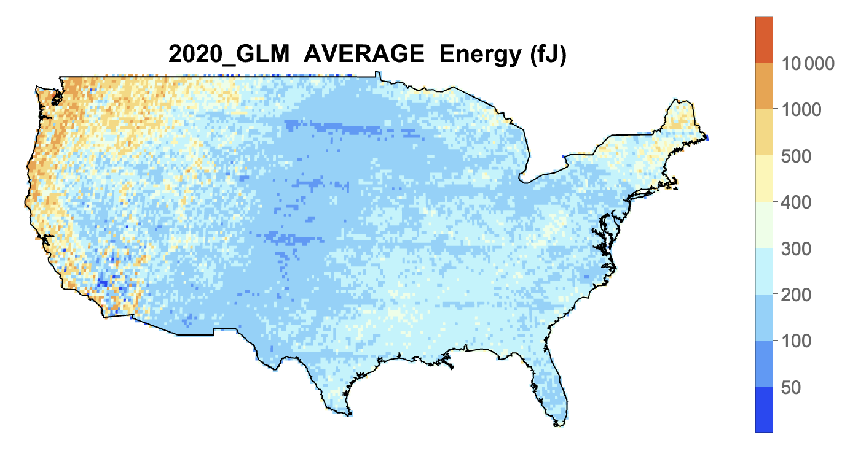
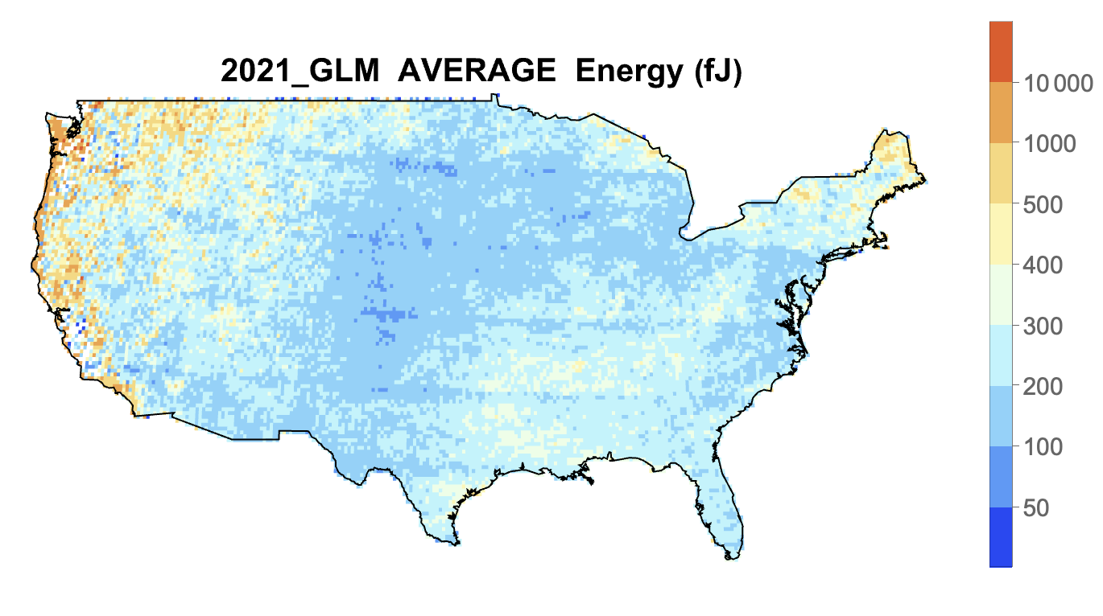
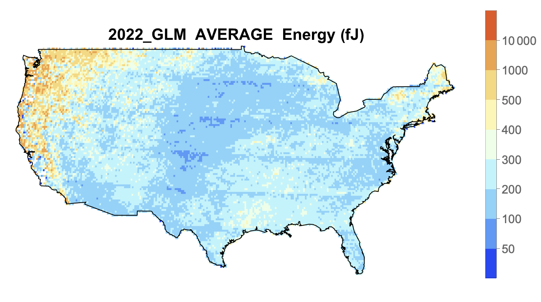
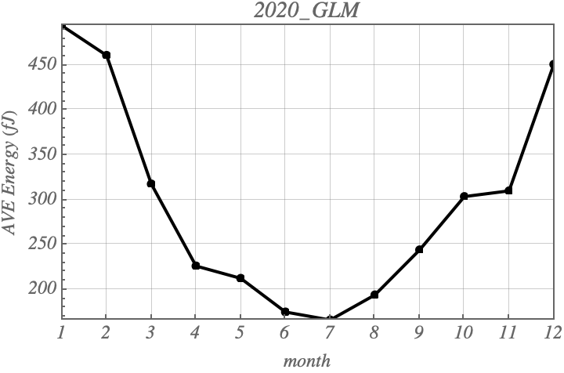
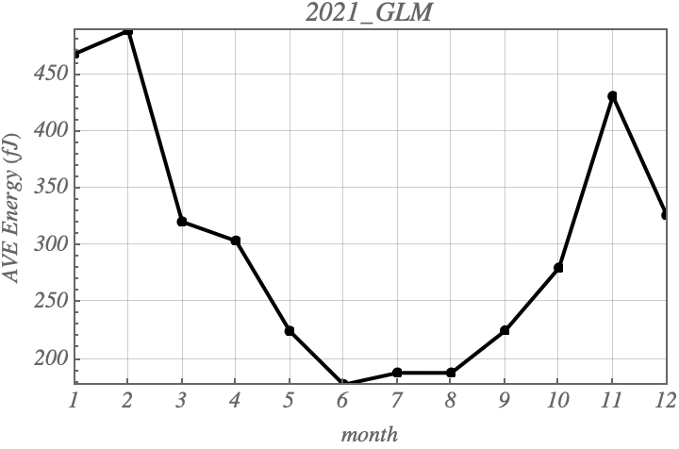
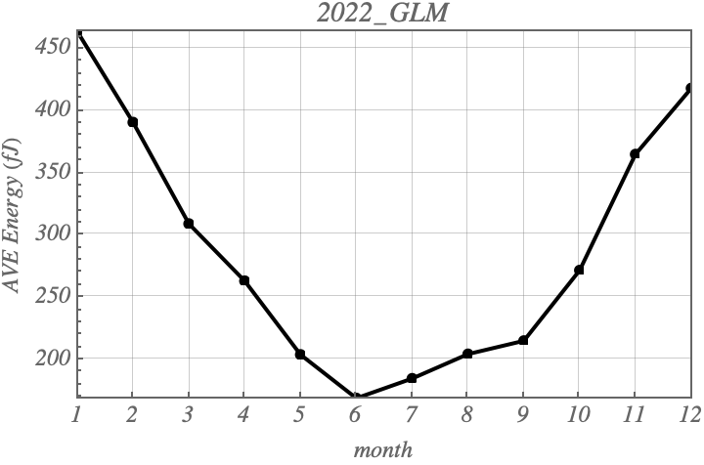
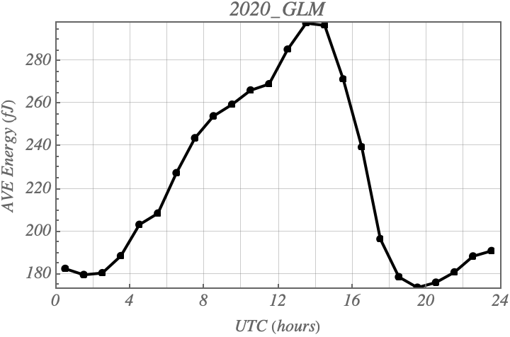
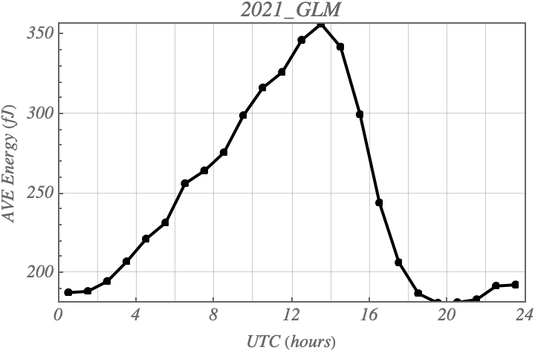
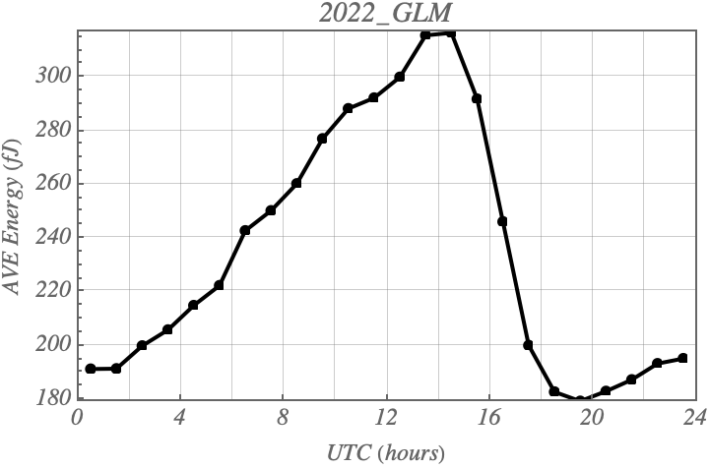
GLM-16 Flash Energy (2020 – 2022)
Koshak, NASA/MSFC

Slide 13
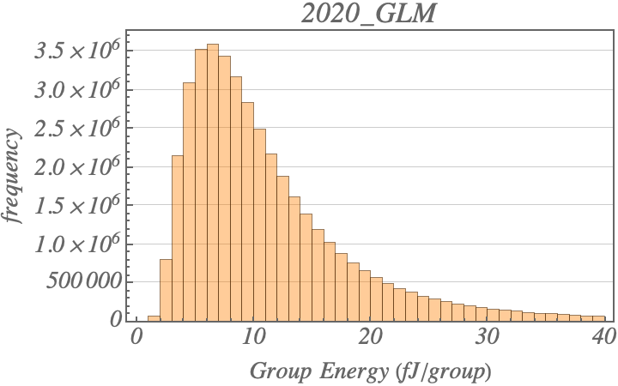
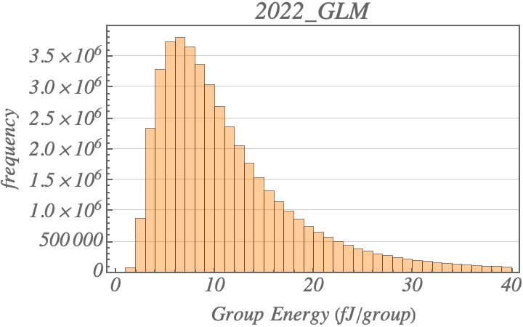

GLM-16 Group Energy (2020 – 2022)
N = 42,368,490
Max = 7649.4
Ave = 12.8
Std = 15.3
Med = 9.4
Min = 0.6
N = 46,438,720
Max = 11,017.1
Ave = 13.4
Std = 17.5
Med = 9.6
Min = 0.6
N = 45,318,145
Max = 6841.3
Ave = 13.3
Std = 16.2
Med = 9.7
Min = 0.6
Koshak, NASA/MSFC

Slide 14
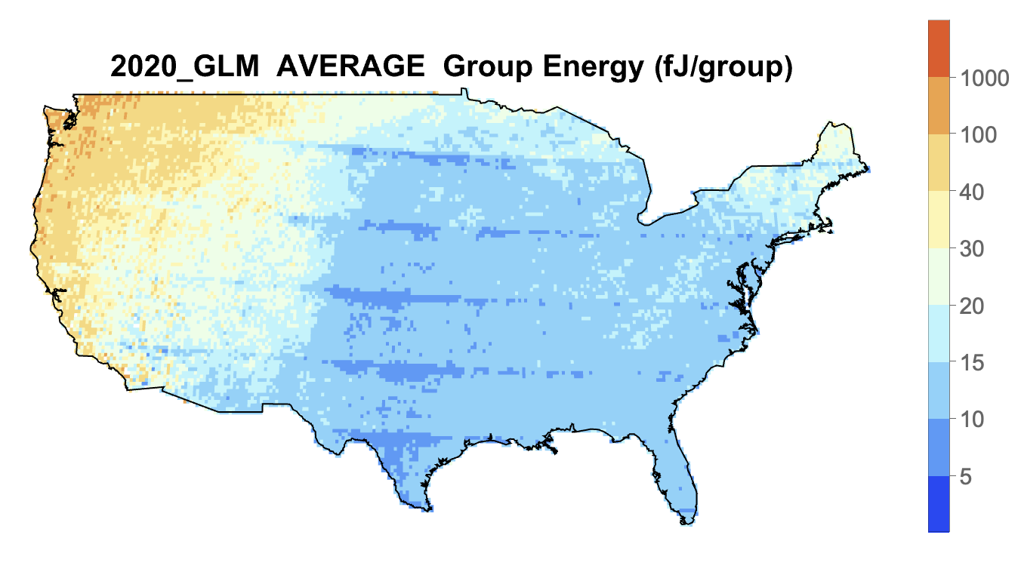
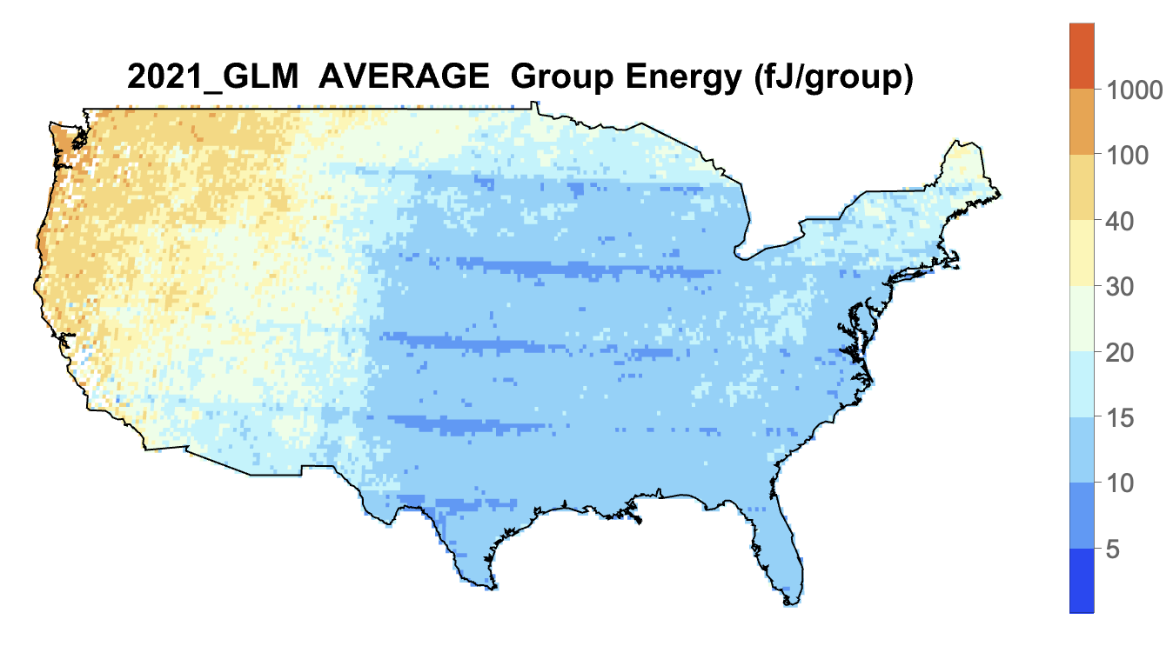
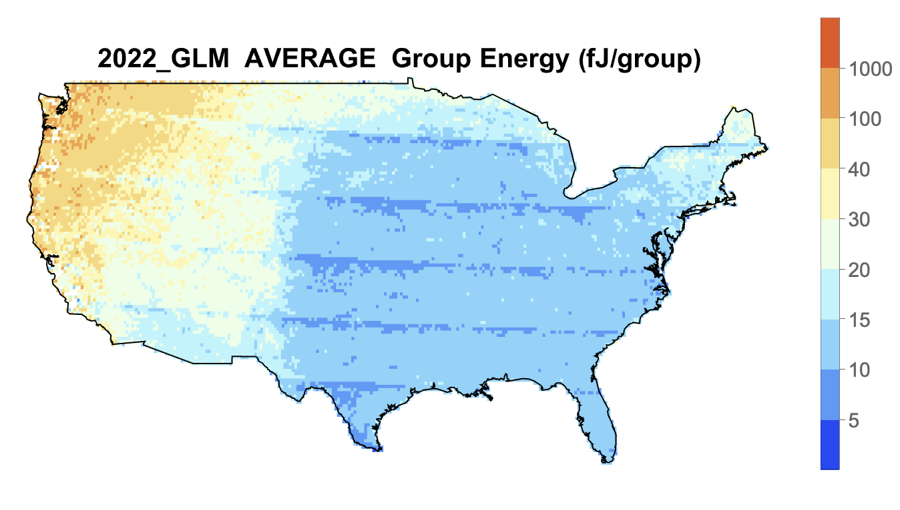
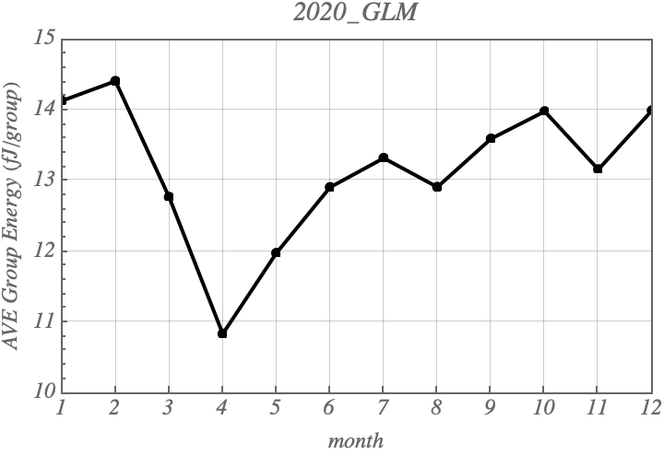
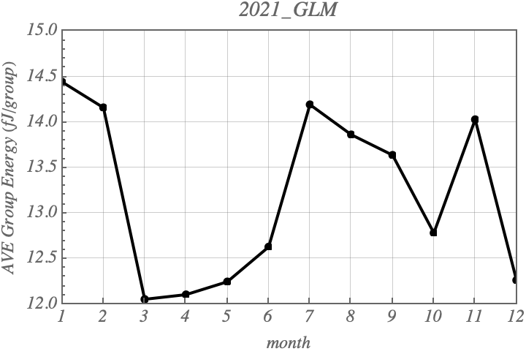
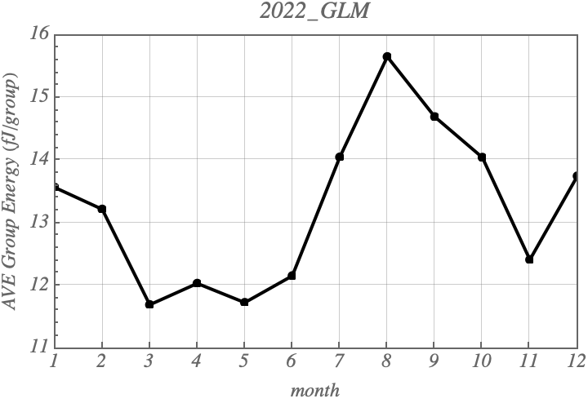
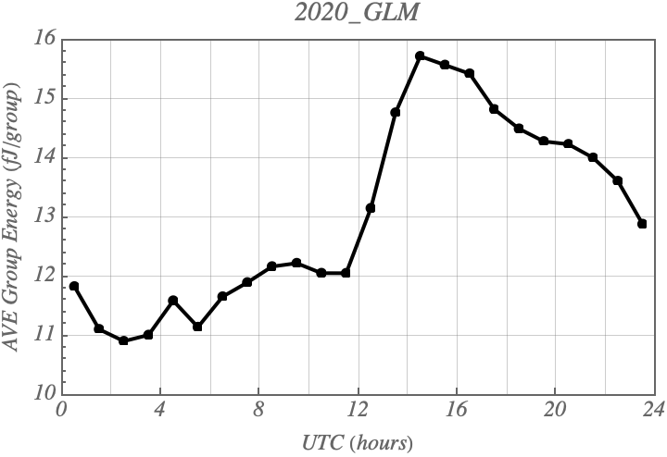
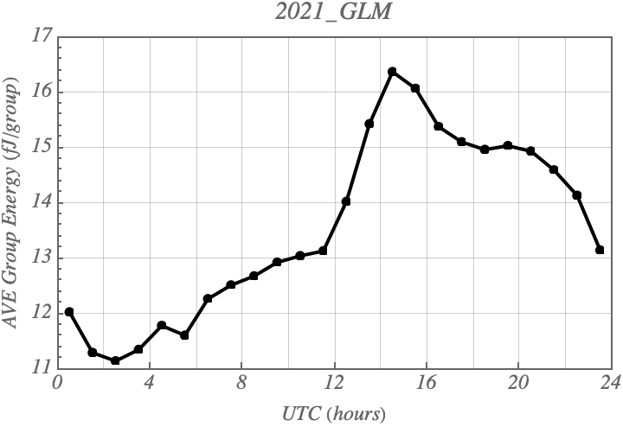
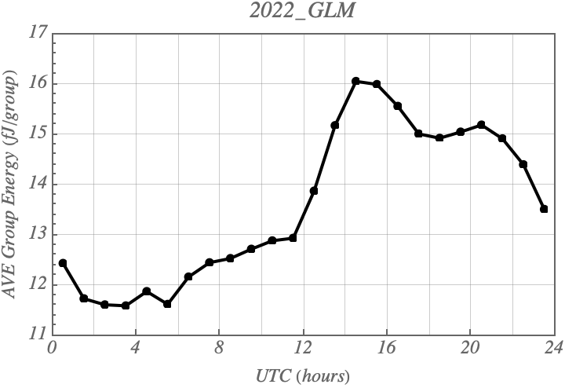
GLM-16 Group Energy (2020 – 2022)
Koshak, NASA/MSFC

Slide 15
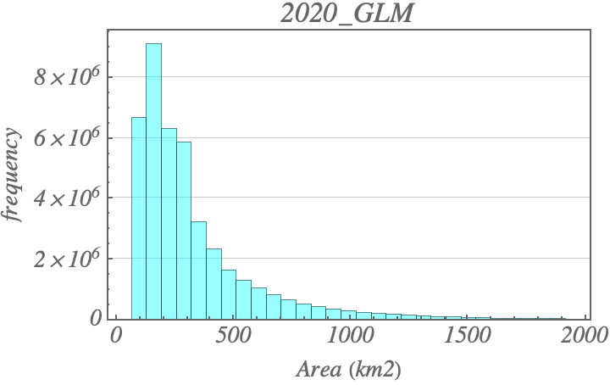
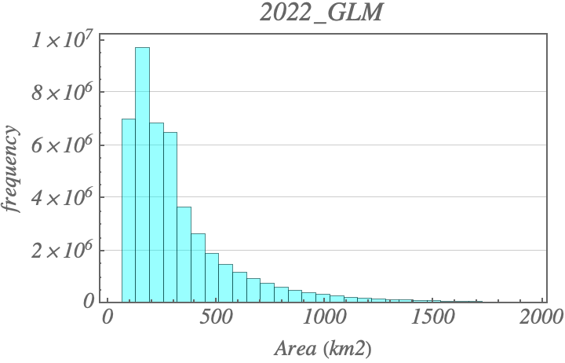

GLM-16 Flash Area (2020 – 2022)
N = 42,368,490
Max = 10,000.8
Ave = 337.6
Std = 344.3
Med = 226.6
Min = 65.2
N = 46,438,720
Max = 10,000.0
Ave = 343.3
Std = 347.4
Med = 231.8
Min = 65.2
N = 45,318,145
Max = 10,000.8
Ave = 347.9
Std = 356.6
Med = 233.3
Min = 65.2
Koshak, NASA/MSFC

Slide 16
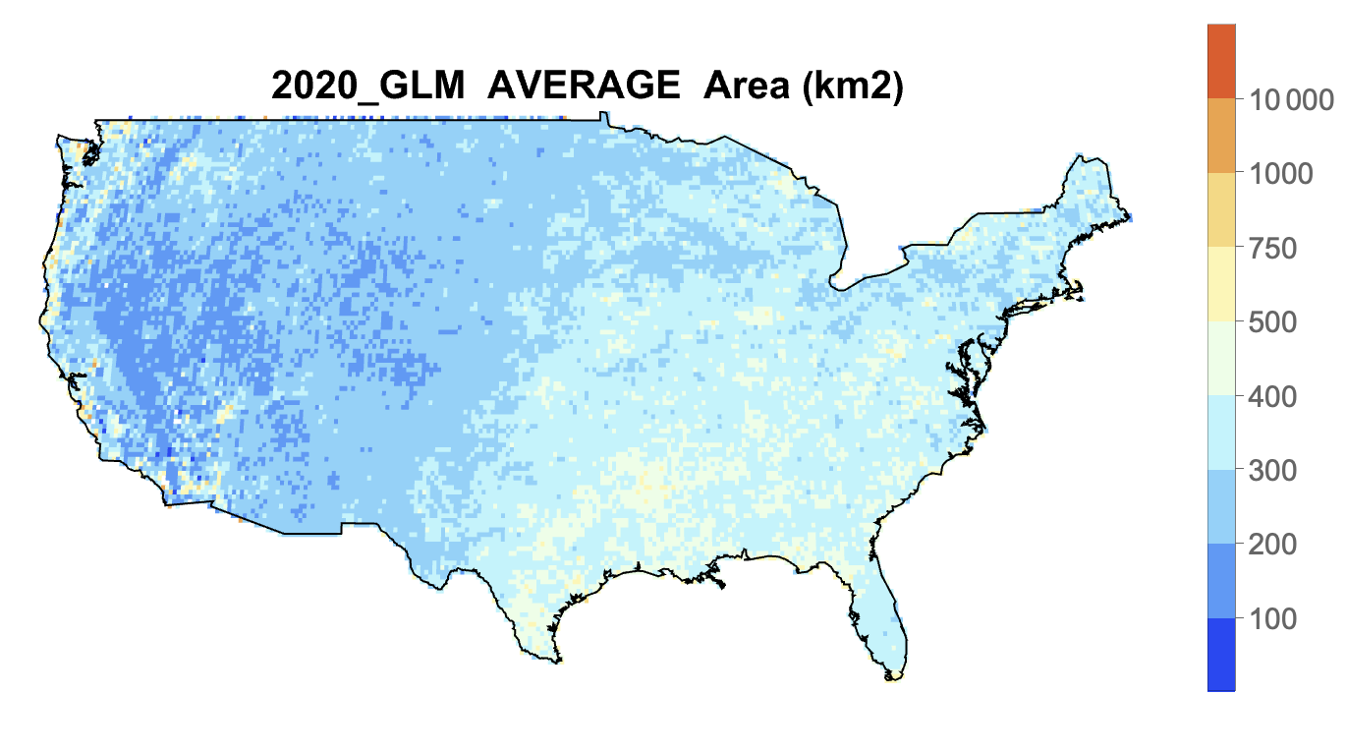
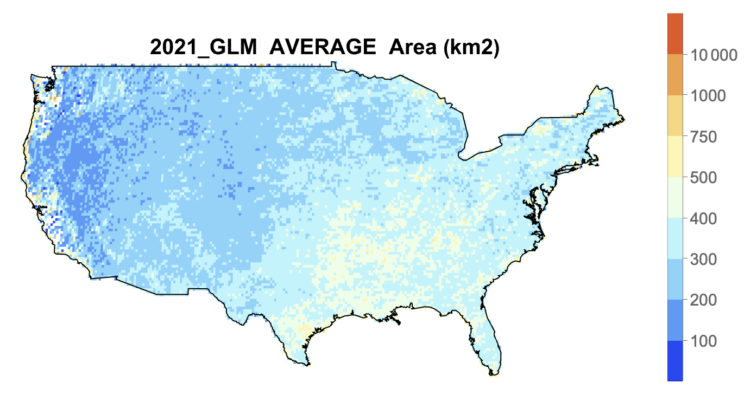
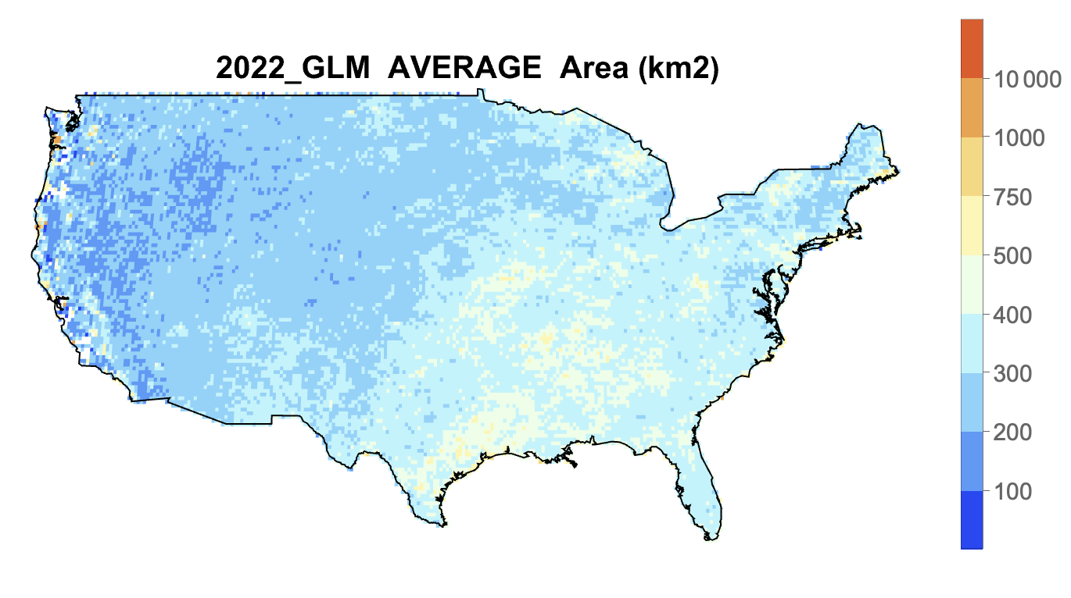
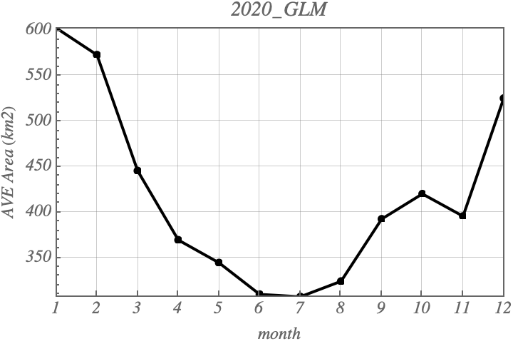
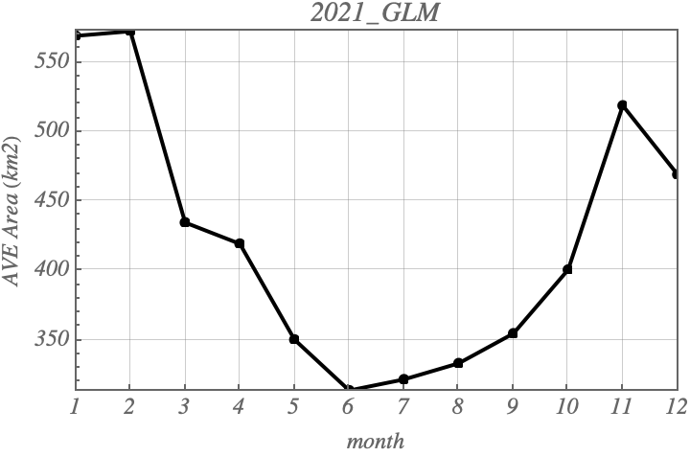




GLM-16 Flash Area (2020 – 2022)
Koshak, NASA/MSFC

Slide 17



GLM-16 Flash Duration (2020 – 2022)
N = 42,368,490
Max = 3.0
Ave = 0.279
Std = 0.258
Med = 0.217
Min = 0.0
N = 46,438,720
Max = 3.0
Ave = 0.280
Std = 0.257
Med = 0.217
Min = 0.0
N = 45,318,145
Max = 3.0
Ave = 0.282
Std = 0.258
Med = 0.219
Min = 0.0
Koshak, NASA/MSFC

Slide 18









GLM-16 Flash Duration (2020 – 2022)
Koshak, NASA/MSFC

Slide 19



GLM-16 # Groups in Flash (2020 – 2022)
N = 42,368,490
Max = 101
Ave = 13.2
Std = 15.4
Med = 7
Min = 1
N = 46,438,720
Max = 101
Ave = 13.3
Std = 15.7
Med = 7
Min = 1
N = 45,318,145
Max = 101
Ave = 13.6
Std = 16.0
Med = 8
Min = 1
Koshak, NASA/MSFC

Slide 20









GLM-16 # Groups in Flash (2020 – 2022)
Koshak, NASA/MSFC

Slide 21



GLM-16 Max Group Area (2020 – 2022)
N = 42,368,490
Max = 10,000.8
Ave = 290.9
Std = 290.2
Med = 216.2
Min = 65.2
N = 46,438,720
Max = 10,000.0
Ave = 297.1
Std = 294.5
Med = 217.3
Min = 65.2
N = 45,318,145
Max = 10,000.8
Ave = 300.9
Std = 303.2
Med = 218.7
Min = 65.2
Koshak, NASA/MSFC

Slide 22









GLM-16 Max Group Area (2020 – 2022)
Koshak, NASA/MSFC

Slide 23
Summary
The 20 yr NLDN CG Count has trended downward
  Data from 2015-2022 was reclassified to normalize the 20yr record (removed even a steeper downward trend)
  Downward trend of about 31% over the 20 yr period.
Best (2020-2022) GLM-16 total flash count showed mild upward trend coming out of COVID, as did NLDN CG flash count
A solid benchmark of basic GLM-16 measurements (flash count, flash energy, group energy, flash area, flash duration, # groups per flash, maximum group area) were provided to help detect/assess possible future changes in instrument performance & natural lightning variability over CONUS pertinent to NCA analyses
Future Improvements
  Future reprocessing of GLM-16 data will back-fill results (TBDmonth/2016 – July/2019)
  GLM-16 counts to be boosted by dividing by GLM-16 DE results
  GLM-17/18 data to be used to examine/patch GLM-16 low DE in NW CONUS
Koshak, NASA/MSFC

