Slide 1


Hunting Energetic Radiation from Thunderstorms
University of Bergen
Jackson Remington
NASA Postdoctoral Program
Marshall Space Flight Center
E. Grove (NRL), J. Montanya (UPC)
M. Pazos (UNAM), M. Stanley (LMA Tech.)
C. Velosa (UNC), M. Fullekrug (Bath University),
S. Cummer (Duke), M. Cohen (GIT), R. Longenbaugh (Sandia NL)
N. Østgaard, M. Marisaldi, A. Mezentsev, D. Sarria (U. of Bergen)
T. Lang, M. Quick, C. Schultz, R. Blakeslee (MSFC)
I. Adams, R. Kroodsma, G. Heymsfield (GSFC)
H. Christian, P. Bitzer (UAH)

Slide 2
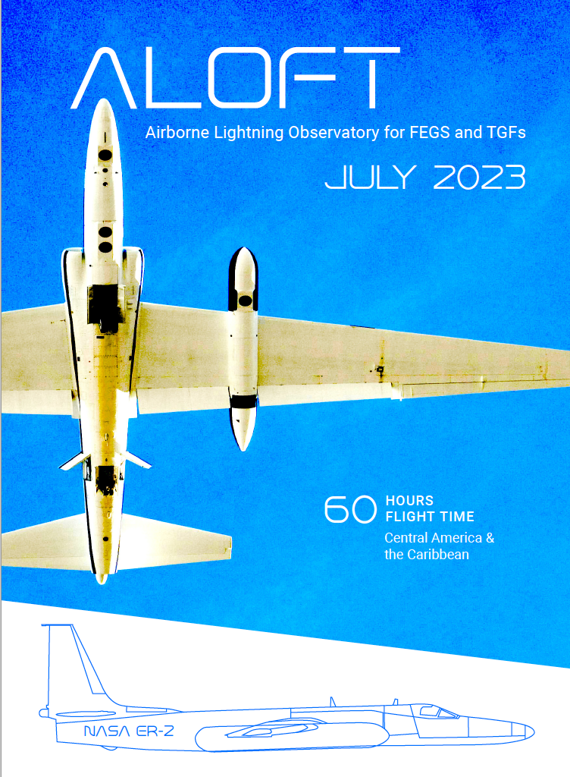
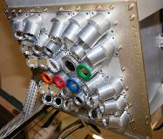


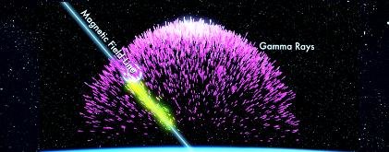
Airborne Lightning Observatory for FEGS and TGFs
Fly’s Eye GLM Simulator
Geostationary Lightning Mapper
Terrestrial Gamma-ray Flashes

Slide 3
Terrestrial Gamma-ray Flashes & Gamma-ray Glows
Relatively rare events
“Series of happy accidents”
Cascades of relativistic electrons fueled by large-scale electric fields
TGFs:
Gamma-ray photons up to 10s of MeV
Duration: 10s – 100s of μs
Produced by extreme, small-scale electric fields
  occurs first few ms of lightning leader development
Fluence anywhere from 10¹⁵ – 10¹⁹ photons
Gamma-ray glows:
Gamma-ray photons up to 10s of MeV
Duration: ~Minutes
Produced and maintained by large-scale electric fields

Slide 4
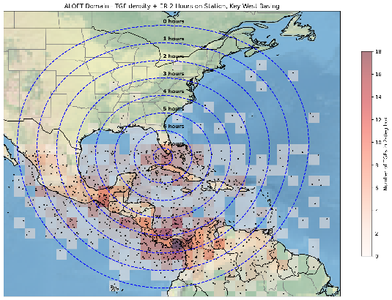

The ALOFT Campaign
July 2023
Based out of MacDill AFB, Tampa, FL
Identify, seek out, and observe TGFs/glows over tropical thunderstorms
  How are they related? Different?
  What is their connection to storm state?
NASA ER-2 aircraft outfitted with a suite of instruments:
  UIB-BGO and iSTORM gamma detectors
  FEGS for multi-spectral lightning observations
  EFCM and LIP electric field change sensors
  Active and passive microwave sensors
    AMPR, EXRAD, CoSSIR, CRS

Slide 5
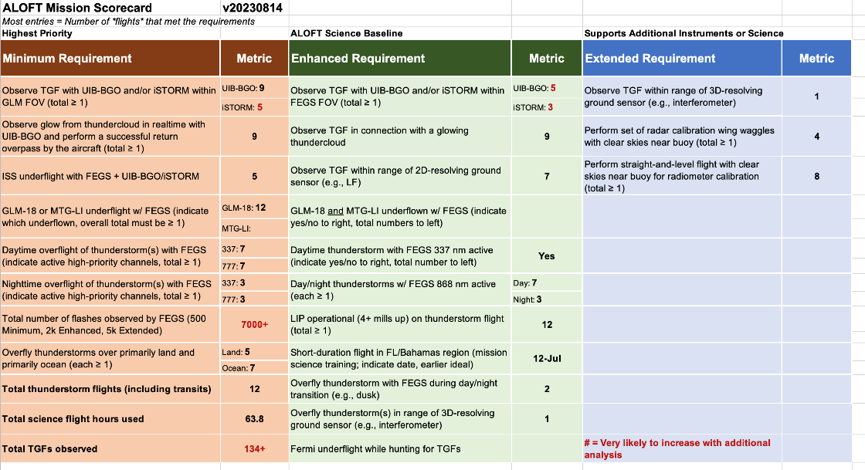

Slide 6
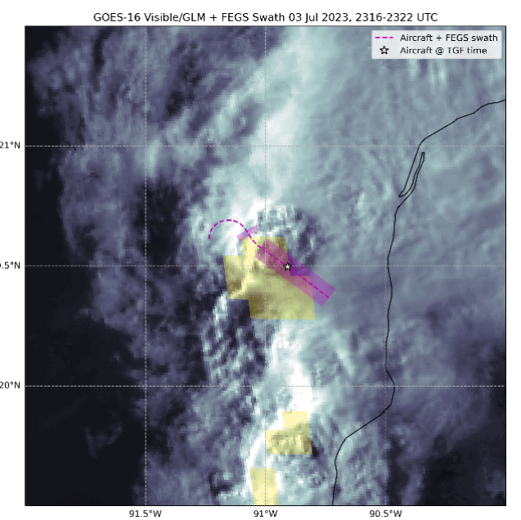
First Science Flight: July 3-4
First science flight
Off the West coast of Yucatan Peninsula
Multiple passes with active gamma glows
One TGF!
PRELIMINARY

Slide 7

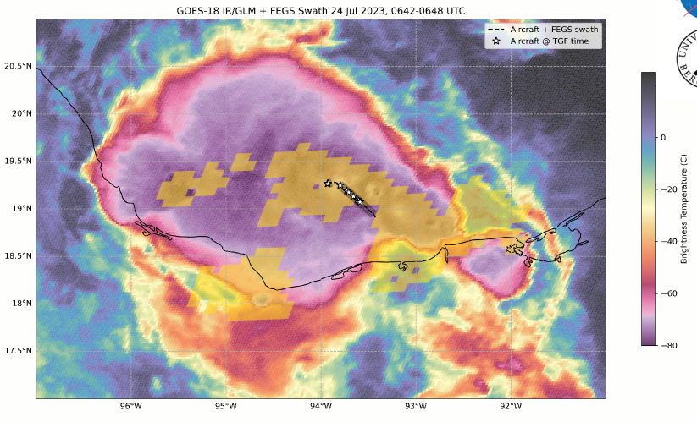
July 24
Campache Bay
  Most TGF results at this location (even ignoring this flight)
Nearly constant glows and 85 confirmed TGFs!
PRELIMINARY

Slide 8
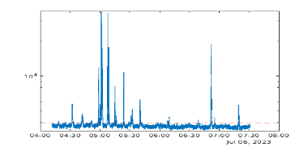
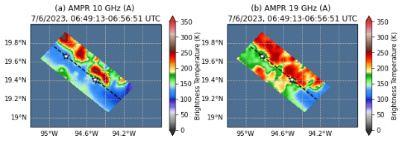
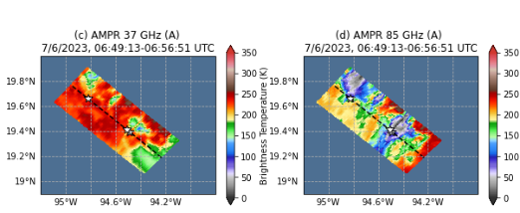
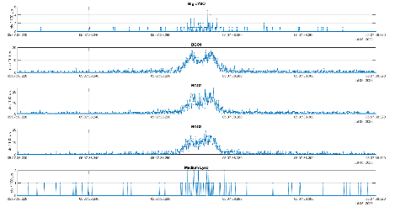
Example data: July 6
PRELIMINARY
Long-duration TGF(s)
~10 ms total with definite sub-structure
TGFs typically observed over pockets of greatest convection and lowest temperature

Slide 9
Future ALOFT Data Research
TGF studies
  134+ TGF observations
  TGF characteristics from suborbital platform?
  Gamma-ray production mechanisms?
Lightning and meteorology studies
  7000+ lightning flashes
  Strong dataset of tropical storms
Validate other lightning mappers/gamma detectors
  Multiple satellite and ISS underpasses, overflights of ground networks
Examine relationship between TGFs, gamma-ray glows, and thunderstorm microphysics
  Predict chance of electromagnetic showers?
AGU 2023!

Slide 10
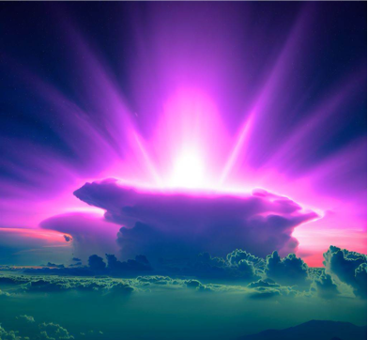
Summary
ALOFT Campaign 2023 incredibly successful!
  7000+ lightning flashes
  134+ TGFs, many during active gamma-ray glows
Still many unknown factors of TGFs and gamma glows
  High rate of coincident observations
  Production mechanisms?
Potential to connect energetic radiation to thunderstorm characteristics and cloud microphysics
Image generated using Bing AI: The New Bing - Terms of Use

