Slide 1
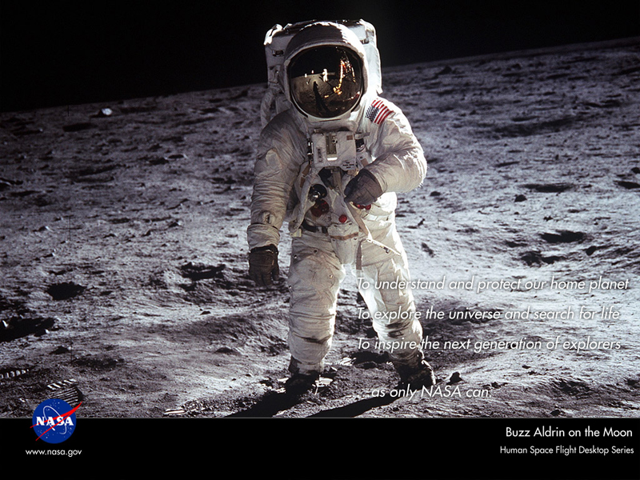
NASA Astronaut Selection and Training:
Overview by
Felix.A.Soto-Toro@NASA.gov
Kennedy Space Center
Audit Liaison Representative
November 14, 2023

Slide 2
Agenda
Definition
Categories
Background
Requirements
Pay and benefits
Frequently asked questions
Typical interview activities
Selection process timeline
Number of astronauts selected by year
Probability of being selected
Recent composition of selected astronauts
Building up your profile
Where is their office ?
What do astronauts do at work… when they are not flying ?
Some astronauts’ hobbies
Recommendations
Some useful websites

Slide 3
Definition of Astronaut
The term "astronaut" derives from the Greek words meaning "space sailor," and refers to all who have been launched as crew members aboard NASA spacecraft bound for orbit and beyond.
Since the inception of NASA's human space flight program, we have also maintained the term "astronaut" as the title for those selected to join the NASA corps of astronauts who make "space sailing" their career profession.
The term "cosmonaut" refers to those space sailors who are members of the Russian space program.

Slide 4
Definition of Astronaut
(continued)
The crew of each launched spacecraft is made up of astronauts and/or cosmonauts.
The crew assignments and duties of commander, pilot, Space Shuttle mission specialist, or International Space Station flight engineer are drawn from the NASA professional career astronauts.
A special category of astronauts typically titled "payload specialist" refers to individuals selected and trained by commercial or research organizations for flights of a specific payload on a space flight mission.
At the present time, these payload specialists may be cosmonauts or astronauts designated by the international partners, individuals selected by the research community, or a company or consortia flying a commercial payload aboard the spacecraft.

Slide 5
Space Flyers Categories
Classification | Description
Active | U.S. astronauts who are currently eligible for flight assignment, including those who are assigned to crews.
Management | Experienced astronauts who have been promoted to other positions within NASA, or astronauts on special duty assignments or sabbaticals that make them unavailable for direct support to the Astronaut Office.
Former | Those who have left NASA after a career in the Astronaut Corps, including those who are deceased.
International | Those individuals from international space agencies who have trained at Johnson Space Center and serve as mission specialists with NASA.
 | Astronauts: Arab Canada China “Taikonauts” Europe India Japan | Cosmonauts: Russia Tourists….

Slide 6
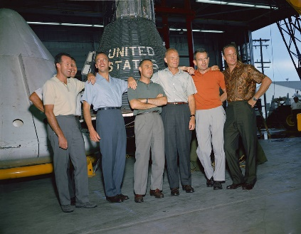
Astronaut Selection Facts
The first U.S. astronauts were selected in 1959, before human spaceflight operations began. NASA asked the military services to provide a list of personnel who met specific qualifications.
After stringent screening, NASA announced
its selection of seven men, all pilots, as the
first American astronauts.
NASA has selected 22 more groups of
astronauts since the “Mercury Seven.”
The backgrounds of NASA’s latest group of Astronaut Candidates included university professors, doctors, scientist, engineers and pilots.
NASA selects astronauts from a diverse pool of applicants with a wide variety of backgrounds.
From the thousands of applications received, only a few are chosen for the intensive Astronaut Candidate training program.
Including the “Mercury Seven”, only 370 astronauts have been selected to date (2021).
The astronauts of the 21st century will help lead NASA through the next steps of its Vision for Space Exploration as we explore the Moon, Mars, and beyond.
Scott Carpenter,
Gordon Cooper,
John Glenn,
Gus Grissom,
Walter Schirra,
Alan Shepard, and
Deke Slayton.
Notes:
Image Credit: https://www.nasa.gov/image-article/mercury-astronauts-2/

Slide 7
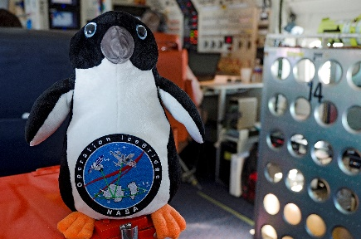
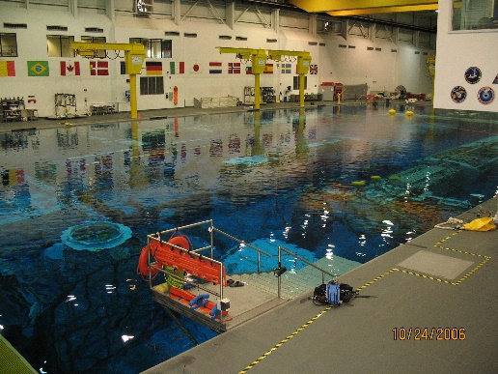
General Program Requirements
Selected applicants will be designated Astronaut Candidates and will be assigned to the Astronaut Office at the Johnson Space Center, Houston, Texas.
The astronaut candidates will undergo a training and evaluation
period lasting Approximately 2 years, during which time they will
participate in the basic Astronaut Candidate training program,
which is designated to develop the knowledge and skills
required for formal mission training upon selection for a flight.
Astronaut Candidates (Piloting background) will maintain
proficiency in NASA aircraft during their candidate period.
As part of the Astronaut Candidate training program, Astronaut
Candidates are required to complete military water survival
before beginning their flying syllabus, and become SCUBA
qualified to prepare them for the EVA training. Consequently,
all Astronaut Candidates will be required to pass a swimming
test during their first month of training. They must swim
3 lengths of a 25-M pool without stopping, and then swim
3 lengths of the pool in a flight suit and tennis shoes. There
is no time limit. They must also tread water continuously for 10 minutes.
(Applicant → Candidate → Astronaut “penguin” → Flown Astronaut)
Notes:
Image credit: https://blogs.nasa.gov/icebridge/2012/11/14/post_1351263310044/

Slide 8
General Program Requirements
(continued)
Applicants should be aware that selection as an Astronaut Candidate does NOT ensure selection as an astronaut.
Final selection as an astronaut will depend upon satisfactory completion of the training and evaluation period.
Civilian candidates who successfully complete the training and evaluation and are selected as astronauts will become permanent Federal employees and will be expected to remain with NASA for a period of at least 5 years.
Civilian candidates who are NOT selected as astronauts may be placed in other positions within NASA, depending upon Agency requirements and labor constraints at that time.
Successful military candidates will be detailed to NASA for a specified tour of duty.
NASA has an affirmative action program goal of having qualified minorities and women among those selected as Astronaut Candidates.
Therefore, qualified minorities and women are encouraged to apply.

Slide 9
Minimum Requirements for Mission Specialists Position
Astronaut requirements have changed with NASA's goals and missions. Today, to be considered for an astronaut position, applicants must meet the following qualifications: Be a U.S. citizen Possess a master's degree* in a STEM field, including engineering, biological science, physical science, computer science or mathematics, from an accredited institution. Have at least two years of related professional experience obtained after degree completion or at least 1,000 hours pilot-in-command time on jet aircraft. Be able to pass the NASA long-duration flight astronaut physical. *The master's degree requirement can also be met by: Two years (36 semester hours or 54 quarter hours) of work toward a doctoral program in a related science, technology, engineering or math field. A completed Doctor of Medicine or Doctor of Osteopathic Medicine degree. Completion (or current enrollment that will result in completion by June 2021) of a nationally recognized test pilot school program. Astronaut candidates must also have skills in leadership, teamwork and communications. NASA’s Astronaut Selection Board reviews the applications (a record-breaking 18,300 applications in 2016) and assesses each candidate’s qualifications. The board then invites a small group of the most highly qualified candidates for interviews at NASA's Johnson Space Center in Houston, Texas. Of those interviewed, about half are invited back for second interviews. From that group, NASA’s new astronaut candidates are selected. They report for training at Johnson and spend the next two years learning basic astronaut skills like spacewalking, operating the space station, flying T-38 jet planes and controlling a robotic arm. With NASA's plans for the future of exploration, new astronauts will fly farther into space than ever before on lunar missions and may be the first humans to fly on to Mars.

Slide 10
Minimum Requirements for Pilots Position
Pilot (Applicants with less than Jet aircraft pilot licenses do NOT qualify for this position) …frequent flyer miles do not count, sorry ! | Astronaut Candidate (Piloting background) Bachelor’s degree from an accredited institution in engineering, biological science, physical science or mathematics. An advanced degree is desirable. Quality of academic preparation is important. At least 1,000 hours pilot-in-command time in jet aircraft. Flight test experience is highly desirable. Ability to pass the NASA long-duration space flight physical which includes the following specific requirements: Distant visual acuity: Must be correctable to 20/20, each eye (NOTE: For those applicants under final consideration, additional visual screening will be performed to include the following standards: refractive error (distant vision)-cycloplegic refractive error must be between +3.50 and -4.00 diopters in any meridian. Astigmatism may require up to 2.00 diopters of cylinder correction. Anisometropia of up to 2.50 diopters. You are not required to provide this information with your initial application. We will request it later if needed.) Near visual acuity: Must be correctable to 20/20 each eye The refractive surgical procedures of the eye, PRK and LASIK, are now allowed, providing at least 1 year has passed since the date of the procedure with no permanent adverse after effects. For those applicants under final consideration, an operative report on the surgical procedure will be requested. Blood pressure not to exceed 140/90 measured in a sitting position Standing height between 62 and 75 inches (5’ 2” and 6’3”)

Slide 11
Pay and Benefits for
Astronaut Candidates
Source | Guidelines
Civilian | Starting in 2021, salaries for civilian Astronaut Candidates are based on the NASA Excepted (NEX) authority, due to the unique nature of their jobs, duties, work roles, requirements, and other aspects of carrying out mission assignments. Though NASA continues to recruit astronauts with diverse skills sets and experience levels, all astronaut candidates begin astronaut training at the same level; no one has prior experience as an astronaut, so all astronaut candidates start at the same rate of pay. The current pay structure ranges from $141,888 to $183,300. Pay increases are tied to specific, job-related milestones, such as successful completion of all astronaut training requirements.
Military | Military Astronaut Candidates are detailed to the Johnson Space Center and remain in an active duty status for pay, benefits, leave, and other similar military matters.
Notes:
Source: https://www.nasa.gov/humans-in-space/becoming-an-astronaut-frequently-asked-questions/

Slide 12
Frequently Asked Questions (FAQs)
General FAQs
Education FAQs
Medical FAQs
Military FAQs
Application FAQs

Slide 13
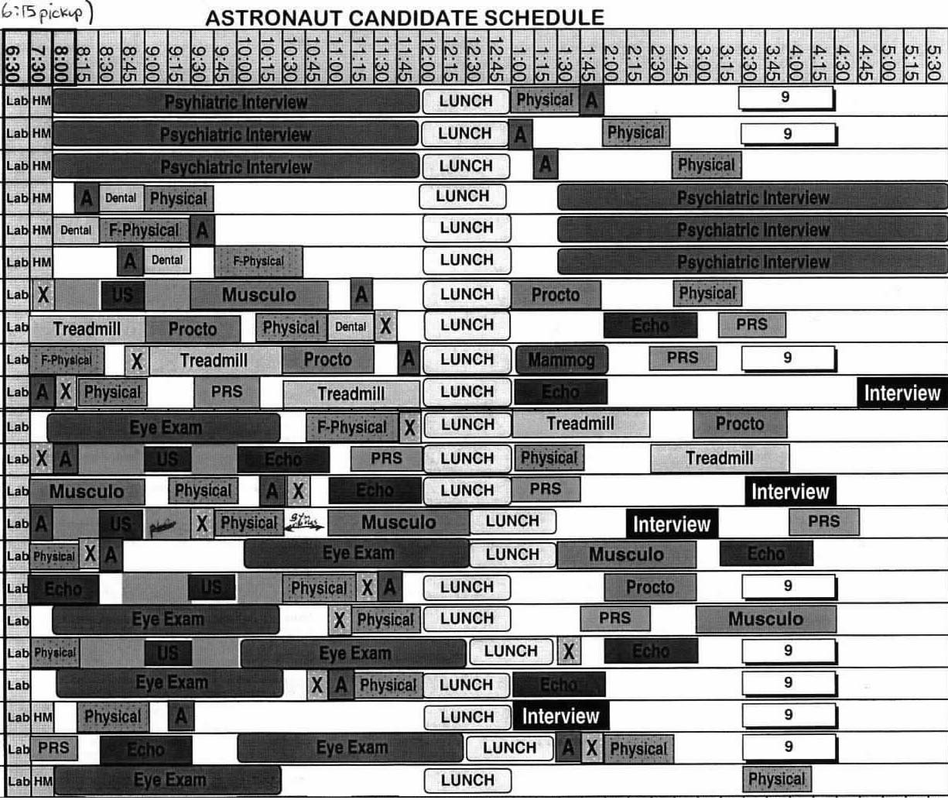
Typical Interview Activities
Monday

Slide 14
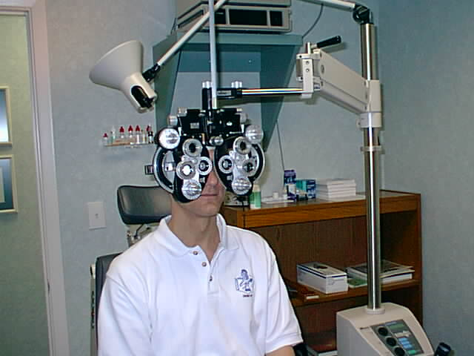
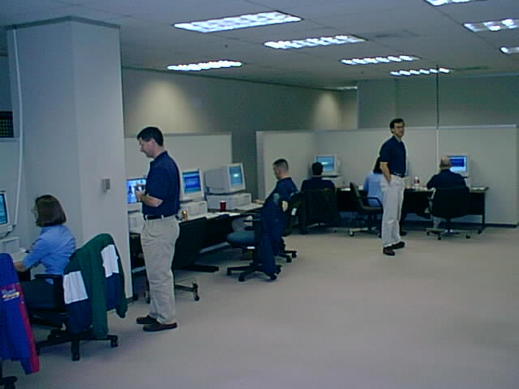
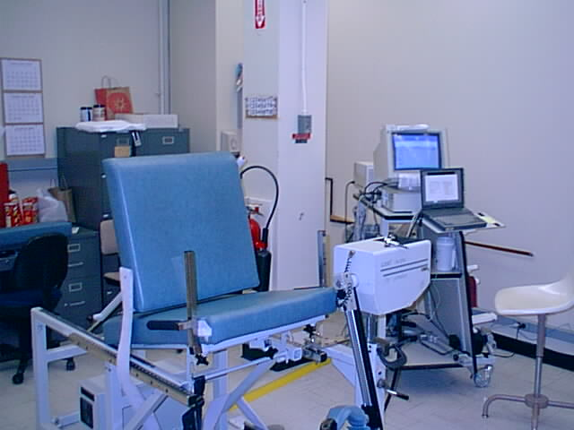
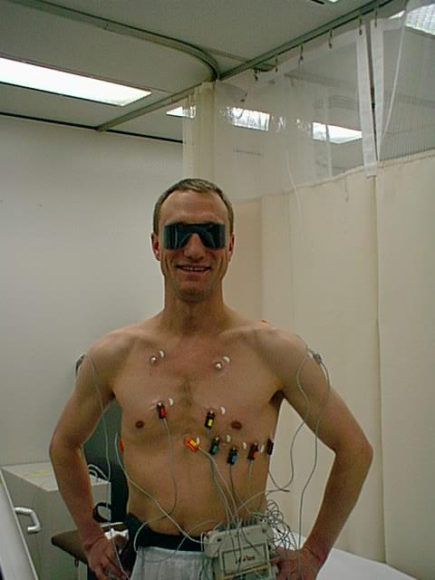
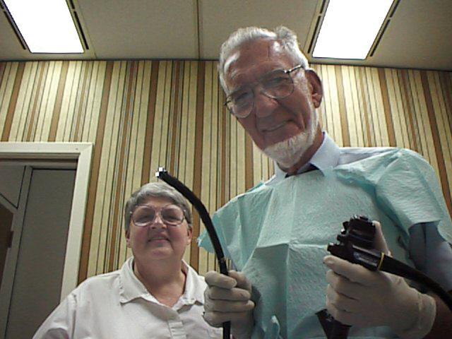
Typical Interview Activities
(Continued)
…and it is not inserted
through your mouth
☹
Additional activities:
  Essay
  Panel Interview
  Individual Interviews
  X-Rays
  MRI (new)
  and more…
Not looking
forward
for this !!!
Nurse Mona &
Dr. Hein

Slide 15
Typical Interview Activities
(Continued)
…and it is not inserted
through your mouth
☹
Additional activities:
  Essay
  Panel Interview
  Individual Interviews
  X-Rays
  MRI (new)
  and more…
Nurse Mona &
Dr. Hein

Slide 16

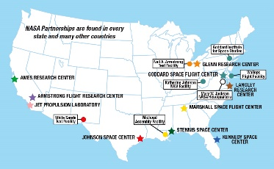
Astronaut Candidate Selection Process Timeline
(Continued)
Levels
of
notification:
Amount of Candidates
March 2, 2020 | Vacancy Announcement opens in USAJOBS
March 31, 2020 | Vacancy Announcement closes
April –July 2020 | Qualified Applications reviewed to determine Highly Qualified applicants. Qualifications Inquiry form sent to Supervisors/References.
September 2020 – April 2021 | Highly Qualified applications reviewed to determine Interviewees
May - July 2021 | Interviewees brought to JSC for initial interview, medical evaluation, and orientation. Interviewees will be selected from the Highly Qualified group and contacted on a week-by-week basis.
August - September 2021 | Finalists determined
December 2021 | Astronaut Candidate Class of 2021 announced. Also knows as “The Flies”. Previous class was “The Turtles”. ☺
January 2022 | Astronaut Candidate Class of 2021 reports to the Johnson Space Center
1st
12,000+ applications
2nd
2,400 (Top 20%)
3rd
400 (Top 3.3%)
120 (Top 1.0%)
4th
5th
40 (Top 0.33%)
6th
12 (Top 0.10%)
Group
#23
7th
…and yes, Astronauts have to move to Texas !
Notes:
Image credit: https://www.nasa.gov/partnerships/nasa-locations-capabilities-and-points-of-contact/

Slide 17
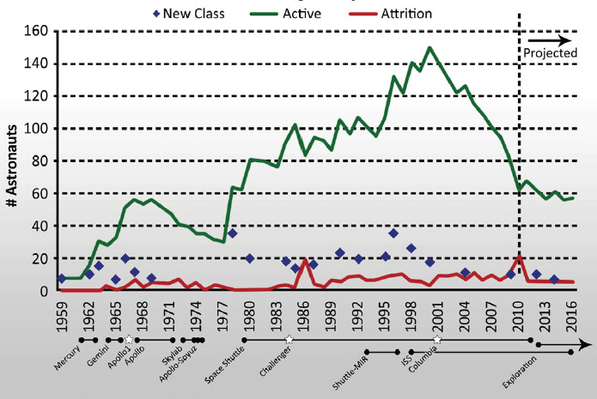
Number of astronauts in office in each year of selection
As of 10/24/2023, there are 38 active astronauts (not including class #23)
Notes:
Image credit:
https://cosmos-book.github.io/human-spaceflight/yearly.html
https://nap.nationalacademies.org/read/13227/chapter/3
https://www.nasa.gov/humans-in-space/astronauts/active-astronauts/

Slide 18
Number of astronauts in office in each year of selection
Apollo-Soyuz (1975)
ISS (1993 – Present)
Columbia Loss (2003)
Apollo 13 (1970)
Challenger Loss (1986)
Shuttle-MIR (1993 – 1998)
Commercial Crew (2011 – Present)
Mercury (1958 – 1963)
Skylab (1973 – 1974)
Artemis (2017 – Present)
Gemini 1961 – 1966)
Apollo (1968 – 1972)
Space Shuttle (1981 – 2011)
Group’s Nickname
Group #
Year
Selected
As of 10/24/2023, there are 39 active astronauts (not including class #23)
Notes:
Image credit:
https://cosmos-book.github.io/human-spaceflight/yearly.html
https://en.wikipedia.org/wiki/NASA_Astronaut_Corps
https://www.nasa.gov/humans-in-space/astronauts/

Slide 19
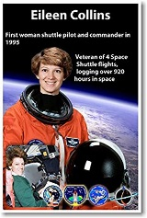
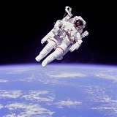
If you applied, what would be your chances of being part of the
2021 Astronaut Candidate Class ?
Position | Odds* | Percentage
Pilot | 5 / 12,000 | 0.042%
Mission Specialist | 5 / 12,000 | 0.042%
*Assuming exclusive probability or 10 Astronaut Candidates selected.

Slide 20
2021 Astronaut Candidate Group #23
 | Astronaut’s Name | Age* | Classification | Affiliation | Education / Former Job
1 | Nichole Ayers | 32 | Pilot | Air Force Fighter Pilot | BS degree in mathematics. MS in computational and applied mathematics from Rice University in Houston.
2 | Marcos Berrios | 36 | Pilot | Air Force Helicopter Test Pilot | BS in mechanical engineering from MIT, MS in mechanical engineering and PhD in aeronautics and astronautics from Stanford University in California.
3 | Christina Birch | 35 | Mission Specialist | Bioengineer, Team USA Track Cyclist | BS in mathematics & biochemistry and molecular biophysics from the University of Arizona, minor in Spanish. Doctorate in biological engineering from MIT.
4 | Deniz Burnham | 36 | Mission Specialist | Drilling Engineer | BS in chemical engineering from the University of California. MS in mechanical engineering from the University of Southern California.
5 | Luke Delaney | 41 | Pilot | NASA Langley Research Pilot | BS in Mechanical Engineering from University of North Florida. MS in Aerospace Engineering from the Naval Postgraduate School in California.
6 | Andre Douglas | 34 | Mission Specialist | Space Systems Engineer | BS in mechanical engineering, U.S. Coast Guard Academy in Connecticut. MS in mechanical engineering, University of Michigan. MS in naval architecture and marine engineering, University of Michigan. MS in electrical and computer engineering, Johns Hopkins University. Doctorate in systems engineering, George Washington University.
7 | Jack Hathaway | 38 | Mission Specialist | Navy Test Pilot | BS in physics and history from the U.S. Naval Academy. MS in flight dynamics from Cranfield University. Master’s in national security and strategic studies from the U.S. Naval War College. Empire Test Pilot’s School in 2011, part of Fixed Wing Class 70.
8 | Anil Menon | 44 | Mission Specialist | Medical Director, SpaceX | BS in Neurobiology, Harvard University, Massachusetts. MS in Mechanical Engineering, Stanford University, California. Doctor of Medicine, Stanford Medical School, 2006. Residency in Emergency Medicine, Stanford University, 2009. Fellowship in Wilderness Medicine, Stanford University, 2010. Residency in Aerospace Medicine, University of Texas. Master’s in Public Health, UTMB-Galveston.
9 | Christopher L:. Williams | 37 | Mission Specialist | Medical Physicist | BS in physics from Stanford University. Doctorate in physics from MIT. Residency training at the Harvard Medical Physics Residency Program.
10 | Jessica Wittner | 37 | Pilot | Navy Test Pilot, Research Engineer | BS in Aerospace Engineering, University of Arizona. U.S. Naval Test Pilot School (Class 150), Maryland. MS in Engineering Science (Aerospace Engineering), U.S. Naval Postgraduate School. Naval Command and Staff Graduate, U.S. Naval War College.
There are no age restrictions for the program.
Astronaut candidates selected in the past have ranged between the ages of 26 and 46, with the average age being 35.
*The 2021 US class age average: 37 years old. Age Spectrum: 32 – 44.

Slide 21
2017 Astronaut Candidate Group #22
 | Astronaut’s Name | Age* | Classification | Affiliation | Education / Former Job
1 | Kayla Barron | 30 | Mission Specialist | Lt. U.S. Navy. | Master’s degree in Nuclear Engineering from the University of Cambridge.
2 | Zena Cardman | 30 | Mission Specialist | The University of North Carolina, Chapel Hill | Bachelor of Science degree in Biology and Master of Science degree in Marine Sciences at The University of North Carolina, Chapel Hill
3 | Raja Chari | 40 | Pilot | U.S. Naval Test Pilot School | Master’s degree in Aeronautics and Astronautics from Massachusetts Institute of Technology and graduated from the U.S. Naval Test Pilot School.
4 | Matthew Dominick | 36 | Pilot | U.S. Naval Test Pilot School | Bachelor of Science in Electrical Engineering from the University of San Diego and a Master of Science degree in Systems Engineering from the Naval Postgraduate School. He graduated from U.S. Naval Test Pilot School.
5 | Bob Hines | 42 | Pilot | University of Alabama | U.S. Air Force Test Pilot School, where he earned a Master’s Degree in Flight Test Engineering. He continued on to earn a Master’s degree in Aerospace Engineering from the University of Alabama.
6 | Warren Hoburg | 32 | Mission Specialist | University of California, Berkeley | Bachelor’s degree in Aeronautics and Astronautics from the Massachusetts Institute of Technology (MIT) and a Doctorate in Electrical Engineering and Computer Science from the University of California, Berkeley.
7 | Dr. Jonny Kim | 33 | Mission Specialist | Doctorate of Medicine at Harvard Medical School | Navy SEAL, completing more than 100 combat operations and earning a Silver Star and Bronze Star with Combat “V”. Afterward, he went on to complete a degree in Mathematics at the University of San Diego and a Doctorate of Medicine at Harvard Medical School.
8 | Dr. Robb Kulin | 34 | Mission Specialist | Launch Chief Engineer, SpaceX | Master’s degree in Materials Science, and a doctorate in Engineering, both from the University of California, San Diego. Resigned from NASA, effective August 31, 2018, before completing astronaut training.
9 | Jasmin Moghbeli | 34 | Mission Specialist | Naval Postgraduate School. | Bachelor’s degree in Aerospace Engineering with Information Technology at the Massachusetts Institute of Technology, followed by a Master’s degree in Aerospace Engineering from the Naval Postgraduate School.
10 | Loral O’Hara | 34 | Mission Specialist | Purdue University | Bachelor of Science degree in Aerospace Engineering at the University of Kansas and a Master of Science degree in Aeronautics and Astronautics from Purdue University.
11 | Dr. Francisco Rubio | 42 | Mission Specialist | Uniformed Services University of the Health Sciences | U.S. Military Academy and earned a Doctorate of Medicine from the Uniformed Services University of the Health Sciences.
12 | Dr. Jessica Watkins | 29 | Mission Specialist | University of California, Los Angeles (UCLA) | Bachelor’s degree in Geological and Environmental Sciences at Stanford University, and a Doctorate in Geology from the University of California, Los Angeles (UCLA).
There are no age restrictions for the program.
Astronaut candidates selected in the past have ranged between the ages of 26 and 46, with the average age being 35.
*The 2017 US class age average: 35 years old. Age Spectrum: 29 – 42.

Slide 22
2013 Astronaut Candidate Group #21
 | Astronaut’s Name | Age* | Classification | Affiliation | Former Job
1 | Josh A. Cassada, Ph. D. | 39 | Pilot | U.S. Navy. University of Rochester, NY | Naval aviator. Physicist by training and previously served as co-founder and Chief Technology Officer for Quantum Opus.
2 | Victor J. Glover | 37 | Pilot | U.S. Navy. California Polytechnic State University, San Luis Obispo, Calif.; Air University and Naval Postgraduate School | F/A-18 pilot and graduate of the U.S. Air Force Test Pilot School.
3 | Tyler N. Hague (Nick) | 37 | Pilot | U.S. Air Force Academy, Massachusetts Institute of Technology, and the U.S. Air Force Test Pilot School, Edwards, Calif. | Department of Defense as Deputy Chief of the Joint Improvised Explosive Device Defeat Organization
4 | Christina M. Hammock | 34 | Mission Specialist | North Carolina State University, Raleigh, N.C. | National Oceanic and Atmospheric Administration (NOAA) Station Chief in American Samoa.
5 | Nicole Aunapu Mann | 35 | Pilot | U.S. Marine Corps. U.S. Naval Academy, Stanford (Calif.) University and the U.S. Naval Test Pilot School | F/A 18 pilot, currently serving as an Integrated Product Team Lead at the U.S. Naval Air Station, Patuxent River.
6 | Anne C. McClain | 34 | Pilot | U.S. Army. U.S. Military Academy at West Point, N.Y.; the University of Bath and the University of Bristol, both in the United Kingdom | OH-58 helicopter pilot, and a recent graduate of U.S. Naval Test Pilot School at Naval Air Station, Patuxent River.
7 | Jessica U. Meir, Ph.D. | 35 | Mission Specialist | Brown University, has an advanced degree from the International Space University, and earned her doctorate from Scripps Institution of Oceanography | Assistant Professor of Anesthesia at Harvard Medical School, Massachusetts General Hospital, Boston.
8 | Andrew R. Morgan, M.D. | 37 | Mission Specialist | U.S. Army. U.S. Military Academy at West Point, and earned doctorate in medicine from the Uniformed Services University of the Health Sciences | Emergency physician and flight surgeon for the Army special operations community, and currently is completing a sports medicine fellowship.
There are no age restrictions for the program.
Astronaut candidates selected in the past have ranged between the ages of 26 and 46, with the average age being 35.
*The 2013 US class age average: 36 years old. Age Spectrum: 34 – 39.

Slide 23
My Astronaut Application Progress: Increasing my Odds ???
Attempt # (my age) | Year | Degrees completed at time of application | Other Activities | Comments
1 (24) | 1991 | BS in Electrical Engineering | Graduate studies | Did not meet minimum requirements (3 years of professional experience)
2 (26) | 1993 | BS in Electrical Engineering MS in Engineering Management | College Professor | Eligible to apply ! Levels advanced: 1. Levels to go: 8
3 (28) | 1995 | BS in Electrical Engineering MS in Engineering Management | Robotics & Automation | Did not advance to the next level
4 (30) | 1997 | BS in Electrical Engineering MS in Engineering Management MS in Electrical Engineering | College Professor | Did not advance to the next level
5 (32) | 1999 | BS in Electrical Engineering MS in Engineering Management MS in Electrical Engineering | American Sign Language, SCUBA | Did not advance to the next level
 | 2001 | BS in Electrical Engineering MS in Engineering Management MS in Electrical Engineering Ph.D. in Electrical Engineering | College Professor, Research | No Class Selection this year
6 (36) | 2003 | BSEE, MSEM, MSEE, PhDEE | Project Management Professional Certification | Advanced to the next level ! Levels advanced: 2. Levels to go 3
 | 2005 | BSEE, MSEM, MSEE, PhDEE | College Professor, NASA Fellowship | No Class Selection this year
7 (41) | 2008 | BSEE, MSEM, MSEE, PhDEE | College Professor, Private Pilot, Multi-Center Project Experience, Russian Language | Back to square 1 !
8 (45) | 2012 | BSEE, MSEM, MSEE, PhDEE | Orion Capsule EGSE Lead | Did not advance to the next level
9 (49) | 2016 | BSEE, MSEM, MSEE, PhDEE | Added flying hours, worked for the Center Director’s Office | Did not advance to the next level
10 (54) | 2021 | BSEE, MSEM, MSEE, PhDEE | Worked for the HQs Mission Support Directorate | Did not advance to the next level

Slide 24
Will you be prepared ?
Step | Year | Your Age | Academic Level | Professional Experience | Degree must be followed by at least 3 years of related, progressively responsible, professional experience or at least 1,000 pilot-in-command time in jet aircraft. An advanced degree is desirable and may be substituted for experience as follows: master’s degree = 1 year of experience, doctoral degree = 3 years of experience.
1 | 2023 | 20 | Undergraduate student | 0 years
2 | 2025 | 22 | Start Graduate school | 0 years
3 | 2027 | 24 | Graduate with Masters Degree | 2 years
4 | 2028 | 25 | Start Doctoral Degree | 3 years Eligible to apply to become an Astronaut
5 | 2030 | 27 | Graduate with Doctoral Degree | 5 years (Selected as an Astronaut)
6 | 2032 | 30 | Selected for Mars Exploration Program ! ☺
NASA has a need to fulfill !
There are only 39 (Active: 16 females + 23 males)
Attrition rate: ≈ 8 per year

Slide 25
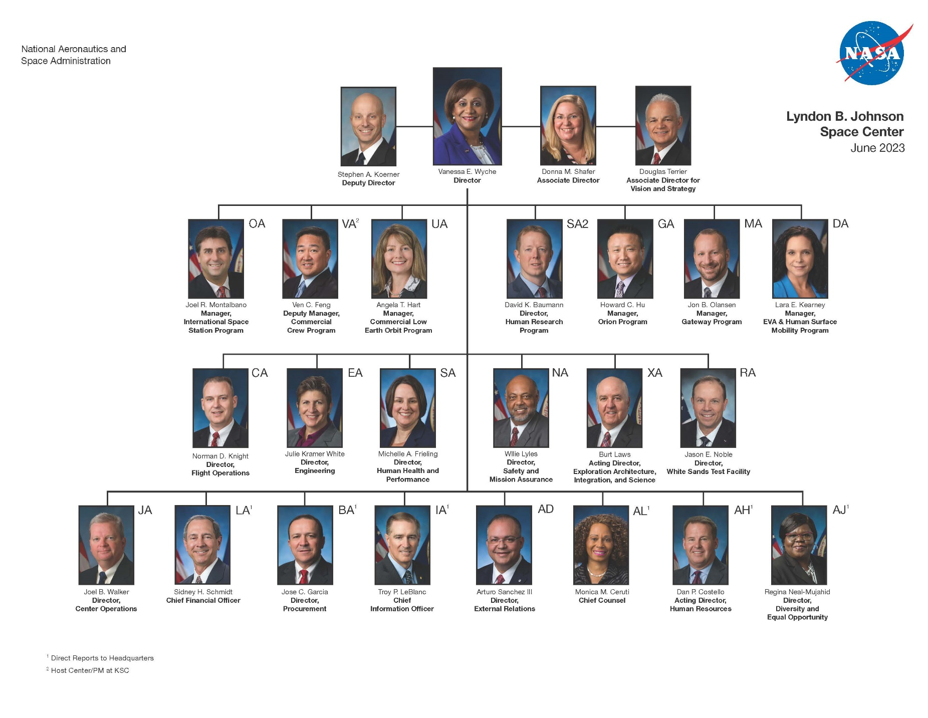
Where do Astronauts report @ JSC

Slide 26
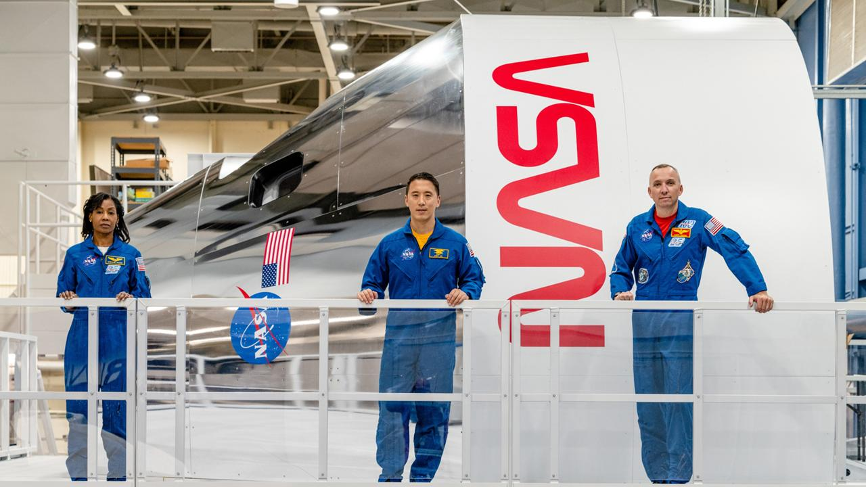
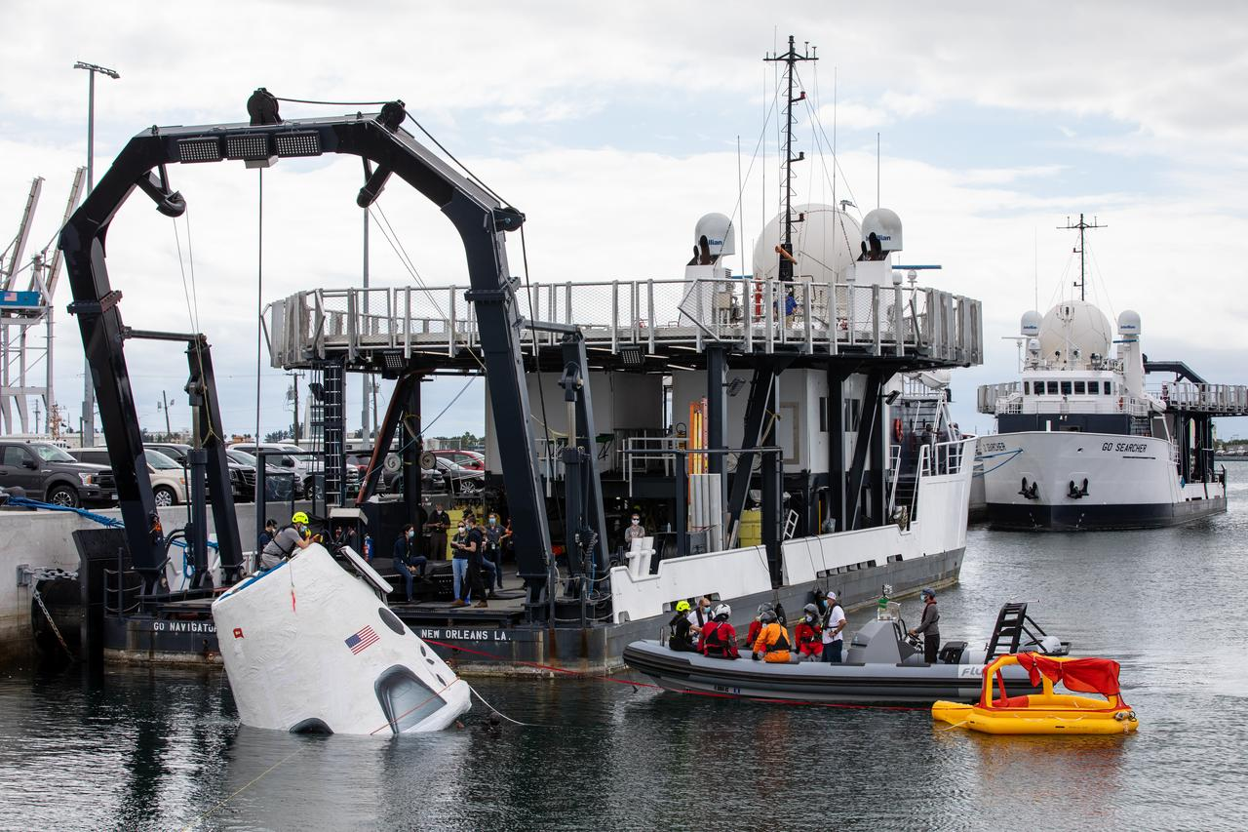
What do Astronauts do at work…
…when they are not flying?
Training for their missions
Help others train for their missions
Notes:
Image credit:
https://images.nasa.gov/details/Astronaut%20training%204
https://images.nasa.gov/details/KSC-20201001-PH-AJW01_0093

Slide 27

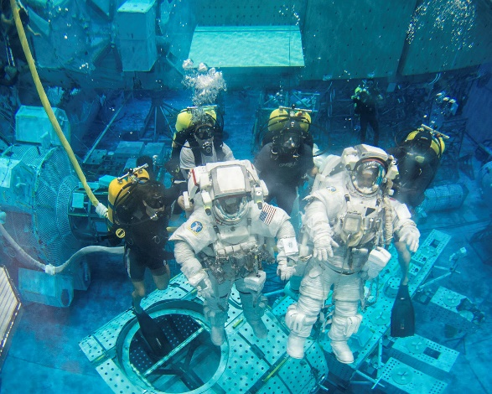
Astronaut Training
The water within the NBL is recycled every 19.6 hours. It is automatically monitored and controlled to a temperature of 82-88 degrees Fahrenheit to minimize the potential effects of hypothermia on support divers. It is also chemically treated to control contaminant growth while minimizing long-term corrosion effects on training mockups and equipment.
Neutral Buoyancy Laboratory (NBL). The NBL was sized to perform two activities simultaneously; each uses mockups sufficiently large to produce meaningful training content and duration. It is 202 ft in length, 102 ft in width, and 40 ft in depth (20 ft above ground level and 20 ft below) and holds 6.2 million gallons of water. Even at this size, the International Space Station, at 350 ft x 240 ft when complete, will not fit inside the NBL.
Notes:
Image credit: https://www.nasa.gov/podcasts/houston-we-have-a-podcast/neutral-buoyancy/

Slide 28
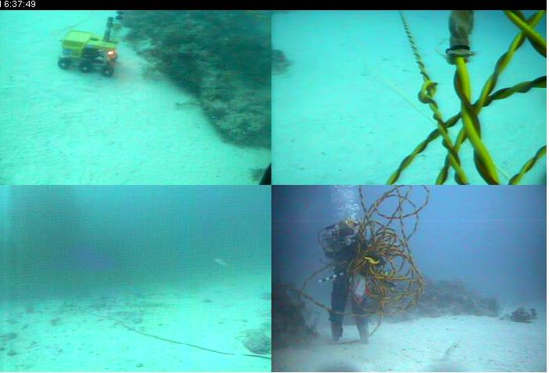
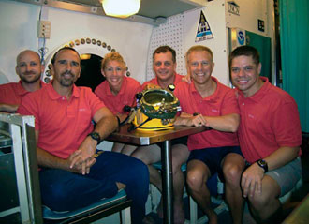
What do Astronauts do at work…
…when they are not flying? (continued)
Support mission from ground
  Mission Control
  Be with family & VIP during missions
  Support design reviews
  Participate in Brainstorming activities
  Support fit checks
  Familiarize with Spacecraft systems
  Familiarize with ISS systems
  Travel to ISS partners countries
  Public Affairs & Education Outreach
  Maintain flying proficiency
  Conduct Research
  Familiarize with Robotics and Flight Simulation H/W & S/W
  …and much more !
NEEMO 11 crew
Notes:
Image credit: https://www.nasa.gov/mission_pages/NEEMO/NEEMO11/index.html

Slide 29
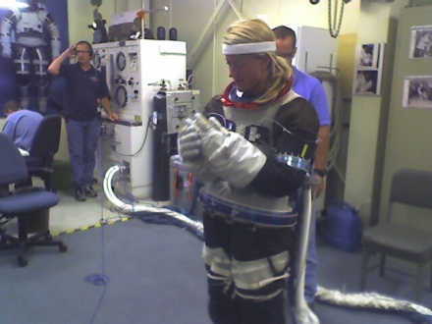
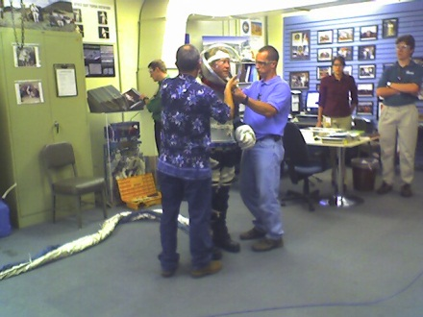
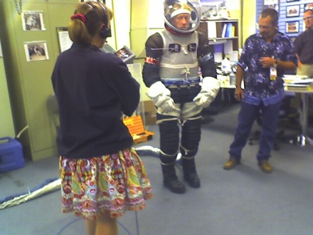
What do Astronauts do at work…
…when they are not flying? (continued)

Slide 30
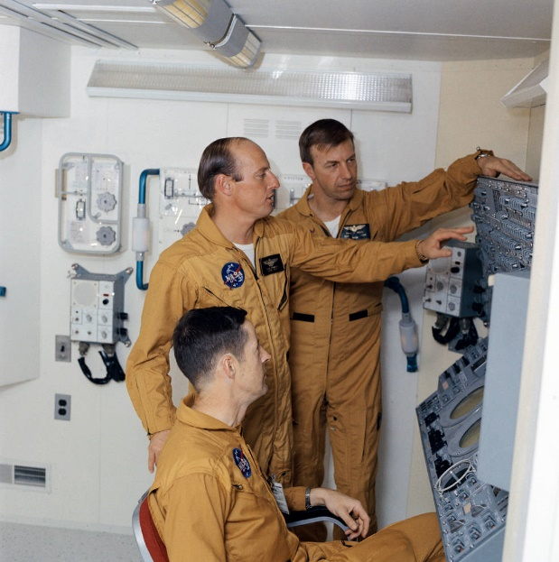
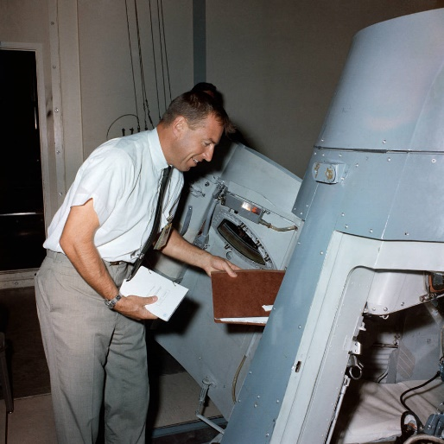
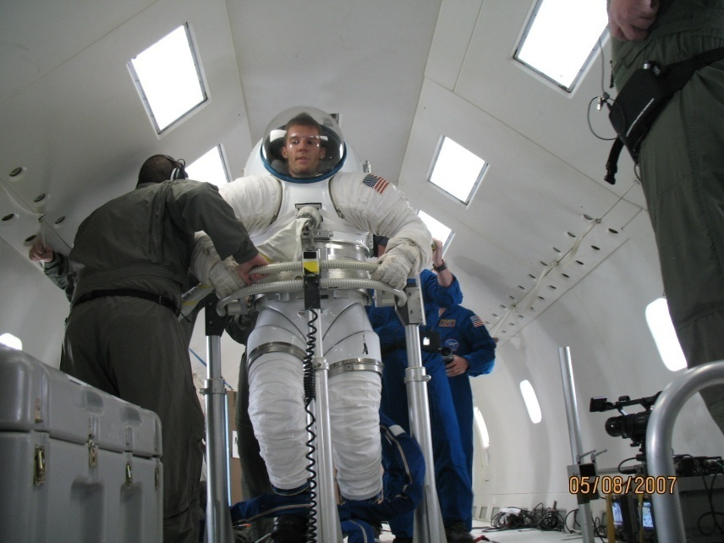
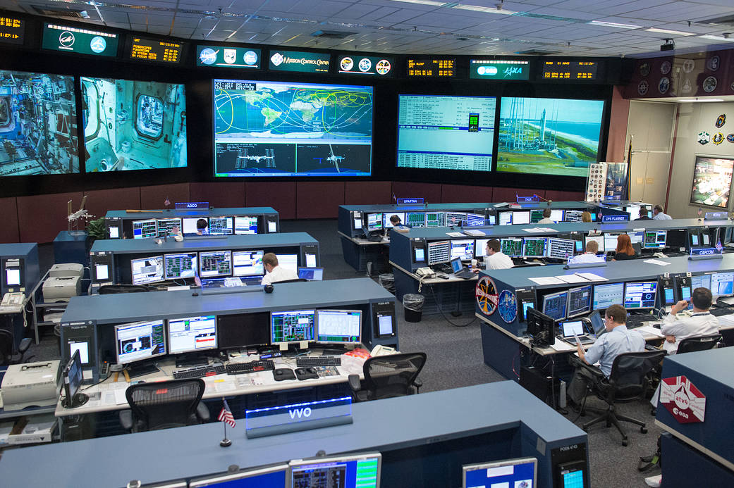
What do Astronauts do when they are NOT flying ? (continued)
”Divide and Conquer !”
Notes:
Image credit:
https://www.nasa.gov/history/building-on-a-mission-astronaut-training-facilities/
https://www.nasa.gov/image-article/johnson-space-centers-mission-control-center-2/

Slide 31
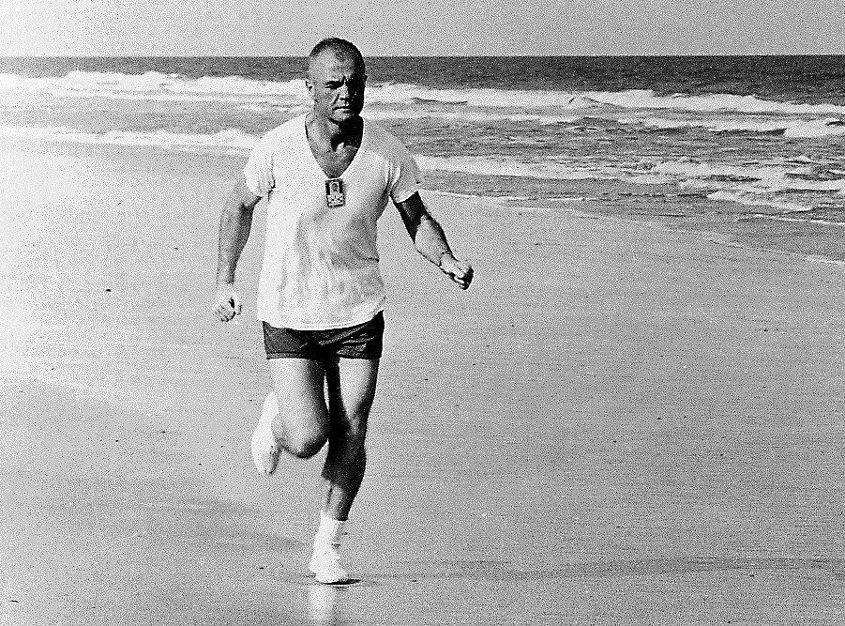
What do some Astronauts do when they are NOT flying ? (continued)
  Auto Repair
  Astronomy
  Basketball
  Baseball
  Bike Mountain
  Bicycling
  Camping
  Collecting Stamps
  Collecting Toy Trains
  Cooking
  Drawing and Painting
  Exploring Physics
  Flying Small Planes
  Hiking
  Home Improvement
  Jogging
  Learning Languages
  Golfing
  Playing Musical Instruments
  Photography Reading
  Rock Climbing
  Sailing
  SCUBA Diving
  Sewing
  Singing
  Soccer
  Softball
  Snow Skiing
  Spending Time With Loved Ones
  Swimming
  Tap and Jazz Dancing
  Tennis
  Theatre
  Volleyball
  Water Skiing
  Weight Training
  Wind Surging
  Writing Software
Notes:
Image credit: https://www.nasa.gov/image-article/running-beach/
Mercury astronaut John Glenn stays fit by running on the beach in Cape Canaveral, Florida.Credit: NASA

Slide 32
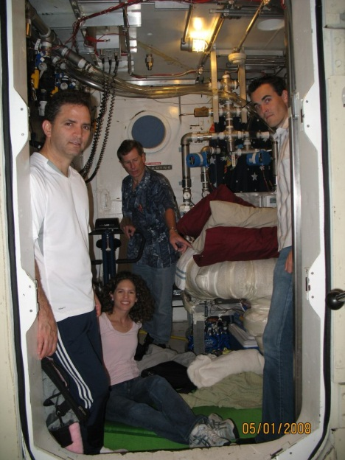
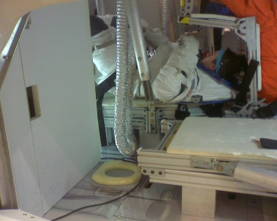
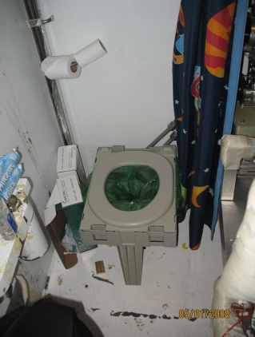
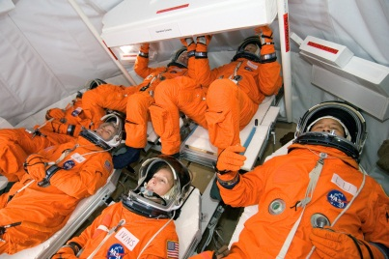
Astronauts Test Subjects

Slide 33
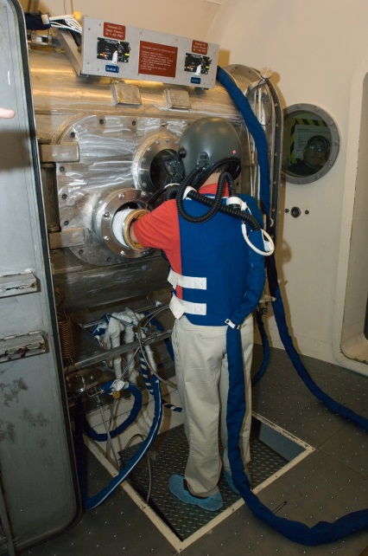
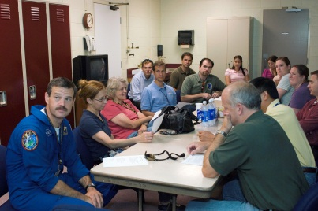
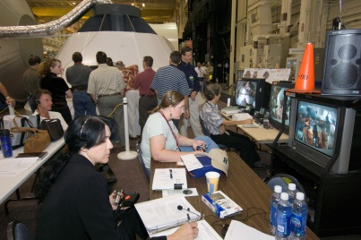
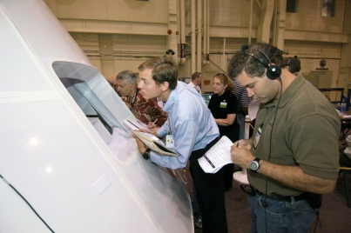
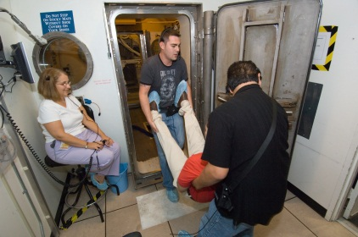
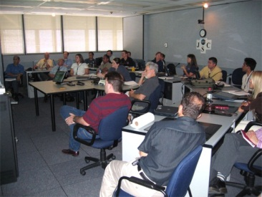
Astronauts Test Subjects (continued)
Help with design of new vehicles

Slide 34
Recommendations
Your goal to becoming an Astronaut should not be your only goal in life !
  Have faith in God !
  Obtain training that will benefit both you and your employer
  Establish interesting, hard to attain but reasonable goals
  Be a role model
  Promote mentorship
  Share your knowledge
  Maintain a clean mind and a healthy body
  Maintain a good attitude, it might dictate your altitude !
  Respect others
  Balance your life
Apply gained skills in your personal and professional life.

Slide 35
Some Useful Websites
NASA Fact Sheet Library
  https://www.nasa.gov/content/digital-library-fact-sheets
NASA Agency Wide Jobs
  http://www.usajobs.gov/
Astronaut Fact Book
  http://www.nasa.gov/pdf/740566main_current.pdf
Becoming an Astronaut Astronaut Frequently Asked Questions
  https://www.nasa.gov/feature/frequently-asked-questions-0/
Astronaut Selection Timeline
  https://www.nasa.gov/image-feature/astronaut-selection-timeline
Astronaut Hopefuls (non-NASA site)… a profile may be created to view content.
  https://www.reddit.com/r/AstronautHopefuls/
Interesting Statistics on Astronauts (non-NASA site) … a profile may be created to view content.
  https://towardsdatascience.com/reddits-dataviz-battle-nasa-astronaut-eda-6f34a59962e

Slide 36
Is the next Astronaut in this picture?
Insert picture of audience here ☺

Slide 37
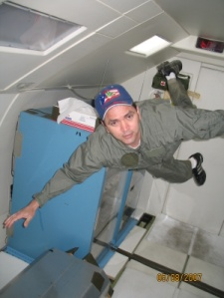
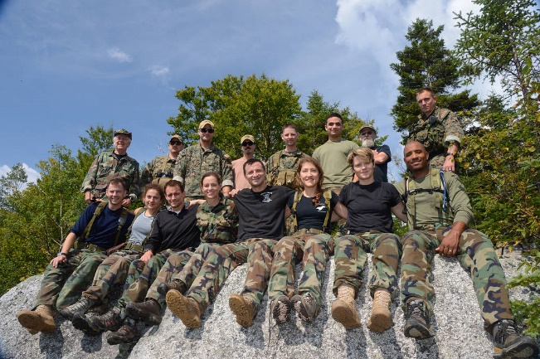
THANK YOU !
  Suggestions ?
  Questions ?
  Comments ?
Felix.A.Soto-Toro@NASA.gov
Notes:
Image credit:
https://www.nasa.gov/image-article/buzz-aldrin-moon/
https://www.nasa.gov/image-article/astronaut-candidate-land-survival-training/

