Slide 1
What risks are acceptable for a Class D mission?
Is Class D the wild west?
Jesse Leitner,
Chief SMA Engineer, GSFC
November 8, 2023
Notes:
What do our colors really mean?
Yellow (Warning)
Management awareness/attention needed
Items usually get discussed at Division/Directorate meetings
Red (Critical)
Impact is significant and management awareness/attention needed
Items usually get discussed at Directorate/Center meetings

Slide 2
Outline
Class D principles
What is risk?
What risks are acceptable for Class D?
Summary

Slide 3
Class D Principles: Dos & Don’ts
Do:
  Streamline processes (less formal documentation, e.g., spreadsheet vs. formal software system for waivers, etc.)
  Focus on tall poles and critical items from a focused reliability analysis
  Tolerate more risk than A, B, or C (particularly schedule risk)
  Capture and communicate risks diligently
  Rely more on knowledge than indirect requirements
  Put more decisions into the hands of the engineers on the floor.
  Have significant margin on mass, volume, power (not always possible, but strongly desirable)*
  Have significant flexibility on performance (level 1/level 2) requirements (not always possible, but strongly* *desirable)
Don’t:
  Ignore risks!
  Reduce reliability efforts (but do be more focused and less formal)
  Assume nonconforming means unacceptable or risky
  Blindly eliminate processes
While the impression may be that a Class D is higher risk from the outside, if implemented correctly (and consistent with the intention), in reality the extra engineering thought about risk may actually reduce the practical risk of implementation.
*outside scope of MAR

Slide 4
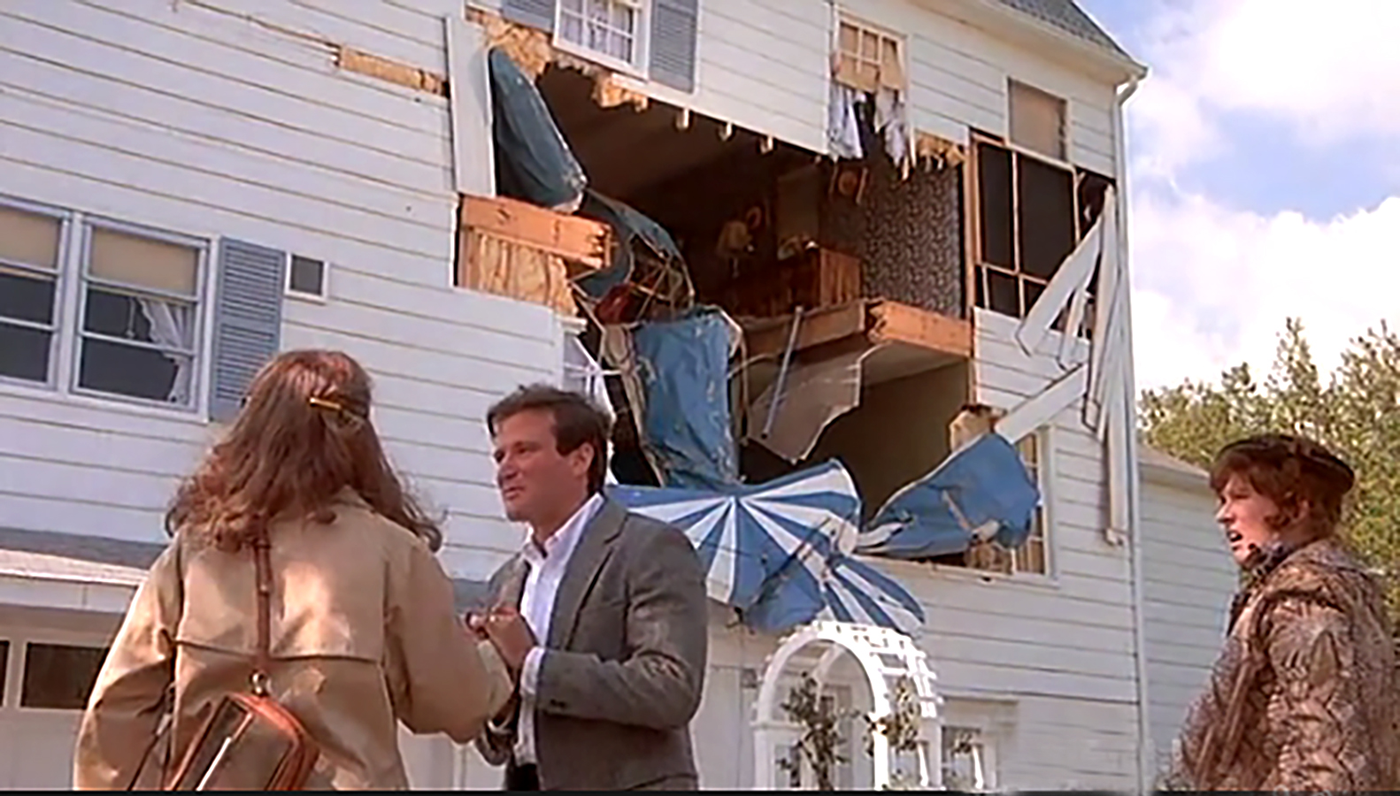
Risk
We'll take the house. Honey, the chances of another plane hitting this house are astronomical. It's been pre-disastered. We're going to be safe here.
From: The World According to Garp, Warner Bros., 1982
Notes:
Garp was possibly a budding reliability engineer with a scenario in front of him that we frequently encounter. However, he may missed some things that would have been important to make this assessment. Is this house on a high-traffic path to a nearby airport? How many crashes have we seen in this area? Is there any supporting data to compare this crash to a lightning strike or to a monthly occurrence?

Slide 5
Anatomy of a Risk
Context
Impact/Criticality
Concern
Statistics
Uncertainty
Structured risk statement
Likelihood
Consequence

Slide 6
Concern
Definition: A logical determination that an undesired event may occur or that the protections against such an event may not be sufficiently well understood based on available data
This is the core element upon which a risk is founded
In some sense, it is the risk without the context, likelihood or consequence.
Can come in the same “flavors” (categories) as risks
  Technical
    A part may fail
  Cost
    Cost of an item may grow
  Schedule
    Delivery may be delayed
  Safety
    The spacecraft may fall off the crane

Slide 7
What is Risk?
Definition: the combination of
  a) the probability (qualitative or quantitative) that an undesired event will occur, and
  b) the consequence or impact of the undesired event
  c) a factual context or scenario that exists to cause the risk to be present
  In short, risk is an expectation of loss in statistical terms based an existing condition.
Categories of risk (consequences)
  Technical (failure or performance degradation on-orbit)
  Cost ($ it will take to fix the problem)
  Schedule (time to fix the problem)
  Safety (injury, death, or collateral damage)
This is the substantive version of a concern
The category may not match that of the concern
  Common: programmatic risk based on technical concern
programmatic
Notes:
It is important to be explicit about what we mean when we say risk. This will be clear when we contrast risk with “possibility”.

Slide 8
Risk Statement (GPR 7120.4D)
Given the [CONDITION*]
  There is a possibility that [INTERMEDIATE CONSEQUENCE] will occur
  Resulting in [CONSEQUENCE]
  CONDITION: A factual statement that describes the context that elevates the likelihood of a failure or shortfall. A system being single string does not automatically indicate that a risk is above baseline risk. What is the condition that exists that elevates the likelihood of failure?
  - there is a part installed that is a GIDEP direct hit
  - the supplier is located in a war zone
  - the expert personnel have just retired
  INTERMEDIATE CONSEQUENCE: The immediate, direct effect from a concern being realized
  - a part will fail
  - an item will be delivered late
  CONSEQUENCE: Foreseeable, negative impact(s) to meeting performance, programmatic, or safety requirements at the level of a project that is tracking the associated risk. Project level risks are threats to mission requirements.
  - instrument will fail
  - mission will fail
  - launch will slip
  - a person will be injured
*[CAPITALIZED] terms will be called fillable items

Slide 9
Key Rules to follow
The CONDITION must exist today and should be indisputable
No conditional statements or risks should be in any of the fillable items (the condition is already included in the statement structure) – see example on p. 20
  Rationale: Conditional statements within the risk will result in arbitrary likelihoods and “risk of a risk” scenarios.
Avoid using multiple consequences in a single risk statement (see p. 21)
  Especially if they are different flavors (common) as risk scales are different
The CONSEQUENCE represents the category
Safety of your own hardware is in the category of technical or programmatic risk
Avoid using “loss of redundancy” as a risk consequence at the project level (project level risks should be threats to level 1 requirements)
  Can result in unbalanced risk by comparing one risk of loss of function to another with no effect on mission performance
  Loses the benefit of redundancy
If possible, avoid risks that suggest that your own project team is going to make bad decisions – better to address those concerns directly within the project.

Slide 10
(aggregate) Risk Example
Given: the massive size, complexity, development constraints, and one-of-a-kind nature (with no historical reliability) of the JWST observatory that prevent complete test as you fly verification and/or validation of complex models,
There is a possibility that: a key interaction that impacts system performance is not identified,
With the result that: mission performance will be moderately degraded.
LxC: 2x3
Closure on performance verification of instruments after commissioning

Slide 11
Context for Risk in Parts
COTS
Parts with special features that are difficult to manufacture consistently (never available on MIL-SPEC)
  e.g., extra-low ESR and ESL ceramic capacitors
Parts used in brutal operating regimes
  High-voltage (particularly > 3 kV)
  Cryo
Low volume and hand-produced parts
  Lack a basis for reliability and often do not have optimized manufacturing processes
Parts used in extremely sensitive (poor) designs (based on variability of parameters not in part spec)
Parts used in applications in which the environment is unknown
Parts from unknown or poor-performing vendors (no recent examples)
No “hi-rel” or automotive parts available
MIL-SPEC
All risk-contexts for COTS, plus:
Low-volume parts
Lead time and costs can reduce system-testing resources
Designed for old manufacturing processes and broad environments
When used broadly, they can bring false hope and extensive problems may ensue
Processes will miss new manufacturing flaws
Performance and reliability not driven by the need to stay in business
Performance limitations may lead to weak designs
NASA-screened COTS
All risk-contexts for COTS, plus:
Parts are often overtested since MIL-SPEC testing regimes are not related to actual usage and parts are often not designed or optimized for such regimes
False hope that screening is relevant to operation
False hope that screening, testing, and qualification increase reliability or quality
The prospect for burying a problem or reduced lifetime into a part by the “overtest by design”.
Note that the contexts for risk in COTS parts all arise from mission performance requirements that would be present no matter which parts approach is used, so they apply to all cases.

Slide 12
What kinds of risks are acceptable for Class D?
Risks that the stakeholder has declared to be acceptable
Those tied to compressed schedules and tight development constraints as long as there is a solid plan and acknowledgement of the challenging elements
The use of new, modern, innovative approaches at development
The use of yet-to-be-established standard or COTS components that are the only solution
  Use of standard and COTS components outside of their qualified environment, or that are as of yet unproven when they constitute the only viable solution
    Risk should be acknowledged with a plan for addressing or accepting
  Note: Use of standard and COTS components/assemblies that have been proven in the same environment for same time frame is lower risk than any piece-part assured approach
The use of new select new technologies when necessary to advance science, with a viable plan for maturation and incorporation

Slide 13
Will use of COTS cause a radiation nightmare?
It certainly can if you’re in a radiation environment and you pretend it’s not there, but that has nothing to do with COTS.
Typically, about 90% of the part count even for large missions are not radiation-hardness-assured (because they don’t need to be).
  The majority of places where COTS are really needed are for non-susceptible parts
The problem is no different from that of using a 5962-XXX microcircuit or a JANS2NXXXX BJT (neither of which is radiation hardness assured)
For reference, an IRHM58160 is a COTS part (and it is radiation hardness assured).
No matter whether you use COTS, MIL-SPEC or “special drawing” parts, radiation should be addressed in the same way
As we transition to newer technologies and higher performance, we will have to think about radiation mitigation in different ways because parts with RHA will almost always be multiple generations behind
  However, some of the new technology parts will be less susceptible to radiation by the nature of their designs (thinner gate oxides, etc)

Slide 14
Summary
Class D missions are an opportunity to move the space community forward and make use of new products and approaches
Navigating the risks of a Class D development need not be representative of the wild west

Slide 15
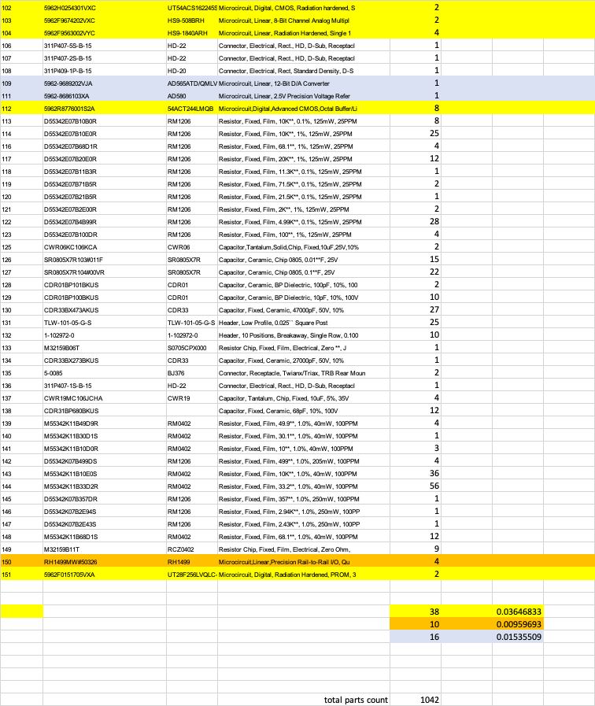
Typical BOM excerpt from high-end mission (Class B GEO)
Yellow highlight
MIL-SPEC FMRR
Orange highlight
COTS FMRR
Gray/purple highlight
Actives with no FMRR
Total parts count: 1042
Total MIL-SPEC FMRR: 3.6%
Total COTS FMRR: 10: 0.96%
Total non-FMRR and discrete semiconductors (requiring radiation testing or other forms of analysis: 16 (1.5%)

Slide 16
Common approaches for addressing radiation
Avoidance: dormancy of sensitive electronic elements in high stress regions such as SAA or Van Allen Belts
RHBD: Proven rad-hard by design approach, applied to circuits and/or parts
Traditional parts-centric: Use of RHA* parts with radiation-tolerant design to accommodate high stress region operation
Modern parts-centric: Use of familiar sensitive** parts along with proven circuit designs in comparable environment, normally combined with select strategic parts testing outside of specific projects to characterize variability or parts changes in general
Radiation-tolerant design: Use radiation-tolerant circuit design techniques including features such as MOSFET protection and overcurrent detection with reset capability, resettable processors, EDAC, derating beyond EEE-INST-002 recommendations, etc.
Risk-based approach combining past on-orbit experiences in similar stressing environments.
System fault-tolerance (including redundancy): This may include new, unproven approaches, with backup proven systems.
* RHA = radiation-hardness assured, with lot-specific testing and accompanying paperwork
**Sensitive parts include memory, processors, CMOS devices, MOSFETs, etc.

Slide 17
Vendor trust (and established reliability basis)
ILPM
Established relationship
DLA verified (MIL-SPEC)*
QML manufacturer, not under DLA for part
PPAP provided
All vendor screening and qual data provided
High-volume part
100% manufacturer screening across datasheet (possibly at single temp)
Part in-service at least 1 year.
*while most MIL-SPEC parts will have a factor of 1 based on trust, some may not be established while being low-volume, requiring a higher factor

Slide 18
Intelligent use of COTS parts
Always use parts within the limits of their datasheets
  Respect the datasheet!
AEC-qualified parts (not just “for automotive use”) from leading manufacturers, produced under IATF 16949 will maximize reliability
Use familiar parts when possible
Avoid an approach that prompts you to use more parts as often happens with capacitors
Conservative derating is good practice, but excessive and forced derating may result in need for many extra parts, a mass or space problem, or a weaker design with less margins.
Buy parts from authorized distributors
  There is no purpose in MIL-SPEC distributor restrictions when buying COTS parts
There are many great options for “enhanced space” COTS parts for microcircuits and discretes

Slide 19
Radiation and on-orbit non-RHA performance data sources
Test data:
  Traditional: radhome.gsfc.nasa.gov, transitioned to https://nepp.nasa.gov/pages/pubs.cfm
  New: esarad.esa.int
  New: pmpedia.space
On-orbit experiences (“fact of” - some info available)
  Spacecube data (LEO on-orbit – extensive non-RHA and COTS – 10+ yr)
  Aerocube data (LEO on-orbit – 100% non-RHA COTS – 10+ yr) (Aerospace Corporation)
  Swift data (585km x 604km, 20.6 deg - extensive COTS ~ 19 yrs)
  Ascent (GEO cubesat – launched 12/2021) (AFRL)
  Biosentinel (deep space cubesat – launched with Artemis)
  Newspace – extensive, limited data availability

Slide 20
The path to part-driven mission risks
Known threats
Vendor trust*
Part failure data
Part used outside datasheet
Alert-based failure likelihood
Uncertainty factor
General failure likelihood
Manufacturer
Discussion
X
Qual by analysis or test
Σ
Early failure likelihood
# parts req’d for mission effect (reliability calc)
Risk likelihood calculation
Detailed failure likelihood assessment considering circuit and shielding
Consequence Table
Consequence determination
Risk LxC
X
*vendor trust should also include established reliability basis for the part, driven by high-volume and at least a year in the field

Slide 21
Risk example 1
Given: the use of a properly-derated, high-volume, established BME capacitor from a trusted-ILPM with 10 reported field failures due to manufacturing defects out of 12 million parts delivered
It is possible that three capacitors will fail, taking out the (non-redundant) power supply, within mission lifetime
Resulting in early mission failure
In this case, all three of this type of capacitor must fail to cause a PS failure. Consequence would be 5.
Let’s assume the pool is actually 3 million parts to account for parts that are not actually used and to adjust for non-reporting (even if manufacturer is trusted). We will also freeze time for the mission and field reporting. So vendor failure likelihood is 10/3e6
Uncertainty (Vendor trust) factor we will set at 1.5 (1 is complete trust) because we have no PPAP.
Early failure likelihood of a single part is 1.5*10/3e6 = 5e-6
Important quantity is failure of the PS, because that will end the mission. Three part failures are required, likelihood = (5e-6)^3 ~ 0 (well off of any risk scale)
Risk is noncredible

Slide 22
Risk example 2
Given: the use of a properly-derated, high-volume, established BME capacitor 50 reported field failures due to manufacturing defects out of 20 million parts delivered
It is possible that one capacitor will fail, taking out the star tracker, within mission lifetime
Resulting in severe mission degradation
In this case, one capacitor takes out the star tracker, and the loss of the tracker greatly reduces science value, consequence 4
Let’s assume the pool is actually 5 million parts to account for parts that are not actually used and to adjust for non-reporting. We will also freeze time for the mission and field reporting. So vendor failure likelihood is 50/5e6
Uncertainty (Vendor trust) factor we will set at 100 (1 is complete trust) because vendor is not ILPM but there is past history with this vendor and no known part failures that have been to reported to us.
Early failure likelihood of a single part is 100*50/5e6 = 1e-3 = 0.1%
0.1% is a “1” likelihood on GSFC’s technical risk scale, so risk is 1x4.

Slide 23
Risk example 3
On ELC on the ISS, the Tantalum capacitor for both main/aux feeds of the LVPS was installed in reverse polarity.
  Additional Finding: All active ExPCAs on ELC1-4 and spare on ELC3 were built with same capacitor in reversed position
This has resulted in 2 failures on the ground - one in initial ground testing of the ELC simulator (at KSC in 2011, resulting in replacement of parts without solving problem*), and another in 2012 in operation of the ELC simulator to support a customer, each after a few hundred hours of operation
The primary sides of each ELC pallet have been operating continuously without any observed anomalies for many years; secondary sides have not been exercised on-orbit (with the possible exception of initial checkout).
The assertion from NESC & Aerospace Corp testing has been that temperature is the critical factor and that 25 deg C is the threshold above which there is a real threat to the capacitors and associated circuits
  This is based on temperature cycling that occurred in ambient pressure
  This drives ISS to restrict Payloads’ operations loading in the 120 to 28V converter above a particular beta angle
  There have been no failures, leakage current excursions, or circuit issues to date in any operation in vacuum
  No failures have occurred on-orbit in 4+ years of operation, albeit at temperatures mostly around 15 deg C with infrequent excursions up to about 30 deg C
*Since there was no resolution of PFR-ELC-003, there is not broad agreement that this failure is due to the reverse-bias capacitor

Slide 24
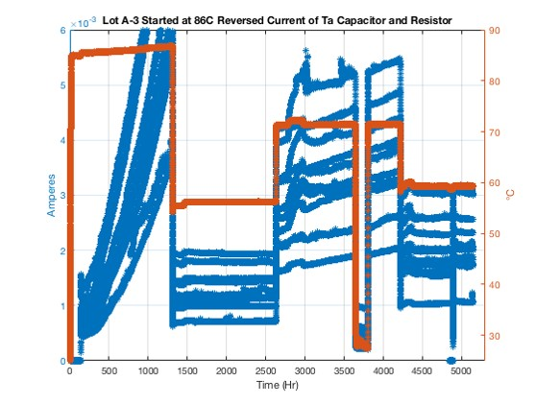
Risk example 3 cont’d
Testing profile of reverse caps from same lot in vacuum at operational V (-5.4V)

Slide 25
Risk example 3 cont’d
What is the risk of mission failure in the next 5 years of the temperature restriction is lifted from 40 deg C to 85 deg C and the temperature is maintained at a steady 85 deg C?
Given the reverse 25V Ta caps installed in the ELC LVPS (operating at -5.4V at 85 deg C) and the subsequent testing profile in the previous figure
It is possible that the leakage current will exceed 8 mA, taking out the MOSFET that regulates primary and secondary side power
Resulting in failure of the ELC pallet
The 85/86 deg C portion of the figure shows a parabolic profile of leakage current that would surpass 8 mA in < 2000 hrs, with almost complete certainty. This risk is a 5x5.

Slide 26
Risk example 3 cont’d
What is the risk of mission failure in the next 5 years of the temperature restriction is lifted from 40 deg C to 85 deg C and the temperature is less than 50 deg C 95% of the time, 60 deg C 5% of the time (but never for more than 24 hours) and spurious jumps to 85 deg C for no more than 2 hours each instance?
Given the reverse 25V Ta caps installed in the ELC LVPS (operating at -5.4V at the described temperatures conditions) and the subsequent testing profile in the previous figure
It is possible that the leakage current will exceed 8 mA, taking out the MOSFET that controls switching between primary and secondary side power
Resulting in failure of the ELC pallet
The majority time period of 50 deg C involves flat, stable leakage current. At 58 deg C, the leakage current remains flat as well. At 60 deg C, we can assume there is a very slight slope, but with no more than 24 hours time at 60 at any instance and maximum total hours of 2190, the leakage is insignificant. (note that at 70 deg C in figure, the continuous rise in leakage current would be around 1 mA over 2000 hrs). Furthermore, the brief periods of operation at 85 deg C also have insignificant effect on leakage current. Thus, the likelihood of exceeding 8 mA is insignificant (well below 0.1%) and the risk is noncredible.

Slide 27
Risk example 3 cont’d
Note that for other conditions in between the two provided, the figure can be used to estimate cumulative leakage current, and by covering the ranges over the individual tested capacitors, the likelihood of exceeding 8 mA for the range of conditions can be predicted.
In some cases, the data will be available to make reasonable predictions of risk, while in others testing will be required.
In this example there were enough test data and accumulated time on-orbit to understand that under temperature restrictions, the hardware would be safe while extensive testing was performed.
This case is extreme in that there should be no cases where you would want to so egregiously misuse a part when you have a choice.

