Slide 1
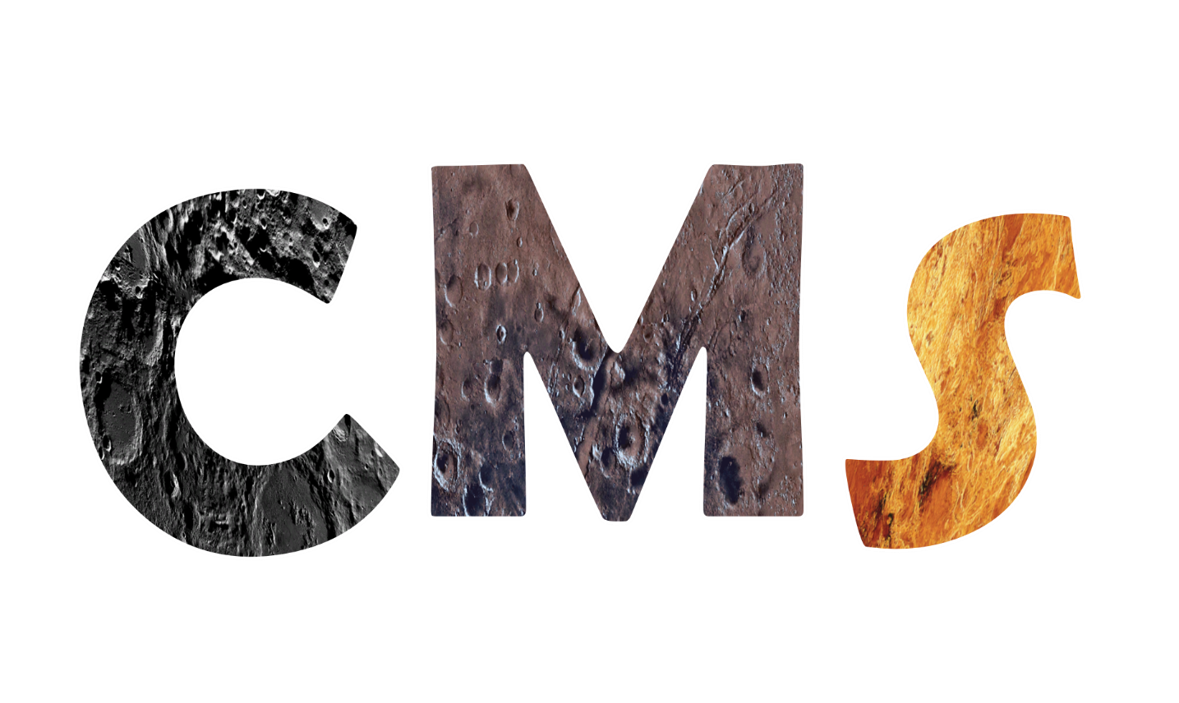
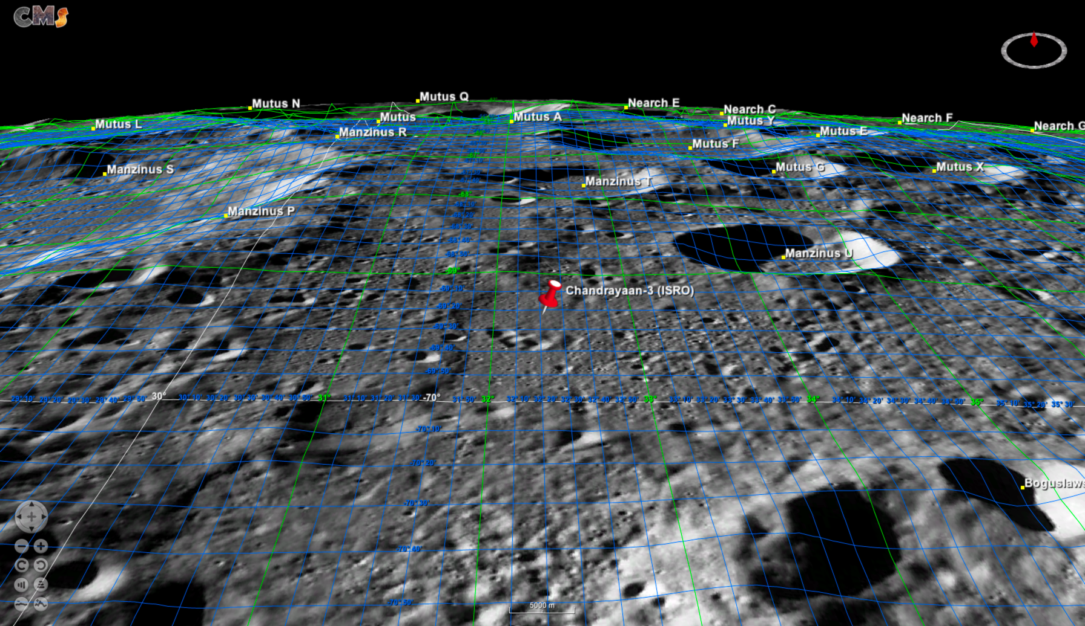
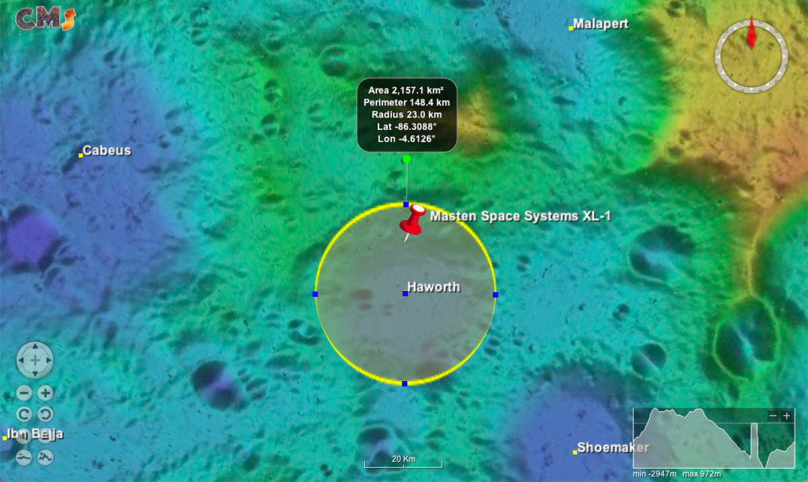
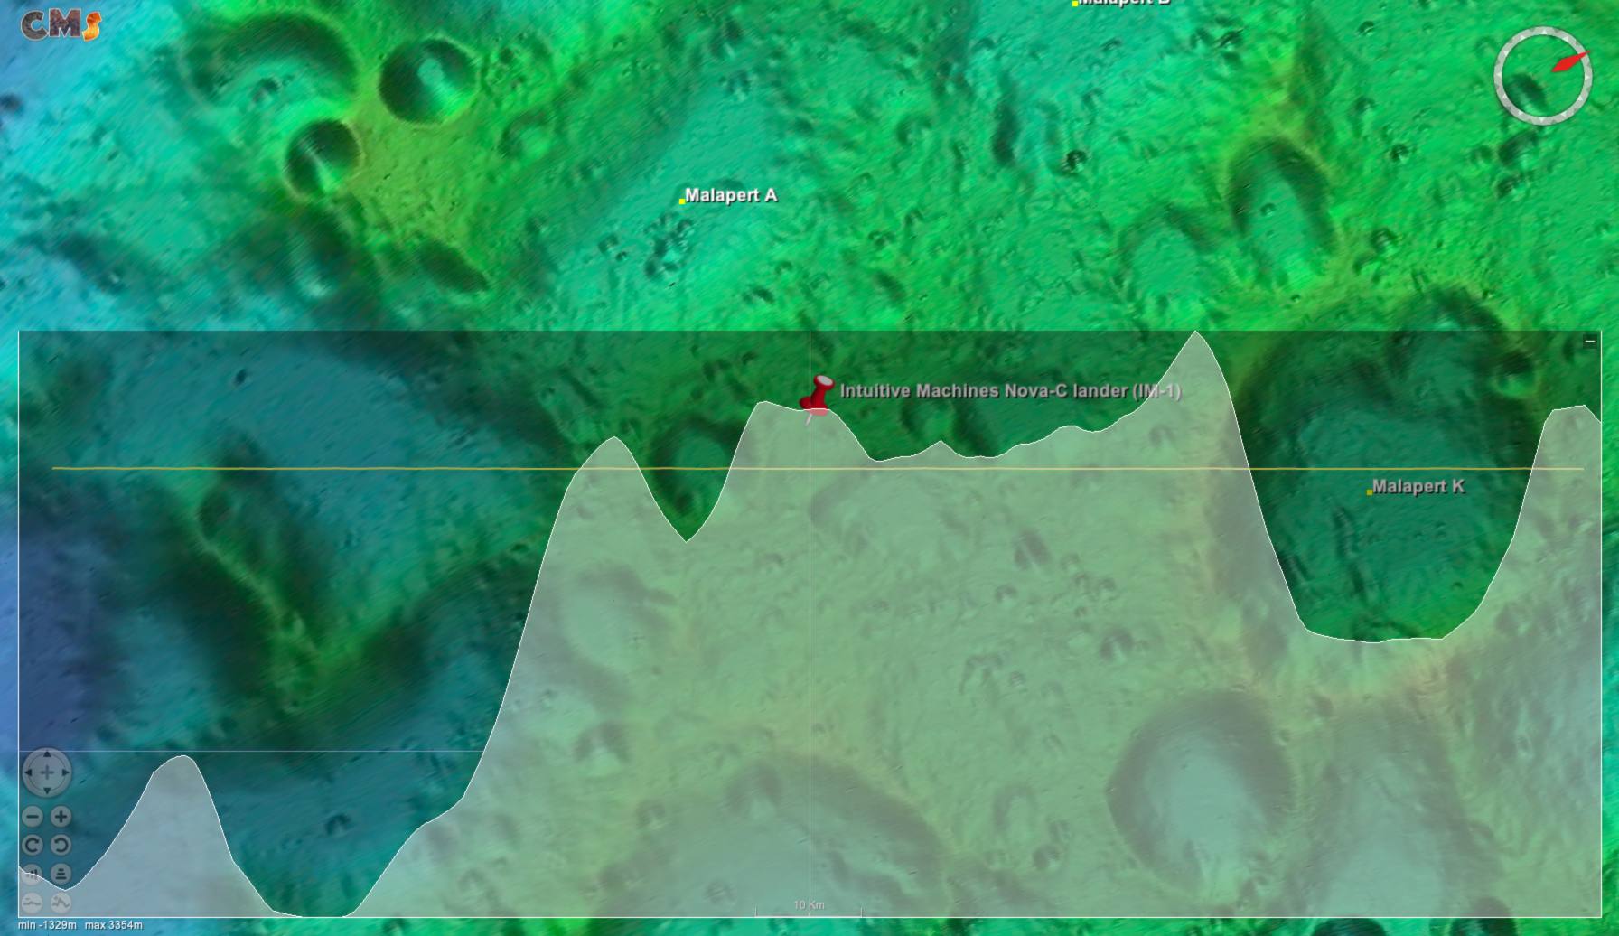
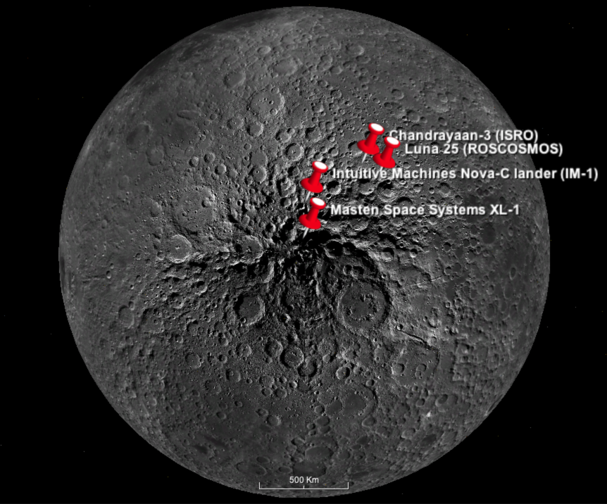
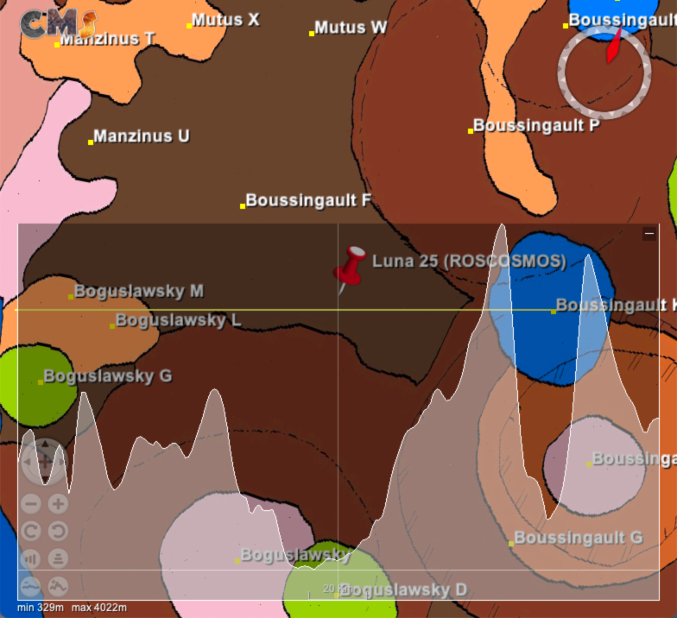
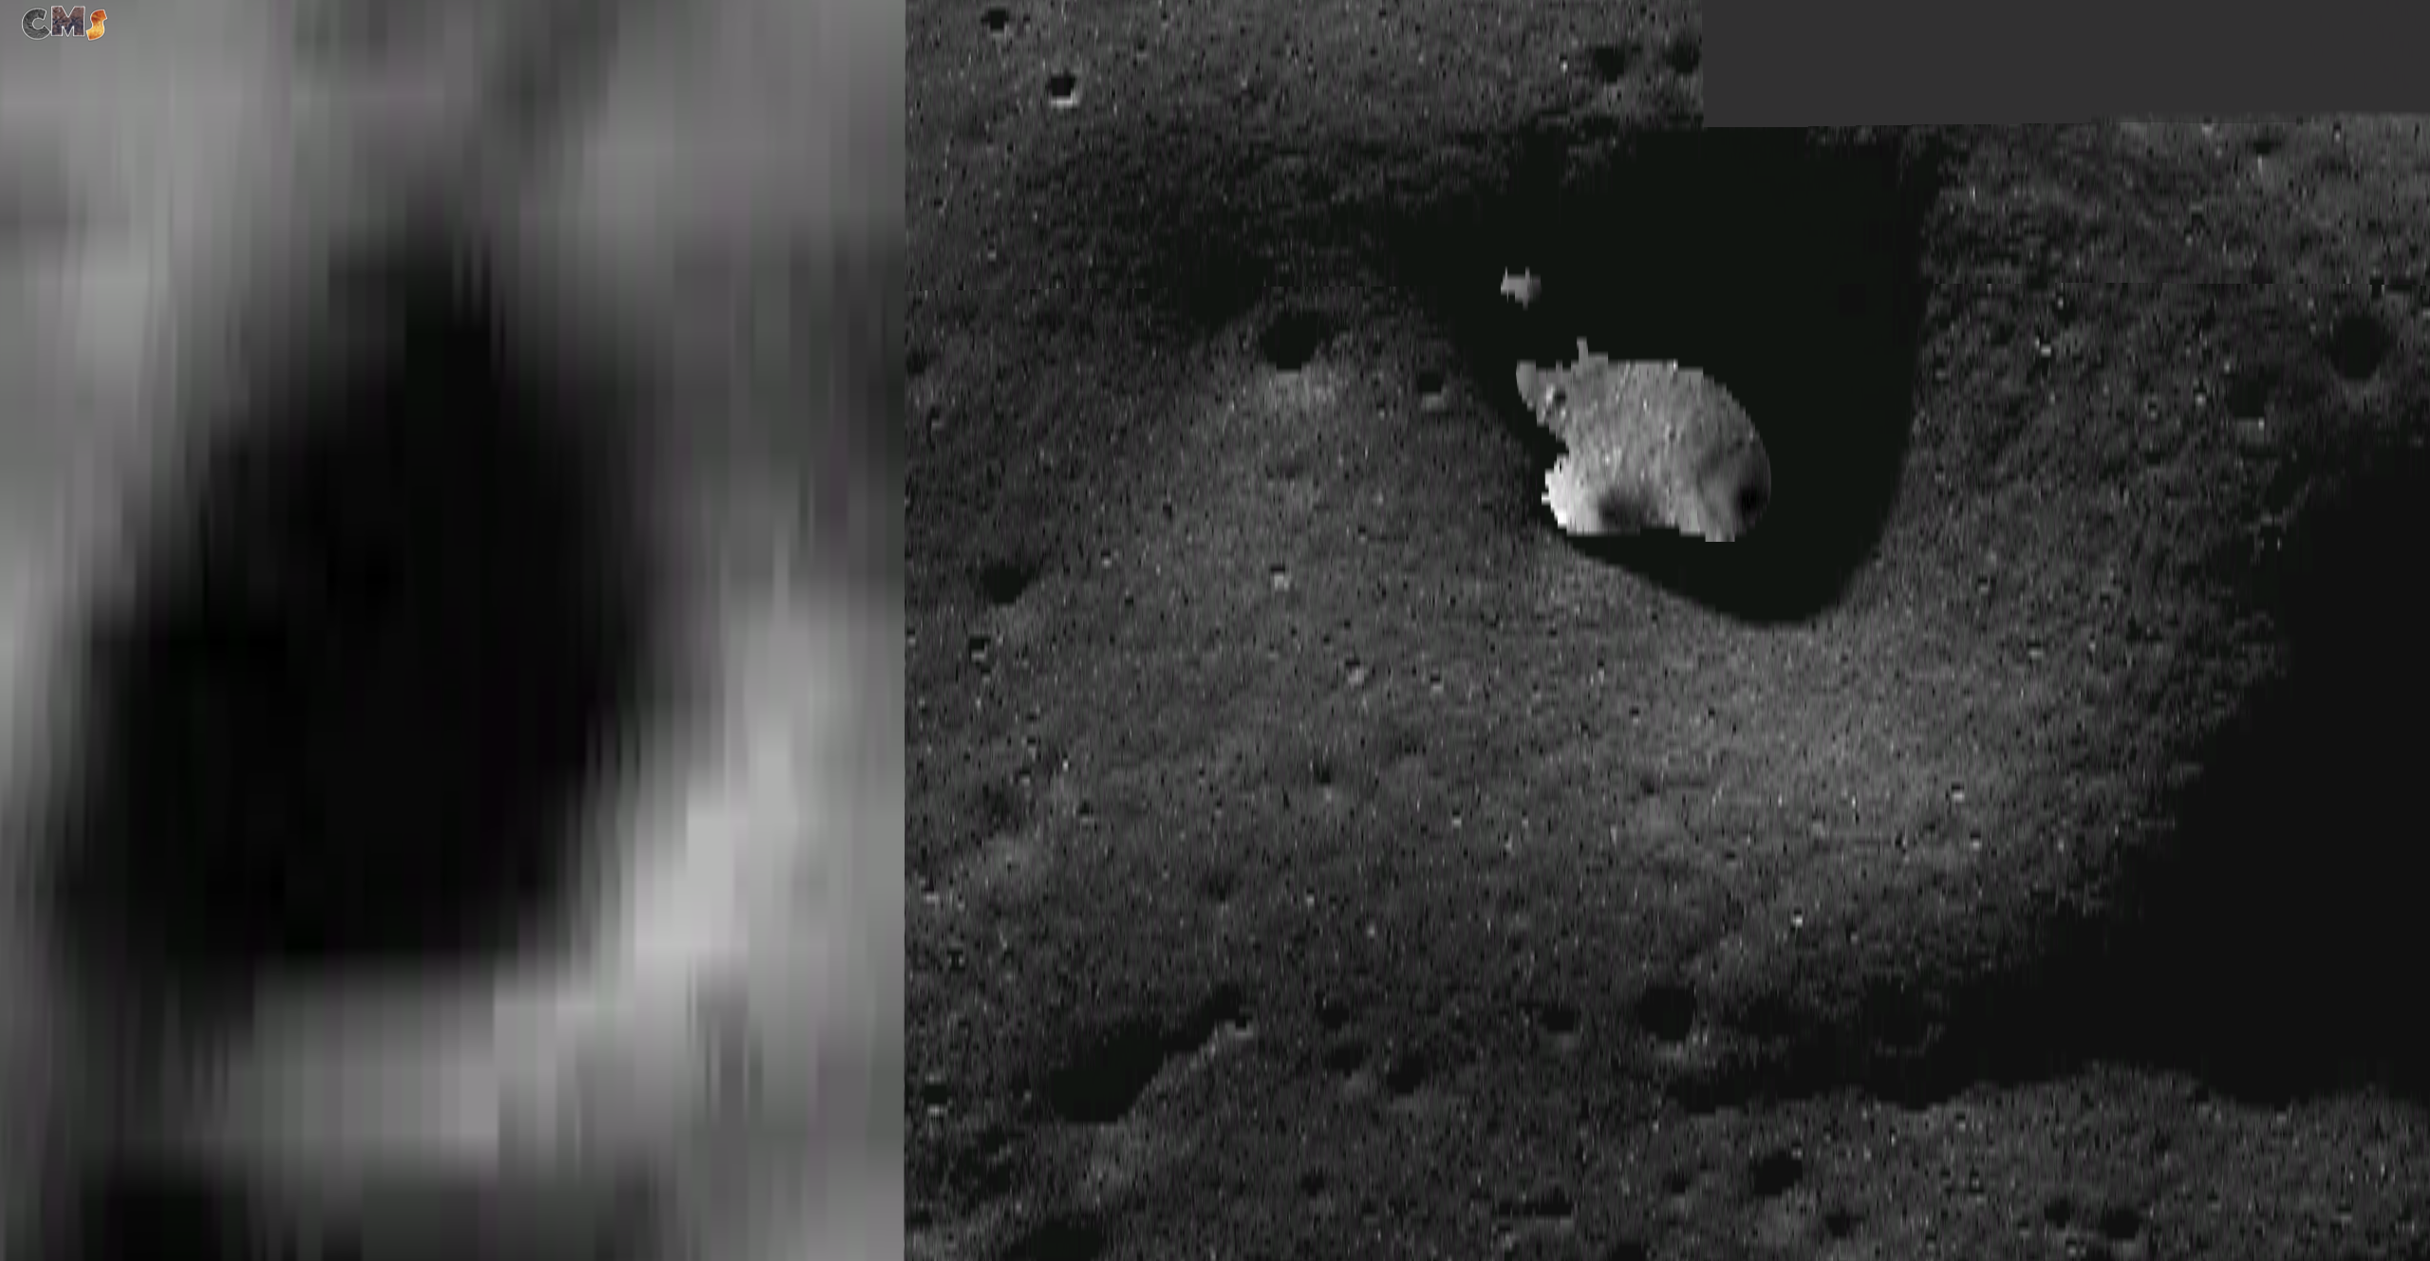
Upcoming Lunar Mission Landing Sites: Viewing and Analysis with Celestial Mapping System
Background: to analyze future missions to the lunar south pole over the next few years, CMS rendered customizable and precise maps of the surrounding lunar surface
By: Raghavendra Raikar, Abhinav Vishnuvajhala, Jackson Cooley
Mentors: Parul Agrawal, Miguel Del Castillo, Mark E. Peterson
NASA Ames Research Center
Chandraayan 3: Terrain-Conforming
Lat-Long Graticules (5 km view)
Intuitive Machines Nova-C lander I:
Terrain Elevation Profile (10 km view)
Xelene 1: Crater Area Measurement (10 km view)
Mission Objective: Conduct in-situ scientific experiments for the Indian Space Reseach Organization
Imagery: 3D Lunar-Reconnaissance Orbiter Camera Wide Angle Camera (LRO WAC) Global Mosaic
Landing Site: [32.4, -69.4] near Manzinus C and Simpelius N craters
Launch/Landing Date: July 14th/August 23rd 2023
Mission objective: NASA Commercial Lunar Payload Services lander
Imagery: Lunar Orbiter Laser Altimeter (LOLA) Color-Shaded Relief
Landing site: [-87, 5] near rim of Haworth crater
Launch Date: November 2023
Mission Objective: NASA Commercial Lunar Payload Services lander
Imagery: Lunar Orbiter Laser Altimeter Color-Shaded Relief
Landing Site: [0.9, -80.2] rim of Malapert crater A
Launch Date: Q3 2023
Russian Space Agency's Luna 25:
Terrain Profile (20 km view)
Current Development: AI-Generated Images
Eratosthenian Crater
Pre-Nectarian Terra
Nectarian Terra-Mantling and Plains
Imbrian Plains
Nectarian Basin, Secondary Crater
Nectarian Crater
Pre-Nectarian Crater
Pre-Nectarian Basin
Imbrian Imbrium Crater
Upcoming mission landing sites near South Pole
Mission objective: Studying the composition of the polar regolith and the plasma and dust components of the lunar polar exosphere
Imagery: United States Geological Survey Unified Geologic Map
Landing site: [43.5, -69.5] North of Boguslavsky crater
Launch Date: August 2023
References
[1] https://celestial.arc.nasa.gov
[2] Agrawal et. al. “Celestial Mapping System for Lunar
Surface Mapping and Analytics”, Lunar Surface
Innovation Consortium, 2021
[3] Bickel V. et al. (2021) Nat Commun 12, 5607
Goal: We are in the process of ingesting HORUS (Hyper-effective nOise Removal Unit Software) generated images into CMS to render them in 3D globe and build several functionalities to assist the planetary science community and mission planners
Description: current CMS image next to a HORUS image

