Slide 1
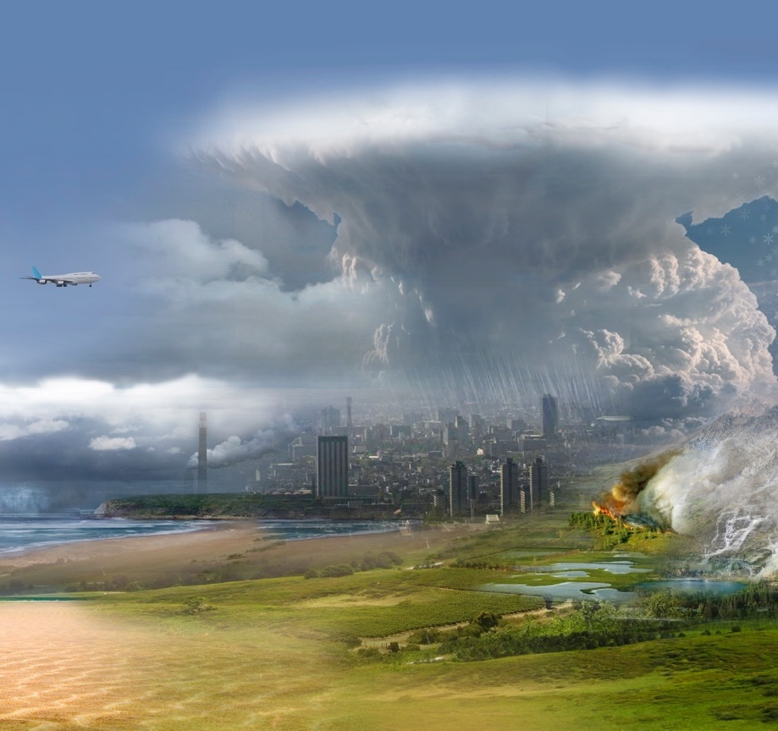
NASA Atmosphere Observing System (AOS)
Daniel J. Cecil¹, NASA MSFC
AOS Deputy Project Scientist – Suborbital
Daniel.J.Cecil@nasa.gov
Scott Braun², John Yorks², Tyler Thorsen³
1 NASA Marshall Space Flight Center
2 NASA Goddard Space Flight Center
3 NASA Langley Research Center
ESA-JAXA Pre-Launch EarthCARE
Science and Validation Workshop
November 2023
Notes:
NASA’s Earth System Observatory is a constellation of satellite observing systems that addresses the five major designated observables from the 2017 NASA Earth Science Decadal Survey. The Atmosphere Observing System, or AOS, addresses two of these designated observables, aerosols and clouds, convection, and precipitation, or CCP. In this talk, I will provide a brief background on the decadal survey recommendations, the AOS science objectives, and the observing system.

Slide 2
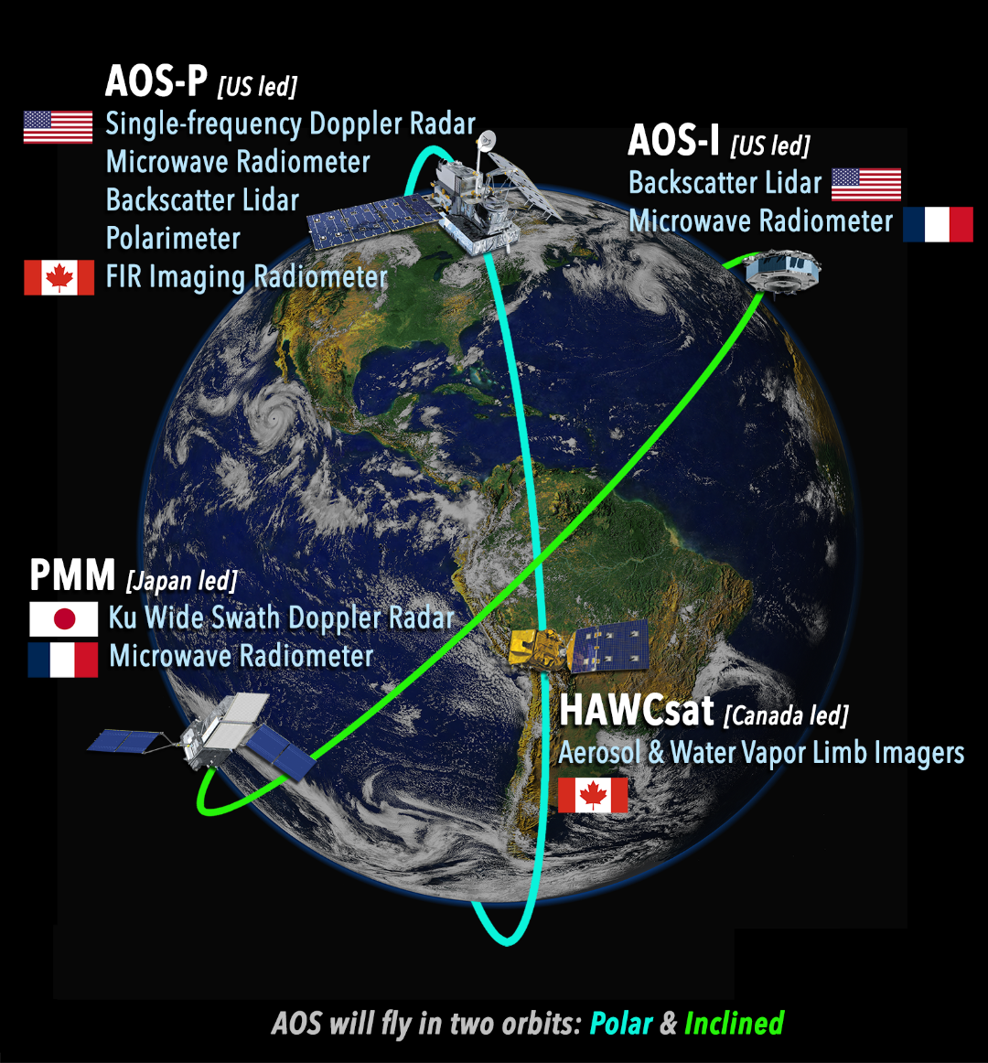
AOS Addresses Aerosol, Cloud, Convection, and Precipitation Processes
AOS-Storm (Inclined orbit, 2029)
  JAXA PMM Radar (Ku-band, Doppler)
  CNES C2OMODO tandem radiometers (89-325 GHZ)
  ALICAT backscatter lidar (532, 1064 nm)
AOS-Sky (Sun-synchronous orbit, 2031)
  Backscatter lidar (details TBD – Italian partnership?)
  Doppler radar (details TBD)
  Passive microwave radiometer (89-700 GHz)
  Polarimeter (350-1570 nm)
  CSA Thin Ice Cloud Imaging Radiometer (4-73 μm)
  CSA aerosol and moisture limb imagers
AOS Suborbital
  Post-launch field programs
  Surface-based networks, supersites
  Leverage existing capabilities, more international partners
Pre-decisional
AOS-Sky [US led)
Doppler Radar
AOS-Storm [US led)
International partnerships are very important to AOS, both in the satellite constellation and in suborbital activities.

Slide 3
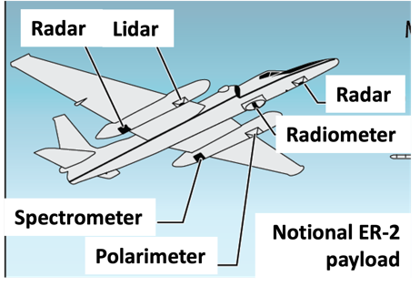
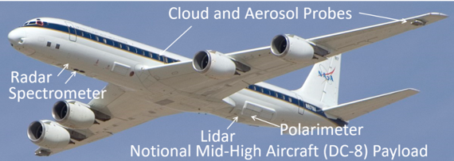
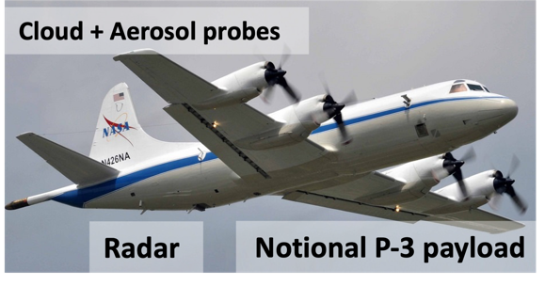
AOS Suborbital
Low Clouds: Microphysics, precipitation initiation
Convection/High Clouds: Microphysics and dynamics, anvil cirrus lifecycle.
Aerosol-Cloud-Radiation Interactions: Vertically resolved aerosol-cloud-radiation interaction processes and lifecycle.
Aircraft and payloads depicted are notional… instruments to be prioritized / deconflicted for each campaign.
Need a high altitude (over-storm) remote sensor…
…mid/high altitude aircraft to provide both remote sensing and in situ (aerosol, cloud, precip)
Large airborne campaigns addressing all science themes
Link airborne campaigns with well-instrumented surface sites
Partner with other programs / nations where practical
…low/mid altitude aircraft to provide both remote sensing and in situ (aerosol, cloud, precip)
Campaigns after launch to enable cal-val
Aircraft, surface sites, and networks from partners will be especially helpful.

Slide 4
AOS and EarthCARE
Pre-decisional
AOS and EarthCARE approach cloud and aerosol profiling using similar instrument types, but different frequencies and other details
  Many people / institutions aligned with both missions
Some commonality in the cal-val needs
Surface-based measurements, field campaigns, validation approaches used by each will be of interest to the other
  Validation best-practices talk Wednesday afternoon
  I’m here to discuss collaborations, match names to faces, etc.
AOS-Sky [US led)
Doppler Radar
AOS-Storm [US led)
Graphic reflects initial architecture concept directed at KDP-A. Additional direction was provided to study architecture changes, which are still on-going.

Slide 5
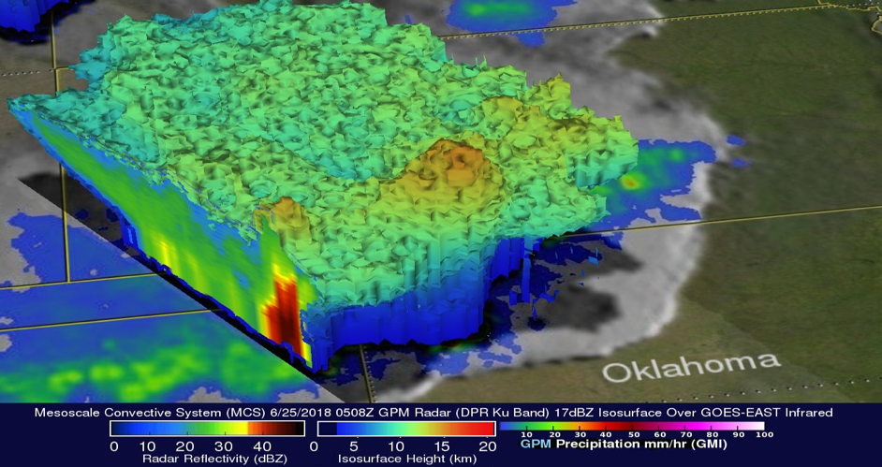
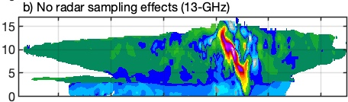
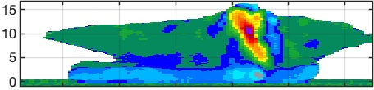
JAXA PMM Radar Capabilities
  NLT March 2029 launch
  430 km orbit, 55° inclination
JAXA Wide Swath Ku Doppler Radar
Baseline Requirements
Vertical sampling, resolution:
250, 500 m for Doppler, dense
125, 250 m for normal scan
Horizontal Resolution: 5 km
Observation range (altitude):
Doppler 17 km
Dense 20 km
Normal 18-20 km
Swath: 250 km
Sensitivity (min dBZ):
Doppler 7.3 dBZ
Dense 7.3 dBZ
Normal 15 dBZ
Doppler uncertainty: 2 m/s @ 16 dBZ
Unambiguous Doppler range: ±30 m/s
Doppler obs.
Dense sampling obs.
Model “Truth”
x3
Normal scan obs.
x49
・・・
Height (km)
Simulated Ku Doppler Velocity
Nadir direction of flight
Courtesy of Pavlos Kollias
Notes:
As mentioned, the inclined project is comprised of contributions from NASA, JAXA, and CNES. JAXA will contribute a Ku-band wide-swath precipitation radar with nadir Doppler capability for measuring convective vertical air motions. Dense over-sampling at nadir combined with the use of the displaced phase center antenna, or DPCA, approach for better removal of spacecraft motion and non-uniform beam filling effects allows us to obtain good measurements of the structure of convective vertical motions for many convective systems. Takuji Kubota will provide details of the radar in his presentation. CNES will provide two identical passive microwave radiometers with channels ranging from 89-325 GHz for characterization of ice cloud properties. The tandem radiometers provide the time rate of change of brightness temperatures over a 2-minute period to allow inference of evolving microphysics and convective vertical ice mass flux. NASA will provide a two-wavelength backscatter lidar with performance similar to or better than CALIPSO, but in a more compact, lower-cost package. The lidar will provide profiles of aerosols and clouds as well as boundary layer height. The expected launch is no earlier than mid 2028.

Slide 6
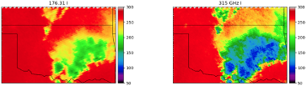
C2OMODO Radiometer Capabilities
  NLT March 2029 launch
  430 km orbit, 55° inclination
C2OMODO: Convective Core Observations through MicrOwave Derivatives in the trOpics (Brogniez et al. 2022)
CNES Radiometer Scan Pattern Near Nadir
CNES Microwave Radiometers (89, 183, 325 GHz)
89 GHz
183 GHz
325 GHz
Time-differenced radiometer measurements (~1-2-minutes) contain information on convective vertical motions
89 GHz 10 km FOV 1 channel Nyquist sampling
183.31 GHz 5 km FOV 6 channels Nyquist sampling
325.15 GHz 3 km FOV 3 channels Continuous sampling
Notes:
As mentioned, the inclined project is comprised of contributions from NASA, JAXA, and CNES. JAXA will contribute a Ku-band wide-swath precipitation radar with nadir Doppler capability for measuring convective vertical air motions. Dense over-sampling at nadir combined with the use of the displaced phase center antenna, or DPCA, approach for better removal of spacecraft motion and non-uniform beam filling effects allows us to obtain good measurements of the structure of convective vertical motions for many convective systems. Takuji Kubota will provide details of the radar in his presentation. CNES will provide two identical passive microwave radiometers with channels ranging from 89-325 GHz for characterization of ice cloud properties. The tandem radiometers provide the time rate of change of brightness temperatures over a 2-minute period to allow inference of evolving microphysics and convective vertical ice mass flux. NASA will provide a two-wavelength backscatter lidar with performance similar to or better than CALIPSO, but in a more compact, lower-cost package. The lidar will provide profiles of aerosols and clouds as well as boundary layer height. The expected launch is no earlier than mid 2028.

Slide 7
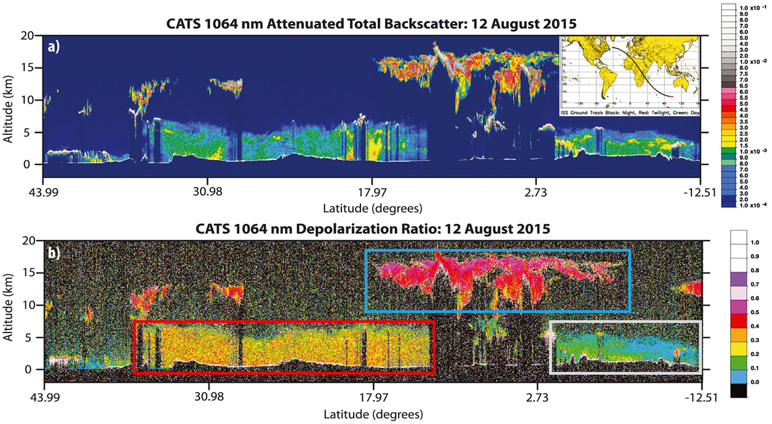
ALICAT Lidar Capabilities
  NLT March 2029 launch
  430 km orbit, 55° inclination
CATS Backscatter Lidar Example
ALICAT: Atmospheric Lidar for Cloud and Aerosol Transport
Low pulse energy, high pulse repetition frequency
Frequencies: 532, 1064 nm
Provides total attenuated backscatter and depolarization at both frequencies
Heritage: Cloud Physics Lidar, Cloud-Aerosol Transport System (CATS)
Notes:
As mentioned, the inclined project is comprised of contributions from NASA, JAXA, and CNES. JAXA will contribute a Ku-band wide-swath precipitation radar with nadir Doppler capability for measuring convective vertical air motions. Dense over-sampling at nadir combined with the use of the displaced phase center antenna, or DPCA, approach for better removal of spacecraft motion and non-uniform beam filling effects allows us to obtain good measurements of the structure of convective vertical motions for many convective systems. Takuji Kubota will provide details of the radar in his presentation. CNES will provide two identical passive microwave radiometers with channels ranging from 89-325 GHz for characterization of ice cloud properties. The tandem radiometers provide the time rate of change of brightness temperatures over a 2-minute period to allow inference of evolving microphysics and convective vertical ice mass flux. NASA will provide a two-wavelength backscatter lidar with performance similar to or better than CALIPSO, but in a more compact, lower-cost package. The lidar will provide profiles of aerosols and clouds as well as boundary layer height. The expected launch is no earlier than mid 2028.

Slide 8
AOS-Sky Lidar
  NET December 2031 launch
  450 km orbit, sun-sync-13:30 LTAN
532 nm, 1064 Backscatter Lidar*
• Target requirement of daytime SNR equivalent to CALIPSO night SNR
• NASA HQ has initiated study of partnership with Italian Space Agency (ASI)
ASI lidar:
  355 nm Raman (extinction)
  532, 1064 nm backscatter
• Requires formation flying of AOS-Sky and ASI lidar
Clouds
Dust
Smoke
Clouds
Notes:
The polar mission builds on the heritage of the A Train and is designed to optimize instrument synergies to obtain accurate information on processes relevant to climate sensitivity and feedback and aerosol forcing of climate, which requires globally distributed observations. It includes several advanced sensors provided by NASA and industry and contributed instruments from CSA. The next several slides will focus on the key capabilities within each orbit.

Slide 9
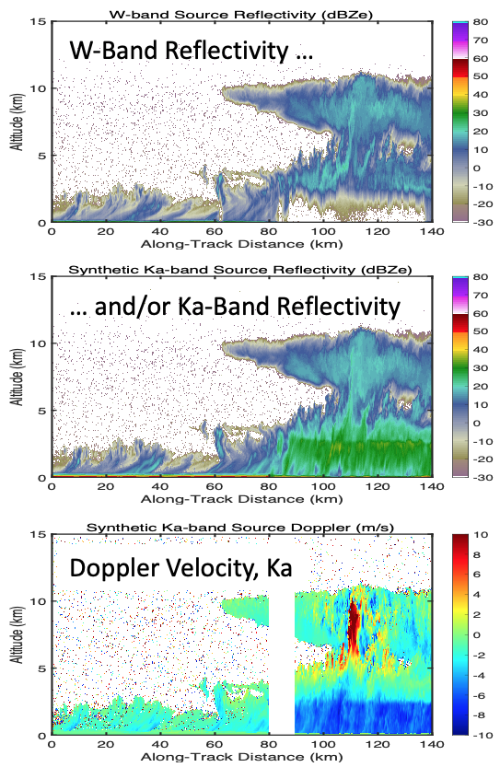
AOS-Sky Radar
  NET December 2031 launch
  450 km orbit, sun-sync-13:30 LTAN
Baseline Requirements
Quantity | Resolution @ altitude | Accuracy | Sensitivity @ altitude
Radar reflectivity, cloud-profiling | Horiz.: 2.0 km Vert.: 300 m @ 0.5 – 1.0 km 300 m @ 1.0 - 2.5 km 500 m @ 2.5 – 6 km 500 m @ 6 – 20 km | 1.5 dB * | ≤–5 dBZ @ 0.5 km – 1 km ≤–15 dBZ @ 1 km – 2.5 km ≤–20 dBZ @ 2.5 km – 6 km ≤–24 dBZ @ 6 km – 20 km
• Requirements are frequency agnostic
• Enhancements to be studied: Second frequency, narrow swath, passive measurements if Ka band, LDR
Figures at left courtesy of Matt McLinden
Notes:
Third party images:
Lower center image provided by Vanderlei Martins, permission obtained June 8, 2022. Email text below:
“Hi Scott,
Yes, this is a multi-angle sequence from HARP showing 10 viewing angles.
Since all other examples in your slide are for level 2, I am also attaching an example of level 2 retrieval from HARP and, another case with 60 viewing angles.
Feel free to use any combination you prefer.
Vanderlei
Lower right figure provided by Landon Rieger, permission obtained July 13, 2022. Permission email text is below:
Lidar image from https://www.researchgate.net/figure/The-CATS-1064-nm-attenuated-total-backscatter-ATB-a-volume-depolarization-ratio-b_fig1_351400300, with CC 4.0 license.
Hi Sheri and Scott,
Feel free to use that graphic wherever it's helpful, including posting it online. If you ever need a higher resolution or vector format just let me know too.
Best regards,
Landon

Slide 10
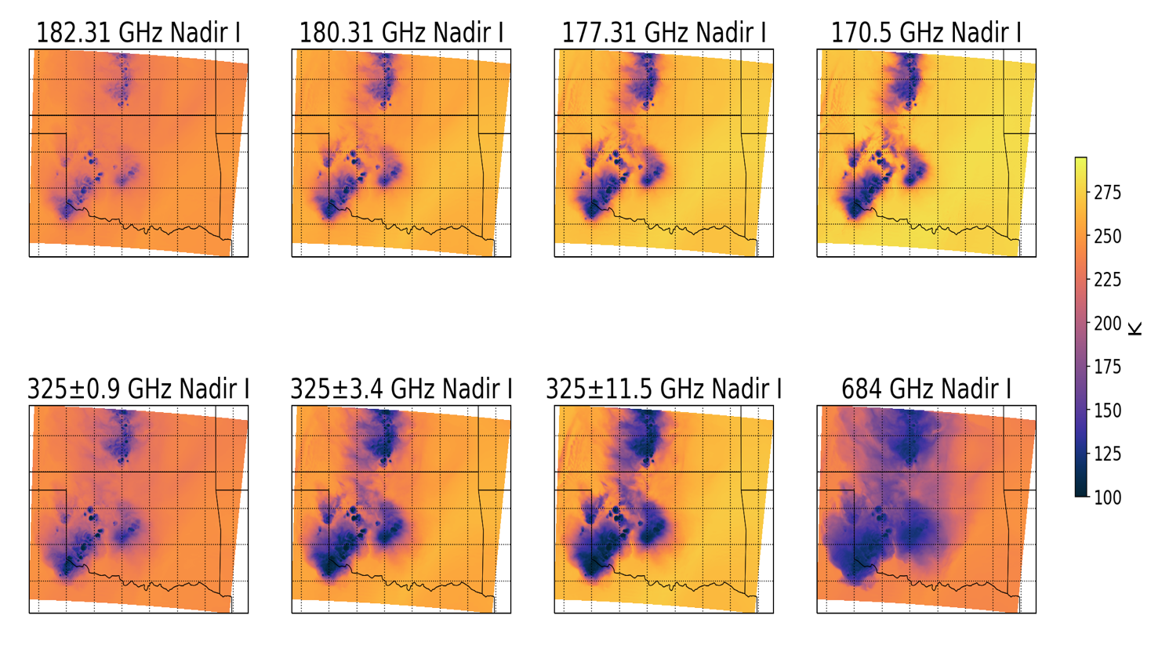
AOS-Sky Radiometer Requirements
Microwave Radiometer: 89-700 GHz
Baseline Requirements
Bands (# Channels) | Accuracy (K) | Polarization
89-113 GHz (1) 118 GHz (3) | ≤ 0.5 K ≤ 0.75 K | Target: Dual Minimum: Single
183.3 GHz (3) 165/205 GHz (1) | ≤0.75 K ≤0.75 K | Target: Dual Minimum: Single
310 GHz (3) 325.2 or 380.2 GHz (2) | ≤ 1.5 K ≤ 1.5 K | Target: Dual Minimum: Single
640-700 GHz (1) | ≤ 1.5 K | Dual
Courtesy of Matt McLinden
Courtesy of Yuli Liu, UMBC
Sub-mm wavelengths bring a cloud sensitivity that is new for NASA missions
Cross-track scanning, ≥750 km swath
FOV ≤10 km at nadir, ≤20 km at edge of swath
Notes:
Third party images:
Lower center image provided by Vanderlei Martins, permission obtained June 8, 2022. Email text below:
“Hi Scott,
Yes, this is a multi-angle sequence from HARP showing 10 viewing angles.
Since all other examples in your slide are for level 2, I am also attaching an example of level 2 retrieval from HARP and, another case with 60 viewing angles.
Feel free to use any combination you prefer.
Vanderlei
Lower right figure provided by Landon Rieger, permission obtained July 13, 2022. Permission email text is below:
Lidar image from https://www.researchgate.net/figure/The-CATS-1064-nm-attenuated-total-backscatter-ATB-a-volume-depolarization-ratio-b_fig1_351400300, with CC 4.0 license.
Hi Sheri and Scott,
Feel free to use that graphic wherever it's helpful, including posting it online. If you ever need a higher resolution or vector format just let me know too.
Best regards,
Landon

Slide 11
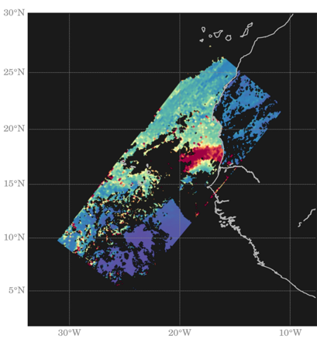

AOS Polarimeter Requirements
UV-VIS-NIR-SWIR Multi-angle Polarimeter
Baseline Requirements
Example AOD from HARP
Cloud-top properties available also
Type and/or Wavelength range (nm) | Number of spectral channels | Number of viewing angles per pixel
UV: 350 – 390 nm¹ | 1 | 10
VIS: 410 – 750 nm | 2 | 10
Hyperangle: 660 – 870 nm | 1 | 60
Water Vapor: ~940nm | 1 | 10
SWIR Cirrus: ~1380 | 1 | 10
VNIR-SWIR: 870 – 1570 nm | 3 | 10
300 km swath width
0.5 km IFOV (at nadir)
Notes:
Third party images:
Left image provided by Vanderlei Martins, permission obtained June 8, 2022. Email text below:
“Hi Scott,
Yes, this is a multi-angle sequence from HARP showing 10 viewing angles.
Since all other examples in your slide are for level 2, I am also attaching an example of level 2 retrieval from HARP and, another case with 60 viewing angles.
Feel free to use any combination you prefer.
Vanderlei

Slide 12
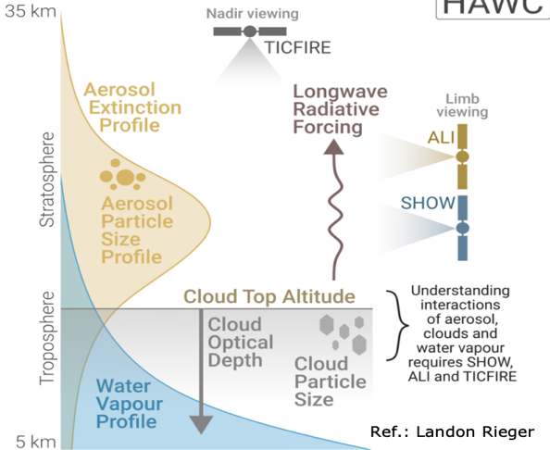
CSA Contributions
Canadian Space Agency Longwave-Far Infrared Imaging Radiometer (4-73 μm),
Aerosol/Moisture Limb Sounding
AOS-Sky [US led)
AOS-Storm [US led)
Notes:
Lower right figure provided by Landon Rieger, permission obtained July 13, 2022. Permission email text is below:
Hi Sheri and Scott,
Feel free to use that graphic wherever it's helpful, including posting it online. If you ever need a higher resolution or vector format just let me know too.
Best regards,
Landon

Slide 13
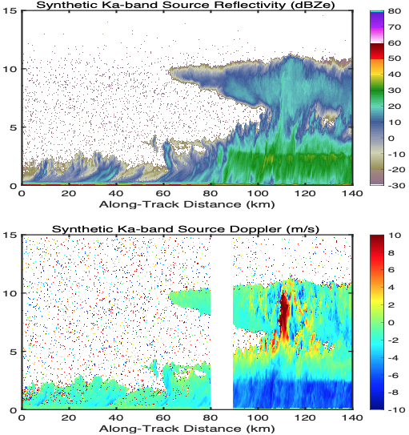
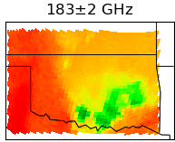
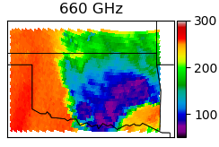
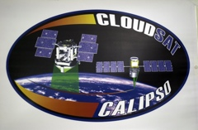

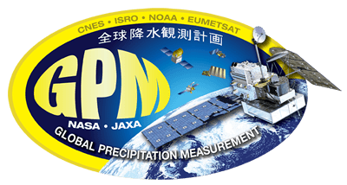
Summary of AOS Measurements & Timeline
Inclined orbit (diurnal variations)
Polar orbit
Sun-synch
1330 LTAN
NET Dec 2031
55° inclination
NLT March 2029
AOS-Storm, JAXA PMM, and CNES C2OMODO:
Ku-Doppler radar
dTB/dt (~mm-wavelength)
Backscatter lidar
AOS-Sky, CSA HAWCsat:
Cloud-profiling Doppler radar
Backscatter lidar
sub-mm radiometer
Polarimeter
Longwave radiometer
Limb sounder (aerosol+moisture)
2019
2023
2027
2031
Polar
CloudSat/CALIPSO
Possible extended mission
AOS-Sky + HAWCsat
Possible extended mission
End of GPM station keeping fuel
CSA
Inclined
Suborbital campaigns
after launches
GPM
INCUS
PMM
Possible extended mission
AOS-Storm
Possible extended mission
JAXA
CNES
Notes:
Radiative forcing license info: https://creativecommons.org/licenses/by-sa/4.0/. No change made to figure. Source: https://archive.ipcc.ch/report/graphics/index.php?t=Assessment%20Reports&r=AR5%20-%20WG1&f=Chapter%2008

