Slide 1
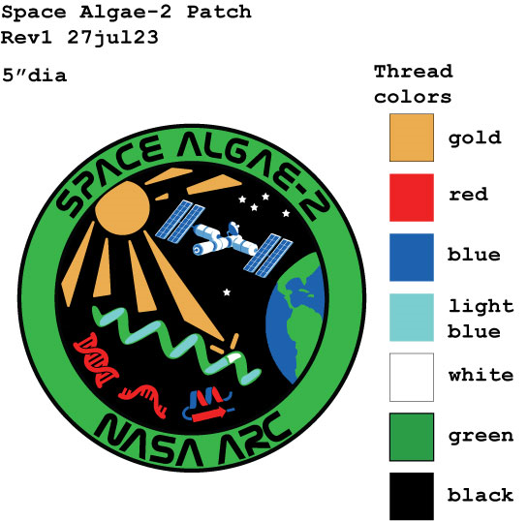
Space Algae-2: Preflight testing for a long-duration, multi-omics analysis of Arthrospira platensis
Katherine Fisher, MS, Research Scientist, KBR
Jared Broddrick, PhD, Research Scientist, NASA
A. Mark Settles, PhD, Principal Investigator, NASA
November 18th, 2023

Slide 2
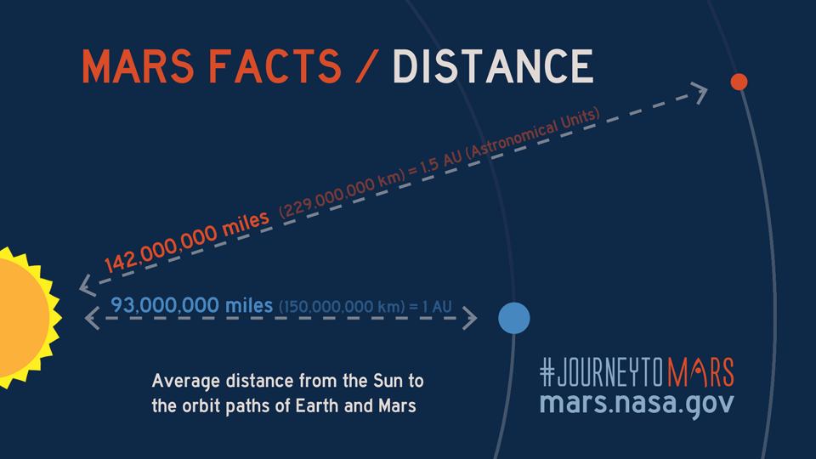
Distance from Earth increases mission cost and risk
Mission resources will need to be produced on-site to increase sustainability and to reduce costs of deep space exploration.
Fuels, food, essential nutrients, chemicals, plastics, binders, and medicines are resources that could be produced in mission.
Biomanufacturing can provide some compounds that abiotic systems cannot.
Image credit: NASA

Slide 3
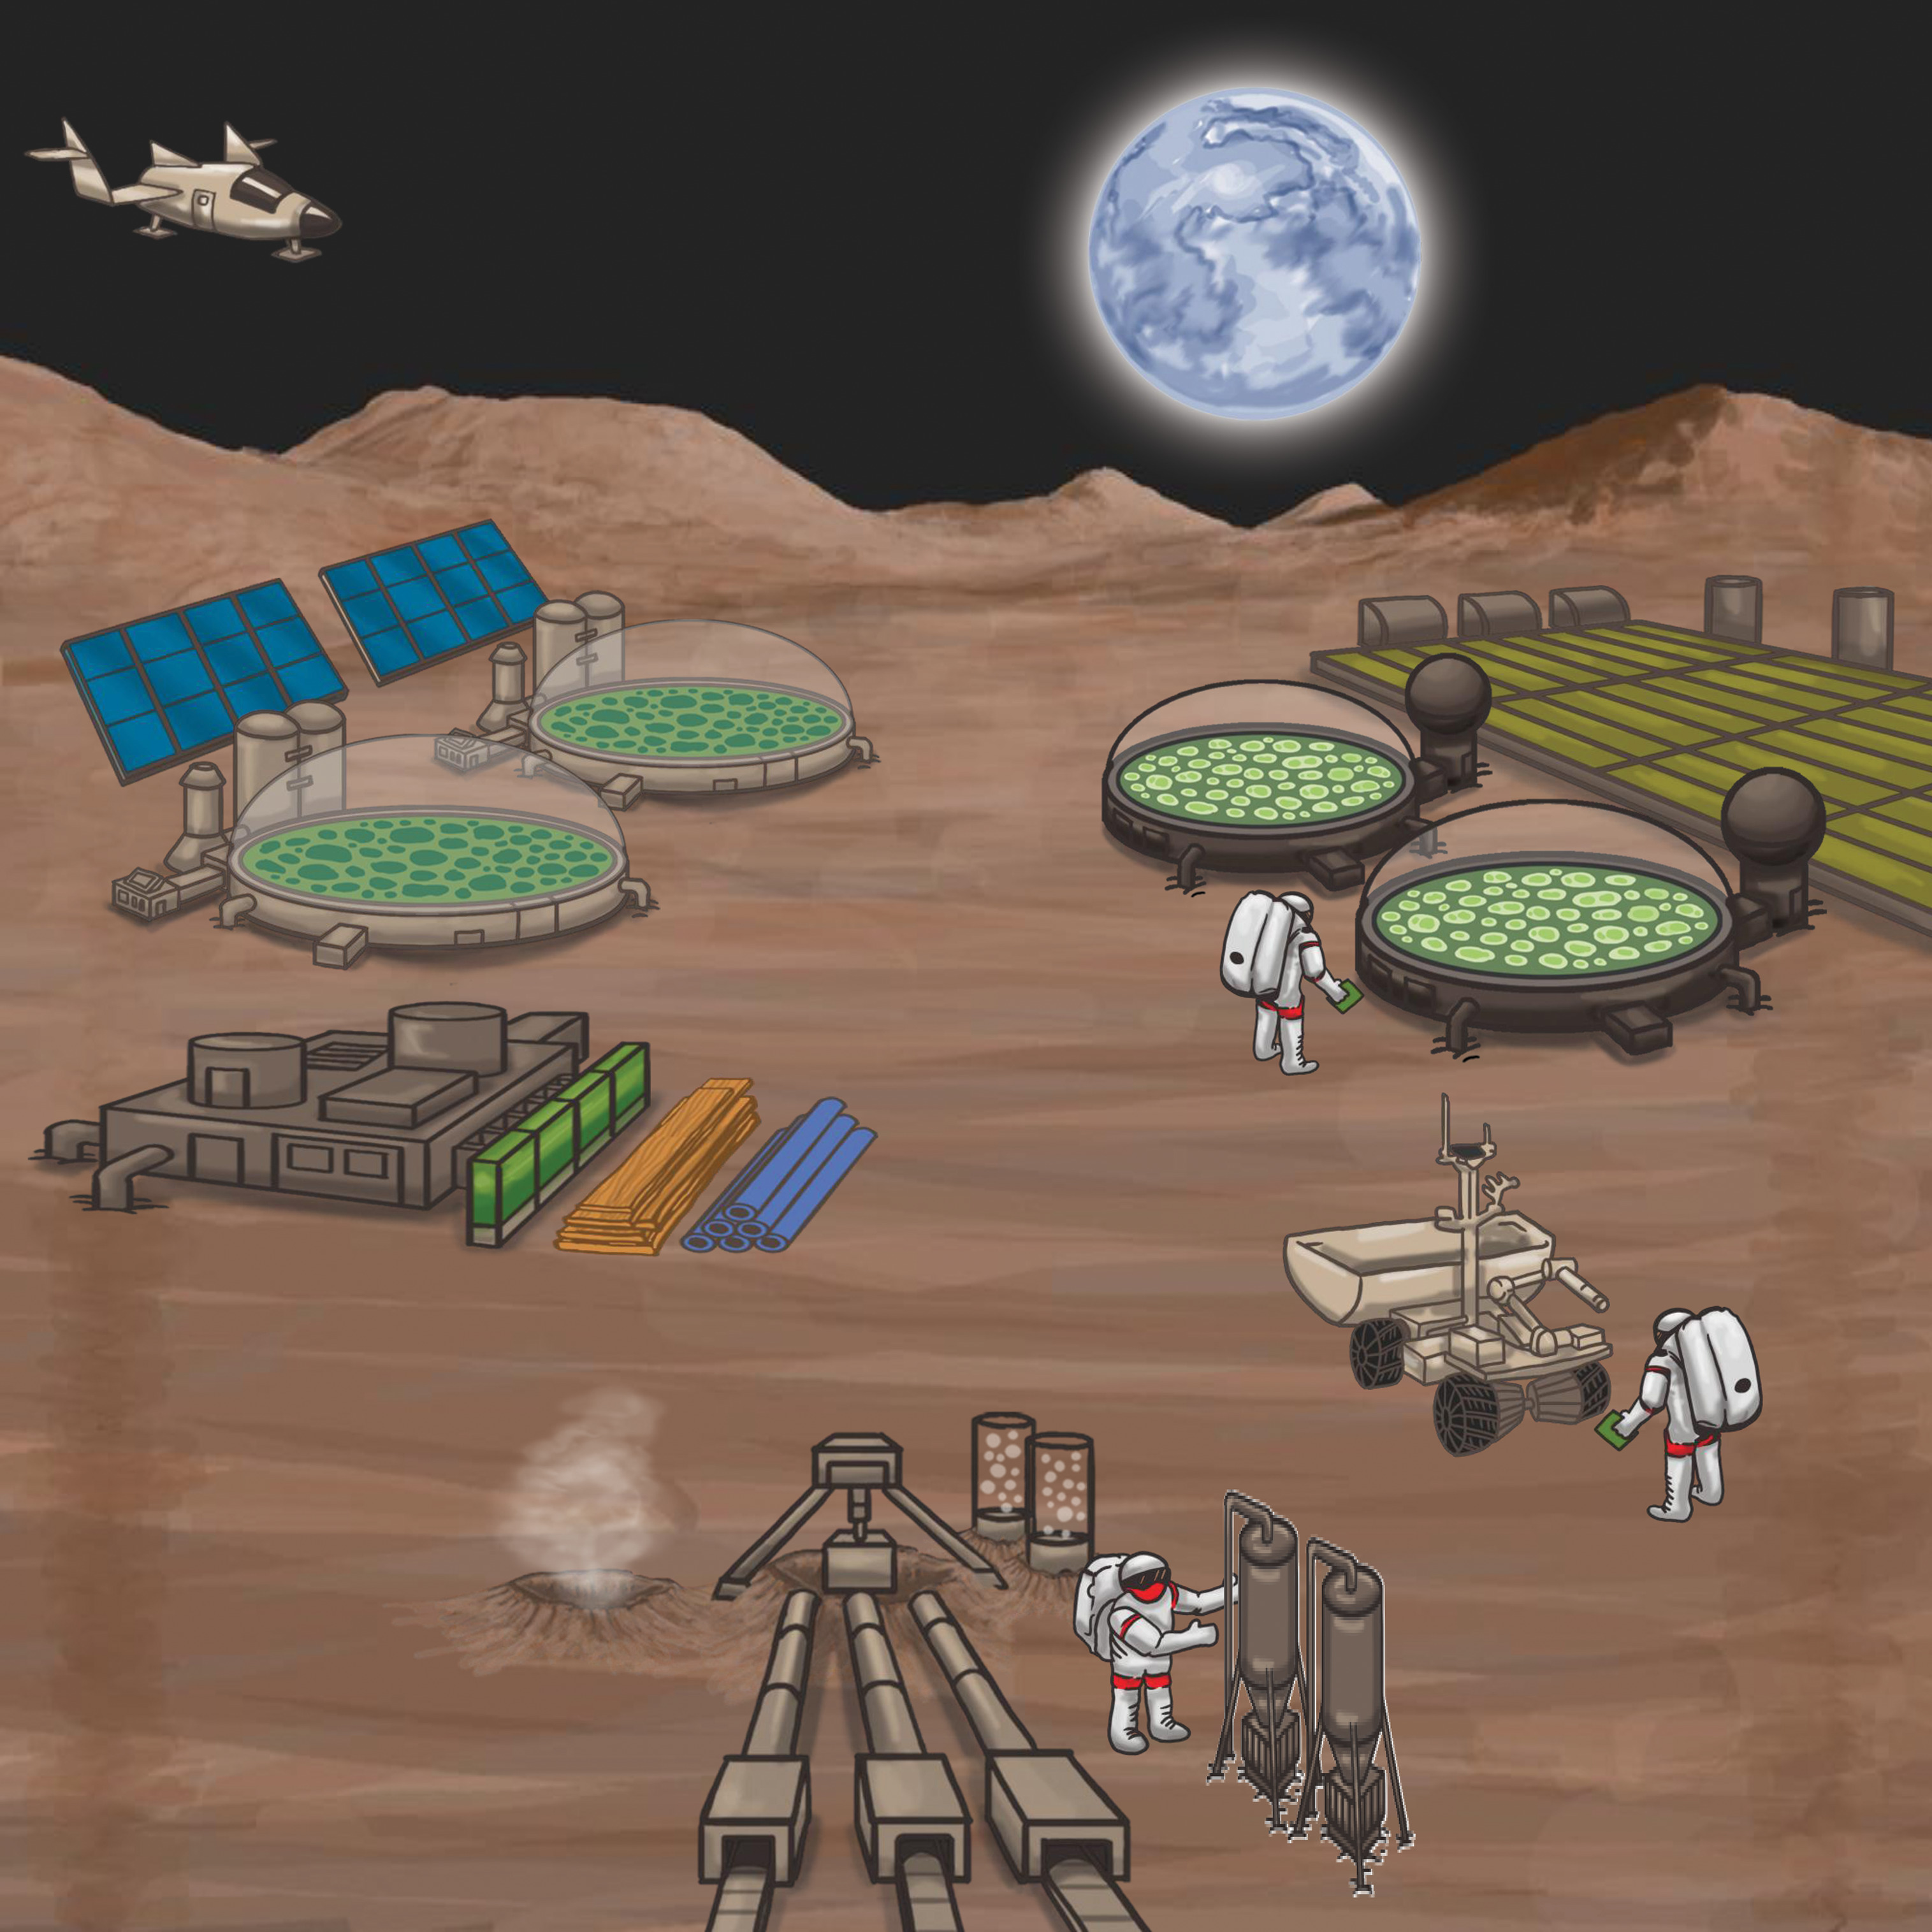
Microalgae for renewable production in space
Uses for microalgae in space (and on Earth)
  Recycle carbon dioxide into oxygen for bioregenerative life support systems (BLSS)
  Generate biomass for food & animal feed
  Wastewater treatment
  Biofuels & organic feedstocks
  Vitamins & essential amino acids
Menezes et al. (2015) J R Soc Interface. 2012: 20140715. doi:10.1098/rsif.2014.0715, under CC BY 4.0

Slide 4

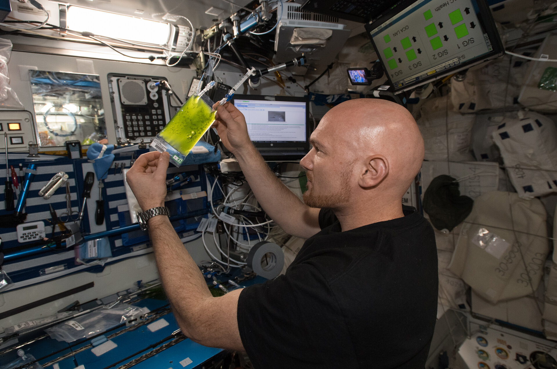
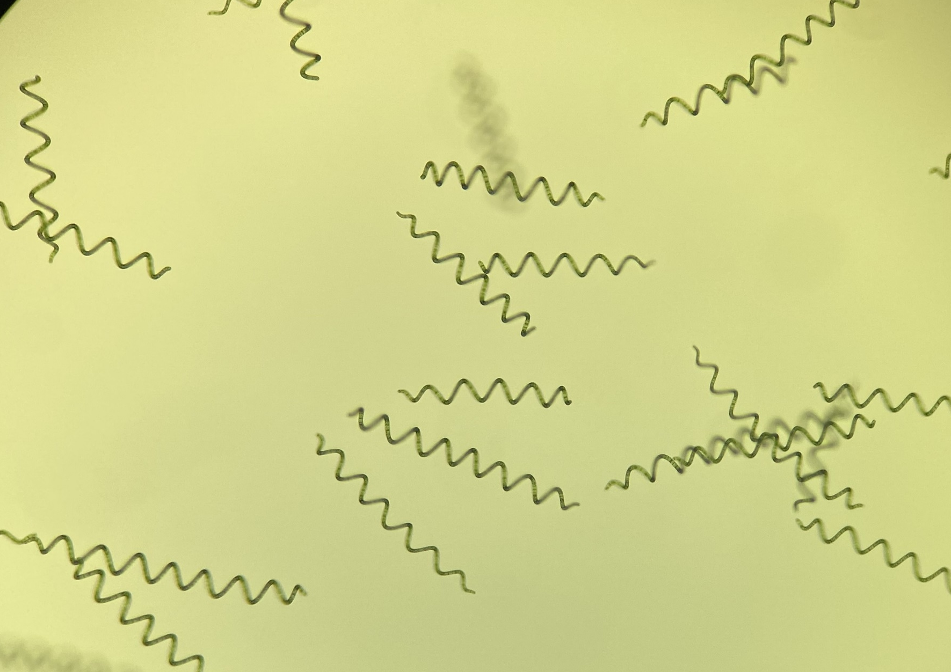
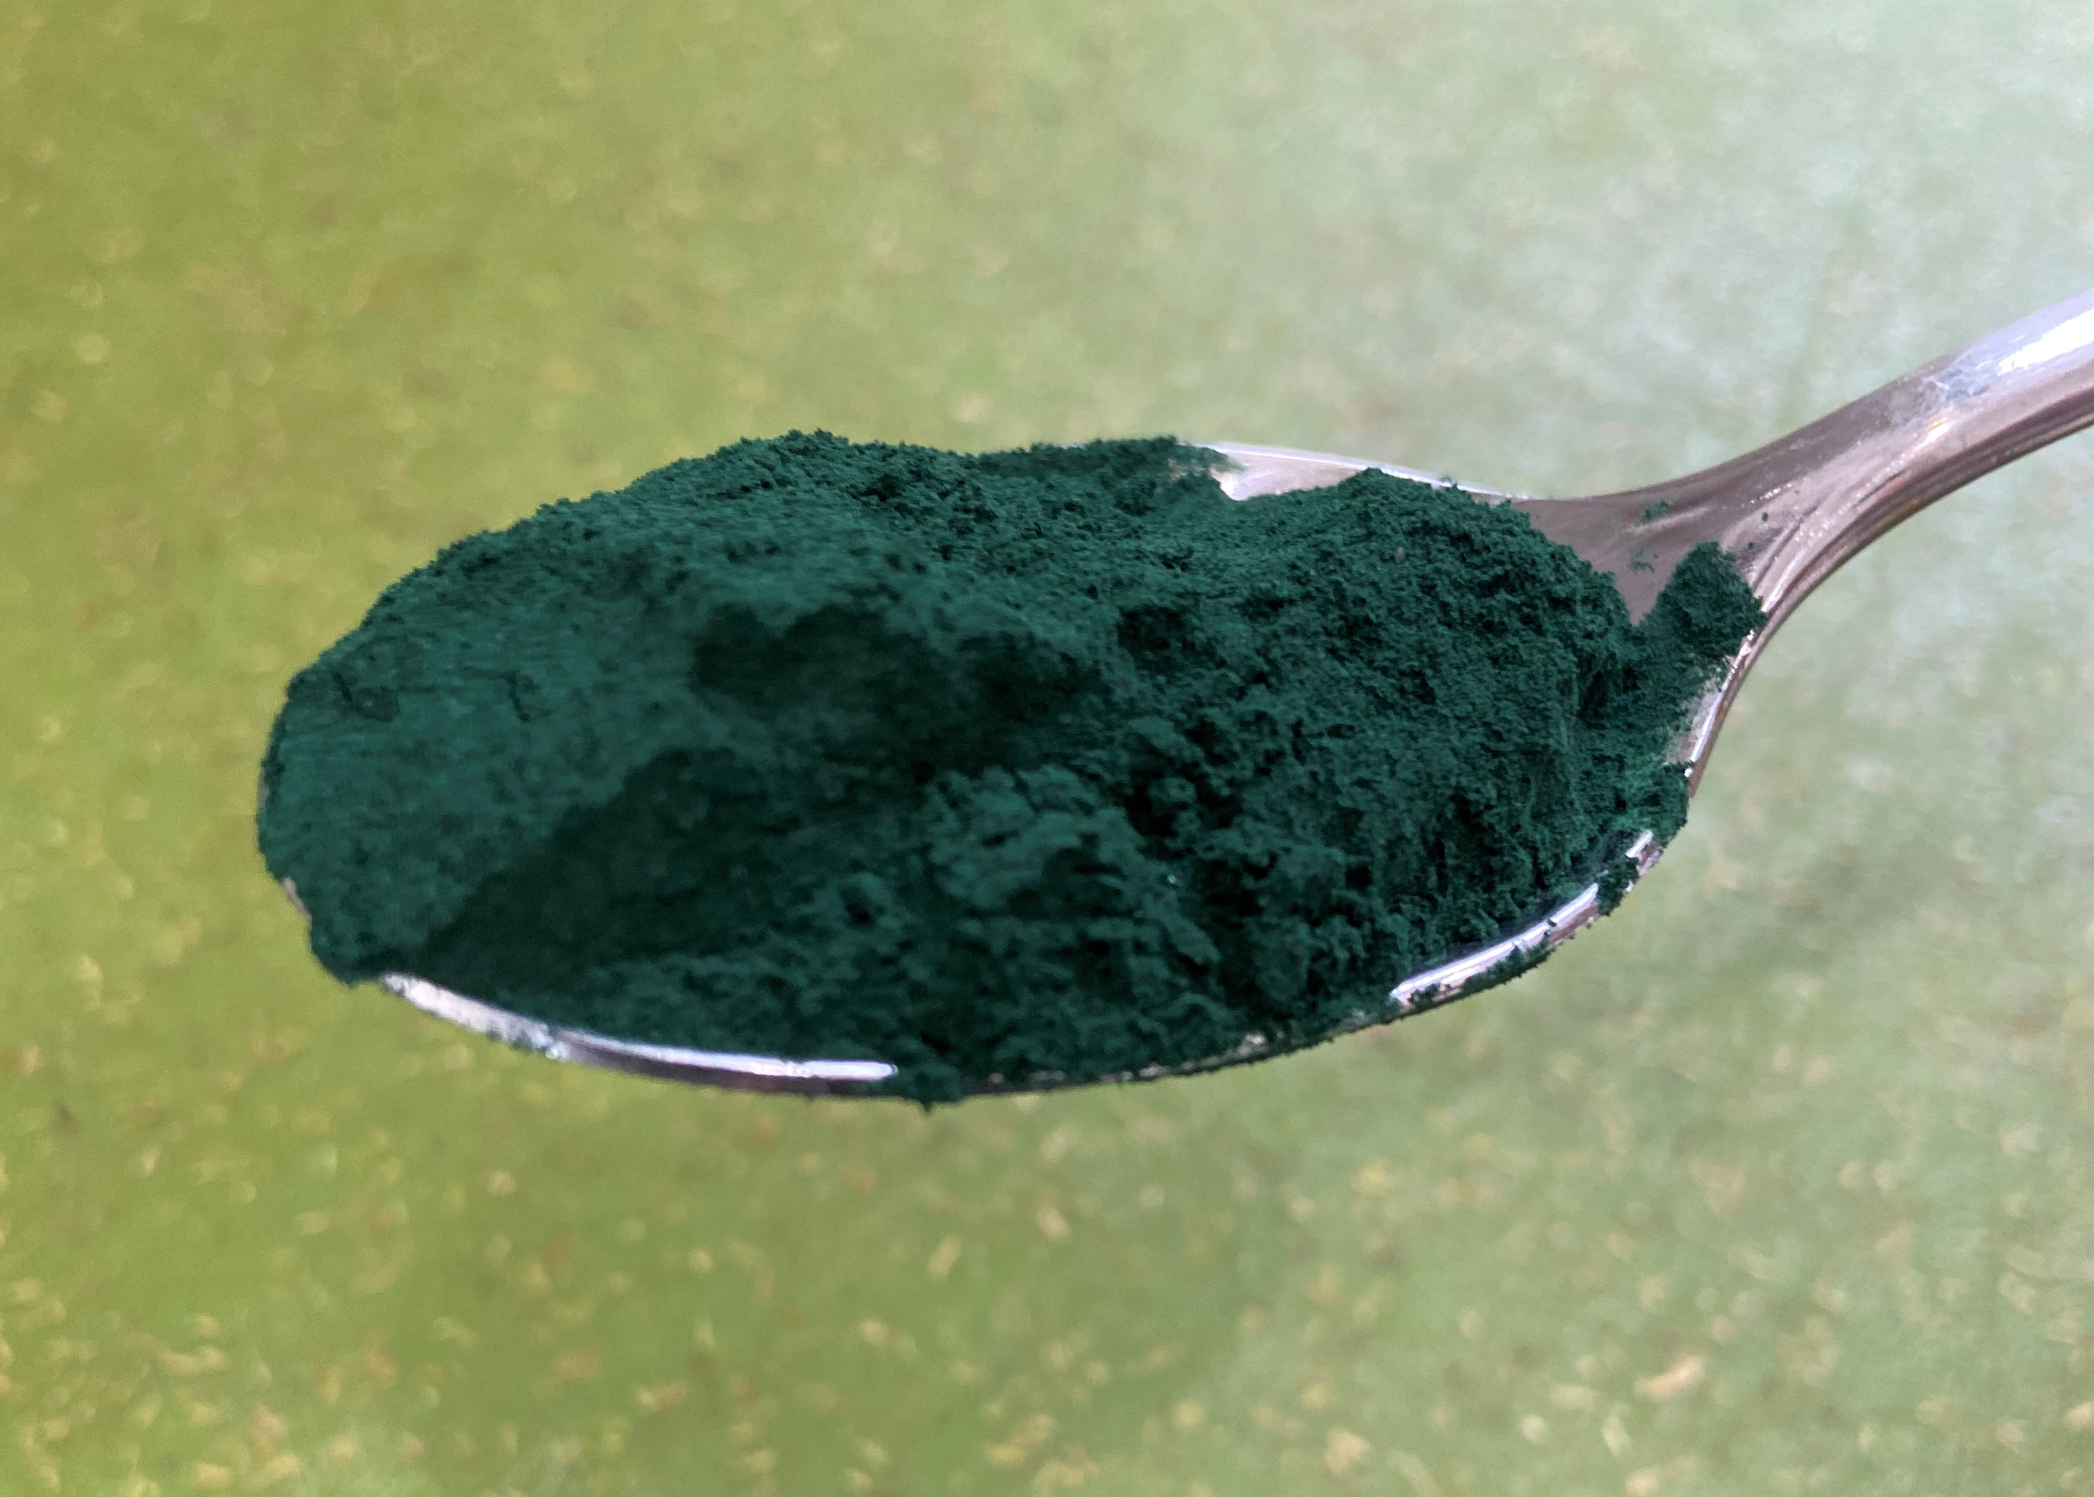
Space Algae-2
  5–6-months of continuous culture of Arthrospira platensis NIES-39 (common name spirulina) on the International Space Station (ISS)
    Multi-omics analysis
    Nutritional profile
ESA astronaut Alexander Gerst handling a culture bag for Space Algae-1. Image credit: NASA
Builds off Space Algae-1: mutagenized Chlamydomonas reinhardtii, one-month on ISS in 2018
  ~50% increase in DNA mutation compared to ground control, spaceflight specific T>A mutations
250 µm
Light microscopy image of A. platensis NIES-39 spiral shaped trichomes.
Powdered spirulina health food.
Notes:
Cyanobacteria with high photosynthetic efficiency
Traditional protein source in Mesoamerica and Central Africa and modern health food
Generally Regarded As Safe (GRAS) for human consumption and easily digested
One of the target organisms for the ESA MELiSSA project
More resistant to ionizing radiation than Chlamydomonas (Badri et al. 2015, Yadav et al. 2021)
Small genome size of 5-7 Mbp genome allows deep sequencing for mutation discovery

Slide 5
Space Algae-2 objectives
Determine if spaceflight increases mutation loads of A. platensis.
Complete multi-omics profiling of cell morphology, transcriptome, proteome, and metabolome responses of A. platensis during spaceflight culture.
Determine the impacts of long-term growth in spaceflight on A. platensis and the nutritional composition.
Hypothesis:
A. platensis will show high resistance to spaceflight stresses

Slide 6

Experiment Design: Growth & Exposure Timeline
Serial Passages
Fluorinated ethylene propylene (FEP) Bag bioreactors (n=6) in a lighted growth chamber
Cumulative growth (d)
10
24
38
52
66
80
164
Serial Culture No.
1
2
3
4
5
6
12

Slide 7
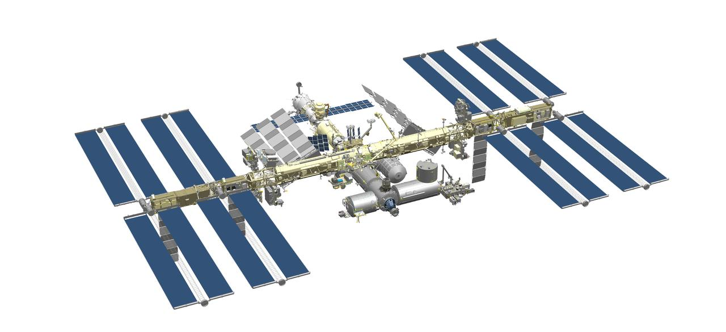
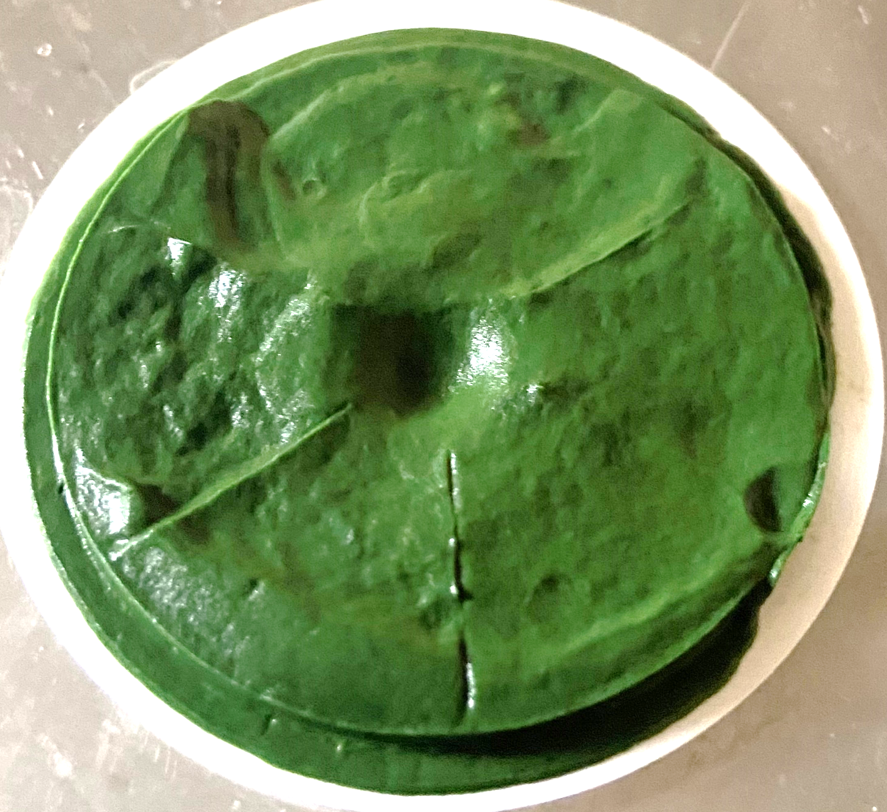
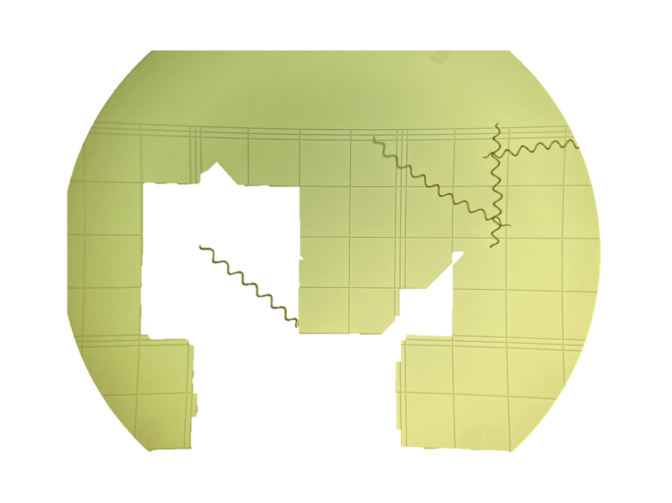

Concept of Operations
Complete 5-6-months of growth on the ISS with serial passaging every two-three weeks
Collect & preserve cell samples after each passage
Return live cells to isolate individual clones
Conduct multi-omics analysis and nutritional profiling
Launch viable algae culture to ISS
ISS Image: images-assets.nasa.gov/image/200623_ISS_1/200623_ISS_1~orig.png

Slide 8
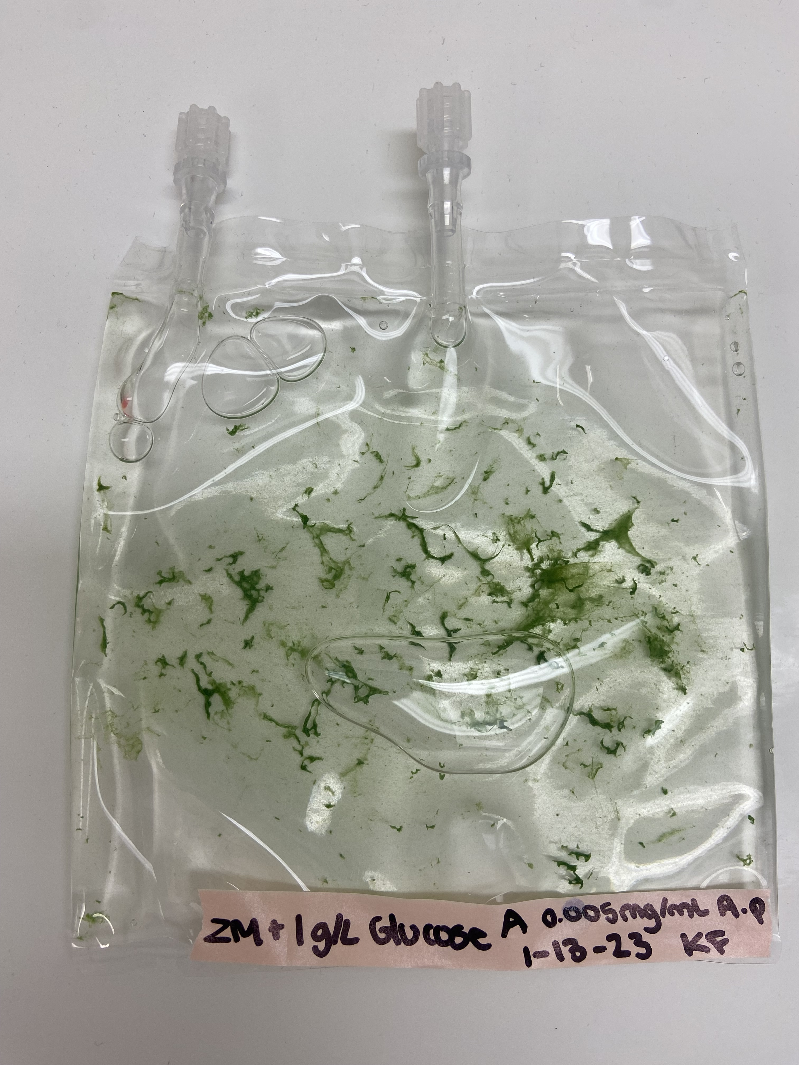
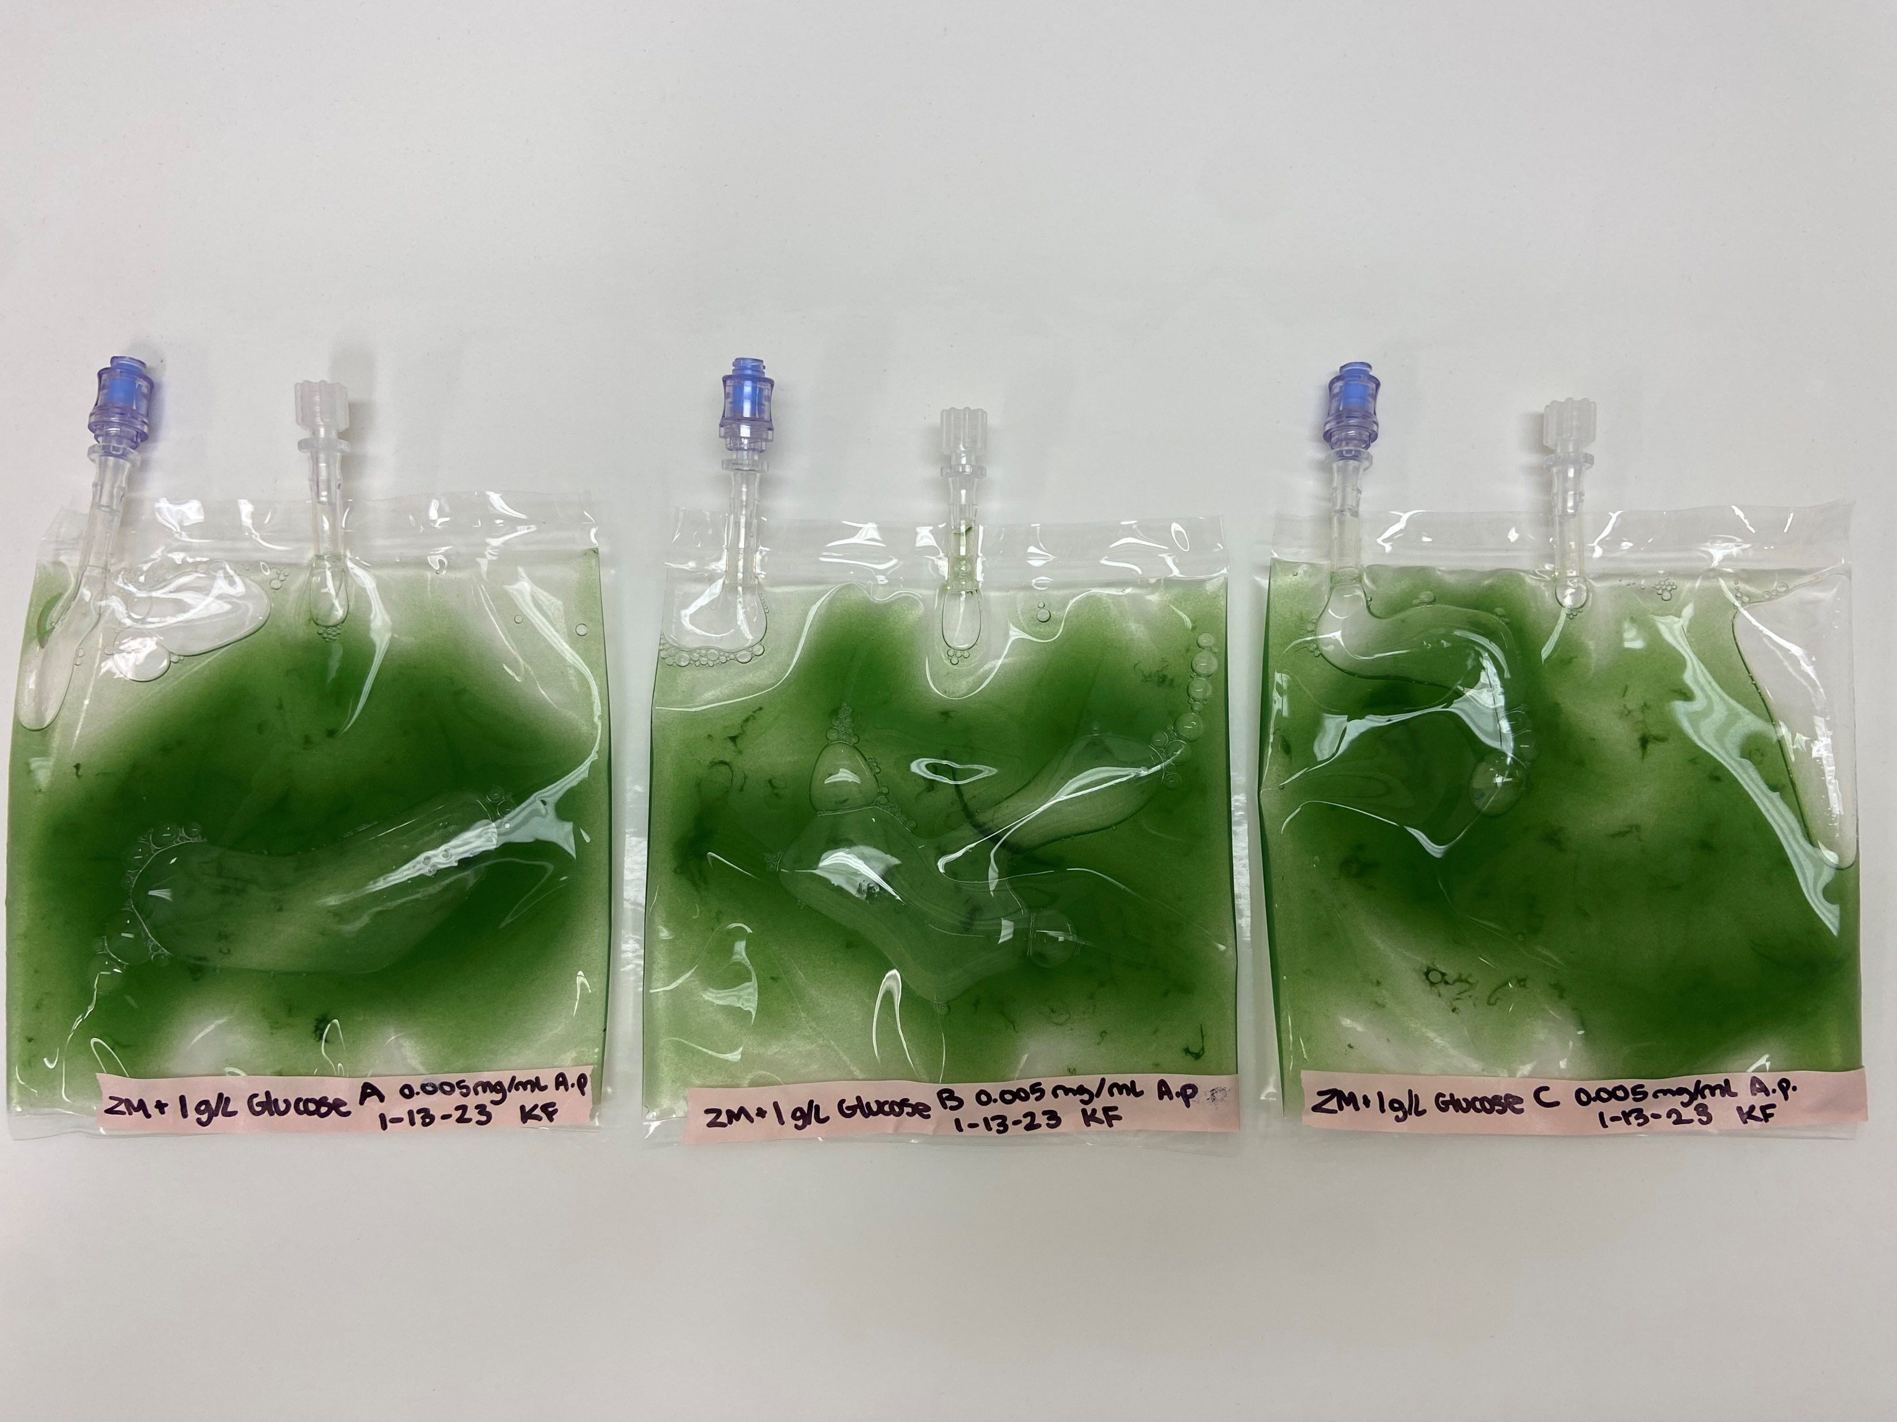
Storage of live cells
Stability of the payload before flight will affect timing and con-ops
A. platensis does not store well desiccated, long reactivation phase, viability loss and metabolic changes (Kharchuk, 2020)
A. platensis can grow with glucose without light (Marquez et al. 1993)
Supplement ZM with glucose
  Store 10 ml cultures in the dark
  Test growth for 6-13 weeks of storage
Dark storage tested for 100 ml FEP flight bag
  Cultures remained viable throughout with rapid regrowth (17 weeks)
10-week storage period selected for margin
Growth curve of glucose supplemented A. platensis culture moved to lighted conditions after dark storage. Green= optimal storage, red/orange= non-optimal storage.
10-weeks dark
Day 5 in light

Slide 9
Concept of Operations
Complete 5-6-months of growth on the ISS with serial passaging every two-three weeks
Collect & preserve cell samples after each passage
Return live cells to isolate individual clones
Launch viable algae culture to ISS
Conduct multi-omics analysis and nutritional profiling
ISS Image: images-assets.nasa.gov/image/200623_ISS_1/200623_ISS_1~orig.png

Slide 10
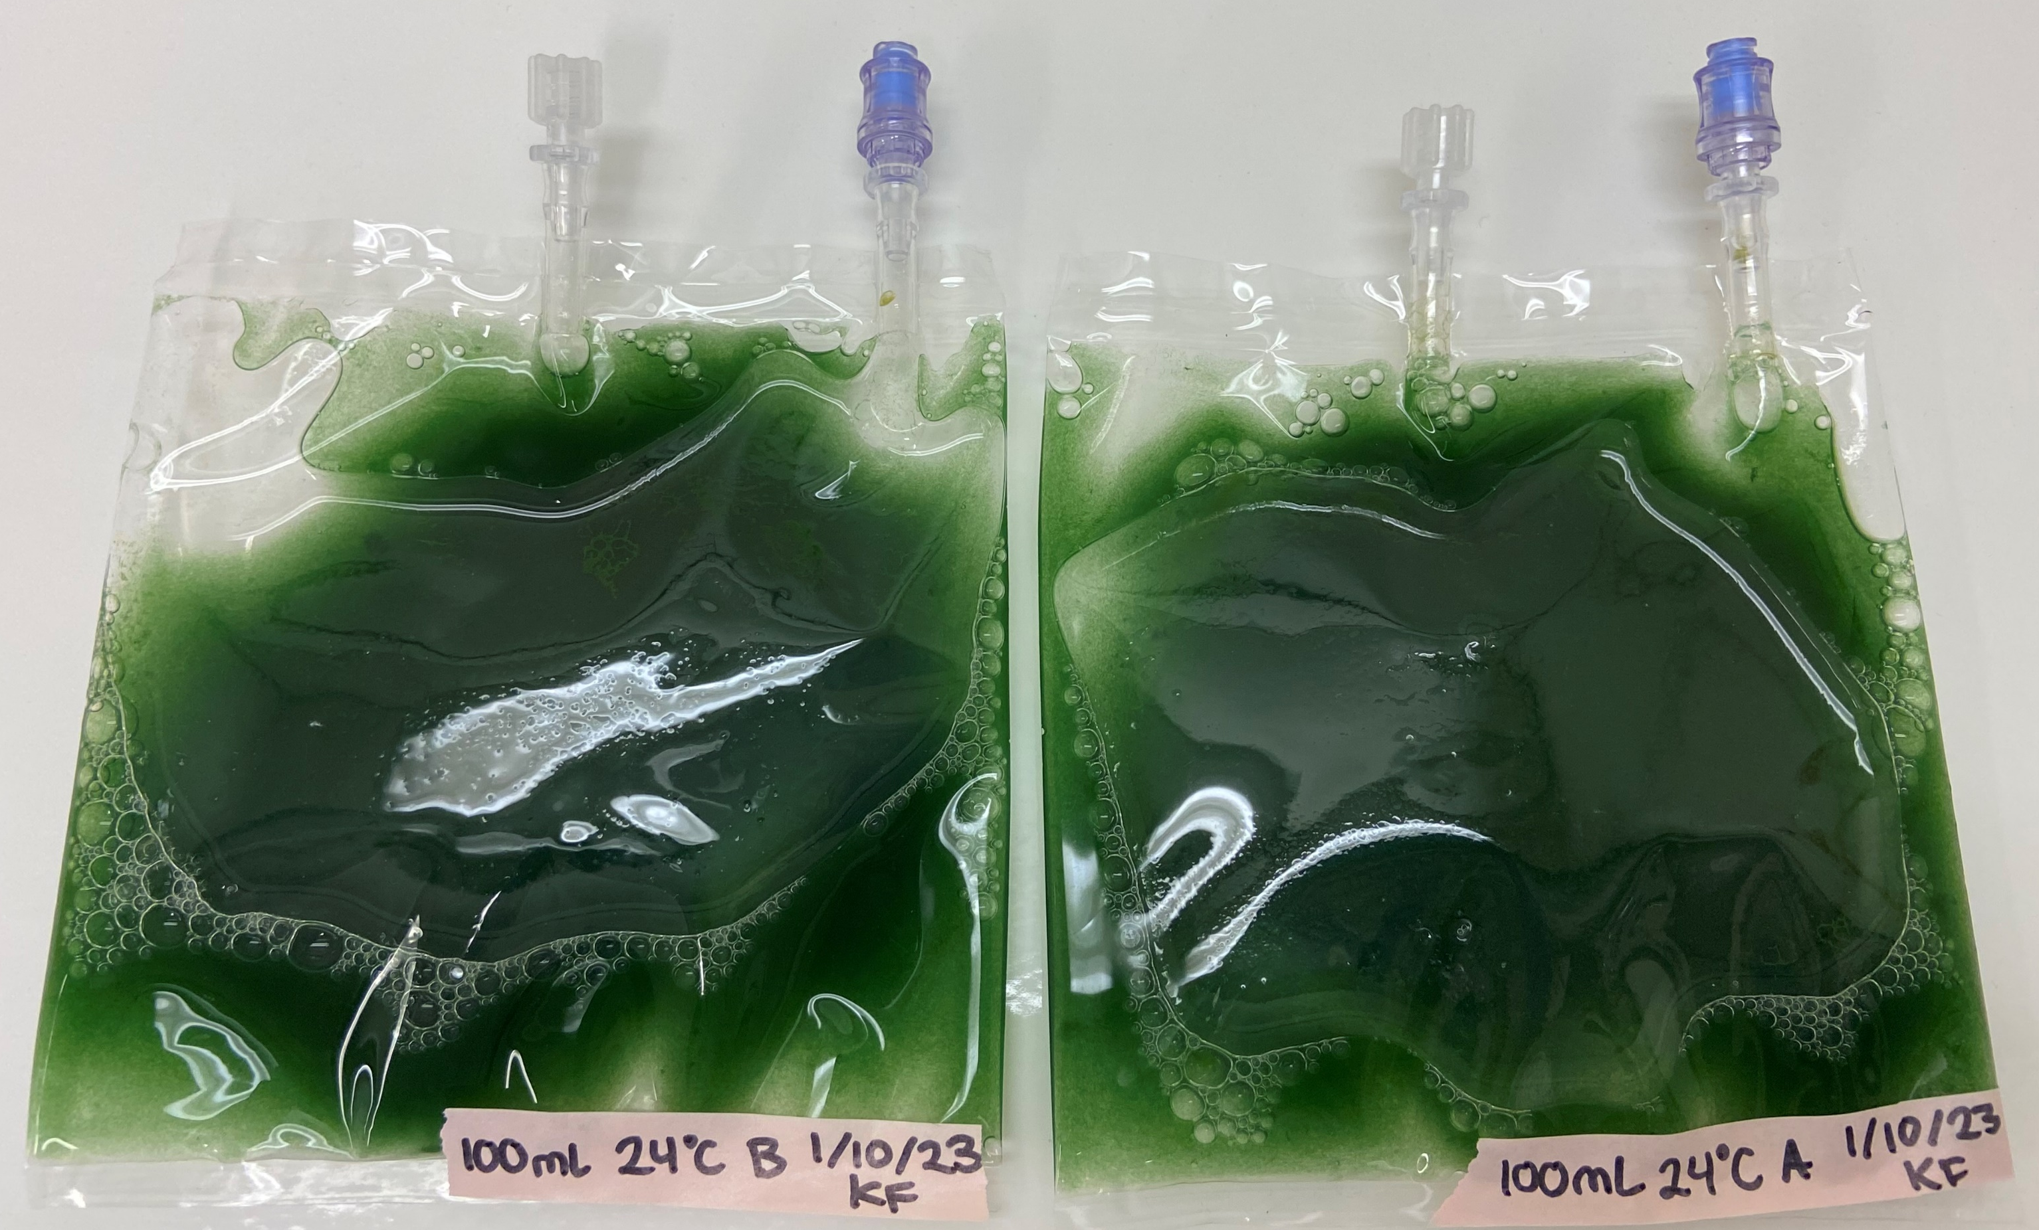
Extending the growth cycle
Typical growth cycle at 35°C in shake flasks for A. platensis is 5-8 days
We extended the growth cycle to 14-17 days
Growth conditions for static FEP bag culture were determined
  Light intensity
  Temperature
  Inoculum concentration and age
  pH + growth medium
Yield: ~180 mg/100 mL
1.6-2.7 L needed for 3-5g serving
Growth curve of 100 mL FEP bioreactors for 17 days of growth at 24 °C and 20 µmol/m²/s light. N=3. Dotted line shows exponential growth curve.
FEP bioreactors containing 100 mL dense culture of A. platensis after 14 days of growth at 24 °C and 20 µmol/m²/s light.
Notes:
Figure: feb 2023 growth curves excel sheet

Slide 11
Concept of Operations
Complete 5-6-months of growth on the ISS with serial passaging every two-three weeks
Collect & preserve cell samples after each passage
Return live cells to isolate individual clones
Launch viable algae culture to ISS
Conduct multi-omics analysis and nutritional profiling
ISS Image: images-assets.nasa.gov/image/200623_ISS_1/200623_ISS_1~orig.png

Slide 12
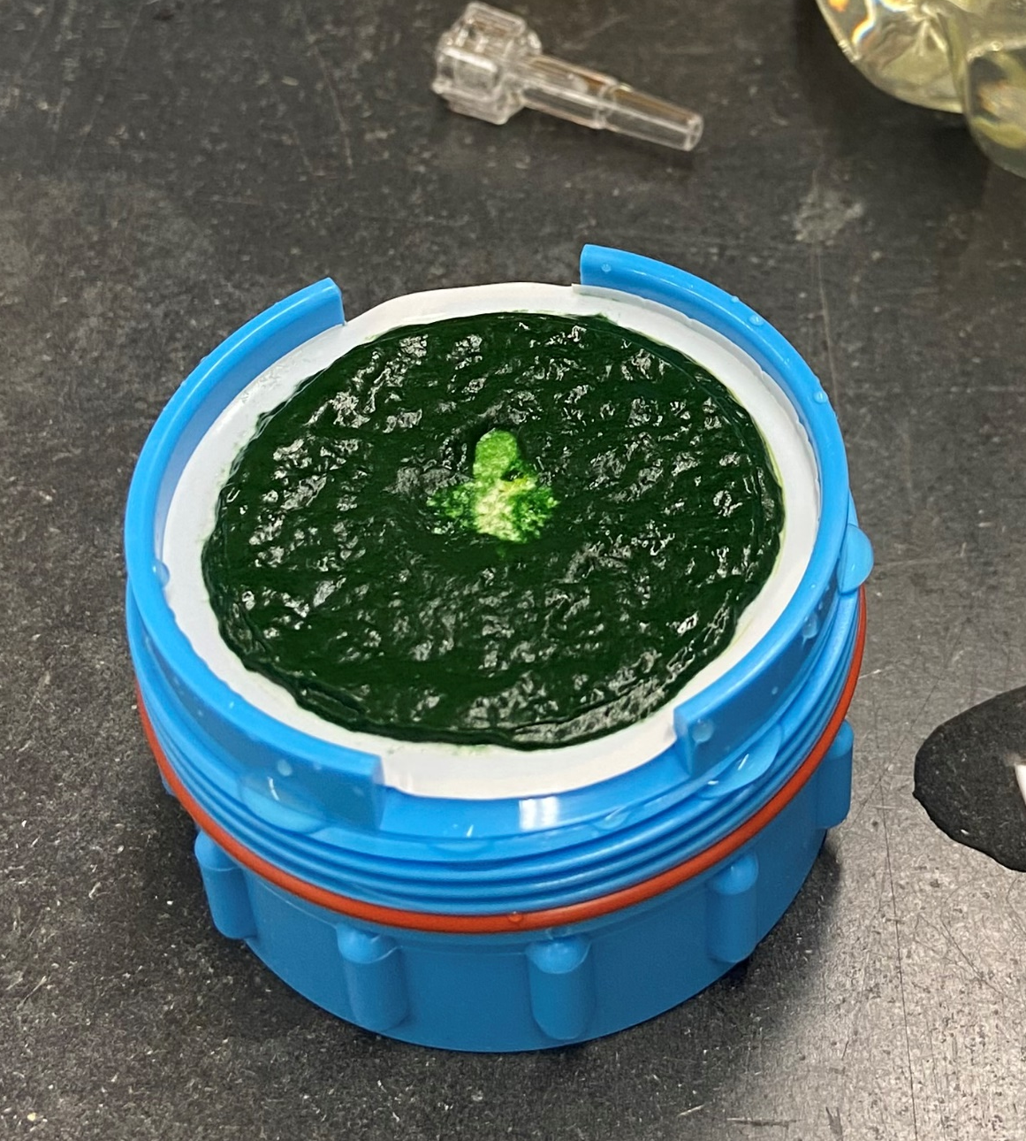
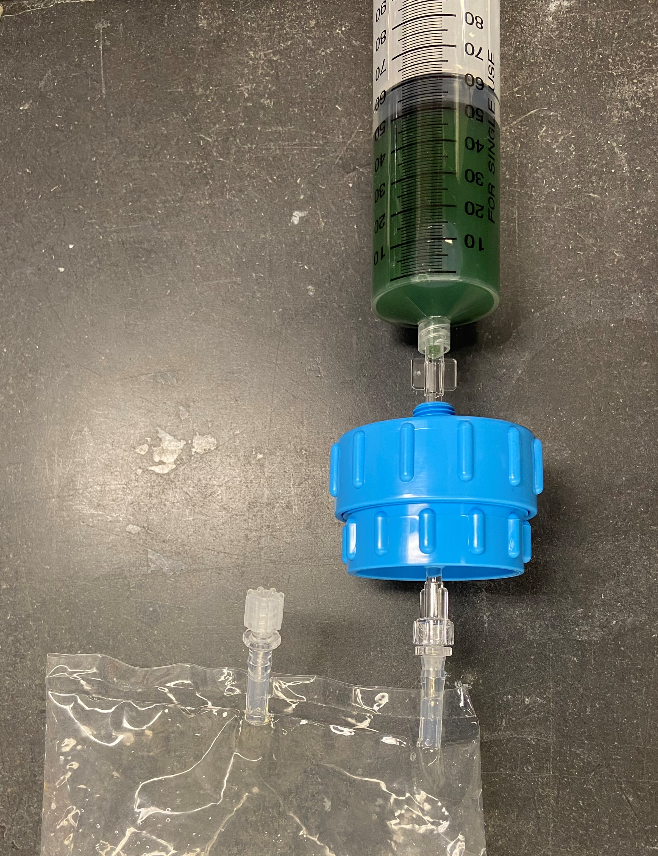
Biomass harvesting
Algae biomass can be viscous and hard to filter
Most optimal: Syringe filter dense culture into 47mm Advantec filter unit with 1.2 um membrane (all trichomes collected)
  Nylon or cellulose nitrate membrane
  100 ml filtration: 4-7 min average, 1-4 backflows
  50 ml filtration: 1.2 min average, 0 backflows
Filtered biomass stored at -80°C
Timing, mass, and volume considerations for the final method
95 mL of A. platensis biomass syringe filtered onto a 1.2 um cellulose nitrate membrane on an Advantec filter unit.
Filtration set-up containing syringe, filter unit, and filtrate collection bag.
Notes:
Optimization of filter size: 25 mm or 47 mm, and pore size: 1.2-20 µm
Larger surface area reduces filtration time, but increases mass
Most optimal: Syringe filter culture into 47mm Advantec filter unit (does not leak) with 1.2 um membrane (all trichomes collected)
Nylon or cellulose nitrate
Potentially 2 filter units per 100 ml bag
Backflows are needed >50 ml to unclog the membrane

Slide 13
Concept of Operations
Complete 5-6-months of growth on the ISS with serial passaging every two-three weeks
Collect & preserve cell samples after each passage
Return live cells to isolate individual clones
Launch viable algae culture to ISS
Conduct multi-omics analysis and nutritional profiling
ISS Image: images-assets.nasa.gov/image/200623_ISS_1/200623_ISS_1~orig.png

Slide 14
Cryopreservation for live cell return
10% DMSO in medium for -80°C cryopreservation
  Shiraishi et al. 2016 found 30% recovery after 12-month freeze
  Our testing showed 4% recovery after 2-week freeze
    Percent recovery = OD_{Frozen}/OD_{Fresh} *100
16-day Freeze
Tested 10% DMSO, 10% Ficoll-70+DMSO, and 10% Trehalose +DMSO
Three different culture phases were tested: Early (OD 0.475), Middle (OD 0.960), and Late (OD 1.683)
The cells were frozen for 16 days at -80°C, thawed at 37°C and grown for 6 days, n=2
Control: Fresh cells diluted and grown for 6 days
**
**
Optical density after 6 days of growth post 16-day freeze for three different cell phases. N=2. Error bars = ± Standard Dev. Paired t-test: ** p-value < 0.001.
10% trehalose +10% DMSO: 95% recovery for 16-day freeze

Slide 15
Concept of Operations
Complete 5-6-months of growth on the ISS with serial passaging every two-three weeks
Collect & preserve cell samples after each passage
Return live cells to isolate individual clones
Launch viable algae culture to ISS
Conduct multi-omics analysis and nutritional profiling
ISS Image: images-assets.nasa.gov/image/200623_ISS_1/200623_ISS_1~orig.png

Slide 16
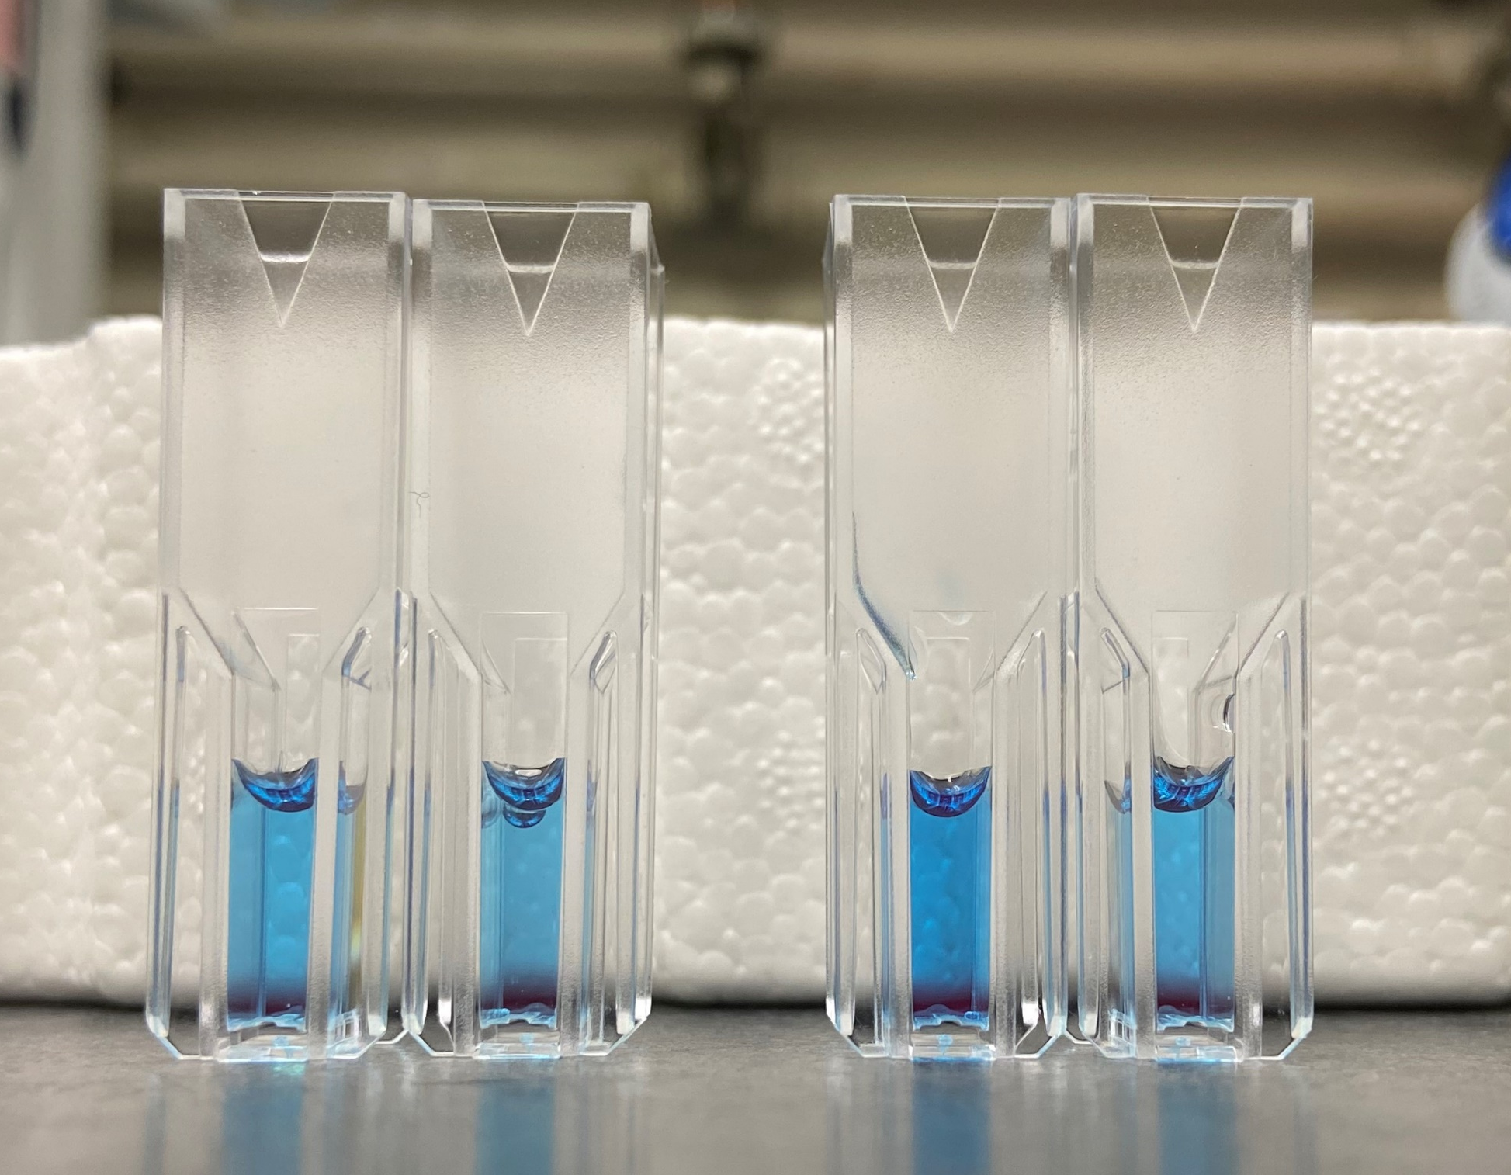
Nutritional profile: antioxidants
Pigment content is correlated with protein and antioxidant content
Extracted chlorophyll A, allophycocyanin, and phycocyanin (Fahrion et al. 2023)
Concentration was measured with spectrophotometry and calculated with published equations
Pigment concentration over time. Optical density is shown in grey on the secondary Y-axis. Three biological replicates and two technical replicates. N=6. Error bars ± standard deviation.
Phycocyanin extracts from A. platensis.
Credit: Kristen Saban
SLSTP 2023 Summer Research Associate

Slide 17
Multi-omics preparation
Genomics – Mutations
  CTAB precipitation with phenol:chloroform:isoamyl alcohol DNA extraction
Transcriptomics – Gene expression
  Zymo Direct-zol RNA extraction kit (Zymo Research)
Validating nucleic acid extractions from non-concentrated frozen culture
Proteomics – Protein/Nutritional composition and Metabolomics – Vitamins/ other nutrients
  Baseline proteomic and metabolomic analysis, Iowa State University and Washington State University, respectively
  Comparison of flight-like samples and flask grown/flash frozen cultures
DNA
RNA
Protein
Metabolites
Multi-omics analyzes the Central Dogma of Molecular Biology

Slide 18
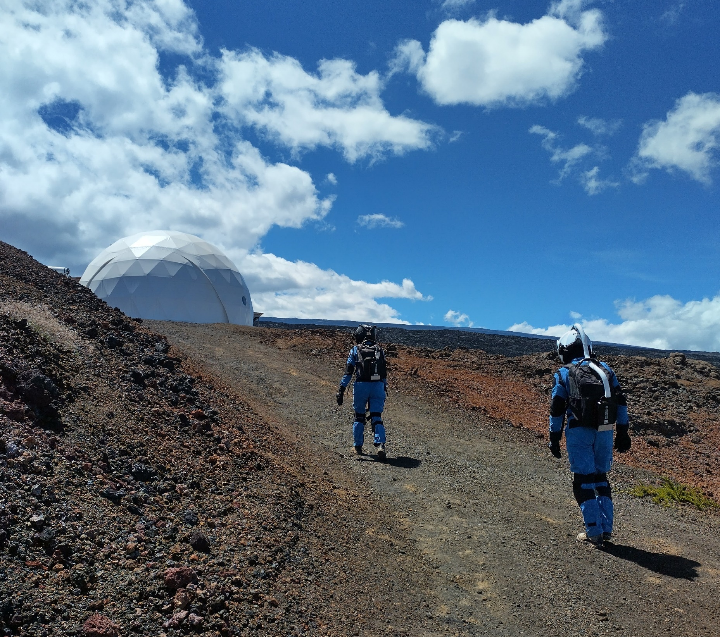
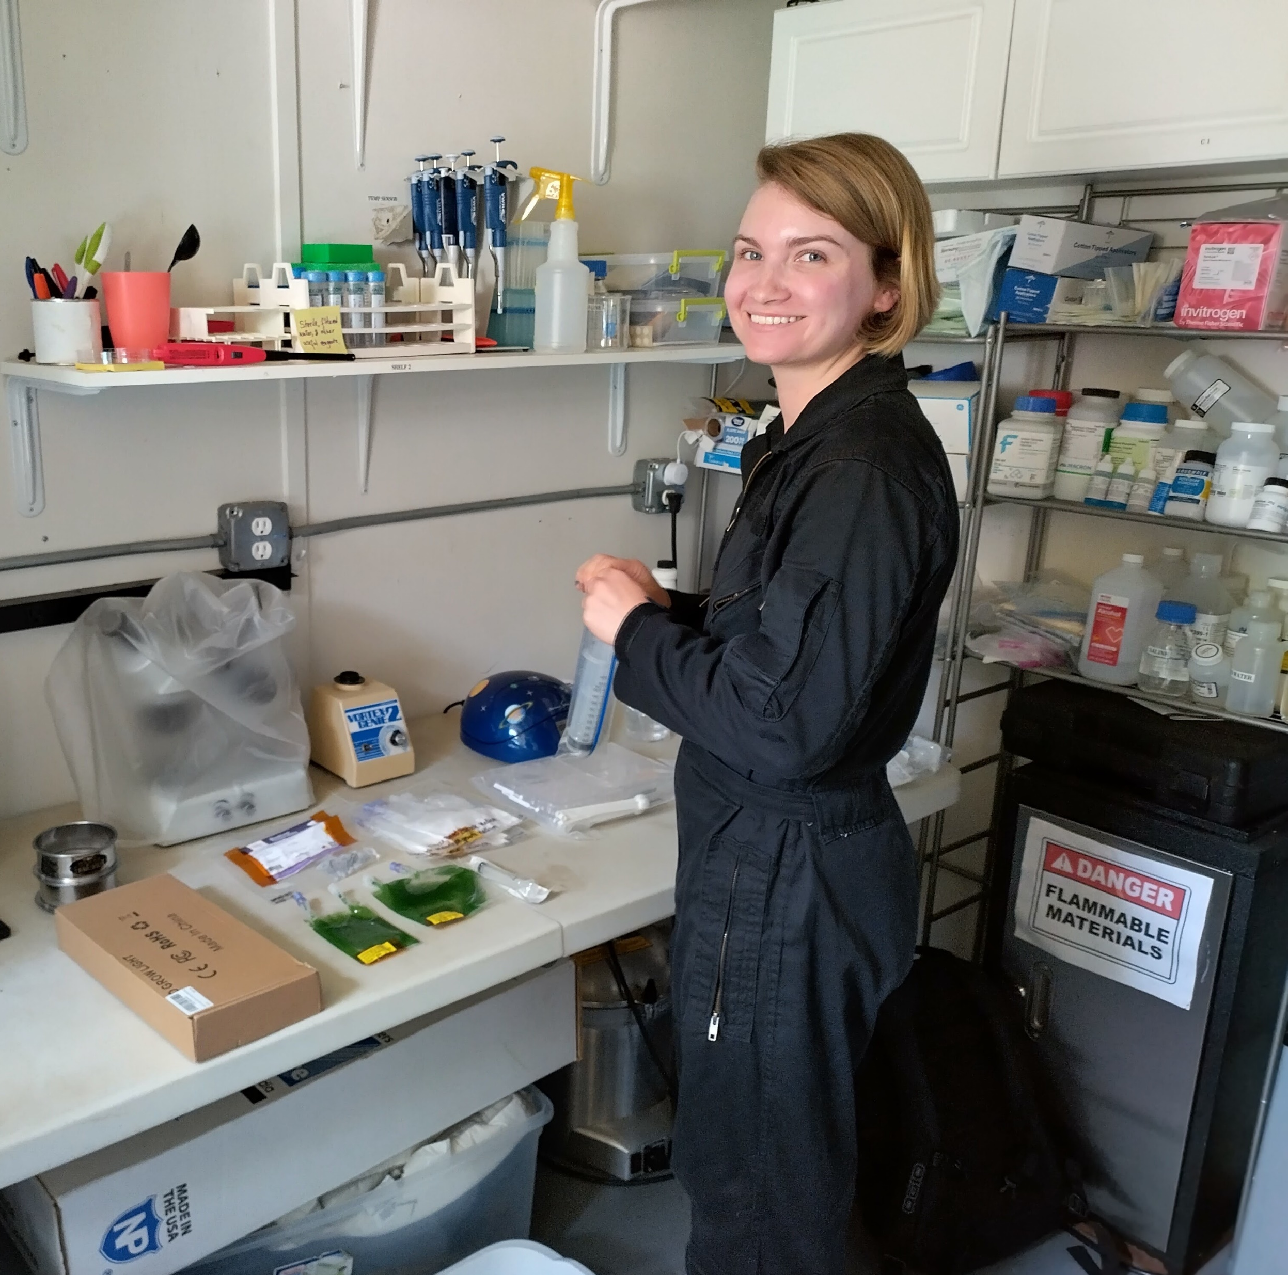
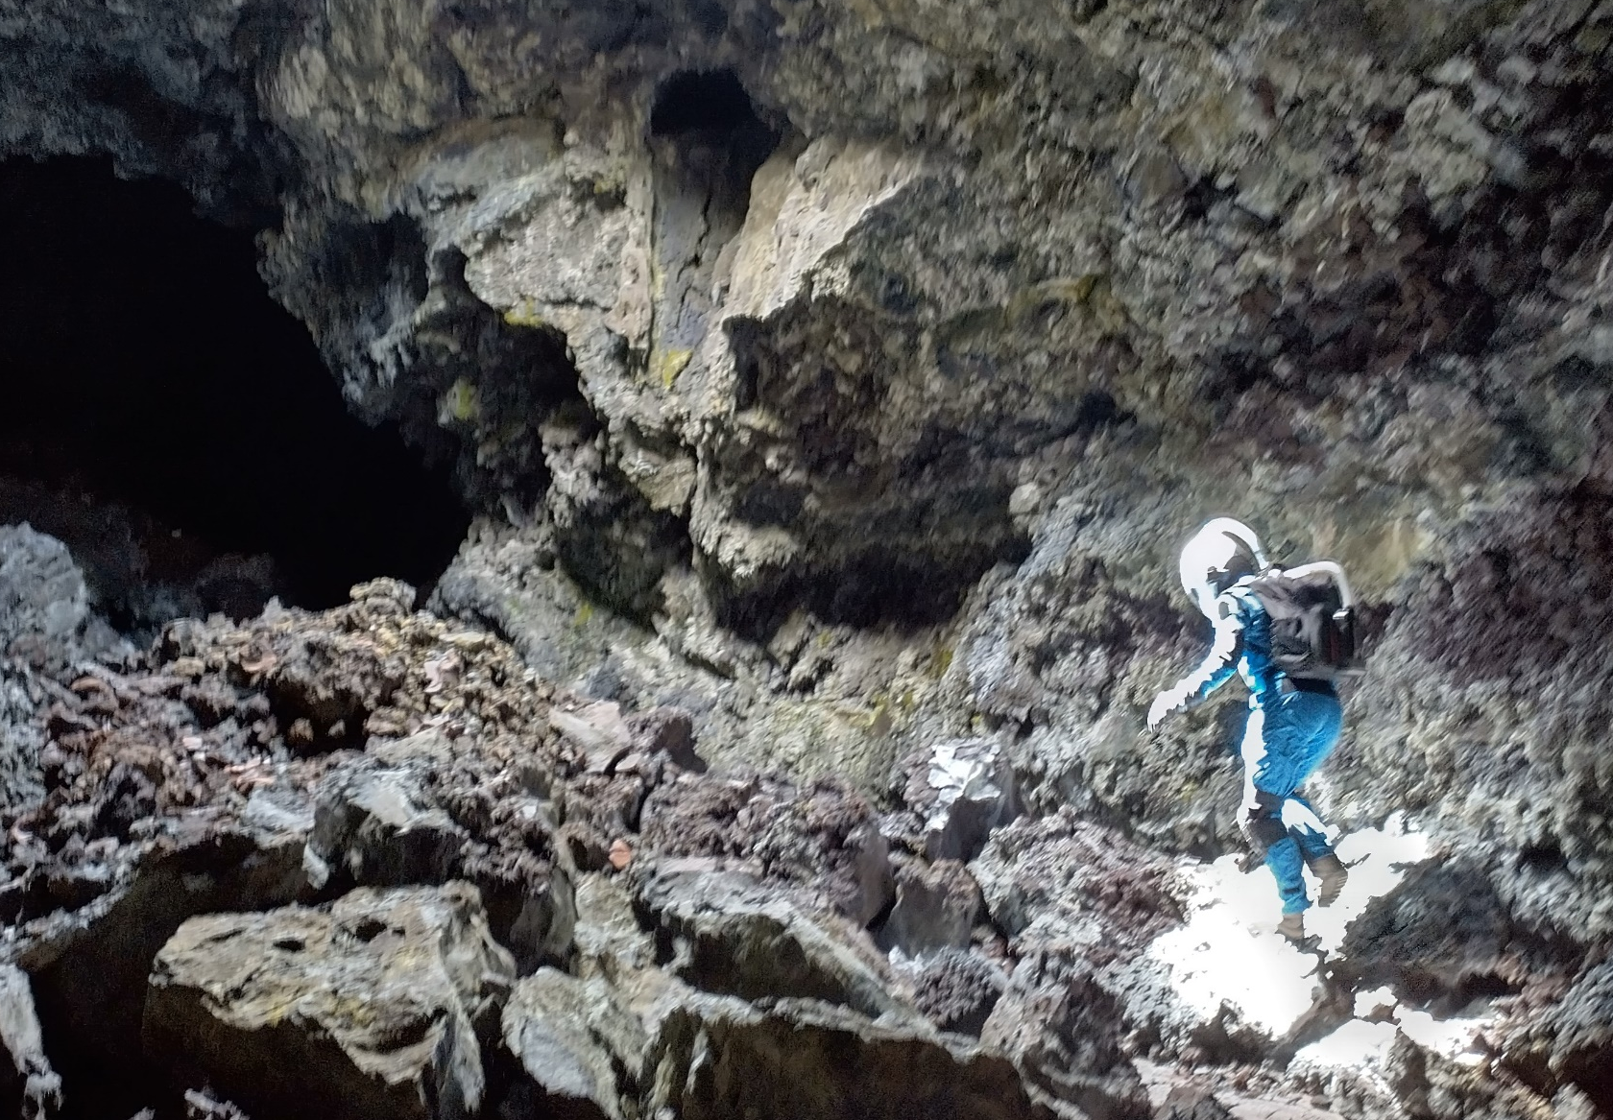
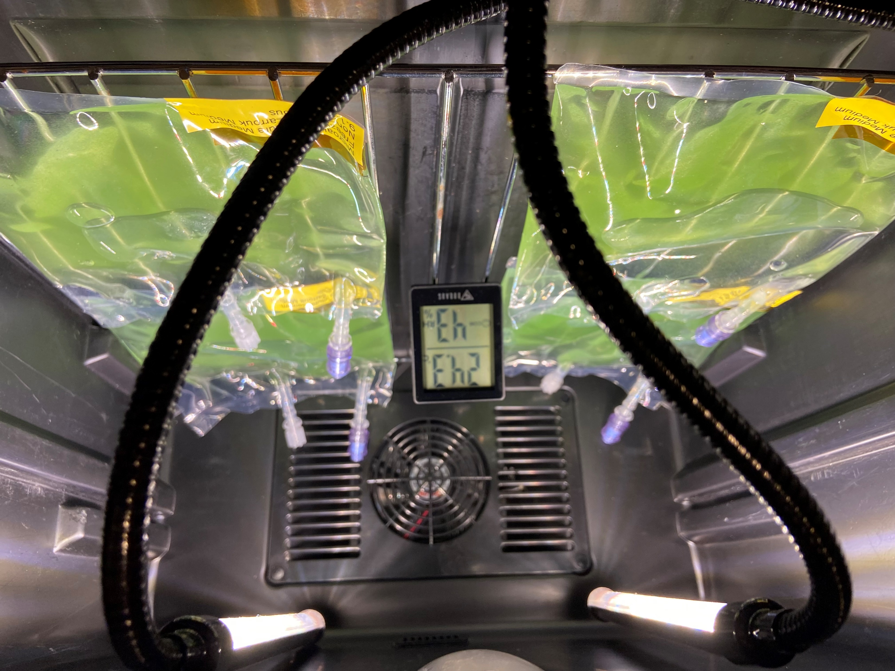

Hawai’i Space Exploration Analog and Simulation (HI-SEAS)
1-week Lunar Mission
- International crew of 5-6
- Rigorous schedule with multiple EVAs
- Crew conduct personal experiments
- Currently accepting applications for 1–2-week missions https://www.hi-seas.org/apply-now

Slide 19
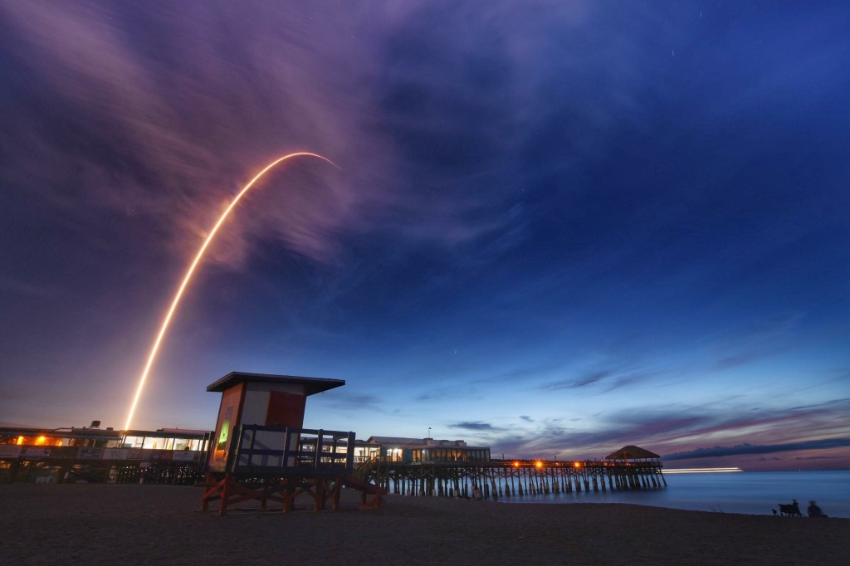
Next steps
Implementation partner
Hardware development/selection
Flight timeline
Science Verification Test and Experiment Verification Test
Launch!
Post-flight multi-omics analysis
Space Algae-1 Launch on June 29, 2018. Image credit: NASA

Slide 20



Acknowledgements
NASA Ames Research Center
A. Mark Settles, Principal Investigator
Hami Ray, Project Scientist
Gwo-Shing Sun, Project Scientist
Jared Broddrick, Research Scientist
Kristen Saban, SLSTP Research Associate

Slide 21
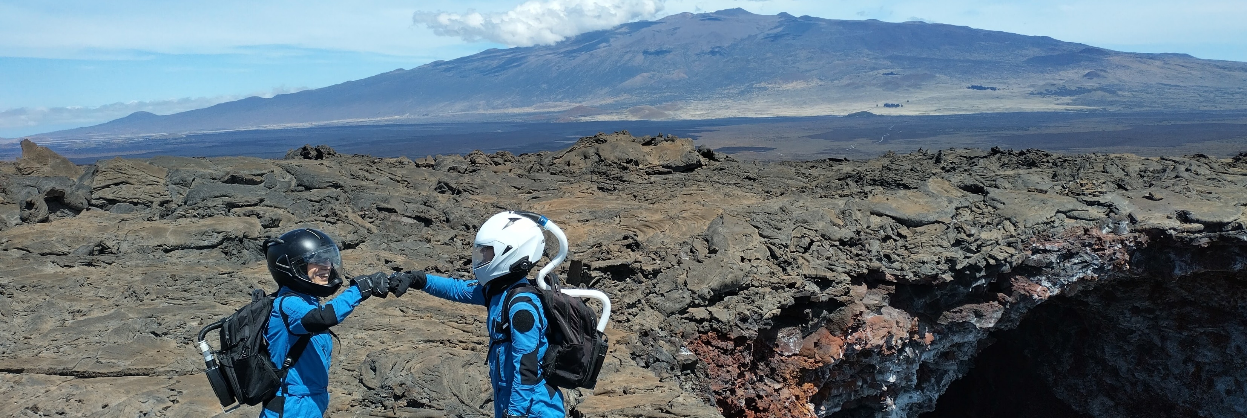

Thank you!

Slide 22
References
Fahrion, J., Dussap, C. G., & Leys, N. (2023). Assessment of batch culture conditions for cyanobacterial propagation for a bioreactor in space. Frontiers in Astronomy and Space Sciences, 10. https://doi.org/10.3389/fspas.2023.1178332
Kharchuk, I. A. (2020). Changes in Morphometric Indices of Arthrospira (Spirulina) platensis Cells and Trichomes during Dehydration and the Reactivation Period. Russian Journal of Plant Physiology, 67(4), 680–689. https://doi.org/10.1134/S1021443720030152
Marquez, F. J., Sasaki, K., Kakizono, T., Nishio, N., And, I., & Nagap, S. (1993). Growth Characteristics of Spirulina platens& in Mixotrophic and Heterotrophic Conditions. In JOURNAL OF FERMENTATION AND BIOENGINEERING (Vol. 76, Issue 5).
Shiraishi, H. (2016). Cryopreservation of the edible alkalophilic cyanobacterium Arthrospira platensis. Bioscience, Biotechnology and Biochemistry, 80(10), 2051–2057. https://doi.org/10.1080/09168451.2016.1189320

