Slide 1
Evolving a New Numerical Paradigm for Radiative Transfer during Hypersonic Planetary Entry
Amal Sahai
AMA, Inc. at NASA Ames Research Center
November 6, 2023

Slide 2
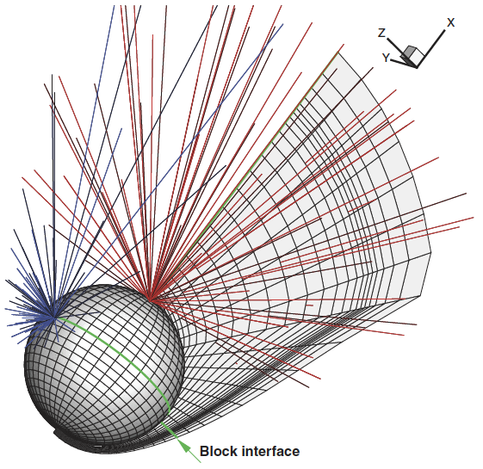
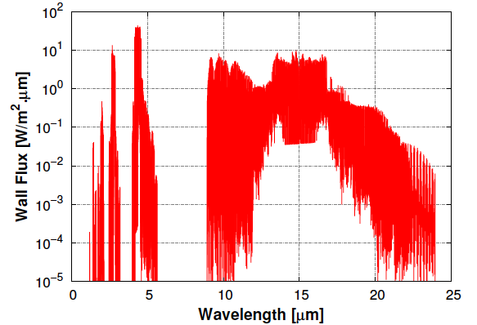
Introduction
EDL phases being planned with increasingly complex requirements: higher velocities (MSR-EES), denser atmospheres (Dragonfly).
  Radiative heating key design driver.
  Simplifying physics/spacecraft geometry raise uncertainty, safety margins.
  Flow-radiation coupling critical.
Why is radiation hard?
  Radiation is non-local; photons emitted at one point can move in different directions and be absorbed elsewhere.
  Individual radiative processes involve photons with specific energies; absorption/emission changes rapidly with frequency – line-by-line (LBL) model.
Non-local radiation propagation
Carbon dioxide IR spectra

Slide 3
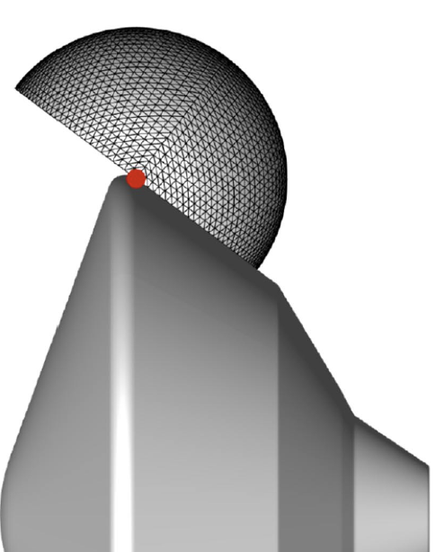
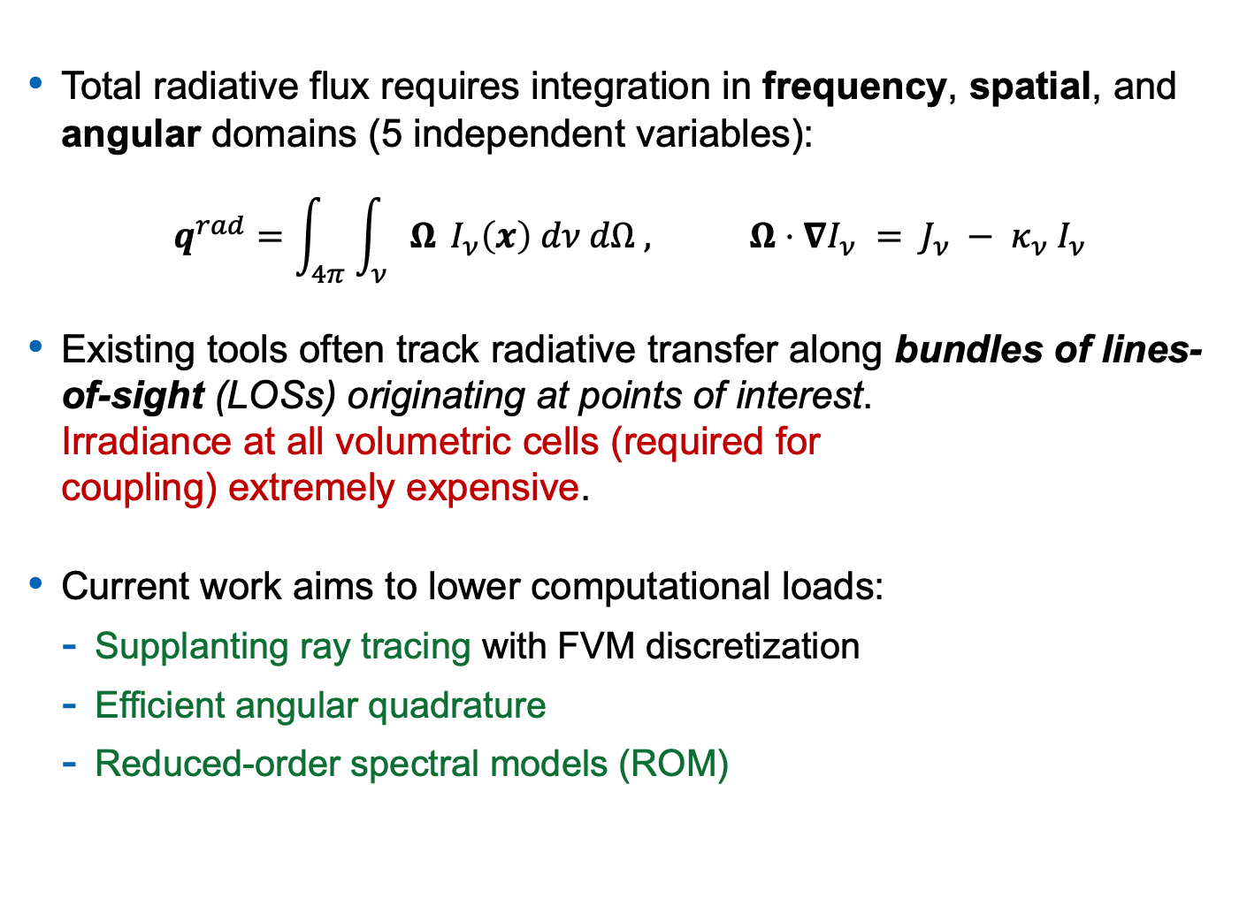
Introduction
Total radiative flux requires integration in frequency, spatial, and angular domains (5 independent variables):
$$q^{rad}=\int_{4π}{\int_{ν}{Ω}} I_{ν}\left(x\right) dν dΩ , Ω⋅∇I_{ν} = J_{ν} − {κ_{ν} I}_{ν}$$
Existing tools often track radiative transfer along bundles of lines-of-sight (LOSs) originating at points of interest. Irradiance at all volumetric cells (required for coupling) extremely expensive.
Current work aims to lower computational loads:
  Supplanting ray tracing with FVM discretization
  Efficient angular quadrature
  Reduced-order spectral models (ROM)

Slide 4
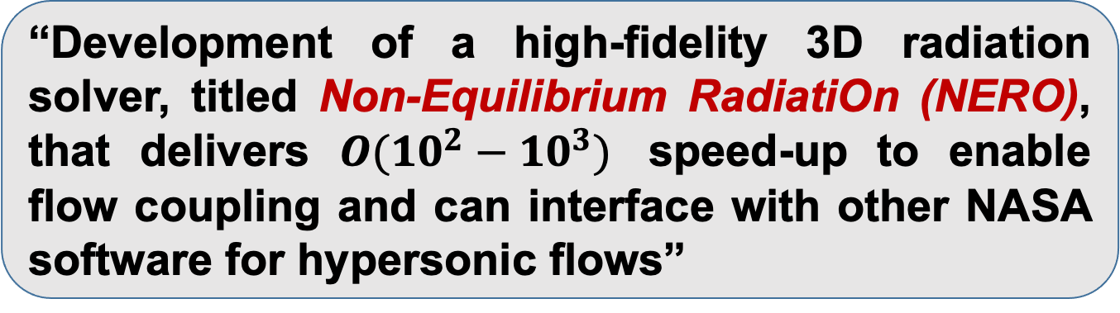
Objective
“Development of a high-fidelity 3D radiation solver, titled Non-Equilibrium RadiatiOn (NERO), that delivers $O(10^{2}−10^{3})$ speed-up to enable flow coupling and can interface with other NASA software for hypersonic flows”
CFD
(US3D)
Particle
Radiation
Ablation
Maxwell

Slide 5
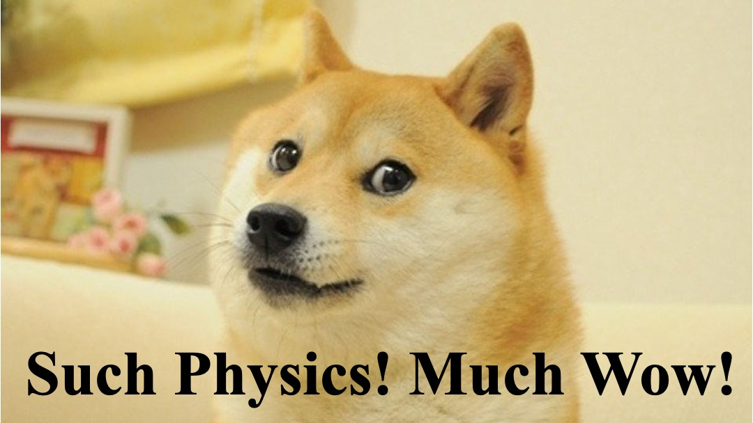
Objective

Slide 6
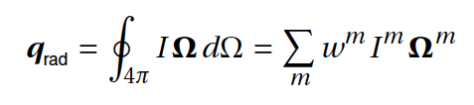
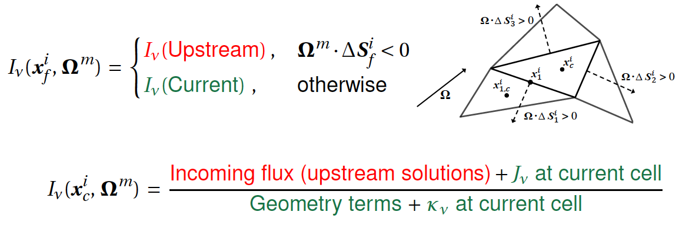
NERO: Efficient Angular-Spatial Solutions
Lebedev type quadrature minimizes angular directions [1]:
FVM discretization of RTE with first-order upwinding for surface fluxes [2]:

Slide 7
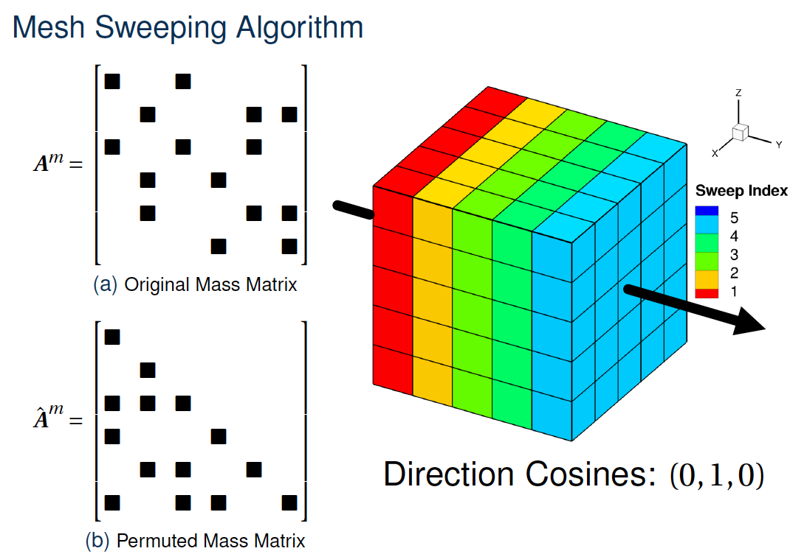
NERO: Efficient Angular-Spatial Solutions
Mesh Sweeping Algorithm [3]
Upstream
Current
Downstream
Improvements to angular-spatial solution strategy underway:
  On-demand mesh sweeping to reduced memory footprint.
  Processor scheduling for solving triangular matrices in parallel:
    Downstream processors wait while upstream processors solve for their partition.
    Once upstream dependencies updated, local solution is computed and propagated downstream.

Slide 8
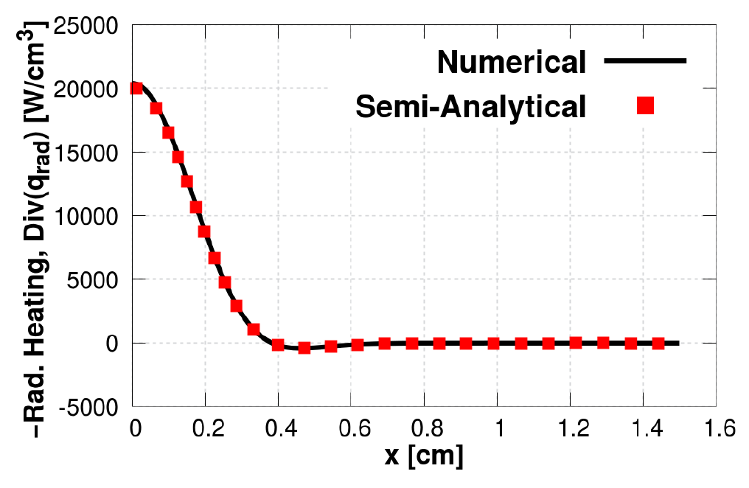
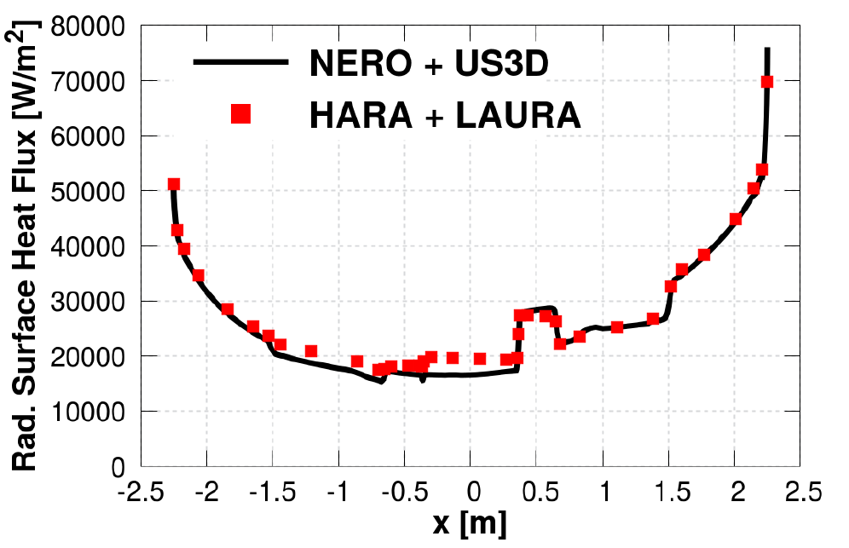
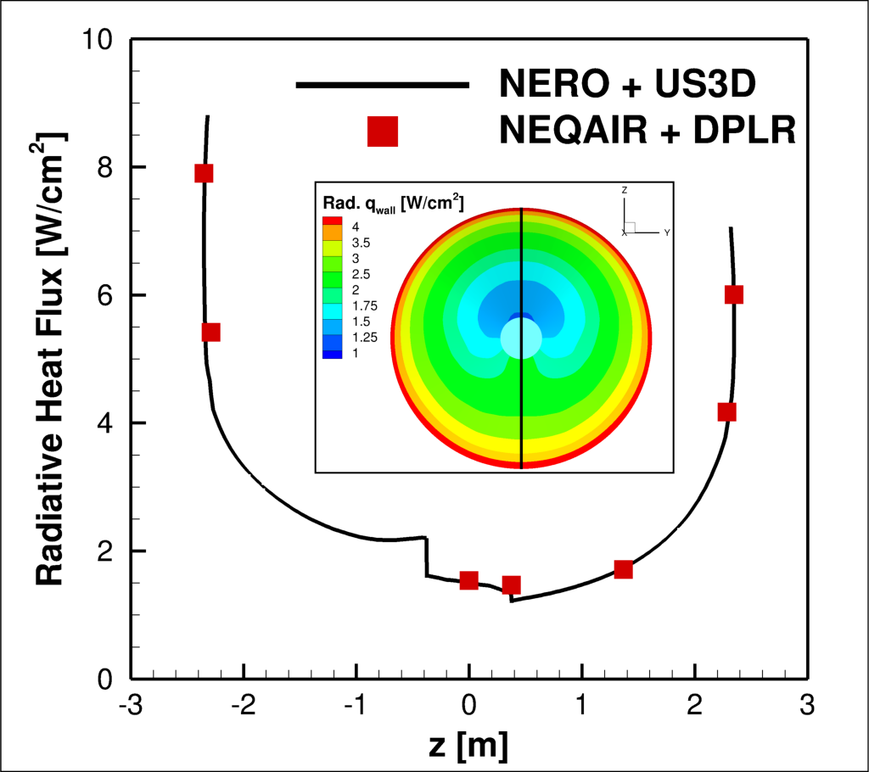
V&V For Angular-Spatial Approach
Semi-analytical tangent sphere
Surface Heating for Mars 2020
Surface Heating for Mars Sample Return Lander (SRL)

Slide 9
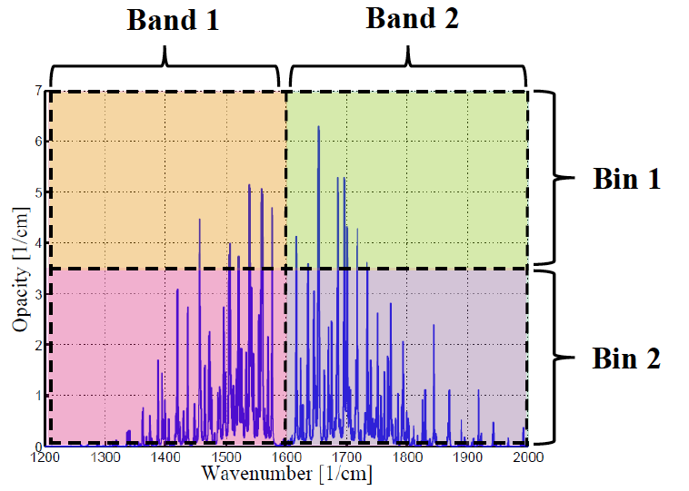
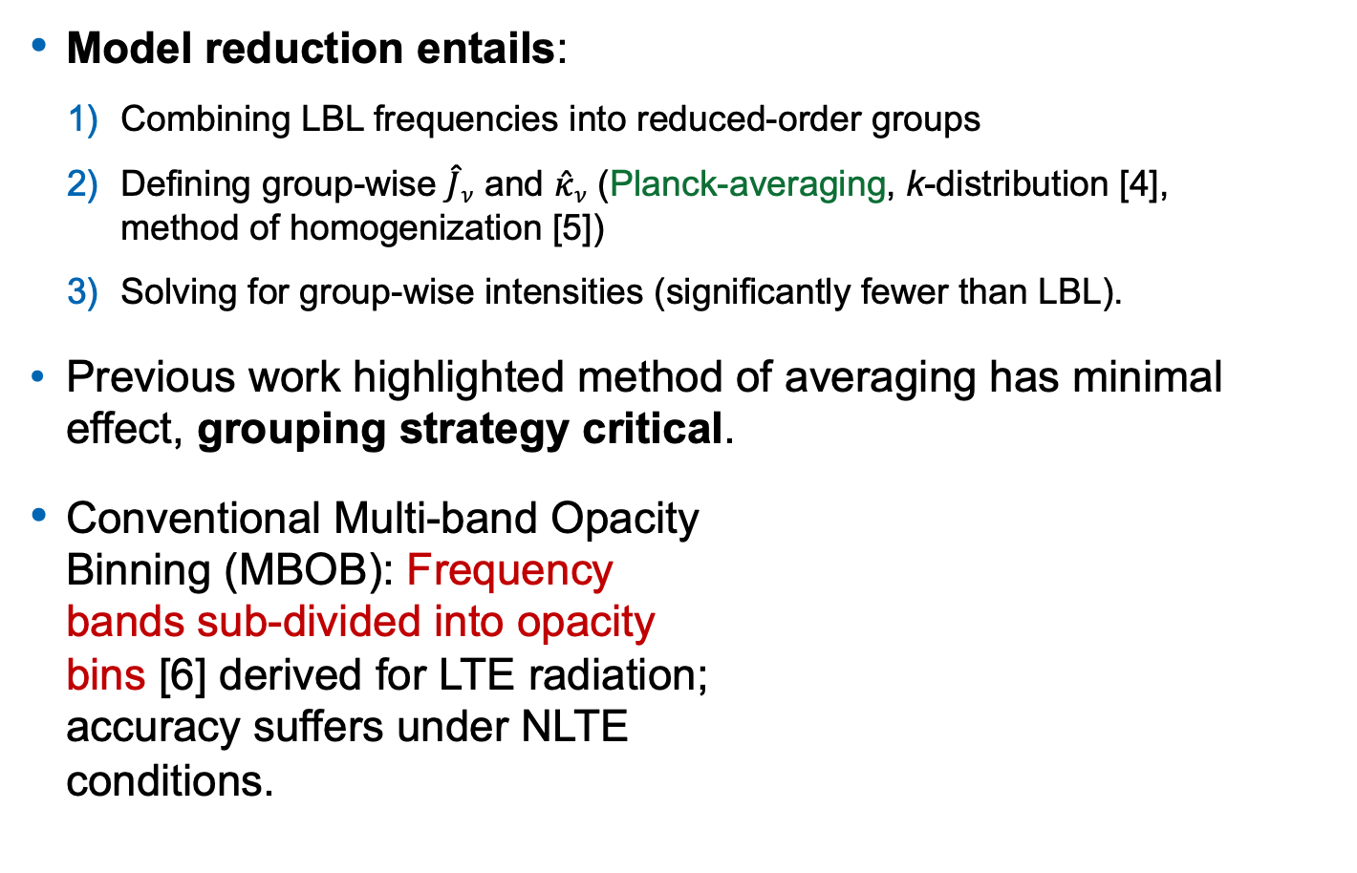
NERO: Reduced-order Spectral Models
Model reduction entails:
  Combining LBL frequencies into reduced-order groups
  Defining group-wise $\hat{J}ν$ and $\hat{κ}ν$ (Planck-averaging, k-distribution [4], method of homogenization [5])
  Solving for group-wise intensities (significantly fewer than LBL).
Previous work highlighted method of averaging has minimal effect, grouping strategy critical.
Conventional Multi-band Opacity Binning (MBOB): Frequency bands sub-divided into opacity bins [6] derived for LTE radiation; accuracy suffers under NLTE conditions.

Slide 10

Generalized Grouping Strategy
Existing approaches derived for LTE radiation.
$$Ω⋅∇I_{ν} = κ_{ν}{ (I}_{ν}B−I_{ν}), J_{ν}=κ_{ν}{ I}_{ν}B$$
Non-equilibrium : $J_{ν}≠κ_{ν}{ I}_{ν}B$, both $κ_{ν}$ and $J_{ν}$ vary rapidly.
New generalized grouping strategy – bands based on $J_{ν}$ and bins based on $J_{ν}{ κ}_{ν}$ (Sahai et al., JQSRT, 2020 [7]).
Old
New

Slide 11
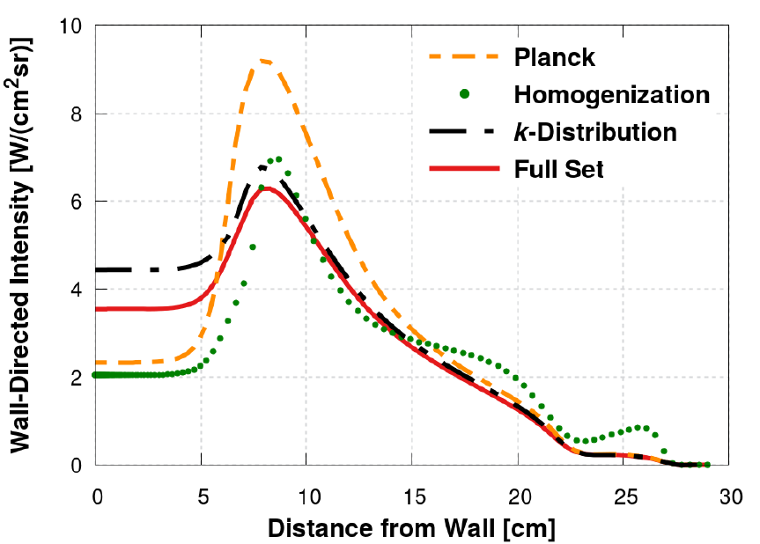
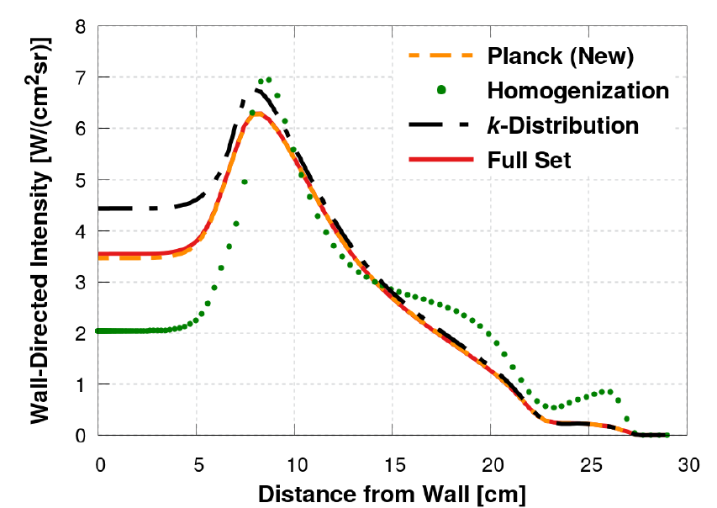
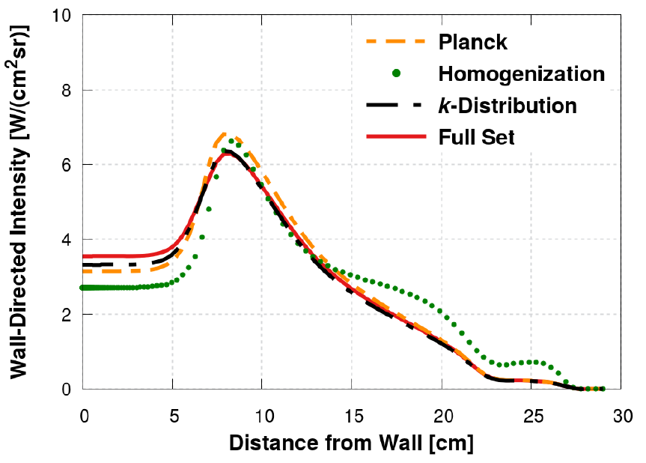
Stardust Stagnation LOS Analysis
Conventional Methods: Slow convergence to LBL
400 ROM groups
New Grouping Strategy
1250 ROM groups
400 ROM groups

Slide 12
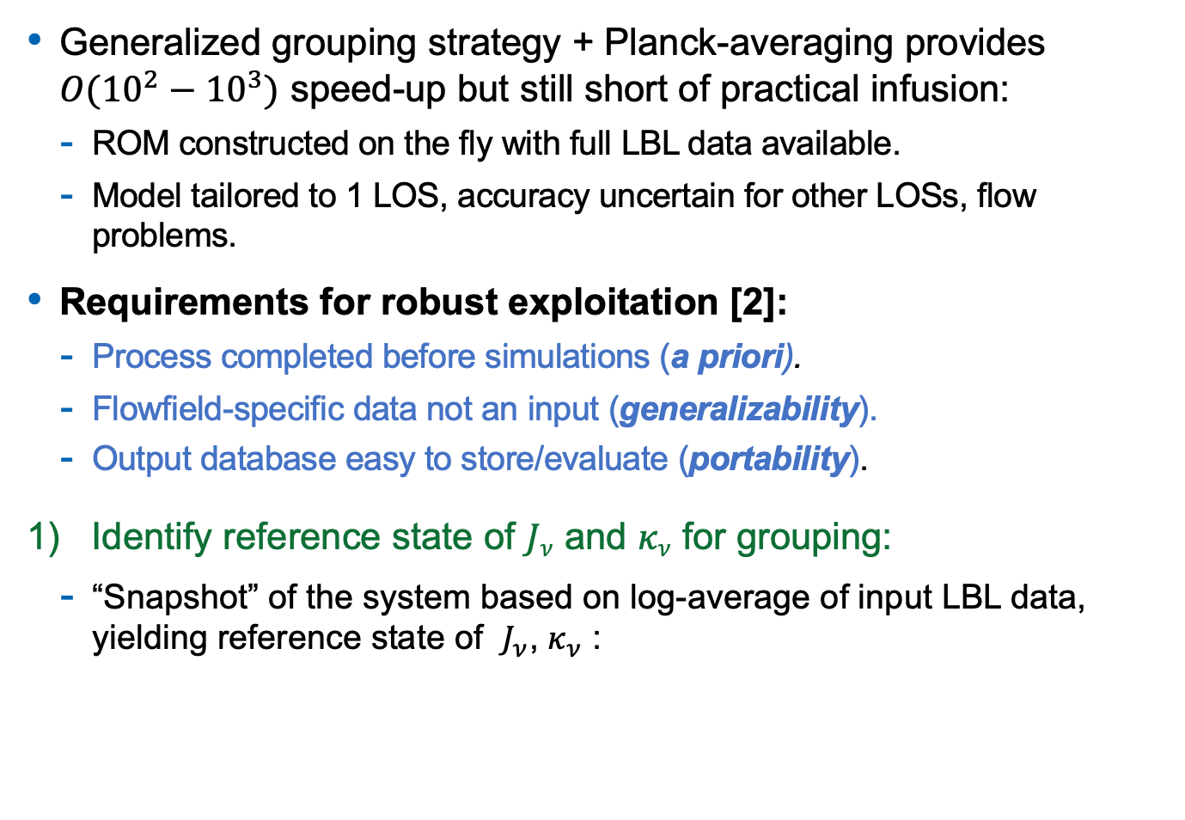
NERO: General-purpose ROM Database
Generalized grouping strategy + Planck-averaging provides $O(10^{2}−10^{3})$ speed-up but still short of practical infusion:
  ROM constructed on the fly with full LBL data available.
  Model tailored to 1 LOS, accuracy uncertain for other LOSs, flow problems.
Requirements for robust exploitation [2]:
  Process completed before simulations (a priori).
  Flowfield-specific data not an input (generalizability).
  Output database easy to store/evaluate (portability).
Identify reference state of $Jν$ and $κν$ for grouping:
  “Snapshot” of the system based on log-average of input LBL data, yielding reference state of $J_{ν}$, $κ_{ν}$ :

Slide 13
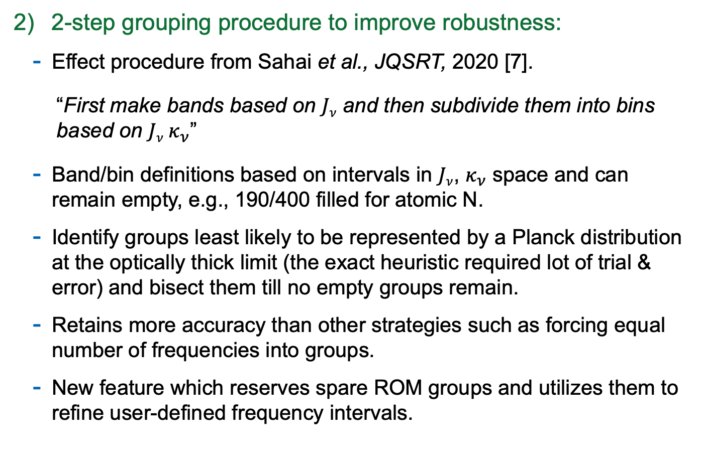
Backup Slides: Portable ROM Database
2-step grouping procedure to improve robustness:
  Effect procedure from Sahai et al., JQSRT, 2020 [7].
  “First make bands based on $Jν$ and then subdivide them into bins based on $Jν κ_{ν}$”
  Band/bin definitions based on intervals in $Jν$, $κ_{ν}$ space and can remain empty, e.g., 190/400 filled for atomic N.
  Identify groups least likely to be represented by a Planck distribution at the optically thick limit (the exact heuristic required lot of trial & error) and bisect them till no empty groups remain.
  Retains more accuracy than other strategies such as forcing equal number of frequencies into groups.
  New feature which reserves spare ROM groups and utilizes them to refine user-defined frequency intervals.

Slide 14
NERO: General-purpose ROM Database
Ingenious organization of ROM look-up table (builds on previous work on extending Planck-averaging to non-Boltzmann populations).
The following hierarchy is adopted (reduce table dimensions):
Type of radiative process (e.g., bound-bound, bound-free, free-free)
  List of transitions between specific internal levels
    Discrete physical conditions (e.g., temperatures, electron number density, pressure) which also capture effects such as line-broadening.
      Level number density normalized coefficients for absorption, spontaneous emission, and induced emission for each group.

Slide 15
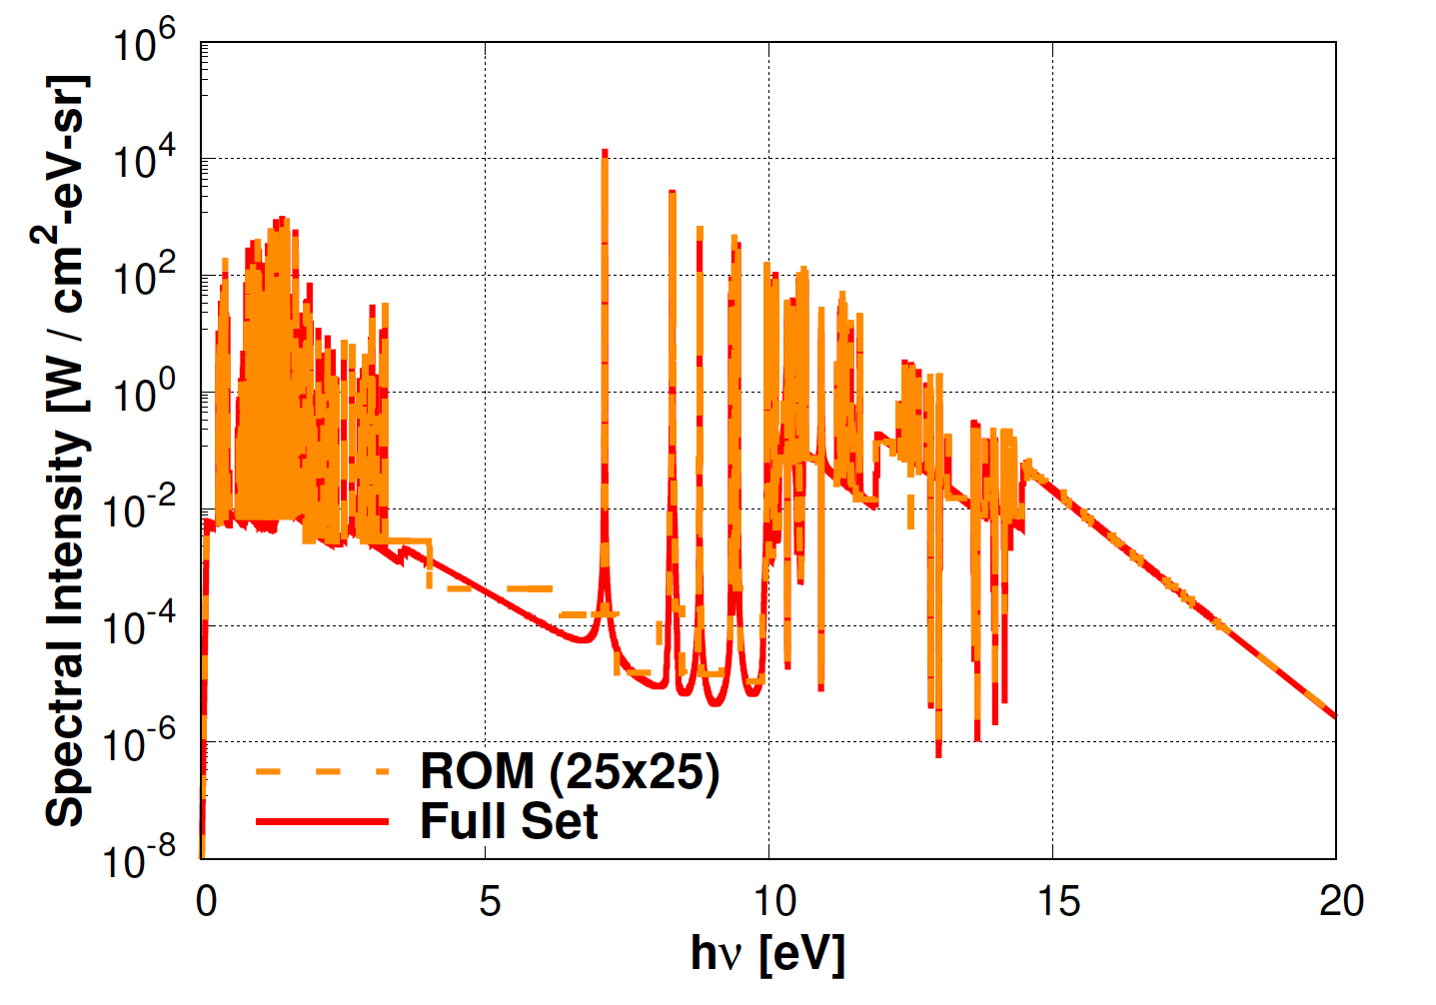
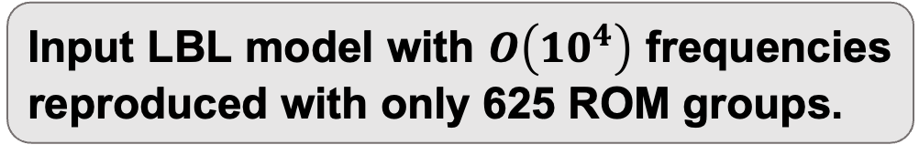
Results: N Radiation LOS Analysis
Stardust Stagnation
FIRE II Wake
Input LBL model with $O\left(10^{4}\right)$ frequencies reproduced with only 625 ROM groups.

Slide 16
Results: Anatomy of Grouping for N
Grouping initiated with 20 bands further sub-divided into 25 bins.
279/625 groups are empty, filled by bisecting existing groups that exhibit high variance.
Reserve 5 bands used for further refining region [10, 15] eV.

Slide 17
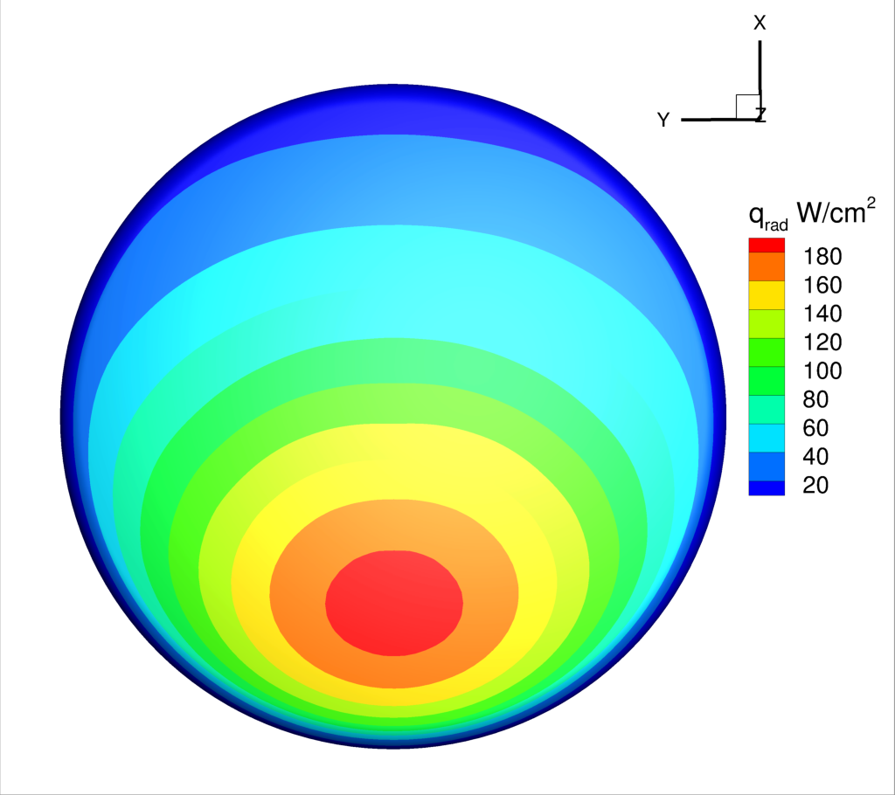
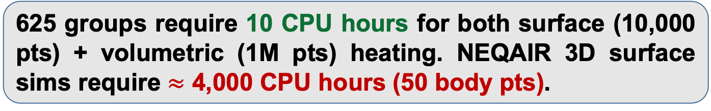
Results: N Radiation for Orion Forebody
625 groups require 10 CPU hours for both surface (10,000 pts) + volumetric (1M pts) heating. NEQAIR 3D surface sims require $≈$ 4,000 CPU hours (50 body pts).

Slide 18
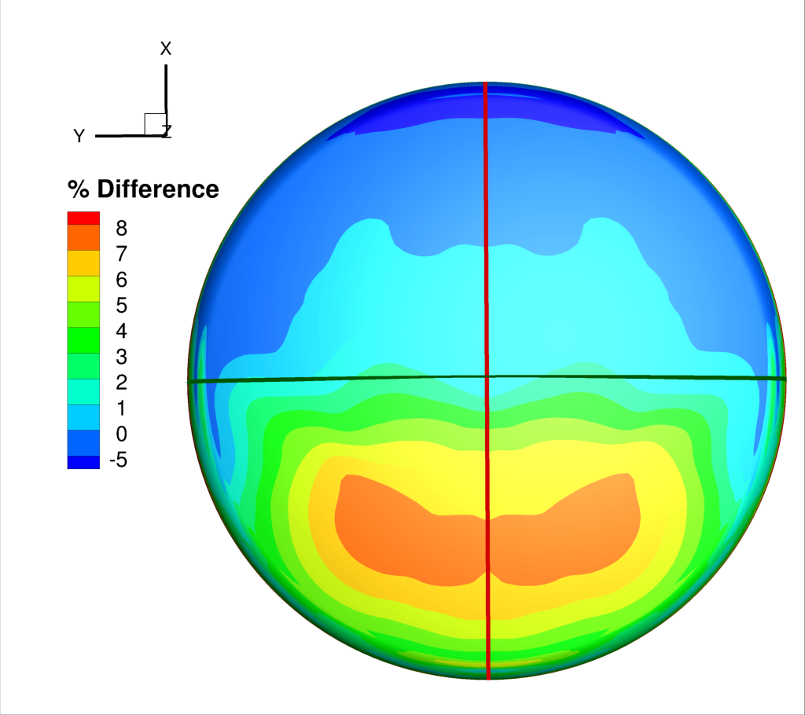
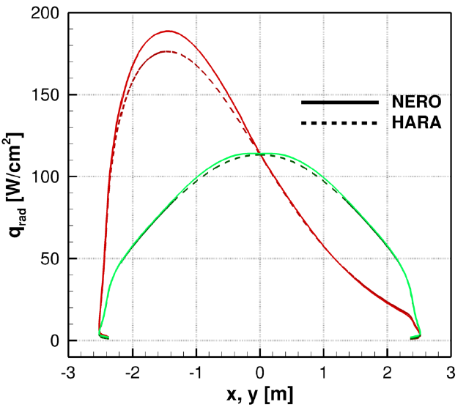
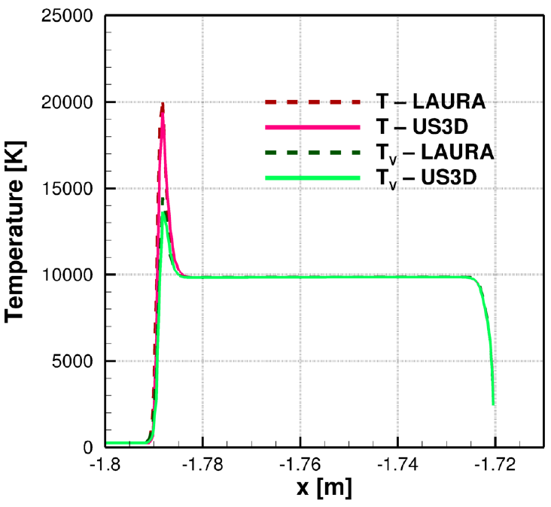
Results: N Radiation for Orion Forebody
Maximum difference in surface heat flux ~ 8%; 5-10% differences in peak temperatures between LAURA and US3D contributory factor.

Slide 19
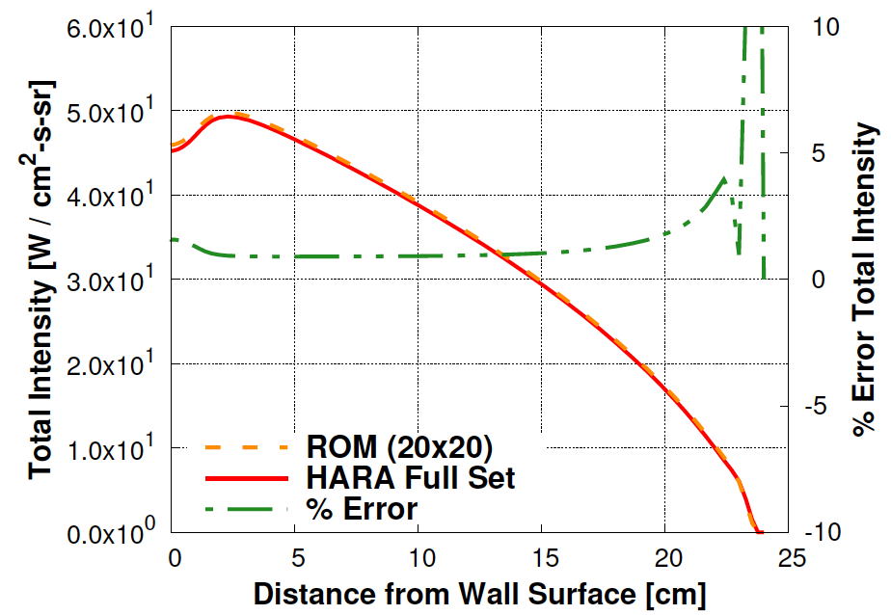
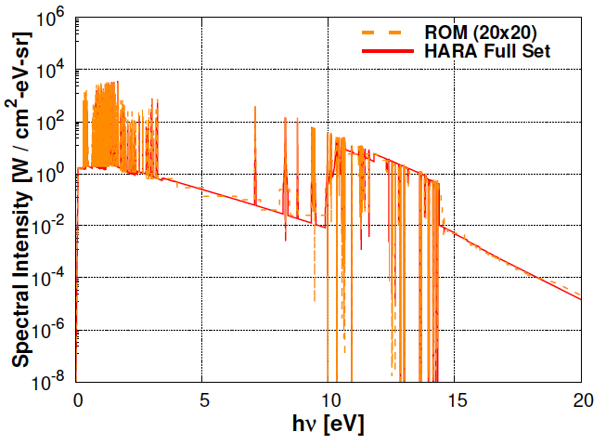
Results: N Radiation for Orion Forebody
Total/spectral quantities match when evaluating same US3D stagnation LOS. Need flow solution converter.

Slide 20
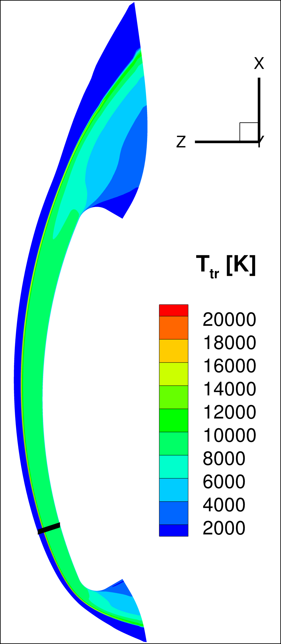
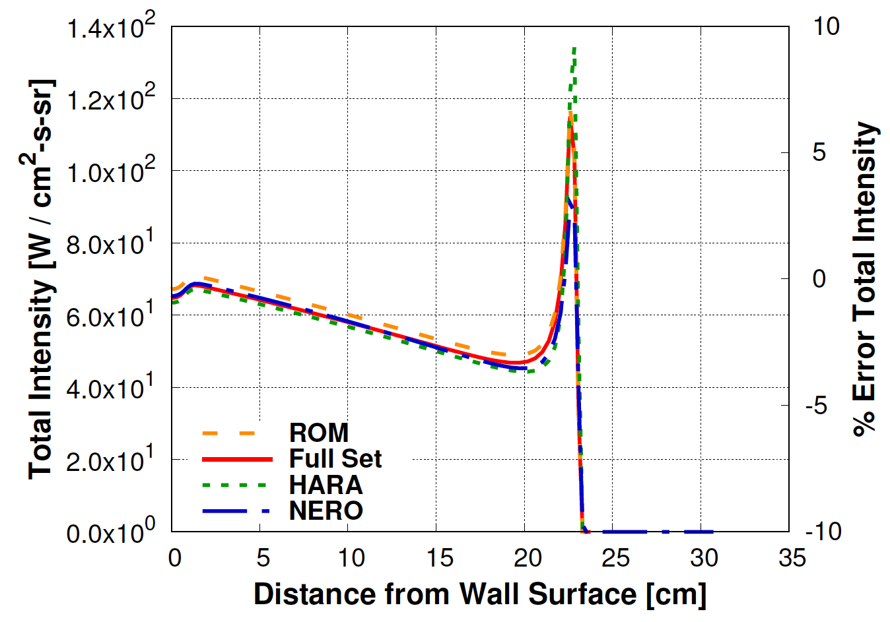
Results: N Radiation for Orion Forebody
Results more consistent once processing same flowfield.

Slide 21
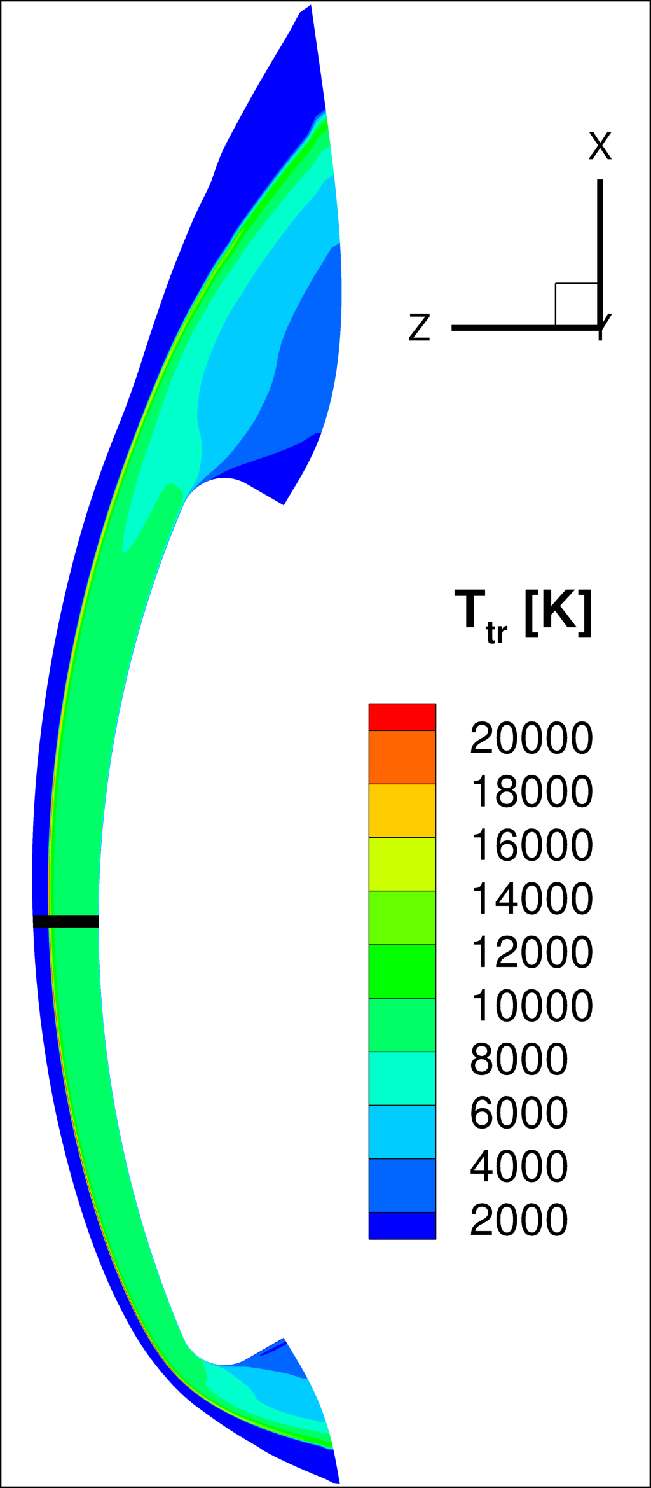
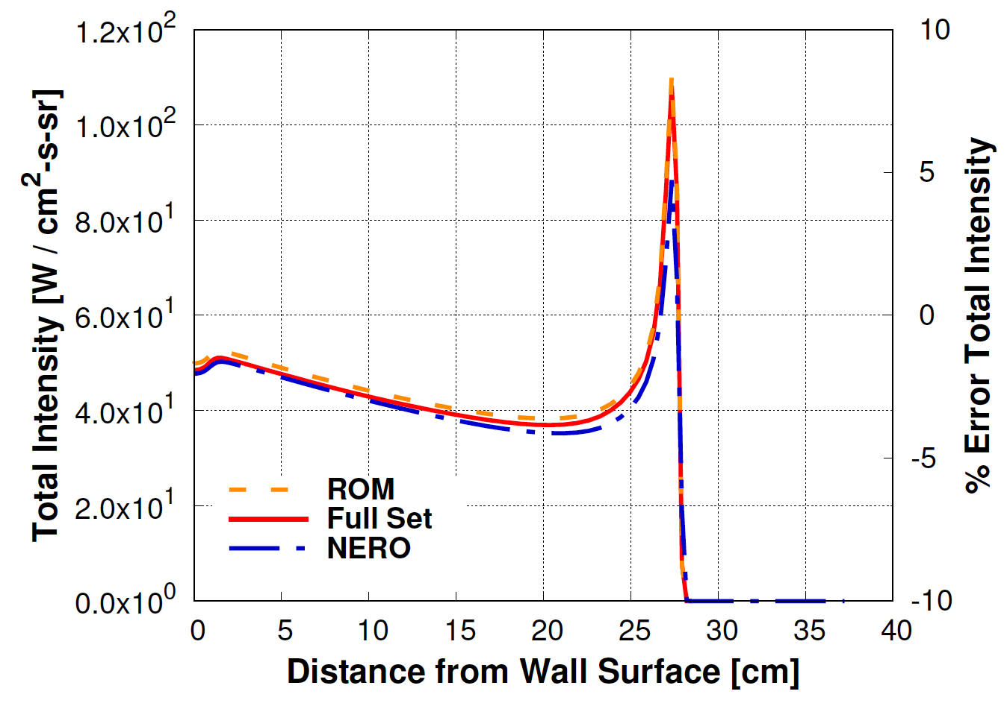
Results: N Radiation for Orion Forebody
Results more consistent once processing same flowfield.

Slide 22
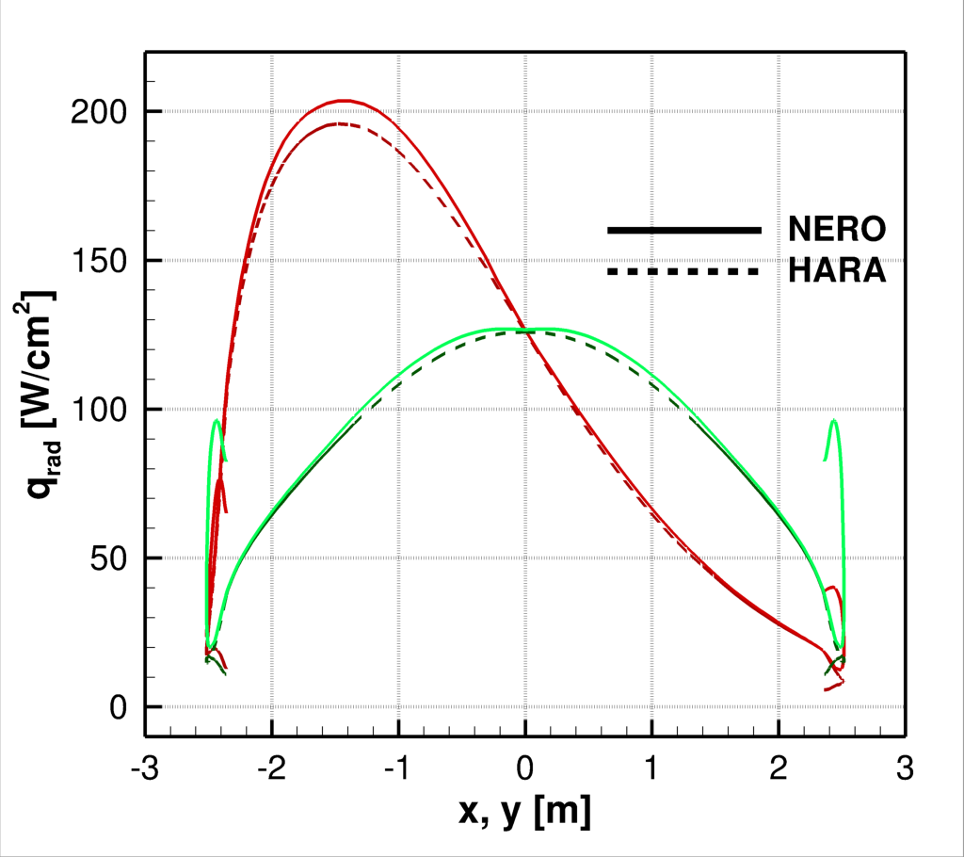
Results: N Radiation for Orion Forebody
Maximum difference in surface heat flux ~ 3.8% (from 8%); Increasing groups reduces this further.

Slide 23
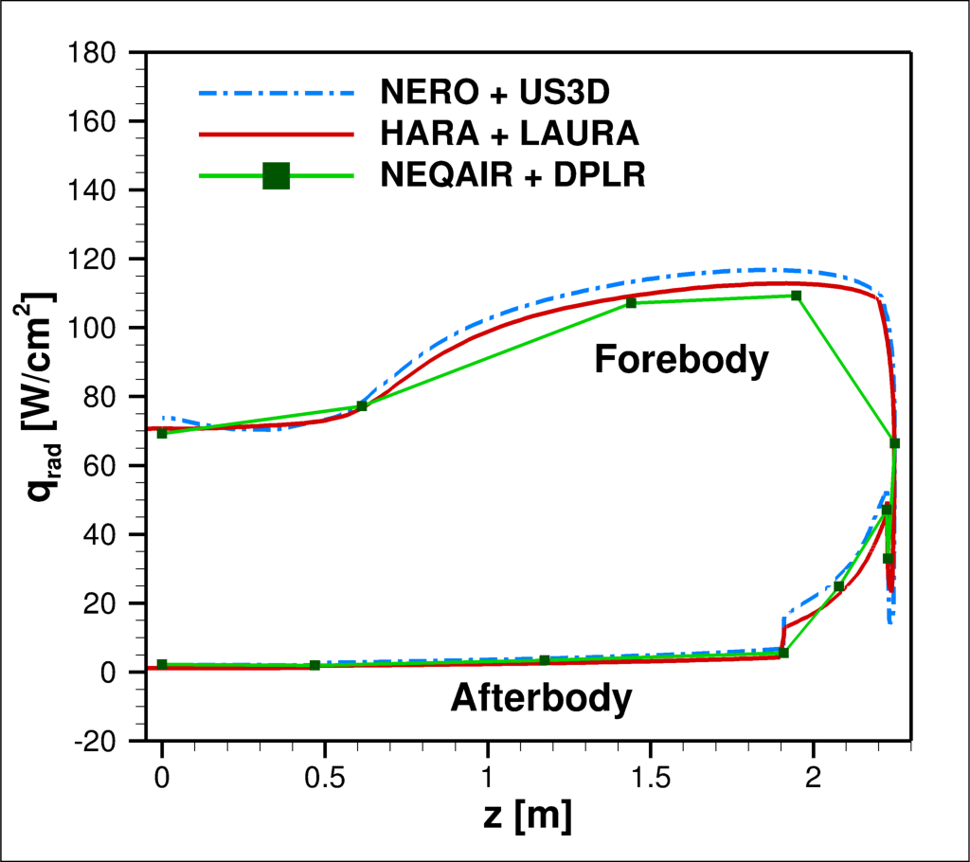
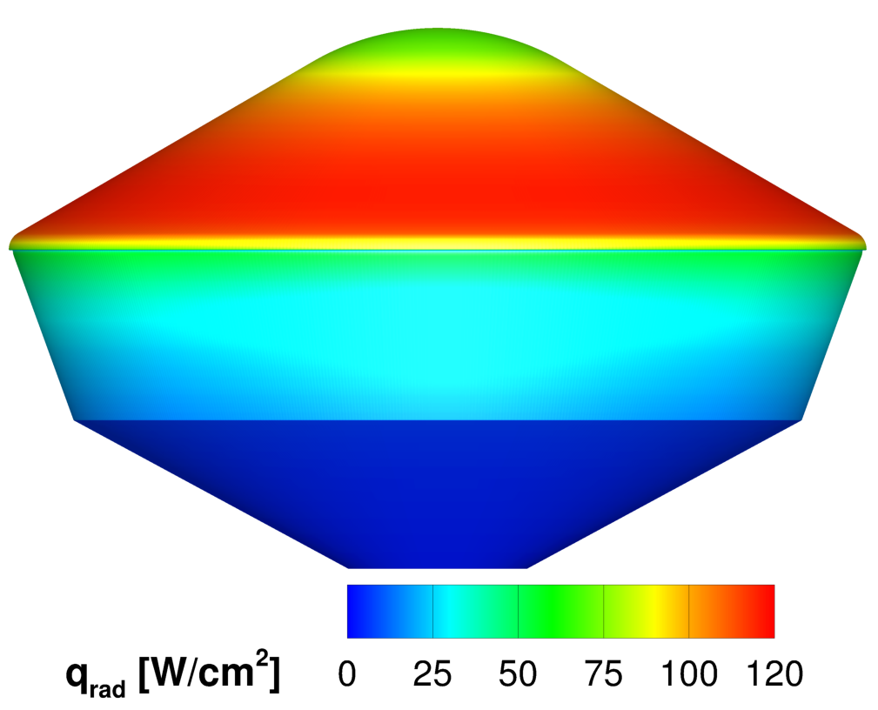
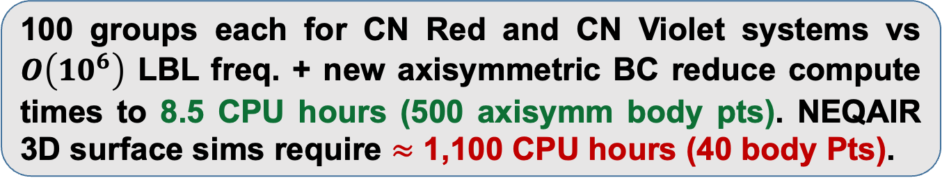
Results: CN Radiation for Dragonfly
100 groups each for CN Red and CN Violet systems vs $O\left(10^{6}\right)$ LBL freq. + new axisymmetric BC reduce compute times to 8.5 CPU hours (500 axisymm body pts). NEQAIR 3D surface sims require $≈$ 1,100 CPU hours (40 body Pts).

Slide 24
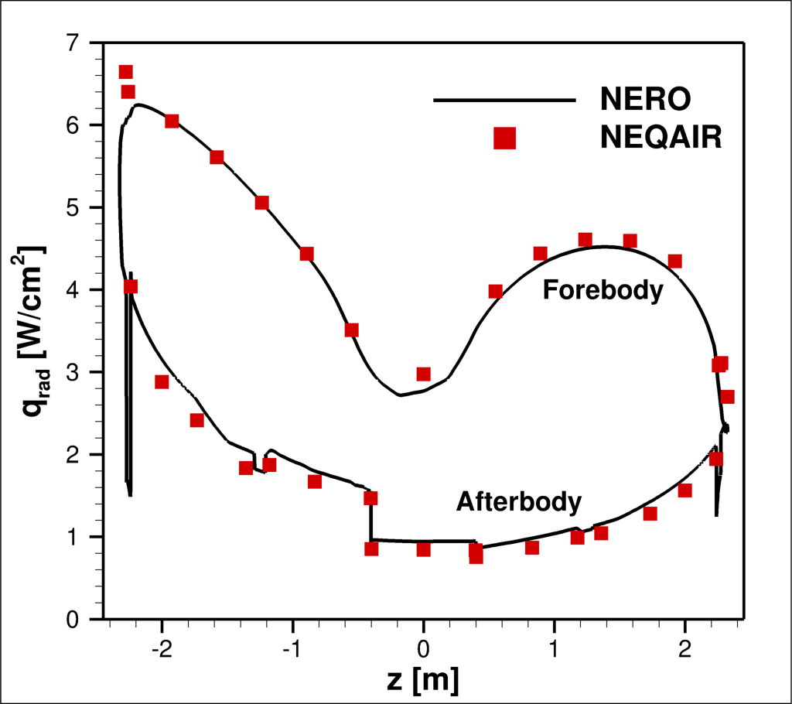
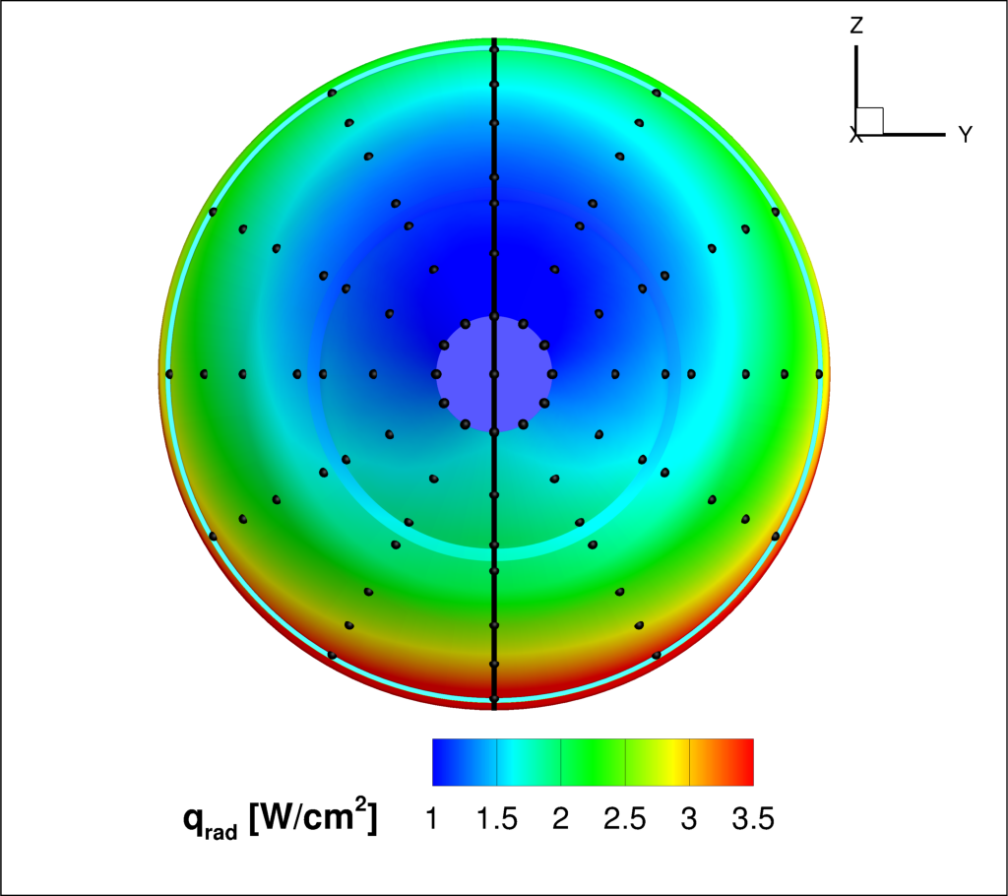
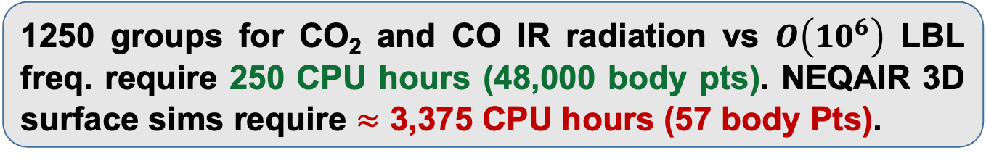
Results: CO₂ + CO IR Radiation for SRL
1250 groups for CO₂ and CO IR radiation vs $O\left(10^{6}\right)$ LBL freq. require 250 CPU hours (48,000 body pts). NEQAIR 3D surface sims require $≈$ 3,375 CPU hours (57 body Pts).

Slide 25
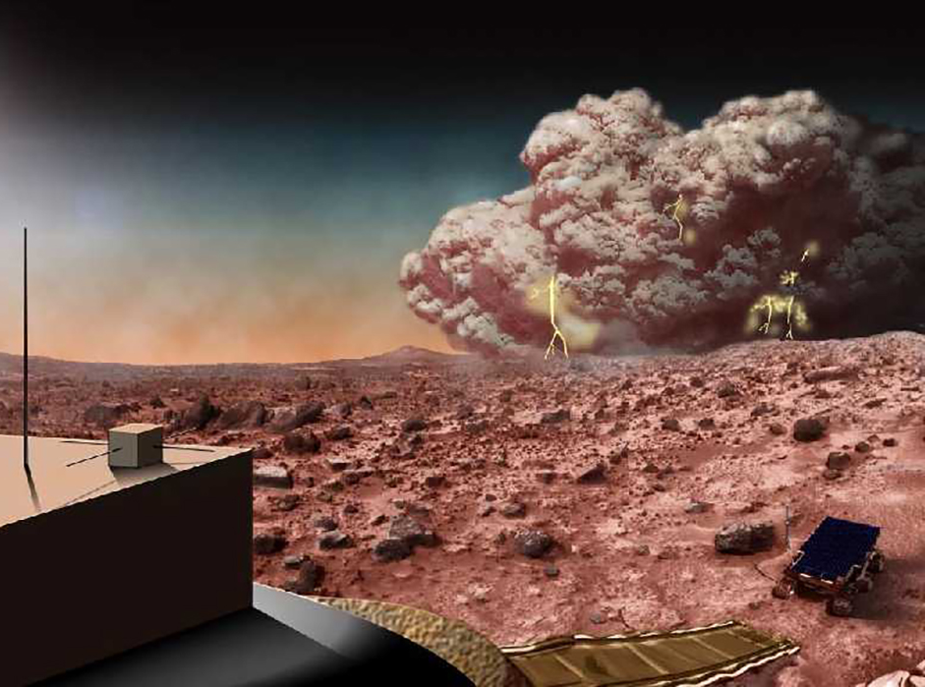
Bonus: Particle-radiation Coupling
Inexpensive radiative calculations pave way for complex multi-physics coupling.
Particulates in planetary atmosphere pose significant risk to spacecraft health.
Recent work indicates TPS erosion due to particle impacts comparable to thermochemical ablation [8].
Limited characterization of indirect effects of particulates on hypersonic environment:
  Change in radiative energy transfer
  Altered wall roughness due to pitting
  Induce flow transition
Source: NASA

Slide 26
Bonus: Particle-radiation Coupling
“Perform integrated high-fidelity modeling of radiative heat transfer (NERO) and particulate flow dynamics (DUST) in order to 1) assess impact of this interplay on spacecraft environment, 2) begin testing multi-physics coupling concepts through GLUE”.
CFD
(US3D)
Particle
Radiation
Ablation
Maxwell
GLUE

Slide 27
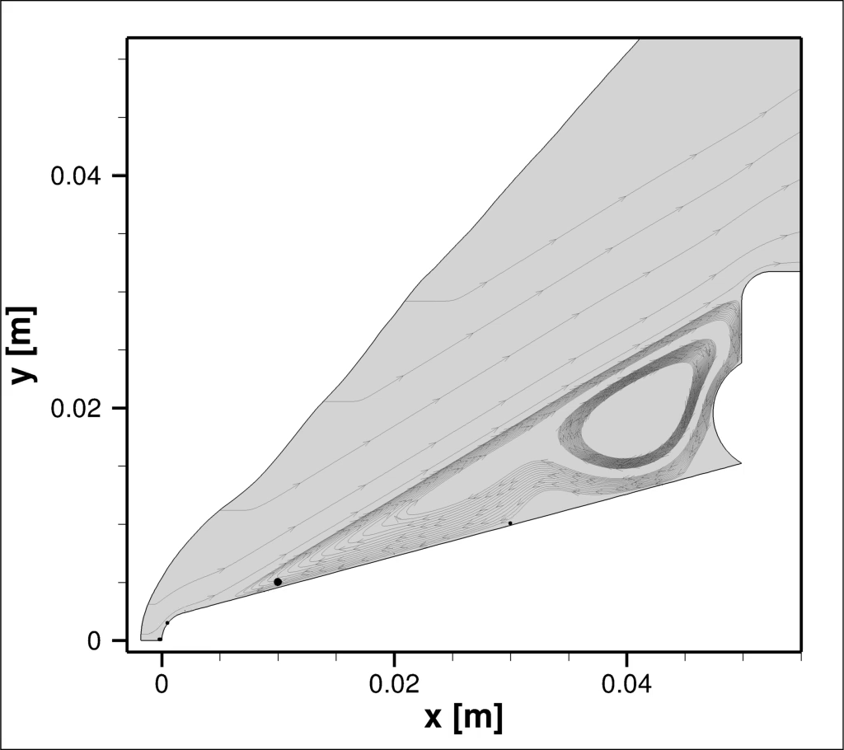
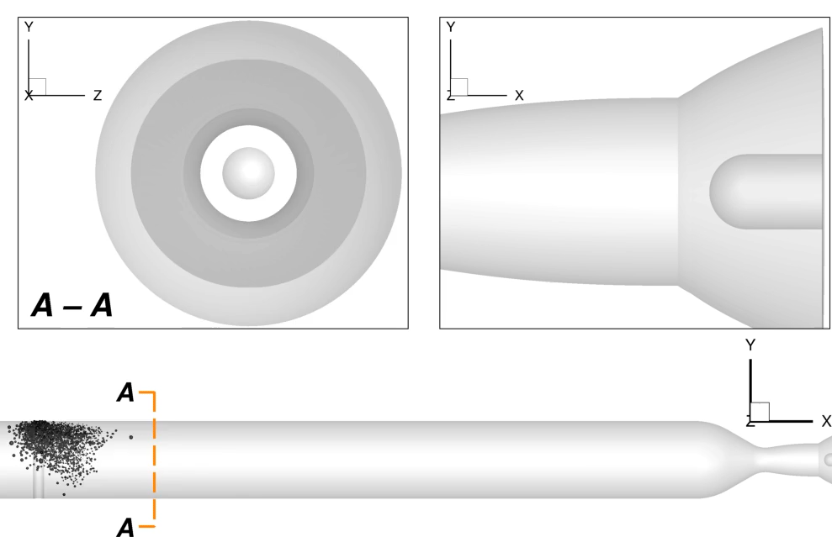
Dust Simulation and Tracking (DUST)
DUST [9] is a new massively parallel, variable-fidelity, Lagrangian particle solver that links with US3D – an unstructured, finite-volume hypersonic flow code and workhorse of NASA ARC.
2-Way: Caltech Nozzle
4-Way: Jet Impingement
Spallation in HyMETS
Particle collisions near
Mars 2020
Dust-laden flow in DLR-GBK Wind Tunnel

Slide 28
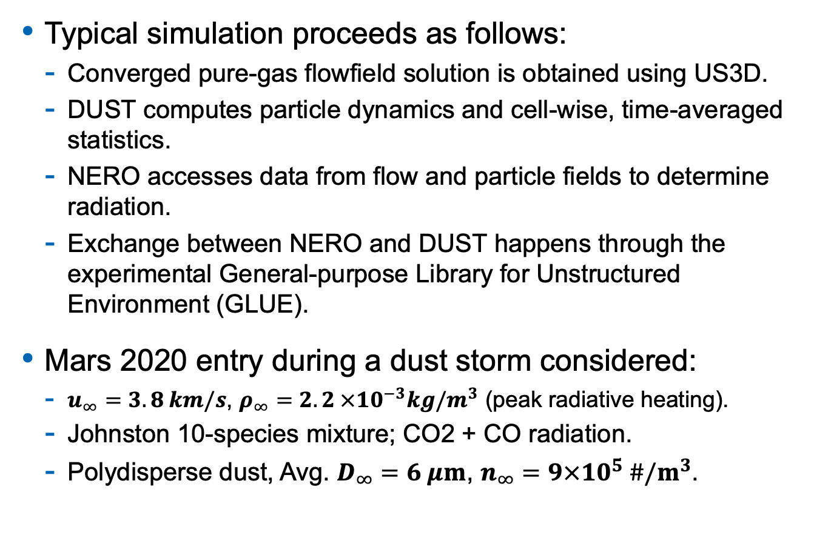
Simulation Methodology
Typical simulation proceeds as follows:
  Converged pure-gas flowfield solution is obtained using US3D.
  DUST computes particle dynamics and cell-wise, time-averaged statistics.
  NERO accesses data from flow and particle fields to determine radiation.
  Exchange between NERO and DUST happens through the experimental General-purpose Library for Unstructured Environment (GLUE).
Mars 2020 entry during a dust storm considered:
  $u_{∞}=3.8 km/s$, $ρ_{∞}=2. 2 ×{10}^{−3}kg/m^{3}$ (peak radiative heating).
  Johnston 10-species mixture; CO2 + CO radiation.
  Polydisperse dust, Avg. $D_{∞}=6 μm$, $n_{∞}=9×10^{5} \#/m^{3}$.

Slide 29
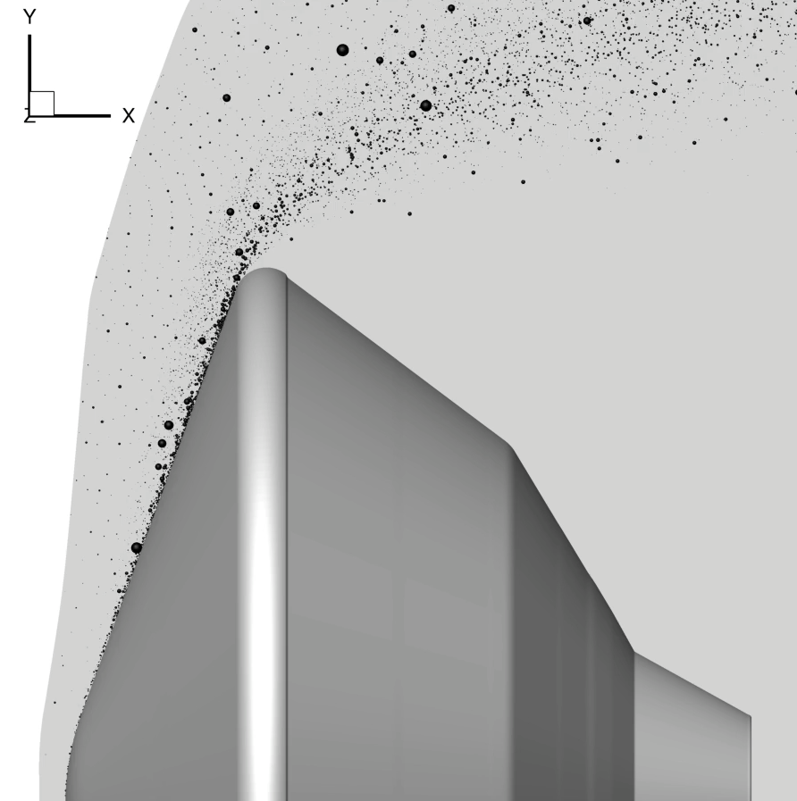
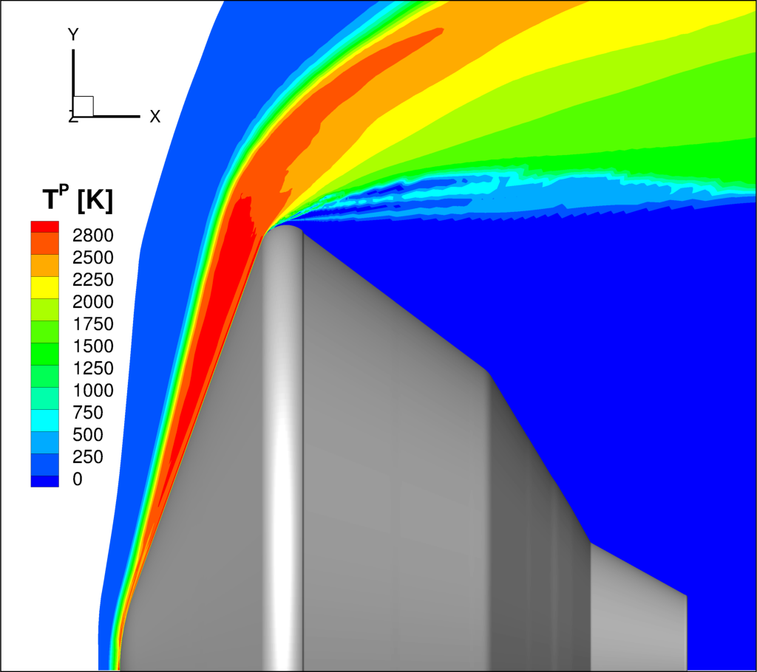
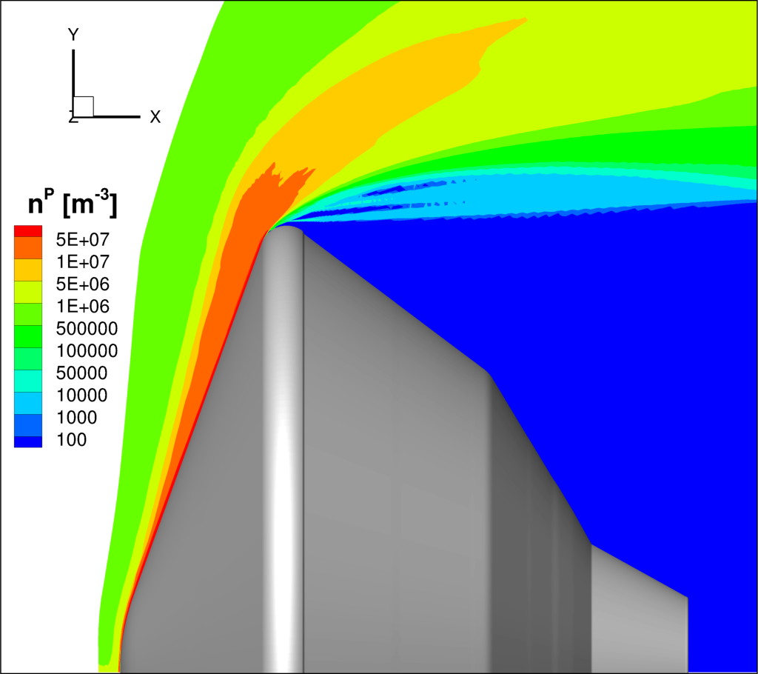
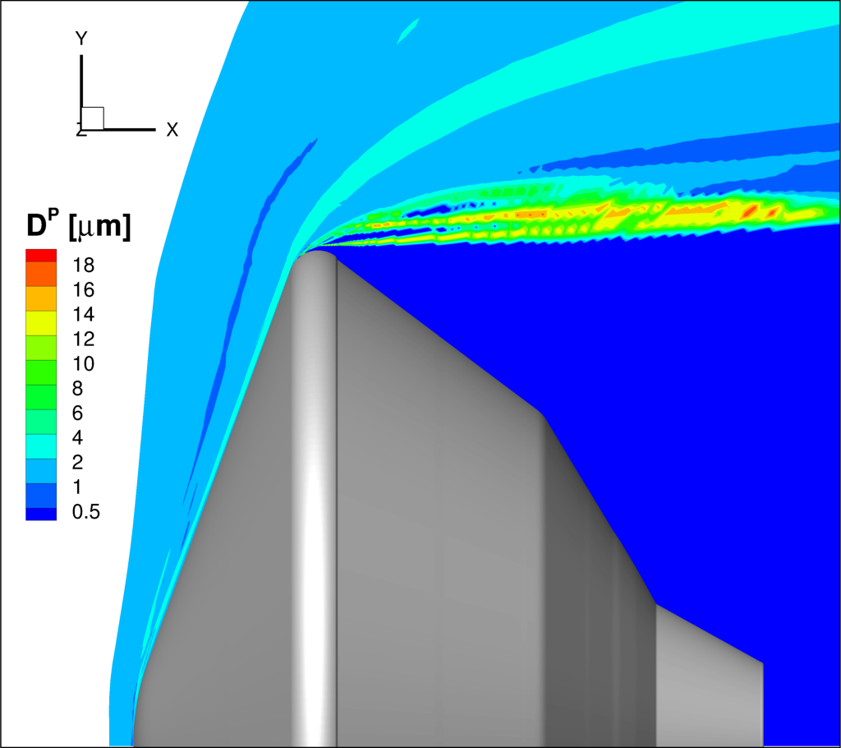
Results: Mars 2020 in a Dust Storm
Time-averaged Particle Statistics

Slide 30
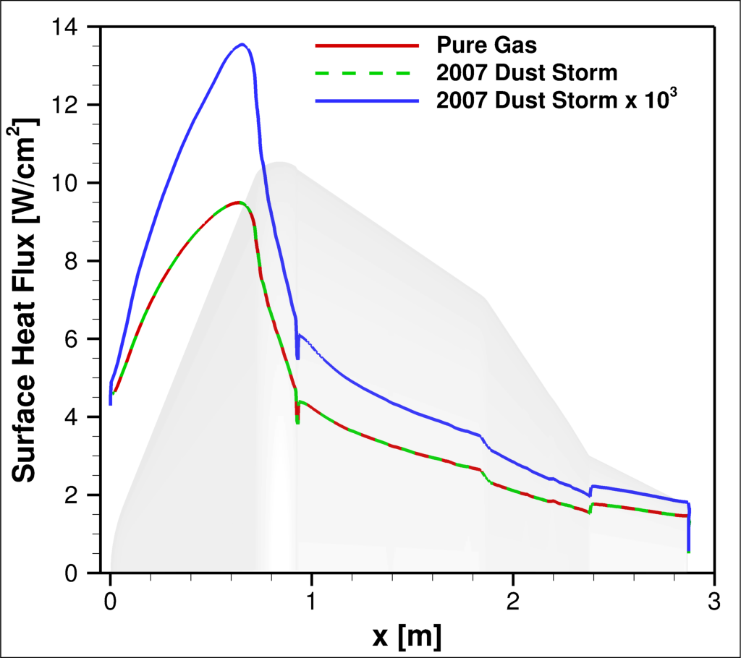

Results: Mars 2020 in a Dust Storm
$${ κ}_{ν}^{P}={\overline{n}}_{P}\frac{π \overline{D_{P}^{2}}}{4}Q_{a}^{P}$$
$$J^{P}=κ^{P}\frac{σ{\overline{T}}_{P}^{4}}{π}$$
Dust number density/size not large enough to appreciably alter surface radiative heat flux.
Competing processes – additional emission, blocking of gas-phase radiation – cancel each other out.
Radiative heat flux (somewhat counter-intuitively) increases as dust number density artificially increased.
Hot dust particles can travel closer to spacecraft (since they tend to be larger) while emitting radiation.
Surface Radiative Heat Flux

Slide 31
Conclusions and Future Work
Conclusions
Radiation framework under development with massive efficiency gains through reduced-order spectral models, FVM discretization, and Lebedev quadrature.
Novel methodology for creating portable, general-purpose ROM spectral databases.
Demonstrated efficacy on a diverse set of problems such as Mars Sample Return Lander, Orion, and Dragonfly.
Inexpensive radiative calculations can enable diverse coupled simulations.
Future Work
Add radiative systems, examine overlap in frequency space (e.g., O and N).
Explore different techniques for spatial-angular resolution – linear solvers, parallelization, M1 model.

Slide 33
References
Lebedev, V. I., “Quadratures on a sphere,” USSR Computational Mathematics and Mathematical Physics, Vol. 16, No. 2, 1976.
Sahai, A. and Johnston, C.O., “On computationally efficient radiative transfer calculations for three-dimensional entry problems,” AIAA Paper 2023-0204, 2023.
Sahai, A., “Reduced-order modeling of Non-Boltzmann thermochemistry and radiation for hypersonic flows,” PhD Thesis, University of Illinois at Urbana-Champaign, 2019.
Modest, M. F., “Radiative heat transfer,” Academic Press, 2013
Haut, T.S., Ahrens, C., Jonko, A., Lowrie, R. and Till, A., “A new multigroup method for cross-sections that vary rapidly in energy,” Journal of Quantitative Spectroscopy and Radiative Transfer, 187, 2017.
Scoggins, J. B., Magin, T. E., Wray, A. A., and Mansour, N. N., “Multi-group reductions of LTE air plasma radiative transfer in cylindrical geometries,” AIAA Paper 2013-3142, 2013.
Sahai, A., Johnston, C.O., Lopez, B. and Panesi, M., “Comparative analysis of reduced-order spectral models and grouping strategies for non-equilibrium radiation,” Journal of Quantitative Spectroscopy and Radiative Transfer, 242, 2020.
Palmer, G., Ching, E., Ihme, M., Allofs, D. and Gülhan, A., “Modeling heat-shield erosion due to dust particle impacts for Martian entries,” Journal of Spacecraft and Rockets, 57(5), 2020.
Sahai, A. and Palmer, G., “Variable-fidelity Euler–Lagrange framework for simulating particle-laden high-speed flows," AIAA Journal, 60(5), 2022.

Slide 34
Backup Slides: Planck-Averaging

Slide 35
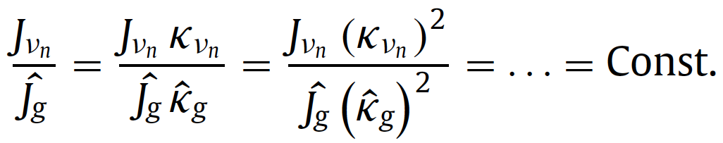

Backup Slides: Generalized Strategy
Conventional strategy: Form frequency intervals (bands) and sub-divide them into opacity intervals (bins).
Existing approaches derived for LTE radiation.
$$Ω⋅∇I_{ν} = κ_{ν}{ (I}_{ν}B−I_{ν}), J_{ν}=κ_{ν}{ I}_{ν}B$$
Non-equilibrium : $J_{ν}≠κ_{ν}{ I}_{ν}B$, both $κ_{ν}$ and $J_{ν}$ vary rapidly.
New generalized grouping strategy – bands based on $J_{ν}$ and bins based on $J_{ν}{ κ}_{ν}$ (Sahai JQSRT 2020).

Slide 36


Backup Slides: Dragonfly through Haze
$$κ_{ν}^{P}={\overline{n}}_{P}\frac{π \overline{D_{P}^{2}}}{4}Q_{a}^{P}$$
Haze particle number density/size not large enough to appreciably alter surface radiative heat flux.
Since no heating model employed for haze particles, attendant emission by them is ignored.
Consequently, surface heat flux decreases with rise in particle number density as propagation of gas-phase radiation impeded.
Surface Radiative Heat Flux

