Slide 1
Bayesian Absolute Detection Efficiency of the GLMs
Katrina Virts
University of Alabama in Huntsville (UAH)
William Koshak
National Aeronautics and Space Administration (NASA)
GLM Science Team Meeting
13 November 2023

Slide 2
Calculating GLM’s detection performance
Detection efficiency (DE) = % of true lightning flashes a sensor detects
Most studies calculate relative DE
  Probability that sensor A detects a discharge given that sensor B detected the same discharge
  Assumes that the reference sensor (B) detects all lightning
Bitzer et al. (2016) introduced a Bayesian method for absolute DE (ADE)
  Does not assume that either sensor detects all lightning
  Calculated with respect to the larger universe of detected lightning
  Provides an upper estimate of ADE for each sensor being analyzed
Bitzer and Burchfield (2016) applied the Bayesian method to ground network pulses/strokes: ENTLN (56.8% ADE), GLD360/NLDN (59.8%), and WWLLN (7.9%)
Virts et al. (in review) applied the Bayesian method to TRMM and ISS LIS ground networks, and GLM16

Slide 3
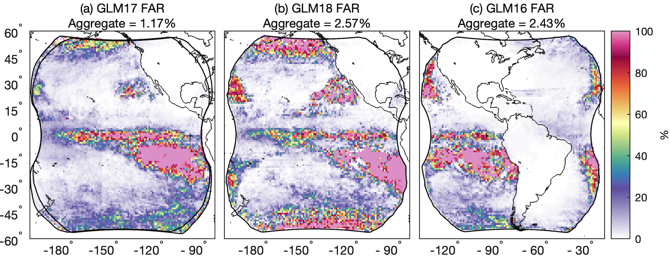
Caveat: GLM artifacts
False alarms are counted as missed flashes for other sensors
~1-3% of GLM reported flashes cannot be matched to *any* reference flash (within ±10 min, 50 km)
FAR is higher when averaging over all grid boxes (e.g., weighting each location instead of each flash the same)

Slide 4
Lightning data available for Bayesian analysis
Source | Lightning data | Time period | Domain
Satellite optical sensors
GLM16 | Flash | Aug 2019 – Jul 2023 | Western Hemisphere
GLM17 |  | Aug 2019 – 10 Jan 2023 | Central/Eastern Pacific
GLM18 |  | Nov 2022 – Jul 2023 | Central/Eastern Pacific
Ground-based RF networks
ENGLN | Pulse -> flash | Aug 2019 – Jul 2023 | Global
GLD360 | Stroke -> flash | Aug 2019 – Jul 2023 | Western Hemisphere (through 2020) Extended Western Hemisphere (2021 and later)
Begin analysis after the blooming filter was implemented
ENGLN and GLD360 stroke/pulse data clustered into flashes using Weighted Euclidean Distance (parameters ±330 ms and 5.5 km)
Flash matching criteria: ±1 s and 50 km

Slide 5
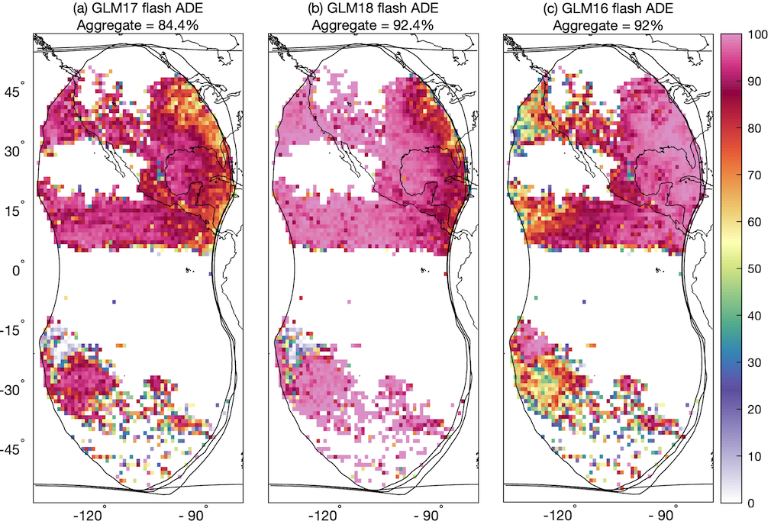
Three-GLM comparison
Three-GLM comparison possible from 1 Nov 2022 – 10 Jan 2023
  ~4.5-5.0 million flashes
GLM16/18 aggregate ADE 92% over all flashes
  GLM17 ADE was ~8% lower
Lower ADE near FOV edges, western US (GLM16), and southern Pacific

Slide 6
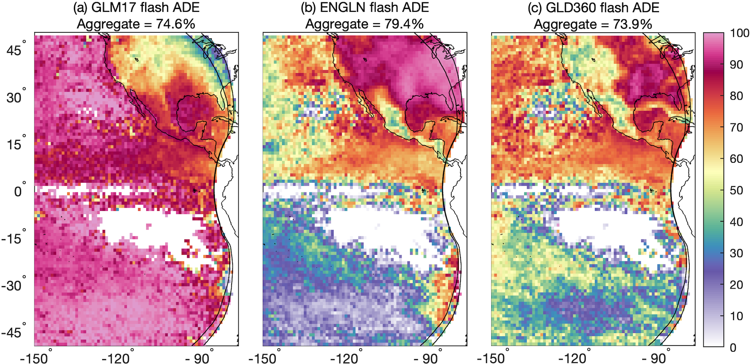
GLM17 performance
GLM17 aggregate ADE ~75% is comparable to the ground networks for this domain
ENGLN has largest spatial ADE variations and performs best over CONUS
GLD360 has fewer spatial variations than ENGLN and lower ADE for this domain

Slide 7
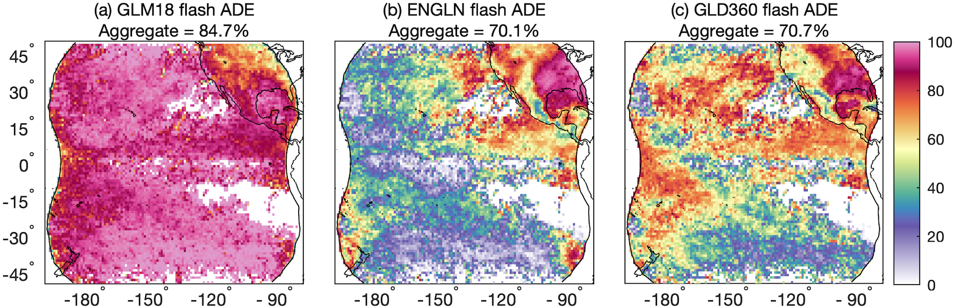
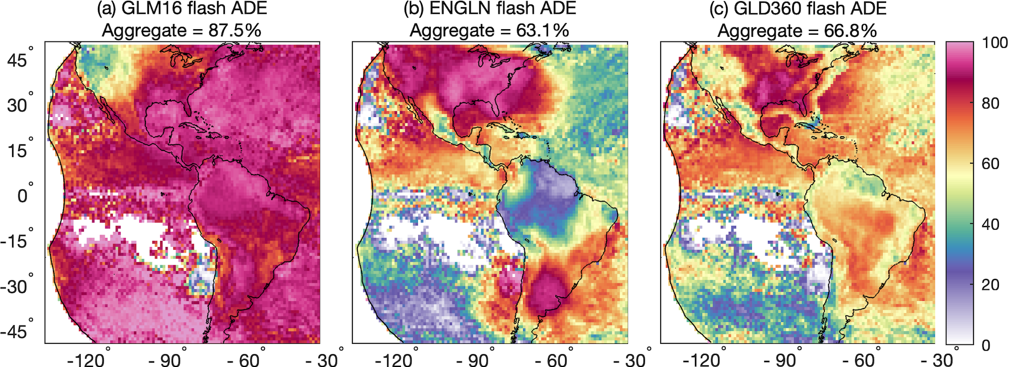
GLM16/18 performance
GLM16/18 out-perform both reference networks (ADE=85-88%)
GLM blooming artifacts produce locally low reference network ADE

Slide 8
GLM flash ADE in the overlap region
GLM17 |  | GLM18 |  | GLM16
Analyzed With | ADE | Analyzed With | ADE | Analyzed With | ADE
GLM16, ENGLN | 68.7% | GLM16, ENGLN | 80.6% | GLM17, ENGLN | 79.5%
GLM16, GLD360 | 73.1% | GLM16, GLD360 | 82.3% | GLM17, GLD360 | 84.4%
GLM16, GLM18 | 84.8% | GLM16, GLM17 | 92.7% | GLM17, GLM18 | 92.3%
ENGLN, GLD360 | 74.4% | ENGLN, GLD360 | 84.1% | ENGLN, GLD360 | 84.8%
 |  |  |  | GLM18, ENGLN | 82.0%
 |  |  |  | GLM18, GLD360 | 83.6%
Median | 73.8% | Median | 83.2% | Median | 84.0%
GLM18 ADE is ~10% higher than GLM17, and similar to GLM16

Slide 9
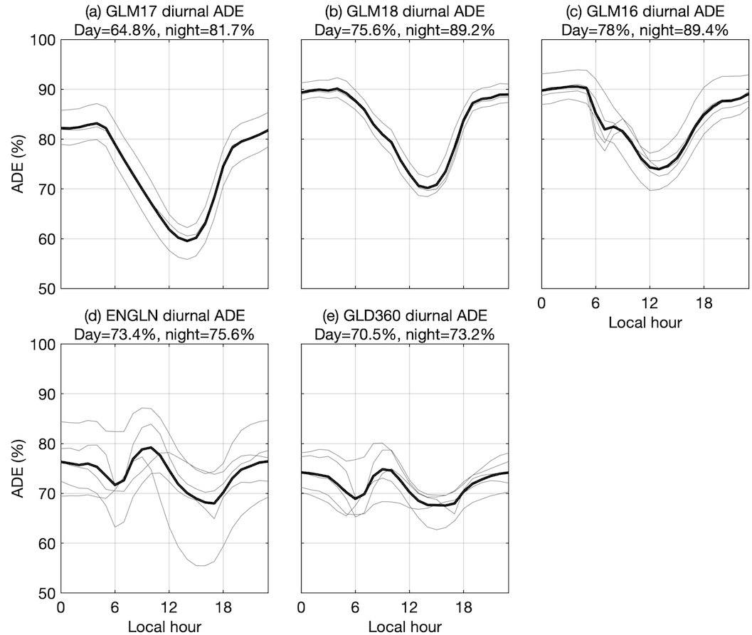
Diurnal variability of GLM ADE
Gray lines = hourly ADE from 3-way comparisons involving at least one GLM and one ground network
GLM16/18 ADE:
  Remains above 70% throughout the diurnal cycle
  Diurnal amplitude is ~11-14%
GLM17 has larger diurnal amplitude and is as low as 60% during the afternoon
Maxima in GLM false flashes around 06-07 and 16-17 LT create semi-diurnal cycle in reference network ADE

Slide 10
Conclusions
GLM and reference network ADE largely follow expected geographical patterns
GLM16/18 aggregate flash ADE is 83-84%
  GLM17 flash ADE is 10% lower
  Each GLM has ~100% ADE over some oceanic areas
Diurnal amplitude of GLM16/18 ADE is 11-14%, minimizing ~13-14 LT
GLM16/18 aggregate ADE is >70% throughout the diurnal cycle

Slide 11
Thank You!
Katrina Virts
(katrina.virts@uah.edu)

Slide 12
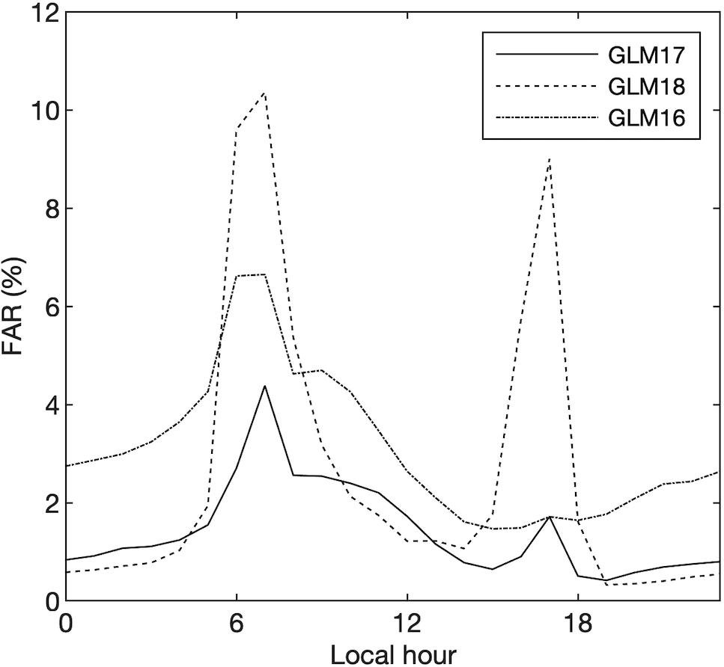
Diurnal variability of GLM false alarms
GLM false alarms spike around 06-07 and 16-17 LT due to solar intrusion and blooming
These artifacts artificially decrease the ground network ADE

