Slide 1

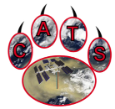

NASA GSFC Elastic Backscatter Lidar Efforts Relevant to EarthCARE Calibration/Validation and Synergistic Data Products
Ed Nowottnick – NASA Goddard Space Flight Center
with contributions from:
John Yorks (NASA GSFC), Matt McGill (U. Iowa), Kenny Christian (NASA GSFC/ESSIC), Patrick Selmer (NASA GSFC/SSAI), Natalie Midzak (U. North Dakota), Joe Finlon (NASA GSFC/ESSIC), Alex Matus (NASA GSFC/NPP)
EarthCARE Science and Validation Workshop
November 16, 2023

Slide 2
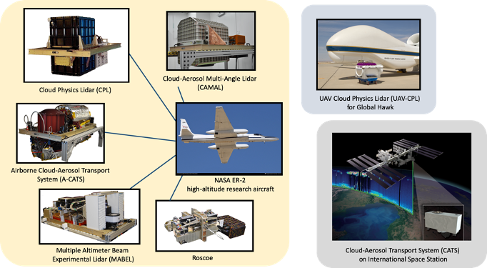
Airborne Lidar Suite at GSFC
Since 1999 multiple autonomous instruments have been built by our lidar group at GSFC photon-counting/high rep-rate designs
Designed primarily for NASA high-altitude aircraft (ER-2, WB-57, Global Hawk) – now Gulfstreams as well
Utilize high repetition rate, photon counting technique
Led to the development of the Cloud Aerosol Transport System (CATS) technology demonstration on the ISS

Slide 3
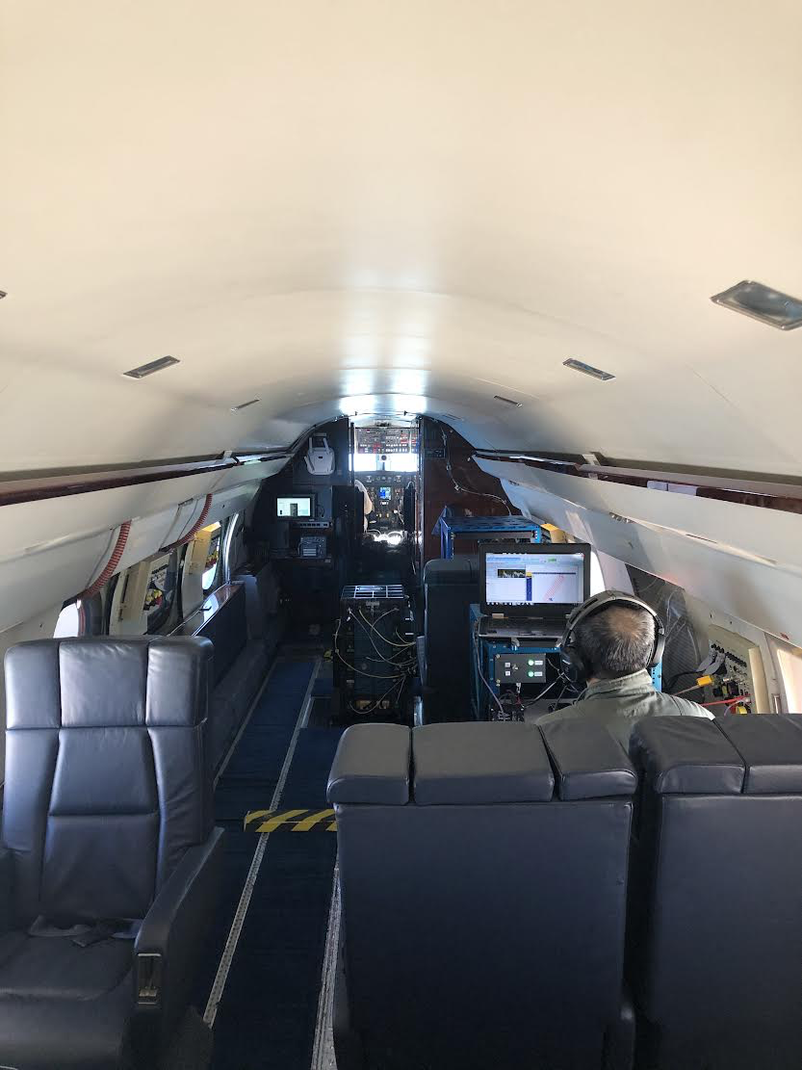
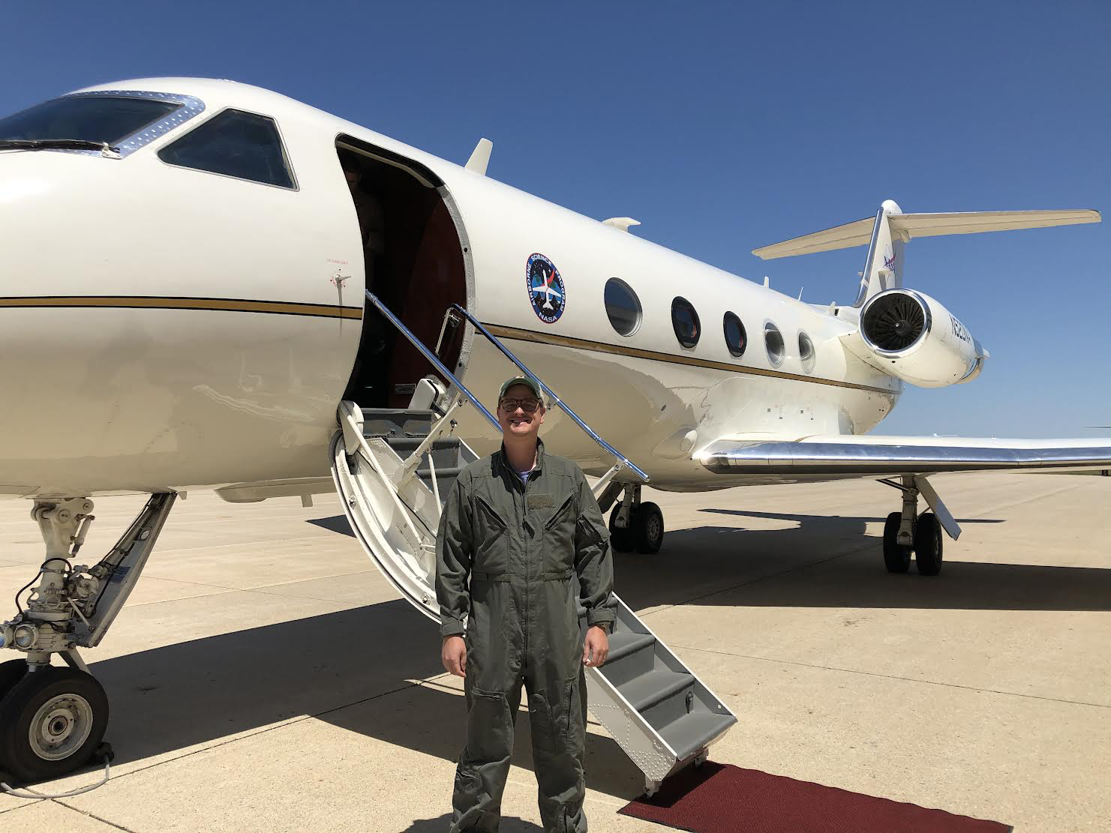
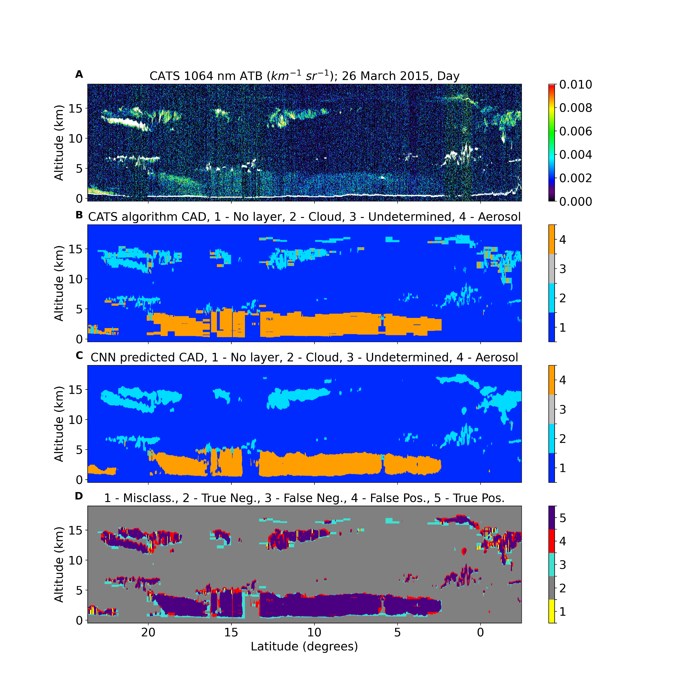
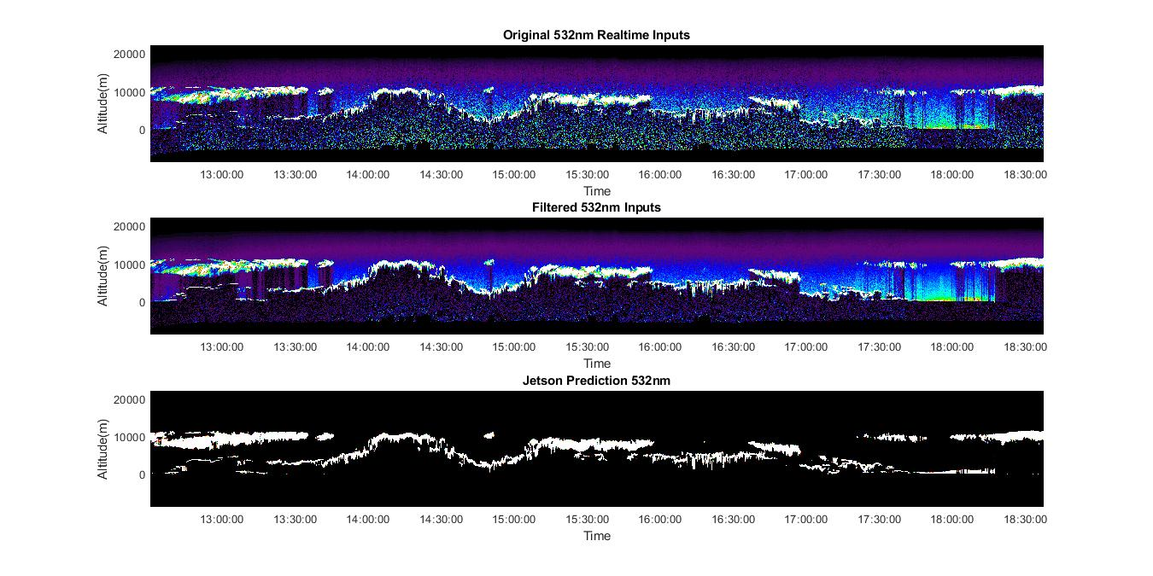
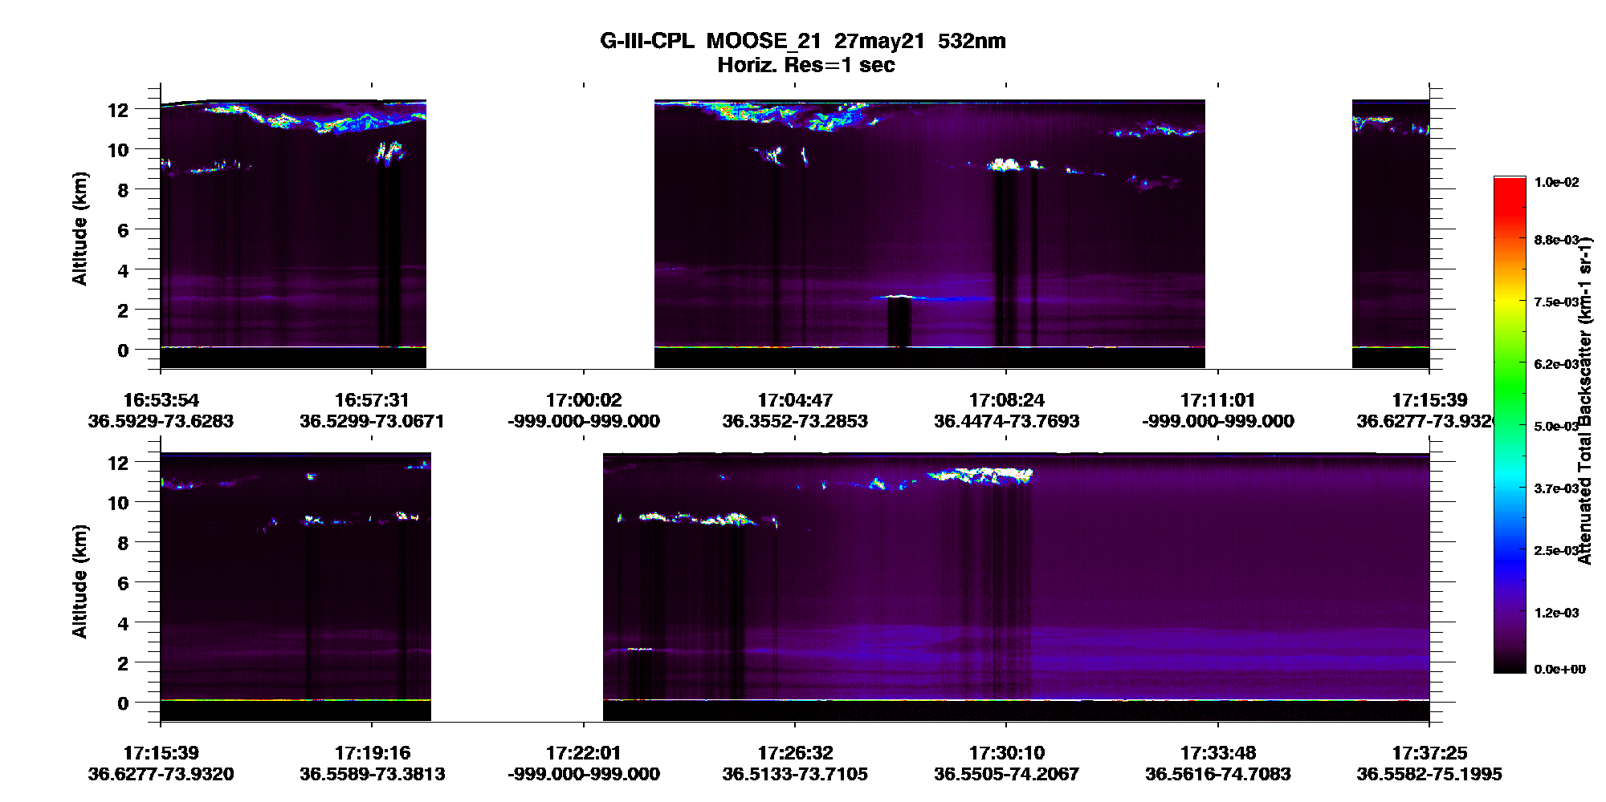
What’s new with CPL?
Integrated on G-III
Real-Time Data Products
CPL flew on the NASA G-III (LaRC) in the summer of 2021 as part of the Michigan-Ontario Ozone Source Experiment
As part of review process, also cleared to fly on the NASA G-V (JSC)
CPL now employs a Jetson TX-2 GPU that applies signal denoising and convolutional neural network techniques developed on CATS data described in Yorks et al., 2021 for real time data products
Provides data in real time for flight plan adjustments/coordination
350 m
Raw Data
60 km
Denoised Raw Data
350 m
Feature Classification

Slide 4
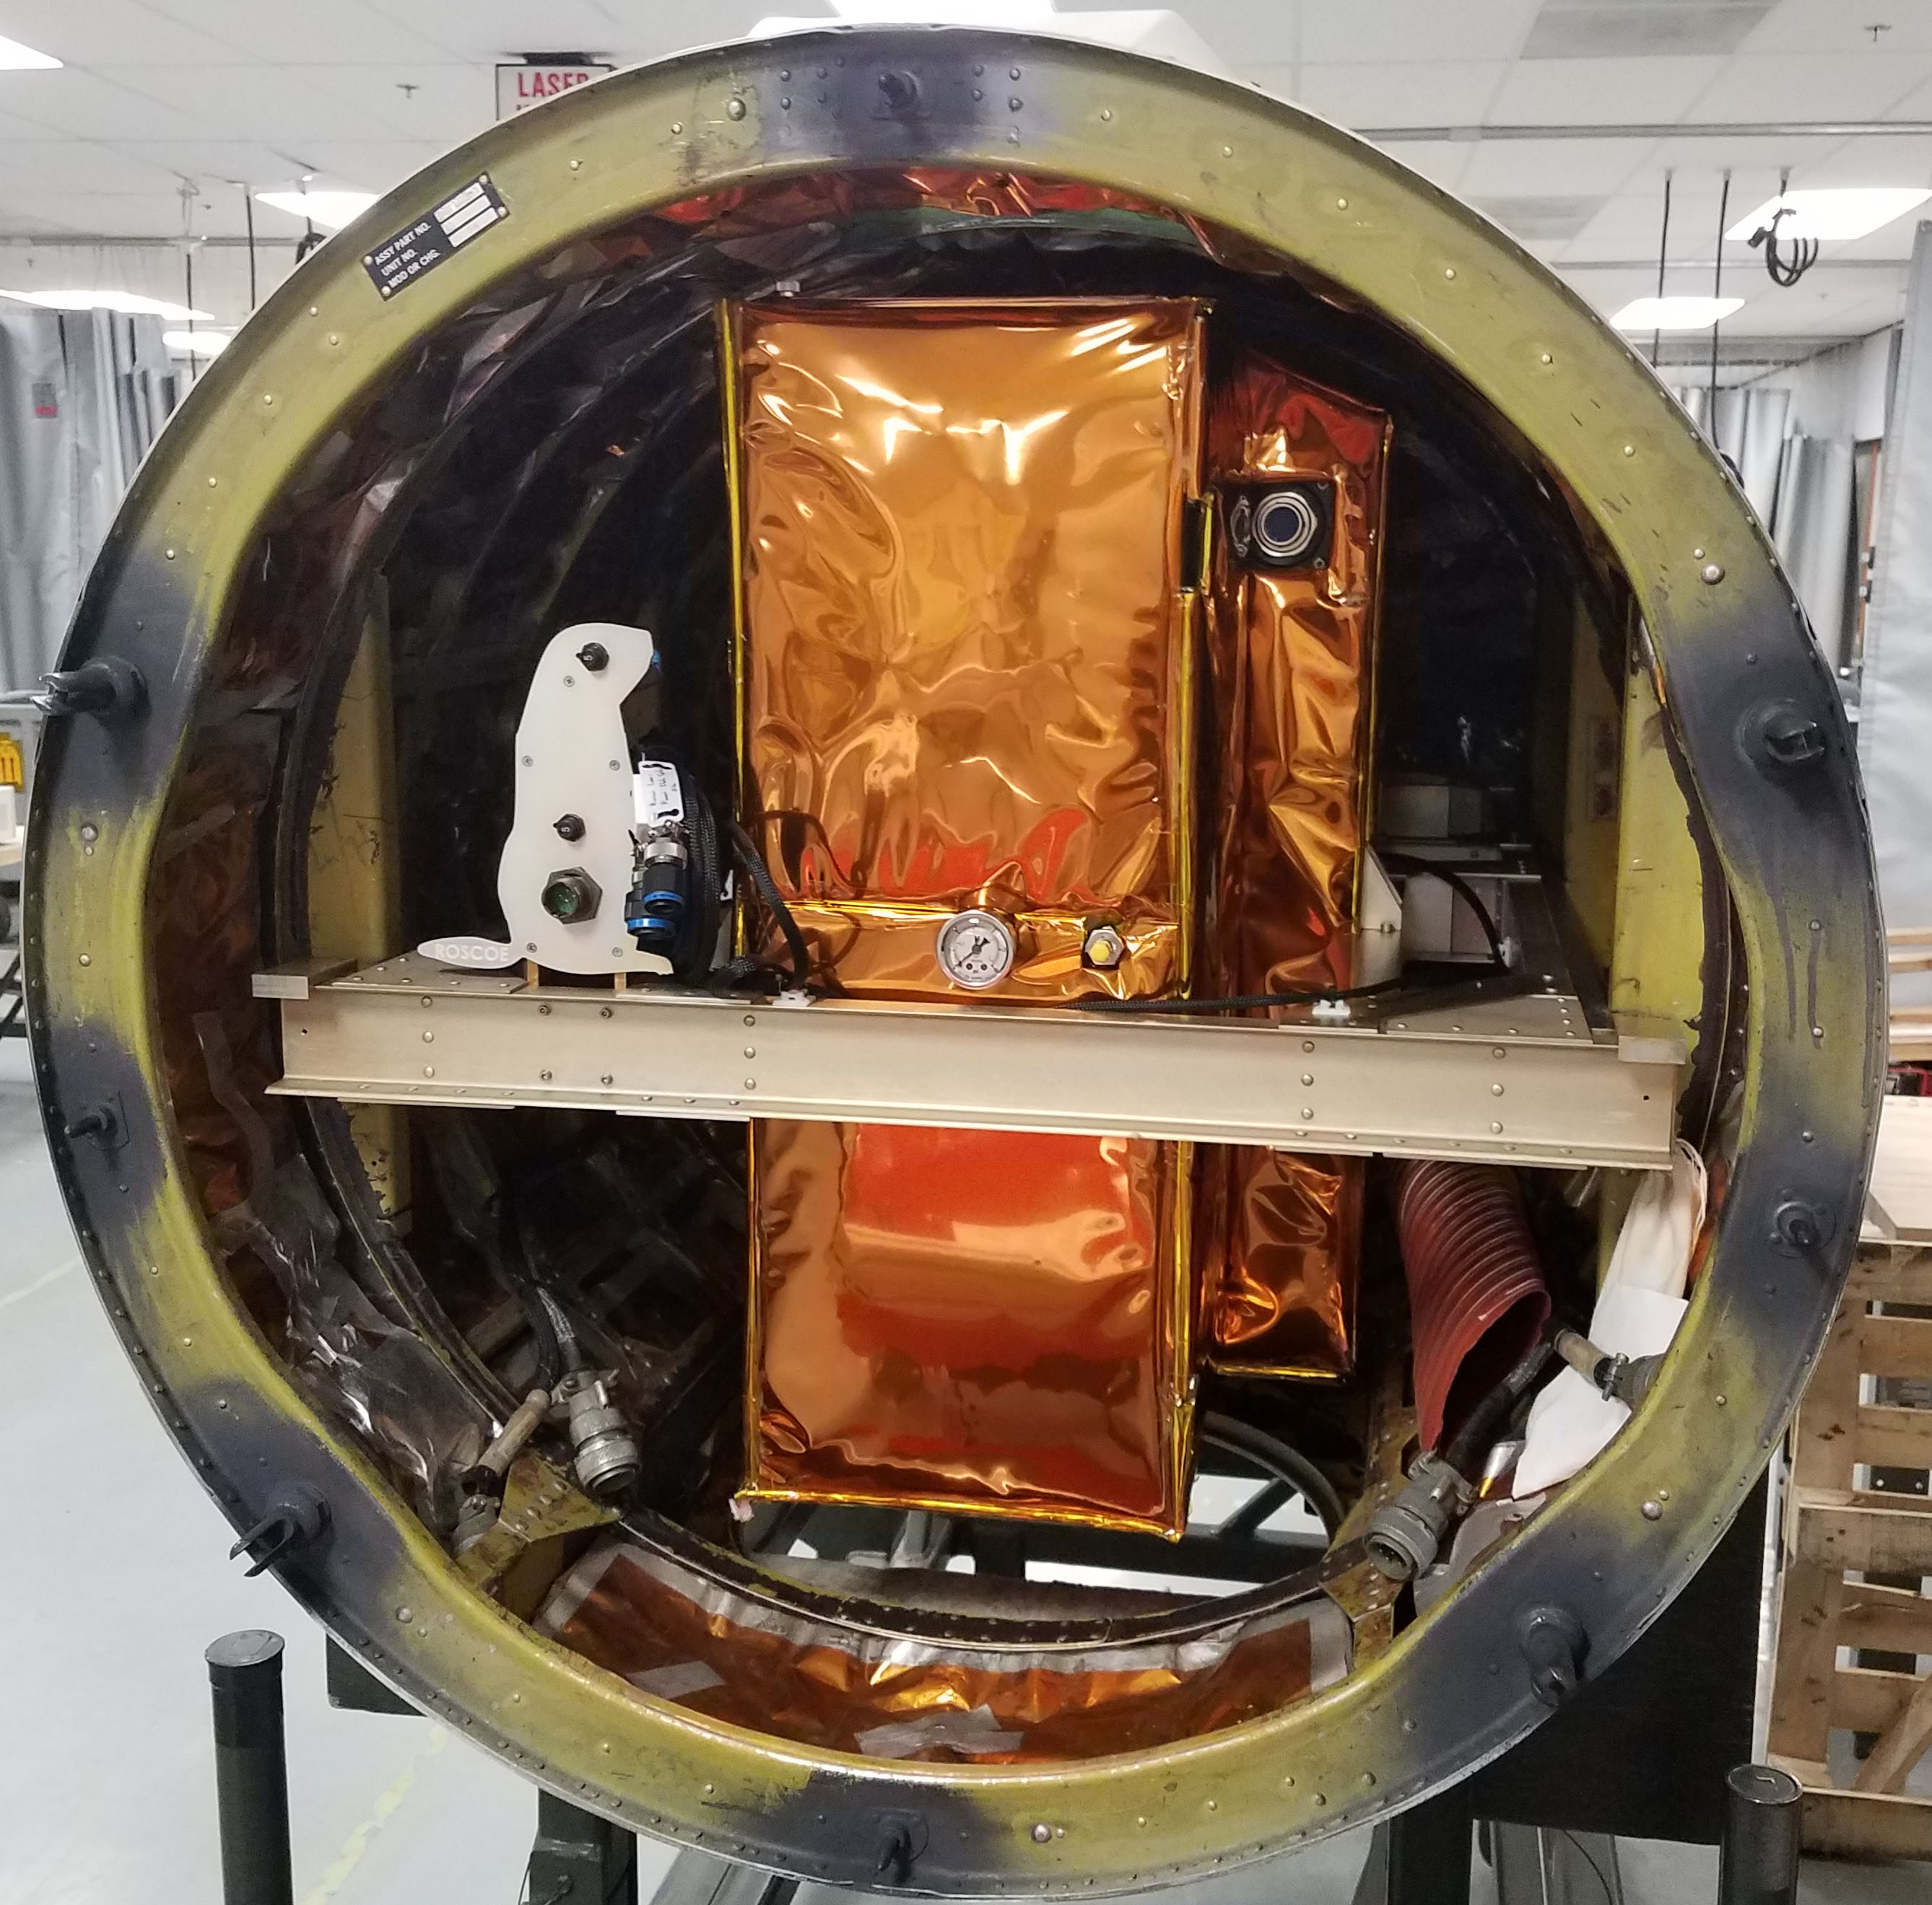
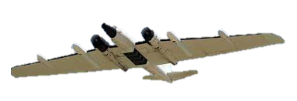
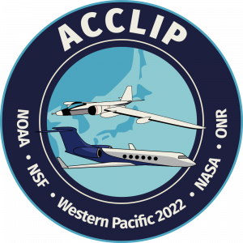

What’s Roscoe?
Roscoe is a new airborne lidar that has heritage from GSFC’s Cloud Physics Lidar (CPL)
What’s the difference?
  CPL – Downward looking with attenuated backscatter measurements at 355, 532, and 1064 nm with polarization sensitivity at 1064 nm
  Roscoe – Upward and downward looking attenuated backscatter measurements at 355 and 1064 nm with polarization sensitivity in all wavelengths and directions. Enables UTLS aerosol/cloud measurements while mitigating eye safety concerns (no visible).
Provides the same data and real-time products as CPL
The 2021 ACCLIP Test Flights were the first for Roscoe on the WB-57. Engineering flights on the ER-2 were performed pre-pandemic.

Slide 5

Maiden Test Flights Along with CPL on the ER-2
First test flights on the ER-2 in October 2019
Roscoe 1064 nm [ km⁻¹ sr⁻¹]
CPL 1064 nm [km⁻¹ sr⁻¹]
12 km
12 km
12 km
0.05
8 km
8 km
8 km
0.025
4 km
4 km
4 km
0 km
0 km
0 km
0.00

Slide 6
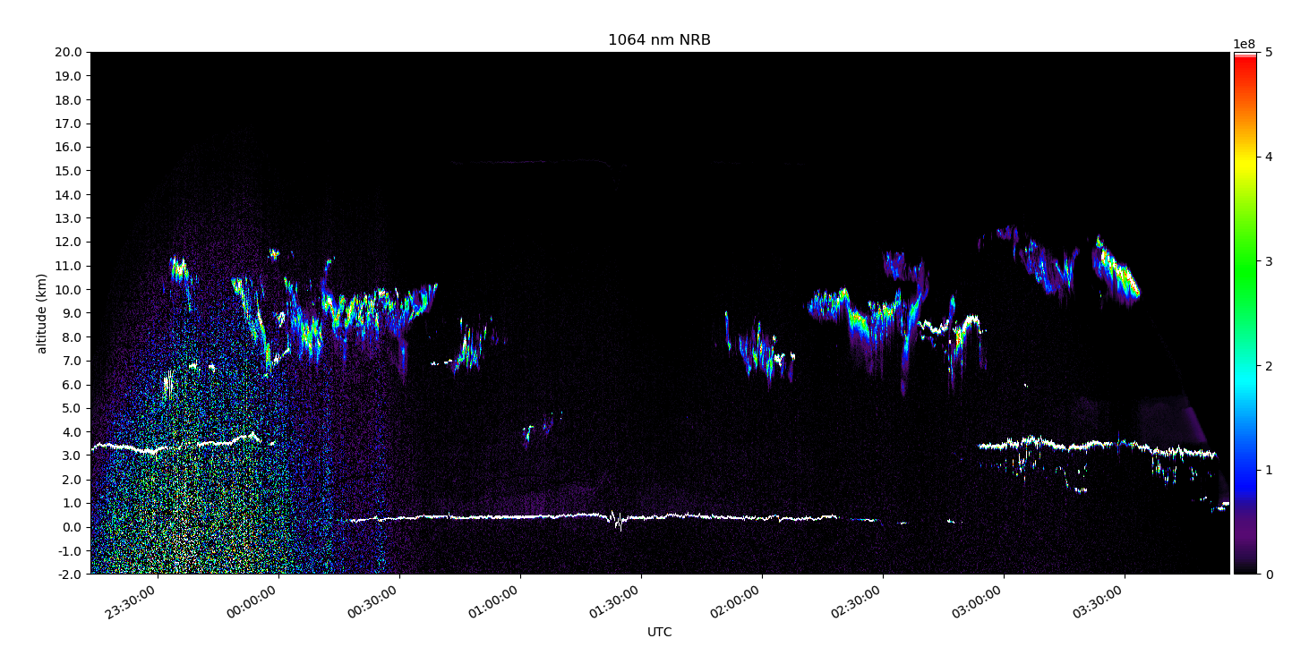
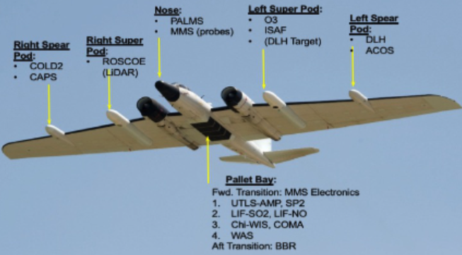
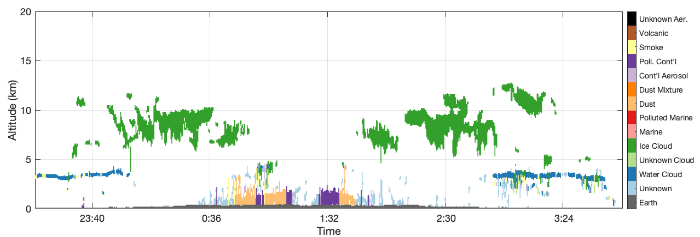
ACCLIP and SABRE Results
Participated in SABRE test flights (Feb 2022) and ACCLIP Field Campaign (summer 2022)
Existing CPL processing algorithms working well with Roscoe data
Still refining the feature typing algorithm but successful first series of campaigns

Slide 7
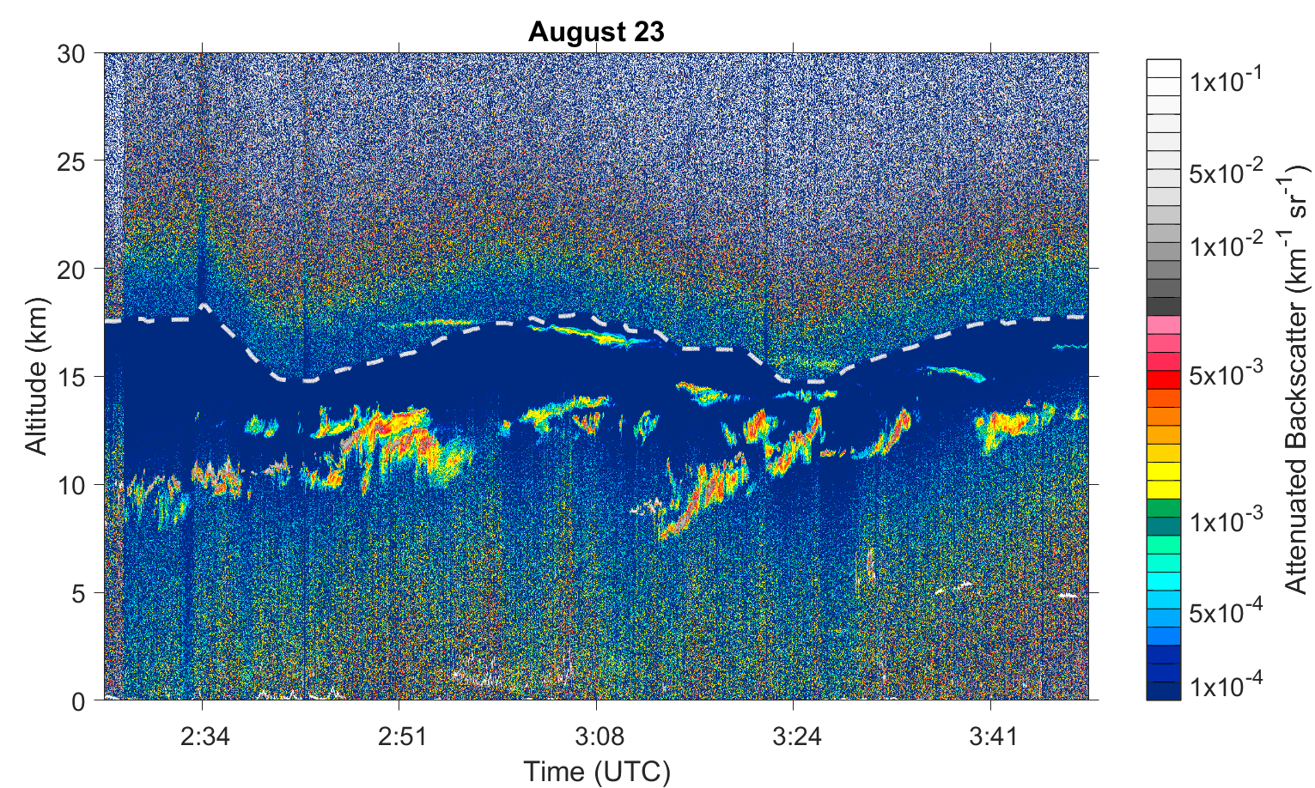
More ACCLIP Results
Great opportunities to test the upward and downward channels
Enables lidar measurements on single airborne platform deployments that utilize both remote sensing and in situ instruments

Slide 8
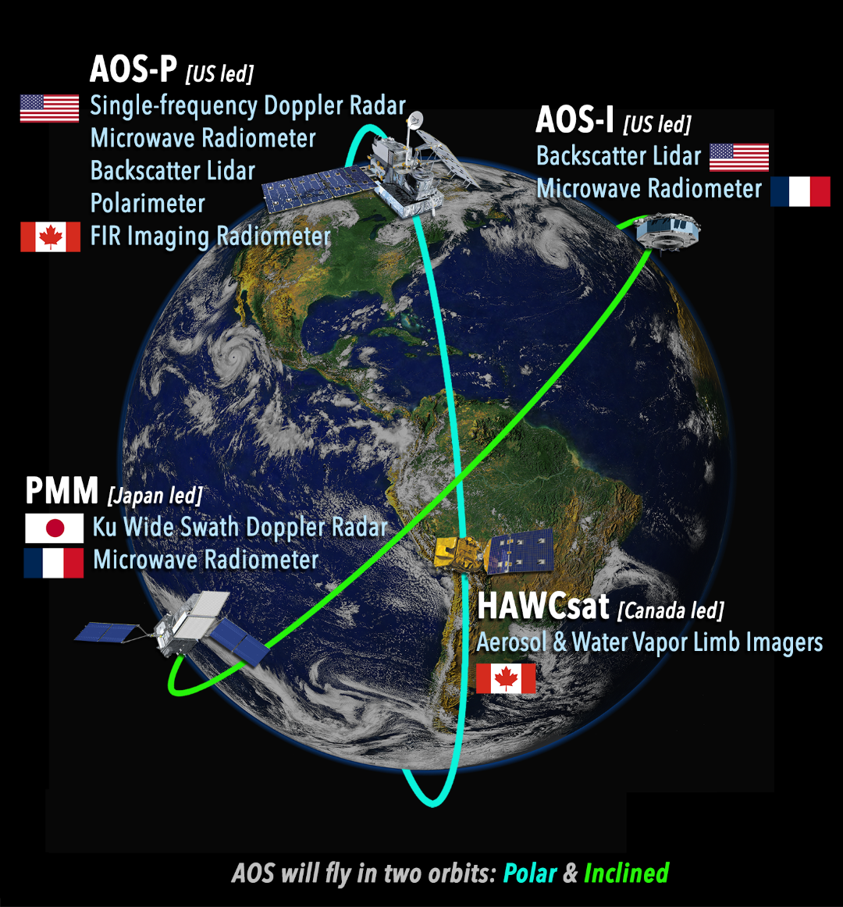

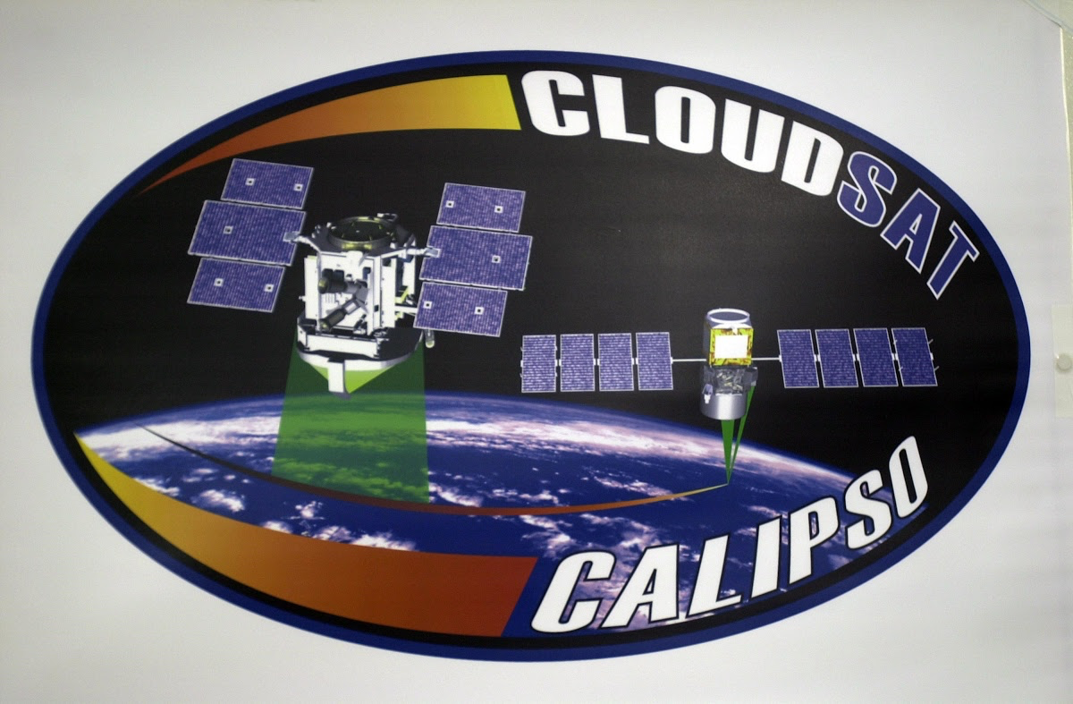

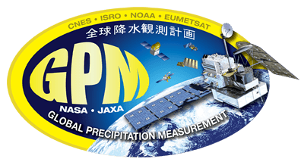
Beyond Airborne Work – ALICAT for AOS
ALICAT:
Provides vertical profiles of total and perpendicular attenuated backscatter at 532 and 1064 nm to identify clouds, aerosols, as well as their phase and type
Provides a new exciting opportunity for synergistic products in an inclined orbit (e.g. Ku radar+radiometer+lidar products) not possible with CALIPSO or CATS
Will deliver near-real time (<6 hours) data products to the applications community
Leverages 20 years of lidar instrument heritage at NASA GSFC, including the Cloud Aerosol Transport System (CATS) that flew on the ISS from 2015-2017 – building and testing it now
Offers early science delivery for AOS by launching later this decade (2029)
2019
2023
2027
2031
CloudSat/CALIPSO
AOS-P
GPM
AOS-I
INCUS

Slide 9
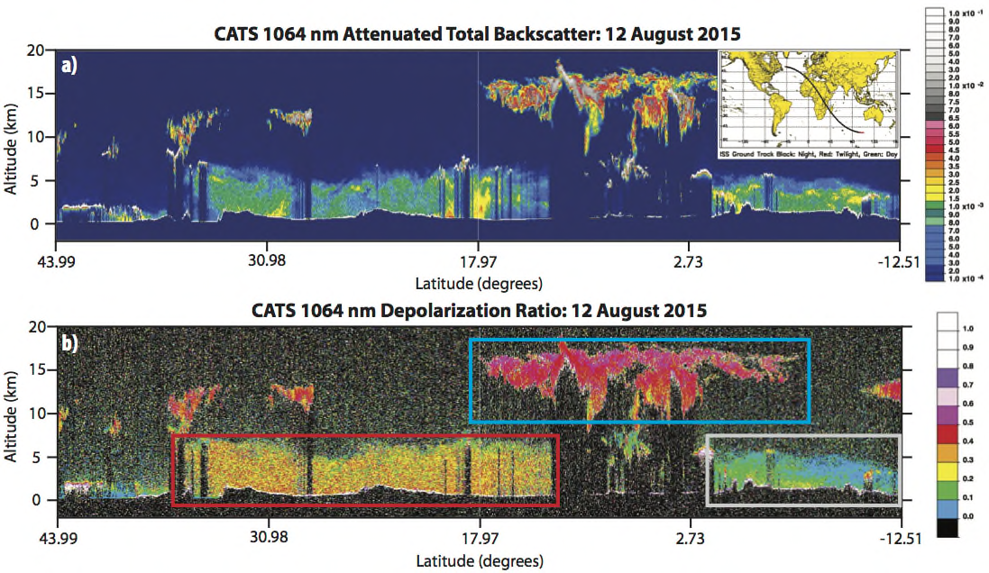
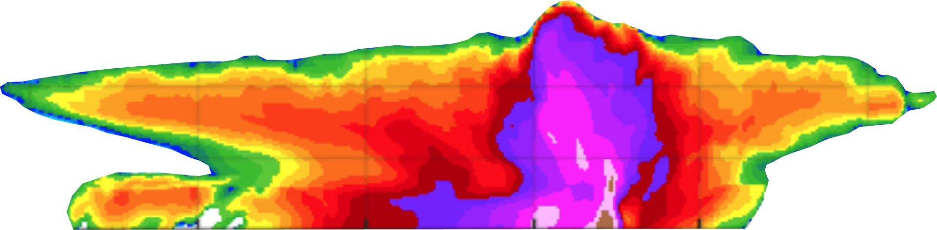
Central AOS Science Addressed by ALICAT
AOS is a process-focused mission with lidars and radars as centerpieces to provide critical vertical measurements of aerosols, clouds, and precipitation – and their diurnal variability
Objective 2: High Clouds
Measurements of thin high clouds, especially in the presence of convection
Objective 3: Convective Storms
Detection of environmental aerosols in the presence of convection
Objective 5: Aerosol Attribution/Air-Quality
Measurements of optically thick dust, smoke, and anthropogenic aerosols in source regions above and within the PBL
Dust
Objective 6: Aerosol Removal & Redistribution
Synergistic observations of aerosols and convective precipitation/vertical motions
Smoke
ALICAT’s strengths are detection and quantification of optically thin high clouds and dust/smoke aerosols, all features with diurnal variability

Slide 10
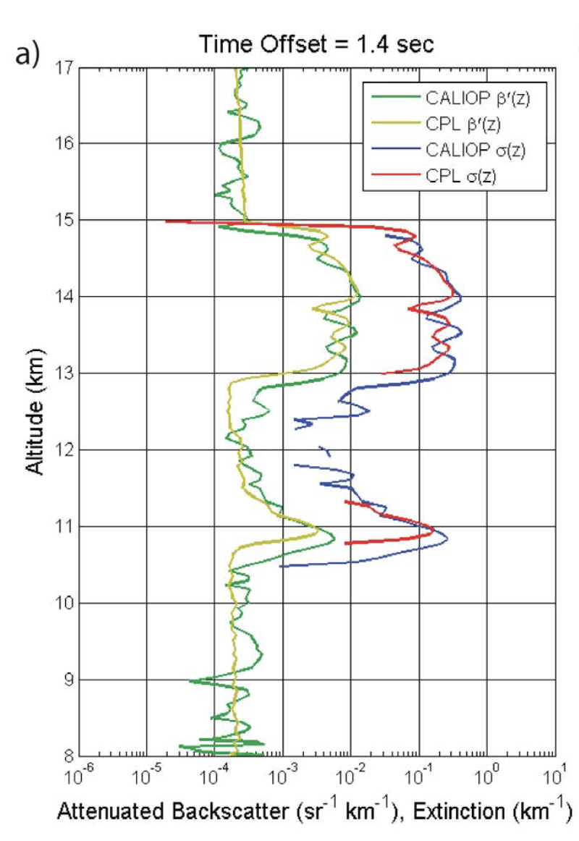
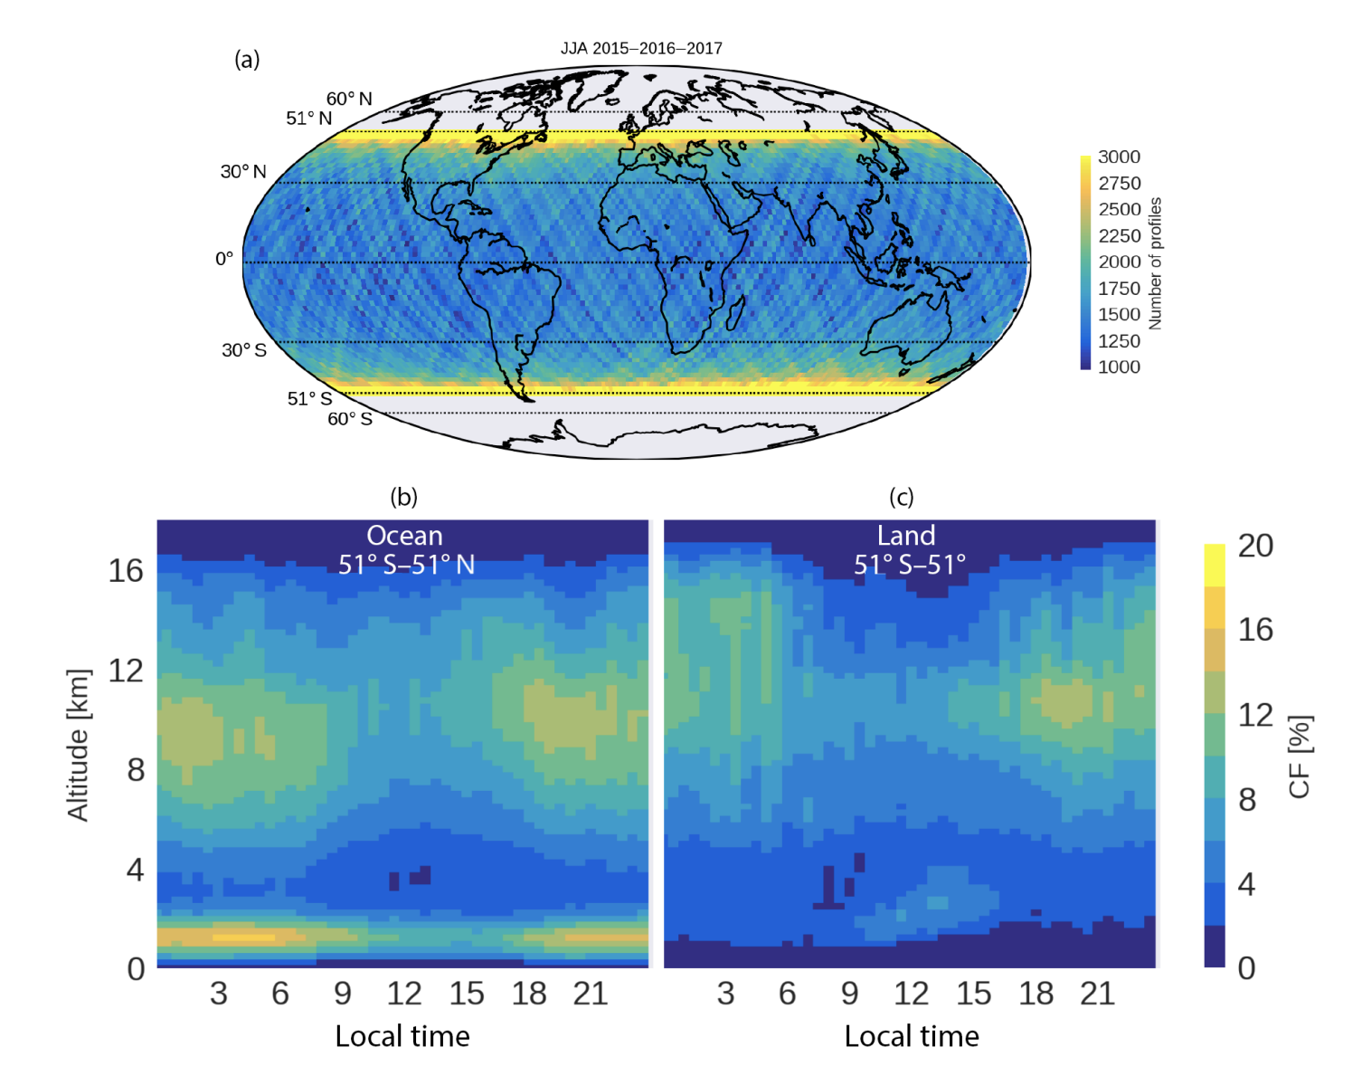

ALICAT Science: Cirrus Clouds
CALIPSO has provided cloud measurements for 16 years in a sun-sync orbit
CATS provided diurnal measurements of clouds with a single wavelength, but was a tech demo without science requirements
ALICAT offers improved SNR compared to CATS and an opportunity to provide CALIPSO quality measurements with an added time dimension in an affordable package
AOS-I matches ALICAT with microwave radiometers and a Ku radar for diurnal sampling of convective processes
CALIPSO Cirrus Validation of Cloud Measurements using Airborne CPL
Diurnal Cycle of Clouds Observed by CATS Tech Demo (2015-2017)
Hlavka et al., 2012
Noel et al., 2018

Slide 11
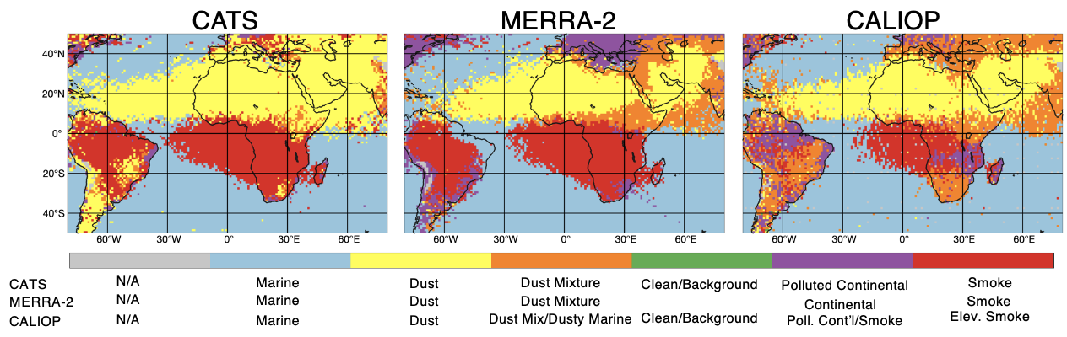
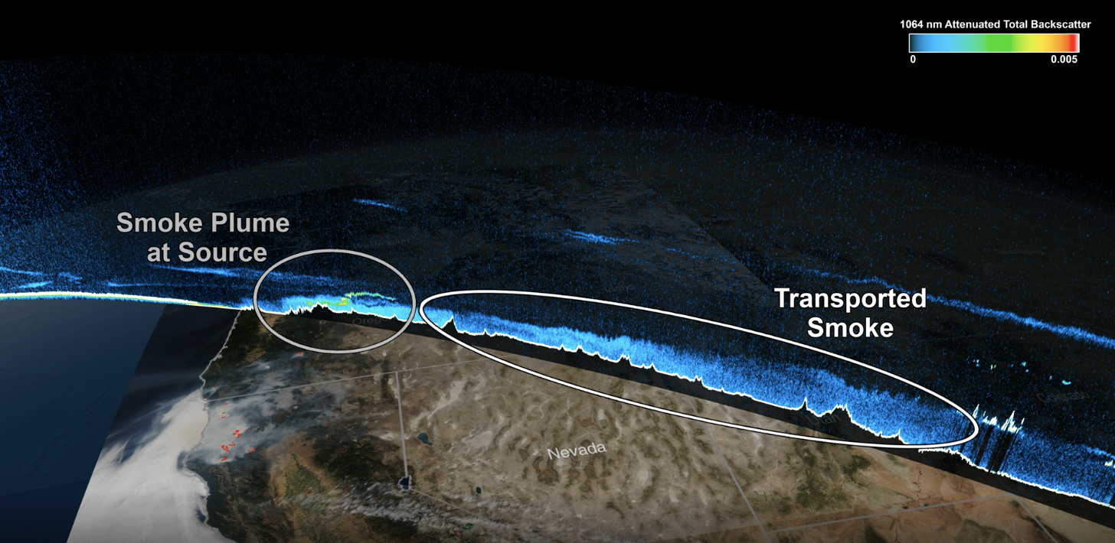
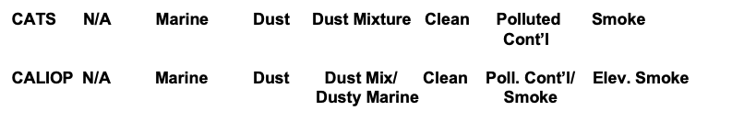
ALICAT Science: Aerosols
Dust and smoke aerosols exhibit diurnal cycles that typically correspond to enhanced burning during daytime hours*
Smoke interacts with the evolution of the planetary boundary layer and has implications for the diurnal cycle of convection** - important for smoke transport forecasting in current models***
CATS V3 2015-2017
Diurnal Variability of Smoke Aerosols Observed by CATS over Borneo
Smoke from Oregon: Implications for Transport and Air Quality Observed by CATS
CALIPSO V4.20 2015-2017
* Hyer et al., 2013
** Zhang and Zuidema, 2019; Hodzik and Duvell, 2017
*** Ye et al., 2021

Slide 12
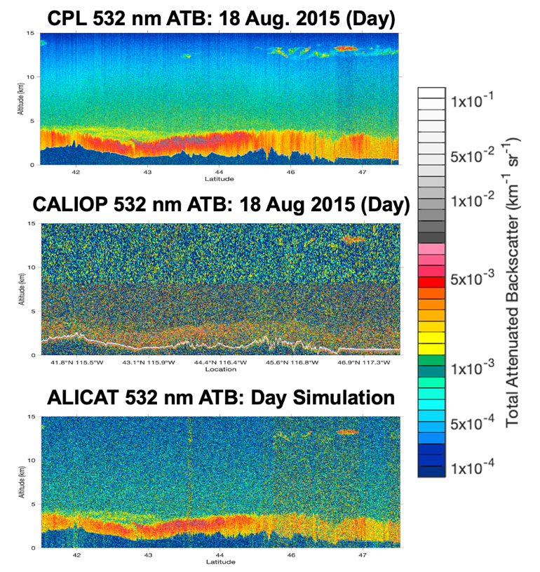
ALICAT Daytime Performance
ALICAT daytime 532 nm ATB (bottom) demonstrates that the daytime SNR and detection capabilities are better than CALIOP (middle)
CPL data from the NASA ER-2 aircraft (top panel) and CALIOP (middle panel) during a validation flight on 18 August 2015 over the western US. ALICAT ATB (bottom) simulated for day using the airborne lidar data as input.

Slide 13
Opportunities for Future Collaboration
Airborne:
  Planned NASA ER-2 mission using CPL in the fall 2024 out of Palmdale, California – underpasses of EarthCARE?
  UTLS aerosol detection validation using Roscoe
  Future NASA EVS-4 opportunities (TBD) or joint field campaign activities (e.g. CPEX-AW; CPEX-CV)
Spaceborne:
  Leverage aerosol typing capability from ATLID and any planned validation efforts to help inform lidar ratio selection for ALICAT – more robust than simple algorithms that rely on ancillary information despite differences in wavelength

Slide 14
Backup

Slide 15
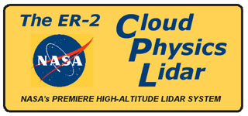

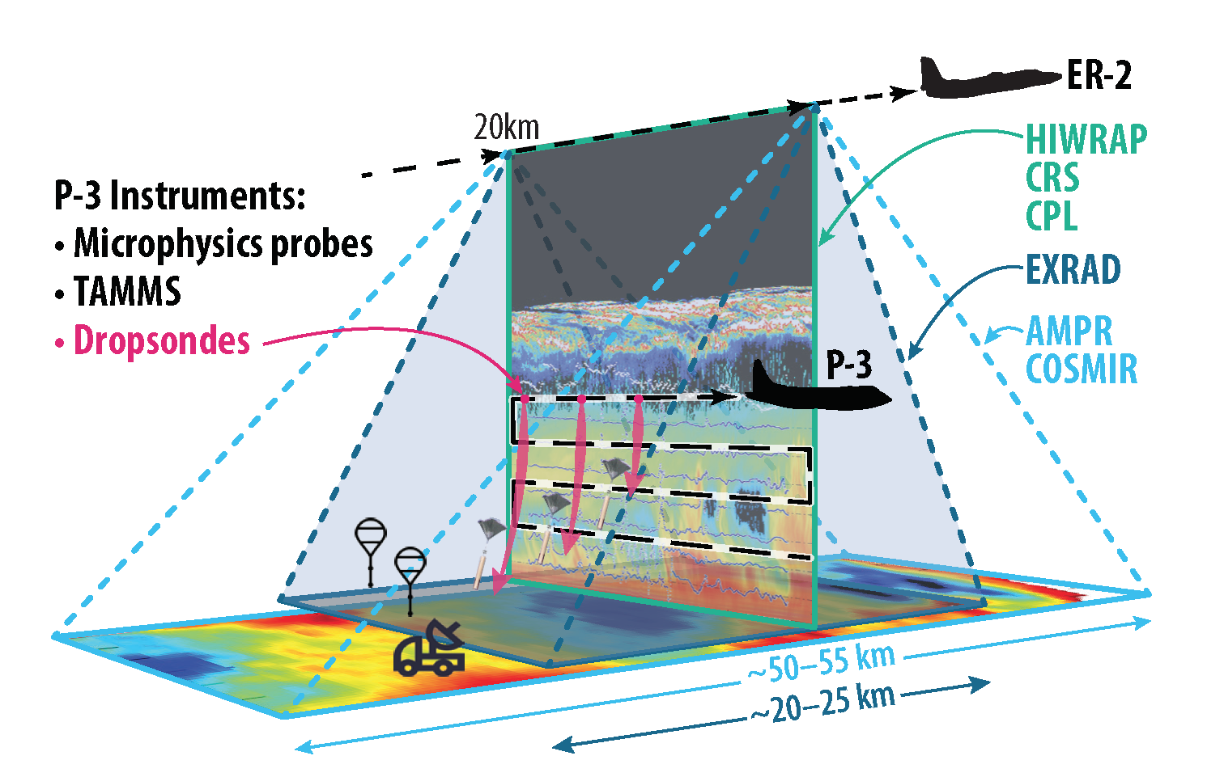
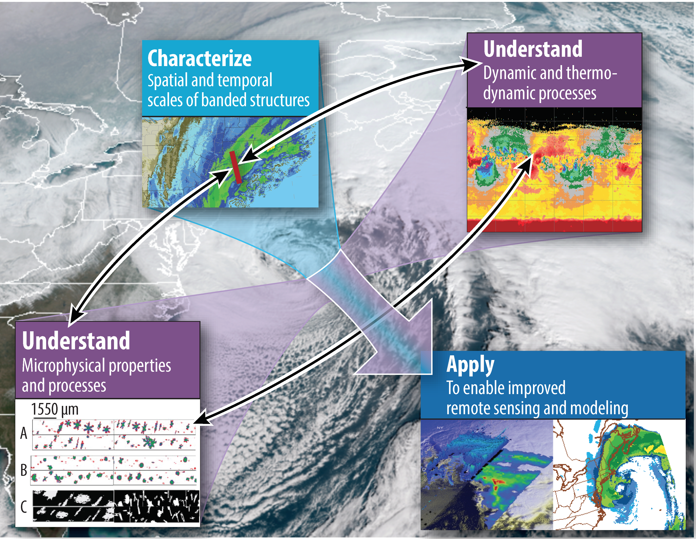
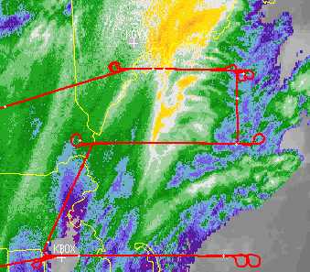
IMPACTS EVS-3 Field Deployment (2020-2023)
Deployments: Jan– Feb 2020, 2022, 2023
Aircraft on station time: 4 – 6 hours
Conducted 33 flights and over 150+ hours (21 coordinated flights) in 2020-2023 during strong winter storms, weaker storms, and clippers.
29 Jan

Slide 16
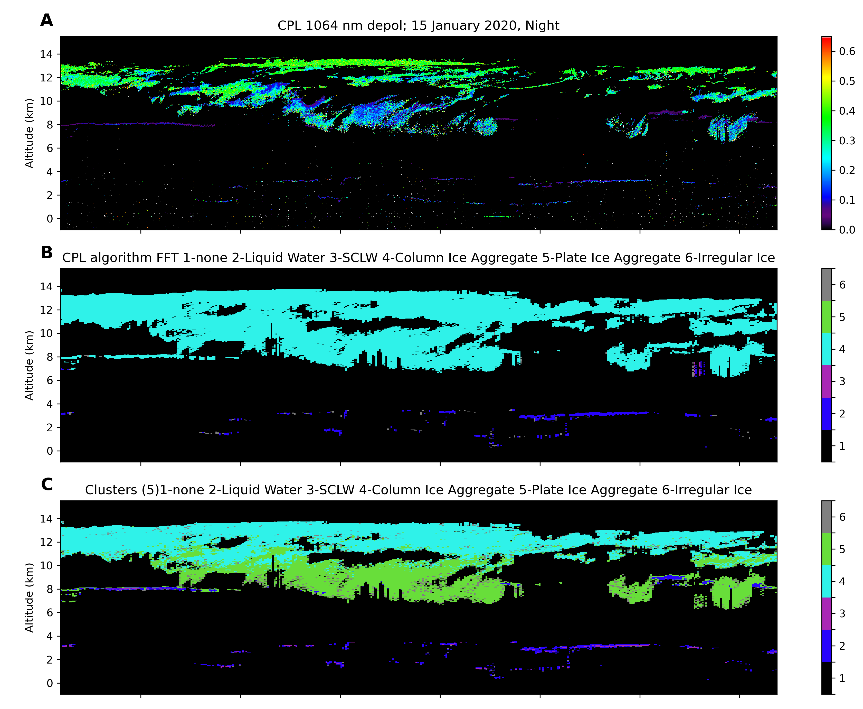
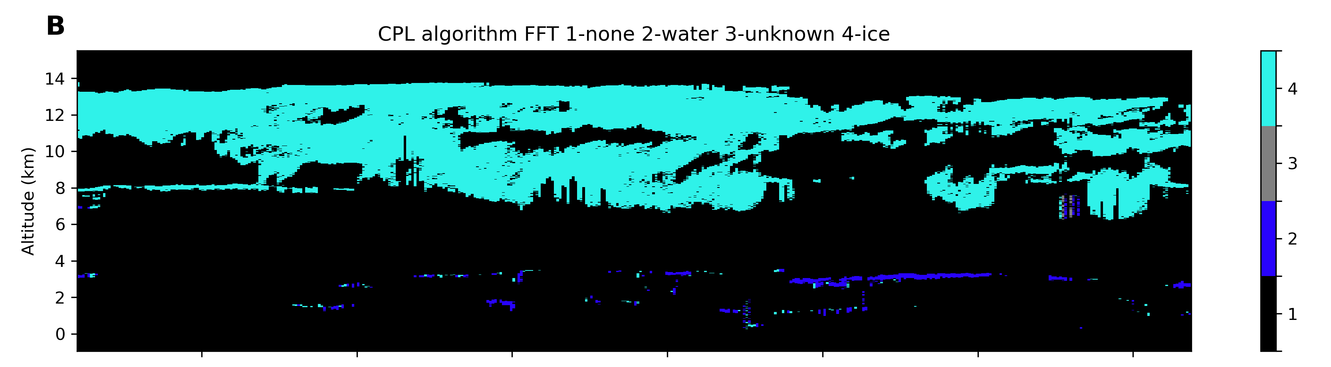
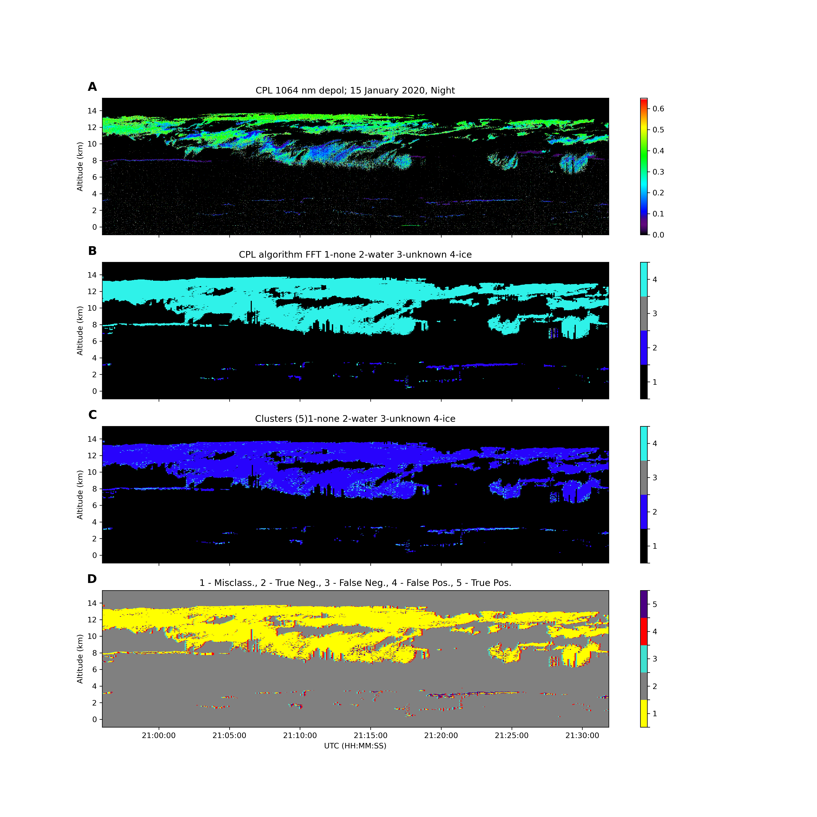
Cloud Phase & Habit Type using CPL during IMPACTS
Hierarchical clustering technique to enable finer cloud particle phase/type classifications with improved vertical resolution and create a training dataset for a CNN model
Uses BSL depol. ratio, temperature, and altitude of each bin
5 clusters of potential particle phases/types: column aggregates, plate aggregates, irregular/other ice, SCLW, warm liquid water (C, right)
Particle phases/types are assigned based on literature and/or collocated in situ data from P-3 aircraft during IMPACTS field campaign flights.
Current cloud phase algorithms classify phase on a cloud “layer” basis for each profile
This does NOT capture the vertical variability within a cloud
Clustering technique DOES capture this vertical variability
Cloud Top Phase w/ BSL
Cold
Columns
Rosettes
Plates
Spheriods
HOI
SCLW
Mixed
Phase
Temp
Noel et al. (2004) &
Lawson et al. (2006)
0 C
Liquid
Water
Cloud
Warm
Dust Aerosols
0.0
Depol
0.6
Ongoing work at NASA GSFC (Joe Finlon)

Slide 17

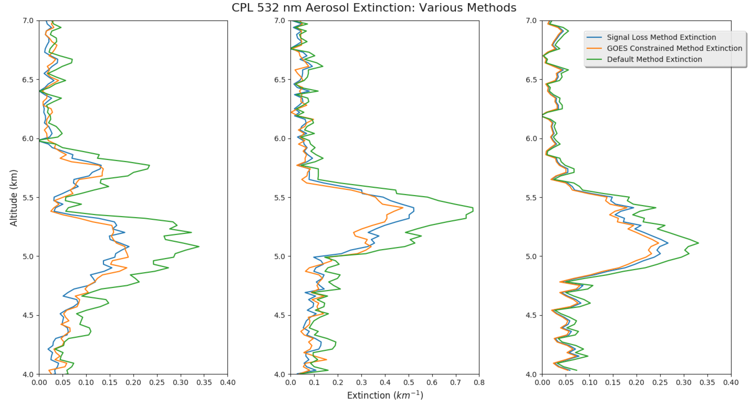
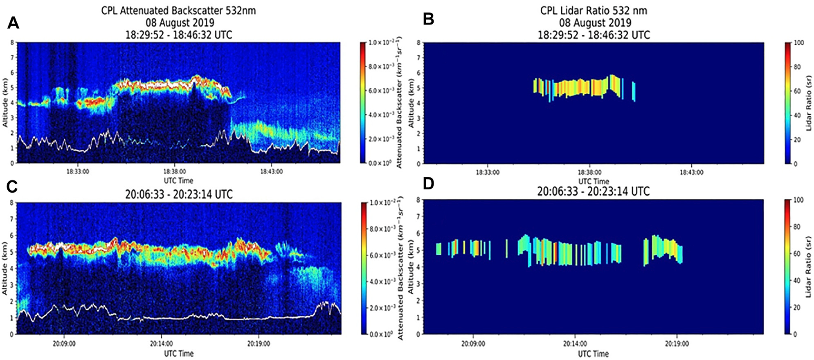
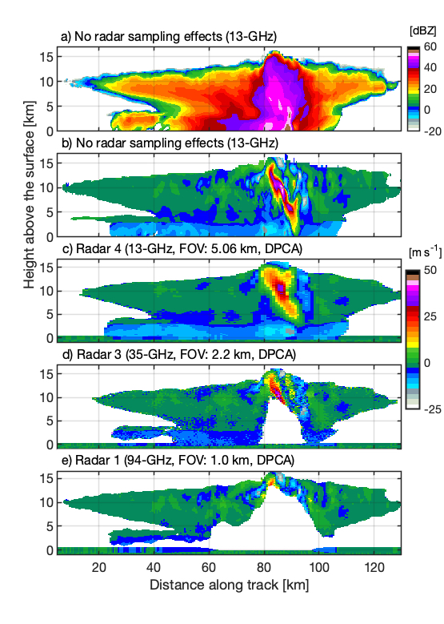

Improved Constrained Retrievals of Extinction
Signal Loss Method for Aerosol Layers
Constraints from Geostationary AOD
    Technique is traditionally restricted to clouds
      Results in an iterative, best-fit solution to measured two-way transmittance loss of signal through a transparent layer
    Integrated attenuated total backscatter is compared to the estimated integrated molecular signal in the clear air zone to calculate layer transmission
Uses the AOD from a passive aerosol sensor (i.e., MODIS, VIIRS, ABI, etc.) to retrieve a layer-average lidar ratio and thus more accurate extinction profile.
Midzak et al. (2022) shows errors <25%
Williams Flats Fire
Signal Loss Method
GOES Constrained
Unconstrained
CPL overpass of Williams Flats Fire on 08 August was collocated with GOES-R
AOD values from both sensors compare well
GOES: 0.59$±$0.09
CPL constrained: 0.59$±$0.66
CPL unconstrained: 0.81$±$0.62
Courtesy of
Natalie Midzak (UND)
Midzak et al. 2022 [Frontiers]

