Slide 1
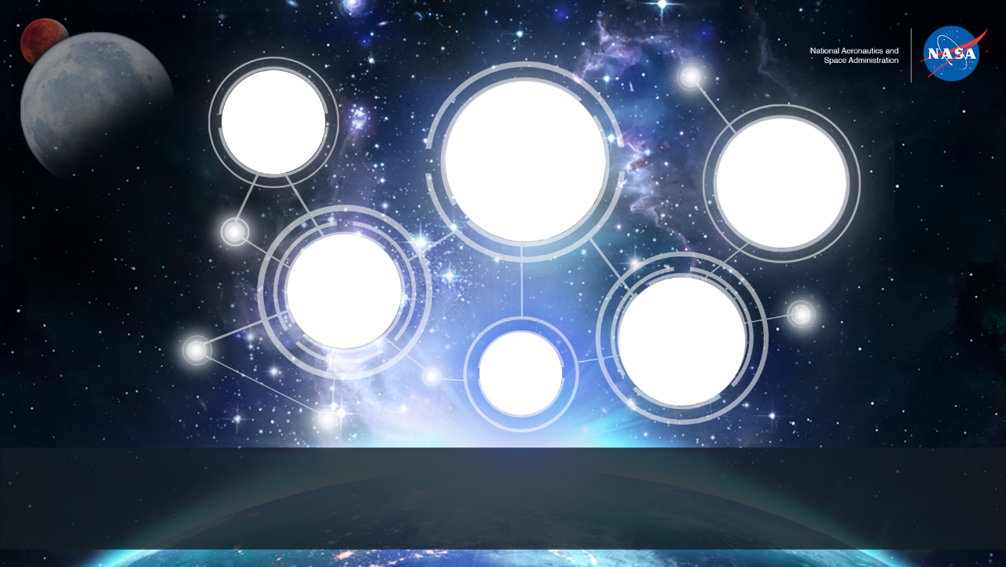
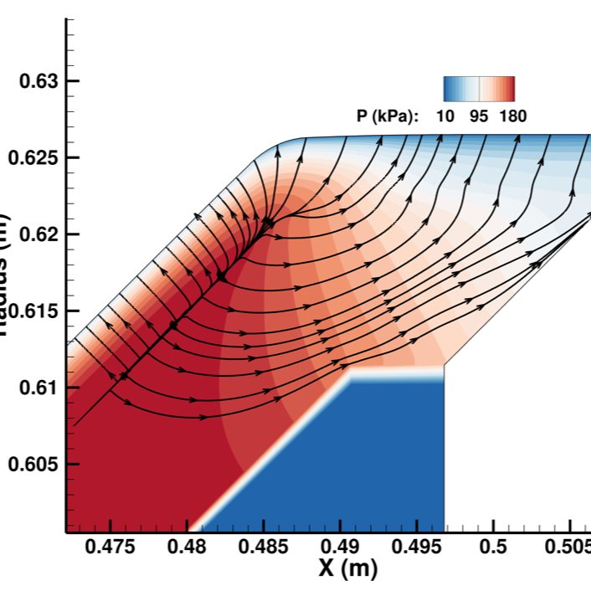
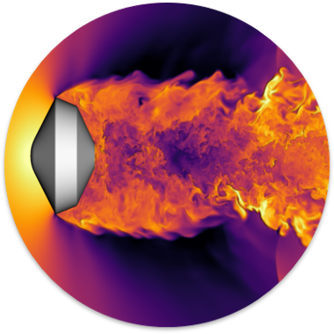
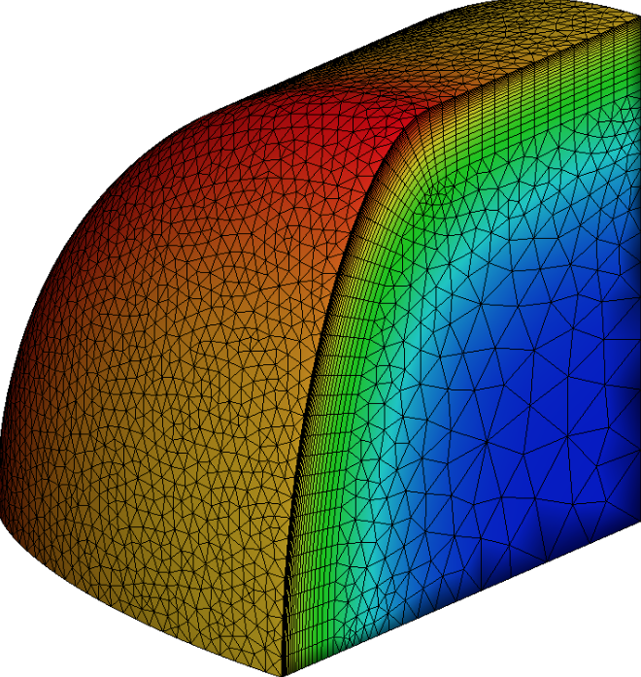
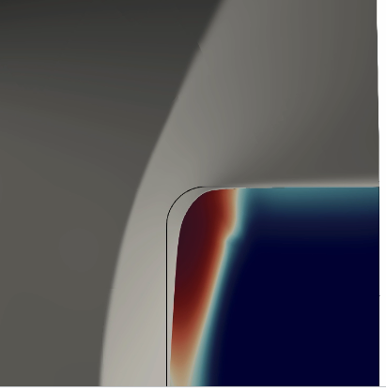
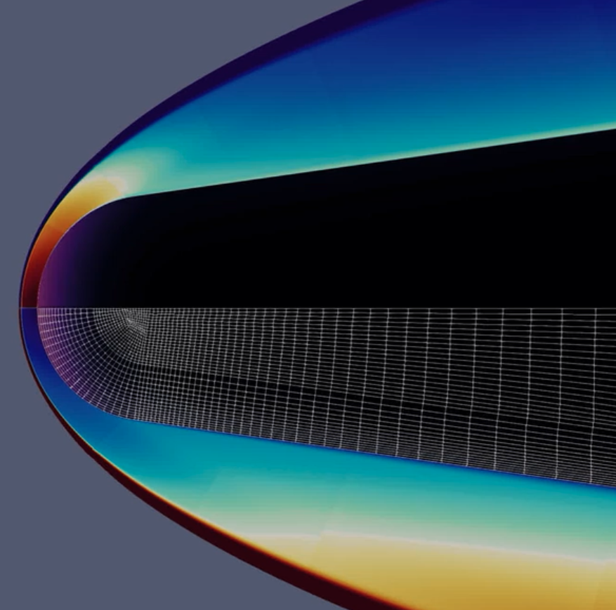
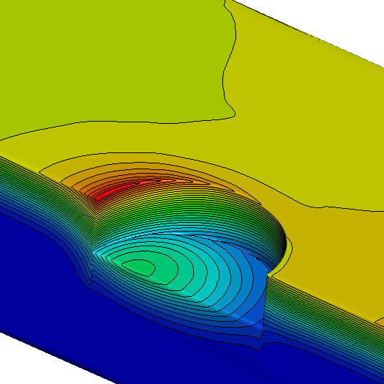
Developments to the Ares Multi-Physics Framework
Olivia Schroeder, Joseph Schulz, Georgios Bellas, Prakash Shrestha, Amal Sahai, Grant Palmer, Eric Stern | 13th Ablation Workshop | 11.06.23
olivia.schroeder@nasa.gov
Notes:
Probably need to cut stuff
Shoot for 15 minutes

Slide 2

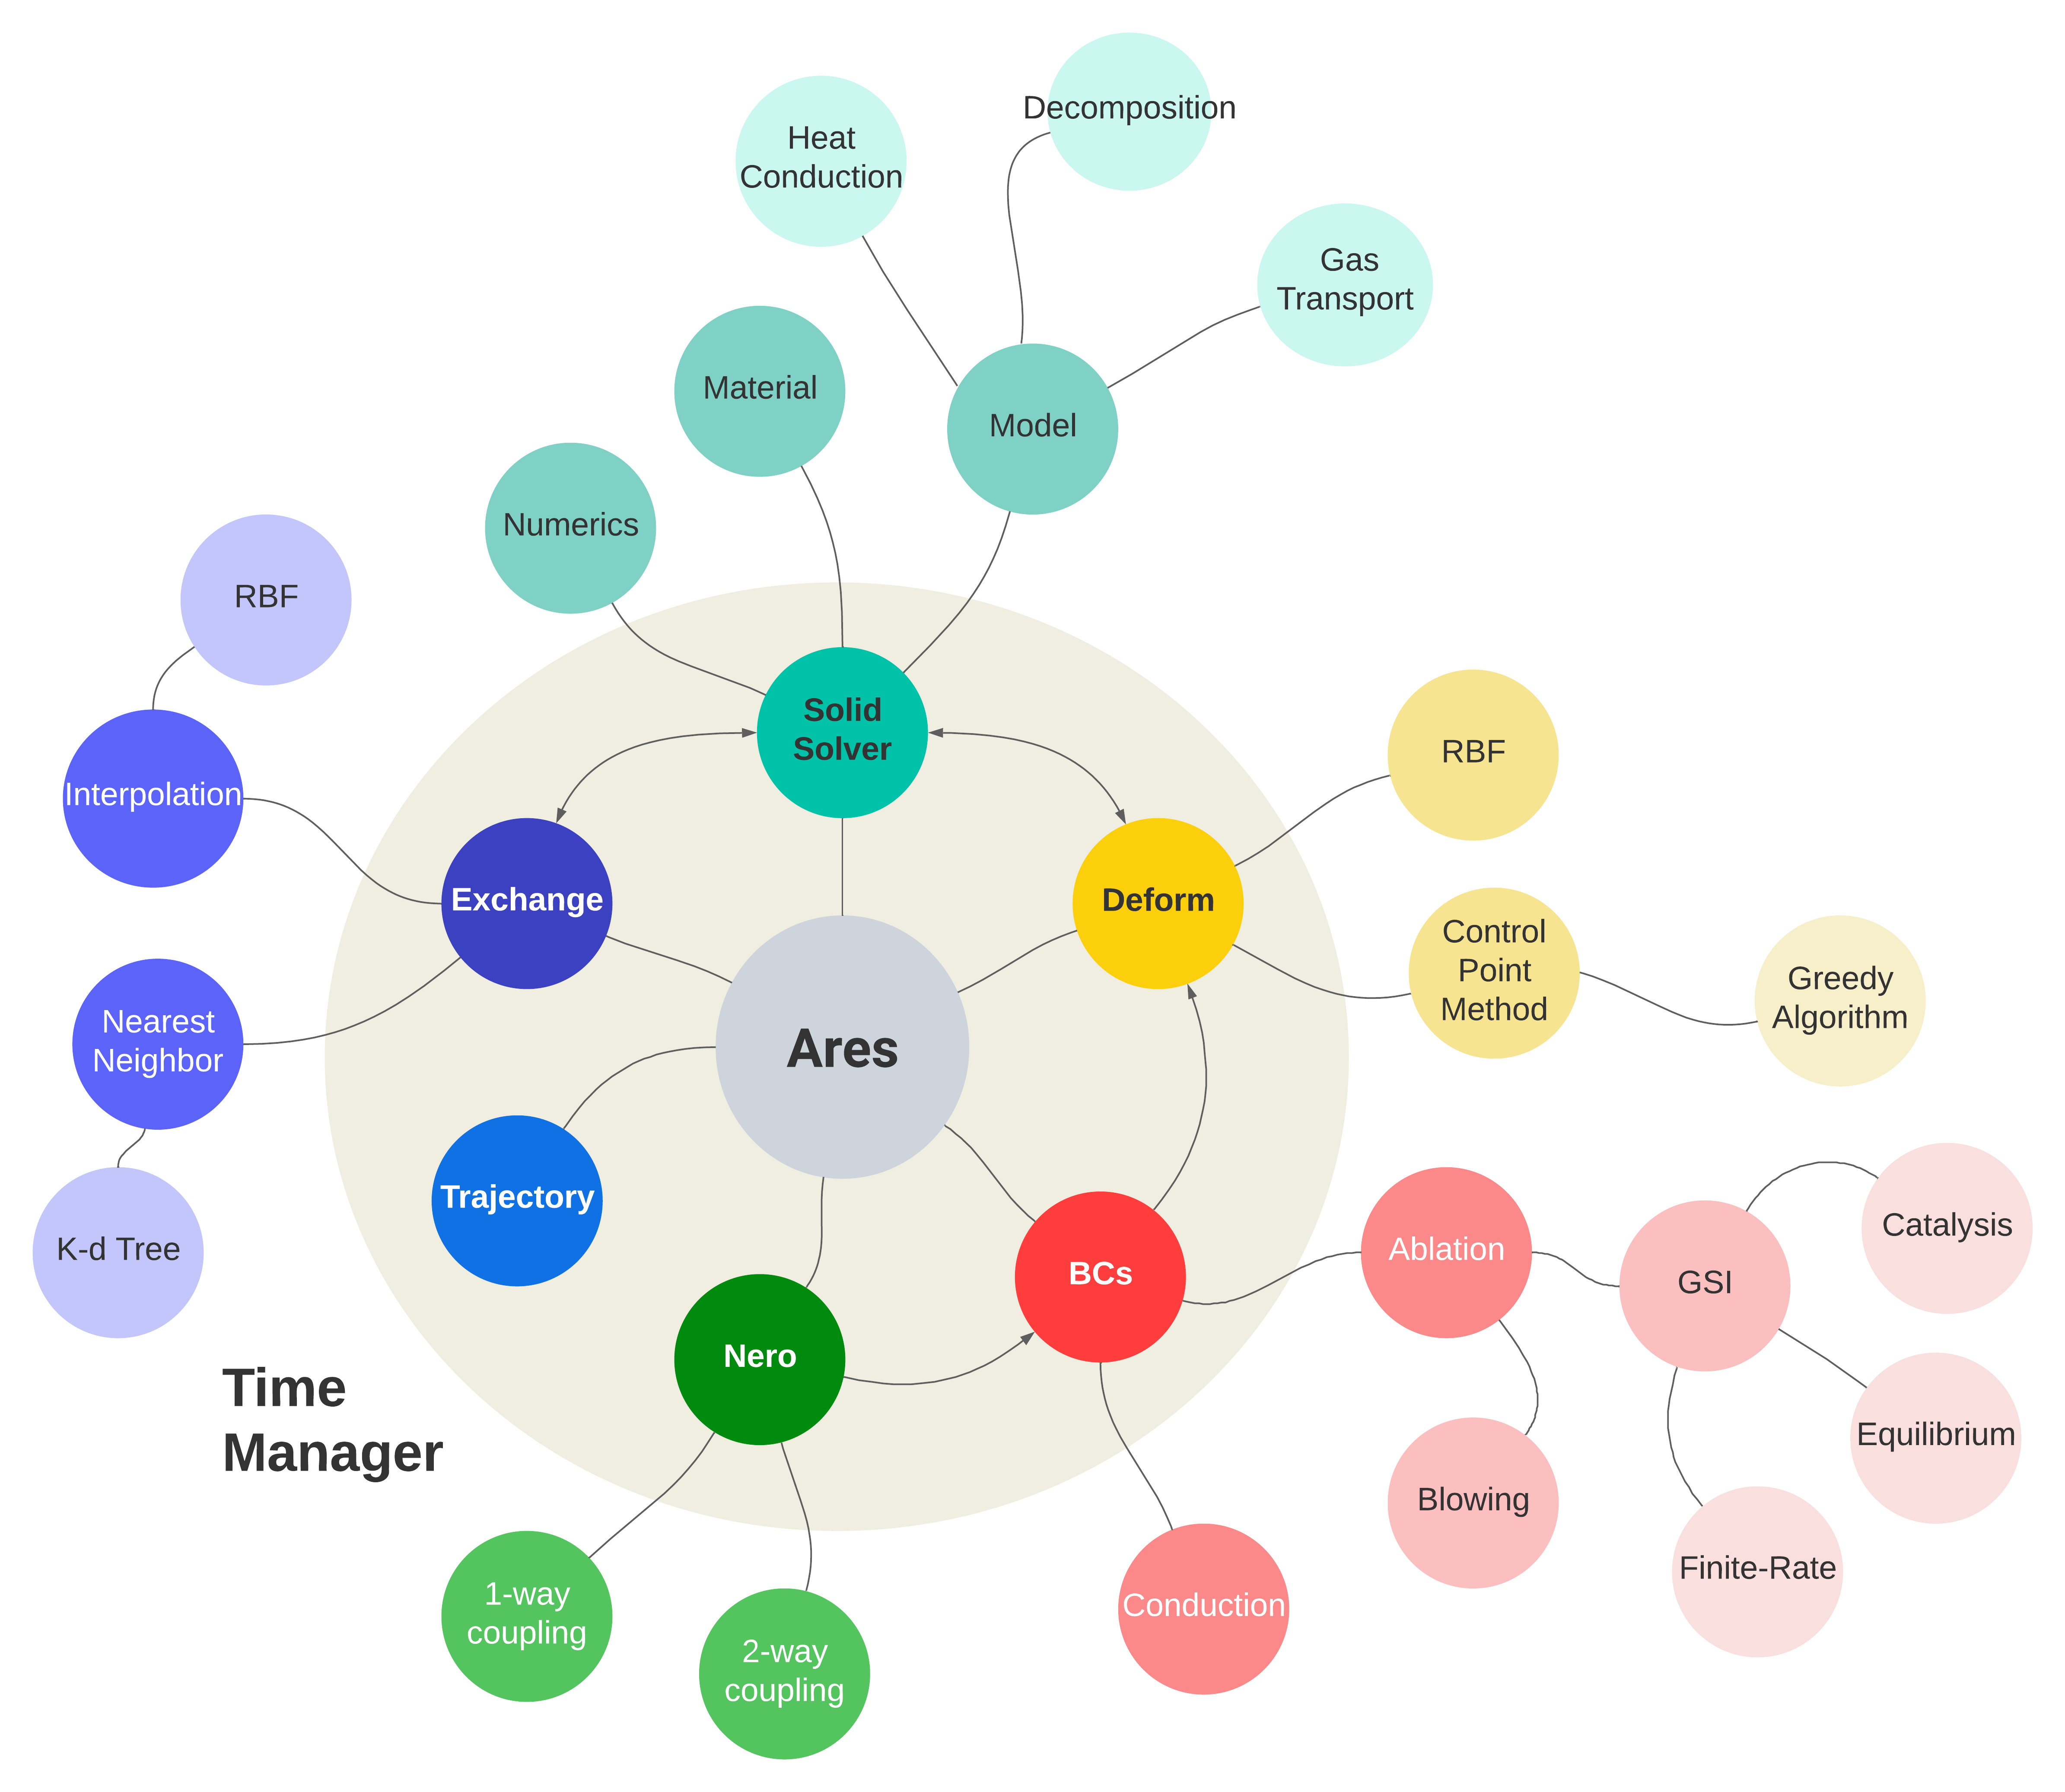
Background
What is it in essence?
  API to manage complex, multi-physics simulations through detailed information processing
    Sometimes this requires implementing the physics but the bulk modeling is done outside of Ares.
What is it in practice?
  A plugin to US3D that couples external libraries (e.g. Icarus, Nero) in a physically meaningful way
  Implements coupled boundary conditions/chemistry
To what end?
  Reduce assumptions/approximations made in uncoupled processes
  Provide a tested methodology to solve highly coupled problems naturally
  Offer a foundation for detailed analysis of entry systems (high fidelity research)
Notes:
Next slide can be applications we are interested in:
- Make reference to wedge stuff from thesis
- point out some application areas that we believe coupling is important
- tie back in with ares apabilities (relative to application needs – e.g. dfly – nero, msr – mesh motion .. Bla bla)

Slide 3
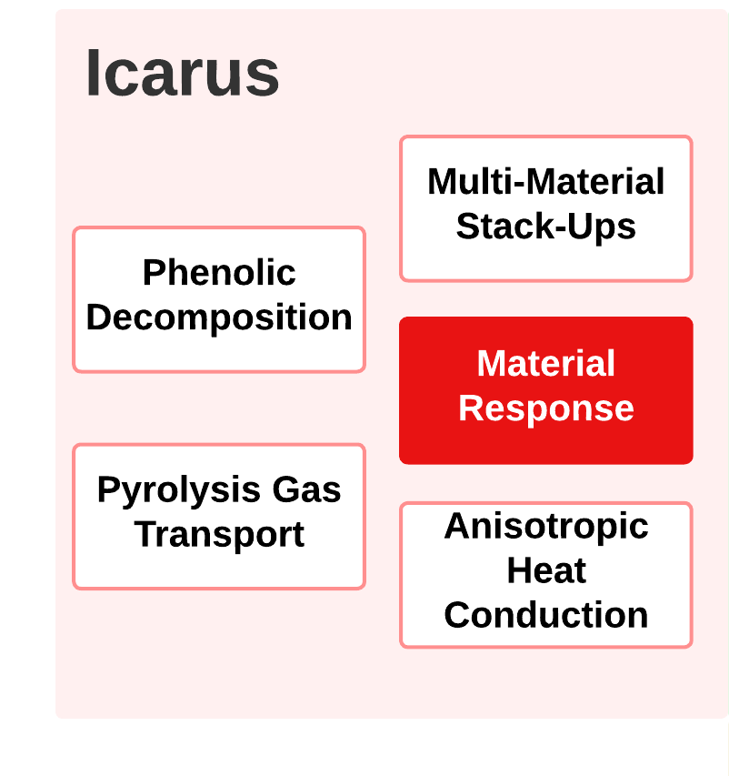

Slide 4
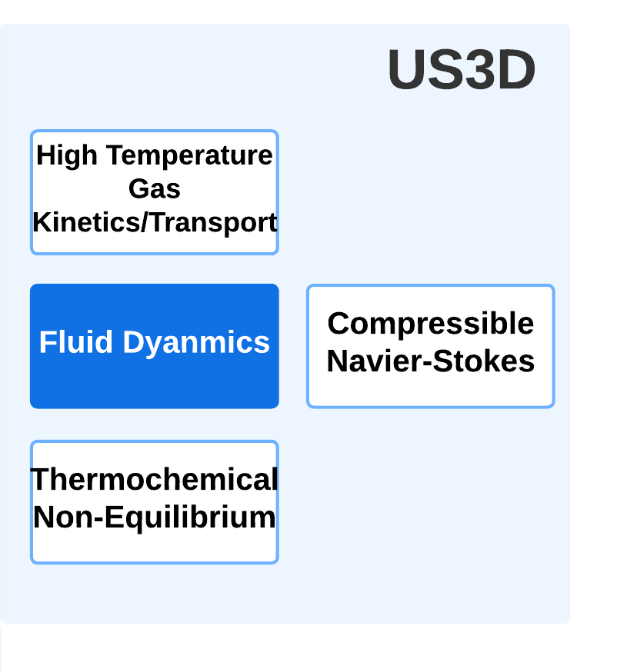

Slide 5
Temperature, Thermal Properties
Heat flux
Shape Change

Slide 6
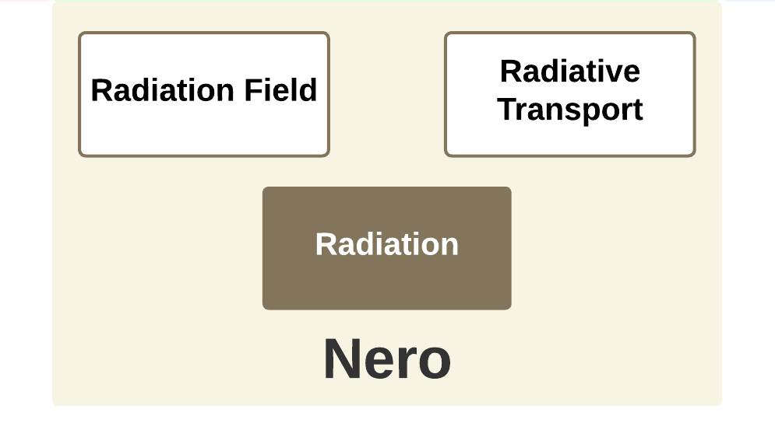
Temperature, Thermal Properties
Heat flux
Shape Change

Slide 7
Temperature, Thermal Properties
Heat flux
Shape Change
Radiative Heat Flux
Flow Field

Slide 8
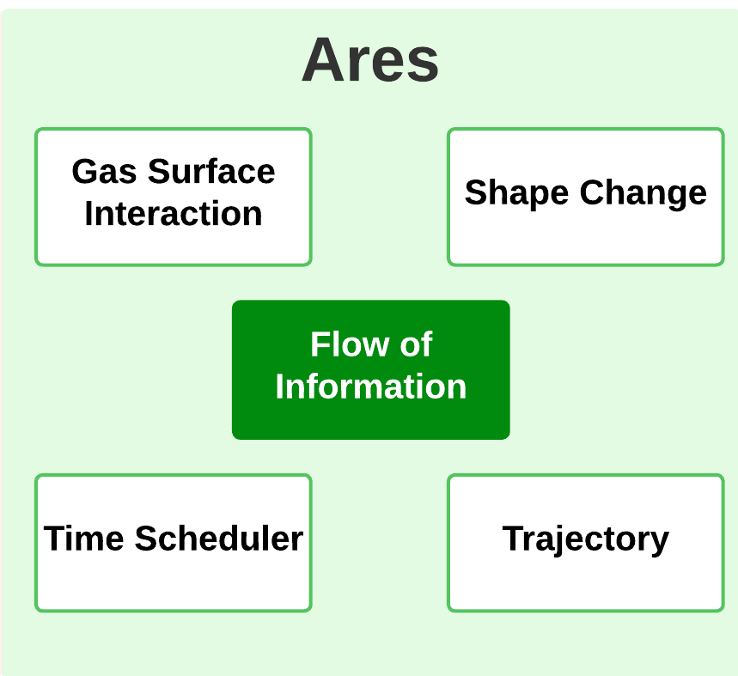

Slide 9
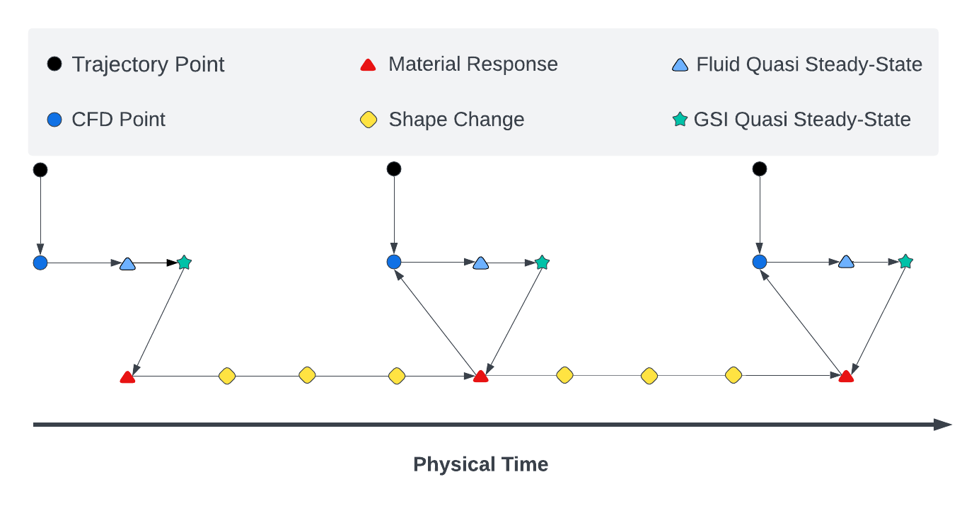
Challenges of Coupling
Fundamental challenge of fluid/solid coupling relates to time-scales and boundary conditions.
Want: Time-marching according to largest time-stepper – heat conduction/material response
Need: Converged steady-state flow solutions at lowest frequency that still captures relevant changes in parameters such as:
  Surface heat-up/cool-down
  Shape change
  Inflow conditions
Requires a coupled boundary condition that is
consistent between domains, but that in practice
may not be, due to disparate time-scales.
Cost of this coupling methodology is directly related to how much physical time the solid can integrate before requiring a fluid update, as is the accuracy of the boundary condition.
Notes:
This can probably go or moves.. Or Fits with the solve schedule convergence study

Slide 10
Coupled Boundary Condition Approaches
Supported CFD Boundary Conditions
Methodologies:
Fixed state
  Wall temperature fixed from solid
Surface Balances
  Fluxes are balanced at the wall to solve for temperature (energy) and char blowing (mass)
Surface Chemistry Models:
Inert
Catalytic
Finite-rate carbon ablation (ACA)
Supported Material Response Boundary Conditions
Methodologies:
Direct flux
  Energy balance solved in CFD, recession rate passed to material response
Aeroheating
  Film coefficient from CFD for convective heating
  Recession rate computed on material response side based on B’
  CM~CH approximation for blowing
  Blowing correction
Note: Energy balance with re-radiative component is always solved on material side

Slide 11
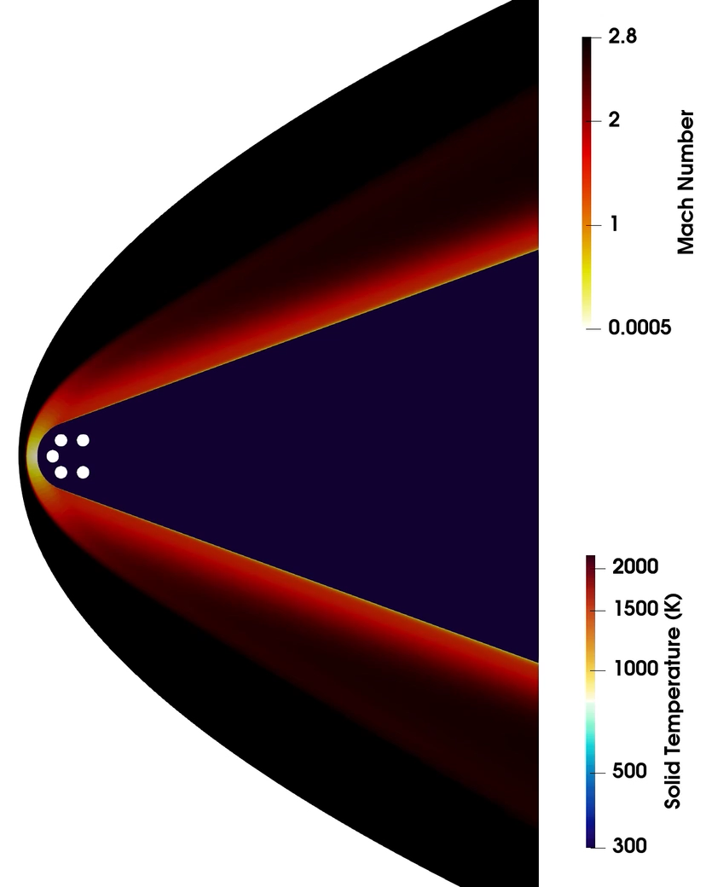
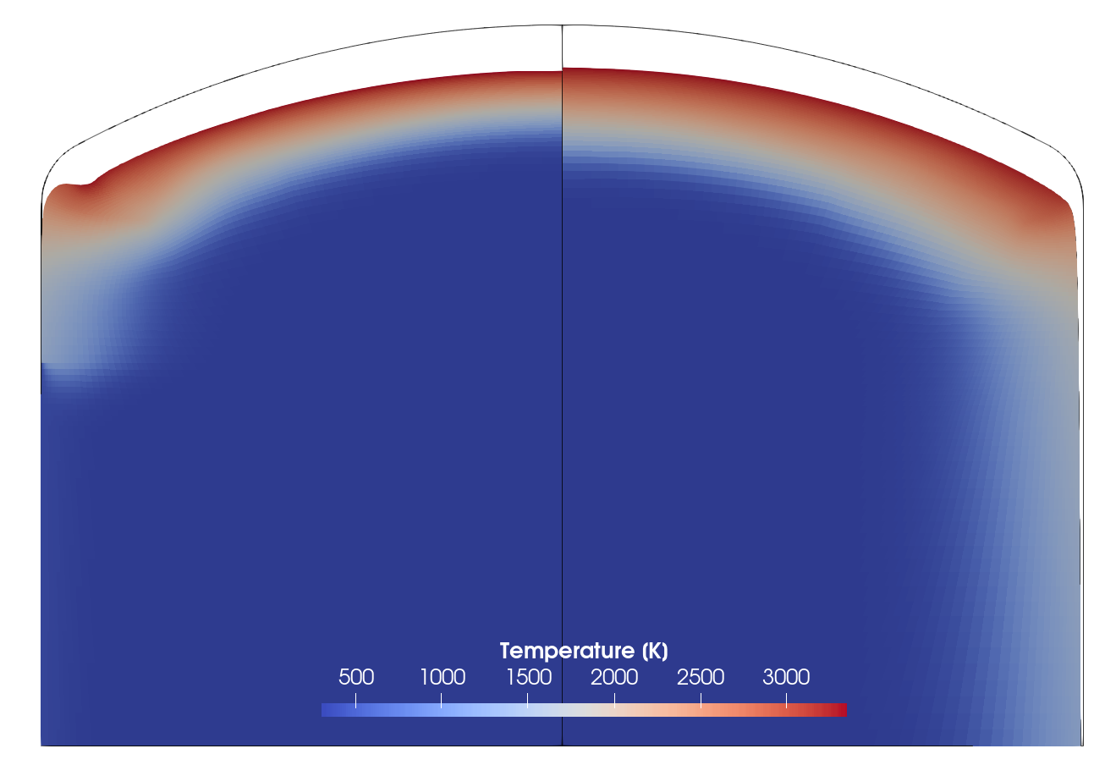
Developments Motivated by Application Needs
Ground Testing Facilities
Provides rich datasets for validation and benchmarking
Unique challenges:
Facility environments (expertise required)
Long exposure times
In-depth physics – often data comes from thermocouples
Wide range of conditions and gas compositions
Variety of geometries with complex shape change
Development requirements:
Mesh motion robustness
Boundary condition package
Generalized GSI models
Non-face matched grids
Uncoupled
Coupled
Coupling alleviates non-physical behavior near corners/shoulders.

Slide 12
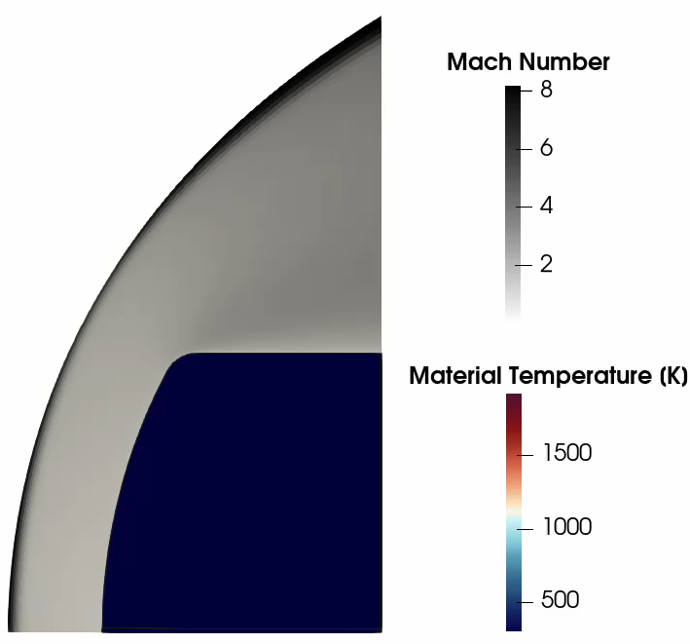
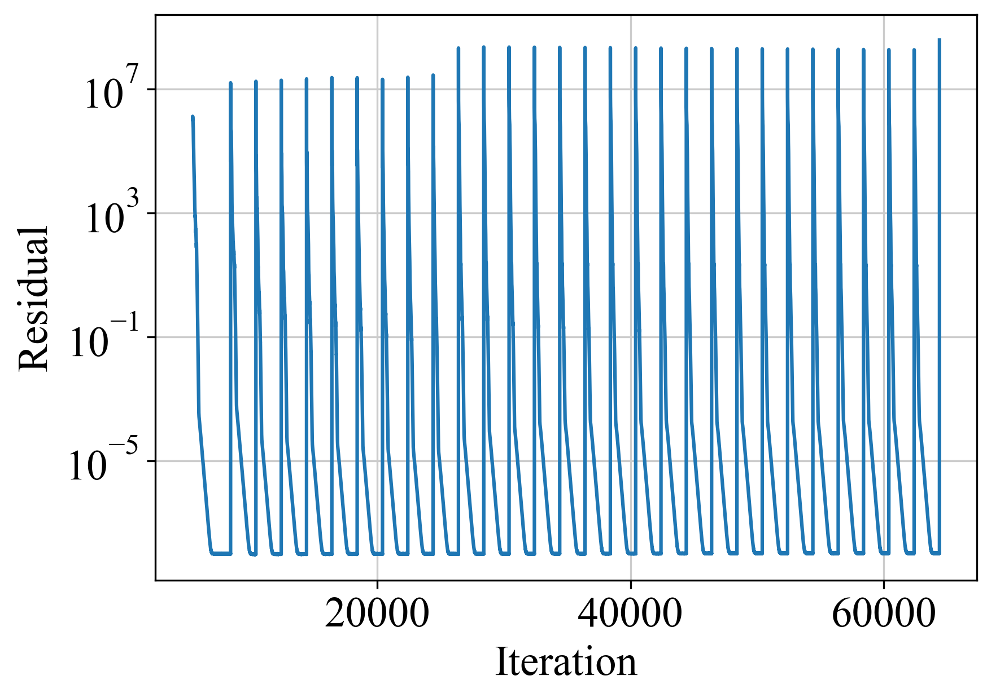
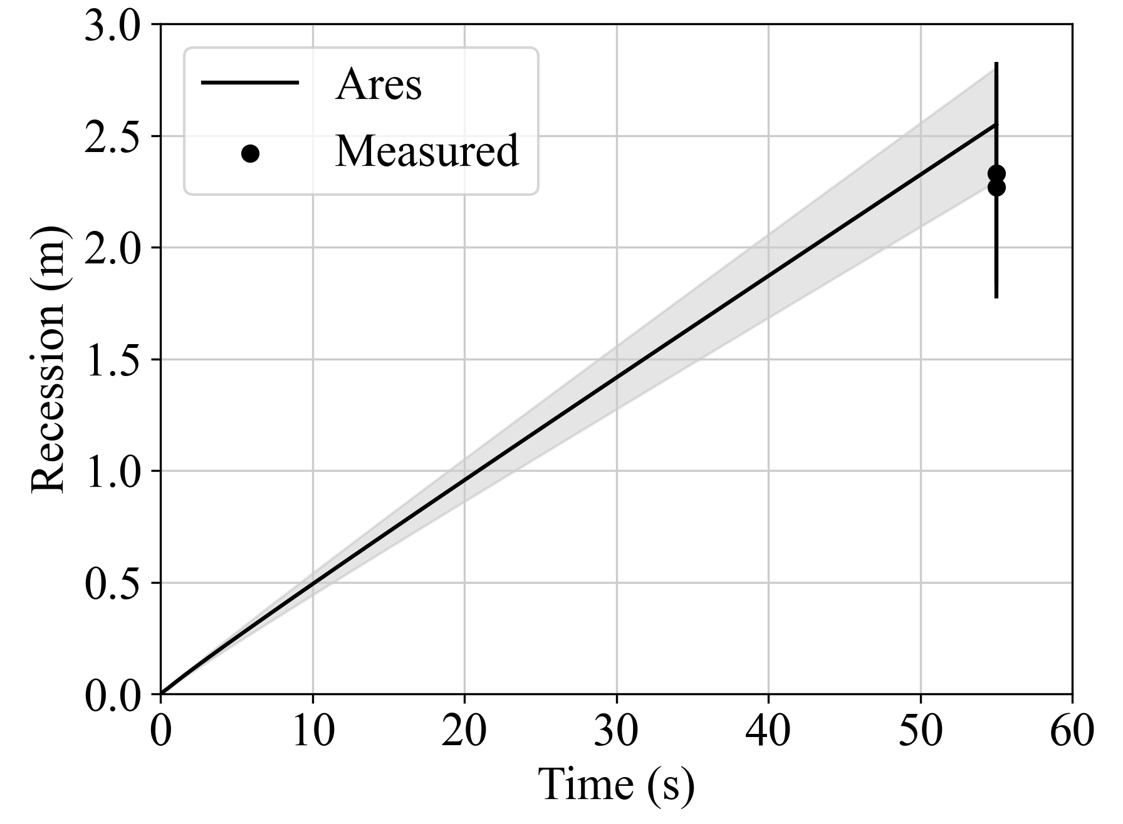
Arc-Jet Series: PICA
PICA Arcjet Validation Campaign (Milos & Chen, 2009)
6 cases identified for further study
Facility Environment
  N2/O2 with added Ar
  Icarus validation run using DPLR, aeroheating BCs
Ares
  Icarus solve every 0.1 seconds
Comp cost ~ 4 hours, 20 cores
Milos, F.S. and Chen, Y.-K. “Ablation and Thermal Response Property Model Validation for Phenolic Impregnated Carbon Ablator”, AIAA-2009-262

Slide 13
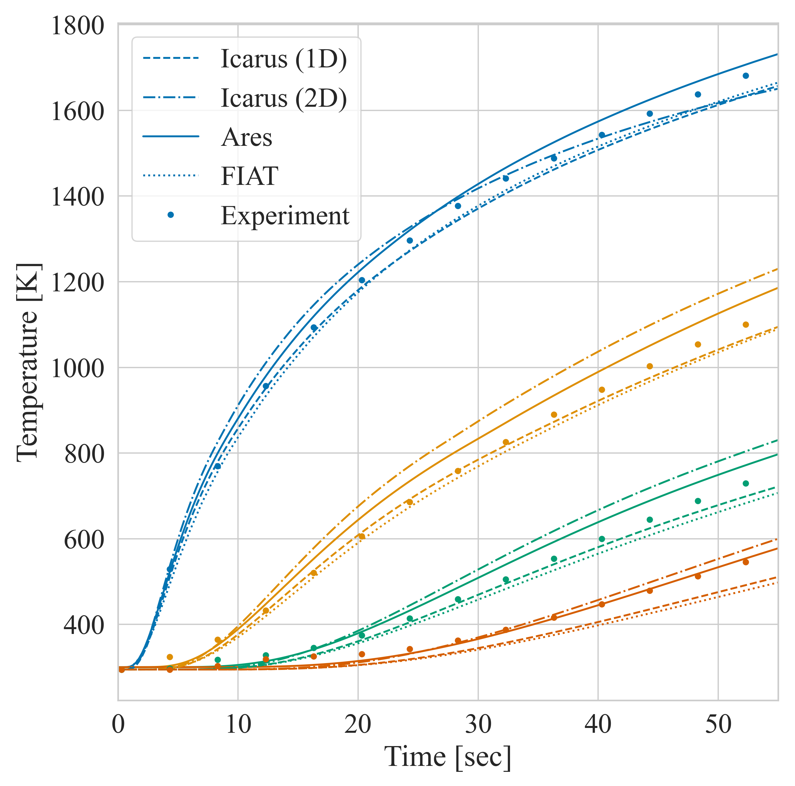
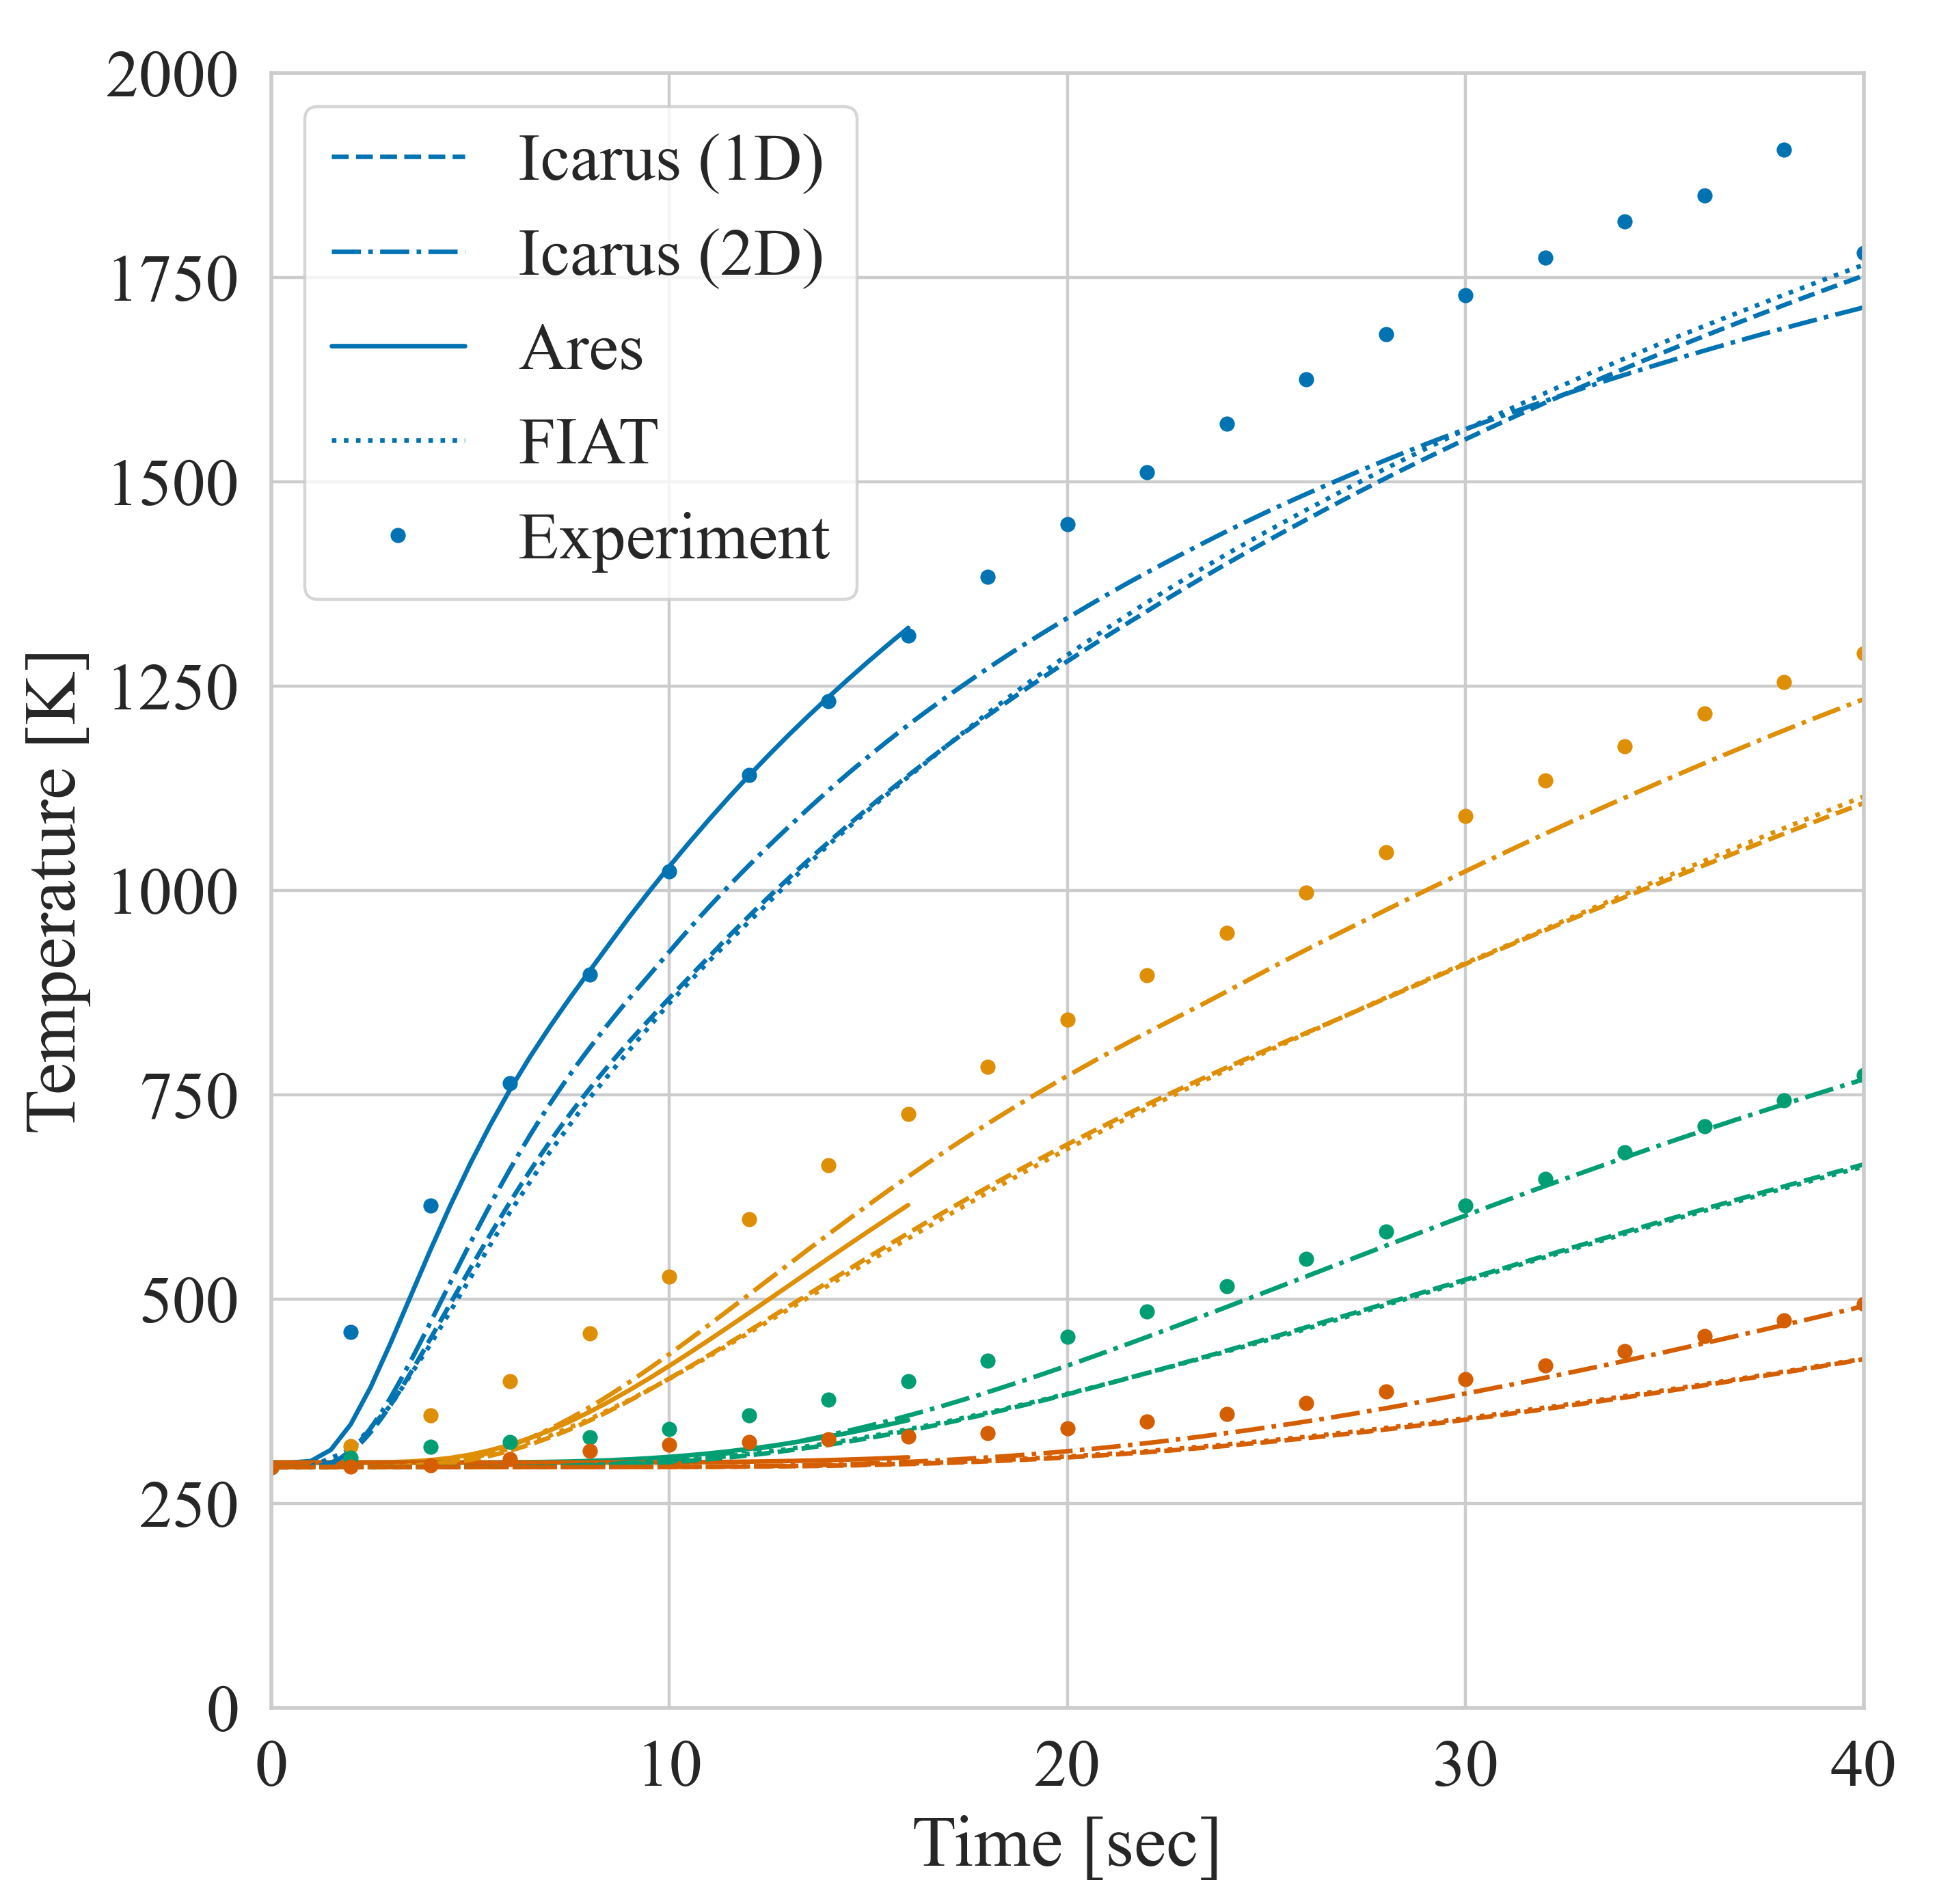
Arc-Jet Series: PICA
Case 1: AHF 18, 107 W/cm2, p = 2.3 kPa
Case 2: AHF 18, 169 W/cm2, p = 5.0 kPa

Slide 14
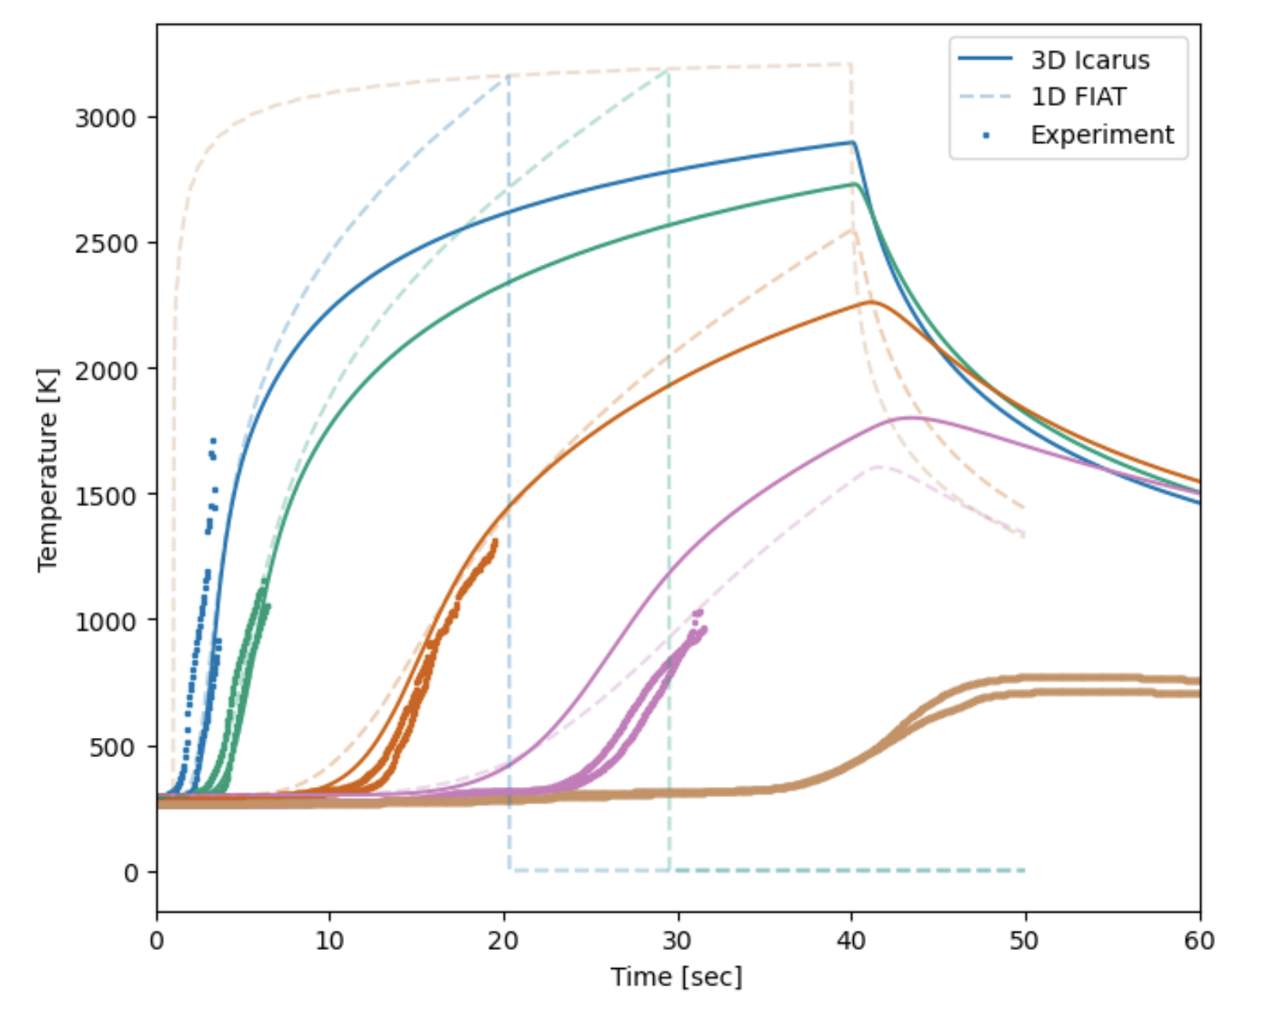
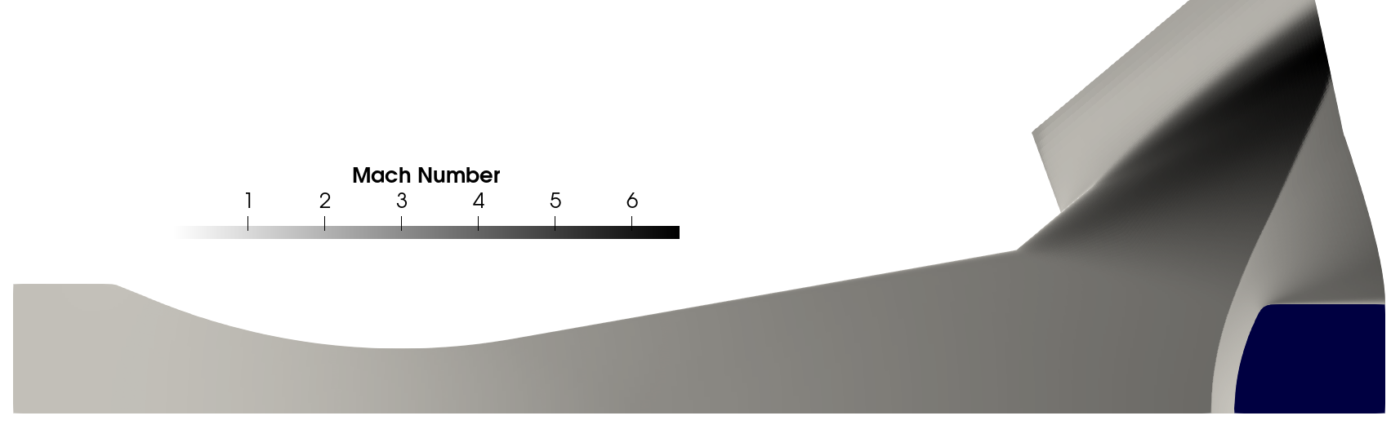
Arcjet Series: 3MDCP
IHF-385 Arcjet Tests
Performance of the 3MDCP material for MSR-EES
  4” Flat Face
  5” Iso-Q
Facility Environment
  N2/O2 with added Argon
  Exposure time: 38 seconds
Ares
  Icarus solve every 0.1 seconds
  Simulate IHF nozzle + vacuum chamber
Comparison of Icarus (uncoupled) to experiment and FIAT for Iso-Q
Uncoupled
Coupled
Unphysical distortion of test article for uncoupled Icarus simulations
Flat-face test article simulations more noticeable

Slide 15
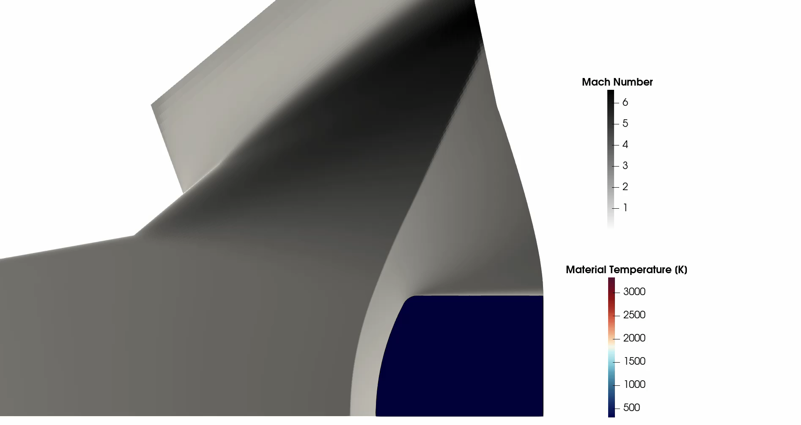
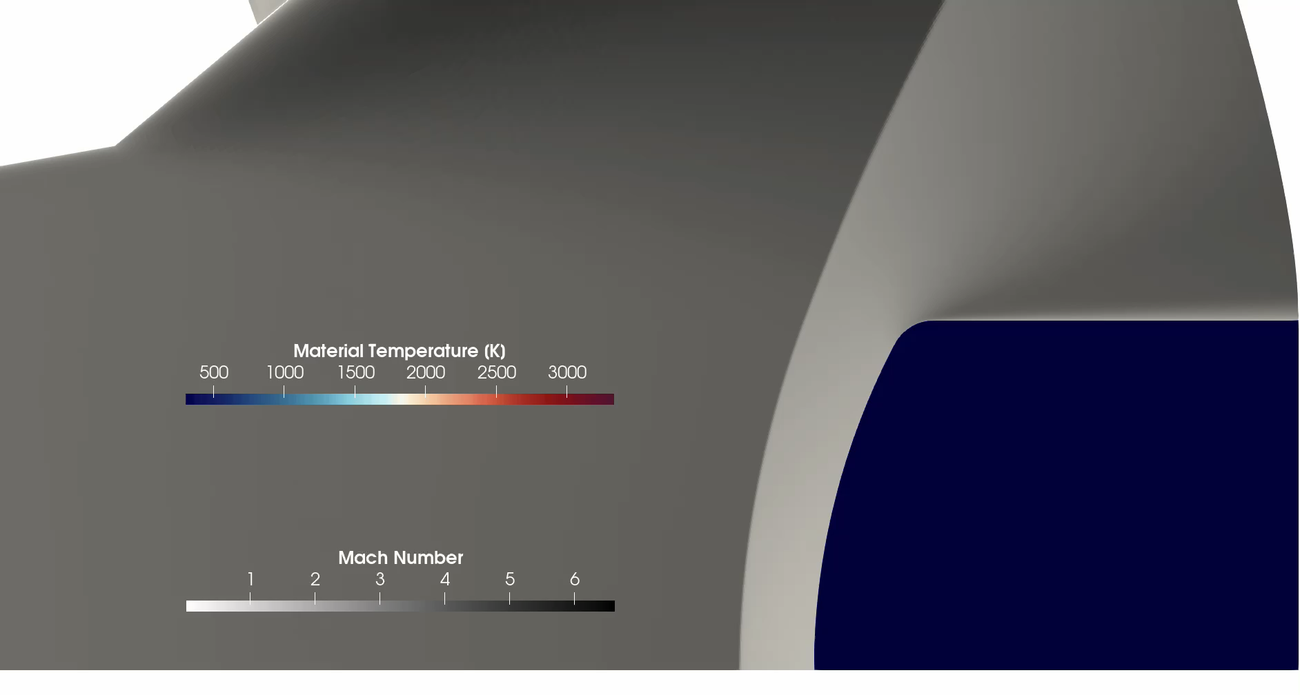
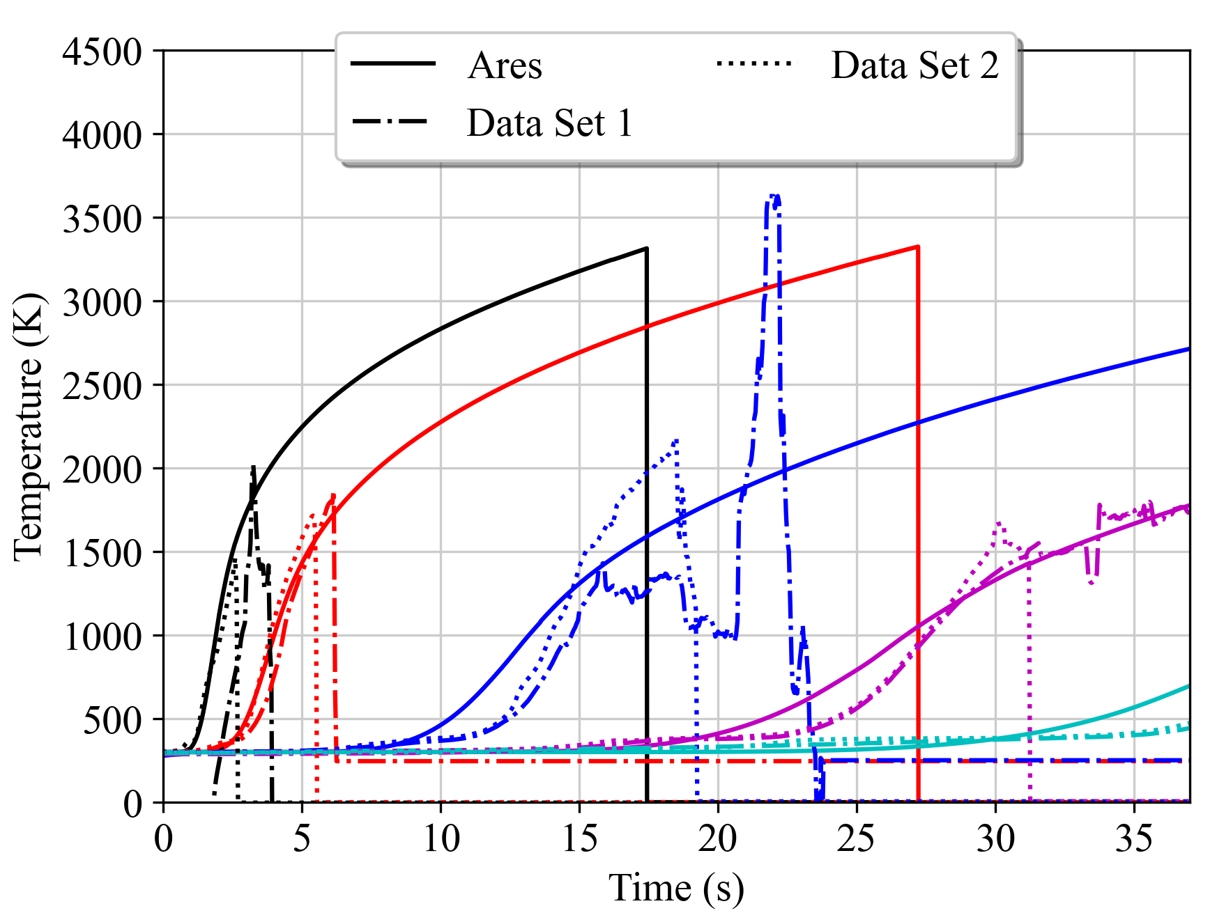
Arcjet Series: 3MDCP
Two data sets for IHF-385 IsoQ
Recession Error: ~10%
Measured : 6.5 mm
Computed : 5.8 mm
Comp cost ~ 23 hours, 40 cores

Slide 16
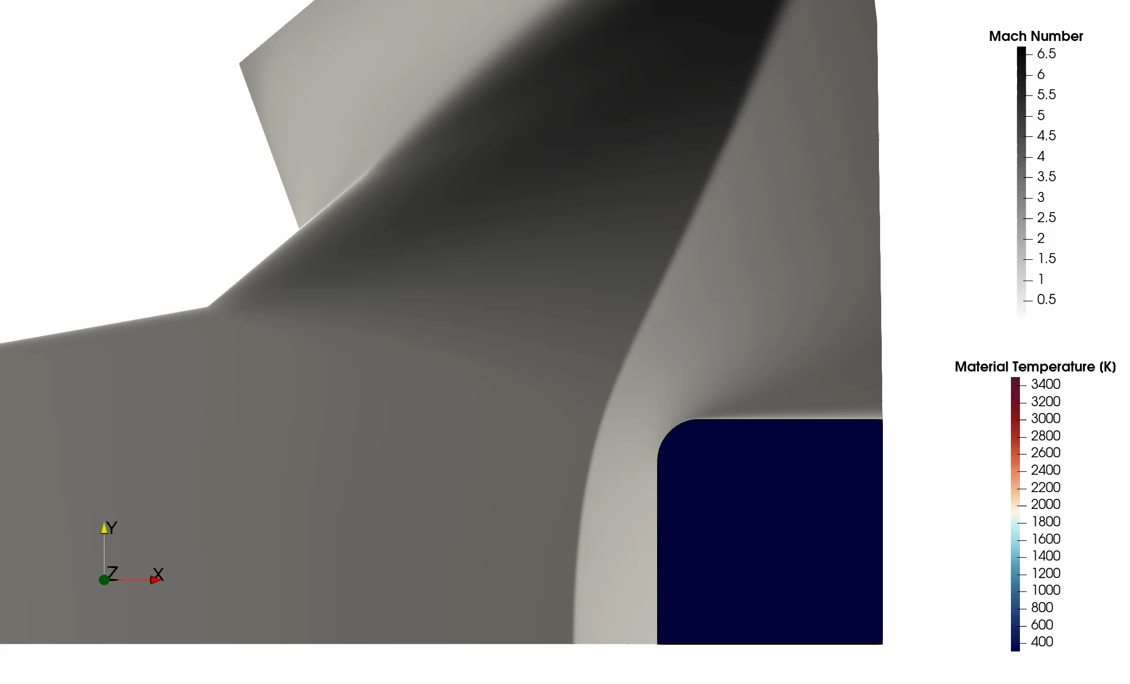
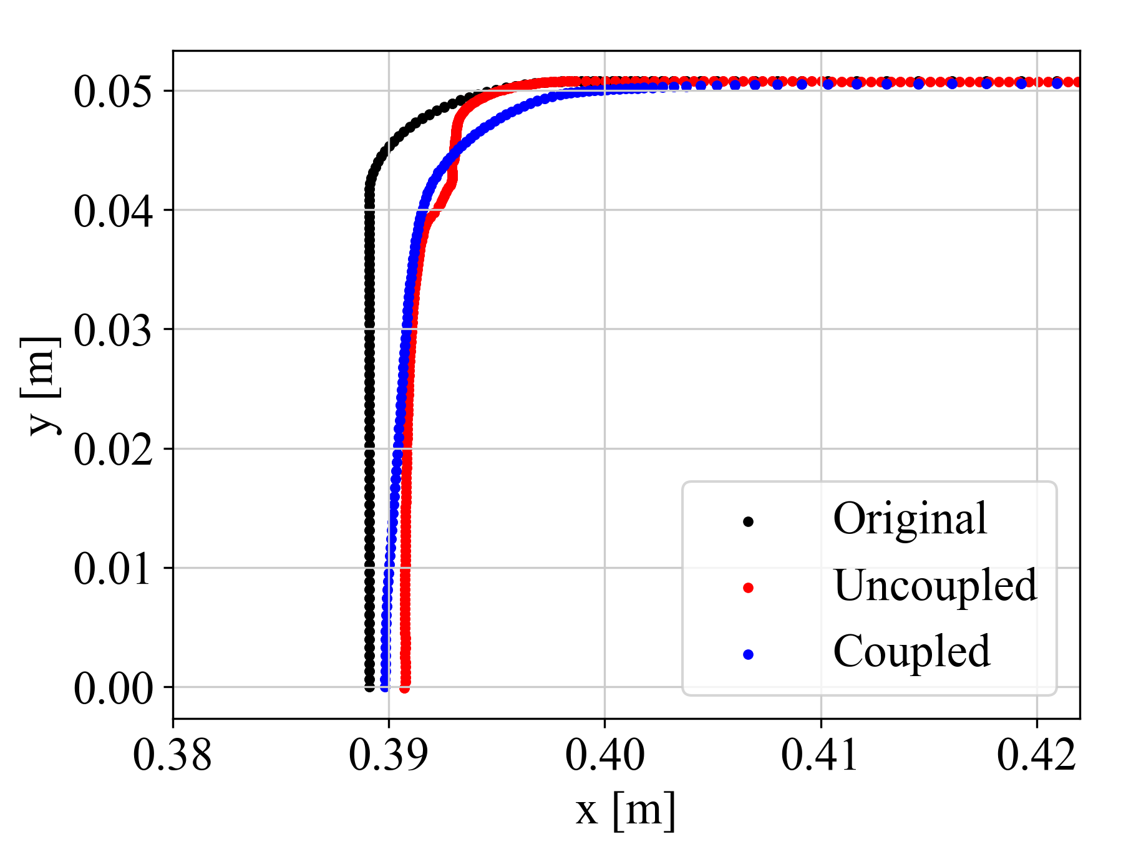
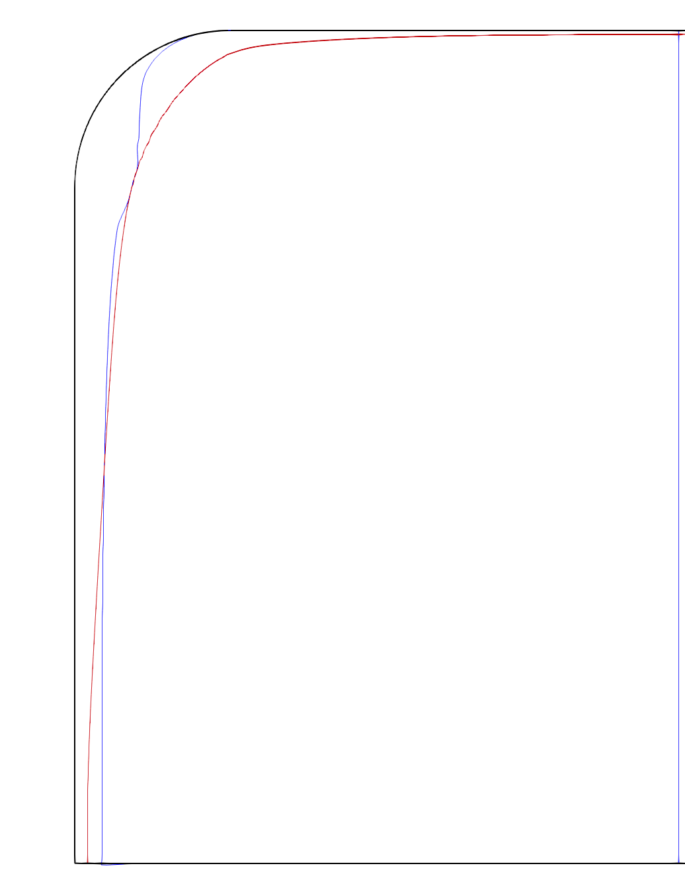
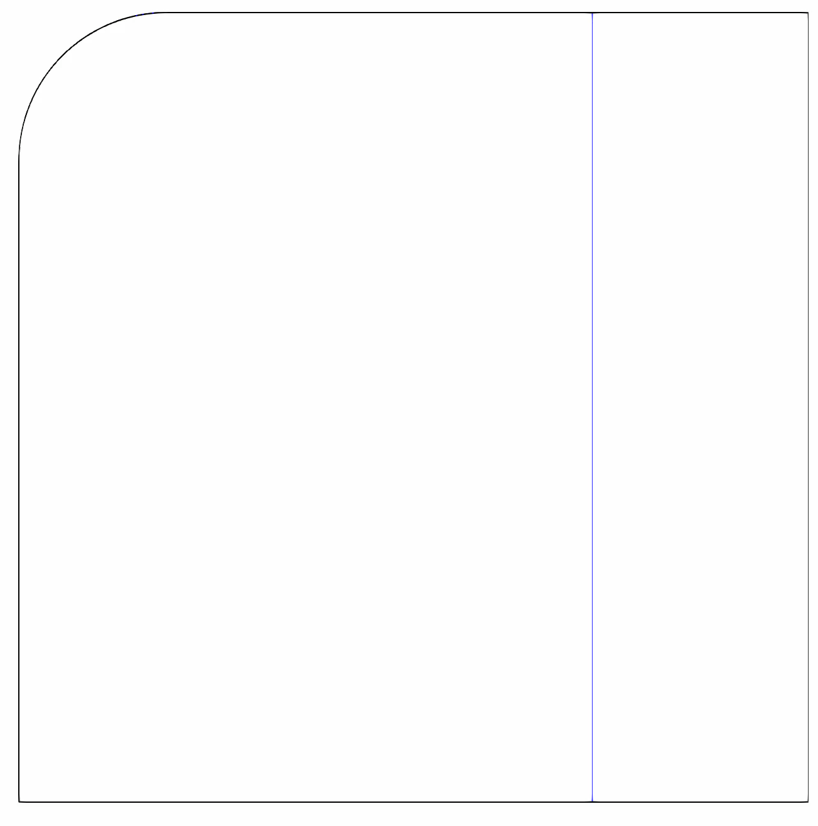
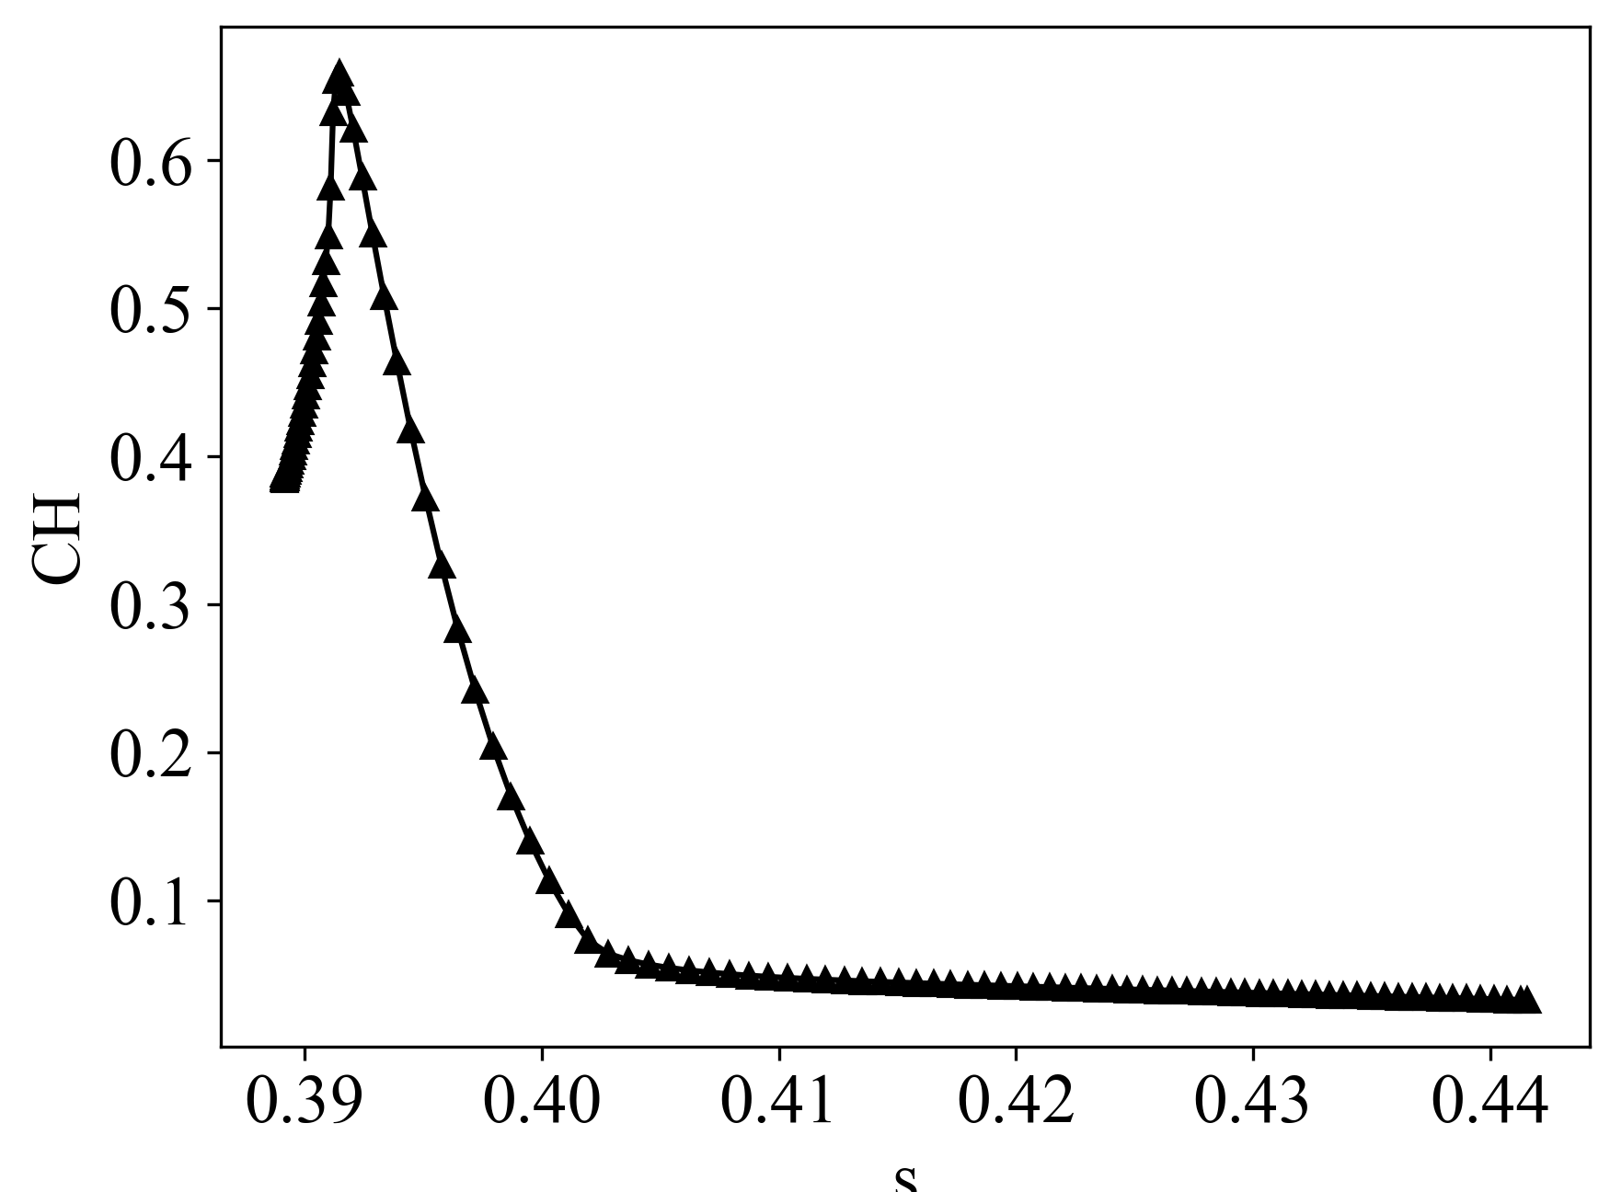
Arcjet Series: 3MDCP
Two data sets for IHF-385 Flat-faced Cylinder
Exposure time: 16 sec
Recession Error: ~16%
Measured : 2.4/2.5 mm
Computed : 2.0 mm
Uncoupled BC
Comp cost ~ 30 hours, 40 cores
Coupling alleviates non-physical behavior near corners/shoulders.
Notes:
Can add MSR trajectory and aeroshell? – plug Prakash poster
- Highlight need to maehs motion/shape change to msr flight project

Slide 17
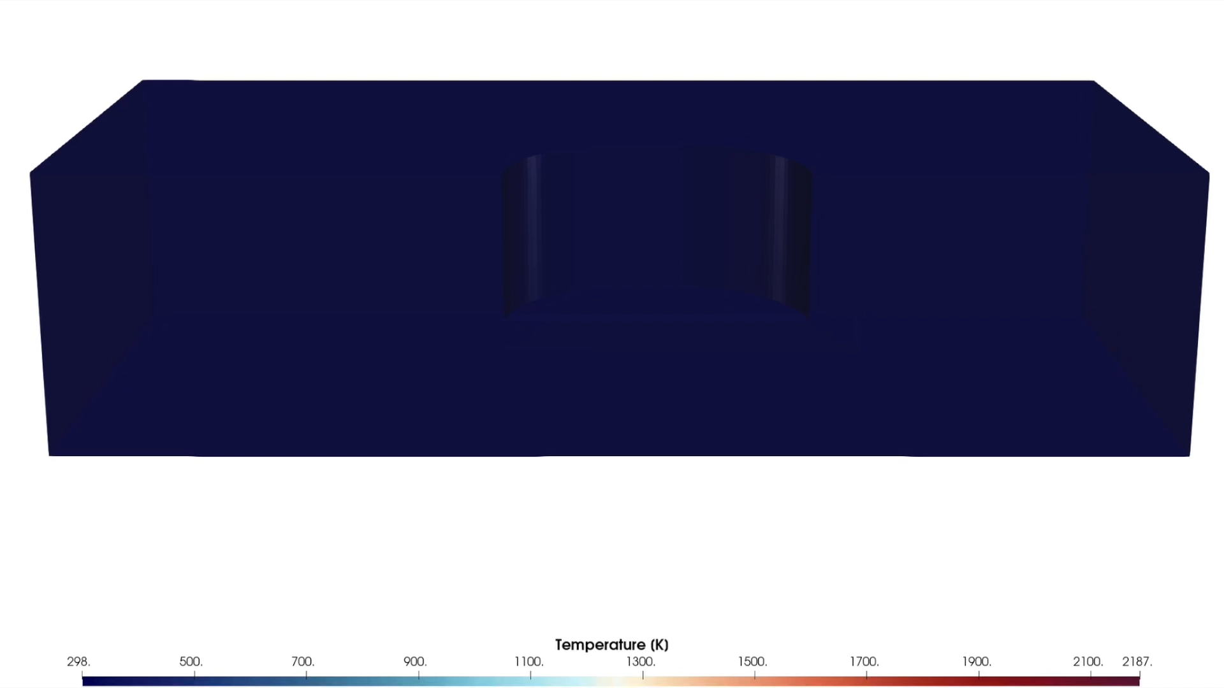
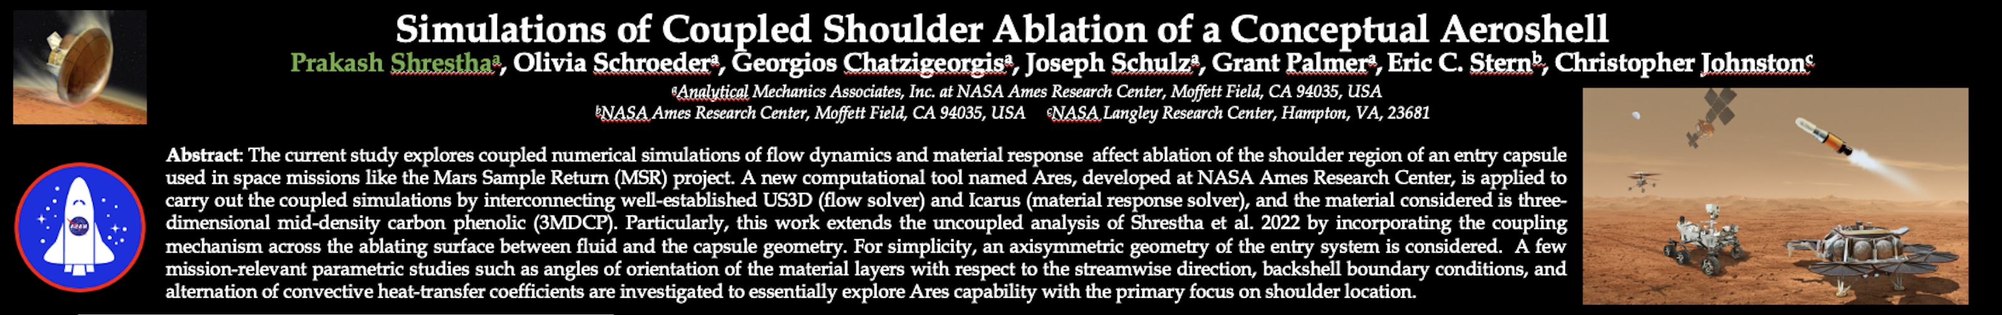
Developments Motivated by Application Needs
Mars Sample Return Earth Entry System (MSR-EES)
Stringent design requirements and aggressive environments
Challenges:
High speed entry/Aggressive aerothermal environment
Mid-density, pyrolyzing material: 3MDCP
High recession rates
Unique problems:
MMOD
Shoulder ablation
Development requirements:
Mesh motion robustness
Expansion of boundary condition package
Trajectory
3MDCP
MMOD analysis with Icarus
Featured in Poster Session

Slide 18
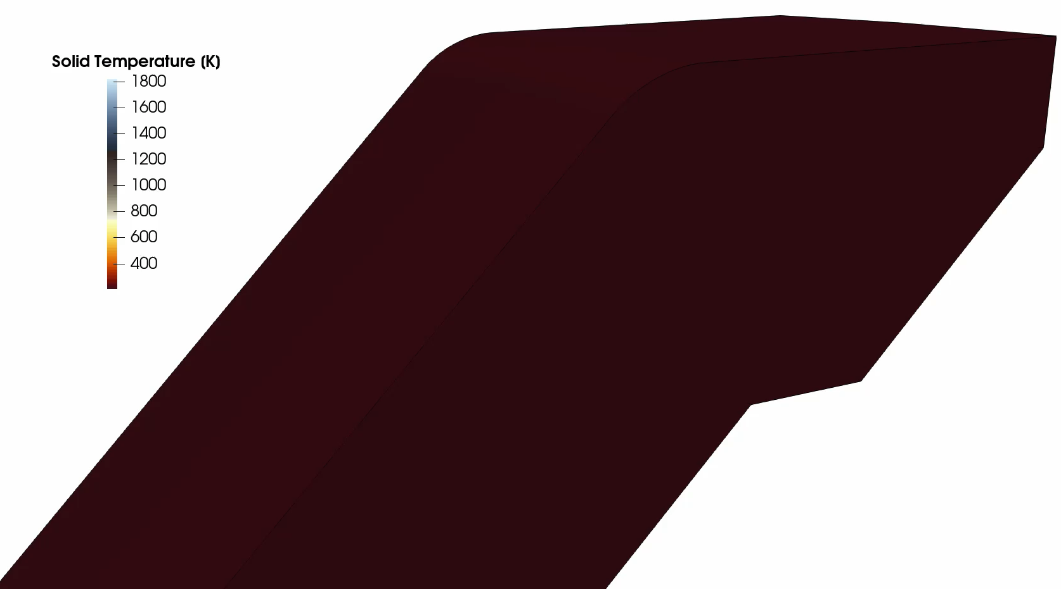
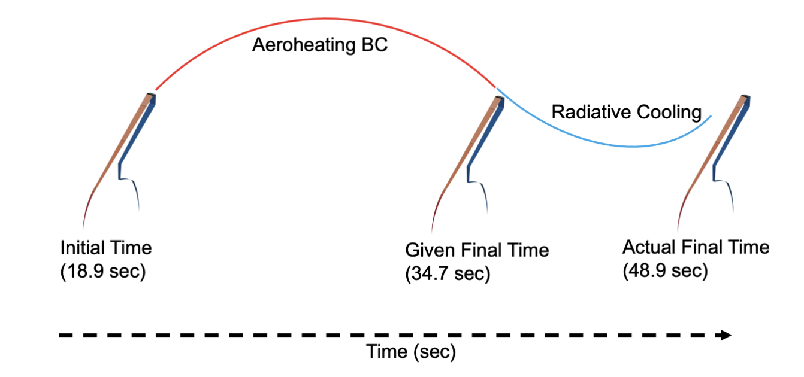
MSR-EES Aeroshell
Geometry:
Forebody, axisymmetric aeroshell
Trajectory:
15 seconds simulated
Material:
3MDCP with Aluminum substructure
Pyrolysis gas modeled in material response
Equilibrium GSI model
Coupled Simulation
Ares
Entry
From Shrestha et al., 2022

Slide 19
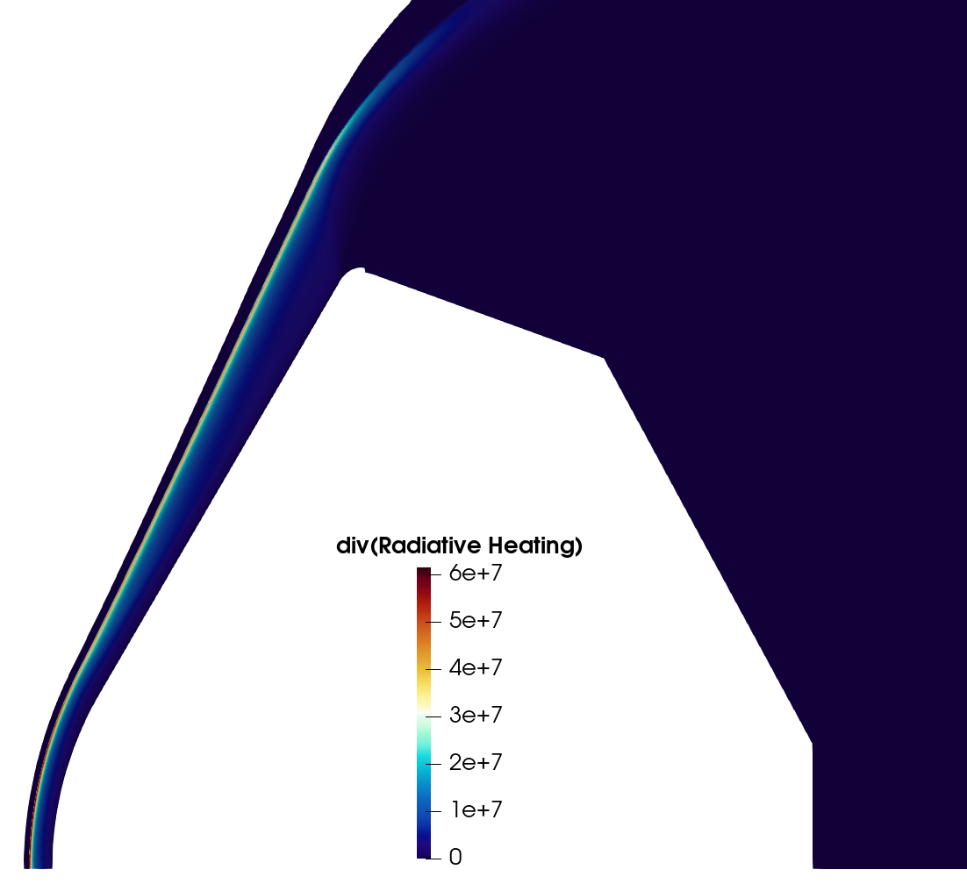
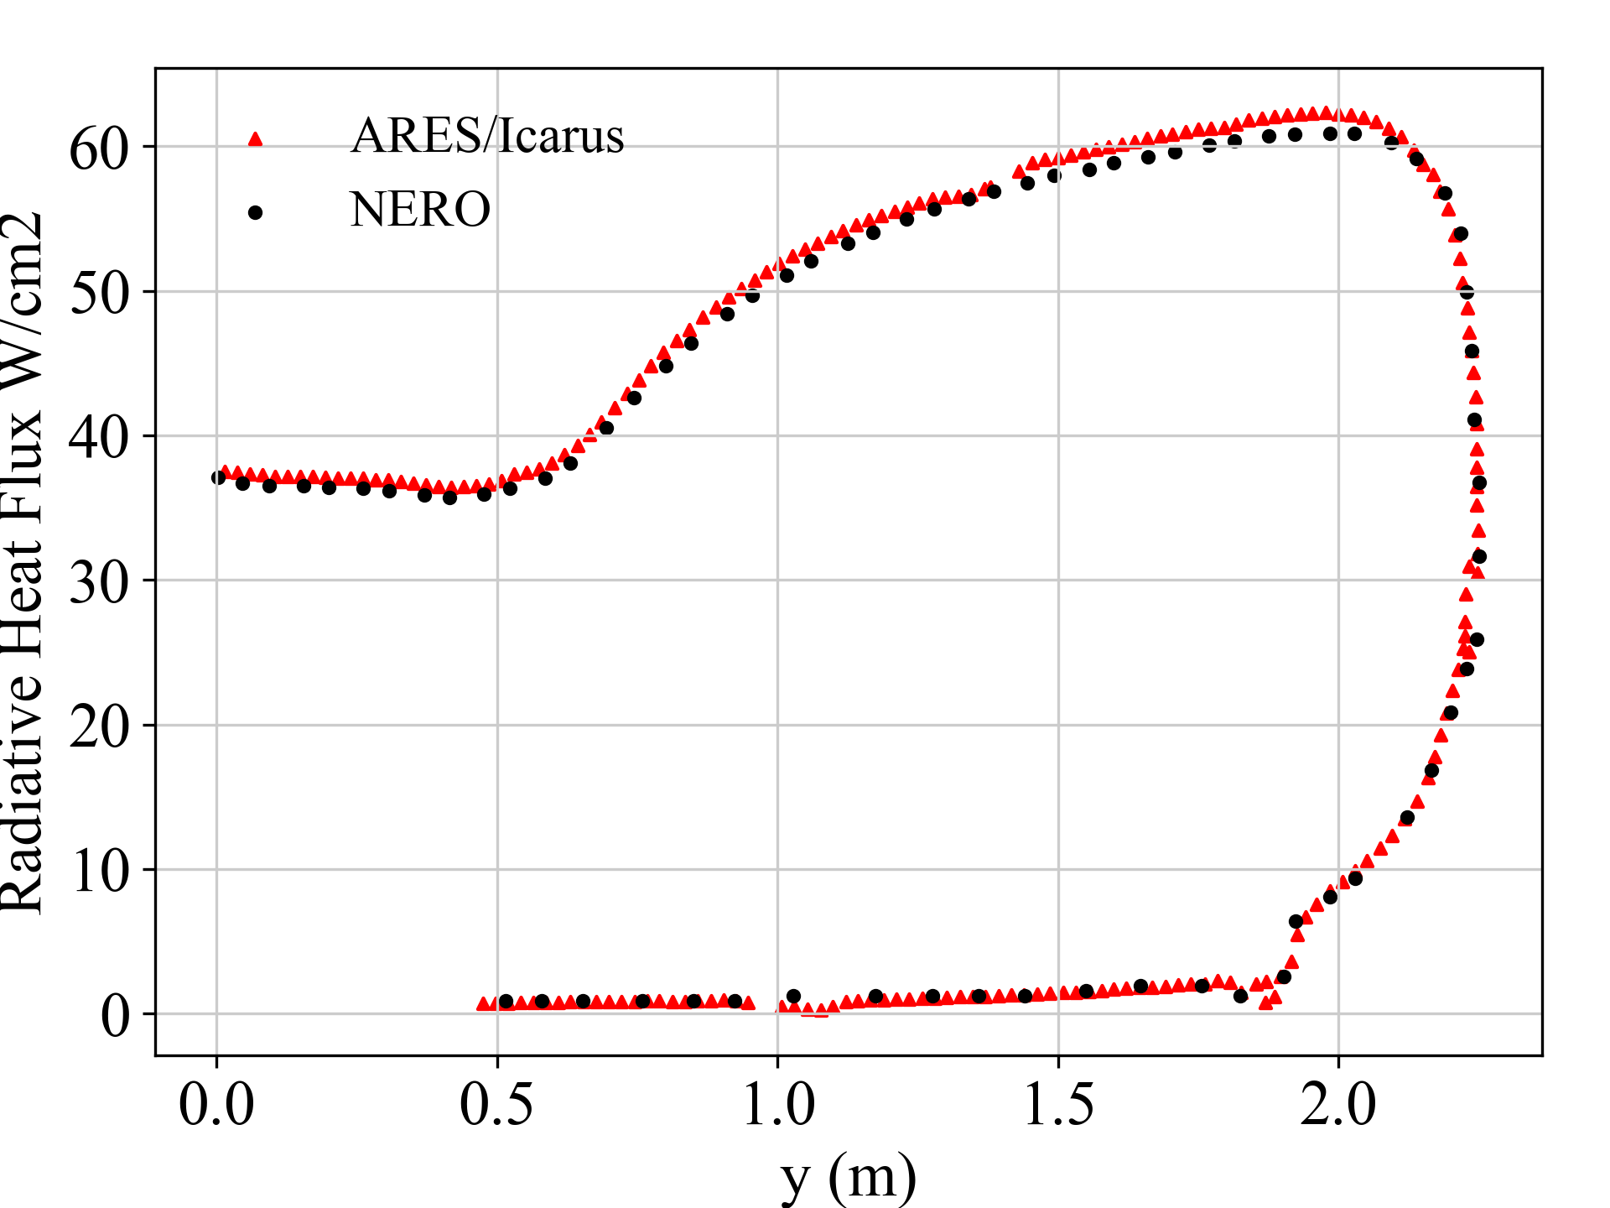
Developments Motivated by Application Needs
Dragonfly
Challenges:
Long trajectory
Titan atmosphere (nitrogen and methane)
Pyrolyzing ablator (PICA)
Significant radiative heating
Unique problems:
Importance of nitrogen catalycity
Production of CN from GSI chemistry and radiation
Development requirements:
Coupled radiation
Pyrolysis gas modeling
Finite-rate chemistry
Titan atmosphere modeling
Trajectory
Nero Integration Recipe:
Radiative field update frequency is user input.
Flow field converged to quasi-steady-state
Nero calls are made to solve radiation field to convergence
Convective and radiative heating components at the boundaries are packaged and interpolated to Icarus
Material response is advanced
Trajectory is updated
Verification that computations are consistent with standalone Nero.
Zero-D verification of finite-rate ACA model implementation

Slide 20
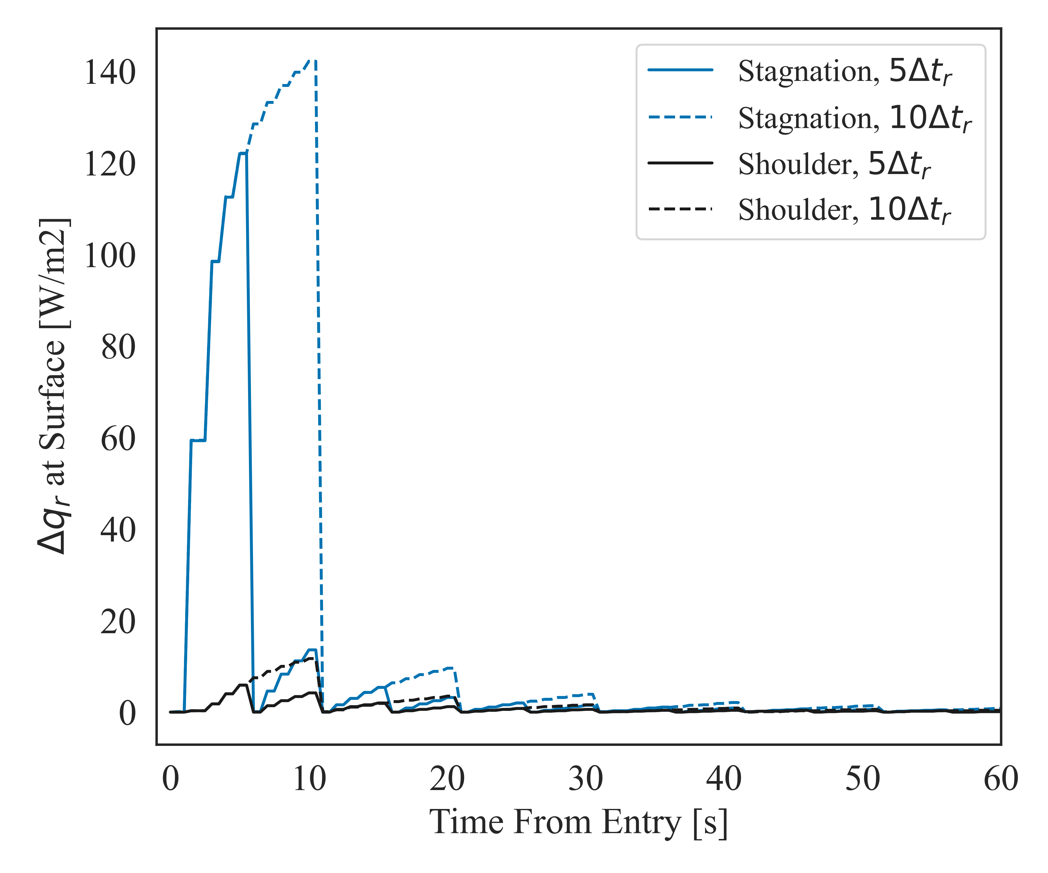
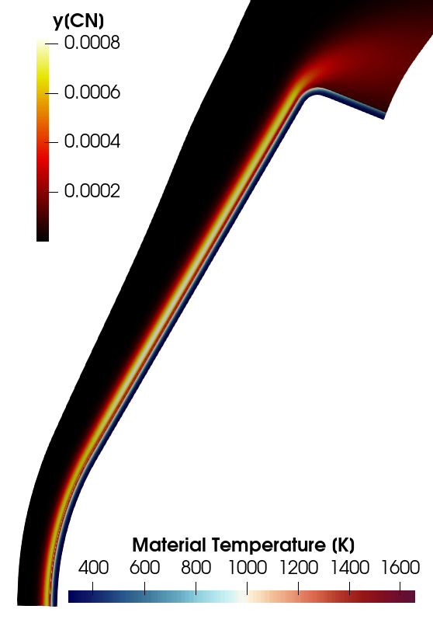
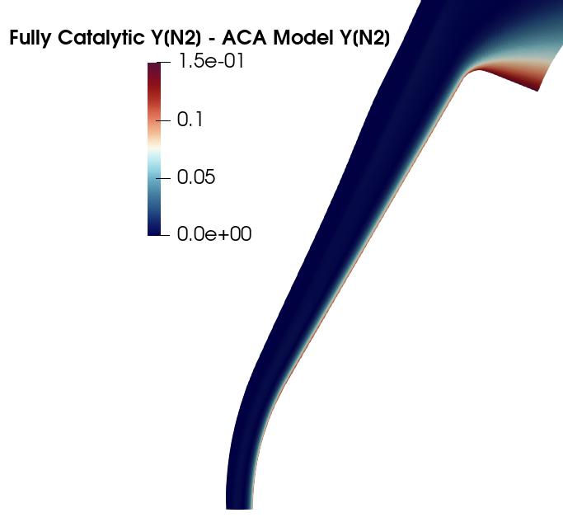
Dragonfly
Enabling new areas of investigation, only possible with fully integrated framework.
Is the fully-catalytic assumption for nitrogen supported by finite-rate?
What are the driving time-scales for coupling?
Flow-Material
Surface-Chemistry
Radiation-Flow
Flow-Trajectory
Dragonfly Entry Aerosciences Measurements (DrEAM) Instrumentation Suite
Use thermocouple and radiometer data to better understand Titan’s atmosphere
Can Ares help us better understand how to interpret these data?
  Sources of CN production
  Uncertainties in the reconstruction of the aerothermal environments
Comp cost ~ 2 hours, 20 cores
How meaningful is production of CN from GSI chemistry to radiative heating?
Notes:
We can run Dfly trajectory – can do variations of the problem
Can push this slide to Joey
Scheduling, finite rate results, convergence study can go to Joey’s talk
Add radiative heat flux on the plut with finite-rate/Equil.
Can mention next presentation will have more details

Slide 21
Dragonfly
Unlocking new areas of investigation, only possible with fully integrated framework.
Is the fully-catalytic assumption for nitrogen supported by finite-rate?
Addressing these questions, and more, in the next talk!
Coupled Material Response Simulations of Dragonfly Capsule and DrEAM Reconstruction
By Joseph Schulz
What are the driving time-scales for coupling?
Flow-Material
Surface-Chemistry
Radiation-Flow
Flow-Trajectory
Dragonfly Entry Aerosciences Measurements (DrEAM) Instrumentation Suite
Use thermocouple and radiometer data to better understand Titan’s atmosphere
Can Ares help us better understand how to interpret these data?
  Sources of CN production
  Uncertainties in the reconstruction of the aerothermal environments
Comp cost ~ 2 hours, 20 cores
How meaningful is production of CN from GSI chemistry to radiative heating?
Notes:
We can run Dfly trajectory – can do variations of the problem
Can push this slide to Joey
Scheduling, finite rate results, convergence study can go to Joey’s talk
Add radiative heat flux on the plut with finite-rate/Equil.
Can mention next presentation will have more details

Slide 22
Conclusions and Future Efforts
Ares is in continuous development.
Currently main capabilities are:
  Flow-Material coupling
  Various coupling boundary conditions and GSI models
  Coupled shape change
  Radiation coupling
  Trajectory
Demonstrated reasonable turn-around times for significant range of problems.
Benchmarked the solver against increasing portfolio of test cases.
Ongoing work:
Pyrolysis gas blowing (CFD integration)
Physics informed time scale management
Shock tailoring (from recession and changing inflow environments)
Exploratory areas of interest:
Enclosure radiation
Hybrid mesh-motion/re-meshing for material response
Notes:
Re-do this
Get rid of Maintenance needs, software release, modules

Slide 23
Thank you for listening.
Questions?

