Slide 1

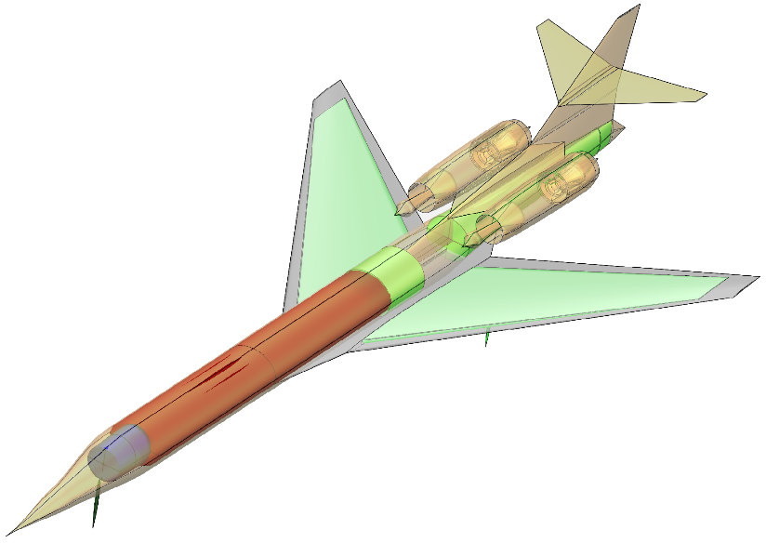
Low-Boom Supersonic Transport
Demand Modeling
National Aeronautics and Space Administration
Systems Analysis Symposium 2023
Ty Marien
November 15, 2023
Cabin
Cockpit
Conformal fuel tanks
www.nasa.gov

Slide 2
ISAT Supersonic Studies Background
For past few years, the PAMO/ISAT has sponsored a series of studies with the Virginia Tech Air Transportation Systems Laboratory to look at supersonic transport market demand through the contract with the National Institute of Aerospace.
Objectives:
Determine the target size/range/speed of the low-boom “objective vehicle”
Explore the market feasibility of supersonic transports
Understand how low-boom designs compare to conventional designs in terms of vehicle economics.
Study Participants
Study leads: Ty Marien (LaRC), Jon Seidel (GRC)
Vehicle definition: Karl Geiselhart, Wu Li (LaRC)
Demand prediction: Dr. Antonio Trani, Zhou Wang, Edwin Freire Nick Hinze (Virginia Tech), Sam Dollyhigh (Analytical Mechanical Associates)

Slide 3
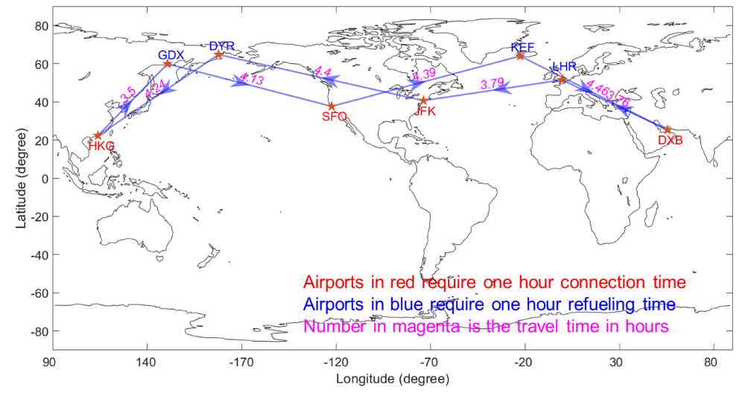
FY22-23 Supersonic Transport Scheduling and Fleet Analysis Study
Over the course of these previous studies, Virginia Tech has developed a passenger demand methodology called the Low-Boom Systems Analysis Model (LBSAM).
In the next set of charts, Dr. Toni Trani from Virginia Tech will give an overview of LBSAM, describe the work that was done in the most recent Supersonic Transport Scheduling and Fleet Analysis Study, and share some of the latest demand results.
Study Primary Tasks:
Add a network model with tail tracking and feasible flight schedules to help verify our aircraft network utilization assumptions.
Add a passenger preference model to LBSAM to better predict the passenger switch rate from subsonic to supersonic service.
Run sensitivity studies of the integrated demand model to validate its operation.

Slide 4
Low-Boom Market Studies Current Status
The most recent Supersonic Transport Scheduling and Fleet Analysis Study represented the final critical development pieces for LBSAM. The contract with Virginia Tech completed last December and there is no current follow-on study.
LBSAM has been handed off to NASA and it is being used to inform the design of low-boom supersonic transport concepts.
In the next presentation, Dr. Wu Li will describe how the NASA team is using LBSAM in their design process and the results they are getting.
ISAT has interest in further developing LBSAM and possibly adapting LBSAM for other vehicle markets, but we are currently in a challenging funding environment.

