Slide 1


Novel Ceramic Dispersion Strengthened Refractory Metals for Improved Printability and Properties
Carly J. Romnes
NASA Marshall Space Flight Center
Nuclear, Plasma, & Radiological Engineering, University of Illinois Urbana-Champaign
Special thanks to:
Those working on RAAMBO at NASA; and at UIUC: Stubbins Group, SMEE Group, ETRL, and CPMI
2023 Formnext Annual Expo
8 November 2023

Slide 2


Presentation Overview
Motivation for work
Background on nanoparticle effects in AM
Our research goal, further background
Initial material down-selection process
Experimental methods used and initial results of some of those methods
Computational methods, results and approach for design of experiments
Experimental results, comparison with computational results

Slide 3
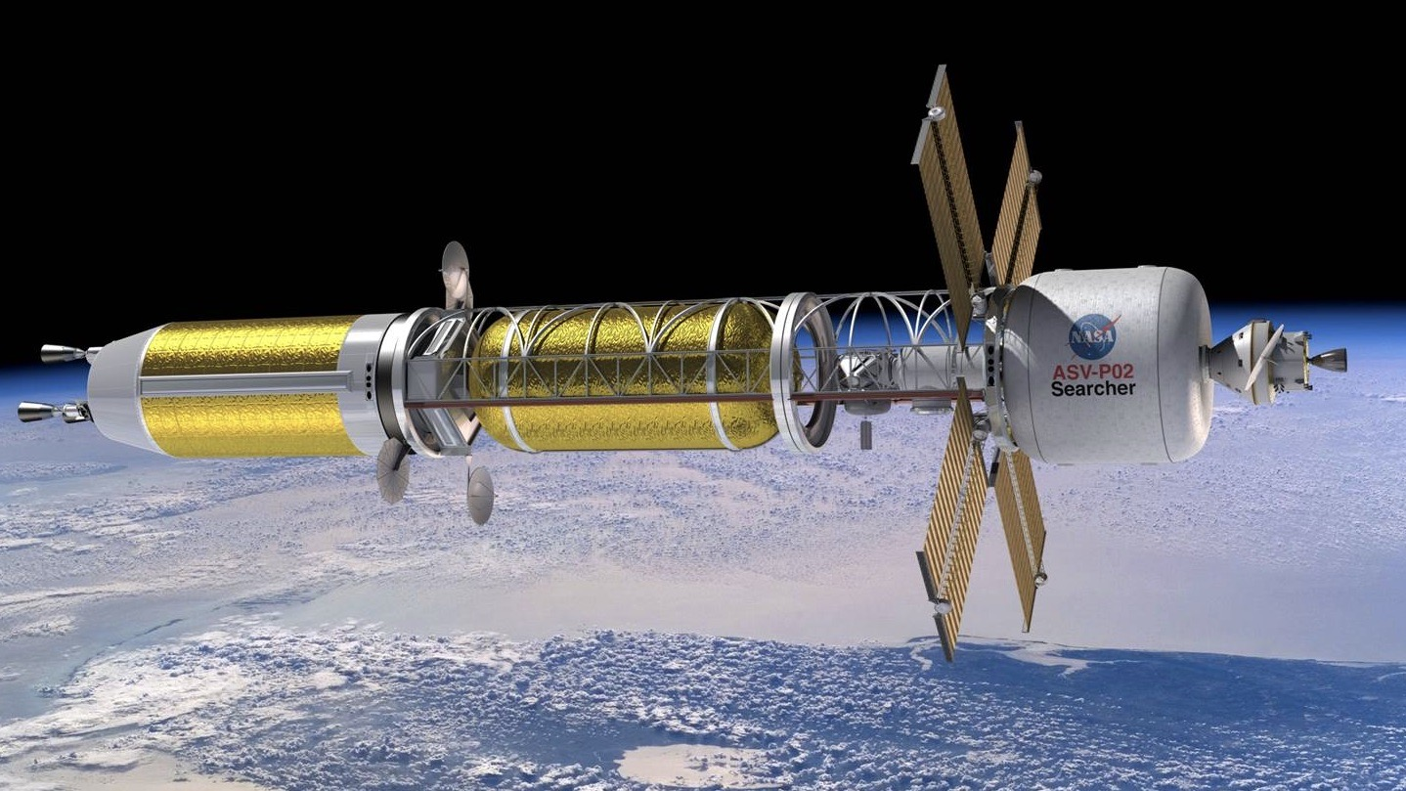
Next-generation nuclear energy systems require refractory materials
Refractory alloy components are difficult and expensive to fabricate
These alloys have a variety of applications in extreme environments:
Nuclear fusion systems (divertors, plasma facing components)
Space nuclear power and propulsion
Elevated temperature environments (>1500C)
Aerospace systems
Hypersonic applications
Machining difficult
Fabrication expensive due to amount of waste
NASA’s Nuclear Thermal Propulsion Project Concept
NASA.gov
Background

Slide 4
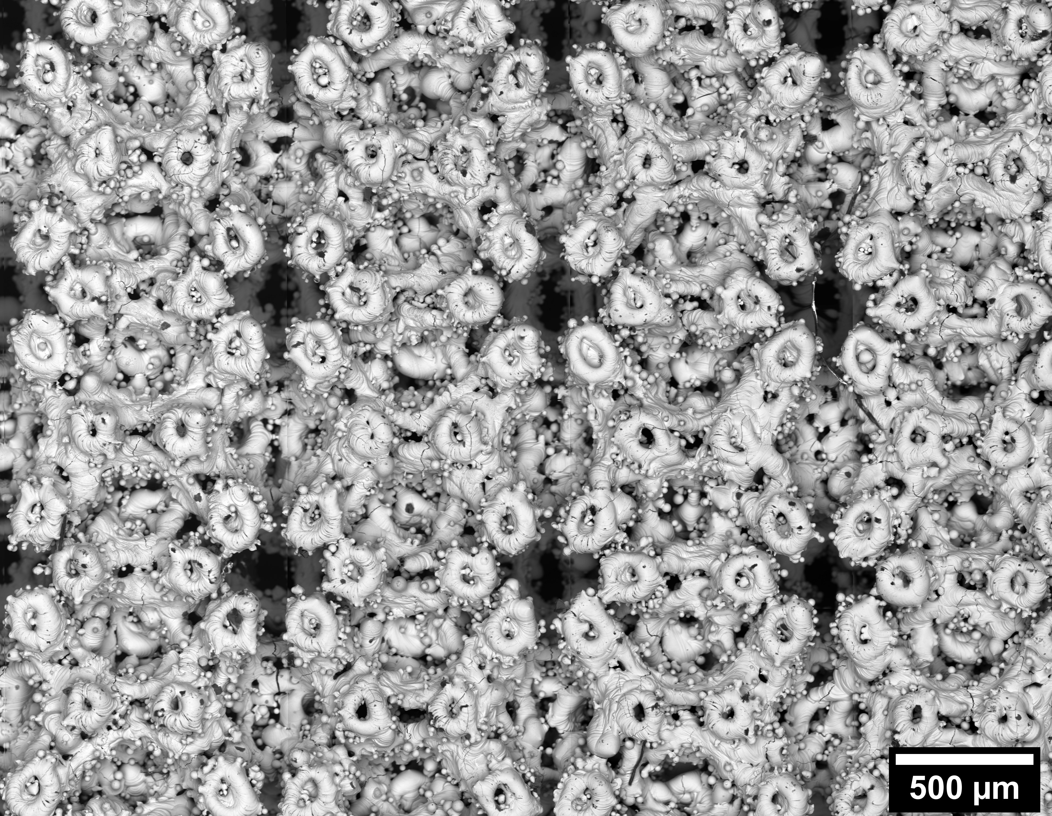
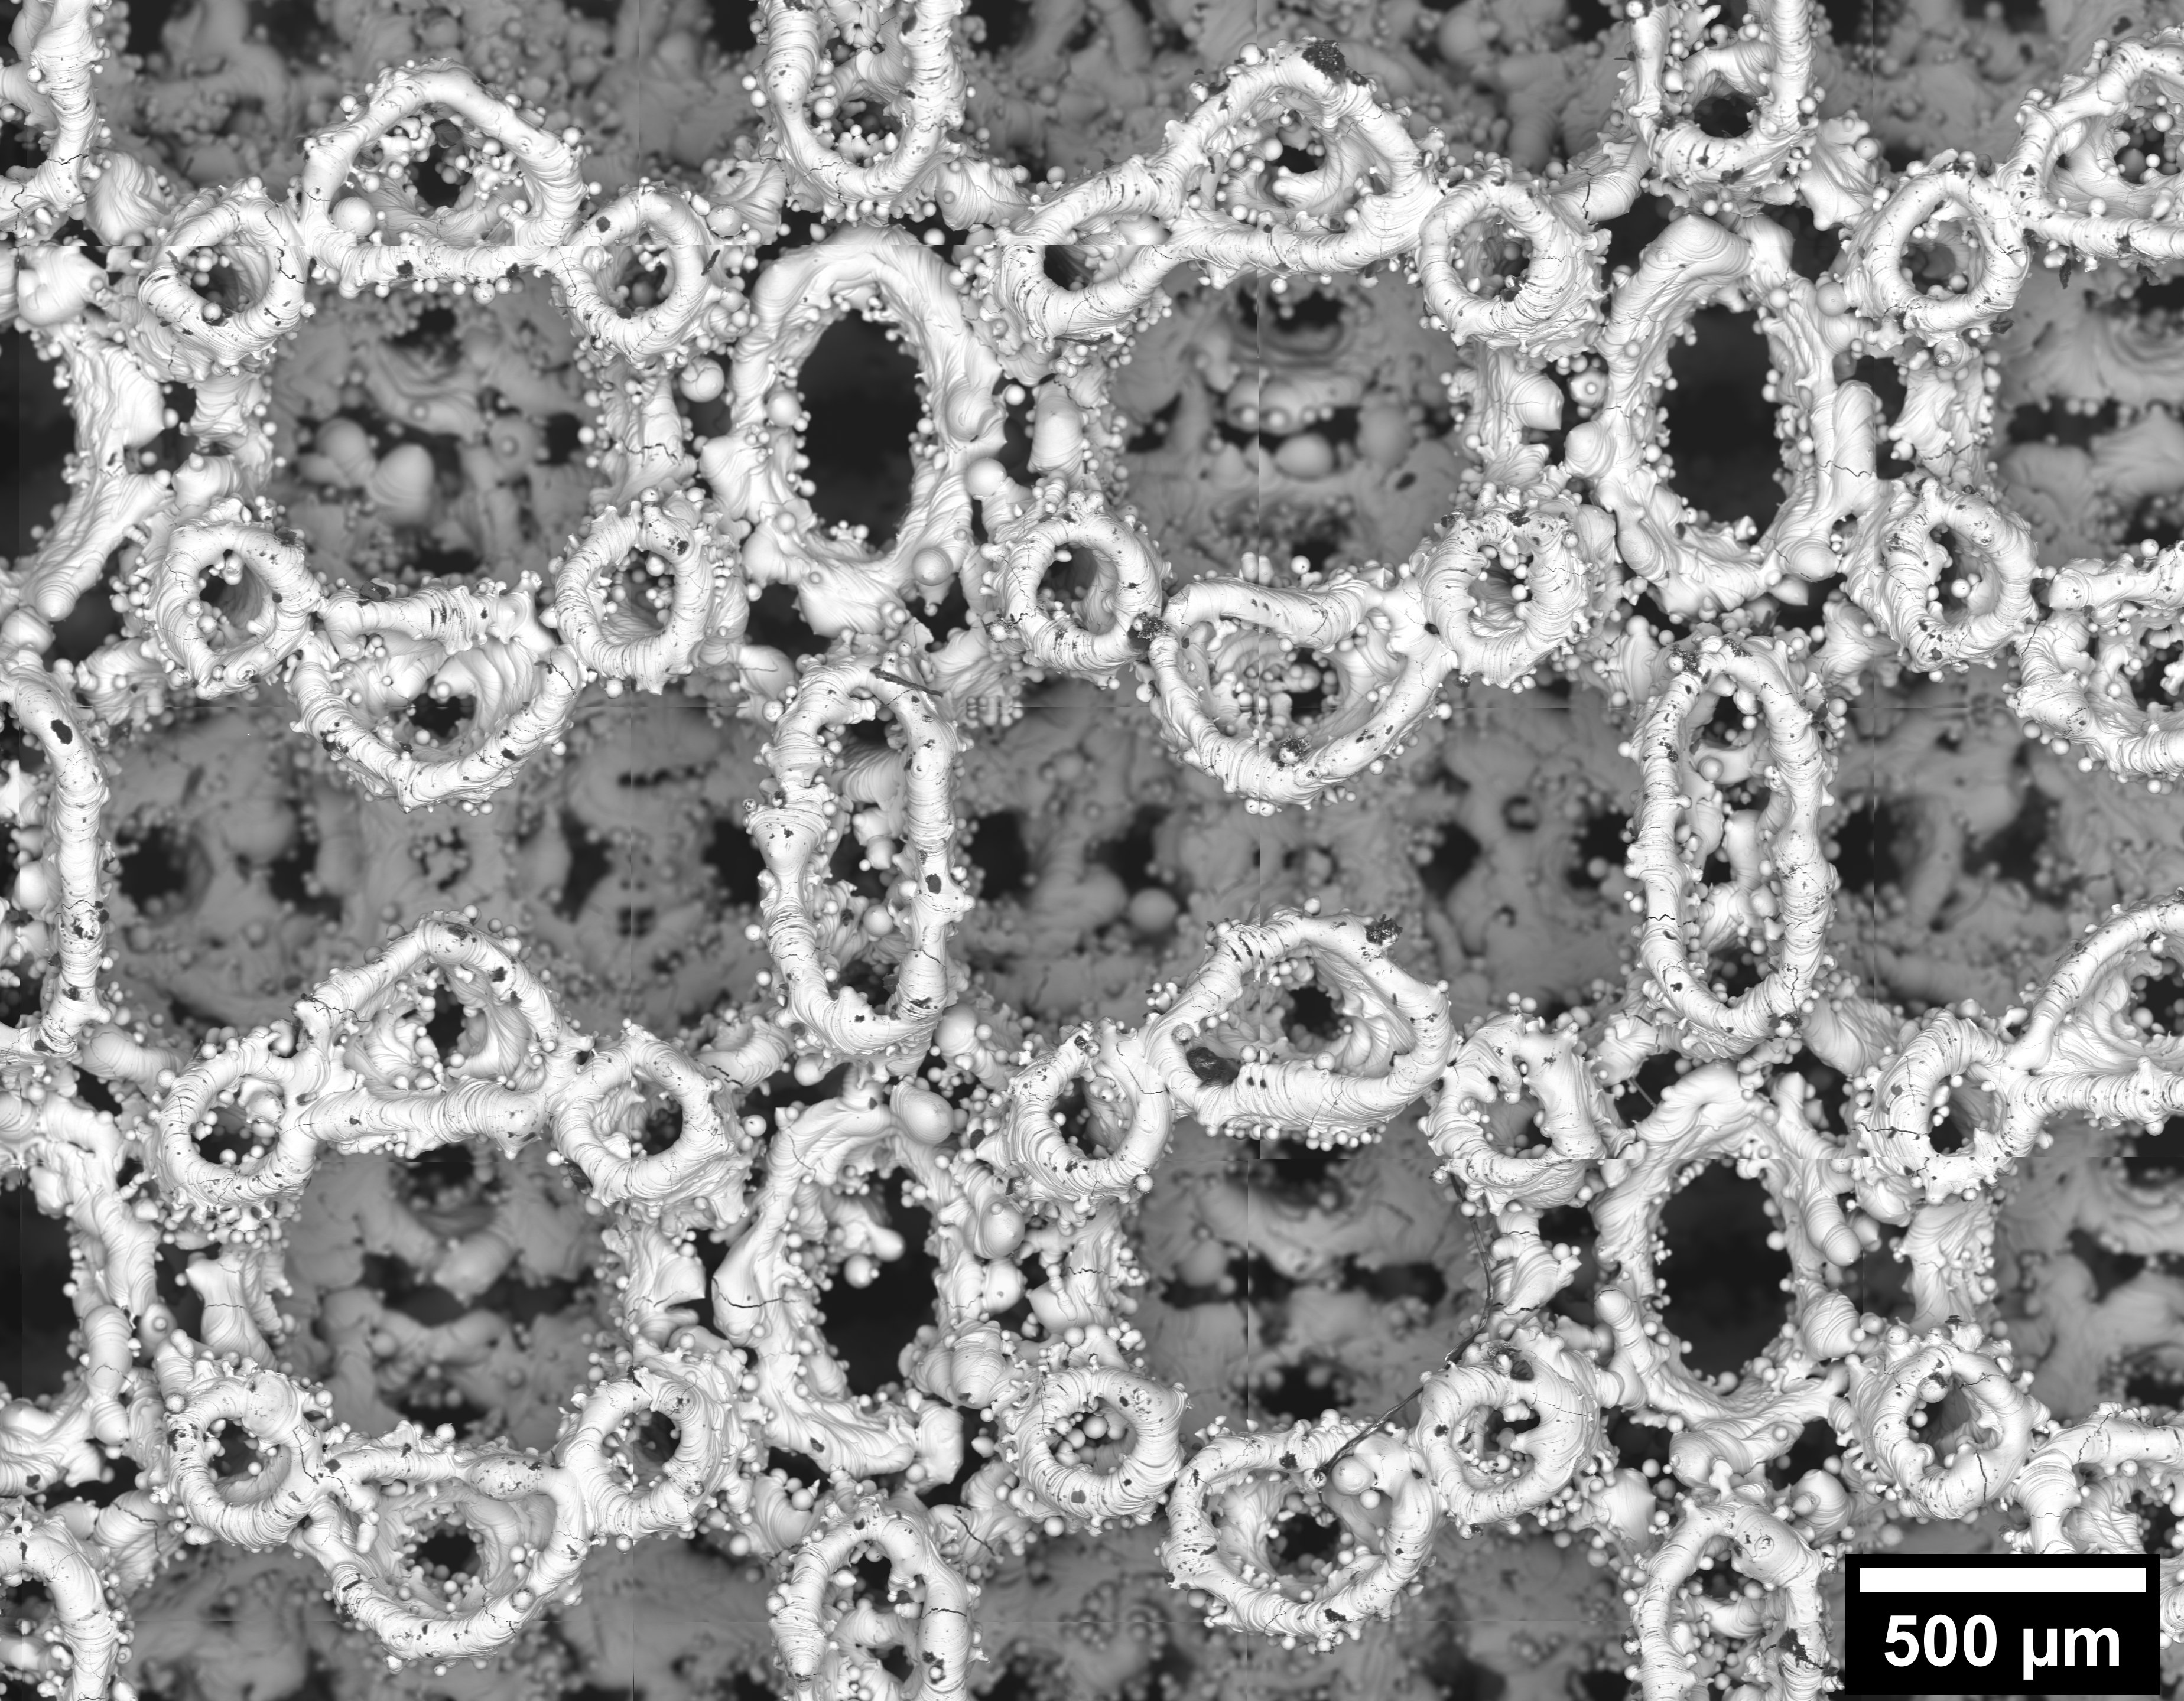
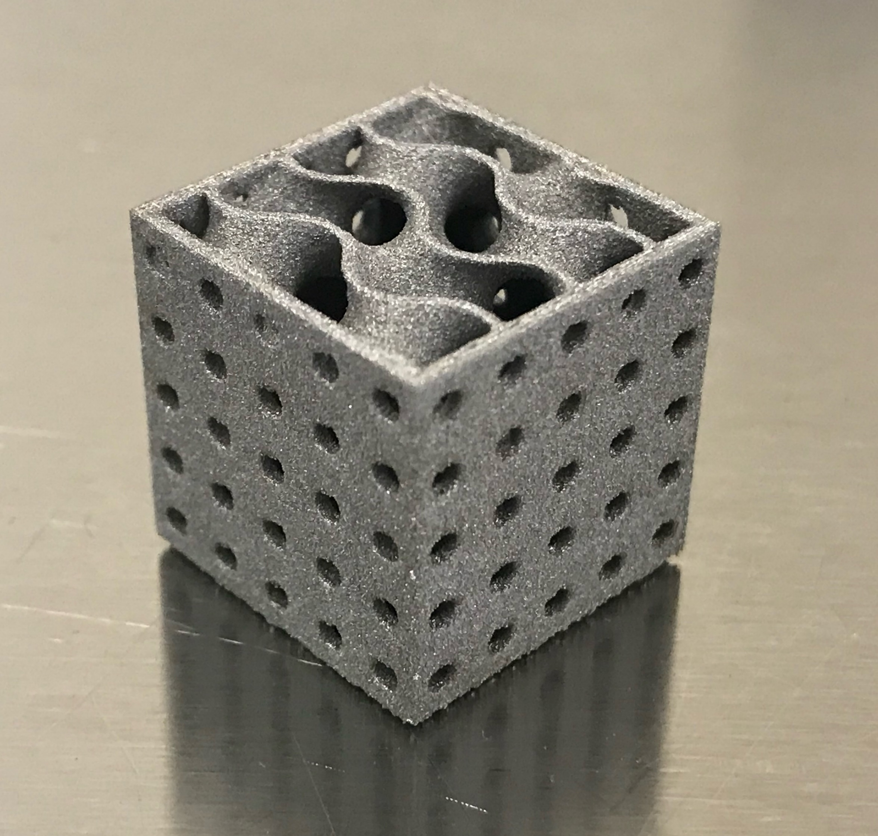
AM of refractory metals has many benefits
L-PBF molybdenum lattice structures with different unit cell sizes
Additive manufacturing (AM) can help reduce fabrication expenses of refractory materials
Used to fabricate near-net-shape components
Powder recycling reduces material waste and cost associated with fabrication
AM promotes fabrication of particularly complex structures
UC = 1.0 mm
UC = 1.5 mm
NASA RAAMBO, unpublished.
L-PBF tungsten test print of optimized heat exchanger design
L-PBF tungsten, ultra-fine lattice, UC = 0.5 mm
Courtesy of B. Colon, UTEP
C. Romnes et al., JMEP 31(8) (2022), pg. 6256-6269.
Background
Notes:
AM promotes fabrication of particularly complex structures than can be achieved using traditional fabrication techniques

Slide 5
AM of pure refractory metals shows microcracking and porosity
L-PBF Tungsten
After print parameter optimization, results still unfavorable
High thermal gradients and reheating result in residual stresses that can cause cracking
Brittleness of some metals results in stress-relief through microcracking
Porosity often due to lack of fusion
How to decrease cracking and porosity in AM refractory metals?
→ Grain refinement
Microcracks
L-PBF Molybdenum
Build Direction
NASA RAAMBO, unpublished.
Background
Notes:
Add image of cracking in DED samples
High thermal gradients and reheating result in residual stresses that can cause cracking
Most AM metals are heat treated to relieve stresses before removal from build plate
Brittleness of some metals results in stress-relief through microcracking
Directional heat flow results in dendritic grains which promote crack propagation
Porosity often due to lack of fusion due to high melt temp of refractories, which overly-aggressive print parameters can reduce
Aggressive parameters result in issues with printing complex geometries
3 cracking mechanisms:
Hot cracking, solidification cracking
Thermal shock (large deltaT, deltaL = alpha*deltaT)
DBTT-shift
DBTT – smaller grains, lower DBTT. How to keep small? Zener Pinning
T_{L}-T_{S} = large, then hot cracking is a problem, steep Scheil curve (eutectic has low crack sus)

Slide 6
Current need for rigorous approach to AM refractory alloy design
Some work with adding ceramic dispersoids has shown promising results
A few studies have showed that adding ZrC and TaC to tungsten AM feedstock helped reduce cracking
No justification for why the ceramic or the composition was chosen
K. Li et al., IJRMHM 79 (2019), pg. 158-163.
J. Chen et al., JALCOM 897 (2022) 162978.
Direct impact of nanoparticle is unclear due to melting
Nanoparticle melting can be caused by:
Low nanoparticle melting temperature compared to base metal
Melting temperature suppression of nanoparticles
Aggressive print parameters
Result is different compounds form, as well as cellular structures if large amounts added
Background
Notes:
Issue is most studies only look at one composition
Need for rigorous approach to design AM refractory alloys with favorable properties
So is this good or bad? Well, the theory behind nanoparticle addition is based on the assumption that the nanoparticles DO NOT melt or form compounds fairly early on in the solidification process.

Slide 7
Current need for rigorous approach to AM alloy design
The goal of this work is to prevent cracking and improve printability for AM of refractory metals
Identify and utilize computational tools to narrow down the experimental space
Develop a rigorous computational approach for AM alloy design utilizing feedback from experimental work
Want to add small amount of other material, prevent large changes in properties
Is melting good or bad??
L-PBF Pure W
NASA RAAMBO, unpublished.
J. Martin et al., Nature 549 (2017), pg. 365-369.
Goal
Notes:
Well, the theory behind nanoparticle addition is based on the assumption that the nanoparticles DO NOT melt or form compounds fairly early on in the solidification process.

Slide 8
Nanoparticles can act as grain nucleation sites, helping control solidification
Nanoparticles added to AM feedstock can have multiple effects:
Acts as grain nucleation sites
Promotes equiaxed grains during fabrication
Reduces grain size, promoting decreased DBTT
Prevents grain growth by Zener pinning
These effects can result in increased strength, nearing the values of wrought metals
Background
Notes:
Fine, equiaxed grains more readily accommodate strain caused by thermal contraction
Helps prevent cracking by decreasing grain size:
Increases fracture toughness
Increases strength
Reduces brittleness

Slide 9
Is melting good or bad?
Promising results but melting may result in smaller impact of nanoparticles
Bad because different phases formed, new phases could be undesirable
May be okay if secondary phase forms at beginning of solidification
How to predict nanoparticle influence?
Background
Notes:
Issue is most studies only look at one composition
Need for rigorous approach to design AM refractory alloys with favorable properties

Slide 10

Material Down-selection

Slide 11
Material down-selection depends on application of interest
Used nanoparticle melt temperature as major selection criteria
Will allow us to show direct impact of solid nanoparticle vs. nanoparticle melting
Highest melting temperature materials are ceramics:
Carbides
Borides
Oxides
Methods

Slide 12
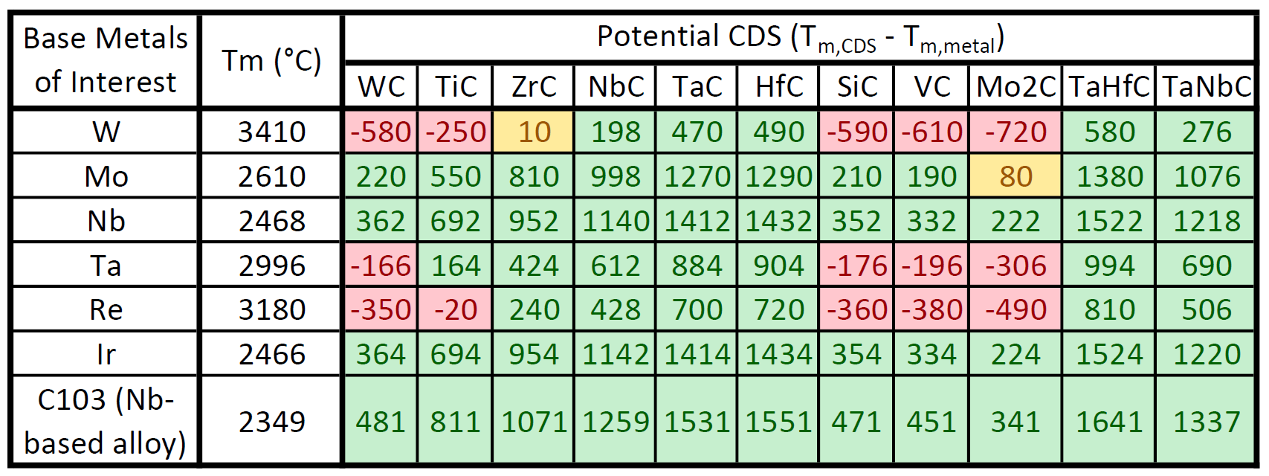
Initial computational selection criteria based on melting temperatures
Melting temperature was used to try to ensure ceramic particle survival during the print process
Color Legend
 | Disqualified, T_{m,ceramic} < T_{m,metal}
 | Likely will melt, T_{m,ceramic} < T_{m,metal} + 100
 | Good candidate, T_{m,ceramic} > T_{m,metal} + 100
Methods
Notes:
The highest melting temperature ceramics are carbides, borides, and oxides
This work focuses on carbides
Oxides eliminated due to poor oxidation resistance of refractory metals
Additionally, oxygen content of AM powders is fairly high, and oxygen is introduced during fabrication
Borides eliminated due to high neutron absorption cross-section

Slide 13
Material down-selection depends on application of interest
Used nanoparticle melt temperature as major selection criteria
Will allow us to show direct impact of solid nanoparticle vs. nanoparticle melting
Highest melting temperature materials are ceramics:
Carbides
Borides
Oxides
Additional selection criteria:
Cost
Database availability for ICME design
Neutron absorption cross-section
Strength-to-weight ratio
Oxidation and corrosion resistance
Methods
Notes:
Issue is most studies only look at one composition
Need for rigorous approach to design AM refractory alloys with favorable properties

Slide 14
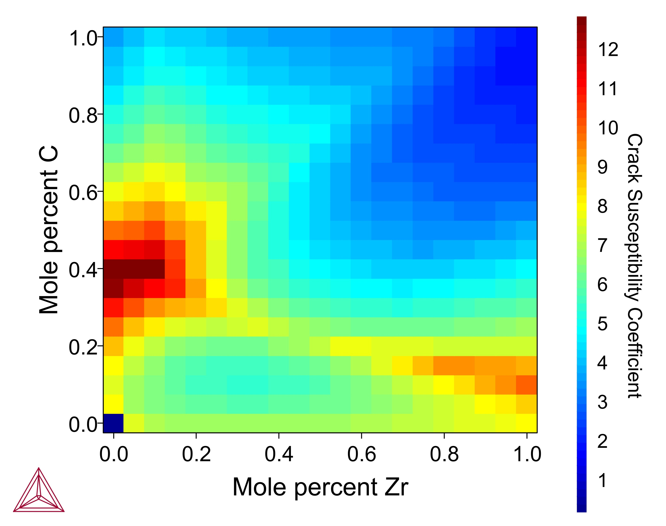
Initial Simulations

Slide 15
Many simulations have been proposed to help predict alloy behavior, printability, and nanoparticle survivability
Utilize computational tools to narrow trade space
Thermo-Calc Simulations:
Phase diagram modeling
Diffusion simulations
Precipitation simulations
Scheil solidification simulations
Crack susceptibility coefficient
Other models:
Kou crack susceptibility index
Rosenthal melt pool model
Big Question:
Do nanoparticles melt or survive printing?
Computational Methods

Slide 16
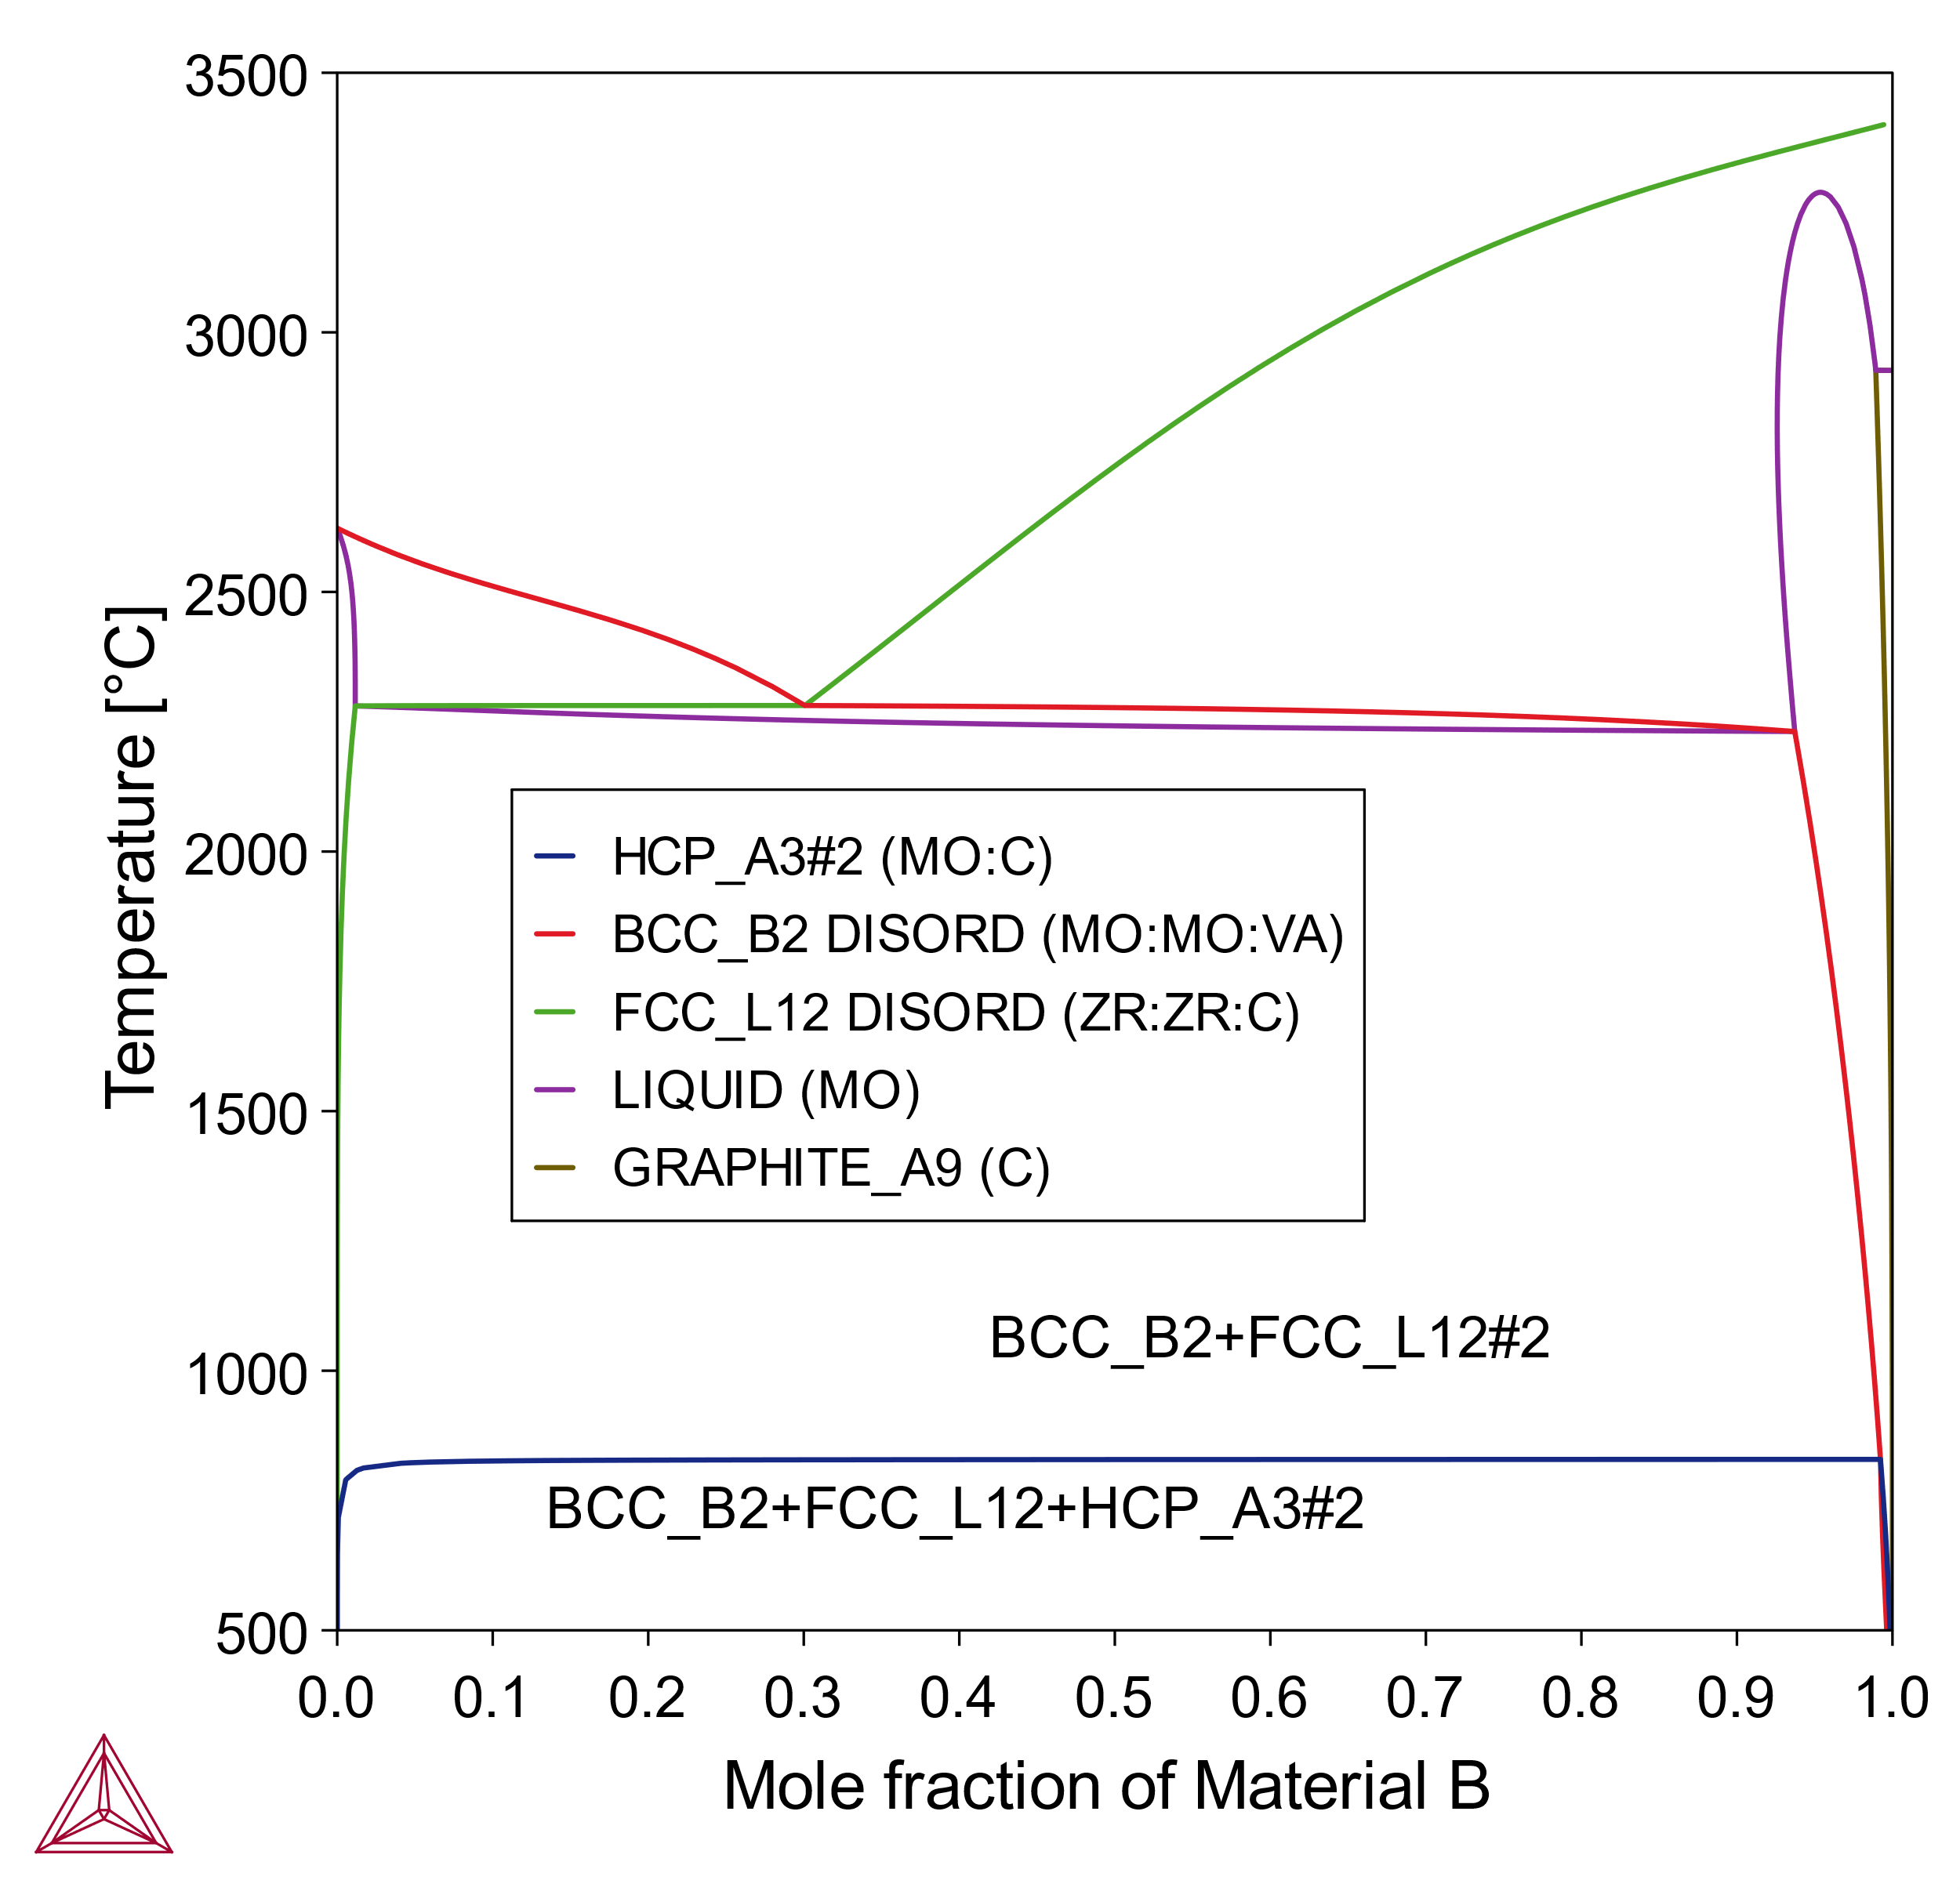
Thermo-Calc: first step is to calculate phase diagram information
Thermo-Calc’s Material-to-Material calculator allows phase diagram calculations
Need to ensure that material system has been assessed for the database used
Can be used to identify unwanted phase formation
Biggest issue is ability to add oxygen to simulations
Not many databases have been well evaluated for oxygen in refractory metals
GRAINGER ENGINEERING
Mo + ZrC Computational Results

Slide 17
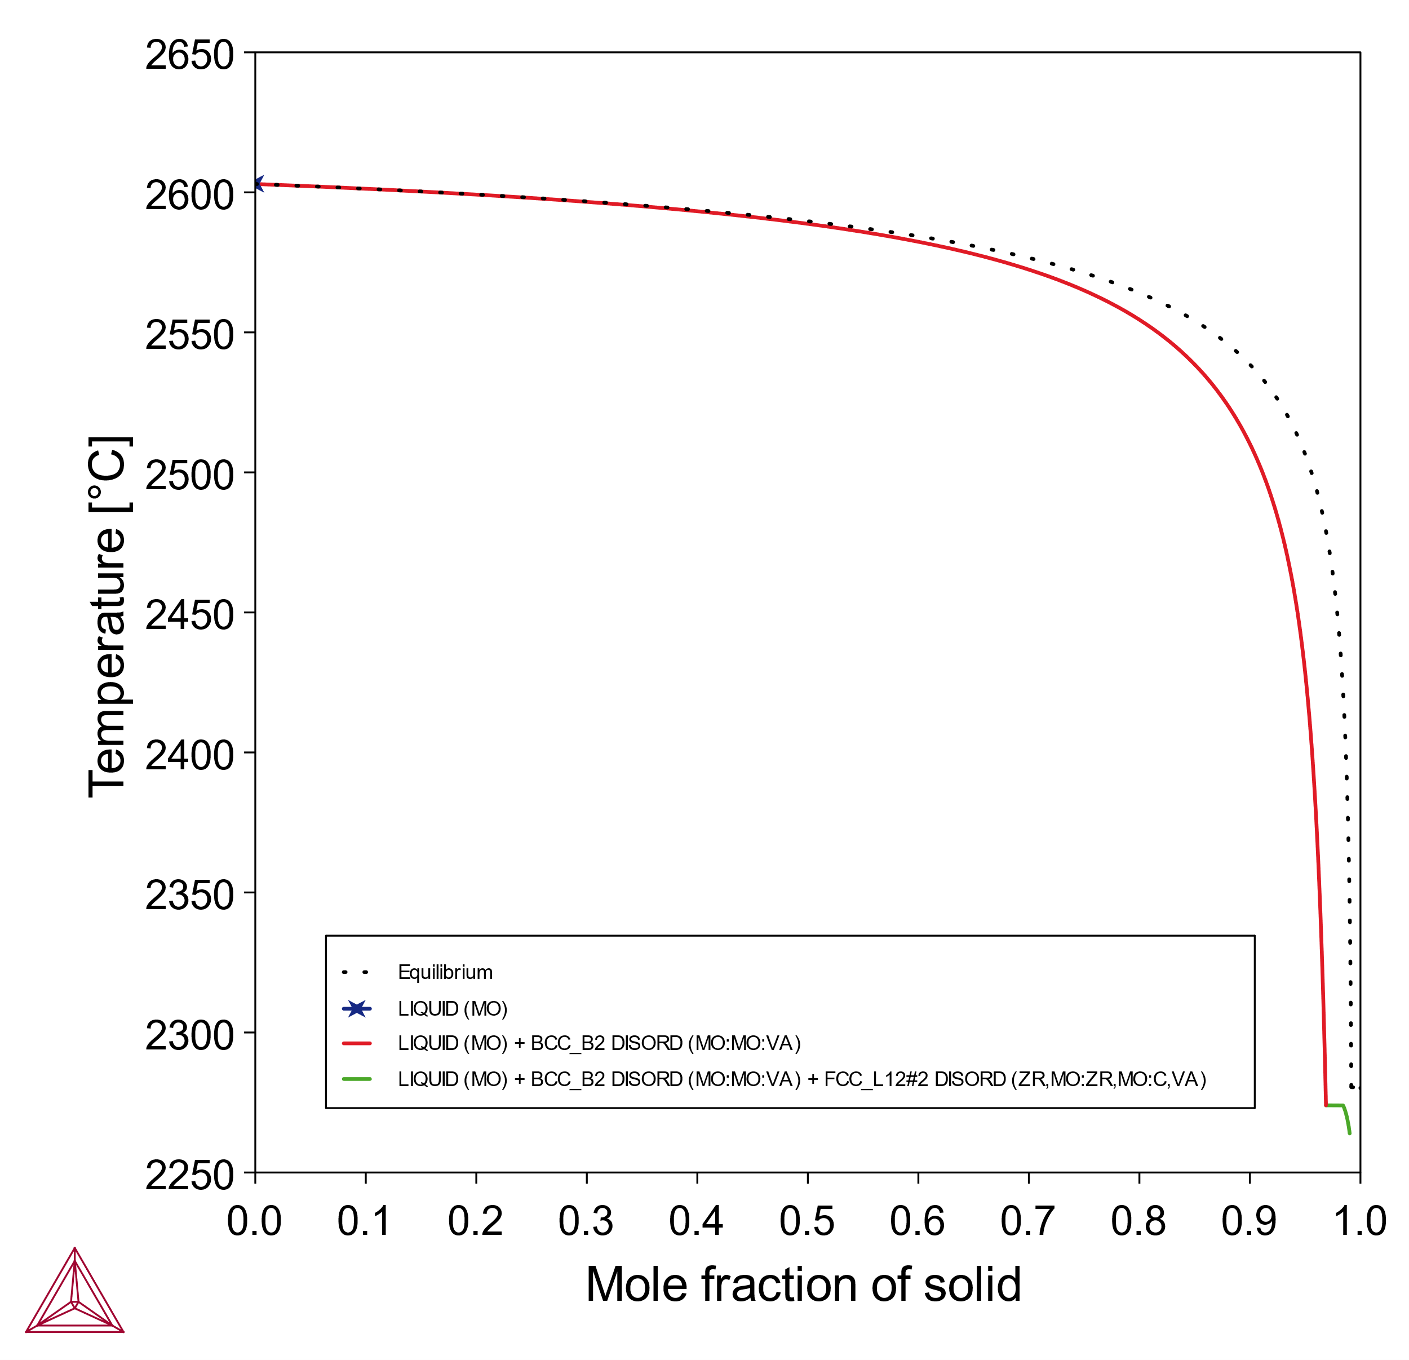
Thermo-Calc: then perform Scheil solidification simulations
Thermo-Calc’s Scheil solidification simulations help predict dendrite behavior
Different types of Scheil simulations, classic Scheil typically the go-to
Crack susceptibility (Kou method) is estimated from the slope at the end of the Scheil solidification curve
Inclusion of C and O essential for accurate predictions of segregation behavior
GRAINGER ENGINEERING
Mo + ZrC Computational Results

Slide 18
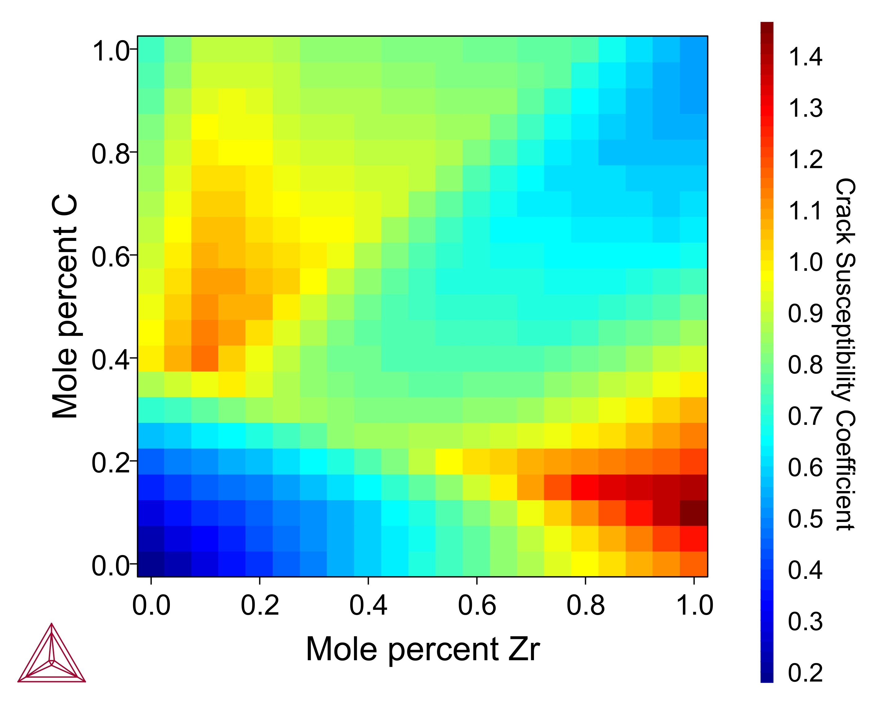
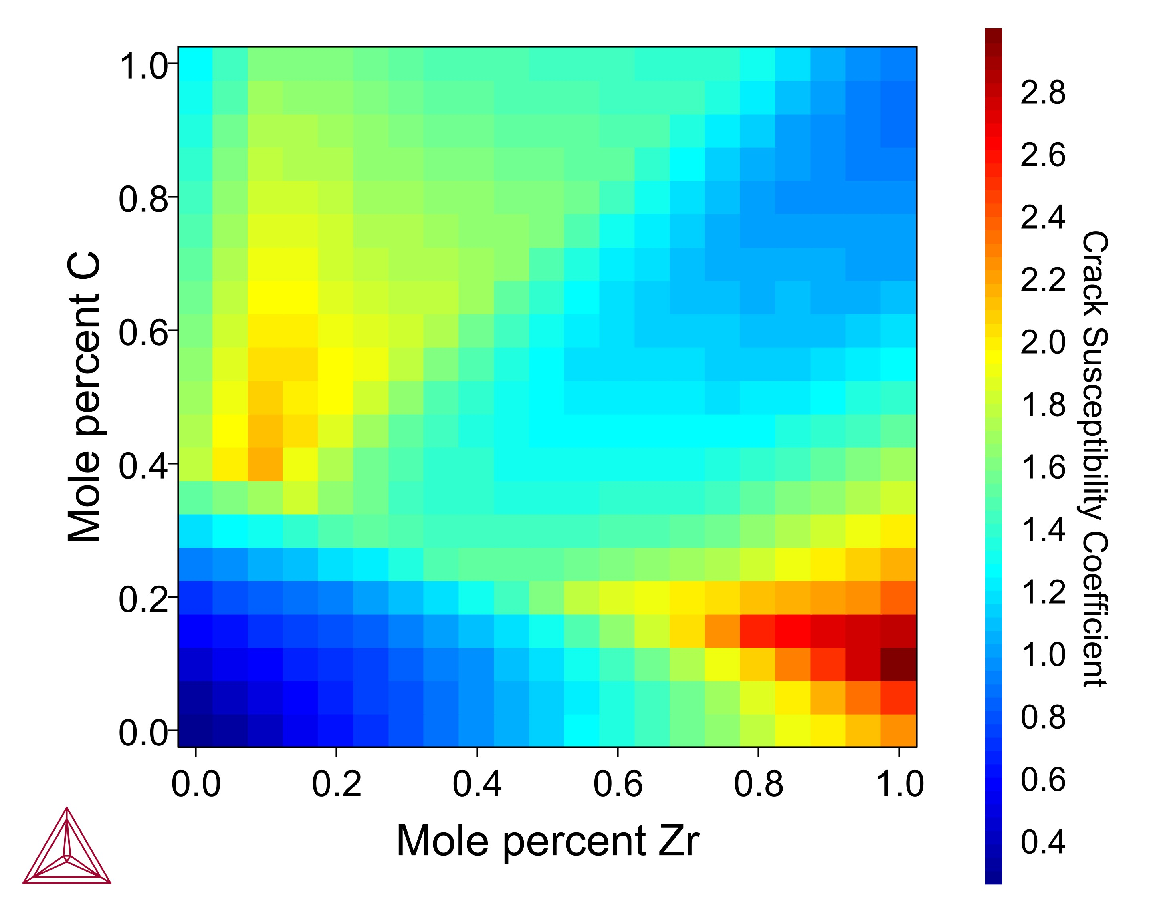
Thermo-Calc: crack susceptibility was calculated using several approaches
*
Built in Crack Susceptibility Coefficient (CSC) property modeler is used to predict hot cracking
Several options for this module that is based on the work of Yan and Lin
Constant cooling rate likely most similar to what expected for Kou method performed with classic Scheil simulations
*
*
*
Constant Heat Flow (dQ/dt = C)
Heat Flow ∝ 1/sqrt(t)
Constant Cooling Rate (dT/dt = C)
GRAINGER ENGINEERING
Mo + ZrC Computational Results

Slide 19
Experimental Methods

Slide 20
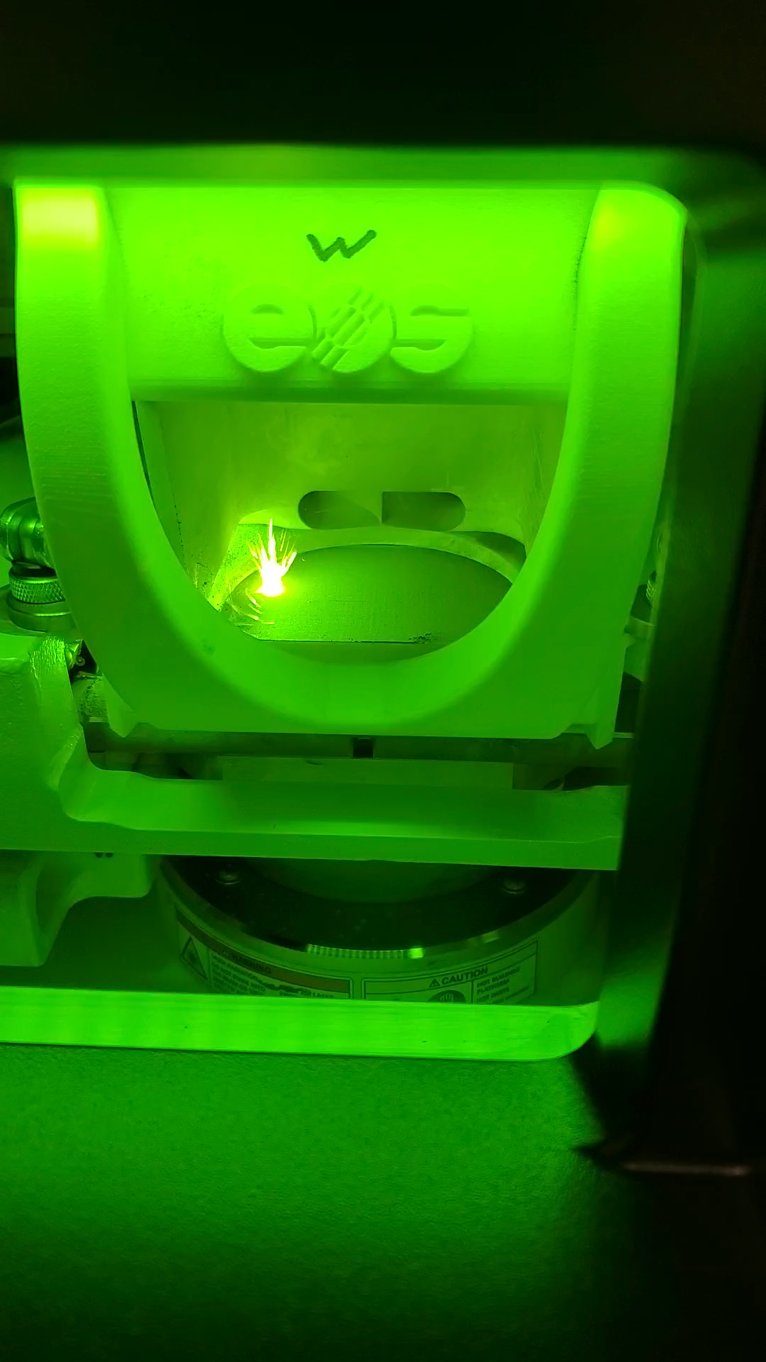
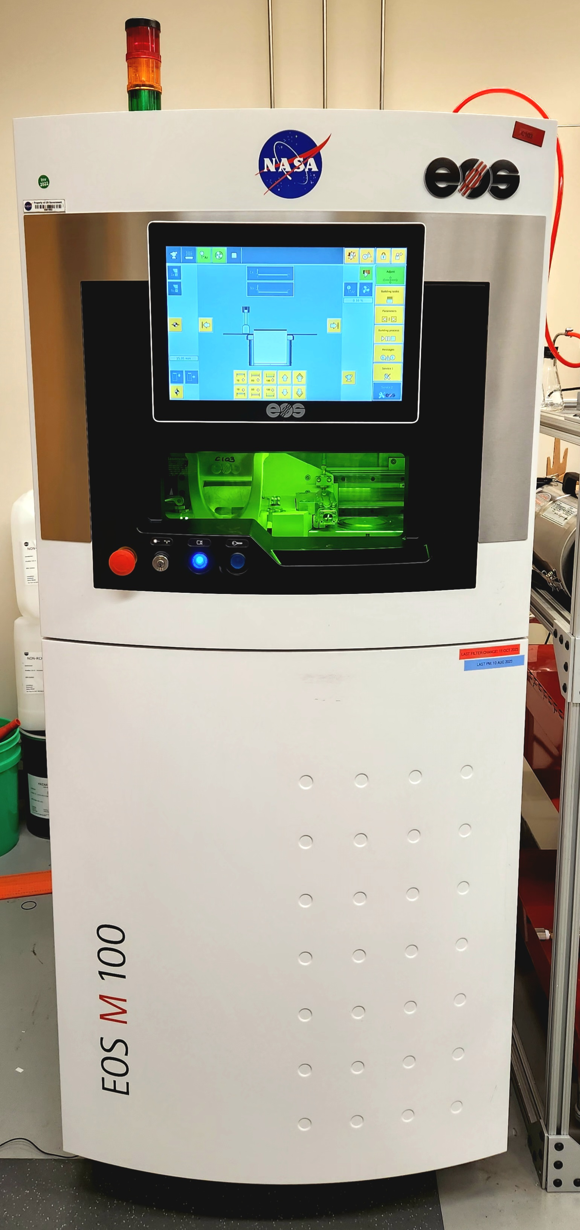
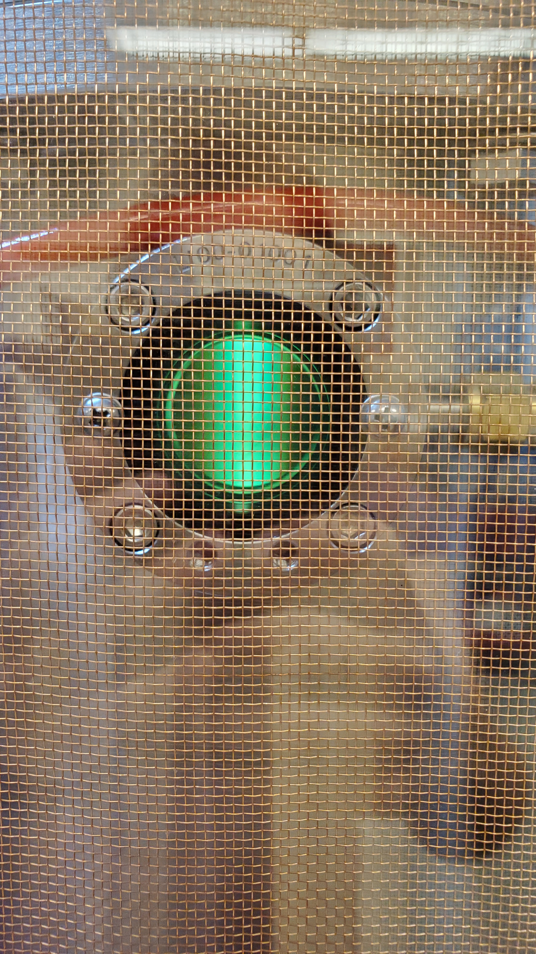
Small L-PBF system used to reduce cost associated with alloy development
EOS M100 Metal L-PBF System with high accuracy oxygen meter
Plasma spheroidization may be required to prevent inhomogeneities
Excess powder from printing is sieved to remove oversized powder
Nanoparticles may detach during powder recycling
TEKNA TEKSPHERO-15 plasma spheroidizer
Experimental Methods

Slide 21
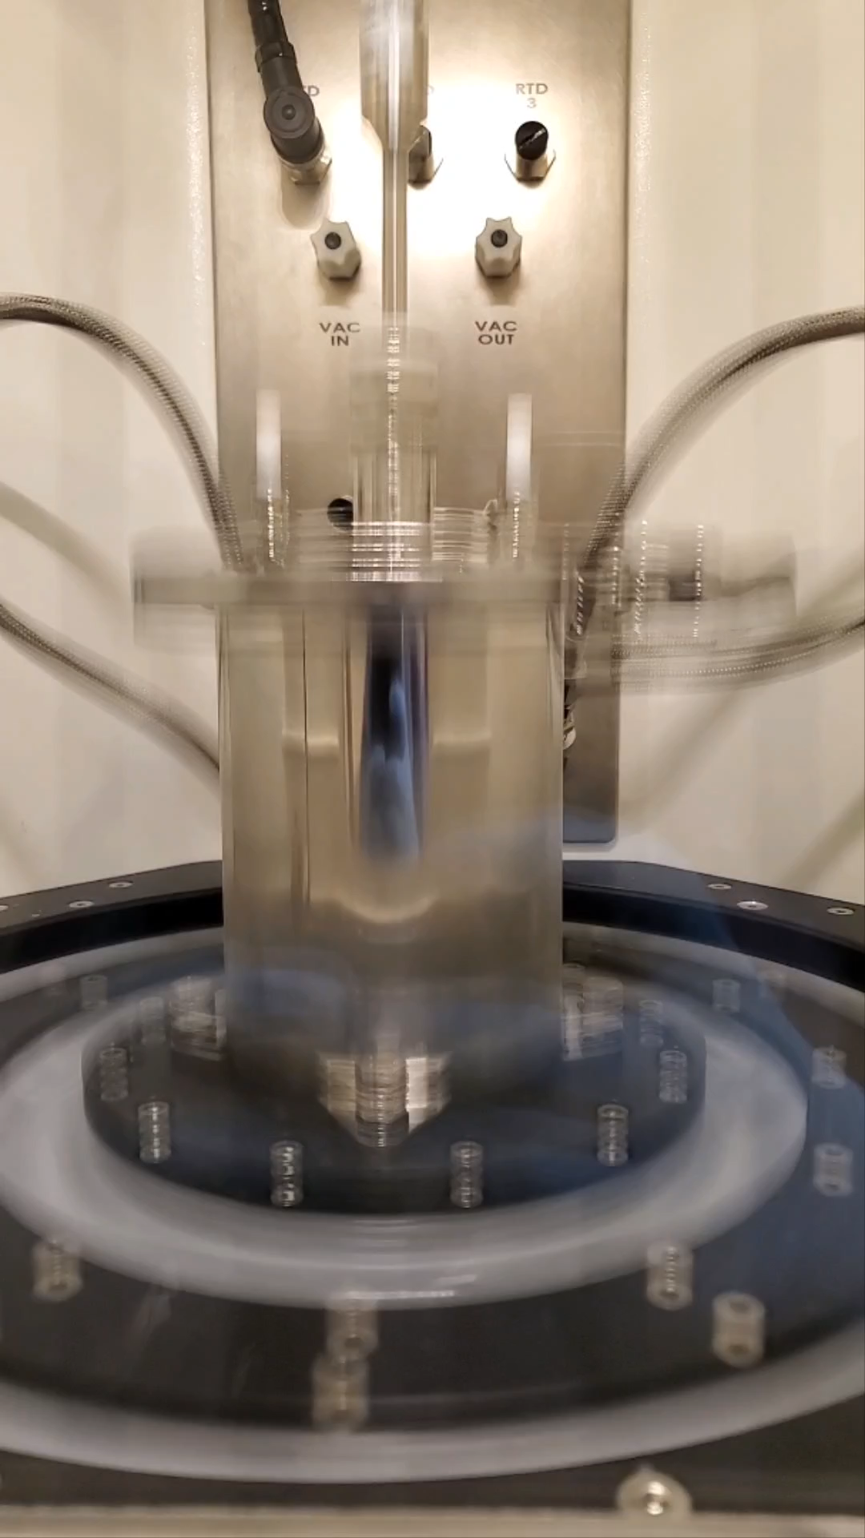
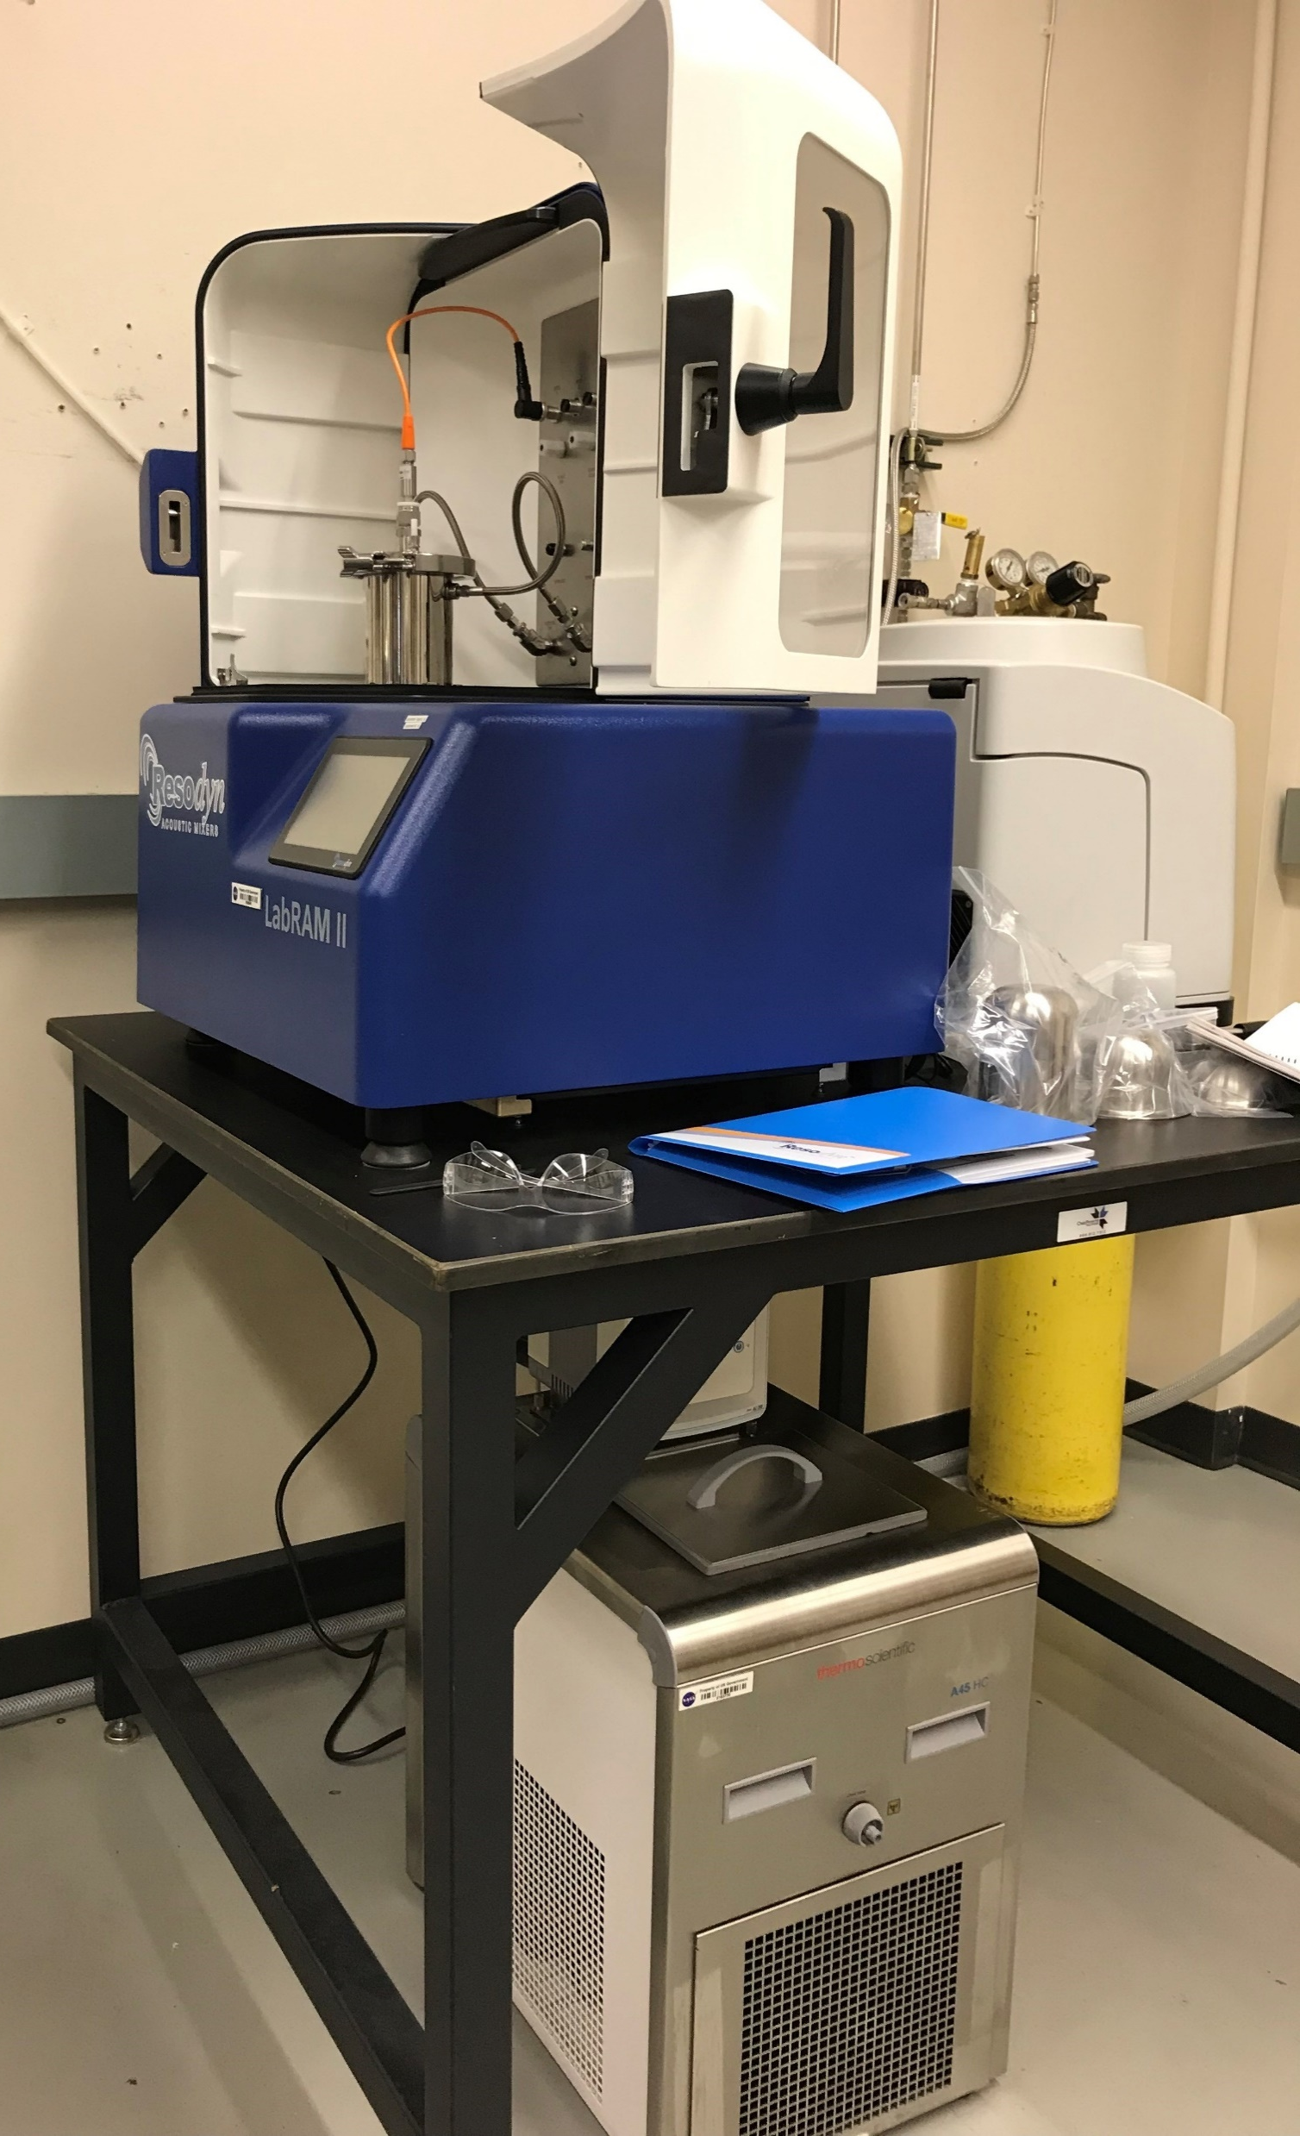
Acoustic mixing promotes uniform nanoparticle distribution without AM powder damage
Resodyn LabRAMII Acoustic Mixer with Cooling Fixture
Acoustic mixing prevents damage and deformation of spherical AM powder
Cooling fixture prevents powder overheating during mixing
Experimental Methods

Slide 22
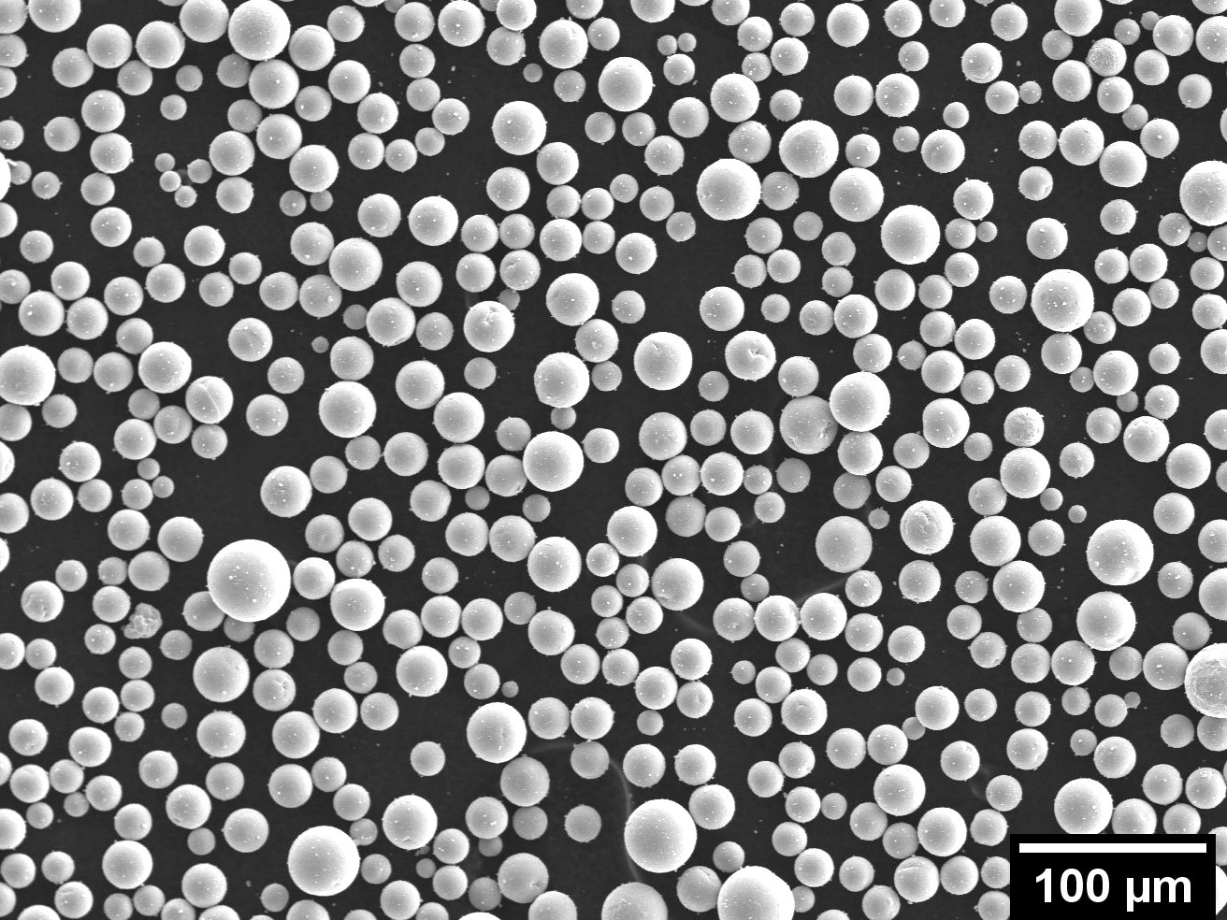
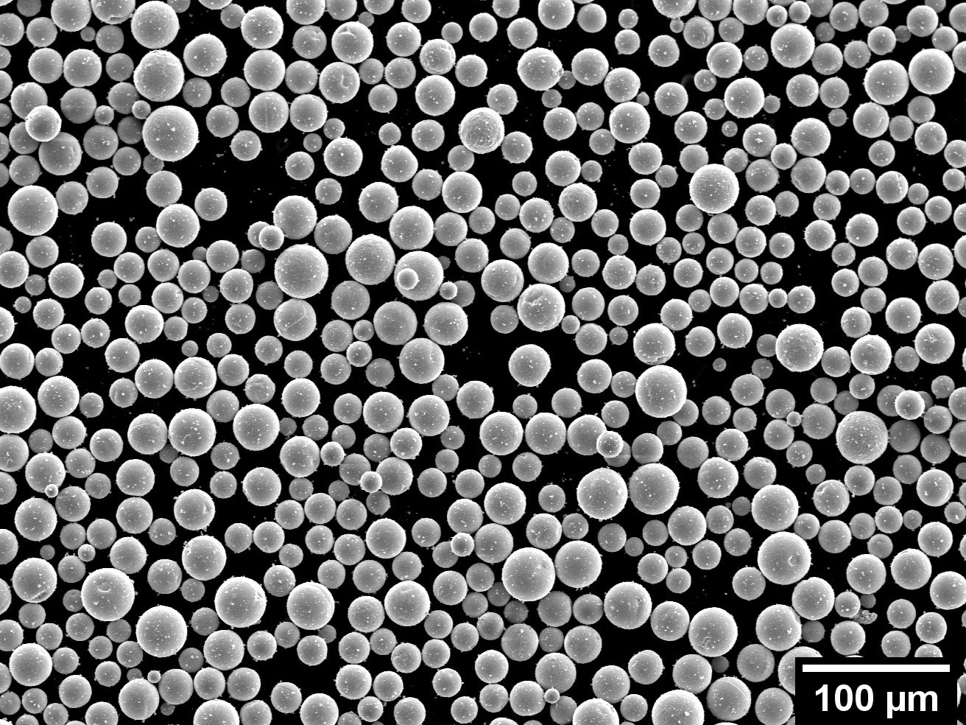
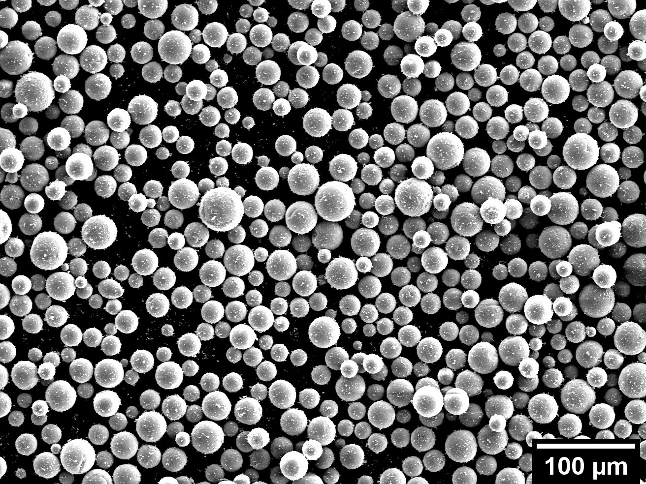
Acoustic mixing promotes uniform nanoparticle distribution without AM powder damage
Acoustic mixing prevents damage and deformation of spherical AM powder
Promotes uniform powder distribution without issues seen with mechanical mixing
Even after spheroidization, studies have seen irregular powder morphology
Ensures particle size distribution does not change
May eliminate need for spheroidization after mixing
K. Li et al., IJRMHM 79 (2019), pg. 158-163.
J. Chen et al., JALCOM 897 (2022) 162978.
Spherical Mo + ZrC (400-1200nm) Acoustically Mixed
0.15 mol %. ZrC
0.30 mol %. ZrC
0.60 mol %. ZrC
NASA RAAMBO, unpublished.
Experimental Methods/Results

Slide 23
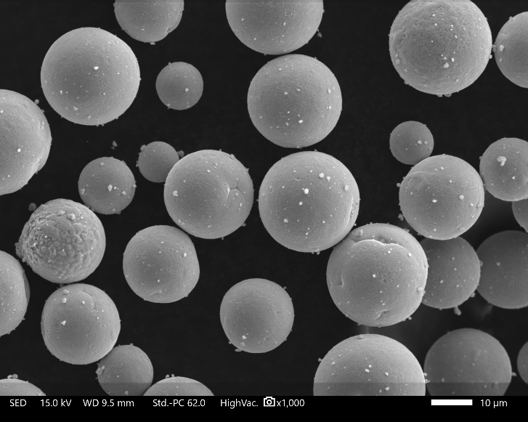
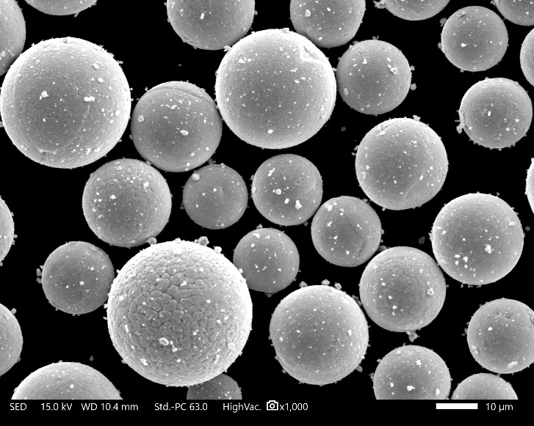
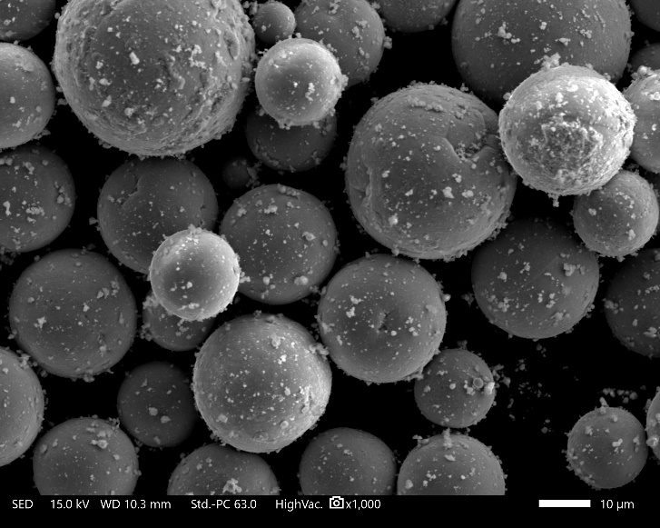
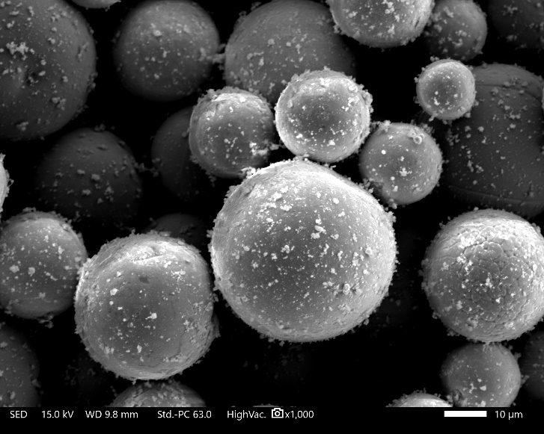
Acoustic mixing does have limitations
Spherical Mo + ZrC (400-1200nm) Acoustically Mixed
One issue seen is the saturation limit of powder homogenously mixed
ZrC caking on vessel walls seen after mixing 0.60 mol% in Mo
0.15 mol %. ZrC
0.30 mol %. ZrC
ZrC
ZrC
Mo
10 µm
0.60 mol %. ZrC
1.35 mol %. ZrC
ZrC
ZrC
NASA RAAMBO, unpublished.
Experimental Methods/Results

Slide 24
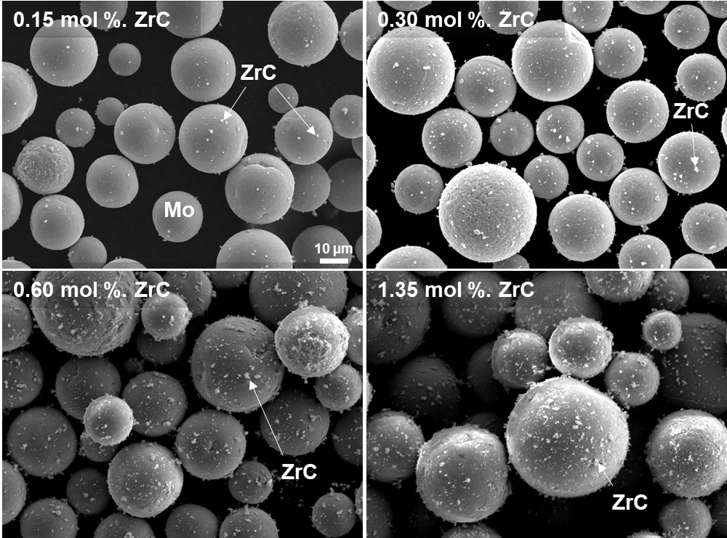
Acoustic mixing does have limitations
BSE Image
EDS Overlay
One issue seen is the saturation limit of powder homogenously mixed
ZrC caking on vessel walls seen after mixing 0.60 mol% in Mo
Saturation observed was dependent on nanoparticle size used
Not all nanopowders behave similarly
400 – 1200 nm
Zr
Mo
20 µm
80 nm
20 nm
NASA RAAMBO, unpublished.
Experimental Methods/Results
Notes:
TaC nanopowder was more agglomerated and didn’t mix as well
May require some nanopowder pre-processing to remove large agglomerates

Slide 25
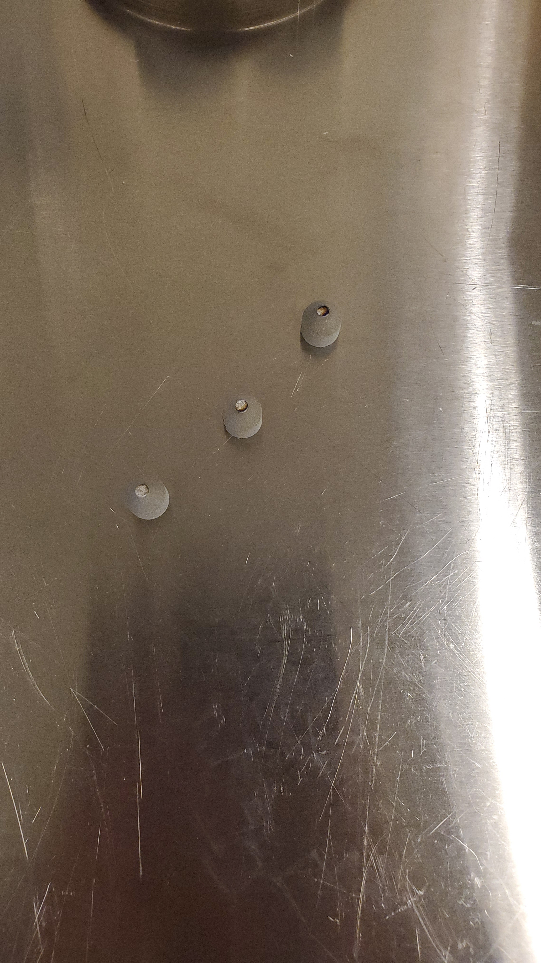
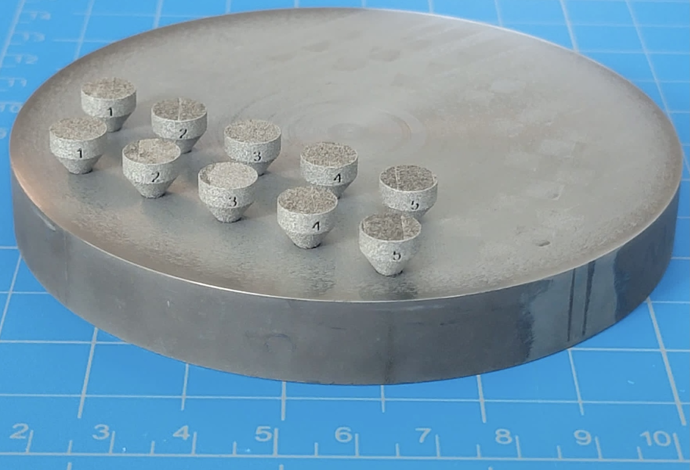
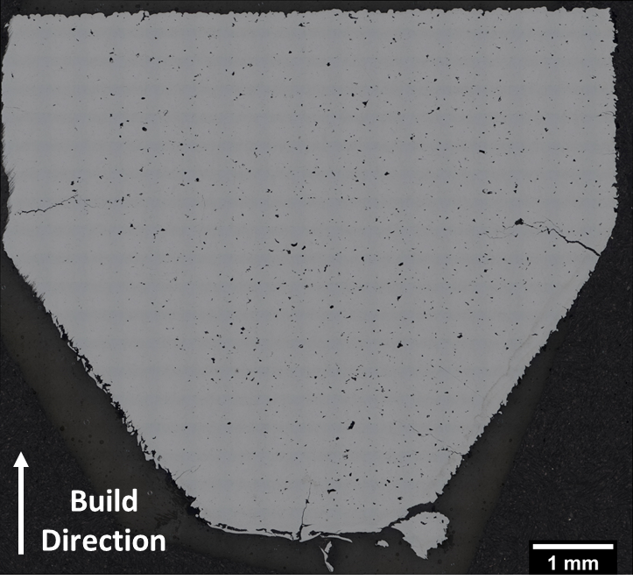
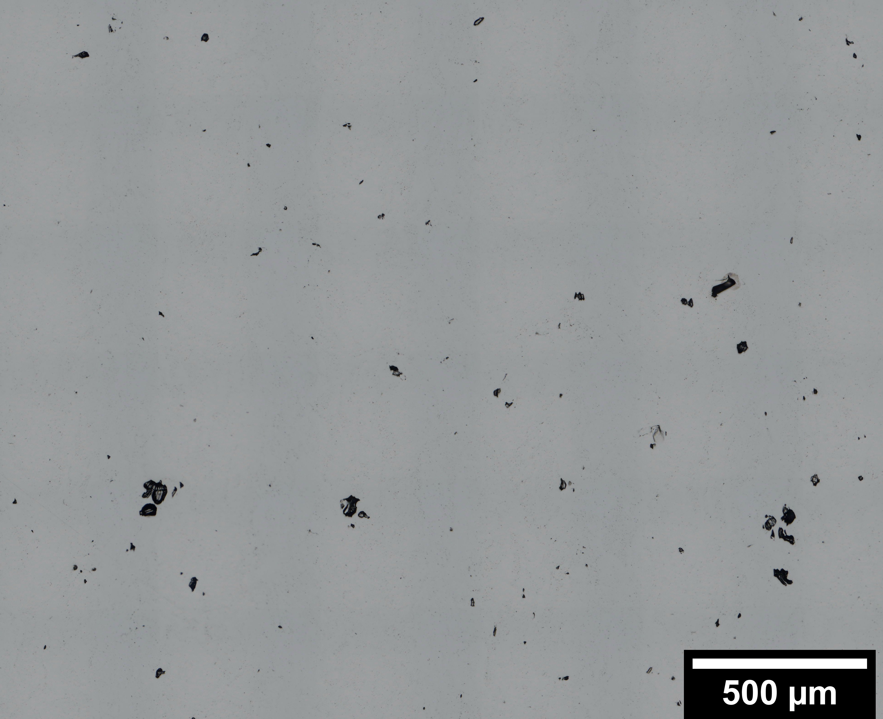
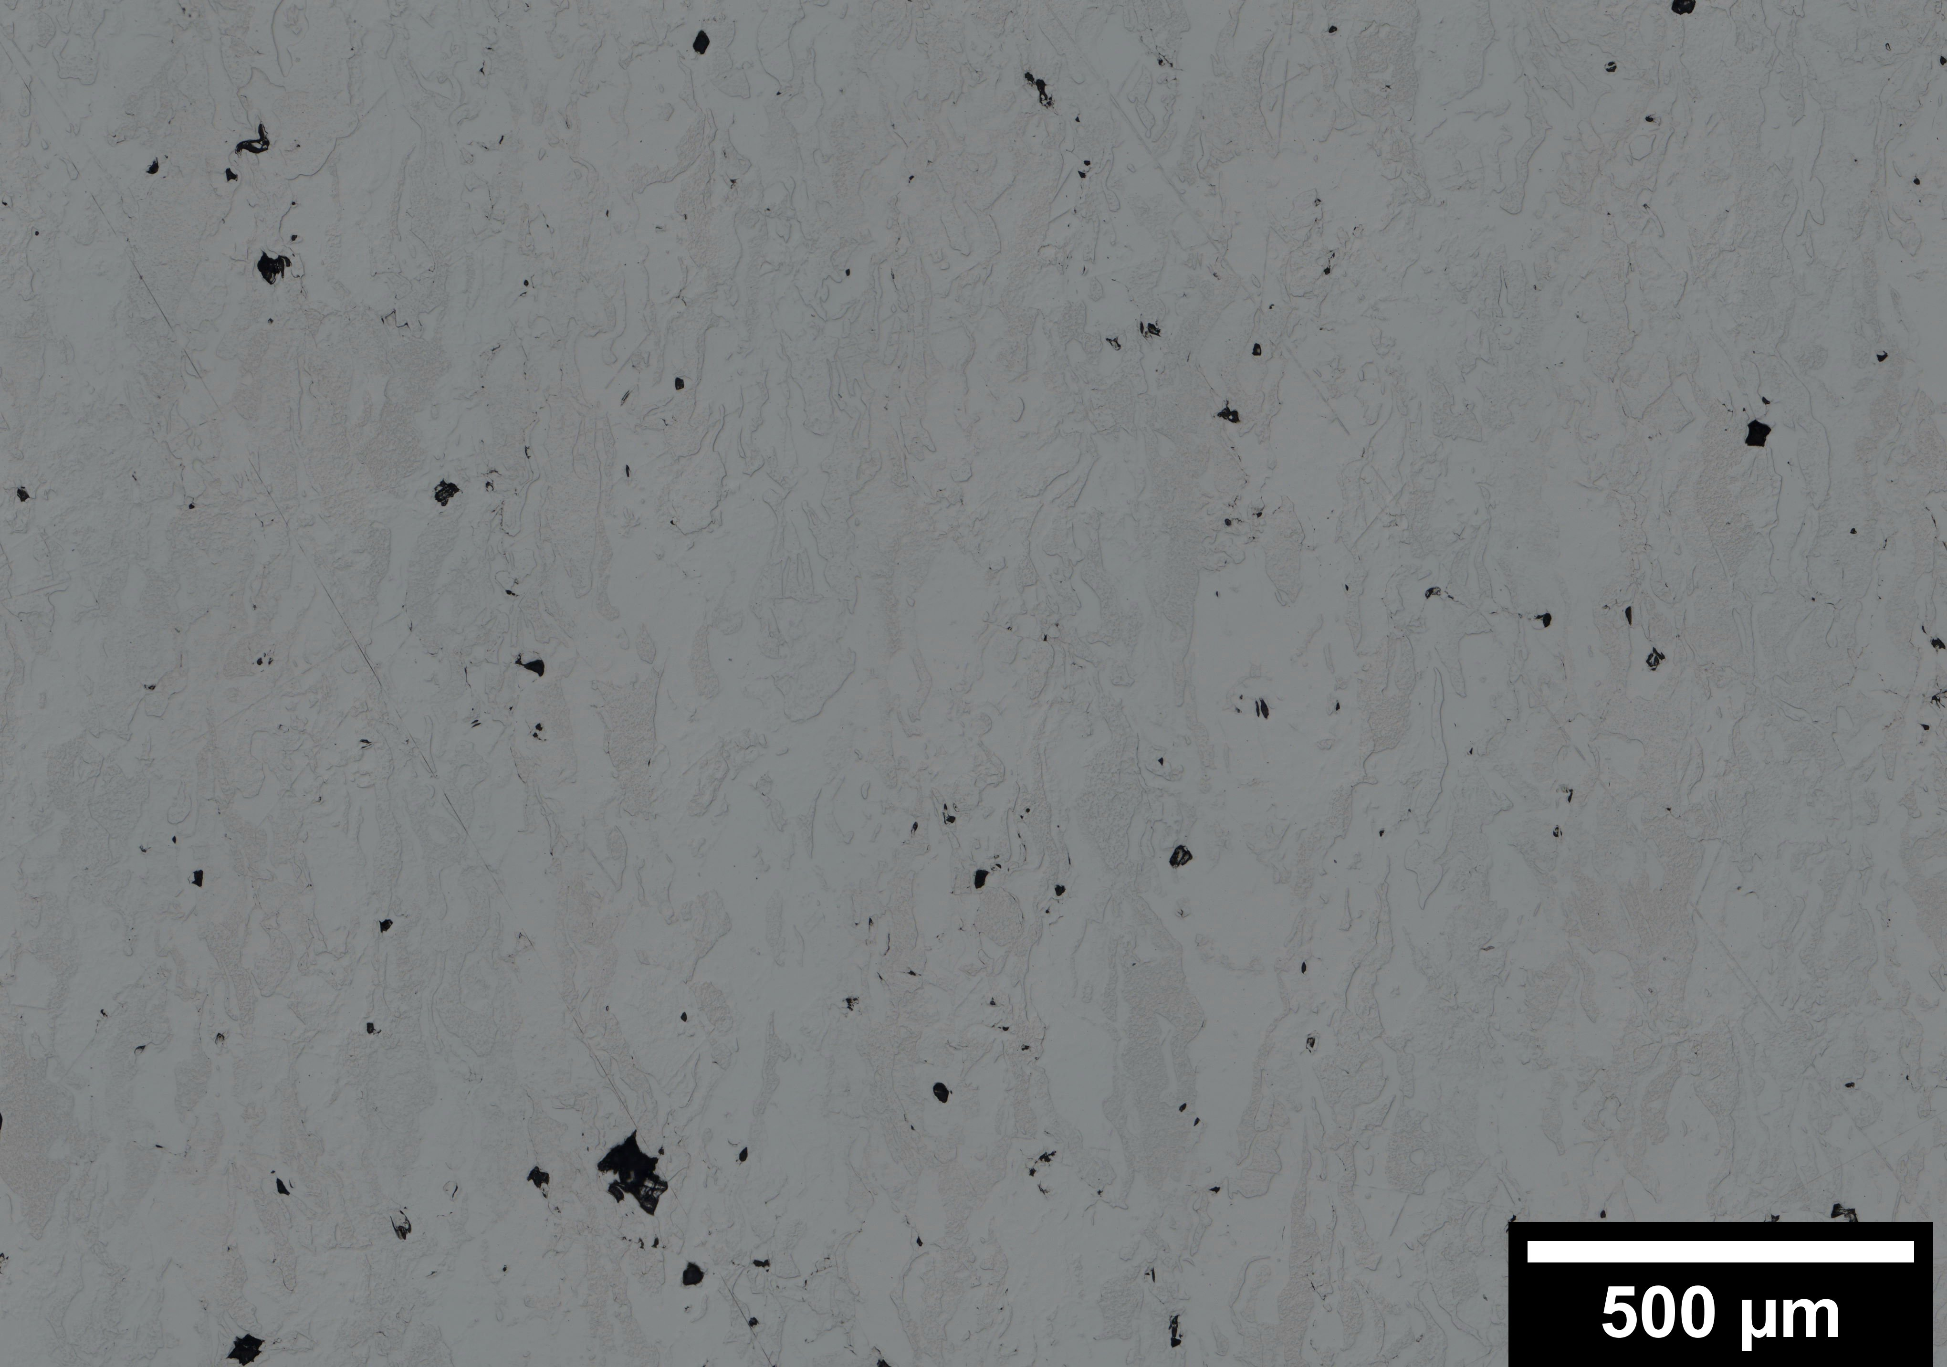
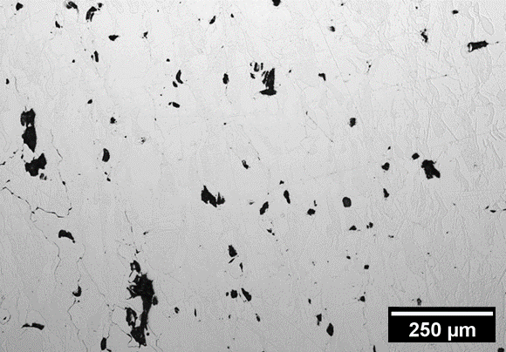
L-PBF Molybdenum print parameter optimization showed fairly good results
Parameter optimization sample geometry used
After parameter optimization, few defects observed in pure molybdenum
EOS optimized parameters were not accurate for the particle size distribution of this powder
L-PBF Pure Mo DOE1
TEKNA Spherical Powder
L-PBF Pure Mo DOE2
TEKNA Spherical Powder
L-PBF Pure Mo EOS Parameters Optimized for Different Particle Size Distribution
Density (He Pycnometer): 99.6 %TD
Density (Archimedes): 95.1 %TD
Density (OM Image Analysis): 99.3 %RD
Density (He Pycnometer): 99.3 %TD
Density (Archimedes): 95.6 %TD
Density (OM Image Analysis): 99.2 %RD
Build Direction
NASA RAAMBO, unpublished.
Experimental Results

Slide 26
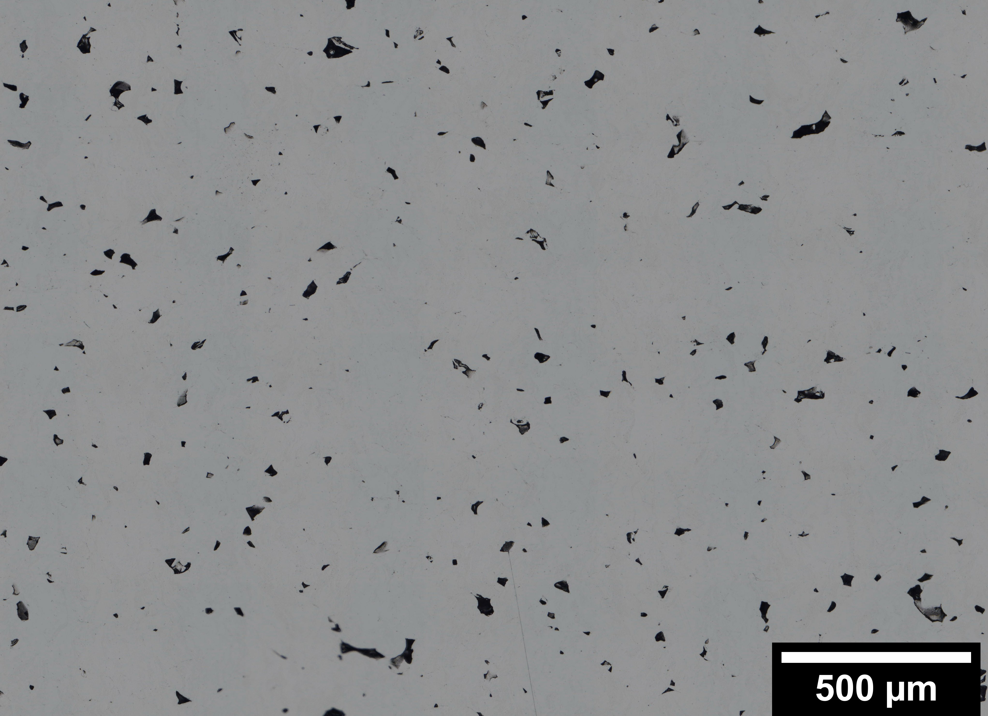
Initial Results: Mo + ZrC
Mo + 0.15mol% ZrC
Notes:
Maybe add image of full sample?

Slide 27
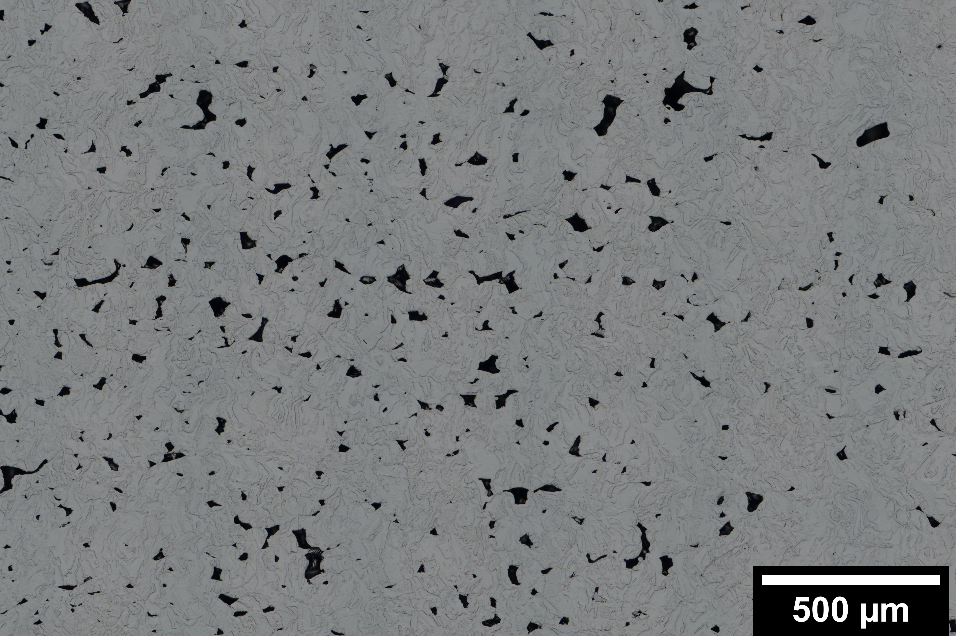
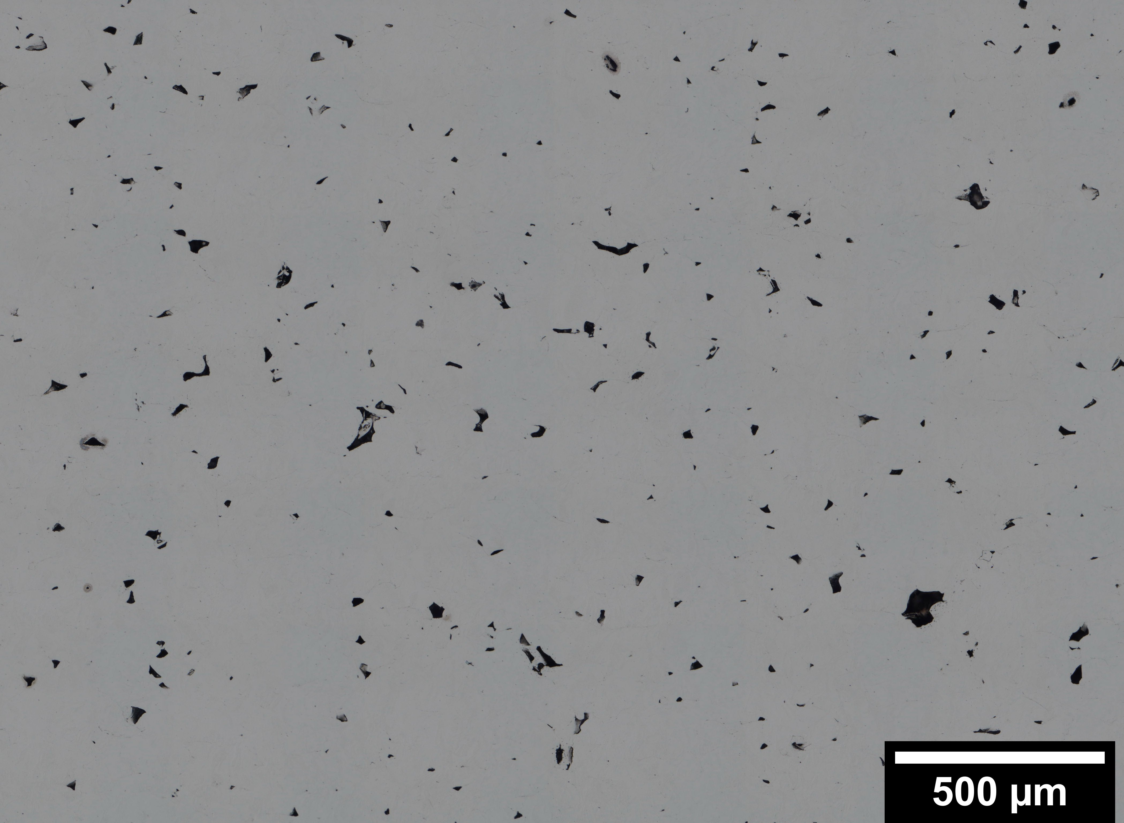
Initial results with 400-1200nm ZrC follow crack susceptibility trends
*
Thermo-Calc’s CSC property modeler seems to reasonably predict results
Where hot cracking should be largest, see more defects in as-built samples
*
*
Build Direction
Mo + 0.15 mol% ZrC
Mo + 0.30 mol% ZrC
Mo + 0.60 mol% ZrC
GRAINGER ENGINEERING
NASA RAAMBO, unpublished.
Mo + ZrC Results

Slide 28
Acoustic mixing does have limitations
One issue seen is the saturation limit of powder homogenously mixed
Caking of ZrC seen after mixing at 0.60 mol% in Mo
0.15 mol %. ZrC
0.30 mol %. ZrC
ZrC
ZrC
Mo
10 µm
0.60 mol %. ZrC
1.35 mol %. ZrC
ZrC
ZrC
NASA RAAMBO, unpublished.
Experimental Methods/Results

Slide 29
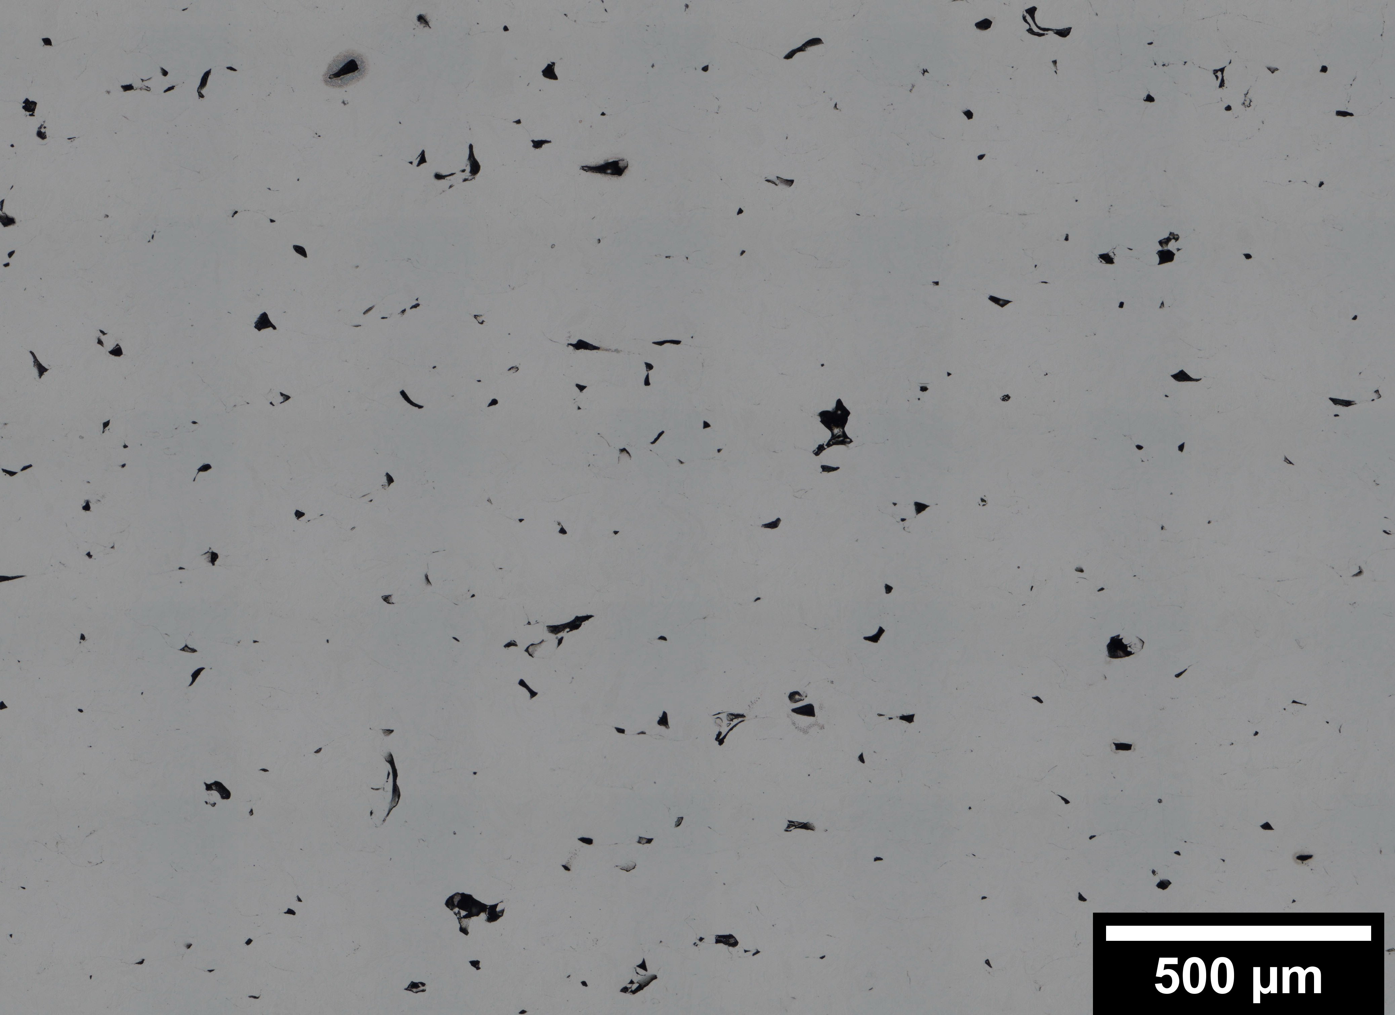
Initial results with 400-1200nm ZrC follow crack susceptibility trends
Mo + 1.35mol% ZrC
Thermo-Calc’s CSC property modeler seems to reasonably predict results
Where hot cracking should be largest, see more defects in as-built samples
No large difference between 0.6 and 1.35 mol%
Build Direction
Mo + 0.15 mol% ZrC
Mo + 0.30 mol% ZrC
Mo + 0.60 mol% ZrC
GRAINGER ENGINEERING
NASA RAAMBO, unpublished.
Mo + ZrC Results

Slide 30
Initial results with 400-1200nm ZrC show higher AB porosity
As-built Density results using different methods all follow CSC trends
Mo + ZrC samples all had a higher porosity than pure Mo
Mo-optimized parameters used
Parameter optimization needed for adding carbides
Mechanical testing can help elucidate potential benefits of nanoparticles
Density Measurements with CSC Overlaid
Pure Mo
Mo + 0.15 mol% ZrC
Build Direction
GRAINGER ENGINEERING
NASA RAAMBO, unpublished.
Mo + ZrC Results
Notes:
ZrC grain size reduction may improve mechanical properties and reduce crack propagation

Slide 31
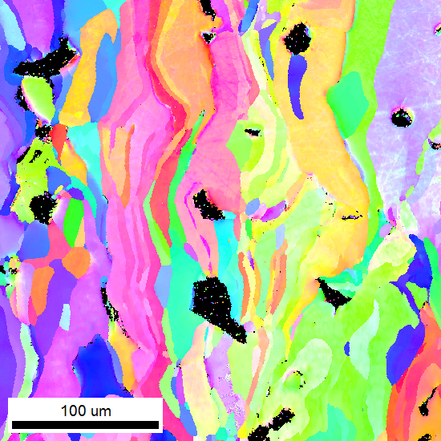
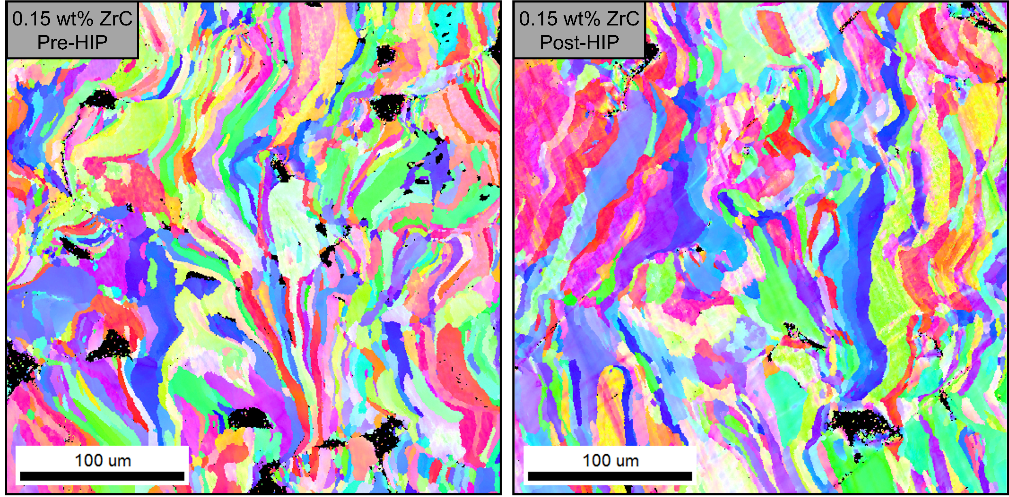
Initial results with 400-1200nm ZrC show promise regarding microstructure and response to heat treatment
EBSD shows smaller grain size in Mo-ZrC sample both in AB and HIP conditions
Little to no grain growth observed after HIP heat treatment with ZrC added
Large change in density seen, obtaining values similar to pure Mo
Likely results in better mechanical properties
Optical Density Measurements for AB and HIP
Pure Mo
Mo + 0.15 mol% ZrC
AB (Pre-HIP)
Post-HIP
Build Direction
GRAINGER ENGINEERING
NASA RAAMBO, unpublished.
Mo + ZrC Results
Notes:
ZrC grain size reduction may improve mechanical properties and reduce crack propagation

Slide 32
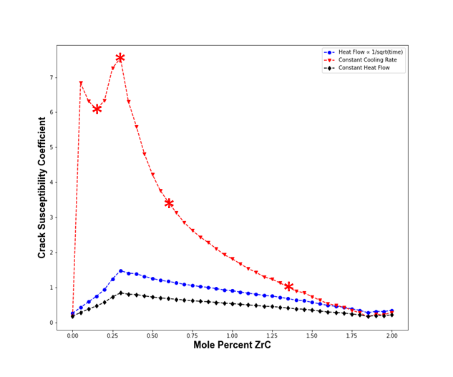
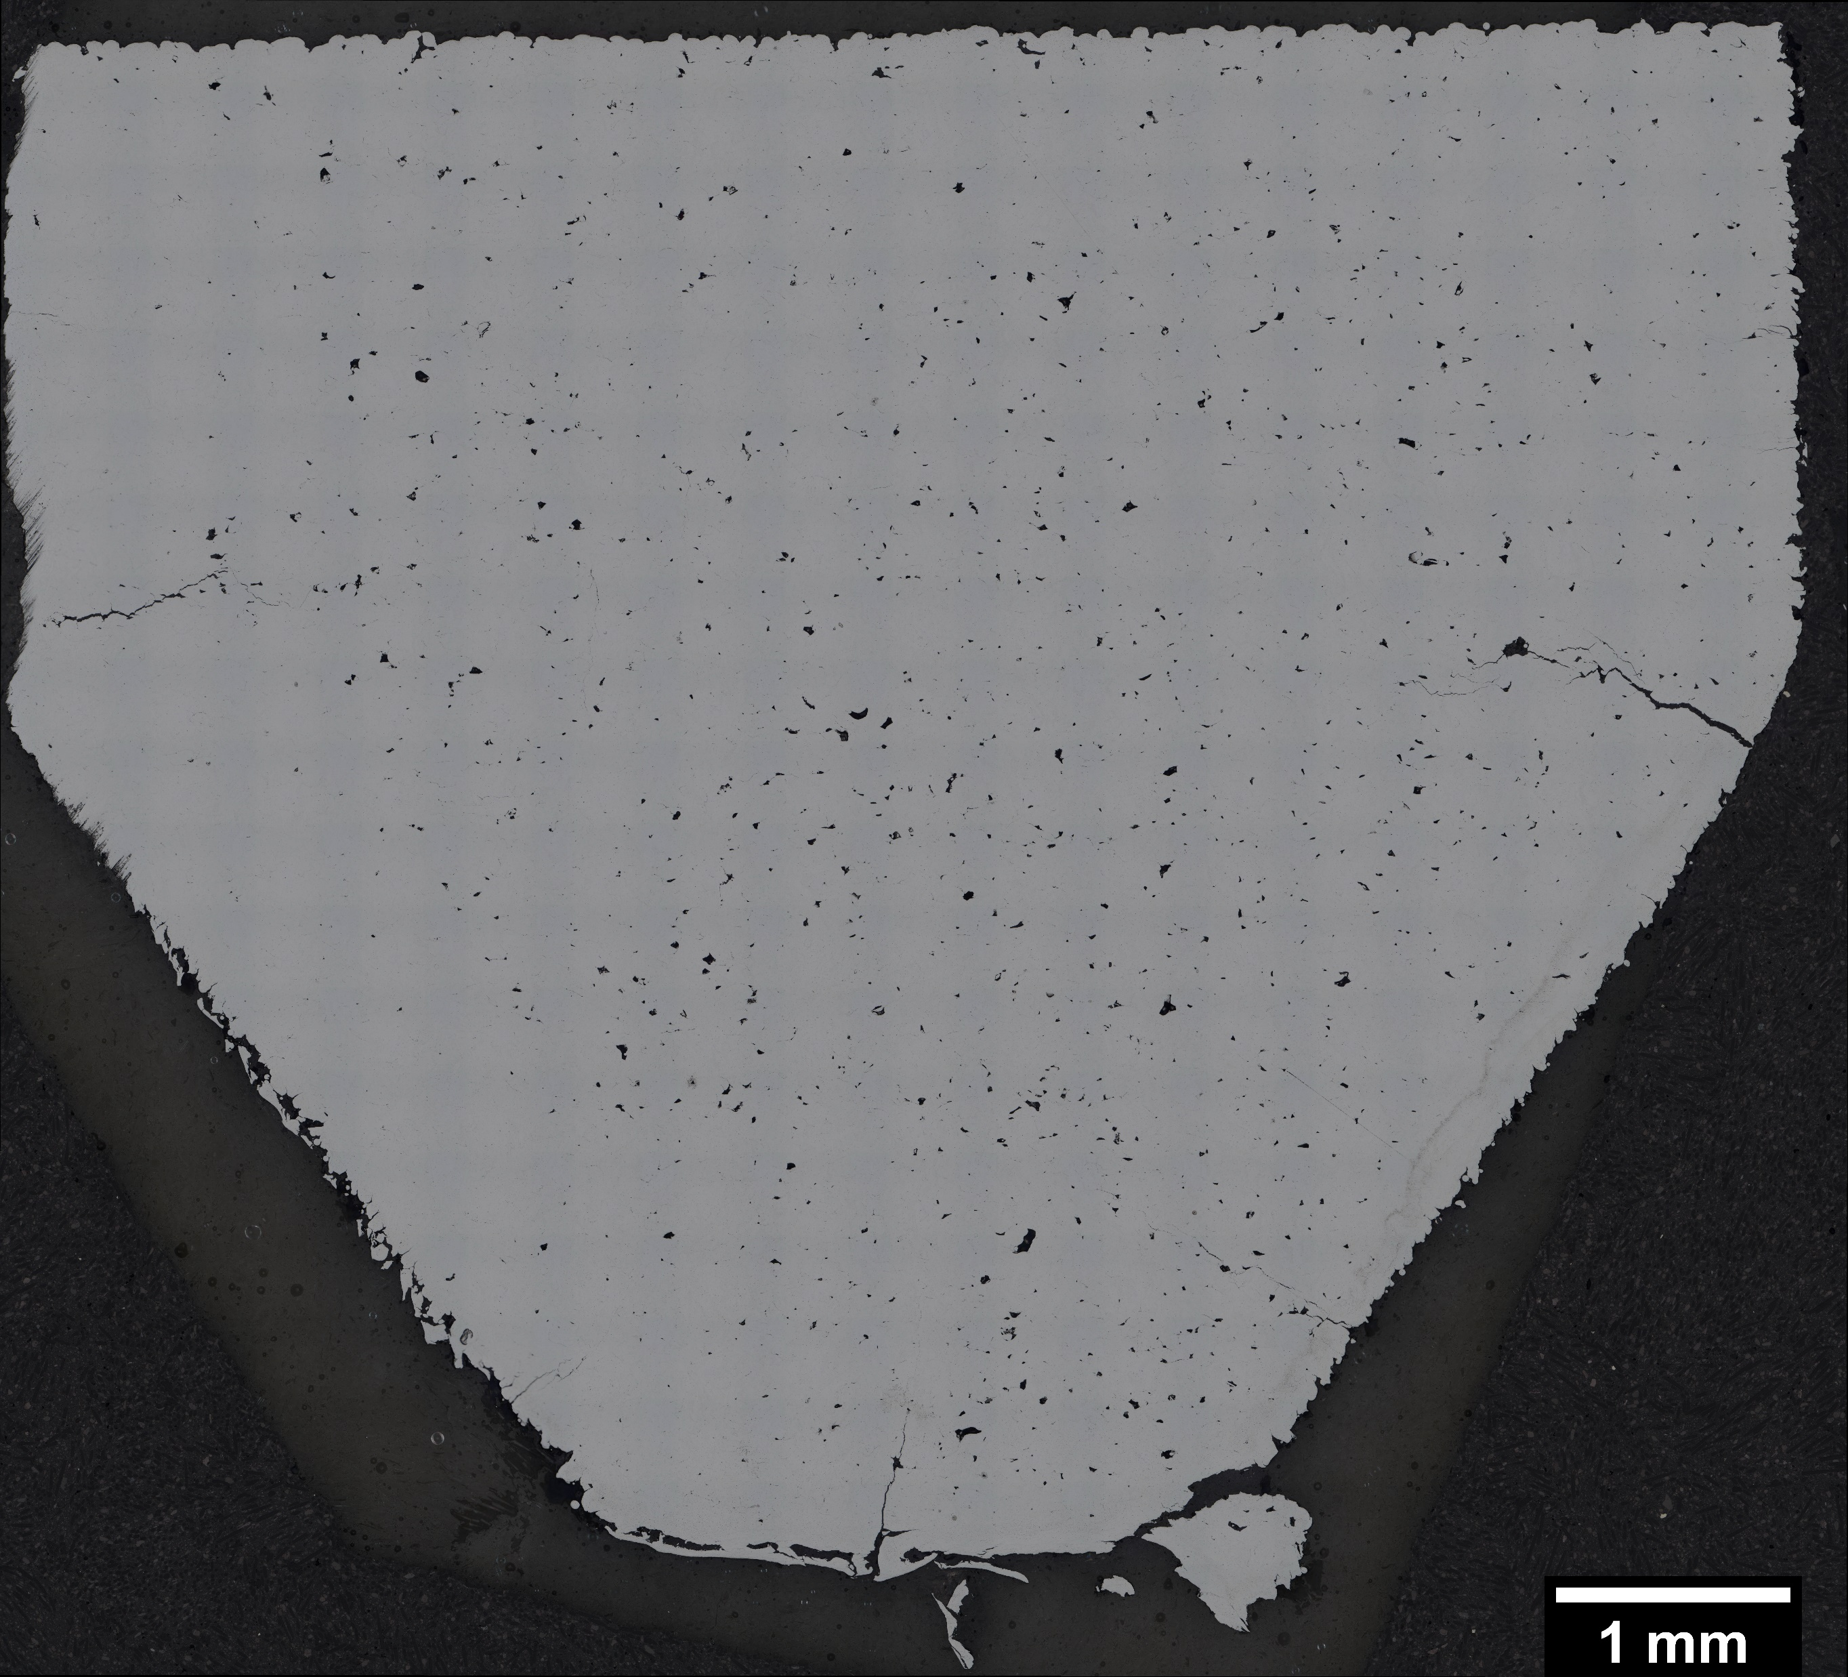
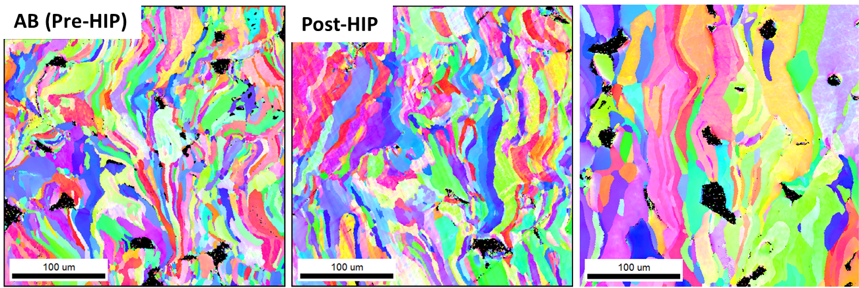
Summary and Future Work
Goal of this work is to reduce/prevent AM refractory alloy cracking through material design utilizing computational approaches
Initial experimental validation of computer simulations started, issues identified
Pure metal print parameter optimization performed, in-process for Mo-carbide samples
Initial Mo + ZrC results show promising trends, particularly after heat treatment
Investigate effects of dispersoids on mechanical properties
Further investigate effects of nanoparticle size and print parameters
Extend work to W and Mo + other carbides
Thank you for your attention!
Feel free to contact me with additional questions: cromnes2@illinois.edu or carly.j.romnes@nasa.gov
Pure Mo
Mo + 0.15mol% ZrC

Slide 33
Special thank you to: Fernando Reyes-Tirado, Toren Hobbs, Jamelle Williams, Omar Mireles, Prof. James Stubbins, Prof. Jessica Krogstad, and the NASA RAAMBO team
Summary and Future Work
Goal of this work is to reduce/prevent AM refractory alloy cracking through material design utilizing computational approaches
Initial experimental validation of computer simulations started, issues identified
Pure metal print parameter optimization performed, in-process for Mo-carbide samples
Initial Mo + ZrC results show promising trends, particularly after heat treatment
Investigate effects of dispersoids on mechanical properties
Further investigate effects of nanoparticle size and print parameters
Extend work to W and Mo + other carbides
Thank you for your attention!
Feel free to contact me with additional questions: cromnes2@illinois.edu or carly.j.romnes@nasa.gov
Pure Mo
Mo + 0.15mol% ZrC
This research is supported by a NASA Space Technology Research Fellowship, No. 80NSSC19K1168 and was carried out in part at the Materials Research Laboratory Central Research Facilities at the University of Illinois at Urbana-Champaign and the NASA Marshall Space Flight Center.

Slide 34
Backup Slides

Slide 35
Specimen shape used for print parameter optimization ensured parameters useful for more complex shapes
Build plate with several samples for parameter optimization
Example of parameter optimization sample cross-section
Example of parameter optimization sample burnout at build plate interface
Build Direction
Experimental Methods/Results

