Slide 1
SWIFT Study
ACO Management Review
AU
Dan Thomas
Advanced Concepts Office
NASA Marshall Space Flight Center
September 21 / 2023

Slide 2
Study Overview

Slide 3
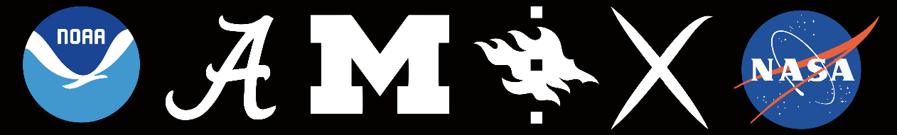
Team Members
MSFC Design Team
Study Lead | Dr. Dan Thomas | ED04
Study Co-lead | Tyrone Boswell | ED04
Mission Analysis | Ben Diedrich | EV42
Design and Configuration | Mike Baysinger | ED04
Avionics and Comm | Pete Capizzo | ED04
Thermal Analysis | Thomas Brooks | ED04
GN&C | Ben Diedrich | EV42
Power | Leo Fabisinski | ED04
Propulsion | Tyrone Boswell | ED04
Structures | Jay Garcia | ED04
Cost | Teresa Brown | CS50
Langley Team Members
Mission Analysis | Dr. Keats Wilkie | D322
Mission Analysis | Johnny Fernandez | D322
Redwire Team Members
Sail Integration | Dana Turse | Redwire Space
Sail Integration | Michael Winters | Redwire Space
Customer / PI | Dr. Mojtaba Akhavan-Tafti | Univ Mich
Customer | Les Johnson | MSFC ST20
Co-Investigators
Les Johnson (MSFC, ST20) | Dr. Adam Szabo (GSFC-6720)
Prof. James Slavin (Univ Mich) | Dr. Lynn Wilson (GSFC-6720)
Prof. Tuija Pulkkinen (Univ Mich) | Dr. Douglas Biesecker (NOAA)
Prof. Sue Lepri (Univ Mich) | Prof. Rohan Sood (Univ Alabama)
Dr. Tsige Atilaw (Univ Mich) | Dr. Dominique Fontaine (Ecole Polytechnique, France)
Dr. Matti Ala-Lahti (Univ Mich) | Prof. Emilia Kilpua (Univ Helsinki, Finland)
Mission Analysis

Slide 4
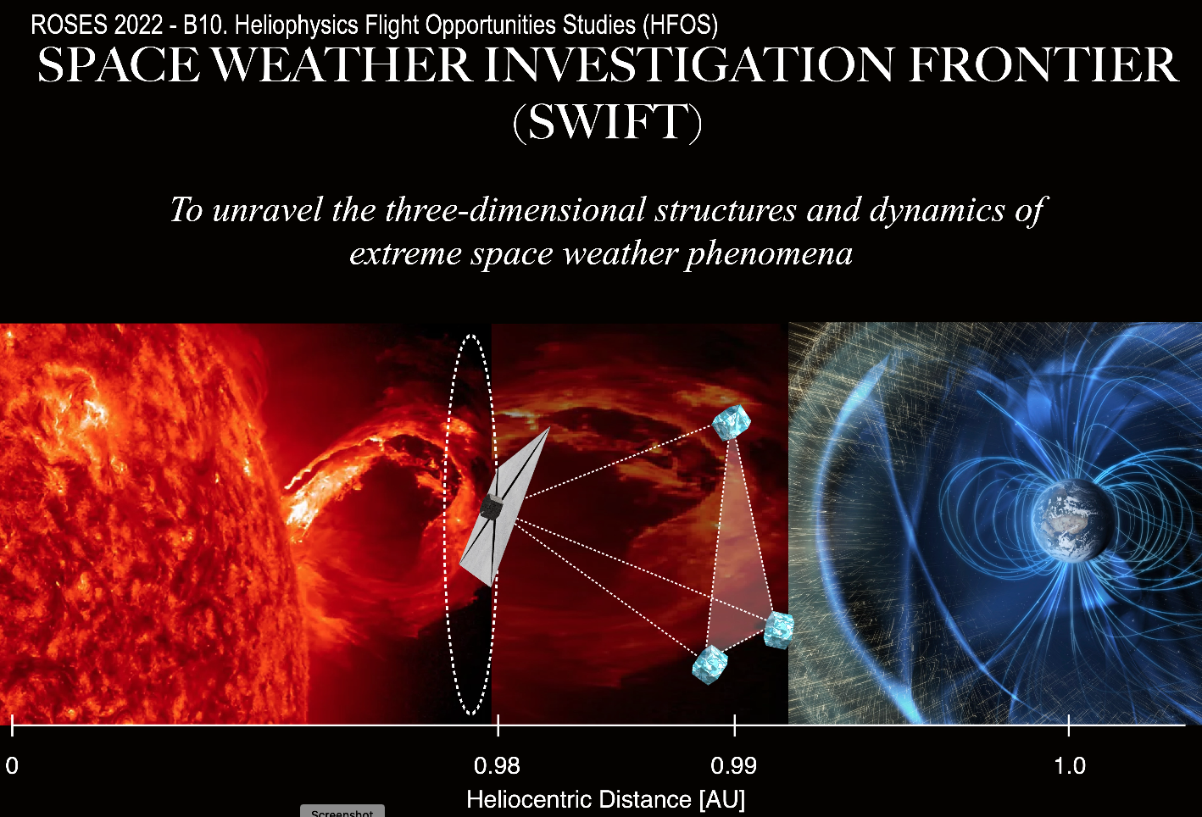
SWIFT
The Space Weather Investigation Frontier (SWIFT) mission will aim at making major discoveries on 3D structure and dynamics of heliospheric structures that drive space weather
A probe sampling the upstream solar wind at sub-L1 (XL1),
  Providing continuous observations of solar wind structures, such as CMEs, along the Sun-Earth-line (SEL),
  Enhancing WIND, ACE, and DSCOVR (and IMAP), by providing upstream measurements for multiscale analyses
Solar sail UNIQUELY enables:
  Affordable orbit insertion, and
  Long-duration attitude control, allowing to “park” at a desired location.
The science objective is important to both NASA & NOAA and addresses the space weather goals set forth by the Decadal Survey
Leverages Solar Cruiser sail development
Study covers preliminary designs for:
Main “hub” sailcraft in Sub-L1 Lissajous orbit
3 identical smallsats (“nodes”) orbiting SE-L1

Slide 5
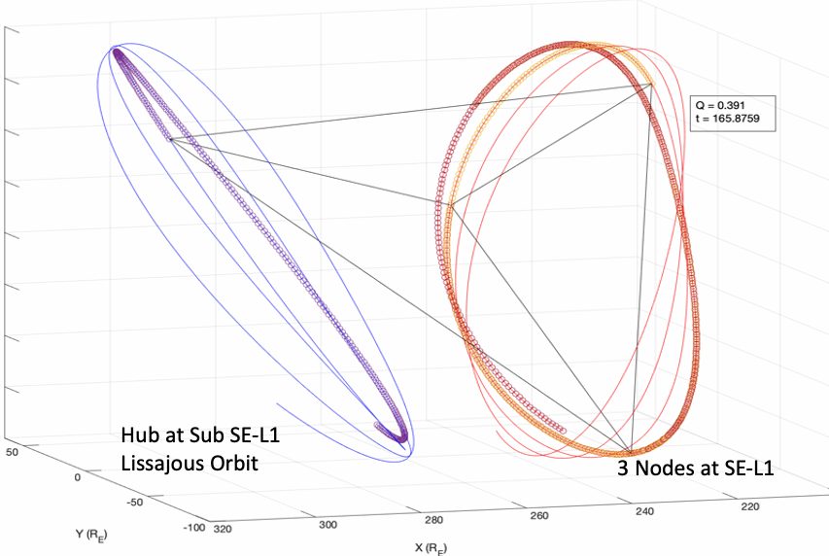
SWIFT Constellation
Notes:
The SWIFT mission will send one “Hub” sailcraft to a Lissajous orbit at Sub Sun-Earth L1 (SE-L!). Launching on the same launch vehicle, three identical “Node” spacecraft will travel to a HALO orbit about SE-L1 and will be phased such that all spacecraft will form a tetrahedron.

Slide 6
SWIFT Spacecraft Designs
Hub
  Solar Cruiser-derived Solar Sail
Node (up to 3 identical)
  Trade Solar Sail vs. Chemical Propulsion
    High TRL Hydrazine system
No design restrictions (e.g., must be cubesats)
  Reduced size is better
Hub and Nodes are fully-independent
Notes:
The “SWIFT ACO Design Study” focused on performing preliminary designs for both the Hub and Node spacecraft. For the Node spacecraft, both solar sail and chemical propulsion options were designed, with the chemical propulsion consisting of a high TRL monopropellant hydrazine system. The overall design goal was to produce minimum mass designs that fit within the smallest dimensions possible.

Slide 7
General Mission/Spacecraft Requirements
Requirement | Value
Lifetime | 3 years minimum
Mission Class | MIDEX, Class D
Destination | Sub-SE-L1 and SE-L1
Pointing requirements | < 1 deg
Pointing scenarios | Sun facing
Fast Slew Requirements | None
Slow Slew Requirements | None
Pointing Accuracy (roll, pitch, yaw*) | < 1 deg
Pointing Knowledge (roll, pitch, yaw) | < 0.1 deg
Pointing Stability (roll, pitch, yaw) | < 0.1 deg
Inertial Pointing | Continuous
Roll Angle and Rate | None
If this is a constellation, describe any requirements relating to how each satellite must operate relative to the others | Independently controlled probes
Sized chemical propellant load for 10 years on-orbit
Notes:
The overall mission length will be a minimum of 3 years. However, the hydrazine propellant will be sized to accomplish 10 years on-orbit.

Slide 8
Science Payload (on each spacecraft)
Assumptions |  | Instrument
Req's |  | Mag | 2X (Ions w/o Comp) | 2X (Electrons) | 1X (Ions w Comp)
Instrument |  |  | PAS (SolO) | EAS (SolO) | FIPS (UM/Sue)
 | Size/dims | 11cmx6.6cmx8.6 cm | 30cm x 20cm x 20cm | 12cm x diam 14cm | 21cmx23cmx15cm
 | Mass | 1.0 kg (sensor: 250grams) | 3 kg | <2 kg | 5kg
 | Placement on S/C | on boom (sun facing) | sun facing | including sun dir. | sun facing
 | Power | 1.8 W | 3 W | 2 W | 5W
 | Survival Temp | -40 C - +65C |  |  | -35C-65C
 | Operating Temp | -30C - +40C | -20C / +50C | -10C / +40C | -30C-30C
Data
 | Volume (daily) | 1 kbps continuous without compression | 3 kbps (per second) | 2 kbps (per second) | 5kbpsx24x3600s
 | Latency | real-time |  |  | real-time (beacon-mode)
Pointing
 | Stability | <1 deg | <1 deg | <1 deg | <1 deg
 | Accuracy | <1 deg | <1 deg | <1 deg | <1 deg
Environment
 | Cleanliness | Magnetic cleanliness
 | Radiation Shielding |  |  |  | 30 krad (tunable)
Avoidance Angles
Notes:
Each spacecraft carries the instrument package given above. Note: the sail node options carry two 250 g sensors, instead of just one.

Slide 9
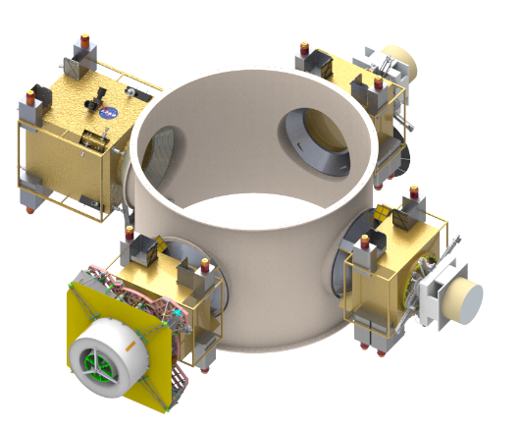
Stowed Designs (as Secondary Payloads, ESPA Grande)
Note: all 3 Nodes will be either “Sail” or “ChemProp”
(separate options displayed to show relative size)
Node Sail
ChemProp Node
Node Sail
Hub Sail

Slide 10
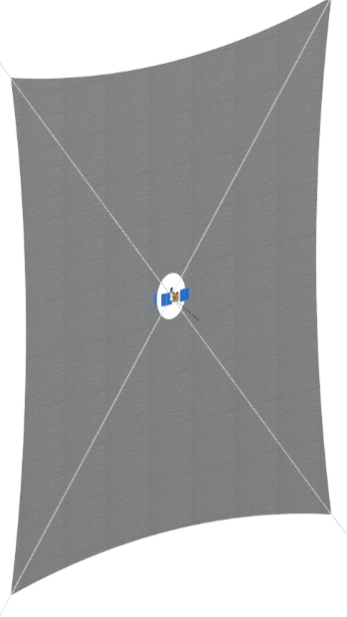
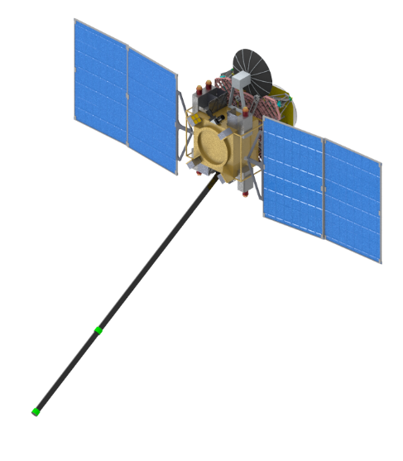
Hub Sailcraft (Deployed)
Sail Area = 2060 m²
4 m Center-hole
Two Magnetometer Sensors
46 m

Slide 11
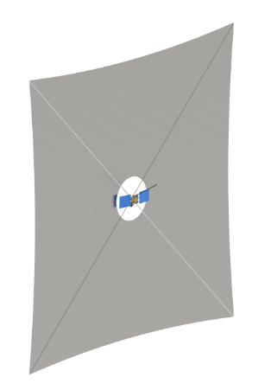
Node Sailcraft (Deployed)
Sail Area = 780 m²
Identical Bus Size
4 m Center-hole
Two Magnetometer Sensors
28.2 m

Slide 12
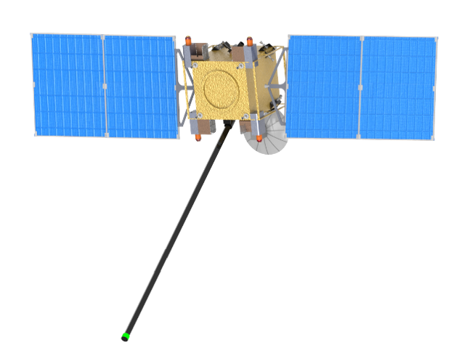
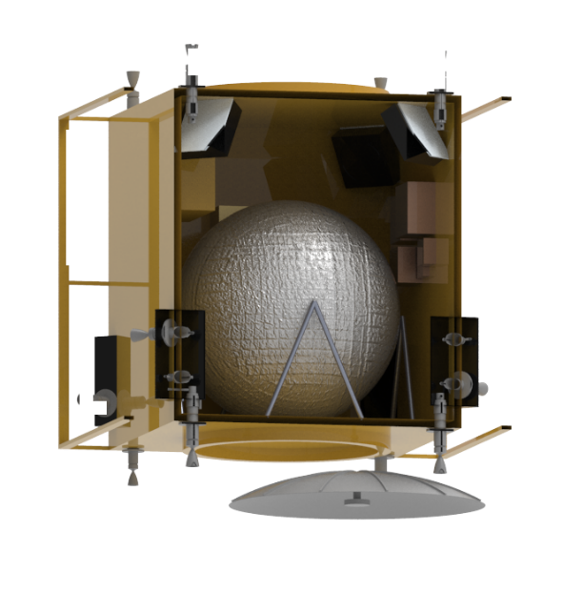
ChemProp Node (Deployed)
Larger Bus due to Propellant Tank
Single Magnetometer Sensor

Slide 13
Mass Results
Hub |  |  |  |  | Sail Node |  |  |  |  | ChemProp Node
System | Dry Masses (kg) |  |  |  | System | Dry Masses (kg) |  |  |  | System | Dry Masses (kg)
 | Basic | MGA | Predicted |  |  | Basic | MGA | Predicted |  |  | Basic | MGA | Predicted
Structures | 18.6 | 20.0% | 22.4 |  | Structures | 17.3 | 20.0% | 20.8 |  | Structures | 20.3 | 20.0% | 24.4
Solar Sail System | 44.8 | 7.3% | 48.0 |  | Solar Sail System | 22.9 | 16.6% | 26.6 |  | Solar Sail | 0.0 | 0.0% | 0.0
Electric Propulsion | 5.3 | 5.0% | 5.6 |  | Electric Propulsion | 5.3 | 5.0% | 5.6 |  | Chemical Propulsion | 15.9 | 4.9% | 16.7
Power | 9.0 | 22.7% | 11.1 |  | Power | 6.3 | 23.9% | 7.8 |  | Power | 7.1 | 23.5% | 8.8
Avionics | 11.7 | 9.5% | 12.9 |  | Avionics | 10.7 | 9.6% | 11.7 |  | Avionics | 11.3 | 10.1% | 12.5
GN&C | 5.2 | 5.0% | 5.5 |  | GN&C | 4.2 | 5.0% | 4.5 |  | GN&C | 4.2 | 5.0% | 4.5
Thermal | 2.1 | 40.0% | 2.9 |  | Thermal | 2.0 | 40.0% | 2.9 |  | Thermal | 3.6 | 40.0% | 5.1
Science Instruments | 19.6 | 2.7% | 20.1 |  | Science Instruments | 19.6 | 2.7% | 20.1 |  | Science Instruments | 18.3 | 2.5% | 18.8
Total Dry Mass | 116.4 | 10.3% | 128.4 |  | Total Dry Mass | 88.4 | 13.1% | 100.0 |  | Total Dry Mass | 80.8 | 12.1% | 90.6
Extra Systems Margin: (15% of Basic) |  |  | 17.5 kg |  | Extra Systems Margin: (15% of Basic) |  |  | 13.3 kg |  | Extra Systems Margin: (15% of Basic) |  |  | 12.1
Non-prop Fluids (all fluids other than usable prop): |  |  | 0.0 |  | Non-prop Fluids (all fluids other than usable prop): |  |  | 0.0 |  | Non-prop Fluids (all fluids other than usable prop): |  |  | 4.2
Total Inert Mass: |  |  | 145.9 kg |  | Total Inert Mass: |  |  | 113.3 kg |  | Total Inert Mass: |  |  | 106.9
Maneuver Propellant |  |  | 0.0 |  | Maneuver Propellant |  |  | 0.0 |  | Maneuver Propellant |  |  | 26.4
Mass at Launch: |  |  | 145.9 kg |  | Mass at Launch: |  |  | 113.3 kg |  | Mass at Launch: |  |  | 133.3
Mass after ESPA Separation: |  |  | 140.4 kg |  | Mass after ESPA Separation: |  |  | 107.8 kg |  | Mass after ESPA Separation: |  |  | 127.8
 |  |  |  |  |  |  |  |  |  | Total Loaded Propellant: |  |  | 30.1 kg
Notes:
Table shows masses for all the preliminary designs. All subsystems followed mass growth allowance (MGA) directives given in ANSI/AIAA “Mass Properties Control for Space Systems”. Also note that an additional “Systems Margin” of 15% was applied to the basic dry mass. Along with the launch masses, the masses after ESPA-separation are given, since these values are used to determine sail sizes and required maneuver propellant.

Slide 14
Major Findings
Desired Hub sail ac = 0.12 mm/s²
  Current sail area = 2060 m²
  At limit of scaling Solar Cruiser sail system without TRL decrease
Desired Node sail ac = 0.06 mm/s²
  Current sail area = 780 m²
  Too large to scale from HIPERSail technology
Current ChemProp Node designed for a ΔV = 495 m/s
  Updated ΔV = 557 m/s proposed late in the study
  Will increase mass after ESPA separation to ~ 145 - 150 kg (13 – 17% increase over current design)
Notes:
The mission trajectories currently require characteristic accelerations of 0.12 mm/s^2 and 0.06 mm/s^2 for the Hub and Node sails, respectively. The preliminary designs in this report resulted in a Hub sail area of 2060 m^2 and a Node sail area of 780 m^2. The Hub sail design is at the limit of being able to scale the Solar Cruiser sail system without decreasing the TRL. The Node sail size, however, is too large to scale from the HIPERSail design without a TRL decrease. Note: The 4 m center-hole may be reduced by increasing the solar array width (potentially down to 3 m diameter hole).

Slide 15
Design Specifics

Slide 16
Configuration
Mike Baysinger / NASA MSFC ED04

Slide 17
Approach and Tools
Each bus design was based on existing Solar Cruiser layout and design.
Sail node bus designs are nearly identical to maintain commonality
Sail models were based on or from existing models
Notes:
Each individual bus design was based on the Solar Cruiser layout and design wherever possible. The simple rectangular bus shape was kept to minimize complexity and weight. Each bus designs are nearly identical to each other maintain commonality between each. The sail CAD representative models were based on the actual Solar cruiser sail model.

Slide 18
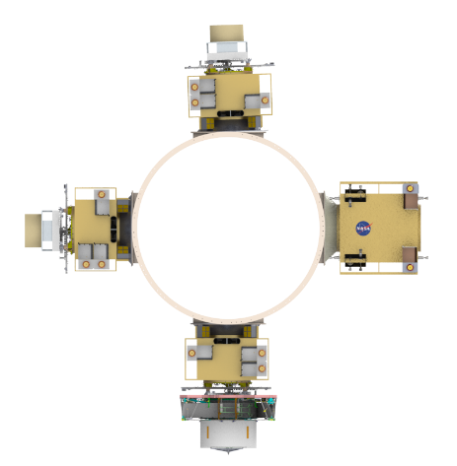
Results-Launch Configuration
These three will be Sail or Chem Configuration
Node Sail
Node Sail
Chem Node
Node Sail
Chem Node
Node Sail
Hub Sail
Hub Sail
ESPA Grande Ring
Notes:
The above figure represents the launch configuration on the ESPA Grande Ring. The payloads would include one Hub and 3 Node spacecraft. The Hub spacecraft would be either a chemical or sail based configuration. There were no protuberances or protrusions from the standard ESPA Grande allowed envelope.

Slide 19

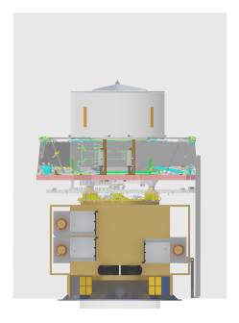
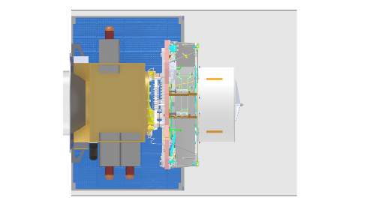
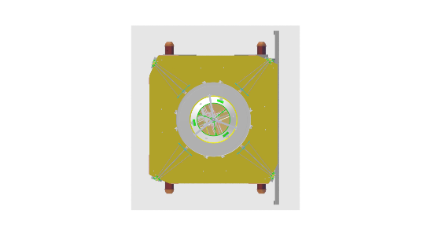
Results-Hub Sail
1 m
Solar arrays maximized to envelope to minimize sail center hold diameter
ESPA Grande Envelope
Notes:
The above figure shows a three view of the Hub sail configuration. A 24” to 15” adapter interface is utilized between the ESPA ring the spacecraft. This enables the interface adapter to remain attached to the ring to save weight from the spacecraft. The solar array area dimensions were maximized for the ESPA envelope to minimize the deployed radial distance. This also minimizes the required center hole diameter in the sail.

Slide 20
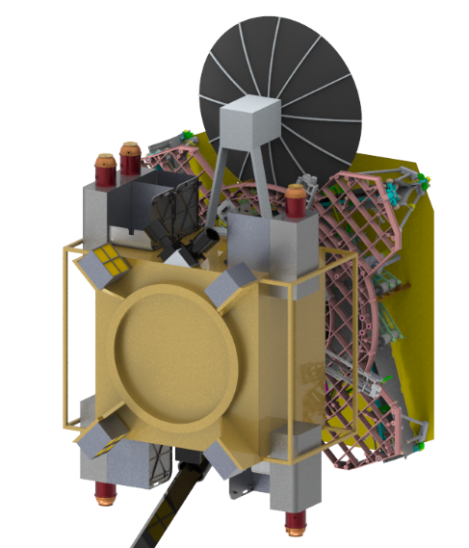
Results-Hub Sail
Sun
Stowed sail
Bus
Notes:
This chart shows how the bus and sail sections make up the total spacecraft and the relative position of the sun.

Slide 21
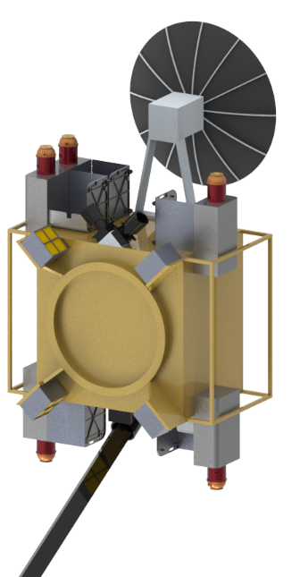
Results-Hub Sail
Antenna (deployable)
Electron w/o comp
Ion w/comp
Ion w/o comp
Electric thruster (4)
Sun
Electron w/o comp
Ion w/o comp
MAG boom
Notes:
This view shows just the external hub bus portion. The primary instruments are noted to show their positioning and placement. The instruments are: Electron without composition (2), Ion with composition (1), Ion without composition (2), and a magnetic boom instrument.

Slide 22
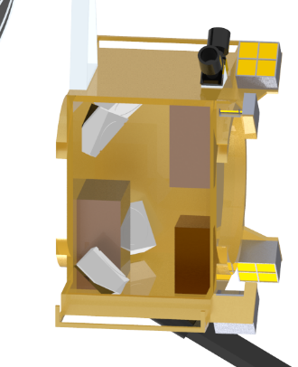
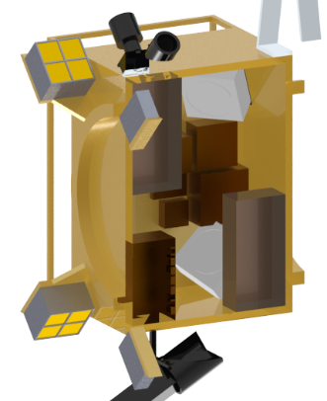
Results-Hub Sail
Star tracker
Antenna
thrusters
Xband
Battery
IAU
IAU
Battery
Reaction wheels (4)
Notes:
This view shows just the internals of the hub bus. The components shown are the major volume components and may not be inclusive of all required or noted in the MEL. There is sufficient room leftover to accommodate these smaller components.

Slide 23
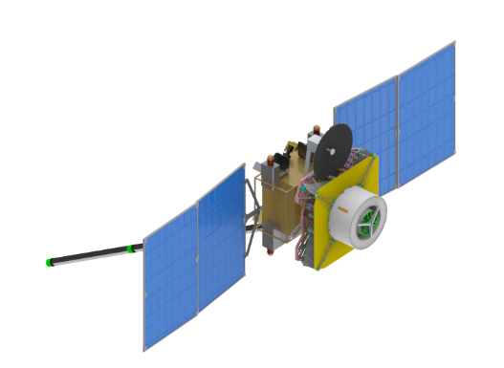
Results-Hub Sail
Sun
Sun
Stowed Sail
Earth
Notes:
This shows the deployed state of the bus and the sail in the stowed position. The relative position of the Sun and Earth are shown.

Slide 24
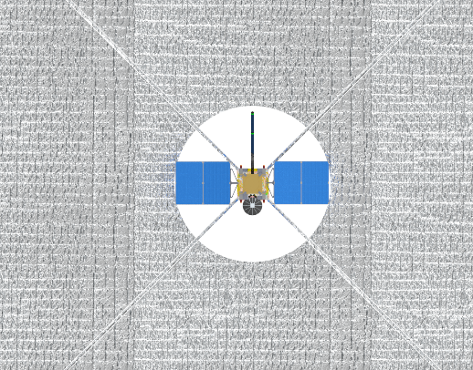
Results-Hub Sail
2060 m² sail area
Ø4 m hole
46 m
Notes:
The deployed Hub sail is shown to give a relative perspective of size. A 4m center hole is required to allow for the solar arrays sun viewing. A 49m sail side dimension is required to provide the required sail array (with the 4m center hole)

Slide 25
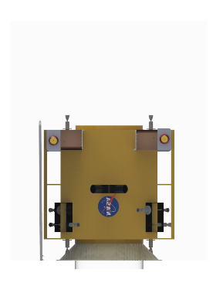
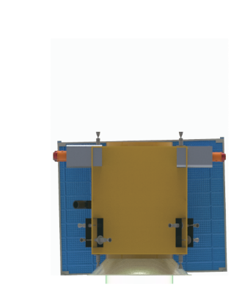
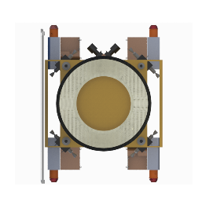
Results-Chemical Node
0.83 m
Solar arrays maximized to envelope
ESPA Grande Envelope
Notes:
The above figure shows a three view of the chemical node configuration. A 24” to 15” adapter interface is utilized between the ESPA ring the spacecraft. This enables the interface adapter to remain attached to the ring to save weight from the spacecraft. The solar array area dimensions were borrowed mainly from the other designs due to similar sizing.

Slide 26
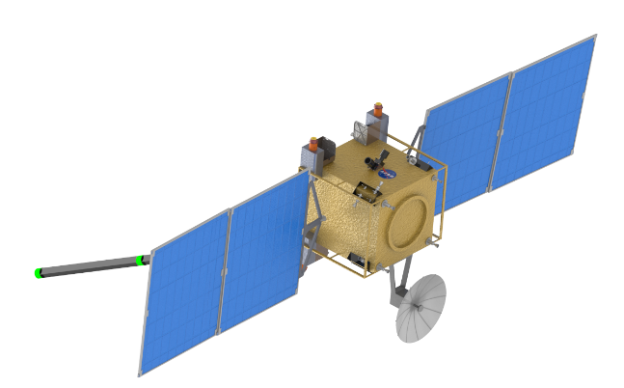

Results-Chemical Node
Sun
Sun
Earth
Notes:
This shows the deployed state of the chemical node. The relative position of the Sun and Earth are shown.

Slide 27
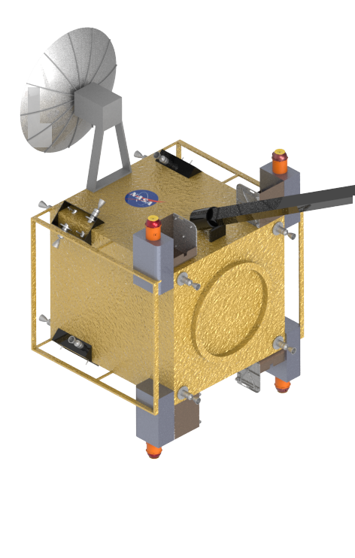
Results-Chemical Node
Ion w/o comp
thruster
MAG boom
Ion w/comp
Ion w/o comp
Electron w/o comp
Sun
Notes:
This view shows just the external chemical node portion. The primary instruments are noted to show their positioning and placement. The instruments are: Electron without composition (1), Ion with composition (1), Ion without composition (2), and a magnetic boom instrument.

Slide 28
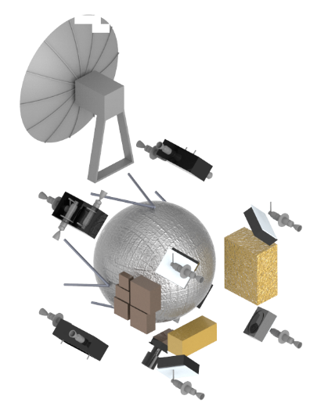
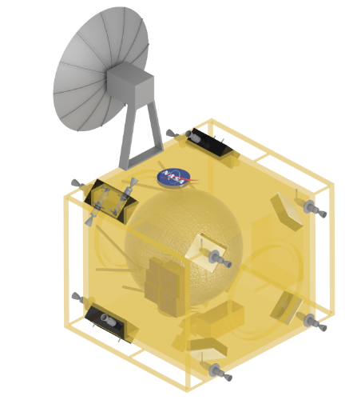
Results-Chemical Node
Antenna
Reaction wheels (4)
thrusters
Prop tank
IAU
Battery
Notes:
This view shows just the internals of the chemical bus. The components shown are the major volume components and may not be inclusive of all required or noted in the MEL. There is sufficient room leftover to accommodate these smaller components

Slide 29
Results-Chemical Node
Reaction wheels (4)
Battery
IAU
thrusters
Prop tank
Launch interface
Antenna
Notes:
This supplemental view shows just the internals of the chemical bus. It shows how the bus size was scaled up to incorporate the addition of a propellant tank. The components shown are the major volume components and may not be inclusive of all required or noted in the MEL. There is sufficient room leftover to accommodate these smaller components

Slide 30
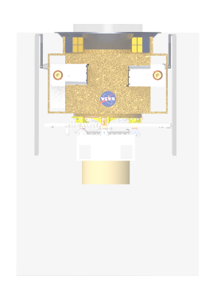
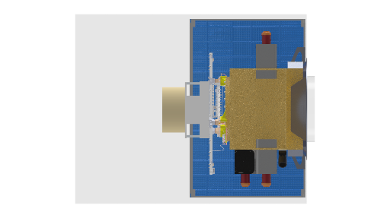
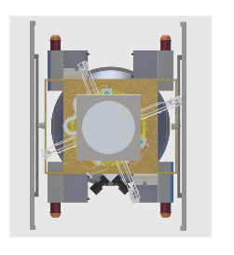
Results-Node Sail
0.8 m
Solar arrays maximized to envelope to minimize sail center hold diameter
ESPA Grande Envelope
Notes:
The above figure shows a three view of the Node sail configuration. A 24” to 15” adapter interface is utilized between the ESPA ring the spacecraft. This enables the interface adapter to remain attached to the ring to save weight from the spacecraft. The solar array area dimensions were maximized for the ESPA envelope to minimize the deployed radial distance. This also minimizes the required center hole diameter in the sail.

Slide 31
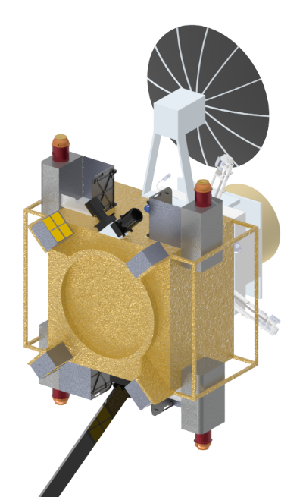
Results-Node Sail
Sun
Stowed sail
Bus
Notes:
This chart shows how the bus and sail sections make up the total spacecraft and the relative position of the sun.

Slide 32
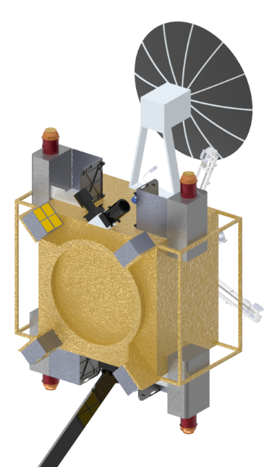
Results-Node Sail
Antenna (deployable)
Ion w/comp
Ion w/o comp
Electric thruster (4)
Electron w/o comp
Sun
Ion w/o comp
MAG boom
Notes:
This view shows just the external sail bus portion. The primary instruments are noted to show their positioning and placement. The instruments are: Electron without composition (1), Ion with composition (1), Ion without composition (2), and a magnetic boom instrument.

Slide 33
Results-Node Sail
Star tracker
Antenna
thrusters
Xband
Battery
IAU
IAU
Battery
Reaction wheels (4)
Notes:
This view shows just the internals of the node sail. The components shown are the major volume components and may not be inclusive of all required or noted in the MEL. There is sufficient room leftover to accommodate these smaller components.

Slide 34
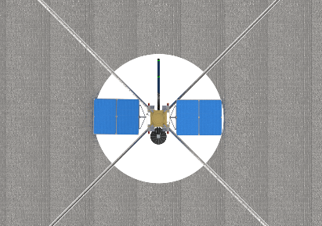
Results-Node Sail
780m² sail area
Ø4 m hole
28.2 m
Notes:
The deployed Hub sail is shown to give a relative perspective of size. A 4m center hole is required to allow for the solar arrays sun viewing. A 29m sail side dimension is required to provide the required sail array (with the 4m center hole)

Slide 35
Conclusions and Recommendations
Solar array dimensions may be need further analysis to fit into minimum size sail center hole.
  Adjusting length, width and deployment approach.

Slide 36

Mission Analysis
James Pezent, Jared Sikes, and Rohan Sood
Astrodynamics and Space Research Laboratory
The University of Alabama

Slide 37
Work Summary
Analysis for two mission concepts:
  Solar sail equipped node spacecraft
  Chemical propulsion equipped node spacecraft

Slide 38
Key Assumptions
Solar Sailing Spacecraft
  Hub Spacecraft $a_{c}=0.12 \frac{mm}{s^{2}}$
  Spoke Spacecraft $a_{c}=0.06 \frac{mm}{s^{2}}$
  Max Sun-incidence Angle ($α$) = $60°$
Chemical Propulsion Spacecraft
  3 Impulsive maneuvers per spacecraft
Earth-Sun Circular Restricted Three Body Problem

Slide 39
Approach and Tools
Astrodynamics and Science Enabling Toolkit
  Multiple shooting and LGL Collocation

Slide 40
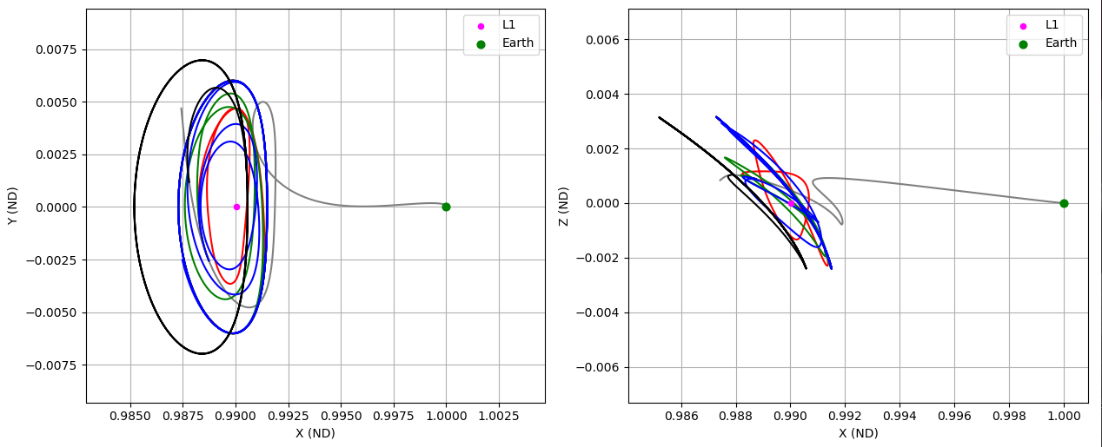
Results: Solar Sailing

Slide 41
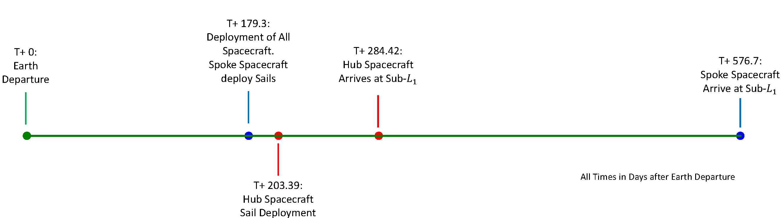
Results: Solar Sailing
Nodes Arrive
Phased at L1

Slide 42
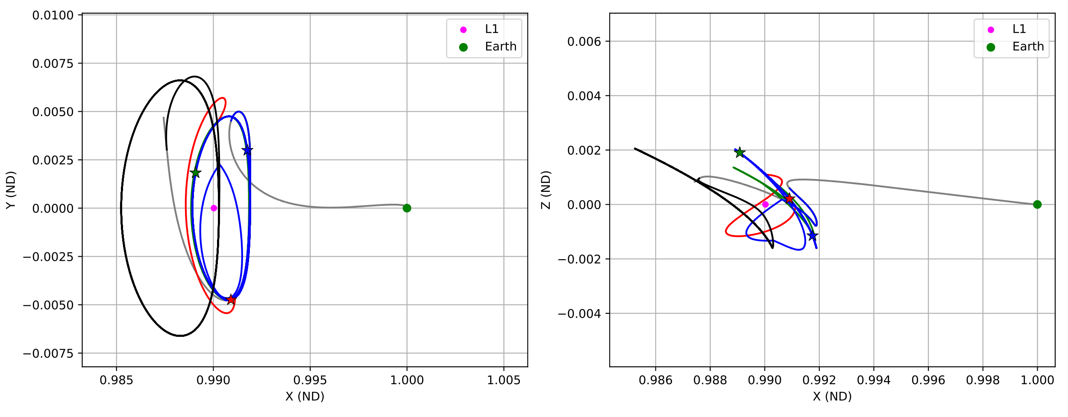
Results: Chemical Propulsion

Slide 43
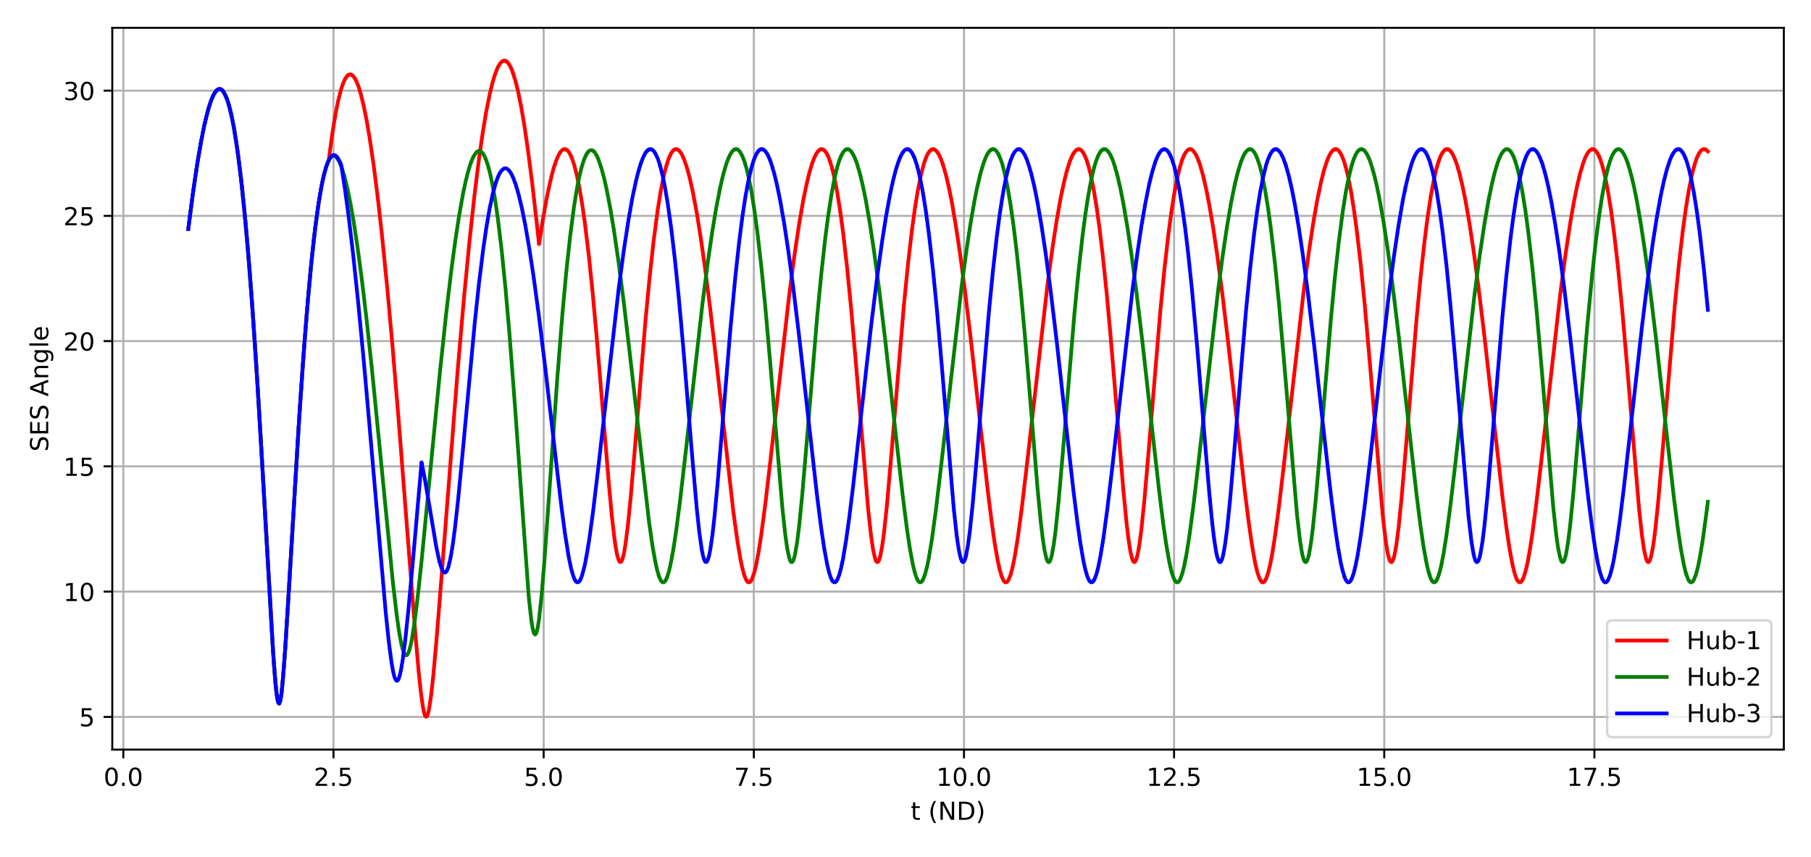
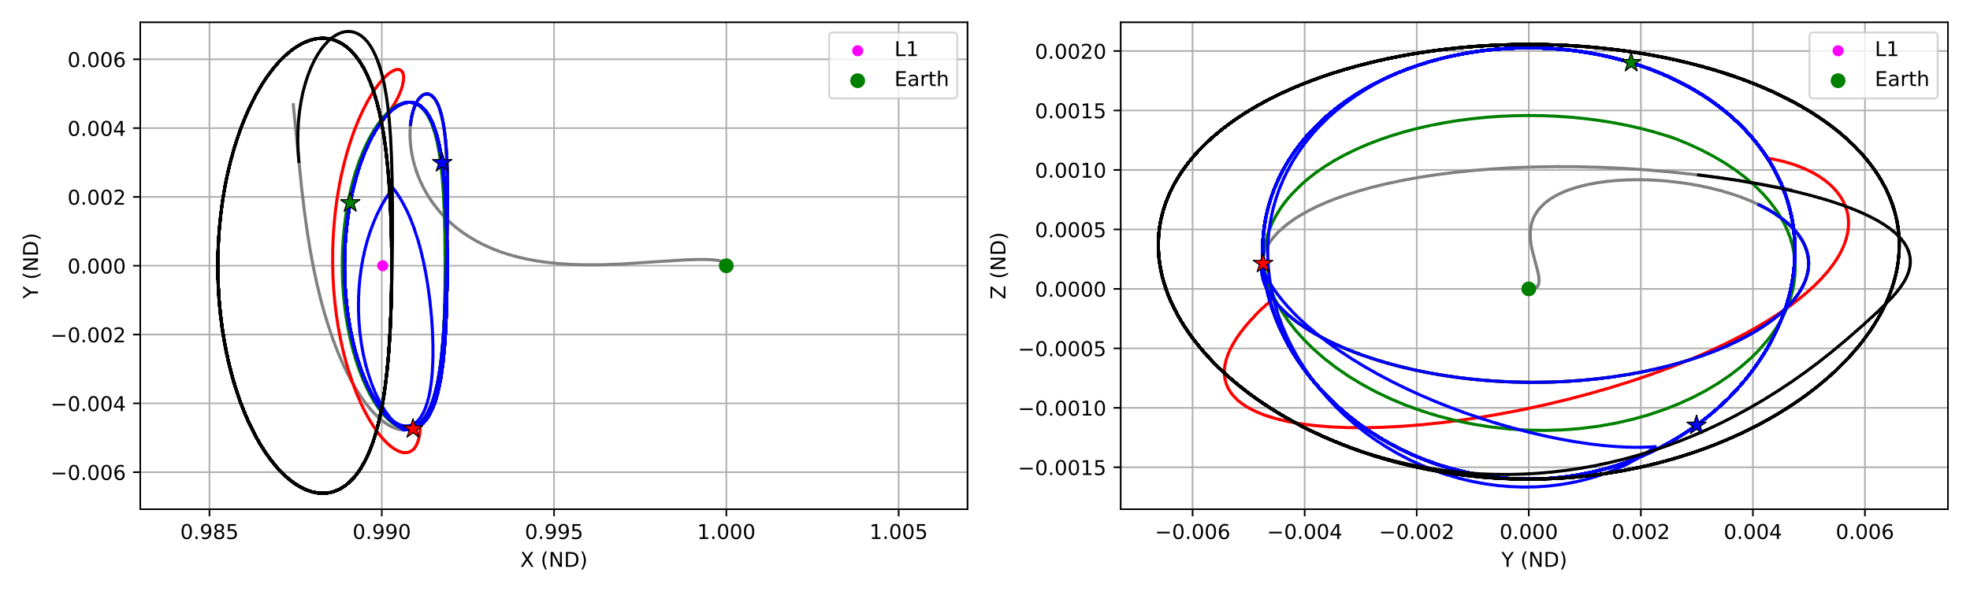
Results: Chemical Propulsion
Improve Q factor and obey SES constraints
  Doubled Z amplitude
  > 5 degree (Sun-Earth-Spacecraft) SES angle at all times for exclusion zone
  Increases DV by 60 m/s per spacecraft
  Total DV 531 m/s per node for two nodes and 63 m/s for third node
  Chemical prop feasible (preferred) solution compared to solar sail for three nodes
Node -1
Node -2
Node -3

Slide 44
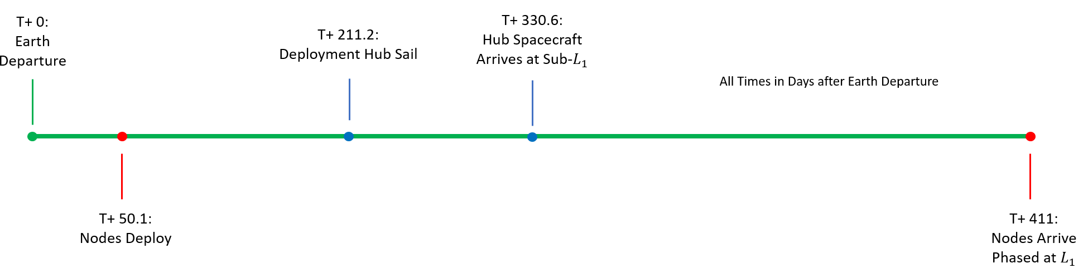
Results: Chemical Propulsion
Impulsive mission requires 531 m/s per spacecraft (for two nodes) at a minimum to be able to do the mission quickly. The third node requires 63 m/s

Slide 45
Conclusions and Recommendations
Solar sailing proves to be feasible option
  Hub: Solar Cruiser size
  Nodes: NEA Scout size
  Additional analysis recommended for:
    New/updated constraints to be incorporated
    High-fidelity analysis
Preliminary analysis for chemical propulsion gives higher but more realistic numbers
  The DV requirements are higher compared to SOHO because node phasing require additional propellant
  Increasing or decreasing number of DV maneuvers per node did not have significant effect on overall DV.
  Three maneuvers per node appeared to be sweet spot.
  Additional analysis in higher-fidelity model will be good down the line.
Chemical Propulsion for three nodes and solar sail for hub is preferred

Slide 46
Hub Solar Sail System
Dana Turse/ Redwire

Slide 47
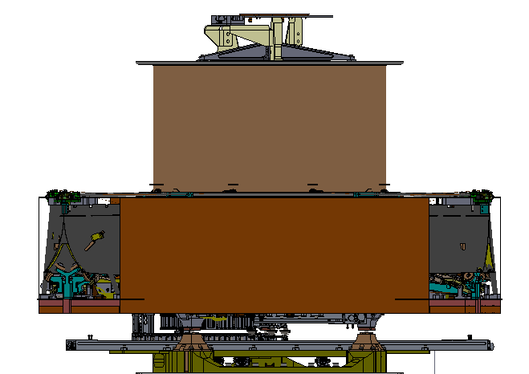
Solar Sail System – Top-level Overview, Stowed
Solar Sail System (SSS)
Active Mass Translator (AMT)
Launch Restraint Subassembly (LRS)
Bus

Slide 48
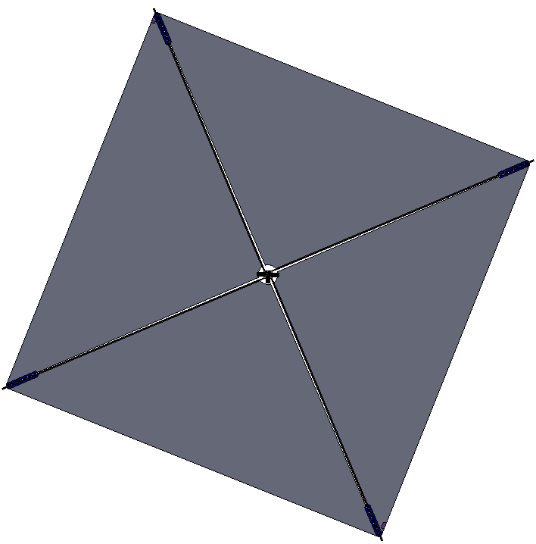
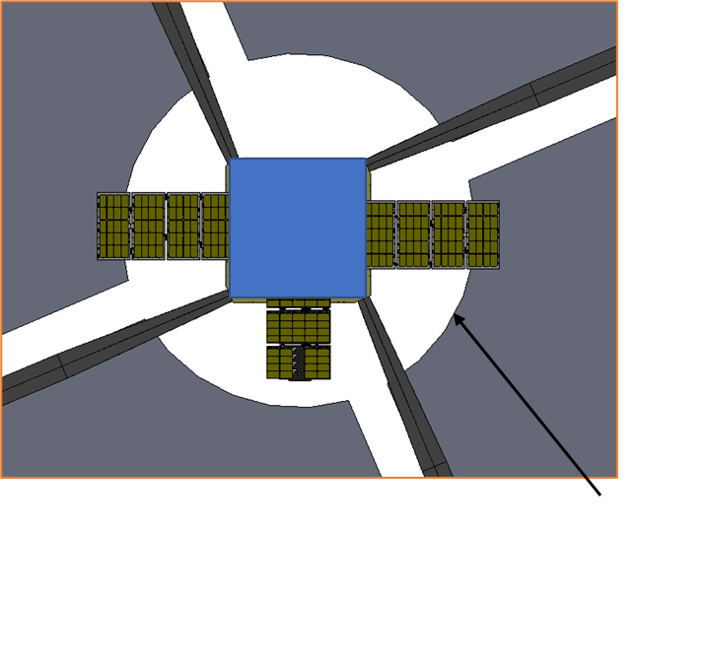
Solar Sail System – Top-level Overview, Deployed
~45m

Slide 49
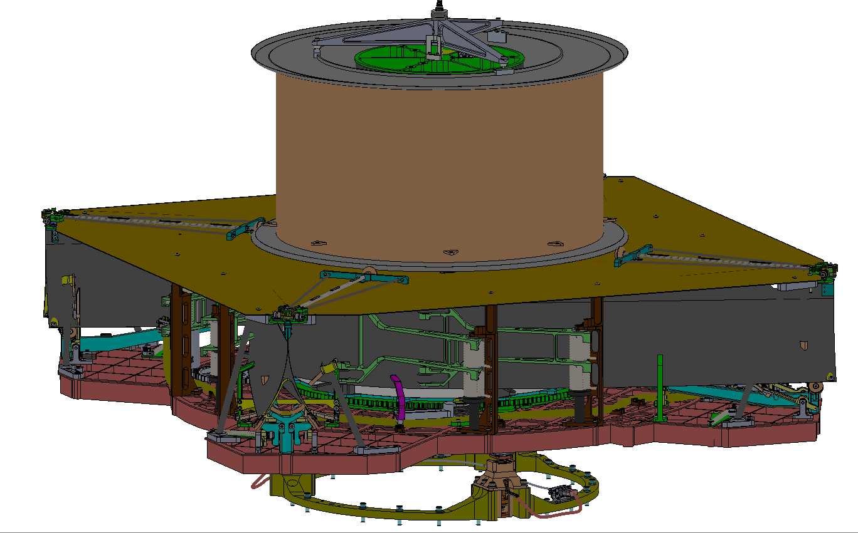
Solar Sail System – Key Features
Sail Spool Launch Restraint Tripod
Sail and Sail Spool
Upper Deck
Boom
Aluminum Base Plate
Root Guide Assemblies
Bus Interface Plate
LRS Stanchion

Slide 50
Technical Maturity
Describe test campaign and the fact that Solar Cruiser will be at TRL 6 by end of 2023

Slide 51
Modifications From Solar Cruiser for SWIFT
Talk about need to grow size and impacts/implications (relatively minor)

Slide 52
Solar Sail System (Node Spacecraft)
Johnny Fernandez & Keats Wilkie / NASA Langley Research Center (LaRC) D322

Slide 53
Work Summary
A solar sail system preliminary design for the Node Spacecraft for the SWIFT ACO Study has been performed based on LaRC composite boom and solar sail technology developed under STMD.
A 650-750 m² sail area was deemed necessary to achieve a characteristic acceleration requirement of a_{c} = 0.05-0.06 mm/s2, based on technology previously developed at the 500-m² scale.
It is possible to grow the solar sail system with minor redesign of the sail canister and sail deployment mechanism and extend boom length from existing 16.5 m to 19-20.5 m using a non-NASA fabrication facility and extension of current molds.
A compact and lightweight solar sail system that weights ~26 kg and fits in a ~27U Cubesat form factor is proposed.

Slide 54
Key Assumptions
Solar sail system design proposed needs to use key technology at TRL = 5/6 at the appropriate needed scale.
The characteristic acceleration of the Node Spacecraft with the solar sail attached needs to be >0.05 mm/s² with a goal of 0.06 mm/s².

Slide 55
Approach and Tools
Based on the desired characteristic acceleration, LaRC sized the sail area needed using existing technology.
At the appropriate lengths, the booms were sized structurally against deployed loads using an analytical model. No deployment loads were assumed in this initial sizing effort.
The packaged configuration of the four-boom system was determined and a boom deployer was sized.
The sail canisters were also sized accordingly to the required sail area.
The Active Mass Translation (AMT) unit and deployment system electronics for Solar Cruiser were assumed to be used in this solar sail system to reduce duplication efforts and use existing parameters for systems designed for interplanetary travel.

Slide 56
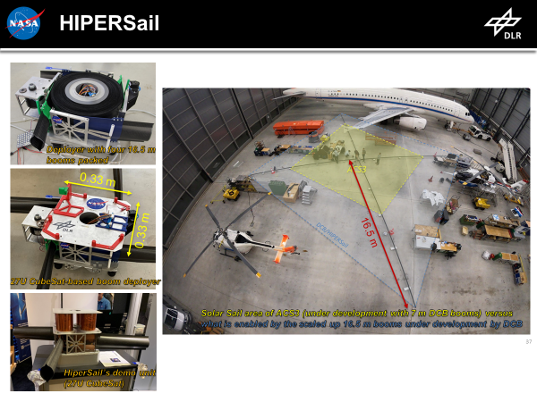
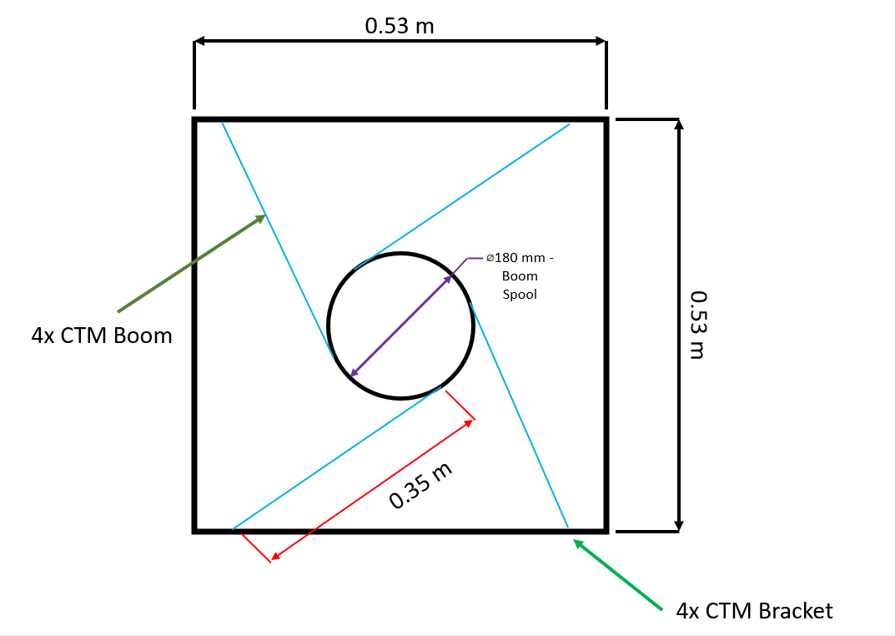
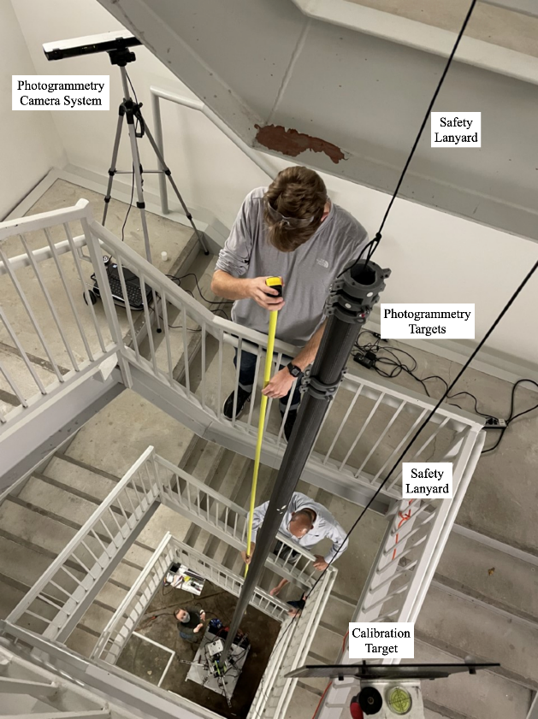
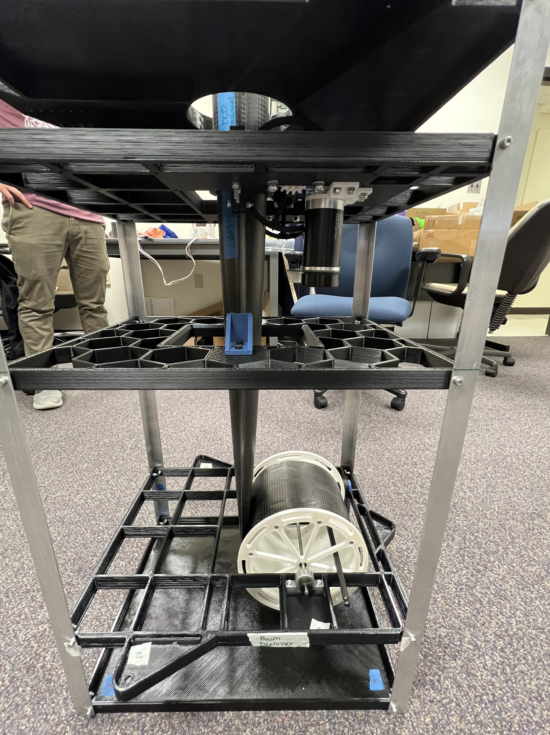
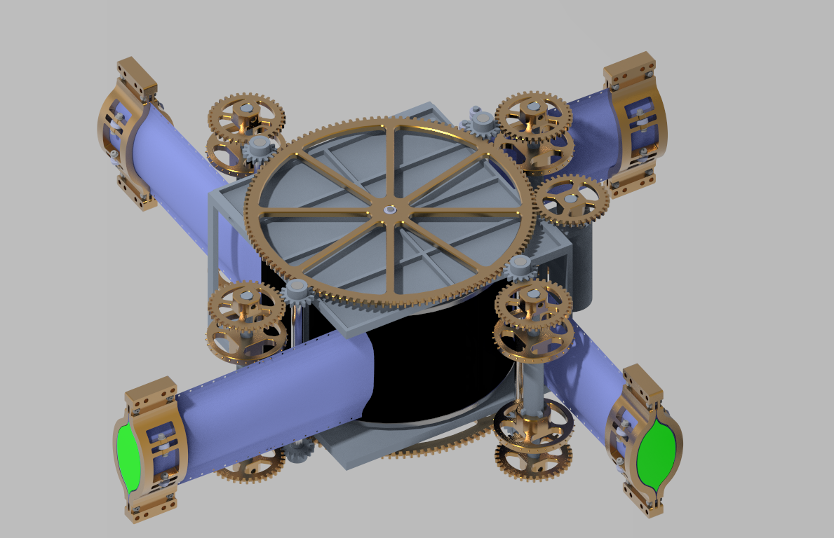
Trades: Boom Deployment Mechanism
For existing +15m scale composite booms trade different deployment mechanisms under development:
DLR deployer design previously used in the STMD DCB project to characterize and evaluate performance of 16.5 m long composite booms developed at NASA LaRC.
LaRC design developed for a lunar tower concept that uses similar composite booms, adapted to a four-boom configuration as required for a solar sail system.
Option 1
Option 2

Slide 57
Trades: Boom Deployment Mechanism
The DLR deployer developed under the joint NASA-DLR Deployable Composite Booms (DCB) project was preferred as the highest TRL solution. A smaller version of this design developed by LaRC will be flown in LEO in Q2 2024 as part of the ACS3 12U Cubesat solar sail demonstration mission.
‘Lunar Tower’ deployer technology, although preferred for larger scale solar sail systems and more compact designs (sail membrane can be collocated within the boom bay) is at a lower TRL and would not meet the entry requirement for the expected follow-on SMD proposal from this SWIFT study.
A redesign of the DLR-NASA LaRC deployer would be required to scale up unit to support the 650-750 m2 sail area needed for SWIFT.
Deployer Type / Metric | DLR-NASA LaRC for HIPERSail | Lunar Tower adapted to quad-boom system
TRL | 5 | 4 (for single boom system)
Mass | 11.5 kg | 13 kg
Volume (just the boom deployer) | 33 cm x 33 cm x 15 cm | 53 cm x 53 cm x 17 cm
Sail canisters integrated within volume | No | Yes
NASA-design | Partially | Yes
Flight Heritage | No, but ACS3 is based on this design | No
Development time to TRL 6 | 0.5-1 year | 1.5-2 years

Slide 58
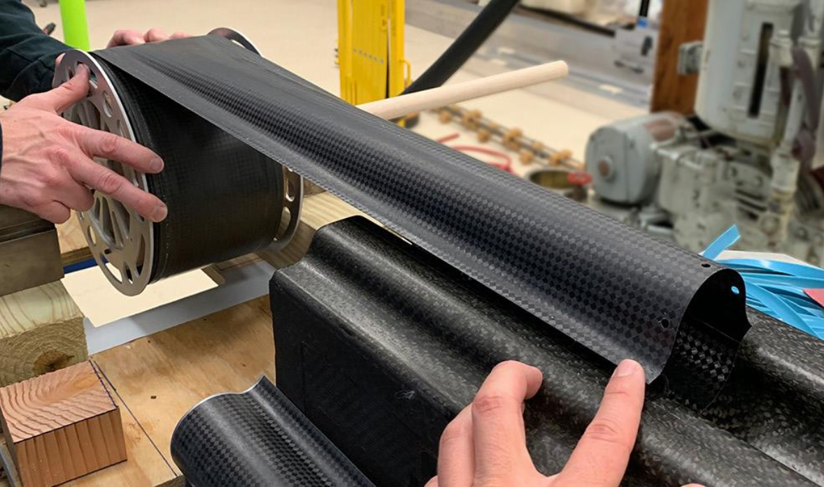
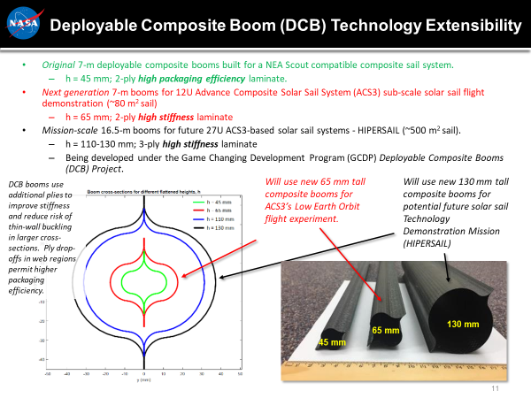
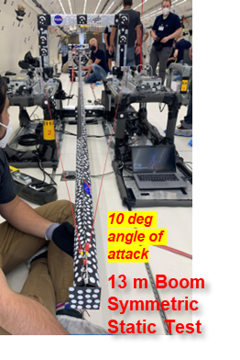


Results: Booms
CTM Boom rolled up
Boom Technology chosen for the solar sail is the Collapsible Tubular Mast (CTM) boom developed and fabricated by LaRC under the STMD DCB project to TRL 6. For more details on the booms see: https://doi.org/10.2514/6.2021-0903 and https://doi.org/10.2514/6.2023-0938
130-mm flattened height CTM Booms at the 16.5 m scale deployed in ambient and microgravity condition using a DLR deployer.
Boom static and dynamic load testing and in 0-g tests emulated forces on a single boom as part of a 500 m² square solar sail through deployment and final tensioning to an average 5 psi sail skin stress, including a safety factor (SF) of 3.
The 130-mm CTM Boom would be scaled up only in length, not in cross-section, to meet the demands of the SWIFT mission as the SF is still sufficient.
A maximum of 5 N tip compressive load and 0.1 N tip side load can be sustained by this boom design at a 20.5-m length scale. A 750 m² solar sail can be designed to operate within these requirements.
Microgravity test
Ground test at DLR

Slide 59

Results: Mass Breakdown and Solar Sail System Layout
For the larger 750 m² system:
 | Mass Breakdown Structure |  | Qty | Unit Mass (kg) | Basic Mass (kg) | Contingency (%) | Contingency (kg) | Predicted Mass (kg)
2.0 | Solar Sail System |  |  |  | 22.66 | 16.63% | 3.77 | 26.43
 | 2.1 | Booms | 1 | 5.41 | 5.41 | 10.00% | 0.54 | 5.95
 | 2.2 | Sail Membrane | 1 | 3.03 | 3.03 | 20.00% | 0.61 | 3.64
 | 2.3 | Sail Canisters | 1 | 2.50 | 2.50 | 20.00% | 0.50 | 3.00
 | 2.4 | Boom Deployer Mechanism, including electronics | 1 | 9.50 | 9.50 | 20.00% | 1.90 | 11.40
 | 2.5 | AMT | 1 | 2.22 | 2.22 | 10.00% | 0.22 | 2.44
Four sail spools/canisters for each sail membrane quadrant
Sail bay volume: 38 cm L x 38 cm W x 15 cm H.
Boom deployer with four booms co-wrapped (electronics will reside on spacecraft bus)
Boom bay volume: 38 cm L x 38 cm W x 18 cm H.
AMT will be located between the
boom deployer and the spacecraft bus

Slide 60

Results: Solar Sail System Inertias for Attitude Control
For the smaller 650 m² system:
Boom Length: 19.0 m
Sail area: 650 m2
Sail mass (deployed mass): 7.3 kg
Sail inertia (kg-m2; about boom reference plane):
1080 0 0
0 540 0
0 0 540

Slide 61
Results: Solar Sail System Estimate Cost
ROM cost of an EDU and a protoflight unit of a 750 m2 solar sail system, based on DCB and ACS flight solar sail system development: $12 M.
Cost includes booms, boom deployer, sail membrane, sail canister, and deployment system electronics.
Costs do not include the AMT.

Slide 62
Conclusions and Recommendations
A compact solar sail system based on the heritage STMD DCB and ACS3 technology developed at LaRC is recommended for the Node Spacecraft sail.
A 750 m² solar sail system is required to achieve a_{c} = 0.06 mm/s2.
The DCB/ACS3 boom design previously characterized and modelled under 1-g and 0-g tests with an increase in boom length from 16.5 m to 20.5 mis proposed . Such booms would have to be manufactured outside of LaRC as the composite cure oven is 16.8 m. Existing modular boom molds would be used with an extension to the larger length.
The deployer mechanism would follow the designed developed by DLR under the STMD DCB project but adapted to the longer booms.
The sail bay will follow the design for STMD ACS3, scaled up to the sail area required.
LaRC team recommends further lightning the spacecraft bus so the sail area can be reduced from 750 m² down to < 650 m². In addition, a deeper look at the minimum a_{c} required for the Node spacecraft to do the science proposed is recommended.

Slide 63
Avionics and Comm
Pete Capizzo / NASA MSFC ED04

Slide 64
Work Summary
Comm analysis shows Direct-to-Earth links for each probe is best option
  Using the Hub for relay to ground is not a good option
  An additional comm system would be needed for cross-links, larger than DTE
X-band communications is best option using NEN
  Assuming DSN is not available for this mission
  Ka-band is not a good option using NEN
    Ka-band downlink only provided
    An additional S-band system would be required for uplink Command and Navigation
Real-time solar event comm to NOAA ground network is achievable
  Using existing network of at least 3 stations globally separated
  DSCOVR tracking network used for example
  Assuming made available in the future for this mission
    SWIFT provides better warning time than existing missions
Notes:
A communications trade analysis was done for this study, trading one hub ground link used for all four probes versus each probe having its own ground link capability. The analysis shows Direct-to-Earth links for each probe is best the option. Using the Hub for relay to ground is not a good option because an additional comm system would be needed for cross-links that would be larger than DTE.
Trading Ka versus X-band, its seen that X-band communications is best option using the NEN, assuming DSN is not available for this mission. Ka-band is not a good option using the NEN because Ka-band is used for downlink only. An additional S-band system would be required for uplink Command and Navigation.
Analysis for the Real-time solar event communications to NOAA ground network shows it is achievable using an existing network of at least 3 stations globally separated. The DSCOVR tracking network is used for example. It's assumed that this or a similar network will be made available in the future for this mission because SWIFT provides a better warning time than any existing missions.

Slide 65
Key Assumptions
Flight Computer to provide all S/C command and control functions
  Including data management, navigation, power and thermal control
  Store and format data for downlink
Science Instruments to supply electronics required to process data
  Including Analog to Digital conversion, data compression, serializing, etc.
Use NOAA ground stations for real-time solar event notification and data
  6 kbps total link rate (Magnetometer 1 kbps, FIPS 5 kbps)
Use NEN ground stations for daily downlinks of telemetry data (DSN not available)
  20 kbps total science data (continuous), plus 30% overhead and margin
  2.5 Gbits/day (includes 2 kbps housekeeping data, CCSDS formatting)
No S/C pointing maneuvers will be provided for data downlink
  Antenna gimbaling allowed during observation times
Data storage provided for sun-outage times (10 days)
  Science data to be taken before and after solar sail deployment
Class D mission, no Avionics redundancy required
Notes:
Key Avionics and Comm assumptions for this study are as follows: Flight Computer to provide all S/C command and control functions, including data management, navigation, power and thermal control, and store and format data for downlink. Science Instruments are to supply electronics required to process data, including Analog to Digital conversion, data compression, serializing, etc. Use NOAA ground stations for real-time solar event notification and data, 6 kbps total link rate (Magnetometer 1 kbps, FIPS 5 kbps). Use NEN ground stations for daily downlinks of telemetry data (DSN not available), 20 kbps total science data (continuous), plus 30% overhead and margin, 2.5 Gbits/day (includes 2 kbps housekeeping data, CCSDS formatting). No S/C pointing maneuvers will be provided for data downlink. Antenna gimbaling allowed during observation times. Data storage provided for sun-outage times (10 days). Science data to be taken before and after solar sail deployment. This is a Class D mission, no Avionics redundancy is required.
CCSDS – Consultative Committee for Space Data Systems

Slide 66
Avionics Approach
Use high TRL levels were possible for Avionics
  Space Micro avionics suite is small, low mass, with flight heritage
All Avionics, Power, and Navigation boards are packaged into one Integrated Avionics Box: 11 slice Proton X-Box
    Provides best packaging and thermal management efficiencies
    Minimizes cabling required
  Flight computer SBC: Space Micro Proton 400k SBC
    32-bit dual core Power PC processor, 1.2 GHz, 5760 MIPS, 100krad TID
  Memory board: 8 GB provides 10 days of data storage with redundancy
    <4 GB required for 10 days of memory at 2.5 Gbit/day
  Two I/O boards: analog and digital signals, RS-422, LVDS
  Two controller boards: Reaction Wheels, Antenna Gimbal
    Sail deployment and AMT controllers supplied with sail mechanism
  Three power switching boards (see power section)
  Power conditioning and management board (see power section)
  Power conditioning board: 5 VDC, 3.3 VDC, +/-12 VDC, EMI filters
Notes:
The approach used for Avionics and Comm are as follows: Use high TRL levels were possible for Avionics. Use Space Micro avionics suite. Its small, low mass, with flight heritage, and has very good space radiation tolerance. All Avionics, Power, and Navigation boards are packaged into one Integrated Avionics Box, an 11 slice Proton X-Box. This approach provides the best packaging and thermal management efficiencies, while minimizes cabling required. The following circuit boards are contained within the Integrated Avionics Unit (IEU):
1-Flight computer SBC: Space Micro Proton 400k SBC, with 32-bit dual core Power PC processor, 1.2 GHz, 5760 MIPS, 100krad TID
1-Memory board: 8 GB provides 10 days of data storage with redundancy, where<4 GB is required for 10 days of memory at 2.5 Gbit/day
2- I/O boards: analog and digital signals, RS-422, LVDS
2- Controller boards: Reaction Wheels, Antenna Gimbal (Sail deployment and AMT controllers supplied with sail mechanism)
3- Power switching boards (see power section)
1-Power conditioning and management board (see power section)
1-Power conditioning board: 5 VDC, 3.3 VDC, +/-12 VDC, EMI filters

Slide 67

Integrated Avionic Unit
Notes:
This diagram shows the Space Micro Integrated Avionics Unit (IAU) and how it is constructed. It is an 11-slice box where the previously described circuit boards are bolted together to make an integrated unit. Each board slice has the required housing wall already included. The IEU total mass is 2.4 kg, and the total nominal power consumption is 44 watts.

Slide 68
Communications Approach
Nominal Science and S/C telemetry Communications
  Each S/C will communicate individually with ground
    Trade shows a Hub relay to ground is not a good option
    An additional comm system would be needed for cross-links, larger than DTE
  X-band will be used for science/telemetry downlink and command/navigation uplink
    Trade shows Ka-band is not a good option using NEN (Ka downlink only provided)
      An additional S-band system would be required for uplink command and navigation
  No Spacecraft pointing maneuvers will be provided for communication links
    Antenna gimbal mechanism used to achieve X-band pointing requirements
    Assume gimbaling is allowed during science observations
Real-time Solar Event Communications
  Only the Hub S/C needs to downlink real-time event data
  Use NOAA ground stations, 3 stations ~120 deg separation for continuous contact time
  Use same X-band antenna for both nominal and real-time links
    Event data can be integrated with nominal downlink to NEN during those link times
    NEN station will relay event data to NOAA SWPC
Notes:
For the communications approach, Each S/C will communicate individually with ground for nominal Science and S/C telemetry. The trade analysis shows a Hub relay to ground is not a good option because an additional comm system would be needed for cross-links, which would be larger than the DTE system. X-band will be used for science/telemetry downlink and command/navigation uplink. The trade analysis shows Ka-band is not a good option using NEN because Ka is used for downlink only. An additional S-band system would be required for uplink command and navigation. No Spacecraft pointing maneuvers will be provided for communication links. An antenna gimbal mechanism is used to achieve the X-band pointing requirements, assume gimbaling is allowed during science observations. For Real-time Solar Event Communications, only the Hub S/C needs to downlink real-time event data. Use NOAA ground stations. 3 stations with ~120 deg separation will provide continuous contact time. Use same X-band antenna for both nominal and real-time links. Event data can be integrated with nominal downlink to NEN during those link times. The NEN stations will relay event data to NOAA SWPC.
SWPC - Space Weather Prediction Center

Slide 69
Link Budget Results
Science and Telemetry NEN link budget results for 2.5 Gbits/day
  1 Mbps data rate is achieved using the 0.75 meter dish antenna for both Hub and Nodes
    To 13m SouthPoint X-band antenna, 37 G/T
      SouthPoint only NEN station with both X-band downlink/uplink for command and navigation
    Hub: 12 watts of RF power, at a distance of 2.1Mkm
    Nodes: 8 watts of RF power, at a distance of 1.6Mkm
  Downlink time required: 0.7 hour/day for each probe, 2.8 hours/day total for all 4 probes
    Wallops has 16.4m X-band antennas that would work, but used for GOES-R satellites
      Other possibility is the 16.4m antennas at the Consolidated Backup (CBU) facility in West Virginia
Solar event NOAA ground station link budget results
  6 kbps data rate is achieved using the same 0.75 meter dish antenna and 1 watt of RF power:
    At a distance of 2.2Mkm, to a 7.2m NOAA antenna, with 30 G/T X-band
  Using DSCOVR tracking stations continuous coverage could be achieved
    KSWC S. Korea 13m, DRL Germany 7.2m, WCDAS Wallops 9.1m
    Its assumed NOAA will want to switch to SWIFT due to the increased warning time
Notes:
The Science and Telemetry NEN link budget results for 2.5 Gbits/day shows 1 Mbps data rate is achieved using the 0.75-meter dish antenna for both Hub and Nodes. The South Point Hawaii 13m X-band antenna is used for the ground station, with a 37 G/T. South Point is the only NEN station with both X-band downlink and uplink for command and navigation within the same antenna. The Hub requires 12 watts of RF power at a distance of 2.1 Mkm. The Nodes require 8 watts of RF power at a distance of 1.6 Mkm. Downlink time required are 0.7 hour/day for each probe, 2.8 hours/day total for all 4 probes. As an option, Wallops has 16.4-meter X-band antennas that would work, but they are used for GOES-R satellites. Another possibility is the 16.4-meter antennas at the Consolidated Backup (CBU) facility in West Virginia.
For the Solar event NOAA ground station link budget results, 6 kbps data rate is achieved using the same 0.75-meter dish antenna and 1 watt of RF power at a distance of 2.2 Mkm to a 7.2-meter NOAA antenna with 30 G/T X-band. Using the DSCOVR tracking stations, continuous coverage could be achieved (KSWC S. Korea 13m, DRL Germany 7.2m, WCDAS Wallops 9.1m). Its assumed NOAA will want to switch to SWIFT due to the increased warning time over existing missions.

Slide 70

Communications Diagram
Notes:
This diagram shows the components of the communications system. Two SWIFT transceivers by Tether Unlimited Incorporated (TUI) are used, one for the Science data and telemetry to the NEN, and the other for the real-time solar event notifications to the NOAA network. The SWIFT radios are small, low mass, with good power capability, which is highly desirable for this mission. The SWIFT radios have flight heritage. The two radios will operate at different frequencies to the different ground networks. The NEN radio has a 12-watt RF capability while the NOAA radio only needs 1 watt RF for the warning signal. The NOAA radio will be running continuously, so the lower power usage is better for sizing the spacecraft power system. The two radios are connected to the same X-band dish antenna through an RF switch. The antenna is gimbaled to provide the required pointing of the dish for ground contact using a space qualified type 1 actuator by Moog.

Slide 71



MEL Results
Hub has additional Comm for real-time NOAA link
Chem Hub includes a propulsion controller
Notes:
The mass results for Avionics and Comm show that the systems for all 4 probes are vary similar. The Hub probe will have an additional X-band radio for the NOAA soler event notification. For the Chemical Node option, a Thruster Controller is added.

Slide 72
Conclusions and Recommendations
No new Avionics technologies required for this mission
  Many Off-the-Shelf components with flight heritage used
  Some typical modifications of circuit boards, Low risk
  Avionics and Comm systems are nearly the same for all 4 probes
    Commonality helps with cost
All communications requirements are achievable:
  Using NEN ground stations for nominal telemetry and NOAA stations for real-time solar event
    Availability of ground stations is always an issue for all missions
  0.75m pointing dish antenna and 8 to 12 watts RF power is reasonable for this mission
    Same system on all 4 probes, good commonality, reduced cost
Notes:
In conclusion, no new Avionics technologies is required for this mission. Many Off-the-Shelf components with flight heritage are used. Some typical modifications of circuit boards will be required, but this is low risk. The Avionics and Comm systems are nearly the same for all 4 probes, where this commonality will help with cost. All communications requirements are achievable using NEN ground stations for nominal telemetry and NOAA stations for real-time solar event notification. Availability of ground stations is always an issue for all missions. The 0.75m pointing dish antenna and 8 to 12 watts RF power is reasonable for this mission.

Slide 73
Avionics Backup

Slide 74
Communications Trade Analysis
General Trade Assumptions:
  Worst case distance for Hub to Earth: 2.04 Mkm
  Crosslink Hub to Nodes distance 1.15 Mkm
  Worst case distance for Nodes to Earth: 1.61 Mkm
  Hub relay daily data volume: 10 Gbits (2.5 Gb x4)
  Independent daily data volumes: 2.5 Gbits
  DSN: use 34m antennas
  NSN: for X-band, use SouthPoint 13m antenna ( in use)
    * for Ka-band, use Wallops 11m antenna (in development)
    (when using Ka for downlink, S-band required for PNT)

Slide 75

Communications Trade Analysis

Slide 76
Communications Trade Analysis - Results
Larger Antennas and more RF power required means more mass and volume for the comm system
The Hub relay option is the worst for size and power
  Hub needs an additional crosslink comm to the Nodes
  The link times are 4 times longer than independent link (using same hardware)
    This is may be an advantage since ground has only one contact to make instead of 4 per day
  The Node relay comm is larger than independent DTE
DSN wins over NSN with less power and smaller antennas needed
  But availability of DSN may be an issue in the future with all the Lunar activity
  Kept DSN link times to about 1 hour (1.4 hr. for X-band)
    NEA Scout used about 1-hour DSN link time per day
  If NSN were used, X-band would win over Ka-band
    When using Ka-band for downlink, S-band is required for navigation and tracking
    This S-band was not included in analysis, but would exceed savings of Ka sizing over X-band

Slide 77
Guidance, Navigation, & Control
Ben Diedrich / NASA MSFC EV42

Slide 78
Work Summary
GN&C subsystem concept needed for 3 different spacecraft elements
  1 hub spacecraft (solar sail at sub-L1)
  3 node sail spacecraft (L1)
  3 node chemical propulsion spacecraft (L1)
Actuator and sensor selection based on heritage missions
  Solar Cruiser
  NOAA Solar Sail Design Study
Reaction wheels (RWs)
  Size and arrangement designed to accommodate
    Detumble momentum of stowed sailcraft
    Solar Cruiser slew rates
Electric propulsion (EP)
  Arrangement to maximize 3-axis torque
  Evaluated using sail solar torque accumulation
Reaction Control System (RCS)
  Arrangement to maximize 3-axis torque
  Evaluated based on estimated chemical propulsion spacecraft solar torque accumulation
Notes:
The work involved scaling critical actuators needed for attitude control and determination of the three different spacecraft configurations. This did not include design and testing of ADCS algorithms. Design heritage from Solar Cruiser (which reached PDR and Key Decision Point-C levels of design) and the ACO NOAA Solar Sail Study were leveraged for the detailed work put into verifying the capability of their selected hardware. Considering the uniqueness of the solar sail attitude control problem, these mission designs (which themselves leveraged the NEA Scout flight design) are the most representative of the SWIFT mission.

Slide 79
Key Assumptions
Margin philosophy
  Goddard Gold Rules
Slew rates
  0.02 °/s pitch & yaw, 0.0075 °/s roll
Tipoff rates from launch vehicle upper stage
  5 °/s pitch & yaw, 2 °/s roll
Sail element actuators & sensors
  Reaction Wheels (RWs) for detumble & attitude control
  Active Mass Translator (AMT) for pitch/yaw momentum management (MM)
  Electric Propulsion (EP) for roll MM
  Star Trackers (STs) for attitude determination & post-sail deploy rates
  Inertial Measurement Unit (IMU) for pre-sail deploy rates & ST backup
  Coarse Sun Sensors (CSS) for sun pointing safe mode
Chemical Propulsion Elements
  Reaction Wheels (RWs) for attitude control
  Reaction Control System (RCS) for detumble, MM, and backup attitude control
  Sensors same as sail elements
Mission requirements
  Duration: 3 years
  Pointing accuracy: < 1 deg
  Pointing knowledge: < 0.1 deg
Notes:
This chart lists the key assumptions that drive the GN&C design.
The slew rates come from Solar Cruiser, which has a similar mission profile as SWIFT. These slew rates were found to be fast enough to respond to mission design attitude changes and deliver the commanded trajectory.
The tipoff rates come from Solar Cruiser, which had a similar launch accommodation as SWIFT - ESPA secondary launch to Sun-Earth L1.

Slide 80
Approach and Tools
Size actuators based on driving requirements & assumptions
  Deployed sail slew rates
  Tipoff rate damping
  Solar torque accumulation
Select sensors based on pointing requirements
Employ heritage designs if possible
  Solar Cruiser and NOAA Solar Sail study
Wrote a selection of Python and Matlab notebooks for calculations
  Scale deployed hub sail inertias from Solar Cruiser to SWIFT size
  Calculate reaction wheel size needed for slews rates
  Chemical propulsion detumble & MM delta-V
  Electric propulsion position & alignment for optimal MM torques
Notes:
Matlab and Python code was used for the SSADCS design of NEA Scout and Solar Cruiser ADCS. Using them allowed re-use of existing resources for scaling the actuators for the SWIFT sail.

Slide 81
Trades
For chemical propulsion node spacecraft, evaluated feasibility of damping tipoff rates with RCS vs. RWs
  Minimal delta-V usage
  RCS has large torque authority
  Control design previously developed for NEA Scout
  Relieves constraint on RW design
  Either method would work
Notes:
The question of RWs vs. RCS was raised for detumble after separation from the launch vehicle upper stage because the Solar Cruiser design uses RWs.
Solar Cruiser only has a low-thrust EP system for MM, which is incapable of detumble in a reasonable time, and the RWs are larger anyway to support the larger sail.
The SWIFT hub and node sail elements use the same design, so they require using the RWs for detumble.
For the chemical propulsion node design, detumble can be performed quickly and with minimal propellant usage with the RCS thrusters, which are typically much higher torque than wheels or EP thrusters.
Using RCS for detumble, when available, also removes an additional constraint on the RW design, so they can be optimized to support attitude control and slews without the higher momentum requirements of detumble.
The RW selected for the chemical propulsion stage are large enough to be used for detumble, but by using the RCS instead, future detailed design can be done without detumble as a RW requirement.

Slide 82
Analysis
Pointing knowledge
  2 Star Tracker solution from Solar Cruiser meets SWIFT requirement
  SWIFT: < 0.1 deg/axis, Solar Cruiser: 20 arcsec pitch/yaw & 276 arcsec roll
Pointing accuracy
  4 RW controller from Solar Cruiser meets SWIFT requirement
  SWIFT: < 1 deg/axis, which is well above Solar Cruiser's 45 arc pitch/yaw & 306 arcsec roll
IMU and CSS performance from Solar Cruiser will meet SWIFT's needs for pre-sail deploy control (with/without sail) & sun pointing safe mode
AMT design from sail subsystem had >6x control authority for Solar Cruiser
  Sufficient margins to cover increased pitch/yaw torques of larger sail
Notes:
The attitude determination and control performance of the Solar Cruiser ADCS design was compared to the SWIFT requirements.
The SWIFT requirements are less stringent because it's science mission measures particles & fields while Solar Cruiser had imaging requirements.
The SC performance is more than sufficient to meet SWIFT requirements, with margin to accommodate changes in the spacecraft design.
The AMT for SC could manage pitch/yaw momentum with >6x control authority (torque output vs. environmental torque), which should provide sufficient margin for the larger SWIFT hub sail.
If in detailed design more margin is needed for SWIFT (due to larger CG and sail torque differences), only modest changes to the AMT are expected.
The SWIFT node sails are smaller, so using the existing SC AMT design will provide even more margin.

Slide 83


Analysis
Using increased area & mass, scale SWIFT inertia over Solar Cruiser
  Using an optimized pyramid layout, 1 Nms RWs have 57-60% margin after absorbing maximum tipoff rates
  Smaller 0.5 Nms RWs sufficient for smaller sub-L1 sail and chemical propulsion node spacecraft
4 EP thrusters aligned for maximum roll/pitch/yaw MM torques
  Increased torque by >4X over Solar Cruiser design, reducing duty cycle from ~33% to < 7%
Chemical propulsion
  2 4-N thruster, ~224 sec Isp, ~0.29 m radius
  Detumble: ~6.1 cm/s delta-V
  Momentum management: 1.8 m/s / year delta-V
Notes:
The reaction wheel (RW) and electric propulsion (EP) configurations on Solar Cruiser were suboptimal due to constraints of the COTS bus selection. These configurations were revisited for SWIFT to find configurations that maximized the available RW momentum and EP torque.

Slide 84
Results
Sub-L1 sail uses larger 1 Nm reaction wheels from Solar Cruiser while L1 sails and chemical propulsion elements use 0.5 Nms RWs from NOAA Solar Sail study
Attitude determination hardware in common
RCS, EP thrusters, and AMT under propulsion & sail complete GN&C functionality
6.0 | Sub-L1 Sail Hub GN&C |  | Qty | Unit Mass (kg) | Basic Mass (kg) | Contingency (%) | Contingency (kg) | Predicted Mass (kg)
 | 6.1 | Reaction Wheels | 4 | 1.10 | 4.40 | 5.00% | 0.22 | 4.62
 | 6.2 | IMU | 1 | 0.007 | 0.01 | 5.00% | 0.00 | 0.01
 | 6.3 | Star Trackers | 2 | 0.31 | 0.62 | 5.00% | 0.03 | 0.65
 | 6.4 | Coarse Sun Sensor | 4 | 0.053 | 0.21 | 5.00% | 0.01 | 0.22
6.0 | L1 Sail Node GN&C |  | Qty | Unit Mass (kg) | Basic Mass (kg) | Contingency (%) | Contingency (kg) | Predicted Mass (kg)
 | 6.1 | Reaction Wheels | 4 | 0.85 | 3.40 | 5.00% | 0.17 | 3.57
 | 6.2 | IMU | 1 | 0.007 | 0.01 | 5.00% | 0.00 | 0.01
 | 6.3 | Star Trackers | 2 | 0.31 | 0.62 | 5.00% | 0.03 | 0.65
 | 6.4 | Coarse Sun Sensor | 4 | 0.053 | 0.21 | 5.00% | 0.01 | 0.22
6.0 | L1 Chemical Propulsion GN&C |  |  | Unit Mass (kg) | Basic Mass (kg) | Contingency (%) | Contingency (kg) | Predicted Mass (kg)
 | 6.1 | Reaction Wheels | 4 | 0.85 | 3.40 | 5.00% | 0.17 | 3.57
 | 6.2 | IMU | 1 | 0.007 | 0.01 | 5.00% | 0.00 | 0.01
 | 6.3 | Star Trackers | 2 | 0.31 | 0.62 | 5.00% | 0.03 | 0.65
 | 6.4 | Coarse Sun Sensor | 4 | 0.053 | 0.21 | 5.00% | 0.01 | 0.22
Notes:
The results show the selection of attitude determination and control hardware needed for the sail hub, sail nodes, and chemical propulsion nodes that fulfill the key assumptions & requirements.
The selection draws largely from the Solar Cruiser and NOAA Solar Sail designs.
The thrusters are covered by propulsion, while the active mass translator (AMT) is included in the sail subsystem.

Slide 85
Conclusions and Recommendations
Conclusions
  SWIFT GN&C requirements can be met leveraging heritage GN&C designs and developments for Solar Cruiser and the NOAA Solar Sail Study
Recommendations
  Scale of SWIFT GN&C problem is close enough to the Solar Cruiser & NOAA designs that the control designs scale well
  Refine analysis by iterating with other subsystems
    Mass properties & sail geometry
    Mission design pointing requirements > higher sun incidence angles
    Increased sail size changes structural modes > impacts control system design & slew rate requirements
Notes:
The Solar Cruiser and NOAA Solar Sail study designs provided complete ADCS solutions for missions that are very similar to SWIFT.
The attitude determination systems as designed should work directly.
The attitude control will require careful attention to scaling the RWs, electric thrusters, and AMT, without any major changes to those actuators.
The existing control algorithms and code for Solar Cruiser can be used with updates to the control gains, filters, and other parameters to the changes in physical configuration.
The larger sail size will decrease the structural dynamic modes, which will require changes to the control gains and filters.
The Solar Cruiser slew rate requirements were designed to accommodate mission design needs as well as that sail's structural modes.
The slew rates will need to be re-visited for a larger sail with different modes.
The smaller node sails may benefit from higher frequency modes than Solar Cruiser.
The final sizing of the SWIFT hub and node sails was not available at the time of GN&C design, so further iteration is required. May continue to change in iteration with spacecraft design.

Slide 86
Chemical Propulsion
Tyrone Boswell / NASA MSFC ED04

Slide 87
Key Assumptions
Propulsion system type: Monopropellant blowdown system
Fuel: Hydrazine
Pressurant: Nitrogen
Thrusters: MR-111G, 4N Thruster (1 lbf)
Specific Impulse: 219-229 seconds
Starting pressure: 365 psia
Final pressure: 115 psia
Starting ullage: 32%
Residual propellant: 1%
Tank temperature: 298.15 deg K
Notes:
The main goal of the propulsion system was to keep it very light, simple, and cost-effective. This led to the selection of a monopropellant blowdown system. The fuel is hydrazine and the pressurant is nitrogen. The thrusters selected are the MR-111G, which are 4 Newton thrusters (1 pound thrust) and the specific impulse is a range from 219 to 229 seconds. The starting pressure is 365 psia and the starting ullage is around 32%. We assumed the residual propellant would be 1% due to the effective ability of diaphragm tanks. The tank was assumed to be a standard temperature of 298.15 Kelvin.

Slide 88
Approach
Fill / Drain Valve
Design philosophy: keep the propulsion simple and light
Result: monopropellant blowdown hydrazine system
Propellant tank is a diaphragm positive expulsion tank
Isolation Valve, Normally Closed
GN2 Pressurant
Propellant Filter
MR-111G, 4N Thruster
Hydrazine
Notes:
This is the schematic for the propulsion system. As mentioned earlier, the main goal of the propulsion system was to keep it very light, simple, and cost-effective. This led to the selection of a monopropellant blowdown system. The fuel is hydrazine and the pressurant is nitrogen. The thrusters selected are the MR-111G, which are 4 Newton thrusters (1 pound thrust) and the specific impulse is a range from 219 to 229 seconds.

Slide 89

Northrop Grumman Tank 80401-1
Notes:
This is the tank selected for the propulsion system. This is a diaphragm tank. If the propellant volume increases due to mission changes, this tank might need to be replaced.

Slide 90

Thruster Info
Notes:
This is the thruster selected for the mission. This thrust class and thruster count was verified by GN&C to work with the current version of the mission. The thrust range refers to the max thrust at beginning of life, and the thrust level at the end of mission assuming the decrease in pressure due to the blowdown configuration. Currently designing the propulsion system to use 16 thrusters, though it is possible to reduce the number of thrusters in future cycles with analysis shared between propulsion, GN&C, and mission analysis disciplines.

Slide 91
Results: MEL
Item | Qty | Unit Mass (kg) | Basic Mass (kg) | MGA (%) | MGA (kg) | Predicted Mass (kg) | Info
Thrusters (1 lbf) | 16 | 0.37 | 5.92 | 3.00% | 0.18 | 6.10 | Aerojet MR-111G
Propellant Tank | 1 | 7.00 | 7.00 | 3.00% | 0.21 | 7.21 | Northop Grumman 80401-1
Pressurant Fill/Drain Valve | 1 | 0.21 | 0.21 | 3.00% | 0.01 | 0.22 | Moog (50-787)
Pressure Transducer | 1 | 0.28 | 0.28 | 3.00% | 0.01 | 0.29 | Lunar Prospector
Propellant Filters | 1 | 0.18 | 0.18 | 3.00% | 0.01 | 0.19 | VACCO (F1D10638-01)
Flow Control Orifice | 1 | 0.02 | 0.02 | 3.00% | 0.00 | 0.02 | AIAA 2003-4470
Latch Valves | 1 | 0.50 | 0.50 | 3.00% | 0.02 | 0.52 | Moog (51-134)
Propellant Fill/Drain Valves | 1 | 0.21 | 0.21 | 3.00% | 0.01 | 0.22 | Moog (50-787)
Propellant Service Valve | 1 | 0.21 | 0.21 | 3.00% | 0.01 | 0.22 | Moog (50-787)
Lines and Fittings | 1 | 1.35 | 1.35 | 25.00% | 0.34 | 1.68 | Estimate
Totals: |  |  | 15.88 | 4.87% | 0.77 | 16.65
Notes:
These components reflect all of the items shown in the schematic. Each component is TRL-9 and each are based on components flown in the missions listed in the "Info" column. The lines and fittings line item is a mass-estimated relationship based on past experience and rules-of-thumb.

Slide 92
Conclusions & Future Work
Design philosophy: keep the propulsion simple and light
The propulsion system consists entirely of TRL 9 components
The number of thrusters (16) were selected as a first cut to ensure full control authority
  Could possibly be reduced after careful analysis of the mission profile and GN&C control authority
Notes:
As mentioned earlier, the main goal of the propulsion system was to keep it very light, simple, and cost-effective. This led to the selection of a monopropellant blowdown system. Each component is TRL-9 and each are based on components flown in past missions. Currently the propulsion system uses 16 thrusters, though it is possible to reduce the number of thrusters in future cycles with analysis shared between propulsion, GN&C, and mission analysis disciplines.

Slide 93
Thermal
Thomas Brooks / NASA MSFC ED04
Elaine Hatfield / NASA MSFC ER15

Slide 94

Approach and Tools
Compare the three bus cases (Hub sail, Node sail, and Node chemical) to determine worst case
Detailed Thermal Desktop analysis of the most challenging bus
Mass estimates based upon quantity and size of hardware
Cross check against NOAA study for comprehensiveness
Notes:
Approach and Tools
The mission requires a hub spacecraft and three node spacecraft. As part of the study, we carried two propulsion options for the nodes: 1) chemical propulsion, or 2) solar sail. Overall, there were three spacecraft designs that were a part of this study. It was infeasible to create a Thermal Desktop model for all three spacecraft, so the spacecraft’s areal heat dissipation requirement was compared to determine which spacecraft would be analyzed in Thermal Desktop. If the Thermal Desktop model verified the thermal subsystem’s ability to meet requirements for the most difficult spacecraft, it will meet the requirements for the other spacecraft as well. Mass estimates were made for all spacecraft options, and the masses were cross checked against the masses from a similar study in the past called the NOAA study.

Slide 95

Key Assumptions
Notes:
Key Assumptions:
The key assumptions that affected the thermal environment are in the table. It’s assumed that the spacecraft will be launched directly to L1 and not loiter in LEO. The solar sail will affect the thermal environment around the spacecraft, and it's assumed that the solar sail will be 2.5 um thick and made from Clear Polymer 1 with its first surface aluminum. The instruments’ power consumption and temperature ranges were provided by the science team and are listed in the table. It is preferrable that the instruments do not rely on the bus for their thermal management, so the instruments were insulated from the spacecraft and relied on their own surface area as a heat sink. The avionics and power interfaces were provided to the thermal engineer by the avionics and power engineers. The design architecture is as simple as it can be. Radiators provide a heat sink to space. Survival heaters provide heat during periods where the other subsystems are turned off and not dissipating heat. Thermal interface material is used to get heat from the electronics boxes to the spacecraft bus. Insulating spacers are used where its preferable to limit heat transfer, like between the instruments and the bus. Heat pipes are used to spread heat to the edges of the radiative surfaces.
Standard temperature margins are used with 15 C of margins on the hot side and 5 C on the cold side. The power engineer adds a 30% power growth allowance, and the resulting predicted power is used to determine heat dissipation. 40% mass margins are used which corresponds to an “estimated” design maturity in the ANSI/AIAA S-120A-2015 “Mass Properties Control for Space Systems” standard. The level of detail in the thermal analysis exceeds this design maturity, but the maturity of the requirements is at an estimated level.

Slide 96

Bus Comparison
The Hub – Sail configuration “worst-case”
  Worst heat dissipation to surface area ratio
  Most likely to have challenging heat rejection
Bus | Surface Area (m2) | Maximum Heat Dissipation (W)* | Areal Heat Dissipation (W/m²)
Hub - Sail | 1.2 | 329.8 | 275
Node - Sail | 1.2 | 196.1 | 170
Node - Chem | 2.1 | 197.4 | 93
  * Includes only heat dissipations the bus must manage (no sail or instrument heat dissipations), 30% power growth allowance, and 20% comms efficiency
Notes:
Bus Comparison:
The main concern for the thermal subsystem of the SWIFT spacecraft, is that there may not be enough surface area to reject the heat produced by the spacecraft’s subsystems. If this is the case, then the spacecraft will require a deployable radiator which adds complexity and mass and could further require additional heat transport systems between the spacecraft bus and the deployed radiator such as heat straps or a fluid loop. Therefore, the areal heat dissipation is the correct metric for comparing the three spacecraft configurations to determine which spacecraft is at greatest risk of closing without adding additional hardware. The Hub – Sail was found to have the highest areal heat dissipation because it has the greatest heat dissipation while only being marginally larger than the Node – sail spacecraft. This is the spacecraft that was analyzed in the Thermal Desktop model.

Slide 97
Heat Flow Map
Radiative Bus Structure
Instruments
Space (2.7K)
Bus Utilities (Avionics, Comm, GNC, and Power)
Sun
(1354 W/m2)
  The bus is a single thermal region connected by heat pipes and TIMs.
  The instruments manage their own heat rejection.
Notes:
Heat Flow Map:
The heat flow map shows how heat flows from the components that the bus’s thermal subsystem manages. The bus utilities like the avionics, comm system, GN&C, and power are mechanically mounted to the spacecraft structure and conductively tied to it using thermal interface materials. The heat conducts from the electronics inside of the boxes to the structure where it is radiated to space. The instruments are adiabatically mounted to the spacecraft bus and therefore do not conduct heat through the bus. The instruments radiate heat directly to space from their own structure.

Slide 98

Radiative Bus Structure
Bus structure serves a dual purpose as a radiator
Covered in silver Teflon tape (paint also acceptable)
Thermal interface materials between the bus and electronics
Heat pipes on 3 sides of the bus spread heat efficiently
Embedded Heat Pipes
Notes:
Radiative Bus Structure:
The bus structure also serves as a radiator. It is covered in silver Teflon tape which has a high emissivity and a low absorptivity to radiate as much heat a possible while absorbing little sunlight as heat. It was found that heat pipes are required on 3 sides of the bus to efficiently spread heat throughout the bus’s structure and reject heat. Otherwise, some of the radiator is very hot while the rest isn’t, and a large portion of the radiator does not radiate much heat while the electronics overheat.

Slide 99

Thermal Desktop Results - Bus
Avionics, Comm, and Power
  Held between their allowable temperature limits
  Heat pipes required to adequately spread the box heat throughout the bus radiator surface area
Notes:
The avionics, comm, and power system needs to be below 45 C (this number includes 15 C margins) or else it will overheat. You can see that these systems can be kept below that value without requiring a deployable radiator.

Slide 100

Thermal Desktop Results - Instruments
Instruments
  Held between their -35 to 25 C allowable
  Instruments adiabatic to the bus
  Instruments use only ~10% of their surface area to radiate heat (plenty of margin)
  Instruments capable of handling their own heat rejection
Notes:
Instruments:
The instruments can be maintained below their maximum temperature without using the bus as a heat sink. The instruments on average used about 10% of their surface area as radiative area and were still able to stay below the 25 C limit (includes 15 C margins).

Slide 101
Mass Estimates
Hub – Sail
Node - Sail
 | Item | Contingency (%) | Predicted Mass (kg) | TRL
7.1 | MLI | 40.00% | 0.18 | 7
7.2 | Heat Pipes | 40.00% | 0.29 | 7
7.3 | Instrument Standoffs | 40.00% | 0.07 | 8
7.4 | Tape and Paint | 40.00% | 1.02 | 8
7.5 | Thruster thermal strap | 40.00% | 0.34 | 8
7.6 | Heaters, thermostats, and wiring | 40.00% | 1.03 | 8
 |  | Total | 2.91
 | Item | Contingency (%) | Predicted Mass (kg) | TRL
7.1 | MLI | 40.00% | 0.18 | 7
7.2 | Heat Pipes | 40.00% | 0.29 | 7
7.3 | Instrument Standoffs | 40.00% | 0.07 | 8
7.4 | Tape and Paint | 40.00% | 0.98 | 8
7.5 | Thruster thermal strap | 40.00% | 0.34 | 8
7.6 | Heaters, thermostats, and wiring | 40.00% | 1.03 | 8
 |  | Total | 2.87
Node – Chemical
 | Item | Contingency (%) | Predicted Mass (kg) | TRL
7.1 | MLI | 40.00% | 1.52 | 7
7.2 | Heat Pipes | 40.00% | 0.37 | 7
7.3 | Instrument Standoffs | 40.00% | 0.07 | 8
7.4 | Tape and Paint | 40.00% | 1.80 | 8
7.5 | Heaters, thermostats, and wiring | 40.00% | 1.03 | 8
7.6 | Tank Insulation | 40.00% | 0.24 | 7
7.7 | Tank heaters, thermostats, and wiring | 40.00% | 0.08 | 8
 |  | Total | 5.10
Notes:
MEL:
The MEL shows the masses of the thermal subsystem for the three options we considered. The driving cause of mass differences between the spacecraft stems from the difference in the size of the spacecraft buses. The Node – Chemical bus was larger to hold the required propellant tanks. Because of this, it required more MLI, tape, and paint. The chemical option also required additional MLI to cover the tank and additional survival heaters to prevent the tank from overheating. The Hub – Sail was marginally larger than the Node – Sail and this also caused a small difference in mass.

Slide 102
Conclusions
The thermal design closes with common thermal hardware
All configurations have enough surface area to reject all the waste heat
Instruments capable of handling their own heat rejection
The larger buses require more insulation, paint, and tape, so the thermal subsystem is more massive
Masses are like those found in the NOAA study
Notes:
Conclusions
SWIFT consumes a lot of power, but the bus’s heat dissipation and the thermal environment do not vary much throughout the mission. The surface area of the bus is more than adequate to reject all the bus’s waste heat, but heat pipes are required to spread the heat out across the bus’s surface area. The Hub bus has the most challenging surface area to heat dissipation ratio, because its comms and GN&C systems use more power and generate more heat. The notional instruments have enough surface area to manage their own heat rejection, so they can be adiabatically mounted to the bus. The thermal subsystem mass were a small part of the overall system mass, and the thermal subsystem masses varied between buses mostly due to variable in the size of the buses. The larger buses required more MLI and surface treatment which causes them to be more massive.

Slide 103
Power System
Leo Fabisinski / NASA MSFC ED04

Slide 104
Work Summary
Analyzed 3 Cases
  Sail Propelled Hub Spacecraft
  Sail Propelled Node Spacecraft
  Chemical Propelled Node Spacecraft
All power systems are solar array based

Slide 105
Key Ground Rules & Assumptions
Power provided to spacecraft bus and all science instruments
Power conversion uses rigid panel solar arrays (27% Efficiency)
Energy storage uses batteries comprised of LG INR18650 MJ1 Cells (each 3500 mAhr).
Max battery depth of discharge is 65%
Deep Space radiation environment
No redundancy / fault tolerance

Slide 106
Approach and Tools
Solar sail acceleration limitations drive minimal mass design for solar sail cases.
Deep space radiation environment combined with long life requirements necessitate hardened power electronics
Batteries and solar arrays sized with Level 1 physics-based tools
Notes:
Because solar sail propulsion is so low thrust, bus mass is especially precious. Every kg of mass will reduce the spacecraft’s acceleration and increase the length of the mission. At the same time, that long mission length increases the risk of component failure including the risk posed by the cumulative ionizing dose of radiation. At the same time, the usual methods for decreasing the probability of component failure (redundancy) increase the mass of the bus. Component selection is always important, but doubly so for solar sail missions.

Slide 107
Power Requirements - Hub
Source | De-Tumble | De-Sat | Ballistic Cruise | Pre-Deploy | Sail Deploy | Sail Cruise | Science | Comm Out
Science | 0 | 16.8 | 3.4 | 0 | 0 | 16.8 | 16.8 | 16.8
Sail | 0 | 0 | 0 | 120 | 37 | 27.5 | 27.5 | 27.5
GNC | 82 | 82 | 82 | 82 | 82 | 82 | 82 | 82
C&DH, Intrumentation | 42 | 42 | 42 | 44 | 44 | 42 | 42 | 42
Communications | 116 | 116 | 116 | 116 | 116 | 116 | 116 | 11
System Controllers, Heaters | 12 | 12 | 23 | 23 | 23 | 23 | 23 | 32
Propulsion | 0 | 2.5 | 2.5 | 2.5 | 0 | 5 | 5 | 5
Thermal | 0 | 0 | 0 | 0 | 0 | 0 | 0 | 0
Totals | 252.0 | 271.3 | 268.9 | 387.5 | 302.0 | 312.3 | 312.3 | 216.3
Growth (30%) | 75.6 | 81.4 | 80.7 | 116.3 | 90.6 | 93.7 | 93.7 | 64.9
Predicted Power | 327.6 | 352.7 | 349.6 | 503.8 | 392.6 | 406.0 | 406.0 | 281.2
Notes:
This is a power breakdown for the Hub spacecraft, listing the power required for each major source during each major mission phase. The De-Tumble phase occurs before array deployment, so battery power will be used throughout. The Pre-Deploy phase requires the most power, but since it lasts only 2 minutes (while the frangibolts are actuated), we will perform this phase with battery power as well. The arrays are sized for the Science mission phase.

Slide 108
Power Requirements – Sail Node
Source | De-Tumble | De-Sat | Ballistic Cruise | Pre-Deploy | Sail Deploy | Sail Cruise | Science | Comm Out
Science | 0 | 16.8 | 3.4 | 0 | 0 | 16.8 | 16.8 | 16.8
Sail | 0 | 0 | 0 | 120 | 37 | 27.5 | 27.5 | 27.5
GNC | 23 | 23 | 23 | 23 | 23 | 23 | 23 | 23
C&DH, Intrumentation | 42 | 42 | 42 | 44 | 44 | 42 | 42 | 42
Communications | 74 | 74 | 74 | 74 | 74 | 74 | 74 | 6
System Controllers, Heaters | 10 | 20 | 23 | 23 | 23 | 23 | 23 | 30
Propulsion | 0 | 2.5 | 2.5 | 2.5 | 0 | 5 | 5 | 5
Thermal | 0 | 0 | 0 | 0 | 0 | 0 | 0 | 0
Totals | 149.0 | 178.3 | 167.9 | 286.5 | 201.0 | 211.3 | 211.3 | 150.3
Growth (30%) | 44.7 | 53.5 | 50.4 | 86.0 | 60.3 | 63.4 | 63.4 | 45.1
Predicted Power | 193.7 | 231.8 | 218.3 | 372.5 | 261.3 | 274.7 | 274.7 | 195.4
Notes:
This is a power breakdown for the Sail Node spacecraft, listing the power required for each major source during each major mission phase. The De-Tumble phase occurs before array deployment, so battery power will be used throughout. The Pre-Deploy phase requires the most power, but since it lasts only 2 minutes (while the frangibolts are actuated), we will perform this phase with battery power as well. The arrays are sized for the Science mission phase.

Slide 109
Power Requirements – Chem Node
Source | De-Tumble | De-Sat | Ballistic Cruise | Propulsion | Science | Comm Out
Science | 0 | 16.8 | 3.4 | 3.4 | 16.8 | 16.8
GNC | 23 | 23 | 23 | 23 | 23 | 23
C&DH, Intrumentation | 42 | 42 | 42 | 42 | 42 | 42
Communications | 72 | 72 | 72 | 72 | 72 | 6.4
System Controllers, Heaters | 10 | 20 | 23 | 23 | 23 | 30
Propulsion | 0 | 79 | 0 | 79 | 0 | 0
Thermal | 10 | 10 | 10 | 10 | 10 | 10
Totals | 157.0 | 262.8 | 173.4 | 252.4 | 186.8 | 128.2
Growth (30%) | 47.1 | 78.8 | 52.0 | 75.7 | 56.0 | 38.5
Predicted Power | 204.1 | 341.6 | 225.4 | 328.1 | 242.8 | 166.7
Notes:
This is a power breakdown for the Chemical Node spacecraft, listing the power required for each major source during each major mission phase. The De-Tumble phase occurs before array deployment, so battery power will be used throughout. The arrays are sized for the Science mission phase.

Slide 110
Power Requirements – Element Comparison
bnbnbnbn
Mission Phase | Hub | Sail Node | Chem Node
De-Tumble | 328 | 194 | 204
De-Saturation | 353 | 232 | 342
Ballistic Cruise | 350 | 218 | 225
Propulsion | N/A | N/A | 328
Pre-Deploy | 504 | 372 | N/A
Sail Deploy | 393 | 261 | N/A
Sail Cruise | 406 | 275 | N/A
Science | 406 | 275 | 243
Comm Out | 281 | 195 | 167
Sizes Battery
Sizes Solar Array for Chem Node
Sizes Solar Array for Sail Craft
Notes:
This is a comparison of the power requirements (predicted power) for all 3 cases by mission phase. In all 3 cases, the De-Tumble phase sizes the battery. For the Sail craft, the Science phase sizes the solar array, but for the Chemical Node, the solar array is sized by the requirements for the Propulsion phase.

Slide 111

Solar Arrays
Each wing is 90% covered with Photovoltaic Cells – 27% conversion efficiency with knockdown. Inverted Meta Morphic IMM cells are used for weight reduction
Hub and Sail Node Arrays sized for max 61 deg Off-Point
Assume 3% yearly degradation rate
Case | Area (m²) | Predicted Mass(kg) | Power Production (W)
Hub | 3.2 | 8.6 | 466
Sail Node | 2.3 | 6.0 | 332
Chem Node | 2.7 | 7.0 | 387

Slide 112

Energy Storage
Each Battery is comprised of LG INR18650 MJ1 Cells
28VDC requires (8) 3.6V Cells / String
At 65% Depth of Discharge, each string will provide 65.7 Whr energy
De-Tumble phase sizes battery for every case
Case | Energy Required (Whr) | Number of Strings | Predicted Mass (kg)
Hub | 78 | 2 | 1.2
Sail Node | 50 | 1 | 0.6
Chem Node | 50 | 1 | 0.6
Notes:
The Chemical and Sail Node require 50Whrs, so 1 string will be sufficient. The Hub, however, requires 2 strings.

Slide 113



Power Electronics
Power Electronics are contained in the same enclosure with the Avionics Boards (Proton X Suite)
1 Power / Battery Management board (interfaces solar array and battery)
3 Power Switching boards (switches and conditions individual load circuits
Board masses are bookkept in Avionics

Slide 114
Results
Predicted Mass Comparison (kg)
Item | Hub Mass | Sail Node Mass | Chem Node Mass
Solar Arrays | 8.64 | 6.00 | 6.96
Secondary Battery | 1.20 | 0.60 | 0.60
Power Electronics | 0.74 | 0.74 | 0.74
Cabling | 1.23 | 1.23 | 1.23
Total | 11.07 | 7.83 | 8.79
Notes:
As expected, the Hub is slightly higher mass than the node cases. The Chemical Node option is a bit higher in mass than the Sail Node option, but is lower risk

Slide 115
Conclusions and Recommendations
Solar Sail propulsion necessitates low mass design, but deep space environment requires high radiation tolerance and relatively long life.
Solar arrays comprised of thin Inverted Meta-Morphic cells on a light rigid panel
Power electronics are sized from Space Micro Proton X suite known for small size and high radiation tolerance
Secondary batteries are used only for de-tumble and pre-deployment – future designs could allow batteries and perhaps reaction wheels to be discarded after sail deployment

Slide 116
Structures
Jay Garcia / NASA MSFC ED04

Slide 117
Work Summary
Sized primary structures for the following SWIFT Spacecraft. This is a multi spacecraft design which has one Hub and three Node spacecraft that work together as a group to perform science tasks. A trade study was performed to evaluate Node spacecraft using either Solar Sail or chemical propulsion. Note that only one of the Node options will be selected for final use.
  Hub – Solar Sail
  Node – Solar Sail
  Node – Chemical Propulsion (No solar sail)
The chemical propulsion Node required one additional design iteration to meet the mission requirements. Updates included a larger tank and BUS structure.
Note that no analysis was performed for design of the solar sail assembly. These mass inputs were obtained either from Solar Cruiser or provided by solar sail design.

Slide 118
Key Assumptions
Primary structures are designed to meet minimum strength and stability requirements as stated in NASA STD-5001B
  Assume Proto-flight design approach
Assume Planetary Systems Corp 15 inch Lightband Separation System
Assume launch / ascent loads as recommended in the ESPA users guide
Assume the following strength factors of safety in accordance with a Proto-flight design approach
  FSu = 1.4, FSy = 1.25
Assume all metallic aluminum construction
Assume use of locking mechanisms during launch/ascent (This applies to Solar arrays and Dish Antenna)
SWIFT Spacecraft should adhere to mass/cg requirements as stated in the ESPA PUG
Stiffness Requirements
  First Cantilever lateral mode > 25Hz
Secondary structure mass assumes 20% of subsystem mass (Excluding tanks, solar panels, and solar sail related mass)
Notes:
All spacecraft require a conical adapter which transitions from a 24 inch diameter ESPA Grande port interface to the 15 inch Lightband separation system diameter. Note that the conical adapter is assumed to remain with the ESPA ring when the spacecraft is jettisoned
Assume recommended 8.5g Axial / 8.5g Lateral loads as recommended in the ESPA Payload users guide. See backup notes for additional information. Note that these loads are applied in the launch vehicle coordinate frame.
A first cantilever mode of 25Hz is assumed as stated in the Falcon 9 Payload Users Guide. (No specific launch vehicle has been selected for this study)
Locking mechanisms will likely be required to provide additional support to the Solar Arrays during earth launch / ascent

Slide 119
Approach and Tools
Structural model created using Creo CAD provided by design.
SWIFT HUB and Node BUS primary structure sized using MSC Nastran finite element models
Structural Analysis Tools
  Pre Processor - MSC Patran
  MSC Nastran SOL 101 – Linear Static
  MSC Nastran SOL 103 – Normal Modes
  Sizing Optimization – Collier Research Hypersizer
Subsystem components represented using either stiff elements with appropriate mass density or concentrated masses
  Subsystem components attached to primary structure using Multi Point Constraint (MPC) definitions
Notes:
Three finite element models were created to represent the three spacecraft configurations in the study. The Hub-Sail BUS and Node-Sail BUS are assumed to be identical in overall dimension, with the exception of the Solar Sail assemblies which differ in size and mass. The Hub-Sail assumes a 2060m² sail while the Node-Sail assumes an 780m² sail.
Subsystem component placement in the BUS is identical for the Hub-Sail and Node-Sail but is different in the Node-Chem option due to the fact that the Node-Chem configuration includes an internal Propellant tank in the BUS
All analysis models were evaluated using MSC Nastran with sizing optimization performed by Hypersizer.
Subsystem mounting provision mass is assumed to be included in the secondary mass estimate which assumes 20% of the subsystem mass.

Slide 120



SWIFT Hub / Node – with solar sail
Instr
Electrons
Instr
Electrons
Sail Spool
HUB Bus
Boom Spool
Instr Ions – w Comp
Instr Ions – w/o Comp
Solar Arrays
Instruments
X-Band Boxes
Mag Boom
Battery
Conical Adapter
Comm Antenna Box
Star Trackers
IAU
Note: Hub and Node Solar Sail assembly mass are different
BUS mounted subsystems
Notes:
Hub-Sail and Node-Sail configurations are assumed to have identical BUS dimensions. Variations in BUS sizing exists due to the Hub and Node having different Solar Sail area/mass
Subsystem and instrument definitions for both Hub-Sail and Node-Sail are assumed to be identical

Slide 121



SWIFT Node – Chemical Propulsion
Instr Ions – w Comp
Instr
Electrons
Node Bus
Instr Ions – w/o Comp
Instruments
Solar Arrays
Battery
IAU
Mag Boom
Prop Tank
Star Trackers
Prop Tank Struts
Conical Adapter
X-Band Boxes
Comm Antenna Box
Note: Chemical thrusters exist at each corner of the SWIFT BUS
BUS mounted subsystems
Notes:
The Node-Chem design features a larger BUS structure which houses a propulsion tank located inside the BUS
Only four instruments exist in the Node-Chem option (One less than the Hub and Node Sail options)
Subsystem mass for the Node-Chem option is identical to that used in the Hub-Sail and Node-Sail options
Subsystem placement within the BUS is different for the Node-Chem option.
The Node-Chem option only assumes the use of one Magnetometer sensor while the Hub-Sail and Node-Sail options assume two Mag sensors mounted to the deployable Boom

Slide 122

SWIFT HUB / Sail (Mass Properties)
Mass = 111.97kg
Ixx = 4211.08 kg-m²
Iyy = 8389.97 kg-m²
Izz = 4216.94 kg-m²
**Note – Mass inertia at CG in system shown
Notes:
Mass and mass inertias are assumed to be defined at the CG of the deployed spacecraft in the system shown
CG location relative to the BUS can be provided upon request

Slide 123
SWIFT Node / Sail (Mass Properties)
Mass = 83.9kg
Ixx = 539.63 kg-m²
Iyy = 1076.62 kg-m²
Izz = 546.07 kg-m²
**Note – Mass inertia at CG in system shown
Notes:
Mass and mass inertias are assumed to be defined at the CG of the deployed spacecraft in the system shown
CG location relative to the BUS can be provided upon request

Slide 124

SWIFT Node / Chem Prop (Mass Properties)
z
x
y
Mass = 104.72 kg
Ixx = 22.74 kg-m²
Iyy = 27.13 kg-m²
Izz = 31.46 kg-m²
**Note – Mass inertia at CG in system shown
Notes:
Mass and mass inertias are assumed to be defined at the CG of the deployed spacecraft in the system shown
CG location relative to the BUS can be provided upon request

Slide 125

SWIFT Applied Loads (Typical)
8.5g Axial
8.5g Lateral
(Into Screen)
ESPA Grande Ring
Notes:
Loads are applied as shown, with the lateral load clocked to multiple vehicle radial positions.

Slide 126

SWIFT HUB-Sail 1st Cantilever Normal Mode
**Note – First Cantilever Mode 29.3Hz
Notes:
The first cantilever mode of 29.3Hz meets the 25Hz requirement assumed for this analysis. Note that the value of 25Hz was set using engineering judgement and recommendations from the Falcon 9 Payload Users Guide

Slide 127

Results HUB / Sail
Notes:
Basic / Predicted mass results do not reflect any additional margin carried by the study

Slide 128

Results Node / Sail
Notes:
Basic / Predicted mass results do not reflect any additional margin carried by the study

Slide 129

Results Node / Chemical Propulsion
Notes:
Basic / Predicted mass results do not reflect any additional margin carried by the study

Slide 130
Conclusions and Recommendations
All primary structures meet or exceed strength / stability requirements per NASA STD5001B
Hub-Sail first cantilever mode is 29.3Hz which meets the 25Hz first cantilever mode requirement
Structural mass/cg is within the ESPA Grande recommended limits
Future work remains to define design details for subsystem attachment to the primary structure
Future work remains to define the structural integration of the BUS panels
Notes:
Additional analysis may be required to account for vibro-acoustic / dynamic loading. (ESPA recommended loads should encompass these loads)
Subsystem components are attached to primary structure using Nastran MPC definitions. Models should be updated to reflect detail brackets, etc used to interface subsystems to the spacecraft BUS once these are defined.
The current analysis models do not include detail mechanical assembly of the BUS panels. Work remains to design the assembly of the six panels which make up the spacecraft BUS for each SWIFT configuration

Slide 131
Magnetometer Booms prepared by Redwire Space

Slide 132
Key Assumptions
Hub & Node (solar sail variant)
  Two Magnetometers deployed at different distances from bus
  1x @ 2.0m from bus; 1x @ 3.5m from bus
Node (chemical propulsion variant)
  One Magnetometer deployed at different distances from bus
  1x @ 3.5m from bus
Deployed stiffness
  Greater than 1 Hz
  First Mode (TBR)
Bus
hub & sail node
3.5m
2.0m
Mag #2
Mag #1
Boom
Bus
chemical propulsion
node only
3.5m
Mag #1
Boom

Slide 133
Approach and Tools
Existing prototypes and flight hardware produced under flight program
  Anticipate TRL-6 by Oct 2023
In-house Finite Element Modeling & Analysis tools created
  Conduct sensitivity analyses to iterate and identify optimal design
Additional prototypes to be developed to verify analyses
  Conduct various mechanical & environmental testing
  Vibe, thermal, strength, stiffness, repeatability, etc.
Composite lay-up and testing performed in-house
Manufacturability assessments & improvements planned to minimize recurring cost

Slide 134










Mag-Boom Trade
Subset of Redwire product portfolio
payload
Hinged Boom
Cost
Mass
Stiffness
TRL-6/7
Telescoping Boom
Cost
Mass
Stiffness
TRL-6
Collapsible Truss
Cost
Mass
Stiffness
TRL-5/6 (Oct 23)
Open Lattice Mast
Cost
Mass
Stiffness
TRL-9
OMNI Arm
Cost
Mass
Stiffness
TRL-4
Rhino Deployer
Off the Shelf
Cost
Mass
Stiffness
TRL-9
Closed Section Tube
Cost
Mass
Stiffness
TRL-3
Simple truss architecture with repeating bays meets aggressive price & performance targets
Pathfinder flight program at CDR
Evaluation based on very long deployed position and desire for low system mass

Slide 135



Results
Dual Isogrid Column selected
Known as: Collapsible Truss Boom
Magnetometer dims assumed, TBR
Ideal architecture
Lowest mass architecture
Strain energy driven
Minimal/negligible magnetic materials
Stackable architecture
  Accommodates multiple mags
Rate controlled pay-out optional
HDRM config TBD
Magnetometer size TBD
deployed
one bay shown
Bus I/F
Mag #2
stowed
Mag #1

Slide 136
Conclusions and Recommendations
TRL 5/6 Collapsible Truss Boom architecture selected
  Low mass
  High stiffness
  Low stowed volume
  Stackable for multiple mags with minimal
Further maturation ongoing
  Baseline architecture for other near term magnetometer pursuits
Rapidly iterated with in-house tools pending requirements update
  Stay-in volume
  Deployed stiffness
  Mass budget

