Slide 1


Nanoflare heating in coronal X-ray Bright Points
Biswajit Mondal
NASA Postdoctoral Program Fellow
Marshall Space Flight Centre, Alabama
Amy R. Winebarger¹ , P. S. Athiray², MaGIXS-team
¹Marshall Space Flight Centre, ²The University of Alabama in Huntsville
Nov-06-2023
Lamar University, Beaumont, Texas

Slide 2
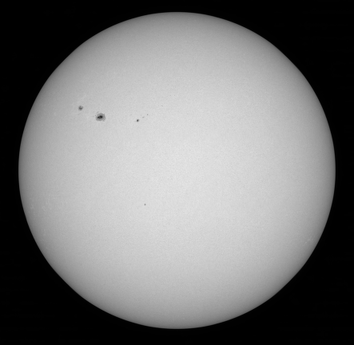
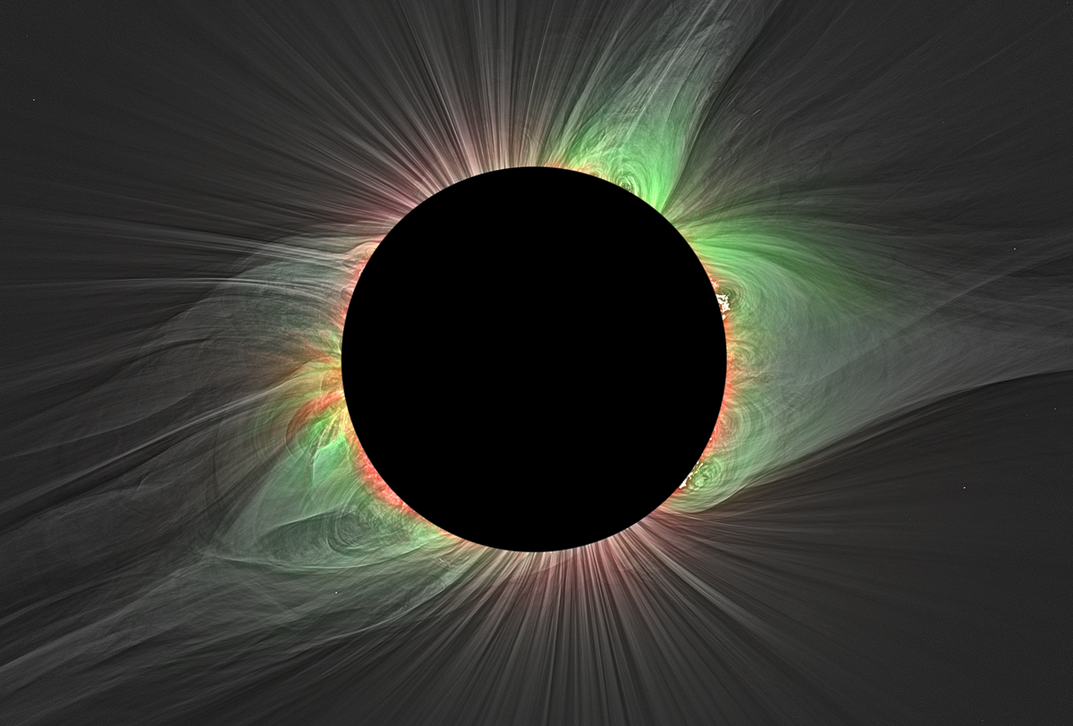
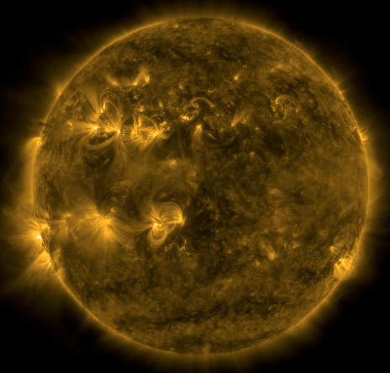
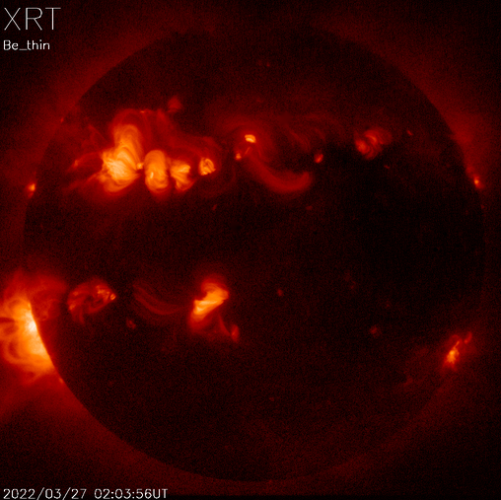
Sun in different wavelengths
Visible
Visible wavelength, during solar eclipse
X-rays
EUV
Druckmüller et al., (2009)

Slide 3
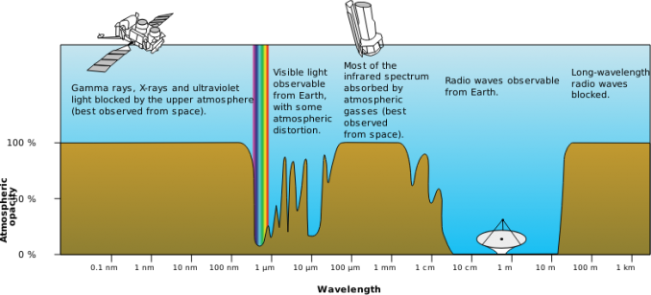
Absorption of EUV and X-rays by Earth atmosphere

Slide 4
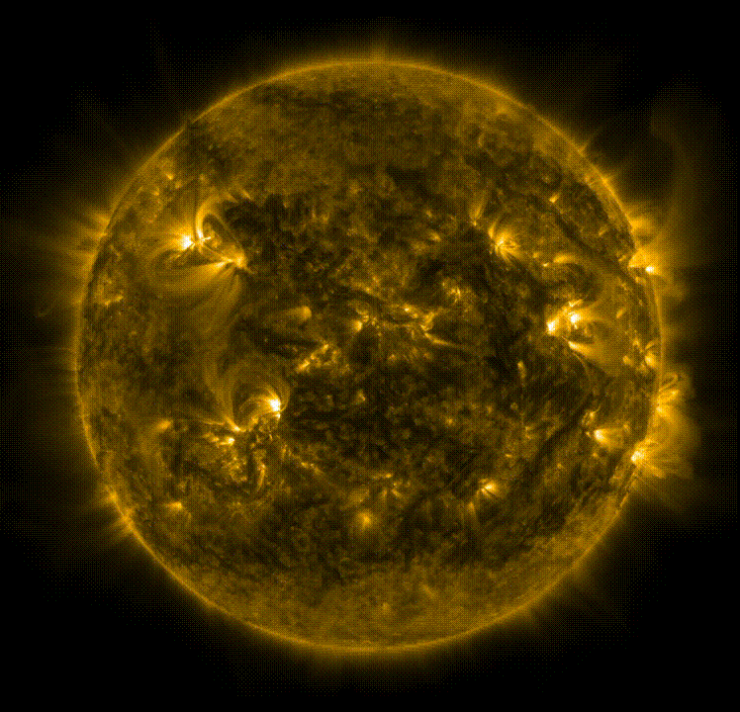
Dynamics of solar corona
EUV, AIA/SDO

Slide 5
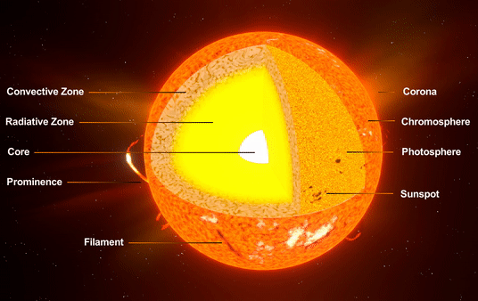
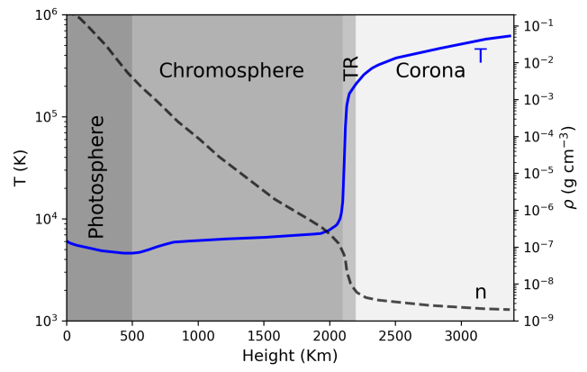
Coronal Heating Problem

Slide 6
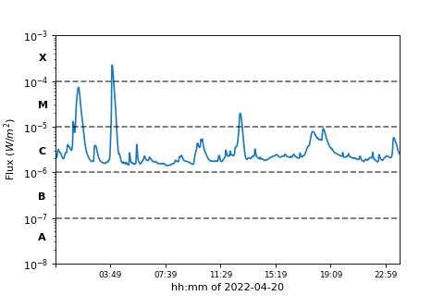
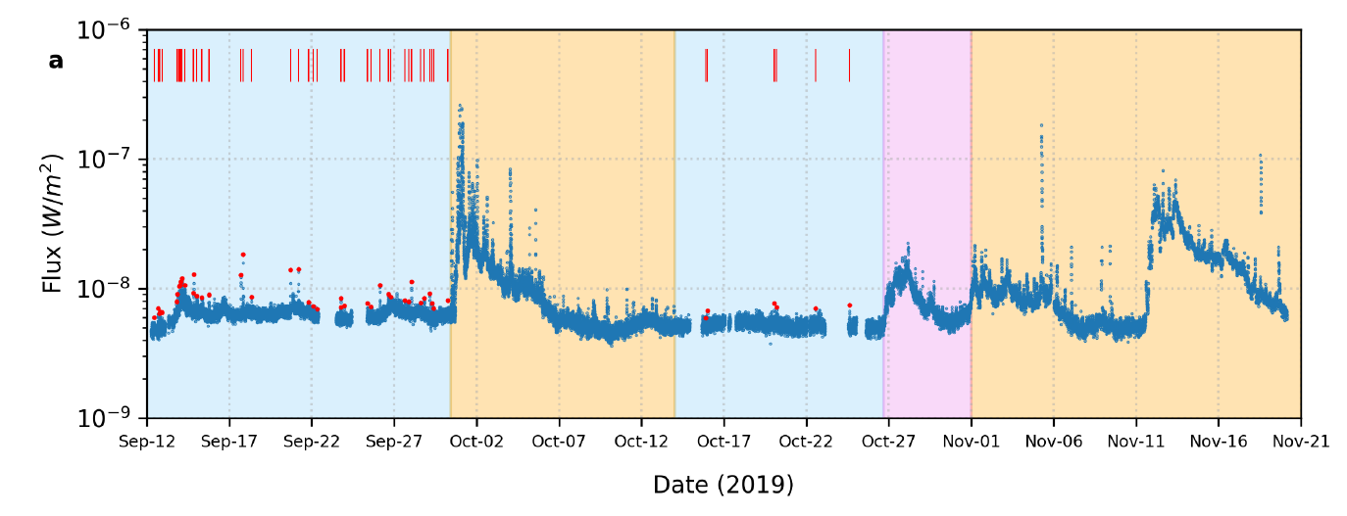
Nanoflare concepts from larger flares
The large solar flares, can not account for the overall coronal energy requirement (Sakurai 2017).
smaller flares occur more frequently.
Parker (1988) hypothesized the small-scale flares, termed as nanoflares having total energy around ∼10²⁴ erg, occurring all over the Sun.
most sensitive detection of a large number X-ray flares in quiescent Sun by Solar X-ray Monitor (XSM, Vadawale et al 2021)

Slide 7
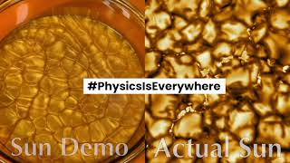
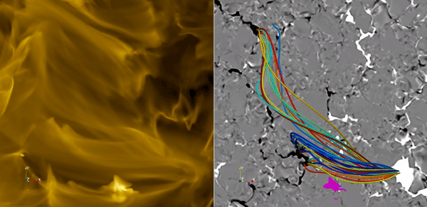
Physics of nanoflares

Slide 8
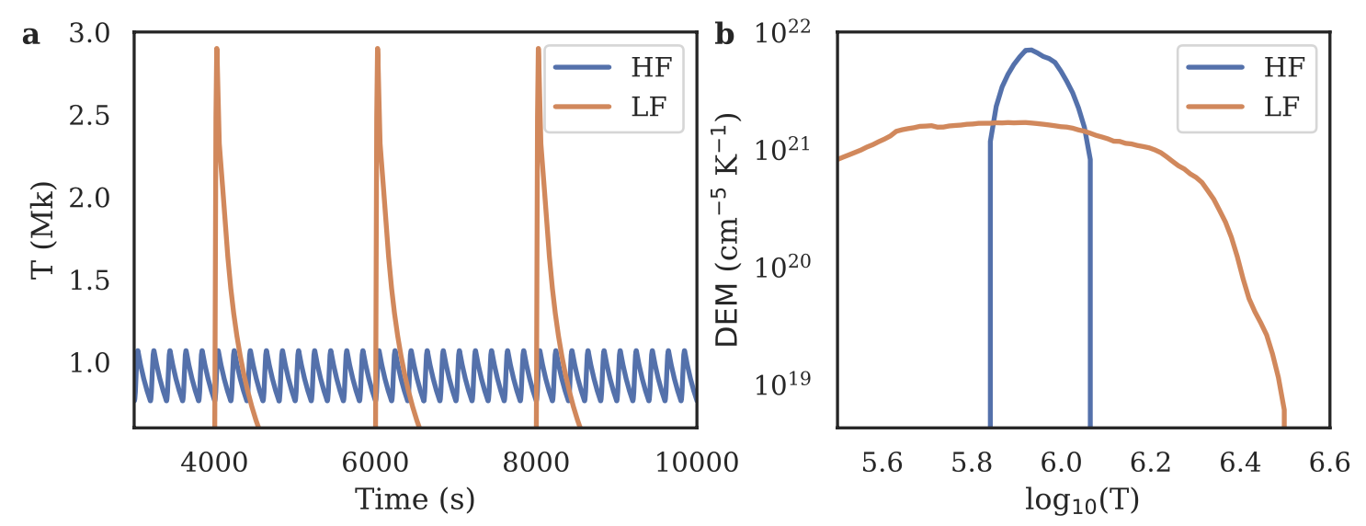
Nanoflare heating
Direct detection of individual nanoflares are difficult, with present generation instruments.
Used indirect methods: DEM -> measurement of plasma emission associated with different temperatures
Want to understand this
Observable

Slide 9
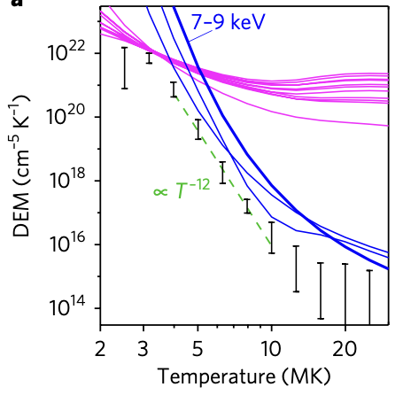
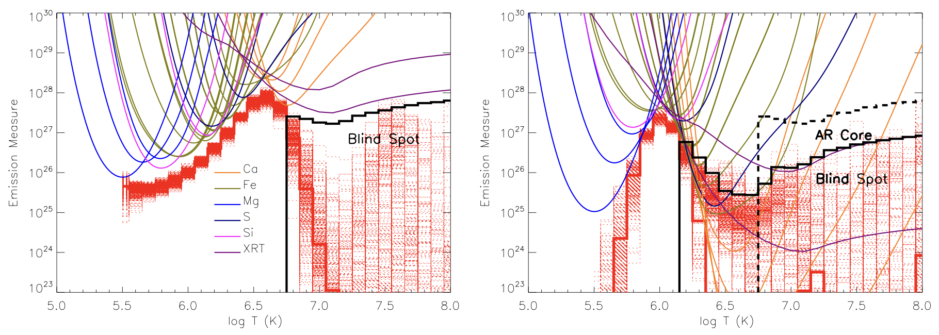
Observational limitations
EIS + XRT -> Poorly constrained the hot part of DEM
A few observations to support nanoflare heated plasma: e.g:
XRT + FOXSI
Ishikawa et al (2017)
In a few more studies combined EUV observations with X-ray observations of NuSTAR
Winebarger et al (2012)
Thus, sensitive soft X-ray observations are important for non-flaring ARs.

Slide 10
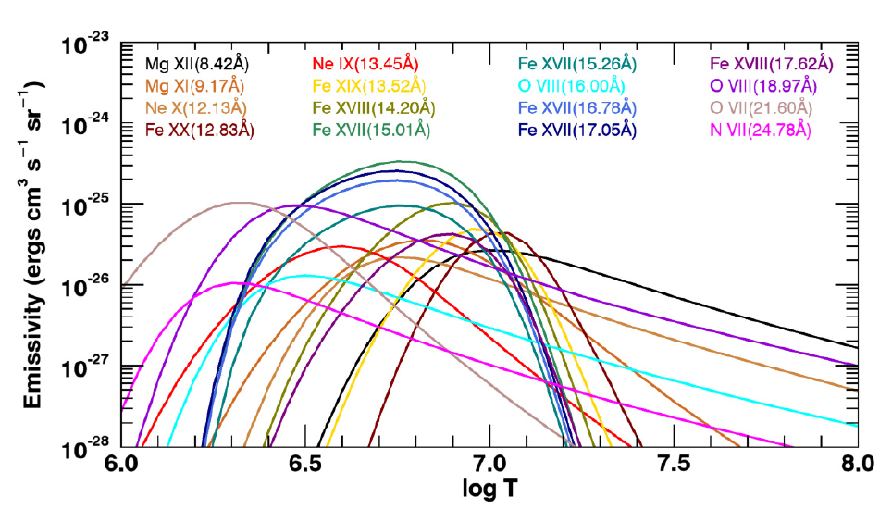
Observation requirement
Champey et al. 2022

Slide 11
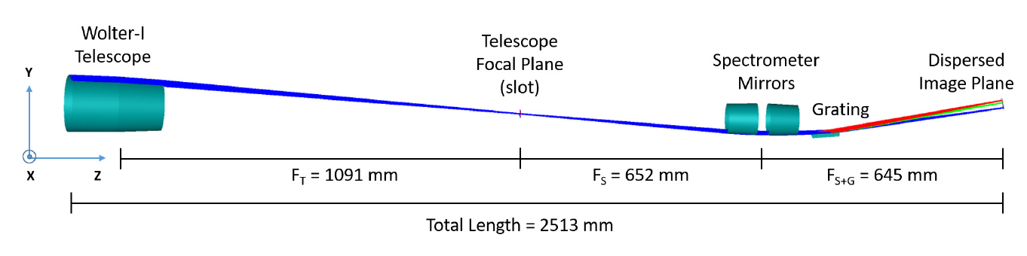
Marshall Grazing Incident X-ray Spectrometer (MaGIXS)
MaGIXS is sensitive to hot plasma whereas most of the EUV instruments (e.g., EIS) is more sensitive to cool plasma.
Champey et al. 2022

Slide 12

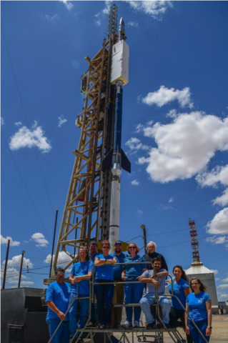
First flight of MaGIXS
July-30-2021, 18:20 UT
Credit: MaGIXS team

Slide 13
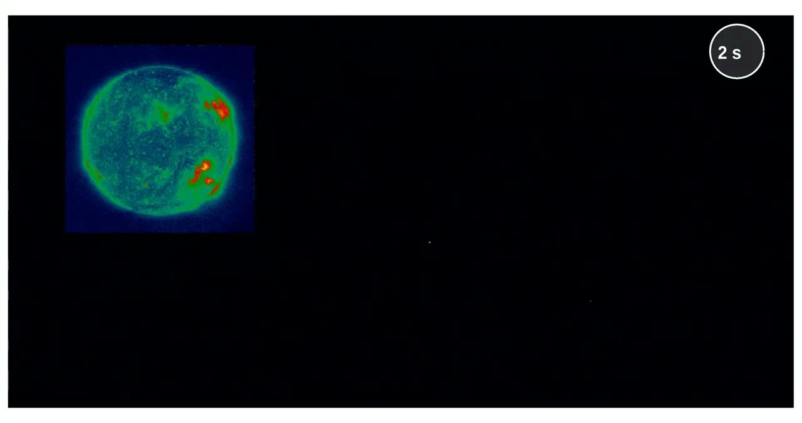
First flight of MaGIXS
Credit: Athiray, MaGIXS team

Slide 14
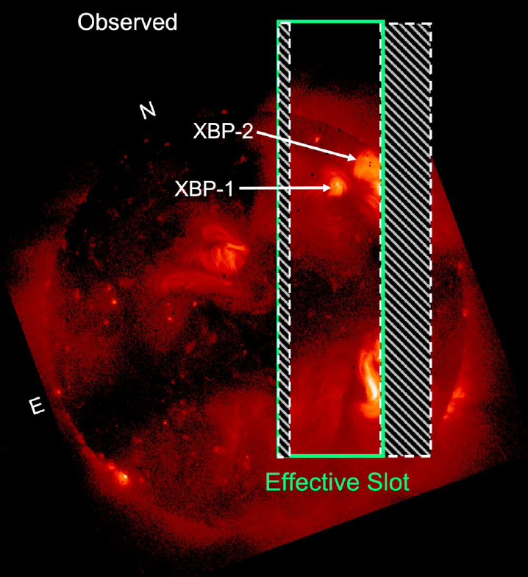
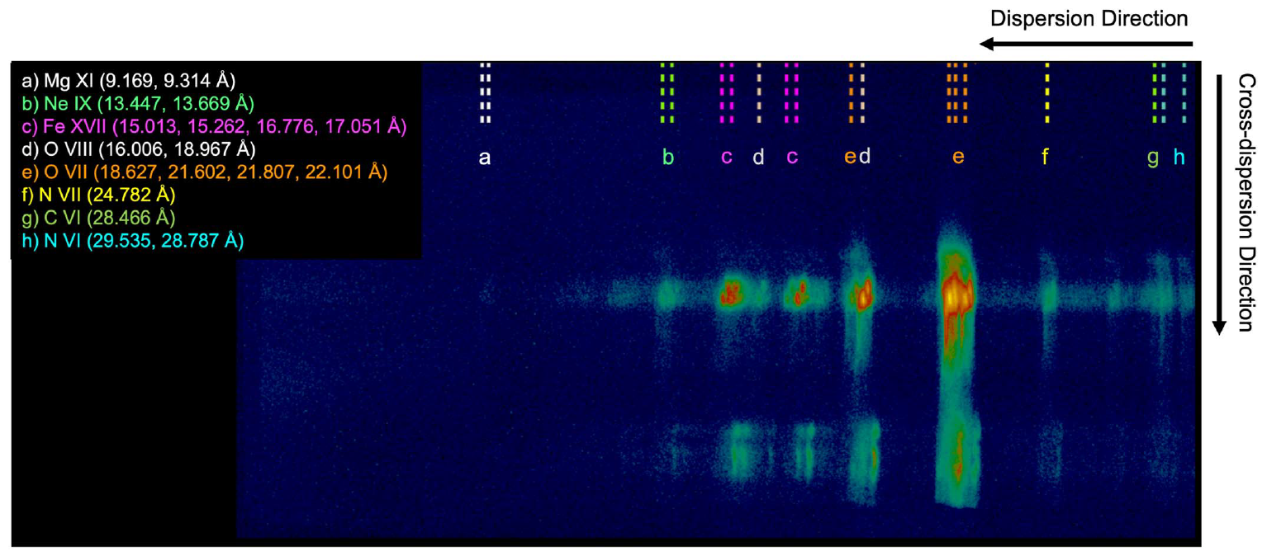
Overlapping spectral images observed by MaGIXS
Savage et al 2023
Connect Obs to Model

Slide 15
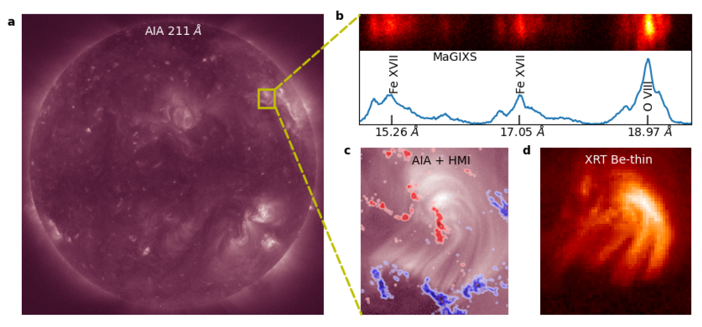
Concurrent observations of XBP-1 by MaGIXS, AIA, and XRT
July-30-2021, 18:20 UT

Slide 16
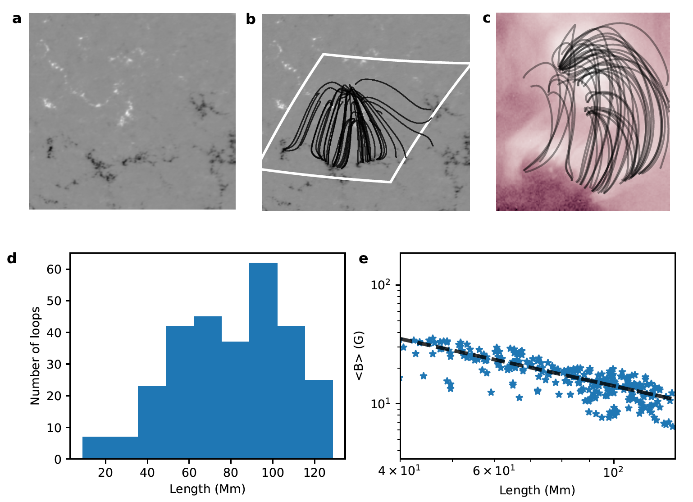
Hydrodynamic simulation of XBP-1
Our goal is to simulate XBP-1 emissions considering the nanoflare heating scenarios.
We use field-aligned hydrodynamic codes HYDRAD.
Determine Magnetic skeleton using potential field extrapolation.
XBP-1 located away from the disk-centre.
Required projection corrections.

Slide 17
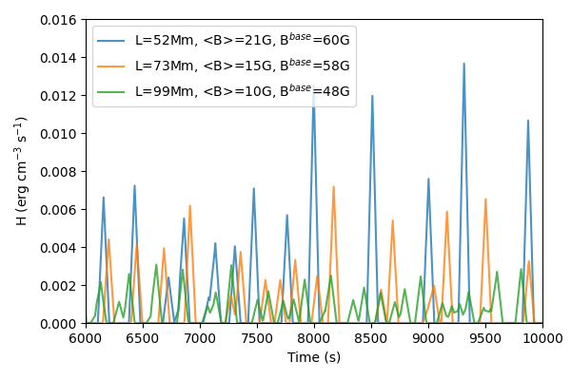
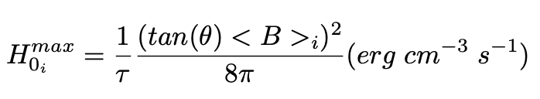
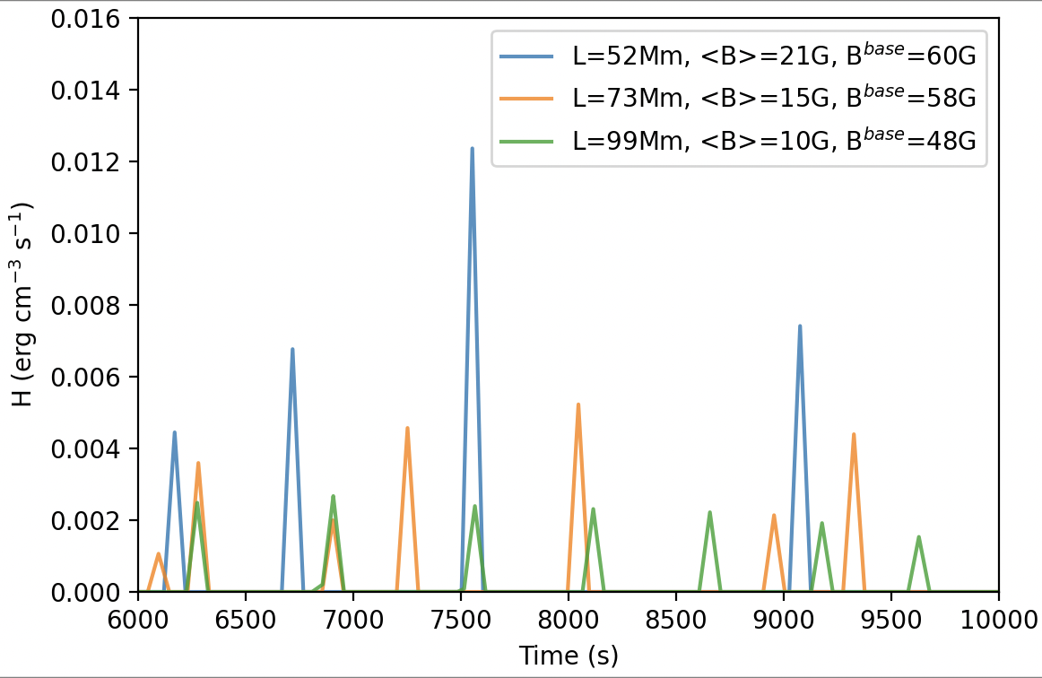
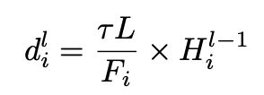
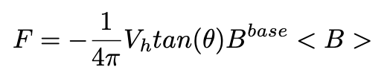
Nanoflare heating sequence
Consider triangular heating profiles having a duration, 𝜏 = 100 s.
The peak heating rate during an event is randomly chosen between minimum (H₀^{min} ) and maximum (H₀^{max}) values that are loop dependent.
tan(θ) = 0.2
V_{h} = 1.5 km/s
tan(θ)= 0.2
V_{h} = 0.5 km/s
Mondal, Klimchuk et al 2023

Slide 18
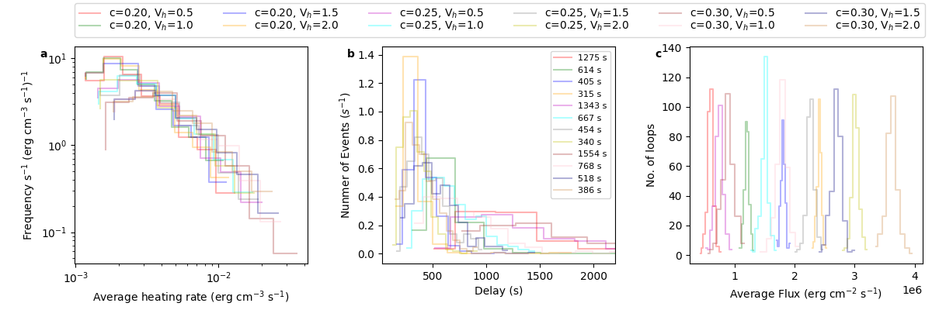
Distribution of nanoflare events for different heating parameters
c = tan(θ)
Run the simulation setup for various combination of tan(θ) and V_{h}.
For each combination, we create the DEM map for the XBP.
Convolving instrument response with the DEM map provides the images.

Slide 19
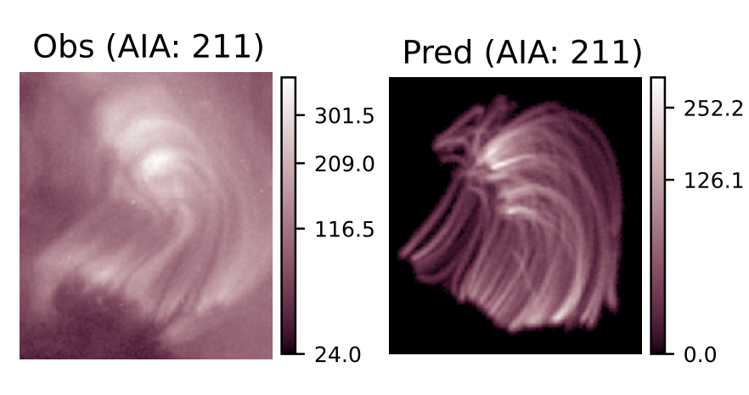
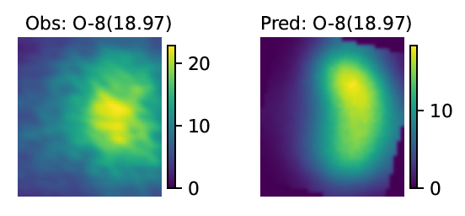
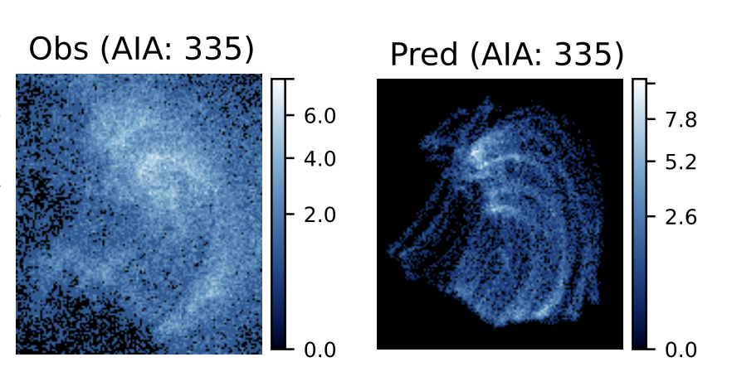
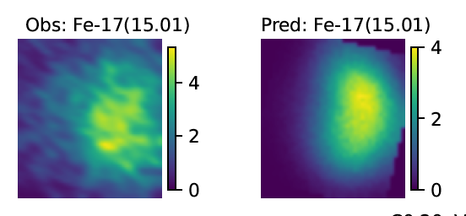
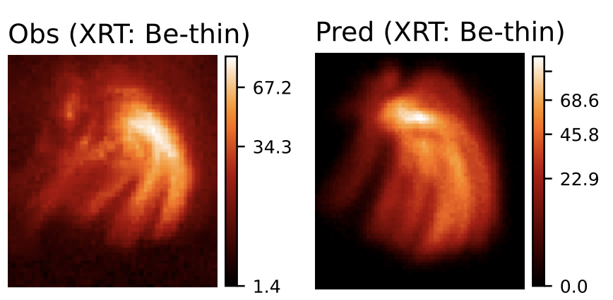
Observed and Predicted images of XBP-1
DN/s
DN/s
Derived from MaGIXS
Simulated
Observed by AIA & XRT
Simulated
HF hanoflare heating can explain the observed intensity with average delay time in the order of 400-700 s.

Slide 20
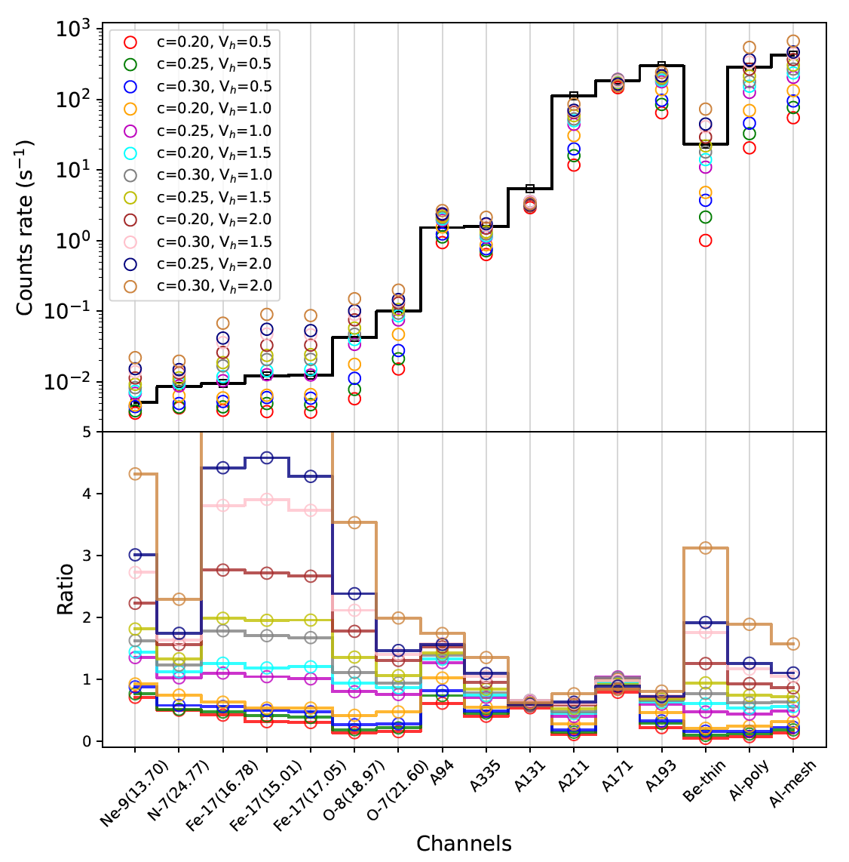
Results for all heating parameters
Count rates (s⁻¹)
Ratio
AIA
XRT
MaGIXS

Slide 21
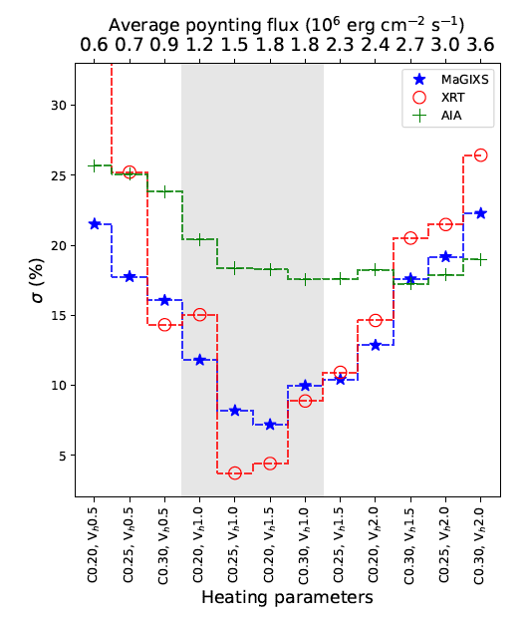
Discussions
HF hanoflare heating can explain the observed intensity with average delay time in the order of 400-700 s.
MaGIXS and XRT are more sensitive compared with AIA to diagnose the heating frequency.

Slide 22
Summary
Investigated the nanoflare heating of an XBP observed by MaGIXS, AIA and XRT
Nanoflare heating can reproduce the observed intensity of the XBP with an average nanoflare delay time in the order of 400-700 s, which is likely to be high-frequency.
The average poynting flux is found to be in the range of 1.5-2.3 ✕ 10⁶ erg cm⁻² s⁻¹, which is intermediate between the total coronal loss of quiet-Sun and ARs, as predicted by Withbroe et al 1977.
MaGIXS and XRT are more sensitive to diagnose the heating frequency, whereas only AIA channels are less sensitive.
MaGIXS-2 will fly next year!!

Slide 23
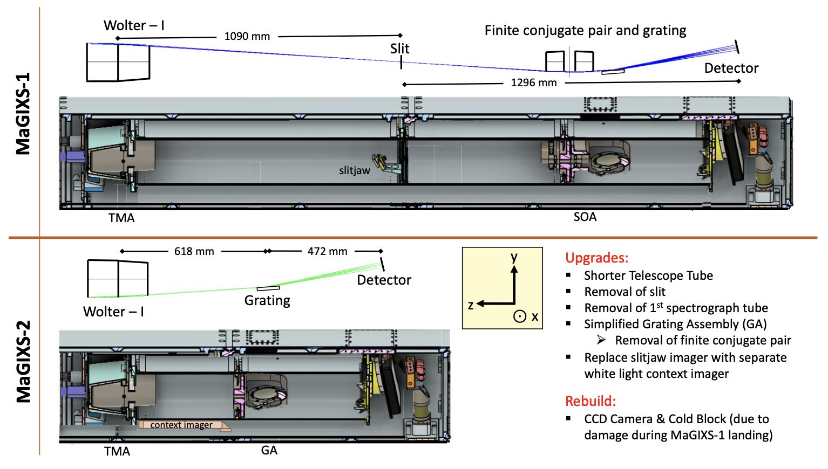
MaGIXS-2 (Next Summer)
Thank You for your attention!

