Slide 1
Commercial High Speed Market Study(s) Summary
Jeff Robinson
15 Nov 2023
2023 Systems Analysis Symposium

Slide 2


FY20/21 High-Speed Market Studies
The overwhelming number one request that industry had for NASA from the Jan 2020 Commercial High-Speed Workshop was to conduct an independent market study to determine the viability of high-speed / hypersonic commercial travel.
NASA subsequently funded two contracts, one to Deloitte/SpaceWorks and one to SAIC/Bryce, to study the market given three specific tasks:
  Define the market – how many people would be willing to travel and how much revenue could be generated
  Define the business case – can an aircraft (Mach 2-5+)be fielded to serve this market and be able to generate enough profit to make it economically viable
  What are the barriers preventing this market from becoming reality
Deloitte and SAIC spent six months studying the problem; final reports are public
  SAIC Report: https://ntrs.nasa.gov/citations/20210015471
  SAIC Presentation: https://ntrs.nasa.gov/citations/20210015472
  Deloitte Report: https://ntrs.nasa.gov/citations/20210014711
  Deloitte Presentation: https://ntrs.nasa.gov/citations/20210014932
SAIC/Bryce
Deloitte/SpaceWorks

Slide 3
General Approach
Deloitte/SpaceWorks
Examined commercial, private, cargo
Evaluated demand / price elasticity by surveying willingness to pay (actual $) for various flight time savings (correlated to Mach 2, 3, 4, 5, 6) across three proxy routes
Developed list of 90 city pairs deemed favorable for high-speed travel considering multiple factors
  City pairs are predominantly over water
  Five additional over-land routes would add 24% annual revenue (four are over US)
Developed “Level 0/1” aircraft sizing model to drive costs and environmental factors
  Sizing model anchored to existing (Concorde, Tu-144) and proposed aircraft
  Estimates for sonic boom, LTO noise & emissions
  Costs calculated using Galorath SEER
  Average IRR primary cost output; required to be equal across manufacturers and operator; minimum 25% IRR to be “viable”
  Single aircraft type operating model
SAIC/Bryce
Examined commercial, private, cargo
Evaluated demand / price elasticity by speed (Mach 2, 3, 4, 5) and willingness to pay (1.5x, 2.5x, 5x, 10x subsonic premium fair price)
Surveyed 150 high net worth individuals and executive travelers
800 long-haul city pairs considered
Demand & revenue growth forecasted thru 2070
Interviewed 50+ engineering SMEs, aircraft developers, industry experts and observers
Business case subtracts costs from available revenue, what remains is available for RDT&E
  Costs include operating costs, marginal aircraft manufacturing costs, and industry ecosystem profit
  Operating costs use multipliers over current aircraft operating costs on a per seat mile basis
  25% profit for manufacturers and operator
  Single aircraft type operating model

Slide 4
Initial Market Study Summary
 | SAIC (with Bryce Space and Technology) | Deloitte (with SpaceWorks and NIA)
Mach | 3 | 2 to 4⁽¹⁾
Range | 4,500 nmi | 4,000 nmi to 4,500 nmi
Number of routes⁽²⁾ | 300 | 90
Aircraft Size (# PAX) | 10 GA or 50 Commercial | 20 to 50
Aircraft Cost | $200M to $300M | $131M to $228M⁽³⁾
Results DO NOT include accommodations to meet
environmental / regulatory constraints
⁽¹⁾ Analysis showed profitable routes up to M5.25
⁽²⁾ Deloitte only considers over-water routes
⁽³⁾ Mach 3 at 4,500 nmi

Slide 5
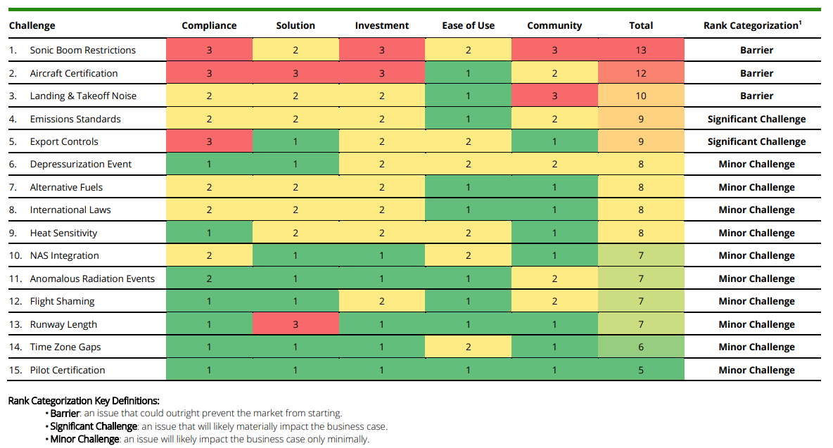
Deloitte/SpaceWorks – Barriers / Challenges Heat Map

Slide 6
SpaceWorks Initial Follow-on Tasks (Sep21)
Initial Deloitte and SAIC efforts use single “aircraft type” model; first task here was to explore whether a “two type” model was better or worse economically (e.g. only a 737 vs both 737 & 777) with A/C split by range
Evaluate economic cases for specific matrix of aircraft requirements
  20 and 50 PAX, Mach 2, 3, 4, & 5, for “short-range” and “long-range” versions
  All on Jet-A, and include an “optimized” short- and long-range A/C
Develop “baseball card” format for ease of data comparison
Evaluate “alternate fuels” (SAF, LNG, LH2) across same matrix
What impact does inclusion of overland flights have?
What impact does delay of IOC have (does optimal PAX or Mach change)?
Develop Discrete Event Simulation (DES) to provide additional fidelity / insight into “two type” operational model

Slide 7
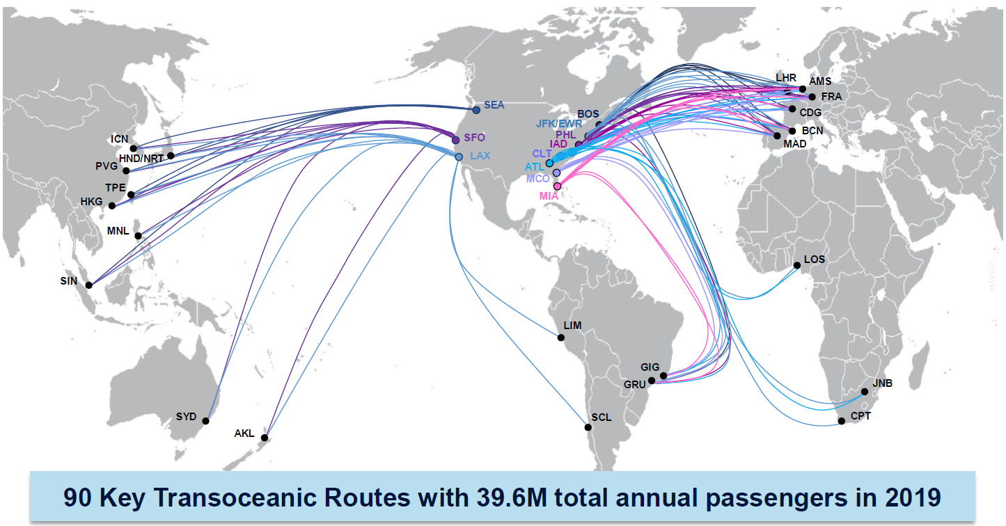
Baseline US-Based Transoceanic Flight Routes (90 routes)

Slide 8
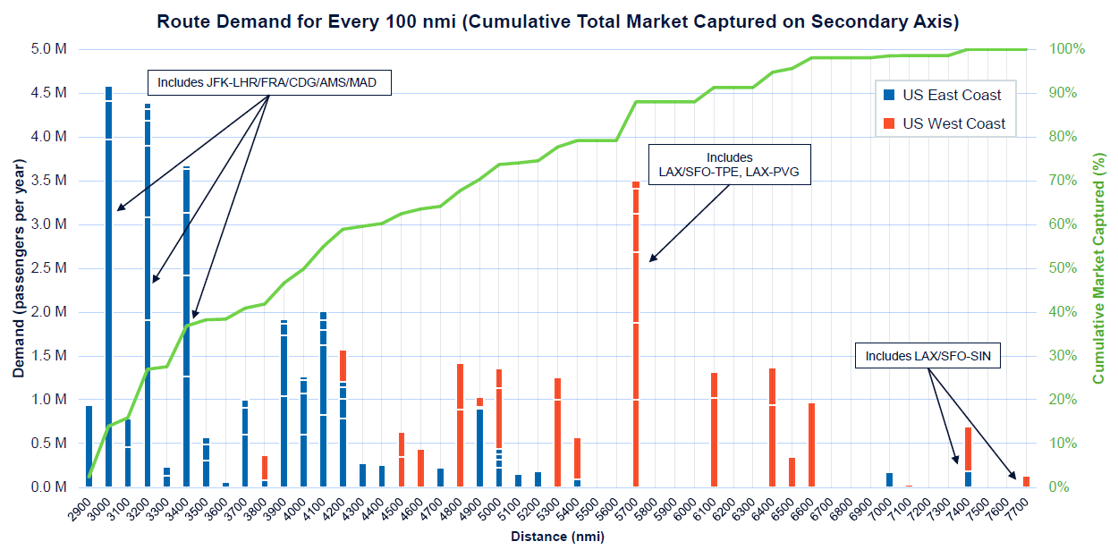
Annual Passenger Market by Route Distance

Slide 9
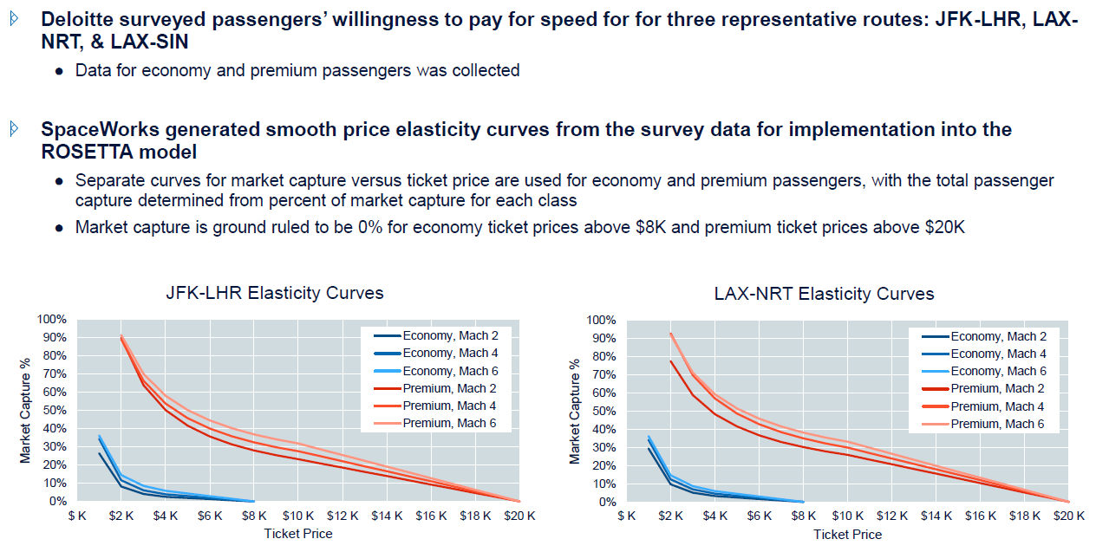
Price Elasticity Curves

Slide 10
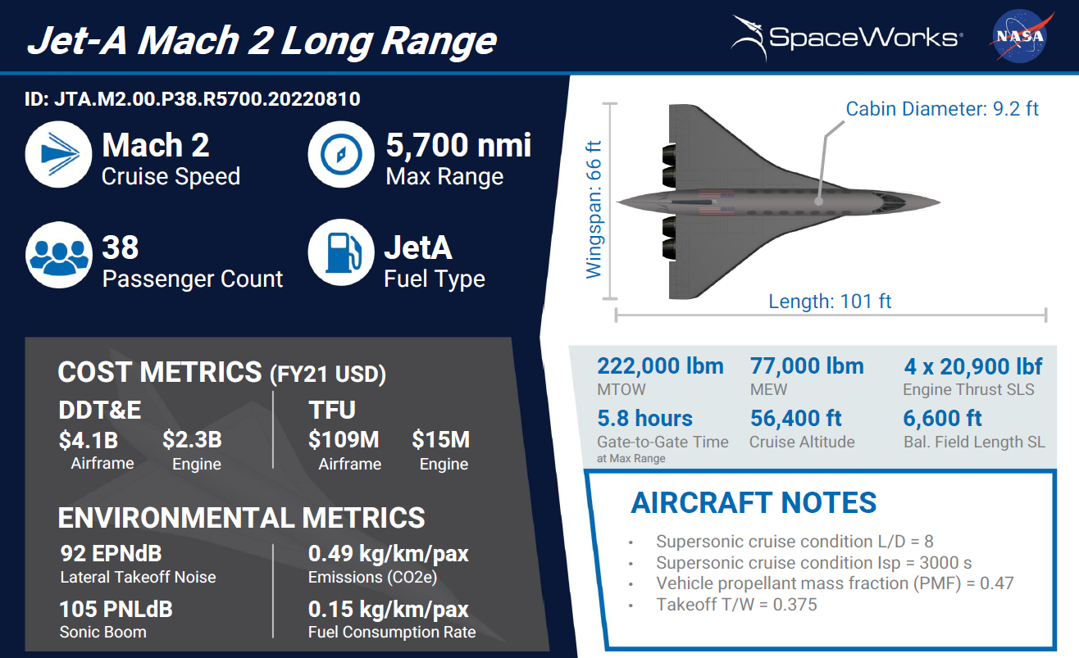
Example Baseball Card (front)
No accommodations
to try to achieve regs;
output engineering
estimates based
on SOA tech

Slide 11
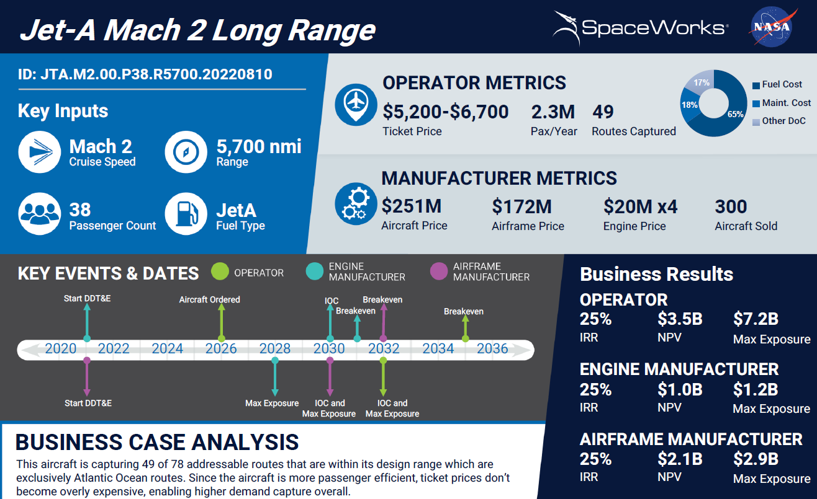
Example Baseball Card (back)
Engine guy
goes first
But Operator’s
outlay is the
biggest

Slide 12
Key Findings from Follow-on (Phase 1)
Overall, when modeling a single Jet-A fueled aircraft type that serves a subset of our 90 candidate transoceanic passenger routes that lie within its unrefueled range, the Mach 2-2.5, 4,500-5,500 nmi, and 40-50 passenger aircraft had the best business cases
Safety, noise compliance, emission, compliance, and sonic boom remain significant challenges to this industry
Trade results:
  A two-type model with A/C split by range offered minimal improvement over single type A/C operating model
  Jet-A had the best economics initially, transitioning to SAF over time (assumed lower future cost of SAF and adequate producibility); jury still out on LNG, LH2 largely infeasible due to A/C physical size (size=cost)
  Adding overland routes (still U.S. based) increases market > 5X; capital outlay for single operator becomes restrictive; optimal PAX increases, ticket prices lower
  Delayed IOC improves economics (market grows, tech advances), but environmentals (impacts not modeled here) also likely to get more stringent

Slide 13
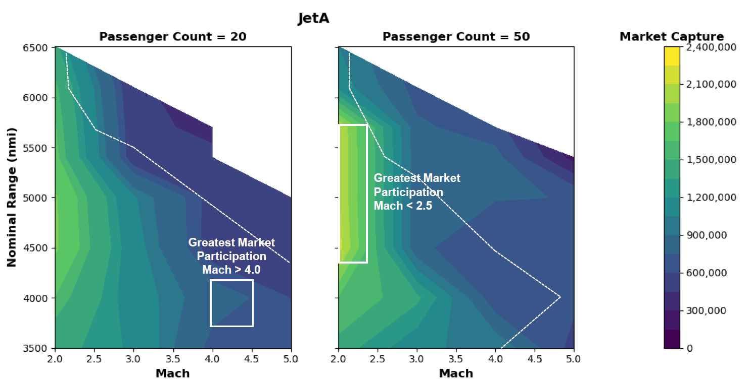
Best Solutions Are on Edge of Trade Space

Slide 14
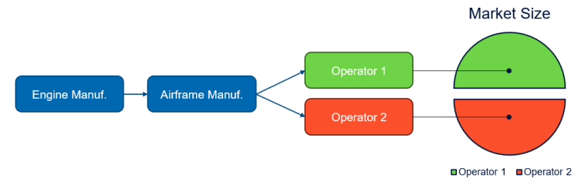
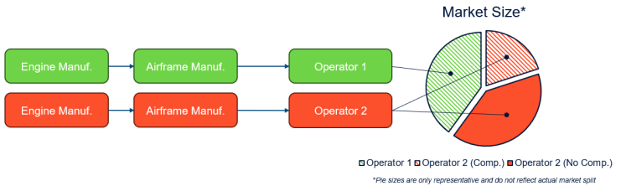
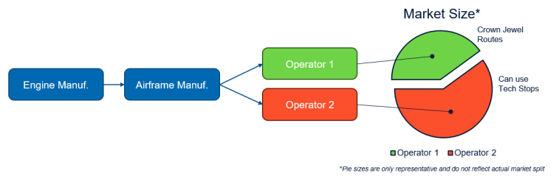
Contract Extension (Phase 2) - Tasks
Additional analysis with ROSETTA model
  Add Mach 1.5 to trade space
  Evaluate impact of performing tech stops
  Change “two type” model from range-based to demand-based
  Rerun design space for all fuels given new market data (task 2.0)
  Evaluate same-day round-trip case
  Evaluate various competitive scenarios to
  understand economic impact
Updated market research data
Enhance DES capability to:
  Analyze round-trip “business traveler” case
  Analyze competitive market cases
  Analyze tech stops
Competitive Scenarios

Slide 15
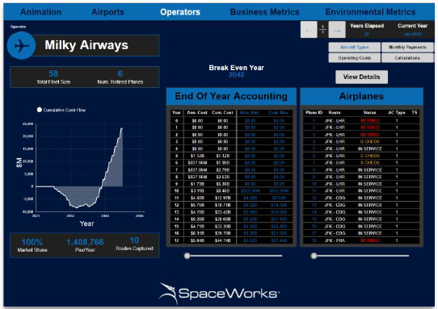
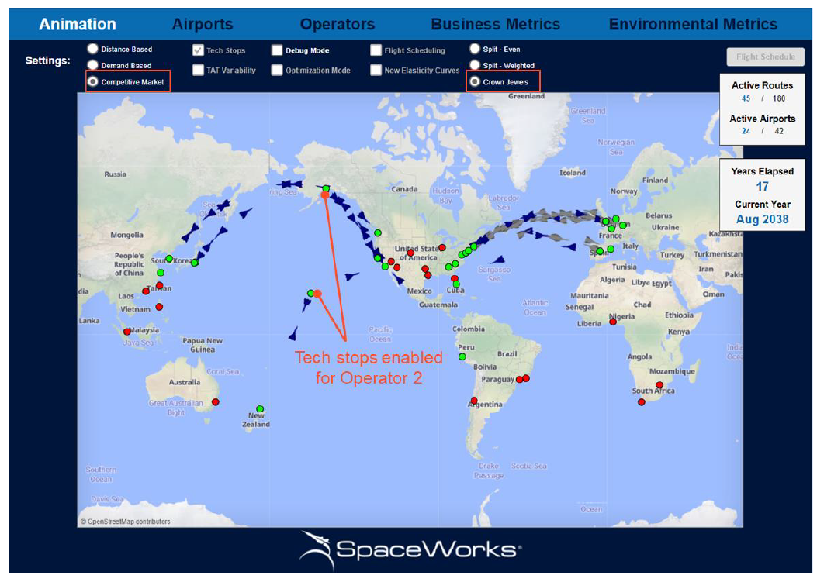
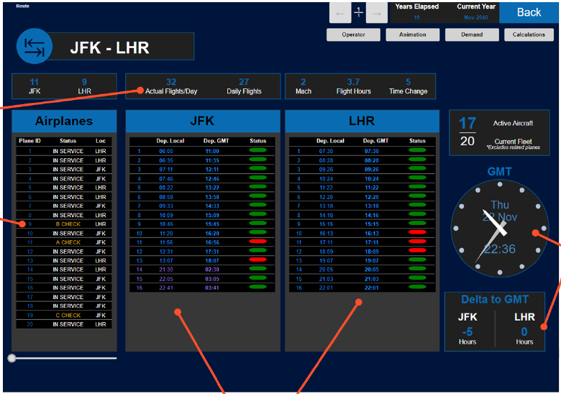
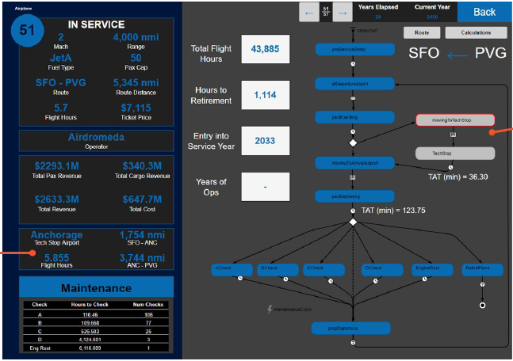
New MIDAS DES Tool

Slide 16
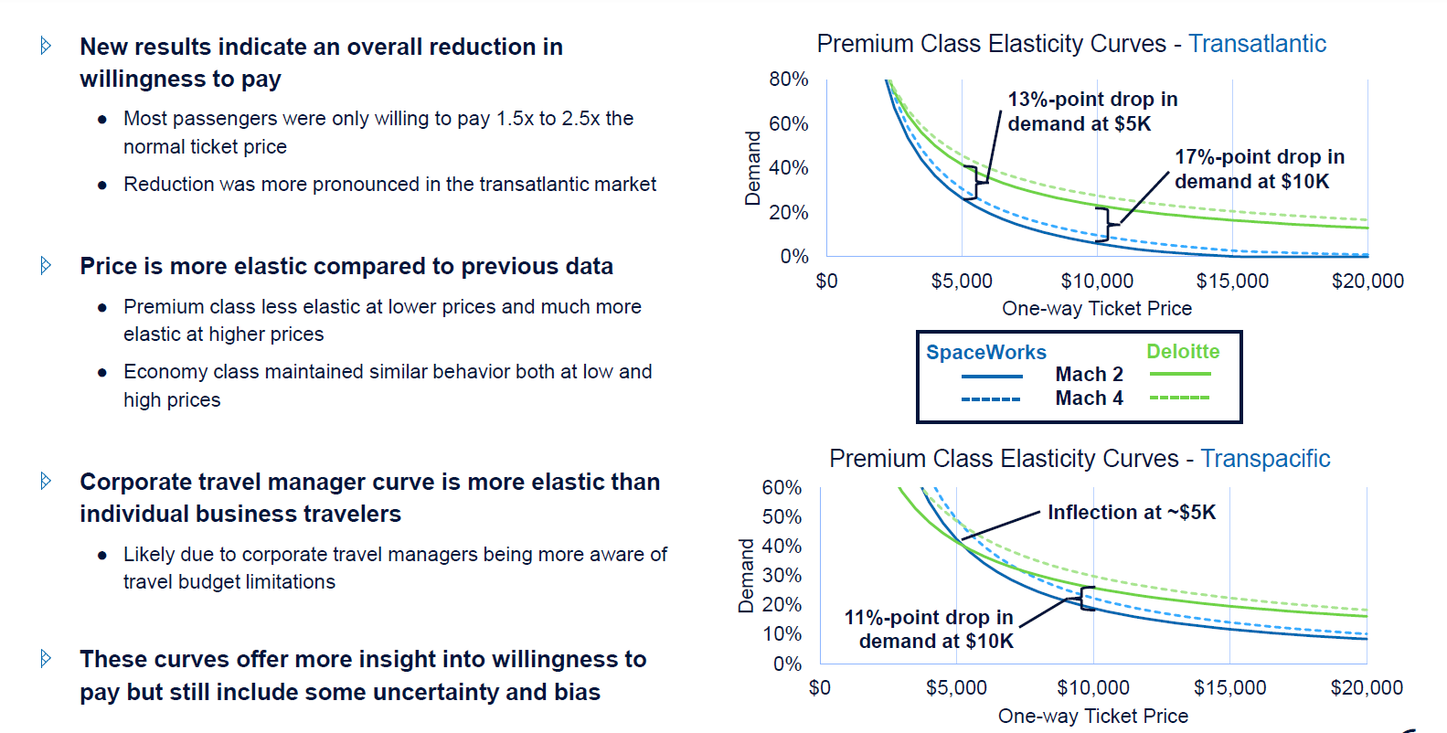
Price Elasticity Curve Differences

Slide 17
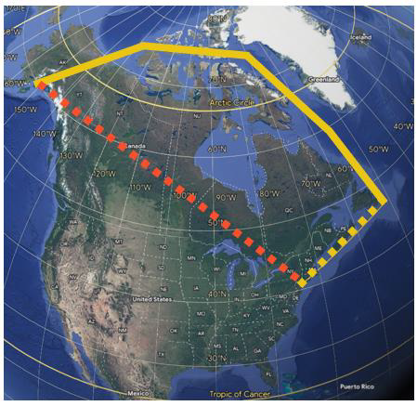
Phase 2 Trade Study Summary
Demand-based two-type aircraft model still showed only modest improvement over single type aircraft model
No premium found in new market data for “same day businessman” scenario; DES model incorporated flight scheduling / manifest
Tech stops modestly improve addressable market for
shorter range aircraft (helps highspeed aircraft more)
  Potential to open up Asian routes to east coast cities
Competitive analyses:
  Even split of demand lowered operator outlay; all else
  similar to single type / single operator
  Similar to mixed fleet; splitting demand between manufacturers has adverse effect on entire business case
  Most promising results; advantage of splitting risk between operators and maximizing route/demand capture via tech stops; supports “leader/follower” scenario

Slide 18
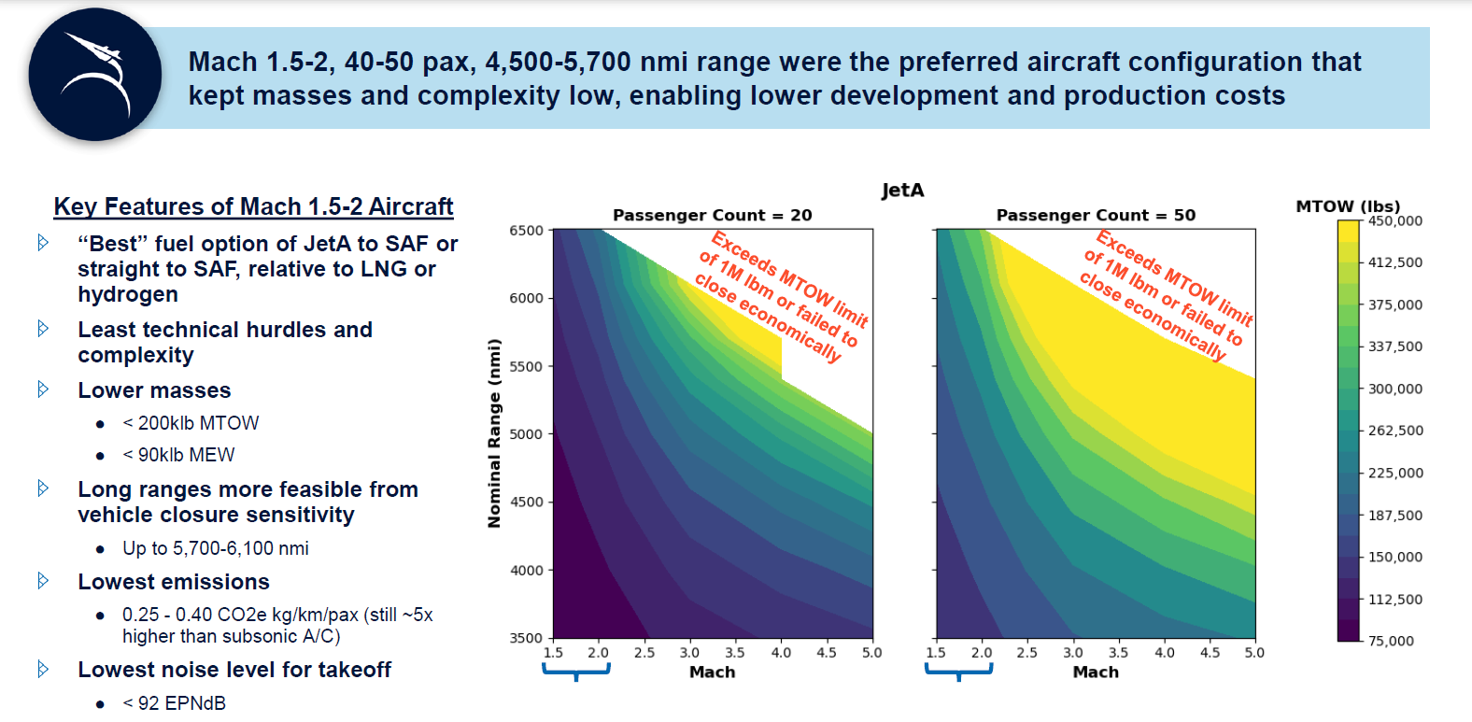
Final Aircraft Results

Slide 19

SEI Recommendations
NASA and FAA should continue their efforts to enable and permit overland supersonic flight
  Potential to drastically increase market size by six-fold and increase access to providers
  Provides more robust business cases for supersonic / hypersonic developers and operators
In the meantime, enact a two-phased “leader-follower” strategy to allow markets and technology to mature
  First-to-market transoceanic “leader” aircraft in Mach 1.5-2 range aimed at addressing high demand routes
  “Follower” aircraft designed to address growing and/or newly emerging markets via further technology improvements (longer range, higher speeds, etc.)
  Allows for initial regulatory requirements and certification processes to be established and matured for lower speed systems (Mach 1.5 to 2) before attempting higher speeds (Mach 3+)
Continue investments in supersonic and hypersonic aircraft technologies,
particularly in the areas of:
  Engine fuel efficiency and emissions
  Takeoff noise
  Aircraft and engine structures/materials
Continue investment in SAF with further exploration of LNG and LH2 viability
  Supply of all alternative fuels needs to be orders of magnitudes greater
  LNG shows promise while LH2 is economically viable for some simulated solutions
https://ntrs.nasa.gov/citations/20230012245

