Slide 1

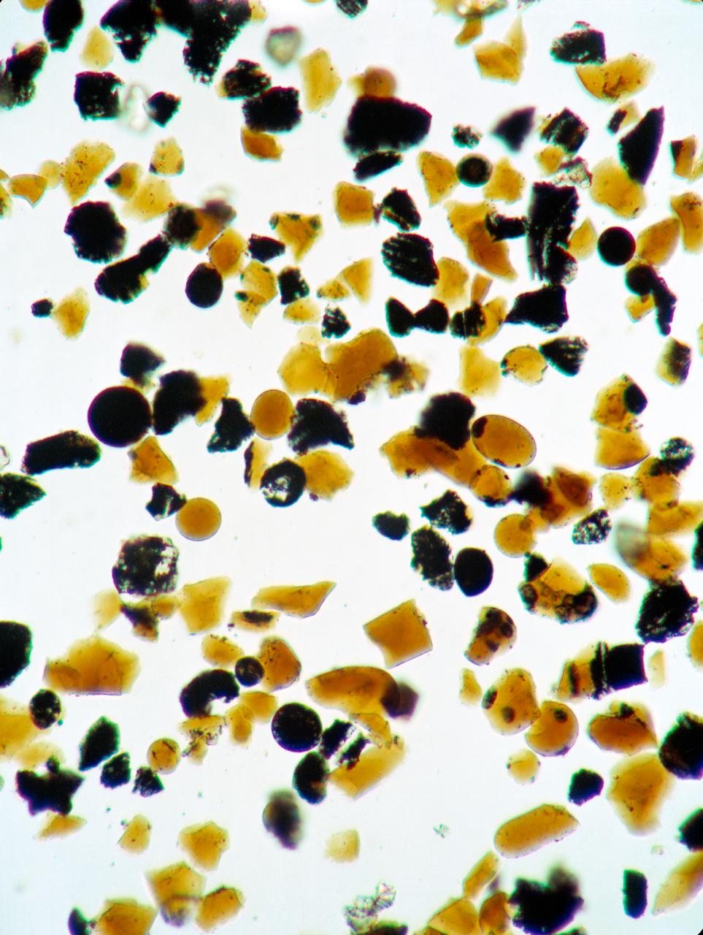
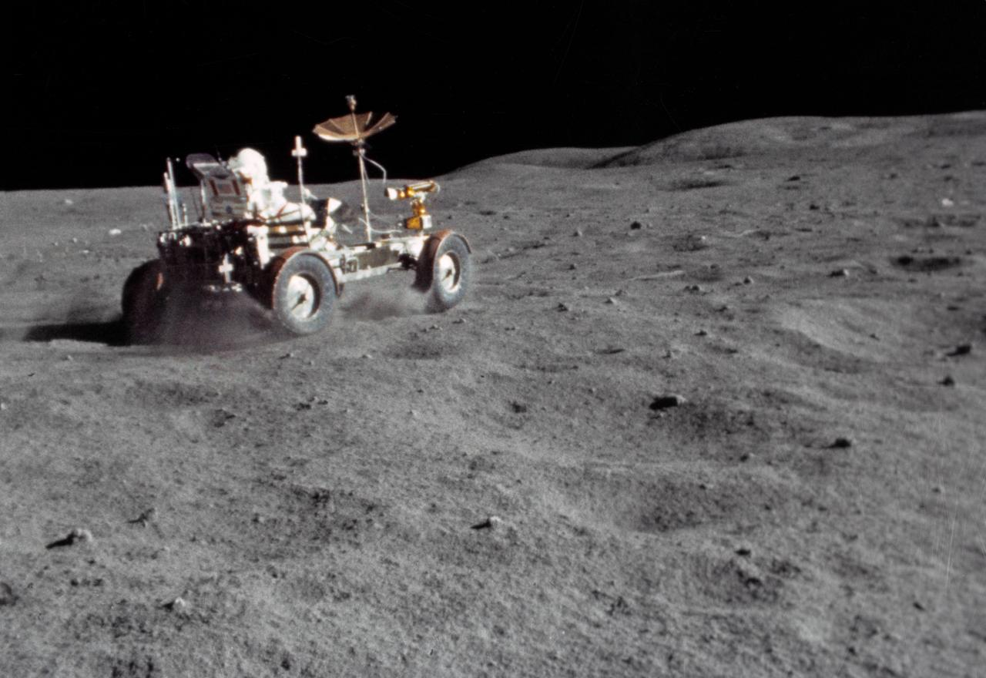
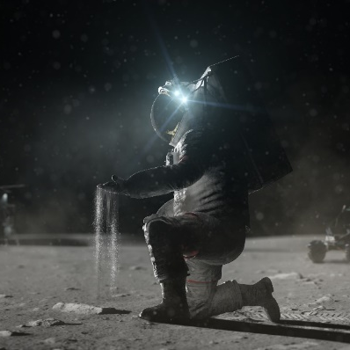
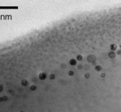
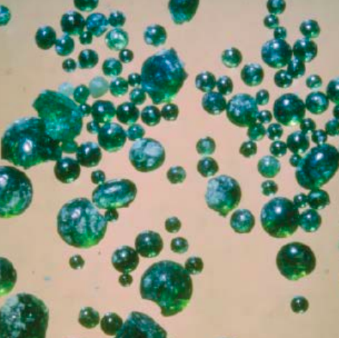
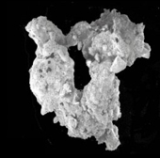
Space Technology Mission Directorate
Game Changing Development Program
Phillip Abel | Lunar Dust Mitigation Guide - Sustainable Technologies in the Lunar Surface Environment Workshop | Nov. 2023

Slide 2
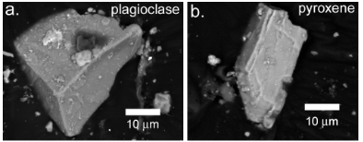
Dust Mitigation Best Practices Guide Motivation
Why the concern about lunar surface dust effects - sustained ops?
  Abrasive, adherent, sharp fine particulates - a problem for mechanisms?
  Ubiquitous - as discovered by the Apollo astronauts, completely avoiding lunar dust during surface operations would be nearly impossible.
  Electrostatics - potentially negatively or positively charged depending on solar illumination and charged particle flux, and in low gravity.
  Particle reactivity - chemically reactive fracture surfaces possible in hard vacuum.
What should you be testing?
  Which dust effects are your primary failure concern? Mechanical wear? Optical effects / visibility? Thermal control? Combined effects?
  How long *must* your asset operate? Should it degrade gracefully?
  Are dust mitigation schemes to be tested? Measured & compared?
How are you quantifying exposure / coverage / mitigations?
  Lunar surface particle size distribution extends down to nanometer range - optical microscopy resolves at best to ~micrometers. Mass balance measurements typically cannot detect dust (<20 µm dia.) differences.
Lunar Roving Vehicle (LRV) spraying regolith during Apollo 16 mission,
(NASA Photo S72-37002)
Mineral grains common in lunar soils of
(a) highland material (b) mare soils,
Christoffersen et al., NASA TP-2009-214786
Notes:
Provide an overview of why lunar dust is a concern and what some considerations would be.

Slide 3
Dust Mitigation Best Practices Guide Overview
Technology Product Capability
  Develop an accessible, understandable, comprehensive, and refereed guide to avoiding lunar dust problems during surface operations, both for inexperienced mechanisms designers in academia or small companies *and* for seasoned mission veterans.
  Extensive references into the detailed technical literature provide a “how to” lunar dust mitigation reference.
Technical Capabilities
  Interactions and input from potential Guidebook users in industry that are external to NASA during COVID 19, to be incorporated
  Identification and availability of technical expertise across NASA
Exploration & Science Applicability
  Publication and distribution to NASA stakeholders, aerospace industry, and academic partners
    For use by designers, commercial partners, and service providers
  NASA missions targeted by the guidebook: CLPS, Artemis, Gateway, HLS
Lunar Roving Vehicle (LRV) spraying regolith during Apollo 16 mission,
(NASA Photo S72-37002)
Mineral grains common in lunar soils of
(a) highland material (b) mare soils,
Christoffersen et al., NASA TP-2009-214786
[ As presented > 1 yr. ago ]
Notes:
Overview of the Project/Task - as conceived pre-Covid

Slide 4
Dust Mitigation Best Practices Guide - Contents
Table of Contents:
1.0 Introduction and Rationale p.1
2.0 Dust Mitigation Overview
2.1 The ART of Lunar Dust Mitigation
2.2 Technique Categorizing: Avoid, Remove, Tolerate
2.3 Specific Areas of Concern
3.0 Optical Surfaces
4.0 Radiator and Thermal Control Surfaces
5.0 Communications Antennas and Electronics
6.0 Mechanisms and Mechanical Assemblies
6.1 Bearings and Gears
6.2 Seals
7.0 Spacesuit Fabrics
8.0 Human Health
9.0 For Further Reading
10.0 Concluding Remarks p.38
Key Take-Away:
To the extent possible -
by design, avoid dust exposure, or
*if* possible, remove the dust,
or just design to tolerate some level of dust loading in operation.
Topics focused on lunar surface operation consequences, much less emphasis on cabin interior (filtration) / human health or on Conops mitigations.

Slide 5
Dust Mitigation Best Practices Guide - Contents
Table of Contents (continued):
Appendix A - Lunar Dust - What Is It? pp. 39 - 64
Appendix B - Measuring Lunar Dust and Simulants pp. 65 - 75
Appendix C - Inertial Particle Removal pp. 77 - 80
Appendix D - Terrestrial Dust Mitigation Best Practices pp. 81 - 83
Appendix E - Nomenclature pp. 85 - 88
References pp. 89 - 94
Synopsis of the Lunar Sourcebook, +
Important to quantify testing amounts
Basis for limited use on small particles
Six pages long - a useful start!

Slide 6
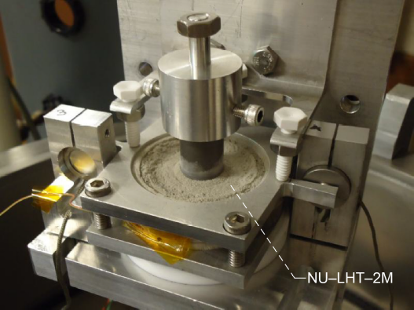
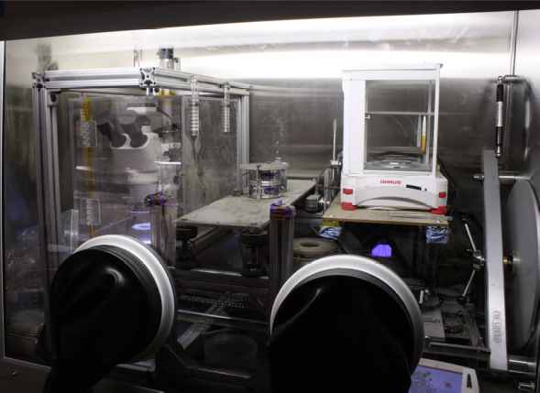
Lunar Dust Tolerance - Terrestrial Testing Concerns
Test fidelity
  The simulant dust effects to be measured dictate the type and fidelity of testing needed, particularly if comparing mitigation scheme effectiveness.
  If dust mitigation is to be used, the approaches involve either avoiding lunar dust exposure, removing particulates as possible, or tolerating particulates during surface operations - or some combination of those three general approaches.
Fidelity determinants
  Which simulant(s) to use, and particle size range of interest
    LSIC, and other websites - e.g., Univ. of Central Florida, Colorado School of Mines.
    Classifications and Requirements for Testing Systems and Hardware To Be Exposed To Dust in Planetary Environments, NASA Standard 1008 (2021), https://ntrs.nasa.gov
    Lunar Regolith Simulant User’s Guide, Schrader et al., NASA TM-2010-216446 (being updated!)
  Vacuum level required / achievable with simulant, if relevant.
  Simulant particle surface cleanliness / reactivity, if relevant.
  Electrostatic field environment, if relevant.
Low temperature mechanism seal - dust tolerance testing,
Delgado et al., NASA TM-2013-216587
Uniform Dust Deposition System,
Gerdts et al., NASA TM-20210024128
Notes:
Provide some terrestrial testing fidelity considerations.

Slide 7
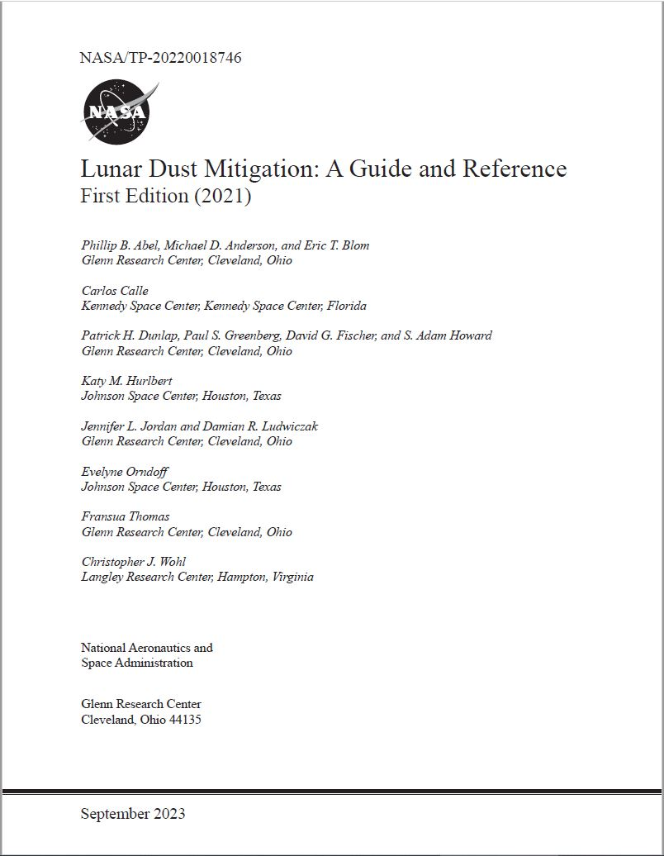
Dust Mitigation Best Practices Guide
Additional resources:
Levine, Joel S. (Ed.) (2021) “The Impact of Lunar Dust on Human Exploration” Newcastle: Cambridge Scholars Publishing
And “Lunar Dust and Its Impact on Human Exploration: A NASA Engineering and Safety Center (NESC) Workshop” TM-2020-5008219
NASA (2021) “Classifications and Requirements for Testing Systems and Hardware To Be Exposed To Dust in Planetary Environments” NASA-STD-1008
Schrader, C.M., Rickman, D.L., McLemore, C.A., & Fikes, J.C. (2010) “Lunar Regolith Simulant User's Guide” TM-2010-216446
Gaier, J.R. (2005) “The Effects of Lunar Dust on EVA Systems During the Apollo Missions” TM-2005-213610
NASA publications are available at https://ntrs.nasa.gov/search including:
“Lunar Dust Mitigation: A Guide and Reference First Edition (2021)” as TP-20220018746
To all the Guide contributors - thank-you!

Slide 8
Dust Mitigation Best Practices Guide
Thank-you!

