Slide 1
PSL ASME Nozzle Test:
Uncertainty Analysis
Methods and Results
Turbine Engine Test Working Group (TETWoG)
Erin Hubbard
11/16/23

Slide 2
What is uncertainty?
  No physical value is ever truly “known” (except occasionally within the confines of primary calibration laboratories).
  Uncertainty defines the range within which the true value is likely to fall at a given level of confidence.
  Many different sources can contribute to errors in a measured or calculated value and should be considered when estimating uncertainty.
Calibration methods
Vibration effects
Data reduction algorithms
Electrical Noise
Communications and timing
Dynamic motion
Deterioration
Misalignment
Leakage
Corrections
Thermal effects
Math models
Simplifications
Assumptions
Response times
Orifice quality
Dynamic response
Uncertainty range
Measurement errors
Installation effects
Surface quality
Geometries
Wire types
Instrument drift
Deflections
Reference measurement errors
Interconnects
Nonuniformities
Condition stability
Test techniques
Hysteresis
Nonlinearity
Zero offset
Measurement methods
Interference effects
-U
+U
Measured/Calculated value
True value (unknown)

Slide 3

Uncertainty Classification
x
x
Random: uncertainty due to random effects from unknown sources; dispersion of observable results
  “repeatability”, “precision”, “scatter”
  Gaussian distribution
Systematic: uncertainty due to offset-type effects from instrumentation, calibrations, corrections, assumptions, installation effects, etc.
  “bias”, “accuracy”
  assumed distributions
systematic
random
X_{true}
X_{mean}
x
x
Notes:
Classification is important because different aspects of uncertainty answer different questions…two examples
- Customers looking to compare test results with CFD results are more concerned with systematic uncertainty effects.
- Customers testing for the effect of model changes will be more concerned about random uncertainty effects.

Slide 4
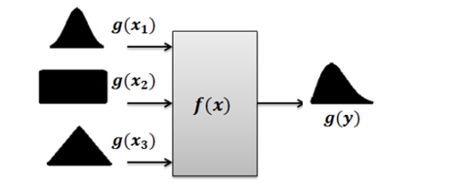
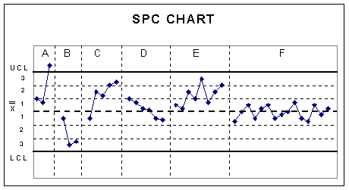
Full picture of uncertainty
  Random uncertainty quantification
  Quantify OBSERVABLE variation statistically
    Back-to-back repeats at steady-state condition
    Within-test repeats
    Between-test repeats
  Check calibration, check probes, check standard testing, reference probes are common sources of data for analysis
  Systematic uncertainty quantification
  Quantify the impact of INVISIBLE biases via computer simulations
    Analytical approach using uncertainty source estimates and uncertainty propagation methods
Both are critical to characterize uncertainty
https://www.moresteam.com/toolbox/statistical-process-control-spc.cfm
Notes:
PSL team obtained test data to aid in understanding baseline random uncertainty from ASME nozzle test
MUA team has put together a simulation to estimate systematic uncertainty in the ASME test envelope
Customers are encouraged to incorporate repeats within their test matrices to get test-specific repeatability information.

Slide 5
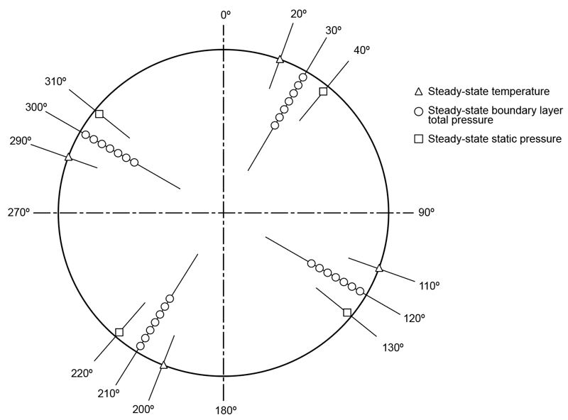
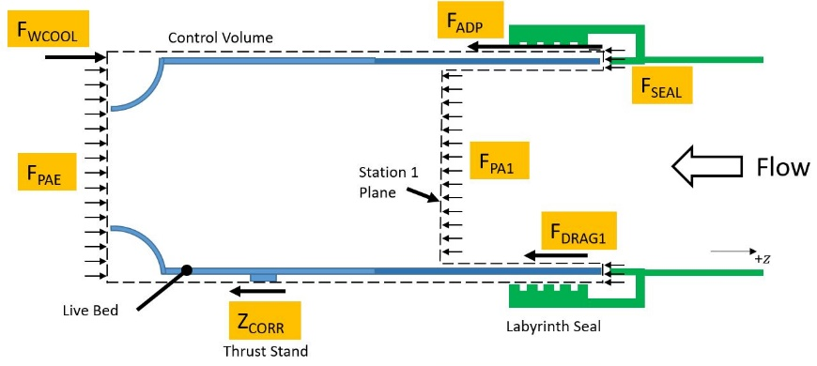
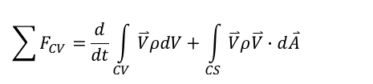
Variables of Interest
Mass flow rate at Station 1, WA1
Thrust, FGZ
$$\sum{F_{CV}}=\frac{d}{dt}\int_{CV}{\overset{⃑}{V}ρdV}+\int_{CS}{\overset{⃑}{V}ρ\overset{⃑}{V}∙d\overset{⃑}{A}}$$
Calculated from:
  Momentum entering the control volume (Station 1 measurements)
  Pressure and area measurements
  Motion resisting thrust stand force (load cell measurements, characterized thrust stand response)
  Drag force on inner duct surface (surface area, temperature and pressure measurements)
  Drag force on outer duct through lab seal (experimentally characterized)
  Cooling air force (experimentally characterized)
Calculated from:
  Diameter, TC measurements, differential pressure measurements, and metal temperature at Station 1
  Area weighted pressure using pressure measurements from 4 rakes

Slide 6
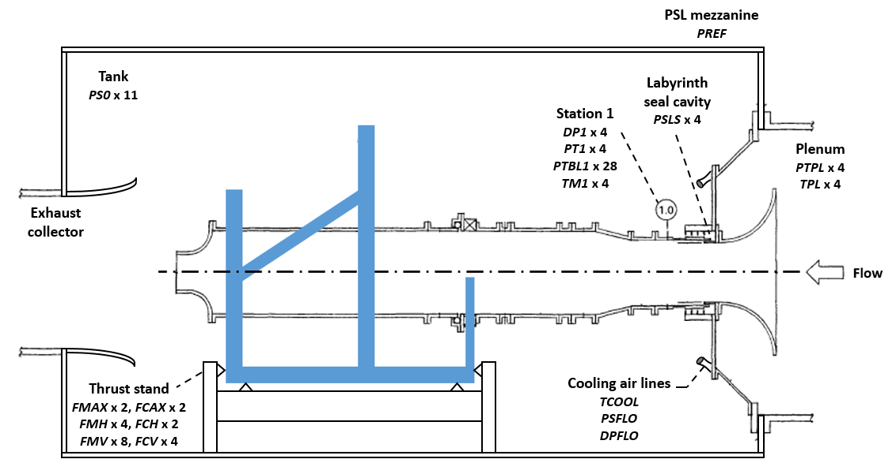
ASME Nozzle Test Setup and Critical Measurements

Slide 7
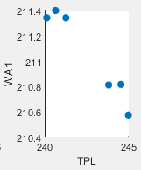
PSL Random Uncertainty
Data description from ASME Nozzle Test, Side 4
  6 repeats obtained at 34 distinct facility conditions
  Repeats spread out as much as the test plan would allow
  Repeats are not back-to-back; some or all set point conditions were changed between repeats
Random uncertainty estimates
  Normal distribution; 2-sigma (95% coverage interval) estimates
  Data analysis techniques were used to remove “expected” levels of variation due to small set point differences (does not represent “uncertainty”)
  Small sample size statistics used since n < 10
  Results defined as a “within-test” uncertainty
    i.e., the level of variability expected over a short-term test installation
  Thrust uncertainty is specific to ASME nozzle test setup – cannot guarantee a customer would observe the same levels of variability in thrust
    Each test setup is unique
    A running engine is more dynamic than a passive nozzle
    Cooling air dynamics are unique to each test installation
Notes:
“canonicalization”

Slide 8
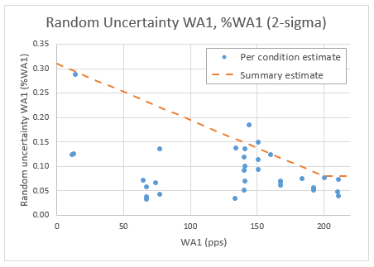
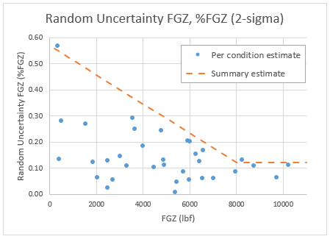
PSL Random Uncertainty Results for Station 1 Mass Flow (WA1) and Axial Thrust (FGZ)
Axial thrust random uncertainty
Uncertainty range:
1-12 lbf across range
(0.1% to 0.6% of FGZ)
Mass flow random uncertainty
Uncertainty range:
< 0.25 pps across range
(0.05% to 0.3% of WA1)
Notes:
2 main variables of interest
Summary estimate can be viewed as a “ceiling” estimate underneath which “within test” variability would be expected to stay
This is a baseline estimate; more time = more data = more robust estimates
Customers encouraged to obtain some repeats; can use this summary model to target small number of set points to repeat and ensure variability levels are acceptable

Slide 9
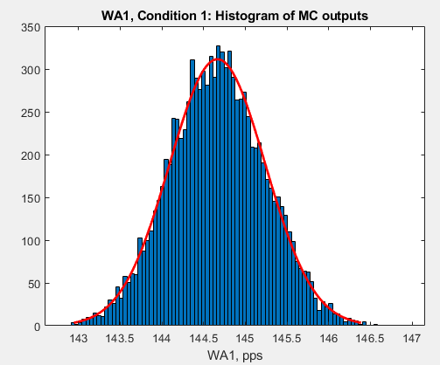
PSL Systematic Uncertainty
PSL Side 4
  Monte Carlo method of uncertainty propagation
    Uncertainty inputs
      Instrumentation system specifications for measured pressures, loads, temperatures
      Facility specifications for parameters (diameters, areas, lengths, rake configs, etc.)
      Calibration fit residuals
    Simulation of full test sequence
      Thrust stand calibration
      ADP calibration
      Cooling air calibration
      Customer test (ASME nozzle points used to seed simulation)
    MC outputs are large populations of WA1,
    FGZ for each condition, impacted by all uncertainties
    considered in the propagation
Systematic uncertainty estimates
  Normal distribution of results; 2-sigma (95% coverage interval) estimates
Notes:
Sim of full test sequence: Uncertainty from calibration tests and their effects on variables calculated in customer test captured in the simulation and results

Slide 10

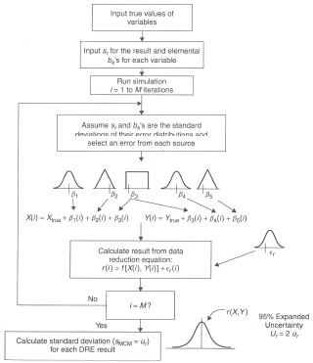
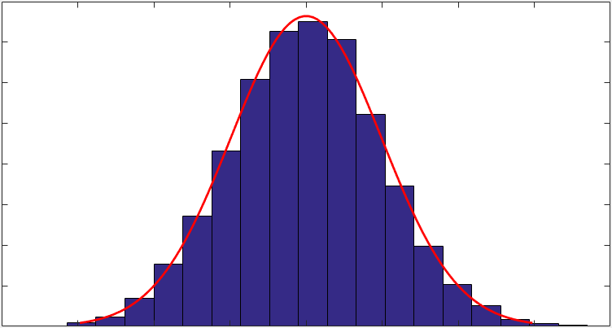

Performing a Monte Carlo Analysis
Generate random numbers along appropriate distributions for each uncertainty source to create simulated errors (β, ϵ)
Calculate result of value of interest from applicable data reduction equation(s)
Input nominal values of measurements
Input random and systematic uncertainties to be applied
Apply errors to appropriate variables
Calculate uncertainty of value of interest
M₁
b_{M1}
β_{M1}(i)
M₁(i) = M₁
+ ϵ_{M1}(i) + β_{M1}(i)
y(i) = f [M₁(i), M₂(i), … , M_{n}(i)]
s_{M1}
ϵ_{M1}(i)
no
M₂
Run simulation: i = 1 to j iterations
i = j?
yes
M_{n}
b_{Mn}
β_{Mn}(i)
M_{n}(i) = M_{n}
+ ϵ_{Mn}(i) + β_{Mn}(i)
s_{Mn}
ϵ_{Mn}(i)
Sources of uncertainty estimates:
Determine uncertainty u_{y} from values and distribution of j simulated outcomes
s_{M}
: SPC, data analysis, analysis of repeats
b_{M}
: Data analysis, instrument spec sheets, calibration reports…

Slide 11
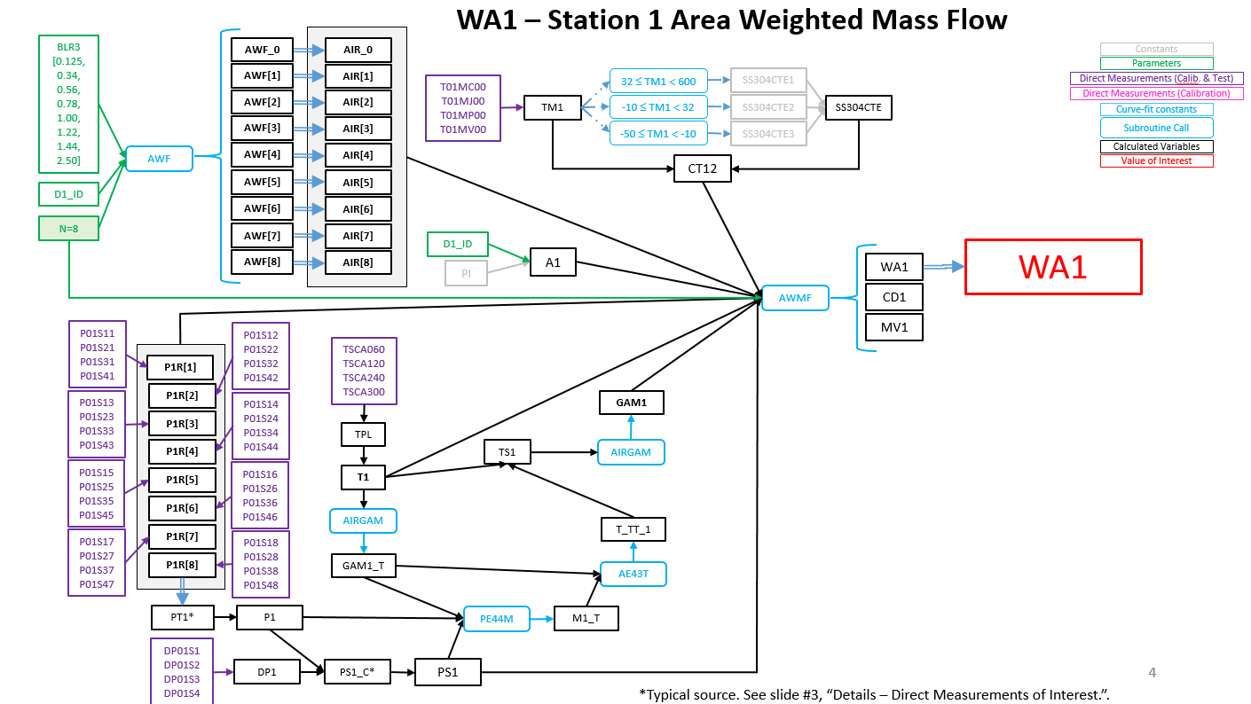
Variables of interest: Mass Flow, WA1
Notes:
Even though there’s a lot involved in its calculation, station 1 mass flow is very straightforward since dependent only on live measurements and constant parameters

Slide 12
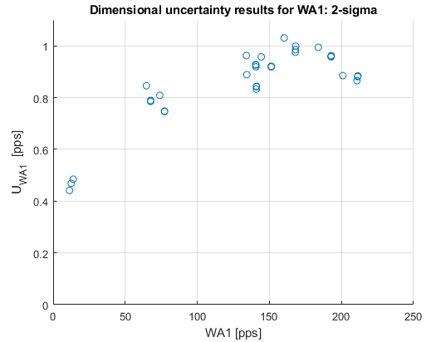
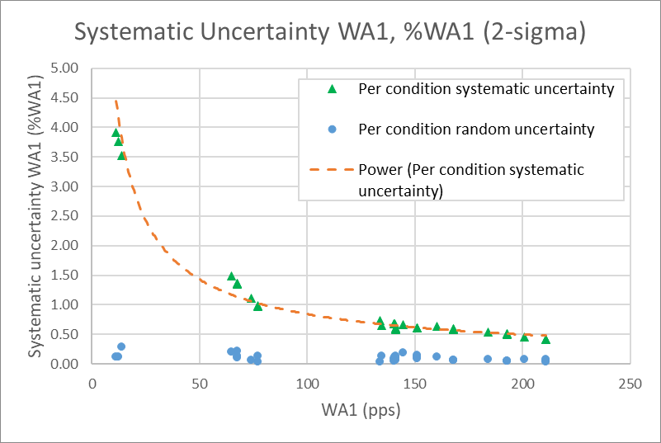
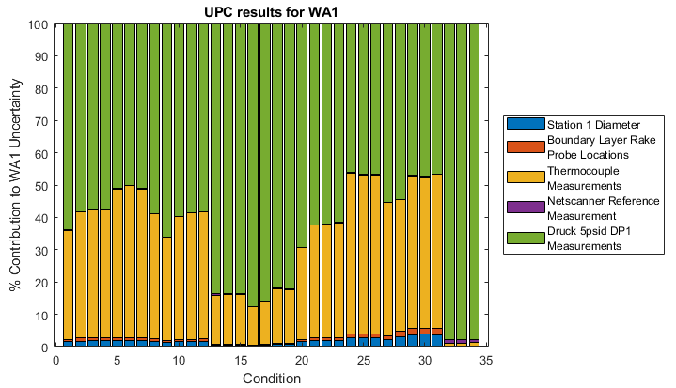
PSL Systematic Uncertainty Results for Station 1 Mass Flow, WA1
Mass flow systematic uncertainty
Uncertainty range:
<1 pps across range
(0.45% to 4% of WA1)
Notes:
Order of magnitude scale differences between random and systematic – this is a typical finding
There is likely room for improvement here but still need to investigate source contribution levels to see where majority of uncertainty is coming from

Slide 13
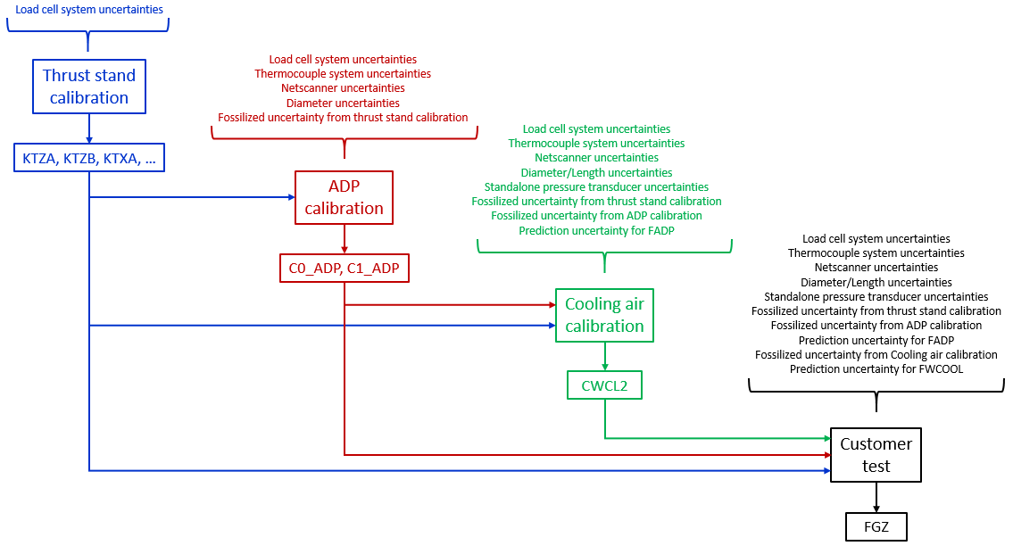
Variables of interest: Axial thrust, FGZ (cont’d)
Notes:
Main sequence of calibrations/corrections for PSL
Uncertainties present during calibration tests are fossilized into the correction terms used “downstream”

Slide 14
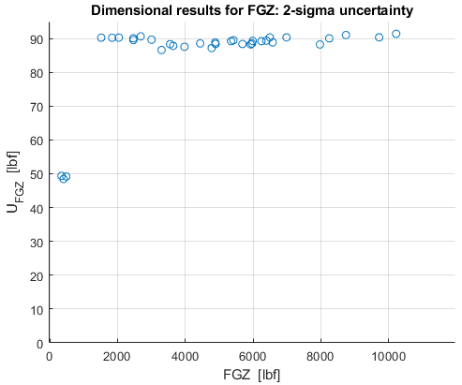
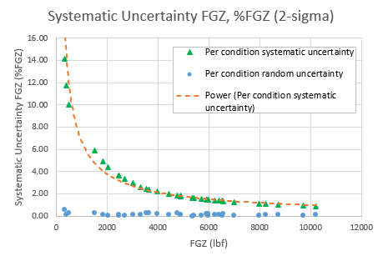
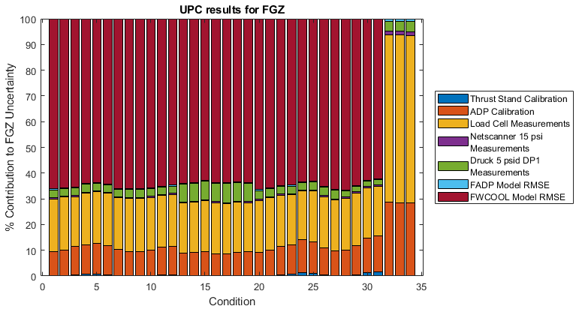
PSL Systematic Uncertainty Results for Thrust, FGZ
Thrust systematic uncertainty
Uncertainty range:
~90 lbf across tested range
(0.45% to 4% of FGZ)
Notes:
Order of magnitude scale differences between random and systematic – this is a typical finding
There is likely room for improvement here but still need to investigate source contribution levels to see where majority of uncertainty is coming from

Slide 15
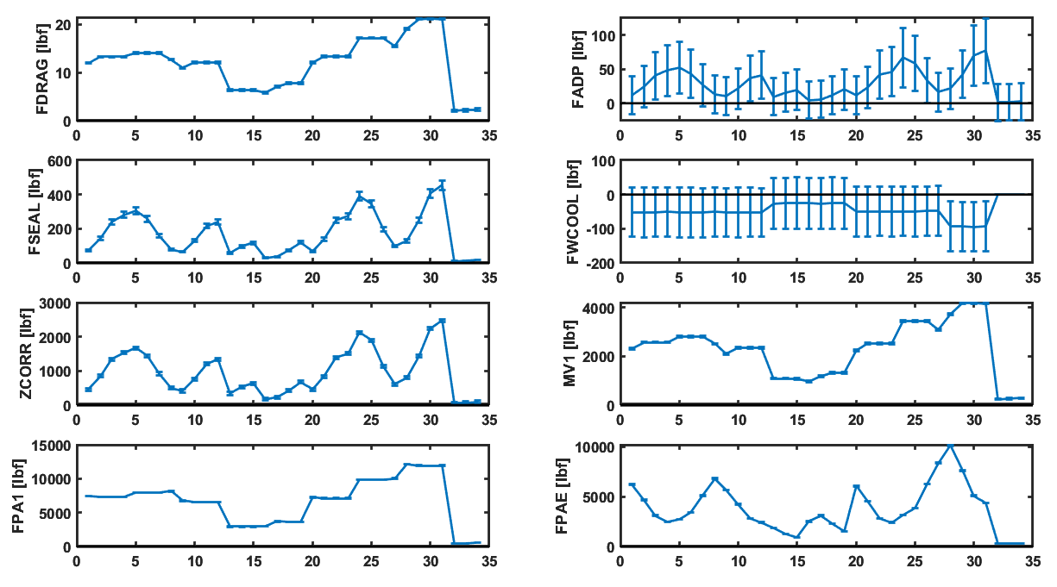
Main force components and their uncertainties
CONDITION #
CONDITION #

Slide 16

Relative contributions of thrust build-up terms
to uncertainty in FGZ
10-25%*
20-25%
55-65%
negligible
$$F_{GZ}=F_{MV1}−F_{PAE}+F_{PA1}+F_{SEAL}+F_{ADP}+F_{DRAG1}+Z_{CORR}−F_{WCOOL}$$
*Uncertainty in these terms highly correlated
F_{WCOOL}
F_{ADP}
Control Volume
F_{PA1}
F_{SEAL}
FGZ
MV1
Station 1
Plane
F_{PAE}
F_{DRAG}
+$z$
Live Bed
Z_{CORR}
Labyrinth Seal
Thrust Stand

Slide 17
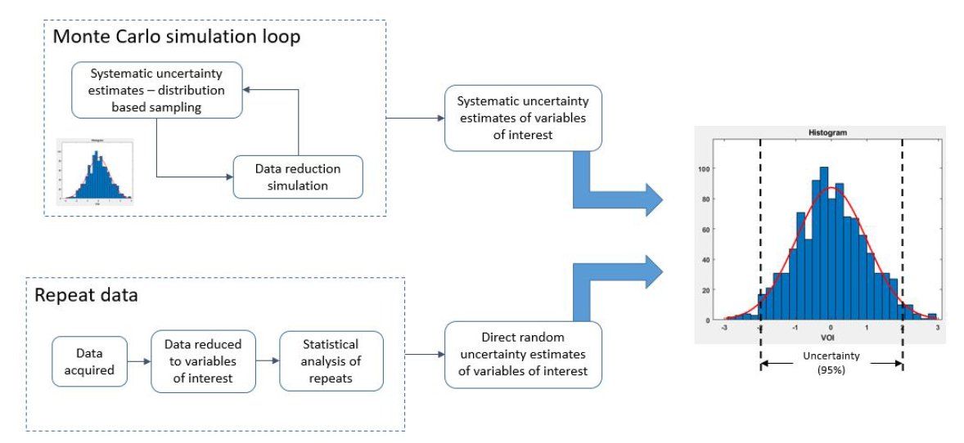
Total uncertainty estimation

Slide 18
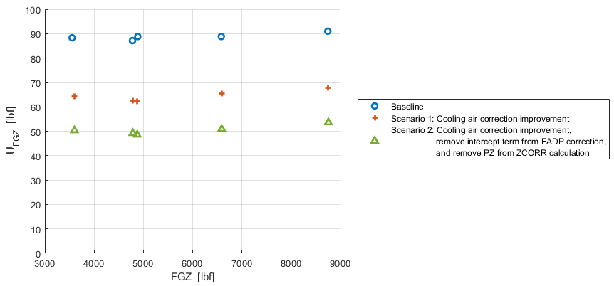
Improvement Scenarios for Thrust Uncertainty Reduction
Improve cooling air calibration model
  25% uncertainty reduction
Additionally, remove statistically insignificant values from data reduction (PZ, FADP model intercept term)
  45% uncertainty reduction!
Notes:
Using UPC charts and the information it provides, we can continue to iterate to see if the “long pole” is easily reducible or what it would take to reduce it
Can use code already set up for MC to run simulations of improvements to find how beneficial they are to enable decision making about improvement efforts (cost/benefit analysis)
Note that these improvements are not added cost (except for this analysis) – no additional testing required, using current data this is expected improvement

Slide 19
Questions?

Slide 20
Supplemental Slides

Slide 21
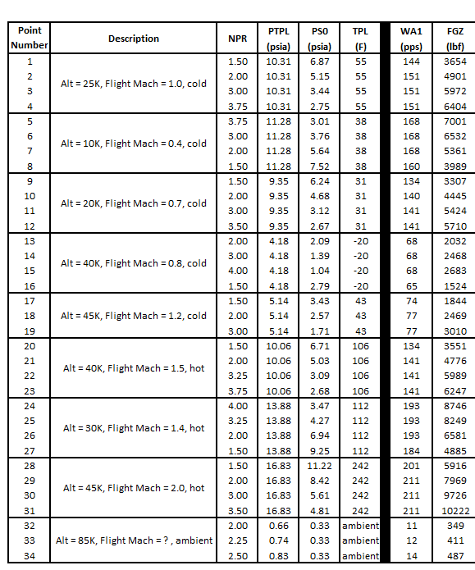
Conditions list (nominal)

Slide 22
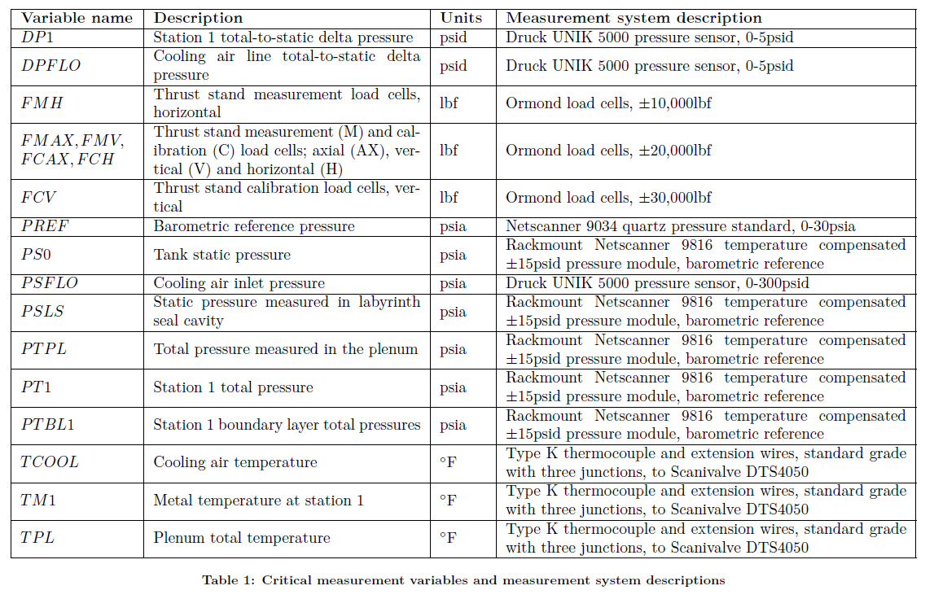

Slide 23
