Slide 1
Network telemetry
Nathaniel Garcia
VA-E1

Slide 2
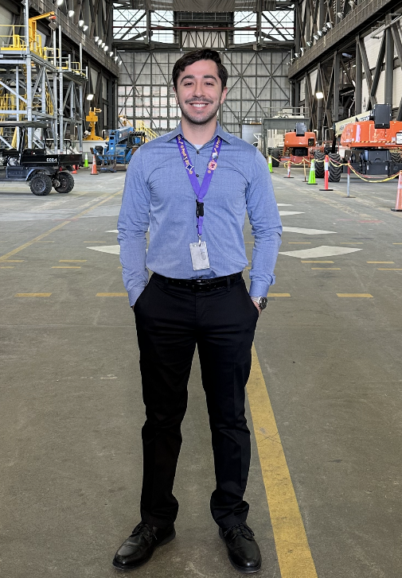
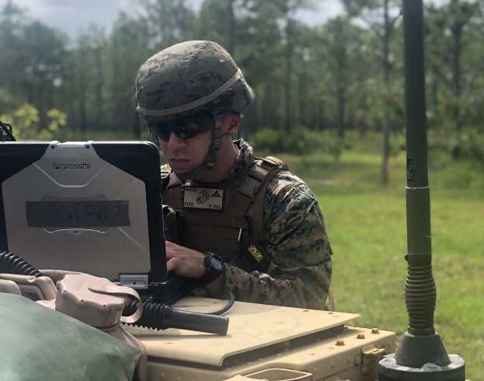
About Me
Born and raised in Miami, FL.
Electrical Engineering major, attending Florida International University.
Currently serving in the USMCR as of 2019.
First rotation with NASA Pathways.
Assigned to train as an MCE for the Ground Systems
Integration branch of LSP.

Slide 3
The Task at Hand
Create a prototype model of Juniper Network Telemetry facilitated through a TIG stack, having it collect, store, and display server metrics.
This design would replace WUG and SNMP for Hangar AE’s network.
The JTI model used for this design would be JTI Native.

Slide 4
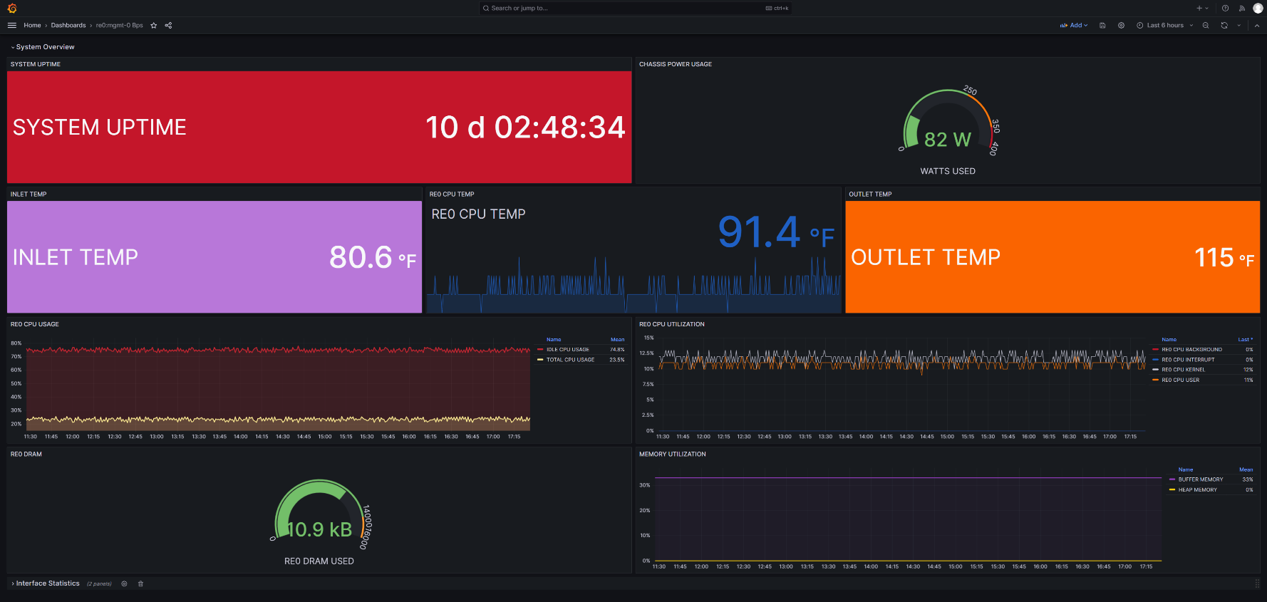
What that looks like

Slide 5
Network Telemetry
Currently, the method for gathering network metrics has been via Simple Network Management Protocol in conjunction with tools such as WhatsUp Gold as a method of viewing this data.
As more data passes through at higher speeds, more data tends to get lost in between data requests.
Network telemetry is a newer method of gathering metrics, delivering data in a continuous stream, ensuring that no information is lost.

Slide 6

SNMP
Network Managed
Device
Human
Network Manager
UDP port 161
Read/Write
Messages
Management
System
Manager
UDP port 162
WUG
SQL Management Database
Management
Information Base
Management
Information
Base
Managed Objects

Slide 7

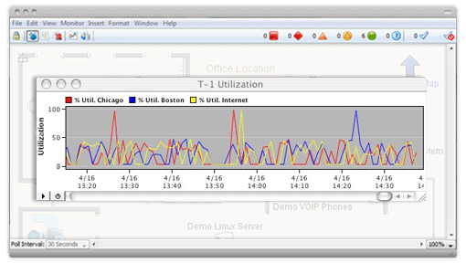
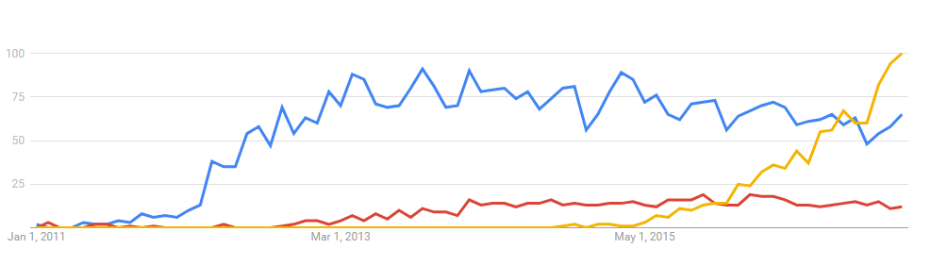
SNMP Manager
Human
Network Manager
SNMP Manager
Manager
WUG
SQL Management Database
Management
Information Base

Slide 8
SNMP vs Telemetry
PULL Model (SNMP)
Traditional model for monitoring the network health is based on a “pull” model.
Uses SNMP, CLI or API calls to periodically poll network elements.
Has inherent scalability limitations and are resource intensive, particularly when polling many metrics at a very high frequency.
PUSH Model (Telemetry)
Telemetry relies on a “push” model to continuously deliver data as a stream to a collector.
More scalable and supports the monitoring of thousands of objects in a network with high resolution.

Slide 9
Telemetry Collection – TIG Stack
Collection
Collecting telemetry data typically involves three types of functions:
Collecting and parsing the telemetry data using an appropriate data collection engine, such as Telegraf.
Persistence
Persisting the collected telemetry data in some type of datastore, like InfluxDB - a time series database.
Visualization
Displaying the collected telemetry using some type of data dashboard tool, such as Grafana.
Telegraf, InfluxDB, Grafana = TIG stack.

Slide 10
Juniper Telemetry Interface
For this design, we are using the “Native” Juniper Telemetry Interface (JTI) model.
Things to know about JTI Native:
  Compact and efficient, high performance and little overhead.
  Best suited for direct export from the network processor.
  For third party use, defined by Juniper, but open.

Slide 11

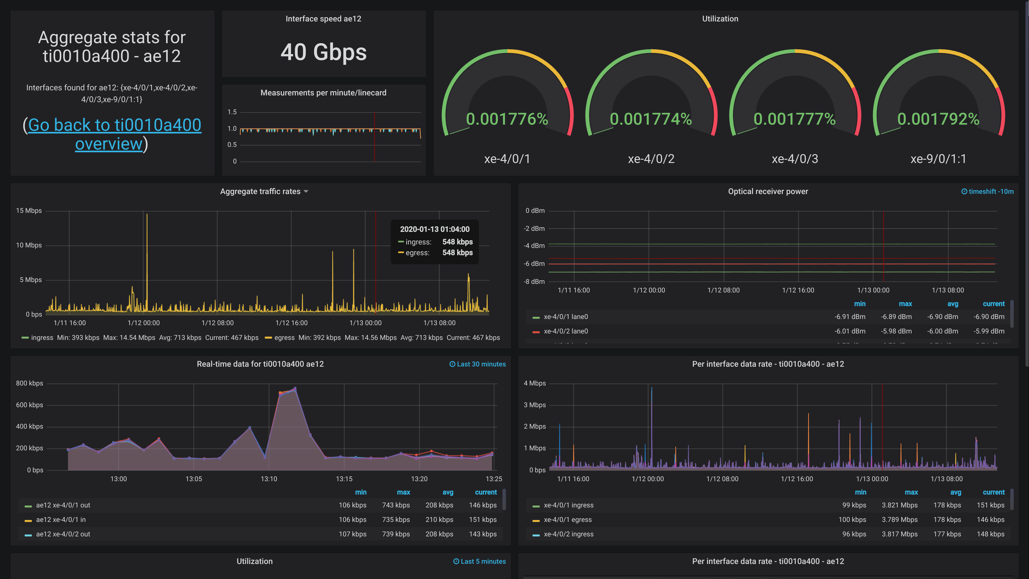

Juniper Native Telemetry
Network Element
Routing Engine
Sensor Configuration
Grafana
Provision Sensors
Request
Receive
Line Card
Database
(InfluxDB)
Collector
(Telegraf)
Native Telemetry Data

Slide 12
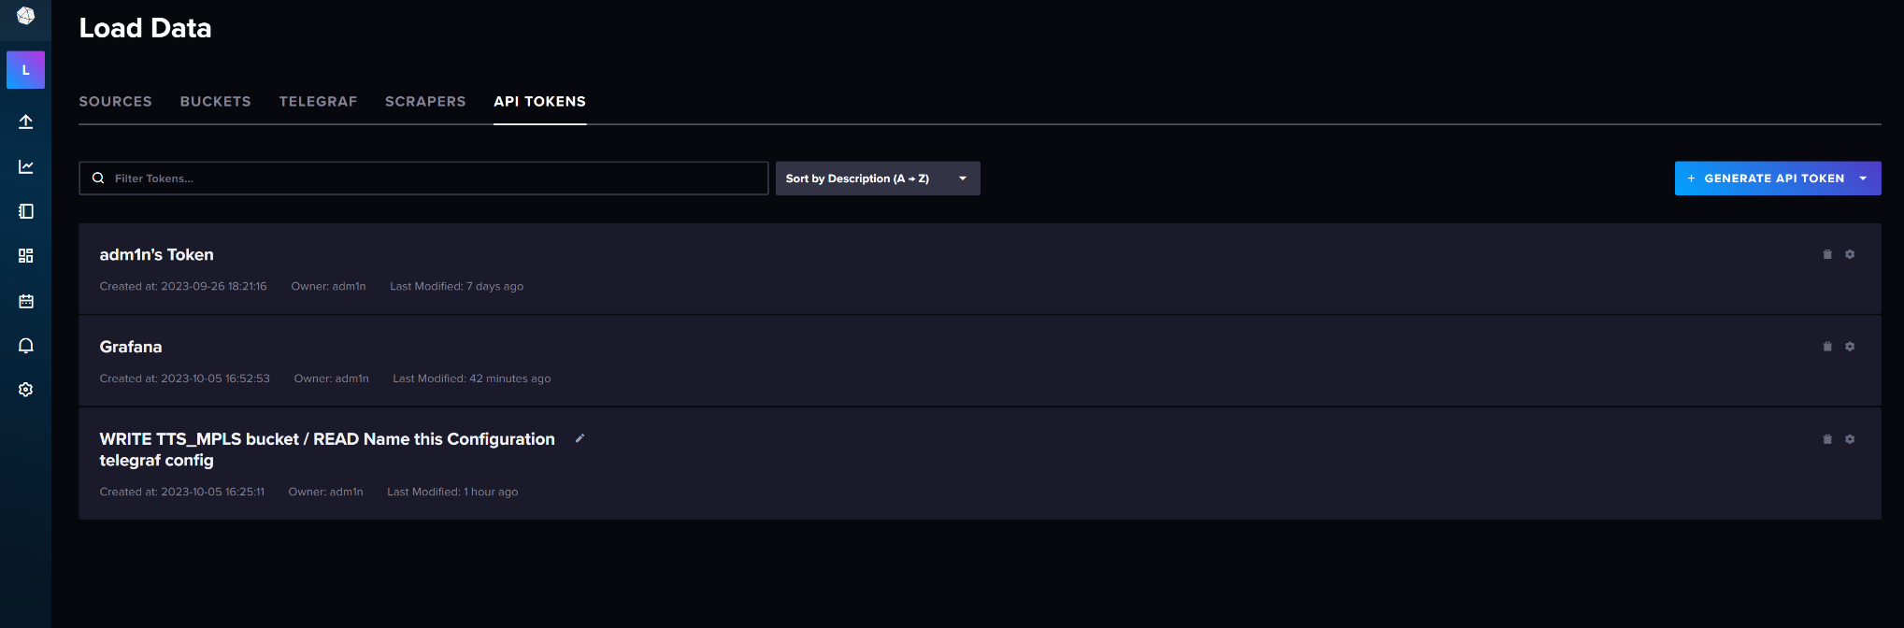
InfluxDB Setup

Slide 13
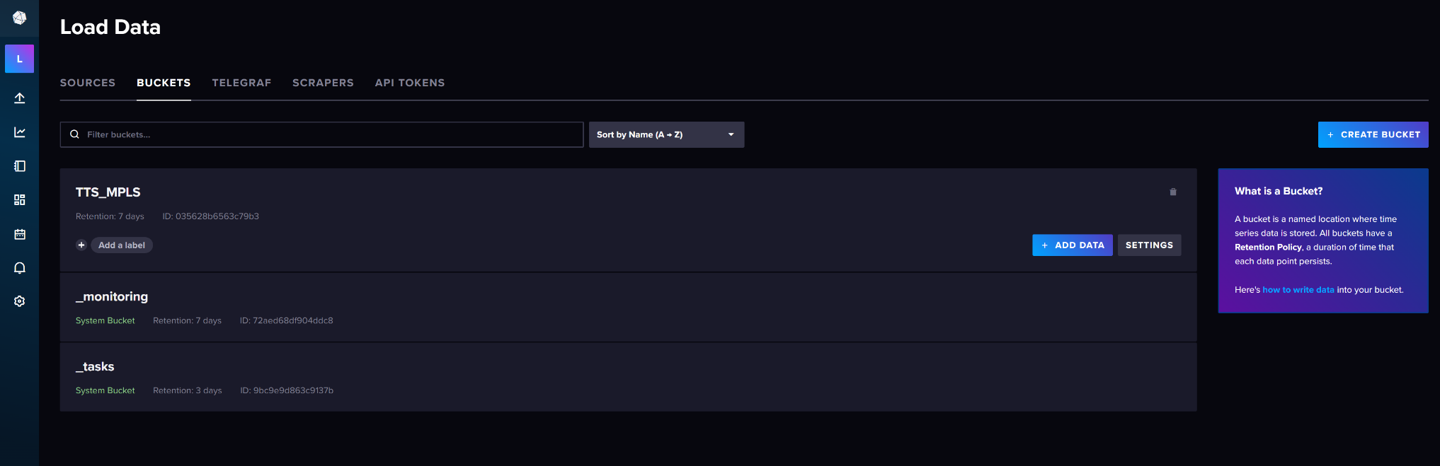
InfluxDB Setup

Slide 14
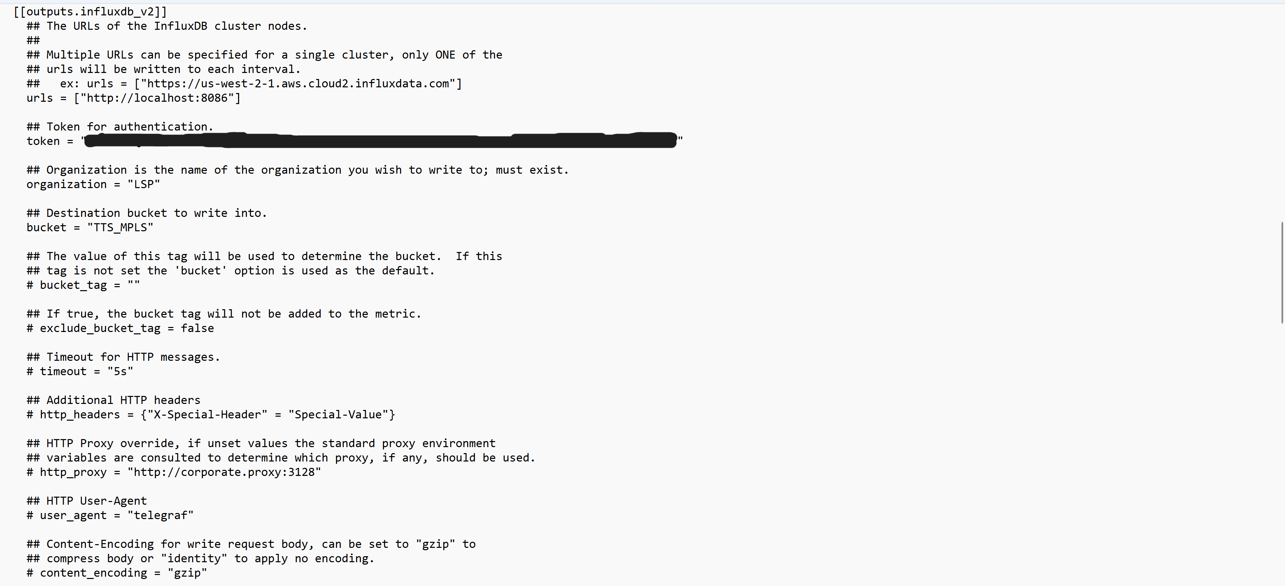
Telegraf Configuration

Slide 15
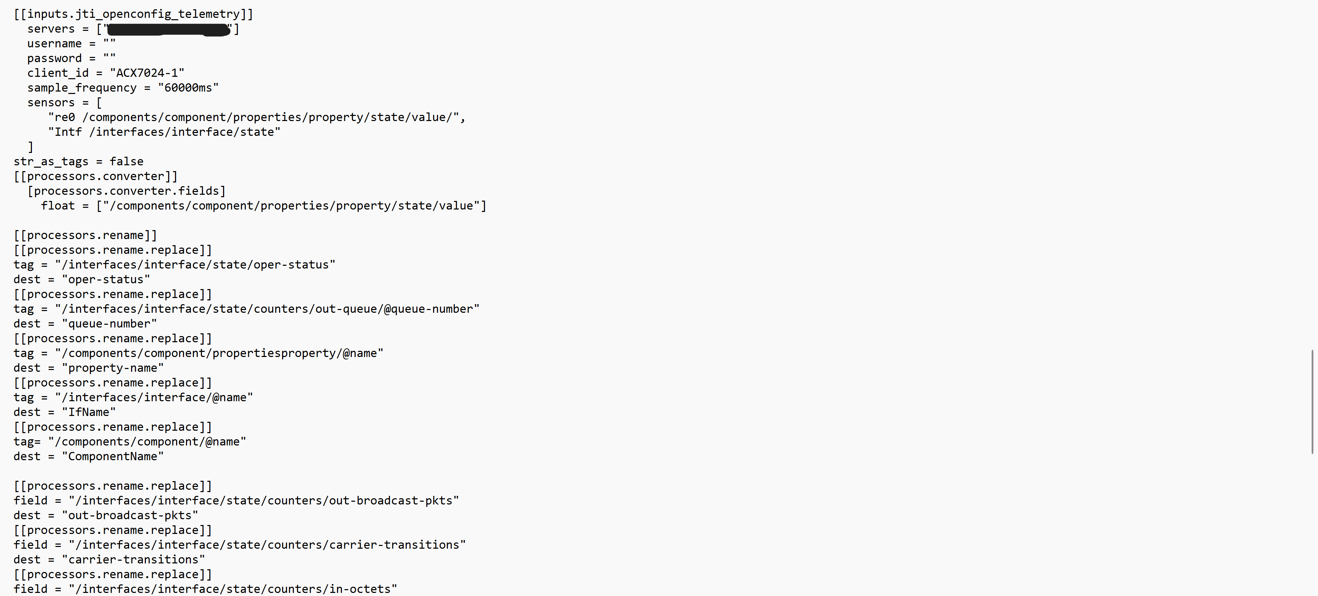
Telegraf Configuration

Slide 16
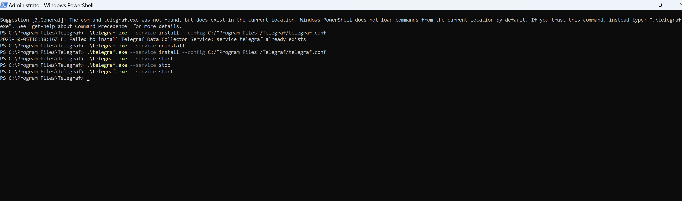
Connecting Telegraf to InfluxDB

Slide 17
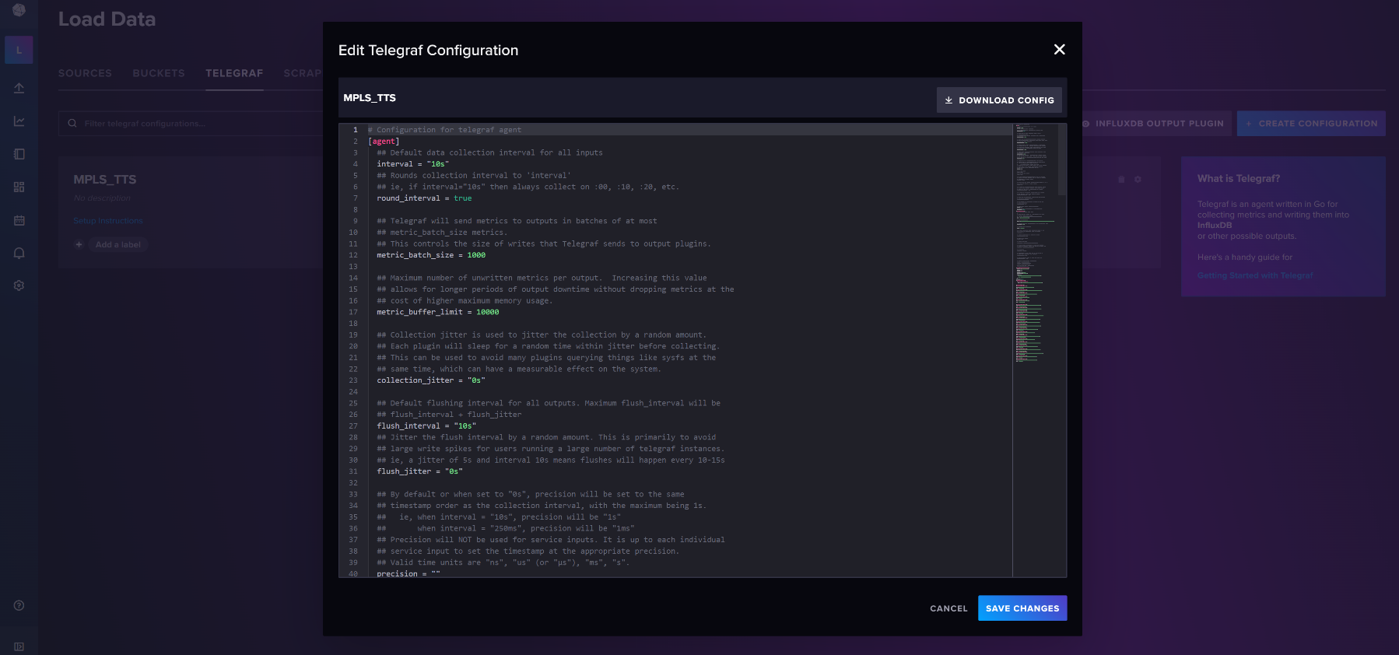
Connecting Telegraf to InfluxDB

Slide 18
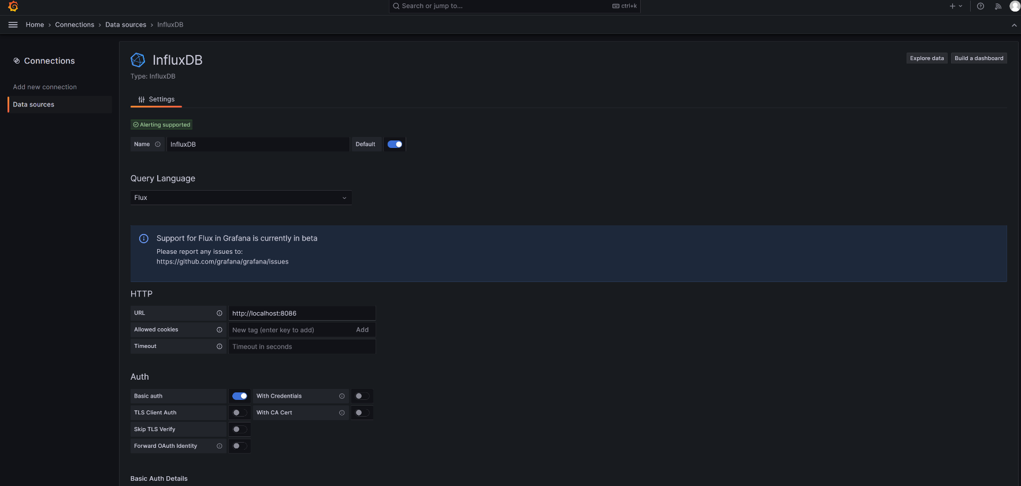
Configuring Grafana

Slide 19
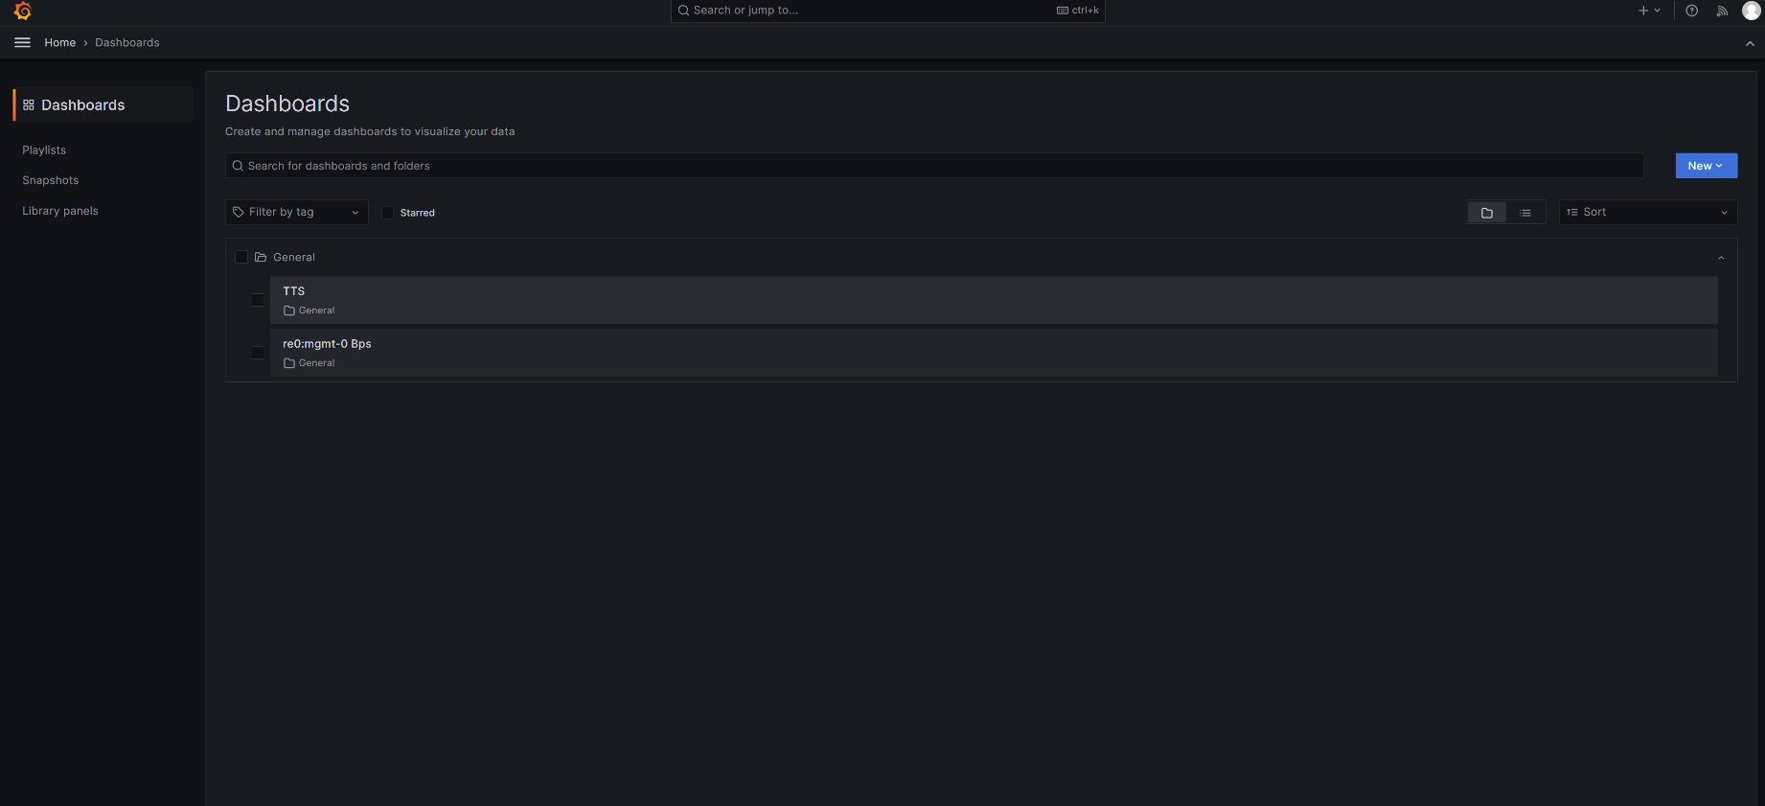
Configuring Grafana

Slide 20
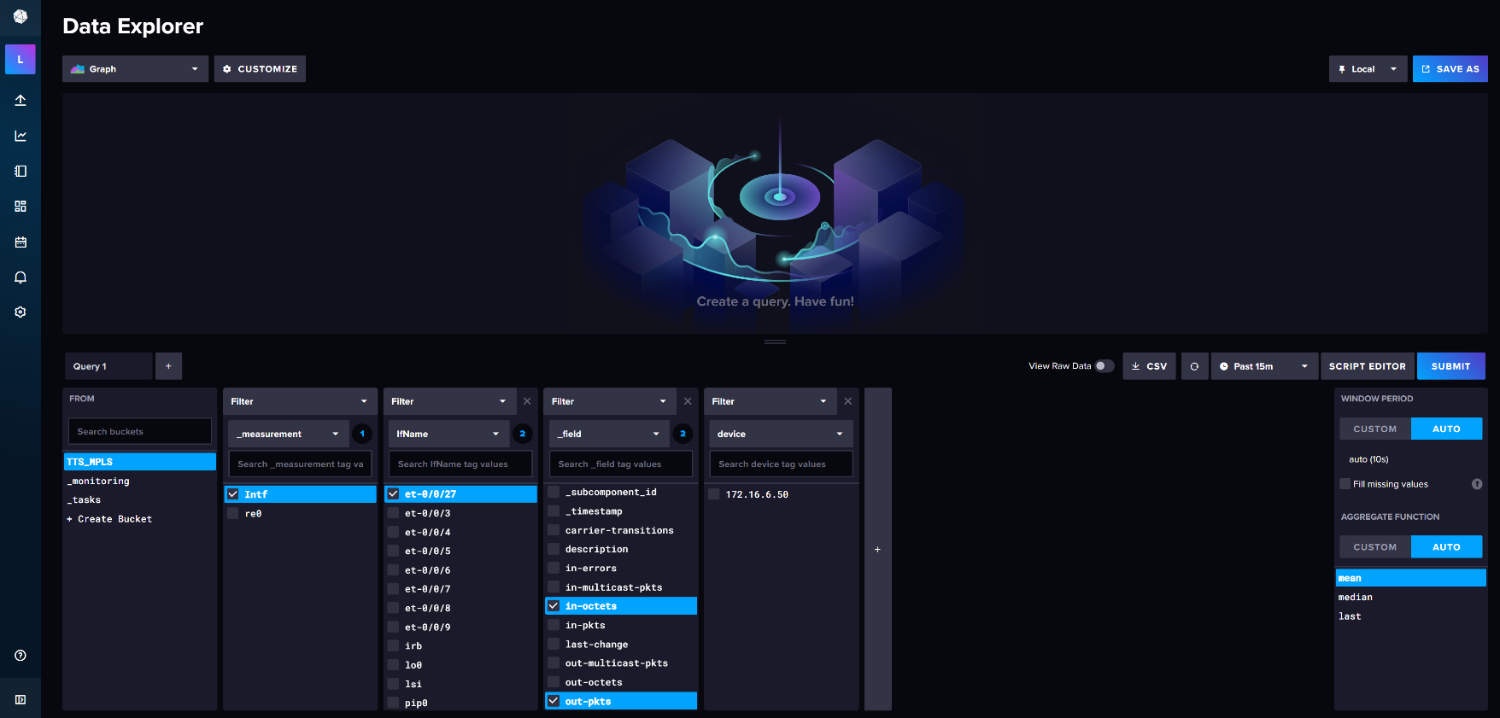
Connecting InfluxDB to Grafana

Slide 21
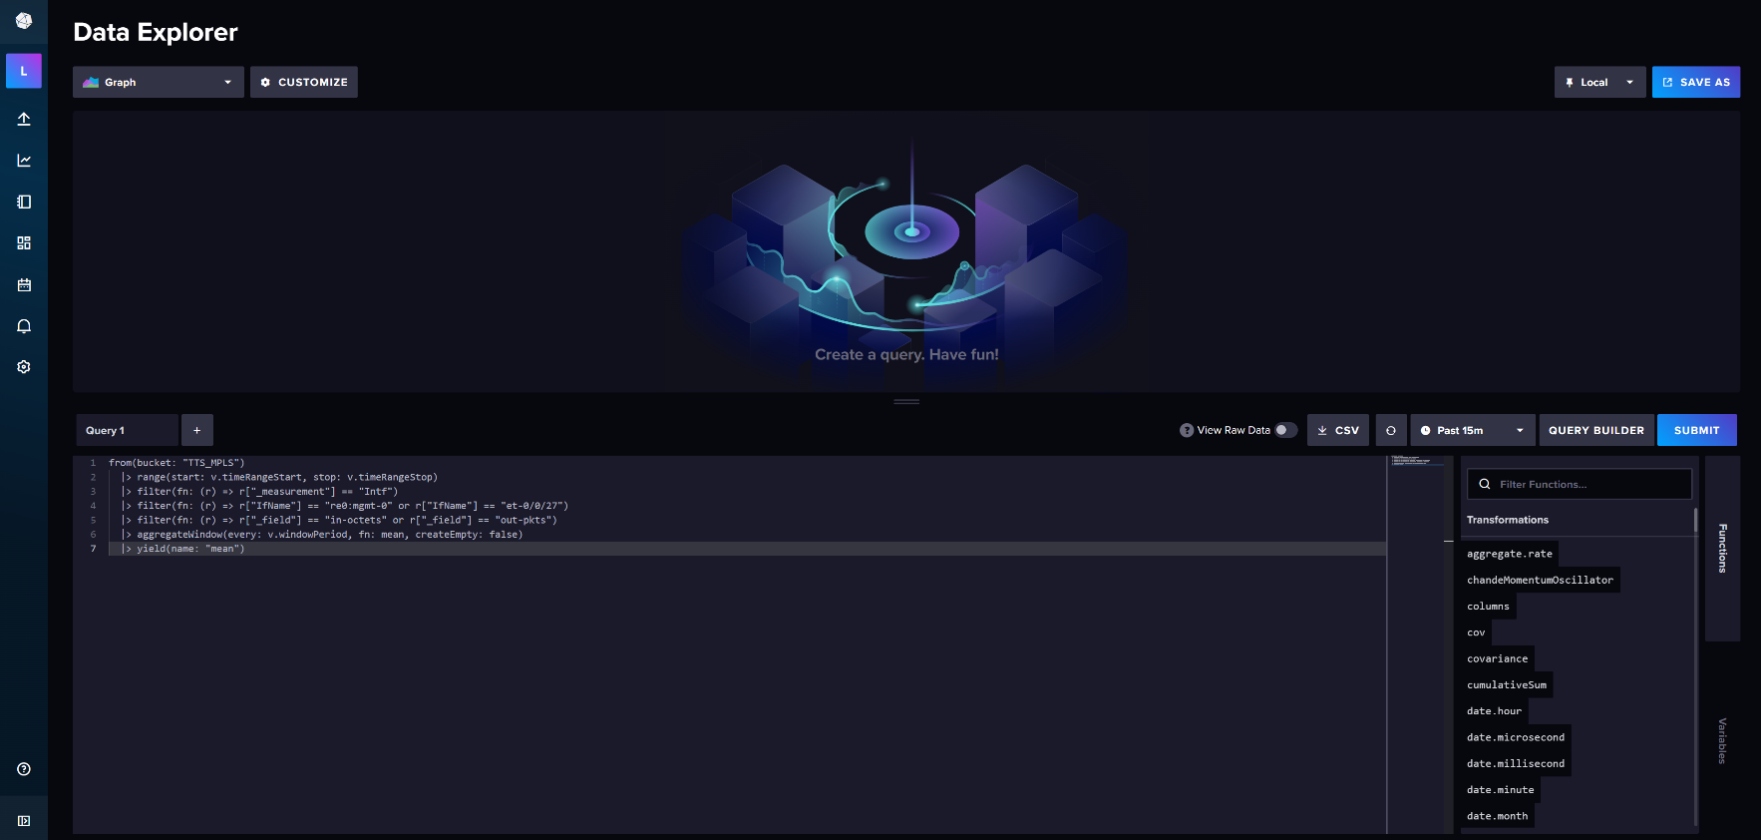
Connecting InfluxDB to Grafana

Slide 22
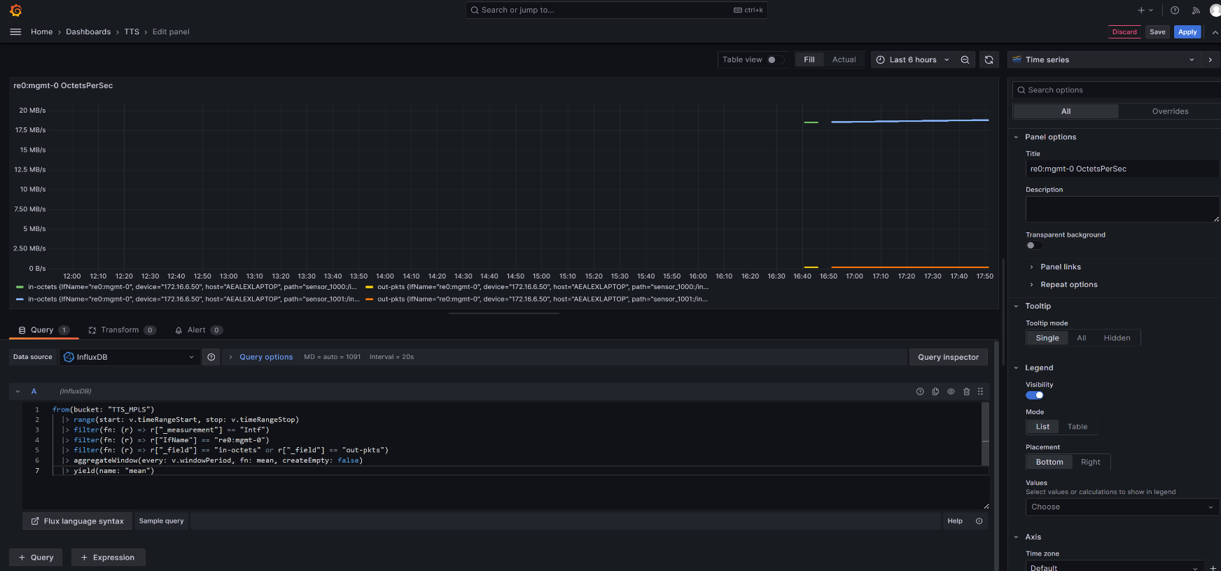
Displaying Information on Grafana

Slide 23
End Result

Slide 24
Moving Forward
Now that this configuration has been accomplished, we need to think about implementation.
The idea is, now that we have this design on a single device, how could we scale it for the entirety of Hangar AE’s network?
How could a larger scale affect the performance of the collector agent (Telegraf) and what could be done to ensure optimal performance?

Slide 25
QUESTIONS?

Slide 26

Thank you for coming to the
KSC Pathways
Fall 2023 Student Showcase
Please take a few minutes to complete feedback evaluations for any of the presentations you attended. The survey link is in the chat.
The next Student Showcase will be in
April 2024.
We hope you will join us again!

