Slide 1
Spatial Mode-Diversity Optical Receivers for Free-Space Optical and Quantum Communications
Brian Vyhnalek
NASA Glenn Research Center
November 13, 2023

Slide 2

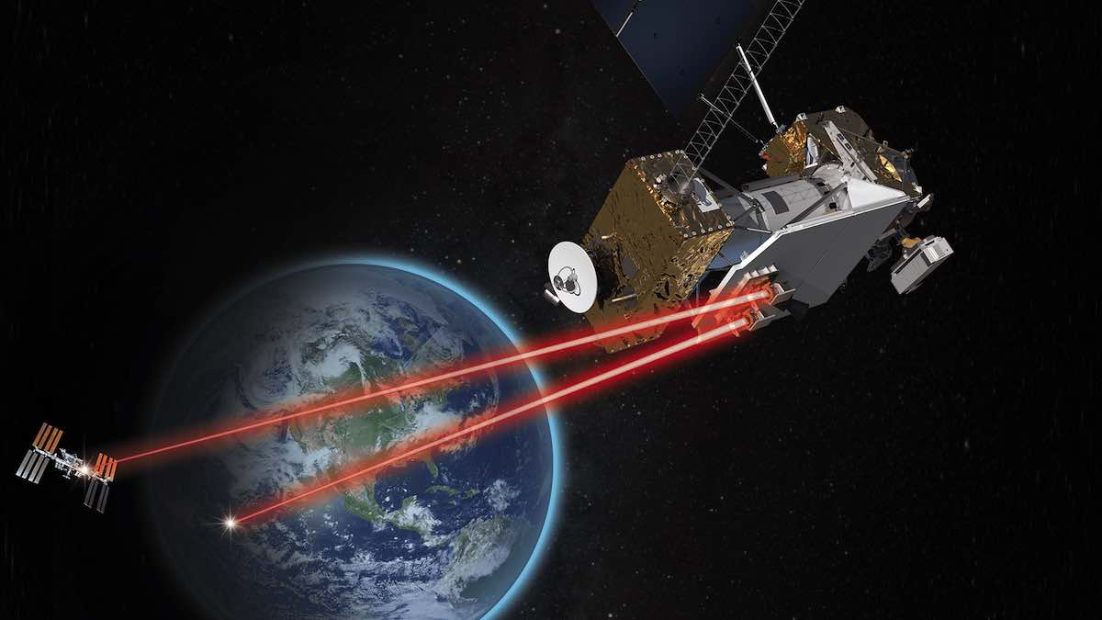
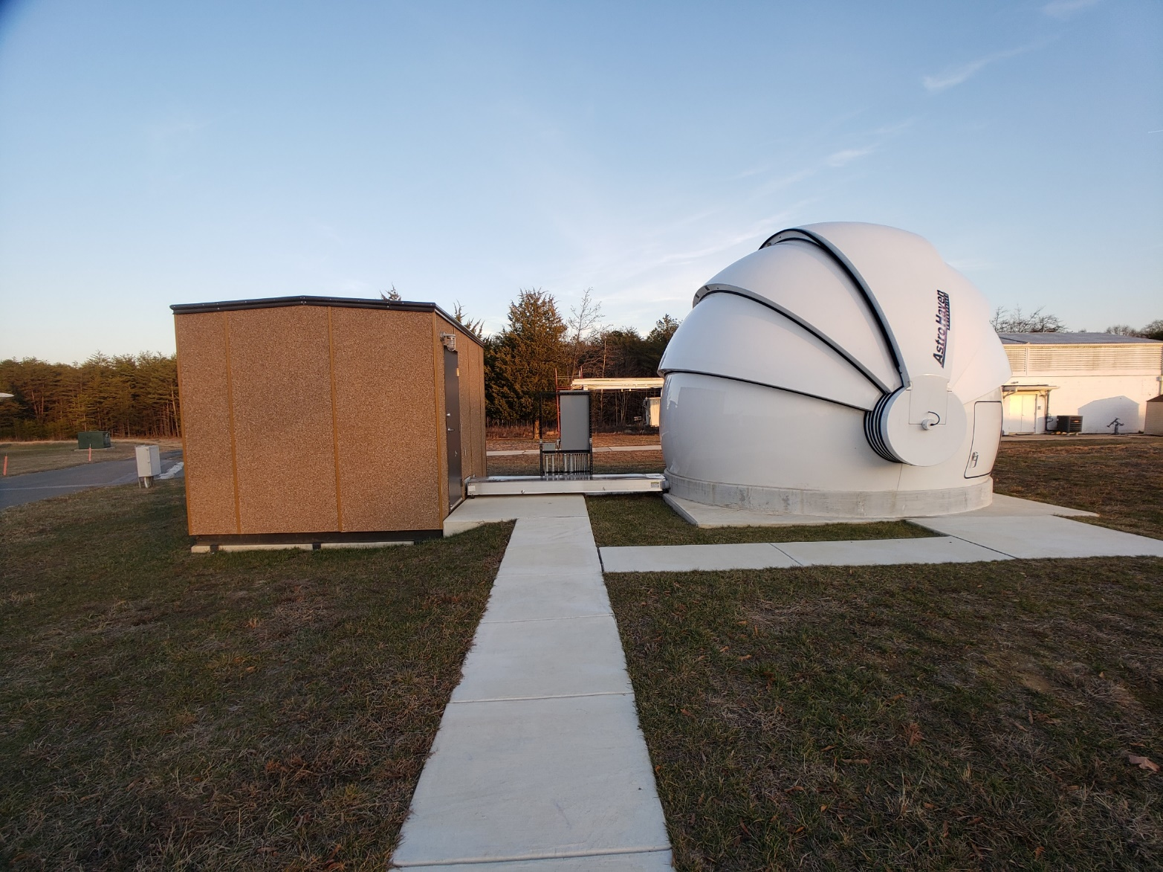
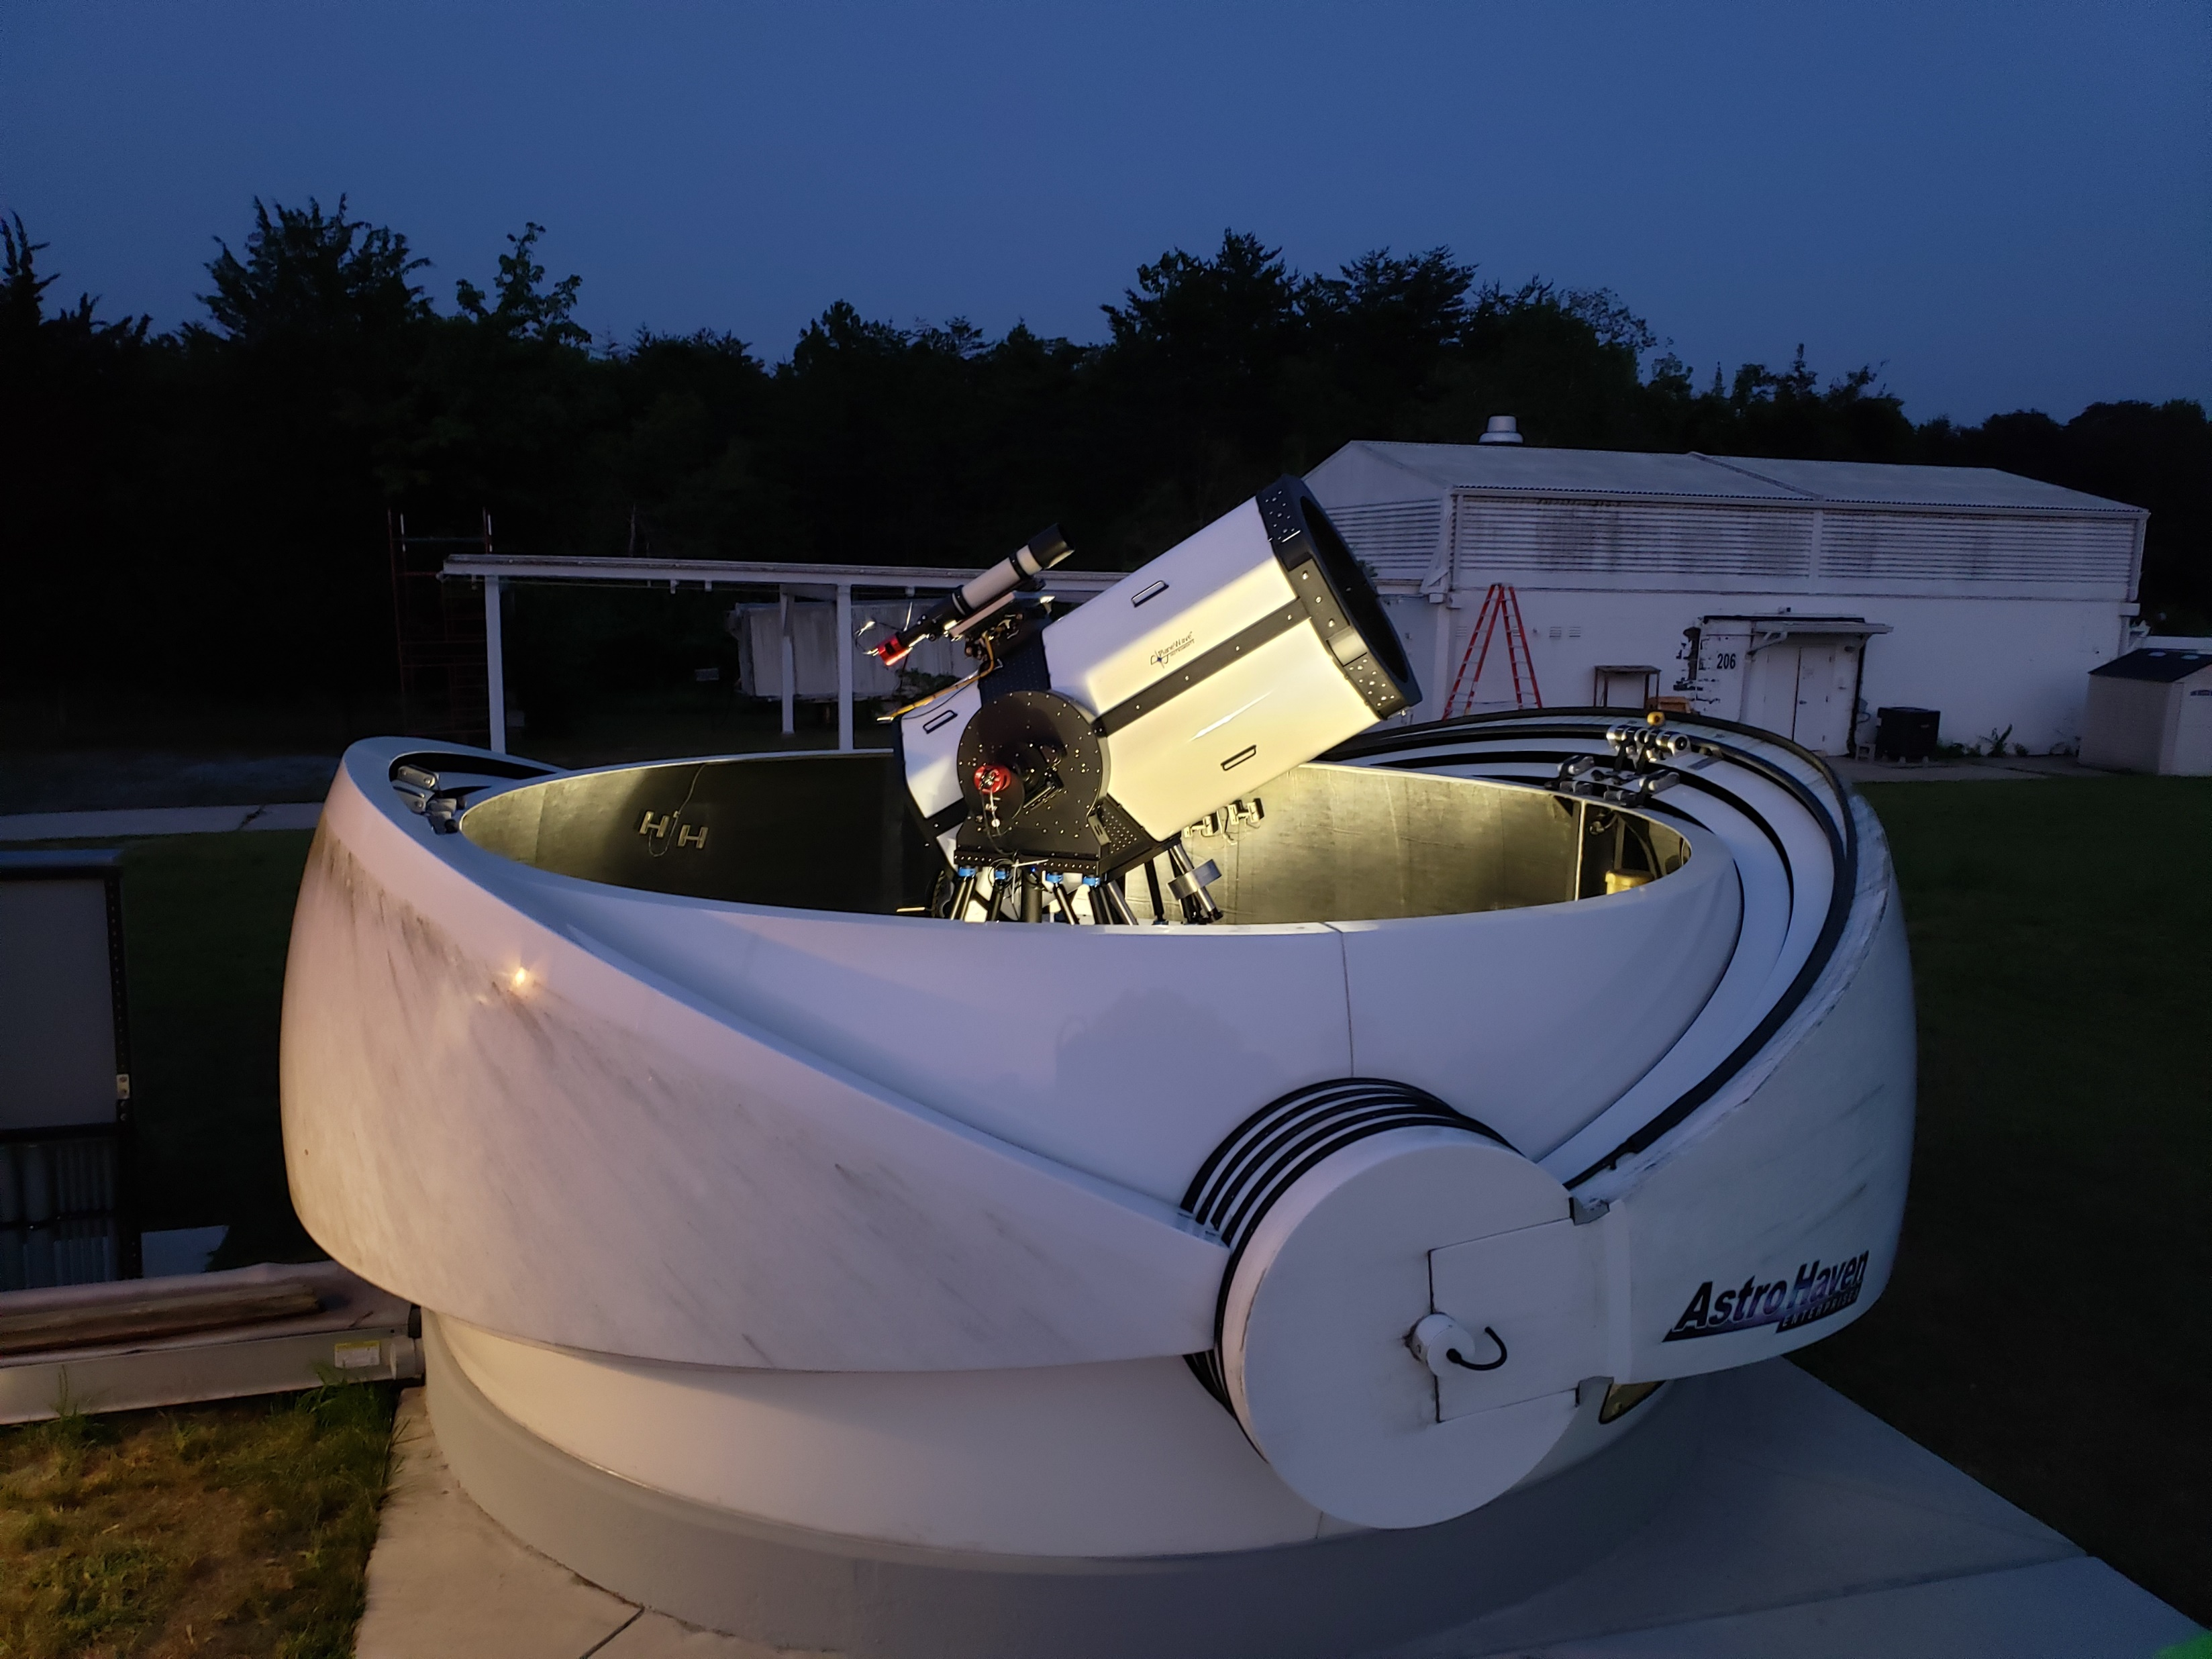
Overview
NASA communications and navigation systems in the Lunar and deep space environment envisioned for the future will need to accommodate human exploration, science experiments, human and robotic mobility operations, basecamp operations, and other missions in general requiring high data-volume transmissions
Optical communications can provide orders of magnitude system improvements vs. current RF systems
Need operational optical ground stations
  Low-cost, 1-meter class (20 – 70 cm) telescopes
  Efficient multi-spatial mode receivers
  Low-cost adaptive optics
NASA Laser Communications Relay Demonstration (LCRD)
NASA GSFC Low-cost optical terminal (LOCT)

Slide 3
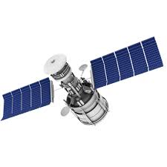
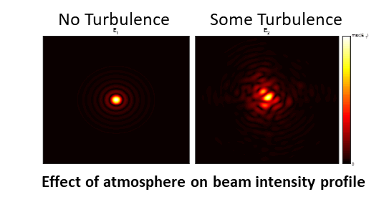
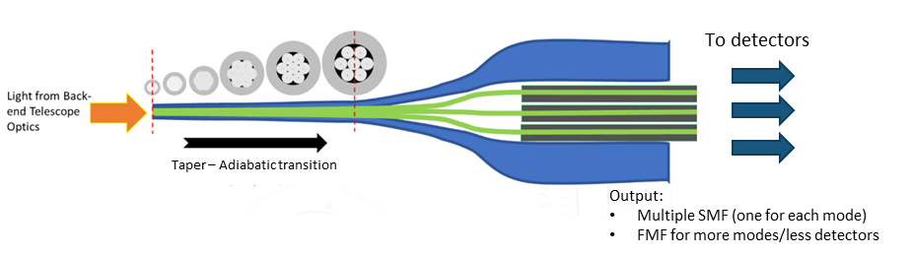
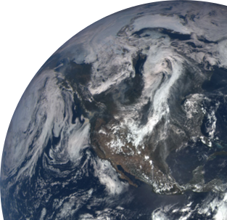
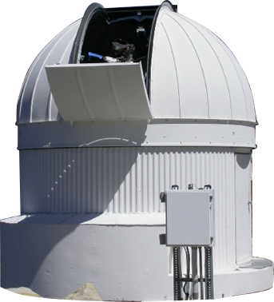
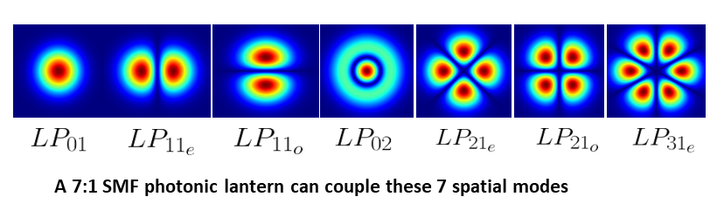
Efficient Multi-Spatial Mode Receivers - Photonic Lanterns
The laser transmitted from a spacecraft originates as a Gaussian shape (LP₀₁)
Atmosphere distorts the beam profile and scatters energy into higher-order spatial modes
The number of fiber spatial modes coupled by a photonic lantern matches the sum of the modes supported by the output fibers

Slide 4
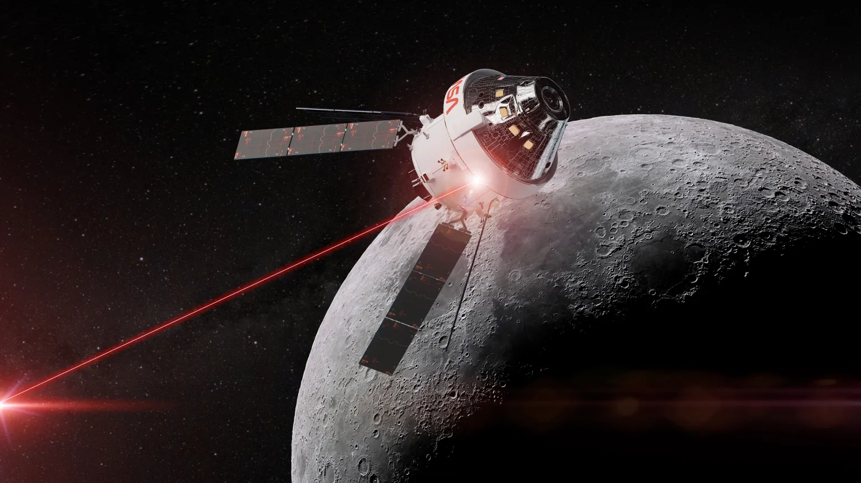
Direct-Detection Photon-Counting Optical Receiver
NASA is using the CCSDS Optical Communications High Photon Efficiency (HPE) waveform on future missions: Optical Artemis-2 Orion (O2O), Psyche
  PPM: 4, 8, 16, 32, 64, 128, 256
  Slot widths: 512 ns - 125 ps
  Maximum data rate: ~2 Gbps
NASA Glenn is building a photon-counting ground receiver compliant with the CCSDS Optical Communications HPE standard
  PPM: 16, 32
  Slot widths: 2 ns, 1 ns, 0.5 ns
  Maximum data rate: 267 Mbps
Goals:
  Utilize commercial off the shelf (COTS) components where possible
  Demonstrate with O2O at the NASA Goddard Low-Cost Optical Terminal (LCOT) ground station

Slide 5
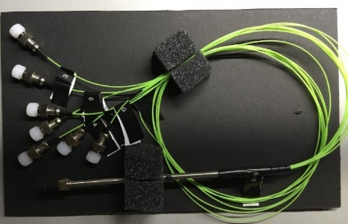
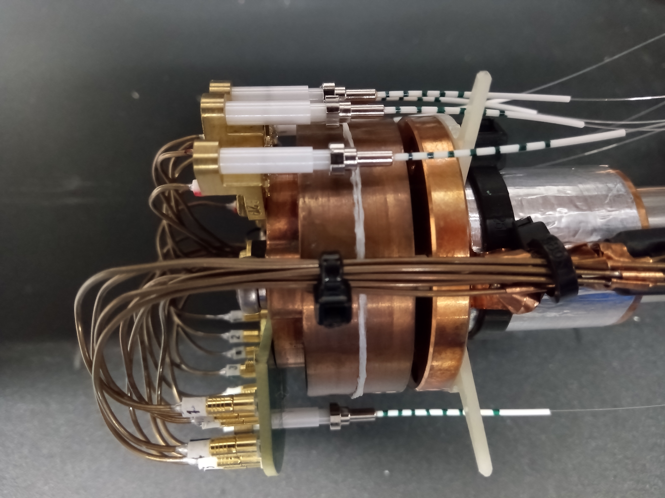
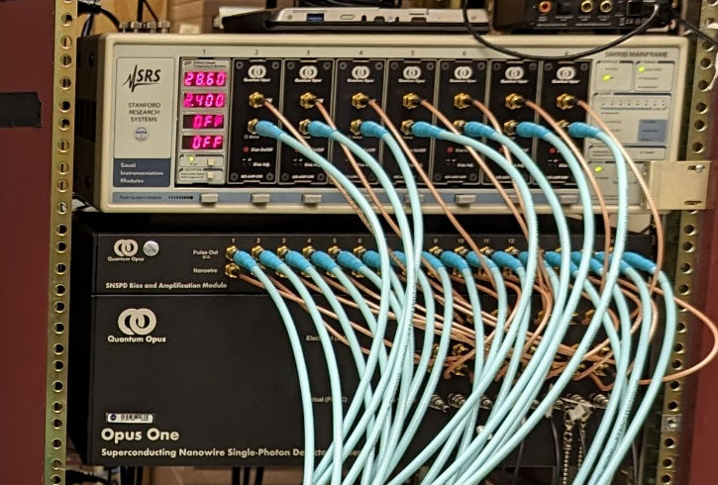
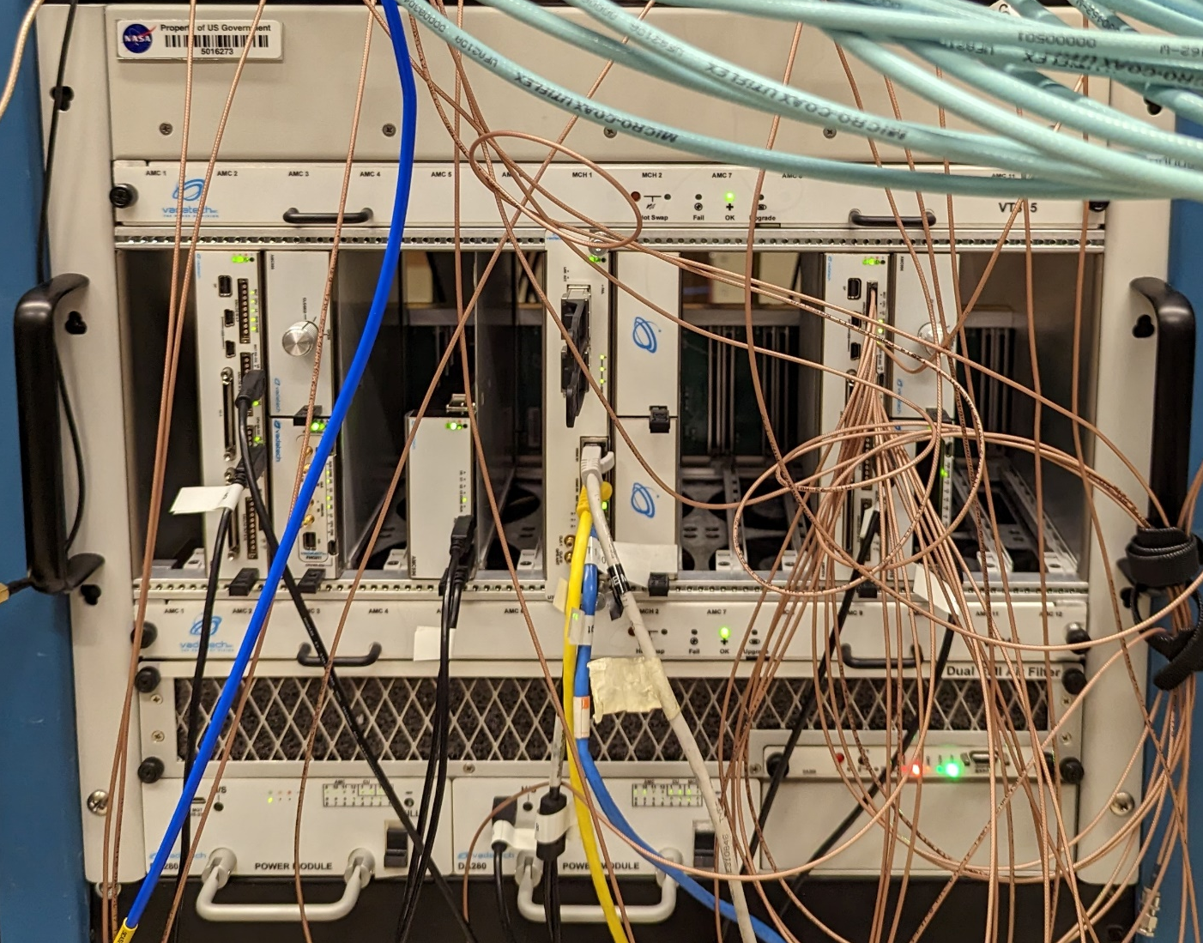
Receiver Subsystems Under Development at NASA GRC
Fiber Interconnects:
Photonic lantern (one multimode fiber input to 7-FMF outputs) or FMF
Input fiber core size, number of outputs, and output fiber core size scalable to application
In house prototyping capability; development partnership with University of Sydney
Single Photon Detectors:
Superconducting nanowire single-photon detectors (SNSPDs)
Individual FMF-coupled detectors, or single 16-channel array
Continuous < 3 K operation, 60-80% detection efficiency, < 100 ps timing resolution
FPGA-based Receiver:
1 ADC per detector channel; digital detector channel combining
Real time processing; COTS development platform
Compatible with CCSDS downlink optical waveform (high photon efficiency)
FPGA VHDL/Verilog receiver code will be released

Slide 6
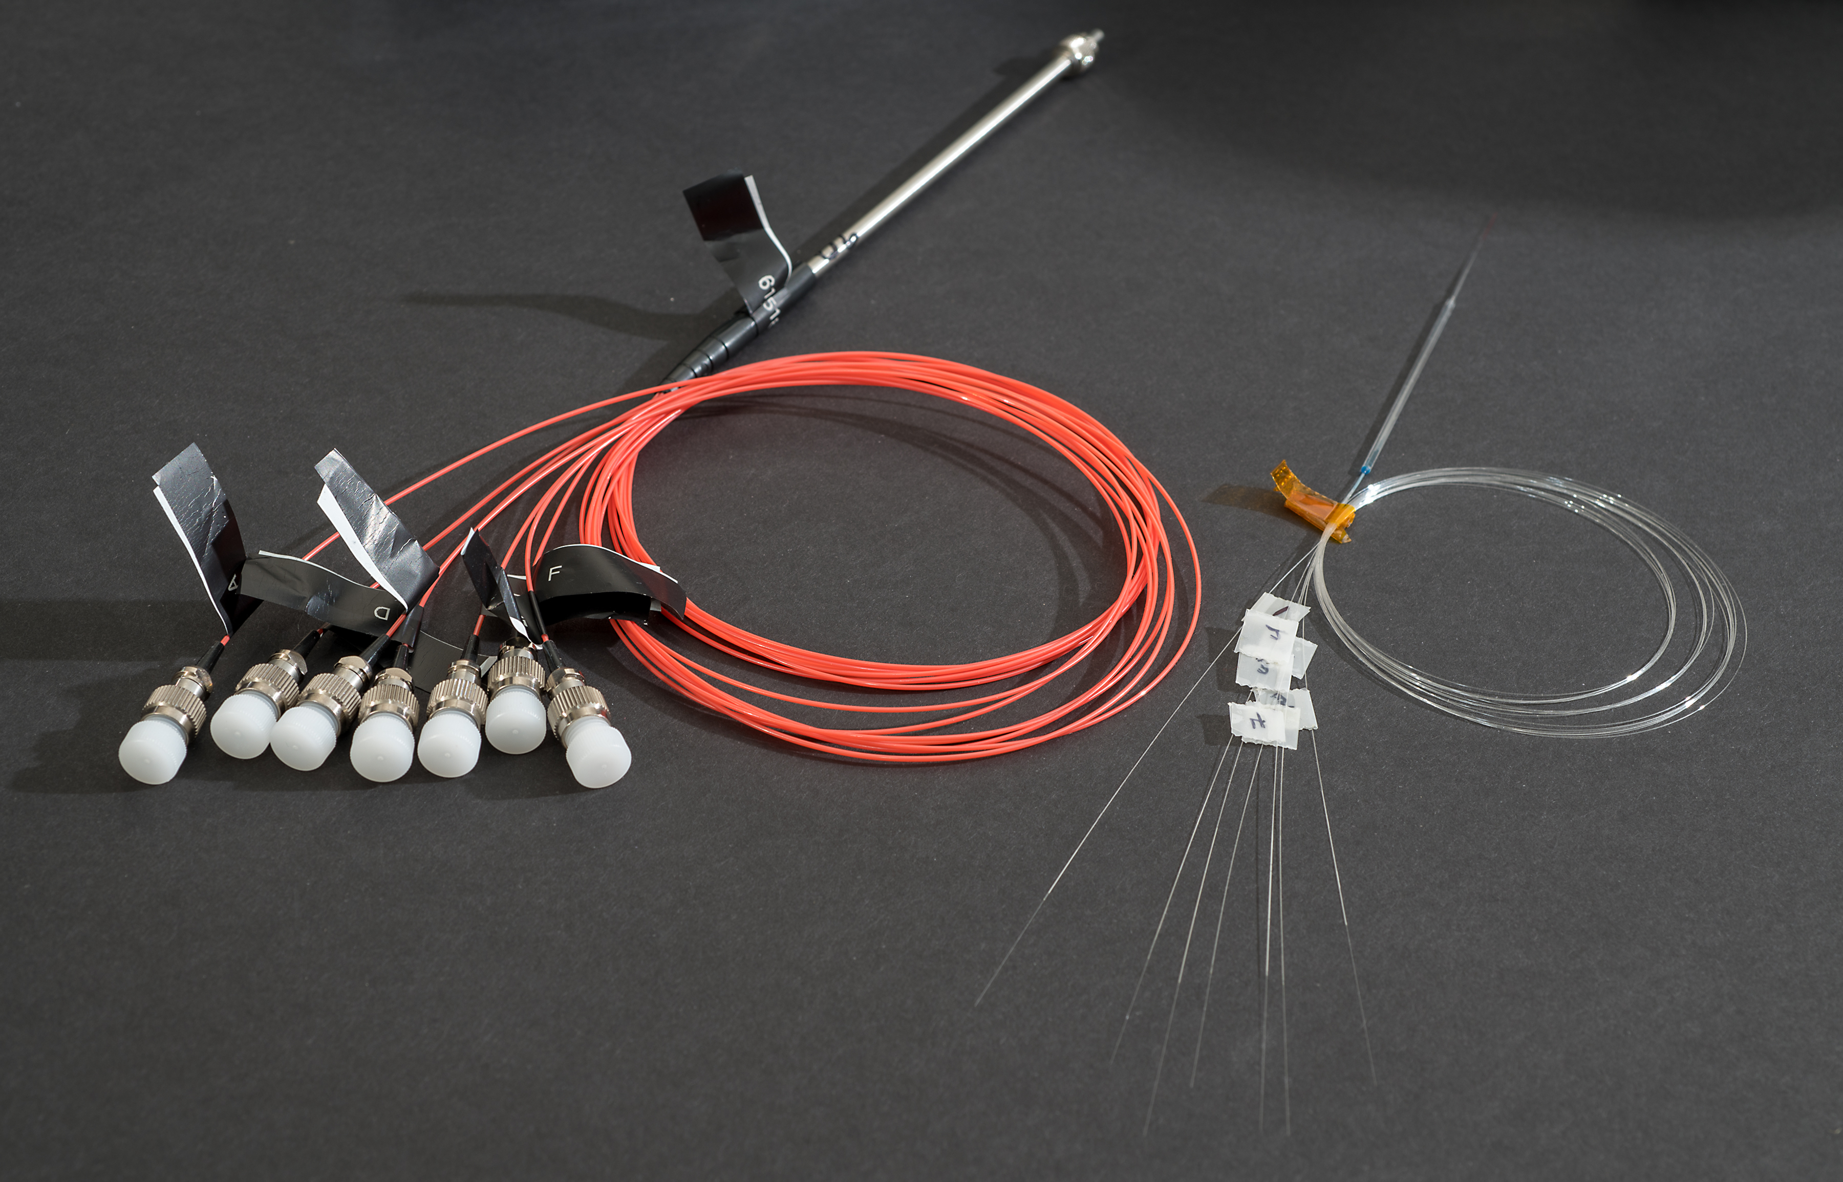
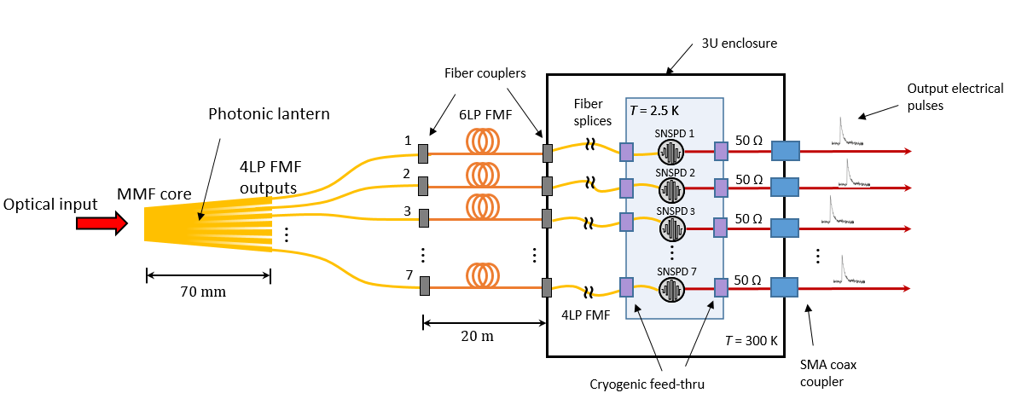
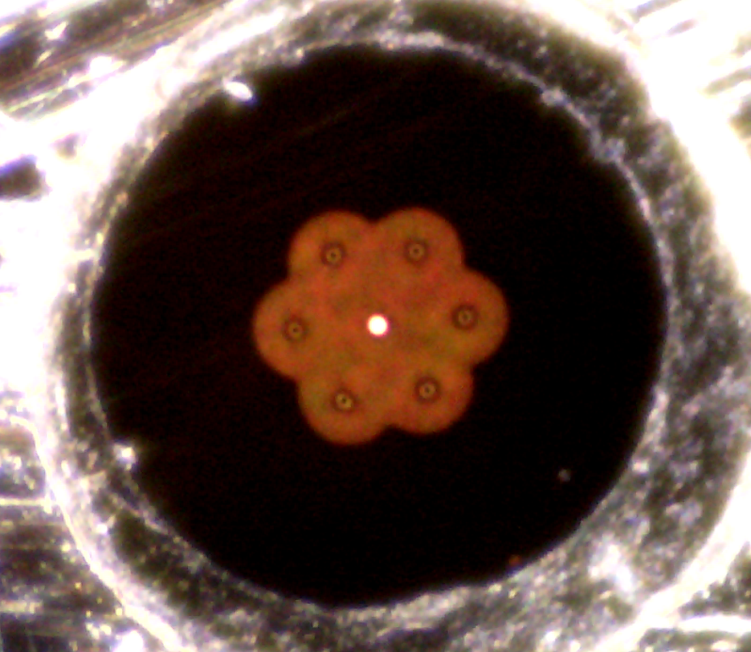
Fiber-Detector Receiver Subsystem
Photonic Lantern:
FMFs:
  20 um graded-index core
  4LP, 6-mode
MMF input:
  55 um
  42 total modes
Fully packaged photonic lantern
Rack-mounted SNSPD cryogenic system
System Diagram
55 um

Slide 7
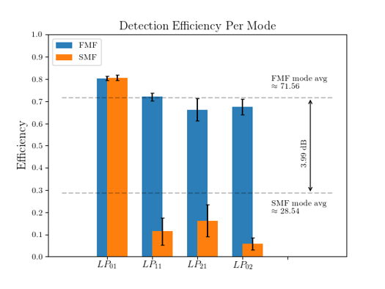
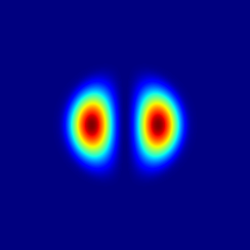
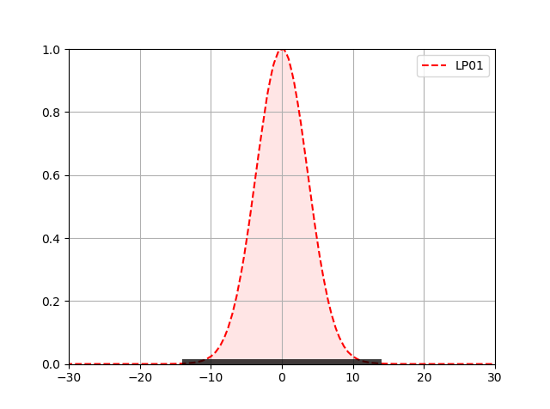
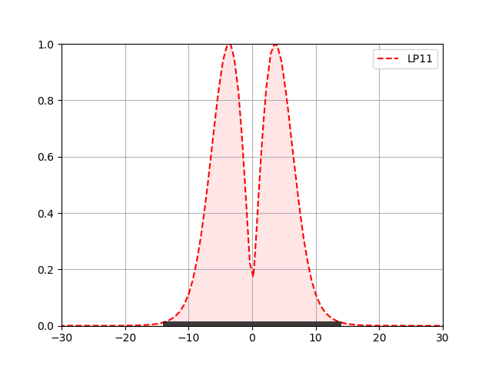

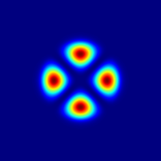
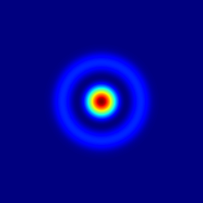
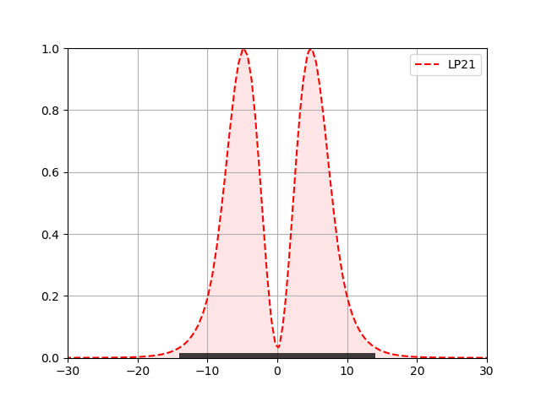
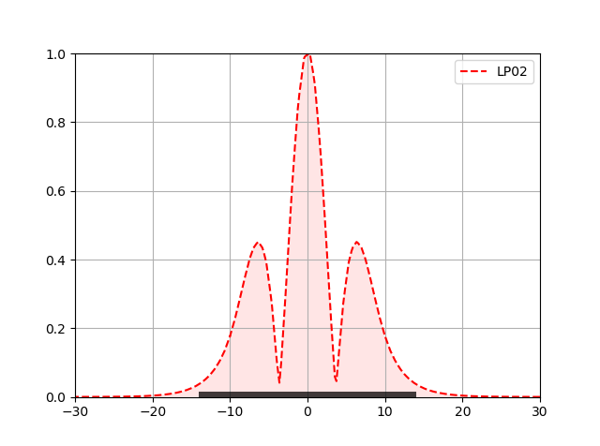
FMF Coupling to Single-Element SNSPDs
14 µm detector
Position (um)
Position (um)
 | LP01 | LP11 | LP21 | LP02
MFD (μm) | 10.30 | 14.67 | 18.43 | 18.86
A_{eff} (μm²) | 83.12 | 168.08 | 235.77 | 185.13
Graded-index 20- μm FMF can couple to ≈ 14x14 μm² SNSPDs with minimal fiber/chip coupling loss. Compared with SMF the additional modes represent a gain of ≈ 4 dB
Detector area ~ 14 x 14 um^2 (196 um^2)

Slide 8
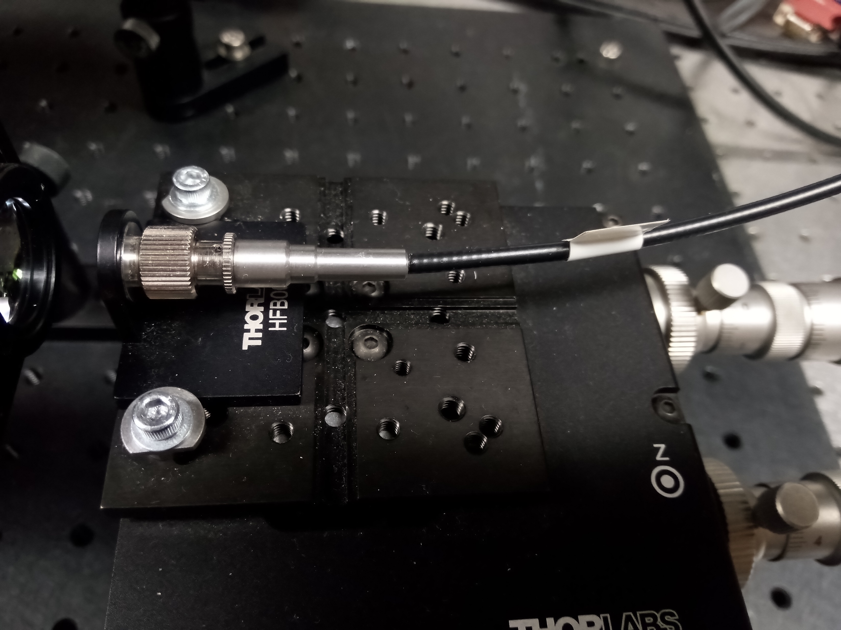
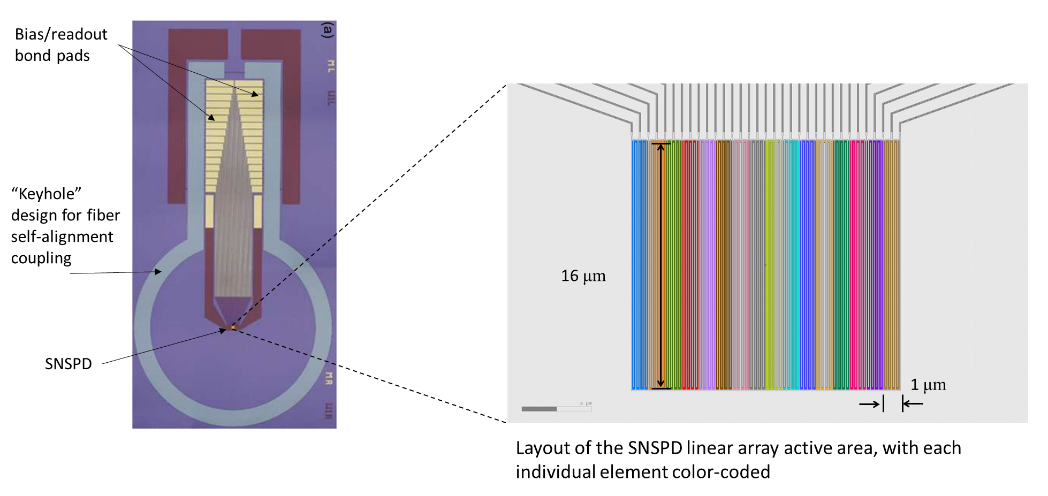
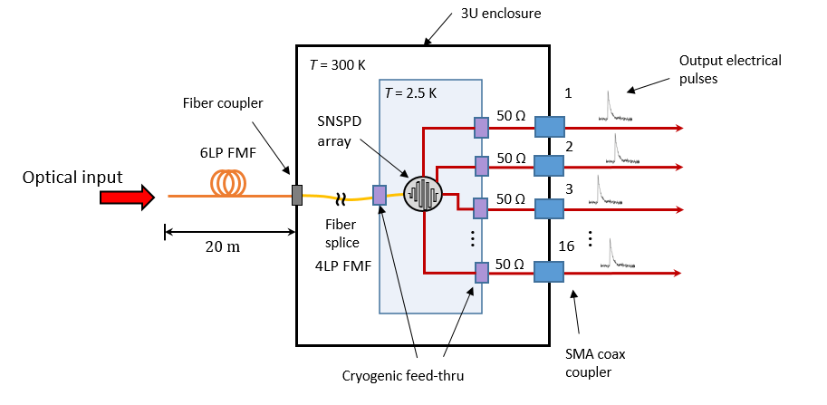
FMF + 16-Channel SNSPD Array
FMF #1 (coupled to SNSPD array):
20 um graded-index core
4 LP, 6-modes
FMF #2 (20 m system input):
25 um graded-index core
6 LP, 10-modes
Detector array layout*
FMF on alignment stage
Rack-mounted SNSPD cryogenic system
System Diagram
*Rambo, T. M., Conover, A. R., and Miller, A. J., “16-element superconducting nanowire single-photon detector for gigahertz counting at 1550-nm," (2021). https://arxiv.org/abs/2103.14086

Slide 9
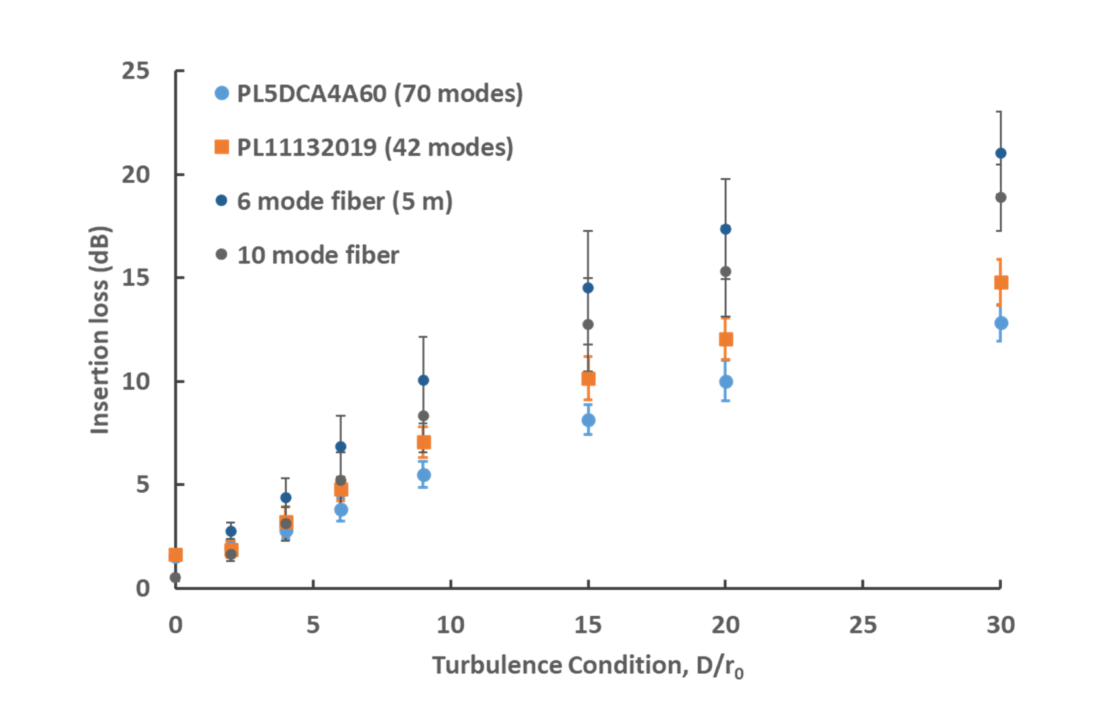
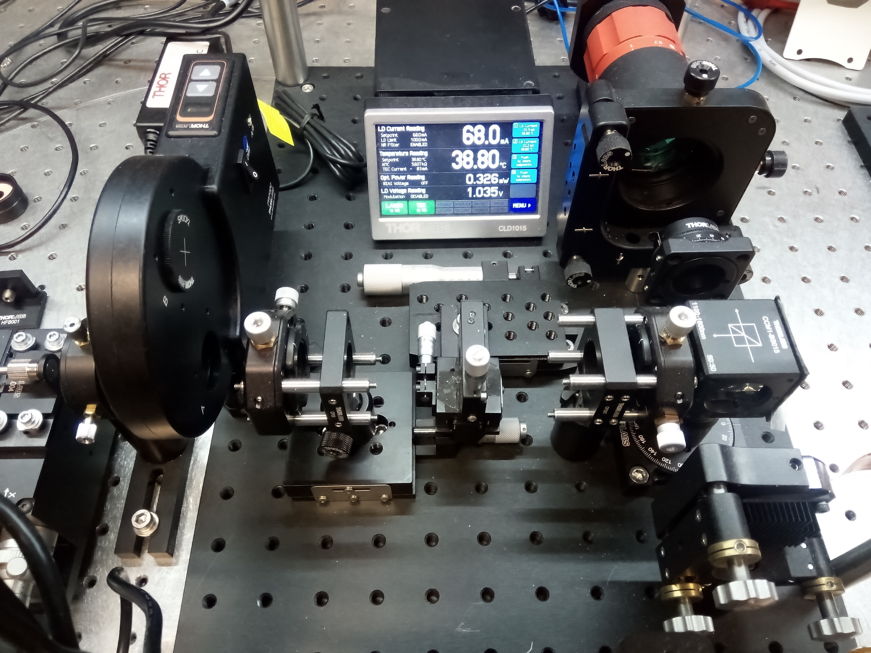
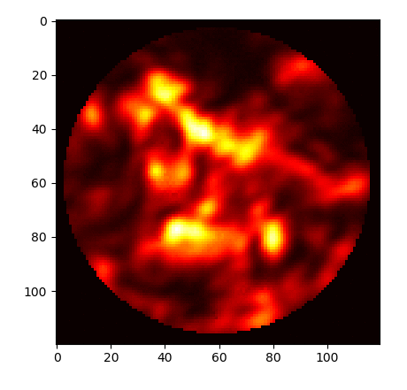
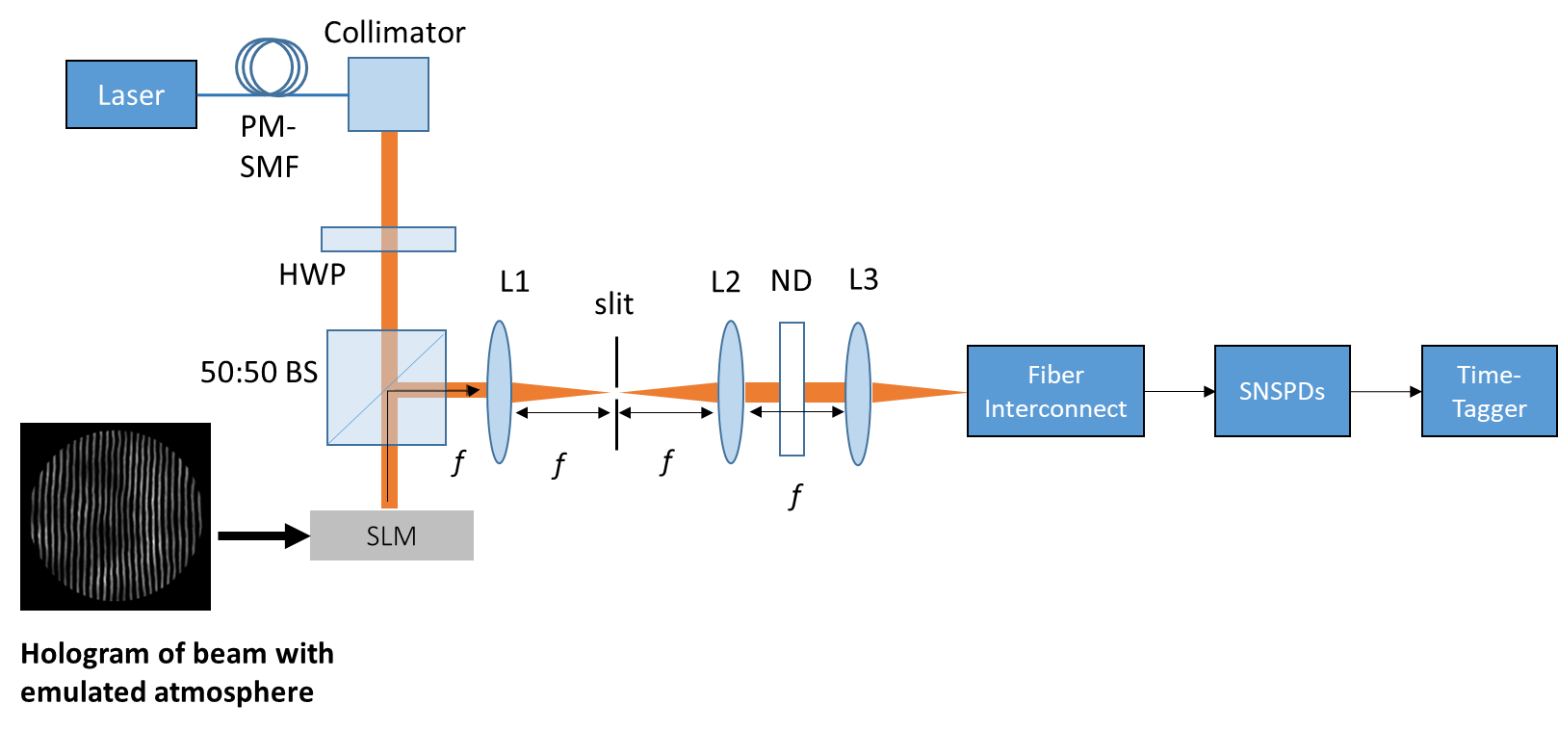
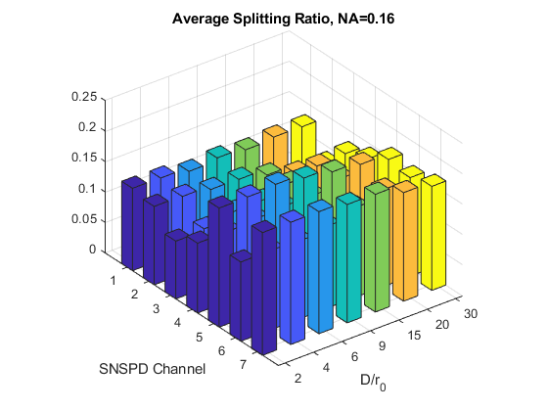
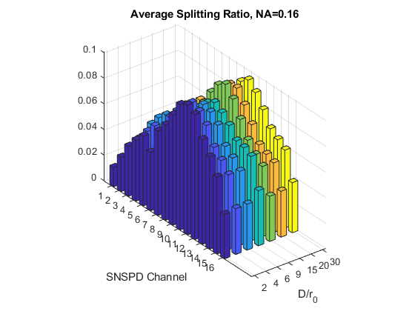
Test Setup With Arbitrary Light Field Generator (ALF-G)
Simulated 2D beam profiles (phase and intensity) are recreated in the lab by modulating the beam via a complex amplitude phase hologram written to the SLM.
42 modes/7 detectors
10 modes/16 detectors
Vary numerical aperture with L3 to measure light distribution on detectors

Slide 10
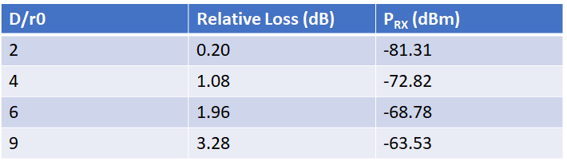
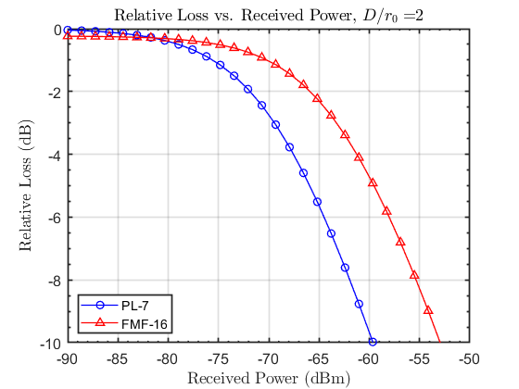
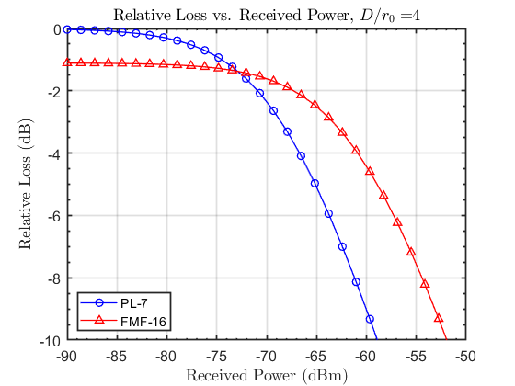
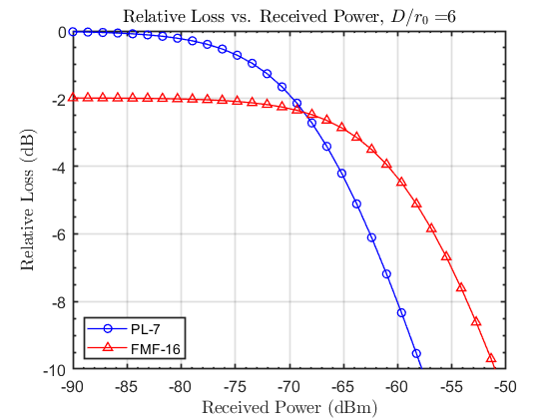
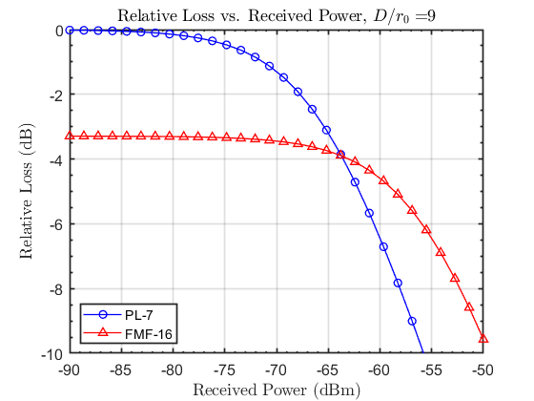
Fiber-Detector Subsystem Loss Comparison
Combined coupling loss, blocking loss, and input distribution effects over a range of input power
FMF/SNSPD array system has more loss at lower received power and higher D/r₀ due to coupling
Photonic lantern/single SNSPDs system has more loss at higher input powers due to detector count rate limitations/blocking loss
There is a cross-over input power where relative coupling loss balances detector blocking losses

Slide 11
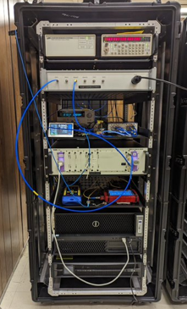
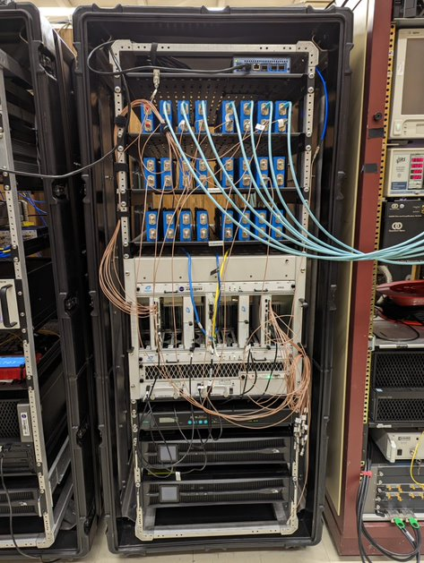
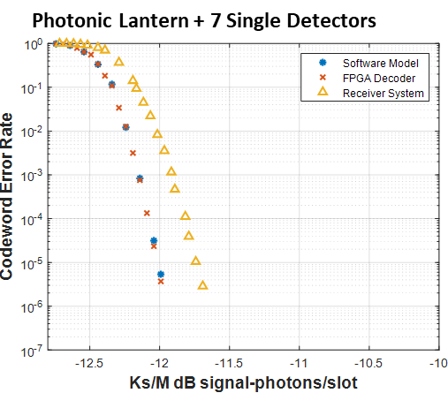
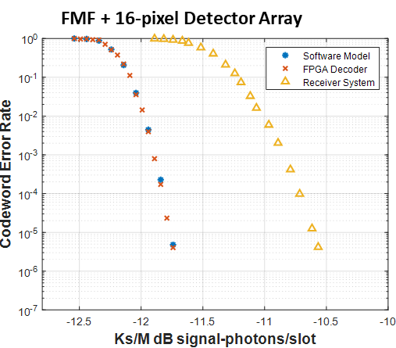
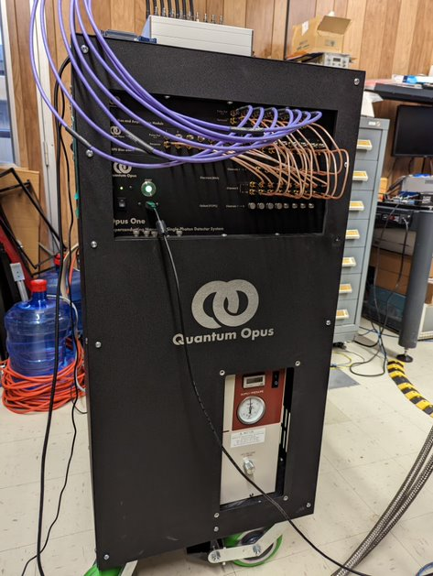
CWER Results – PPM-16, Code Rate 1/2, 200 Mbps
Test transmitter
Receiver
Detector Jitter & FPGA Implementation Loss (dB) |  | Fiber & Detector Loss (dB) |  | Measured K_{b} at 10⁻⁵ CWER (dB photons/slot) |  | Required Input Power at 10⁻⁵ CWER (dBm)
PL | A | PL | A | PL | A | PL | A
0.3 | 1.2 | 9.6 | 3.5 | -24.7 | -20.8 | -68.7 | -73.5
SNSPDs

Slide 12
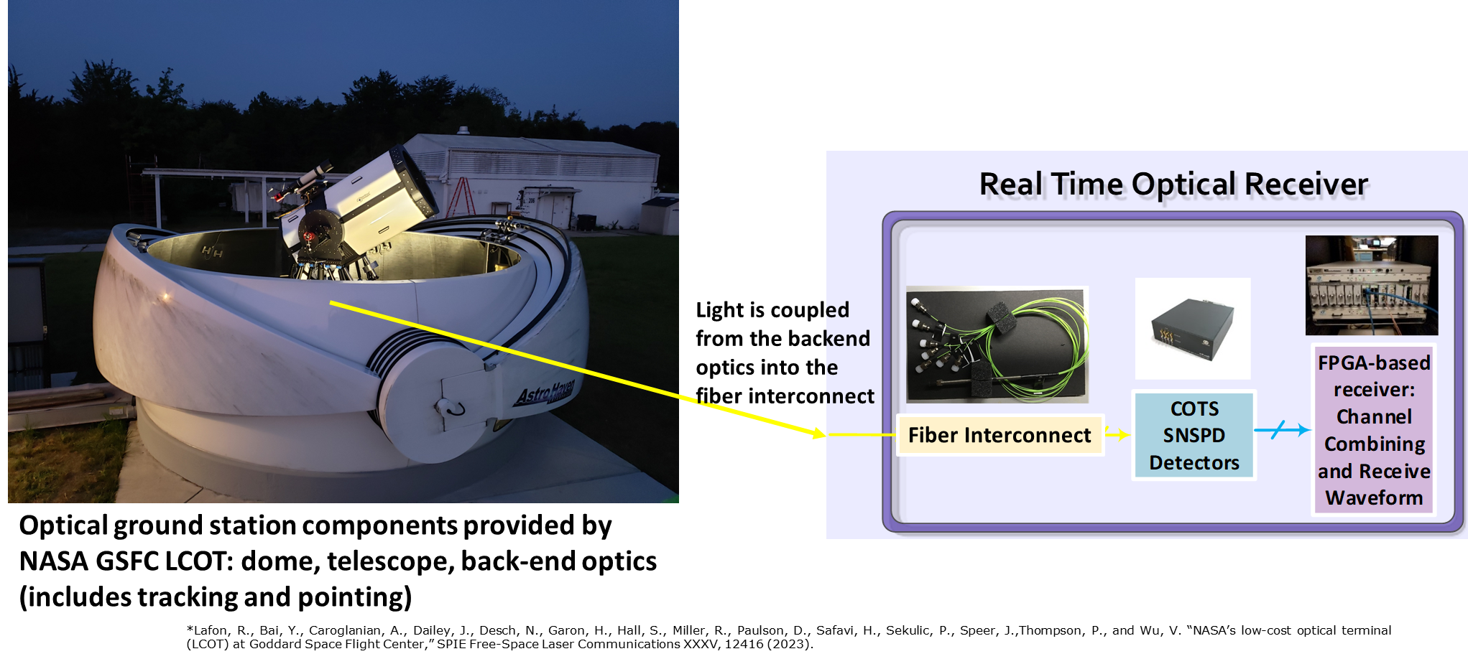
Receiver will be demonstrated at the NASA GSFC Low Cost Optical Terminal*

Slide 13
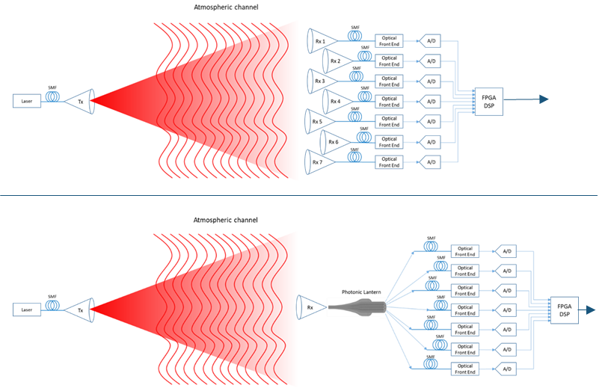
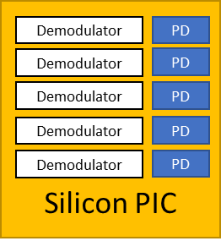
Multi-Gbps Spatial Mode-Diversity Coherent Optical Receivers
Multi-aperture array
Photonic lantern can provide spatial diversity similar to a multi-aperture array, but with considerable savings in SWaP and cost
A silicon photonic integrated circuit (PIC), can couple to the photonic lantern and incorporate on-chip demodulators and high bandwidth photodetectors (10s of GHz)
  Serves as the optical front-end outputting electrical signals for further processing.
  Accommodate many 10s of channels
  Wide variety of other functions such as narrowband filtering, and wavelength multiplexing.
  Can support coherent optical modulations – DPSK, QPSK, dual-polarization, QAM, etc.
Possible to do active signal combining on-chip to reduce output channels to one SMF for processing – currently under investigation
Single-aperture with photonic lantern
Optical front end can be realized on a single PIC chip –
or in combination with optical pre-amp stage

Slide 14
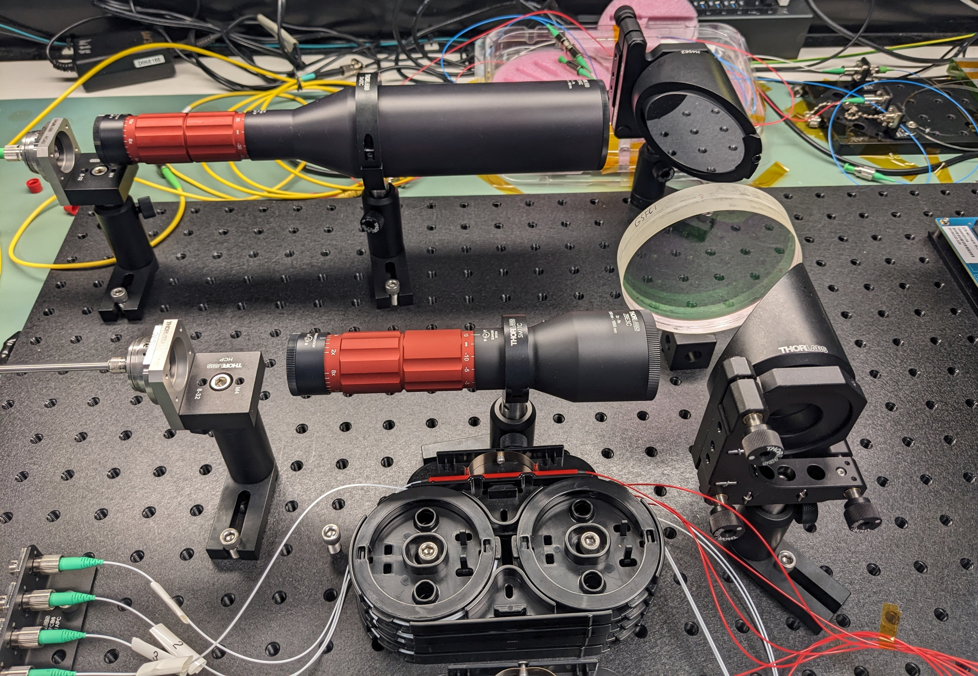
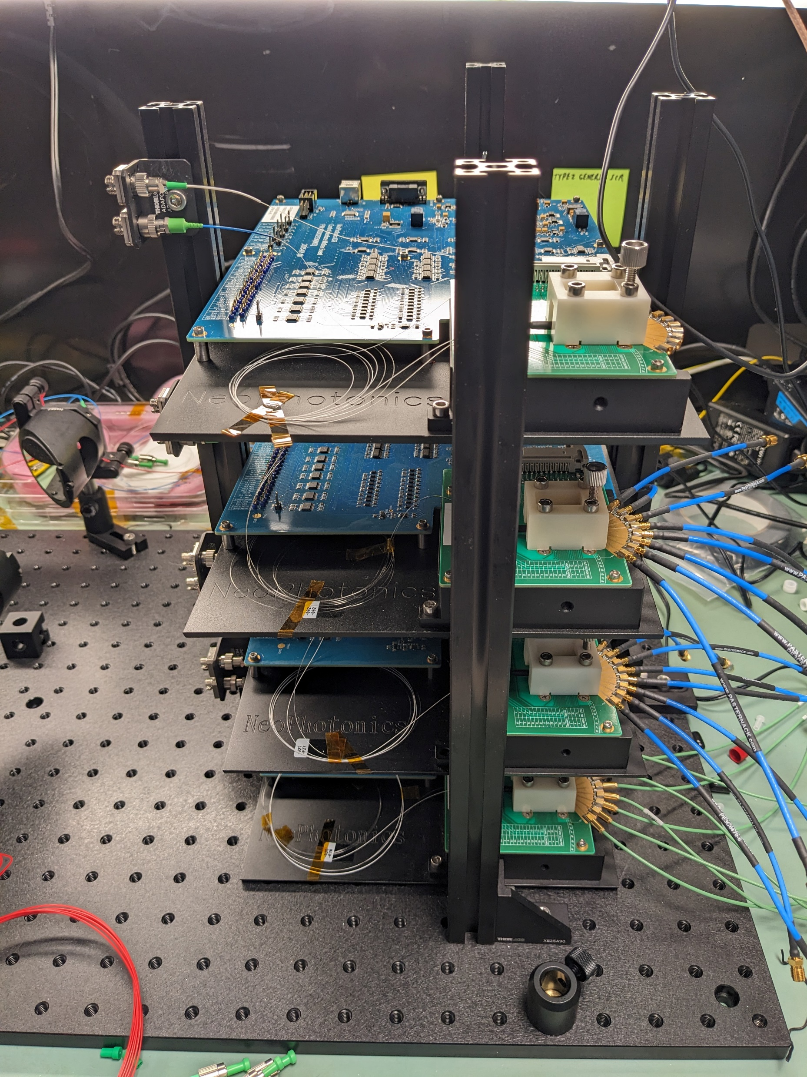
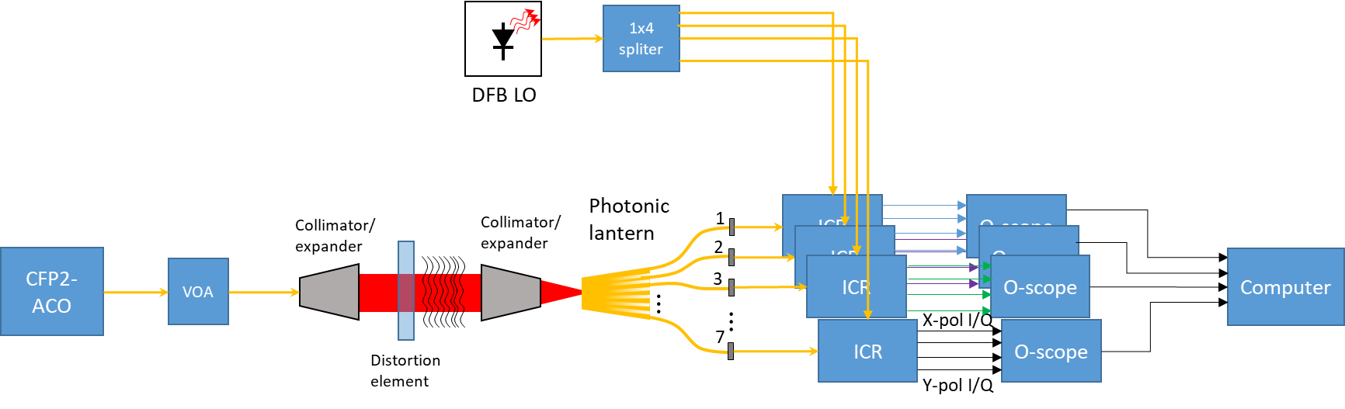

Photonic Lantern Coherent Combining at NASA GSFC*
10 Gbps DP-QPSK transmit signal from CFP2 module
Variable optical attenuator and atmospheric distortion emulator
Four separate integrated coherent receivers (ICR)
DFB local oscillator shared between integrated receivers
High sample rate digitizing oscilloscopes collect X/Y-pol I and Q signals for post processing
Experiments repeated at powers between -3 and -33 dBm
Distortion element
Photonic lantern
Coherent combining test setup
COTS Integrated coherent receiver (ICR) module stack
*Yevick, A., Lafon, R., Bayne, R., Garcia, R., Grigoryan, V.S., and J. Veselka,
“Experimental demonstration of coherent receiver with photonic lantern and digital signal processing”
Multiple sampling oscilloscopes for data collection

Slide 15

GSFC - Recent Coherent Combining Results*
Digital-domain coherent combining
  Optical carrier frequency recovery and equalization
  Optical carrier phase recovery and equalization
  Signal clock recovery
  Signal polarization tracking and polarization demultiplexing
  Time misalignment equalization between PL output legs
  Optimal digital coherent combining of signals from PL output legs to maximize signal SNR
SNR improvement due to optimum coherent combining increases as SNR for best individual leg decreases: SNR improvement reaches ≈ 4dB at Pch = -34dBm
Theoretical maximum ≈ 4.77 dB
Power monitoring each signal will maximize SNR improvement
*Yevick, A., Lafon, R., Bayne, R., Garcia, R., Grigoryan, V.S., and J. Veselka,
“Experimental demonstration of coherent receiver with photonic lantern and digital signal processing”

Slide 16



Photonic Lantern Wavefront Sensing
Photonic lanterns can efficiently couple to single mode fiber (needed for coupling to coherent comm. detectors)
Intensities and phases of the SM outputs have a direct relationship to both phase and amplitude information of the incident wavefront
Replace the wavefront sensor (WFS) – expensive part of adaptive optics (AO) systems
If combined with a photonic integrated circuit, could serve as both light delivery and adaptive optics system through optical coherent combining to greatly reduce size, weight, power, and complexity
Increase optical ground station scalability
Intensity
1
2
3
4
5
6
7
Phase
1x7 SMF photonic lantern input/output measured with wavefront sensor
Light from space

Slide 17

Towards Satellite-Based Quantum Networks
Quantum entanglement distribution over long distances
  Quantum key distribution (QKD)
  Teleportation / entanglement swapping
  Distributed quantum computing
NASA GRC has established the NASA Quantum Metrology Laboratory (NQML):
  Compactified metrology builds: Reduction in system footprints, complexities, and photon losses
  Environmental emulation: Measurement of space-based environmental impacts on quantum processes.
  Verification and validation: Entanglement swapping link analysis (among many other link assessment capabilities)
  Standards for space-based assets: Establishment of definitions consistent with the overall research community
Analysis and testing of quantum communications protocols
Currently investigating use of photonic lanterns, multi-plane light conversion (MPLC) for transmit and receive systems

Slide 18




Integrated Quantum Technologies Under Development
Sources
MgO-doped LiNbO3 spontaneous parametric down-conversion (SPDC) waveguide sources
Silicon photonic spontaneous four-wave mixing (SFWM) bi-photon sources nominally in the 1530-1570 nm wavelength range; also 775 nm, 794 nm, etc.
Thin-film lithium niobate (TFLN) SPDC sources (SBIR/STTR)
Analysis
Bell state analyzer (BSA) with Franson-type interferometry capability for highly-nondegenerate sources, i.e. 1588/794 nm, 1550/775 nm, etc.
Two-photon interference for BSA and entanglement swapping, or thermal source interference
Integrated tunable, high-Q resonant filters
Tunable phase shifters
Detectors
Waveguide integrated SNSPDs
Waveguide integrated SNSPDs
Waveguide SPDC source
Micro-ring resonator SFWM entanglement source
Integrated photonic chips on probe station

Slide 19
Summary
We have developed 1x7 MMF – FMF photonic lantern coupled to superconducting nanowire single photon detectors (SNSPDs) for a spatial-mode diversity photon-counting optical receiver – will demonstrate with the GSFC 70-cm low-cost optical receiver (LCOT)
With optimal coupling, the receiver concept based on a FMF photonic lantern with 7 single-element SNSPDs has lower total losses - data rate and input power dependent, due to detector blocking
Currently investigating applications to coherent optical communications – multiple parallel channels digitally combined
Photonic lanterns can be used for wavefront sensing – can potentially reduce cost and requirements for adaptive optics
Currently investigating use of photonic lanterns, multi-plane light conversion (MPLC) for quantum communications transmit and receive systems
Developing photonic circuit packages for integrated receiver systems

Slide 20
Acknowledgements:
NASA GRC: Sarah Tedder, Jennifer Downey, Bertram Floyd, and Yousef Chahine
NASA GSFC: Aaron Yevick, Robert Lafon, Vladimir Grigoryan, and John Veselka
NASA GRC Communications and Intelligent Systems Division
NASA Space Communications and Navigation (SCaN) Program

