Slide 1


NASA ECLSS Technology Overview
University of Houston
Human Systems Integration Seminar - 6201
11/8/2023
Jim Broyan – HQ / ECLSS-CHP SCLT Lead
(Environmental Control and Life Support Systems –
Crew Health and Performance)

Slide 2
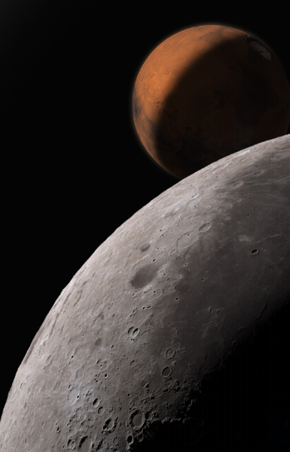
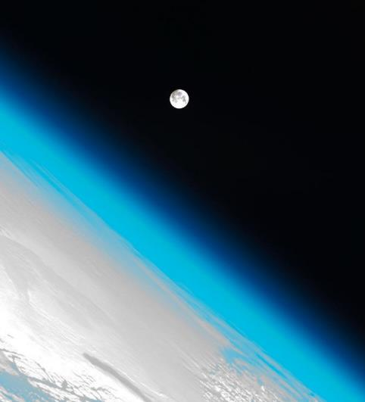

Agenda
Open loop ECLSS for 4 Crew on round trip Mars mission (860 days) requires:
~16,500 kg water
~3,300 kg oxygen
~ 6,000 kg food (at 50% hydration)
Does not include tankage, packaging and structure
ECLSS-CHP Overview
  Capability area gaps
  Capability area overview (SOA and envisioned futures)
ISS ECLSS Overview
Mars ECLSS Evolution
Architecture and ECLSS-CHP Interactions
ECLSS Capability Area Summaries
  Life Support
  Environmental Monitoring
  Fire Safety
  Logistics Reduction
CHP Capability Area Summaries
  Spacesuit Physiology
  Crew Health Countermeasures
  Radiation Protection
  Exploration Medical
  Food & Nutrition
Backup
  NASA Architecture Definition Document
  References
  Acronyms
  ECLSS = Environmental Control and Life Support Systems
  CHP = Crew Health and Performance
  SCLT = System Capability Leadership Team
Note at bottom of page indicates original information source – investigate for more details

Slide 3









ECLSS-CHP Capability Areas
Broadly characterized into vehicle Environmental Control and Life Support Systems (ECLSS) and Crew Health and Performance (CHP) Capability Areas (ECLSS-CHP)
Capabilities keep astronauts healthy and productive while living in space and planetary vehicles
4 ECLSS Capability Areas
Capabilities
6 CHP Capability
Areas
Capabilities
ECLSS-CHP – Primary Capabilities
LIFE SUPPORT
    Atmosphere Management
    Water Management
    Waste Management
ENVIRONMENTAL
MONITORING
FIRE SAFETY
    Detection
    Protection
    Suppression
    Cleanup
  LOGISTICS
    Tracking
    Relocating
    Clothing
    Trash
Pressure
Moisture
Particles
Microbes
Chemicals
Sound
Enable long duration human exploration missions with Hab Sys technologies
ENVIRONMENTAL CONTROL AND LIFE SUPPORT SYSTEMS (ECLSS)
  SPACESUIT PHYSIOLOGY
  Suited Physiology & Performance
  Bioinformatics & Decision Support
  Fit & Injury Risk Mitigation
  Atmosphere/Pre-breathe
CREW HEALTH COUNTERMEASURES
Exercise Systems
Sensorimotor
Physiology Monitoring
Informatics
RADIATION PROTECTION
Space Weather Forecasting
Monitoring
Shielding
Health Risk Models
Biomedical CM
EXPLORATION MEDICAL
Diagnostic
Treatment
Imaging
Pharmacy
FOOD & NUTRITION
Pre-packaged
Food Resources
Dietary Tracking
Health &
Perform-
ance
HUMAN SYSTEM INTEGRATION
Earth independent diagnostics & repair
CREW HEALTH AND PERFORMANCE (CHP) SYSTEMS
Broyan, J. L., McKinley, M., Stambaugh, I., Ruff, G.A., Owens, A. C., ‘NASA Environmental Control and Life Support Technology Development and Maturation for Exploration: 2021 to 2022 Overview,’ 51st International Conference on Environmental Systems, St. Paul, Minnesota, ICES-2022-281, July 10-14, 2022

Slide 4


Capability Gaps
The ability to meet an exploration objective through Architecture, Engineering, Development, Technology, Operations or Research for a given set of constraints and level of risk.
CAPABILITY
Current Capabilities (state of the art)
THE DIFFERENCE IS THE
Future Needed Capabilities (Envisioned Future)
Capabilities we have today, supporting or available for human or robotic missions….
Anticipated future capabilities based on future mission architectures and
agency strategic planning
GAP
Abercromby, F.J., et. al., NASA Crew Health & Performance Capability Development for Exploration: 2022-2023 Overview - 52nd International Conference on Environmental Systems, ICES-2023-255, July 16-20, 2023

Slide 5

Advanced ECLSS-CHP State-of-the-Art by Capability Area
LIFE SUPPORT
ENVIRONMENTAL
MONITORING
FIRE SAFETY
  LOGISTICS
ISS life support demonstrations have identified required system reliability issues – fixes in work
  ~21,700 kg spares + food, 4 crew x 860days x Probability of Sufficiency (POS)=0.99
  Resupply every 2-6 months
  Nearly uninterrupted use of wetted systems
  ~47% oxygen recovery at 2 mm-Hg CO₂
  No in-flight EVA oxygen recharge capability
  ~93% water recovery
  HEPA filters require frequent manual cleaning
Detailed gas/water chemical, microbial identification, and particle analysis only with samples returned to ground
Major air constituents & limited targeted trace gases in flight
Water analysis limited to total organic carbon
Culture based microbial sample return, DNA sequencing limited to surface microbes
Limited particle measurement capability demonstrated
Mass intensive passive acoustic adsorption/damping
Partial understanding of large ug fire propagation and properties
Very limited knowledge of partial gravity fire properties
Obsolete monitoring
Cleanup by depress/repress
Limited mask emergency response
CO₂ based fire extinguishers
Manual trash compaction, short storage time, module level jettison only
No planetary protection compliance for waste disposal
Manual & limited In-flight autonomous logistics tracking
Disposable & flammable clothing, towels, & wipes
  SPACESUIT PHYSIOLOGY
COUNTER-MEASURES
RADIATION PROTECTION
EXPLORATION MEDICAL
FOOD & NUTRITION
EARTH INDEPENDENT HUMAN OPERATION
Physiological inputs/outputs adequately known for ISS EVA only
Limited informatics; primarily ground-monitored
Ground, ISS, and Apollo suit injuries occur (27 injury mechanisms identified)
Prebreathe protocols for 14.7 and 10.2 psia microgravity only
3+ large devices, large mass
Returning crew egress from landing vehicle requires ground team assistance
Exercise planning and monitoring via ground
Limited sensorimotor countermeasures
Mature shielding design tools
Reconfigurable SPE shielding & limited GCR shielding
Crew radiation monitoring
Short term space weather using earth centric assets
Evacuate <8 hrs
Resupply 2-3 months
Limited in-mission diagnostic, treatment
Ground medical data & decision support systems
~1.5 year shelf life, fresh food resupply every 2-3 months
Only ~215 standard food items, μg plant experiments
~47% launched water content
In-mission nutrient intake monitoring in development
Minimal on-board crew decision support
Near real time communication and control from Earth
Minimal automatic emergency responses
Unplanned repair/stabilization developed by ground control
Broyan, J. Advanced Habitation Systems (AHS) Overview, STMD Game Changing Division, Annual Program Review, San Antonio, TX 9/19/2023 (with minor mods)

Slide 6
(Mission need)
L = Lunar surface
T = Transit to Mars
M = Mars surface
ECLSS-CHP Envisioned Future (goals) by Capability Area
LIFE SUPPORT
ENVIRONMENTAL
MONITORING
FIRE SAFETY
  LOGISTICS
Reliable long-duration life support with Earth independent diagnostics and repair (L,T,M)
  >20% reduction in spares and installed mass (T)
  Enable single missions >800 days w/o resupply (T)
  Repeated missions with >9 months dormancy (L,T,M)
  >75% oxygen recovery at 2 mm-Hg CO₂ (T)
  High pressure oxygen recharge for EVA (L,M)
  >98% water recovery (L,T,M)
  Remove respirable lunar and Mars dust (L,M)
  Planetary protection compatible ECLSS venting (M)
Identify and quantify chemical (>12 water, >33 air) and microbial species in-mission with out sample return (L,T,M)
Ability to detect unknown constituents (T,M)
Distinguish between fire, habitat dust, and surface dust particles (L,M)
Support forward and backward planetary protection detection (both microbial and non-DNA techniques) (M)
Test-verified partial gravity flammability characteristics and countermeasures (L,M)
ECLSS compatible fire suppression (L,T,M)
Reduce post fire clean-up time (L,T,M)
Common fire safety strategy across element architectures (L,T,M)
Jettison >90% of trash mass during Mars transit (T)
Mars trash disposal compatible with planetary protection (M)
In-flight autonomous logistics (L,T,M)
Reducing clothing and wipes mass by >50% (L,T,M)
Clothing flammability (and other non-metallics) >36% O2 (L,M)
  SPACESUIT PHYSIOLOGY
COUNTER-MEASURES
RADIATION PROTECTION
EXPLORATION MEDICAL
FOOD & NUTRITION
EARTH INDEPENDENT HUMAN OPERATION
100% of tasks within human performance (L,T,M)
Predict and mitigate decompression sickness for surface EVA (L,M)
Predict and mitigate suited injury (L,M)
6 Major physiological informatics parameters provided in-suit to enable real time self-assessment or loss of communication areas (L,M)
Reduce mass and volume (L,T,M)
Maintain/monitor fitness in-flight to enable unassisted landing egress & EVA (L,T,M)
Validated lunar and Mars fitness standards (L,M)
24-hr prediction of solar storm duration and intensity to >90% (L,T,M)
High energy neutron detectors (L,T,M)
Earth independent monitoring/forecasting (T,M)
GCR shielding (T,M)
In-mission diagnostics and treatment for 100 of 120 medical risk conditions (L,T,M)
Autonomous medical
skill and & decision
support systems (T, M)
Integrated data architecture (L,T,M)
100% of nutrient stability
>5-year shelf life (T,M)
Food acceptability >90% (L,T,M)
<30% launched water content (T,M)
Exploration counter-measure in-mission nutrition intake monitoring (L,T,M)
Crew decision support systems (L, T, M)
Asynchronous communication and control systems (L, T, M)
Autonomous response to time to effect emergency
<40 min (T,M)
Autonomous critical unplanned repair/stabilization <20 days (T,M)
Broyan, J. Advanced Habitation Systems (AHS) Overview, STMD Game Changing Division, Annual Program Review, San Antonio, TX 9/19/2023 (with minor mods)

Slide 7
ISS ECLSS Overview

Slide 8
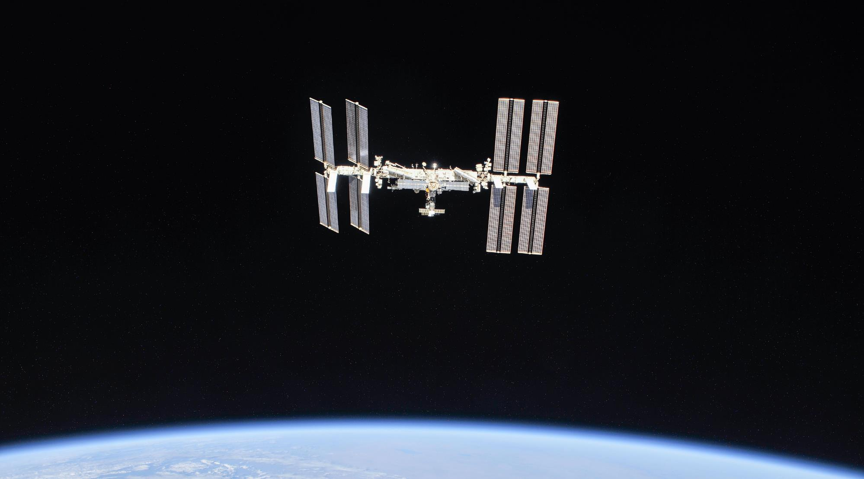
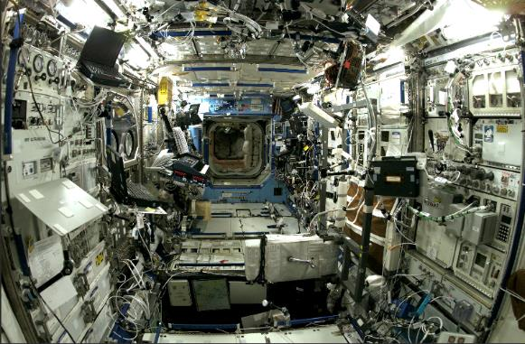
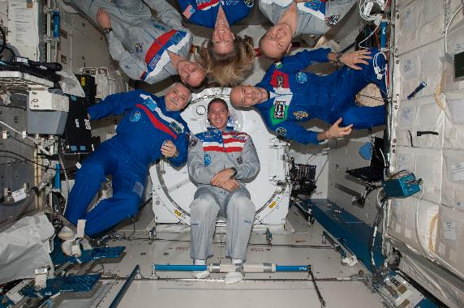

The International Space Station is a unique place…
A microgravity laboratory
Home to an international crew of 6+ people for 25 years
Traveling at a speed of 5 miles per second
Orbiting Earth every 90 minutes
nasa.gov/station
International Space Station Facts and Figures - NASA
Notes:
iss056e201352 (Oct. 4, 2018) --- The International Space Station photographed by Expedition 56 crew members from a Soyuz spacecraft after undocking. NASA astronauts Andrew Feustel and Ricky Arnold and Roscosmos cosmonaut Oleg Artemyev executed a fly around of the orbiting laboratory to take pictures of the station before returning home after spending 197 days in space. The station will celebrate the 20th anniversary of the launch of the first element Zarya in November 2018. Credit: NASA/Roscosmos
Expedition 37 in-flight photo. NASA photo.

Slide 9
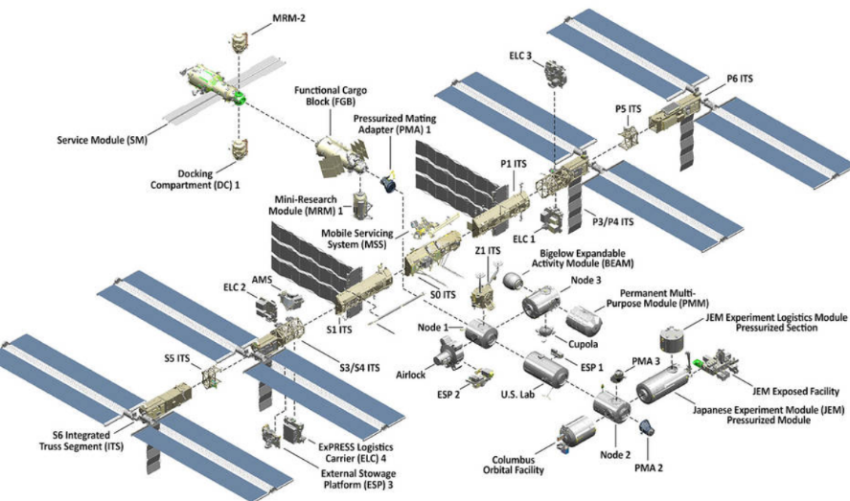
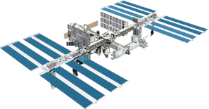
The International Space Station: Facts & Figures
The space station was built in orbit over 41 assembly flights between 1998 and 2011.
There have been 220+ successful launches to ISS to date to deliver crews, supplies, and science.
Internal volume of 32,333 cubic feet about the size of a 6-bedroom house
Powered by 262,400 solar cells housed on 38,400 square feet of solar arrays
240 ft long
45 ft high
Travels approximately 250 miles above the Earth at 17,500 mph
Orbits Earth 16 times per day
350 ft wide
Orbital path covers 90% of Earth’s population
3.3 million lines of code on the ground support 1.8 million lines of flight code
nasa.gov/station
Notes:
Assembly photo is from NASA website. Oct 2019 version.
https://www.nasa.gov/feature/facts-and-figures

Slide 10
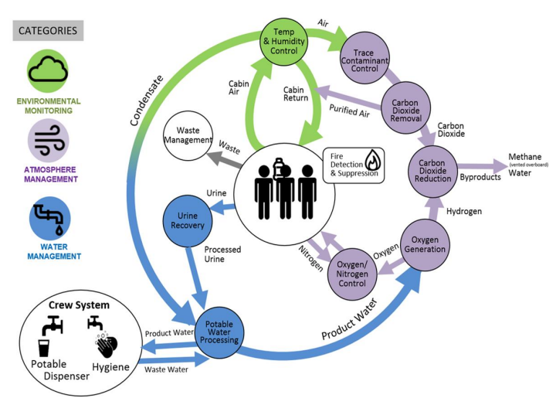
Basic ISS ECLSS Recycling – Material Flow
Schneider, W., et. al., NASA Environmental Control and Life Support Technology Development for Exploration: 2022-2023 Status - 52nd International Conference on Environmental Systems, ICES-2023-312, July 16-20, 2023

Slide 11
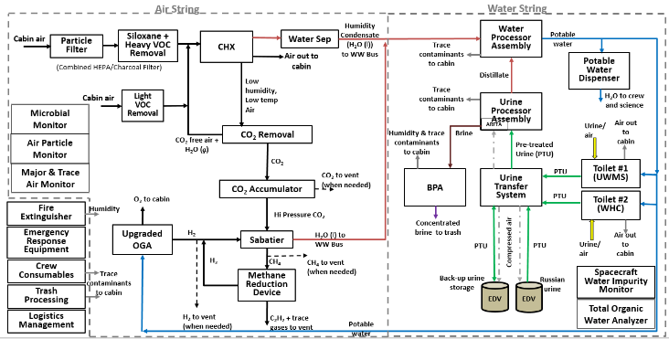
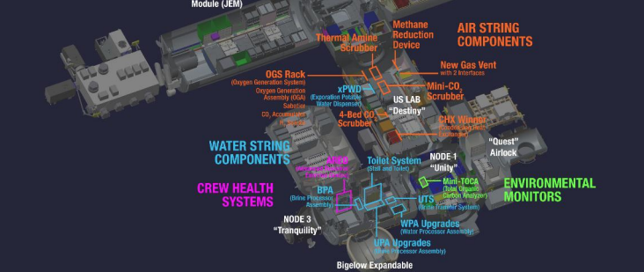
ISS ECLSS Recycling – Requires Many Integrated Systems
1
Crew Quarters (4)
2
Broyan, J. L., McKinley, M., Stambaugh, I., Ruff, G.A., Owens, A. C., ‘NASA Environmental Control and Life Support Technology Development and Maturation for Exploration: 2021 to 2022 Overview,’ 51st International Conference on Environmental Systems, St. Paul, Minnesota, ICES-2022-281, July 10-14, 2022
Ridley, A.H., et. al., International Space Station as a Testbed for Exploration Environmental Control and Life Support Systems – 2023 Status, - 52nd International Conference on Environmental Systems, ICES-2023-259, July 16-20, 2023

Slide 12
ISS ECLSS Recycling – Lots of Processes and Challenges
1
Chemical processes include
Adsorption
Absorption
Thermo-catalytic reactions
Chemical deposition
Redox reactions
Electrolysis
Precipitation
UV oxidation
Crew Quarters (4)
Long term system operation is challenging
Troubleshooting supported by ground mission control and large number of system matter experts
Components wear out and must be resupplied regularly from Earth
Microgravity can cause fluids to migrate to unexpected locations
Trace air and water contaminants buildup and change hydrophilic and hydrophobic surfaces and degrade chemical catalysts and membranes
Microbial control without the strong chemicals and large amounts of water used on Earth can cause biofouling
2
Physical processes include
Flow distribution
Filtration
Heating and cooling of materials
Low temperature-pressure boiling
Centrifugal gas-liquid separation
Membrane gas-gas and gas-liquid separation
Precise chemical additions
Microbubble gas introduction
Controlled venting to space
Broyan, J. L., McKinley, M., Stambaugh, I., Ruff, G.A., Owens, A. C., ‘NASA Environmental Control and Life Support Technology Development and Maturation for Exploration: 2021 to 2022 Overview,’ 51st International Conference on Environmental Systems, St. Paul, Minnesota, ICES-2022-281, July 10-14, 2022
Ridley, A.H., et. al., International Space Station as a Testbed for Exploration Environmental Control and Life Support Systems – 2023 Status, - 52nd International Conference on Environmental Systems, ICES-2023-259, July 16-20, 2023

Slide 13
Mars ECLSS Evolution

Slide 14
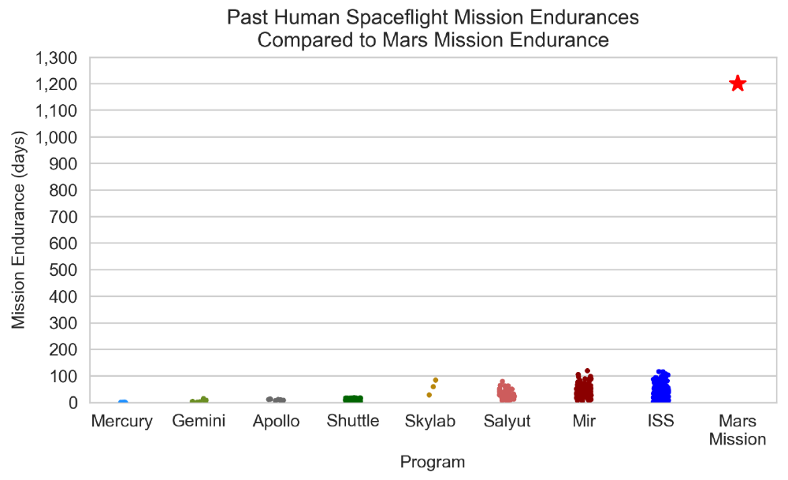
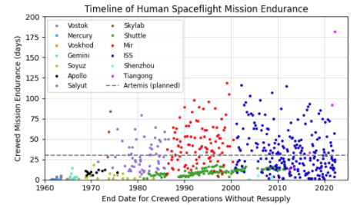
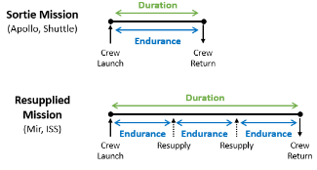
Mission Endurance - Strong Influence on Technology Development
Mars missions require unprecedented endurance
Short mission durations have not
occurred since Apollo
ISS Commercial Crew – ~8-36 hours ug
  SpaceX & Boeing proprietary
Human Landing System - ~10 days ug+
7-30 days lunar surface
Test Verified Reliablity will be critical
Endurance (crewed time between resupply) will be an order of magnitude greater challenge for crewed Mars missions
Absence of logistics resupply opportunities and an extremely limited abort capability drives the need for an updated logistics strategy to ensure a high level of crew safety
Mars missions:
750-1,200 days without logistics resupply, with potential for dormancy at Mars
Artemis/Gateway:
~30 crewed days without logistics resupply, ~330 days of dormancy between missions
Maximum previous on-orbit experience:
up to 119 days without logistics resupply
Dormancy
Each dot represents a time period where a crew remained in space between launch/landing or a new vehicle arrival at stations. Includes missions up to November 19, 2018.
1-Owens, A. C, Cirillo, W. M., Stromgren, C., Cho, J., Lynch, C., Vega, J. M. Integrated Logistics and Supportability Challenges of Sustained Human Lunar Exploration’ 51st International Conference on Environmental Systems, St. Paul, Minnesota, ICES-2022-90, July 10-14, 2022
2-Owens, A. C. Multiobjective Optimization of Crewed Spacecraft Supportability Strategies. Doctoral Thesis. Massachusetts Institute of Technology, Cambridge, MA, 2019.

Slide 15
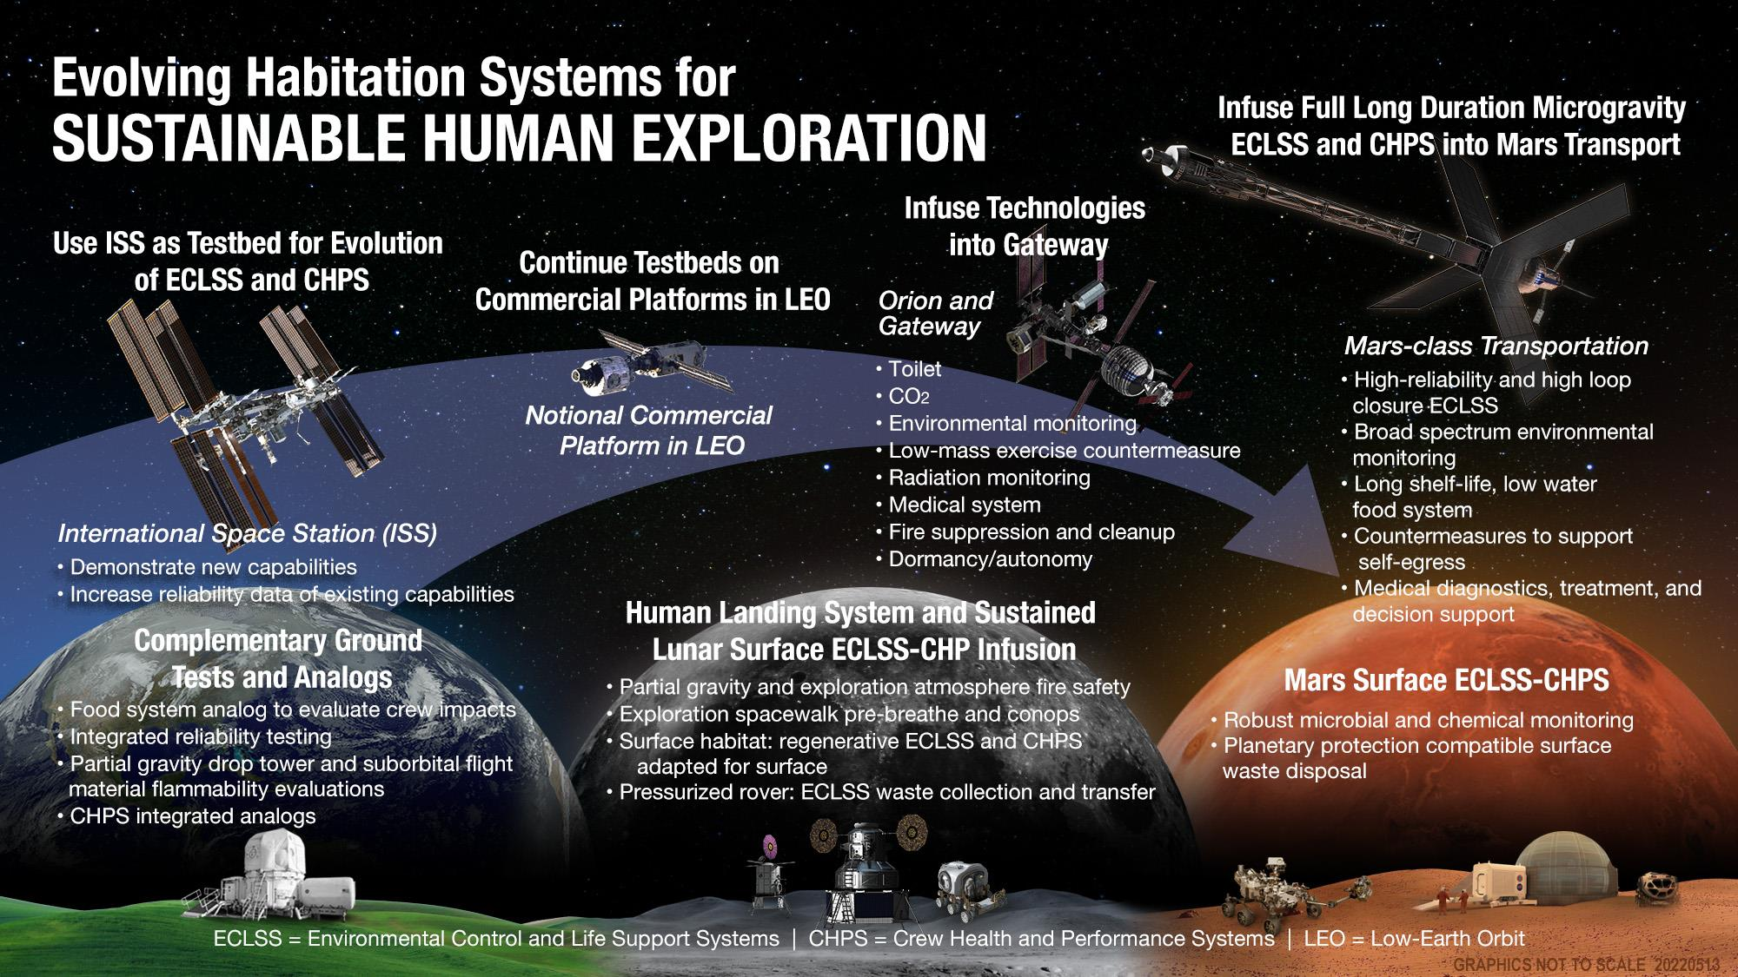
Broyan, J. L., et. al. , ‘NASA Environmental Control and Life Support Technology Development and Maturation for Exploration: 2020 to 2021,’ 5oth International Conference on Environmental Systems, Virtual, ICES-2021-384, July 12-15, 2021

Slide 16
Example of a High-Level Notional Technology Development Roadmap for Crop Research Support for Food & Nutrition
Determine food architecture composition of pre-packaged, cold stored, in-flight produced food architecture for Mars transit missions
Determine crop/food architecture for long duration surface lunar missions
Determine alignment to advanced manufacturing architecture
Food Architecture development
1
Mars Food Validation
CHAPEA – Food Analog Tests
Food formulation/processing/packaging/storage tests
Reduced water content food development
Note: Technology roadmaps are not yet formalized and will be updated in 2024 to align with updated NASA Architecture Definition Document
HRP Food Physiology studies
Mars food system
SynBio – Bionutrients tech demos
DT&E
Crop Production Development
Mars transit crop facility hwd dev
BPS/HRP μgreens, Veggie, Space tomatoes
Salad crop, rootzone, legume evals
Ohalo/ROSBio – crop production hwd dev
2
Tech demo validation
Lunar surface food system
Regolith screening weathering, conditioning, partial-g research for crops
Hardware design & assy
Lunar surface crop production
Related Development
CUBES STRI – mfg/crops
CUBES maturation
3
SynBio – CO2 based mfg
CO2 based mfg maturation
DT&E
Lunar surface infusion
16
Broyan, J. Advanced Habitation Systems (AHS) Overview, STMD Game Changing Division, Annual Program Review, San Antonio, TX 9/19/2023

Slide 17
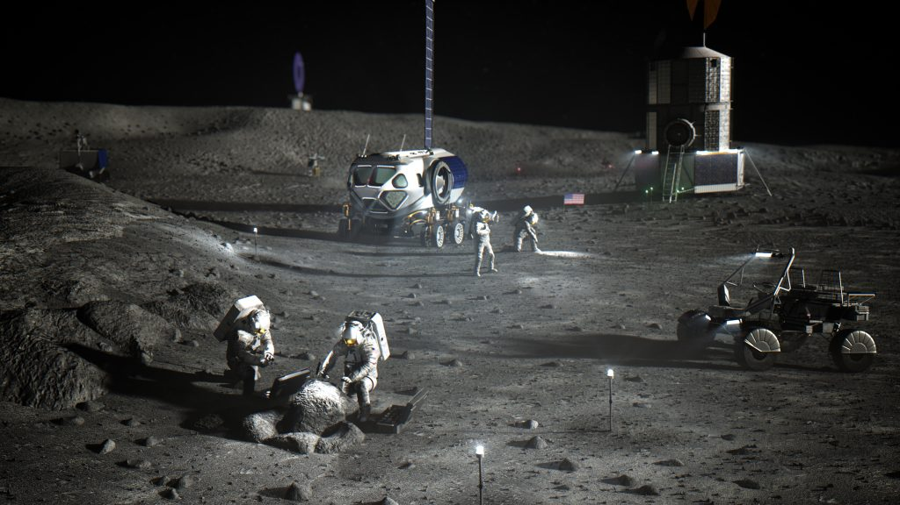
Architecture and ECLSS Interactions

Slide 18
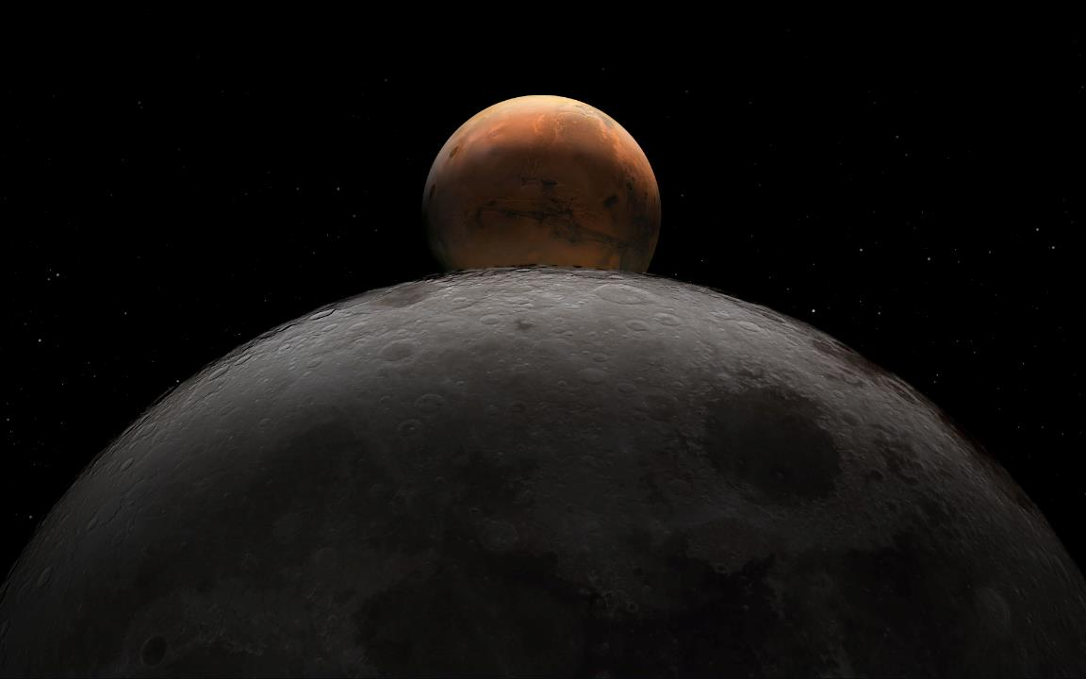
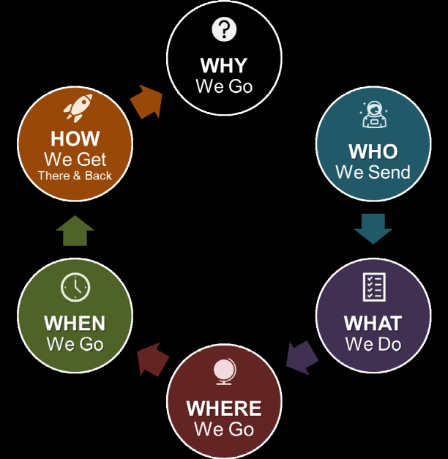
Capabilities Alignment to NASA’s M2M ADD
NASA released 63 blueprint objectives in May 2022 (Transportation-Habitation, Lunar and Mars Infrastructure, Operations, and Science)
NASA released the initial Moon to Mars (M2M) Architecture Definition Document (ADD) in April 2023
  Foster transparency in the evolutionary approach to exploration architecture to meet NASA’s objectives
  Define a systems engineering approach to address the
  large architecture questions
    Why, Who, What, Where, When, and How
  M2MADD_ESDMD-001(TP-20230002706).pdf (nasa.gov)
ECLSS-CHP technology development has been capability
focused for several years
  Approaching technology development using capability needs
  and gaps is robust way supporting higher level NASA goals
  Tech development is most strongly aligned with the ‘How’ question
    But need to answer the other questions first
Broyan, J.L., ‘Utilizing Gaps and Performance Measures to Inform NASA Environmental Control and Life Support Systems and Crew Health and Performance Technology Decisions’, 52nd International Conference on Environmental Systems, ICES-2023-368, July 16-20, 2023

Slide 19

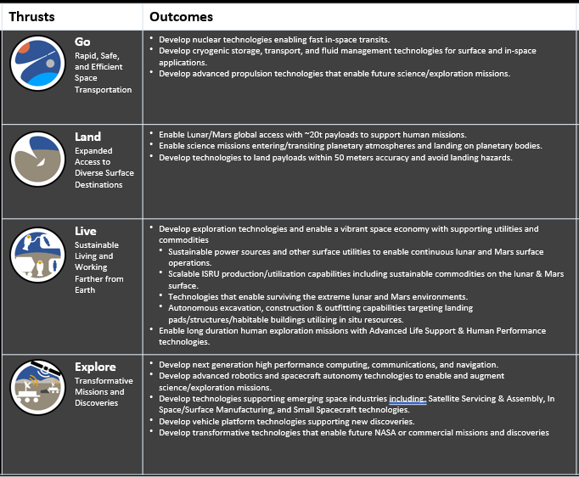
Advanced Habitation Systems (AHS*) Interfaces with multiple strategic outcomes from other PT/SCLTs
(* AHS is a more general term for ECLSS-CHP in some NASA messaging)
AHS Outcome: Enable long duration human exploration missions with Advanced Life Support & Human Performance techs
In Space Transportation SCLT – AHS technology improvements in CO2 reduction, food, trash management, and improved reliability reduce cargo mass ~5 MT x propulsion gear ratio
Entry Descent and Landing SCLT – AHS technology improvements in CO2 reduction, food, reduce landed cargo mass
Avionics PT – Improved crew displays and electronics for deep space radiation environments
ISRU SCLT – Provide consumables; receive waste & trash reduce loop closure requirements. AHS investments in CO2 reduction, gas separation, gas/water contaminant removal and monitoring are extensible to ISRU
Advanced Habitation Systems (AHS)
– Capabilities captured in NASA taxonomy TX06 & TX07
– Largest technology challenges: CO2 reduction (O2 recovery), in-flight food nutrition, earth independent human operations (decision support), system reliability, environmental monitoring, and crew health countermeasures
Autonomous Systems & Robotics – Advances in robotics and autonomy support AHS system maintenance to prepare for crew arrival, allow crew to focus on science.
- Earth Independent Human Operation: Common interfaces and computational technologies to for crew decision support due to time delay and blackout periods
Broyan, J. Advanced Habitation Systems (AHS) Overview, STMD Game Changing Division, Annual Program Review, San Antonio, TX 9/19/2023

Slide 20
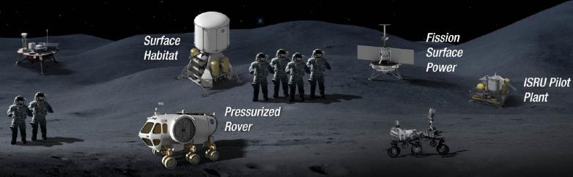

Potential Future Lunar Regen ECLSS and Fluid/Gas Transfers
Consolidate regenerative ECLSS in the surface habitat
  Transfer waste from rover crew to surface habitat for processing
  Recycle urine, condensate water, and carbon dioxide
  Transfer water and oxygen to rovers and EVA
  ECLSS processes, EVA, waste disposal, and leakages contribute to releases to the lunar surface
Water
Oxygen
Wastewater
Urine
Waste
Venting
20
1- Presented at Physical Sciences – Lunar Surface Systems Workshop, August 18, 2021

Slide 21

Spacecraft Habitation Functions + ISRU interfaces with potential forward and backward planetary protection contamination sources
KEY
Habitation Systems Outputs to ISRU
ISRU Inputs to Habitation Systems
Crew Safety
Waste Management
Water Recovery System (WRS)
Crew Systems
Temperature and Humidity Control
Environmental Monitoring
EVA
O2 Generation Assembly (OGA)
CO2 Removal and Reduction
Condensate
Temperature and Humidity Control
Trace Contaminant Control System (TCCS)
CO2 Removal
Water, Plastic, or Regolith from ISRU
Radiation Shielding
Waste Management
Filtration & Heavy VOC Removal
By-Products
Acoustic Monitor
Fire Detection & Suppression
By-Products
Discarded Solid Waste for ISRU
Recovered Water
Atmosphere Monitors
Crew Exercise
Microbial Monitors
Unreacted CO2 for ISRU
Waste Disposal
N
CO2 Reduction
Waste
Urine Recovery
Pre-Treat Urine
O2
O2/N2 Control
H₂ from ISRU
Brine
Discarded Brine Waste for ISRU
Brine & Urine Monitor
Crew
Prebreathe
Medical O2
Brine Water Recovery
N₂ from ISRU
Water Quality Monitors
Particulate Monitor
C
EVA Vehicular Activities
(EVAs)
Extra Vehicular Activities (EVAs)
High P O2
Waste Water
Crew Food Rehydration, Drinking Water and Hygiene
Water Recovery System (WRS)
Brine Water
O2 and H20 Loss
O2
Product Water
O₂ and H₂O Loss
Biocide
Condensate
ISRU Support for Food and Plant Growth
O2 Generation
Product Water
H₂0 from ISRU
O₂ from ISRU
1- Presented at Physical Sciences – Lunar Surface Systems Workshop, August 18, 2021
Notes:
This is for a long duration largely closed ECLSS and its complications have potential for multiple contamination interfaces. Multiple version of this depending on what functions are assumed to be beneficial. Currently these do not consider additional functions for PP. Adding these functions would require understanding the PP requirements.

Slide 22
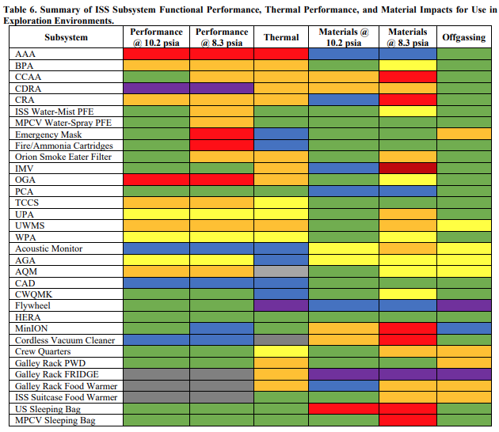
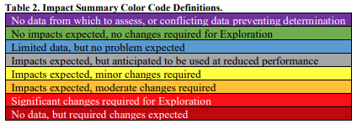
Impact of new Pressure Level and Air Composition (1/2)
  Lowering cabin pressure allows for much shorter EVA pre-breath times
  Potential impacts from reduced pressure and increased oxygen on a range of ECLSS and habitation systems include:
    Decreased fan/blower aerodynamic performance
      Generally constant volume devices will need to rotate faster or have larger diameters
      Increased acoustic noise
    Slower absorption bed kinetics
    Decreased thermal transfer
Abney, M. B., Bagdigian, R. M., Hopkins, C., Knox, J. C., Pedley, M. D., Macatangay, A. V., Cagle, H. A., ‘Evaluation of Heritage Hardware for Use in Cabin Environments with Reduced Pressure and Increased Oxygen Concentration’, 51st International Conference on Environmental Systems, July 10-14, 2021, ICES-2021-45

Slide 23
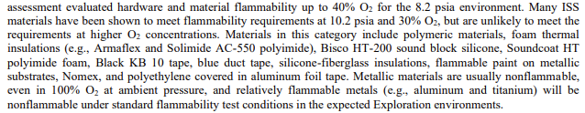
Impact of new Pressure Level and Air Composition (1/2)
  Increased oxygen will significantly limit non-metallic usage
  Non-metallics increasingly used to:
    Reduce vehicle mass
    Allow more complex geometries
    Provide improved crew accommodations and aesthetics
Abney, M. B., Bagdigian, R. M., Hopkins, C., Knox, J. C., Pedley, M. D., Macatangay, A. V., Cagle, H. A., ‘Evaluation of Heritage Hardware for Use in Cabin Environments with Reduced Pressure and Increased Oxygen Concentration’, 51st International Conference on Environmental Systems, July 10-14, 2021, ICES-2021-45

Slide 24
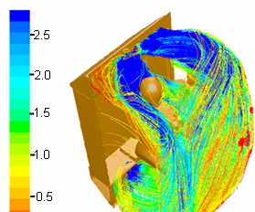
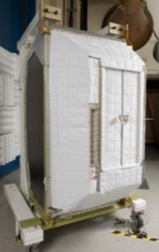
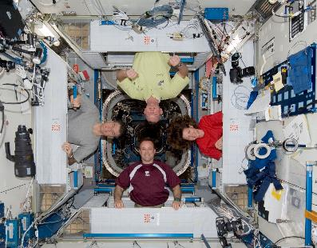
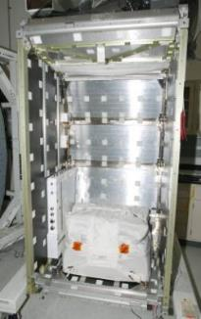
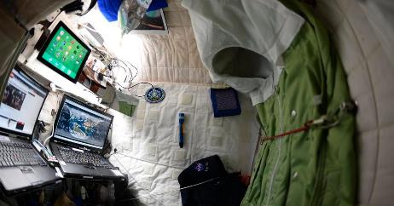
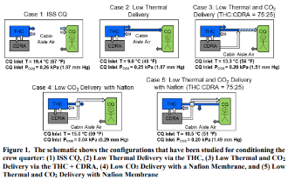
Even ‘Simple’ Architecture Decisions Influence ECLSS
1
1
  ISS Crew Quarters has simple architecture functions
    Visually and acoustically private volume
    Sleep, personal activities, display personal items
    Reduce radiation exposure
  ECLSS – habitation challenges
    Acoustically private volume – acoustic mitigation, alarms
    Visually private – seal all light leaks, limit status LEDs, lighting and emergency lighting, entrapment overrides, separate ventilation
    Personal activities – ethernet and private communications
    Sleep – thermal comfort, CO₂ removal, fan noise, ventilation alarms, prevent hazardous ventilation adjustments
    Display personal items – Velcro™ vs flammability restrictions and particle generation
    Reduce radiation shielding – reduce dose vs interior volume, overall mass, secondary radiation particles from shielding
1
2
Broyan, J. L., Borrego, M. A., Bahr, J., ‘International Space Station USOS Crew Quarters On-orbit vs Design, Performance Comparison’, 40th International Conference on Environmental Systems, July 13, 2009, Savanna, GA, 2009-01-2367
Chen, T., Ewert, M., ‘Analysis of Crew Quarters – ECLSS Interactions for Improved Temperature Control and CO2 Mitigation’, 51st International Conference on Environmental Systems, July 10-14, 2021, ICES-2021-371

Slide 25
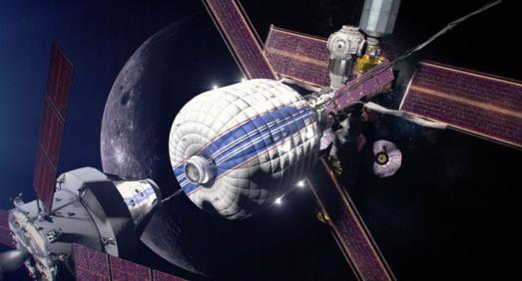
ECLSS Capability Area Summaries
52nd International Conference on Environmental Systems
July 16-20, 2023
25

Slide 26
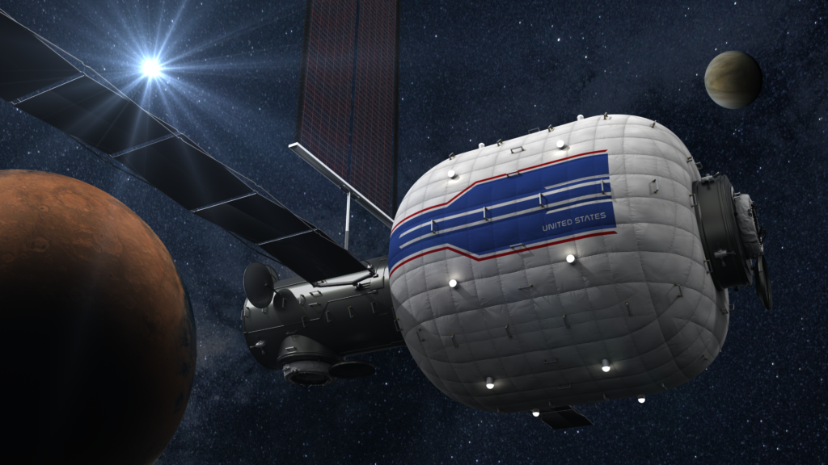
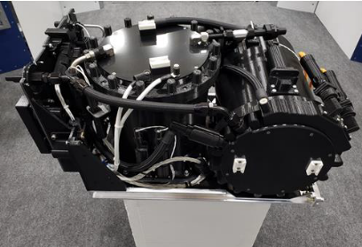
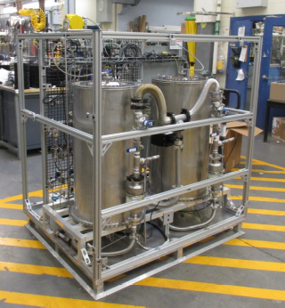
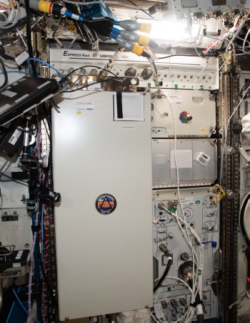
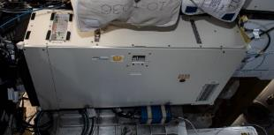
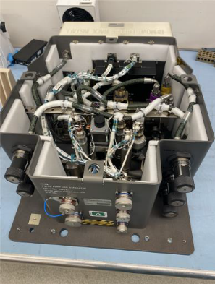
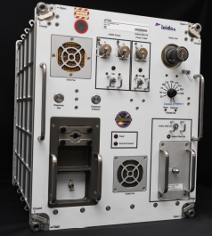
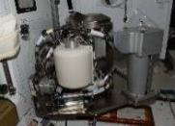
LIFE SUPPORT
Reducing resupply oxygen from increased metabolic carbon dioxide recycling, support EVA high pressure and medical needs
Reliable long-duration life support with Earth independent diagnostics and repair
Repeated missions with >9 months dormancy
>75% oxygen recovery at 2 mm-Hg CO2 (T)
>98% water recovery
Advanced OGA Mockup
Current Capabilities (ISS)
Methanee Pyrolysis Brass board
ISS life support demonstrations have identified required system reliability issues
Nearly uninterrupted use of wetted systems
~47% oxygen recovery at 2 mm-Hg CO2
~21,700 kg spares + food, 4 crew x 860days x Probability of Sufficiency (POS)=0.99
Four Bed CO₂ on ISS
Brine Processor Assembly
eXploration Potable Water Dispenser
UWMS in ISS N3
UPA PPSA
Capability Gap | Gaps | Priority | Examples
Highly reliable, closed-loop-forward carbon dioxide removal systems | 2896 | Near-term Enabling | 4Bed CO2, Thermal Amine, Ionic Liquid, CO2 Deposition, Capillary Sorbent, TSAC
Recovering and Recycling Additional Oxygen from Metabolic Carbon Dioxide | 2897 | Mid-term Enabling | Sabatier 2.0, Methane Pyrolysis, Solid Oxide Electrochemical, Series Bosch,
High pressure oxygen for EVA tank resupply | 2956 | Near-term Enabling | Mechanical Compressor, Static Vapor Feed Electrolysis, High pressure electrolysis, COG
Robust Advanced Water Recovery System | 2925 | Mid-term Enabling | WPA Catalytic Reactor, XPWD, silver biocide and biofilm mitigation techs
Brine processing to recover water from urine brine. | 2914 | Mid-term Enabling | UPA PPSA & Distillation Assy, Brine Processor Assy (BPA), Urine H2O2 pretreat tests
Compact Low Logistics Commode for Exploration | 2931 | Near-term Enabling | Universal Waste Management System (UWMS), Alternate Fecal Container (AFC), Urine Preteat Concentrate Tank
Broyan, J.,L.,
26
26
Broyan, J.L., Approved for release as part of ECLSS-CHP SCLT Overview, Sierra Space, Madison, WI, August 14, 2023

Slide 27
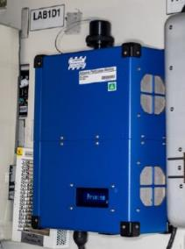
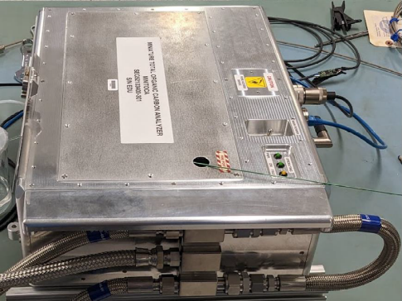
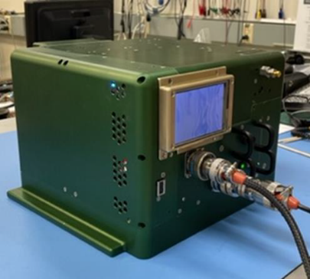
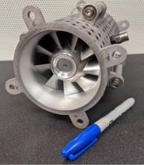
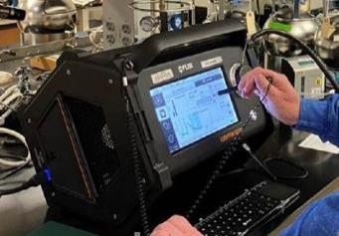
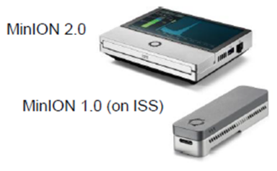
ENVIRONMENTAL MONITORING
Ensure habitat safe air, water, surfaces without sample return analysis
Ability to detect unknown trace compounds in-fight
Distinguish between particle type
Reduced mass for acoustic controls
Support planetary protection characterization
Return samples to Earth for detailed gas, water, microbe analysis
Limited particle size detection can not determine particle type (habitat dust, fire, regolith)
Fans are major noise source requiring adsorbers
Current Capabilities (ISS)
Airborne Particle Monitor in ISS Lab
MiniTOCA EDU
SAM TDU-2
Quiet Cabin Air Fan
COTS Benchtop Test
BioMole/MinION
Capability Gap | Gaps | Priority | Examples
Major constituent & trace contaminant gas monitoring for cabin air | 2899 | Near-term Enabling | Spacecraft Atmosphere Monitor TDU-2 (SAM-2), Air Quality Monitor (AQM), COTS Trace Gas Monitor
In-Flight Identification and Quantification of Microbes in Air, Water, and on Surfaces | 2901 | Near-term Enabling | BioMole/MinION, sample collection technologies for air/water/surfaces
On board particle monitors in the crew respiratory hazard range | 2900 | Near-term Enabling | Airborne Particle Monitor, Aerosol sampler, Gravimetric sensors
In-flight Water Quality Monitors for Quantification and Identification | 2902 | Near-term Enabling | Mini-Total Organic Carbon Analyzer (MiniTOCA), Spacecraft Water Impurity Monitor (SWIM)
Acoustic Monitoring and Control | 2959 | Near-term Enabling | GRC Quiet Fan, Prandtl blade fan, Astrobee autonomous acoustic monitor
27
27
Broyan, J.L., Approved for release as part of ECLSS-CHP SCLT Overview, Sierra Space, Madison, WI, August 14, 2023

Slide 28
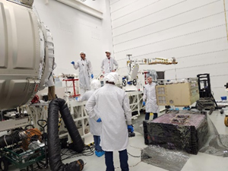
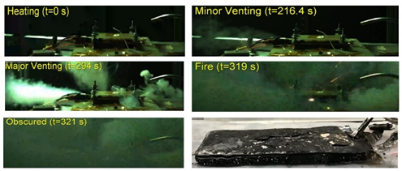
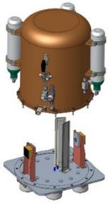
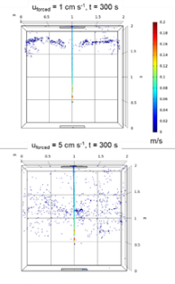
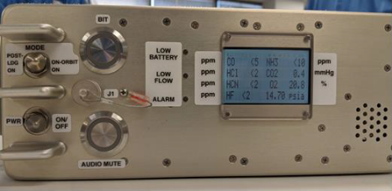
FIRE SAFETY
Materials, procedures, and fire safety equipment for ug and partial-g environments
Test-verified partial gravity flammability characteristics and countermeasures
ECLSS compatible fire suppression
Reduce post fire clean-up time
Loading Saffire VI into NG-19
Laptop Battery Cell Fire Behavior Tests
Partial understanding of large ug fire propagation and properties
Very limited knowledge of partial gravity fire
Obsolete monitoring
Cleanup by depress/repress
Current Capabilities (ISS)
Fire particle spread modeling at 8.2 psia and lunar g
FM2 Hardware Concept
Anomaly Gas Analyzer Testing
Capability Gap | Gaps | Priority | Examples
Material flammability and fire propagation in low- and partial-gravity environments, and at exploration atmospheres | 2934 | Near-term Enabling | Saffire-VI, Lunar-g Combustion Investigation (LUCI), Flammability of Materials on the Moon (FM²), Lithium Ion Battery Flammability Tests, Fire spread models
Fire Detection, Fire Suppression, and Post-Fire Monitoring and Clean-up | 2935 | Near-term Enabling | Anomaly Gas Analyzer (AGA), Water Spray Mist fire extinguisher for gateway, Smoke detector development
Fire emergency breathing mask | 2964 | Near-term Enabling | Emergency Fire Breathing Mask upgrades
Non-flammable materials, additives, coatings | 3525 | Near-term Enabling | SBIR Material development
Clothing for enriched oxygen atmospheres | 2906 | Mid-term Enabling | SBIR Material development, HLS assessment
28
28
Broyan, J.L., Approved for release as part of ECLSS-CHP SCLT Overview, Sierra Space, Madison, WI, August 14, 2023

Slide 29
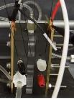
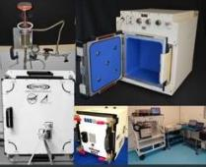



Logistics Reduction
In-flight trash stabilization/disposal, flame resistant crew clothing, and autonomous logistics
>90% trash jettison during Mars transit
Reduced clothing and wipe mass
In-flight autonomous logistics
Mars surface planetary protection compatible trash disposal
SBIR - Hydrogen Peroxide Generator
Manual trash compaction, short storage, module level jettison – odor and volume issues
Disposable & flammable clothing, towels, wipes
Manual & limited in-flight autonomous logistics tracking – frequent lost items
TCPS Prototype
Flame resistant clothing in EVA prebreath chamber test
Current Capabilities (ISS)
REALM-3 (smart stow rack insert)
OSCAR Test Reactor
Capability Gap | Gaps | Priority | Examples
Non-metabolic solid waste processes - reduce vol, stabilize, recover water | 2932 | Long-term Enabling | Trash Compactor Processing System (TCPS), Trash from CHAPEA
Low mass, low volume crew clothing systems | 2958 | Mid-term Enabling | SAA on surfactant and cleaning tech, CHAPEA clothing collaboration
Autonomous inventory tracking and management for multiple element spacecraft | 2961 | Near-term Enabling | RFID Enabled Autonomous Logistics dense zone readers (REALM-3), Hyper-Distributed RFID Antenna (HYDRA), ECLSS sensors, Complex Event Processing localization
In-situ disinfection generation compatible with life support systems | 3518 | Mid-term Enabling | ug Hydrogen Peroxide solution generator (SBIR IIE)
Resource Recovery and Repurposing from Trash | 2957 | Near-term Enabling | Trash to Gas (TtG), Orbital Syngas/Commodity Augmentation Reactor (OSCAR), SBIR IIE
29
29
Broyan, J.L., Approved for release as part of ECLSS-CHP SCLT Overview, Sierra Space, Madison, WI, August 14, 2023

Slide 30
CHP Capability Area Summaries
30

Slide 31




SPACESUIT PHYSIOLOGY
& PERFORMANCE
Protecting crew health and performance during suited testing, training and operations
Decompression sickness risk quantified and efficiently mitigated for exploration destinations
Suited injury risk quantified and mitigated for all anthropometries
Physiological & cognitive capabilities & constraints understood for all tasks
Physiological & cognitive monitoring and decision support solutions identified for operations with delayed or interrupted space-ground comm
Prebreathe protocols only valid for microgravity EVAs & specific atmospheres
Ground, ISS, and Apollo suit injuries documented; 27 potential injury mechanisms identified
Crew capabilities & constraints adequately known for ISS EVA only
Limited crew state monitoring (metabolic & heart rate); fully ground-based decision support
Current Capabilities (ISS)
PersEIDS Testing in APACHE
Capability Gap | Gaps | Priority | Projects
Spacesuit Fit & Injury | 2938 | Mid-term Enabling | Spacesuit Fit & Injury Technologies (S-FIT)
Suited Physiology & Performance | 2937 | Mid-term Enabling | Crew State & Risk Model (CSRM)
Suited Autonomous Health Monitoring & Decision Support | 2941 | Near-term Enabling | Personalized EVA Informatics & Decision Support (PersEIDS)
Decompression Stress Prediction & Mitigation | 2943 | Mid-term Enabling | Aerospace Estimation Tool for Hypobaric Exposure Risk (AETHER)
Abercromby, F.J., et. al., NASA Crew Health & Performance Capability Development for Exploration: 2022-2023 Overview - 52nd International Conference on Environmental Systems, ICES-2023-255, July 16-20, 2023

Slide 32






CREW HEALTH COUNTER-MEASURES
Exercise devices and other technologies to mitigate the effects of spaceflight on crew health & performance
Reduced mass and volume; increased reliability
Maintain/monitor fitness in-flight to enable unassisted landing egress & EVA
Validated lunar & Mars fitness standards (incl. sensorimotor)
Current Capabilities (ISS)
Advanced Resistive Exercise Device
COLBERT (treadmill)
CEVIS (cycle ergometer)
Mass: ~4300 lbs *
Volume: ~19 m³
Power: ~2100 Watts
EPIC / HERMES Informatics
Sensorimotor Balance Board
ESA’s E4D Exercise Device Prototype
Capability Gap | Gaps | Priority | Projects
CHC and Performance Informatics | 2954 | Near-term Enabling | EPIC / HERMES
Expl. Exercise System | 2952; 2947 | Near-term Enabling | E4D (ESA) | Ex VIS | Zero-T2 Study
Expl. Sensorimotor Countermeasures (CM) | 3492 | Near-term Enabling | Balance Board
Expl. Cardiovascular CM | 3514 | Mid-term Enhancing | Fluid Loading Protocol | Orthostatic Intolerance Garment
Expl. Behavioral Health & Performance CM | New | TBD | BHP Roadmap in definition
Abercromby, F.J., et. al., NASA Crew Health & Performance Capability Development for Exploration: 2022-2023 Overview - 52nd International Conference on Environmental Systems, ICES-2023-255, July 16-20, 2023

Slide 33



EXPLORATION MEDICAL
Protocols, technology, and supplies to address in-mission medical conditions
In-flight diagnostics and treatment for 100 of 120 medical risk conditions
Autonomous medical skill and & decision support systems
Long-Duration Pharma
Conventional medical capabilities with real-time supervision & support always available from ground
Regular resupply of consumables and replacement of equipment as needed
Current Capabilities (ISS)
Multi-functional Medical Devices
BHP Diagnostics & Treatment Aides
Capability Gap | Gaps | Priority | Projects
Imaging, Diagnostics & Treatment | 2950 | Near-term Enabling | Regenerable IV Fluid Device Development (Mini IVGEN); Multifunctional Integrated Medical Device; SANS Diagnostic Devices; Mini X-ray;
Medical Ops Decision Support & Informatics | 2904; 2905 | Near-term Enabling | Automated Medical Inventory System (AMIS); Ex. Electronic Heath Record; Hololens Tech Demo; CHP Integrated Data Architecture
Long-Duration Pharmaceuticals | 3508 | Mid-term Enabling | Medications Vacuum Testing; Exploration Formulary
Behavioral Health and Performance Medical Technologies | 2911 | Near-term Enabling | Autonomous BHP Diagnostic/Treatment Aides
Abercromby, F.J., et. al., NASA Crew Health & Performance Capability Development for Exploration: 2022-2023 Overview - 52nd International Conference on Environmental Systems, ICES-2023-255, July 16-20, 2023

Slide 34



Radiation Protection
Protecting crewmembers from radiation through improved monitoring, mitigation & space weather forecasting technologies
24-hr prediction of solar storm duration and intensity to >90%
High energy neutron detectors
Earth independent monitoring/forecasting
GCR shielding
Mature shielding design tools
Reconfigurable SPE shielding & limited GCR shielding
Crew radiation monitoring
Short term space weather using earth centric assets
Current Capabilities (ISS)
Space Weather Forecasting Models
Hybrid Electronic Radiation Assessor (HERA)
Crew Active Dosimeter (CAD) | Radiation Assessment Detector (RAD)
Radiation Area Monitor (RAM) | Advanced Neutron Spectrometer (ANS)
Capability Gap | Gaps | Priority | Projects
Solar Particle Events: Radiation models and forecasting | 2936 | Near-term Enabling | Probabilistic, peak flux, and time profile scoreboard
Active Shielding: Combined GCR with protection from SPEs | 2917 | Near-term Enhancing | RADWORKS active shield modeling and technology development
Onboard Dosimetry Systems: Charged Particle Alert | 3295 | Mid-term Enabling | Active Personal Dosimetry for EVA & IVA
Earth-independent Space Weather Forecast and Crew Alert Systems | 2915 | Mid-term Enabling | Sensor technology testing and data analysis using HERMES SMD payload

Slide 35




FOOD & NUTRITION
Safe, acceptable, nutritious & resource-efficient foods for exploration missions
100% of nutrient stability >5-year shelf life
Food acceptability >90%
< 30% launched water content
Exploration in-flight nutrition intake monitoring
1.5 year shelf life, fresh food resupply every 2-3 months
~215 standard food items, μg plant experiments
~47% launched water content
In-flight nutrient intake monitoring in development
Current Capabilities (ISS)
Airflow test in Ohalo growth chamber prototype
Reduced Water Content Food
Aero/hydroponic crop experiment
CHAPEA: 1 year Food Study
Capability Gap | Gaps | Priority | Examples
Long Duration Food System | 2944 | Near-term Enabling | Crop systems (VEGGIE, APH; OHALO III, XROOTS); Alternative nutrition sources (bacterial, algae, fungi); Synthetic biology approaches (CUBES)
Food System Efficiency | 2945 | Near-term Enabling | Prepackaged food water content reduction
Food Impacts to Health and Performance | 2946 | Near-term Enabling | Crew Health and Performance Exploration Analog (CHAPEA)
Broyan, J.L., Approved for release as part of ECLSS-CHP SCLT Overview, Sierra Space, Madison, WI, August 14, 2023

Slide 36
Takeaways
ECLSS-CHP technology development is need to ensure crew health and productivity for long duration Mars transit and lunar surface missions
The interactions of air, water, crew consumables, and crew in a closed loop habitat are chemically and physically complex and understanding issues evolves over time
Architecture decisions at the vehicle and mission level significantly impact ECLSS-CHP technology needs
Long-term architecture functions are important in setting requirements and goals for technology systems beyond initial operational requirements
Reducing spares mass with reliability testing and CO₂ reduction/reduced launched food water content are the largest knobs to turn to reduce Mars Transit departure mass
Test verified ECLSS-CHP systems requires many years of ground and LEO operation
  Systems fail and interact in unexpected ways
  New failure modes still being identified after 10+ years of operational time

Slide 37


Questions?

Slide 38
Backup

Slide 39

References (beside what is noted at bottom of the slides)
International Conference of Environmental Systems Proceedings – strongest
  https://www.ices.space/conference-proceedings-2/
Human Research Program Investigator’s Workshop - February 2024 (Galveston, TX)
  https://www.nasa.gov/hrp-iws-2024/
2023 AIAA Publication – The Planning and Execution of Human Missions to
the Moon and Mars
  Chapter 14: Human Health Risks Relevant to Deep Space Mars Exploration Missions
  Chapter 15: ECLSS for Spacecrafts Designed for Human Exploration of Mars
  https://arc.aiaa.org/doi/book/10.2514/4.106545
2016 ISS Fly through video (~18 min)
  https://www.youtube.com/watch?v=DhmdyQdu96M
Wikipedia ISS ECLSS page
  https://en.wikipedia.org/wiki/ISS_ECLSS

Slide 40
Acronyms (1/2)
ADD – Architecture Definition Document
AHS – Advanced Habitation Systems
AQM – Air Quality Monitor
AGA – Anomaly Gas Analyzer
ARD – Active Radiation Dosimeter
BHP – Behavioral Health and Performance
BPA – Brine Processor Assembly
BPS – Biological and Physical Sciences
CHAPEA – Crew Health and Performance Analog
CHP – Crew Health and Performance
CHX – Condensing Heat Exchanger
CM – Counter Measures
CLPS – Commercial Lunar Payload Services
COTS – Commercial Off The Shelf
CUBES – Center for the Utilization of Biological Engineering in Space
DT&E – Design Testing & Evaluation
E4D – Exploration Exercise Device
ECI – Early Career Initiative
ECF – Early Career Faculty
ECLS - Environmental Control and Life Support
ECLSS – Environmental Control and Life Support System
EDU – Engineering Development Unit
EPIC – Exercise and Performance Information Console
EVA – Extravehicular Activity
FM2 – Flammability of Materials on the Moon
GCR – Galactic Cosmic Rays
HEPA – High Efficiency Particulate Air
HERA - Hybrid Electronic Radiation Assessor
HERMES - Heliophysics Environmental and Radiation Measurement Experiment Suite
HRP – Human Research Program
ISRU – In-situ Resource Utilization
ISS – International Space Station
IVGen – IntraVenous Generation
JARVIS – Joint Augmented Reality Visual Informatics System
LEO – Low Earth Orbit
LUCI – Lunar-g Combustion Investigation
M2M – Moon to Mars
MEDPRAT - Medical Extensible Dynamic Probabilistic Risk Assessment Tool
MedTED – Medical Technology Demonstration
ML – Machine Learning

Slide 41
Acronyms (1/2)
NBL – Neutral Buoyancy Laboratory
OCT - Optical coherence tomography
OGA – Oxygen Generator Assembly
OSCAR - Orbital Syngas/Commodity Augmentation Reactor
PersEIDS – Personalized EVA Informatics & Decision Support
POS – Probability of Sufficiency
RAD - Radiation Assessment Detector
REALM – RFID Enabled Autonomous Logistics Management
SAM – Spacecraft Atmosphere Monitor
SANS – Spaceflight Associated Neuro-ocular Syndrome
SBIR – Small Business Innovative Research
SCLT – System Capability Leadership Team
SPE – Solar Particle Event
STRG – Space Technology Research Grants
STTR – Small Business Technology Transfer
SWIM – Spacecraft Water Impurities
TCPS – Trash Compactor Processing System
TOCA – Total Organic Carbon Analyzer
TRL – Technology Readiness Level
TtG – Trash to Gas
UWMS – Universal Waste Management System
VIS – Vibration Isolation System
VOC – Volatile Organic Carbon
WHC – Waste and Hygiene Compartment
WRS – Water Recovery System

Slide 42






It Takes Many People to Go to Space
Direct NASA employees: 18,000
Contractor support employees: 30,000
Active NASA astronauts: 46
Astronauts

Slide 43




Learn More!
National Aeronautics and Space Administration
Main NASA website: https://www.nasa.gov/
NASA STEM: https://www.nasa.gov/stem/express
Learn how to apply to be an astronaut: https://astronauts.nasa.gov/
Spot the Space Station: https://spotthestation.nasa.gov
nasa.gov/station

