Slide 1
The Lightning Instrument Package
Presented by
Christopher J. Schultz
NASA/Marshall Space Flight Center
LIP Team:
Monte Bateman, Rich Blakeslee, Jackson Remington, Doug Mach, Timothy Lang, Mason Quick, Michael Stewart, Scott Podgorny, David Corridor
ALOFT Science Team Meeting
November 2023

Slide 2
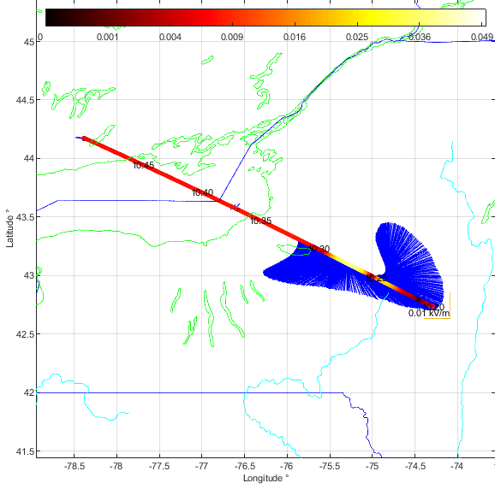
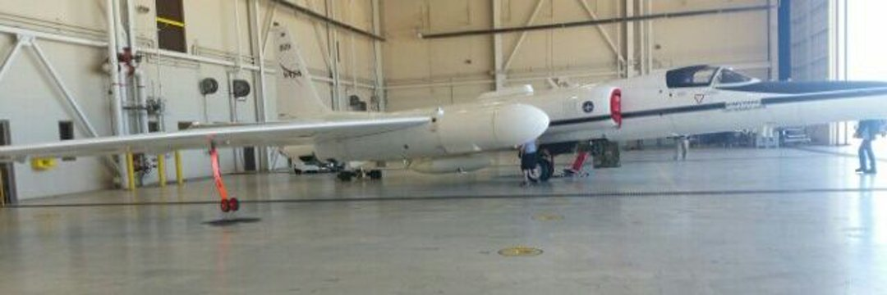
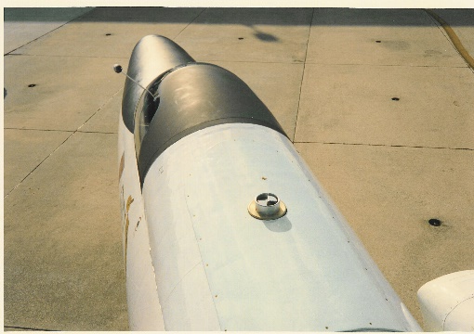
LIP Measurements
Canada
NY
Instrumentation
  Electric Field Mills (7)
Measurements
  Vector components of the electric field ( E_{x} , E_{y} , E_{z} )
  Aircraft Charge
  Lightning statistics ( identified from electric field changes )
  Storm electric currents (derived result )
  Storm charge structure (derived result )
Measurement Range / Accuracy
  Electric Field : few V/m to ten’s of kV/m within 5%
PA

Slide 3
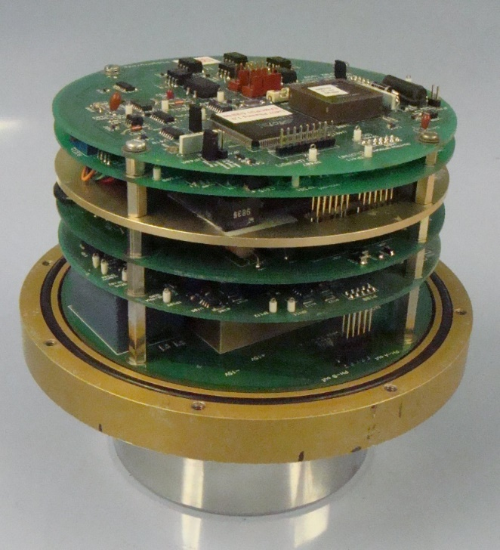
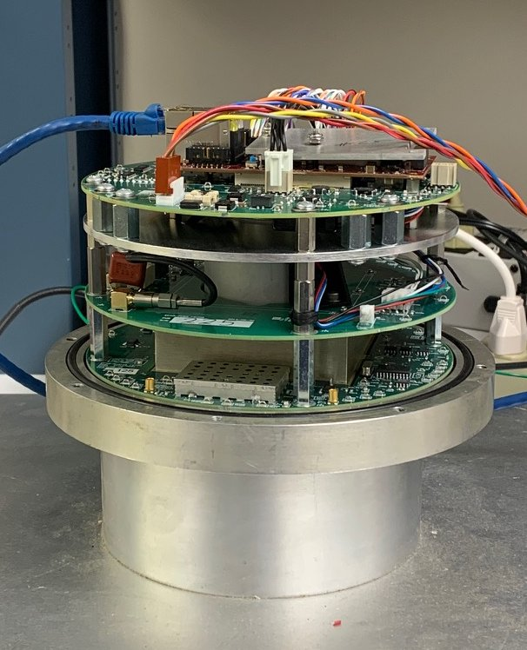
NASA/MSFC Airborne Electric Field Mill
Legacy ABFM
Upgrade ABFM
5 Circuit cards
3 Circuit cards
8-bit MCU
& FPGA
MCU & Linux Arm Processor instantiated in Xilinx FPGA
Command / Data packet exchange
Hosted web page + NTP client
Asynchronous Serial I/O
Ethernet (direct connect to ER2 LAN)
ABFM Electric Field Sensitivity, Dynamic Range & Linearity Requirements:
  Aircraft form factor calibration: Fair weather fields ~70 V/m so for 5% accuracy requires ~ 3 V/m resolution
  Aircraft in-situ charging to ~200 kV/m: Full scale needs to be ~ 2x EF_{Q} -> 400 kV/m
  Detect 100 V/m external field in the presence of 200 kV/m common mode due to highly charged aircraft -> 0.05% linearity
ABFM Upgrade Performance: 1 V/m to 512 kV/m with .03% non-linearity (verified via test)
  Same mass and volume, reduced total power requirements (only one instead of four Embedded Linux Systems needed)

Slide 4
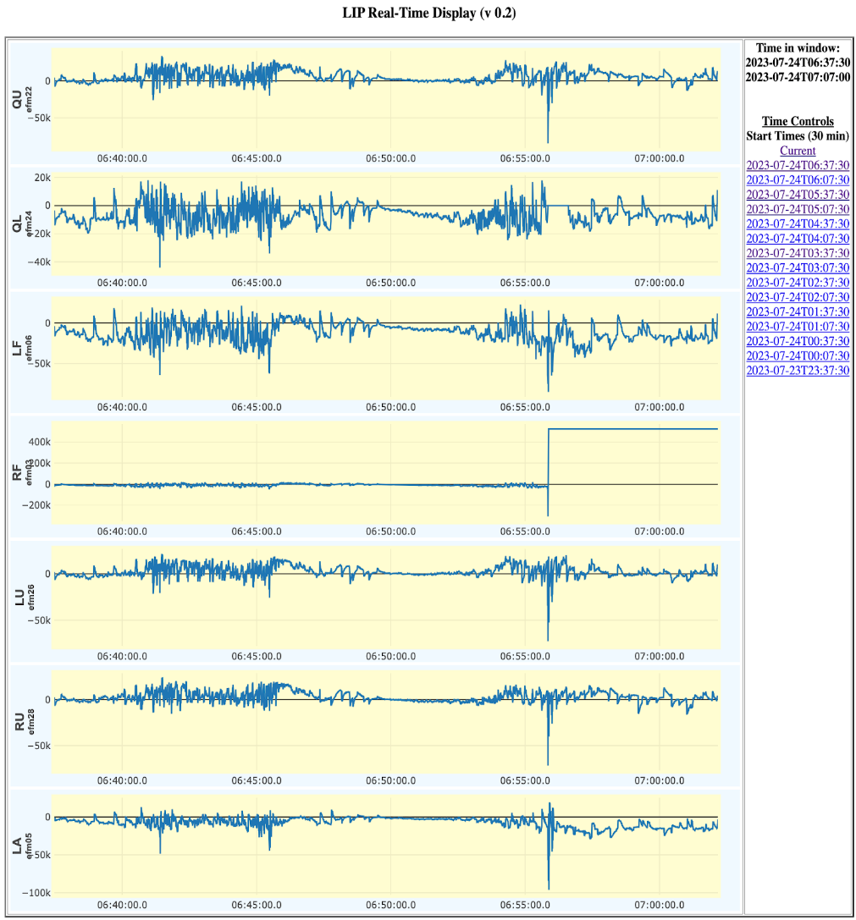
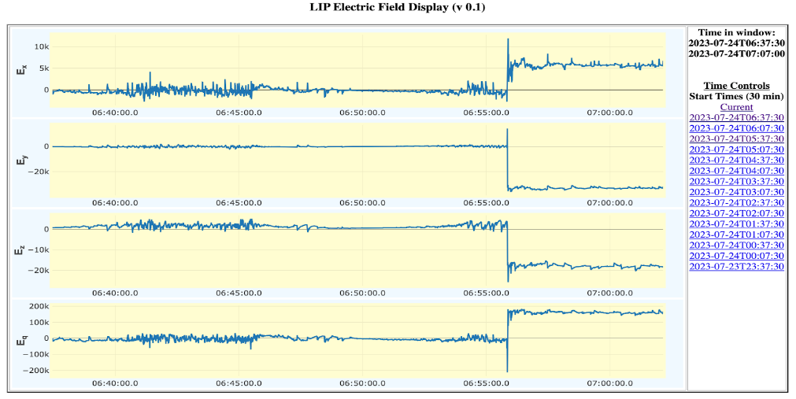
LIP Mission Performance
LIP operated nominally for 63.7 of the 64 total hours of the ALOFT mission
• 1. Yucatan: 3-4 July 2023, 2100-0300 UTC
• 2. Campeche Bay: 6 July 2023, 0200-1000 UTC
• 3. El Salvador: 8 July 2023, 0200-1000 UTC
• 4. Florida: 12-13 July 2023, 2300-0200 UTC
• 5. San Andres: 16 July 2023, 1200-1900 UTC
• 6. Florida: 20-21 July 2023, 2100-0100 UTC
• 7. Campeche Bay: 24 July 2023, 0300-1100 UTC *(~20-minute gap around 640 UTC with two mills lost during the period)
• 8. Inland Mexico: 25-26 July 2023, 2300-0700
• 9. San Andres: 28 July 2023, 1300-2100 UTC
• 10. Florida: 29 July 2023, 1800-2300 UTC
Additionally, there are single passes near active thunderstorms in transit to and from Armstrong over Southeast Louisiana.

Slide 5
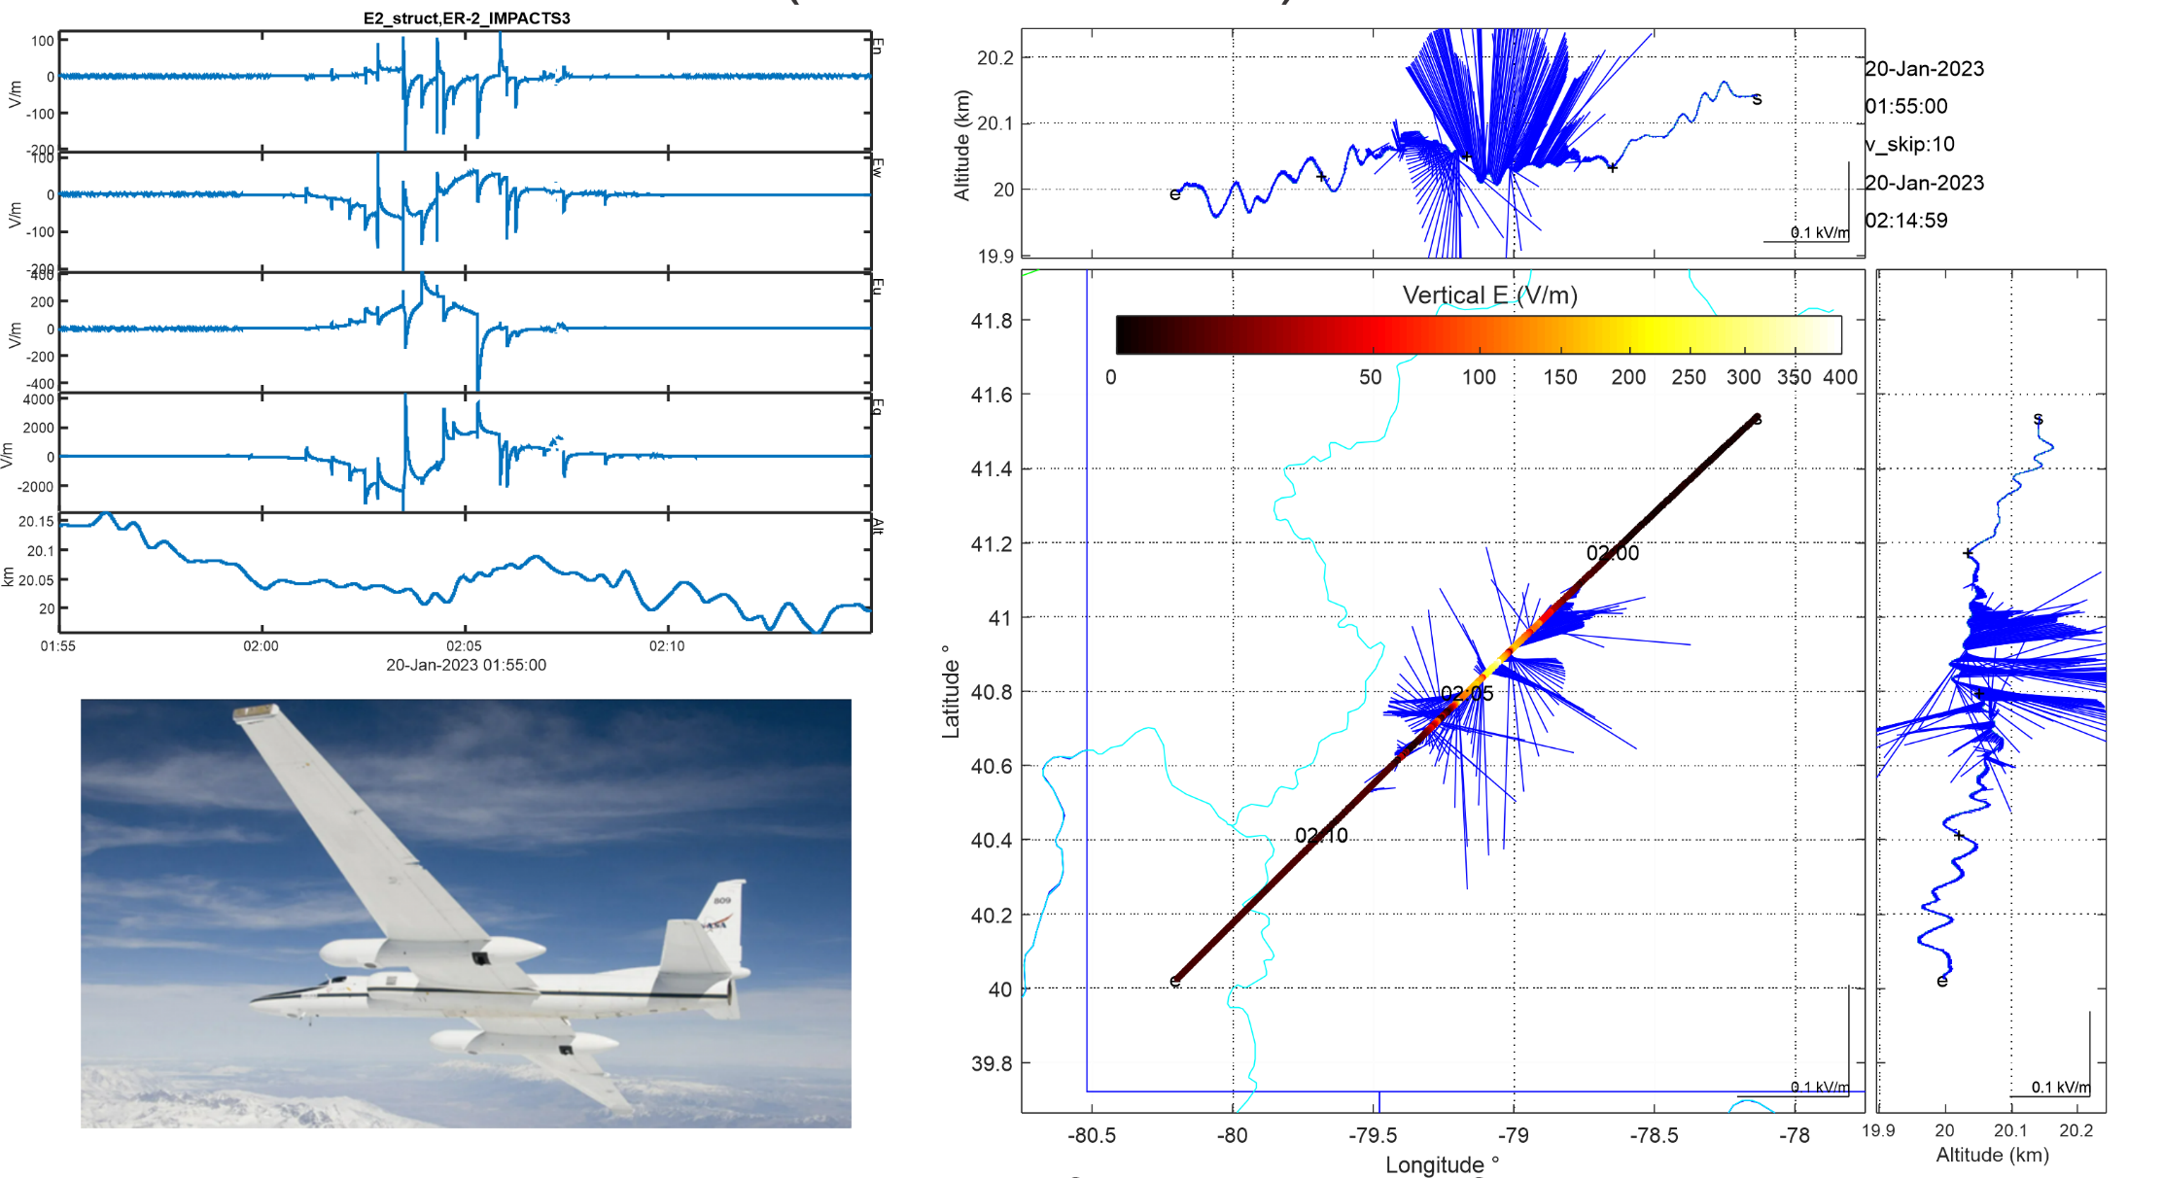
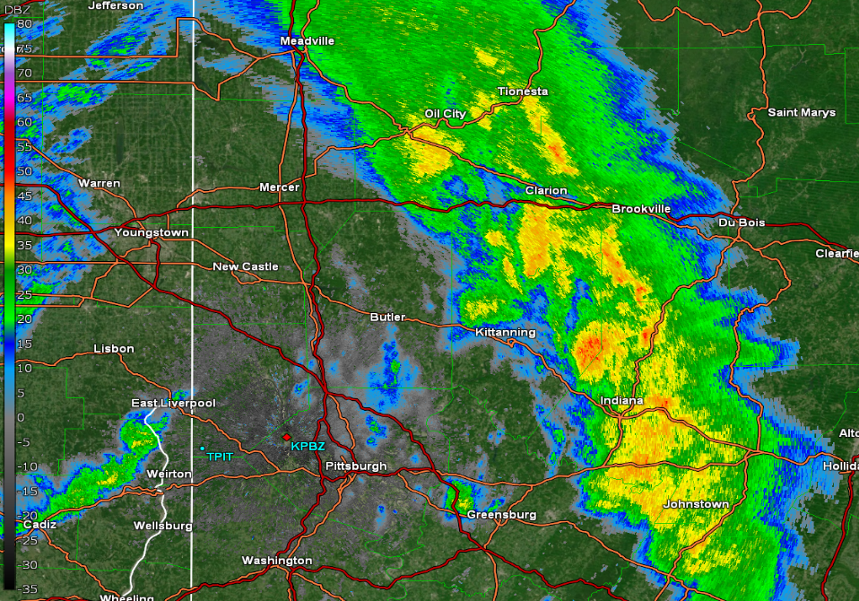
How can I use the electric field data?
Electric Field vector and magnitude information
Flash Counting
Aircraft Direction
Vectors tend to point away from positive charge

Slide 6
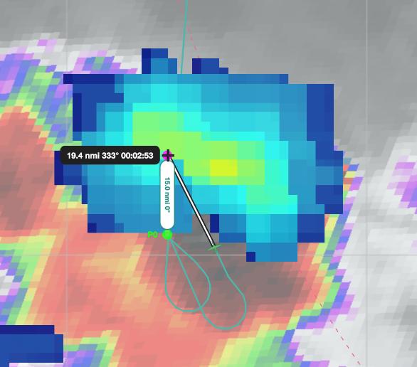
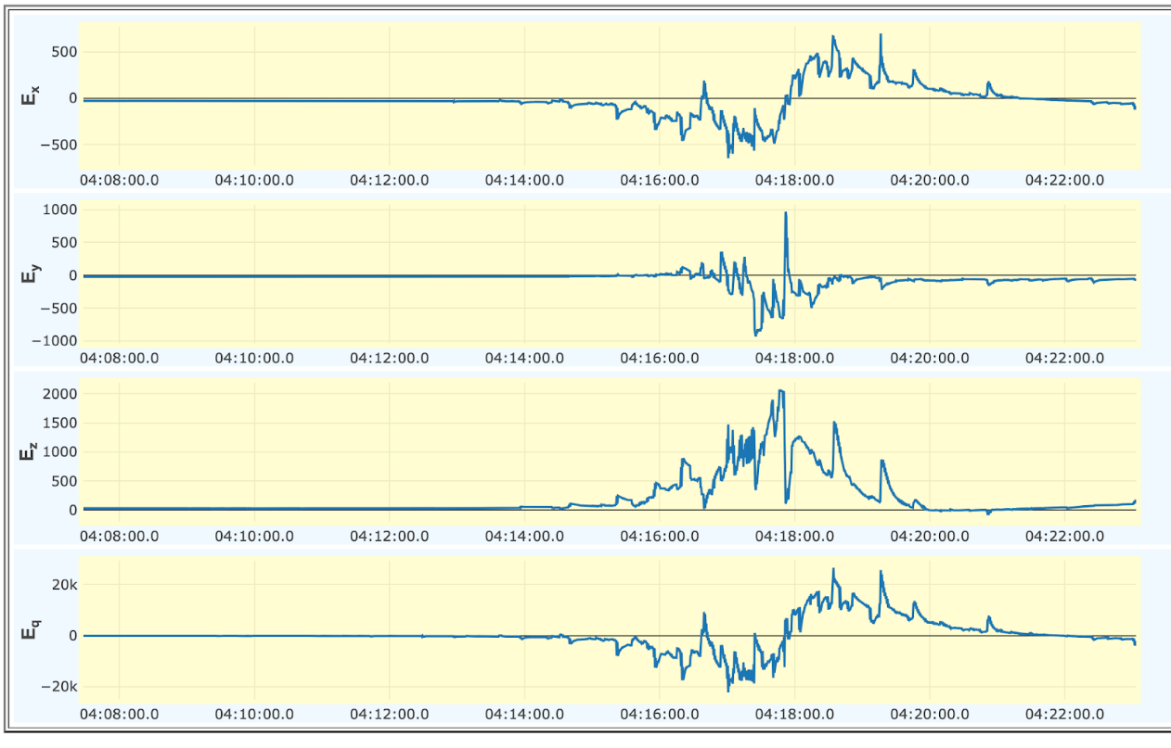
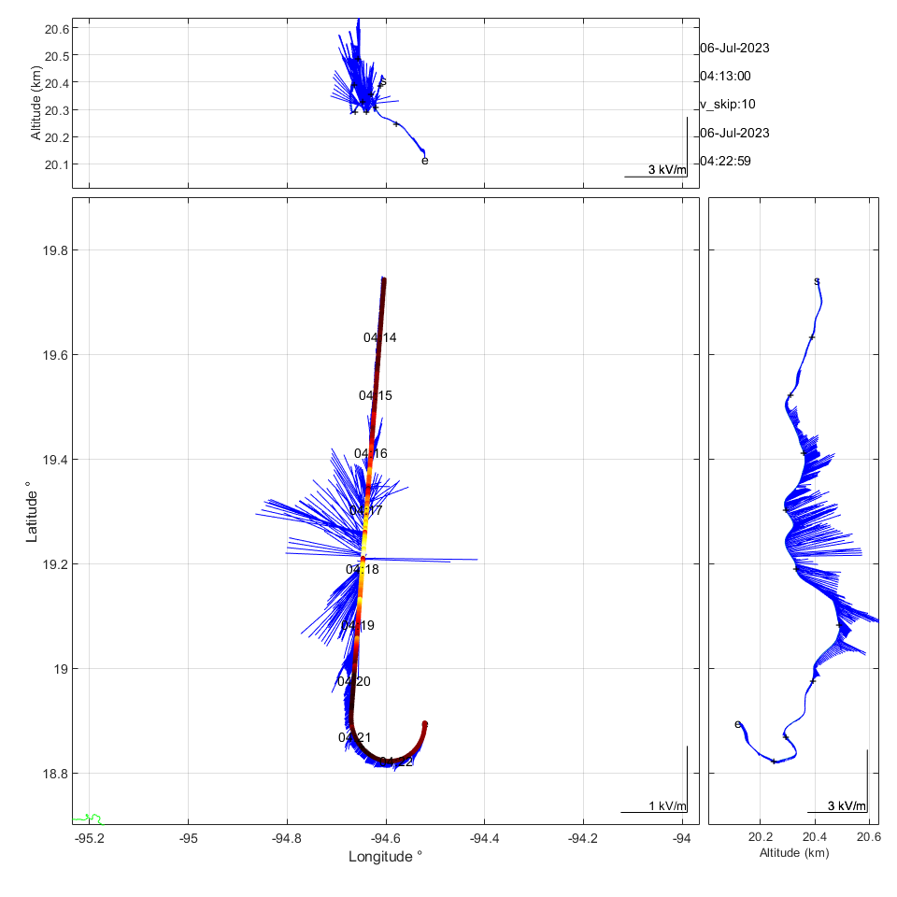
E Field vectors are important and mind bending at times
Ex, positive value, vector pointing to the nose, negative vector pointing to the tail
Ey, positive value, vector pointing to the left wing, negative value, vector to the right wing
Ez, positive is upward, negative is downward.
Charge to left and under aircraft
Aircraft Direction
ER2 moving toward charge (green)
ER2 moving away from charge (red)
Thunderstorm charge would be located here!

Slide 7
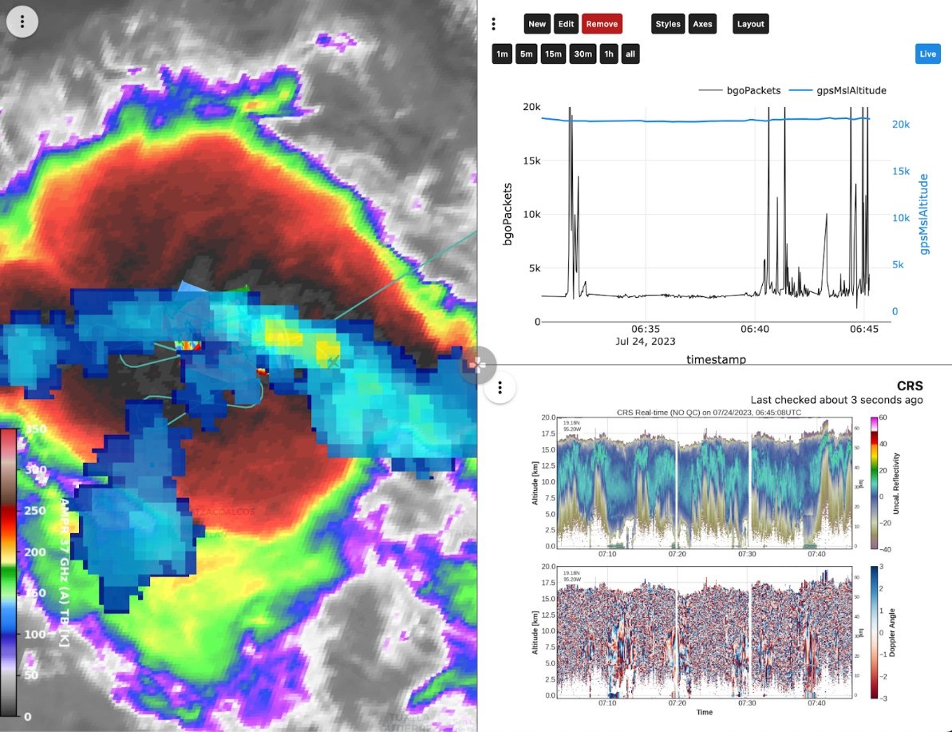
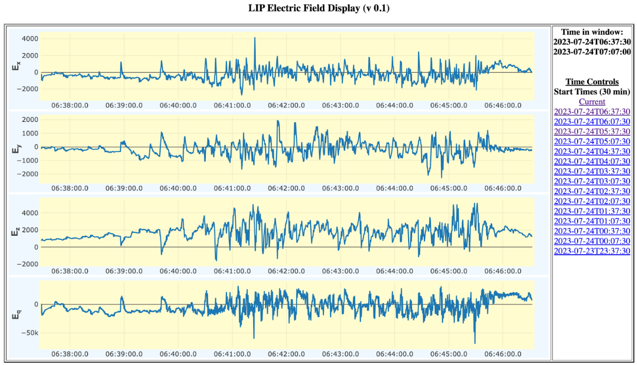
20230724
How is TGF Frequency tied to storm intensity?
Two mature updrafts producing flash rates on the order of 30 flashes per minute
Where are the TGFs relative to the charge centers within the multi-cellular storm?

Slide 8
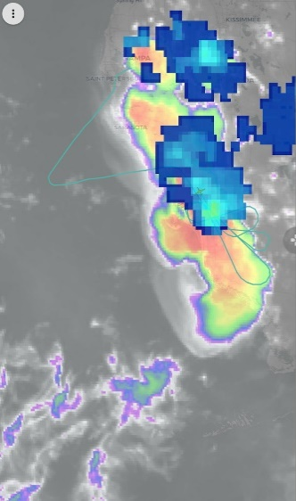
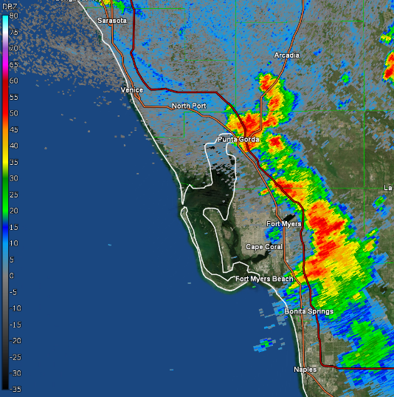
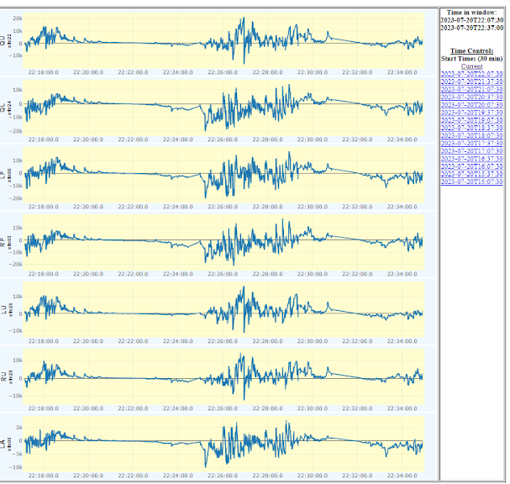
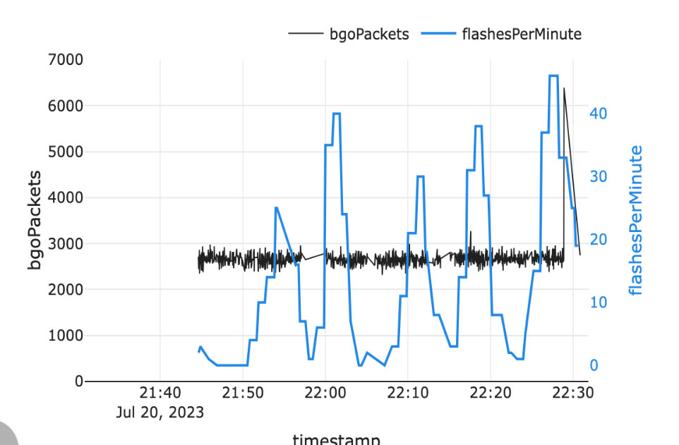
20230720
Ordinary sea breeze driven multi-cellular convection
TGF along the coast!
Flash rates on the order of 10-15 per minute

Slide 9
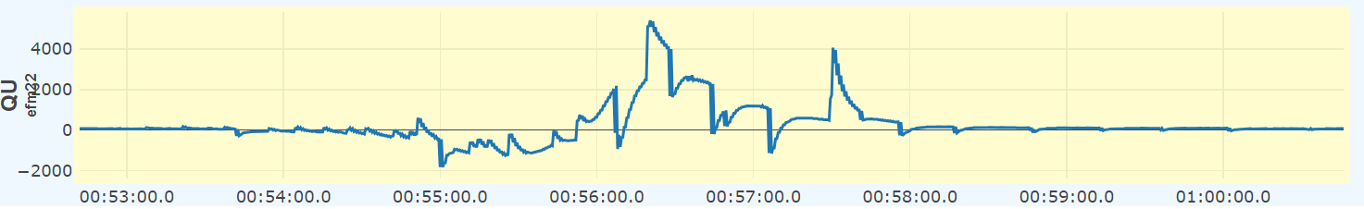
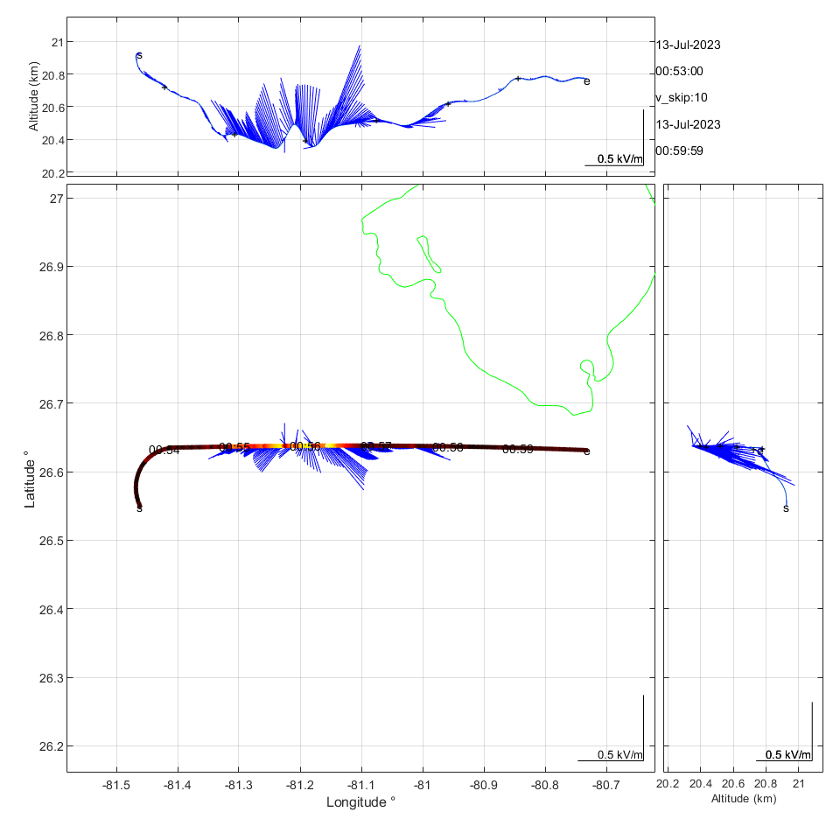
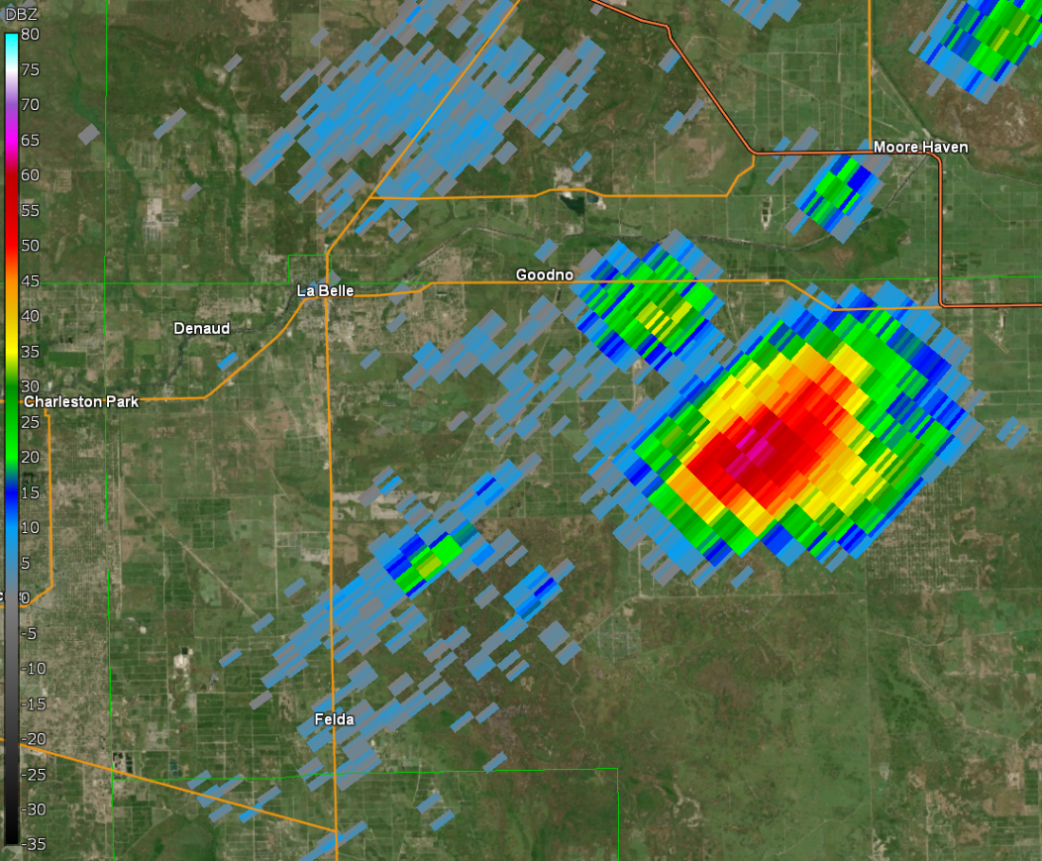
20230712
Null type storms
Intense storm (65 dBZ)
Weak flash rate (7 per minute)
No glow or TGF

Slide 10
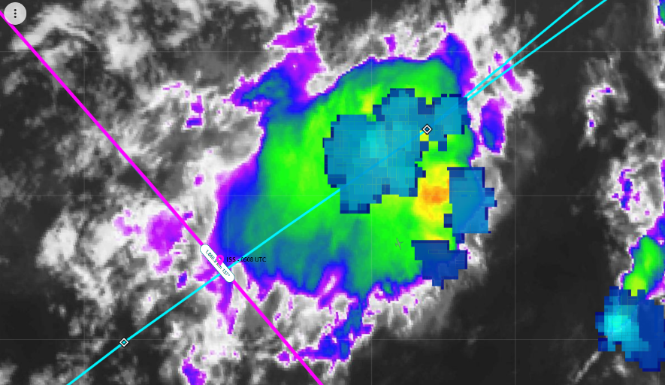
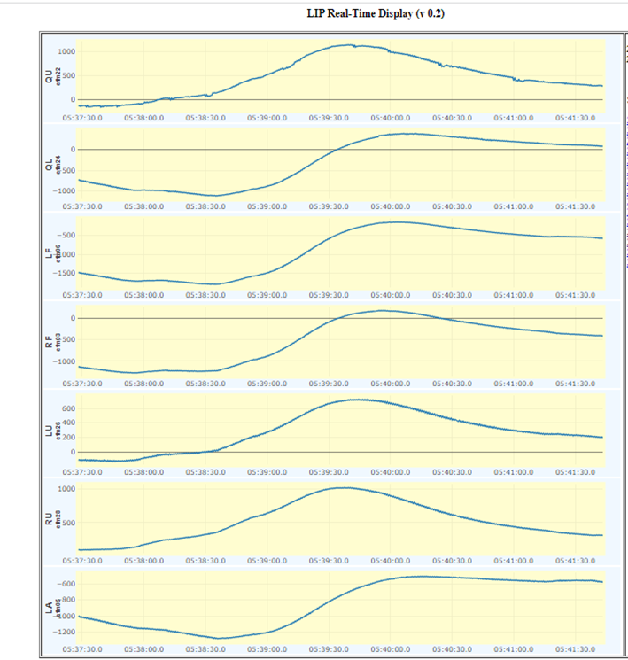
End of Storm Electric Properties
As storms decay, we see broad end of storm oscillations in the electric field.
How do the lack of TGFs and glows signal storm decay?

Slide 11
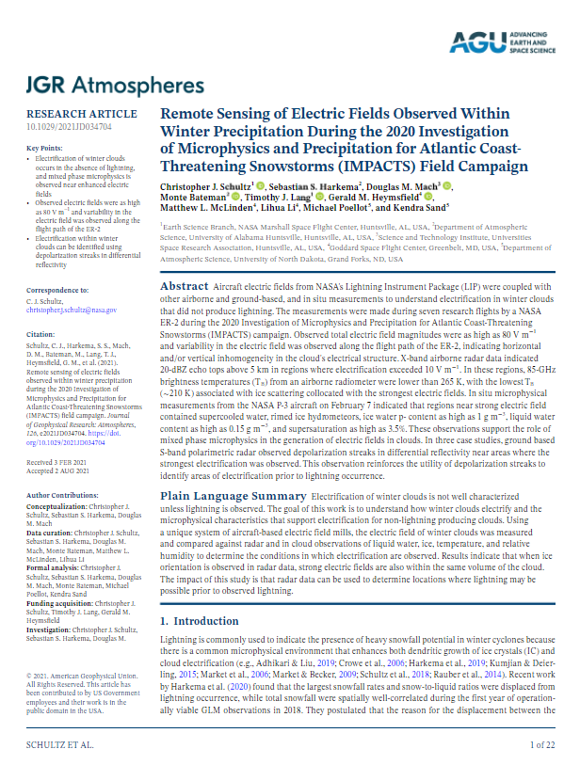
Questions? Ask one of us!
LIP Team POCs
Chris Schultz (christopher.j.schultz@nasa.gov)
Doug Mach (dmach@nasa.gov)
Monte Bateman (monte.bateman@nasa.gov)
Timothy Lang (timothy.j.lang@nasa.gov)
Mason Quick (mason.quick@nasa.gov)
GHRC DAAC POCs
Leigh Sinclair (slb0012@uah.edu)
Geoffrey Stano (gts0007@uah.edu)
https://agupubs.onlinelibrary.wiley.com/doi/epdf/10.1029/2021JD034704

