Slide 1
Title Page
Small Business Innovation Research/Small Business Technology Transfer (SBIR/STTR) National Academies Overview
Jason L. Kessler, Program Executive | November 13, 2023

Slide 2
Agenda
Program Overview
Recent Awards
Spotlights
Success Stories

Slide 3
Program Overview

Slide 4
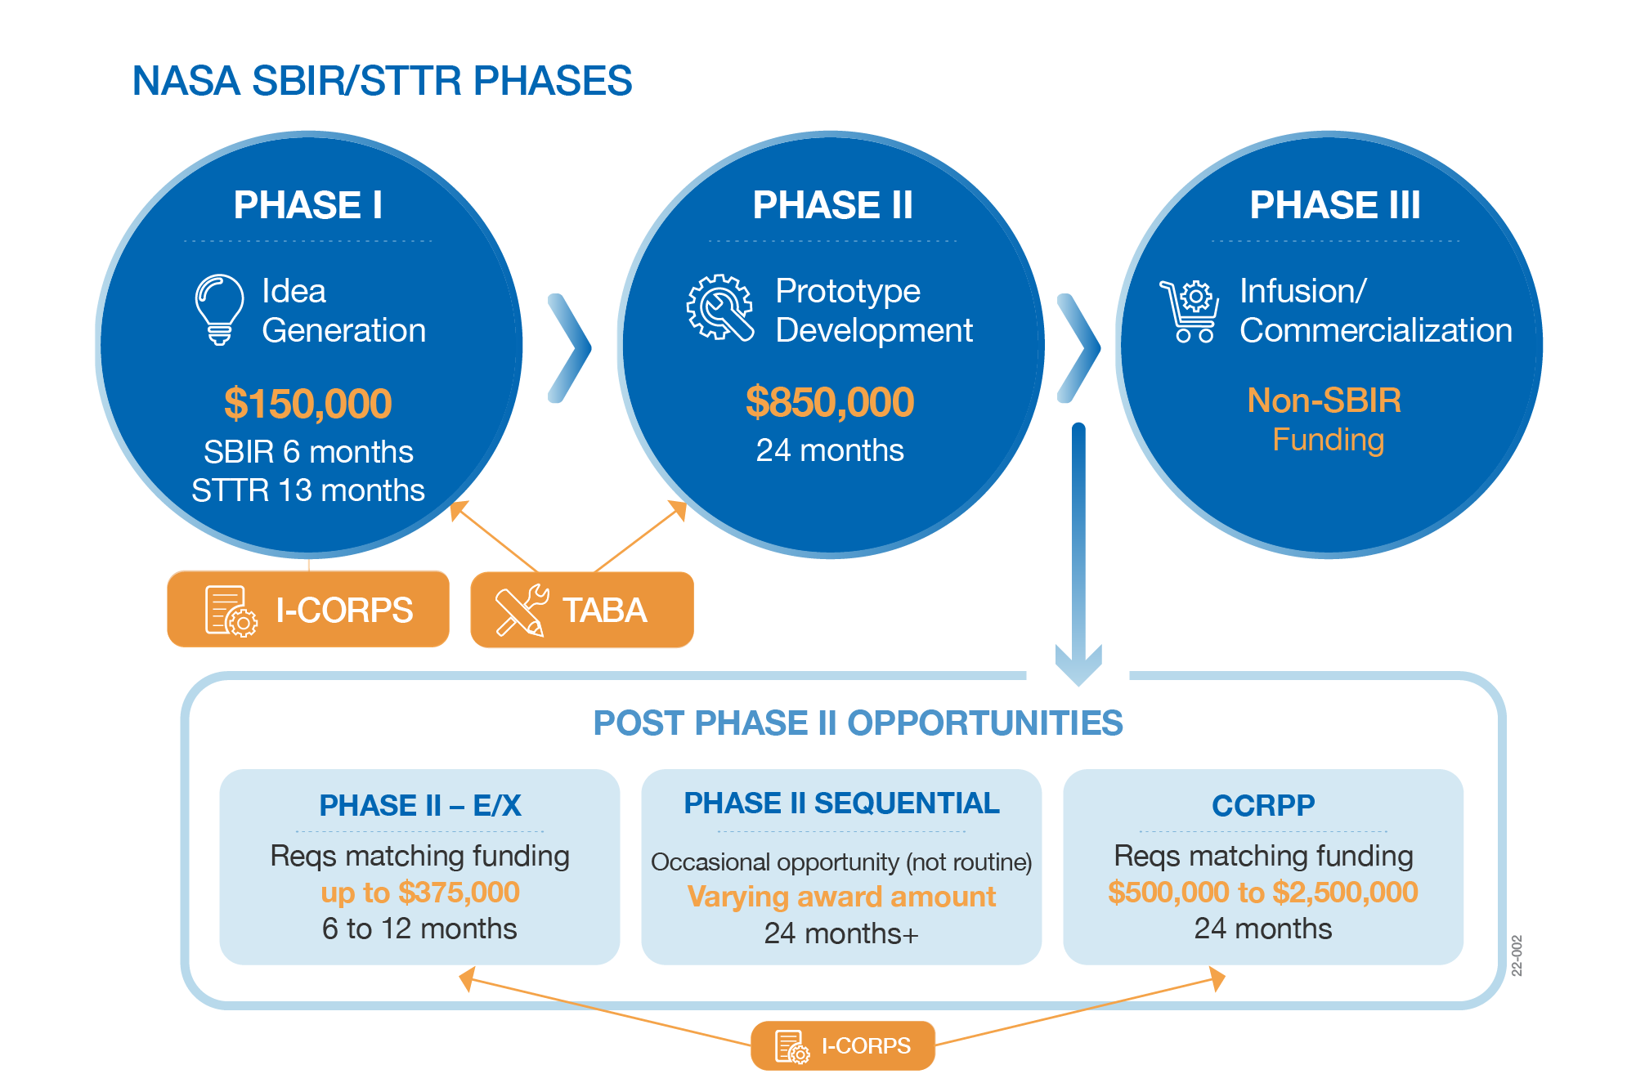
Program Phases
Up to $1 million for Phase I and II and nearly $3 million or more for Post Phase II opportunities!
Notes:
As a quick centering, these are the opportunities for funding that we currently offer….

Slide 5
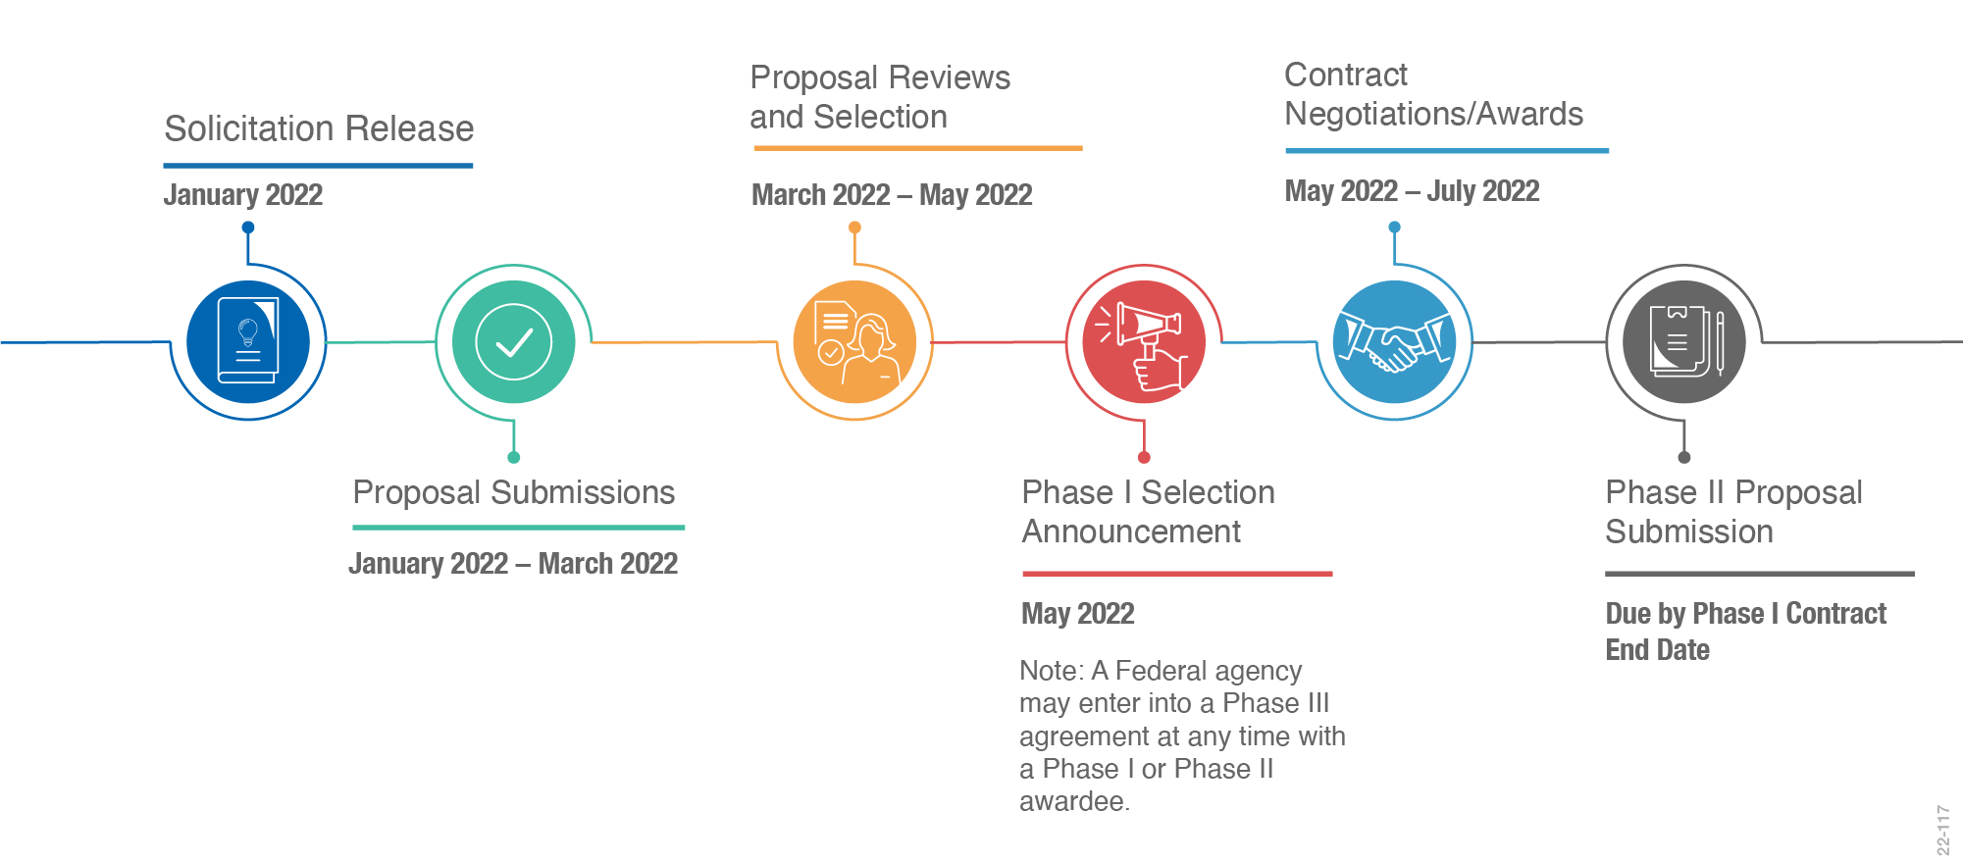
How does it work?
January 2023
March – June 2023
June – August 2023
January – March 2023
June 2023
Due by Phase I Contract End Date
Note: Dates are subject to change. For the latest dates, please visit our website’s “Schedule & Awards” page.

Slide 6
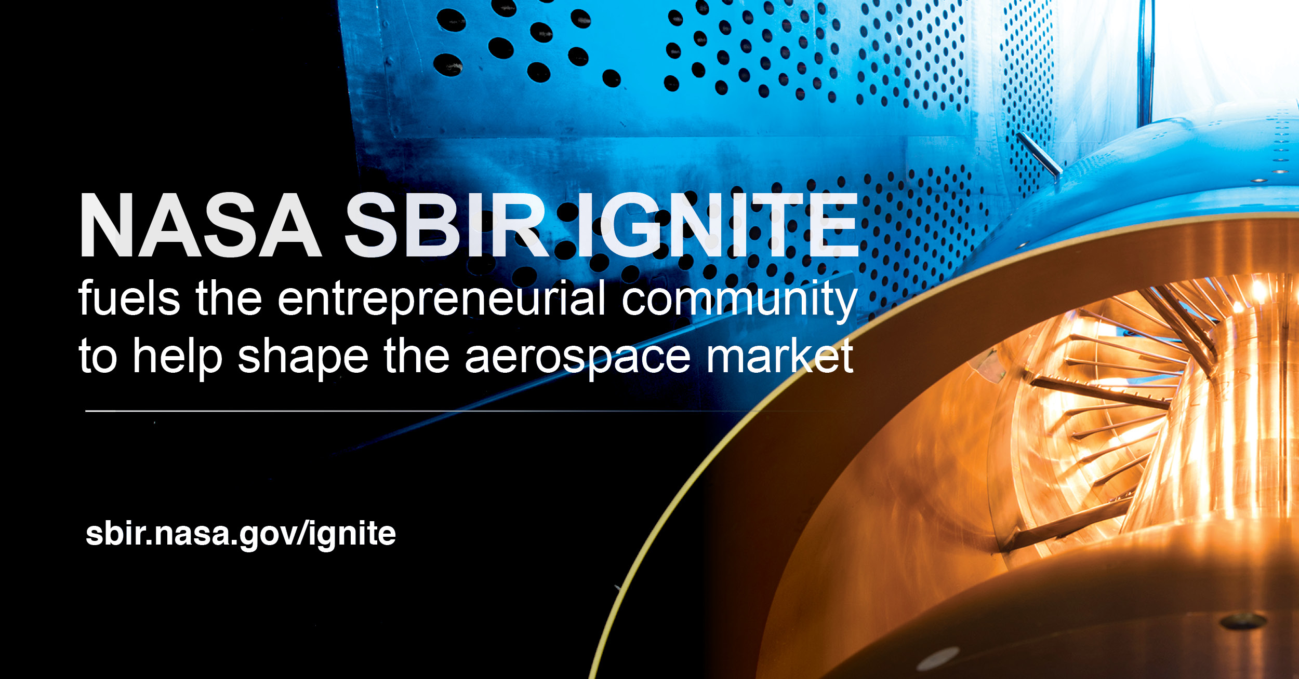
SBIR Ignite vs. Mainline
NASA SBIR Ignite:
Encourages participation from product-driven companies not looking at NASA as their primary customer
Places a heavy emphasis on commercial viability during review and scoring
Streamlines the application process by shortening the solicitation and the proposal requirements
Features the same three phases and funding levels as the main NASA SBIR/STTR solicitations
Read the 2023 Solicitation—open through September 21, 2023—to learn more: https://sbir.nasa.gov/solicit-detail/98342
Awardee Highlights
12 companies selected for Phase I awards in 2022; all selected for Phase II awards in 2023
75% of awardees had never received a NASA SBIR award when they started their Phase Is.
Notes:
Last year, in addition to our 2022 Phase I solicitations, we debuted a new solicitation: NASA SBIR Ignite, which we’re proud to be offering again this year!
As we’ve discussed, the NASA SBIR/STTR program funds the research, development, and demonstration of innovative technologies that fulfill NASA needs as described in the annual solicitations and have significant potential for successful commercialization.
You can see some of the key differences between the two solicitations on this slide. But at a high level:
The NASA SBIR Ignite solicitation is focused on commercialization. While the NASA SBIR/STTR Phase I solicitations also evaluate commercial potential and feasibility, many technologies address a specific NASA challenge or need and have a goal of getting infused into a NASA mission or being sustained with NASA as a key customer. The NASA Ignite solicitation seeks technologies that will stimulate the market and where NASA is not the primary customer.
Some of the key differences between Ignite and the mainline solicitation are...
Commercialization: Ignite seeks tech that will stimulate the market and for which NASA is not the primary customer.
Engagement: Ignite includes direct engagement with a panel of experts for down-selected companies.
Topics: Ignite features a select few topics relevant to emerging commercial markets in aerospace.
Less Prescriptive Solicitation: Ignite encourages companies to maintain their go-to-market strategies
Shorter Proposal: Ignite requires a short proposal and a slide deck in response to the solicitation
Accelerated Award Schedule: Ignite’s Phase II proposals are due earlier in the Phase I period, allowing Phase II awards to be made faster
As always, the best source of information is the solicitation itself. If you’re curious about Ignite, I encourage you to visit our website and review this year’s solicitation—which is open through September 21.

Slide 7
Recent Awards

Slide 8
FY23 Awards Summary
Program​ | # of Awards​ | $ Value of Awards​
SBIR Phase I​ | 245​ | $37,293,693​
SBIR Phase II​ | 112​ | $97,778,147​
STTR Phase I​ | 50​ | $7,651,621​
STTR Phase II​ | 20​ | $15,392,138​
​ | ​ | ​
SBIR Phase II-E​ | 33​ | $9,699,268​
STTR Phase II-E​ | 4​ | $761,881​
CCRPP​ | 3​ | $5,786,190​
Sequentials​ | 5​ | $15,651,917​
​ | ​ | ​
SBIR Phase III​ | 65​ | $74,662,532​
STTR Phase III​ | 3​ | $1,037,196​
SBIR/STTR
Funding = $190M​
​
Non-SBIR/STTR
Funding = $76M​

Slide 9


2022 Phase I & II SBIR/STTR Awards
Separated the SBIR and STTR solicitations to make the difference between programs and different proposal requirements clearer
Separated Phase I and Phase II solicitations to allow for adjustment of requirements before Phase II, if needed
Increased Phase I and Phase II funding
1,392 Proposals/278 Awards
25% underrepresented SBCs
24% First Time Awardees
71% with < 50 employees
SBIR Phase I
$42.2
Million
288 Proposals/124 Awards
22% underrepresented SBCs
72% with < 50 employees
SBIR Phase II
$95.4
Million
131 Proposals/53 Awards
21% underrepresented SBCs
19% partnered with HBCU/MSI
26% First Time Awardees
77% with < 50 employees
STTR Phase I
$8.1
Million
55 Proposals/20 Awards
10% underrepresented SBCs
15% partnered with HBCU/MSI
85% with < 50 employees
STTR Phase II
$15.0
Million
Notes:
The bullets at the top of this slide speak to what changed in FY22…

Slide 10
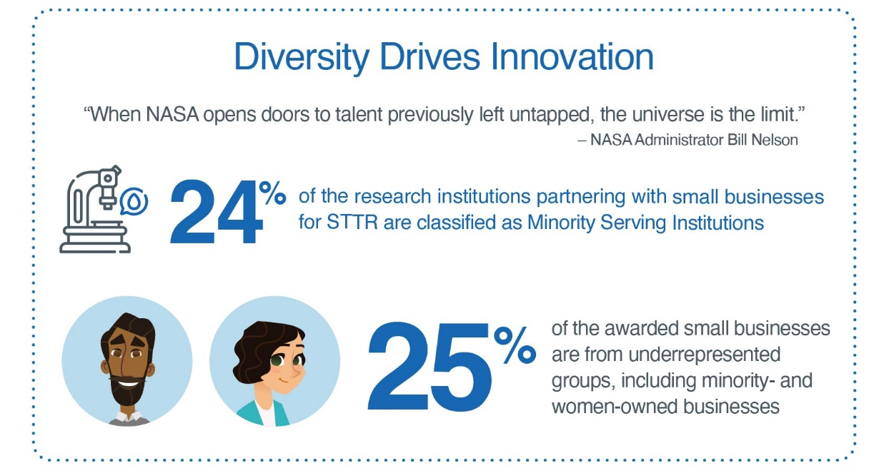
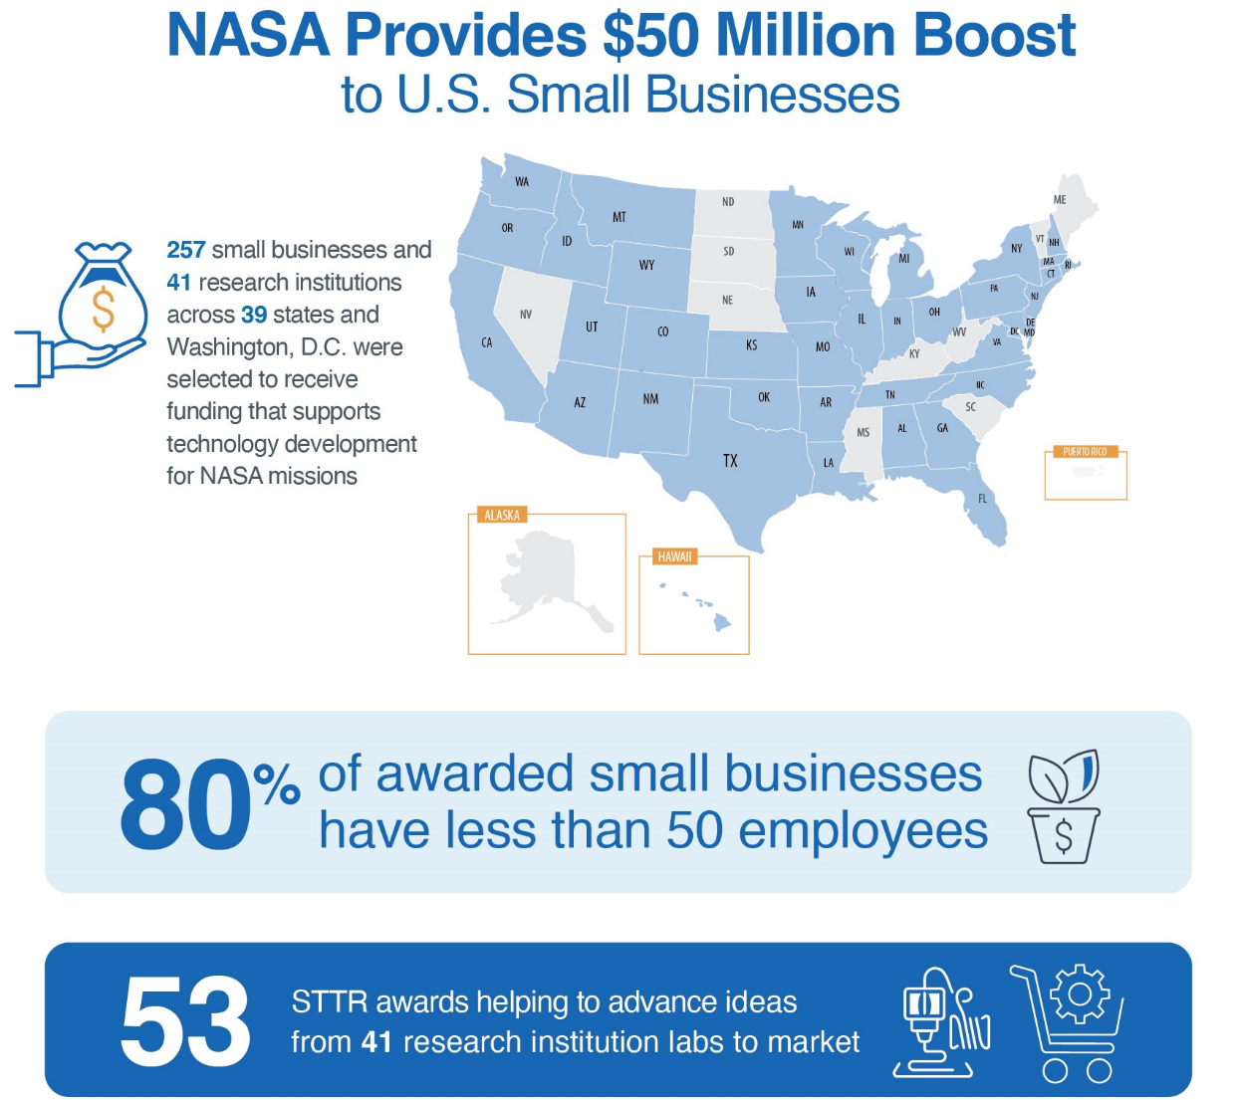
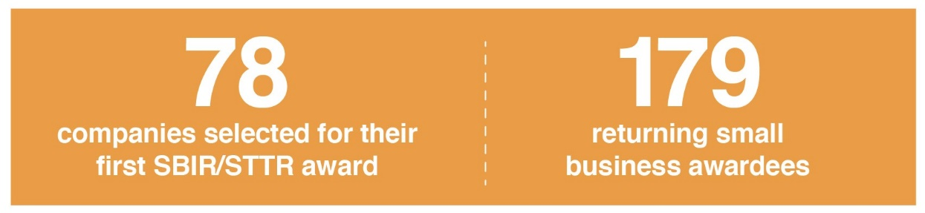
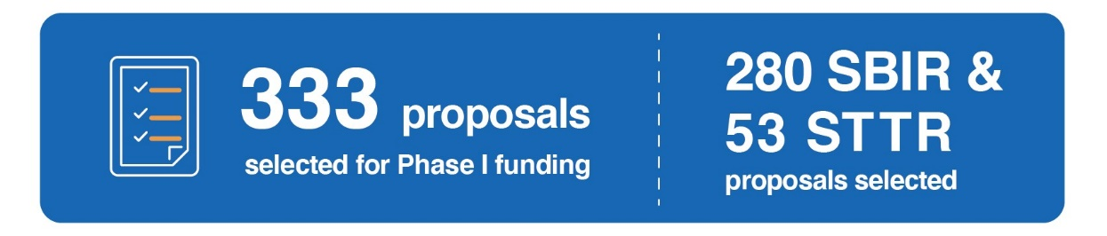
Spotlight: 2022 Phase I Awardees
Notes:
Let me tell you more about our 2022 Phase I awardees.
257 small businesses and 41 research institutions across 39 states and Washington, D.C. were selected to receive funding.
Of those 257 small businesses, 80% have less than 50 employees.
24% of the STTR research institution partners were Minority Serving Institutions, and 25% of the awarded small businesses were from underrepresented groups, including minority-owned and women-owned small businesses.

Slide 11
2022 Post Phase II Highlights
Developed a Sequential Technical Need Area (TNA) in partnership with SMD focused on the Administrator’s priority around climate change
Interest in Phase II-E for both SBIR and STTR exceeded planned budget
Demonstrates strong interest in furthering the development of SBIR/STTR-Funded technologies
Was able to meet demand by shifting funds from CCRPP and Phase I/II
51 Awards
$13.0M SBIR/STTR Funding
$13.8M Investor Funding
($5.9M NASA Investors)
Phase II-E
6 Awards
$8.0M SBIR/STTR Funding
$8.9M Investor Funding
($2.7M NASA Investors)
CCRPP
7 Awards
$29.3M SBIR/STTR Funding
Sequentials
74 Awards
$25.0M Investor Funding*
Phase III
*II-E Match = 21 awards/$3.7M and CCRPP Match = 4 awards/$1.9M
Notes:
Again, the bullets at the top of this slide speak to what changed in FY22…

Slide 12
Spotlights

Slide 13





SBIR/STTR Strategic Plan
VISION
A world where any entrepreneur can benefit humanity
CORE VALUES
Customer-Focused
Teamwork & Collaboration
Commitment to Success
MISSION
Empowering all small business communities to imagine, build, and utilize revolutionary technologies to drive NASA and the national economy to reach new heights
 | Objective 1.1 Approval of a clear definition of “return on investment” the Program seeks for all phases to help target data gathering efforts by 30 September 2023. |  | Objective 1.2 Establish a data analytics capability to support Programmatic decision-making by 31 December 2023.
 | Objective 2.1 Increase participation of MOSB and WOSB within the program. | Objective 2.2 100% of all SBIR/STTR Program initiatives implement appropriate inclusive strategies into program operations. |  | Objective 2.3 Shift variance in selection rates to no less than -1% of the population for underrepresented applicants to increase equity within the RevSel process.
 | Objective 3.1 Establish methodology for acquiring customer satisfaction rating from awardees for quality & sufficiency of the technical support and knowledge sharing provided by NASA for all awardees to support effective award execution. |  | Objective 3.2 Implement one new/major improvement to non-technical offering or program process that will help awardees continue to grow and succeed as a business.
Creating and Measuring Societal Benefit
Demonstrable positive societal benefit to include the Nation, awardees, and the Agency through scientific and technological innovation.
Goal 1
Equitable Access & Diverse Representation
Equitable access for all relevant innovators through increasing diverse representation to create richer SBIR & STTR portfolios.
Goal 2
Exemplary Service for Awardees
An exemplary service providing access to the critical non-monetary support that every awardee needs to successfully progress/transition technology into use.
GOAL 3
Goal 3
Notes:
Here’s our Strategic Plan:
I’m not going to go in depth, but wanted to highlight our Vision, Mission and Goals.
Our Vision is to build towards a world where any entrepreneur can benefit humanity
Our Mission is to empower all small business communities to imagine, build, and utilize revolutionary technologies to drive NASA and the National economy to reach new heights.
Goal 1 – is to be able to demonstrate positive ROI for all of our SBIR/STTR investment vehicles such as our mainline Phase 1/Phase 2, Post Phase II solicitations.
Goal 2 – is to provide equitable access for all innovators by focusing on diverse representation within our program portfolios.
Goal 3 – Is the area that we’re focusing on today, which is providing a world class nonmonetary service that supports awardees to successfully advance their technologies into use.

Slide 14
NASA Organizational Chart

Slide 15
Spotlight: NASA SBIR Ignite
Highlights
Launched in FY22, first awards made in FY23
Encourages participation from product-driven companies not looking at NASA as their primary customer
Places a heavy emphasis on commercial viability during review and scoring
Streamlines the application process by shortening the solicitation and the proposal requirements
Features the same three phases and funding levels as the main NASA SBIR/STTR solicitations
Key Differences from our Mainline Solicitation
Commercialization: Seeks tech that will stimulate the market and for which NASA is not the primary customer.
Engagement: Includes direct engagement with a panel of experts for down-selected companies.
Topics: Features a select few topics relevant to emerging commercial markets in aerospace.
Less Prescriptive Solicitation: Encourages companies to maintain their go-to-market strategies
Shorter Proposal: Requires a short proposal and a slide deck in response to the solicitation
Accelerated Award Schedule: Phase II proposal due earlier in the Phase I period, allowing Phase II awards to be made faster
Notes:
The NASA SBIR/STTR program is in its second year offering SBIR Ignite—a new way for small businesses that have a commercially-viable technology idea to use NASA as a stepping stone in their path towards commercial success. With a greater emphasis on commercialization, SBIR Ignite funds U.S. early-stage, high-risk technology development to help make companies and their technologies more attractive to private sector investors, customers, and partners.
Note that this is an opportunity offered exclusively to small businesses through SBIR right now; there is no STTR equivalent.
What makes Ignite different from the program’s mainline solicitation? A few things.
First is the heightened focus on commercialization. While the NASA SBIR/STTR Phase I solicitations also evaluate commercial potential and feasibility, many technologies address a specific NASA challenge or need and have a goal of getting infused into a NASA mission or being sustained with NASA as a key customer. The Ignite solicitation seeks technologies that will stimulate the market and where NASA is not the primary customer.
The solicitation and submission processes are also different—there are fewer topics, a less prescriptive solicitation, a shorter proposal, and an accelerated award schedule.
But, while these differences exist, the phases and funding amounts are the same as the mainline—up to $150K in Phase I, $850K in Phase II, etc.
The next SBIR Ignite solicitation is expected to open this summer.

Slide 16
Spotlight: MPLAN
The Minority University Research and Education Project Partnership Annual Notification (MPLAN) connects is designed to connect Minority Serving Institutions (MSIs) with NASA Mission Directorates and promotes research collaboration.
This is the first year MPLAN awards are being offered.
MPLAN features topic areas from three NASA Mission Directorates; STMD’s MPLAN opportunity is the evolution of previous years’ M-STTR planning grants (offered in FY21 and FY22).
MPLAN awards provide up to $50,000 in funding (to be shared with a small business) and NASA guidance to MSIs in preparation for larger funding opportunities like the NASA STTR solicitation.
The 2023 NASA MPLAN solicitation is open now through May 30, 2023.
Notes:
Feedback from past program participants indicated that one of the persistent challenges faced when applying to STTR is the need to both build a partnership and co-create a strong technology proposal so quickly. The M-PLAN planning grants intend to address that challenge by cultivating partnerships and enabling the two sides to engage in substantive conversations about shared areas of interest, goals, and long-term outcomes before applying for a Phase I award.

Slide 17
Success Stories: Infusion & Commercialization

Slide 18
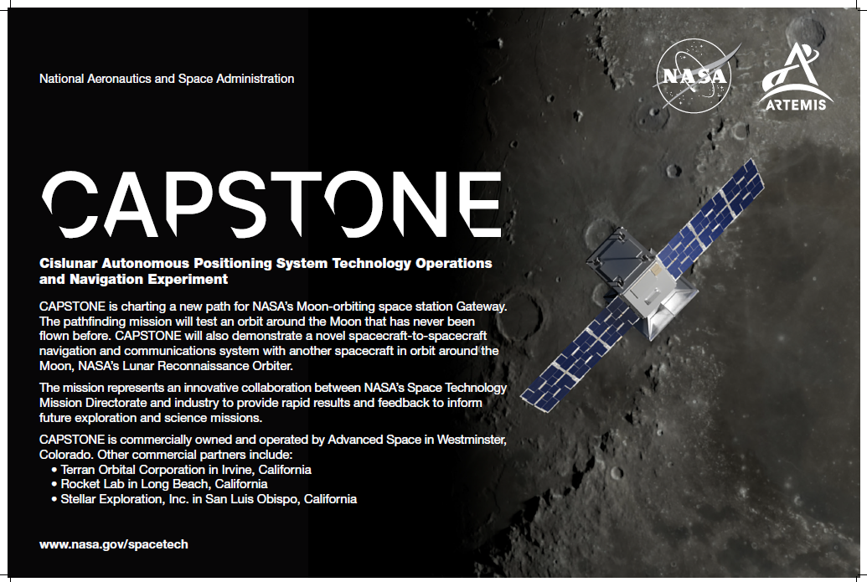
Notes:
As you all know, CAPSTONE will be the first spacecraft to fly a unique orbit around the Moon that will be used for Gateway, NASA’s future Moon-orbiting outpost. This mission is owned and operated by former SBIR awardee Advanced Space, LLC, based in Westminster, CO. Advanced Space began working with the NASA SBIR program in 2015 and since then has received 18 SBIR/STTR contracts to fund a host of projects.
For example, a key software being tested on the mission – the Cislunar Autonomous Positioning System (or CAPS) – was developed by Advanced Space through NASA’s SBIR program. CAPS will allow future spacecraft to determine their location without having to rely exclusively on tracking from Earth, allowing them to perform on their own without needing as much support from the ground.
Advanced Space’s work on CAPSTONE was also supported by a NASA SBIR Phase III contract funded by NASA’s Small Spacecraft Technology Program. The company has also received support for other initiatives through STTR.
Many of the other partners on CAPSTONE are alums of NASA’s SBIR/STTR program as well, including companies like Stellar Exploration, Inc., who received SBIR funding that led to the development and building of CAPSTONE’s propulsion system. When CAPSTONE launches, it will demonstrate the advantages of NASA’s investments in small business collaborations and represent a starting point for the next stage of lunar exploration.
I want to share a quote that we have found especially meaningful from Chris Baker, the Program Executive of both Small Spacecraft Technology Program and the Flight Opportunities Program. “The interplay between small businesses and small spacecraft has driven this industry. These innovative, faster, lower cost missions simply would not exist without the leadership of the small business, start-up, and academic communities.”
Notes on the other two “commercial partners” listed on the slide:
Rocket Lab received nearly $100,000 in SBIR funding from the Department of Defense in 2015 which led to their ability to use their launch complex in New Zealand to send the CubeSat beyond Earth
Terran Orbital Corp developed the CubeSat that is used on CAPSTONE and their contributions are “supported in partnership with Advanced Space through its SBIR contract”; they are also a recipient of seven SBIR/STTR contracts with NASA for other projects

Slide 19
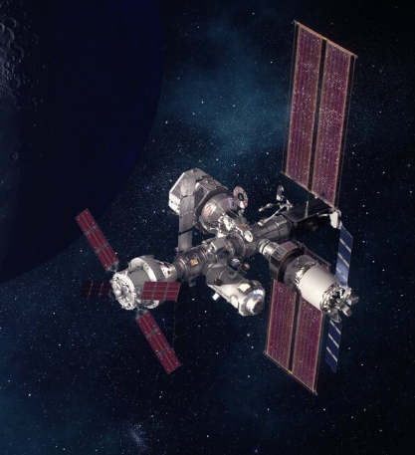
SBIR Sequential Phase II: Technology for Gateway
Robust System Health Management for Deep Space Missions - Qualtech Systems, Inc. (QSI)
The firm has been awarded a “follow-on” Phase III contract for $350,000 to implement its technology in support of NASA Gateway. The Phase III project will complete work to infuse the fault management technology developed under this Lunar Sequential SBIR project into the Gateway Vehicle System Manager (VSM) flight software that will be launched into Lunar orbit in 2025. The project will collaborate with the Gateway Program to assist with flight software integration, test, verification and certification of the product as a part of the on-board safety-critical software. The project will provide rapid response issue resolution for any problems that may arise during test and integration, provide expertise in best use of the technology, and develop any new or improved features required by NASA that are identified during Gateway autonomous fault management software development.
It was determined by Gateway to fund this Phase III before the Sequential effort was complete such that this would be an immediate follow-on to the Sequential effort to support Gateway, a critical asset in NASA’s Artemis Program. This will also serve to certify and demonstrate this capability which may then have a wide range of applications to other NASA missions and assets.

Slide 20
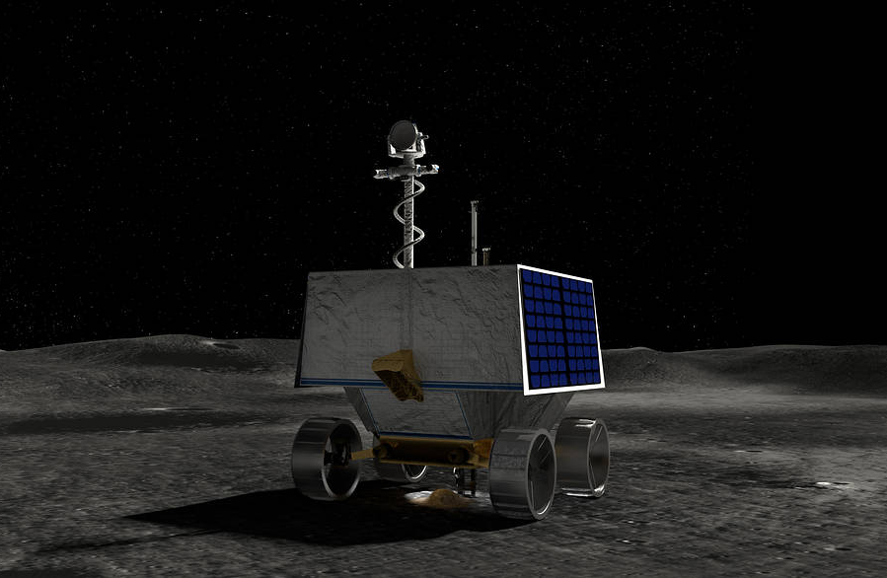
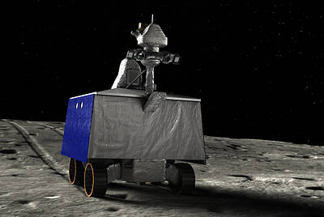
SBIR Sequential Phase II: Technology for VIPER
Rover Slip Estimation and Traction Control for Optimal Mobility in Lunar Environments - Protoinnovations, LLC
The firm has been awarded a “follow-on” Phase III contract for $775,000 to implement its technology on the NASA VIPER mission. This Phase III contract will focus on extending and adapting SBIR innovations developed by ProtoInnovations to support the NASA Volatiles Investigating Polar Exploration Rover (VIPER) mission. These technologies are needed by VIPER to improve the mission’s rover locomotion performance, particularly for traversing terrain with uncertain terramechanical properties and hazards. VIPER is a lunar rover mission that will prospect for water ice near the South Pole of the Moon. VIPER represents the first resource mapping mission on another celestial body and is scheduled to launch in late 2023.
Due to the development status of VIPER and the progress of this Sequential award, it was determined that this technology was at a state where it could address a risk that VIPER had been carrying. This accelerated development advanced the technology to a state where it could be infused into VIPER (whose development had been ongoing) in a timely manner to support the mission. Note that it was determined to make this Phase III award and begin the infusion of the technology even before the completion of the Sequential Phase II effort! The potential impact on the VIPER mission and the progress to date was deemed significant enough to warrant that infusion.

Slide 21
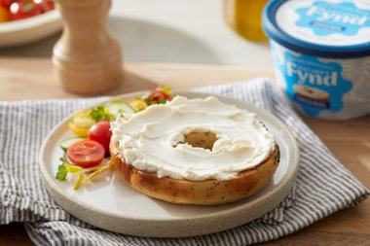
We Promote Commercialization in the Marketplace
A microbe found in Yellowstone National Park during NASA-funded research is now the basis of a fungal protein from which Chicago-based Nature’s Fynd produces meat-alternative breakfast patties and non-dairy cream cheese. The protein is also growing on the International Space Station as potential astronaut food, and the company believes it could one day help ensure sustainable nutrition globally.
Nature’s Fynd partnered with Montana State University on STTR Phase I & II contracts to further develop a system that cultivates a unique fungus to form a dense, edible protein​. As a result of the STTR work, they received additional NASA funding to test the protein on the ISS.
The small business has secured more than $500M in external investments, including from a fund established by Bill Gates to help stop climate change as well as a sustainable investment firm co-founded by Al Gore​.
In 2021, they launched their meatless and dairy-free foods in retailers​.
Notes:
An example of the impact we’re making for everyday Americans--offering new items for them to buy in the grocery store and feed their families. If you have a Sprouts or Whole Foods around you, you may be able to find their cream cheese or vegan breakfast patties!

Slide 22
Questions
Jason L. Kessler, Program Executive
Jason.L.Kessler@nasa.gov

