Slide 1
PACE OCI Response Versus Scan Angle Measurement from Pre-launch Testing
Jeff McIntire¹, Eugene Waluschka², Gerhard Meister³, Joseph Knuble³ and William B Cook³
¹SSAI
²Stellar Solutions
³NASA GSFC
International Ocean Colour Science Meeting 2023
St Petersburg, FL
November 14, 2023

Slide 2
Overview
PACE OCI response versus scan angle (RVS) measurements
Characterized at the NASA GSFC facility
Measured in 2022 for the flight unit (early 2022 and late 2022)
Tested under ambient conditions
Purpose
To characterize the reflectance change with scan angle for OCI, which is necessary to correct the TOA radiance and reflectance products accurately
Test
Observe an extended white light source at various scan angles and measure the OCI response
Analysis
Perform data quality checks
Determine the variation in reflectance with scan angle
Determine the total uncertainty for the correction
Compare to sensor design requirements

Slide 3
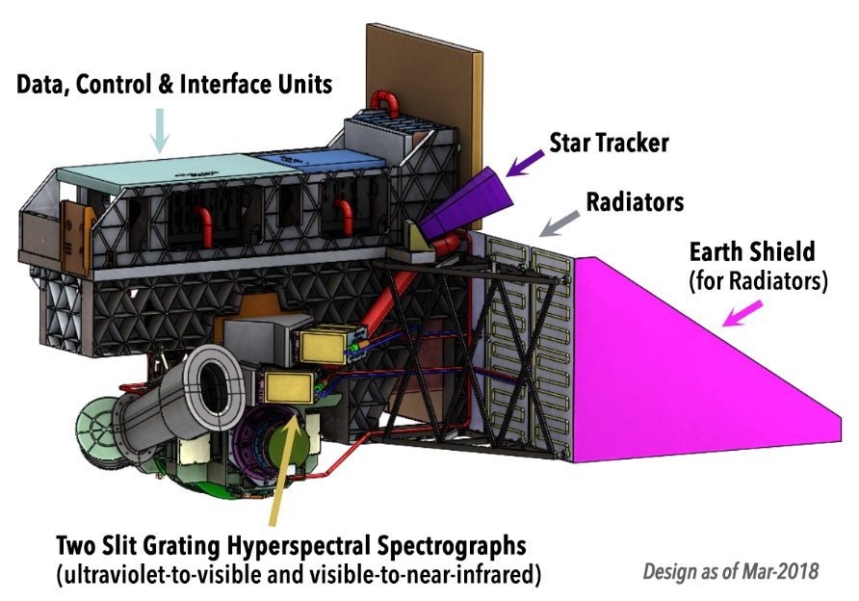
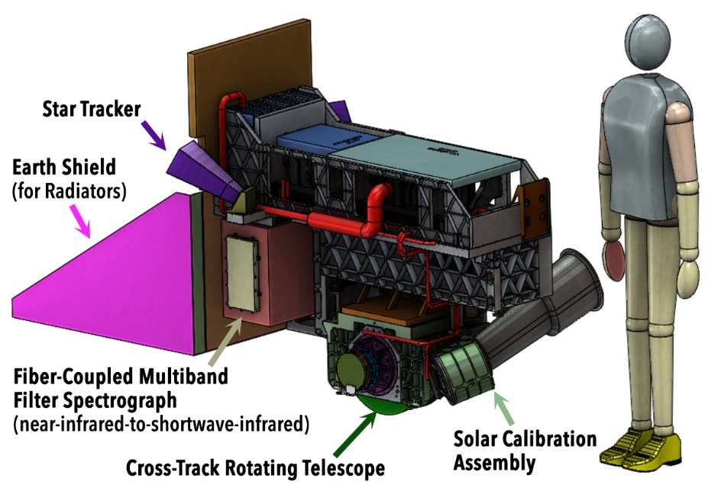
OCI Overview (I)
OCI Instrument Overview – Next Generation NASA Ocean Color Instrument
OCI is a grating spectrometer
Hyperspectral coverage from ~315 nm to 895 nm with 5 nm bandwidth
Two gratings direct light onto two CCDs
Additional channels in the SWIR (InGaAs or HgCdTe)
940, 1038, 1250, 1378, 1615, 2130, and 2260 nm
OCI has a rotating telescope to scan the Earth in the cross-track direction
SeaWiFS and VIIRS heritage
Half Angle Mirror (HAM) rotates at half the speed of the telescope
Slit after the HAM is imaged onto the CCDs or SWIR detectors

Slide 4
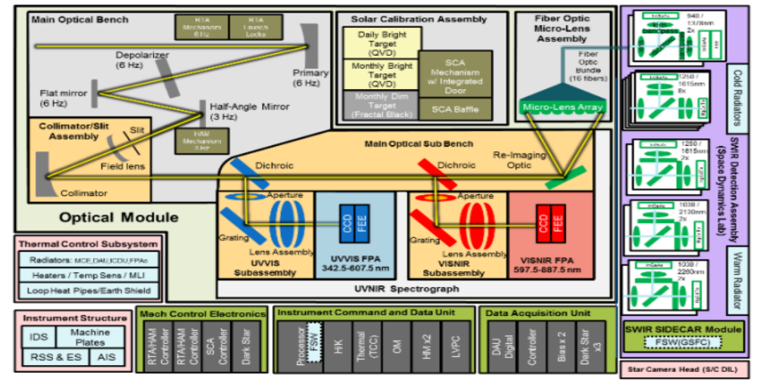
OCI Overview (II)
CCDs have variable spatial and spectral aggregation schemes
An 8 x 8 array of physical pixels is combined into a science pixel
About 1050 meter square ground footprint at nadir
TDI is used in the spatial direction to increase the signal to noise
16 science pixels are summed as the image moves along the slit
OCI can operate in a number of different sensor modes
Science, solar cal, lunar cal, Earth cal, engineering, and snapshot
Science is the nominal mode measuring a ±56.5 degree off nadir swath
Dark view is included in almost all modes
Solar cal view at -90 degrees off nadir
Diffuser assembly has 3 diffusers (daily, monthly, and dim)
Eric T. Gorman, et al., "The NASA Plankton, Aerosol, Cloud, ocean Ecosystem (PACE) mission: an emerging era of global, hyperspectral Earth system remote sensing," Proc. SPIE 11151, Sensors, Systems, and Next-Generation Satellites XXIII, 111510G (10 October 2019)

Slide 5
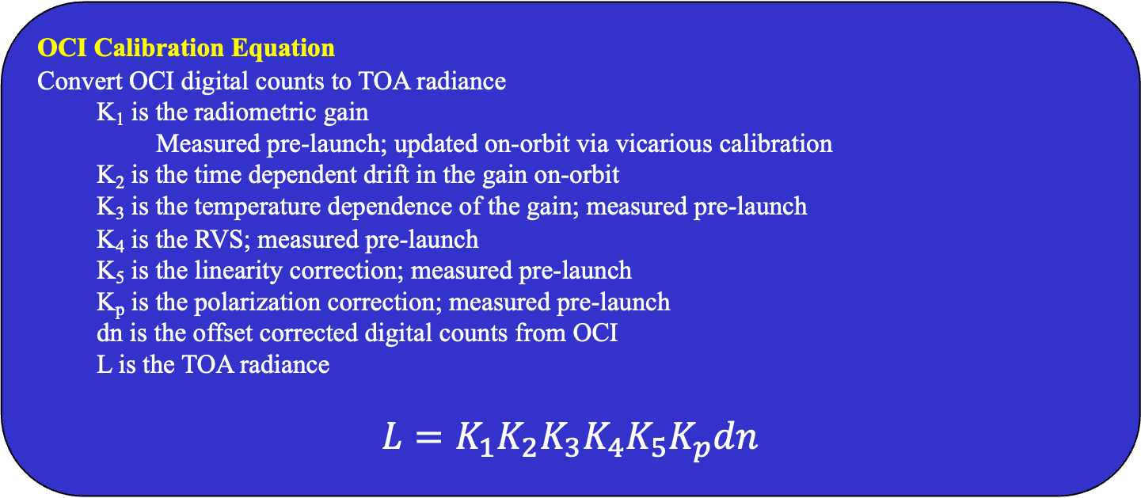
OCI Calibration
OCI Calibration Equation
Convert OCI digital counts to TOA radiance
K₁ is the radiometric gain
Measured pre-launch; updated on-orbit via vicarious calibration
K₂ is the time dependent drift in the gain on-orbit
K₃ is the temperature dependence of the gain; measured pre-launch
K₄ is the RVS; measured pre-launch
K₅ is the linearity correction; measured pre-launch
K_{p} is the polarization correction; measured pre-launch
dn is the offset corrected digital counts from OCI
L is the TOA radiance
$$L=K_{1}K_{2}K_{3}K_{4}K_{5}K_{p}dn$$

Slide 6
Test Setup
OCI Test Setup
OCI was positioned on a rotary table with the scan plane perpendicular to gravity
OCI was rotated such that it views an integrating sphere at a series of discrete scan angles
Ground support equipment will provide source and environment information during the test
Nominal OCI position on the rotating table obscures the solar calibration view
OCI was repositioned on the table to measure the solar calibration view
Rotary Table
Integrating Sphere
Light
OCI
Scan Plane
Gravity

Slide 7
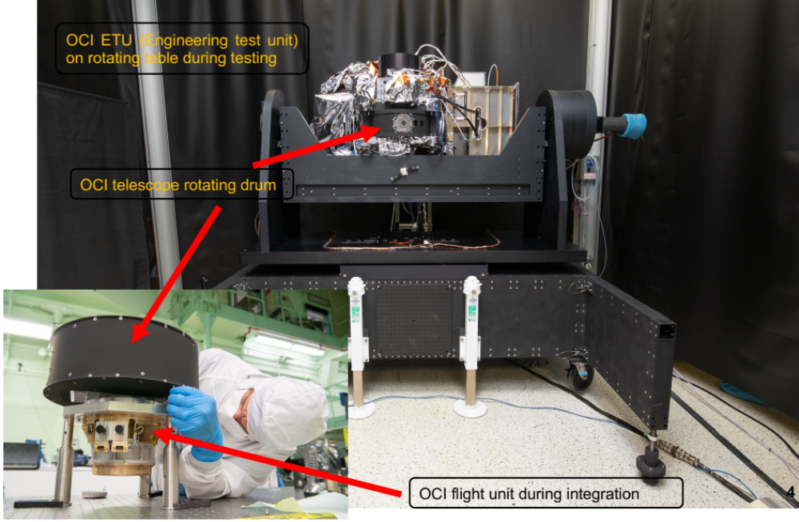
OCI Test Setup

Slide 8
Ground Support Equipment
Ground Support Equipment
Integrating sphere
20 inch integrating sphere with an 8 inch circular aperture
Sources used to illuminate the sphere:
Energetiq EQ-400 source
150 Watt halogen lamp at 50%
Sphere aperture was 47 inches from the OCI telescope aperture in ambient
A SR-4500 radiometer was used to measure the source radiance in real-time
Temperature / Humidity monitors measured the laboratory conditions in real-time
Rotating table
Rotated to view the sphere at different scan angles
To view the solar calibration angle, OCI repositioned on the rotating table
  A riser was installed between the table and OCI
  The rotation axis of OCI was no longer coincident with the table rotation axis

Slide 9
Test
Test Description
Data taken in 8x4 mode (full spatial aggregation and some spectral aggregation)
Data was taken at a series of scan angles
13 discrete scan angles in the science view (±56.5 degrees off nadir)
Each measurement was repeated 3 times (0 degrees 4 times)
Two scan angles measured in the solar cal configuration
-90 and -51 degrees off nadir
Solar diffuser assembly was not installed
OCI took data for about 35 seconds for every measurement (~200 rotations of the telescope)
Dark offset was measured inside the drum for rotating tests
Early 2022 test measured under ambient conditions
  HgCdTe bands were not cooled; measured on a single MCE side
  SCA measurements were taken
  Discovered that MCE side may influence path, especially for SWIR bands
Late 2022 test measured under ambient conditions (retest)
  HgCdTe bands were not cooled, measured on both MCE sides
  No SCA measurement were taken
Combine late 2022 test data with early 2022 SCA measurements to get final RVS
HgCdTe bands RVS was modelled from InGaAs bands
  Based on fiber position and component measurements

Slide 10
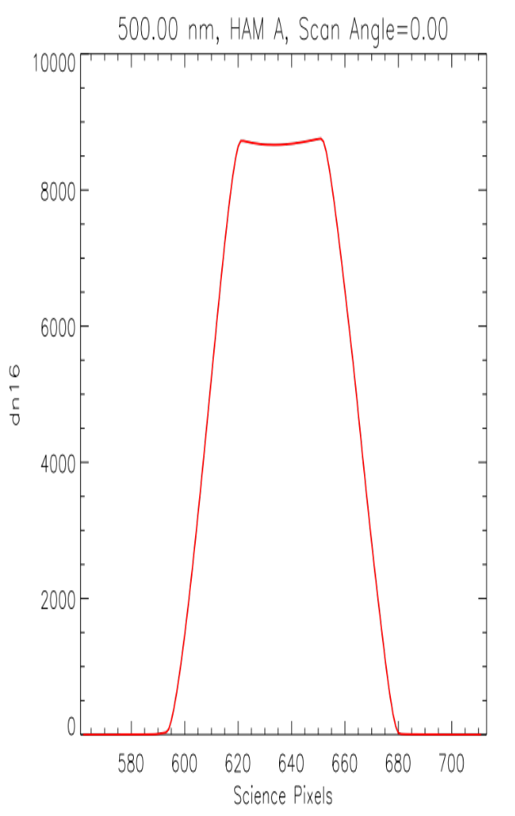
Test Data
Test Data
Plot: scan profile -- OCI’s footprint moves across the source
“Flat top” when footprint is fully within the source aperture
Determine centroid of scan profile, select pixel range around centroid for processing
Average over selected pixels, then drift correct for lamp drift

Slide 11
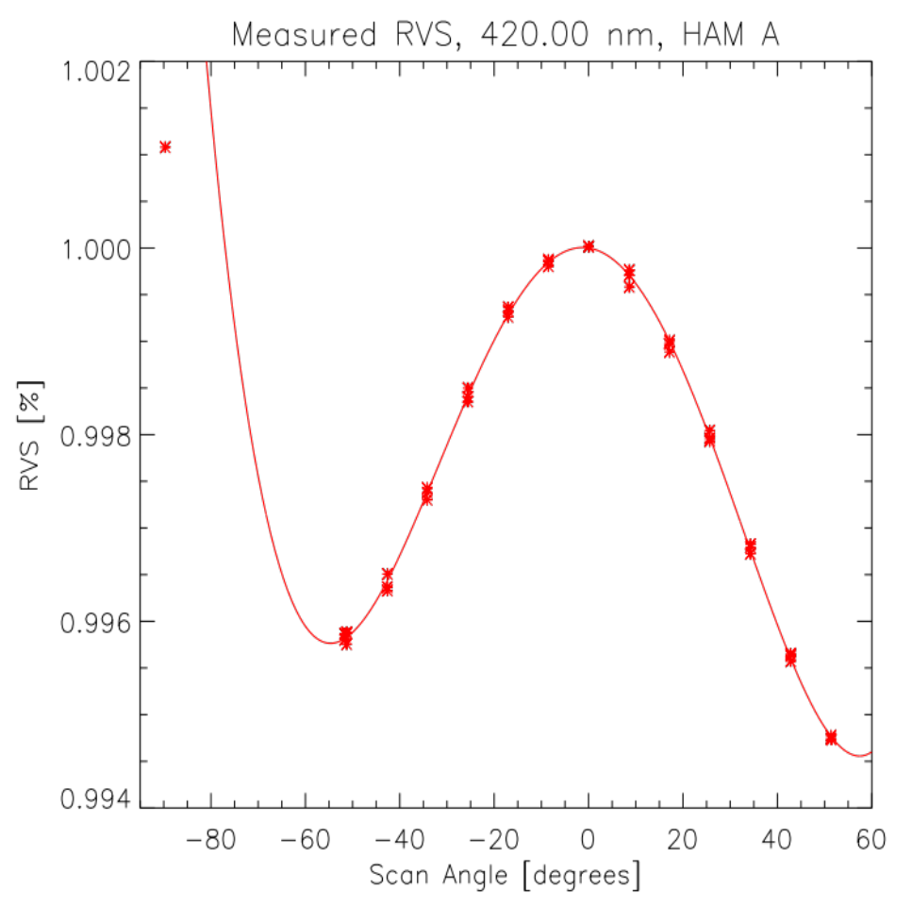
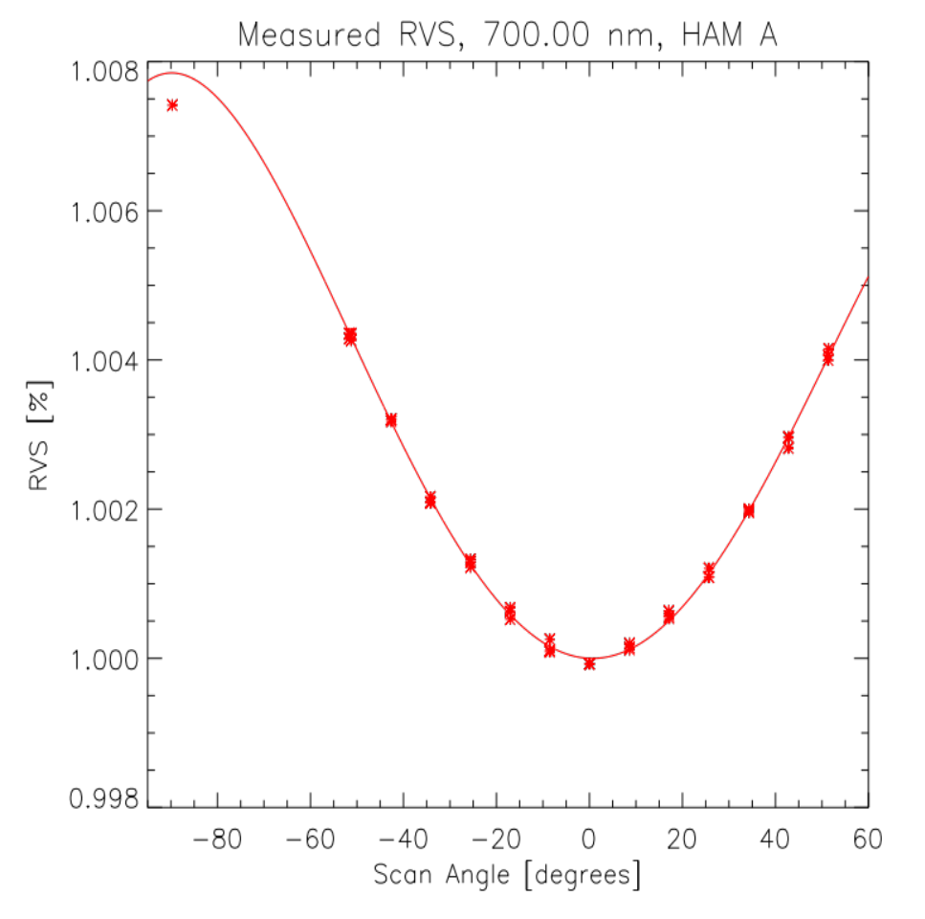
RVS Fitting
RVS Fitting
OCI data plotted (symbols) with fits (lines)
Fourth order polynomial fits the data pretty well (SCA angle not always consistent)
Initially quadratic polynomial was used, but asymmetry was observed

Slide 12
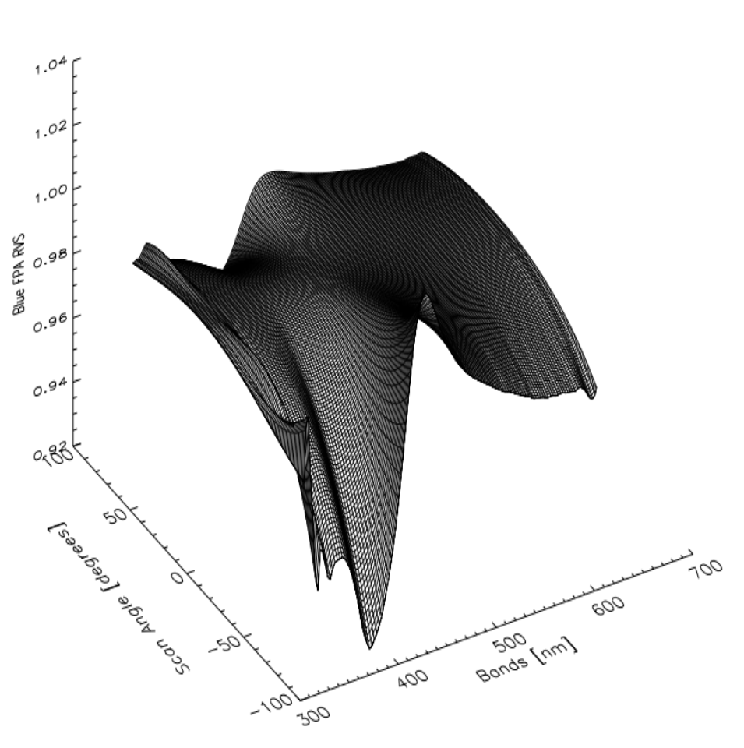
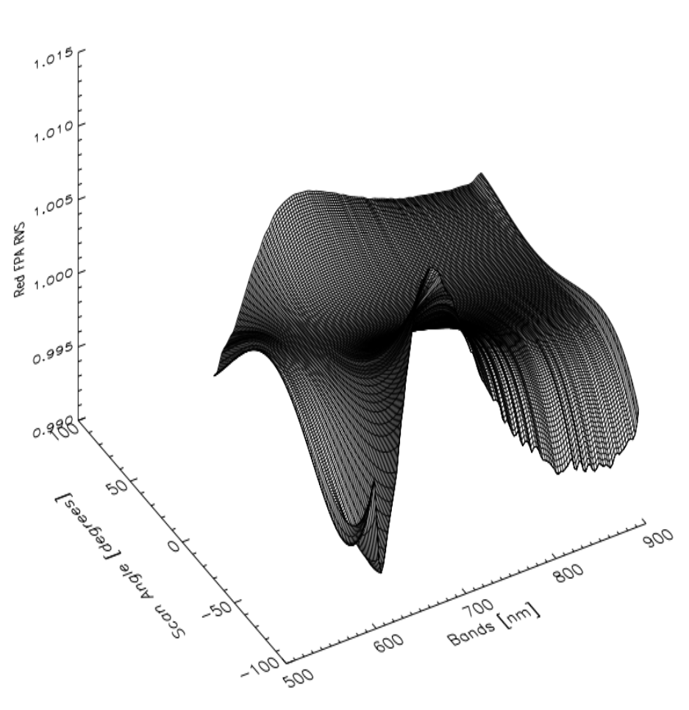
RVS Fitting
RVS Fitting –- Hyperspectral Bands
Left plot: blue FPA RVS; right plot: red FPA RVS
Plots show change in RVS with wavelength
RVS is generally small (less than 1%), but can be as high as 2.5%

Slide 13
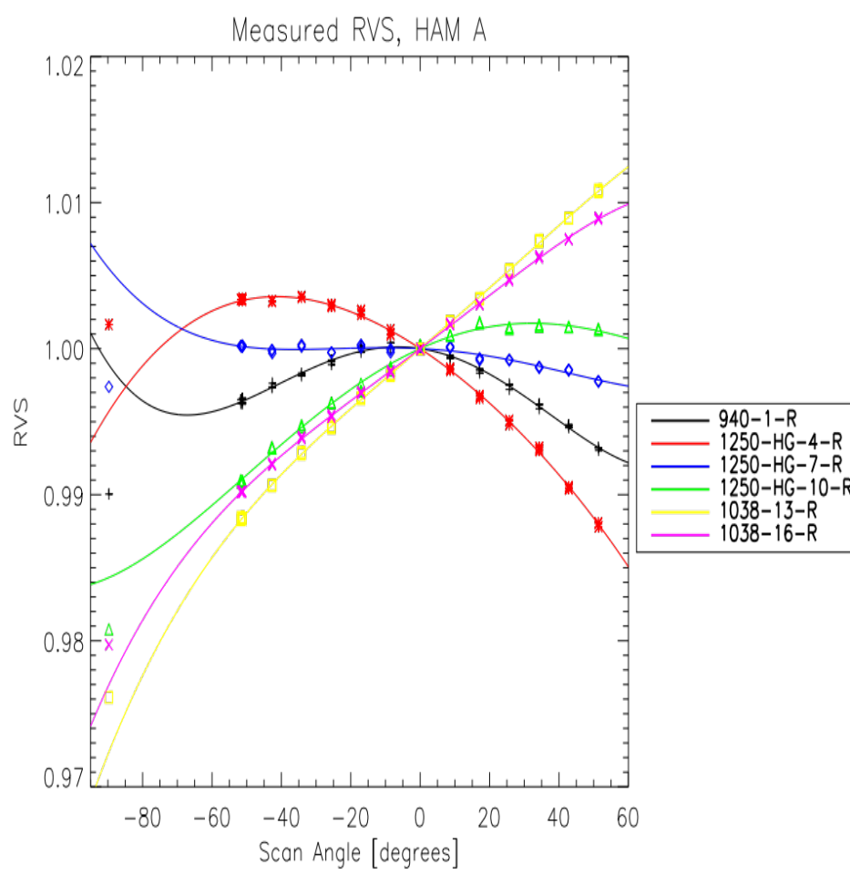
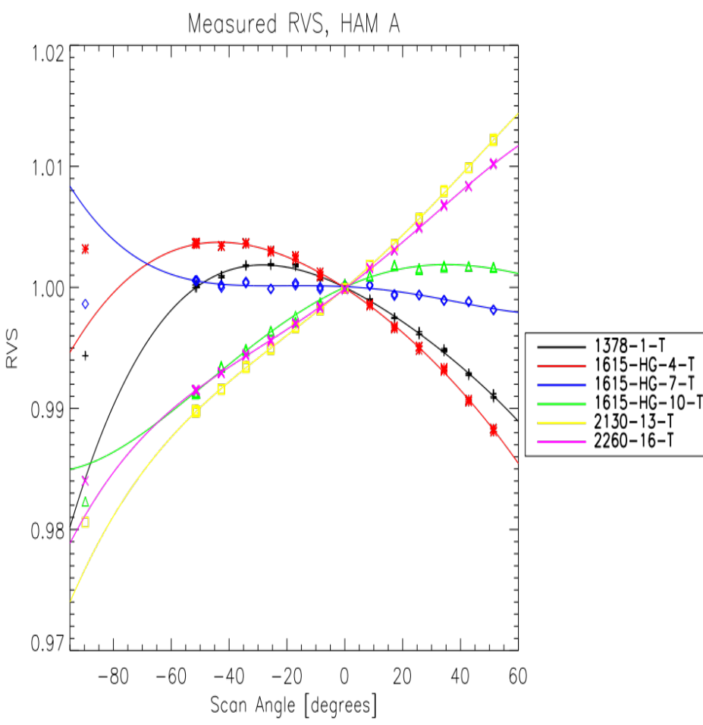
RVS Fitting
RVS Fitting –- SWIR Bands
Left plot: InGaAs RVS; right plot: HgCdTe RVS
Plots show change in RVS with wavelength
RVS varies with position on MLA; can be small or up to 3%
HgCdTe RVS modelled from component RVS and InGaAs RVS

Slide 14
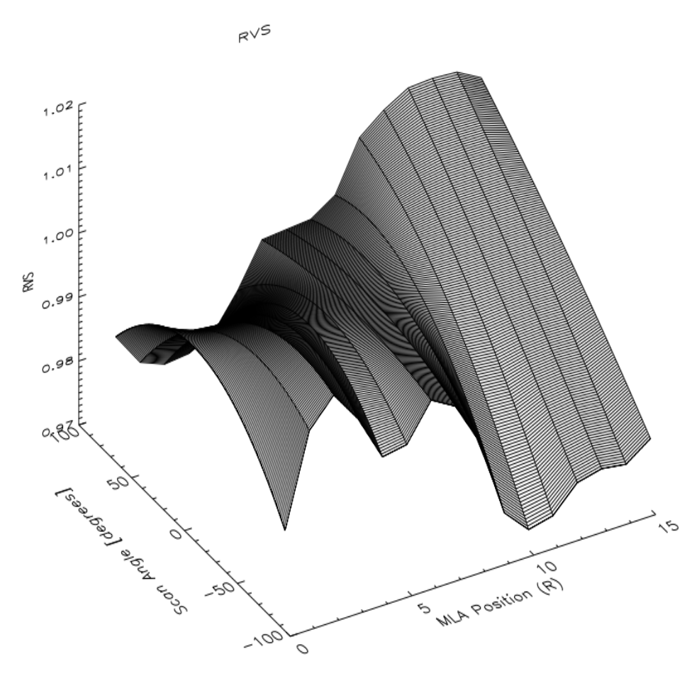

RVS Fitting
RVS Fitting –- SWIR Bands
Left plot: InGaAs RVS; right plot: HgCdTe RVS
Plots show change in RVS with wavelength
RVS is generally small (less than 1%), but can be as high as 2.5%

Slide 15
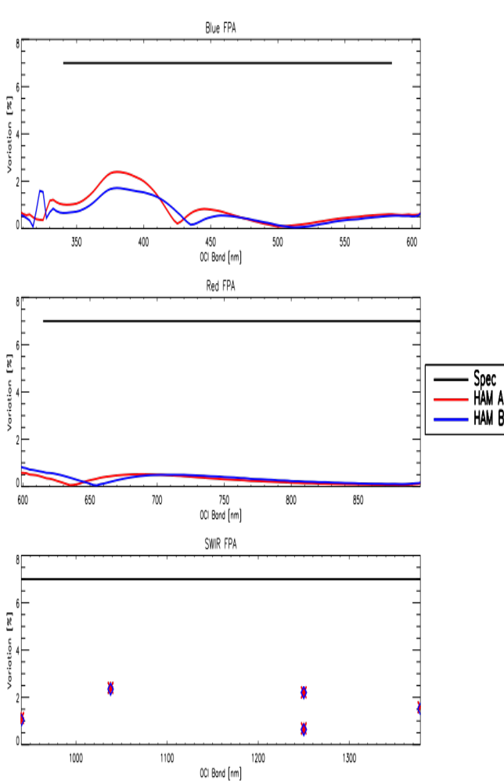
Maximum RVS Variation
Maximum RVS Variation over Scan Range
Upper plot: blue FPA; Middle plot: red FPA; Lower plot: SWIR FPA (InGaAs only)
Black line – design requirement (5%)
Variation larger in blue (350 – 450 nm) with up to 2.5%; SWIR bands also as high as 2%
Most bands are below 1%

Slide 16
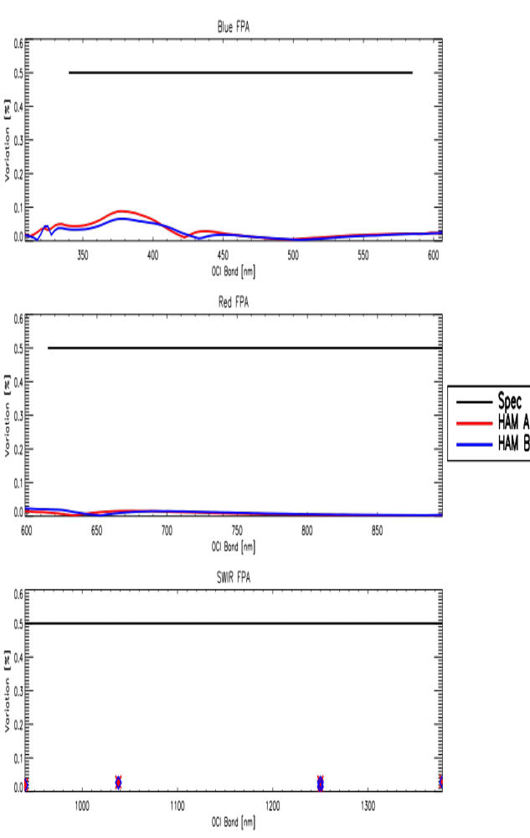
Maximum RVS Variation
Maximum RVS Variation per Degree Scan Angle
Upper plot: blue FPA; Middle plot: red FPA; Lower plot: SWIR FPA (InGaAs only)
Black line – design requirement (0.5%)
Variation larger in blue (350 – 450 nm) with up to 0.1%
Most bands showed very low variation per degree scan angle

Slide 17
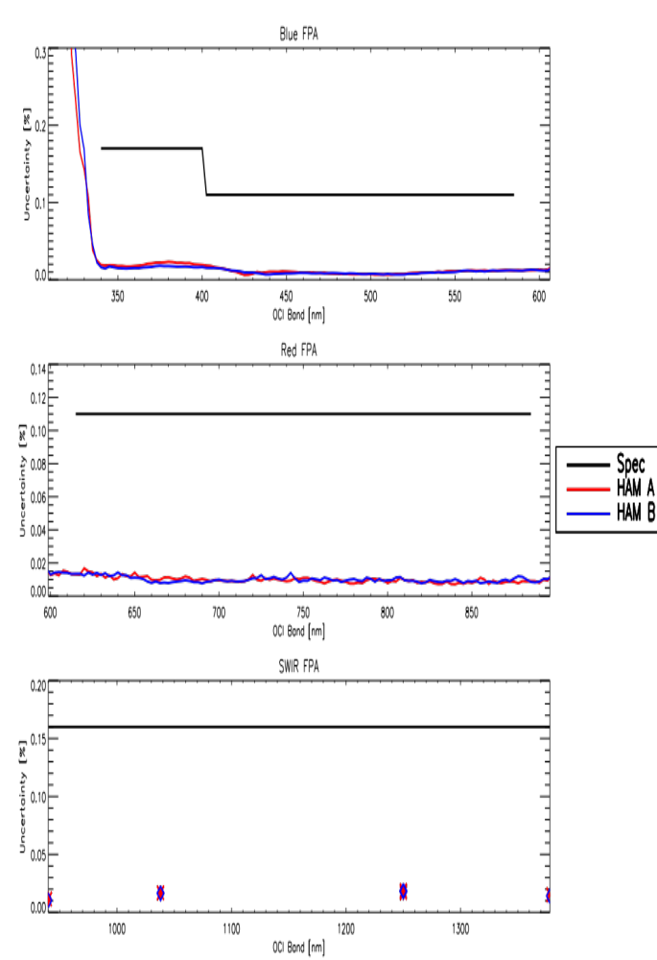
RVS Uncertainty
Maximum RVS Uncertainty
Upper plot: blue FPA; Middle plot: red FPA; Lower plot: SWIR FPA (InGaAs only)
Black line – design requirement (0.11% above 400 nm; 0.17 below 400 nm)
Uncertainties usually in the 0.02 % range, except below 340 nm

Slide 18
RVS Uncertainty
Maximum RVS Uncertainty – HgCdTe Bands
Table shows the uncertainties in the optical model, maximum uncertainty in the InGaAs bands, and prediction error for the 1378nm from the 940nm measurements. The Total uncertainty is the RSS of the three contributors.
 | 1615 nm | 2130 nm | 2260 nm
Model | 0.6% | 0.75% | 0.92%
InGaAs | 0.058% | 0.058% | 0.058%
940 / 1378 | 0.4% | 0.4% | 0.4%
Total | 0.72% | 0.85% | 1.00%
 | 940 nm | 1038 nm | 1250 nm SG | 1250 nm HG | 1378 nm
Total | 0.01% | 0.02% | 0.02% | 0.02% | 0.02%

Slide 19
Conclusions
OCI RVS testing was completed and was successful
RVS and uncertainty were measured
Included all bands over a range of scan angles
Tables were delivered for use in on-orbit corrections
Design requirements were met, indicating expected on-orbit performance will be good
Acknowledgements:
OCI Calibration Working Group
OCI Test Team

