Slide 1


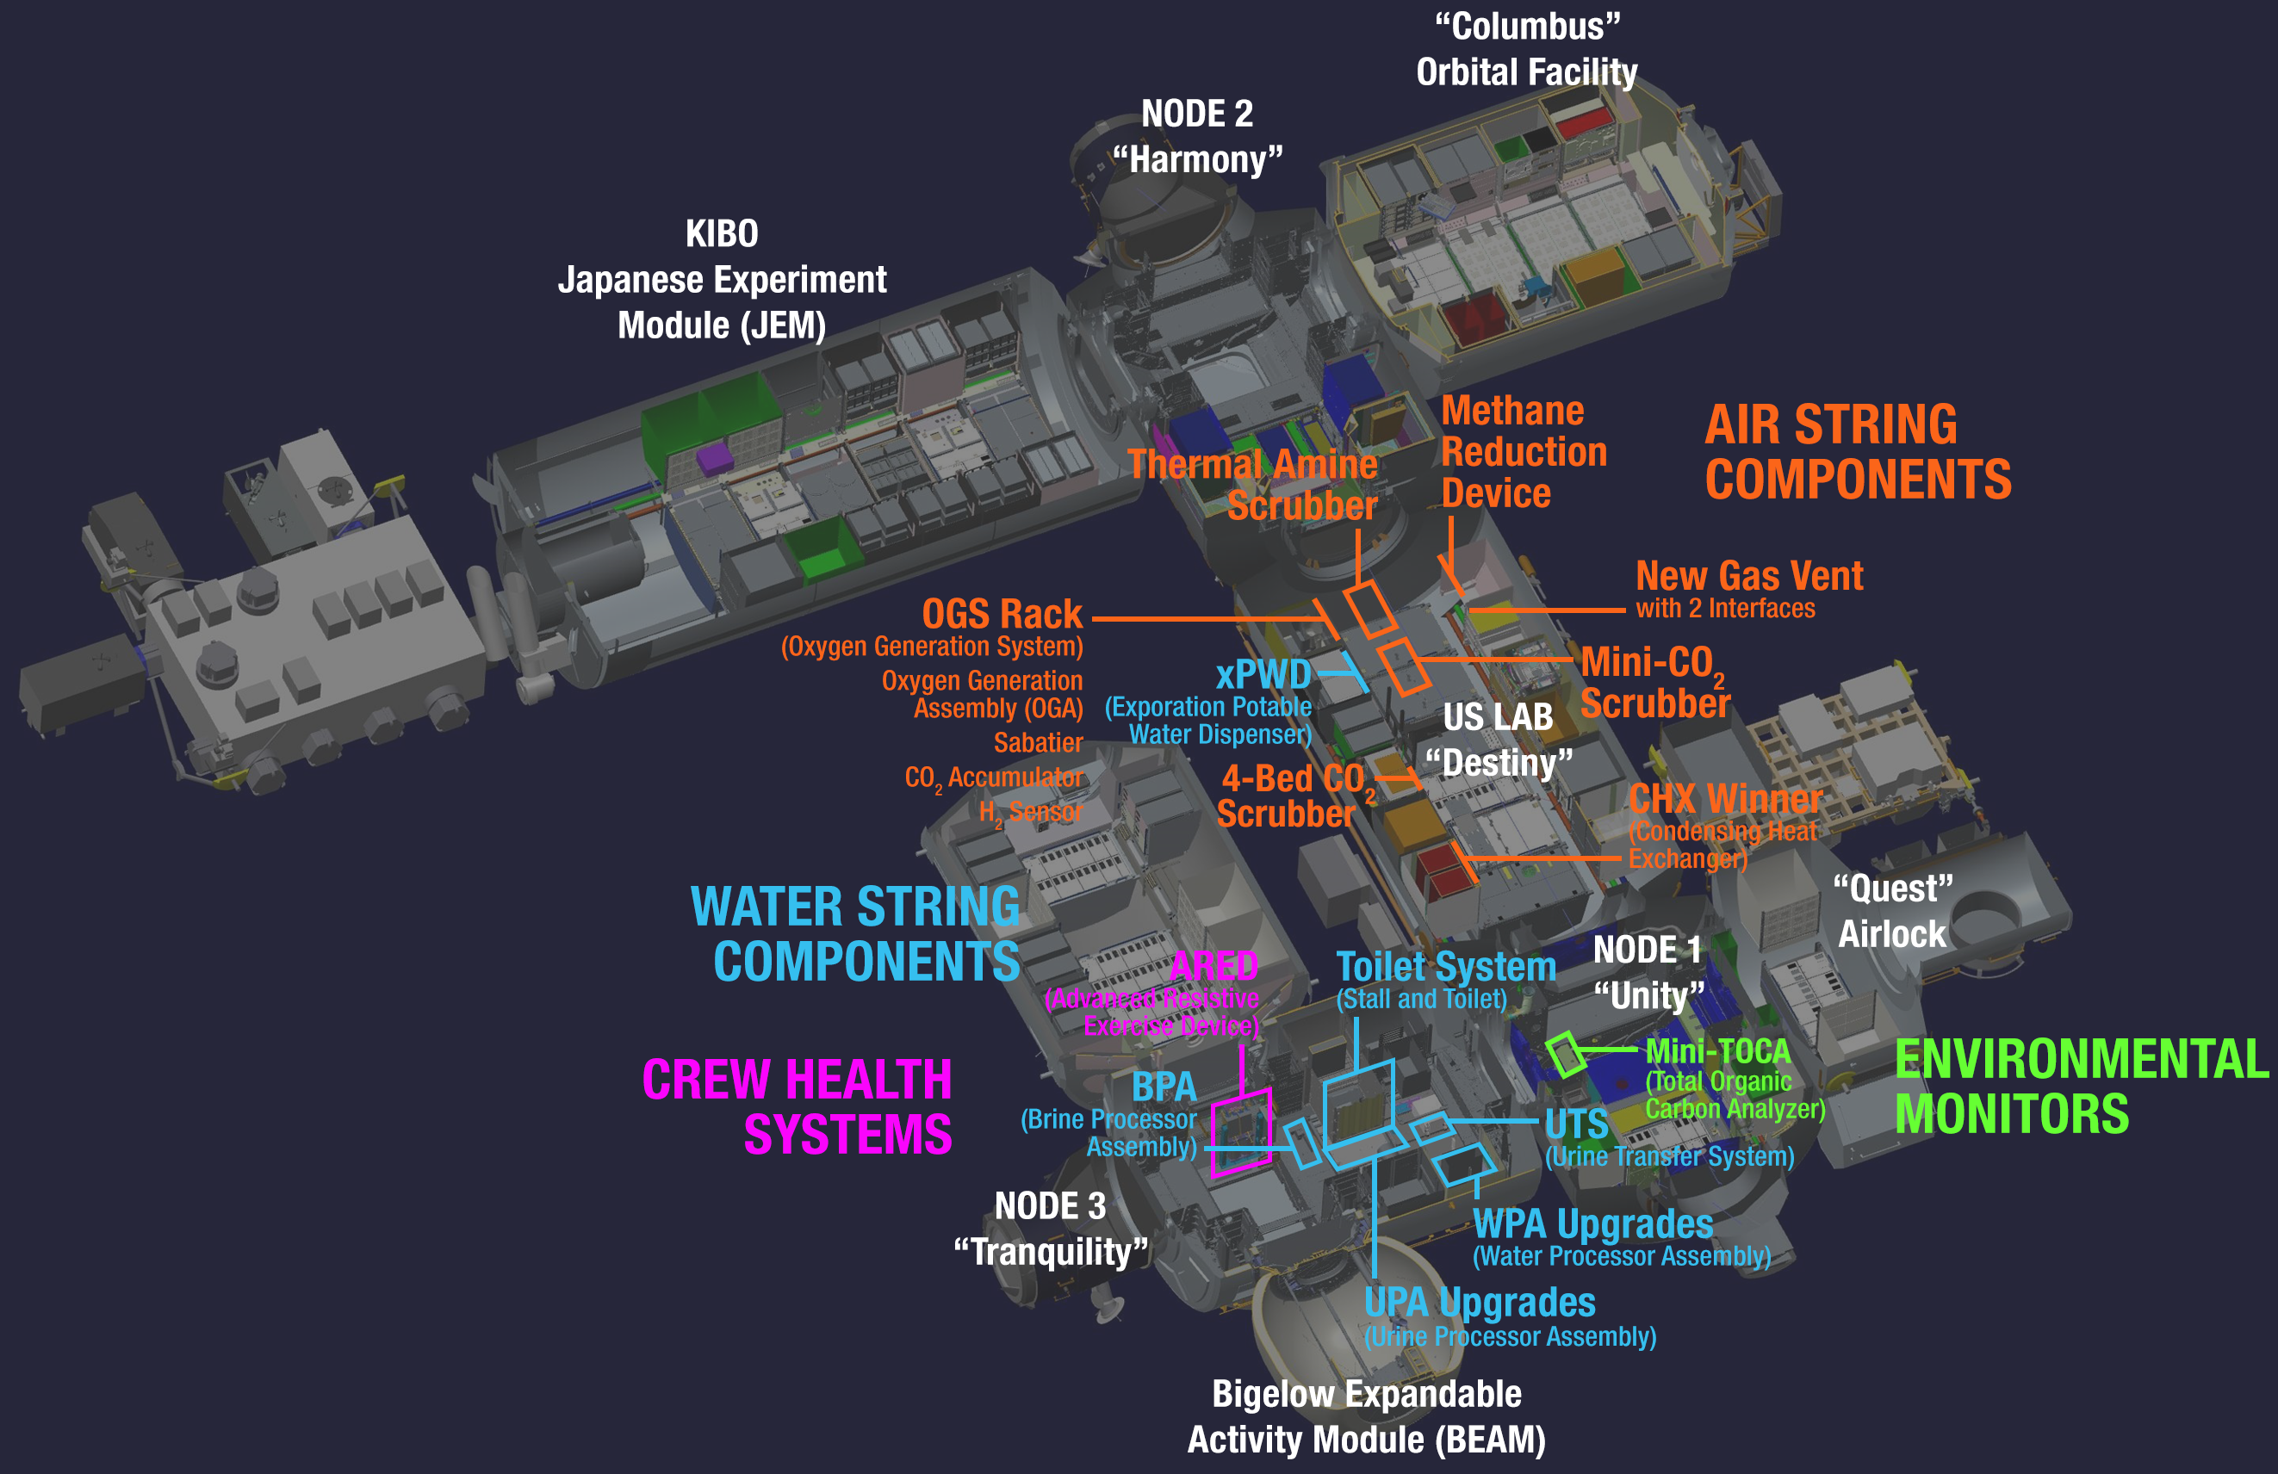
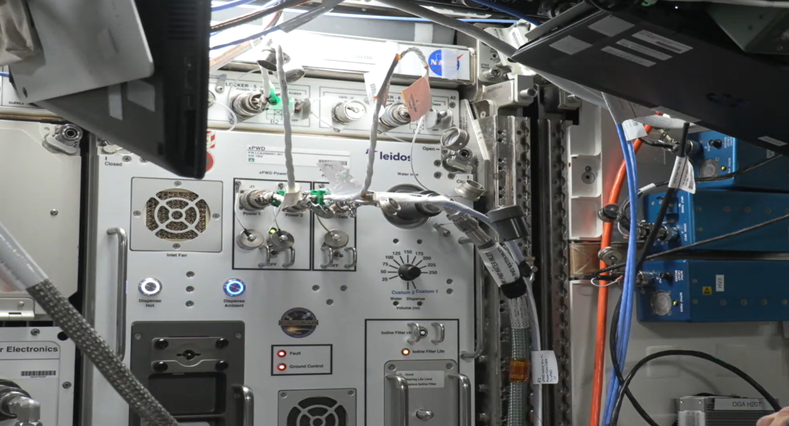
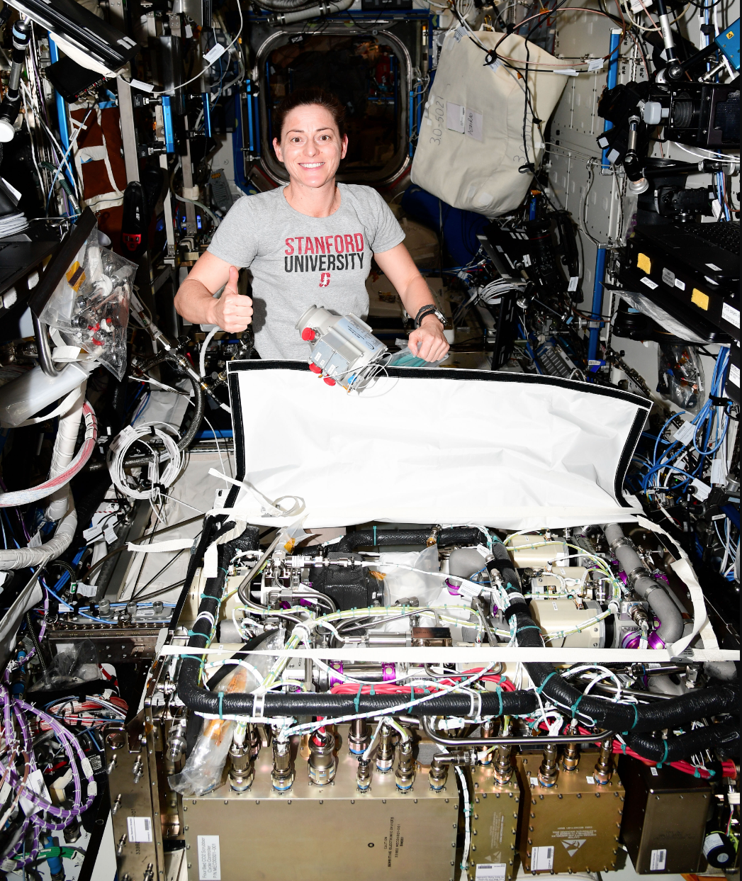
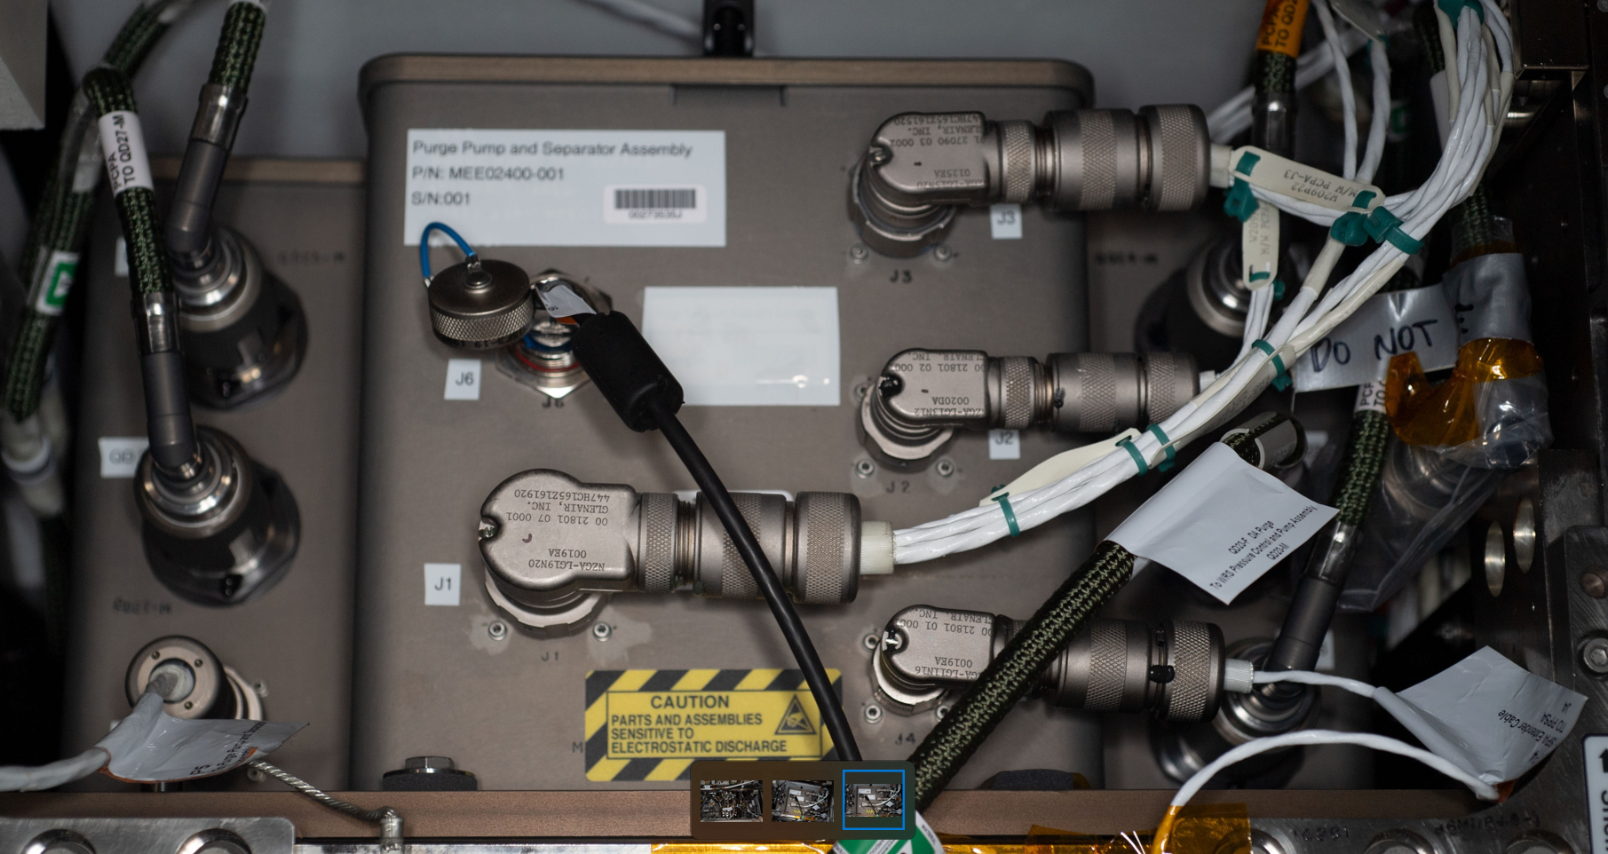
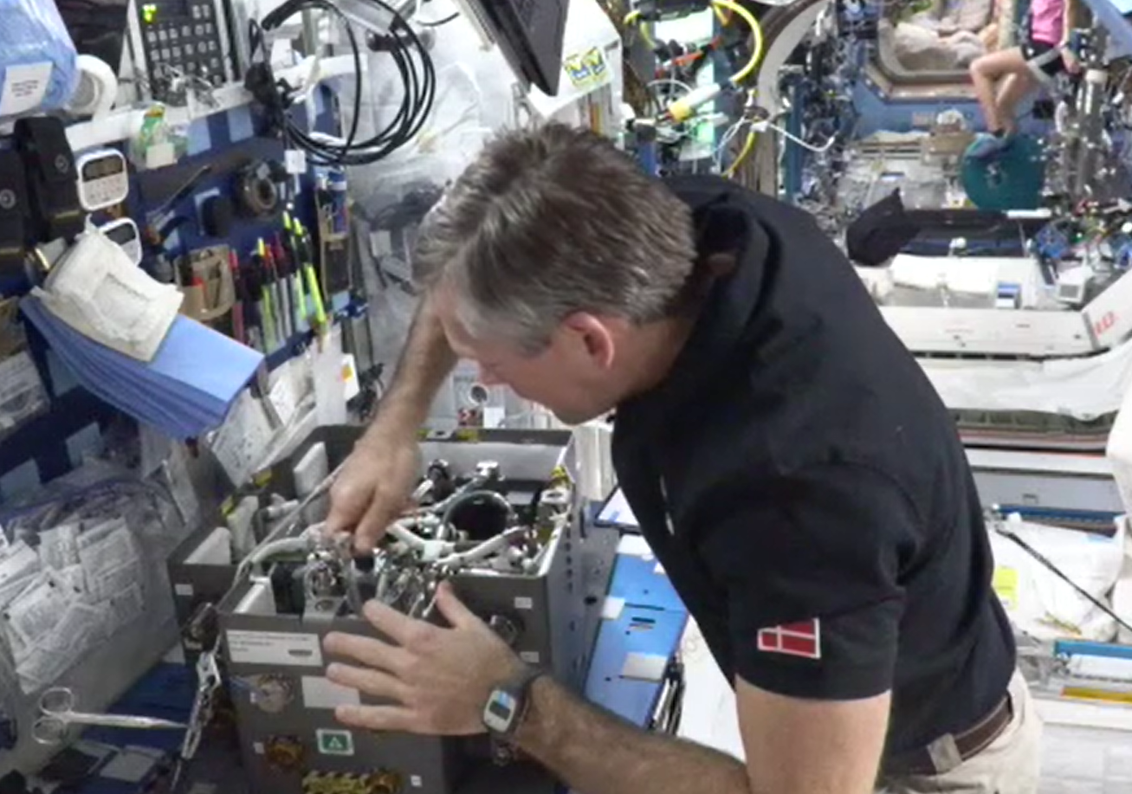
ECLSS Evolution
TBD
PM / PI Info Alesha Ridley| alesha.ridley@nasa.gov
EXECUTIVE SUMMARY
Environmental Control and Life Support Systems (ECLSS) Evolution is comprised of a large portfolio of projects funded by the Mars Campaign Office (MCO) and is focused on the following:
Utilize ISS as a testbed to determine and refine ECLSS gaps
Develop technologies to close ECLSS gaps
Improve performance and reliability of ECLS systems
Prove out integrated system in relevant environment for long duration
Test representative system on ground to increase overall data set
Innovation
Existing, critical life support systems on ISS are upgraded in-situ for Exploration mission demonstration. Innovations include requirements tailoring (prioritizing cost, schedule, and use of new components/materials.)
Purge Pump and Separator Assembly (PPSA) evolves legacy purge pump in the Urine Processor Assembly (UPA) into a much smaller, modular style design that enables component-level maintenance all the way down to valve or sensor removal. PPSA flew in the fall of 2022 and was installed in Aug 2023.
An upgraded blower for the Four Bed CO₂ makes use of a new supplier, utilizes magnetically levitated bearings and enables the performance required for a Mars Transit mission (4 crew at 2.0 mmHg inlet ppCO₂). The upgraded blower was installed in Feb 2023, along with an acoustic blanket to keep the US Lab within acceptable limits.
Exploration Potable Water Dispenser (xPWD) improves upon the legacy design via the elimination of ‘dead legs’ which would pose a microbial growth risk during periods of dormancy and incorporates flow-through ultraviolet sterilization at the outlet (eliminating a consumable filter). xPWD was activated and approved for crew use in Sep 2023.
Brine Processor Assembly (BPA) uses heat to de-water brine removed from the UPA to reclaim more water. ISS has now demonstrated the ability to reclaim up to 98% water with the successful operation of BPA.
Collaboration
NASA works with both existing vendors of state-of-the-art ECLSS as well as new suppliers, other centers, and industry experts where required, in order to solve unique technical problems.
Text Description
Outcomes & Infusion
PPSA installed and activated Modular, maintainable design is extensible to other ECLSS hardware. Currently investigating some unexpected pressure signatures which may be micro-gravity related. This new data is indicative of why demonstration in a relevant environment is critical.
FBCO₂ blower has demonstrated improved performance to date – multiple Commercial Leo Destination (CLD) providers are considering the use of the FBCO₂ design. CO₂ samples collected on-orbit showed that the system is concentrating Freon leaked into the ISS atmosphere by thermal control systems which is a concern for the Sabatier system which is intended to be installed downstream. Ground testing in work and Sabatier 2.0 design may be impacted.
xPWD design is being considered by Commercial Leo Destination (CLD) providers.
Future Work
PPSA failure investigation
Evaluate further upgrades to FBCO₂ blower to fully meet Exploration mission performance requirement
xPWD sample analysis for performance characterization
Continued development on other ECLSS Evolution Projects, including but not limited to:
  Advanced Oxygen Generation Assembly (AOGA)
  Sabatier 2.0
  Additively Manufactured Condensing Heat Exchanger
  MSFC Commercial Off the Shelf (COTS) Conductivity Monitor
xPWD Installed in US Lab
FBCO₂ Blower ready for installation, PPSA installed inside UPA & Crew performing component level troubleshooting
DAA# | #############
NTR#(s) | ############, ############, ############

