Slide 1


­Monthly Mean DNI and GTI Derived from Monthly Mean GHI and DHI Using Two Methods: Comparisons with the BSRN Data and the Results Derived from the CERES Hourly Data
Taiping Zhang¹, Paul W. Stackhouse, Jr.², Bradley Macpherson³, J. Colleen Mikovitz¹
1. AMA / NASA Langley Research Center
Hampton, Virginia, USA
2. NASA Langley Research Center
Hampton, Virginia, USA
3. GSFC/Booz Allen Hamilton, McLean, Virginia
Paper No.
GC23E-08
AGU Annual Meeting 2023
December 11-15, 2023 San Francisco

Slide 2
Outline of the Presentation …
The CERES SYN1deg(Ed4.1) hourly GHI, DNI, DHI and the BSRN data
Bias correction of the hourly DNI and DHI
Derivation of hourly GTI and GTrI
Comparison of DNI, DHI, GTI and GTrI with the BSRN
Calculation of daily and monthly means
Comparison and evaluation of two monthly-mean-based models
Summary and conclusions

Slide 3
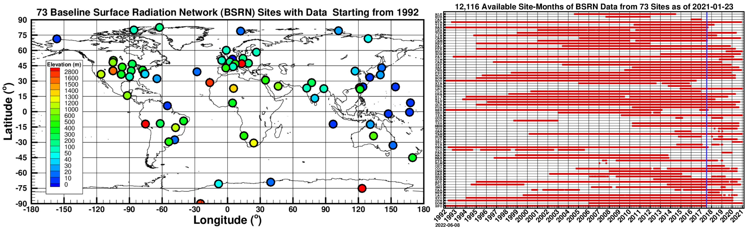
The 73 BSRN Sites and 12,116 Available Site‑Months as of 2021-01-23

Slide 4
The CERES SYN1deg (Ed4.1) Hourly GHI, DHI and DNI in Comparison with the BSRN Data
All-Sky Hourly | Bias | RMS | ρ | σ | μ_{DATA} | N
Original CERES SYN1deg(Ed4.1) and Derived DNI
GHI | -2.90 | 83.46 | 0.9566 | 83.41 | 341.49 | 3,347,216
DHI | 30.54 | 85.83 | 0.8314 | 80.00 | 168.04 | 3,452,616
DirHI | -37.07 | 122.25 | 0.8882 | 116.49 | 192.59 | 3,023,551
DNI, or DirHI/cos(Z) | -54.29 | 203.22 | 0.8233 | 195.83 | 343.24 | 3,010,908
DirIndex Model Derived DNI from CERES SYN1deg(Ed4.1) Hourly GHI
DNI, from DirIndex | 8.54 | 228.21 | 0.7580 | 228.65 | 444.91 | 2,195,000

Slide 5
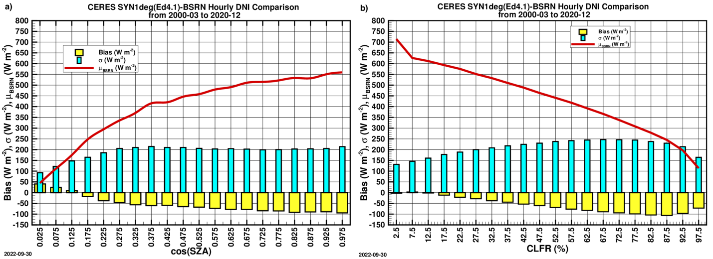
The CERES SYN1deg (Ed4.1) Hourly DNI [DirHI/cos(SZA)] bias as functions of cos(SZA) and CLFR (%)

Slide 6
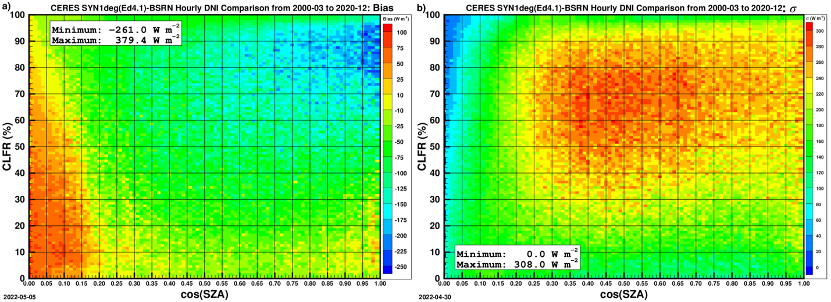
The CERES SYN1deg (Ed4.1) Hourly DNI [DirHI/cos(SZA)] bias in the cos(SZA)-CLFR phase space

Slide 7

The Bias Correction
The Earth is first divided into 5 latitudinal zones whose latitudinal ranges are, respectively, [-90°, -60°), [-60°, -20°), [‑20°, 20°), [20°, 60°) and [60°, 90°]; in each zone, the bias is calculated as percentage of the mean CERES SYN1deg(Ed4.1) DNI in the phase space of cos(SZA) and CLFR. The relative bias, $R_{bias}$, forms a 3D lookup table. The $R_{bias}$ for each individual hourly DNI is first determined according to its latitudinal zone, cos(SZA) and CLFR, and the correction is done simply by multiplying the DNI by the factor (1-$R_{bias}$).
The same method is applied to the correction of the hourly DHI.

Slide 8
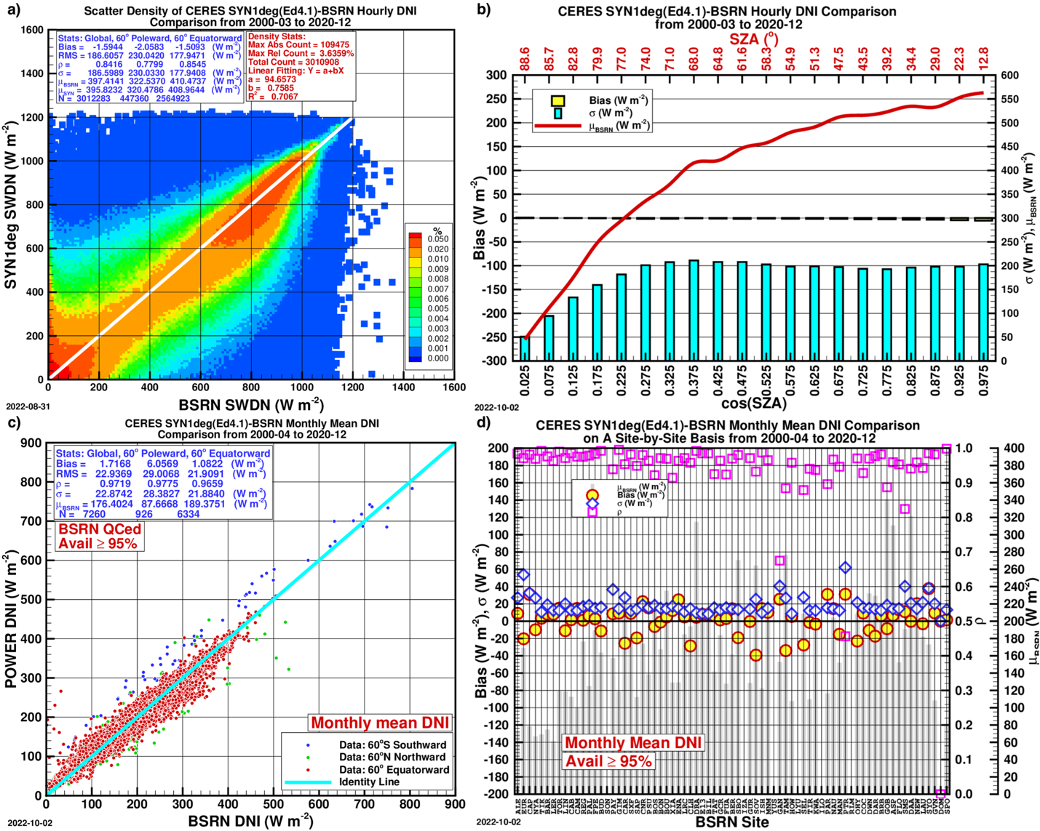
DNI after the correction
Hourly mean scatter plot;
Bias and 𝛔 variation with cos(SZA);
Monthly mean scatter plot;
Monthly mean on a site-by-site basis.

Slide 9
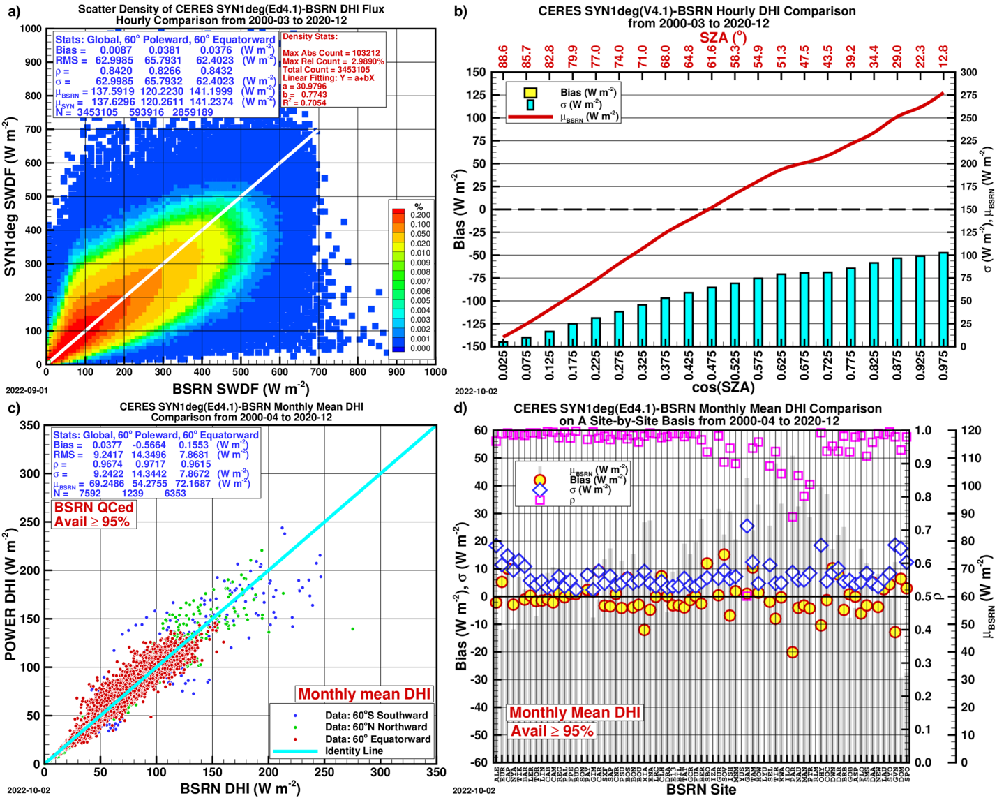
DHI after the correction
Hourly mean scatter plot;
Bias and 𝛔 variation with cos(SZA);
Monthly mean scatter plot;
Monthly mean on a site-by-site basis.

Slide 10
DNI Comparison Statistics after the Correction
Time Scale | Bias | RMS | ρ | σ | μ_{DATA} | N
DNI (Direct Normal Irradiance)
Hourly | -1.59 | 186.60 | 0.8416 | 186.59 | 395.82 | 3,012,283
Daily | 1.84 | 56.56 | 0.9290 | 56.53 | 179.99 | 273,873
Monthly | 1.71 | 22.93 | 0.9719 | 22.87 | 178.11 | 7,260
DHI Comparison Statistics after the Correction
Time Scale | Bias | RMS | ρ | σ | μ_{DATA} | N
DHI (Diffuse Horizontal Irradiance)
Hourly | 0.01 | 62.99 | 0.8420 | 62.99 | 137.62 | 3,453,105
Daily | -0.07 | 19.49 | 0.9070 | 19.49 | 70.58 | 277,630
Monthly | 0.03 | 9.24 | 0.9674 | 9.24 | 69.28 | 7,592

Slide 12
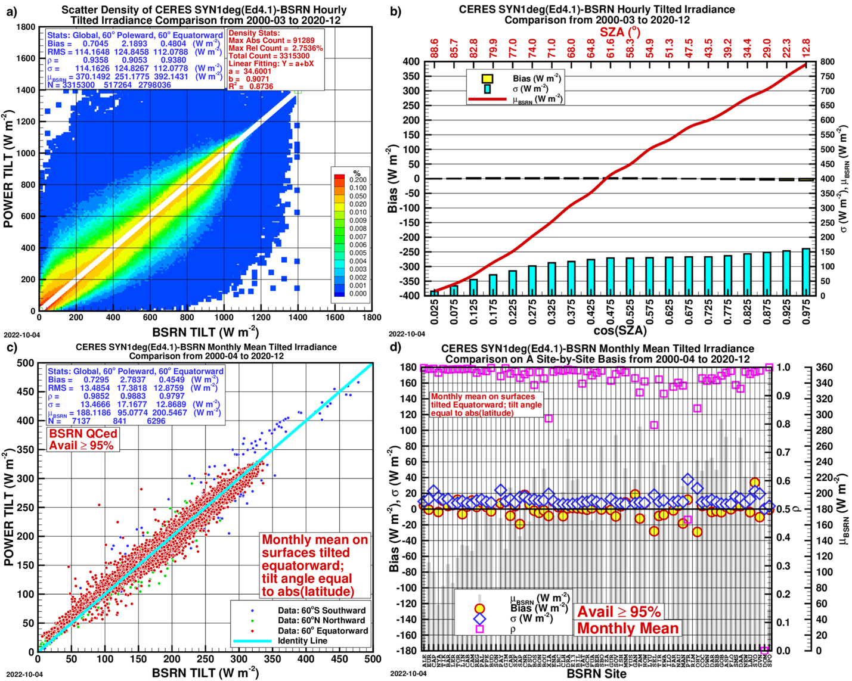
GTI after the correction
Hourly mean scatter plot;
Bias and 𝛔 variation with cos(SZA);
Monthly mean scatter plot;
Monthly mean on a site-by-site basis.

Slide 13
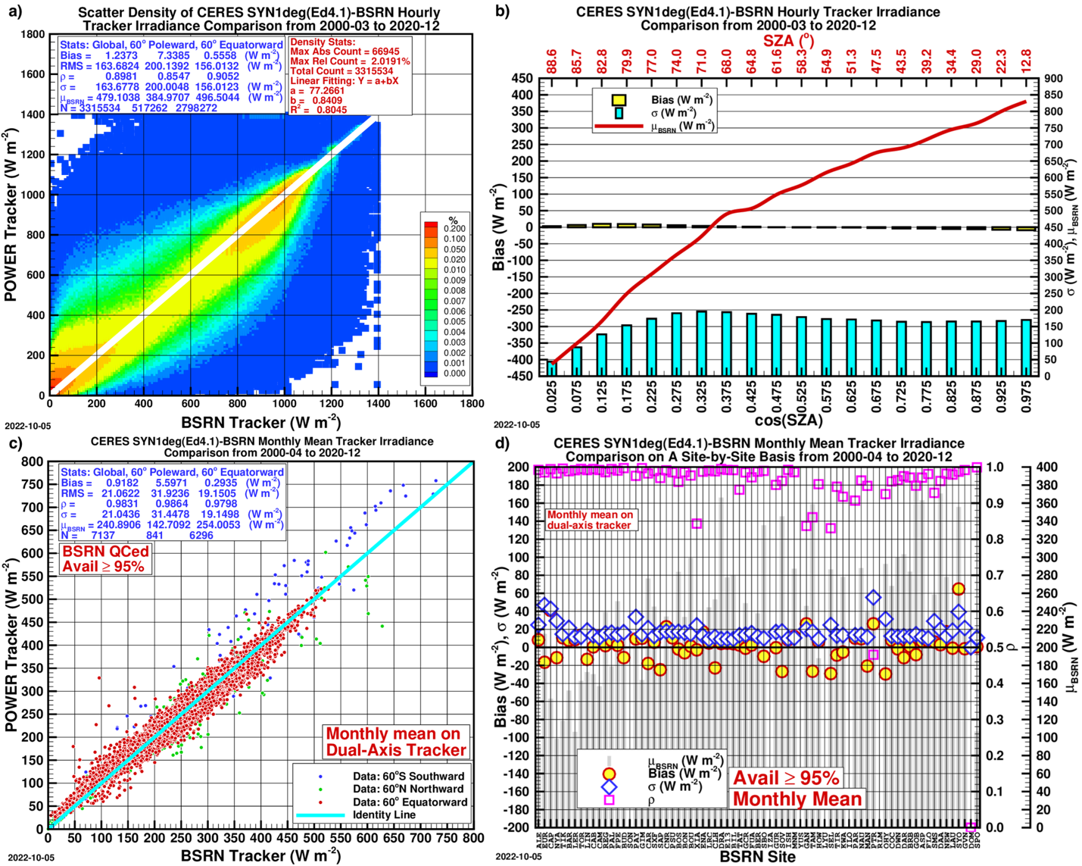
GTrI after the correction
Hourly mean scatter plot;
Bias and 𝛔 variation with cos(SZA);
Monthly mean scatter plot;
Monthly mean on a site-by-site basis.

Slide 14
GTI Comparison Statistics after the Correction
Time Scale | Bias | RMS | ρ | σ | μ_{DATA} | N
Tilted Irradiance on Equatorward Tilted Surfaces [tilt angle = abs(latitude)]
Hourly | 0.70 | 114.16 | 0.9358 | 114.16 | 370.89 | 3,315,300
Daily | 0.63 | 32.78 | 0.9743 | 32.78 | 194.17 | 257,719
Monthly | 0.72 | 13.48 | 0.9852 | 13.46 | 188.84 | 7,137
GTrI Comparison Statistics after the Correction
Time Scale | Bias | RMS | ρ | σ | μ_{DATA} | N
Total Irradiance on a Dual-Axis Tracking Panel (Tracker)
Hourly | 1.23 | 163.68 | 0.8981 | 163.67 | 480.71 | 3,315,543
Daily | 0.91 | 51.37 | 0.9457 | 51.36 | 250.73 | 257,719
Monthly | 0.91 | 21.06 | 0.9831 | 21.04 | 241.80 | 7137

Slide 15
The Monthly-Mean-Based Method I:
The POWER SSE (V6.0) Method
The ratio of the monthly mean DHI to GHI is based on the regression of the BSRN monthly mean data; the regression is done in 6 different cases depending the ranges of latitude and sunset hour angle;
To get the monthly mean DNI, the resulting monthly mean direct horizontal irradiance is divided by the cosine of the solar zenith angle at mid-time between sunrise and solar noon on the monthly-average-day;
The details of this method is given in Zhang et al. (2014).
References
Zhang, T., Stackhouse, Jr., P.W., Chandler, W.S., and Westberg, D.J., 2014. Application of a global-to-beam irradiance model to the NASA GEWEX SRB dataset: An extension of the NASA Surface meteorology and Solar Energy datasets. Sol Energy, 110, 117-131.

Slide 16
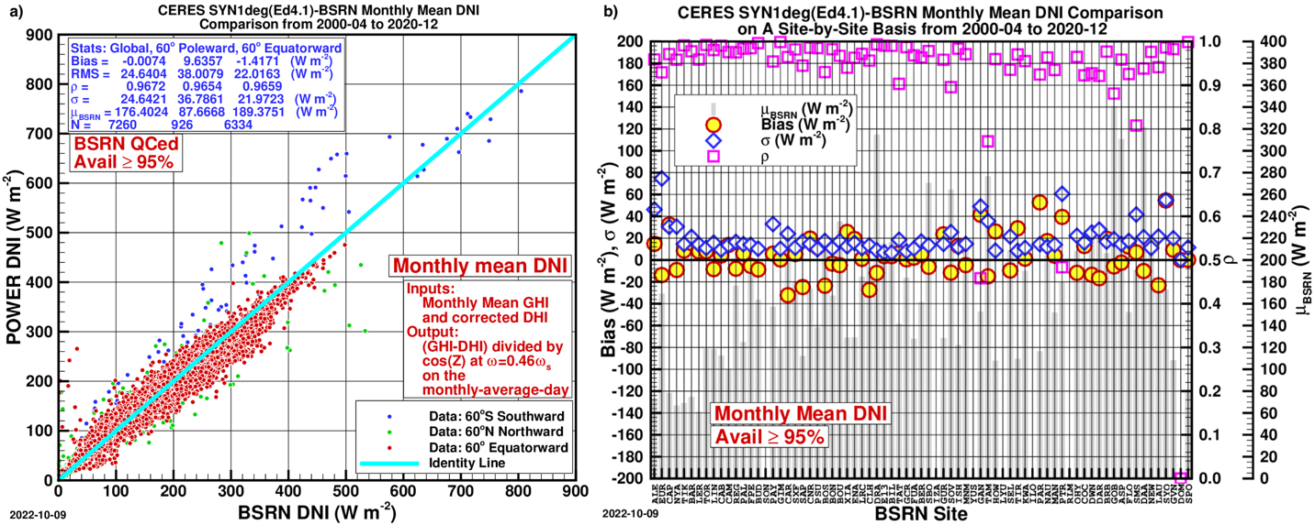
Monthly mean DNI from the POWER SSE (V6.0) Method

Slide 17
The POWER SSE (V6.0) Method
Case 4: Whitlock Method II
Case No. | Parameter | Bias | RMS | ρ | σ | μ_{DATA} | N
1 | Monthly DHI | -7.11 | 15.04 | 0.9328 | 13.25 | 62.13 | 7,592
2 | Monthly DNI | 24.50 | 46.20 | 0.9311 | 39.17 | 200.90 | 7,260
3 | Monthly DNI | 11.10 | 28.13 | 0.9651 | 25.85 | 187.50 | 7,260
4 | Monthly DNI | -0.00 | 24.64 | 0.9672 | 24.64 | 176.39 | 7,260
5 | Monthly DNI | 30.61 | 41.56 | 0.9669 | 28.12 | 207.01 | 7,260

Slide 19
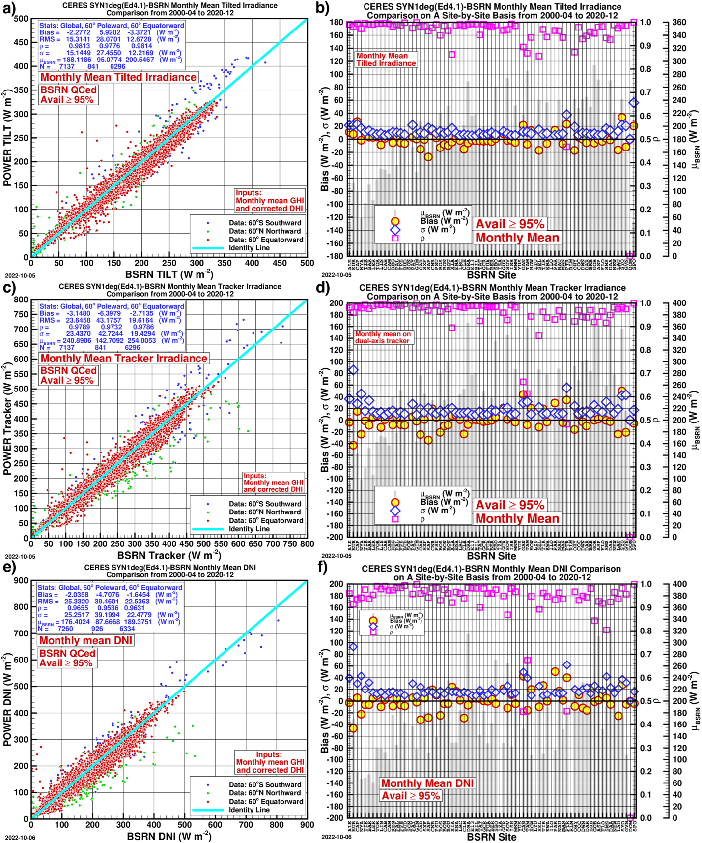
The LJCR Method, as used by RETScreen
a) and b): GTI
c) and d): GTrI
e) and f): DNI

Slide 20
The LJCR Method Results Comparison Statistics
 | Bias | RMS | ρ | σ | μ_{DATA} | N
Monthly Mean Tilted (GTI) | -2.27 | 15.31 | 0.9813 | 15.14 | 185.84 | 7,137
Monthly Mean Tracker (GTrI) | -3.14 | 23.64 | 0.9789 | 23.43 | 237.74 | 7,137
Monthly Mean DNI | -2.03 | 25.33 | 0.9655 | 25.25 | 174.36 | 7,260

Slide 21
Summary and Conclusions
The bias correction of the CERES SYN1deg(Ed4.1) hourly DNI produces a dataset of DNI that is less biased against the BSRN and has a smaller uncertainty than that of the DirIndex model;
The isotropic model applied to the hourly DNI and DHI produces GTIs that agree well with the BSRN data whose hourly, daily and monthly means are from the near-instantaneous tilted irradiances from the same model;
In the modified Whitlock method, the bias of the monthly DNI is reduced to practically zero; the bias/σ (-1.4/21.9) for sites 60° equatorward, where 85% of the BSRN sites are located, is nearly as good as those of the hourly-based results (1.0/21.8); the bias/σ at sites 60° poleward are somewhat larger, though;

Slide 22
Summary and Conclusions (Continued …)
The monthly mean DNI from the RETScreen method is by and large the same as the modified Whitlock method, though the latter is slightly better;
The monthly mean GTI and tracker irradiance from the RETScreen method are nearly as good as those of the hourly-based method on the whole; only at sites 60° poleward, the results show noticeably larger standard deviations. Reformulation for higher latitudes may improve its performance in polar regions.
The POWER SSE (V6.0) method and the LJCR method proved themselves as well as the current dataset.

Slide 23
Thank you!
Thank you!
Information about the NASA POWER Project:
https://power.larc.nasa.gov
AGU Annual Meeting 2023
December 11-15, 2023
San Francisco, California

Slide 24
Extras

