Slide 1
Application of Stuffed Whipple Shield to Robotic Spacecraft
2nd International Orbital Debris Conference
December 6th, 2023
Ivonne Rodriguez

Slide 2
Agenda
Introduction: The PACE Mission
Orbital Debris Environment and Impact Risk
Tank HVI Damage Assessments: Analysis and Results
Human-Rated Stuffed Whipple Shield
Stuffed Whipple Shield for Robotic Spacecraft and Application to the PACE Mission
Shield HVI Testing
Shield Integration
Summary
References
2

Slide 3
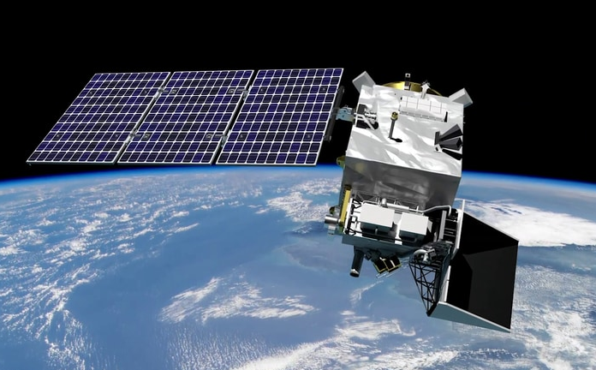
Introduction: The PACE Mission
NASA PACE - Gallery (oceansciences.org)
The Plankton, Aerosol, Cloud, ocean Ecosystem (PACE) spacecraft is designed to improve the ongoing collection of ocean data from space, focusing on phytoplankton production and atmospheric parameters detected on aerosol, clouds, and ocean.
Its primary payload is the Ocean Color Instrument (OCI), a hyperspectral imaging radiometer.
Spacecraft is scheduled to launch in early 2024.
Designed for disposal by controlled reentry.
Notes:
Additional information on the mission, objectives, and OCI instrument.

Slide 4
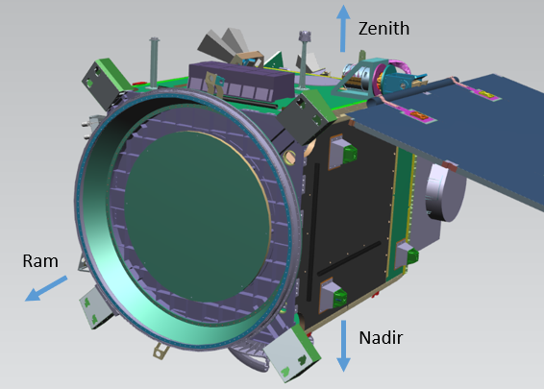
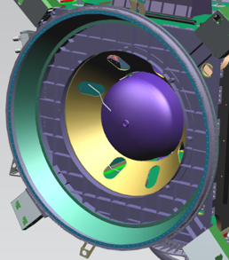
Introduction: The PACE Mission
NASA PACE - Gallery (oceansciences.org)
The Plankton, Aerosol, Cloud, ocean Ecosystem (PACE) spacecraft is designed to improve the ongoing collection of ocean data from space, focusing on phytoplankton production and atmospheric parameters detected on aerosol, clouds, and ocean.
Its primary payload is the Ocean Color Instrument (OCI), a hyperspectral imaging radiometer.
Spacecraft is scheduled to launch in early 2024.
Designed for disposal by controlled reentry.
Notes:
Additional information on the mission, objectives, and OCI instrument.

Slide 5
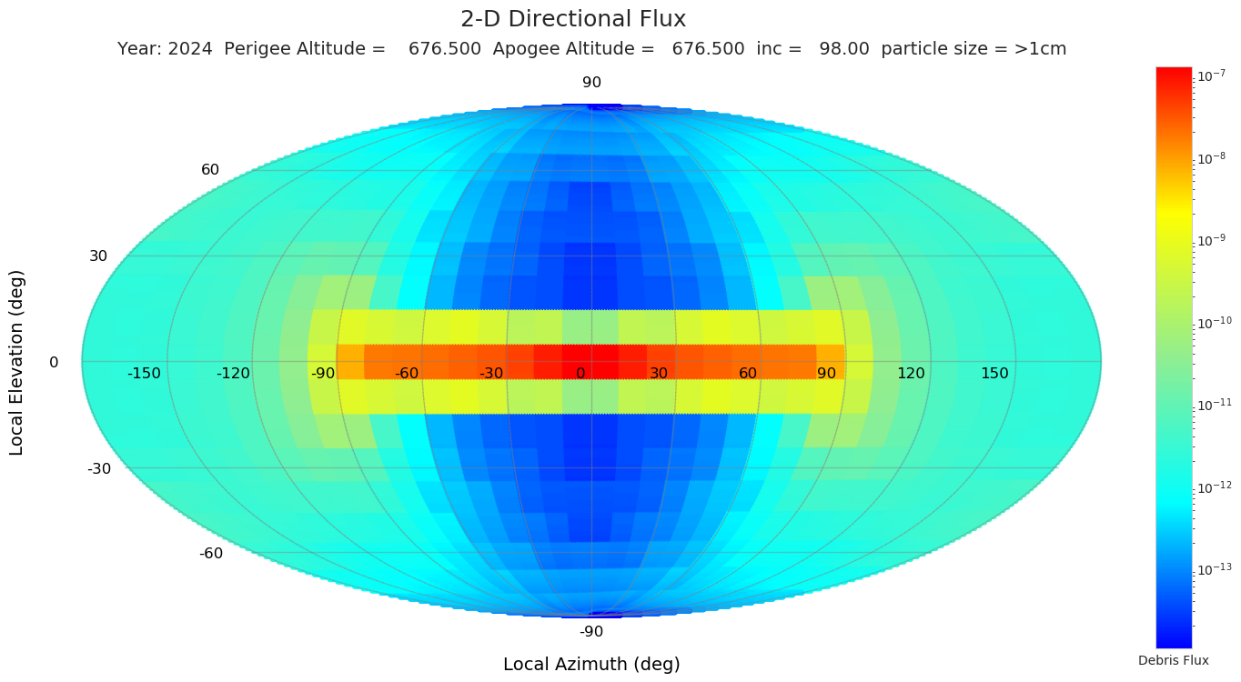
Orbital Debris Environment and Impact Risk
The ORDEM 3.2 plot of the orbital debris environment at the PACE operational orbit, year 2024, shows highest flux at ram (velocity vector) and port/starboard sides (+/- Y).
High flux
Low flux
NASA-STD-8719.14C, Process for Limiting Orbital Debris, Requirement 4.5-2. Limiting debris generated by collisions with small objects when operating in Earth orbit: For each spacecraft, the program or project shall demonstrate that, during the mission of the spacecraft, the probability of accidental collision with orbital debris and meteoroids sufficient to prevent compliance with the applicable postmission disposal maneuver requirements is less than 0.01.
Notes:
US Government ODMSP, Requirement 3-2: “Collision with small debris during mission operations: Spacecraft design will consider and limit the probability to less than 0.01 (1 in 100) that collisions with micrometeoroids and orbital debris smaller than 1 cm will cause damage that prevents planned postmission disposal.”

Slide 6
2019 Tank HVI Damage Assessment
Pressurized vessels present a challenge for hypervelocity impact (HVI) tests because of their potential to fail catastrophically and to damage adjacent components and structures.
Since the Apollo era, pressurized tanks have been designed for a penetration depth that should not exceed 25% of the tank wall thickness. For conservatism, the common practice is to limit the penetration depth to 20% of the Tank wall thickness. This makes the Tank particularly vulnerable to micrometeoroids and orbital debris (MMOD) impacts in HVI simulations.
The original assessment of all reentry-critical components was completed in 2019 using the Bumper3-Sat hypervelocity impact simulation tool. To achieve a total spacecraft risk of less than 0.01, several components were reinforced with typical Whipple shields.
  The tank ram section was reinforced using a Stuffed Whipple Shield (SWS) adapted for robotic spacecraft. This is the only option that reduced the dome risk to less than 0.001, leaving enough margin for other components in need of protection.
Notes:
Typical Whipple shields: aluminum panel, Nextel bumper (flexible).

Slide 7
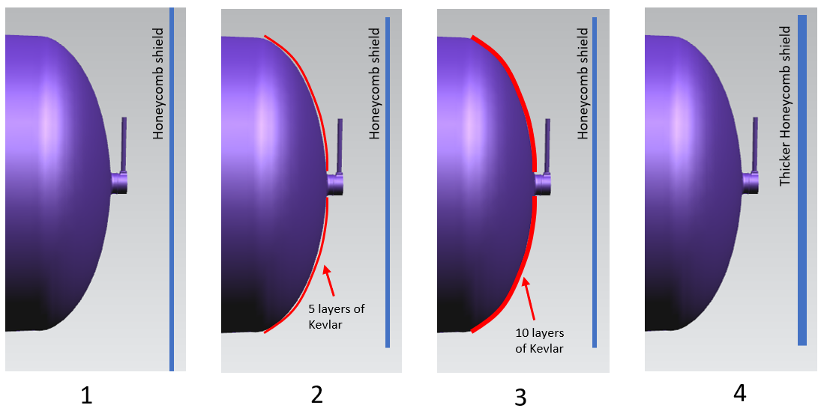
2023 Tank HVI Damage Assessment
By 2023, the original tools (Bumper3-Sat, ORDEM, and MEM) were already updated. To confirm that the conclusions from the 2019 assessment of the PACE Tank dome remain valid, similar or equivalent simulations were run.
Baseline case: honeycomb panel, 0.025 cm facesheets, 2.5 cm core
0.200 cm facesheets, 4.0 cm core, no Kevlar
Same panel, 5 layers of Kevlar in contact with Tank
Same panel, 10 Kevlar layers in contact with Tank (for comparison only)
In all cases, the reduced Tank wall is the critical surface. Failure is defined as 20% penetration of the Tank wall.

Slide 8

Results for Traditional Whipple Shield Configurations (1 of 2)
Case | Description | BLE | Probability of Failure (PF) | PF as % | PF as % of 0.01 spacecraft risk | Exceeds 0.01 by itself
1A | Unprotected tank | NNO | 0.2467 | 24.67% | 2467% | Yes
1B | Unprotected tank | R | 0.2646 | 26.46% | 2646% | Yes
1C | Unprotected tank | TW | 0.2974 | 29.74% | 2974% | Yes
2A | 5 Kevlar layers on tank | NNO | N/A
2B | 5 Kevlar layers on tank | R | 0.0080 | 0.80% | 80% | No
2C | 5 Kevlar layers on tank | TW | 0.0138 | 1.38% | 138% | Yes
3A | 10 Kevlar layers on tank | NNO | N/A
3B | 10 Kevlar layers on tank | R | 0.0031 | 0.31% | 31% | No
3C | 10 Kevlar layers on tank | TW | 0.0035 | 0.35% | 35% | No
4A | 2-mm facesheets, 3.8 cm standoff, no fabrics | NNO | 0.2213 | 22.13% | 2213% | Yes
4B | 2-mm facesheets, 3.8 cm standoff, no fabrics | R | 0.2205 | 22.05% | 2205% | Yes
4C | 2-mm facesheets, 3.8 cm standoff, no fabrics | TW | 0.0089 | 0.89% | 89% | No
Cases 2A and 3A fail applicability rule for NNO:
Valid results for vary from having more than 30% of the allowed risk to failing the Requirement 4.5-2 altogether.
Conclusion: Typical Whipple Shields are insufficient to keep the risk low enough for spacecraft overall compliance.
Ballistic Limit Equations (BLEs):
  NNO (New Non-Optimum, based on the Christiansen/JSC equation)
  R (Reimerdes’ modification of the Christiansen equation, for analysis of thin shields)
  SRL (Schäfer-Ryan-Lambert, also know as Triple Wall Equation, where two walls protect the critical surface).
When applying NNO and R, the two facesheets are modeled as a single plate.
Notes:
The original results (panel only and 5 Kevlar on tank) were 11-13% higher because of flux decrease in ORDEM and increase in MEM.
Clarify that this is not about comparing the merits between BLEs, but to demonstrate that classical Whipple shields are insufficient to reduce the risk regardless of the BLE and assumptions used (consistency).

Slide 9
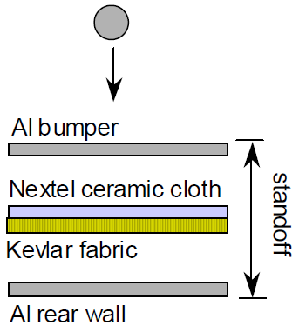
Human-Rated Stuffed Whipple Shield
The Stuffed Whipple shield (SWS) consists of two aluminum plates with several layers of Nextel and Kevlar between them.
The SWS is widely used in the International Space Station (ISS) to protect the crew modules (human-rated).
The rear wall is the critical surface. Failure is defined as penetration of this rear wall, not the surface behind the shield (Damage to anything behind the rear wall, including pressurized tanks, is not defined).
Several variations exist: rear wall thicker than bumper, internal MLI blanket, aluminum mesh, etc.

Slide 10
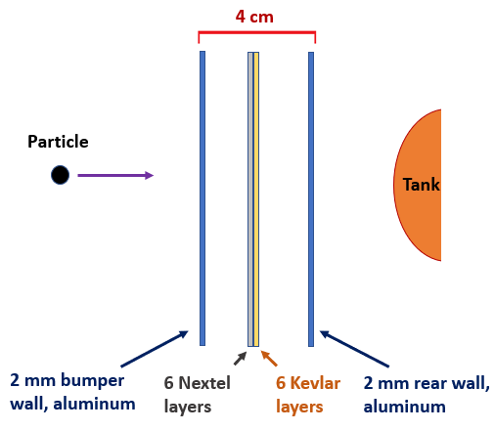
Stuffed Whipple Shield for Robotic Spacecraft
Simulations using Bumper3-Sat and the Stuffed Whipple Shield BLE, assuming 6 layers of Nextel and 6 layers of Kevlar, showed lower risks compared to traditional Whipple shields:
Case | Bumper Thickness (cm) | Bumper Areal Density (g/cm²) | Rear Wall Thickness (cm) | Standoff (cm) | Probability of Failure (PF) | PF as percent | PF as % of 0.01
5 | 0.20 | 0.8426 | 0.20 | 3 | 0.00166 | 0.166% | 16.6%
6 | 0.20 | 0.8426 | 0.20 | 4 | 0.00051 | 0.051% | 5.1%
7 | 0.25 | 0.9783 | 0.25 | 3 | 0.00099 | 0.099% | 9.9%
8 | 0.25 | 0.9783 | 0.25 | 4 | 0.00038 | 0.038% | 3.8%
(Not to scale)
Case 6 (0.20 cm plates, 4 cm standoff) was selected because it has a Probability of Failure (PF) of less than 0.001 but is 3 kg lighter than Case 8 (lowest PF). Case 6 balances performance and shield mass.
Because the failure mode is penetration of the SWS rear wall, the 20% rule for pressurized tanks is not applicable.
  Results are conservative.
Notes:
Overall spacecraft risk: Although the risk increased in several spacecraft components, the margin provided by SWS allowed the mission to absorb the increase and comply with the requirement.

Slide 11
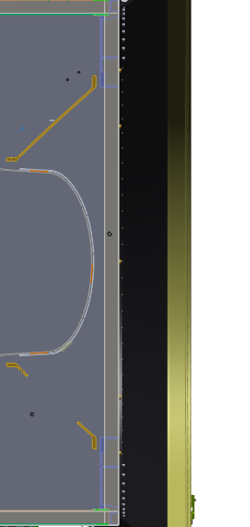
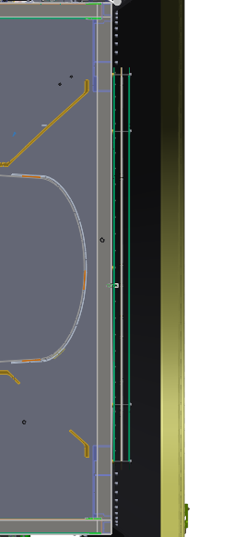
Shield Comparison
For comparison purposes, this is how a typical human-rated Stuffed Whipple Shield would look on the PACE spacecraft:
PACE Stuffed Whipple Shield for robotic spacecraft:
4.8 mm Rear Wall
2 mm Rear Wall
6x Nextel, 6x Kevlar
6x Nextel, 6x Kevlar
2 mm Bumper
2 mm Bumper
Tank
Tank
11 cm standoff
4 cm total width
PF = 0.006%
Estimated Mass = 22.8 kg
PF = 0.051%
Estimated Mass = 15.4 kg
PF is defined as penetration of the Rear Wall, not in terms of damage to the Tank itself.
NASA Goddard Space Flight Center
11
Notes:
Human-rated example has 32% more mass than the robotic version.

Slide 12
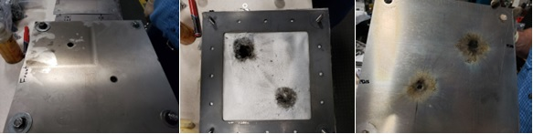
PACE SWS Hypervelocity Impact Test
In 2019, the PACE SWS configuration was tested at the Remote Hypervelocity Test Laboratory in New Mexico. The tests validated the SWS design.
  4.19 mm and 4.59 cm impactors at 7.0 km/s
  No perforation or detached spall on rear wall
  Reasonable agreement with the critical diameter of 0.447 cm predicted by the SWS BLE.
Bumper
Fabric layers with Nextel facing the Bumper
Rear Wall
(Photos used with permission from HVIT)

Slide 13
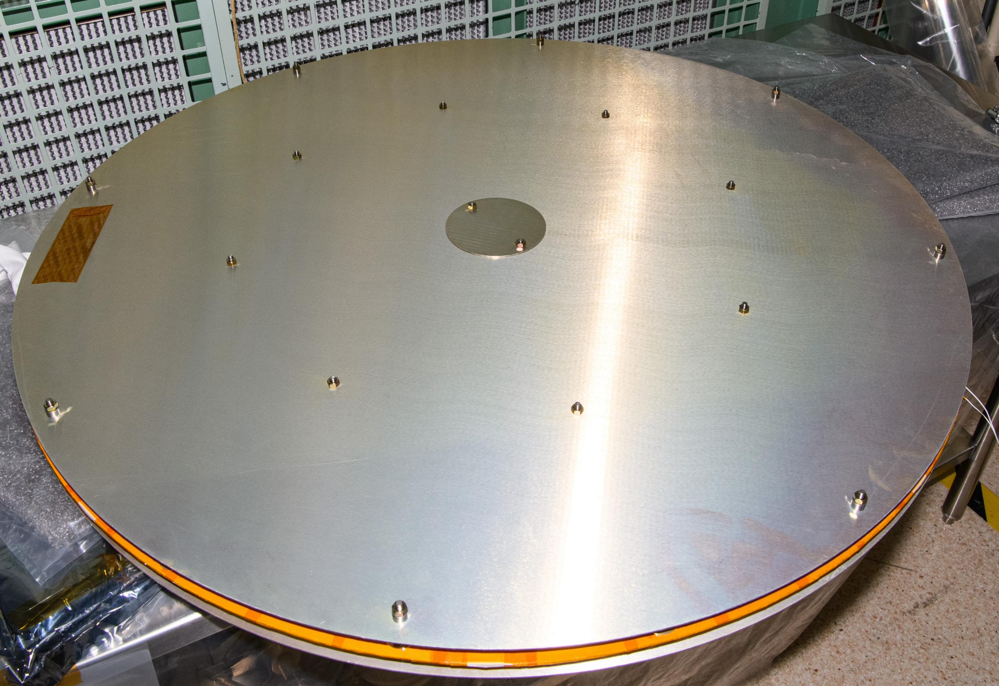
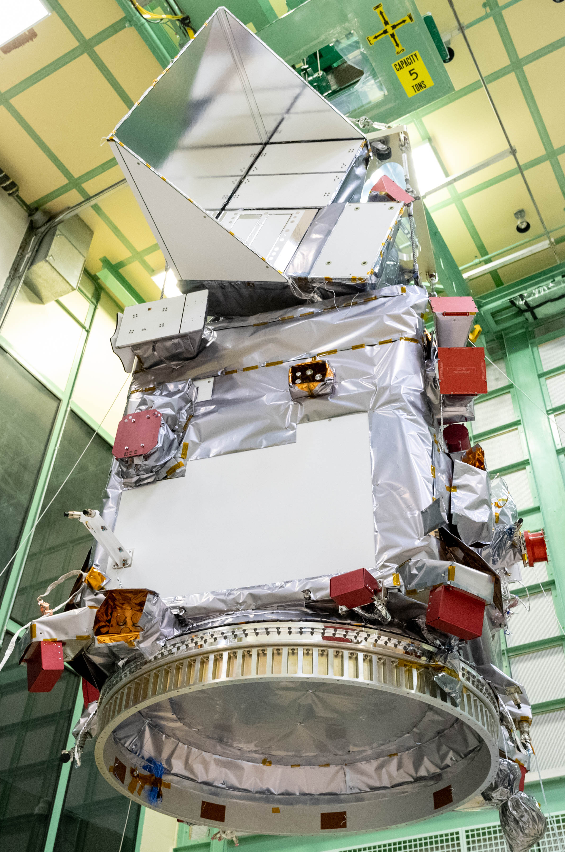
PACE SWS Integration
Photo of the fully assembled Stuffed Whipple shield for PACE, with bumper plate on top, rear wall (plate) at bottom.
The blanket assembly is in the middle: 6 layers of Nextel AF10 (facing up) and 6 layers of Kevlar KM2+ (behind the Nextel) with Kapton tape covering the borders.
Stainless Steel spacers separating the plates and the blanket are not shown.
PACE spacecraft lifted during integration and testing, with the OCI instrument at the top.
Facing down is the ram section with the Launch Vehicle Adapter and the SWS at the center, covered by Multi-Layer Insulation.
(PACE photos approved for public release)

Slide 14
Summary
The Stuffed Whipple shield designed for the ISS can be scaled down for use in robotic spacecraft.
In most robotic spacecraft, classical Whipple shields and flexible shields provide adequate protection to critical components from MMOD impacts.
In extreme cases, the location of critical components and thin wall thickness can expose them to a predicted particle flux that may defeat bus panels and traditional MMOD shields. In those cases, the Stuffed Whipple is a viable alternative for robotic spacecraft, as the PACE SWS design demonstrates.

Slide 15
References
Christiansen, E. L., et al, Handbook for Designing MMOD Protection, JSC-64399, 2009, https://ntrs.nasa.gov/api/citations/20090010053/downloads/20090010053.pdf
Christiansen, E. L., Nagy, K., Lear, D. M., Prior, T. G., Space Station MMOD Shielding, Acta Astronautica 65 (2009) 921-929. Available at https://www.sciencedirect.com/science/article‌/pii/S0094576509000319?via%3Dihub
National Aeronautics and Space Administration, Meteoroid Damage Assessment, NASA SP-8042, 1970. Available at https://ntrs.nasa.gov/citations/19710015594
National Aeronautics and Space Administration, Process for Limiting Orbital Debris, NASA-STD-8719.14C, approved 5 November 2021. Available at https://standards.nasa.gov/sites/default/files/standards/NASA/C/0/nasa-std-871914c.pdf
Reimerdes, H.-G., Nölke, D., Schäfer, F., Modified Cour-Palais/Christiansen Damage Equations for Double-Wall Structures, International Journal of Impact Engineering 33 (2006), 645-654. Available at https://doi.org/10.1016/j.ijimpeng.2006.09.036
Schäfer, F.K., Ryan, S., and Lambert, M., Ballistic Limit Equation for Equipment Placed behind Satellite Structure Walls, International Journal of Impact Engineering 35 (2008), 1784-1791. Available at https://www.sciencedirect.com/science/article/pii/S0734743X08001759

Slide 16
Questions ?

Slide 17

End slide. NASA “meatball” logo

