Slide 1
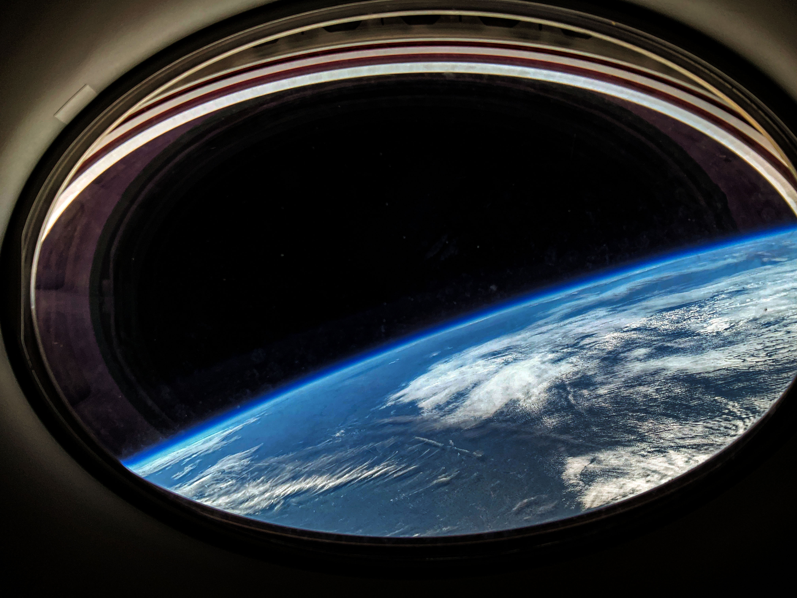

Nov. 16, 2023
Human Research Program​
Commercial LEO Destination Program
Utilization Forum​
Suzanne McCollum​
W. Brandon Vessey​, Ph.D.
Jancy C. McPhee​, Ph.D.
​

Slide 2
Disclaimer
This presentation represents only
the NASA Human Research Program (HRP)
and does not address the needs or priorities
of other NASA organizations.
We are also only presenting a limited subset of information on the unique nature of human research, operations, lessons learned, and capability considerations for future CLDs.

Slide 3
Today's Talk
What is HRP/What does HRP do?
Why human research is unique
Lessons learned from ISS
Specific needs and priorities for HRP from CLD

Slide 4

HRP's Mission
To enable space exploration beyond LEO by reducing risks to health and performance through a focused program of basic, applied, and operational research
Goal: To develop and deliver
  Knowledge relevant to crew health and performance
  Human health, performance, and habitability standards
  Risk mitigation solutions, including countermeasures
  Advanced habitability and medical support technologies

Slide 5
Ongoing Human Health Activities
Human research
Developing operational approaches to crew health and performance
Technology demonstrations for LEO
  Systems capability leadership teams (SCLT)
  Health and medical technical authority (HMTA)
  HRP's current and future risk-based research
    (today's topic)

Slide 6
Hazards of Human Spaceflight

Slide 7
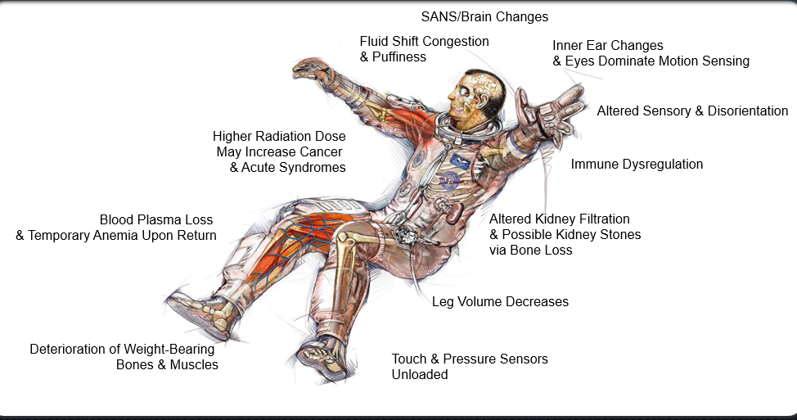
How Spaceflight Affects the Human Body

Slide 8
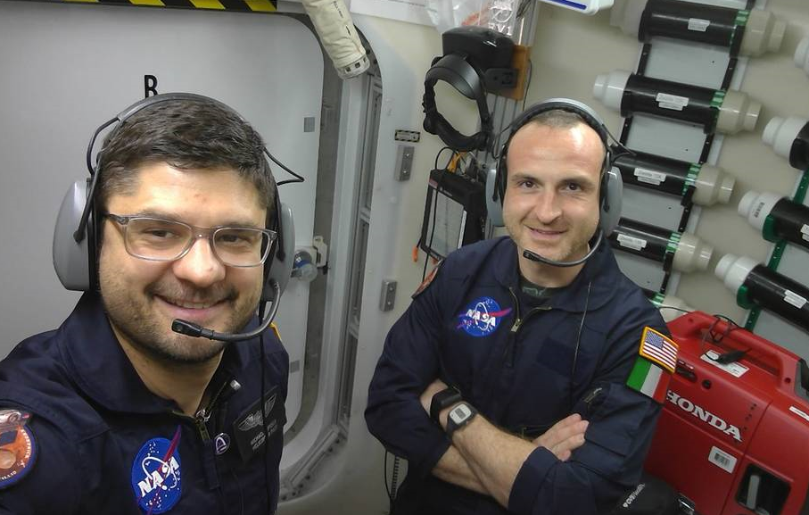
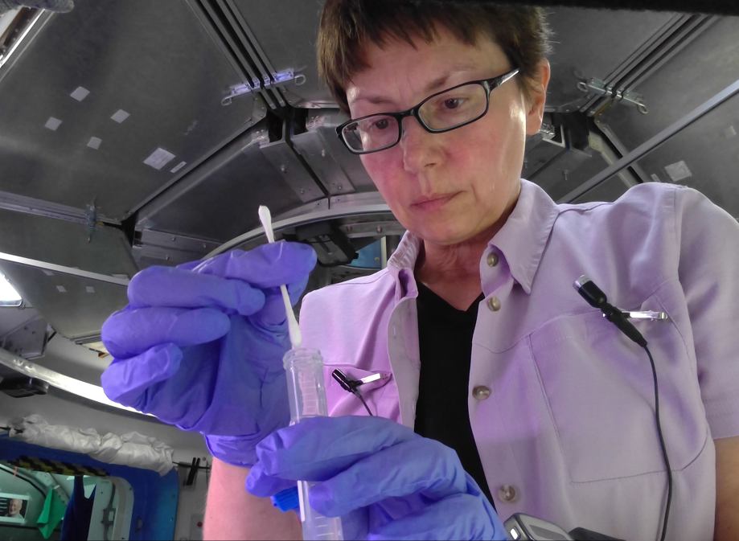
Behavior, Team Dynamics, and HSI
Conditions in space can affect individual mental health and team dynamics.
Distance from Earth reduces
  Communications with ground
  Resupply options
Crews will need
  Greater autonomy
  Advanced human-machine systems
Thus, research studies on human health/performance may occur wherever humans are in space, not just in “payload bays.”

Slide 9
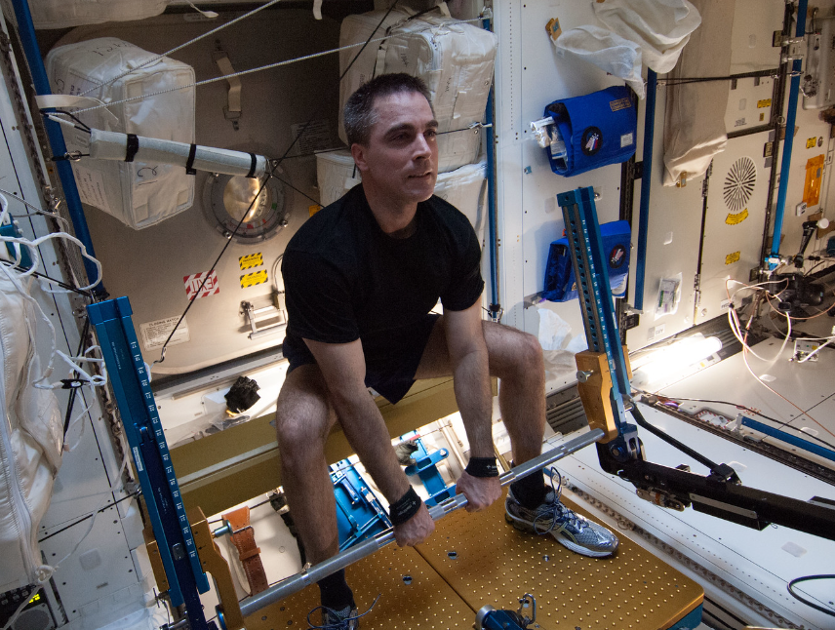
Countermeasures & Medical Systems
Research on CLD platforms will require testing and validation of potentially large and complex countermeasures
Additional research will focus on
  Evaluating complicated hardware
  Software and consumable systems,
    (e.g., future medical capabilities to support crew health on longer autonomous exploration missions)

Slide 10
Human Research Utilization
Researching Countermeasures, Standards, and Technology to inform CLD, Lunar, and Mars Missions
Ops Countermeasures
Behavioral Medicine
Team Dynamics
Food & Nutrition
EVA Physiology
Space Radiation
Cardiovascular
Immune | Microbiome
Spaceflight Associated Neuro-ocular Syndrome
Sensorimotor
Bone Health
Exploration Medicine
Medical Resources
Occupant Protection
Human System Integration Architecture

Slide 11
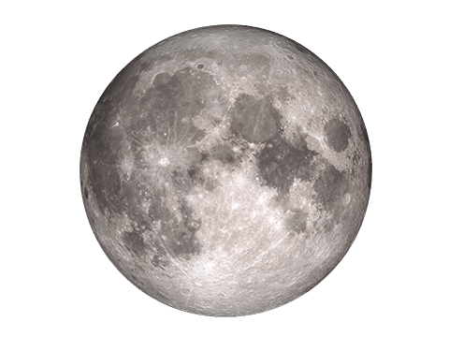
HRP Fosters Artemis Missions
HRP is addressing high-priority mitigation
determined by HMTA*
Medical Conditions
Dynamic Loads
Sensorimotor/ Manual Control
EVA
HSI
— Likely medical conditions
— Integrated seat and EVA suit
— Manual control option for landers
— Improved performance and reduced injuries in EVA suits
— Integration across programs and vehicles
*Health and Medical Technical Authority

Slide 12
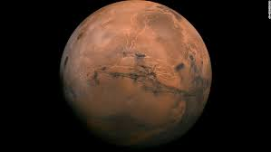
HRP Fosters Mars Missions
HRP is addressing high-priority mitigation determined by HMTA*
Pharm
Medical Conditions
Cardiovascular (LTH)
Dynamic Loads
Food & Nutrition
Team
BMed
HSI
EVA
SANS
— Long-term medications storage
— Likely medical conditions
— Cardiovascular long-term health
— Integrated seat and EVA suit
— Nutritious, desirable, sufficient food system
— Assured isolated team performance
— Assured psychological performance in isolated environments
— Human system integration across programs and vehicles
— Improved performance/reduced injuries in EVA suits
— Protection from spaceflight-associated neuro-ocular syndrome
*Health and Medical Technical Authority

Slide 13
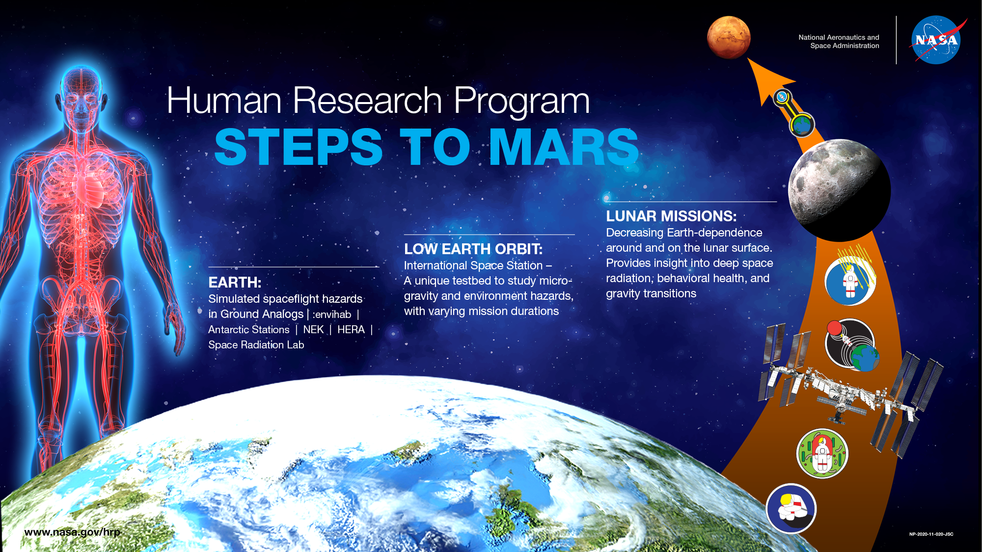
Phased Research

Slide 14
Human Research not a typical "Payload"
Payload = hardware items launched, used in flight, and returned
Human research “payloads” follow this definition, but use of crew as subjects make them unique.
Launch and Operate in Space!
Return Payload or Samples
Payload development and prep for mission
Data analysis and publication

Slide 15
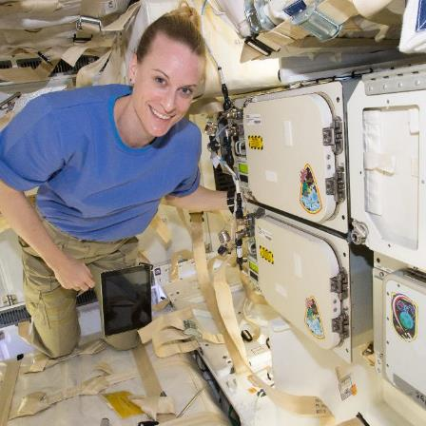
Integrating Human Research Payloads
Because human research collects data from crews, crews must:
  Consent to participate
  Act as their own controls
Altered development and integration schedules are required.

Slide 16
Altered Schedules Required
  Consent needed early (~L-1 year) – before pre-flight data collection
  Study details must be:
    Well-defined so the crew knows what they are consenting to
    Shared with all potential human research investigators to identify conflicts, constraints, or opportunities for efficiencies.
  An assessment of integrated study sets should be performed for pre, in and post-mission phases before any data is collected. This ensures that studies can be successfully performed together given limitations such as:
    Immediate post-flight schedule – limited time means not all studies will fit
    Blood volume limits, opportunities to combine blood draws
    Pre-mission crew availability
  Most human research requires multiple subjects, requiring multiple flights/missions

Slide 17
Important Considerations: Scheduling
Pre- and post-mission data collection requires dedicated facilities and careful scheduling.
This includes:
  Access to specialized laboratories for sample analysis
  Dedicated space to accommodate unique research hardware
  Scheduling must balance nominal crew training schedules with study constraints (e.g. exercise, fasting constraints)
  Studies could require access to crew several years after they land

Slide 18
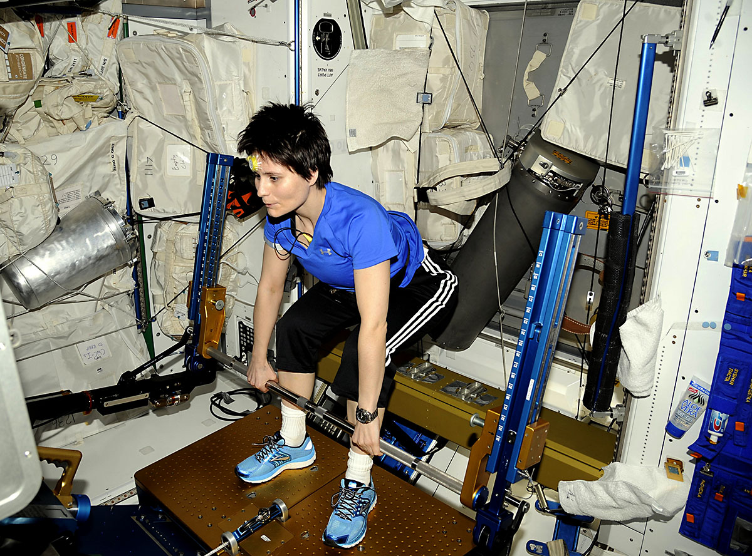
Important Considerations: Operations
Operations are not confined to dedicated payload areas inflight.
For example:
  Exercise studies leveraging existing hardware
  Urine, fecal sample collection in hygiene area
  Team dynamics studies– various locations
  Sleep studies – crew quarters
  Questionnaires in any location
  Crew-worn hardware for multiple days

Slide 19
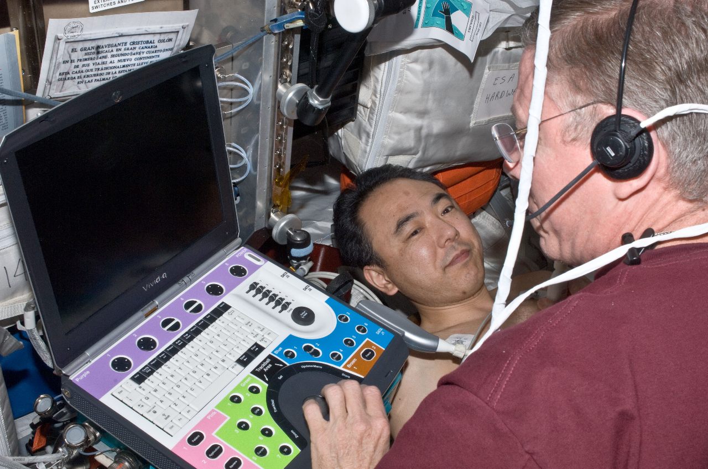
Important Considerations: Data
Human research studies require:
Coordination with space medicine
  Data/hardware sharing and efficiencies where possible between research and medical requirements
  Awareness of conflicts
Data Privacy
  Research data must be protected and encrypted
  Secure transmission

Slide 20
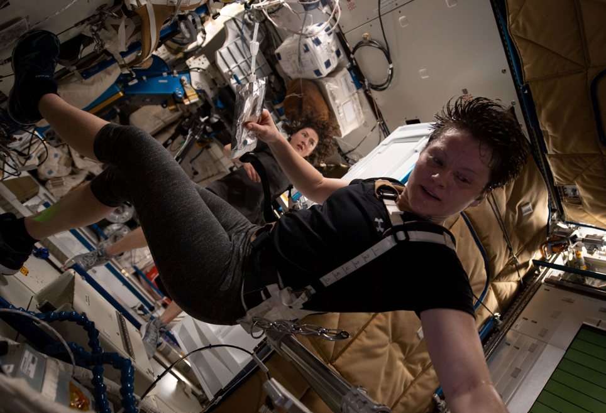
HRP Assumptions for CLD: Operations
Human research will transition from ISS to future CLD platforms (HRP ROI fly-off Plan)
This may also include additional technical demonstrations
Some human research will focus on preparing for human missions to Mars

Slide 21
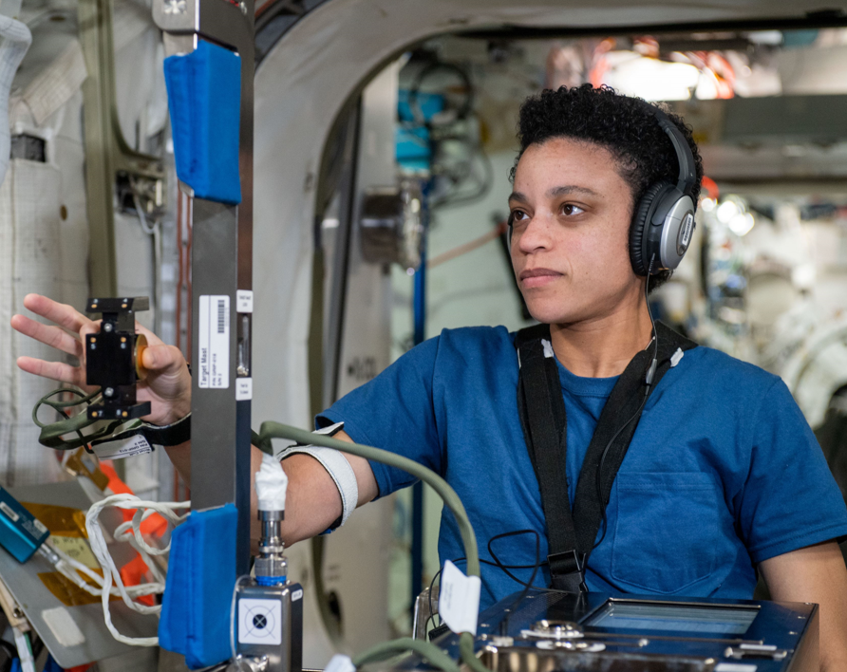
HRP Assumptions for CLD: Crew
Human research studies require:
Access to CLD flight human subjects with appropriate qualifications
Multiple crew durations to provide insight into human adaption over time
Durations of interest are
  short (~6 weeks)
  standard (~6 months)
  extended (12+ months)

Slide 22
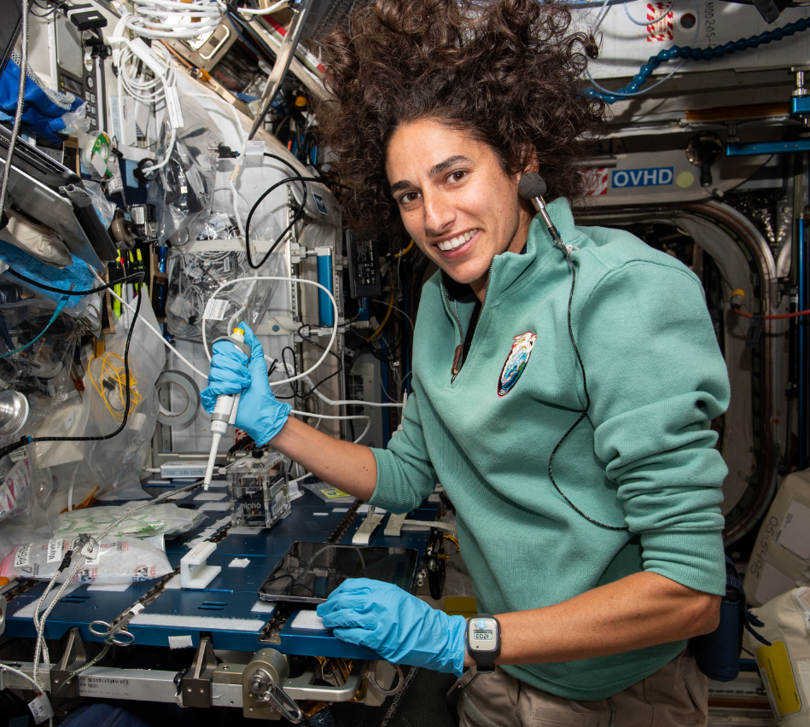
HRP Assumptions for CLD: Resources
Capabilities/onboard resources should:
  Be similar type/scope of laboratory capabilities as on the ISS
  Include dedicated stowage volume for unique payload equipment with available resources

Slide 23
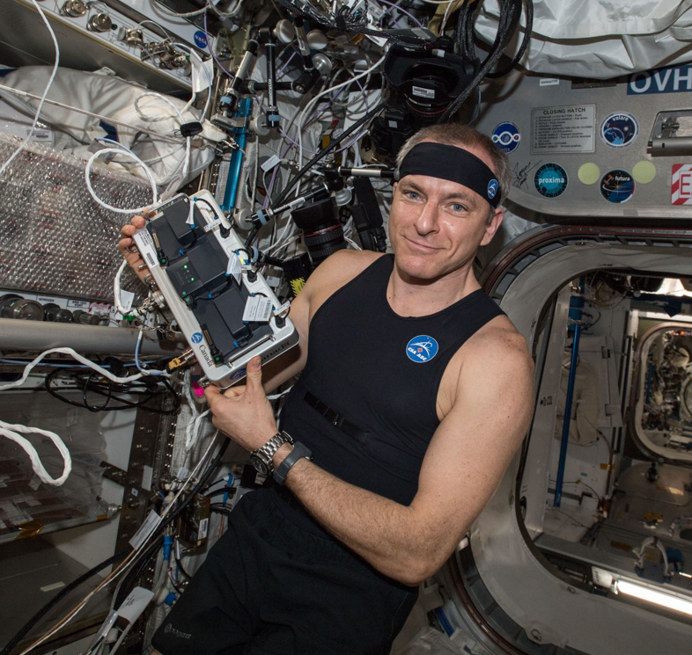
Lessons Learned from ISS: Operations
Inflight operations start with the crew but upmass on these flights is limited.
Must plan to ensure hardware and supplies are available prior to crew arrival—early integration is our friend!
A well-stocked and managed pantry of supplies can protect for delays in cargo flights, allowing studies to start sooner.

Slide 24
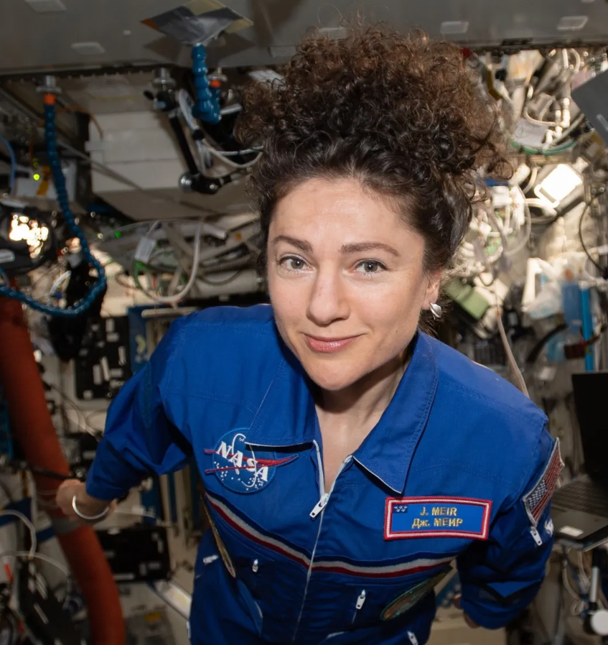
Lessons Learned from ISS: Crew Time
Crew time = limited resource, needs careful management to protect crew and science
  Integration and scheduling pre- and post- mission testing is essential
  Close coordination with space medicine is required
  Dedicating blocks of time pre-flight for data collection is beneficial
  Crew time immediately post-mission is critical but heavily constrained and should be protected for medical and research testing

Slide 25
What Capabilities Do We Need?
Most-utilized ISS payload facilities:
  Cold stowage (primarily -80C)
  Laboratory centrifuge
  Research grade ultrasound
  Mass measurement device
  Laptop computers
  Consumable pantry – supplies for blood, urine, saliva, buccal, fecal collection, electrodes, etc.
  Wearable biometric tracking devices
  Rack stowage for experiment unique hardware – deployed for ops with crew then stowed
Other ISS assets utilized:
  Medical system devices
  Secure transmission of data, privatized comm
  Environmental monitoring
Anticipated future capability needs:
  Wet laboratory, in-situ analysis, and sample prep
  Sample handling and conditioning: Glovebox, microscope, incubators, conditioned water

Slide 26

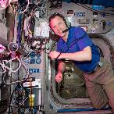
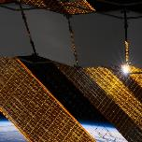
Capabilities in a Nutshell
TRANSPORT
COMMUNICATION
RESOURCES
  Up/Down-Mass: Ambient & Conditioned
  Time Critical Transport
  Frequent Resupply
Audio & Video
On-board Comm
Space-to-Ground Comm
Negligible Comm Delay
  Power & Thermal
  Waste (General & Hazardous)
  Clean/Sterile Environment

Slide 27
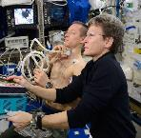
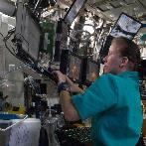
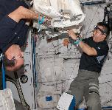
Capabilities in a Nutshell
CREW
DATA
STORAGE & SPACE
  Pre-, In- and Post-Flight access
  Crew Need Projection Assumptions
Data Storage, Analysis, & Distribution
Suite of Imaging, Diagnostic Lab Equipment
Negligible Data Transfer Delay
Storage: Ambient & Conditioned
Free/Workspace
Mars Transit Evaluation

Slide 28
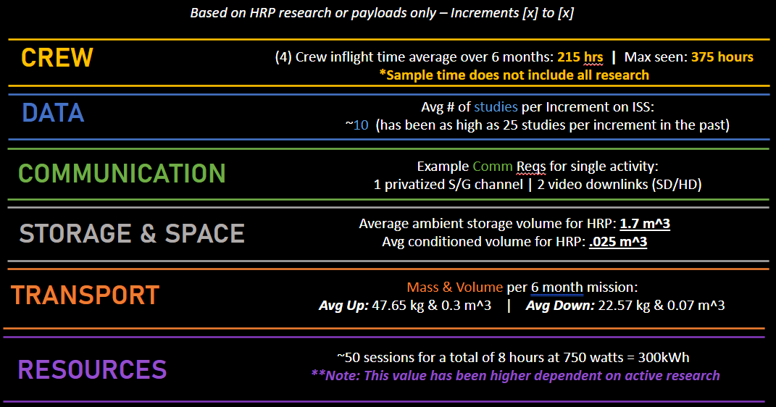
Resource Averages per Increment

Slide 29
Previous Industry Questions
Timing of capabilities and research needs?
  Refer to Human Research Roadmap (https://humanresearchroadmap.nasa.gov/) for the best available information on future HRP research plans
Length of HRP activities, extending past ISS timeframe?
  Yes, HRP has identified research needs both extending research from ISS to other platforms after the end of ISS and the need for unique studies occurring after ISS to enable future exploration missions
Anticipated research throughput needs (e.g., number of crew hours, frequency of facility use)?
  Refer to the next slide for relevant averages from ISS
Typical study duration?
  Extremely variable from study to study, but for human research studies often begin data collection months before launch, collect data at points throughout all in-flight mission phases, and collect data for weeks to months after crew return. Some studies may have requirements extending these windows further.
  Based on sample size needs and number of available astronauts at a time most studies will take multiple years to achieve their full sample size.

Slide 30
Relevant Links
HRP's Webpages: https://www.nasa.gov/hrp/
The Human Research Roadmap: https://humanresearchroadmap.nasa.gov/

Slide 31
Summary/Closing Comments
Through HRP, NASA is focused on enabling future exploration missions to the Moon and Mars by addressing key human health and performance risks
Research conducted in LEO is essential to HRP's strategy; HRP's LEO research will continue past the end of ISS
Human research has unique requirements compared to other research payloads
Key considerations in implementing research include crew consent, scheduling, and research integration
For human research on CLD HRP anticipates:
  Similar access to crew and capabilities on CLD as is currently found on the ISS
  Potential needs for new capabilities relevant to fostering human exploration of deep space

Slide 32
BACKUP

Slide 33


Elements of HRP
Program and Science Management Offices
Translational Research Institute for Space Health (TRISH)
Space Radiation (SR)
Human Health Countermeasures (HHC)
Human Factors & Behavioral Performance (HFBP)
Exploration Medical Capability (ExMC)
Research Operations & Integration (ROI)

Slide 34

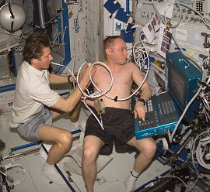




HRP ELEMENTS
Program Elements:
  Space Radiation (SR)—JSC, LaRC, GSFC
    Recommendations to permissible exposure limits, assessment/projection tools/models of crew risk from radiation exposure, and models/tools to assess vehicle design for radiation protection
  Human Health Countermeasures (HHC)—JSC, ARC, GRC, KSC
    Integrated physiological, pharmacological and nutritional countermeasures suite; biomedical expertise for the development and assessment of medical standards and vehicle and spacesuit requirements dictated by human physiological needs
  Human Factors and Behavioral Performance (HFBP)—JSC, ARC, GRC
  Focusing on the human system in space environment, to identify and characterize the human factors and behavioral performance risks associated with training, living and working in space, and returning to Earth
    individual and interpersonal interactions; sleep and stress interfaces between humans and vehicles/habitats/environment
  Exploration Medical Capability (ExMC)—JSC, ARC, GRC, LaRC, GSFC
    Requirements for medical care and crew health maintenance technologies (monitoring, diagnostic, treatment tools and techniques); medical data management; probabilistic risk assessment; technology and informatics development
  Research Operations & Integrations (ROI) —JSC, ARC, KSC
    Research integration and operations for ISS and ground analog facilities
TRISH is funded through a cooperative agreement to lead a national effort in translating cutting-edge, emerging terrestrial research into applied space flight and human risk mitigation strategies for exploration mission

Slide 35

CREW
COMM
TRANSPORT
DATA
STORAGE
& SPACE
RESOURCES
General Needs and Capabilities
Future Commercial LEO Destinations
Not approved for public release. See cover for full disclaimer.

Slide 36

  Access to flight human subjects with appropriate qualifications.
  Multiple crew durations available to provide insight into human adaption over time and similar durations for a human Mars mission.
  Research and Operations Integration support for human health Utilization on CLD’s will be available
CREW
Related
Assumptions
  PRE-flight access: L-365 to L-1 (dependent on study)
  In-flight access: Regular access over varying mission durations
    Short (6 wks.), Medium (6 months), & Long (12 months)
    Note: Certain studies require multiple crew – subject & operator
  POST-flight access: R+0 (At rally airport and JSC) to R+10, and R+180 and R+365 (dependent on study)
  Crew Need Projection: 48 crewmembers assuming 8 crew/yr. - 6 years
    Assumption for 2030-2036 and only to complete current work
    Uncertain of req’s for future HRP studies and SCLT activities
In-flight Crew Time over 6 months for 4 crew
  Average: 215 hours (data from Inc. 61/62-65)
  Max seen: 375 hours = 47 workdays per 180 days​
    Does not include participation in all research
Example Individual Crew Time –
Comprehensive human research complement
PRE | IN (6-month) | POST
71 | ~115 | 107
Notes:
Assuming crew of 4 over 6 months, inflight avg: 215 hrs. (though, has been as high as 375 hrs. in on increment in the past)
375 hours = 47 workdays per 180 days
Total crew time variable with crew size
Inflight w/o CIPHER does not include IP research
Current individual crew time given for sample context – team working more accurate estimations for CLD

Slide 37

Related
Assumptions
Dedicated stowage volume for HHU payload unique equipment with available resources such as: power, laptop computers with specialized software, and data connections for distribution and transmission.
Similar type and scope of human research laboratory capabilities as on the ISS, with access to standard biological research laboratory equipment and supplies.
DATA
Data Storage, Analysis, & Distribution
  Tiered Command & Data Handling structure that interfaces with sensors and effectors.
    Implement medical Integrated Data Architecture (IDA – see backup), and cloud storage for multiuser access
  Access to laptops with dedicated research software
  Real-time secure transfer (ex: Ultrasound images)
    Encryption option for sensitive data
  File and software upload capability
  Downlink: 100 MB avg, ~1GB file size max
Suite of Imaging, Diagnostic Laboratory Equipment
Negligible Data Transfer Delay for generic ops
  Implement an “Autonomous Ops” mode that has an adjustable data transfer delay (Ex: 5-20 minutes for Mars simulation)
  Adjustable (simulated) data transfer bandwidth
Average Number of Studies per Increment
  ~10 (has been as high as 25 studies per increment in the past)
Notes:
Want ISS capabilities at minimum for data transfer
Downlink: (ISS Example: Ku-Band nominally set to its minimum of 1 Mbps down, can be up to 259 Mbps when dumping data if bandwidth available on downlink)

Slide 38


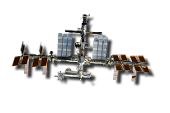
DATA
Crew Health & Performance (CHP) Integrated Data Architecture (IDA)
  Vehicle design should support…
  Collecting CHP Data from:
      …diverse instruments or “sensors” that may mature over time.
      …other vehicle systems (such as ECLS) and performing data analytics.
  Managing all data for Crew Health and Performance purposes
    i.e. vehicle should store, route and combine data appropriately.
  Continuity of care for the crew across all mission phases and vehicle thresholds
    Make the CHP hardware, software, data, planning and activities as similar as possible to reduce confusion and minimize preflight training.
Notes:
Vehicle should be capable of collecting CHP Data from diverse instruments or “sensors” that may mature over time (environmental, medical, Behavioral Performance, Countermeasures)
Vehicle should be capable of collecting CHP related data from other vehicle systems such as ECLS (as opposed to developing CHP unique capabilities) and performing data analytics.
Vehicle should be capable of Managing all data for Crew Health and Performance purposes (i.e. vehicle should store, route and combine data such that it supports CHP decision making by the crew and ground personnel and allows (i.e. situationally relevant data should be routed to who needs it, when they need it and how they need to see it to support decision making)
Enabling the crew to work more and more autonomously is an exploration objective, however, it could result in cost (reduced ground support) for commercial companies.
The vehicle should support continuity of care for the crew across all mission phases and vehicle thresholds
Make the CHP hardware, software, data, planning and activities as similar as possible across the mission to eliminate mistakes, reduce confusion and minimize preflight training

Slide 39
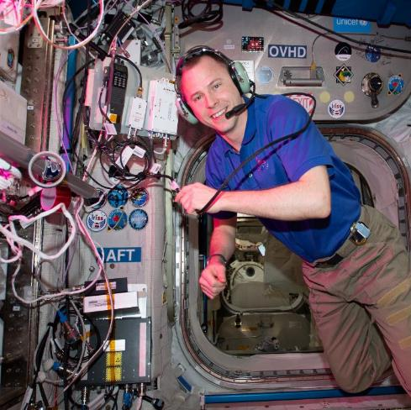
COMMUNICATION
Audio & Video
  Audio and video privatization available for remote guidance and sensitive data
  SD and/or HD Video with recording capability
On-board Communication
  Space-to-Space Audio Channels
Space-to-Ground Communication
  Space-to-Ground Audio Channels
Negligible Audio Communication Delay for generic ops
  Implement an “Autonomous Ops” mode that has an adjustable communication delay
Example Comm Requirements for a single activity
  1 dedicated, privatized S/G channel | 2 video downlinks for live experiment HD view and situational awareness SD view of crew

Slide 40

  Similar type and scope of human research laboratory capabilities as on the ISS, with access to standard biological research laboratory equipment and supplies.
  Dedicated stowage volume for HHU payload unique equipment with available resources such as: power, laptop computers with specialized software, and data connections for distribution and transmission.
STORAGE & SPACE
Related
Assumptions
Storage :
  Note: Total storage volume will be dependent on further development of utilization by HRP and SCLT
  Rack-mounted Utilization devices with power, thermal, data interface
  Non-rack mounted payload devices with access to power for recharge of batteries
  Ambient, Refrigerated, Frozen storage for utilization supplies
  Easily accessible and organized pantry of consumable supplies to support blood, saliva, urine, body, and fecal sample collection
Free Space :
  Space for range-of-motion for human subjects with restraints available
  Rack mounted, powered / thermal locations with open space for working with at least 2 crew
Mars Transit Evaluation:
  Additional stowage anticipated to be required
Inflight Storage Utilization
Avg ambient volume for HRP: 1.7 m^3
*Note: Dependent on number of crew, includes stowage for HRF racks 1, 2, & outside rack storage.
Avg conditioned volume for HRP: .025 m^3
*Note: Avg from 6 months in 2021. Assumes all samples will be returned over 6 months.
Notes:
Average volume of stowage in 2 HRP racks = 0.911 m^3 (~30% of the space)
Average volume of stowage outside the racks = 0.8 m^3
Total: 1.7 m^3
Volume does not include rack experiment hardware
Ambient storage is actual inflight stowage for those racks from Inc 61/62-65.
Conditioned storage only includes volume of samples, NOT packing material
Max for conditioned storage would be doubled if returns are only once a year.

Slide 41
  Similar type and scope of human research laboratory capabilities as on the ISS, with access to standard biological research laboratory equipment and supplies.
  Dedicated stowage volume for HHU payload unique equipment with available resources such as: power, laptop computers with specialized software, and data connections for distribution and transmission.
TRANSPORT
Related
Assumptions
  Note: Total transport volume will be dependent on further development of utilization by HRP and SCLT
  UP-MASS
    Ambient
    Conditioned
  DOWN-MASS
    Ambient
    Conditioned
  Time Critical Transport: Ambient Blood Samples must be transferred to labs 48 hours after collection in flight
  Frequent resupply needed for consumables with limited life
Mass/Volume per 6-month mission
  highly dependent on what types of studies are being done
Avg up-mass: 47.65 kg Avg up- volume: 0.3 m^3
Avg down-mass: 22.57 kg Avg down-volume: 0.07 m^3
Notes:
Masses are actual average per Increment from ISS Inc 61/62-65

Slide 42
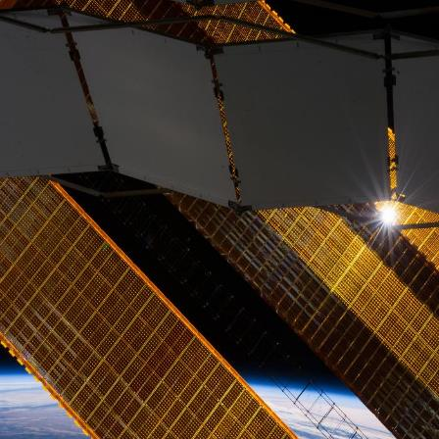
RESOURCES
  Power & Thermal
    Minimum Requirements:
    120 VDC
    28 VDC
    120 VAC
    USB Charging capability
  Waste (General & Hazardous)
    Storage vs Disposal
  Clean/Sterile Environment
Average Power Usage per Increment
~50 sessions for a total of 8 hours at 750 watts = 300kWh
**Note: This value has been higher dependent on active research
Notes:
Need Thermal or Inert Gases?

