Slide 1

Accelerating Transformative Science: Interdisciplinary Information Curation in NASA’s Science Discovery Engine
Kaylin Bugbee¹, Stephanie Wingo², Emily Foshee², Muthukumaran Ramasubramanian²
1: NASA Marshall Space Flight Center, 2: University of Alabama in Huntsville
Special thanks to Shravan Vishwanathan at Left Right Mind
15 December 2023

Slide 2
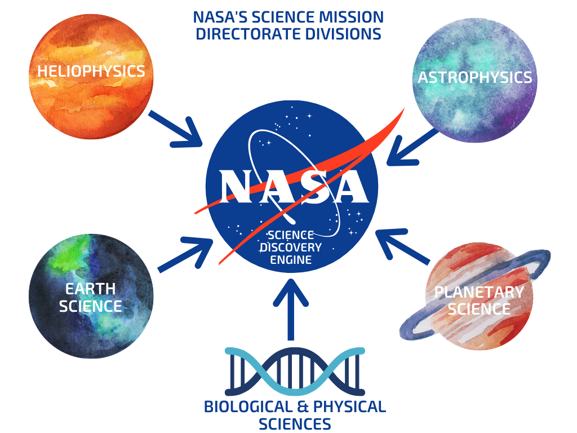
Meet the Science Discovery Engine (SDE)
Goals:
Enable rapid discovery of NASA science data, software and documentation
Support NASA’s open science goals and infrastructure
Promote interdisciplinary science
Prototype emerging technologies and search techniques including Large Language Models
Image credit: SDE Team

Slide 3
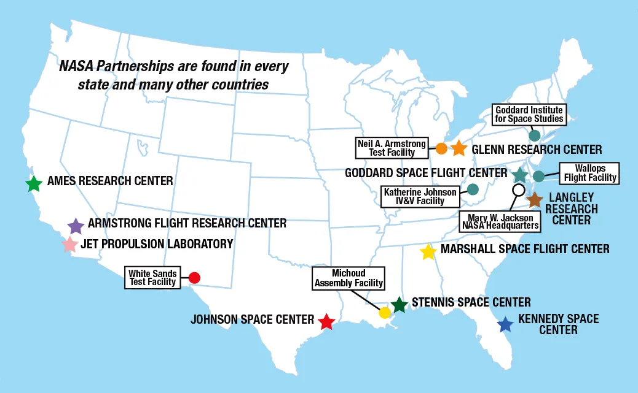
Challenge 1: Finding Data and Information
Data and information is mostly arranged by organization, not by science topics
Organizations include:
NASA centers: primarily have information on center specific missions and publications
  Mission specific pages
Data repositories or archives: authoritative data sets
Divisions: web pages that aggregate information and/or metadata search aggregators
Research groups: datasets not published at the repositories, publications
This represents a challenge for both users and information curators like the SDE team to quickly and efficiently find data and information.
NASA Centers. Image credit: NASA.
Notes:
https://www.nasa.gov/partnerships/nasa-locations-capabilities-and-points-of-contact/

Slide 4
How does Google handle this problem? And why does Google fail?
Correct context and relevance is needed to return correct results
Curation and relevant content helps address the gap
SDE bridges this gap through curation, relevance methods and sponsored links
Query | Google First Result | Correct?
NASA Astrophysics Data | NASA/ADS | No
NASA Biological Science Data | Biological and Physical Sciences Webpage | Partially - Can get to data indirectly
NASA Earth Science Data | Earthdata | Yes
NASA Heliophysics Data | SMD Heliophysics Webpage | Partially - Can get to data indirectly Heliophysics Data Portal is the second result
NASA Planetary Science Data | PDS | Yes
Topical Science Queries
NASA galaxy data | NASA/IPAC Extragalactic Database (NED) | Yes but have to make one extra click to get to the actual NED website
NASA omics data | GeneLab: Omics Database for Spaceflight Experiments | Partially - this is a link to a paper on the GeneLab site, not the repository itself
NASA sea surface temperature data | Earth Observatory: Sea Surface Temperature | No
NASA photosphere data | Solar Physics: The Photosphere | No
NASA Mars data | NSSDCA: Mars | Yes but not the most up-to-date data
Query results obtained 15 October 2023

Slide 5
Challenge 2: Dataset Metadata Completeness
Dataset metadata is at varying levels of completeness
The SDE team has created a core set of metadata concepts needed to enable discovery and reuse. These metadata elements are applicable across the five science areas and include concepts like:
Dataset title, dataset description
Persistent Identifier (DOI)
Data format
Science keywords
As of October 2023, the SDE team has identified 23 SMD-wide core metadata concepts and has completed schema crosswalks for 4 of the 5 schemas. These include:
Earth Science (Unified Metadata Model)
Heliophysics (SPASE)
Planetary Science (PDS 3 and 4 API)
Astrophysics (NAVO Registry)
Notes:
https://thenounproject.com/icon/ideas-5159489/

Slide 6
Challenge 2: Dataset Metadata Completeness
Schema matching between the SDE concepts and the existing schemas are relatively good so far.
Heliophysics SPASE: 21 of 23 core concepts are mapped
  Data Volume and Spatial Resolution are missing
Earth Science UMM: 21 of 23 core concepts are are mapped
  Agency and Operation Wavelength are missing.
  Agency can be inferred but would be preferable to map from an actual element
Planetary Science PDS3 API: 9 of 23 core concepts are mapped
  Data format, Data volume, Access constraints, Use constraints, etc not mapped
Planetary Science PDS4 API: 11 of 23 core concepts are mapped
  Data format, Data volume, Access constraints, Use constraints, etc not mapped
  It should be noted the PDS metadata provided via xml files is rich. However, the SDE team uses APIs whenever possible for scalability purposes.
Astrophysics NAVO registry: 7 of 23 core concepts are mapped
BPS: Open Science Data Repository (OSDR) concept matching in progress

Slide 7
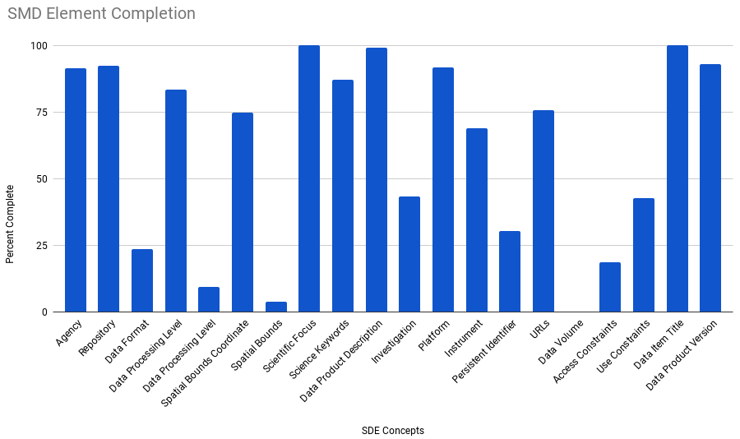
Challenge 2: Dataset Metadata Completeness
We also want to understand how many of the concepts are actually populated with information. Here are some preliminary metrics.
Some caveats on these metrics:
These metrics do not address the quality of the information provided but instead measure whether a response was provided or not.
All 4 divisions receive metadata from other agencies outside of NASA. Completeness may vary by agency. For example, NASA’s Earth science metadata is mostly complete for persistent identifier information. Other records are not required to comply.
Further analysis is required to provide more targeted insights.
Image credit: SDE Team
Notes:
Data Product Description
Earth Science: 100%
Heliophysics: 100%
Planetary Science: 95%
Persistent Identifier
Earth Science: 36%
Heliophysics: 8%
Planetary Science: 3%
Use Constraints
Earth Science: 56%
Heliophysics: 10%
Planetary Science: 0%

Slide 8
Conclusions
Challenge 1: Finding Data and Information
At this time, mitigating this challenge requires a number of approaches including human identification/curation of content along with novel methods to improve the search experience in SDE. AI techniques may assist with this challenge but prototyping is needed to assess the viability of this approach.
Challenge 2: Dataset Metadata Completeness
Preliminary analyses indicate that the SMD schemas are in various stages of completeness as compared to the SDE information needs. Adding new concepts to existing schemas will be needed to enable discovery within the SDE. This will present varying levels of difficulty depending on the schema.
Adoption and use of concepts already available in the schemas is variable. Some concepts are populated and used (dataset description) while others are not (persistent identifiers, use constraints). For example, persistent identifiers are created for most SMD datasets. Yet this information is not provided in the metadata for some datasets.
The quality of information provided in populated concepts is unknown at this time. A layer of automated quality checks can provide additional insights into the quality of the information provided.
The SDE team plans to display all 23 concepts as a part of a cohesive and consistent SMD-level dataset landing page design. Metadata completeness and quality will be essential to ensure a positive user experience both within the SDE and within the division’s own metadata aggregator services.
Notes:
https://thenounproject.com/icon/ideas-5159489/

Slide 9
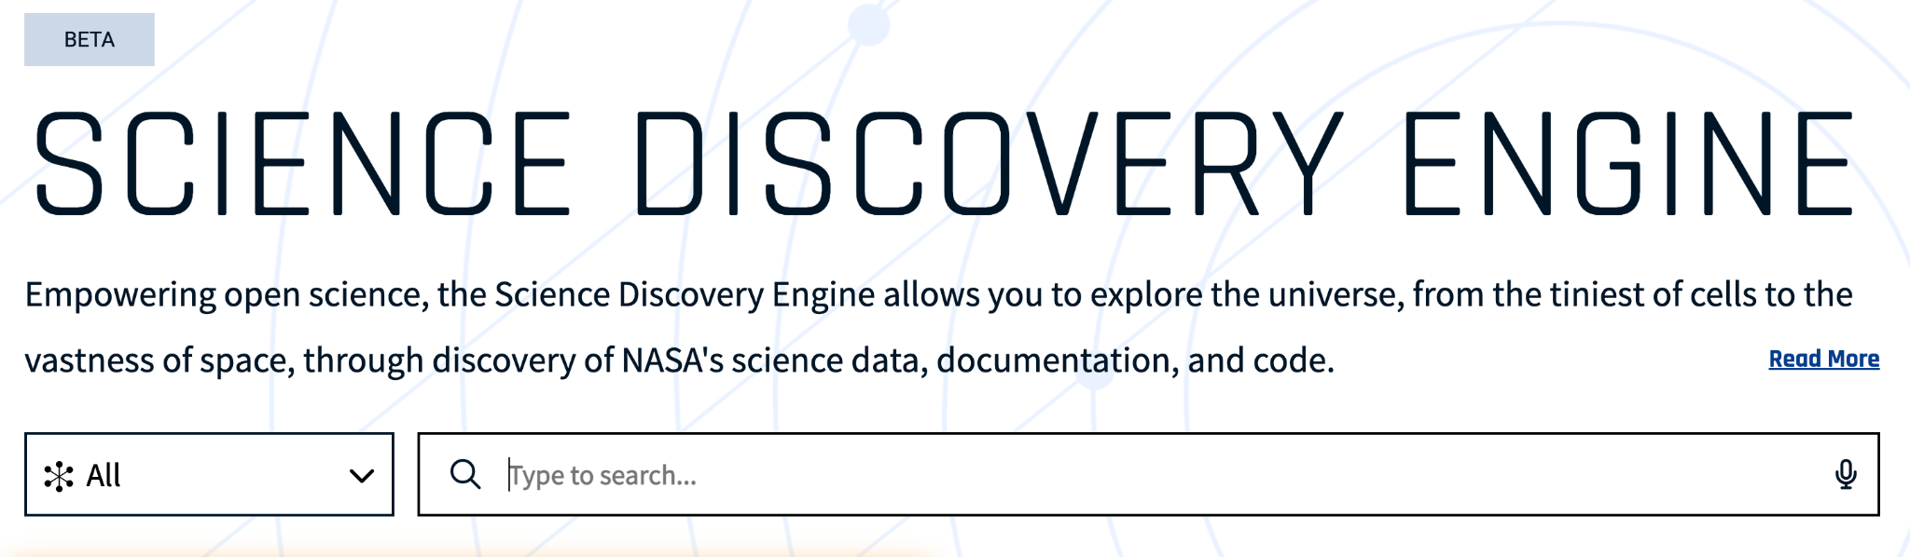
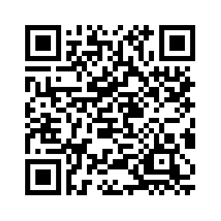
Summary
The beta Science Discovery Engine (SDE) enables search of NASA’s open science data and information.
Enabling interdisciplinary search poses a number of challenges including:
  Finding dispersed content that is typically arranged by organization, not topics.
    Useful content is often buried within websites.
  Metadata quality and completeness will need to be considered in order to improve the user experience in the SDE and other search applications.
sciencediscoveryengine.nasa.gov

Slide 10
Thank You
Contact:
Kaylin Bugbee
kaylin.m.bugbee@nasa.gov

