Slide 1
NOAA-17 Breakup
Engineering Investigation
2nd International Orbital Debris Conference
December 5th, 2023
Scott Hull, NASA GSFC Code 592
Tupper Hyde, NASA GSFC, Code 100
J.-C. Liou, NASA JSC, XI511

Slide 2
Agenda
Introduction
Investigation
  Source for the Debris
  Likely Initiating Event
  Findings
Summary
2

Slide 3
Introduction
The NOAA-17 Spacecraft operated successfully for 11 years, then was decommissioned and passivated to the extent possible
March 10, 2021: Spacecraft broke up almost 8 years after being passivated
Localized event, not a complete breakup
Similar to other events (NOAA-16, DMSP F11, DMSP F13)
Engineering Investigation Board (EIB) was created at the request of NOAA
This paper summarizes the very detailed 44-page EIB report
To date, 114 objects have been cataloged, 109 of which are still in orbit

Slide 4
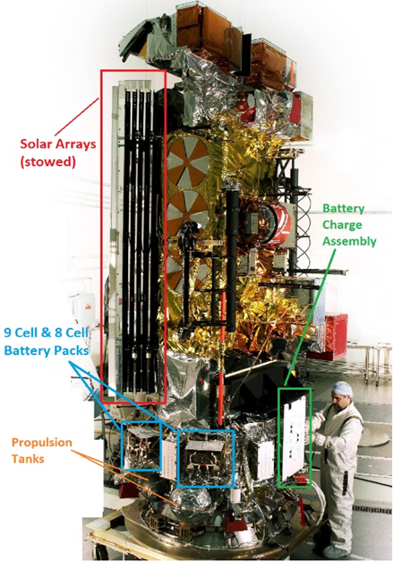
NOAA-17 Overview
Polar weather satellite
Launched on 6/24/2002 to approx. 800 km Sun-synch
Very similar to DMSP Block 5D3 design
Mass is 1430 kg in orbit
Operated nominally until 2013, when it was passivated
  4.98 kg hydrazine remained after isolation
  Nitrogen cold-gas propulsion system was nominally
  depleted before decommissioning
  Two batteries isolated, one left connected to the
  discharge path

Slide 5
Fleet History
Two designs for each of two customers (NOAA and DMSP)
  Block 5D2 Family: 15 spacecraft
  Block 5D3 Family: 10 spacecraft
  19 of the 25 have been decommissioned to-date
Four of these spacecraft have experienced significant debris shedding
Tracked objects are assumed to have ~10 cm threshold size
Spacecraft | Design Family | Objects Detected/Tracked
DMSP F11 | Block 5D2 Family | 85
DMSP F13 | Block 5D2 Family | 236
NOAA-16 | Block 5D3 Family | 458
NOAA-17 | Block 5D3 Family | 114

Slide 6
Investigation
No clear cause ‘jumped out’ based on the evidence
Fault Tree used to associate potential causes with the observed breakup
  Evidence, observations, and logic used to categorize potential root causes as
  Impossible, Unlikely, Possible, or Probable
Identification of the Likely Debris Source
  Debris size distribution
  Debris orbit distribution
  Debris Area to Mass Ratio
  DMSP F13 history
Examination of Potential Initiating Events
Findings: list of possible but unlikely initiating events

Slide 7
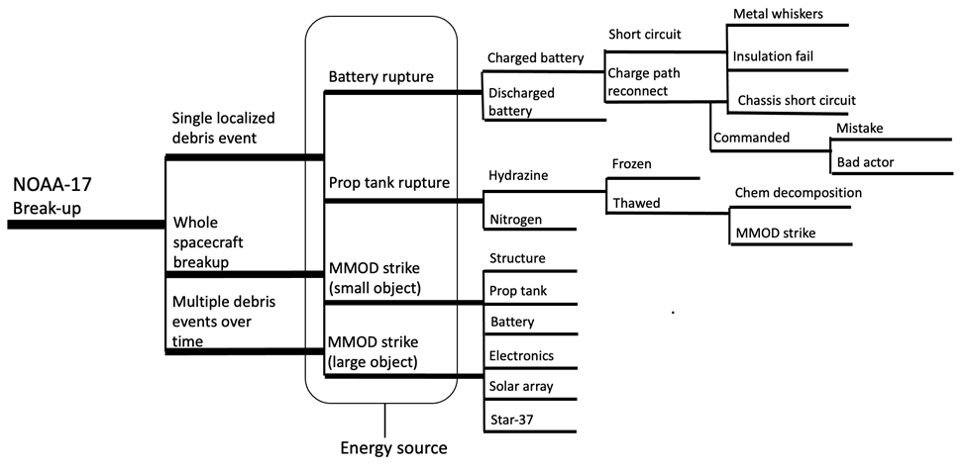
Fault Tree

Slide 8
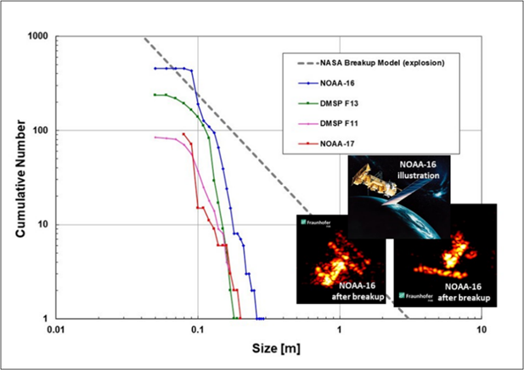
Investigating the Likely Source of the Debris:
Debris Size Distribution
NASA radar Size Estimation Model used along with the Radar Cross-section to determine debris characteristic length distribution
Compared to the standard distribution for a complete spacecraft explosion: not consistent with an explosion
Compared to the three similar breakups: same trends

Slide 9
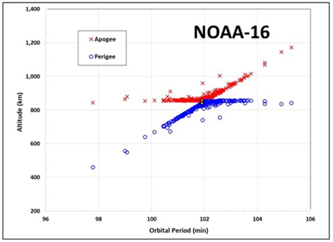
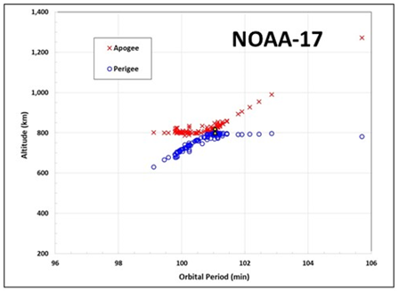
Investigating the Likely Source of the Debris:
Debris Distribution in Orbit
Gabbard diagrams illustrate the altitudes of perigee and apogee vs orbital period
Suggests that the nature and the intensity of the NOAA-16 and NOAA-17 breakups were similar. DMSP breakup diagrams also looked similar to those

Slide 10
Investigating the Likely Source of the Debris:
DMSP F13 History
DMSP F13 broke up while the spacecraft was operational
The breakup is known from telemetry to have occurred simultaneously with a battery overcharge event
Observed debris size distribution and orbit distribution is nearly identical for all four breakup events
Therefore, battery rupture is believed to be the most likely intermediate cause of all four of the breakups

Slide 11
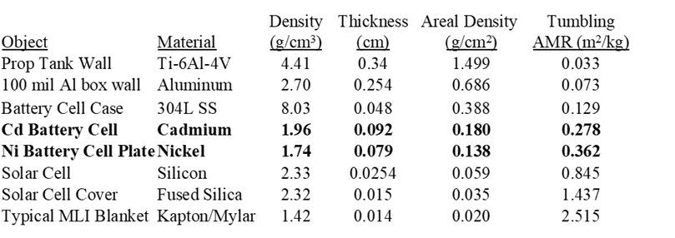
Investigating the Likely Source of the Debris:
Debris Area to Mass Ratio (AMR)
Orbit decay history over days to weeks was used to imply an AMR for each tracked object: two peaks at ~0.3 and ~0.4 m²/kg
Typical spacecraft components were examined for possible matches
Cd and Ni Battery Cell Plates match to the two peaks

Slide 12
Investigating the Likely Initiating Event
MMOD Strike Initiating a Breakup
  No tracked object seen by the US Space Surveillance Network that approached NOAA-17
  Probability of an OD strike by almost-trackable objects is about 1 in 10,000 per year per spacecraft: extremely unlikely, especially considering four such events
MMOD Strike Liberating Star-37 Motor Slag
  No cases reported from exhausted motors
  Many such motors in orbit with no widespread debris: extremely unlikely
Tank Rupture (Hydrazine Decomposition)
  Few objects with AMR matching Ti tank wall (0.03 m²/kg vs. ~0.3 m²/kg observed)
  Tank rupture is considered highly unlikely as an initiating event, but proximity to the batteries and presence of isolated hydrazine means it can’t be completely ruled out

Slide 13
Investigating the Likely Initiating Event
Battery Rupture (Overcharge)
  NOAA-17 is known to have been passivated at decommissioning
  One battery still connected to the discharge path, but disconnected from the charge path
  Reconnection to a power input needed for overcharge to occur: two possibilities
  Direct Short Circuit Developed Over Time
    Metal whiskers could grow to create a temporary switch signal, or a high power plasma: unlikely
    Insulation could rub through to short power to the battery or to the chassis: unlikely
  Reconnection of the Charge Path
    Erroneous command sent after decommissioning: numerous levels of safeguards: very unlikely
    Intentional interference by a bad actor: numerous levels of security safeguards: highly unlikely

Slide 14
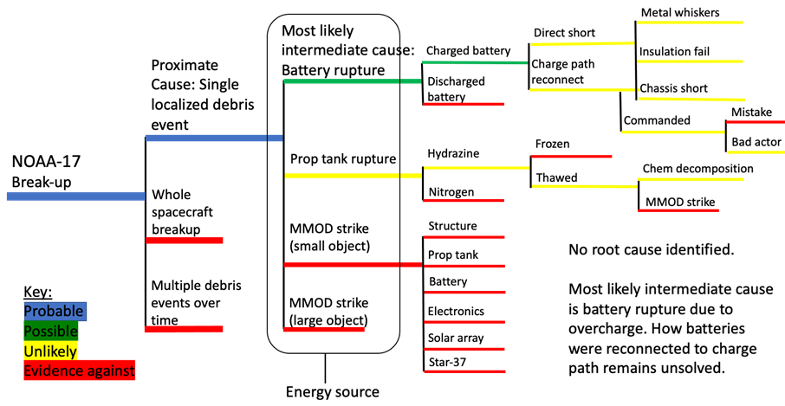
Findings
No clear ‘smoking gun’, but several unlikely but potential initiating events

Slide 15
Summary
NOAA-17 breakup event was found to be very similar to 3 previous events
The four events likely shared the same debris source: a battery cell rupture
No clear root cause for the breakups was identified that can be supported by the available evidence
Based on the investigation, it appears all 25 of the spacecraft of related designs remain at risk of future breakups for decades to come, even if they were or will be appropriately decommissioned
Recommendations have been provided for improved passivation, and
to further the investigation

Slide 16
Questions ?

Slide 17


