Slide 1
Lunar Surface Environment Test Capabilities – JSC B351
Propulsion and Power Division (EP)
JSC Contacts
Michael Reddington
Todd Peters
Thomas Viviano
Emilio Vela
Pooja Desai

Slide 2
Outline
ESTA
General Facility information
Test capabilities
  Lunar Simulant handling areas
  Settling dust chamber
  Component dirty thermal vacuum chamber - 3ft
  System level dirty thermal vacuum chamber - 15ft
  Experience & previous testing
https://www.youtube.com/watch?v=VbK8GR7vWcI
https://www.youtube.com/watch?v=CRao0yq1LE4

Slide 3
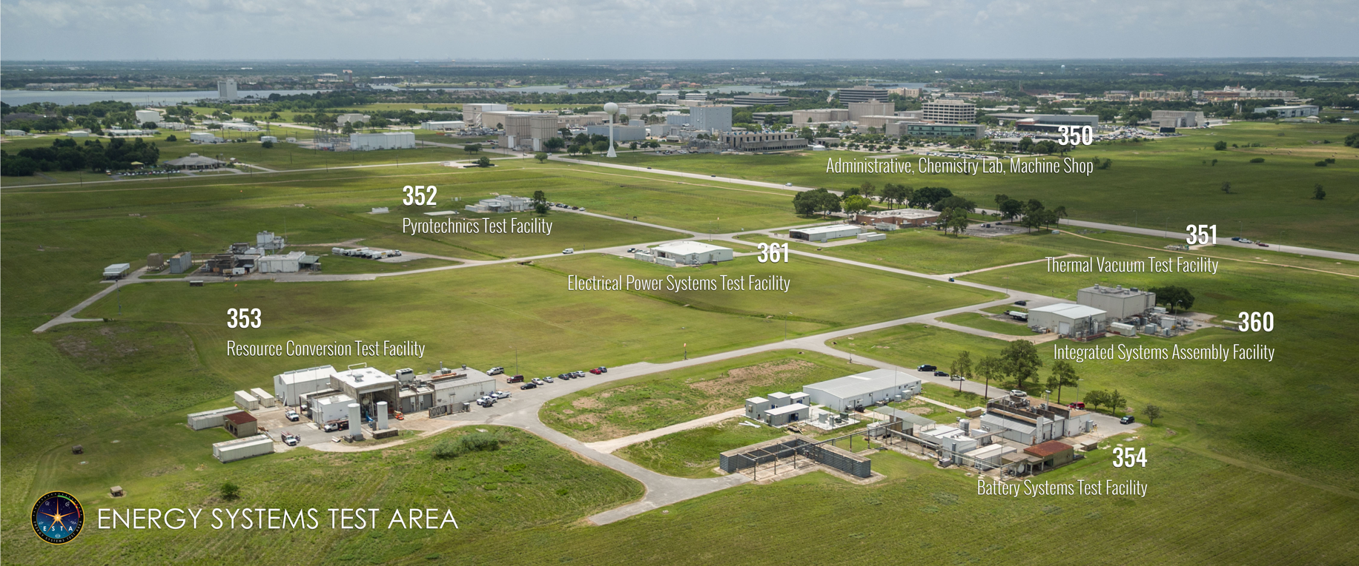
B351: Thermal Vacuum Test Facility

Slide 4
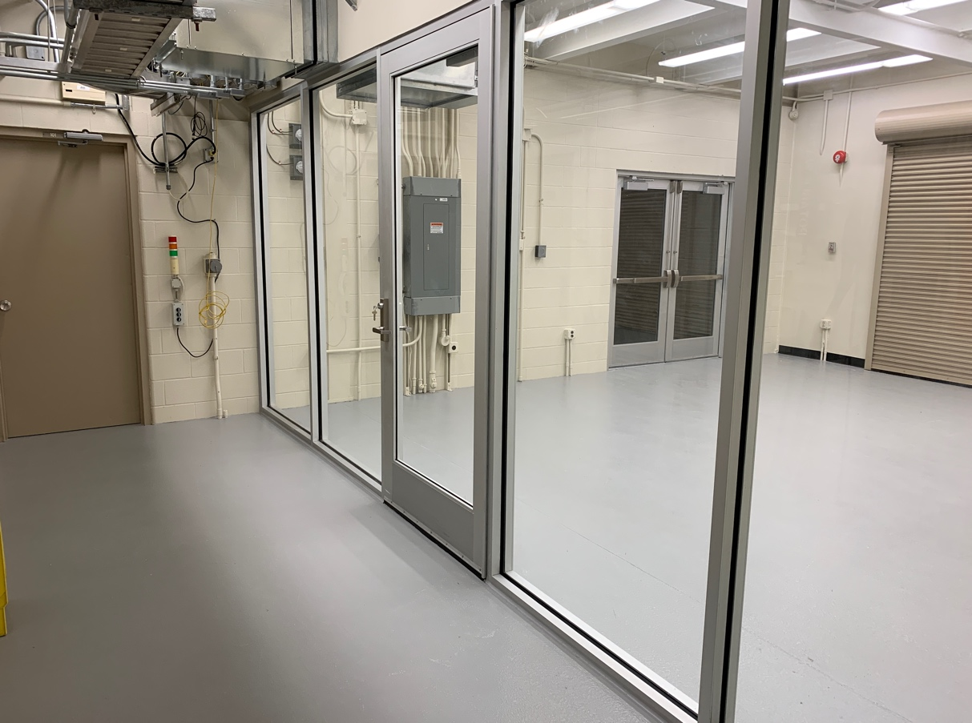
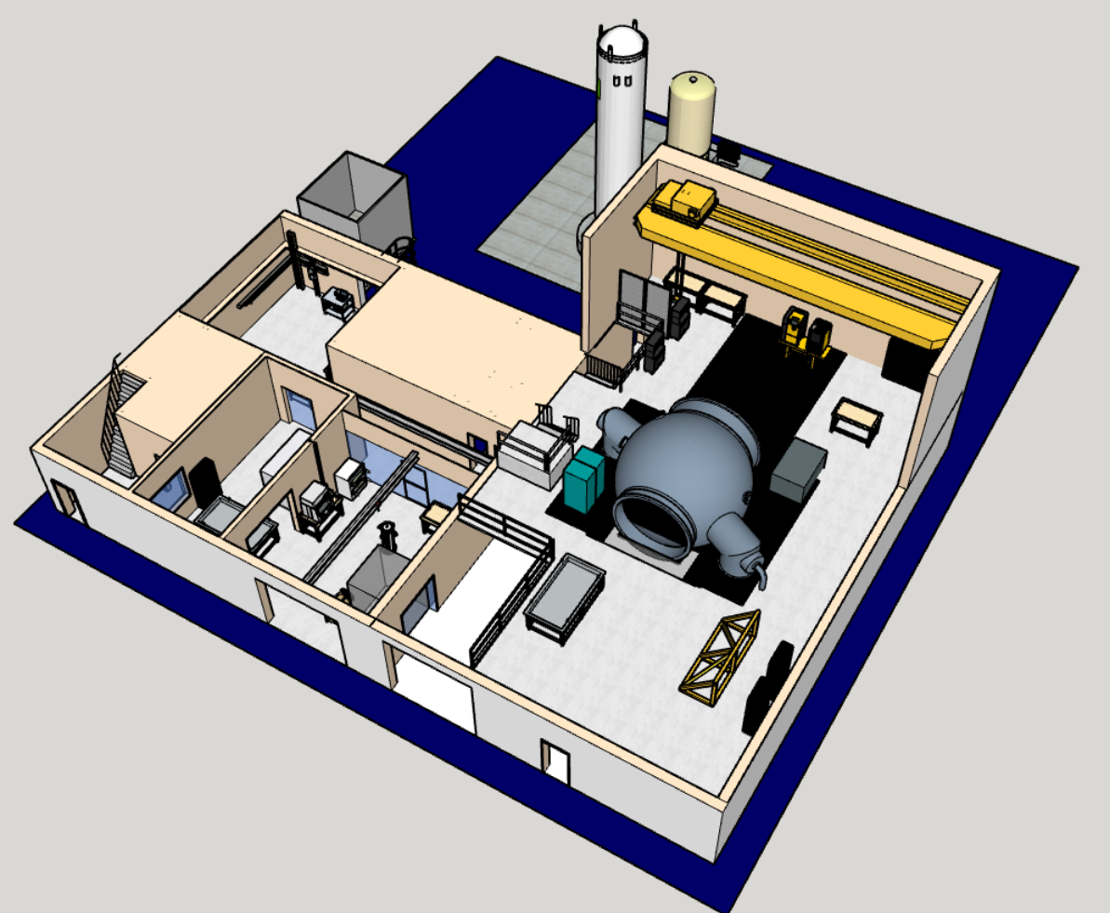
Dust Containment and Preparation Room
15’ chamber
Dust containment & preparation room

Slide 5
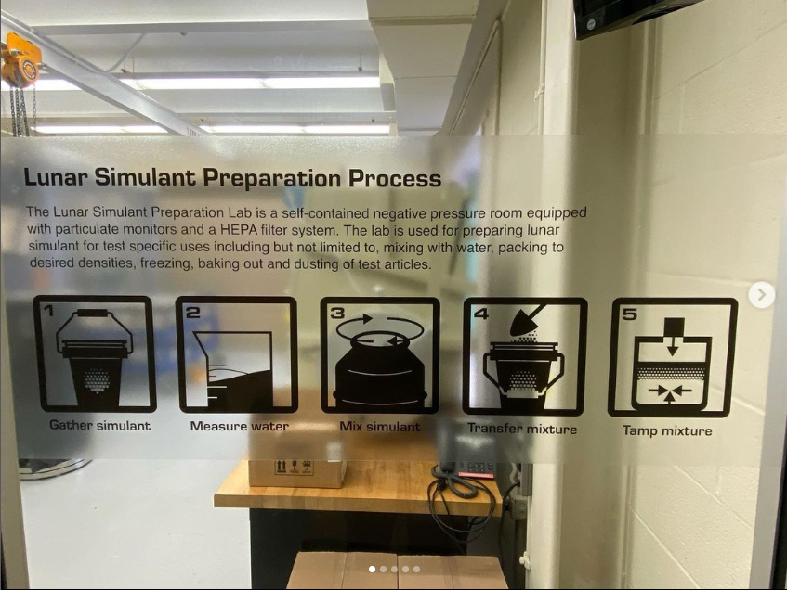
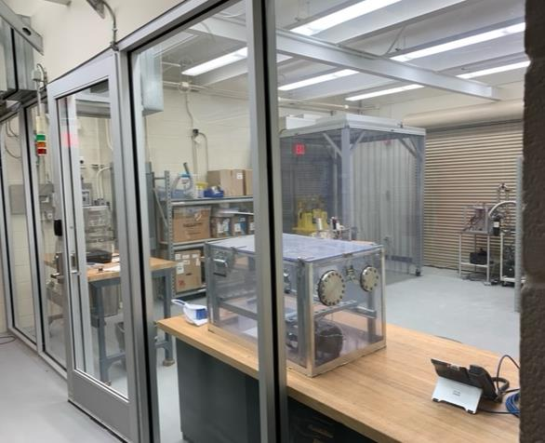
Dust Containment and Preparation Room
Enclosed 750 ft² room sealed and equipped with HEPA fan filtration unit for dust containment and negative pressure maintenance.
Particulate monitoring and audible alarm to ensure air quality is maintained.
Provides room for regolith bin loading and preparation.
Provides room for test article preparation and pre-conditioning prior to transfer to the 15’ chamber.
Houses desktop ambient dust box and small vacuum bell jar.
Notes:
Monitor set at 8-hr TLV-TWA of 25 micro gram/m3 environmental assessment ruled we can go to 75 microgram/m3

Slide 6
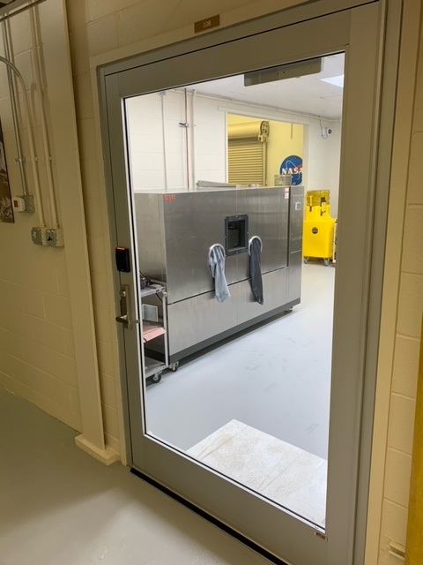
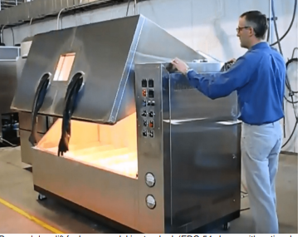
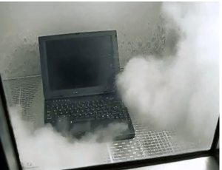
Settling Dust Chamber
Meets some industry standards for dust exposure
72”x36”x30” interior
Timed dusting allows for repeated application of dust to moving test articles
Initial validation testing with Lunar simulants underway
Located in B351 Dust Preparation Room
Status: Online and available for use
Notes:
Standards met: SAE J575 Section 4.5 - Dust testing on automobile lights.
DIN 40050, Part 9, IP Codes 5K and 6K, vertical dust flow
ISO 20653 (2006-08-15), Section 8.3.1 - Requirements and tests for degrees of protection against foreign objects and access.
IEC 529, IP Codes 5 & 6, vertical dust flow (without under-pressure) - Dust testing for ingress into automobile lights

Slide 7
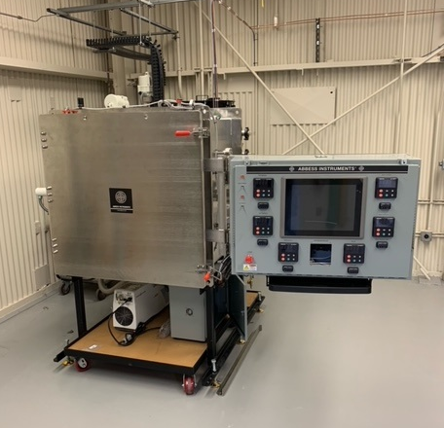
Component Level Dusty Vacuum Chamber
Thermal Vacuum capability with dust mitigation for pumping system
36”x36”x36” Box shape
Rough or High vacuum (10-5 torr range quickly, 10-7 demonstrated)
Shroud temperature range of -300F to +300F
Shroud walls independently controlled for zone temperature conditioning if needed
Status: Online and available for use

Slide 8
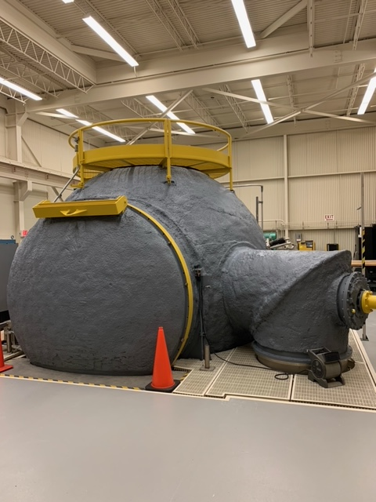
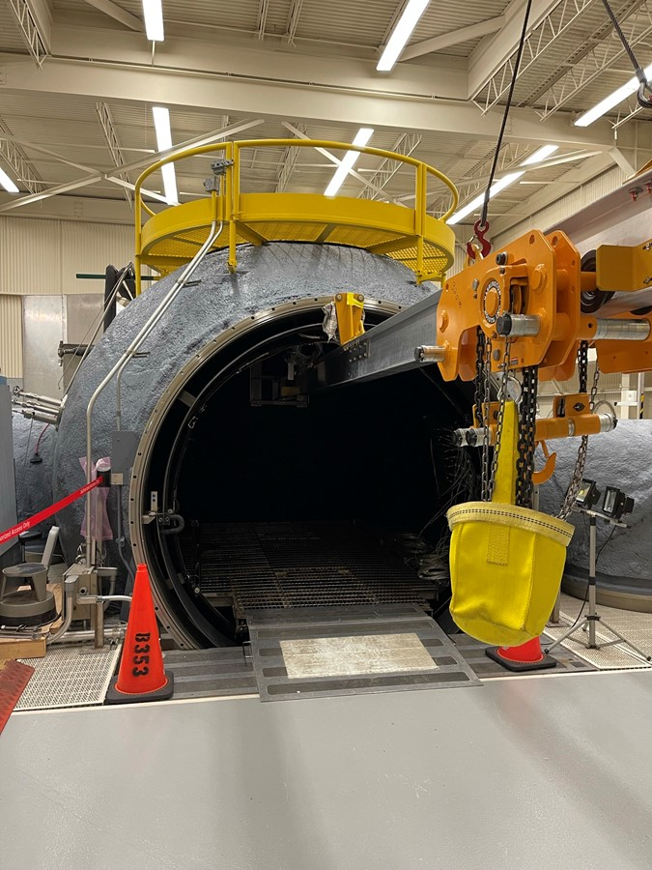
15ft Chamber Capability
Description
  15ft Φ Spherical Chamber with ~78in Φ clear entry
Environment Capability
  Vacuum: 1x10⁻⁶ torr (ultimate),
    Pumping, rotary piston pumps, roots blowers & two 36in diameter diffusion pumps
  Atmosphere: Air or GN₂ Repressurization
  Thermal Range: -185ºC to +120ºC Thermal shroud temperatures
  High channel count data feedthroughs
  High power feedthroughs available
  Max platform load: 4,000 lb
  Test article operation on 48” x 96” regolith bed in chamber with surface interactions with regolith to depths down to ~3 ft
Previous tests: used for fuel cell, electric APU during Shuttle, Cryogenic propellant storage, Apollo lunar rover tire, CaRD (ISRU)

Slide 9
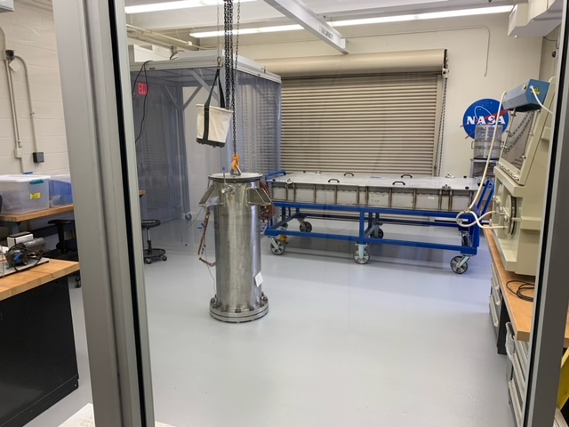
Simulant Drill Tube
Tube jacket to be flooded with LN2 for cooling and heated GN2 for return to ambient temperature
13.5” (.342 m) ID and 42” (1.06 m) drill depth with 4” clearance above soil height
Designed to be filled with compacted lunar regolith simulant with a target water content of 5% water by weight
Holds ~370 lb. (168 kg) of simulant for a combined weight of ~984 lb. (446 kg)
Drill Tube in Dust Prep Room
Notes:
Notes:
Drill Tube holds ~424 lb (192 kg) of simulant for a combined weight of ~1050 lb (476 kg)
Calculated using a compacted density with 5% water by weight of .061 lbm/in3 – (1.7 g/cc) as target density

Slide 10
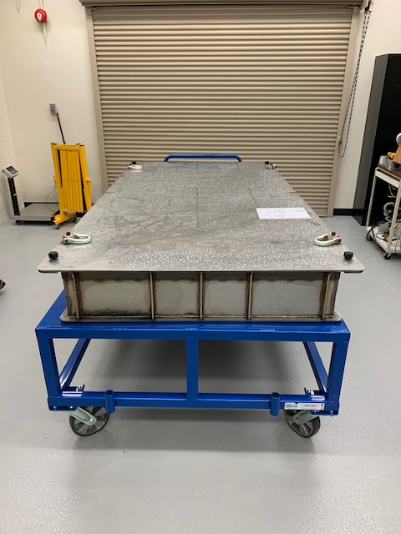
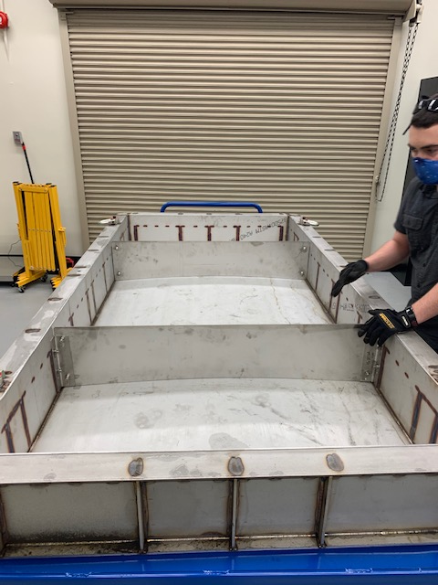
Simulant Bin
Description
  For use in 15’ Chamber
  Basic bin, designed to be filled with simulant in dust containment room and transported into chamber after preparation.
Soil Bin Specifications
  Dimensions: 48” x 96”
  Empty weight: 650 lb
  Max level fill: 8”
  Max level fill weight: 2,880 lb
  Max test article weight at max fill: 520 lb*
Movable partitions provide customization for a lower fill percentage to minimize unnecessary simulant and maximize test article weight budget
* Based on max platform load of 4,000 lb and assuming two techs (200 – 300 lb each) are needed to install into chamber.
Notes:
Atm to 100 Torr: average maybe around 5 torr/min in the higher end and more like 1 or 2 Torr/min by the time you get to 100 Torr. in the 1 to 10 Torr range
100 to 10 Torr: Can really start to have problems here. Generally, around 1 Torr/min is pretty safe.
10 to 1 Torr: At room temp soil, this is also where the water will start to sublimate. KICT had good results at 0.5 mbar/s (2.25 Torr/min) in a regolith height of 0.2 m (7.9”). Stay around 0.3 Torr/min. It all depends on test and soil conditions.

Slide 11
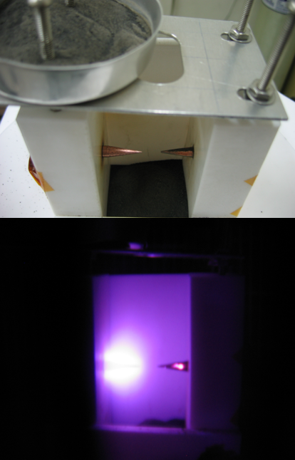
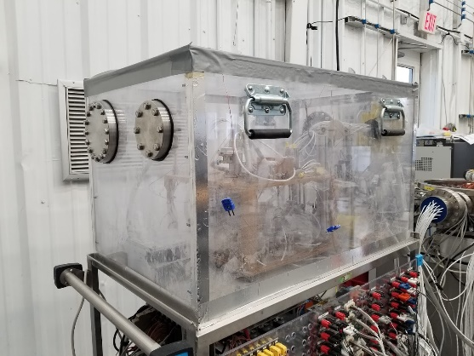
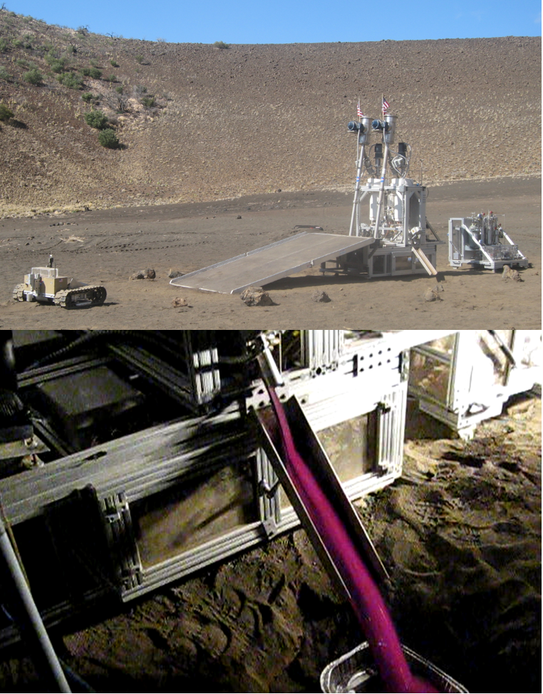
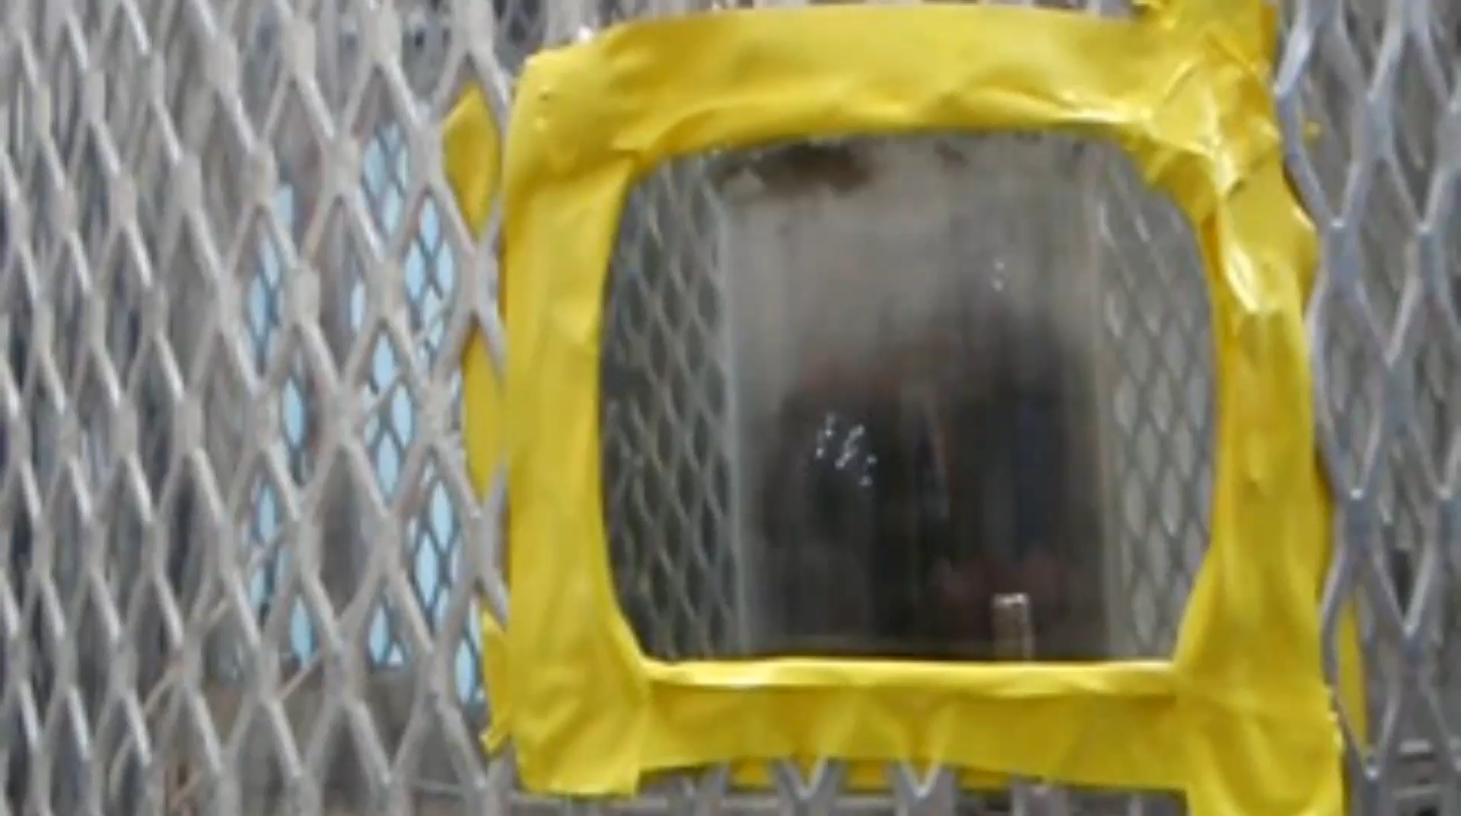
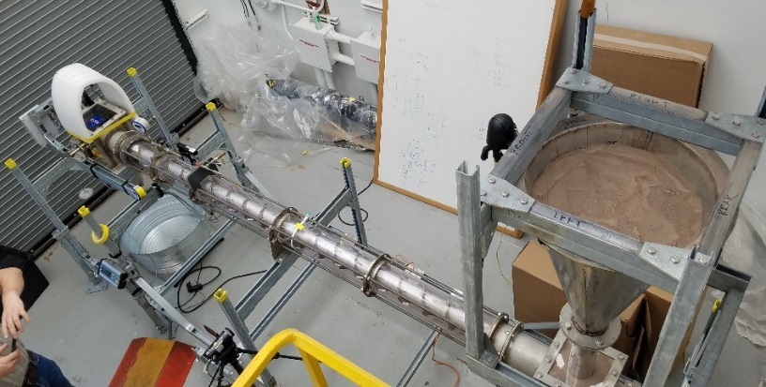
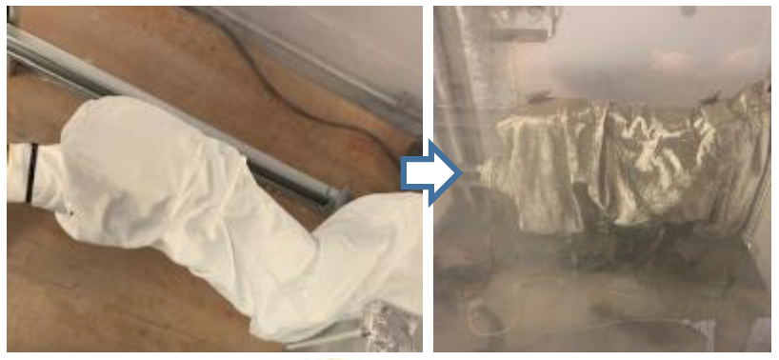
Experience with Regolith Simulants/Dust
Lunar dust effects on electrical components
OVEN in Dust Box (ISRU/Resource Prospector)
O2 Extraction via H2 Reduction (ISRU)
Planetary Surface Simulation- Dust mitigation
VIPER Wheel Assy Dust Exposure Test
Auger Dryer for Water extraction Mars soil (ISRU)

Slide 12
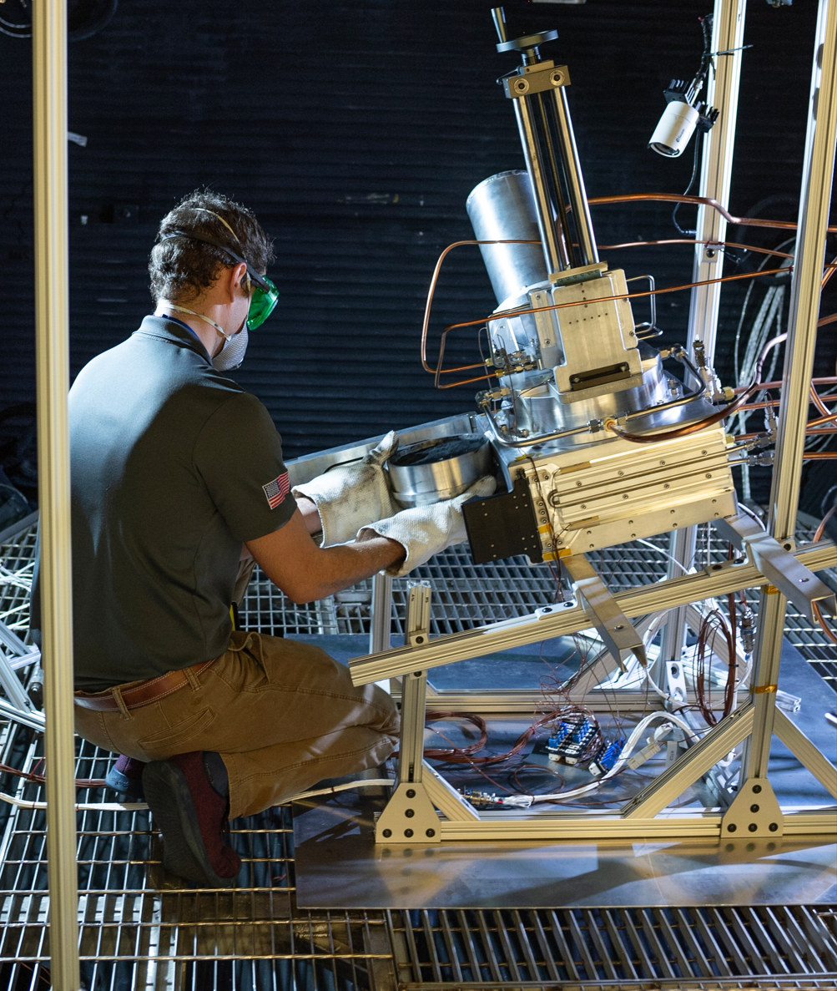
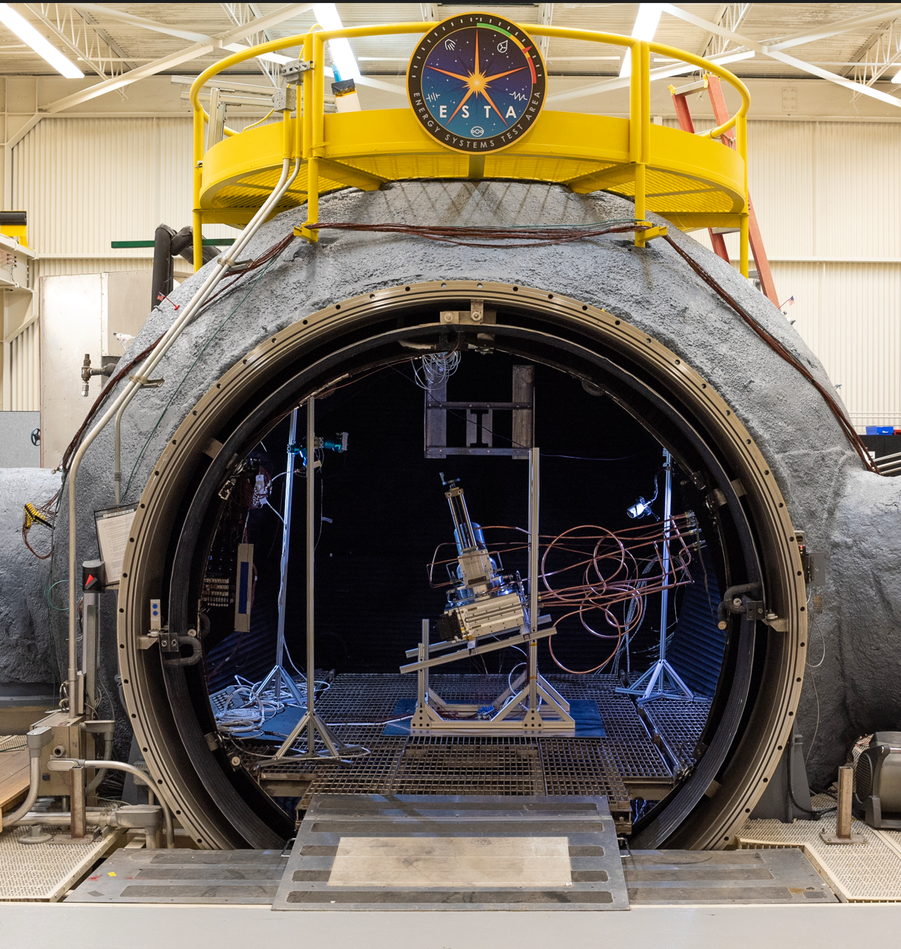
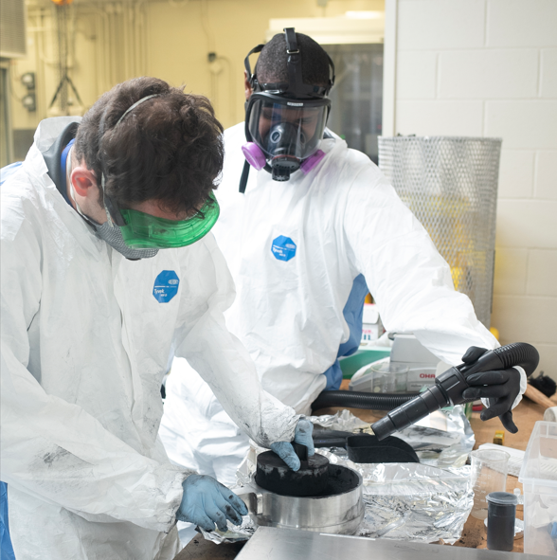
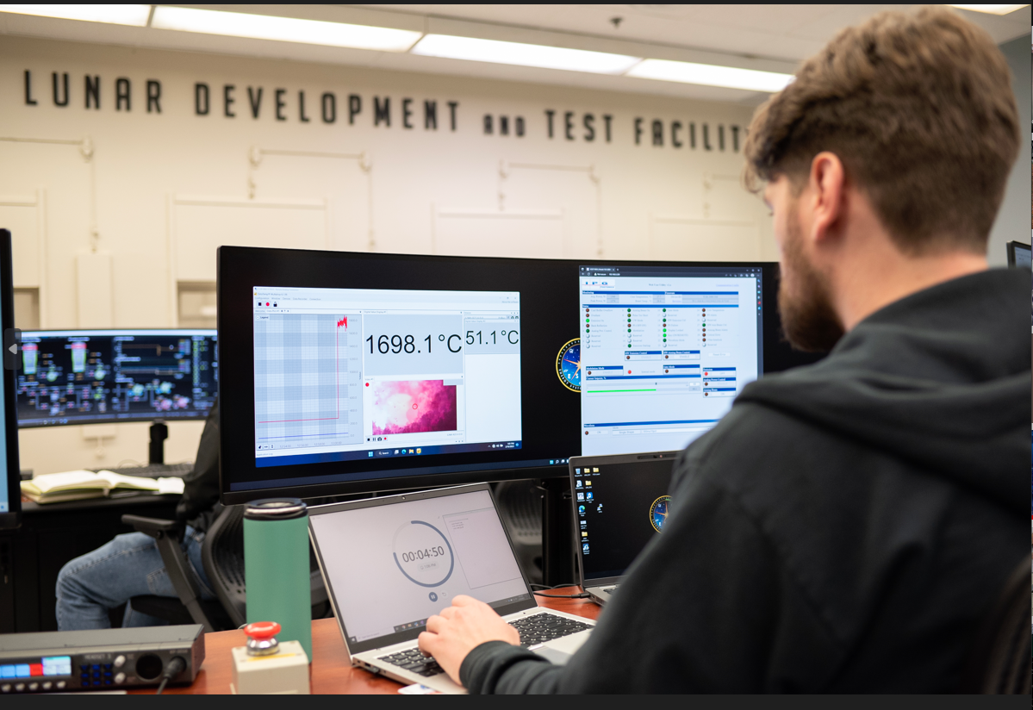
Experience with Lunar Simulant – CaRD (ISRU)
Lunar Simulant Prep (bottom left)
Simulant installation in CaRD reactor – top left
CaRD in 15ft thermal vacuum chamber – top right
CaRD under test – bottom right
Notes:
Reaction: 3C + SiO2 > 2CO + SiC
2kW laser heat over 1600C

Slide 13
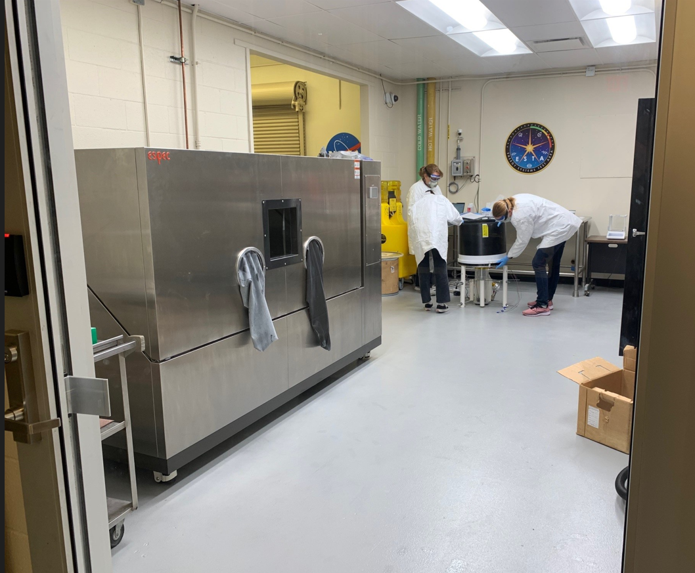
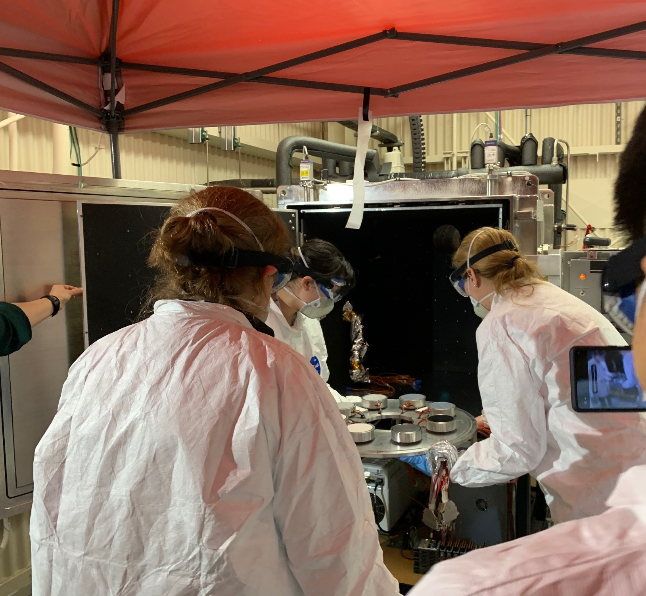
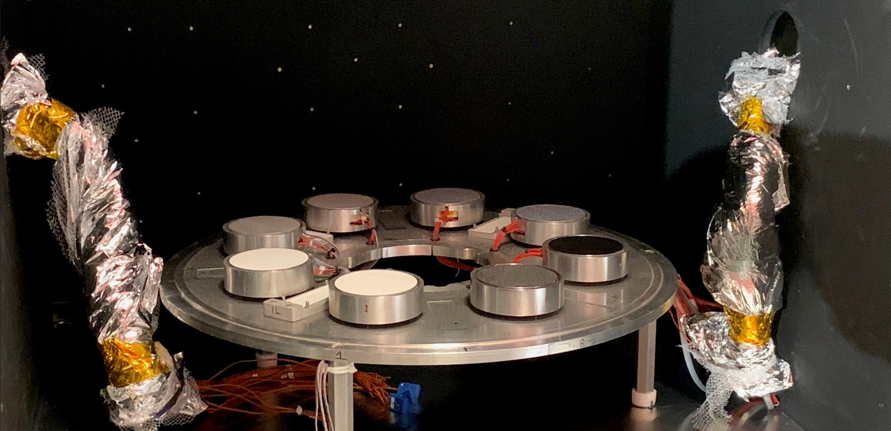
Experience with Lunar Simulant – LDES
Test article dusting in simulant prep & handling area – top left
Loading test article in 3ft vacuum chamber – top right
LDES test setup in 3ft vacuum chamber - bottom
Notes:
different amount of dust coatings, to see how radiator reacts in vacuum conditions
characterize the radiator performance under lunar dust and vacuum conditions
they heat them up, then we pumped down, and cool off -185C
2 different simulants
flight sensors that will be projected to be on the moon in february with intuitive
wanan validate the techniques for managing the effectiveness of heat rejection
want to have an accurate heat rejection

Slide 14
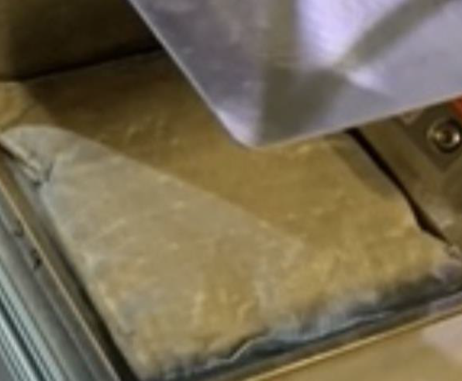
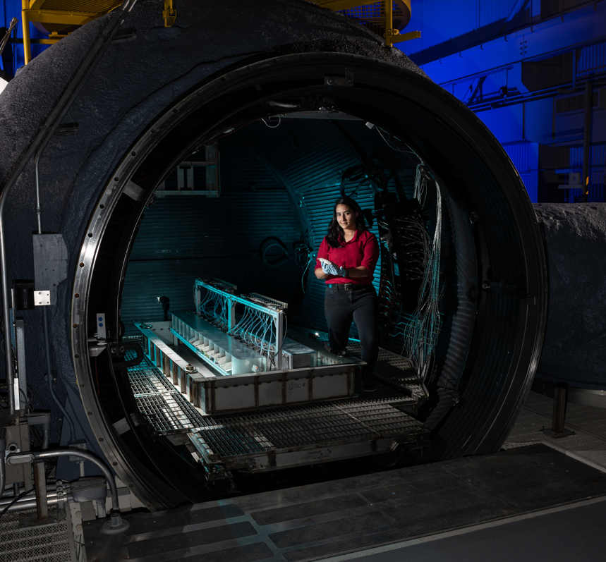
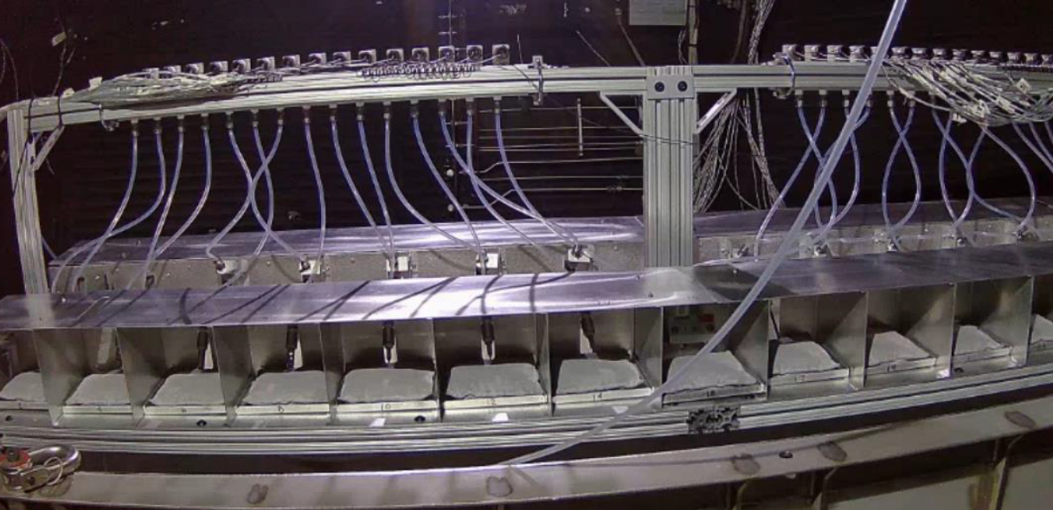
Experience with Lunar Simulant –
Dust Mitigation Study on Suit material
Close-up of suit material coupon covered in dust– top left
Test articles in 15ft vacuum chamber – top right
View of test assembly with dusty coupons -Bottom

Slide 15
Detailed Chamber & Facility Interface Information
Backup

Slide 16
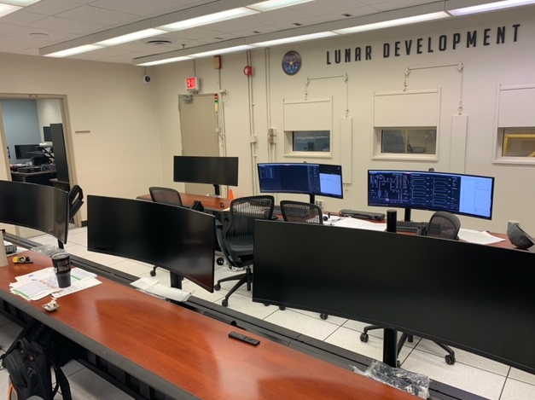
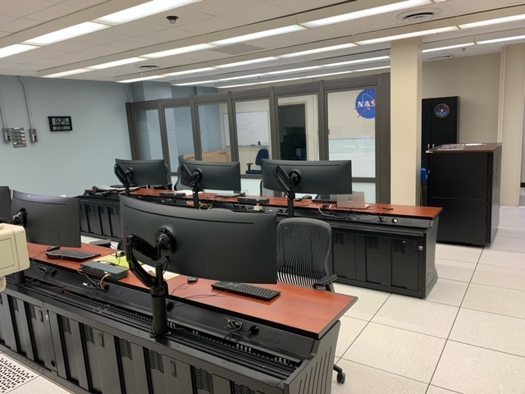
Control Room

Slide 17
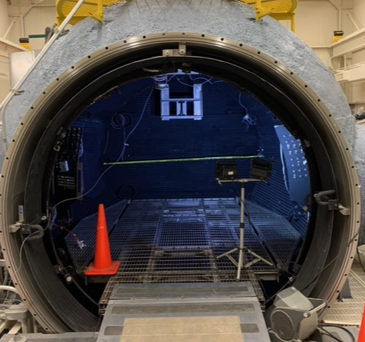
15ft Chamber Platform
Thermal Shroud
126” Deep
~ 74”
Floor grate

Slide 18
15ft Chamber Opening
Thermal Shroud
~ 81”
87”
Floor grate

Slide 19
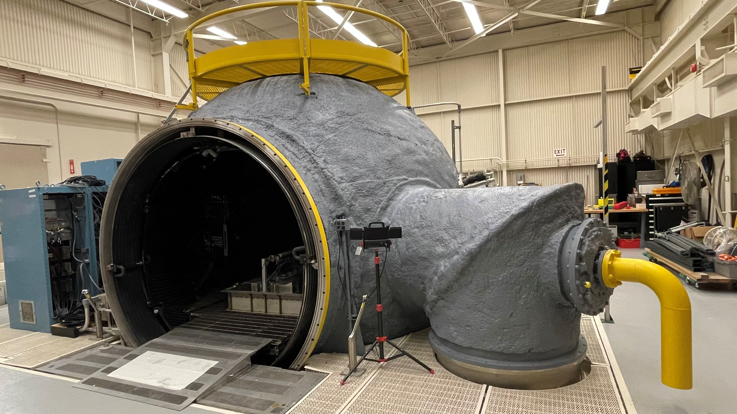
15ft Chamber Facing West
North Side Fluid-through Flange

Slide 20
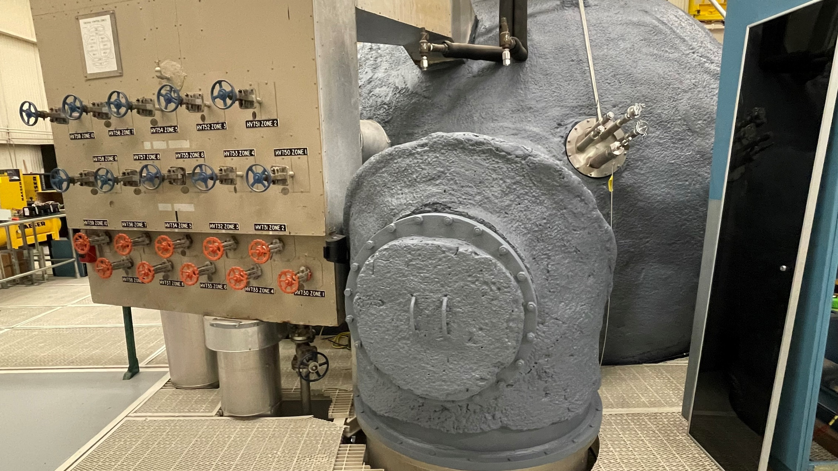
15ft Chamber Facing North
South Side Fluid-through Flange

Slide 21
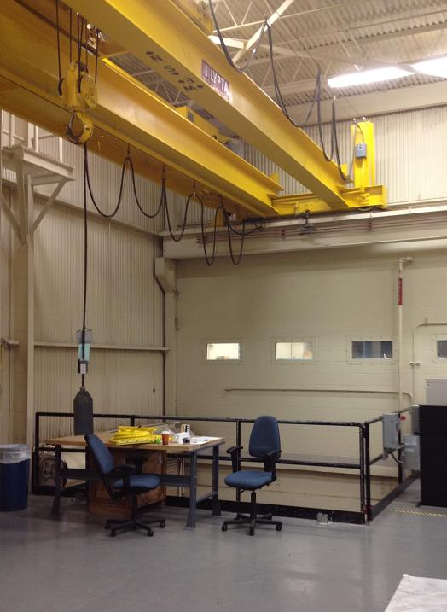
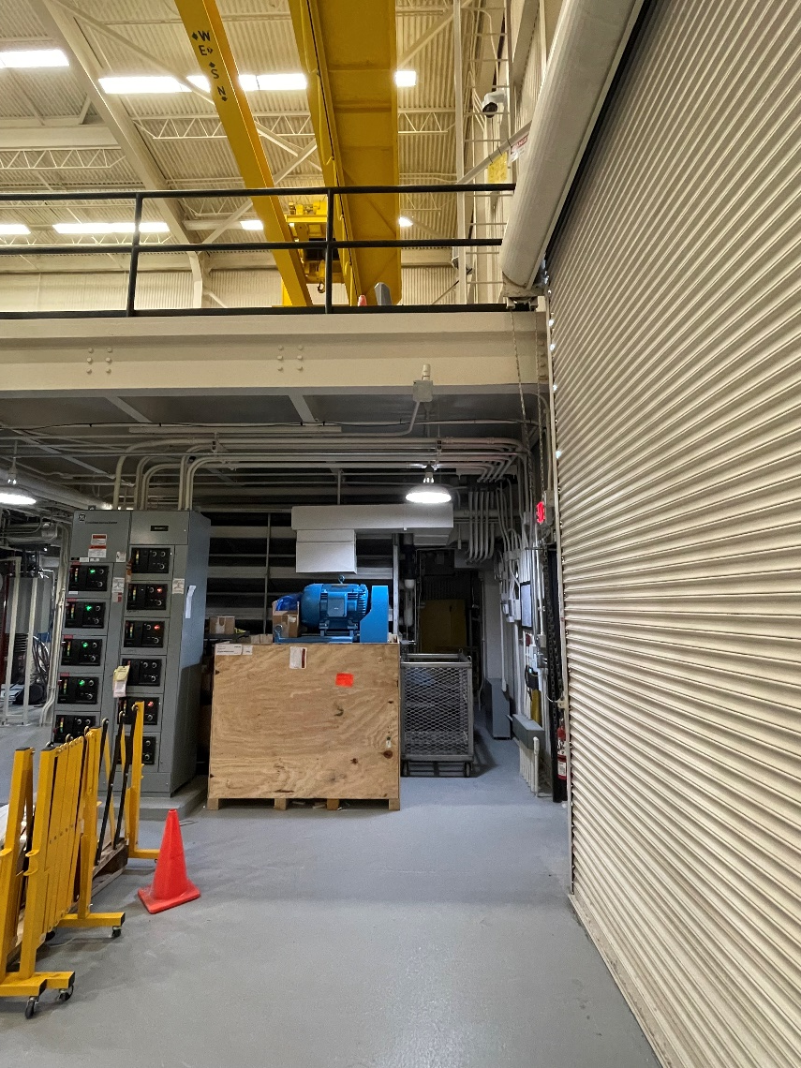
Heights & Clearances for 15ft Chamber
The height of the crane hook over the 2nd floor is 14 ft.
Hardware brought into facility via 12 ft roll-up door
Lifted up over the 3.5 ft railing- railing is removable
10 ton crane
3.5ft
12ft
Max 14ft when hook is fully retracted

Slide 22
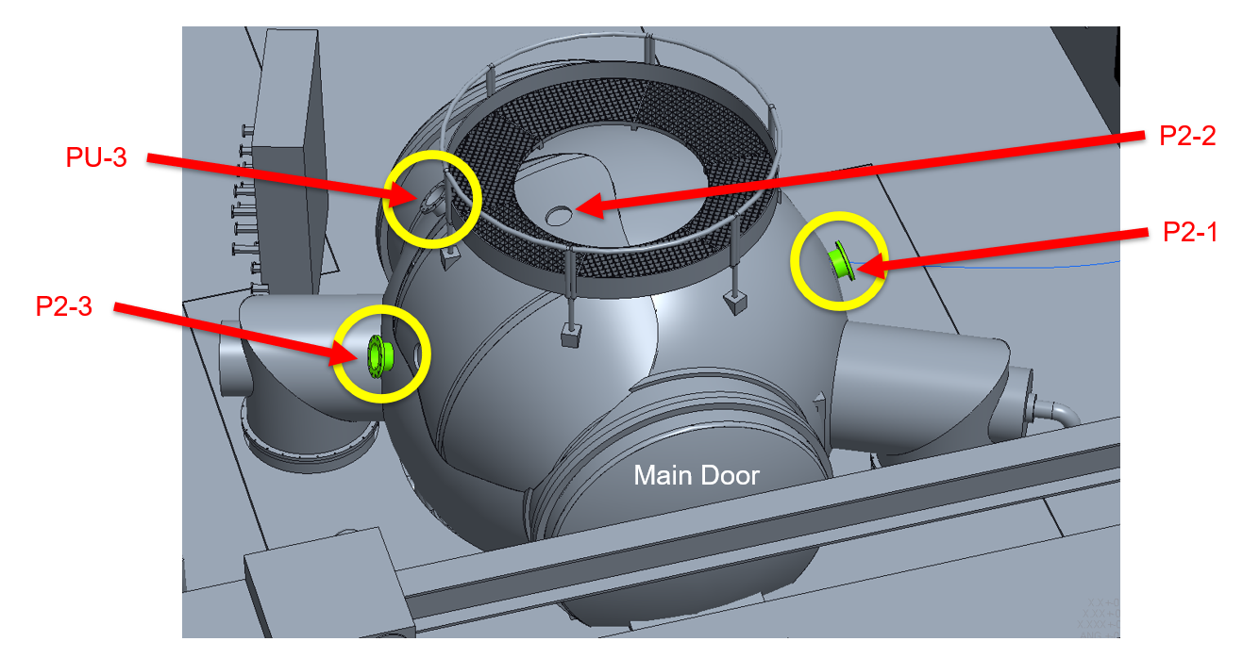
Main Penetration Flange Locations

Slide 23
15’ Chamber Interfaces
15’ TVAC Chamber
Fluids
Fluid Penetrations
Three 15” OD (10.5” feedthrough real estate) available to test article
Multiple flanges on hand to accommodate a variety of fluid line feedthroughs
2 flanges currently installed, each with the following cryogenic feedthroughs:
  Four 1” lines with AN818-16J nut
  One 2” line with AN818-16J nut
1 flange currently installed with the following feedthroughs for water transmission:
  Six ¼” AN lines
  Three ½” AN lines
Feedthrough
Test Article
Required Fluids
Facility Power
480VAC, 30A, Quantity: 2
480VAC, 15A, Quantity: 1
208VAC, 20A, Quantity: 1
Quadplex 120VAC, 20A, Quantity: 4
Standard duplex 120VAC, 20A, Quantity: 10
Required
Power
Power:
Power delivery is flexible
Facility power can be converted from AC to DC as needed using power supplies
Currently known high end power need is 8 kW
Power Conversion
Sensors
Feedthrough
Data Interfaces:
72 Type-T TC connectors
32 Circular MIL Spec Connectors
(3#16 pin Jam nut receptacle)
25 Circular MIL Spec Connectors
(8#20, 4#16 pin Jam nut receptacle)
Connector Panel
DAQ
Feedthrough
Click here for a full list of flanges and connector interfaces for the chamber

Slide 24
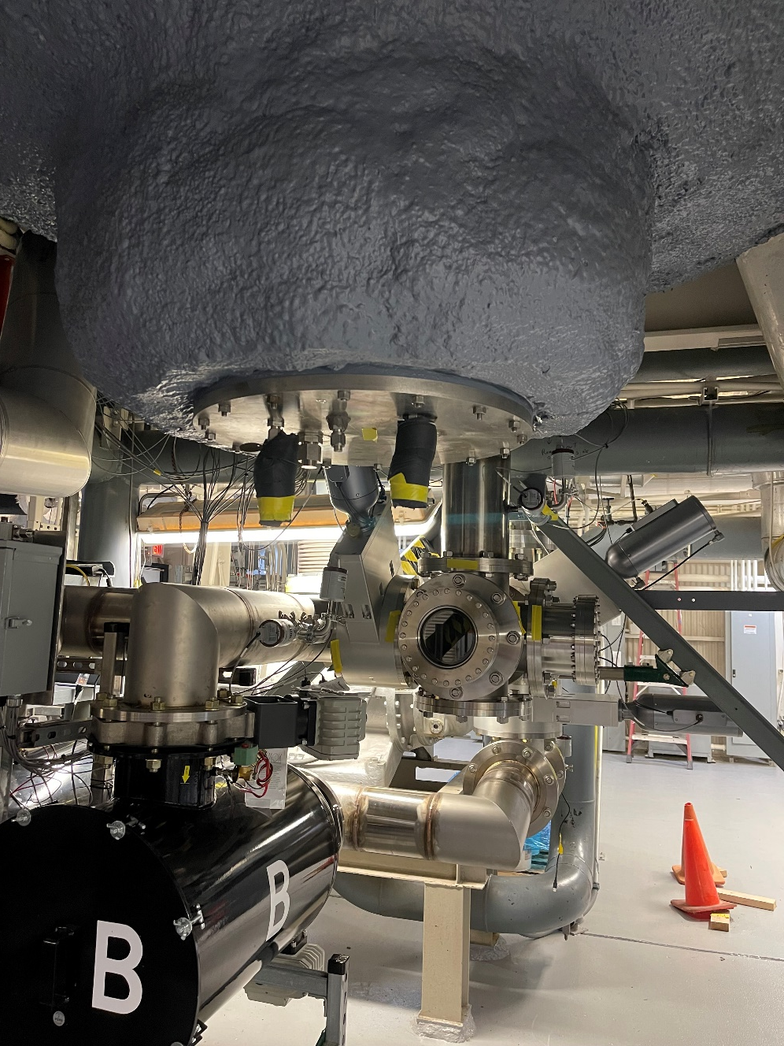
15ft Chamber Bottom
Located directly below the middle of the chamber
20” flange

Slide 25
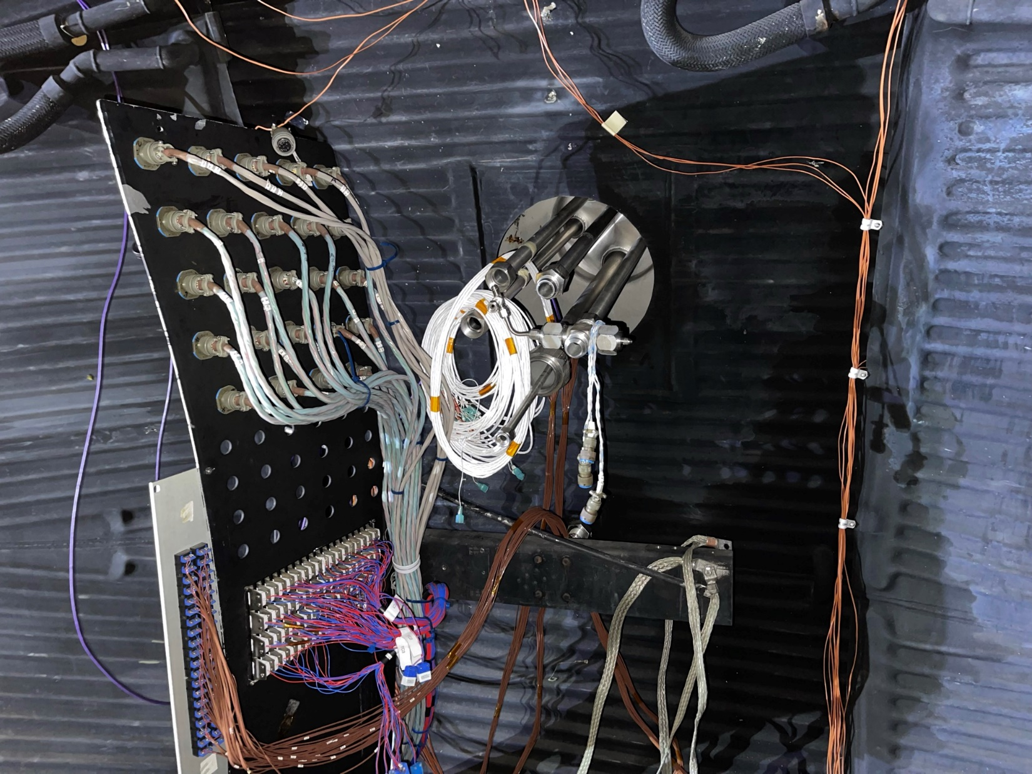
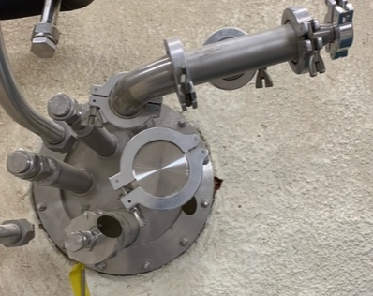
15ft Chamber Fluid Feedthroughs (South)
South Side Fluid Pass-through & Electrical Patch panel
15” Flange, 10.5” Through

Slide 26
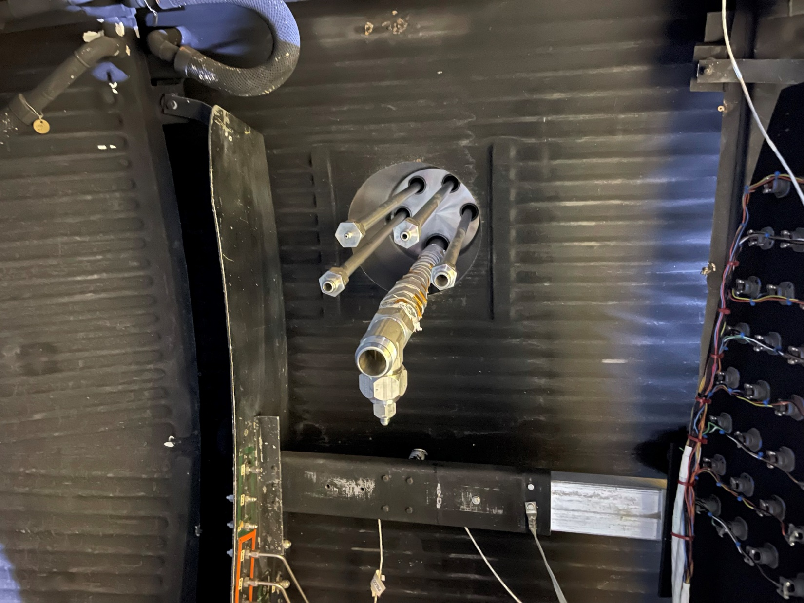
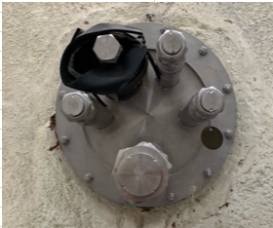
15ft Chamber Fluid Feedthroughs (North)
North Side Fluid Pass-through
15” Flange, 10.5” Through

Slide 27
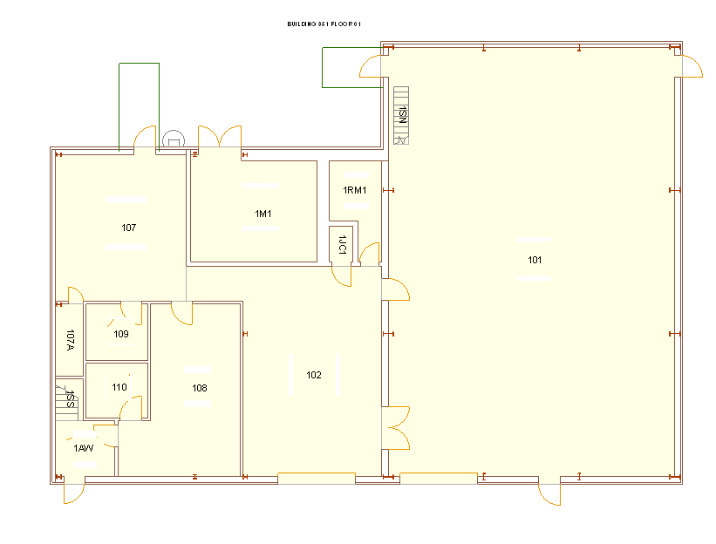
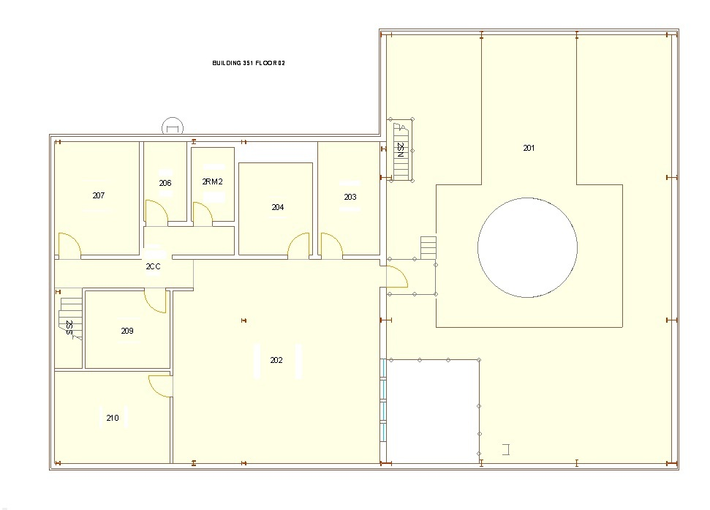
B351: Floor Plan
North
1st Floor
2nd Floor
Control Room
15’ Chamber
12ft Rollup
Door

Slide 28
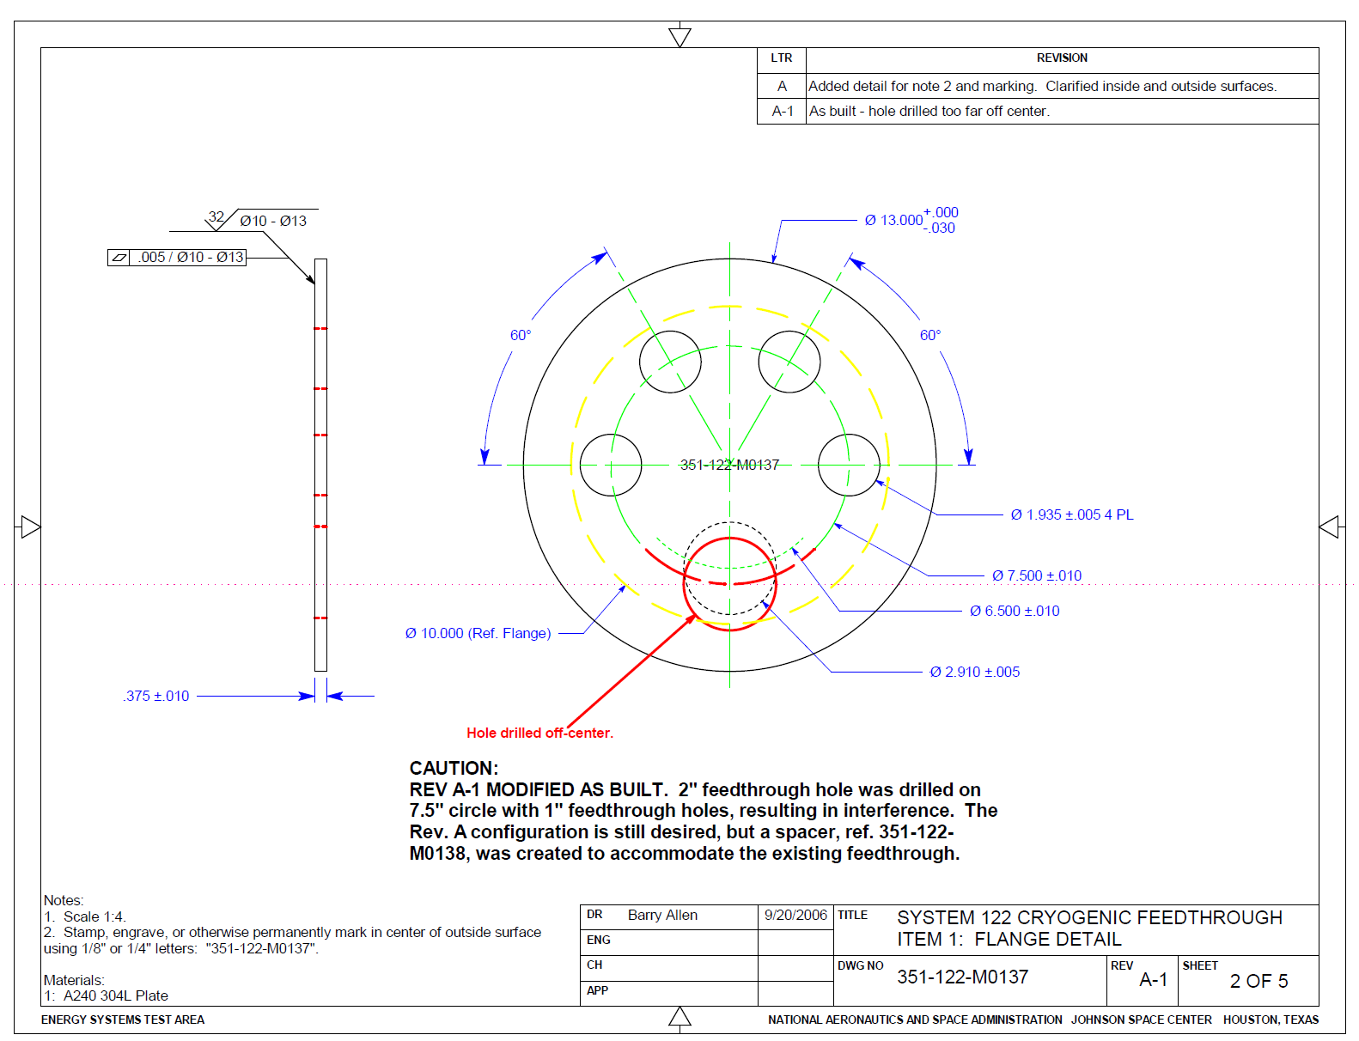
Flange Feedthrough Example

