Slide 1
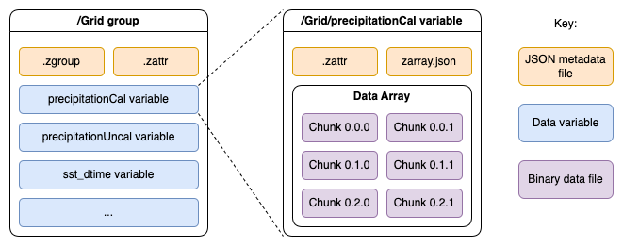
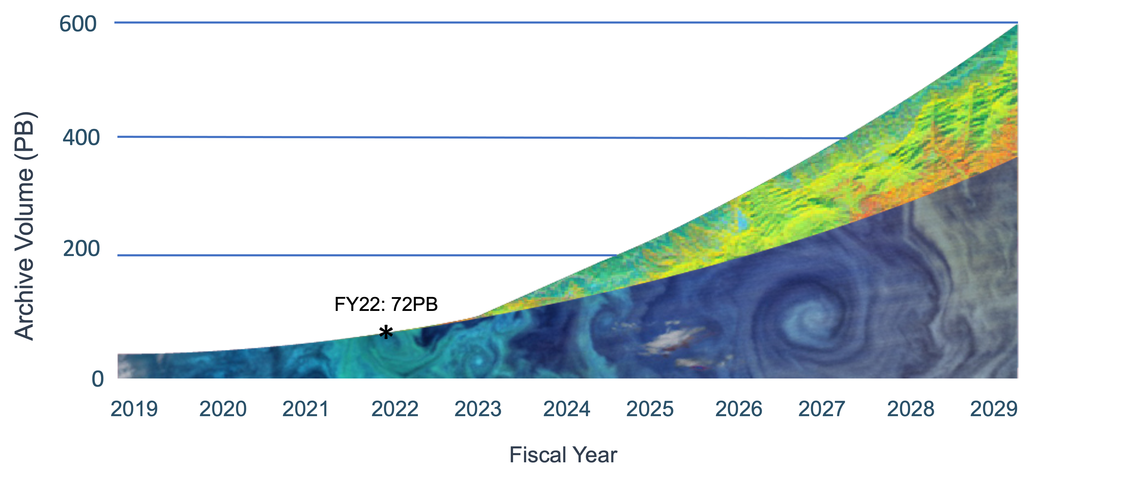
Zarr stores in NASA’s EOSDIS
The need for cloud data formats
What is a Zarr store?
Zarr is an open-source storage format, representing N-dimensional arrays and their associated metadata according to the Zarr specification (https://zarr-specs.readthedocs.io/en/latest/v3/core/v3.0.html). Comprising binary files that each represent a chunk of a data array, and associated JavaScript Object Notation (JSON) metadata files, Zarr is designed for efficient usage via parallel computing. Operations on part of a data array stored in Zarr do not require a user to open the entire data file or array, but only the chunk file(s) for the relevant part of the array.
Persistent Zarr stores representing scientific measurements within NASA data collections are used by the Goddard Earth Sciences Data and Information Services Center (GES DISC) to support Giovanni (https://giovanni.gsfc.nasa.gov/giovanni/). Giovanni is an analysis and visualization tool, which leverages Zarr stores to enable performant time series analyses across many input granules. Data retrieval for such an analysis would otherwise require interactions with an impractical number of native format data files.
Persistent vs on-demand stores
EOSDIS also enables the on-demand production of Zarr stores via the Harmony (https://harmony.earthdata.nasa.gov) NetCDF-to-Zarr service (https://github.com/nasa/harmony-netcdf-to-zarr). Harmony is an EOSDIS service orchestrator providing users with a consistent interface for multiple backend services. The efficiency of Zarr store data access strongly depends on alignment between the chunking scheme of that store and data access patterns. On-demand Zarr store generation could allow users to generate a Zarr store with chunks that will best serve their use-case.
However, on-demand Zarr store generation leads to duplicate copies of the same data. To this end a persistent copy, as used by tools like Giovanni, may be preferable. One challenge being actively researched by developers at GES DISC is the ability to maintain an up-to-date Zarr store representing whole NASA collections, which are still producing files to be added to the store.
Benefits of cloud optimized data formats may be possible without the need for hosting a full Zarr store in the EOSDIS archive. Kerchunk (https://fsspec.github.io/kerchunk), is a library that can produce JSON files that can act as a virtual Zarr store, for one or multiple input files.
Similarly, the zarr-eosdis-store Python package (https://github.com/nasa/zarr-eosdis-store), utilizes the Open-source Project for a Network Data Access Protocol (OPeNDAP) Dataset Metadata Response++ (DMR++) sidecar metadata file to enable the Zarr Python library to access NetCDF-4 files.
Another alternative is Cloud Optimized Hierarchical Data Format version 5 (HDF-5), whereby in-file metadata is consolidated, allowing clients to identify the regions of the file that should be retrieved with range-GET requests.
Data hosted by the National Aeronautics and Space Administration (NASA) are expected to increase to over 600 PB by the end of the decade (see Figure 1). This rapid increase is, in part, driven by the launch of new, high-data-volume Earth observing missions, such as the NASA-Indian Space Research Organisation (ISRO) Synthetic Aperture Radar (NISAR), Surface Water and Ocean Topography (SWOT), Tropospheric Emissions: Monitoring of Pollution (TEMPO) and Plankton, Aerosol, Cloud ocean Ecosystem (PACE) missions.
Alongside increased data volumes, NASA’s Earth Observing System Data and Information System (EOSDIS) is migrating data and services to a commercial cloud environment. This will allow EOSDIS services and applications to leverage emerging data formats in the cloud, such as Zarr stores, to perform novel analyses that would otherwise be prohibitively resource- or time-intensive on traditional file formats such as Network Common Data Form (NetCDF).
Figure 2: Pictorial representation of a Zarr store for a hierarchical NetCDF-4 file.
Alternatives to Zarr stores
Figure 1: Projected growth of NASA Earth Observing data. Presented during the May 2023 Earth Science Data and Information System (ESDIS) project Distributed Active Archive Center (DAAC) User Working Group (UWG). The green region of the plot shows data from 12 missions launching in 2023 or later, taking the total number of EOSDIS-hosted missions to approximately 95.
Zarr stores in EOSDIS today
Abstract ID: 1420348
Owen Littlejohns, NASA EED-3 / INNOVIM LLC

