Slide 1
Transformational Tools and Technologies (T³) Project
Autonomous Systems Discipline
TL: George Gorospe
LaRC POC: Mike Politowicz
T^3 Autonomous Systems Student Overview Better Together Conference
November 16th, 2023
Notes:
Talking Points:
Self introduction, history with Distributed Sensing, work with Kelley, Diagnostics and prognostics, human factors, autonomy.

Slide 2
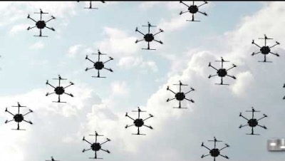
NASA’s Vision for the Future of Aviation
Advanced Air Mobility
Notes:
Advanced Air Mobility (AAM) encompasses a range of innovative aviation technologies (small drones, electric aircraft, automated air traffic management, etc.) that are transforming aviation’s role in everyday life, including the movement of goods and people.
Urban Air Mobility (UAM) represents one of the most exciting and complex AAM concepts with highly automated aircraft, providing commercial services to the public over densely populated cities. This concept has generated tremendous interest and industryinvestment. UAM envisages a future in which advanced technologiesand new operational procedures enable practical, cost-effective air travel as an integral mode of transportation in metropolitan areas.

Slide 3
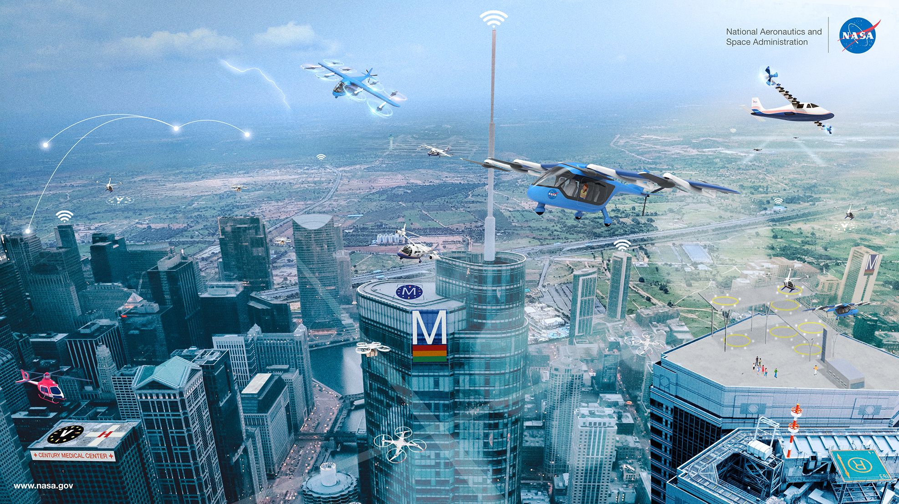
Urban Air Mobility
Commercial services over urban areas moving people and goods using revolutionary aircraft
Notes:
To develop this Vision ConOps, NASA, FAA, and Deloitte built upon the current body of aeronautical research and consulted with more than 100 stakeholder organizations. This UAM community includes entities ranging from legacy aviation leaders to innovators and new market entrants. Stakeholders consulted included the federal government, state and local governments, aerospace original equipment manufacturers (OEMs), localtransportationorganizations, prospective UAM operators, academia, industry standards-setting bodies, airports, service suppliers, and others
Cities are growing, population density is increasing, and transportation infrastructure investment remains a challenge. These trends, combined with a series of technological advances and social trends from electric and semiautonomousaircraft to the sharing economy, are transforming the way people and goods move around urban and regional centers. Central to this transformation is recognition that aviation could play a much larger role in urban and regional mobility in the future.
UAM is the concept of expanding transportation networks to include short flights that transport people and goods around metropolitan areas.

Slide 4
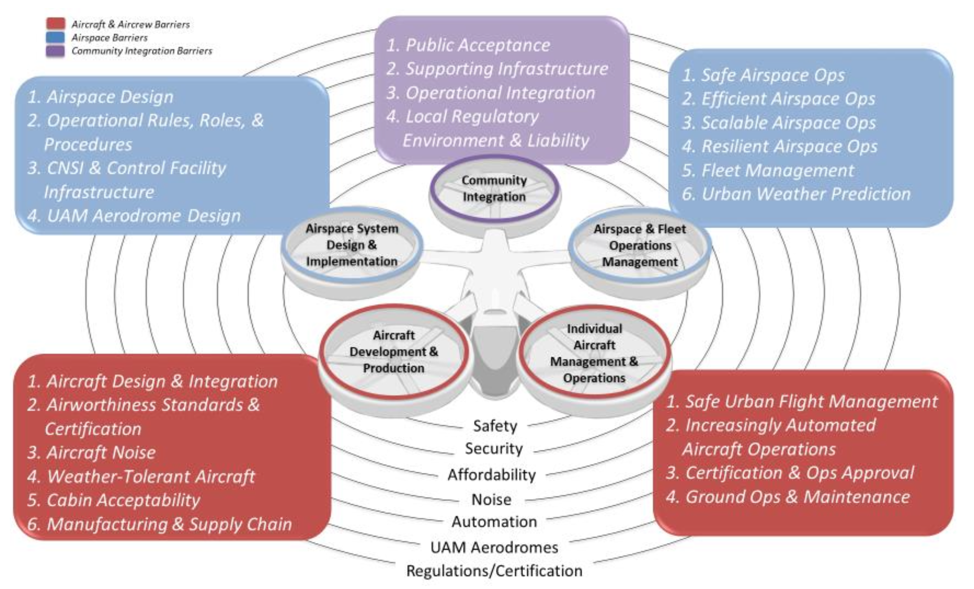
Technical Barriers to Advanced Air Mobility
A breakdown of the many complex technical barriers to achieving new flight regimes
Source: Hill, Brian P., et al. "Uam vision concept of operations (conops) uam maturity level (uml) 4." (2020).
Notes:
Automation is among seven cross-cutting barriers.
Auromation challenges include:
Challenges in developing automation capabilities and associated regulations, policies, standards, and recommended practices that govern and help ensure their safe implementation into a highly scalable air transportation system.

Slide 5
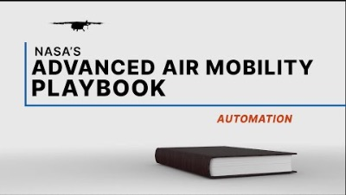
NASA’s Vision for the Future of Aviation
The Role of Autonomy Technology in Advanced Air Mobility
Notes:
Advanced Air Mobility (AAM) encompasses a range of innovative aviation technologies (small drones, electric aircraft, automated air traffic management, etc.) that are transforming aviation’s role in everyday life, including the movement of goods and people.
Urban Air Mobility (UAM) represents one of the most exciting and complex AAM concepts with highly automated aircraft, providing commercial services to the public over densely populated cities. This concept has generated tremendous interest and industryinvestment. UAM envisages a future in which advanced technologiesand new operational procedures enable practical, cost-effective air travel as an integral mode of transportation in metropolitan areas.

Slide 6
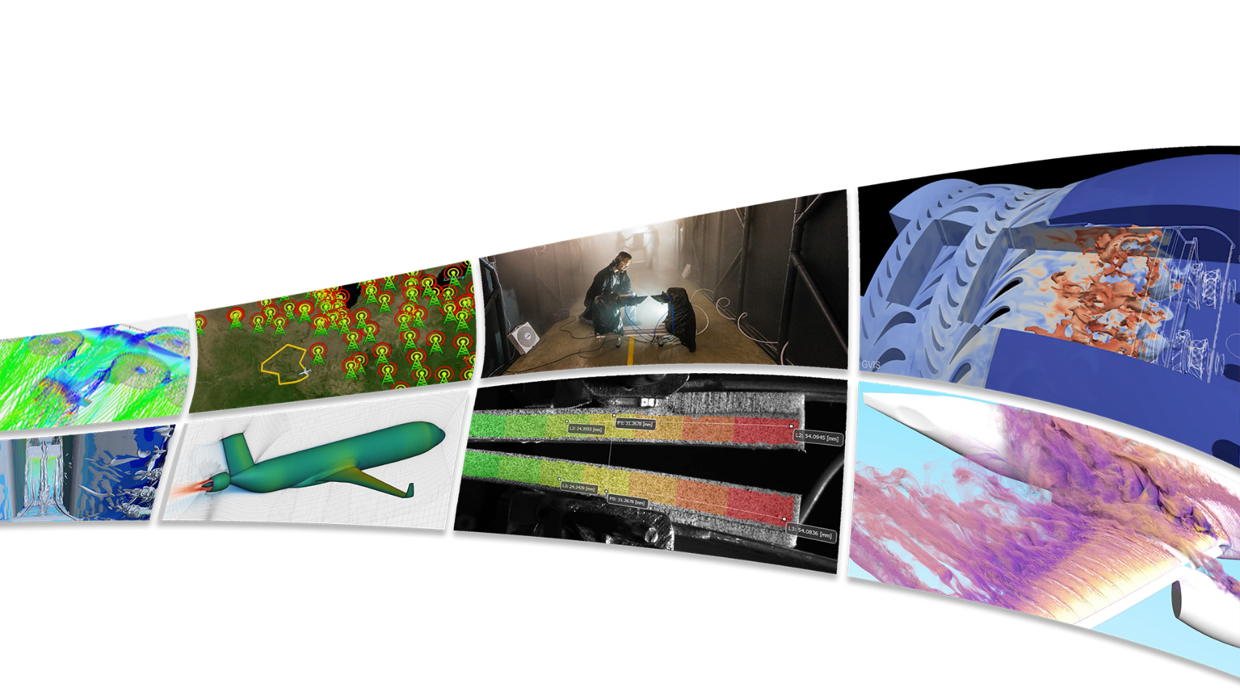
Transformational Tools & Technologies (T³) Project
  Explores the unknown through foundational research that inspires innovation in aeronautics, delivering revolutionary advances in essential areas such as autonomy, certification by analysis, advanced materials, and sustainable aviation
Conducts exploratory research with breakthrough potential to inspire the world through discovery
Enables fast, efficient design and analysis of advanced aviation systems from first principles
Develops innovative tools and technologies to revolutionize air transportation
Sustains critical aeronautics core competencies for the nation, while delivering multidisciplinary system-level results that benefit humanity and improve life on Earth
Delivering cutting-edge research, leading community vision studies, and providing the community with valuable data and innovations that impact aeronautics research throughout the ARMD portfolio

Slide 7
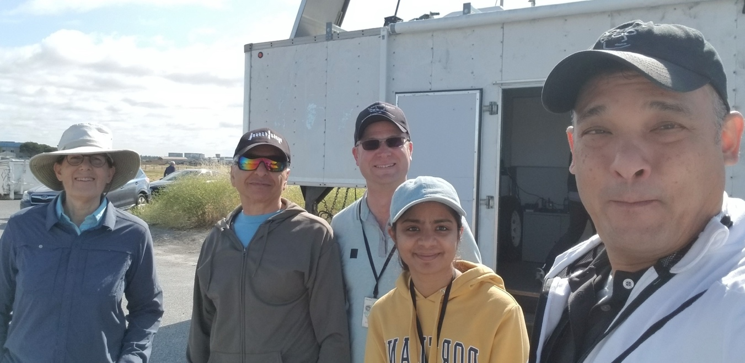
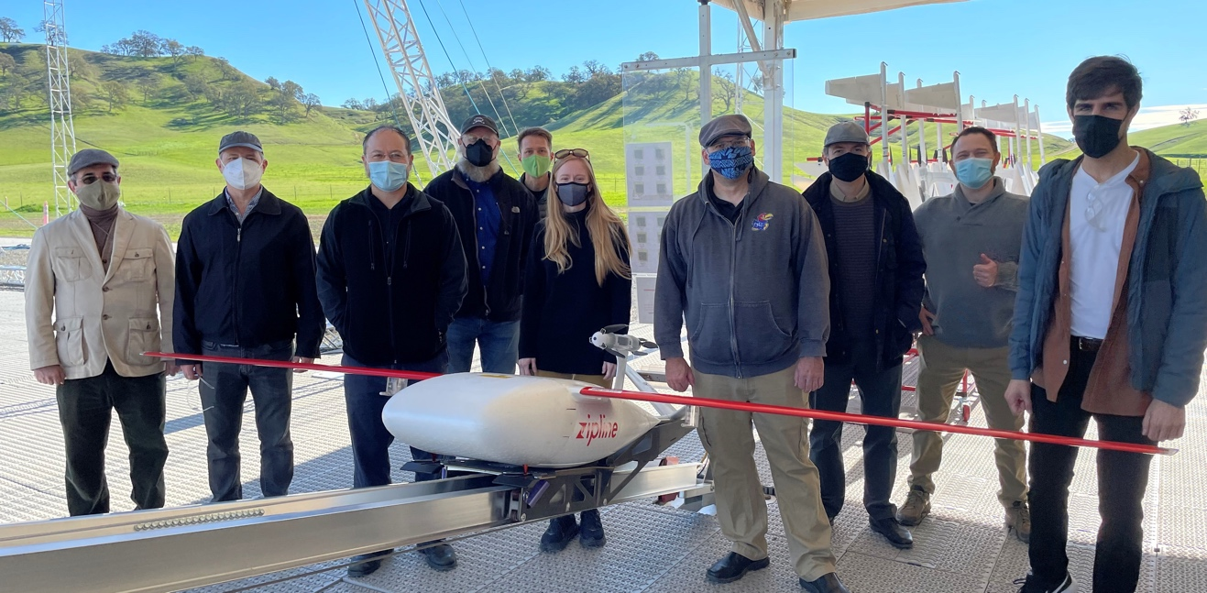
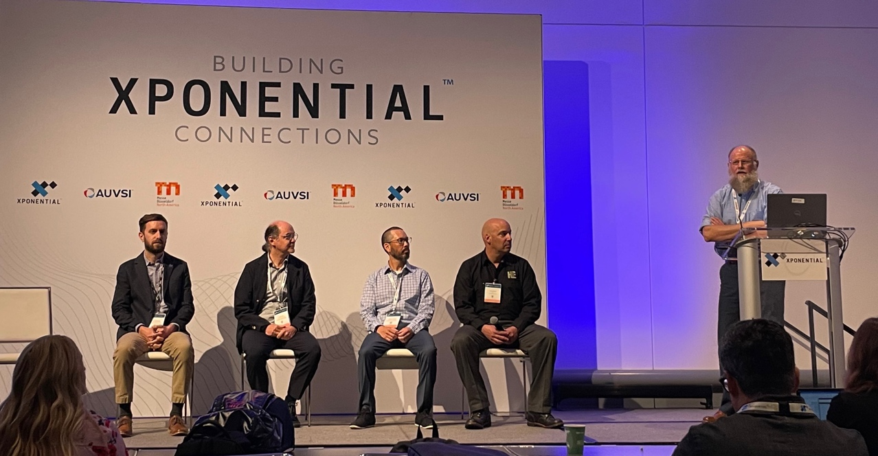

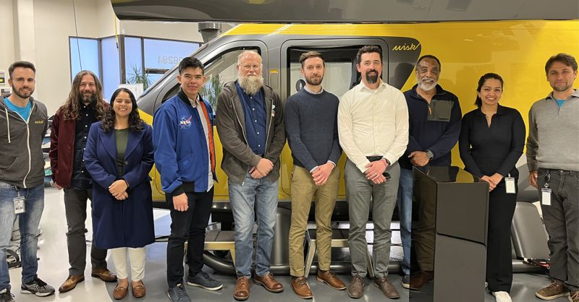
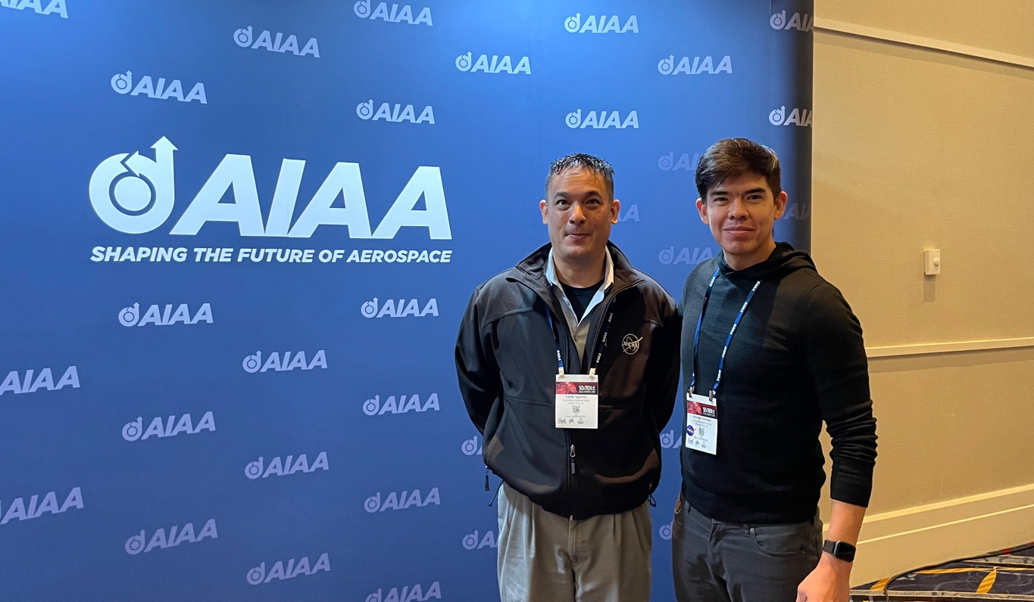
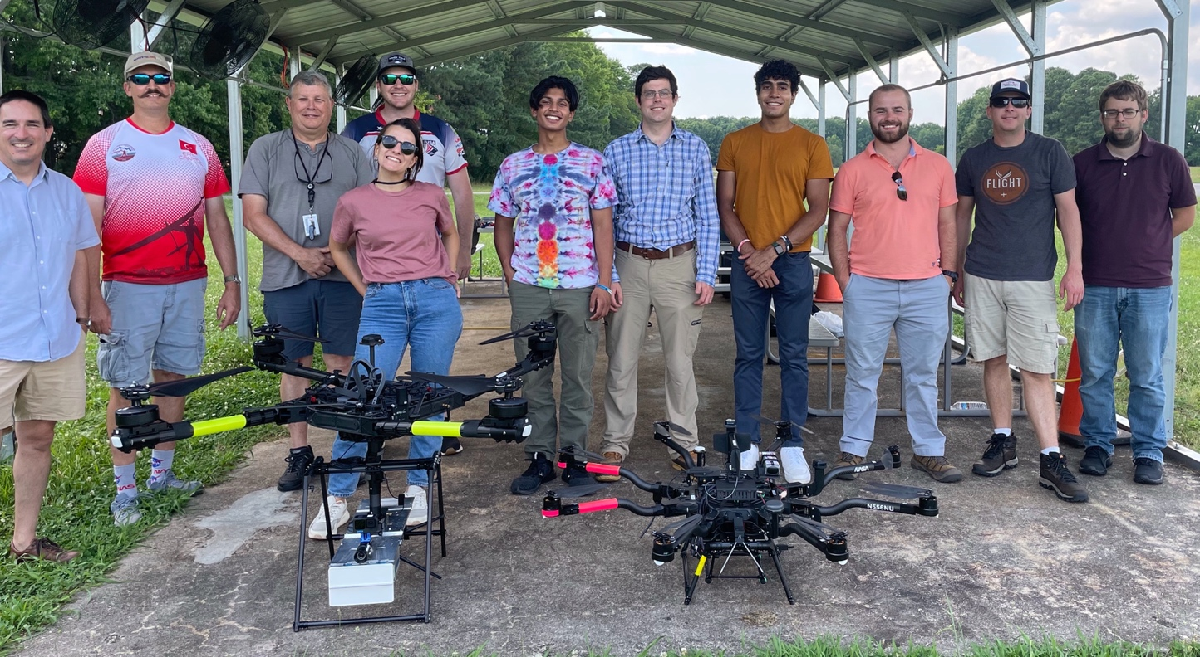

Autonomous System Discipline
Dedicated engineers, scientists, and students working on key barriers to autonomy in the airspace
Autonomous Systems Discipline is a portfolio of seedling and maturing activities addressing the technical, operational, and regulatory barriers to autonomy advancement on multiple levels.
AS activities maintain a balance towards low technology readiness level research and deliverables guided by coordination with community.
Autonomous Systems in FY23
9 Activities across 3 Centers
~ 40 researchers
2 Public Autonomy Meetings

Slide 8
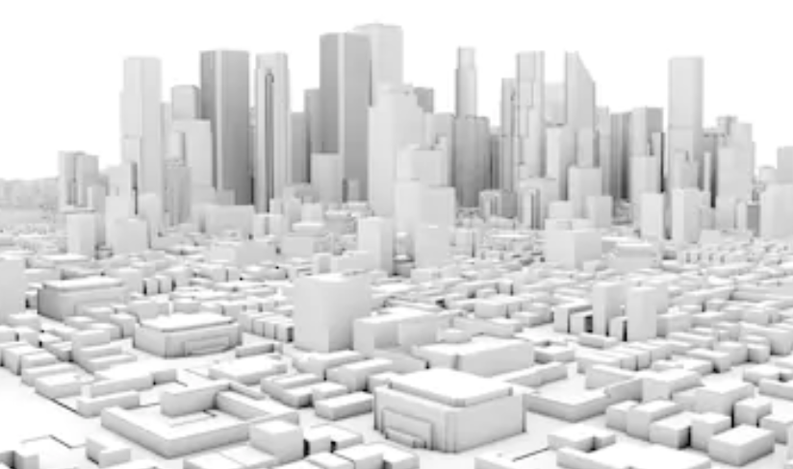





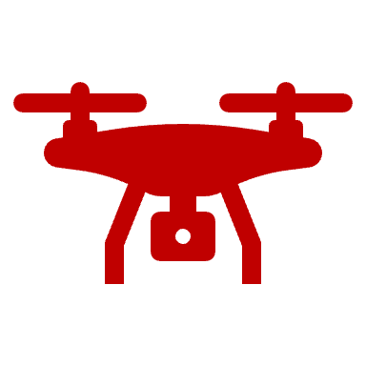
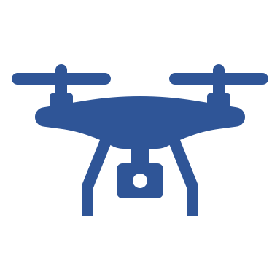



AS scope
Targeted development of tools and technologies to advance the state of autonomy in aeronautics
N₃
Infrastructure for autonomy
N₂
N₅
N₁
⇧
N₄
⇧
Development of vehicle autonomy
m₁
m₂
Human-autonomy teaming
Notes:
Talking Points:
To scope AS, let's first consider this familiar vision of AAM operations in an urban environment. Our scope is defined by three clear problem areas:
UAM manufacturers' business case relies on operations at a grand scale. Critical to achieving this is m:N operations, featuring few humans managing fleets of vehicles. We want to put the humans as the responsible or liable entity, in a role where they can succeed in doing this. Human-autonomy-teaming is the best way to do this.
Although many manufacturers will add autonomy to their vehicle, AS has carved out a subset of the most difficult problems on the horizon, not sandboxing: contingency management, apples to apples evaluation of autonomy.
And finally, infrastructure for autonomy: distributed sensing leading to infrastructure assistance (GPS denied environments, precision navigation, monitoring), identification of barriers to increasing autonomy in the airspace and exploration of solution paths.
Consider this slide first.
Consider RAM, why AS is important,
This is the vision, and our scope is defined by these three problem areas, things that need to be solved for the vision to be realized.
We're ensuring that we're solving the correct problem in this vision by actively engaging the community. Solving problems that NASA is uniquely positioned to solve: coordination, long lead time, human factors
Add animation

Slide 9
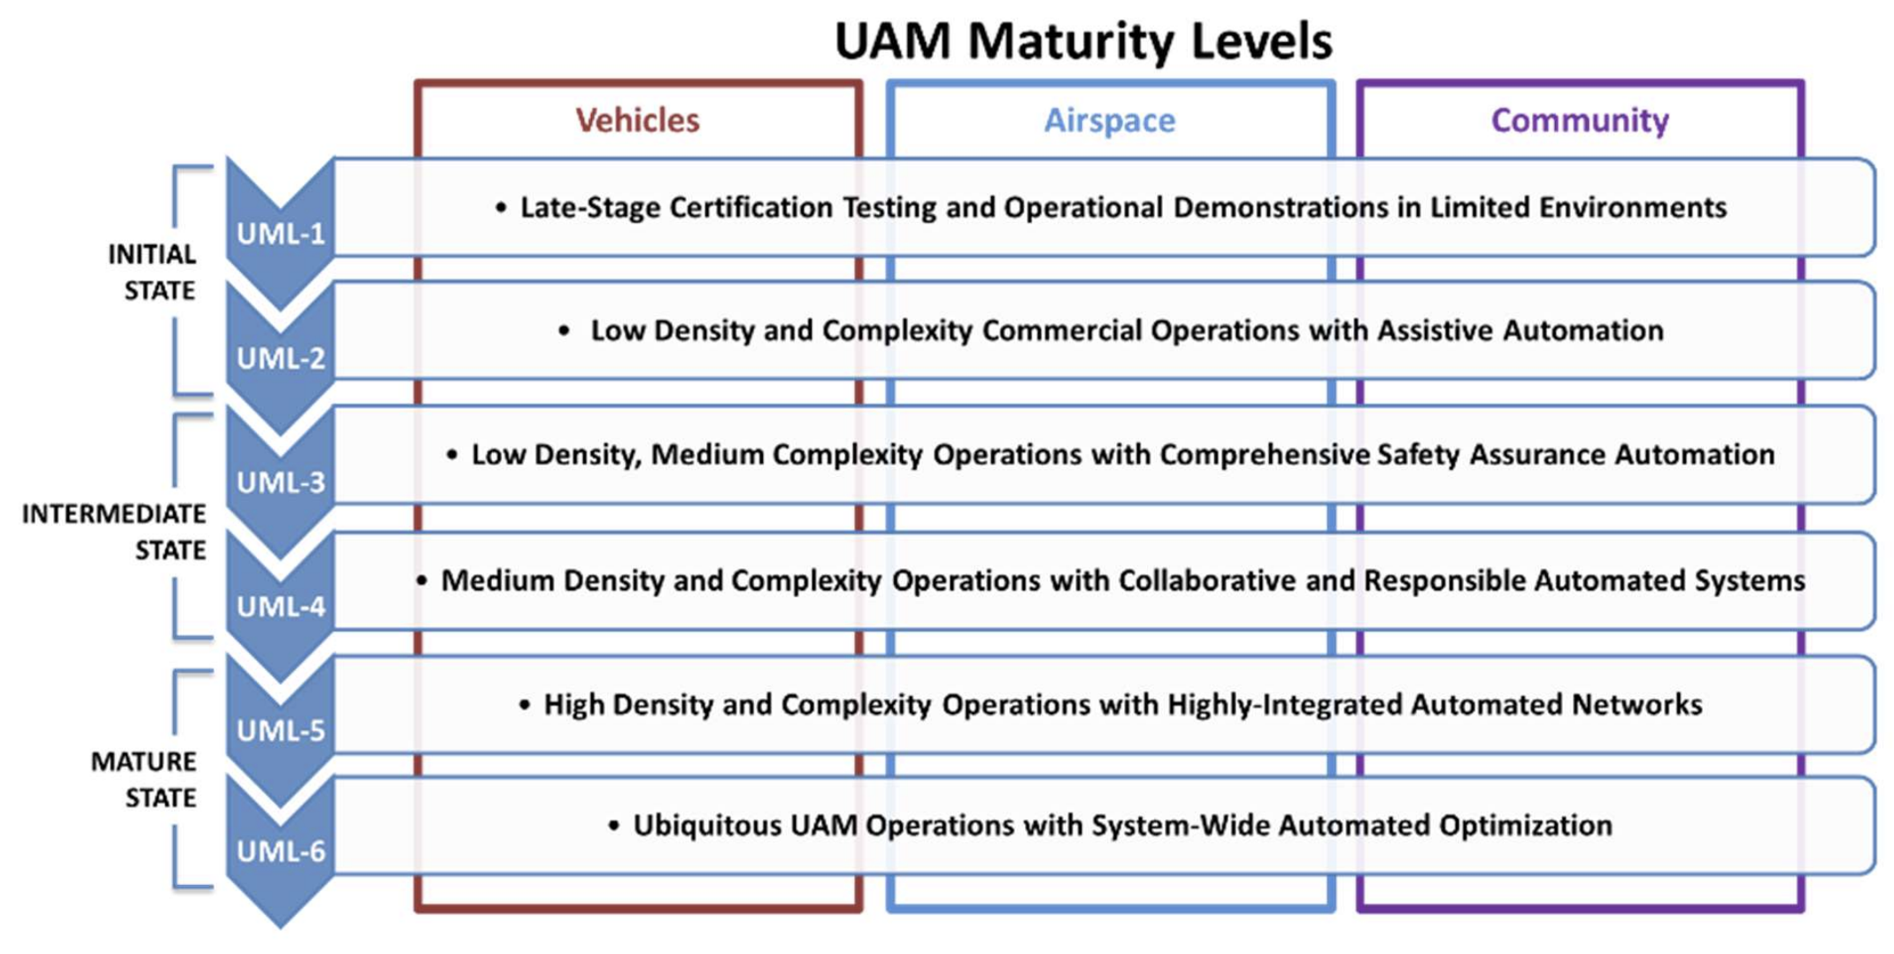
Planning for the Future
Getting a head start on the technologies that enable NASA’s vision.
Source: Goodrich, Kenneth H., and Colin R. Theodore. "Description of the NASA Urban Air Mobility Maturity Levels (UML)." AIAA Aviation Forum 2020.

Slide 10
Planning for the Future
Getting a head start on the technologies that enable NASA’s vision.
The Autonomous Systems Discipline Efforts:
Flight tests to demonstrate perception technology onboard the aircraft and from an infrastructure of distributed sensor nodes.
Human-in-the-loop simulation of vehicle fleet management roles and testing of new software interfaces.
Research and development of advanced methods for on-vehicle contingency management.
Strong community coordination though workshops and discussions to define technology gaps and key barriers.
The collection of large data sets to support machine learning-based tools for perception.

Slide 11

Thank you. Questions?
George Gorospe, George.e.Gorospe@nasa.gov

