Slide 1
Satellite Conjunction Assessment Best Practices
M. D. Hejduk
The Aerospace Corporation
Chief Engineer to the NASA Conjunction Assessment Program Officer
HQ Science Mission Directorate
Office of the Deputy Associate Administrator for Programs
November 29, 2023

Slide 2
Agenda
Conjunction Assessment (CA) basics
Existing CA best practices documents
Design time and Launch / Early Orbit best practices
On-orbit and deorbit best practices
Satellite light pollution to ground-based astronomy
Additional resources

Slide 3
Basic Conjunction Assessment Terminology
Primary
Object
t₁
t₂
TCA = Time of Closest Approach
Miss Distance = 3.5 km
Secondary
Object
TCA
t₂
t₁

Slide 4
CA Operations: 3-Step Process
Secondary Object i+1
Secondary Object
Secondary Object
Secondary Object i
Secondary Object i+2
Maneuver
∆V
Primary S/C
Primary S/C
Primary S/C
Conjunction Assessment (CA) is the process of identifying close approaches between two orbiting objects; sometimes called conjunction “screening”.
The 18th Space Defense Squadron (18 SDS) at Vandenberg SFB maintains the high accuracy catalog of space objects. Orbital Safety Analysts (OSAs) at VSFB screen protected assets against the catalog, perform tasking requests, and generate close approach data.
CA Risk Analysis (CARA) is the process of assessing collision risk and assisting satellites in planning maneuvers to mitigate that risk, if warranted.
The NASA CARA program performs risk assessment for all NASA operational non-human space flight (HSF) satellites, and some partner missions. JSC performs risk assessment for all NASA HSF program assets and also performs maneuver decisions and execution.
Collision Avoidance is the process of executing mitigative action, typically in the form of an orbital maneuver, to reduce collision risk.
Each satellite Owner/Operator (O/O) – mission management, flight dynamics, and flight operations – is responsible for making maneuver decisions and executing the maneuvers.

Slide 5
Orbital Safety Best Practices Documents (1 of 2)
18 SDS (USSF) Space Flight Safety Handbook for Operators
Focus is on how to interact with USSF for launch coordination, safety product exchange, and reentry processing
Rather little on safety in satellite design, operation, and operator coordination
Secure World Foundation Handbook for New Space Actors
Much of the right material, but at a high level
Also somewhat dated (2017 publication); in need of refresh
Space Safety Coalition Best Practices for Sustainability of Space Operations
Comprehensive effort, with broad industry participation (some key omissions)
Reasonable level of detail

Slide 6
Orbital Safety Best Practices Documents (2 of 2)
NASA Spacecraft Conjunction Assessment and Collision Avoidance Best Practices Handbook
Product of government interagency (with some industry review)
More detailed than most other treatments
20 pages of best practices, with explanations
125 pages of technical appendix, giving both theory and operationally-useful tables
Organized by satellite life cycle
AIAA Satellite Orbital Safety Best Practices
Product of three largest commercial O/Os (SpaceX, OneWeb, Iridium)
Largely a distilled version of NASA document, but with additions and a more industry-focused direction
Short, crisp, and readable
Subsequent slides draw principally on NASA Handbook

Slide 7
Design Time and Launch/EO Best Practices

Slide 8
Spacecraft Design Considerations
Important (and efficient) to make plans for conjunction assessment during spacecraft planning and design
CA process needs can be accommodated more easily prior to spacecraft fabrication
Develops and validates all processes and tools well in advance of launch
Key items to consider during design:
Orbit selection
Trackability
Deployment plan
Ephemeris generation process and tools
Lessons learned example:
A NASA spacecraft assumed that two-line elements (TLEs) would be available for use in providing acquisition data to tracking radars.
After launch, it was discovered that the orbit was too low an inclination for DOD CA sensors to reliably track and maintain it, so TLEs were not available.
This situation could have been prevented through pre-launch analysis

Slide 9
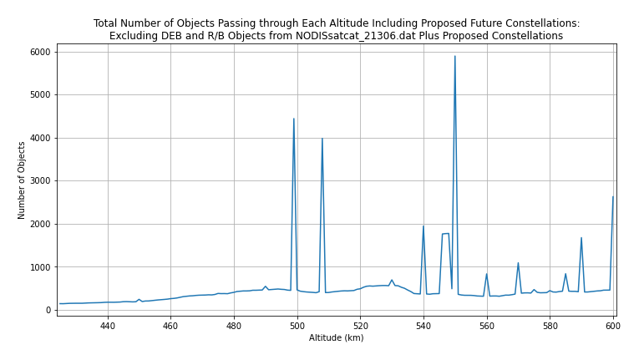
Orbit Selection
Orbit Altitude Affects Event Rate:
Small changes in orbit altitude may make large differences in the number of close approaches
Co-Location:
Determining in advance that there are other neighbors in the intended location of the spacecraft allows planning of communication and space sharing operations concepts.
*NASA CARA Program. (2019) Unpublished internal data.
Transiting to final orbital position can create CA complexities
Transiting spacecraft should yield way to on-station spacecraft
Frequent, sometimes constant, maneuvering must be modeled in ephemerides provided to 18 SDS to communicate position to neighboring spacecraft
Transiting through constellations or large groups of active payloads requires frequent contact with other O/Os to adjudicate close approaches

Slide 10
Trackability [1 of 2]
Technology advances make possible spacecraft that are too small to be tracked by the Space Surveillance Network (SSN)
SSN is the DOD USSF resource assigned to track all on-orbit objects
Objects must be >10 cm to be tracked reliably in LEO
Objects must be >50 cm to be tracked reliably in GEO
CA can be performed only against well tracked objects in the catalog
Un-trackable objects on orbit pose a threat to flight safety
Objects too small to be passively tracked at all
Objects in low inclination orbits (fewer SSN sensors with geometric visibility)
Objects in eccentric orbits (perigee can be away from radars and satellite can be too dim at apogee for optical sensors)

Slide 11
Trackability [2 of 2]
Potential workarounds include:
Provide O/O ephemerides (does not work after end of operations)
On-board tracking radio beacon to provide position and ID
Corner cubes and an arrangement with a laser tracking facility to track and identify the payload
Coded light signals from a light source on the exterior of the spacecraft
Radio frequency interrogation of an exterior Van Atta array
Passive increase of albedo
Best Practice:
Ensure objects are large enough to be tracked passively on-orbit. This enables tracking even after the spacecraft is no longer operational, until demise.
At injection, make sure object is placed far enough away from other deployed satellites and on-orbit objects to allow unique, unambiguous tracking

Slide 12
Deployment Plan
Issue: complex deployments create cataloguing difficulties
Rapid child deployments proliferate deployed satellites, when parents may already be difficult to distinguish, track, and catalog depending on number of objects deployed
Tethered deployments follow non-Keplerian trajectories; difficult to maintain orbit in catalog
Approach: attempt to simplify/prepare for situation
Delay child deployments until 18 SDS is able to catalogue parent
For tethered deployments, work out tracking/maintenance strategy with 18 SDS in advance of launch
Rideshare missions must rely on launch provider to protect their spacecraft by using safe deployment practices
Consider a launch trajectory with a ~350km parking orbit before raising
Infant mortality satellites decay quickly, without threatening other spacecraft

Slide 13
Ephemeris Generation Process and Tools: Producing a CA-Quality Ephemeris
Since close approaches are computed using predictions of future spacecraft position, predictions must be accurate enough to enable maneuver planning
If spacecraft is not passively trackable or if it is maneuverable, predicted trajectory information should be provided to 18 SDS to enable close approach computation
At least once per day
Predicted at least 7 days into the future
Quality modelling, especially atmospheric drag, must be used to reduce errors
Include realistic covariances
Two Line Elements (TLEs, e.g. obtained from SpaceTrack.org) are NOT SUFFICIENT FOR CA
1-2 km theory error is too large for maneuver planning
No covariance available to compute probability of collision and make risk decision
Maintain Space-Track.org information,
Contact information (24x7, since other O/Os may be in a different time zone)
Active and maneuverable status flags

Slide 14
COLA Gap
Until the delivered spacecraft is tracked and cataloged by DOD (up to two weeks in extreme cases), CA not possible –called the COLA Gap period
Important to provide state and covariance ASAP after launch to prevent collisions
Work with ELV provider to request these data
Provide O/O ephemerides ASAP as ELV data is only good for a short period (accuracy degrades the longer the state is propagated).
Many ELVs launch rideshares to 550 km, an orbit regime occupied by a large number of Starlink spacecraft
If the spacecraft do not need to go to this altitude for science reasons, better to choose something lower, preferably below the ISS

Slide 15
On-Orbit and Deorbit Best Practices

Slide 16
On-Orbit CA Screening Best Practices
Register your spacecraft with your screening authority (e.g. USSF)
Provide contact information so that other O/Os can contact you to resolve conjunction responsibility for high-risk encounters
Indicate whether your satellite is maneuverable so other O/Os will know whether they must perform any mitigation action for conjunctions with you
Report your spacecraft’s size so that collision risk assessment can be performed
If your satellite is maneuverable, submit predicted ephemerides, which include planned maneuvers, to the screening authority at least daily
Three times per day preferred for lower orbits (< 500km)
Process the CA screening results from your screening provider and perform CA risk assessment

Slide 17
On-Orbit CA Risk Assessment Best Practices
Use only high-accuracy-catalogue screening results in CA risk assessment
Not TLEs, as remarked earlier
Examine state and covariance data for both objects (predicted to time of closest approach) to determine whether they are sufficiently durable to serve as a basis for mitigation action
Base risk assessment on a probabilistic measure rather than an estimate of the mean value of miss distance
Probability of collision or confidence interval on miss distance
Exception: if mean miss distance is smaller than combined sizes of objects
If using the probability of collision (Pc), use as a threshold for mitigation a Pc value of 1E-04 (1 in 10,000) or smaller

Slide 18
On-Orbit CA Mitigation Best Practices
If the secondary objects is maneuverable, reach out to the other O/O to coordinate a response and determine which satellite will mitigate
Command a mitigation action that will reduce the Pc of the main conjunction to at least 1.5 OoM below the mitigation threshold
For Pc of 1E-04, this means reducing to 3E-06 or smaller
Mitigation actions can be impulsive maneuvers, low-thrust maneuvers, or differential drag activities
Ensure that any other conjunctions introduced by the mitigation action remain below the 1E-04 level, for typically 48 hours past the main conjunction TCA
Confirm the above two calculations by generating a predicted ephemeris containing the planned maneuver and submitting it for screening

Slide 19
Deorbit Best Practices
Deorbit your satellite at the end of its mission life
Required in order to meet 25 year / 5 year deorbit rule
Deorbit by shrinking a circular orbit rather than using a HEO orbit
Creates far fewer conjunctions
Actively manage the deorbit until only a few days away from re-entry
Eliminate active attitude control at this point in order to produce more reliable re-entry predictions
Controlled deorbits are desirable but not required

Slide 20
Satellite Light Pollution

Slide 21
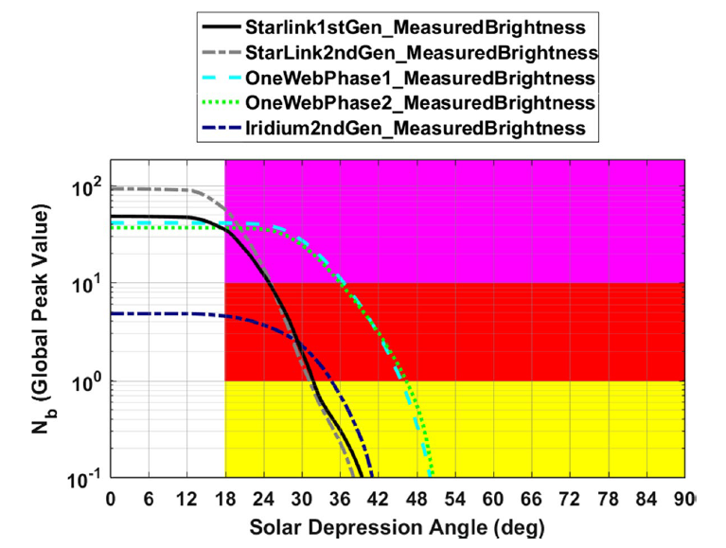
Satellite Light Pollution
Large constellations can produce significant reflected stray light, especially for large-aperture, long-exposure, ground-based astronomy
Degree of pollution (# of reflective sats in view) a function of solar depression angle
*D.T. Hall, “Semi-Empirical Astronomical Light Pollution Evaluation of Satellite Constellations,” Journal of the Astronautical Sciences (2022) 69:1893-1928.

Slide 22
Satellite Light Pollution Best Practices
Consider whether fewer satellites can achieve your mission
Consider whether a lower altitude can still achieve your mission
This will allow ground-based astronomy to proceed at lower solar depression angles, which will allow a greater portion of the observing night to be available
Consider methods to make your satellite less reflective
Starlink (SpaceX) has deployed a low-reflectivity coating on its more recent satellites that has decreased photometric brightness by orders of magnitude

Slide 23
CA Beyond Earth
Catalog of non-cooperatively tracked objects used in CA only available near Earth
Activity at Moon, Mars, and libration points increasing; risk of collision without screening
DOD developing cis-lunar catalog and screening capability
Requirements not yet defined
Implementation is years away
NASA Multimission Automated Deepspace Conjunction Assessment Process (MADCAP) provides ephem-on-ephem screening for missions
Relies on sharing of data; sharing of non-NASA data encouraged
Many foreign nations participate, including China
Area of needed present effort

Slide 24



Additional Information and Resources
NASA CA Handbook: left QR code
Detailed treatment of all of the items discussed in previous charts
NASA CARA tools: center QR code
Large repository of open-source software for most CA calculations, including test cases, documentation, and relevant journal articles
NASA CA Website: right QR code
General CA information, including regularly-updated operational statistics
NASA CA Handbook
CARA Tool Repository
NASA CA website

Slide 25

Questions?

