Slide 1
Orion Artemis I As Flown MMOD Analysis 2nd International Orbital Debris Conference
Kevin D. Deighton | Jacobs CLG
JSC-XI5 (JETS II) Hypervelocity Impact Technology (HVIT) Team
Eric L. Christiansen (NASA), Dana M. Lear (NASA),
James L. Hyde (Barrios Technology-JETS II)
12/5/2023

Slide 2
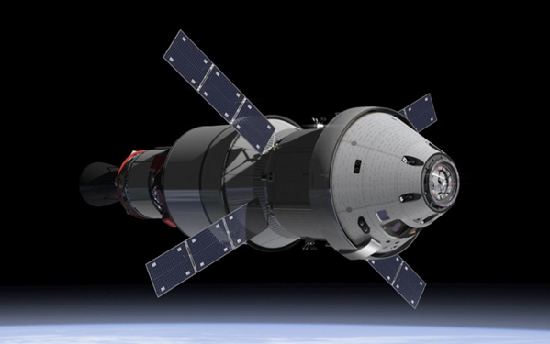
Orion Spacecraft
Orion will provide more recording area to collect small impacts than has ever been flown into deep space before
Thermal Tiles
Windows

Slide 3
Bumper Analysis
The Bumper analysis software was employed to calculate the number of damages of various sizes expected to be caused by MMOD
Environment models used:
ORDEM 3.2
MEM 3
2022 Meteoroid Shower Forecast included
Ballistic limit equations translate environment model impactors into damage size

Slide 4
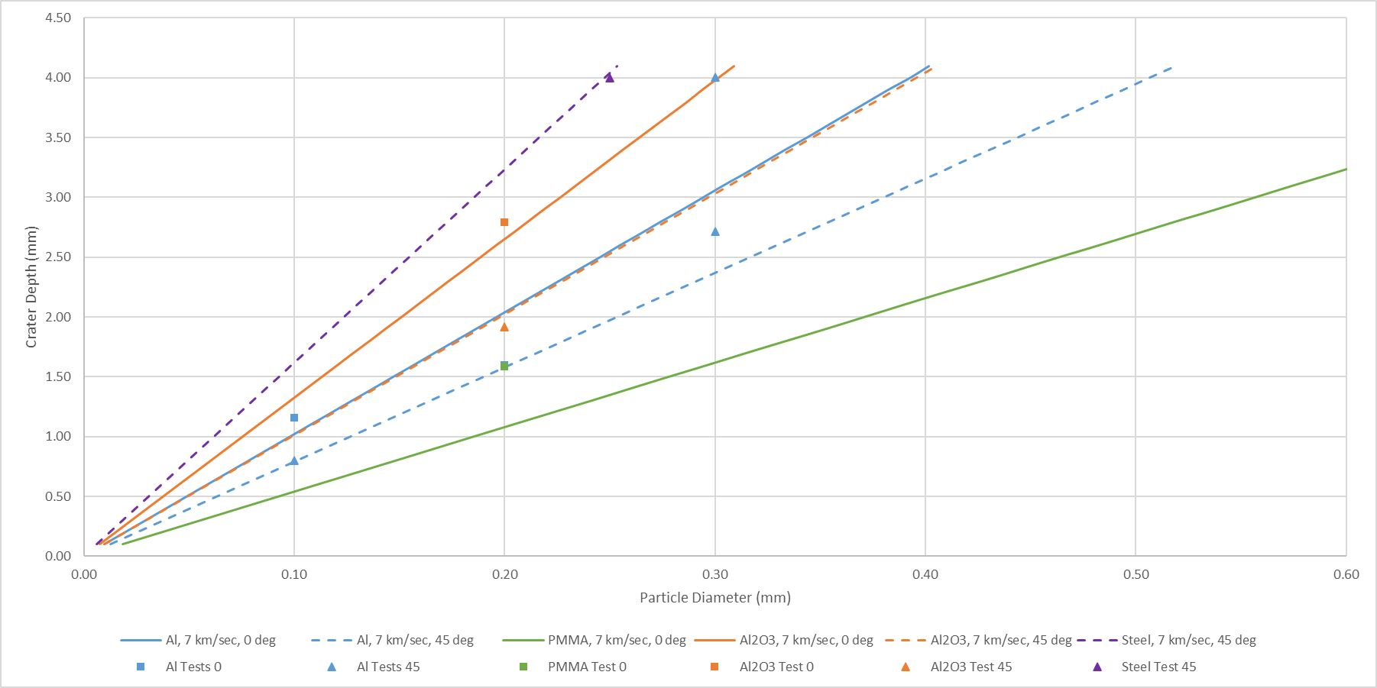
Ballistic Limit Equation: Small Crater in Thermal Tile
No Tape
No Tape
No Tape
Green (6 of 9): BLE within 15% of test
Yellow (2 of 9): BLE off by 25-50% but in opposing directions
Red (1 of 9): Significant disagreement between BLE & test—test result validity in question

Slide 5
Post-Flight Inspection
Primary post-flight inspection of thermal tile & main windows conducted at Kennedy Space Center, January 24-25, 2023
Multiple inspections of various portions of the capsule conducted as opening became available
Thermal tiles bonded to substrate panels that had been removed from the vehicle
Pieces of reflective tape remained on the tiles
Tape mostly burned off during reentry

Slide 6
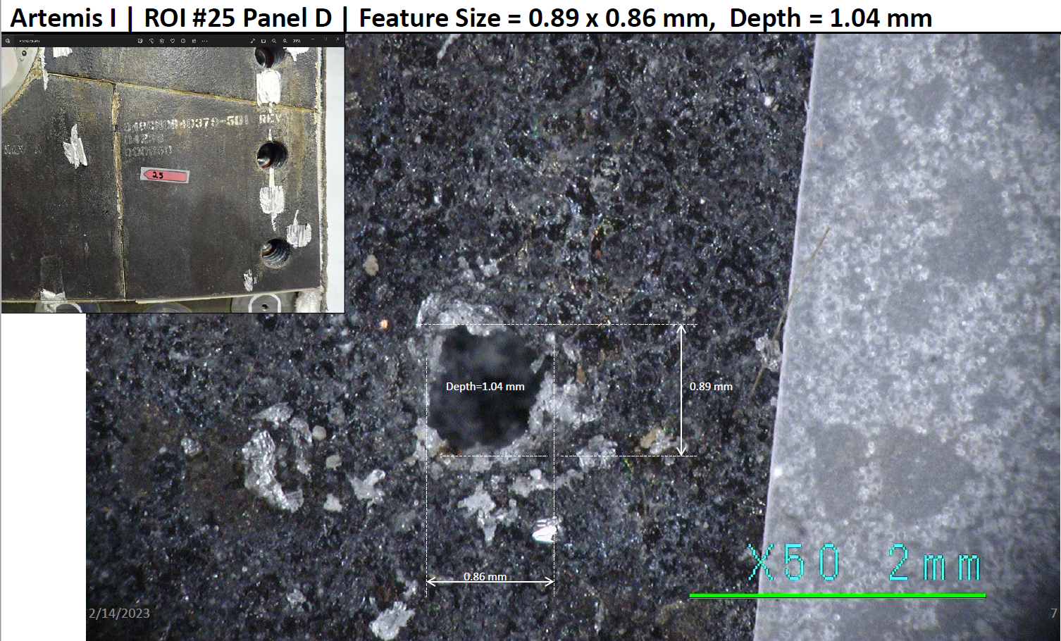
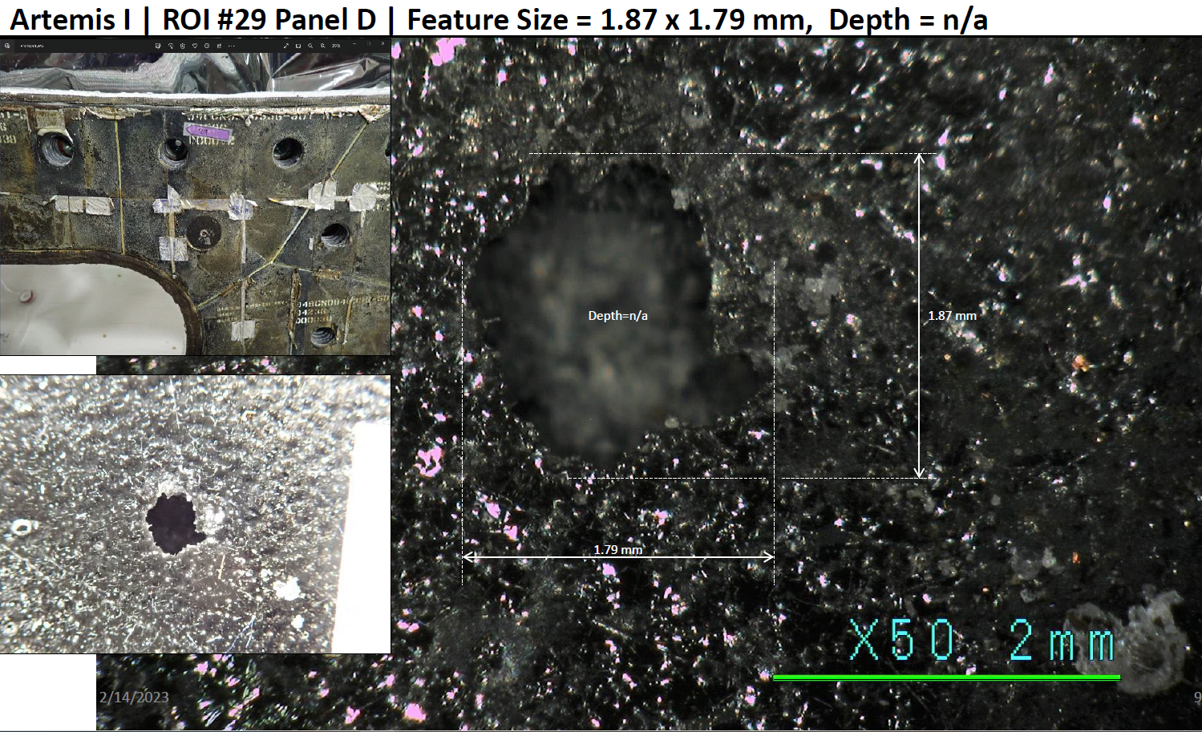
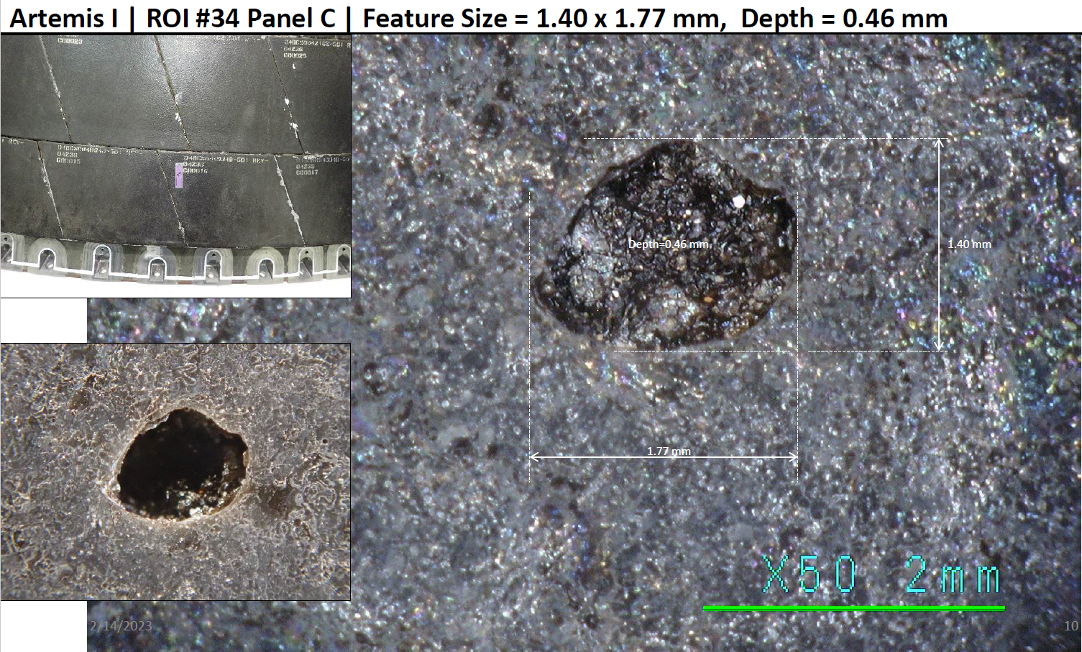
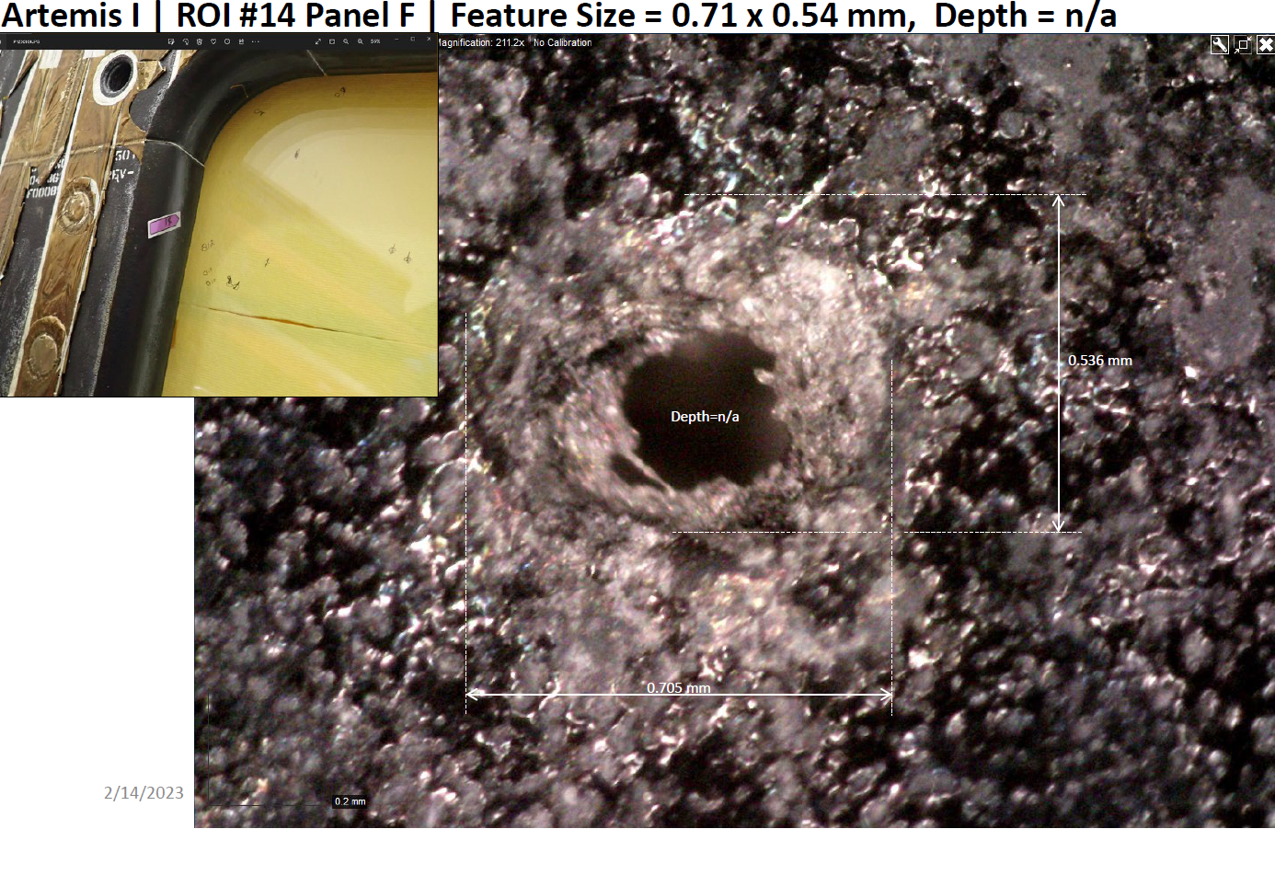
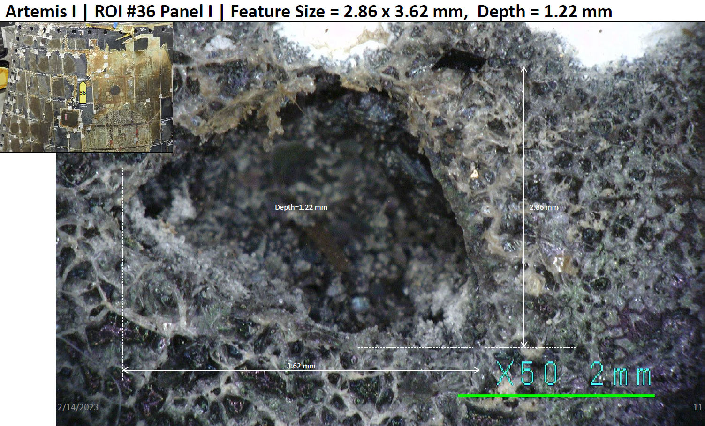
Regions of Interest on Thermal Tile
Five potential MMOD impact sites in the thermal tiles were identified and preliminarily characterized
Further laboratory characterization is planned

Slide 7
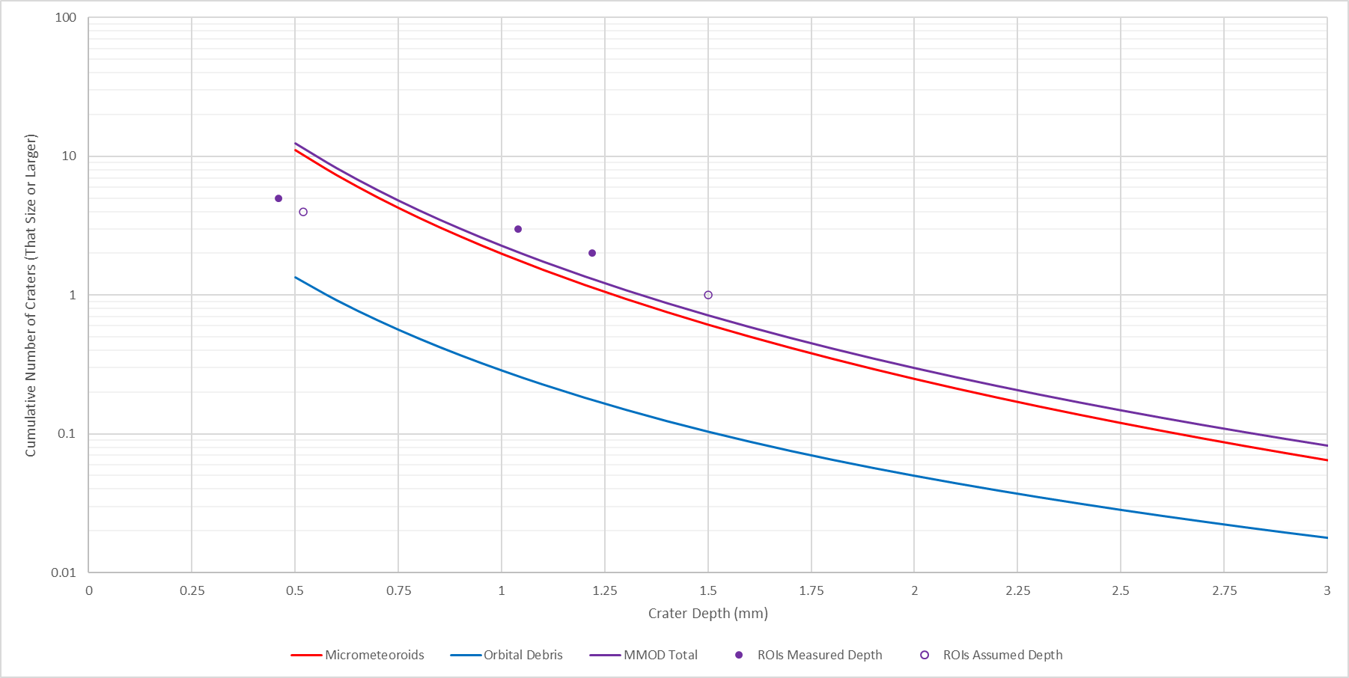
Thermal Tile As-Flown vs. Post-Flight Inspection
Counting the craters found during post-flight inspection in a cumulative manner (points) agrees well with Bumper prediction of the number of craters of a given size or larger (solid lines) for mid-sized craters
Finding fewer small craters than predicted is consistent with other programs
ROI #34
ROI #25
ROI #14
ROI #36
ROI #29
80%-90% Micrometeoroid
10%-20% Orbital Debris

Slide 8
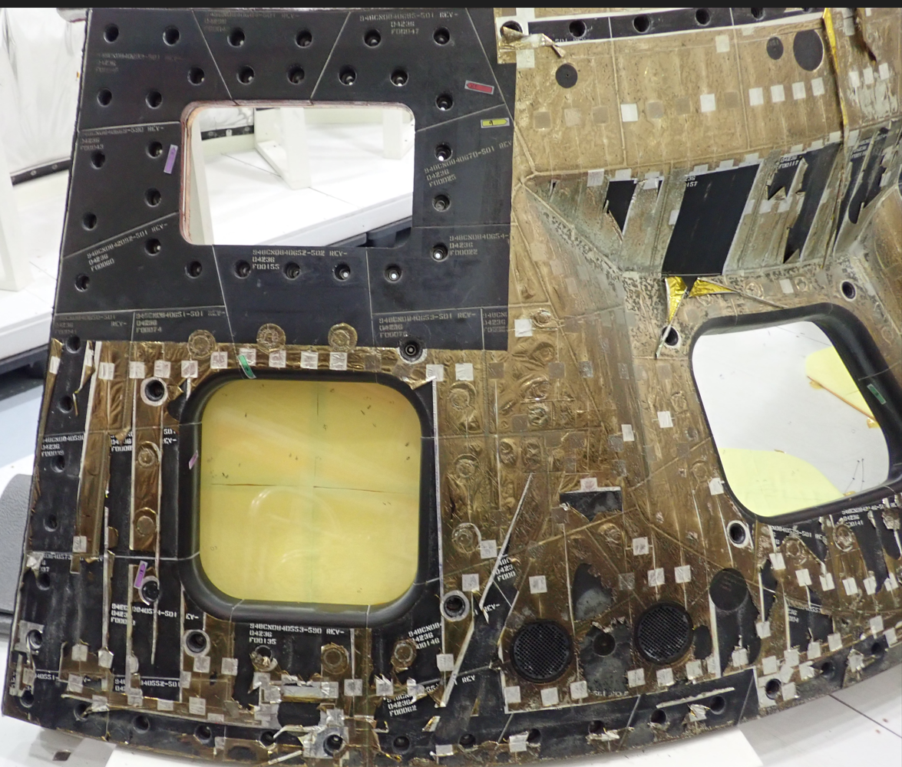
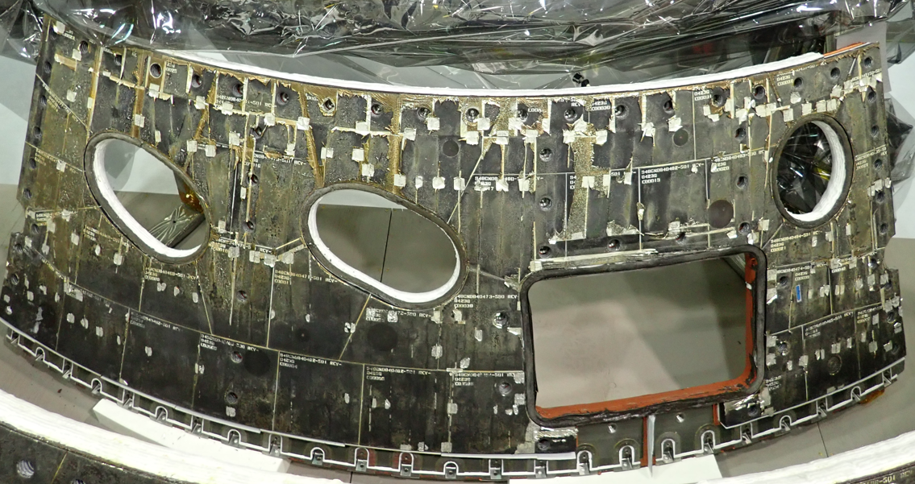
Remaining Tape
Reflective tape was applied to the thermal tiles to achieve various desired properties for the flight
Most of the tape burned off during reentry
Some tape remained, especially on Panel F, where the main windows are located
Scattered small squares of tape remained across the whole capsule (shown on Panel E)
A Bumper analysis was performed to calculate the number of tape damages expected to be caused by MMOD
Analysis included adjustment for how much tape remained
A
E
F
G
D
B
I
Panel F
Panel E
H
C

Slide 9
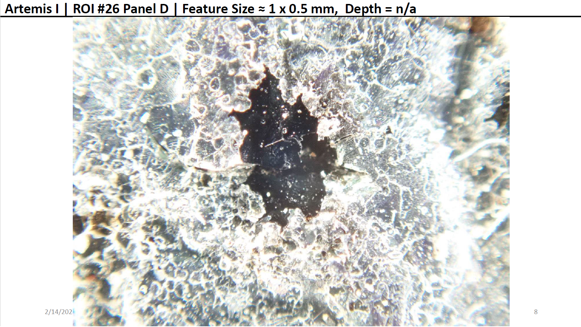
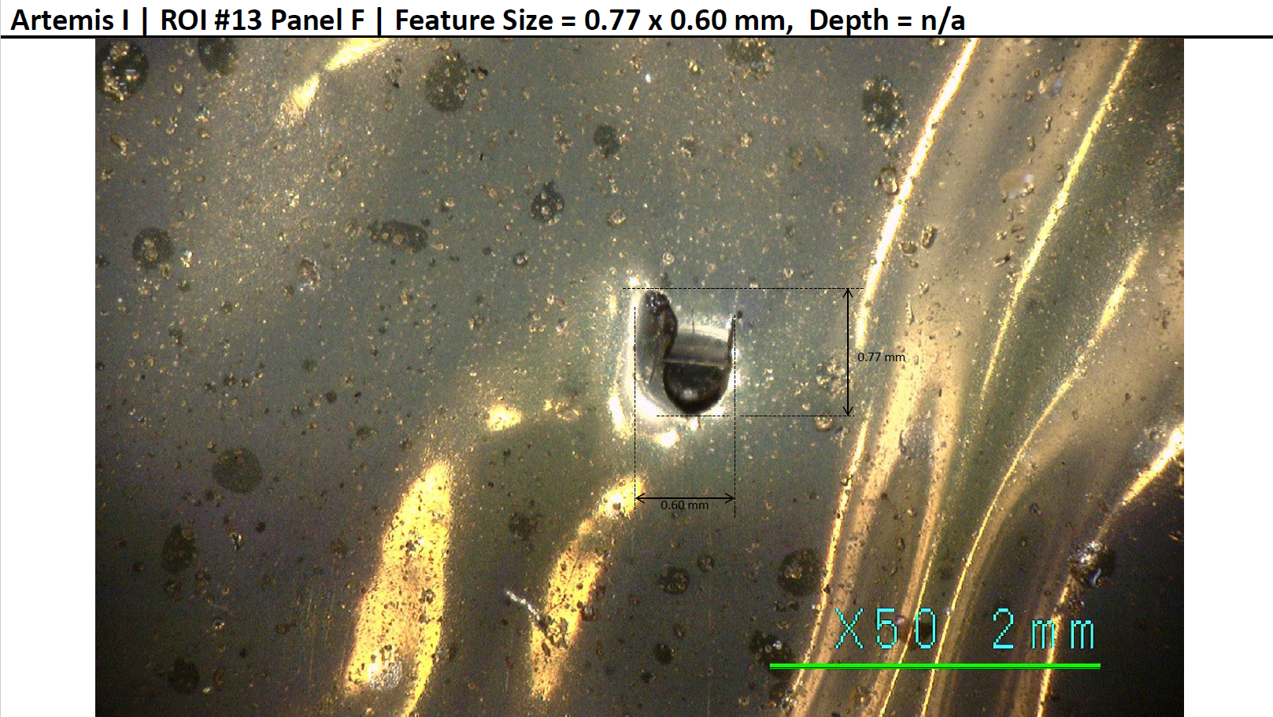
Tape Damage
Tape prediction consistent with findings
Most of tape burned off → only 18% of predicted impacts are on remaining tape
Expected to find 2 holes on Panel F, found 1 ROI
Most complete panel
Expected 1 more ROI across vehicle, found it on Panel D
Panel I would have been more likely due to more remaining tape
Found 1 ROI
Location | Full Panel Number of Tape Holes | Remaining Tape | Adjusted Number of Tape Holes
Panel A | 1.59 | 10% | 0.16
Panel B | 2.01 | 5% | 0.10
Panel C | 3.63 | 2% | 0.07
Panel D | 1.11 | 5% | 0.06
Panel E | 1.05 | 7.5% | 0.08
Panel F | 2.87 | 70% | 2.01
Panel G | 1.05 | 10% | 0.10
Side Hatch | 0.86 | 5% | 0.04
Panel H | 3.56 | 5% | 0.18
Panel I | 1.15 | 40% | 0.46
Total | 18.88 |  | 3.41
Found 1 ROI
Found 2 ROIs

Slide 10
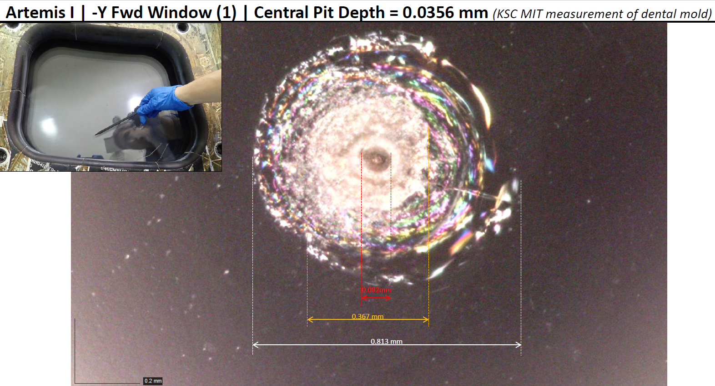
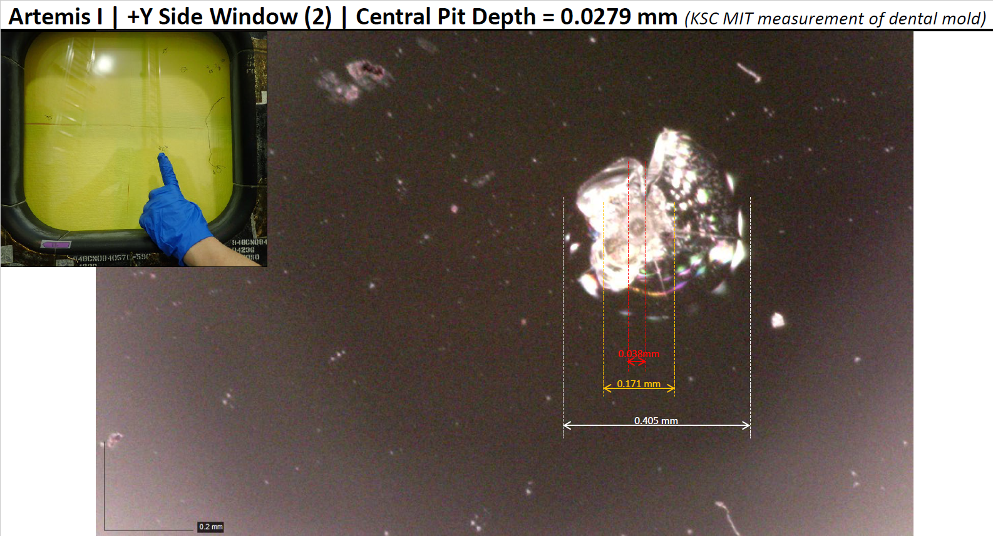
Window ROIs
Diameter = 0.730 mm
Diameter = 0.428 mm
Based on radius determined from maximum glass damage
Assumption: impact obliquity or other factors artificially clipped extent of damage in some directions

Slide 11
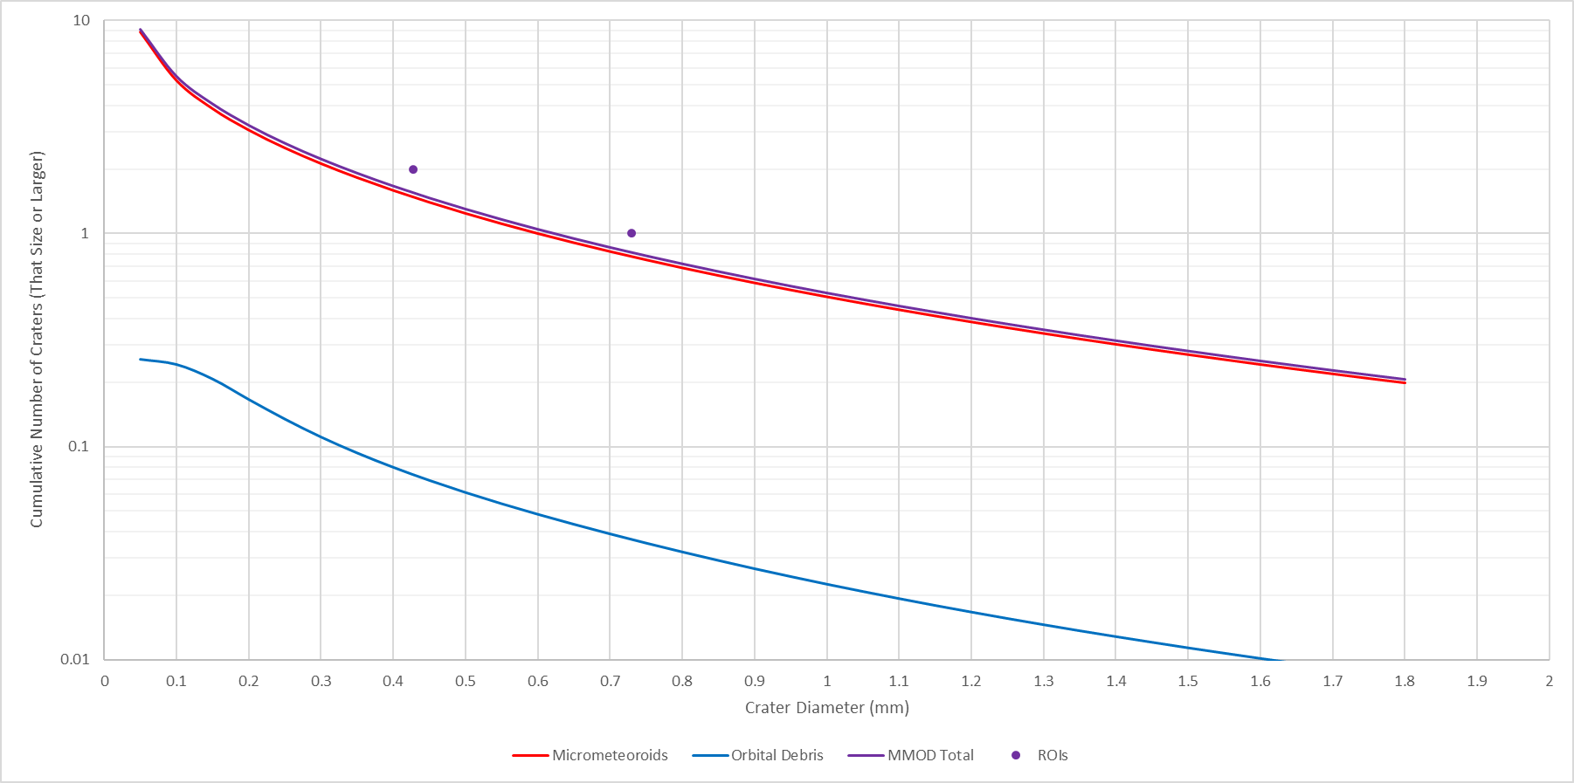
Window Comparison
Bumper predictions accurate to nearest integer
ROI: W2
ROI: W1
Only 4 Main Windows Considered
95% of strikes from micrometeoroids

Slide 12
Summary
NASA inspected the Orion capsule for possible MMOD damage and, separately, a Bumper risk assessment was performed to predict the number of craters expected to be found
Similar to past programs
Comparison of Prediction to Findings
Backshell Tile
5 potential MMOD craters were found
Prediction of crater numbers matches well with inspection findings for depths > 1 mm
Shallower craters: Bumper predicted more craters than were found, which is consistent with historical trends and may be explained by the difficulty in finding very small craters
Extraction of the five potential MMOD damage site tiles is in work to provide more data to improve this assessment
Backshell Tape
2 holes in the remaining reflective tape were found and may have been caused by MMOD
Prediction of hole numbers (3.4 holes) consistent with inspection finding
Predicted ;ocations of holes consistent with inspection finding
Windows
2 potential MMOD craters were found in the main windows
Prediction of crater numbers matches well with inspection findings for diameters > 0.5 mm
Smaller craters: Bumper predicted more craters than were found, which is consistent with historical trends and may be explained by the difficulty in finding very small craters
Conclusions
These comparisons demonstrate a high degree of accuracy in Bumper risk assessment
The inspection findings will aid future refinement of environment models to improve accuracy still further

