Slide 1
Comparisons of Mixing Efficiency for a Strut Fuel Injector Obtained from Large-Eddy and Reynolds-Averaged Simulations, and Experiments
Tom Drozda, Robert Baurle, Cody Ground, Karen Cabell
Hypersonic Airbreathing Propulsion Banch
NASA Langley Research Center
JANNAF, December 2023
Distro A. Approved for public release

Slide 2
Introduction
Motivation: Fuel injector design, leading to efficient fuel-air mixing, combustion, and flameholding, remains one of the key challenges for scramjet propulsion systems.
Reynolds-averaged simulations (RAS), “calibrated” with experiments, continue to be the primary research tool for scramjets.
RAS turbulence models and their parameters, like the turbulent Schmidt number (Sc_{t}), are usually selected based on expert experience and available experimental data.
In very rare cases, performance metrics of practical interest may not be (very) sensitive to modeling choices. More often their sensitivities are significant, especially in reacting flows.
In absence of experiments or in conjunction with experiments, scale resolving simulations, such as large-eddy simulations (LES) can be leveraged to inform RAS modeling choices.
Goal: Compare the mixing efficiency obtained using RAS, LES, and experiments and investigate the applicability of LES to serve as a surrogate or augment for the experimental data

Slide 3
Experiment, Geometry, Flow Conditions
Flow
0.9 in
Experiment simulates combustor entrance for hypervelocity flight
High-speed mixing flow field is generated in the wake of a row of strut fuel injectors
Experiment uses “Open” Plate, Helium-fueled, modular injector block design
NO PLIF and schlieren are collected for flow vis.
In-stream rakes are used for Pt, Tt and gas sampling.

Slide 4
Mixing Efficiency from Experiments and CFD
From Ground et al., AIAA Aviation, 2020
Mass flux
(difficult to measure)
Pitot pressure
(easy to measure)
Gas sampling grid
Experimental values of the mixing efficiency are obtained using pitot pressure measurement and gas sampling of helium
Ground et al., AIAA Aviation, 2020

Slide 5
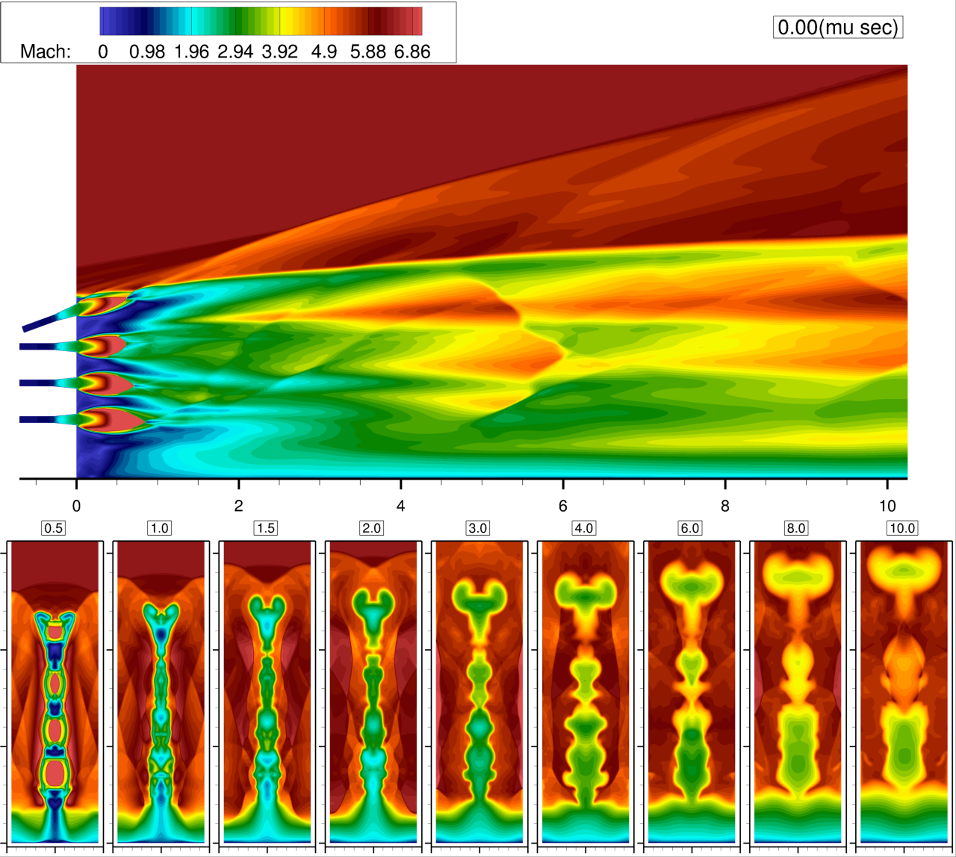
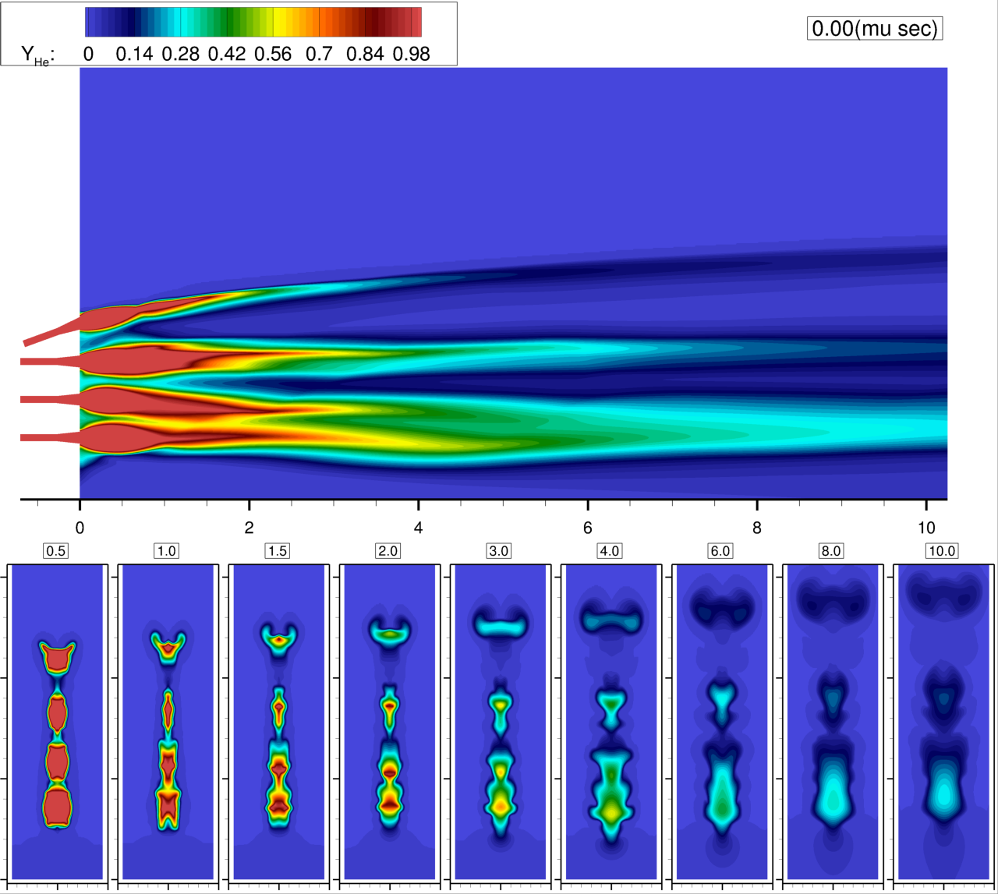
RAS (Menter Sc_{t} 0.5)

Slide 6
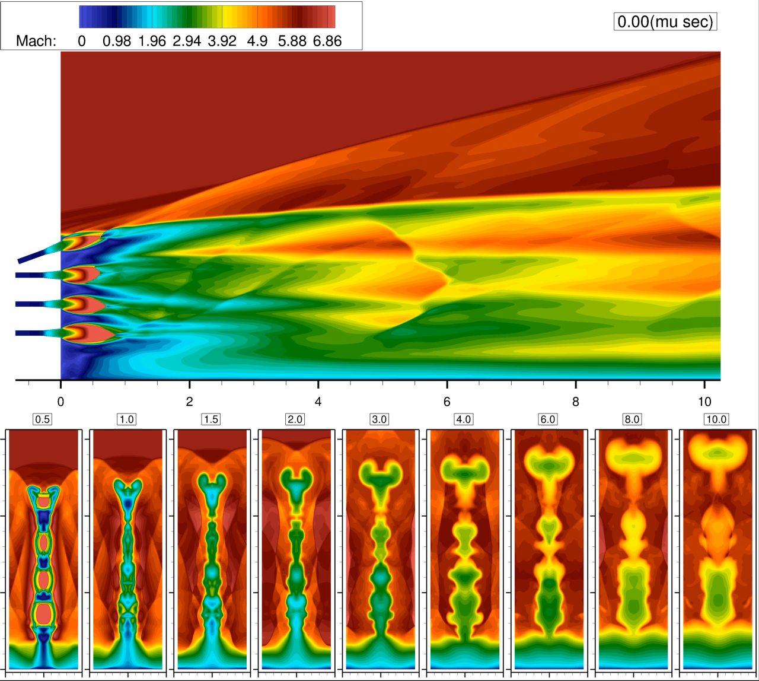
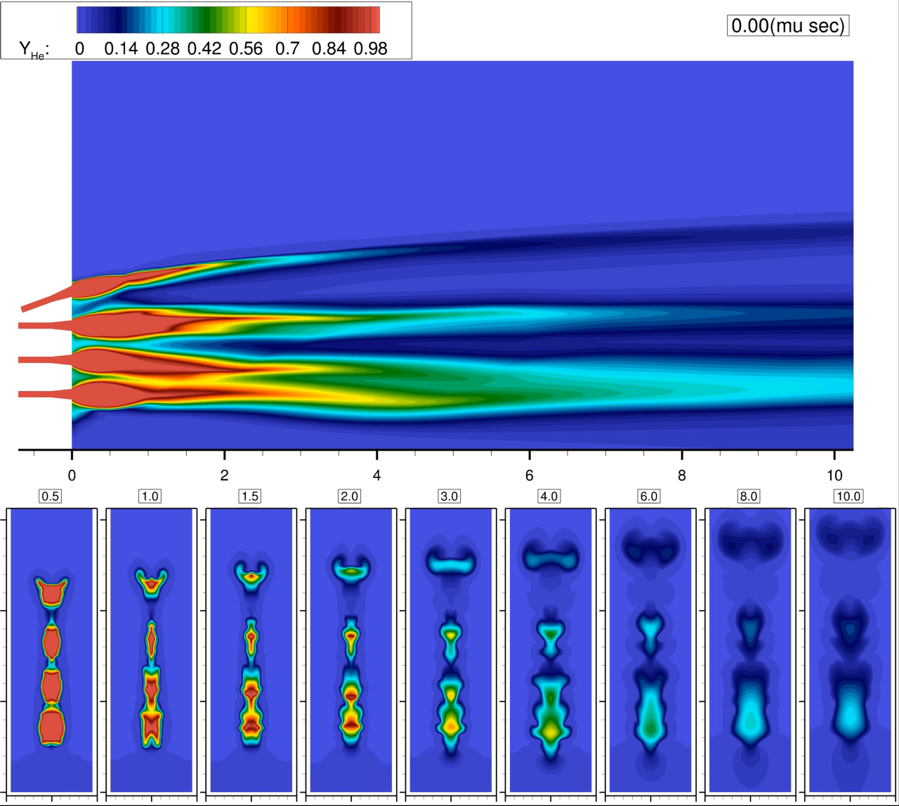
LES

Slide 7
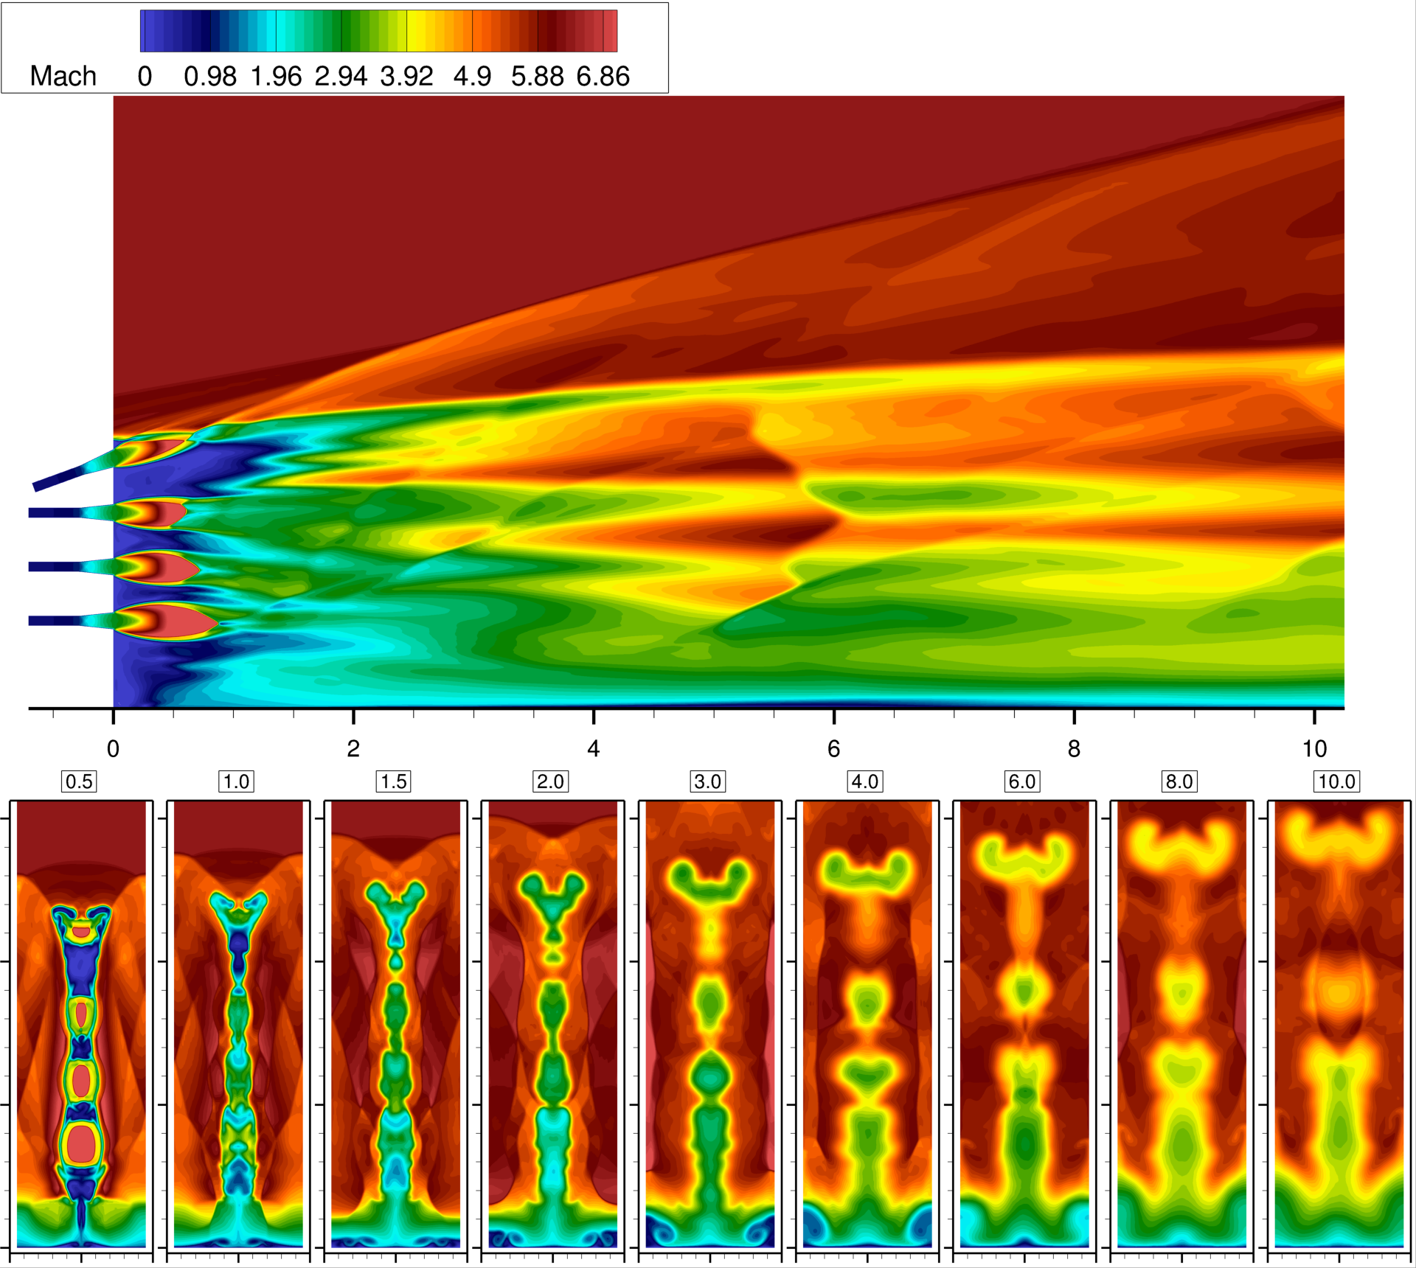
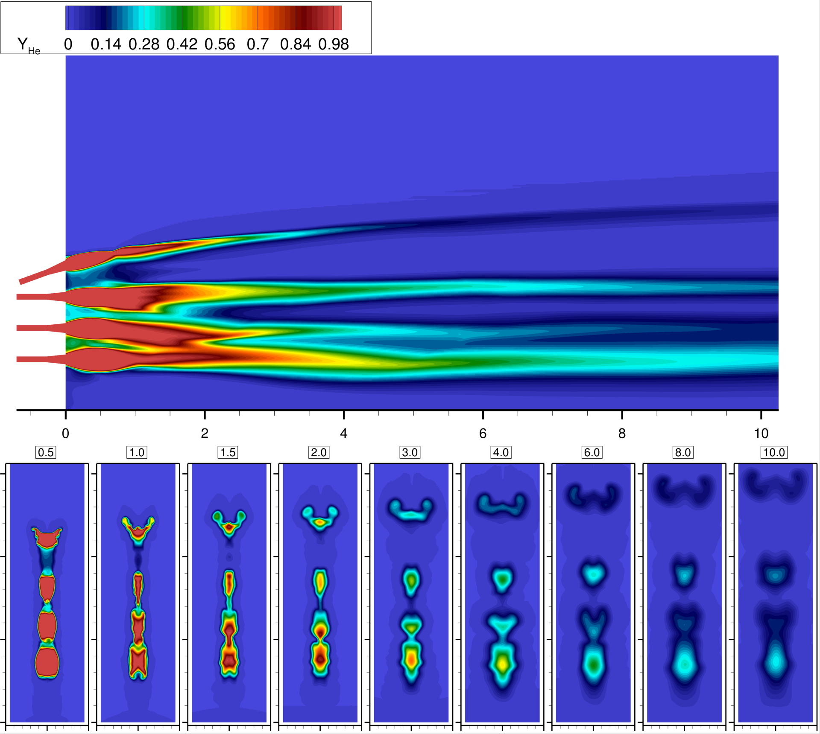
Time-averaged LES

Slide 8
RAS (Menter QCR) and LES
RAS w/ Menter-QCR Sc_{t} 0.5
Time-averaged LES

Slide 9
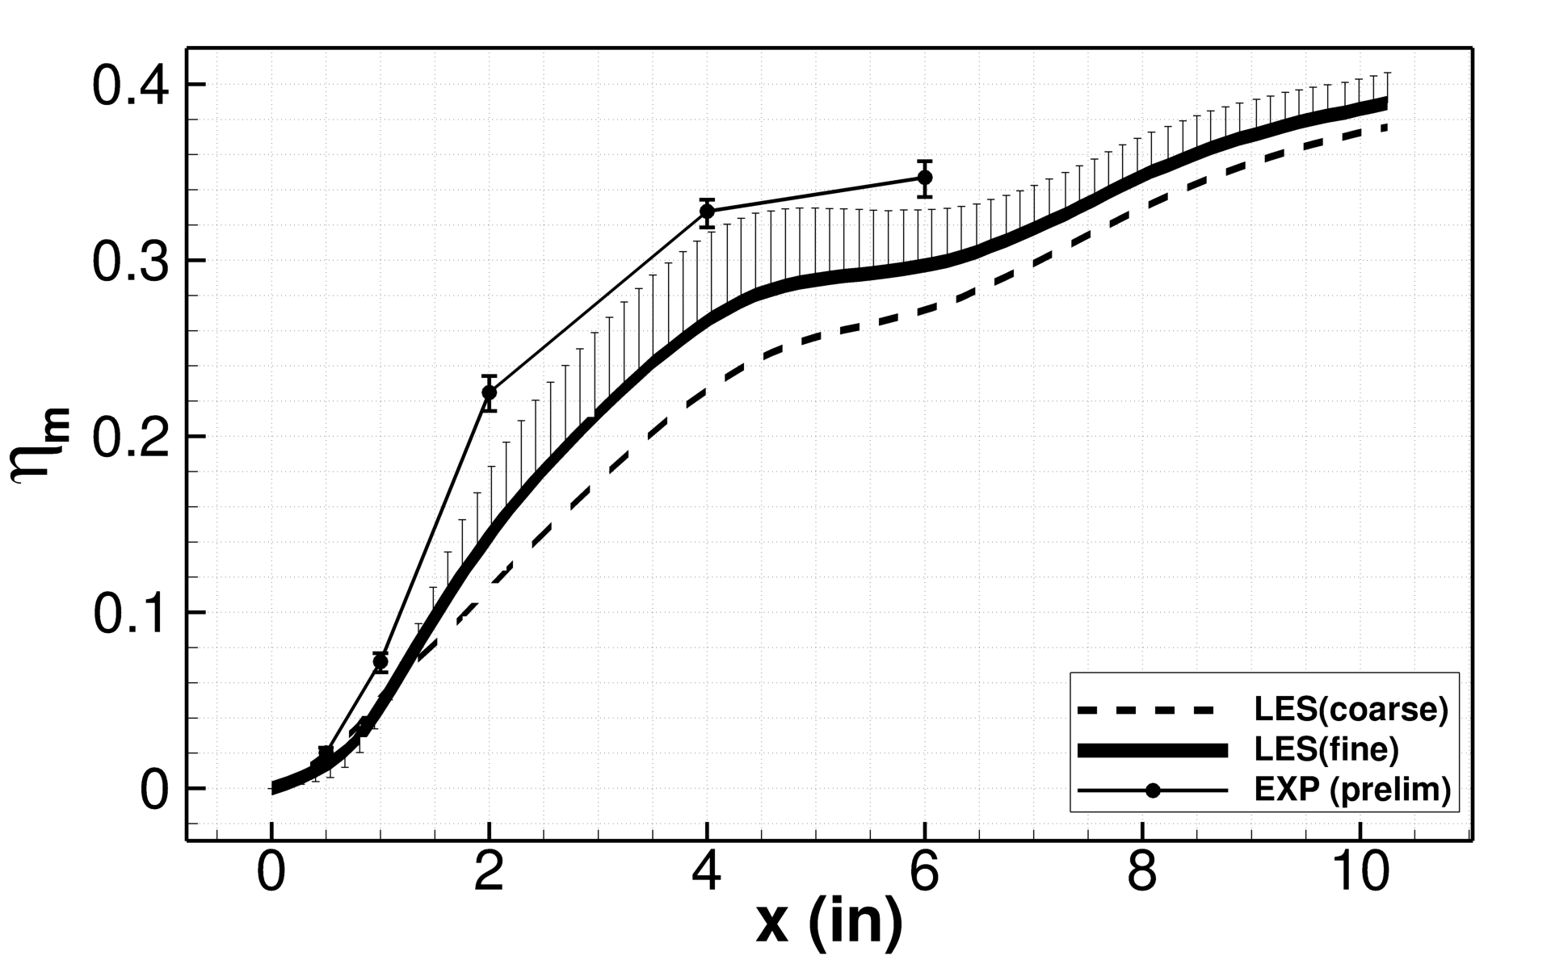
Mixing Efficiency from RAS, LES, and experiments
Region of suppressed mixing
Increasing grid resolution
Increasing resolved turbulent structure
Increasing resolved mixing

Slide 10
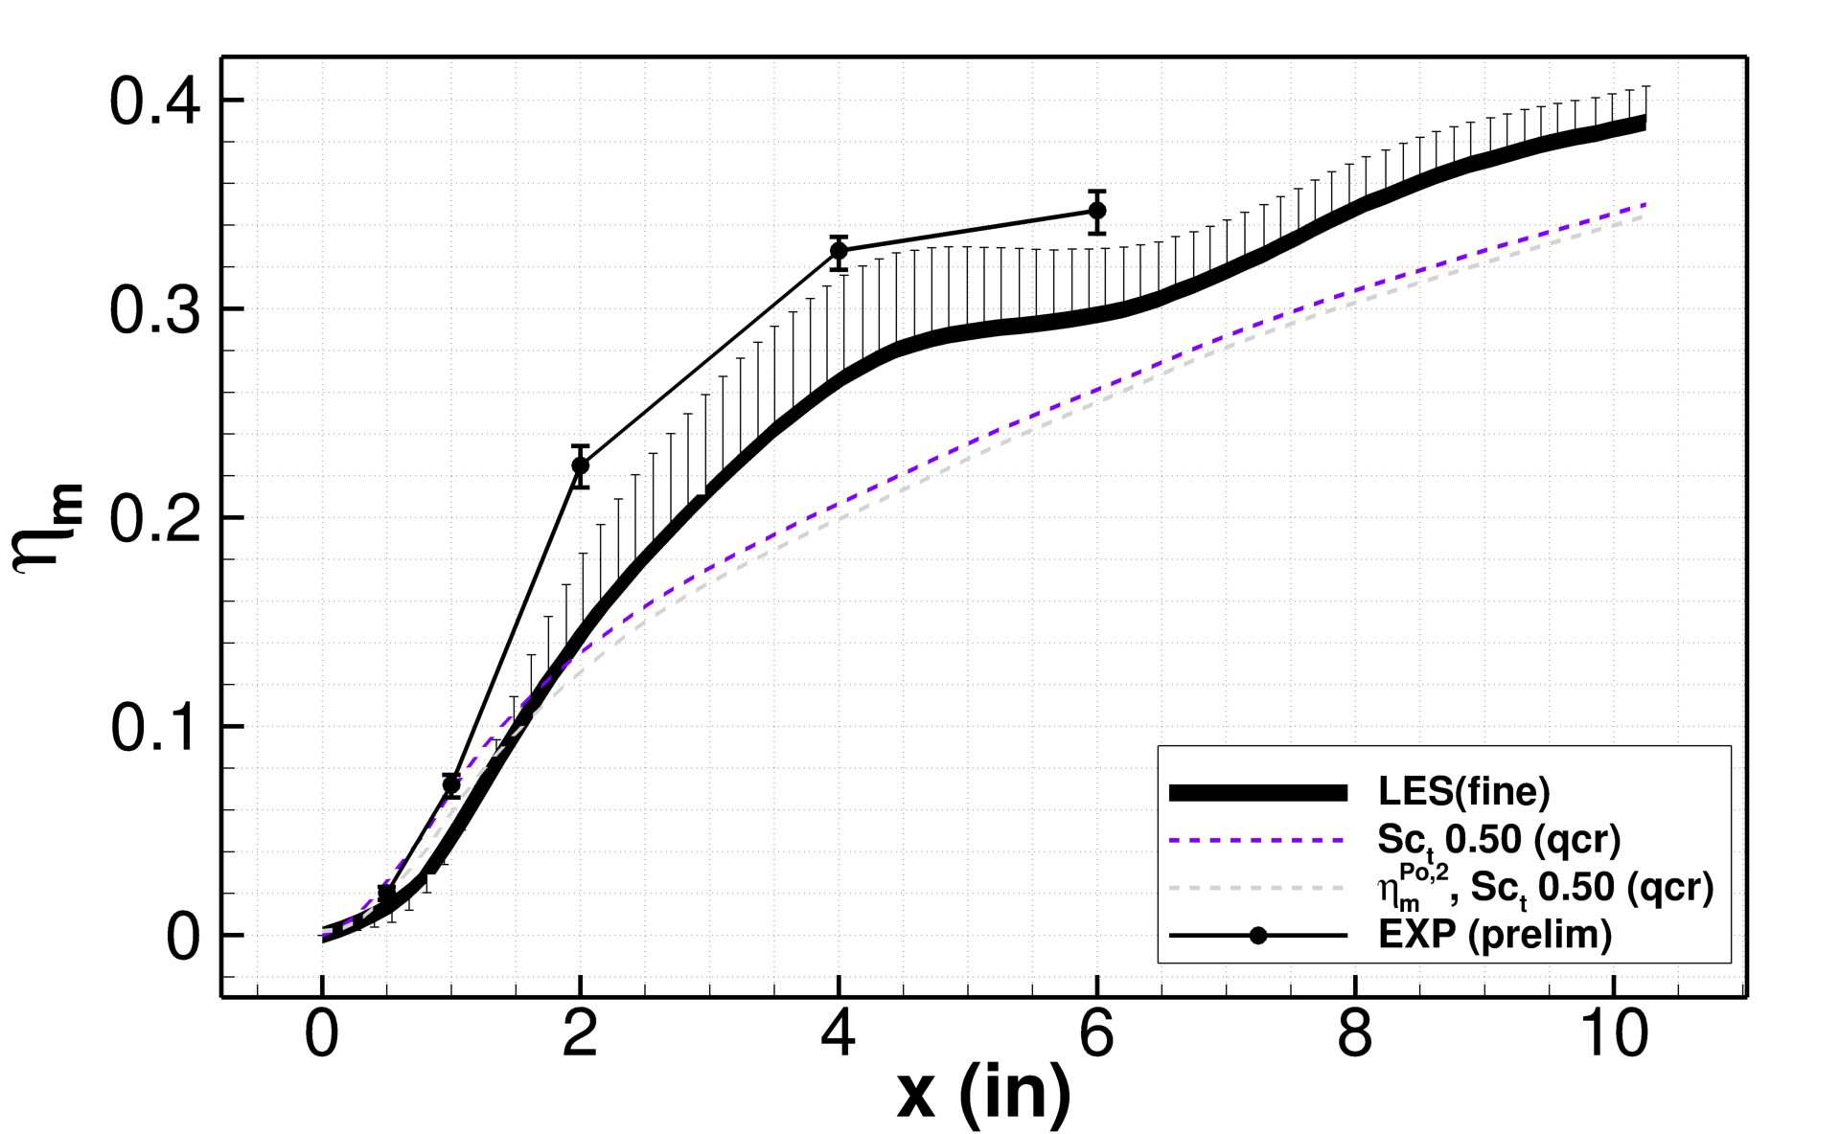
Mixing Efficiency from RAS, LES, and experiments
Mass flux vs. pitot pressure weighted mixing efficiency

Slide 11
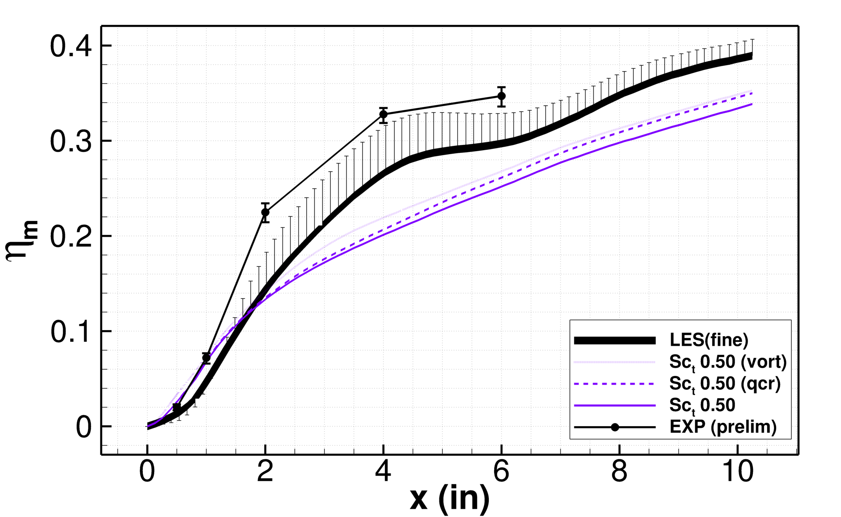
Mixing Efficiency from RAS, LES, and experiments
Menter baseline vs. vorticity production vs. QCR

Slide 12
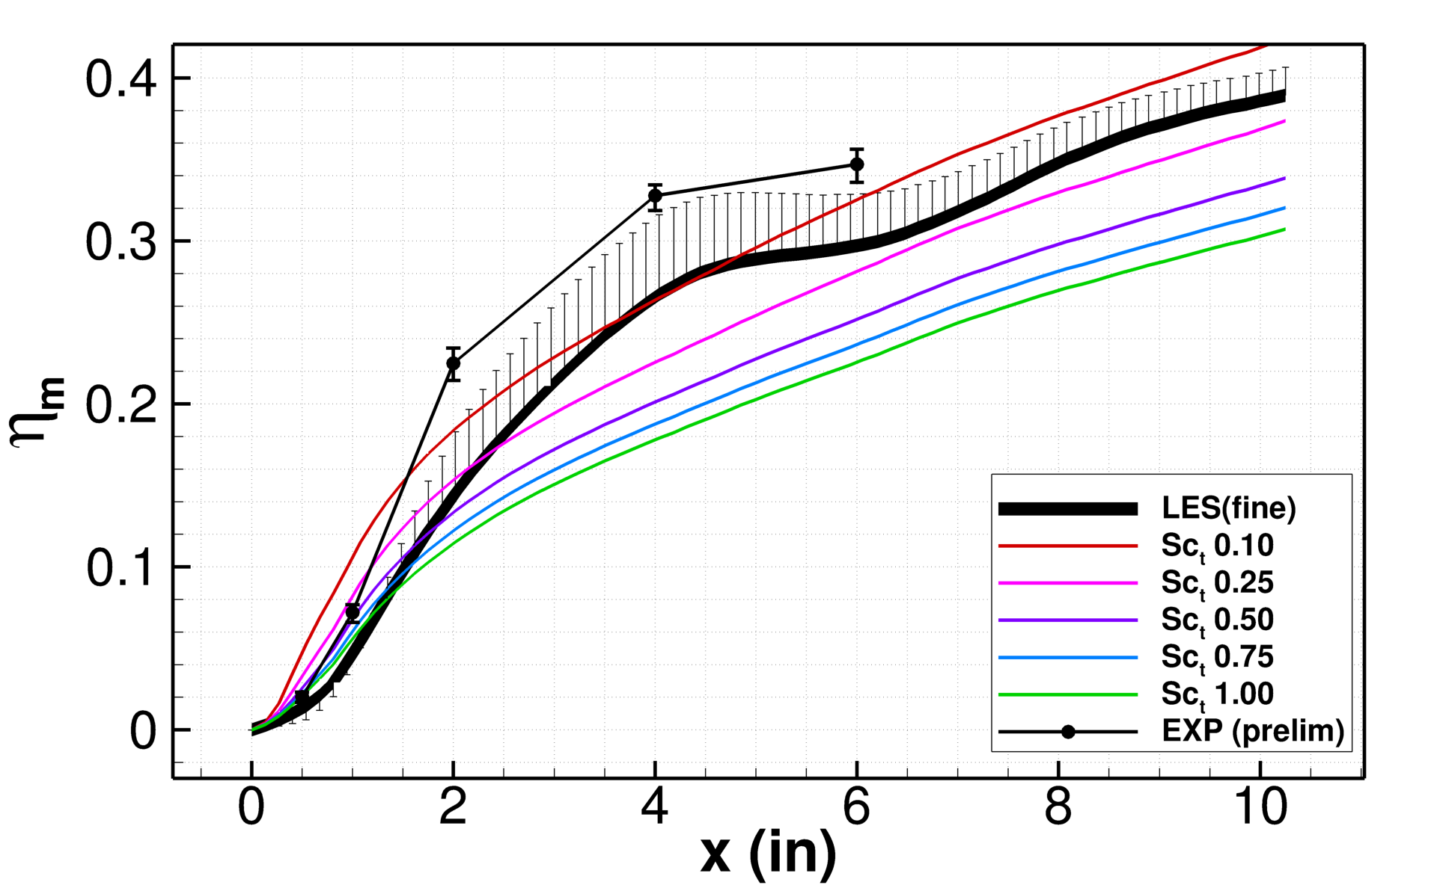
Mixing Efficiency from RAS, LES, and experiments
Increasing Sc_{t} Decreasing mixing

Slide 13
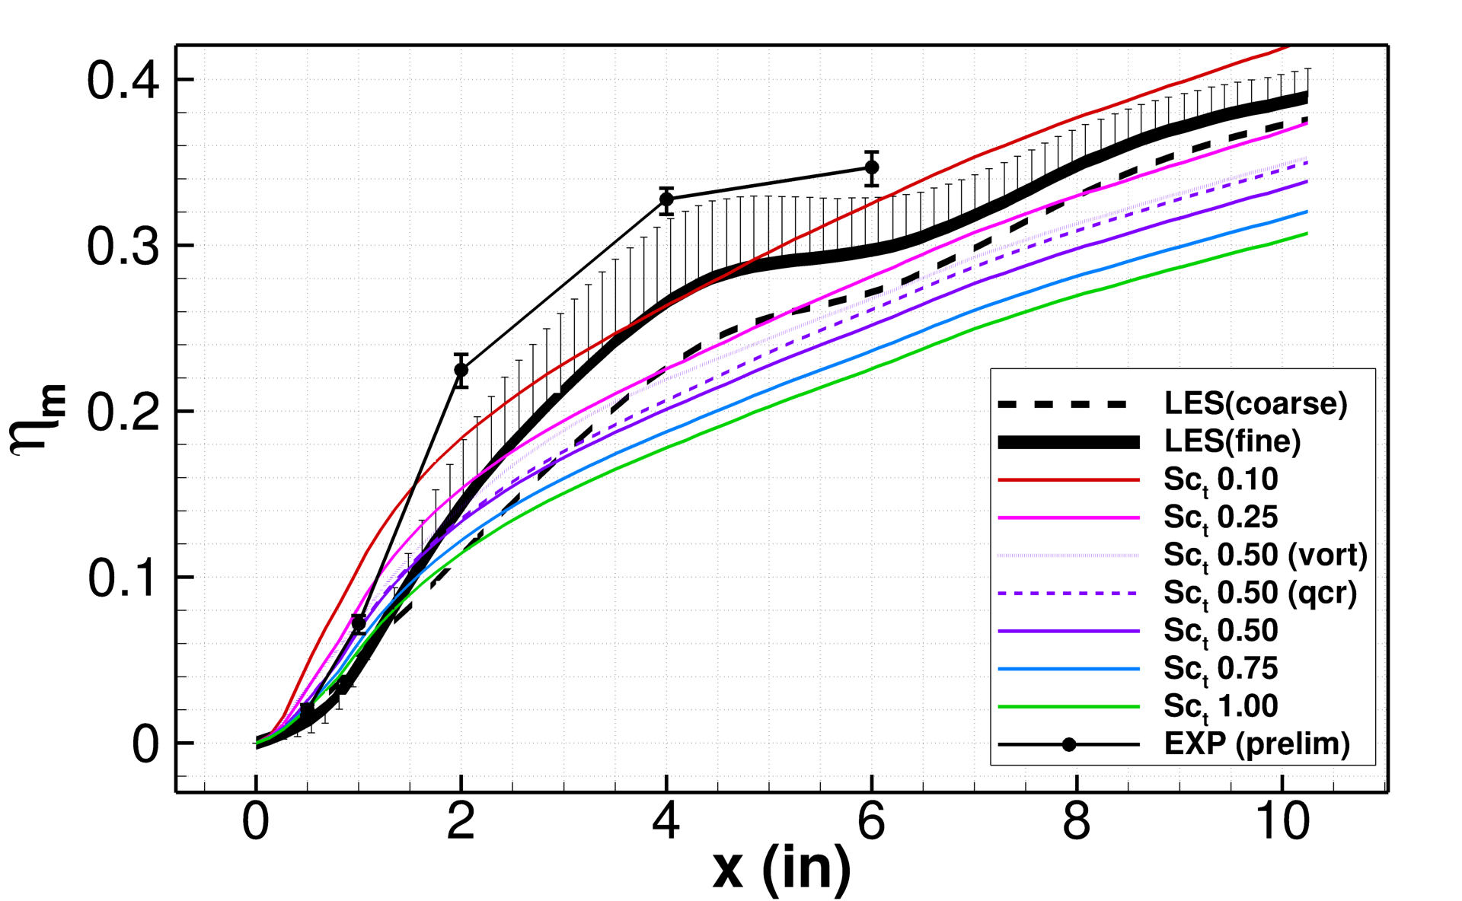
Mixing Efficiency from RAS, LES, and experiments

Slide 14
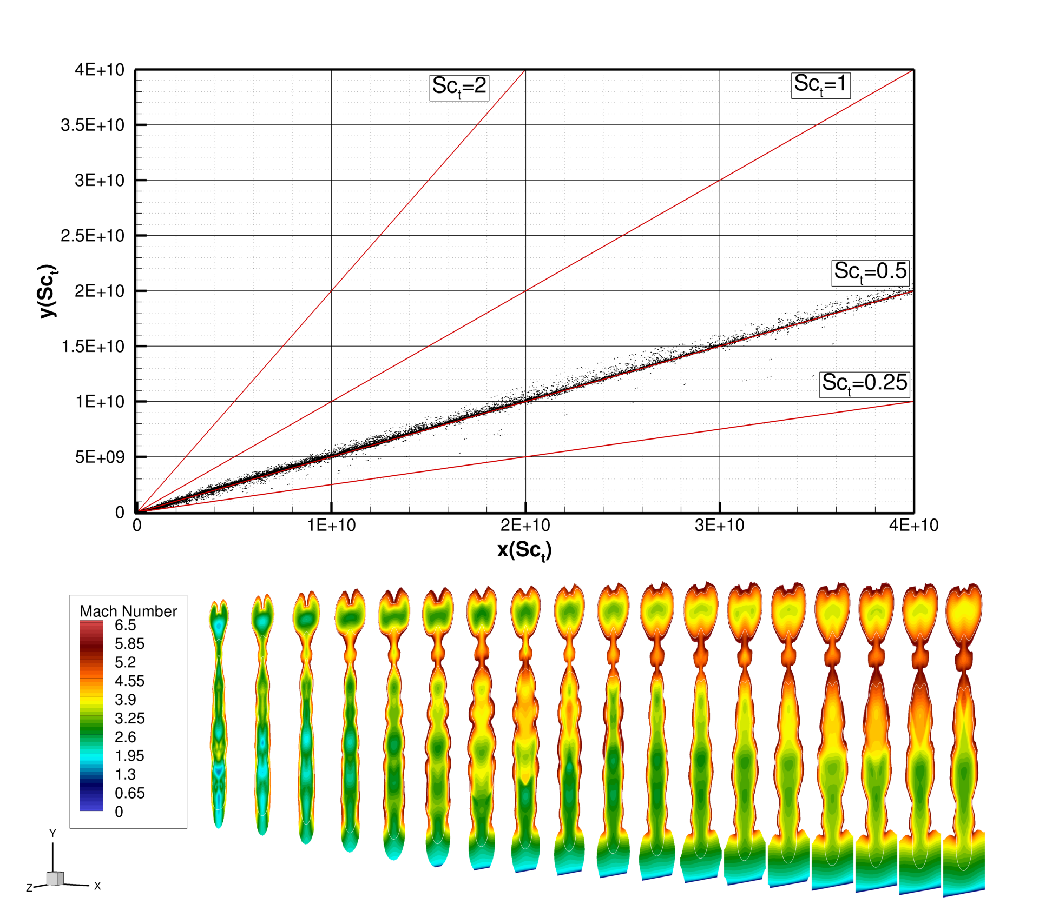
Least-Squares “Best Fit” Verification with RAS
Reynolds stress tensor and mass flux vector
Construct error tensor for stress tensor and error vector of mass flux and differentiate
Apply least mean squared error (LMSE) method
Rearrange:
Small scatter is due to interpolation from cell centers to nodes and computing gradients in postprocessing
RAS with Menter-BSL and Sc_{t}=0.5

Slide 15
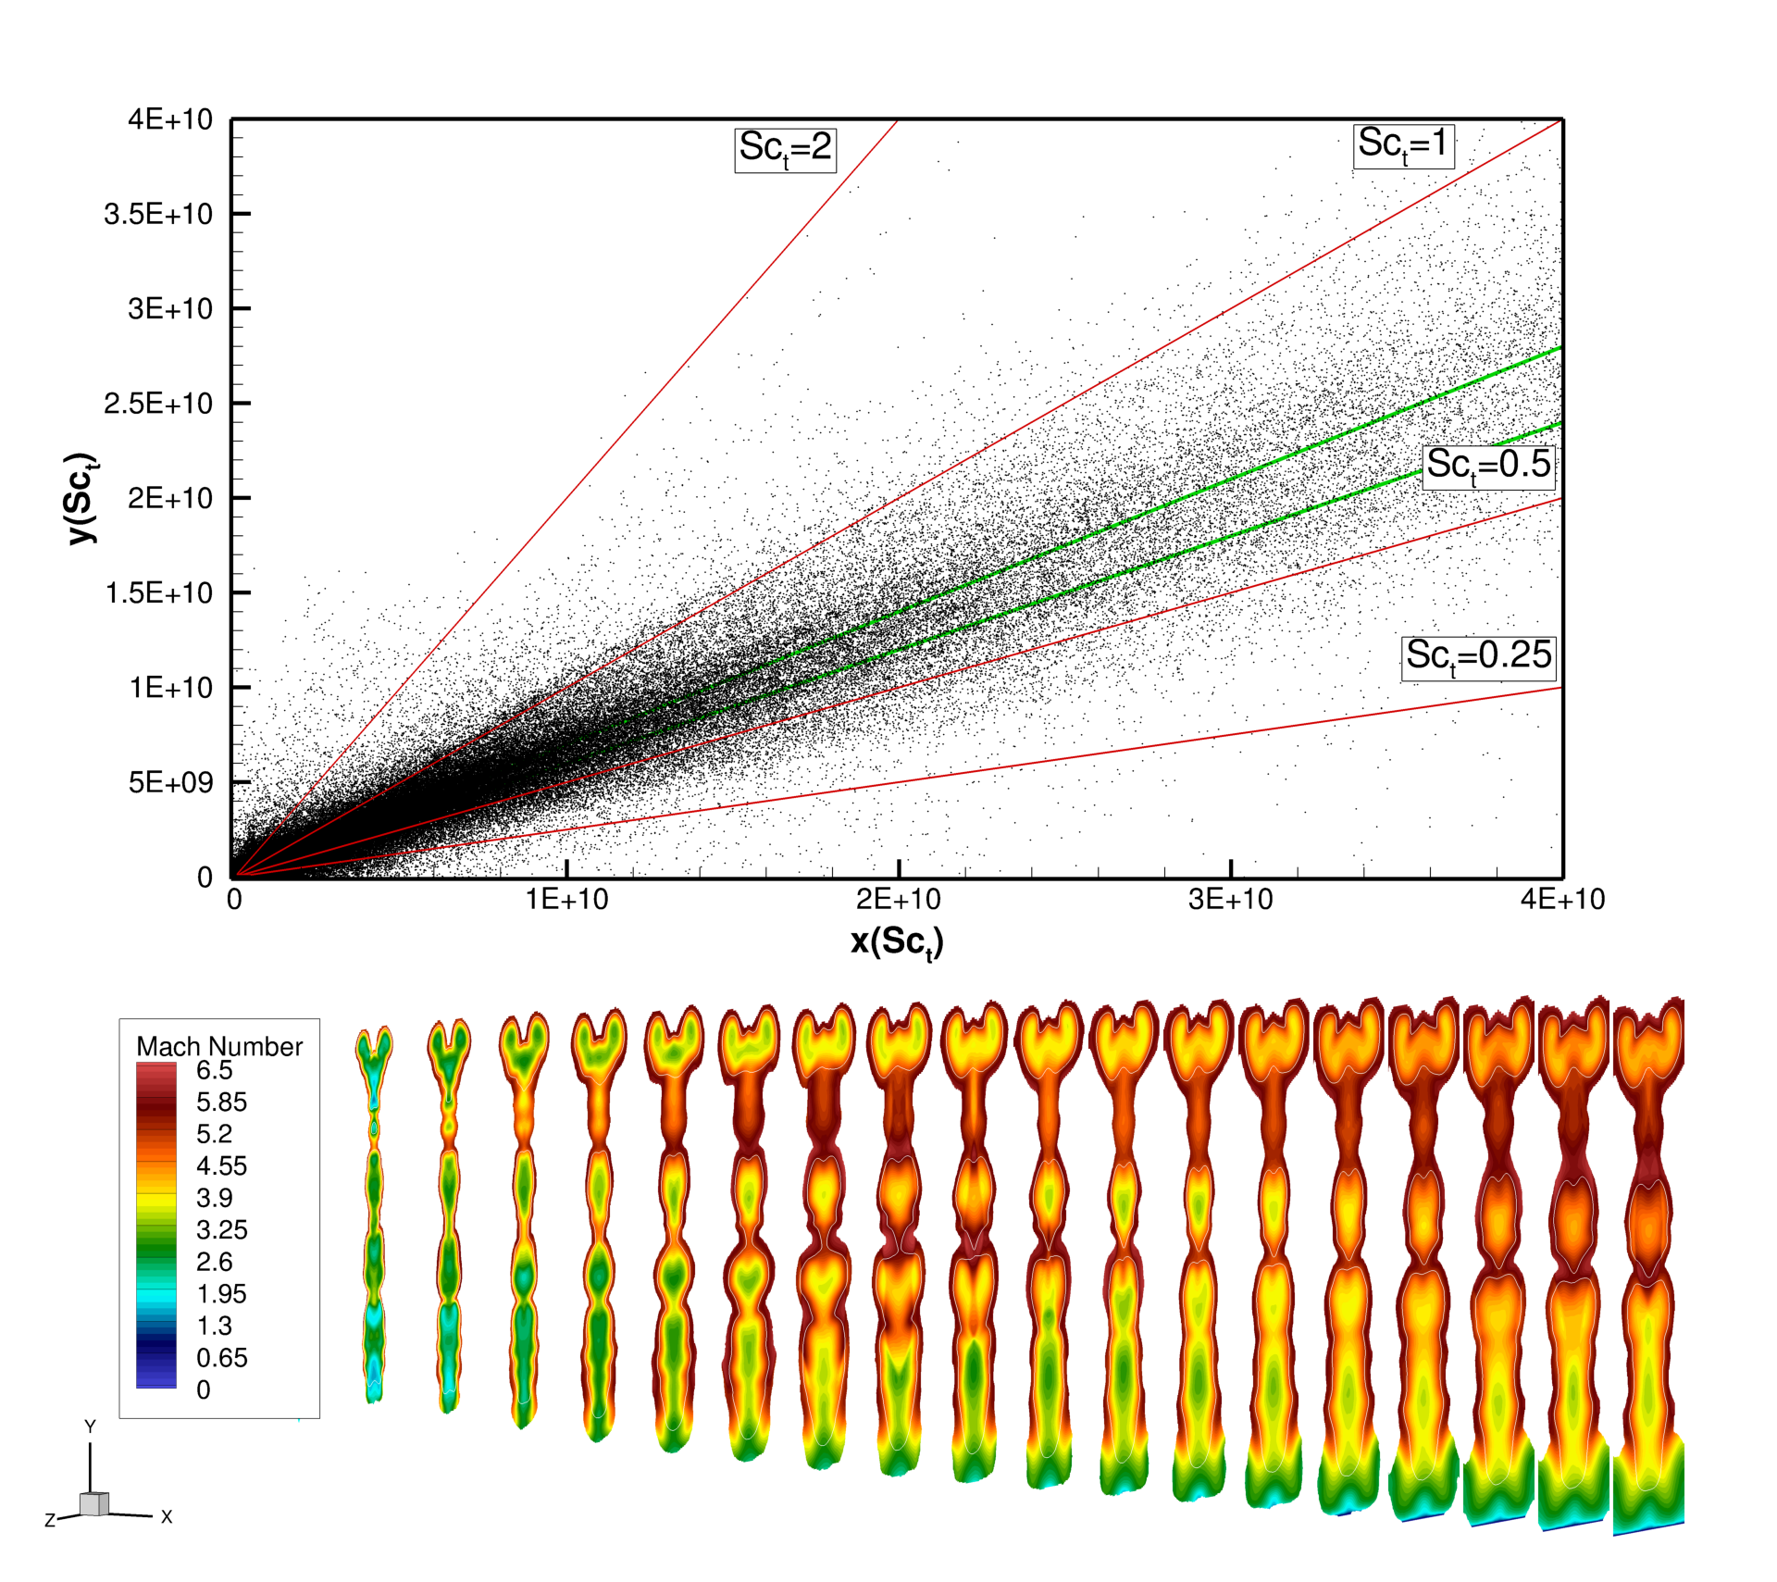
Least-Squares “Best Fit” from LES
Scatter data are limited to helium mass fraction 0.001–0.999
Cloud of points indicates that the linear model is far from perfect for this flow
Clustering of points emerges around the slope of Sc_{t} 0.6–0.7 (green lines)
Consistent with findings of others:
  Zilberter et al., AIAA J., 2014
  Baurle, AIAA J., 2017
Inconsistent with direct comparisons of mixing efficiency, where Sc_{t} in the range 0.1–0.25 matched the LES

Slide 16
Mixing Efficiency from RAS, LES, and experiments
EARSM and Wilcox-2006-NP turbulence models were used with Sc_{t} 0.6–0.7
This was motivated by modeling sensitivity study of Drozda et al. AIAA, 2019, which revealed that these models predicted higher values of the mixing eff.
GCI used in somewhat unconventional manner to predict potential range of further refined LES solutions
Observed improved prediction in the nearfield (x<1.5) and farfield (x>6.5)
Region of suppressed mixing not observed in RAS
Region of suppressed mixing

Slide 17
Summary and Conclusions
Mixing efficiency was obtained for a strut fuel injector at hypervelocity flow conditions using RAS, LES, and experiments.
Current work demonstrated two ways in which LES can be leveraged to improve RAS predictions:
  Direct tuning of the Sc_{t} in RAS (can match LES but potentially for the wrong reasons)
  Use of least-squares “best-fit” approach to determine the most appropriate value of Sc_{t} , allowing for a selection of a turbulence model
Grid convergence index (GCI) was also used in an unconventional way to estimate where a further refined LES solution may reside.
Albeit both RAS and LES underpredicted the experimental data, LES appears to predict a region of suppressed mixing identified in the experiments. Additional experimental data are needed to verify this.
LES was successfully leveraged to improve RAS predictions, and identified Wilcox-2006-NP turbulence model with Sc_{t} of 0.7 as a good candidate for this problem.

Slide 18
Acknowledgements
This work is supported by the Hypersonic Technology Project in the Advanced Air Vehicles Program of the NASA Aeronautics Research Mission Directorate (ARMD). Computational resources are provided by the NASA Langley Research Center and the NASA Advanced Supercomputing (NAS) Division. Authors would like to thank Dr. Michael Park for helpful discussions regarding the automated unstructured grid adaptation workﬂow.

Slide 19
Simulation Grids
Injection plane
(x=0)
To reduce computational expense of LES and allow for a “laminar” inflow conditions (identified by PLIF) at the injection plane, the upstream region was simulated using laminar RAS with only a small region adjacent to the flat plate being turbulent.
The outflow profile of the upstream region was then used as the inflow for the downstream region

Slide 20
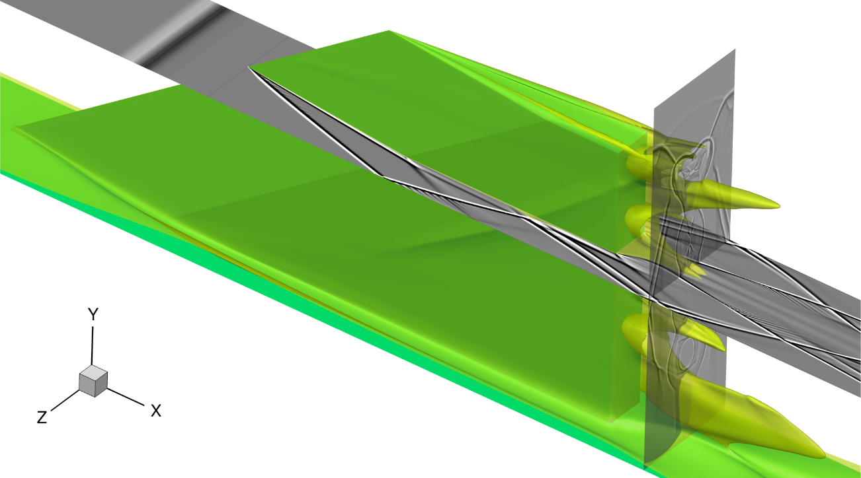

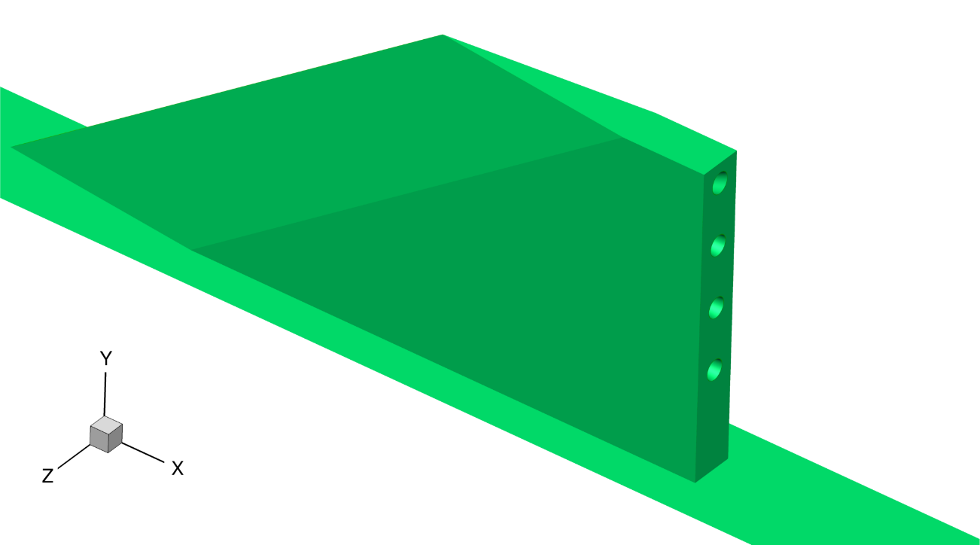
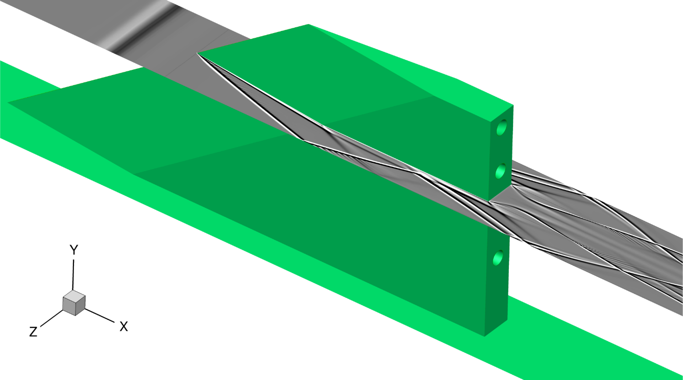
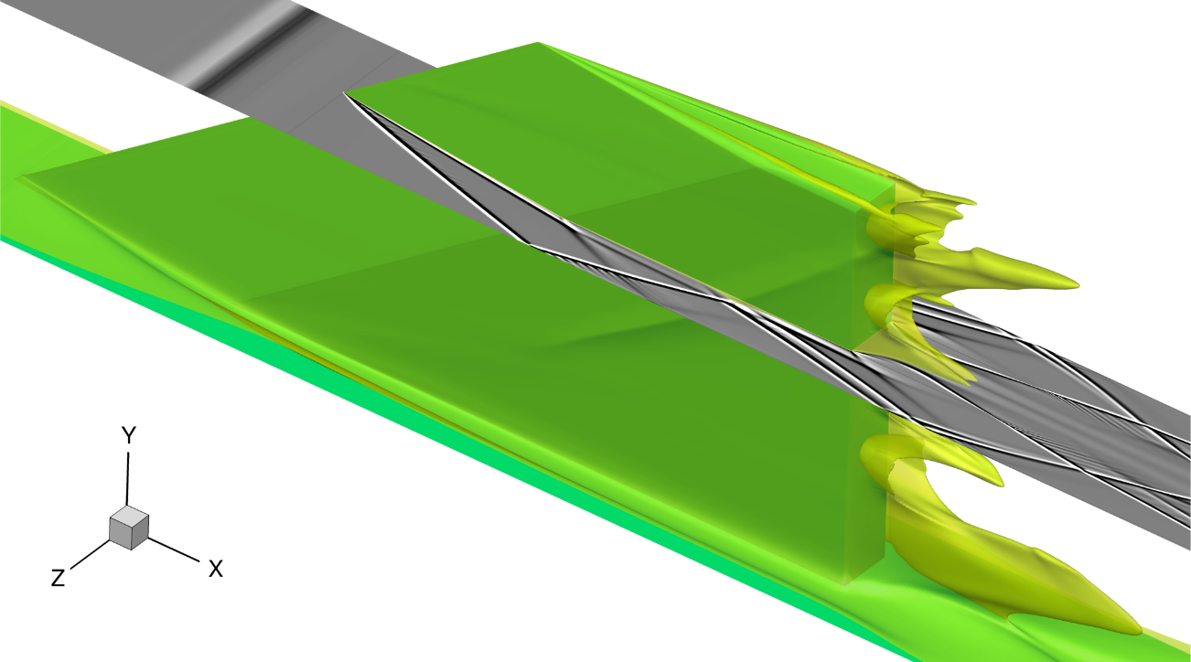
PLIF and CFI (cont.)
PLIF oP12(J=14.5)
Flow
Shock Induced Separation
x=0.5 in
Laminar Simulation
Turbulent Simulation

